Slide 1

A Realism-Based View on Counts in
OMOP’s Common Data Model
14th International Conference on Wearable, Micro- and Nanotechnologies for Personalized Health,
May 14-16, 2017, Eindhoven, The Netherlands.
Werner CEUSTERS, MD and Jonathan BLAISURE, MSc
Department of Biomedical Informatics, Division of Biomedical Ontology,
Department of Psychiatry,
and
UB Institute for Healthcare Informatics,
University at Buffalo

Slide 2


Slide 3


Slide 4
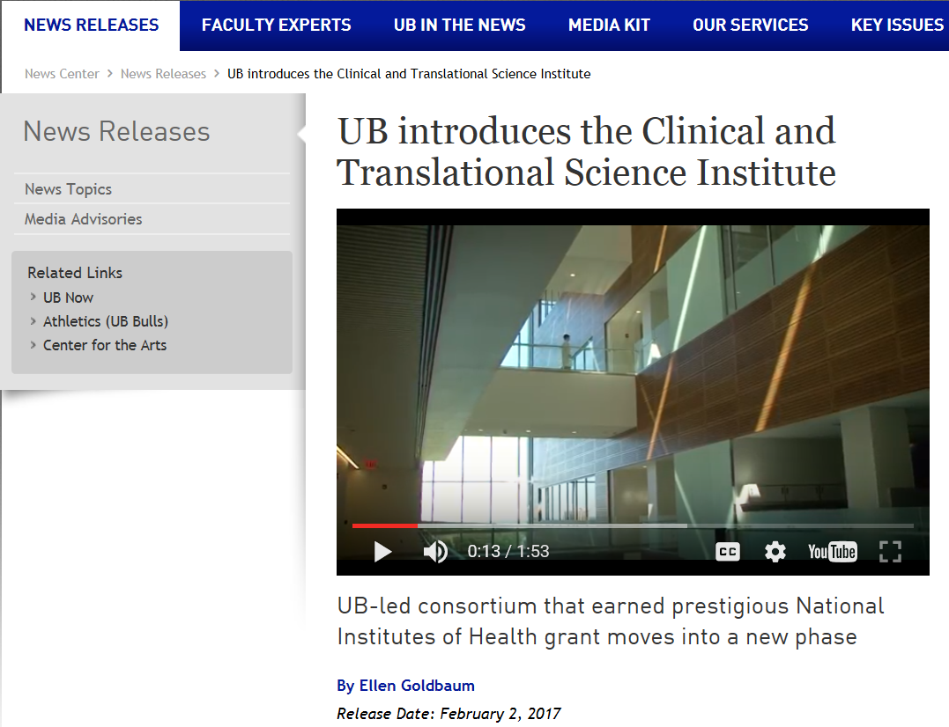


Slide 5
Data aggregation and use
Operational
systems
IHI Clinical
Integrated
Data Repository
Secondary
use
Cohort selection
EHR
Data Marts
EHR
EHR
EHR
Cost effectiveness
research
Common Data Models
Bio Bank
Decision support
Health
Insurers
Referent Tracking
Data Repository
Quality assurance
Health
Insurers
Health
Insurers

Slide 6
Data aggregation and use
Operational
systems
IHI Clinical
Integrated
Data Repository
Secondary
use
Cohort selection
EHR
Data Marts
EHR
EHR
EHR
Cost effectiveness
research
Common Data Models
Bio Bank
Decision support
Health
Insurers
Referent Tracking
Data Repository
Quality assurance
Health
Insurers
Health
Insurers

Slide 7

Realism-based Ontology (RBO)
Referents
  are (meta-) physically the way they are,
  relate to each other in an objective way,
  follow ‘laws of nature’.
Window on reality
  restricted by:
  what is physically and technically observable,
  fit between what is measured and what we think is measured,
  fit between established knowledge and ‘laws of nature’.
References
  follow, ideally, the syntactic-semantic conventions of some representation language,
  are restricted by the expressivity of that language,
  reference collections need to come, for correct interpretation, with documentation outside the representation.

Slide 8
Referent Tracking of Adverse Event (1)
Example: a patient
  born at time t₀
  undergoing anti-inflammatory treatment and physiotherapy since t₂
  for an arthrosis present since t₁
  develops a stomach ulcer at t₃.
Ceusters W, Capolupo M, De Moor G, Devlies J, Smith B. An Evolutionary Approach to Realism-Based Adverse Event Representations. Methods of Information in Medicine, 2011;50(1):62-73.
Notes:
8

Slide 9
Referent Tracking of Adverse Event (2)
IUI | Description of particular | Properties
#1 | the patient who is treated | #1 member_of C1 since t₂
#2 | #1’s treatment | #2 instance_of C3 #2 has_participant #1 since t₂ #2 has_agent #3 since t₂
#3 | the physician responsible for #2 | #3 member_of C4 since t₂
#4 | #1’s arthrosis | #4 member_of C5 since t₁
#5 | #1’s anti-inflammatory treatment | #5 part_of #2 #5 member_of C2 since t₃
#6 | #1’s physiotherapy | #6 part_of #2
#7 | #1’s stomach | #7 member_of C6 since t₂
#8 | #7’s structure integrity | #8 instance_of C8 since t₀ #8 inheres_in #7 since t₀
#9 | #1’s stomach ulcer | #9 part_of #7 since t₃
#10 | coming into existence of #9 | #10 has_participant #9 at t₃
#11 | change brought about by #9 | #11 has_agent #9 since t₃ #11 has_participant #8 since t₃ #11 instance_of C10 (harm) at t₃
#12 | noticing the presence of #9 | #12 has_participant #9 at t_{3+x} #12 has_agent #3 at t_{3+x}
#13 | cognitive representation in #3 about #9 | #13 is_about #9 since t_{3+x}
Ceusters W, Capolupo M, De Moor G, Devlies J, Smith B. An Evolutionary Approach to Realism-Based Adverse Event Representations. Methods of Information in Medicine, 2011;50(1):62-73.
Notes:
9

Slide 10

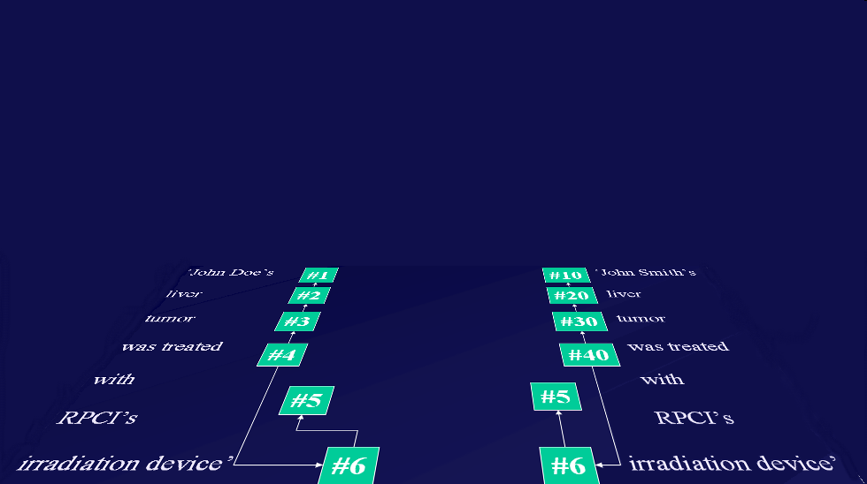
Ontology and Referent Tracking: division of labor
instance-of at t
caused
by
#105

Slide 11
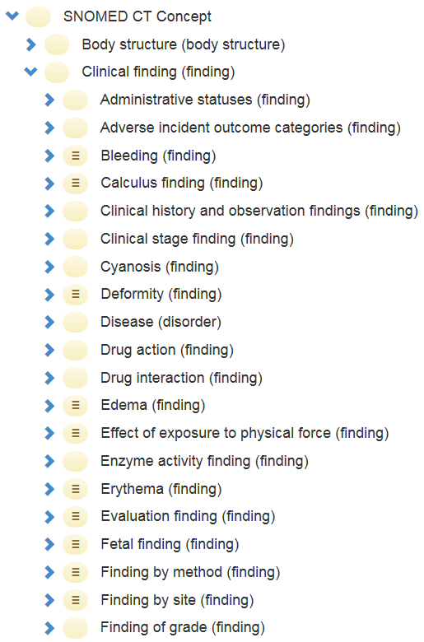
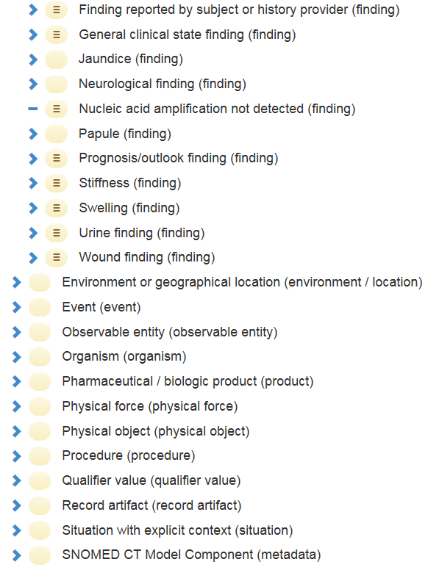
Mixture of levels in SNOMED CT

Slide 12
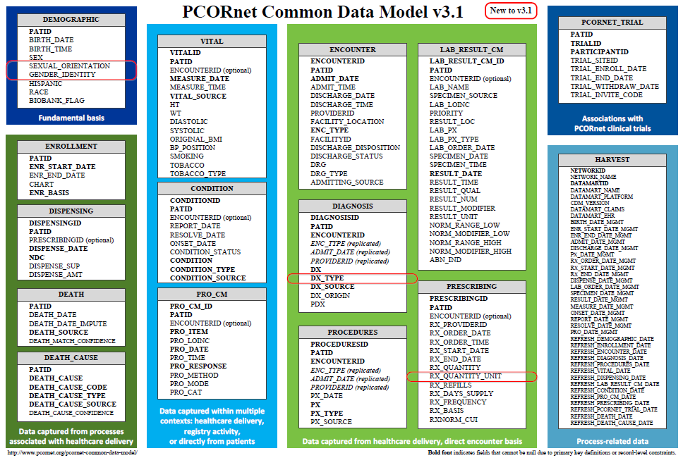
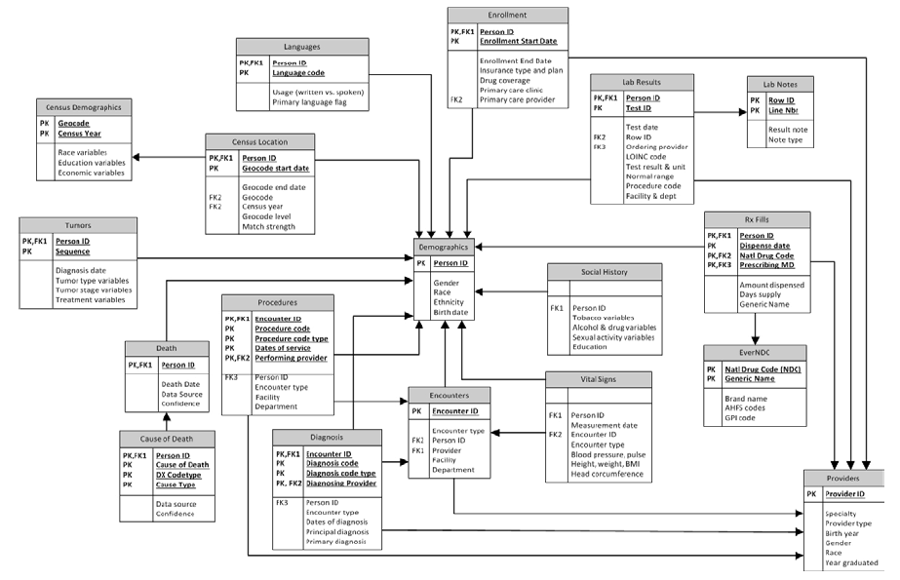
Common Data Models for Secondary Use
The Observational Medical Outcomes Partnership (OMOP)
Health Care Systems Research Network (HCSRN)
The National Patient-Centered Clinical Research Network (PCORNet)

Slide 13
Experiences with CDMs
OMOP scores best:
  Garza M, Del Fiol G, Tenenbaum J, Walden A, Zozus M. Evaluating common data models for use with a longitudinal community registry. J Biomed Inform. 2016 Oct 28.
  Ogunyemi OI, Meeker D, Kim HE, Ashish N, Farzaneh S, Boxwala A. Identifying appropriate reference data models for comparative effectiveness research (CER) studies based on data from clinical information systems. Medical care. 2013 Aug;51(8 Suppl 3):S45-52.
CDMs lead to information loss:
  Hersh WR, Weiner MG, Embi PJ, Logan JR, Payne PR, Bernstam EV, et al. Caveats for the use of operational electronic health record data in comparative effectiveness research. Medical care. 2013 Aug;51(8 Suppl 3):S30-7.
  Rijnbeek PR. Converting to a common data model: what is lost in translation? : Commentary on "fidelity assessment of a clinical practice research datalink conversion to the OMOP common data model". Drug Saf. 2014 Nov;37(11):893-6.
  Yoon D, Ahn EK, Park MY, Cho SY, Ryan P, Schuemie MJ, et al. Conversion and Data Quality Assessment of Electronic Health Record Data at a Korean Tertiary Teaching Hospital to a Common Data Model for Distributed Network Research. Healthc Inform Res. 2016 Jan;22(1):54-8.
Streamlining of CDM evaluation methods is needed:
  Garza M, Del Fiol G, Tenenbaum J, Walden A, Zozus M. Evaluating common data models for use with a longitudinal community registry. J Biomed Inform. 2016 Oct 28.
  Huser V, Cimino JJ. Desiderata for healthcare integrated data repositories based on architectural comparison of three public repositories. AMIA Annual Symposium proceedings / AMIA Symposium AMIA Symposium. 2013;2013:648-56.
None use realism-based ontology for information modeling.

Slide 14


Methodology
OMOP
RBO
?
Are counts reliable?

Slide 15
Results
Three sorts of count errors, resp. due to:
  cardinality and attribute restrictions,
  inconsistent normalization,
  confusing data with what it is about.

Slide 16
PERSON table
Allows for each unique patient only
  one location,
  one gender,
  one primary care provider, and
  one care site.
Although:
  ‘patients over time can have distinct locations, genders’;
  ‘it is the responsibility of the data holder to select the one value to use in the CDM’.
What criteria to use?
What with the multiple observation periods?

Slide 17
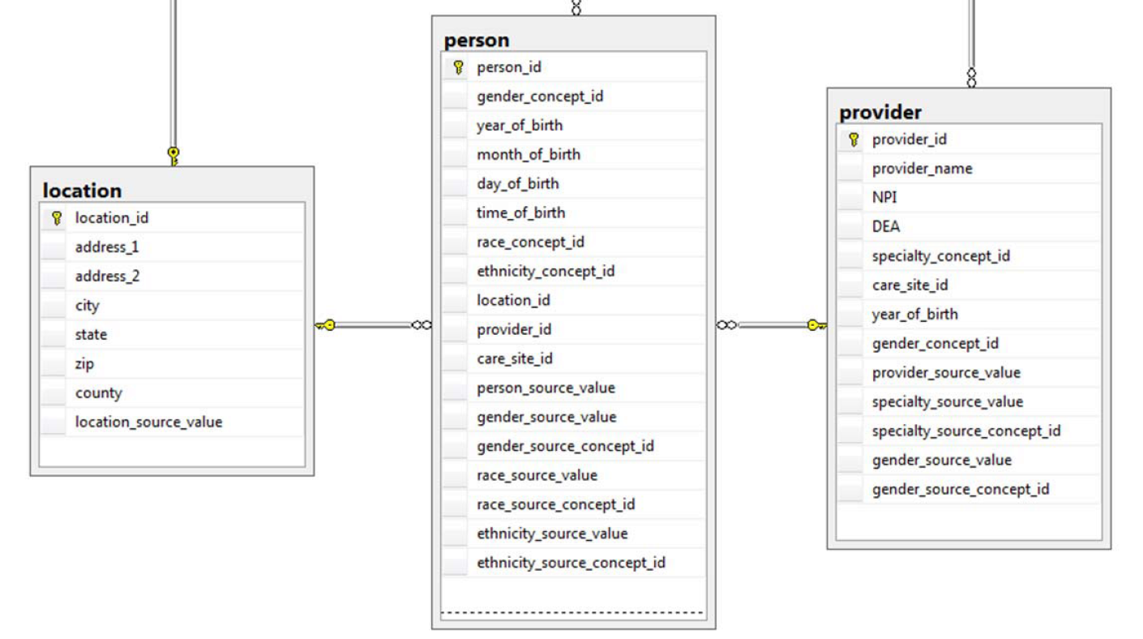
Person versus Provider

Slide 18
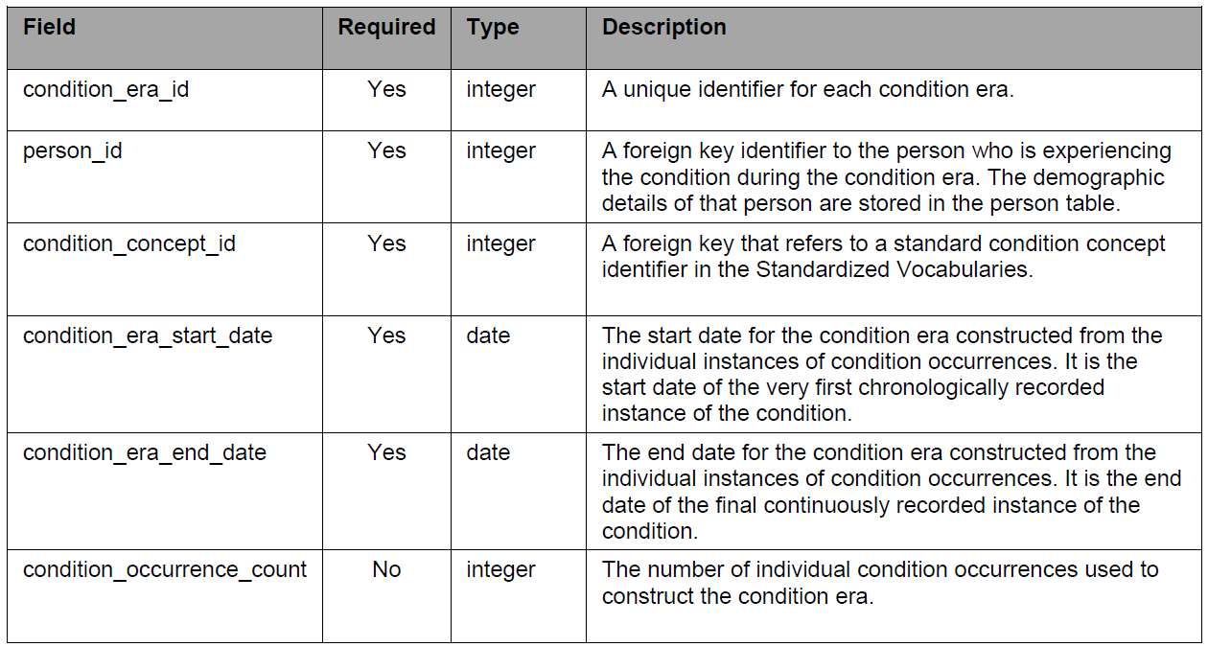
Condition-occurrences versus eras

Slide 19
Conventions
Condition Era records will be derived from the CONDITION_OCCURRENCE table using a standardized algorithm.
Each Condition Era corresponds to one or many CONDITION_OCCURRENCE records that form a continuous interval and contain the same drug condition-occurrence.
The condition_concept_id field contains Concepts that are identical to those of the CONDITION_OCCURRENCE table records that make up the Condition Era.
The Condition Era Start Date is the start date of the first Condition Occurrence.
The Condition Era End Date is the end date of the last Condition Occurrence.

Slide 20
An erroneous example
‘a Condition Era representing ICD-9 code 410.01
  (Acute Myocardial Infarction (AMI) of anterolateral wall, initial episode)
  would be aggregated to a Condition Era representing ICD-9 code 410.41
  (AMI inferior wall, initial episode)
  occurring within 30 days
  as both of these ICD-9 codes annotate to the same Condition Concept, Acute Myocardial Infarction, within the MedDRA hierarchy’.
Reisinger SJ, Ryan PB, O'Hara DJ, Powell GE, Painter JL, Pattishall EN, et al. Development and evaluation of a common data model enabling active drug safety surveillance using disparate healthcare databases.
J Am Med Inform Assoc. 2010 Nov-Dec;17(6):652-62, p656

Slide 21
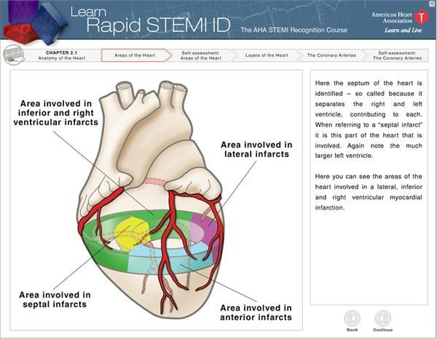
http://myheart.net/articles/stemi/

Slide 22

feline
isa
isa
panther
tiger
Instance-of
Instance-of
Only one feline in this cage?

Slide 23
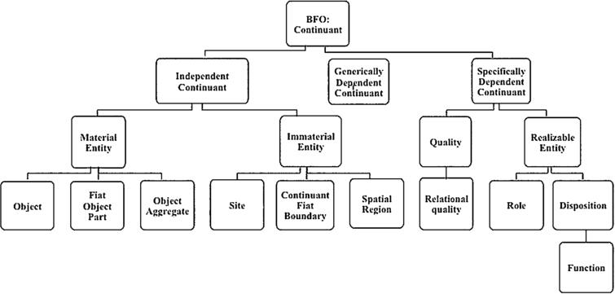
Some suggestions (1)
Basic Formal Ontology
person
patient role
provider role

Slide 24
Some suggestions (2)
Ontology for General Medical Science
disease course
produces
bears
realized_in
part-of
etiological process
disorder
disease
pathological process
produces
diagnosis
interpretive process
signs & symptoms
abnormal bodily features
produces
participates_in
recognized_as

Slide 25
Conclusions
The fit-for-purpose paradigm of the OMOP CDM (and CDMs in general) hampers faithful data analysis.
A realism-based approach is able:
  to identify the root causes,
  to propose improvements.
A dilemma?
  For each purposes a specific CDM?
  Thorough education in the principles of ontological realism?

