Slide 1
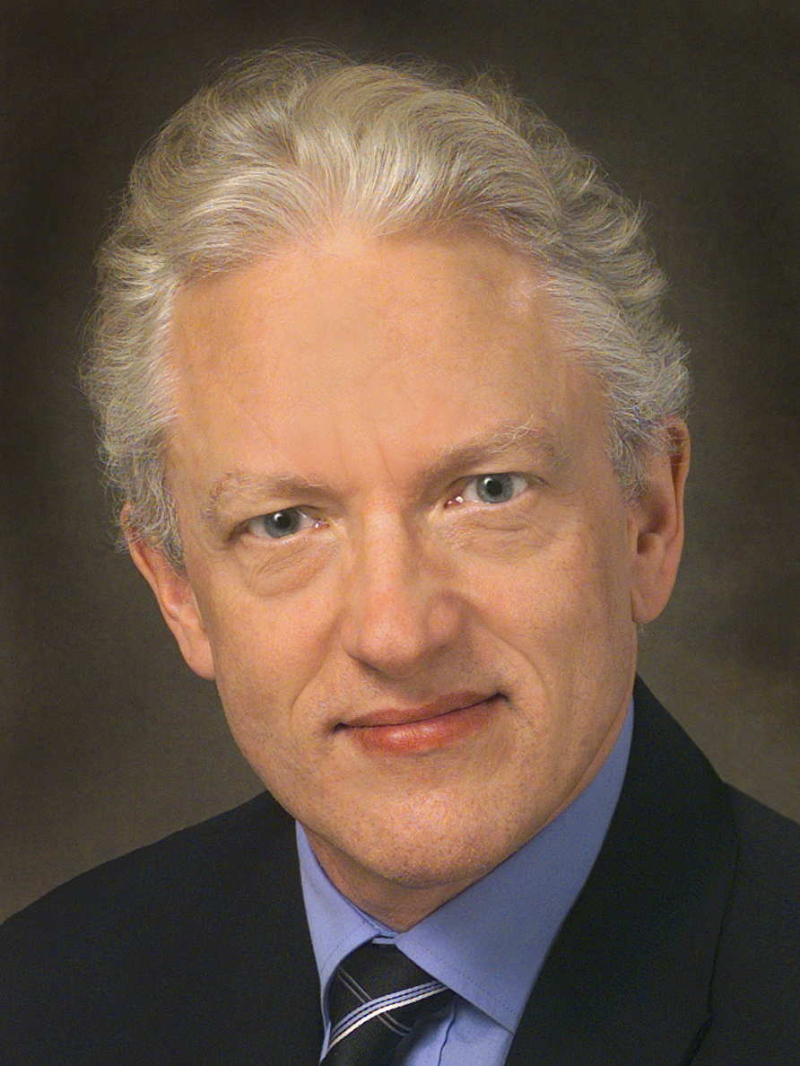
Biomarkers in the Ontology for General Medical Science Medical Informatics Europe (MIE) 2015 May 28, 2015 – Madrid, Spain
Werner CEUSTERS², MD and Barry SMITH¹, PhD
¹ Department of Philosophy, University at Buffalo
² Department of Biomedical Informatics, University at Buffalo

Slide 2
IOM’s definition for ‘biomarker’
Biomarkers are characteristics that are objectively [The committee defines “objectively” to mean “reliably and accurately.”] measured and evaluated as an indicator of normal biological processes, pathogenic processes, or pharmacologic responses to therapeutic intervention.
Cholesterol and blood sugar levels are biomarkers, as are blood pressure, enzyme levels, measurements of tumor size from magnetic resonance imaging (MRI) or computed tomography (CT), and the biochemical and genetic variations observed in age-related macular degeneration.
Evaluation of Biomarkers and Surrogate Endpoints in Chronic Disease, ed. C.M. Micheel and J.R. Ball. 2010, Washington, D.C.: The National Academies Press. 314. [p1]

Slide 3
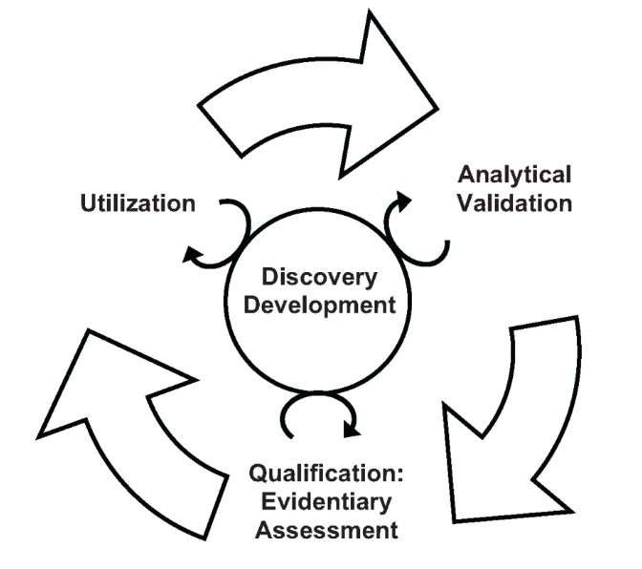
How to get there?
the need is expressed:
to develop a transparent process for creating well-defined consensus standards and guidelines for biomarker development, validation, qualification, and use to reduce the uncertainty in the process of development and adoption.
Evaluation of Biomarkers and Surrogate Endpoints in Chronic Disease, ed. C.M. Micheel and J.R. Ball. 2010, Washington, D.C.: The National Academies Press. 314.
[p7 and p18]

Slide 4
Utility of biomarkers
Disease risk stratification: assess the likelihood for disease to develop or recur
Prevention: identify and track risk factors
Screening: detect and treat early-stage disease in asymptomatic population
Diagnosis: definitively establish the presence of disease
Classification: classify patients by disease subset
Prognosis: predict the probable outcome of disease to determine the aggressiveness of treatment
Treatment stratification: predict response to particular therapies and choose the drug that is mostly likely to yield a favorable response in a given patient
Therapy-related risk management: identify patients with a high probability of adverse effects of a treatment
Therapy monitoring: determine whether a therapy is having the intended effect on a disease and whether adverse effects arise
Surveillance: early detection and treatment of advancing disease or complications
Evaluation of Biomarkers and Surrogate Endpoints in Chronic Disease, ed. C.M. Micheel and J.R. Ball. 2010, Washington, D.C.: The National Academies Press. 314. [p24]

Slide 5
Biomarker terminology is confusing
The committee observed a great deal of inconsistent and imprecise definition and use of terms relevant to biomarkers and biomarker evaluation.
Consistent, precise definition and use of terms is critical for biomarker evaluation because it is a topic important across many disciplines and has been for several decades.
The definition of the term “biomarker” itself is not controversial.
Evaluation of Biomarkers and Surrogate Endpoints in Chronic Disease, ed. C.M. Micheel and J.R. Ball. 2010, Washington, D.C.: The National Academies Press. 314. [p22]

Slide 6
Uncontroversial, yet cumbersome
in light of the principles of Ontological Realism and Basic Formal Ontology
Being
Believing
Communicating

Slide 7
Uncontroversial, yet cumbersome
in light of the principles of Ontological Realism and Basic Formal Ontology
Ontology
Classification /
conceptualization
Being
Believing
Communicating
Terminology

Slide 8
Uncontroversial, yet cumbersome
Ambiguous terminology:
Measuring process or data resulting from measuring?
Biomarkers are characteristics that are objectively [The committee defines “objectively” to mean “reliably and accurately.”] measured and evaluated as an indicator of normal biological processes, pathogenic processes, or pharmacologic responses to therapeutic intervention.
Cholesterol and blood sugar levels are biomarkers, as are blood pressure, enzyme levels, measurements of tumor size from magnetic resonance imaging (MRI) or computed tomography (CT), and the biochemical and genetic variations observed in age-related macular degeneration.
Evaluation of Biomarkers and Surrogate Endpoints in Chronic Disease, ed. C.M. Micheel and J.R. Ball. 2010, Washington, D.C.: The National Academies Press. 314. [p1]

Slide 9
Uncontroversial, yet cumbersome
Ambiguous terminology:
Measuring process or data resulting from measuring?
Supertype ‘characteristic’ is too vague, ‘anything goes’ is not an appropriate ontological category;
Biomarkers are characteristics that are objectively [The committee defines “objectively” to mean “reliably and accurately.”] measured and evaluated as an indicator of normal biological processes, pathogenic processes, or pharmacologic responses to therapeutic intervention.
Cholesterol and blood sugar levels are biomarkers, as are blood pressure, enzyme levels, measurements of tumor size from magnetic resonance imaging (MRI) or computed tomography (CT), and the biochemical and genetic variations observed in age-related macular degeneration.
Evaluation of Biomarkers and Surrogate Endpoints in Chronic Disease, ed. C.M. Micheel and J.R. Ball. 2010, Washington, D.C.: The National Academies Press. 314. [p1]

Slide 10
Uncontroversial, yet cumbersome
Ambiguous terminology:
Measuring process or data resulting from measuring?
Supertype ‘characteristic’ is too vague, ‘anything goes’ is not an appropriate ontological category;
Both entities on the side of the patient, and representations thereof seem to qualify as biomarkers;
Biomarkers are characteristics that are objectively [The committee defines “objectively” to mean “reliably and accurately.”] measured and evaluated as an indicator of normal biological processes, pathogenic processes, or pharmacologic responses to therapeutic intervention.
Cholesterol and blood sugar levels are biomarkers, as are blood pressure, enzyme levels, measurements of tumor size from magnetic resonance imaging (MRI) or computed tomography (CT), and the biochemical and genetic variations observed in age-related macular degeneration.
Evaluation of Biomarkers and Surrogate Endpoints in Chronic Disease, ed. C.M. Micheel and J.R. Ball. 2010, Washington, D.C.: The National Academies Press. 314. [p1]

Slide 11
Uncontroversial, yet cumbersome
Ambiguous terminology:
Measuring process or data resulting from measuring?
Supertype ‘characteristic’ is too vague, ‘anything goes’ is not an appropriate ontological category;
Both entities on the side of the patient, and representations thereof seem to qualify as biomarkers;
Whether an entity qualifies as a biomarker seems to be determined by what we intend to do with it rather than with what it is.
None of the above is satisfactory!
Biomarkers are characteristics that are objectively [The committee defines “objectively” to mean “reliably and accurately.”] measured and evaluated as an indicator of normal biological processes, pathogenic processes, or pharmacologic responses to therapeutic intervention.
Cholesterol and blood sugar levels are biomarkers, as are blood pressure, enzyme levels, measurements of tumor size from magnetic resonance imaging (MRI) or computed tomography (CT), and the biochemical and genetic variations observed in age-related macular degeneration.
Evaluation of Biomarkers and Surrogate Endpoints in Chronic Disease, ed. C.M. Micheel and J.R. Ball. 2010, Washington, D.C.: The National Academies Press. 314. [p1]

Slide 12
Basic Formal Ontology (BFO) and Ontology of General Medical Science (OGMS)
Scheuermann R, Ceusters W, Smith B. Toward an Ontological Treatment of Disease and Diagnosis. 2009 AMIA Summit on Translational Bioinformatics, San Francisco, California, March 15-17, 2009;: 116-120.

Slide 13
Basic Formal Ontology (BFO) and Ontology of General Medical Science (OGMS)
Scheuermann R, Ceusters W, Smith B. Toward an Ontological Treatment of Disease and Diagnosis. 2009 AMIA Summit on Translational Bioinformatics, San Francisco, California, March 15-17, 2009;: 116-120.

Slide 14
Assumptions about IOM’s intention
IOM intended biomarkers to be entities on the side of the patient, and not (for example) processes on the part of the clinician or data obtained through such processes;
in requiring that biomarkers be ‘objectively measured and evaluated’ the IOM had in mind not that an entity becomes a biomarker after and because it has been measured and evaluated, but rather that it was a biomarker already prior to observation because of certain properties it has intrinsically → observability
the logical disjunction expressed by the ‘or’ in the list of processes for which the IOM definition asserts biomarkers to be an indicator has to be interpreted as an exclusive or (XOR).

Slide 15
Entities on the side of the patient qualifying for biomarker
Independent
Continuant
Dependent
Continuant
Process
BFO
isa
isa
isa
Material
Entity
Quality
isa
isa
Bodily
Component
Bodily
Quality
Bodily
Process
OGMS
instanceOf at t
instanceOf at t
instanceOf at t
me
my xanthelasma
my cholesterol
level
my partly obstructed
blood flow

Slide 16
The problem of observability
Because:
Observability is a disposition;
Dispositions can only inhere in independent continuants, not in qualities and processes;
Our ability to evaluate/assess these qualities and processes is brought about in part by the observability of the independent continuants upon which they depend;
what the IOM defined as ‘biomarker’ does not form a homogenous group of entities with similar characteristics;
Therefore: three different types of biomarkers need to be defined.

Slide 17
Material Biomarker
Independent
Continuant
Dependent
Continuant
Process
BFO
isa
isa
isa
Material
Entity
Quality
isa
isa
Bodily
Component
Bodily
Quality
Bodily
Process
OGMS
Material
Biomarker
=def.– bodily component capable of being assessed objectively to determine either (a) what kind of processes it results from, or (b) what kind of processes resulted in qualities that depend on it.

Slide 18
Quality Biomarker
Independent
Continuant
Dependent
Continuant
Process
BFO
isa
isa
isa
Material
Entity
Quality
isa
isa
Bodily
Component
Bodily
Quality
Bodily
Process
OGMS
=def.– BODILY QUALITY inhering in a BODILY COMPONENT c and in virtue of which c is an instance of MATERIAL BIOMARKER
Material
Biomarker
Quality
Biomarker

Slide 19
Process Biomarker
Independent
Continuant
Dependent
Continuant
Process
BFO
isa
isa
isa
Material
Entity
Quality
isa
isa
Bodily
Component
Bodily
Quality
Bodily
Process
OGMS
=def.– BODILY PROCESS p instances of which are capable of being assessed objectively to determine whether p is a realization of NORMAL or of ABNORMAL HOMEOSTASIS.
Material
Biomarker
Quality
Biomarker
Process
Biomarker

Slide 20
Similar proposal for diagnostic biomarkers
DIAGNOSTIC BIOMARKER FOR DISEASE OF TYPE X =def.–
MATERIAL DIAGNOSTIC BIOMARKER FOR DISEASE OF TYPE X,
QUALITY DIAGNOSTIC BIOMARKER FOR DISEASE OF TYPE X, or
PROCESS DIAGNOSTIC BIOMARKER FOR DISEASE OF TYPE X
MATERIAL DIAGNOSTIC BIOMARKER FOR DISEASE OF TYPE X =def.–
MATERIAL BIOMARKER instances of which are capable of being assessed objectively to determine whether a DISEASE OF TYPE X inheres in the ORGANISM of which these instances are part.
QUALITY DIAGNOSTIC BIOMARKER FOR DISEASE OF TYPE X =def.–
BODILY QUALITY which inheres in a BODILY COMPONENT c and in virtue of which c is an instance of MATERIAL DIAGNOSTIC BIOMARKER FOR DISEASE OF TYPE X
PROCESS DIAGNOSTIC BIOMARKER FOR DISEASE OF TYPE X =def.–
BODILY PROCESS in which a BODILY COMPONENT c participates and in virtue of which c is an instance of MATERIAL DIAGNOSTIC BIOMARKER FOR DISEASE OF TYPE X.

Slide 21
Straightforward definitions for disease and prognostic biomarkers
DISEASE BIOMARKER FOR DISEASE OF TYPE X =def.–
BIOMARKER instances of which either start to exist or become clinically abnormal during a part of the DISEASE COURSE which realizes the DISEASE OF TYPE X
PROGNOSTIC BIOMARKER FOR DISEASE OF TYPE X =def.–
DISEASE BIOMARKER FOR DISEASE OF TYPE X which starts to exist during a part p of a DISEASE COURSE d which realizes the DISEASE OF TYPE X and where p is such that it regulates the further unfolding of d.

Slide 22
The final picture
isa
Bodily
Component
subClassOf
Biomarker
Material
Biomarker
Bodily
Quality
Bodily
Process
Disease
Biomarker
Diagnostic
Biomarker
Quality
Biomarker
Process
Biomarker
Material
Diagnostic
Biomarker
Quality
Diagnostic
Biomarker
Process
Diagnostic
Biomarker
Prognostic
Biomarker

