Slide 1
Are linguistics-based event classifications useful for realism-based process classifications?
Philosophy Lunchtime Talk
November 10, 2017
Department of Philosophy, University at Buffalo
Werner CEUSTERS, MD
Ontology Research Group, Center of Excellence in Bioinformatics and Life Sciences,
UB Institute for Healthcare Informatics,
Departments of Biomedical Informatics and Psychiatry,
University at Buffalo, NY, USA

Slide 2
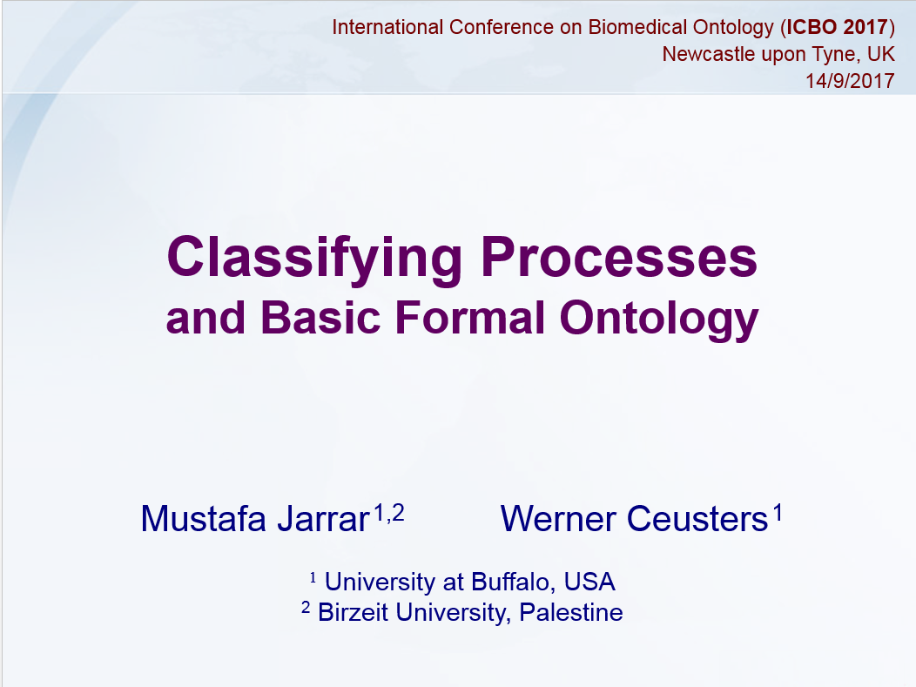

Slide 3
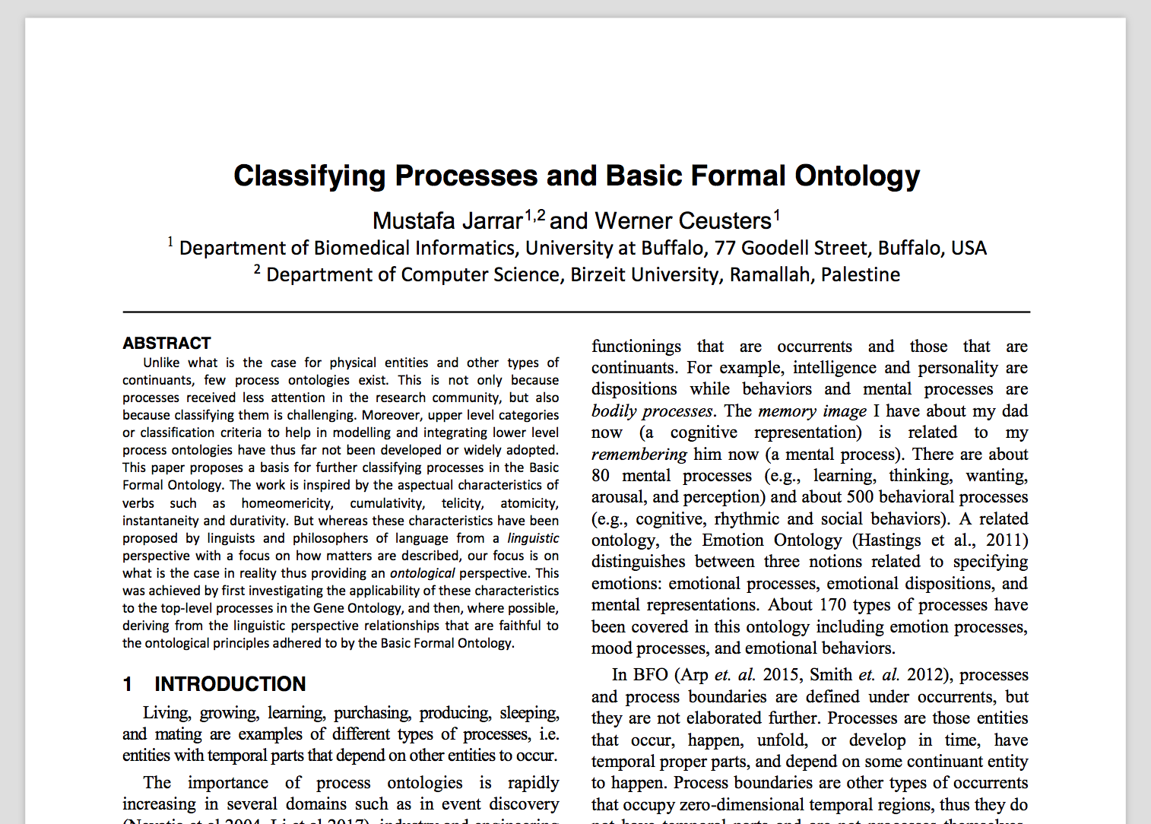
Jarrar M. and Ceusters W.
Classifying Processes and Basic Formal Ontology.
Proceedings of the International Conference on Biomedical Ontology (ICBO 2017), Newcastle, UK
http://www.jarrar.info/publications/JC17.pdf

Slide 4
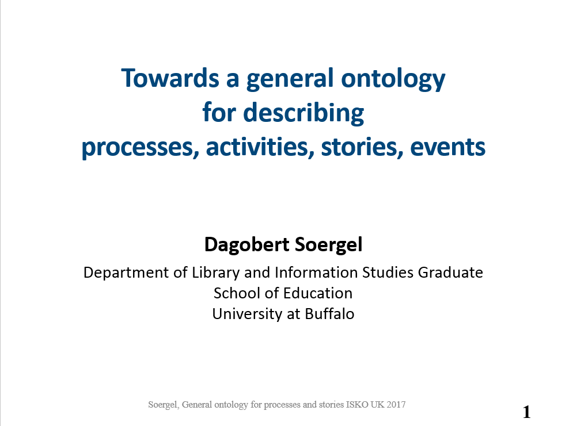

Slide 5
Motivation
Examples of processes:
  Living, growing, learning, purchasing, producing, sleeping, mating, feeding, eating, cooking, tasting, .
    → all those entities with temporal parts that depend on other entities to occur.
Attempts to develop process ontologies are rapidly increasing, but are incompatible:
  e.g. in bioinformatics, event discovery, industry and engineering, software engineering, affective computing
Some biomedical ontologies resort to processes:
  Gene Ontology, Emotion Ontology, Mental Functioning Ontology,…

Slide 6
Work in progress
Goal: develop a basis for classifying processes in BFO.
Inspiration sought in verb semantics and the aspectual characteristics of verbs.
We attempted to revise and redefine (homeomericity, cumulativity, telicity, atomicity, instantaneity and durativity).
In mainstream approaches, these characteristics are focused on how matters are described, but here our focus is on what is the case in reality and stripped from how matters are described.

Slide 7
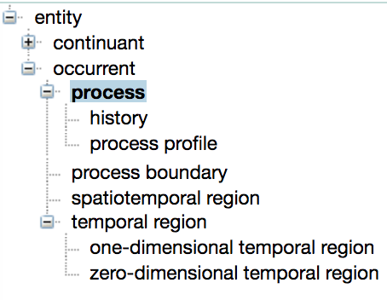
Processes in BFO
Processes unfold through time, have temporal proper parts, and are dependent on some continuant.
Process boundaries (e.g., midnight, departure, arrival) occupy zero-dimensional temporal regions, thus they do not have temporal parts.
Process boundaries are not processes themselves.

Slide 8
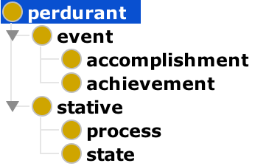
Processes in DOLCE
Perdurants happen in time, by accumulating different temporal parts: thus at any time t at which they exist, only their temporal parts at t are present.
    Statives are cumulative, while events are not.
    Achievements are atomic, while accomplishments are not.
    States are homeomeric, while processes are not.
DOLCE uses homeomericity and cumulativity inspired from lexical semantics, but in unclear ways.
DOLCE – BFO?:
Accomplishment → bfo:process Achievements → bfo:ProcessBoundary
Process → bfo:process States → - (not bfo:process)

Slide 9
‘Events’ in Philosophy and Linguistics
Semantics of verbal phrases, called ‘lexical aspect’ of verbs:
  Different Notions: actions, activities, accomplishments, achievements, processes, performances states, mental and physical events, bodily movements, …
  Different Criteria: homeomericity, cumulativity, atomicity, telicity, durativity and instantaneity. Other aspectual notions, such as incrementality and structure, distributivity and collectivity, and quantization, …
  Casati et al 2015, Mourelatos 1978, Bach 1986, Krifka 1998, Caudal et al. 2005, Trypuz et al 2007, Moens et al 1988, Bhatt 2005, Levin 2009, …

Slide 10
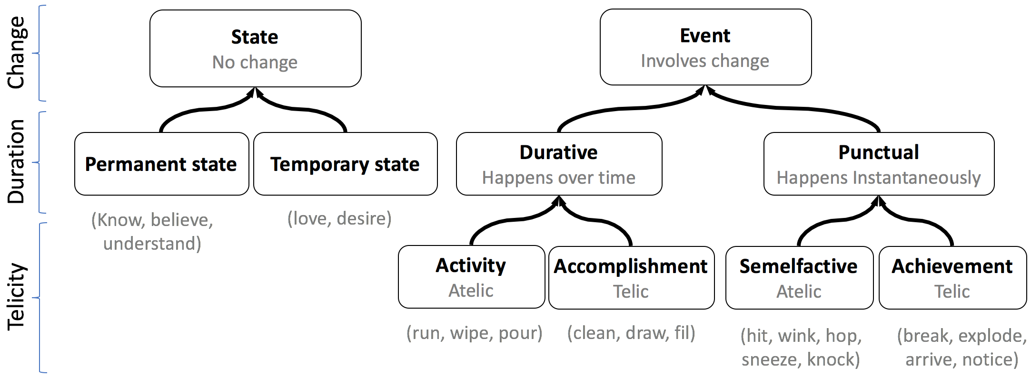
‘Events’ in Philosophy and Linguistics
Our interpretation of part of the literature:

Slide 11
‘Events’ in Philosophy and Linguistics
Krifka made it clear (Krifka 1998):
  ‘These classifications are about predicates’,
  i.e. descriptions, denoting entities such as processes in reality,
  They are not classifications about processes themselves
Same process can be described by distinct predicates each one of which can be classified differently.
Example: ‘Flying’ (as description) is cumulative, however, ‘Flying from A to B’, ‘Flying from H to G’ cannot be summed up.

Slide 12
Our hypothesis
Elements in these linguistic notions do correspond with entities or relationships represented (or representable) in BFO.
Investigated thus far
Homeomericity
Cumulativity
Telicity
Instantaneity
Durativity
Atomicity

Slide 13
BFO: Temporal parts vs. Occurrent parts
Your-life is an instance of a process.
  The first-year-of-your-life is a temporal part of your-life.
  Your-Trip-to-Antwerp is an occurrent part of your-life.

Slide 14
BFO: Occurrent parts
Your-life is an instance of a process.
  Your-Trip-to-Antwerp is an occurrent part of your-life.
p occurrent-part-of q
  a primitive relation of parthood holding independently of time between two process instances when one is a sub-process of the other (Arp et al 2015:135).
P occurrent-part-of Q =def.:
for every particular occurrent p, if p instance-of P, then there is some particular occurrent q such that q instance-of Q and p occurrent-part-of q (Arp et al 2015:139).

Slide 15
BFO: Temporal parts
Your-life is an instance of a process.
    The first-year-of-your-life is a temporal part of your-life
p temporal-part-of q =def.: (Smith 2012, corrected).
  p occurrent-part-of q
  & for some temporal region r p spans r
  & for all occurrents c, r′
  if (c spans r′ & r′ occurrent-part-of r
  then (c occurrent-part-of p iff c occurrent-part-of q))
P temporal-part-of Q =def.:
for every particular occurrent p, if p instance-of P, then there is some particular occurrent q such that q instance-of Q and p temporal-part-of q.

Slide 16
Homeomericity
An occurrence (in DOLCE) is homeomeric iff all of its temporal parts (in BFO sense) are of the same process type.
Example: ‘sitting’ (DOLCE claims) is homeomeric, as one cannot find any temporal part of sitting that is not sitting.
Similar to homogeneity (Dowty 1977:60).
This is a property of universals, not of instances.
BFO’s classification is based on instances, not of universals.

Slide 17
Configurations of temporal parthood and homeomericity

Slide 18
Isotypic parthood
p isotypic-part-of q =def. (R5)
p temporal-part-of q
& p instance-of all types instantiated by q.
Example (figure 2): p₆ isotypic-part-of p₅.
Jarrar M, Ceusters W. Classifying process and Basic Formal Ontology. International Conference on Biomedical Ontology (ICBO 2017), Newcastle upon Tyne, UK, Sept 13-15, 2017.

Slide 19
Configurations of temporal parthood and homeomericity
p6 isotypic-part-of p5
because
p6 temporal-part-of p5
& p6 instance-of all types instantiated by p5.

Slide 20
p weakly-homeomeric-in P =def. (R6)
all temporal parts of p which are not process boundaries are instances of P.
Examples (figure 2): p₂ weakly-homeomeric-in DC1; p₃ weakly-homeomeric-in DC1.

Slide 21
Configurations of temporal parthood and homeomericity
p₂ weakly-homeomeric-in DC1
because all temporal parts of p2 which are not process boundaries are instances of DC1.

Slide 22
Weak and strong homeomericity
p weakly-homeomeric-in P =def. (R6)
  all temporal parts of p which are not process boundaries are instances of P.
p strongly-homeomeric-in P =def. (R7)
  all temporal parts of p which are not process boundaries are instances of P and there is no such part of p that instantiates a subtype of P.
Example (figure 2): p₅ strongly-homeomeric-in DC9, p₈ strongly-homeomeric-in DC11.

Slide 23
Configurations of temporal parthood and homeomericity
p₅ strongly-homeomeric-in DC9 because all temporal parts of p5 which are not process boundaries are instances of DC9 and there is no such part of p5 that instantiates a subtype of DC9.

Slide 24
Unanswered Questions
Is it worthwhile to introduce the DC ‘weakly-homeomeric-process’ as the DC formed by all processes which are – or have an occurrent part which is – weakly-homeomeric-in some process type?
What is better, if worthwhile doing so:
  to implement the notion of ‘strongly-homeomeric-process’ as the DC formed by all processes which are– or have an occurrent part which is – strongly-homeomeric-in some process type or
  would it be sufficient to have an axiom directly at the level of the types to which it applies?

Slide 25
Configurations of temporal parthood and homeomericity
strongly-homeomeric processes

Slide 26
A matter of perspective?
Whether any of the relations R5…7 holds, depends on whether
  (1) a pure metaphysical stance is taken or
  (2) reality is looked at through what an ontology allows us to see and what is observable at the level of instances.
If a restricted ontological commitment would not allow us to observe or describe instances p4…p8, then, under that commitment, e.g., p1 would be strongly-homeomeric-in DC5 and DC6.

Slide 27
Configurations of temporal parthood and homeomericity
p1 strongly-homeomeric-in D5 and D6

Slide 28
Cumulativity
An occurrence is cumulative if the mereological sum of two instances of the same type is also an instance of the same type.
Example: ‘the sum of two sittings is still a sitting’.
Comparison: mass vs. count nouns: two portions of water make one (bigger) portion of water, two bottles of water together do not make one (bigger) bottle.
Adopted by DOLCE, but unclear in what way
  What mereological sum is intended (occurrent vs. temporal parts)
    My sitting + your sitting = sitting?
    My sitting [13:00 -14:00] + My sitting [14:00 -15:00] = Sitting [13:00-15:00] ?
    Flying is cumulative? Flying to London is cumulative?
  Is it a property of processes? or of how a process is described?
➔ Champollion 2014 & Galton 2016: cumulativity is related to process description, rather than what it is ontologically.

Slide 29
Cumulativity as a relation (1)
p cumulative-with q =def. (R8)
all process types instantiated by p and all process types instantiated by q are instantiated by p, q and p+q.
Example: p₂ cumulative-with p₃; DC1, DC5 and DC6 are the all and only types that are instantiated by both p₂ and p₃, as well as p₁ (the mereological sum of p₂ and p₃).

Slide 30
Configurations of temporal parthood and homeomericity
p2 cumulative-with p3;
DC1, DC5 and DC6 are the all and only types that are instantiated by both p2 and p3, as well as p1 (the mereological sum of p2 and p3).

Slide 31
Cumulativity as a relation (2)
P cumulative-in Q =def. (R9)
P isa Q
& for all p₁, p₂ instance-of P:
(p₁+p₂) instance-of Q.
Example: DC5 cumulative-in DC1.

Slide 32
Configurations of temporal parthood and homeomericity
DC5 cumulative-in DC1:
DC5 isa DC1
& for all instances-of DC5 (p1, p2, p3) any (?) sum is instance-of DC1.

Slide 33
Gene Ontology examples
Instances of Growth are weakly-homeomeric-in Growth
All subtypes of Growth would be cumulative-in Growth.
Subtypes of Cell Aggregation are cumulative-in Cell Aggregation.
No instance of Cell Aggregation would be strongly-homeomeric-in Cell Aggregation:
  not every temporal part of a cell aggregation process is of the same type (e.g. its sub-process ‘cells coming close to each other’ is not itself an aggregation).
  However, the mereological sum of two cell aggregations would be a cell aggregation.

Slide 34
Telicity
Telic: action tending towards a goal or a terminal point (Garey 1957)
  “running” is atelic
  “running a marathon” is telic,
  “writing” is atelic
  “writing an article” is telic
Can we apply telicity to processes themselves?, rather than to predicates under which these processes are described?
  In BFO terms, is telicity a notion that applies only to representational units, or can it also be applied to that what the representational units are about?

Slide 35
Telicity
Are there processes that are terminated naturally?
  “Falling”?
  Can a rock keeps falling down forever?
  It stops when reaching a surface.
  ➔‘falling under natural earth conditions’ is a telic process
  It is followed by a “coming to stop, when reaching a surface” process that terminates it.

Slide 36
Telicity - definitions
p is-telic-in R =def. (R10)
p instance-of P
& there exists some process q instance-of Q and some process r instance-of R, such that
(1) q not instance-of P,
(2) p not instance-of Q,
(3) p precedes q, and
(4) p and q are temporal-part-of r.
Example: each of p₄ , p₅, p₇ is-telic-in DC1.

Slide 37
Configurations of temporal parthood and homeomericity
p₇ is-telic-in DC1:
p7 instance-of DC10
& there exists some process p8 instance-of DC11 and some process p3 instance-of DC1, such that
(1) p8 not instance-of DC10,
(2) p7 not instance-of DC11,
(3) p7 precedes p8, and
(4) p7 and p8 are temporal-part-of p3.

Slide 38
Telicity - definitions
P is-telic-in R =def. (R11)
  for all process p instance-of P, p is-telic-in R.
For example: falling (i.e. under normal earth conditions) is-telic-in moving:
  p is the falling proper,
  q is the coming to a stop (bouncing, penetrating, …),
  r=p+q is the entire motion process.
Note that in general language, both p and r might be denoted by ‘falling’ Another example: ‘walking leg swing’ is-telic-in ‘walking’.

Slide 39
Instantaneity
Instantaneous Vs. durative!
Instantaneous (also called punctual) takes just a moment, a complete action with no explicit internal temporal structure (Garey 1957, Mourelatos 1978, Krifka 1998).
Examples: knocking, hitting, blinking, arriving, departing.
There are no processes that develop in zero-time.
The arrival process boundary vs. the arriving process.

Slide 40

Instantaneity (Very rough proposal)
We propose processes with peak moment, “touching-the-door” in “knocking”
All parts of knocking before and after the peak moment alone are not knocking.
Instantaneous processes cannot be strongly-homeomeric-in some universal because their temporal parts before and after their peak are not of the same type.
Boundaries of instantaneous processes are typically fiat boundaries

Slide 41
Atomicity
A one-step change-of-state, lacking any internal sub events (Caudal et al. 2005, Krifka 1998).
Adopted by DOLCE to distinguish between accomplishments (non-atomic) and achievements (atomic).
Atomicity depends on the granularity level and is subject to one’s perspective!
We are not sure yet whether this is a fantasy or something essential.

Slide 42
Conclusion and Future Work
We examined the re-use of aspectual notions used to classify verbal phrases for building process ontologies under BFO.
We provided BFO-compatible interpretations of homeomericity, cumulativity and telicity, discussed instantaneity, and rejected atomicity.
We plan to explore the use these notions to build a process profile ontology in BFO.

Slide 43
References
Arp R, Smith B, Spear AD. 2015. Building ontologies with Basic Formal Ontology. MIT Press.
Bach, E. 1986. The algebra of events. Linguistics & philosophy, 9(1),5-16.
Bhatt, R., & Pancheva, R. 2005. The syntax and semantics of aspect. LSA Summer Institute handout, Cambridge, MA.
Casati, R., Varzi, A. 2015. Events, The Stanford Encyclopedia of Philosophy (Winter 2015 Edition), Edward N. Zalta (ed.)
Caudal, P., & Nicolas, D. 2005. Types of degrees and types of event structures. Event arguments: Foundations and applications, 277-300.
Champollion, L. 2014. Distributivity, collectivity and cumulativity. Wiley’s companion to semantics.
Dowty, D. 1977 Toward a Semantic Analysis of Verb Aspect and the English 'Imperfective' Progressive. Linguistics & Philosophy, 1(1):45-77
Galton, A. 2016. The Ontology of Time and Process. Third Interdisciplinary School on Applied Ontology, Bozen-Bolzano, Italy
Garey, H. B. 1957. Verbal Aspects in French. Language 33, 91-110.
Gene Ontology Consortium. 2001. Creating the gene ontology resource: Design and implementation. Genome Res, 11:1425–1433.
Hastings, J., Ceusters, W., Smith, B., Mulligan, K. 2011. Dispositions and processes in the Emotion Ontology. Proceedings of ICBO 2011.
Hastings, J., Smith, B., Ceusters, W., Jensen, M., Mulligan, K. 2012. Representing mental functioning: Ontologies for mental health and disease. Proceedings of ICBO 2012.
Hennig, B. 2008. Occurrents. In Munn, K., Smith, B. (Eds.) Applied Ontology: An Introduction, chapter 12 (pp 255-284)
Krifka, Manfred. 1998 The origins of telicity". In Susan Rothstein (ed.), Events and Grammar. Dordrecht: Kluwer, 197-235.
Krifka, Manfred. 1989. "Nominal reference, temporal constitution and quantification in event semantics". In Semantics and Contextual Expressions 75-115. Dordrecht: Foris.
Levin, B. 2009. Aspectual Approaches to Lexical Semantic Representation. Course LSA 116 UC Berkeley
Li, M., Wang, D., Lu, Q., Long, Y . 2016. Event Based Emotion Classification for News Articles. PACLIC 30, 153.
Li, C., Bendersky, M., Garg, V., Ravi, S. 2017. Related Event Discovery. Proceedings of WSDM '17. ACM, New York, USA, 355-364.
Masolo, C., Borgo, S., Gangemi, A., Guarino, N., Oltramari, A., Oltramari, R., Horrocks, I. 2002. The WonderWeb library of foundational ontologies and the DOLCE ontology. WonderWeb deliverable D18.
Moens, M., & Steedman, M. 1988. Temporal ontology and temporal reference. Computational linguistics, 14(2), 15-28.
Morbach, J., Yang, A., Marquardt, W. 2007. OntoCAPE -A large-scale ontology for chemical process engineering. Engineering applications of artificial intelligence, 20(2), 147-161.
Mourelatos, A. P. 1978. Events, processes, and states. Linguistics and philosophy, 2(3), 415-434.
Nevatia, R., Hobbs, J., Bolles, B. 2004. An ontology for video event representation. Proceedings of CVPRW'04. IEEE
Ruy, F. B., Falbo, R. A., Barcellos, M. P., Guizzardi, G., Quirino, G. K. 2015. An ISO-based software process ontology pattern language and its application for harmonizing standards. ACM SIGAPP.15(2), 27-40.
Smith B. 2012. Classifying processes: an essay in applied ontology. Ratio. December 1; 25(4): 463–488
Smith, B., et al .2012. Basic Formal Ontology 2. Specification and User’s Guide, (version 3/6/2014).
Smith, B., & Varzi, A. C. 2000. Fiat and bona fide boundaries. Philosophical and Phenomenological Research, 401-420.
Trypuz, R., Vieu, L. 2007. An ontology of the aspectual classes of actions. Proceedings of LogKCA-07. 393-409.
Vendler, Z. 1957. Verbs and times. The philosophical review, 143-160.

