Slide 1
Biomedical Ontology PHI 548 / BMI 508
Werner Ceusters and Barry Smith

Slide 2
Lecture 2 Ontology of Clinical Practice
Werner Ceusters

Slide 3
Schedule
Lecture 2:
The diagnostic process
The Ontology for General Medical Science (OGMS)
Entities on the side of the patient
Lecture 3:
The Ontology for General Medical Science (OGMS)
Representations
Application to medical documentation

Slide 4
The diagnostic process

Slide 5
Notes:
Photos of Medicine Clinical Associate Professor, Anthony Martinez, with a patient in Buffalo General Hospital Photograph: Douglas Levere
From: https://ubphoto.smugmug.com/Years/2014/14061-Photos-of-Medicine/i-shnhQPC

Slide 7
Notes:
Otolaryngology Chair David Sherris examining a patient Photographer: Douglas Levere
From https://ubphoto.smugmug.com/Years/2007/20265-Photo-of-Otolaryngology/i-Hsd6WFj

Slide 9
Notes:
Photodynamic Therapy for Non-Melanoma Skin Cancer J Natl Compr Canc Netw 2007;5:531-540
Allan Oseroff with a patient at Roswell Park Cancer Institute Photographer: Douglas Levere
From https://ubphoto.smugmug.com/Years/2006/20124-Allan-Oseroffs-Office/i-KcMMttr

Slide 10
Misdiagnosis

Slide 11
Improving Diagnosis in Health Care
Erin P. Balogh, Bryan T. Miller, and John R. Ball, Editors;
Committee on Diagnostic Error in Health Care;
Improving diagnosis in health care.
National Academies of Sciences, Engineering, and Medicine. 2015. Washington, DC: The National Academies Press.
http://nap.edu/21794

Slide 12
The diagnostic process
http://nap.edu/21794

Slide 13
Diagnostic errors
A conservative estimate found that 5 percent of U.S. adults who seek outpatient care each year experience a diagnostic error.
Postmortem examination research spanning decades has shown that diagnostic errors contribute to approximately 10 percent of patient deaths.
Medical record reviews suggest that diagnostic errors account for 6 to 17 percent of hospital adverse events;
See Ontology for Adverse Events
Diagnostic errors are the leading type of paid medical malpractice claims, are almost twice as likely to have resulted in the patient’s death compared to other claims, and represent the highest proportion of total payments.
http://nap.edu/21794

Slide 14
Terminology/Ontology (1)
‘diagnostic error’ / ‘delayed diagnosis’ / ‘missed diagnosis’ ‘misdiagnosis’
‘diagnostic error’ versus ‘diagnosis error’
‘In part, the various definitions that have arisen reflect the intrinsic dualistic nature of the term “diagnosis,” which has been used to refer both to a process and to the result of that process’.
Similar examples:
poisoning (process) vs. poisoning (result)
writing (process) vs writing (result)
http://nap.edu/21794

Slide 15
Terminology/Ontology (2)
The committee’s patient-centered definition of diagnostic error is as follows:
Diagnostic error =def.
the failure to
(a) establish an accurate and timely explanation of the patient’s health problem(s)
or
(b) communicate that explanation to the patient.
http://nap.edu/21794

Slide 16
Outcomes from the diagnostic process
http://nap.edu/21794

Slide 17
https://www.facebook.com/advisor.healthcare/photos/pb.1593184380929079.-2207520000.1463376332./1655624751351708/?type=3&theater
Notes:
Cartoonist: Harley Schwadron

Slide 18
Something awkward ?
The committee’s patient-centered definition of diagnostic error is:
Diagnostic error =def.
the failure to
(a) establish an accurate and timely explanation of the patient’s health problem(s)
or
(b) communicate that explanation to the patient.
http://nap.edu/21794

Slide 19
Something awkward ?
The committee’s patient-centered definition of diagnostic error is:
Diagnostic error =def.
the failure to
(a) establish an accurate and timely explanation of the patient’s health problem(s)
or
(b) communicate that explanation to the patient.
p1 or p2 don’t happen
Diagnosing process plus Interpretive process (p1)
If p1 produces a result r, communication process (p2) of r
http://nap.edu/21794

Slide 20
Something awkward ?
What if:
the patient does not have health problems (but pretends to have such problems)?
no explanation can be found within the current state of the art?
the patient does not understand a word of what is said?

Slide 21
Compare with IASP definition for ‘pain’ (IASP = International Association for the Study of Pain)
‘an unpleasant sensory and emotional experience associated with actual or potential tissue damage, or described in terms of such damage’;
This definition presupposes:
that there is a common phenomenology (‘unpleasant sensory and emotional experience’) to all instances of pain,
that there are three distinct subtypes of pain involving, respectively:
actual tissue damage,
what is called ‘potential tissue damage’, and
a description involving reference to tissue damage.
Smith B, Ceusters W, Goldberg LJ, Ohrbach R. Towards an Ontology of Pain.
In: Mitsu Okada (ed.), Proceedings of the Conference on Logic and Ontology, Tokyo: Keio University Press, February 2011:23-32

Slide 22
For sure awkward is the following assertion provided by the committee:
‘The committee’s definition is two-pronged;
if there is a failure in either part of the definition, a diagnostic error results.’
http://nap.edu/21794

Slide 23
Notes:
Photos of Medicine Clinical Associate Professor, Anthony Martinez, with a patient in Buffalo General Hospital Photograph: Douglas Levere
From: https://ubphoto.smugmug.com/Years/2014/14061-Photos-of-Medicine/i-shnhQPC

Slide 24
Notes:
http://www.bloomberg.com/news/articles/2012-06-21/why-dont-more-hospitals-use-electronic-health-records

Slide 25
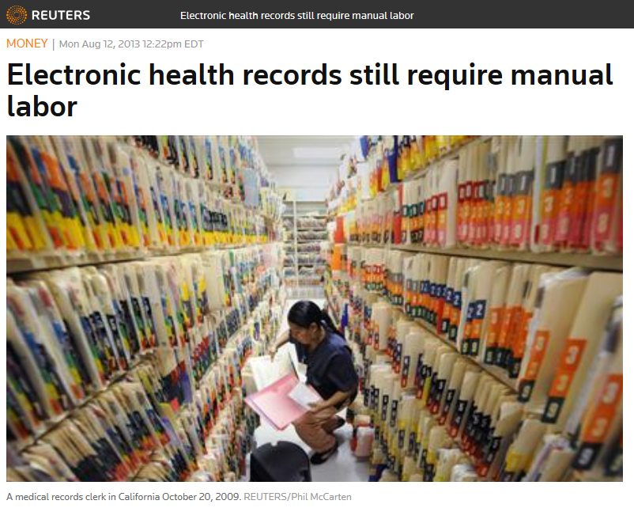
Notes:
http://www.reuters.com/article/us-healthcare-costs-electronicrecords-idUSBRE97B0HB20130812

Slide 26
10 Dimensions of the EHR
http://cmapspublic2.ihmc.us/rid=1GM0728VN-15TD0DN-12W4/ehr10dimensions.png

Slide 27
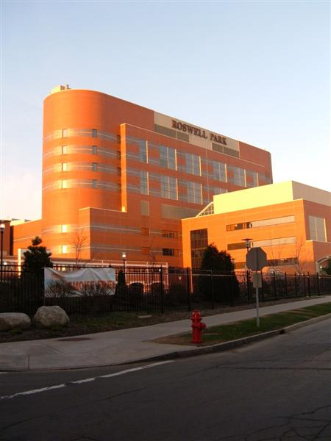
The vision of semantic interoperability
Everything collected wherever, whenever and about whomever which is relevant to a medical problem in whomever, whenever and wherever, should be accessible without loss of relevant detail.

Slide 28
The vision of semantic interoperability
Everything collected wherever, whenever and about whomever which is relevant to a medical problem in whomever, whenever and wherever, should be accessible without loss of relevant detail.

Slide 29
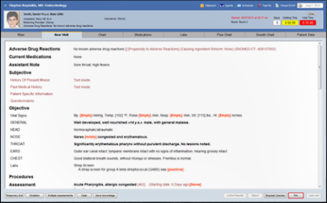
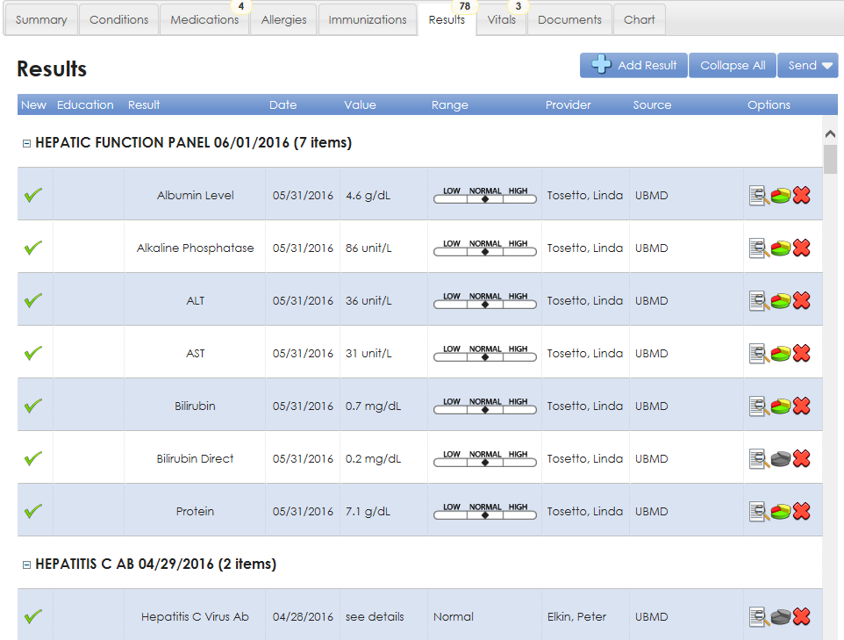
Relevance determination requires a global view
https://www.sigmundsoftware.com/
http://www.praxisemr.com/
https://ubmd.followmyhealth.com

Slide 30
However !
https://www.sigmundsoftware.com/
There is a lack of data for making analytics and decision support work
http://www.praxisemr.com/
https://ubmd.followmyhealth.com
Optimized for practice management and patient care
Optimized for analytics and decision support

Slide 31
Idiosyncrasies of …
The diagnostic process:
Diagnosis may be recorded when there is only a suspicion of disease;
Some overlapping clinical conditions are difficult to distinguish reliably;
Patients may only partially fit diagnostic criteria;
Patients in whom diagnostic testing is done are still more likely to have disease even if the result of the test is negative.
Reporting a diagnosis:
Repeated diagnosis codes over time may represent a new event or a follow-up to an earlier event;
First diagnosis in a database is not necessarily an incident case of disease.
Hersh, WR, Weiner, MG, et al. (2013).
Caveats for the use of operational electronic health record data in comparative effectiveness research. Medical Care. 51(Suppl 3): S30-S37.

Slide 32
Ontologically interesting items
The diagnostic process:
Diagnosis may be recorded when there is only a suspicion of disease;
Some overlapping clinical conditions are difficult to distinguish reliably;
Patients may only partially fit diagnostic criteria;
Patients in whom diagnostic testing is done are still more likely to have disease even if the result of the test is negative.
Reporting a diagnosis:
Repeating diagnosis codes over time may represent a new event or a follow-up to an earlier event;
First diagnosis in a database does not necessarily entail an actual corresponding case of disease.
Hersh, WR, Weiner, MG, et al. (2013).
Caveats for the use of operational electronic health record data in comparative effectiveness research. Medical Care. 51(Suppl 3): S30-S37.

Slide 33
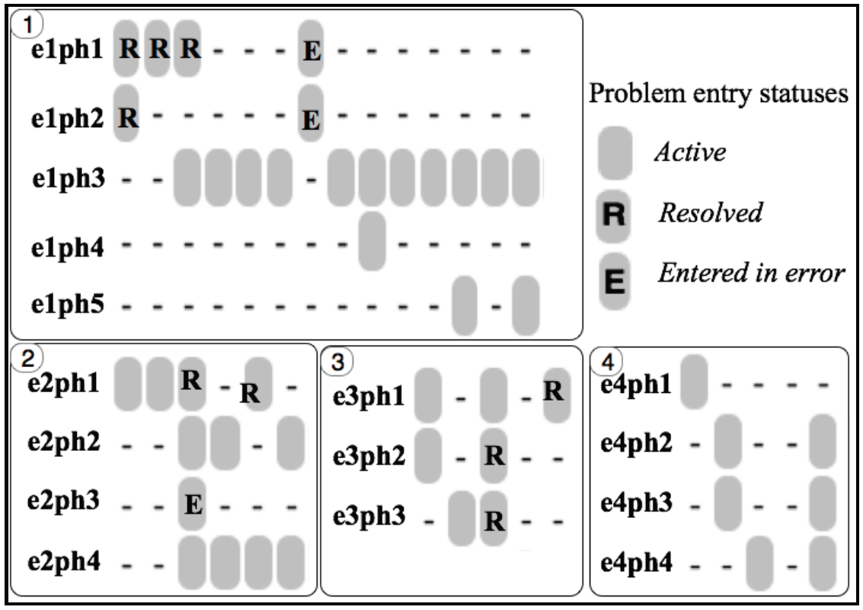
Idiosyncrasies in problem entry updates
e1ph1: Diabetes mellitus type II (NIDDM)
e1ph2: Diabetes Mellitus With Complication
e1ph3: Diabetes mellitus
e1ph4: DM (diabetes mellitus), type 1, uncontrolled
e1ph5: Diabetes mellitus with complication
e2ph1: Type 1 Diabetes Mellitus - Uncontrolled
e2ph2: Type II diabetes mellitus with ketoacidosis
e2ph3: Type 2 Diabetes Mellitus - Uncomplicated, Uncontrolled
e2ph4: Acanthosis nigricans
e3ph1: Closed Fracture Of The Shaft Of The Humerus
e3ph2: Closed Fracture Of Neck Of Femur - Transcervical
e3ph3: Closed Fracture Of The Humerus
e4ph1: Open Treatment Of Humeral Shaft Fracture w Plate/Screws
e4ph3: Fracture of left humerus
Bona J, Ceusters W. Replacing EHR structured data with explicit representations. International Conference on Biomedical Ontologies, ICBO 2015, Early career track, Lisbon, Portugal, July 27-30, 2015;85-86
Notes:
What is needed in addition are mechanisms to determine and represent not only (1)
how assertions (for instance diagnoses) relate to reality (diseases in patients) and how
changes in the pool of assertions relate to changes in reality and vice versa, but also (2)
the extent to which data are incomplete and inconsistent. As an example, we examined
Electronic Healthcare Records (EHR) of 570,000 patients from Western New York to
assess the extent to which diagnostic assertions in these records correspond to disorders
in the patients [3]. This analysis uncovered many ways in which the data fail to represent
explicitly what they are supposed to represent.

Slide 34
Prominent types of inconsistencies
Changes in reality not faithfully reflected in the medical record updates;
Updates in the records inadequately documented as to whether they reflect changes in reality or changes in caregivers understanding thereof;
Inconsistencies amongst observers;
Plain mistakes and ambiguities.
Beginnings of a solution: an ontology for general medical science
Ceusters W, Hsu CY, Smith B. Clinical Data Wrangling using Ontological Realism and Referent Tracking. International Conference on Biomedical Ontologies, ICBO 2014, Houston, Texas, Oct 6-9, 2014;
CEUR Workshop Proceedings 2014;1237:27-32.

Slide 35
Ontology for General Medical Science OGMS
Scheuermann R, Ceusters W, Smith B. Toward an Ontological Treatment of Disease and Diagnosis. 2009 AMIA Summit on Translational Bioinformatics, San Francisco, California, March 15-17, 2009;: 116-120. Omnipress ISBN:0-9647743-7-2

Slide 36
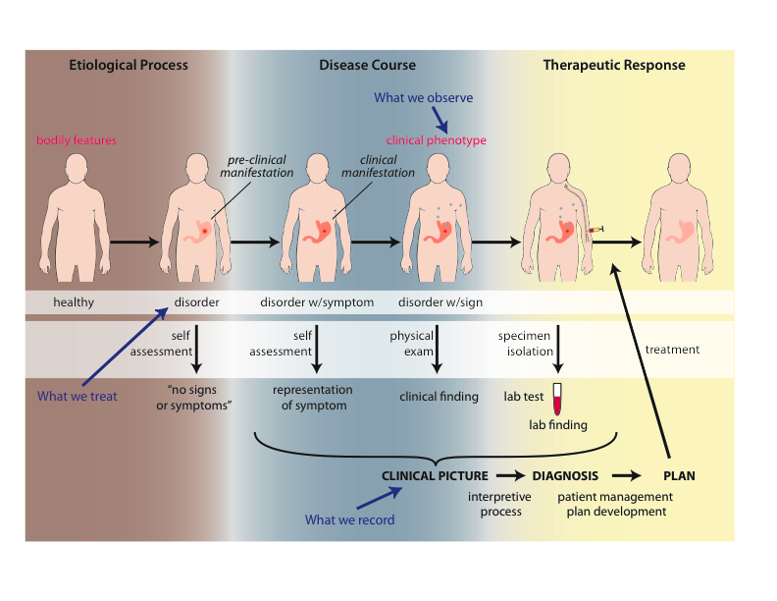
Big Picture

Slide 37
Motivation
Clarity about:
disease etiology and progression;
disease on the side of the patient and the diagnostic process on the side of the clinician or healthcare system;
phenotype and signs/symptoms;
how the entities relate to each other.
Better support for use of evidence in the context of patient care, clinical research and translational research;
Includes use of medical record information in support for clinical and translation research.
Extensibility.

Slide 38
Motivation Four distinct classificatory tasks
of people (patients, carriers, …)
of diseases (cases, instances, problems, …)
of courses of disease (symptoms, treatments…)
of representations (records, observations, data, diagnoses…)
International Classification of Diseases (ICD) confuses 1. & 2.
HL7, most standard terminologies, confuse 2. and 4

Slide 39
Examples of unprincipled classification
International Classification of Diseases (ICD):
V01: Contact with or exposure to communicable diseases
V02: Carrier or suspected carrier of infectious diseases
V03: Need for prophylactic vaccination and inoculation against bacterial diseases
V08: [Asymptomatic] human immunodeficiency virus (HIV) infection status
V09: Infection with drug-resistant microorganisms
V10: Personal history of malignant neoplasm (i.e. cancer)
V16: Family history of malignant neoplasm

Slide 40
Health Level 7 (HL7) Reference Information Model (RIM) Philosophy
“The truth about the real world is constructed through a combination and arbitration of attributed statements ...
“As such, there is no distinction between an activity and its documentation.”
https://www.hl7.org/fhir/v3/ActClass/index.html. Accessed, Sept 12, 2016.

Slide 41
Goals of OGMS
To serve as a consistent, logically well-defined extensible framework (ontology) for the representation of:
features of disease;
clinical processes;
results of tests and diagnostic processes.

Slide 42
Goals of OGMS
What are the fundamental types of things for which we need ontological categories (what’s the domain)?
disease initiation, progression, pathogenesis, signs, symptoms, assessments, clinical and laboratory findings, disease diagnosis, treatment, treatment response and outcome;
normal phenotype, homeostatic (normal) profile.
Notes:
Answer the following questions.

Slide 43
Goals of OGMS
What are the fundamental relationships:
between the process of observing, the results of the observation and what is being observed;
between signs/symptoms and disease (no absolutes?);
between clinical and pre-clinical pathological processes, their manifestations and their representations in the EHR.
Notes:
Answer the following questions.

Slide 44
Goals of OGMS
How should ontologies be developed - intelligent design or natural selection (evolution)?
What is the relationship between
the ontologies,
the terminologies and
the information models?
Notes:
Answer the following questions.

Slide 45
Ontology / Terminology
Notes:
http://browser.ihtsdotools.org/?perspective=full&conceptId1=40733004&edition=en-edition&release=v20160731&server=http://browser.ihtsdotools.org/api/snomed&langRefset=900000000000509007

Slide 46
Ontology / Terminology
Notes:
http://browser.ihtsdotools.org/?perspective=full&conceptId1=40733004&edition=en-edition&release=v20160731&server=http://browser.ihtsdotools.org/api/snomed&langRefset=900000000000509007

Slide 47
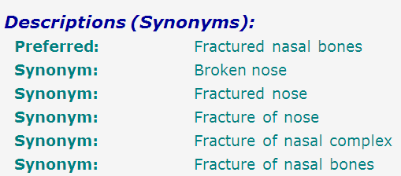
SNOMED-CT: abundance of false synonymy
bones
nose
fracture

Slide 48
EHR Information Models (simplified)
diagnosis
finding
finding
patient
patient
encounter
drug
drug
diagnosis

Slide 49
Constraints
We need to be accurate;
We need to be practical (reproducibility vs dogma).
What can we expect the clinicians to understand and provide?
Is the distinction between chronic and progressive easily determined?
We need to leverage and harmonize existing and emerging standards.

Slide 50
Outcomes Assessment
What are the criteria by which we can judge whether we have good categories and good definitions?
The degree to which ordinary clinicians can understand and reproducibly apply the definitions.
The degree to which entities can be easily mapped between humans and animal models.
The degree to which the categories can accommodate new diagnostic technologies (e.g. proteomics).
The degree to which electronic medical record data can be integrated with clinical and translational research data.

Slide 51
Approach
Propose terms and provide definitions for a representational framework drawing on best practices in ontology development as promulgated within the OBO Foundry for:
Etiological process
Disorder
Disease
Pathological process
Sign
Risk factor
Symptom
Laboratory finding
Diagnosis
Pre-disposition
Clinically abnormal
Biomarker
Notes:
Answer the following questions.

Slide 52
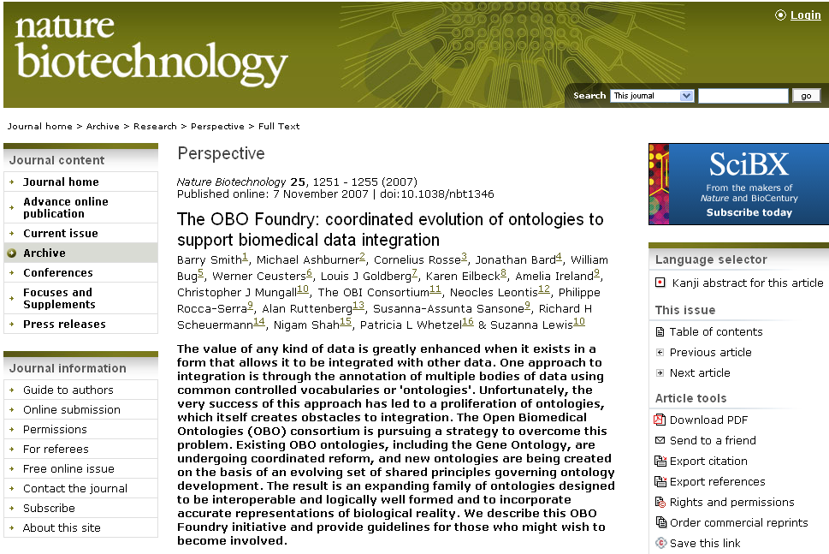

Slide 53
Approach
a disease is a disposition rooted in a physical disorder in the organism and realized in pathological processes.
produces
bears
realized_in
etiological process
disorder
disposition
pathological process
produces
diagnosis
interpretive process
signs & symptoms
abnormal bodily features
produces
participates_in
recognized_as
Notes:
font was too small, color inside green boxes was hardly readable

Slide 54
Cirrhosis - environmental exposure
Etiological process - phenobarbitol-induced hepatic cell death
produces
Disorder - necrotic liver
bears
Disposition (disease) - cirrhosis
realized_in
Pathological process - abnormal tissue repair with cell proliferation and fibrosis that exceed a certain threshold; hypoxia-induced cell death
produces
Abnormal bodily features
recognized_as
Symptoms - fatigue, anorexia
Signs - jaundice, splenomegaly
Symptoms & Signs
used_in
Interpretive process
produces
Hypothesis - rule out cirrhosis
suggests
Laboratory tests
produces
Test results – documentation of elevated liver enzymes in serum
used_in
Interpretive process
produces
Result - diagnosis that patient X has a disorder that bears the disease cirrhosis

Slide 55
Foundational Terms (1)
Disorder =def. – A causally linked combination of physical components of the extended organism that is
(a) clinically abnormal and
(b) maximal, in the sense that it is not a part of some larger such combination.

Slide 56
Basic Formal Ontology
Continuant
Occurrent
(Process)
Independent
Continuant
(molecule,
cell, organ,
organism)
Dependent
Continuant
(quality,
function,
disease)
..... ..... .... .....

Slide 57
Physical Disorder
– independent continuant
objects
fiat object parts
object aggregates
A causally linked combination of physical components of the extended organism.

Slide 58
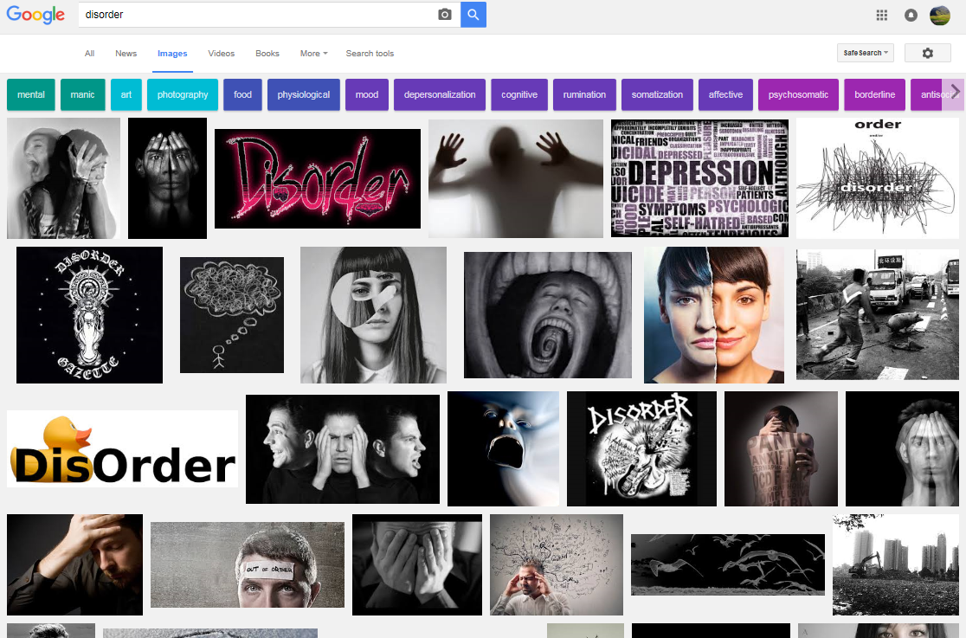

Slide 59
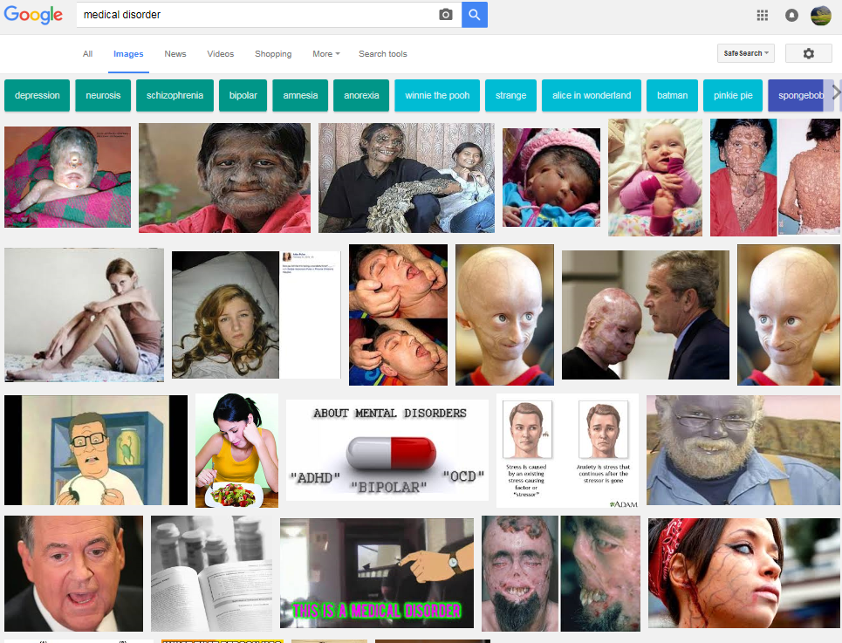

Slide 60
Extended organism
Harth R. War and peace in the human gut: probing the microbiome
https://biodesign.asu.edu/sites/default/files/news/AthenaHostcooperation7.png

Slide 61
Clinically abnormal
something is clinically abnormal if:
is not part of the life plan for an organism of the relevant type (unlike aging or pregnancy),
is causally linked to an elevated risk either of pain or other feelings of illness, or of death or dysfunction, and
is such that the elevated risk exceeds a certain threshold level.

Slide 62
Foundational Terms (2)
Disorder =def. – A causally linked combination of physical components of the extended organism that is
(a) clinically abnormal and
(b) maximal, in the sense that it is not a part of some larger such combination.
Pathological Process =def. – A bodily process that is a manifestation of a disorder and is clinically abnormal.

Slide 63
Basic Formal Ontology
Continuant
Occurrent
(Process)
Independent
Continuant
(molecule,
cell, organ,
organism)
Dependent
Continuant
(quality,
function,
disease)
..... ..... .... .....

Slide 65
Foundational Terms (3)
Disorder =def. – A causally linked combination of physical components of the extended organism that is (a) clinically abnormal and (b) maximal, in the sense that it is not a part of some larger such combination.
Pathological Process =def. – A bodily process that is a manifestation of a disorder and is clinically abnormal.
Disease =def. – A disposition (i) to undergo pathological processes that (ii) exists in an organism because of one or more disorders in that organism.

Slide 66
Continuant
Independent
Continuant
Dependent
Continuant
Non-realizable
Dependent
Continuant
(quality)
Realizable
Dependent
Continuant
(function, role,
disposition)
..... .....

Slide 67
Realizable dependent continuants
plan
function
role
disposition
capability
tendency
continuants

Slide 68
Their realizations
execution
expression
exercise
realization
application
course
occurrents

Slide 69
Disposition
- of a glass vase, to shatter if dropped
- of a human, to eat
- of a banana, to ripen
- of John, to lose hair
dispositions must have some physical basis

Slide 70
Disposition
if it ceases to exist, then its bearer and/or its immediate surrounding environment is physically changed;
its realization occurs when its bearer is in some special physical circumstances;
its realization is what it is in virtue of the bearer’s physical make-up.

Slide 71
Dispositions are realized in processes
dependent
continuant
occurrent
process
disposition
ripening
to ripen
disposition of this
fruit: to ripen
process of ripening
in this fruit

Slide 72
independent
continuant
dependent
continuant
occurrent
disposition
process
integumentary
system
process of going bald
to go bald
John’s
integumentary
system
John’s
disposition:
to go bald
John’s going
bald

Slide 73
Dependence
on the instance level
a depends_on b =def. a is necessarily such that if b ceases to exist than a ceases to exist
on the type level
A depends_on B =def. for every instance a of A, there is some instance b of B such that a depends_on b.

Slide 74
realization depends_on realizable
Continuant
Occurrent
Independent
Continuant
bearer
Dependent
Continuant
disposition
Process of
realization
.... ..... .......

Slide 75
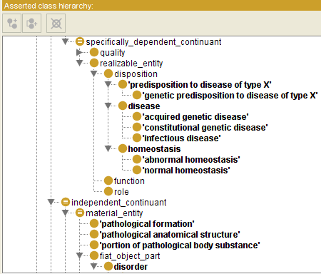

Slide 76
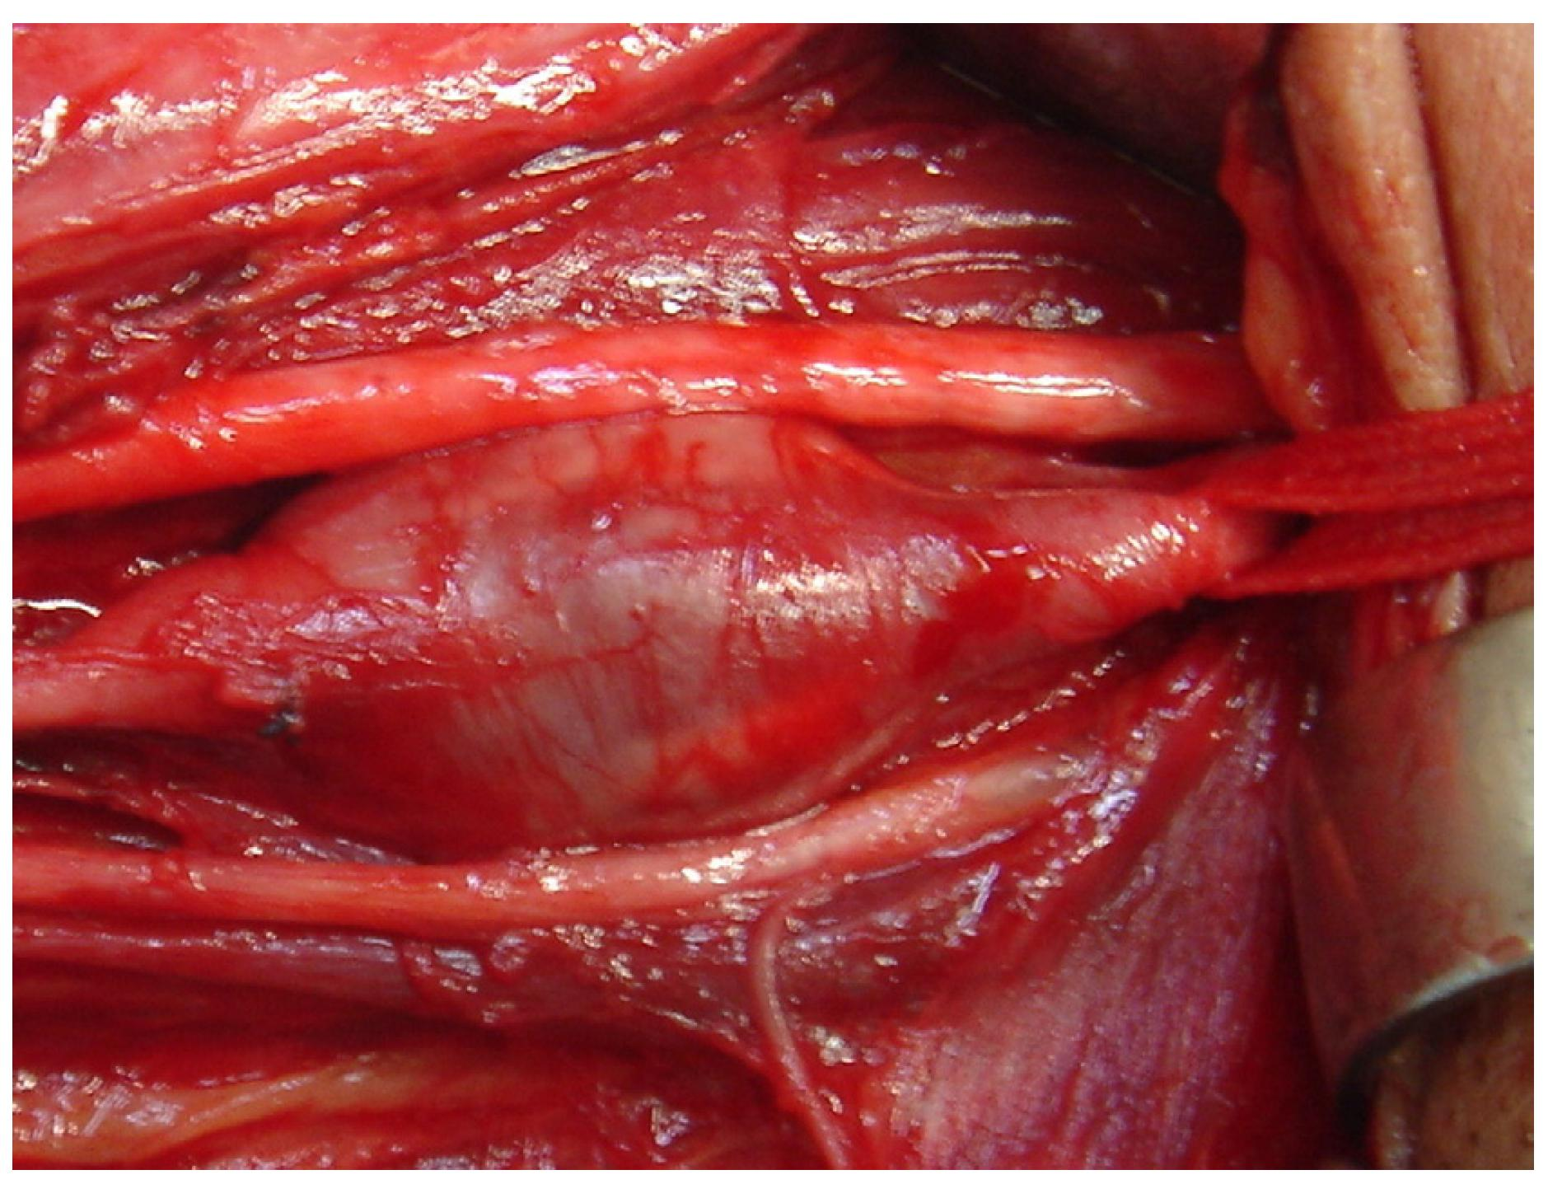
Arterial aneurysm
Jornal Vascular Brasileiro Print version ISSN 1677-5449 J. vasc. bras. vol.12 no.4 Porto Alegre Oct./Dec. 2013 Epub Dec 15, 2013
http://dx.doi.org/10.1590/jvb.2013.054
Subclavian and axillary arterial aneurysms: two case reports
Fernando Pinho Esteves¹ , André Ventura Ferreira¹ , Vanessa Prado dos Santos² , Gabriel Santos Novaes¹ , Álvaro Razuk Filho¹ , Roberto Augusto Caffaro¹

Slide 77
Arterial Aneurysm
Disposition – atherosclerosis
realized in
Pathological process – fatty material collects within the walls of arteries
produces
Disorder – artery with weakened wall
bears
Disposition – of artery to become distended
realized_in
Pathological process – process of distending
produces
Disorder – arterial aneurysm
bears
Disposition – of artery to rupture
realized in
Pathological process – (catastrophic event) of rupturing
produces
Disorder – ruptured artery, arterial system with dangerously low blood pressure
bears
Disposition – circulatory failure
realized in
Pathological process – exsanguination, failure of homeostasis
produces
Death

Slide 78
coronary heart disease
disease associated with early lesions and small fibrous plaques
disease associated with asymptomatic (‘silent’) infarction
disease associated with surface disruption of plaque
unstable angina
stable angina
instantiates at t₂
instantiates at t₃
instantiates at t₄
instantiates at t₅
instantiates at t₁
John’s coronary heart disease
time

Slide 79
independent
continuant
dependent
continuant
occurrent
disposition
process
heart
disease course
coronary heart disease
John’s heart
John’s coronary
heart disease
course of John’s
coronary heart disease

Slide 80
Disease course
The totality of all PROCESSes through which a given DISEASE instance is realized.

Slide 81
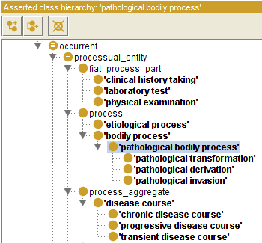

Slide 82
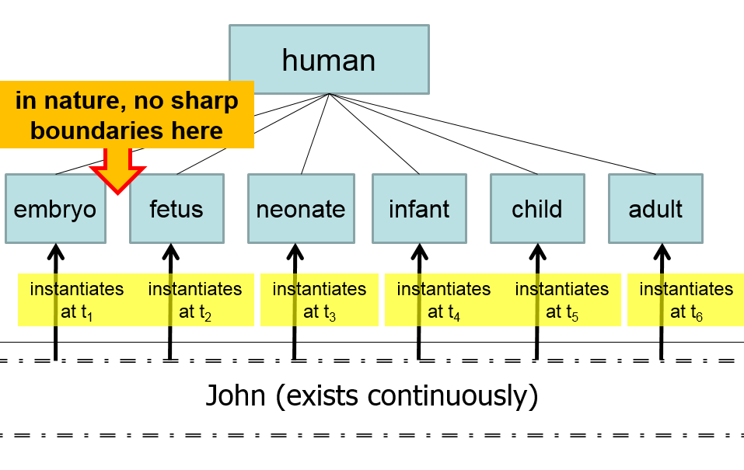
Compare with

Slide 84
Questions
How does one deal with the ever changing nature of the physical disorder?
How does one deal with the evolution of the disposition?
Is an infectious disorder still an infectious disorder even after the pathogenic organism has been sterilized?
Notes:
Answer the following questions.

Slide 85
Acute Influenza Infection Process
Immune response
Pathogen sterilization
State
Viral replication
& tissue destruction
Normal Homeostatic
Range
Etiological
Event
Time

Slide 86
Normal Adaptation
State
Etiological
Event
Normal Homeostatic
Range
Normal Homeostatic
Range
Time

Slide 87
Acute Pathological Process
State
Etiological
Event
Normal Homeostatic
Range
Time

Slide 88
Chronic Pathological Process
State
Abnormal
Homeostatic
Range
Etiological
Event
Normal Homeostatic
Range
Time

Slide 89
Progressive Pathological Process
State
Etiological
Event
Normal Homeostatic
Range
Time

Slide 90
Etiology
Etiological Process =def. – A process in an organism that leads to a subsequent disorder.
Examples:
toxic chemical exposure resulting in a mutation in the genomic DNA of a cell;
infection of a human with a pathogenic virus;
inheritance of two defective copies of a metabolic gene.
The etiological process creates the physical basis of that disposition to pathological processes which is the disease.

Slide 91
Dispositions and Predispositions
All diseases are dispositions; not all dispositions are diseases.
A predisposition is a disposition.
Predisposition to Disease of Type X =def. – A disposition in an organism that constitutes an increased risk of the organism’s subsequently developing the disease X.
Hereditary Non-polyposis Colorectal Cancer (HNPCC) is caused by a:
disorder (mutation) in a DNA mismatch repair gene that
disposes to the acquisition of additional mutations from defective DNA repair processes, and thus
predisposition to the development of colon cancer.

Slide 92
Hereditary Non-polyposis Colorectal Cancer HNPCC - genetic pre-disposition
Etiological process - inheritance of a mutant mismatch repair gene
produces
Disorder - chromosome 3 with abnormal hMLH1
bears
Disposition (disease) - Lynch syndrome
realized_in
Pathological process - abnormal repair of DNA mismatches
produces
Disorder - mutations in proto-oncogenes and tumor suppressor genes with microsatellite repeats (e.g. TGF-beta R2)
bears
Disposition (disease) - non-polyposis colon cancer

Slide 93
Hemorrhagic stroke
http://www.tomfit247.com/2013/05/stroke-what-is-it-what-causes-it-and.html

Slide 94
Hemorrhagic stroke
Disorder – cerebral arterial aneurysm
bears
Disposition – of weakened artery to rupture
realized in
Pathological process – rupturing of weakened blood vessel
produces
Disorder – Intraparenchymal cerebral hemorrhage
bears
Disposition (disease) – to increased intra-cranial pressure
realized in
Pathological process – increasing intra-cranial pressure, compression of brain structures
produces
Disorder – Cerebral ischemia, Cerebral neuronal death
bears
Disposition (disease) – stroke
realized in
Symptoms – weakness/paralysis, loss of sensation, etc

Slide 95
Definitions - Clinical Evaluation Terms (on the side of the patient!)
‘bodily feature’ - an abbreviation for a physical component, a bodily quality, or a bodily process.
Sign =def. – A bodily feature of a patient that is observed in a physical examination and is deemed by the clinician to be of clinical significance. (Objectively observable features)
Symptom =def. – A bodily feature of a patient that is observed by the patient and is hypothesized by the patient to be a realization of a disease. (a restricted family of phenomena (including pain, nausea, anger, drowsiness), which are of their nature experienced in the first person)
Laboratory Test =def. – A measurement assay that has as input a patient-derived specimen, and as output a result representing a quality of the specimen.
Laboratory Finding =def. – A representation of a quality of a specimen that is the output of a laboratory test and that can support an inference to an assertion about some quality of the patient.

Slide 96
Definitions - manifestations
Manifestation of a Disease =def. – A bodily feature of a patient that is (a) a deviation from clinical normality that exists in virtue of the realization of a disease and (b) is observable.
Observability includes observable through elicitation of response or through the use of special instruments.
Preclinical Manifestation of a Disease =def. – A manifestation of a disease that exists prior to its becoming detectable in a clinical history taking or physical examination.
Clinical Manifestation of a Disease =def. – A manifestation of a disease that is detectable in a clinical history taking or physical examination.
Phenotype =def. – A (combination of) bodily feature(s) of an organism determined by the interaction of its genetic make-up and environment.
Clinical Phenotype =def. – A clinically abnormal phenotype.

