Slide 1
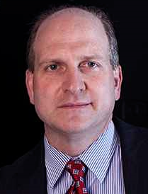
An ontological analysis of diagnostic assertions in electronic healthcare records International Conference on Biomedical Ontology July 27-30, 2015 – Lisbon, Portugal
Werner CEUSTERS¹, MD & William R. HOGAN², MD
¹ Department of Biomedical Informatics, University at Buffalo
² Department of Health Outcomes and Policy, University of Florida

Slide 2
Observation / Claim
Patient data,
as currently gathered through EHRs,
communicated over RHIOs, and
collected and aggregated in data warehouses,
have minimal, but usually missing, background information,
insufficiently precise to allow the construction of a completely accurate view on what is (and has been) the case in reality.

Slide 3
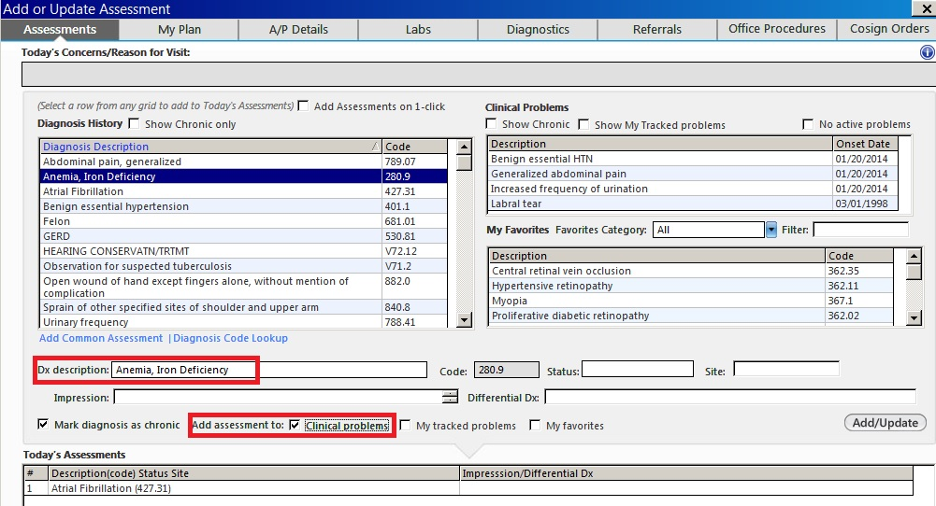
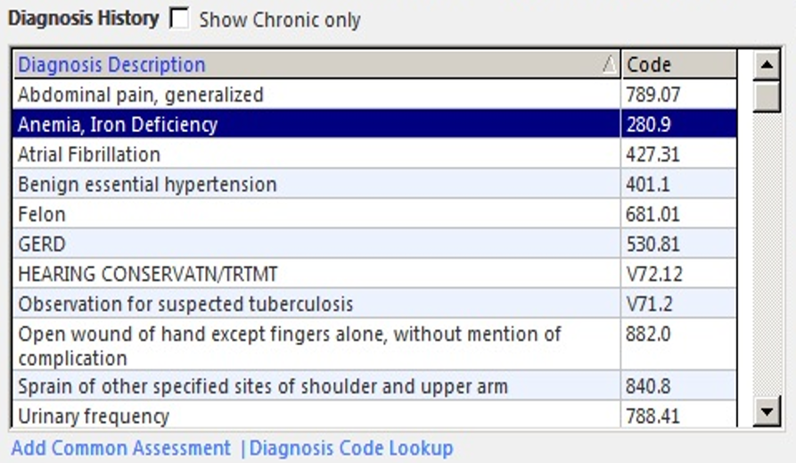
Is this patient really so sick ?
http://incerio.com/planning-nextgen-version-5-8-upgrade-things-know-diagnosis-module/

Slide 4
What are the referents ?
Are there really ‘chronic diagnoses’, or is it diseases that are chronic ?
http://incerio.com/planning-nextgen-version-5-8-upgrade-things-know-diagnosis-module/

Slide 5
What are the referents ?
Whose problems and favorites are intended here: the patient’s or the clinician’s?
http://incerio.com/planning-nextgen-version-5-8-upgrade-things-know-diagnosis-module/

Slide 6
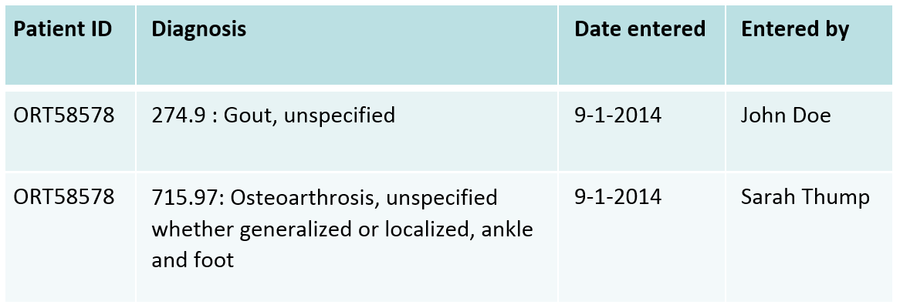
Open questions on a seemingly simple representation
Are the two diagnoses about the very same disorder the patient suffers from (thereby highlighting different aspects of that disorder which cannot be expressed using a single ICD-code) or about two distinct disorders the patient suffers from simultaneously?
Did the persons that entered the diagnoses also make the diagnoses?
How do the dates when the diagnoses were entered relate to the dates when the diagnoses were actually made, or the dates the patient started to suffer from the disease?

Slide 7
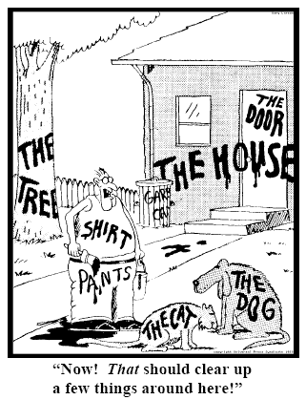
A solution proposed 10 years ago
Referent Tracking
explicit reference to the individual entities relevant to the accurate description of some portion of reality, ...
Ceusters W, Smith B. Strategies for Referent Tracking in Electronic Health Records. J Biomed Inform. 2006 Jun;39(3):362-78.

Slide 8
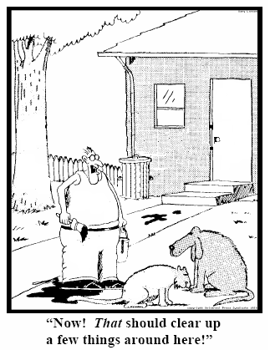
A solution proposed 10 years ago
Referent Tracking
explicit reference to the individual entities relevant to the accurate description of some portion of reality, …
by means of an Instance Unique Identifier (IUI) for each such particular (individual) entity.
78
235
5678
321
322
666
427
Ceusters W, Smith B. Strategies for Referent Tracking in Electronic Health Records. J Biomed Inform. 2006 Jun;39(3):362-78.

Slide 9
Referent Tracking Tuples (RTTs)
From:
“ this patient has ICD-9 diagnosis ‘279.4 – Gout, unspecified’ ”
To (very roughly, simplified and in abstract syntax):
‘this-1 is about this-2 which is realized in this-3’, where
this-1 instanceOf diagnosis …
this-1 isAbout this-2 …
this-2 instanceOf disease …
this-2 realizedIn this-3 …
this-3 instanceOf human being …
…

Slide 10
Referent Tracking Tuples (RTTs)
From:
“ this patient has ICD-9 diagnosis ‘279.4 – Gout, unspecified’ ”
To (very roughly, simplified and in abstract syntax):
‘this-1 is about this-2 which is realized in this-3’, where
this-1 instanceOf diagnosis …
this-1 isAbout this-2 …
this-2 instanceOf disease …
this-2 realizedIn this-3 …
this-3 instanceOf human being …
…
denotators for particulars

Slide 11
Referent Tracking Tuples (RTTs)
From:
“ this patient has ICD-9 diagnosis ‘279.4 – Gout, unspecified’ ”
To (very roughly, simplified and in abstract syntax):
‘this-1 is about this-2 which is realized in this-3’, where
this-1 instanceOf diagnosis …
this-1 isAbout this-2 …
this-2 instanceOf disease …
this-2 realizedIn this-3 …
this-3 instanceOf human being …
…
denotators for appropriate relations

Slide 12
Referent Tracking Tuples (RTTs)
From:
“ this patient has ICD-9 diagnosis ‘279.4 – Gout, unspecified’ ”
To (very roughly, simplified and in abstract syntax):
‘this-1 is about this-2 which is realized in this-3’, where
this-1 instanceOf diagnosis …
this-1 isAbout this-2 …
this-2 instanceOf disease …
this-2 realizedIn this-3 …
this-3 instanceOf human being …
…
denotators for universals or particulars

Slide 13
Referent Tracking Tuples (RTTs)
From:
“ this patient has ICD-9 diagnosis ‘279.4 – Gout, unspecified’ ”
To (very roughly, simplified and in abstract syntax):
‘this-1 is about this-2 which is realized in this-3’, where
this-1 instanceOf diagnosis …
this-1 isAbout this-2 …
this-2 instanceOf disease …
this-2 realizedIn this-3 …
this-3 instanceOf human being …
…
time stamp at least one continuant is referenced

Slide 14
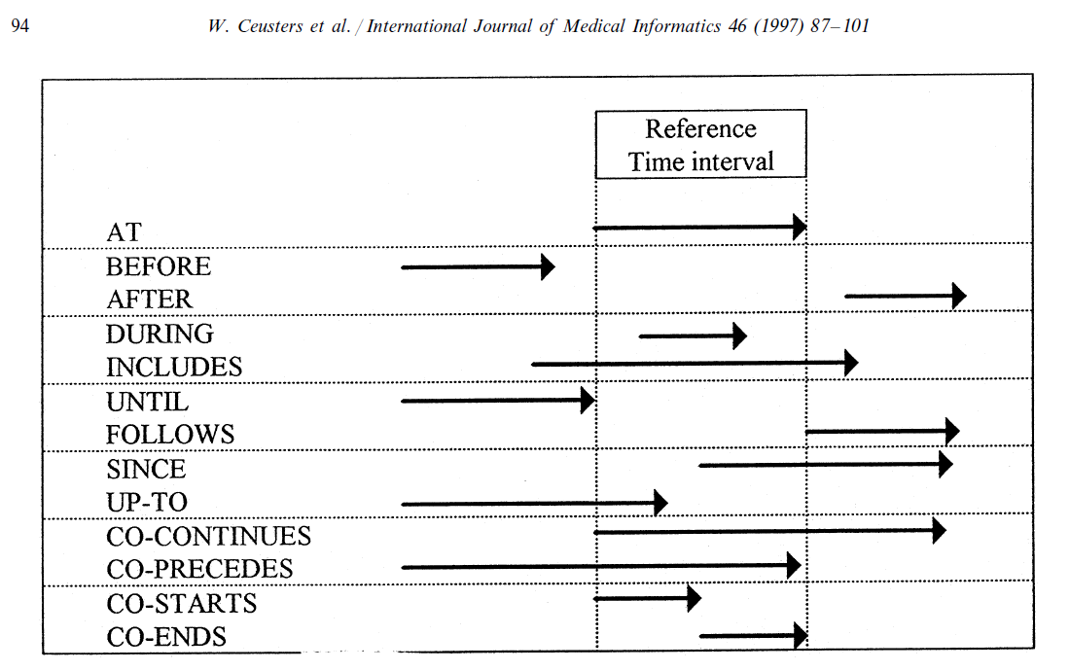
Representation of relation with time intervals

Slide 15
Research question
To what extent is it possible for 2 ontologists to develop independently from one another a collection of RTTs that describe the same portion of reality (POR) in a semantically-interoperable way.
The analysis presented is the first step in this endeavor and focuses on:
the choice of particulars deemed necessary and sufficient for an accurate description of the selected POR,
what these particulars are instances of,
how they relate to each other, and
the motivations of each author for the choices made.

Slide 16
Relevance for this work
Differences in the choice of ontologies constitute a risk: distinct ontologies may represent reality from distinct perspectives and despite being veridical might not be derivable from each other because the axioms required to do so would be missing, for the simple reason that such axioms would fall outside the purpose of the specific ontologies.
This would lead the representations by each of the authors not to be semantically interoperable unless additional ontology bridging axioms would be crafted.

Slide 17
Back to our problem:
What must be the case and can be the case for the following table to make sense, and
How can Referent Tracking and Ontology make that clear?
What follows is an incomplete analysis, examples being taken to make the case for this particular presentation.

Slide 18
Intellectual experiment
Context:
An EHR with a problem list shows in a spreadsheet for a specific patient two diagnostic entries entered at the same date, but by distinct providers:
It is assumed that the patient with ID ORT58578 has only one disorder.
Task:
List the different kinds of Referent Tracking statements that would represent this situation.
Consider what must and can be the case for the table to make sense.
Players:
Ceusters and Hogan, two experts in Referent Tracking
(hereafter referenced as X and Y, not to be assumed in a specific order)

Slide 19
Methodology
No instructions on ontologies to use, or format of RTTs.
Results exchanged after each author finished work.
Analysis:
identification of the particulars that both authors referred to in their assertions.
re-assign IUIs to particulars referred to by both authors as if the collection of RTTs was merged into one single RT system, thereby still keeping track of which RTT was asserted by which author.
analyze and discuss differences in representations, however without paying attention to the temporal indexing required for RTTs describing a POR in which a continuant is involved.

Slide 20
Quantitative Results
 | X | Y | X+Y
# particulars referenced (TR excluded) | 21 | 28 | 39
# instantiations | 23 | 28 | 49/47/41
# instantiated classes | 12 | 11 | 20
# realism-based ontologies drawn from | 5 | 4 | 7
# classes without ontological home | 3 | 4 | 7
# particular-to-particular (PtoP) relations | 26 | 35 | 55
# RTTs judged not at all appropriate | 4 | 0 | 0
of which PtoP / P-inst | 4 / 0 | 0 / 0 | 0 / 0
# RTTs judged arguably appropriate | 22 | 20 | 16
of which PtoP / P-inst | 7 / 15 | 11 / 9 | 7 / 9
# RTTs judged for sure appropriate | 83 | 89 | 83
of which PtoP / P-inst | 48 / 35 | 48 / 41 | 48 / 35

Slide 21
Appropriateness
measured in terms of what an optimal collection of RTTs for the POR under scrutiny would be;
POR under scrutiny:
Assertional part: what is in the EHR
Non-assertional part: what is on the side of the patient
Optimal collection:
satisfies the following criteria:
(1) it consists of RTTs which describe the non-assertional part of the POR only to the extent to which there is enough evidence for what those RTTs themselves assert to be true (e.g. there is sufficient evidence that the patients are human beings, there is not sufficient evidence that the diagnoses are correct), and
(2) it consists of other RTTs which describe the assertional part in relation to the RTTs referenced under (1).

Slide 22
Very high inter-rater agreement
Obs |  | Y
 |  | 0 | 1 | 2
X | 0 | 0 | 4 | 0 | 4
 | 1 | 0 | 16 | 6 | 22
 | 2 | 0 | 0 | 83 | 83
 |  | 0 | 20 | 89 | 109
agreement |  | 0 | 16 | 83 | 99
by chance |  | 0 | 0.73 | 3.27 | 4
Cohen's kappa |  |  |  |  | 0.904762
http://www.real-statistics.com/reliability/cohens-kappa/

Slide 23
Main reasons for disagreement
Absence of uniform conventions on which ontologies and relations to use,
Problems in the ontological theories,
Issues with implementation of ontologies,
both authors resorted to OGMS for a large part of their RTTs,
Yet, differences in representation were observed because of the source material consulted:
X used the OGMS OWL artifact as basis, whereas Y used the definitions and descriptions in the paper that led to the development of OGMS (Scheuermann et al., 2009).
Lack of appropriate documentation.

Slide 24
Ontologies and orphan classes referenced
Ontologies X Y
Ontology of General Medical Science (OGMS) x x
Ontology of Medically Related Social Entities (OMRSE) x
the Foundational Model of Anatomy (FMA) x x
the Disease Ontology (DO) x
Ontology of Biomedical Investigations (OBI) x
Basic Formal Ontology (BFO) x
Information Artifact Ontology (IAO) x
Orphan classes
‘denotator’ x
‘EHR’ x
‘dataset record’ x
‘patient identifier’ x
‘ICD-9-CM code and label’ x

Slide 25
Material entity / human being
Ind | IUI | Description | Ontology Class |  | Y | X
T1 | P1 | the patient | OBI | Homo sapiens | 1 | 2
T2 | P2 | the doctor who made diagnosis #1 | OBI | Homo sapiens | 1 | 2
T3 | P3 | the doctor who made diagnosis #2 | OBI | Homo sapiens | 1 | 2
T15 | P13 | the patient's patient role | OMRSE | Patient role | 2 | 2
Ind | IUI | Description | Ontology Class |  | Y | X
T27 | P1 | the material entity whose ID is ‘1234’ in the spreadsheet | BFO | Material entity | 1 | 1
T2 | P2 | the person whose name is ‘J. Doe’ in the spreadsheet | FMA | Human being | 1 | 1
T3 | P3 | the person whose name is ‘S. Thump’ in the spreadsheet | FMA | Human being | 1 | 1
X represented P1 as a human with a patient role.
Y represented P1 as a material entity (P1 has been a material entity all the time through its existence, but not a human (e.g., it was a zygote at a time prior to being human)) without assigning a patient role.
This difference in representation is related to the temporal indexing that RT requires for continuants.
Given the two authors’ temporal indexing, both agree that each other’s views re material entity/human being (cave next slide) were correct.

Slide 26
Human being / Homo sapiens
Ind | IUI | Description | Ontology Class |  | Y | X
T1 | P1 | the patient | OBI | Homo sapiens | 1 | 2
T2 | P2 | the doctor who made diagnosis #1 | OBI | Homo sapiens | 1 | 2
T3 | P3 | the doctor who made diagnosis #2 | OBI | Homo sapiens | 1 | 2
T15 | P13 | the patient's patient role | OMRSE | Patient role | 2 | 2
Ind | IUI | Description | Ontology Class |  | Y | X
T27 | P1 | the material entity whose ID is ‘1234’ in the spreadsheet | BFO | Material entity | 1 | 1
T2 | P2 | the person whose name is ‘J. Doe’ in the spreadsheet | FMA | Human being | 1 | 1
T3 | P3 | the person whose name is ‘S. Thump’ in the spreadsheet | FMA | Human being | 1 | 1
Disagreement about how to interpret the representational units for the universal Human being from the selected ontologies:
Is ‘human being’ synonym for the FMA’s ‘human body’ class ?
Does OBI’s ‘Homo sapiens’ because of its linking to other ontologies in Ontobee confuse ‘Homo sapiens’ as an instance of ‘species’ with those instances of organism that belong to – but are not instances of – the species ‘Homo sapiens’?
‘Homo sapiens’ and similar classes in OBI all descend from a class called ‘organism’.
The ‘Homo sapiens’ class in OBI has synonyms ‘Human being’ and ‘human’.
The problem here is the lack of face value of terms selected as class names in the respective ontologies.

Slide 27
Disorders, diseases, diagnoses and DO
Agreement on the existence of a disorder, a disease, two diagnoses and two distinct processes that generated each.
Agreement that none of these entities should be confused or conflated: nothing at the same time can be an instance of two or more of the following: disease, disorder, diagnosis, and diagnostic process.
Disagreement on the appropriateness of DO.
Agreement that DO confuses not only disorders and disease, but also disease courses.
E.g.: ‘physical disorder’ is a subtype of ‘disease’, in direct contradiction to OGMS.
Goodwill argument: DO at least purports to strive for compliance with realist principles. If perfection were a requirement to use an ontology, we could make no progress. Nevertheless, the persistent, glaring flaws of DO from the perspective of OGMS give serious pause on using it accurately and precisely.

Slide 28
What part of the EHR constitutes a diagnosis?
Agreement that such part is built out of continuants that are concretizations of instances of ICE reflecting a diagnosis.
Disagreement on the extent of the part that denotes the diagnosis:
the mere concretization of the ICD-code and label?
the above, plus the concretization of the patient identifier?
Root cause of disagreement: distinct interpretations of the literature on
the nitty-gritty of how to deal with ICE and concretizations thereof,
how instances of ICE relate to other instances of ICE,
what exactly the relata are of relationships such as aboutness and denotation.
Examples:
Can ICE be parts of other ICE or does parthood only apply to the independent continuants in which inhere the qualities that concretize the corresponding ICE?
Is it the qualities concretizing the ICE that are about something or the ICE itself?
See Smith & Ceusters, ICBO 2015

Slide 29
Are diagnoses to be assumed correct? (1)
X interpreted both
(1) the RT tuple that instantiated the disease as gout (by Doe) and
(2) the RT tuple that instantiated it as osteoarthritis (by Thump)
as being faithful representations of what Thump and Doe believed at the time they formulated their diagnoses.
X did not believe himself to be recognizing both diagnoses as straightforwardly accurate and therefore resorted in his representation to a mechanism offered in RT to craft RTTs about RTTs that are later found to have been based on a misunderstanding of the reality at the time they were crafted.

Slide 30
Are diagnoses to be assumed correct? (2)
Y crafted a representation that does not commit to what specific disease type(s) the patient’s disease actually is an instance of.
This was achieved by representing the diagnoses to be simultaneously about the patient on the one hand (in contrast to X who represents the diagnoses to be about the disorder/ disease itself), and about the disease universals – gout and osteoarthrosis resp. – denoted by the respective ICD-codes and labels on the other hand.
This aboutness-relation between an instance of ICE and a universal can be represented in RT but of course cannot be represented in OWL without recourse to workarounds such as those discussed by Schulz et al (2014).

Slide 31
Conclusions (1)
The two authors agreed on the existence of key entities for the diagnoses to make sense.
They agreed in general about the types instantiated by the particulars in the scenario, and how the particulars are related to each other.
They chose different representational units and relations from different ontologies due to various issues such as
potential lack of orthogonality in the OBO Foundry and
in some cases disagreement on what types the classes in the ontologies represent.
These distinctions exist, not because the authors entertained distinct competing conceptualizations, but because they expressed matters differently.
Disagreements primarily due to different interpretations of the literature on ICEs.

Slide 32
Conclusions (2)
Although this study is limited by the participation of only 2 subjects and the analysis of one report, it highlights the fact that the RT method and the clarity and precision it requires in representing reality is a powerful tool in identifying areas of needed improvement in existing, realism-based ontologies.

Slide 33
Acknowledgement
This work was supported by award UL1 TR000064 from the National Center for Advancing Translational Sciences. This paper is solely the responsibility of the authors and does not necessarily represent the official views of the NIH..

