Slide 1

Pain Assessment Terminology in the NCBO BioPortal: Evaluation and Recommendations
International Conference on Biomedical Ontology
October 6-9, 2014 – Cooley Center, Houston, TX
Werner CEUSTERS, MD
Professor, Department of Biomedical Informatics, University at Buffalo
Director, National Center for Ontological Research
Director of Research, UB Institute for Healthcare Informatics

Slide 2
Background (1)
July 2008, Toronto:
  the International RDC/TMD Consortium Network identified a need to incorporate the RDC/TMD diagnostic taxonomy into a comprehensive orofacial pain taxonomy.
April, 2009, Miami:
  ‘The International Consensus Workshop: Convergence on an Orofacial Pain Taxonomy’ participants decided that an adequate treatment of the ontology of pain in general, and orofacial pain in particular, together with an appropriate terminology, is mandatory to advance the state of the art in diagnosis, treatment and prevention.
Ohrbach R, List T, Goulet J, Svensson P. Recommendations from the International Consensus Workshop: Convergence on an Orofacial Pain Taxonomy. Journal of Oral Rehabilitation. 2010.

Slide 3
Background (2)
The following consecutive steps were proposed:
  study the terminology and ontology of pain as currently defined,
  find ways to make individual data collections more useful for international research,
  develop an ontology for integrating knowledge and data over all the known basic and clinical science domains concerning TMD and its relationship to complex disorders, and
  expand this ontology to cover all pain-related disorders.

Slide 4
OPMQoL project: Specific Aims
describe the portions of reality covered by five datasets by means of a realism-based ontology (OPMQoL),
design bridging axioms required to express the data dictionaries of the datasets in terms of the OPMQoL and translate these axioms in the query languages used by the underlying databases,
validate OPMQoL by querying the datasets with and without using the ontology and by comparing the results in function of the clinical question identified,
document the development and validation approach in a way that other groups can re-use and expand OPMQoL, and use our approach in other domains.

Slide 5
Design strategy for OPMQoL
Create application ontologies for what is covered in the datasets as well as for the assessment instruments (questionnaires, etc.) used in the development of these datasets,
Build a reference ontology for pain following the principles of Ontological Realism, thus paying attention to what science in the pain domain has discovered.
Smith B, Ceusters W. Ontological Realism as a Methodology for Coordinated Evolution of Scientific Ontologies. Applied Ontology, 2010.
Smith B, Ceusters W, Goldberg LJ, Ohrbach R. Towards an Ontology of Pain. In: Mitsu Okada (ed.), Proceedings of the Conference on Logic and Ontology, Tokyo: Keio University Press, February 2011:23-32.

Slide 6

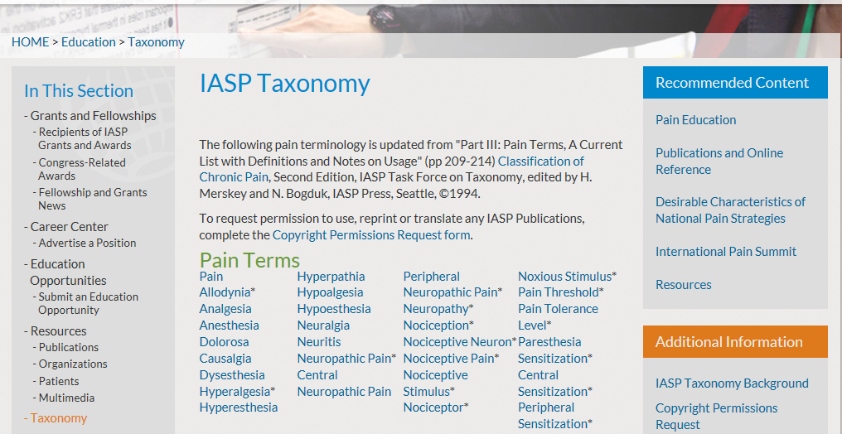
http://www.iasp-pain.org/Education/Content.aspx?ItemNumber=1698&navItemNumber=576

Slide 7
IASP Pain assessment terminology
Allodynia: pain due to a stimulus that does not normally provoke pain. Note: The stimulus leads to an unexpectedly painful response.
Analgesia: absence of pain in response to stimulation which would normally be painful.
Dysesthesia: an unpleasant abnormal sensation, whether spontaneous or evoked. Note: Special cases of dysesthesia include hyperalgesia and allodynia.
Hyperalgesia: increased pain from a stimulus that normally provokes pain.
Hyperesthesia: increased sensitivity to stimulation, excluding the special senses. Note: Hyperesthesia includes both allodynia and hyperalgesia, but the more specific terms should be used wherever they are applicable.
Hyperpathia: a painful syndrome characterized by an abnormally painful reaction to a stimulus.
Hypoalgesia: diminished pain in response to a normally painful stimulus.
Hypoesthesia: decreased sensitivity to stimulation, excluding the special senses.
Paresthesia: an abnormal sensation, whether spontaneous or evoked. Note: it has been agreed to recommend that paresthesia be used to describe an abnormal sensation that is not unpleasant while dysesthesia be used preferentially for an abnormal sensation that is considered to be unpleasant. There is a sense in which, since paresthesia refers to abnormal sensations in general, it might include dysesthesia,

Slide 8
Derived hierarchy from these definitions
This is not the sort of taxonomic backbone acceptable for realism-based ontologies.
Smith B, Kusnierczyk W, Schober D, Ceusters W. Towards a Reference Terminology for Ontology Research and Development in the Biomedical Domain. Proceedings of KR-MED 2006, Biomedical Ontology in Action, November 8, 2006, Baltimore MD, USA

Slide 9
Would the NCBO BioPortal be a good source?
Possible arguments: the BioPortal contains
  370 representational artifacts,
  over 5.6 million classes. (at the time of the study)
Research questions:
  (1) do these resources offer a more adequate view on pain assessment terminology, and
  (2) to what extent is the BioPortal a useful instrument in determining whether (1) is indeed the case?
Approach:
  An exploratory analysis ‘back-of-the-envelope’ study – at least according to one reviewer –

Slide 10
Method
Use the NCBO BioPortal annotator to retrieve all classes from any BioPortal resource on the basis of the 9 pain assessment terms;
Assess the quality of the hierarchy in each resource using a semi-automated procedure based on 7 manually created disjoint collections from 10 groupings;
Retrieve from the BioPortal the inter-resource mappings for all classes directly mapped to by the pain assessment terms;
Do an exploratory analysis of findings.

Slide 11
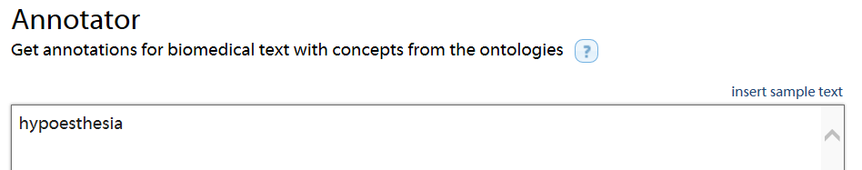
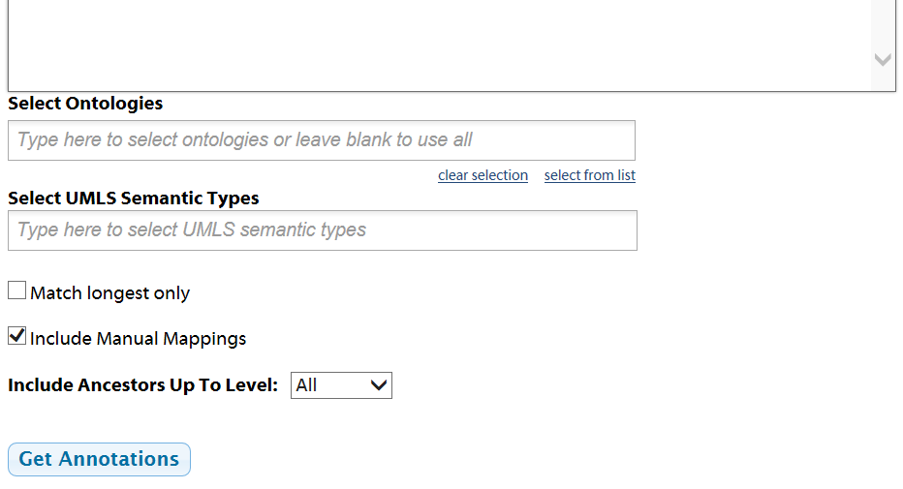
(1) Entering the 9 terms in the annotator

Slide 12
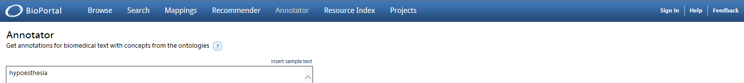
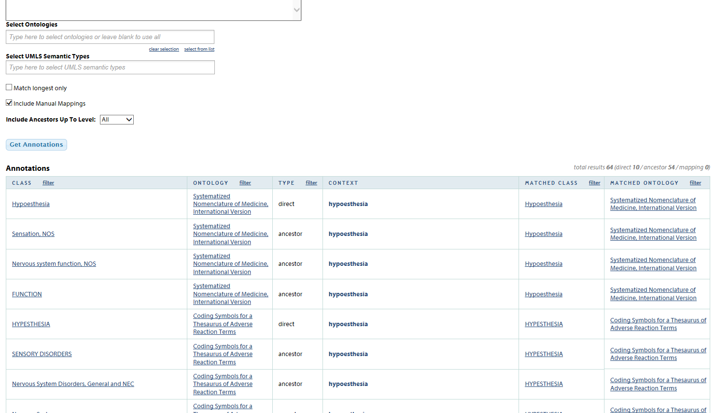
Results from annotator returned

Slide 13
Results copied into a spreadsheet
CLASS | ONTOLOGY | TYPE | CONTEXT | MATCHED CLASS | MATCHED ONTOLOGY
Hypoesthesia | National Cancer Institute Thesaurus | direct | hypoesthesia | Hypoesthesia | National Cancer Institute Thesaurus
Sensory Manifestations | National Cancer Institute Thesaurus | ancestor | hypoesthesia | Hypoesthesia | National Cancer Institute Thesaurus
Neurological Signs and Symptoms | National Cancer Institute Thesaurus | ancestor | hypoesthesia | Hypoesthesia | National Cancer Institute Thesaurus
Sign or Symptom | National Cancer Institute Thesaurus | ancestor | hypoesthesia | Hypoesthesia | National Cancer Institute Thesaurus
Nervous System Finding | National Cancer Institute Thesaurus | ancestor | hypoesthesia | Hypoesthesia | National Cancer Institute Thesaurus
Finding by Site or System | National Cancer Institute Thesaurus | ancestor | hypoesthesia | Hypoesthesia | National Cancer Institute Thesaurus
Finding | National Cancer Institute Thesaurus | ancestor | hypoesthesia | Hypoesthesia | National Cancer Institute Thesaurus
Disease, Disorder or Finding | National Cancer Institute Thesaurus | ancestor | hypoesthesia | Hypoesthesia | National Cancer Institute Thesaurus
Hypesthesia | Medical Subject Headings | direct | hypoesthesia | Hypesthesia | Medical Subject Headings
Somatosensory Disorders | Medical Subject Headings | ancestor | hypoesthesia | Hypesthesia | Medical Subject Headings
Sensation Disorders | Medical Subject Headings | ancestor | hypoesthesia | Hypesthesia | Medical Subject Headings

Slide 14
Results copied into a spreadsheet
CLASS | ONTOLOGY | TYPE | CONTEXT | MATCHED CLASS | MATCHED ONTOLOGY
Hypoesthesia | National Cancer Institute Thesaurus | direct | hypoesthesia | Hypoesthesia | National Cancer Institute Thesaurus
Sensory Manifestations | National Cancer Institute Thesaurus | ancestor | hypoesthesia | Hypoesthesia | National Cancer Institute Thesaurus
Neurological Signs and Symptoms | National Cancer Institute Thesaurus | ancestor | hypoesthesia | Hypoesthesia | National Cancer Institute Thesaurus
Sign or Symptom | National Cancer Institute Thesaurus | ancestor | hypoesthesia | Hypoesthesia | National Cancer Institute Thesaurus
Nervous System Finding | National Cancer Institute Thesaurus | ancestor | hypoesthesia | Hypoesthesia | National Cancer Institute Thesaurus
Finding by Site or System | National Cancer Institute Thesaurus | ancestor | hypoesthesia | Hypoesthesia | National Cancer Institute Thesaurus
Finding | National Cancer Institute Thesaurus | ancestor | hypoesthesia | Hypoesthesia | National Cancer Institute Thesaurus
Disease, Disorder or Finding | National Cancer Institute Thesaurus | ancestor | hypoesthesia | Hypoesthesia | National Cancer Institute Thesaurus
Hypesthesia | Medical Subject Headings | direct | hypoesthesia | Hypesthesia | Medical Subject Headings
Somatosensory Disorders | Medical Subject Headings | ancestor | hypoesthesia | Hypesthesia | Medical Subject Headings
Sensation Disorders | Medical Subject Headings | ancestor | hypoesthesia | Hypesthesia | Medical Subject Headings
source
taxonomy

Slide 15
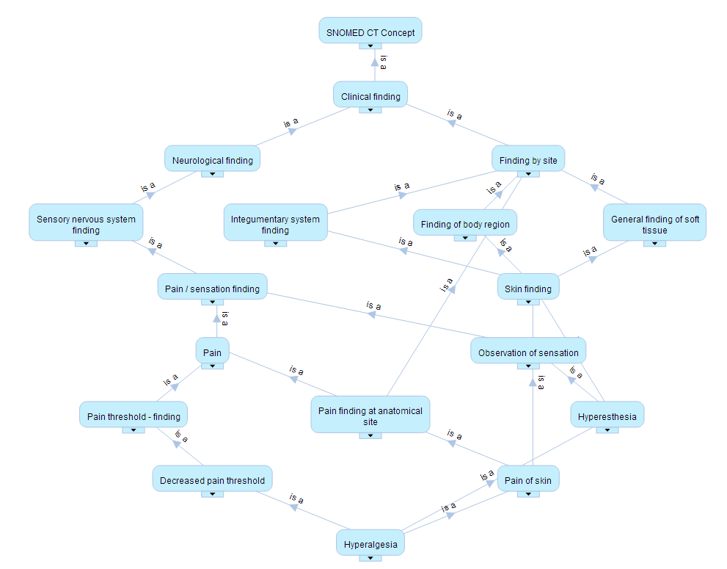
(2) Taxonomy assessment e.g.: hyperalgesia in SNOMED CT
Is a pain threshold finding really a kind of pain?

Slide 16
Taxonomy assessment criteria
Cimino JJ. Desiderata for controlled medical vocabularies in the twenty-first century. Methods of Information in Medicine. 1998;37(4-5):394-403.
Cimino JJ. In Defense of the desiderata. Journal of Biomedical Informatics. 2006;39(3):299-306.
Schulz S, Jansen L. Formal ontologies in biomedical knowledge representation. Yearbook of medical informatics. 2013;8(1):132-46.

Slide 17
Taxonomy assessment criteria
Assessment Parameter |  | Norm
AP1 | IASP search terms covered | 9
AP2 | Number of direct class matches | >8
AP3 | Direct classes with wrong IASP synonymy | 0
AP4 | Direct classes with definitions | =AP2
AP5 | Number of direct classes with inappropriate homonymy | 0
AP6 | Number of additional direct classes through spelling variants | 0
AP7 | Number of class matches | >AP2
AP8 | Foreign classes in hierarchy | 0
AP9 | Number of hierarchy classes with disjointness violations | 0

Slide 18
Disjoint collections from high level classes
[Adverse event]
[Body part]
[Discipline]
[Disease, Disorder or Finding;
NON-pain disorder;
Pain / sensation finding]
[Pharm. Effect / Endpoint]
[Function / Process; Technique / Therapy]
[Meta / Top].
Each class (with disambiguation where required as for instance for ‘analgesia’) was classified into one of these groupings on the basis of its preferred term.
Meta: classes with preferred terms such as Inactive Concept and Unclassified,
Top: classes such as Snomed CT Concept and Topical descriptor .

Slide 19
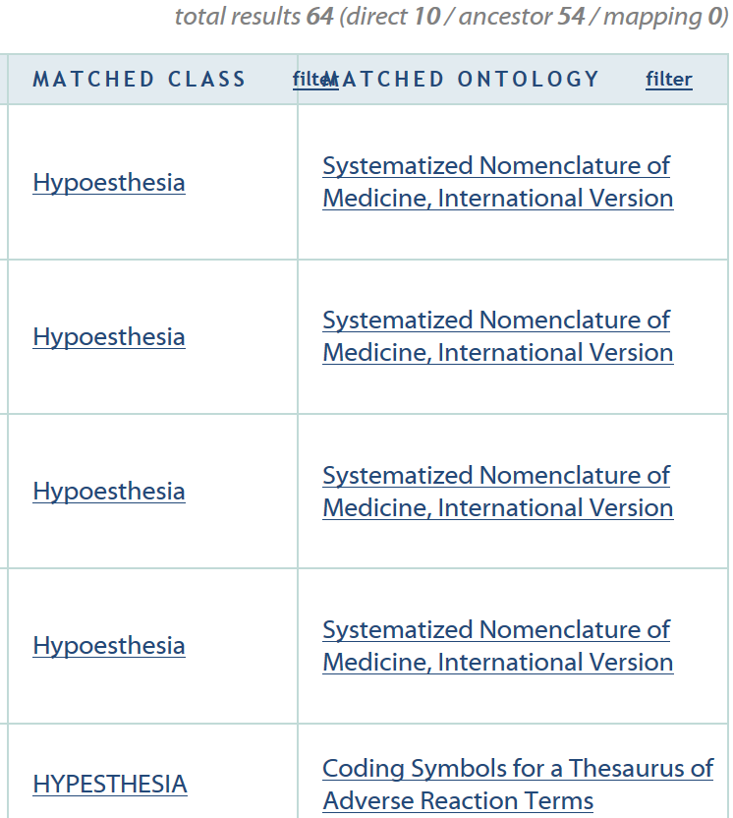
(3) Find mappings for each ‘directly’ mapped class

Slide 20
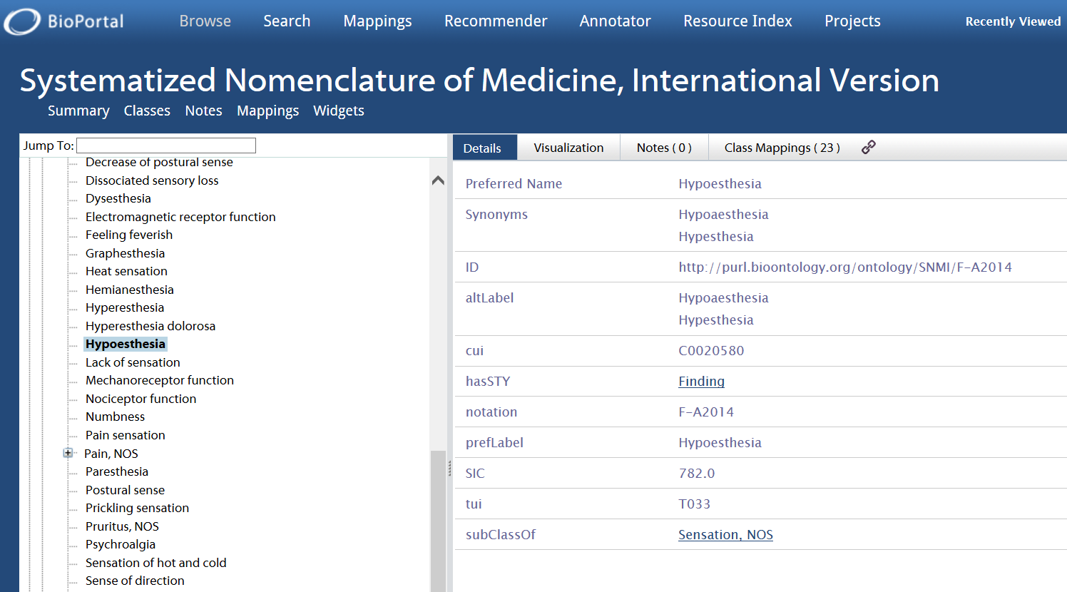
Selecting the class mapped to

Slide 21
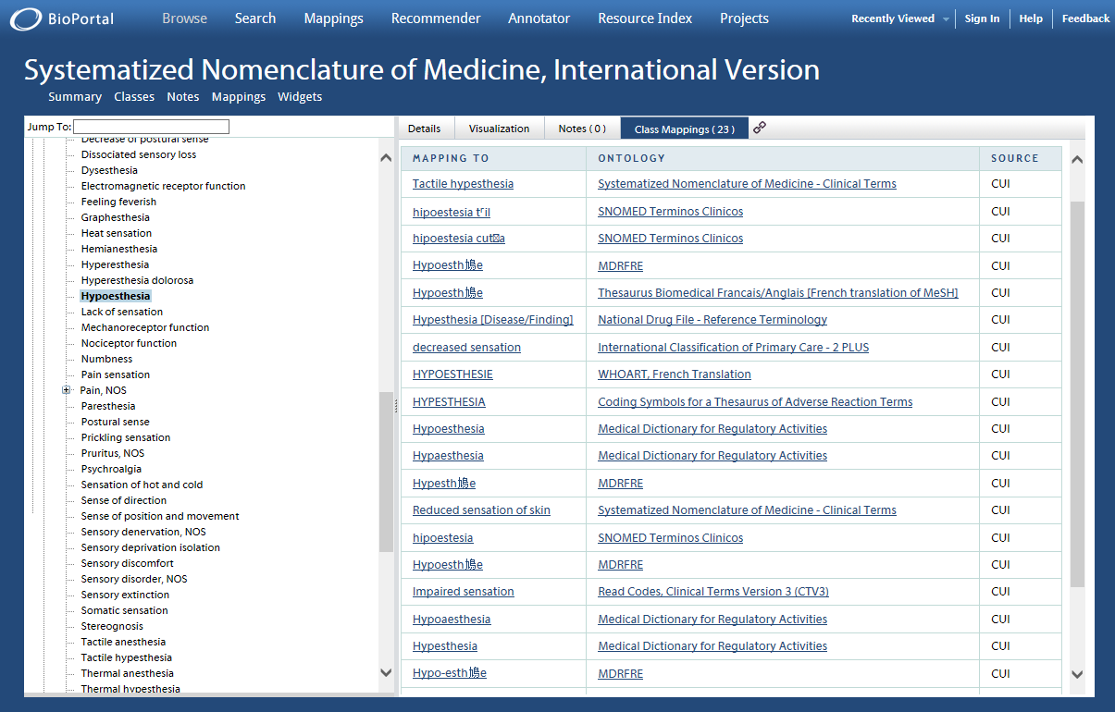
Retrieving all mappings

Slide 22
Copy to spreadsheet
CLASS MAPPED TO | ONTOLOGY | SOURCE
NIFSTD:nlx_0906_MP_0005407 | Neuroscience Information Framework (NIF) Standard Ontology | loom
RCD:X75t9 | Read Codes, Clinical Terms Version 3 (CTV3) | cui, loom
RH-MESH:C10.597.751.791.400 | Robert Hoehndorf Version of MeSH | loom
SNOMEDCT:55406008 | Systematized Nomenclature of Medicine - Clinical Terms | loom
SNOMEDCT:279078006 | Systematized Nomenclature of Medicine - Clinical Terms | cui
SOPHARM:MP_0005407 | Suggested Ontology for Pharmacogenomics | loom
SYMP:SYMP_0000836 | Symptom Ontology | loom
Mappings based on:
CUI: enjoying shared Concept Unique Identifiers (CUIs) from the Unified Medical Language System (UMLS),
LOOM: automatically generated using the Lexical (similarity) OWL Ontology Matcher

Slide 23
Semi-automatic mapping adequacy testing
Mapping records in which the semantics of at least one of the classes could not be determined, were excluded.
Records where only one of the classes was marked as being Meta, were automatically tagged as obsolete.
Records for which the preferred names of both classes were identical, except in the case of ‘analgesia’ given its homonymous semantics, were automatically assigned as being correct.
All other cases were assessed manually.

Slide 24
What was crammed on the back of my envelope?
762 annotation records of which 113 were about 104 ‘direct’ candidate annotation classes from 27 different sources (out of 370);
17 annotation records revealed that in the ICPC2, RH-MeSH and SNOMED CT some of the search terms matched directly to more than one class – thus reflecting homonymy;
9 records with synonymy within that source;
104 direct classes exhibit 25 distinct preferred terms;
225 annotation records by querying for 3 spelling variants suggested by the retrieved preferred terms, matching directly with 14 new classes bringing ICD10 on board
649 annotation records mapping to 206 distinct ancestor classes with together 169 distinct preferred terms;
1036 mapping records for all 104 classes matched directly, of which 71 duplicates, yielding 965 records further analyzed;
399 of those records required manual assessment.

Slide 25
Quality of BioPortal Resources Retrieved
→ poor domain coverage ←
Results:
  only SNOMED CT covers the 9 search terms in the lexical form provided by the IASP (AP1)
  MeDDRA has complete coverage if lexical variants are taken into account (AP6),
  none of the representational artifacts cover the domain delineated by the IASP search terms adequately when taking all assessment parameters into account.
Discussion:
  Different purpose for some resources?
    For what purpose would paresthesia be relevant and dysesthesia not?
  Some resources turn out to exhibit a better coverage when spelling variants are used in the queries, but not to the extent that it can explain the overall lack of coverage.

Slide 26
Quality of BioPortal Resources Retrieved
→ lack of terminological distinctions ←
5 resources do not make the distinctions in terminology made by the IASP (AP3):
  COSTART, MeSH and WHO-ART suffer from the lack of discrimination between terms in pairs such as hypoalgesia/hypesthesia, hyperalgesia/hyper-esthesia, dysesthesia/paresthesia and analgesia/hypoalgesia,
  SNOMED CT only for classes labelled ‘inactive’, thus reflecting that these mistakes made in earlier versions were corrected afterwards.
3 resources exhibit inappropriate homonymy for some of the search terms (AP5).

Slide 27
Quality of BioPortal Resources Retrieved
→ lack of definitions ←
Only 11 resources provide textual definitions for at least some of the classes (AP2, AP4).

Slide 28
Quality of BioPortal Resources Retrieved
→ poor quality of taxonomy ←
15 resources exhibit for at least some of the search terms a hierarchy which on the basis of the face validity of the preferred terms is composed of disjoint classes (AP9):
  analgesia is a kind of
    nervous system (COSTART),
    communication disorder (DOID - Human Disease Ontology), or
    pharmacogenomics (PHARE);
  paresthesia is a kind of peripheral nervous system (OMIM),
  hyperalgesia is a kind of adrenal adenoma (WHO-ART),
                neuroscience (CRISP)
Sloppy design on the side of the authors of these resources, or violation of the principle that preferred terms should have face validity?
Or does the BioPortal represents the structure of these resources erroneously?

Slide 29
Quality of the NCBO BioPortal
→ History ←
March 2010: the case of ‘Henry’
  http://bioportal.bioontology.org/visualize/40392/?conceptid=ConceptGenerality
    Link now inactive
Definition of 'Henry': 1 Wb/A
Parents of 'Henry':
SeverityObservation
CalendarCycleTwoLetter
LivingArrangement
CalendarCycleOneLetter
SetOperator
UnitOfMeasureAtomInsens
Message Waiting Priority
AddressUse
Ampere
UnitOfMeasurePrefixInsens
UnitOfMeasurePrefixSens
Subclasses of 'Henry'
High alert
primary home
vacation home
Subtypes of 'Henry':
High
Independent Household
home address
hecto
convex hull
hour of the day

Slide 30
Quality of the NCBO BioPortal
→ History ←
2011: the WHO-ART case
  Ruttenberg noted an issue with the representation of WHO-ART in the BioPortal,
  acknowledged by BioPortal staff who traced the issue down to be caused by the WHO-ART source codes,
  but nevertheless decided nothing to do about it at that time
    https://mailman.stanford.edu/pipermail/bioontology-support/2011-April/003124.html
  And apparently never since:
    the version of WHO-ART that showed up in the work reported about in this paper was version ‘2013AB’ which was uploaded to the BioPortal, according to the summary page, February 18, 2014, indeed without any attention to the known issues.

Slide 31
Quality of the NCBO BioPortal
→ mapping to odd classes ←
for 8 of the 27 resources retrieved, the Annotator returned ‘UMLS:OrphanClass’ as ancestor for 40 of the classes matched directly;
255 mappings for RH-MeSH and MeDDRA, as well as for (deleted?) sources ‘HOMERUN-UHC’, ‘HOM-CLINIC’, ‘HIMC-LOINC’ and ‘HIMC-ICD09’, have URIs which do not resolve;
  The former 4 resources are also not listed on the BioPortal webpage as being resources it contains, yet classes from them show up in the mapping results.
In case of SNOMED CT, many mappings are involving classes which are marked as ‘inactive’.

Slide 32
Mapping assessment groups
‘B’ or ‘T’: mapping bi-directionally resp. only incoming.
          B-mappings are only counted once in the totals.
‘Excl.’: excluded from analysis because of ambiguity or missing information on target (‘T?’) classes or sources (’S?’).
‘Correct’: mapping results from:
    (1) ‘SAME’: automatic assignment of correctness for class pairs with identical non-ambiguous preferred terms (’SAME’),
    and the manual verification of
      (2) classes with synonymous preferred terms (‘VARIANT’)
      (3) classes with ambiguous preferred terms.
‘ERROR’: brought about by:
  (1) automatic determination of mapping to or from inactive classes (‘OBSO’)
  and manual verification of:
    (2a) mapping to or from classes with ambiguous meaning (‘HOMONYM’), and
    (2b) inappropriate mappings between classes with unambiguous meanings (‘WRONG’).

Slide 33
Quality of the NCBO BioPortal
→ erroneous mappings to legitimate classes ←
 |  |  | Excl. |  |  |  |  |  |  |  | Excl.
Representational |  |  | S? | T? | TOTAL | % WRONG |  | Representational |  |  | S? | T? | TOTAL | % WRONG
Artifacts |  |  |  |  |  |  |  | Artifacts
MEDDRA |  | T |  | 122 | 137 | 100 |  | RCD |  | B | 1 | 11 | 100 | 27.3
RH-MESH |  | T |  | 86 | 98 | 100 |  | NCIT |  | B | 1 | 23 | 115 | 24.2
HIMC-ICD09 |  | T |  | 9 | 11 | 100 |  | SYMP |  | B |  | 18 | 111 | 22.6
ACGT-MO |  | T |  |  | 1 | 100 |  | MESH |  | B | 1 | 16 | 93 | 19.7
AI-RHEUM |  | T |  |  | 1 | 100 |  | OMIM |  | B |  | 2 | 35 | 18.2
SNOMEDCT |  | B | 1 | 4 | 185 | 88.3 |  | ICD10 |  | T |  |  | 6 | 16.7
PHARE |  | B | 1 | 3 | 25 | 61.9 |  | NIFSTD |  | B |  | 2 | 27 | 16
WHO-ART |  | B |  | 17 | 86 | 59.4 |  | CTCAE |  | B |  | 4 | 31 | 14.8
GALEN |  | B | 1 | 3 | 32 | 50 |  | ICD10CM |  | B |  | 4 | 19 | 13.3
NCIt-Activity |  | T |  |  | 4 | 50 |  | BDO |  | B |  | 3 | 31 | 10.7
RPO |  | T |  |  | 4 | 50 |  | CSSO |  | B |  | 3 | 31 | 10.7
SYN |  | T |  |  | 4 | 50 |  | ICPC2P |  | B | 1 | 10 | 87 | 9.21
SOPHARM |  | B | 1 | 10 | 77 | 40.9 |  | LOINC |  | T | 3 |  | 9 | 0
NDF-RT |  | T | 1 | 2 | 49 | 37 |  | HL7 |  | T | 2 |  | 6 | 0
MP |  | B | 1 | 7 | 76 | 36.8 |  | HIMC-LOINC |  | T |  | 3 | 3 | 0
CRISP |  | B | 19 | 21 | 70 | 36.7 |  | HOM-CLINIC |  | T |  | 3 | 3 | 0
COSTART |  | B |  | 44 | 171 | 34.4 |  | HOMERUN-UHC |  | T |  | 3 | 3 | 0
PDQ |  | B | 1 | 11 | 34 | 31.8 |  | PMA |  | T | 1 |  | 3 | 0
HP |  | B |  | 4 | 34 | 30 |  | TRAK |  | T | 1 |  | 3 | 0
NDFRT |  | B | 1 | 28 | 113 | 27.4 |  | IFAR |  | T |  |  | 2 | 0

Slide 34
Quality of the NCBO BioPortal
→ mapping sources ←
Result |  | cui | cui, loom | loom | Grand Total
Error |  | 29 | 20 | 218 | 267
 | WRONG | 5 | 4 | 69 | 78
 | OBSO | 24 | 16 | 108 | 148
 | HOMONYM |  |  | 41 | 41
Correct |  | 50 | 23 | 368 | 441
 | SAME | 2 | 9 | 230 | 241
 | VARIANT | 48 | 14 | 115 | 177
 | DISAMBIG. |  |  | 23 | 23
Excluded |  | 22 | 17 | 218 | 257
 | S? |  |  | 31 | 31
 | T? | 22 | 17 | 187 | 226
Grand Total |  | 101 | 60 | 804 | 965
% Wrong |  | 36.71 | 46.51 | 37.20 | 37.71

Slide 35
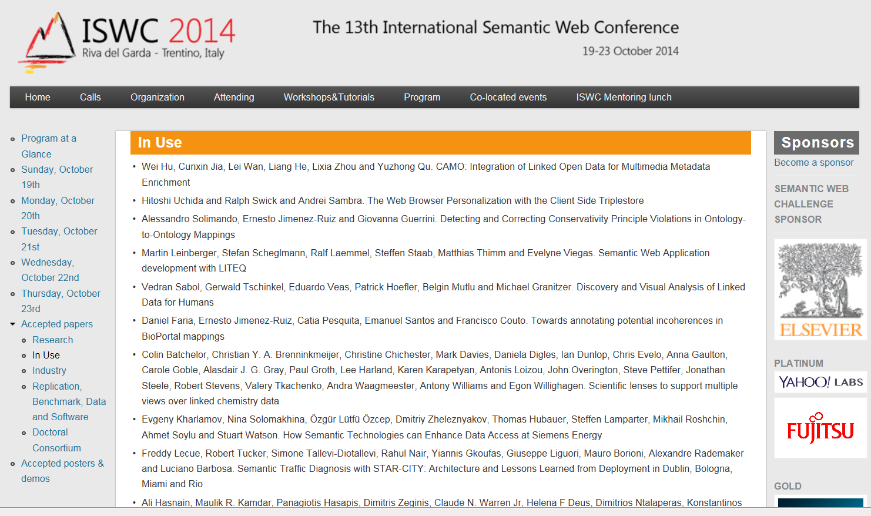


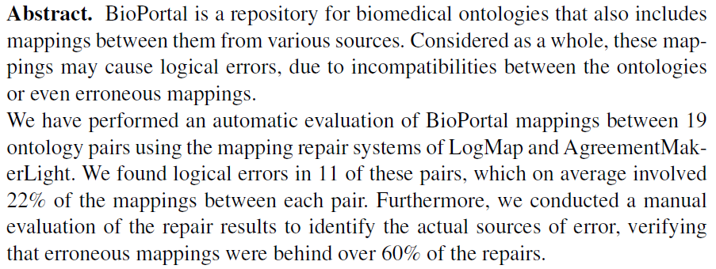
Quality of the NCBO BioPortal: a look in the future
→ History ←

Slide 36
Conclusions (1)
The BioPortal made it possible to reach the objectives of this study which were to find out:
whether the sources in the BioPortal provide a more adequate view on pain assessment terminology
– the answer being no,
and
to what extent the BioPortal itself is a useful instrument in determining whether (1) is indeed the case
– the answer being yes.

Slide 37
Conclusions (2)
The study raises questions about the quality assurance principles for the design and management of the BioPortal:
  (1) about the quality of the resources accepted for inclusion:
    True: investigated resources have different semantic expressivity,
    But: the BioPortal itself does not allow for such distinctions and ‘promotes’ all resources as ontologies;
  (2) the suitability of representing the hierarchy of these resources by means of the subclass relation, and
  (3) about certain house-keeping operations.
Quality seems thus far not to have been much of a concern to the BioPortal scientific community:
  as witnessed by the presence of only one paper in Pubmed that addresses the topic [19].
  although the BioPortal does indeed offer a mechanism to users to make notes on the quality of BioPortal content [6],

Slide 38
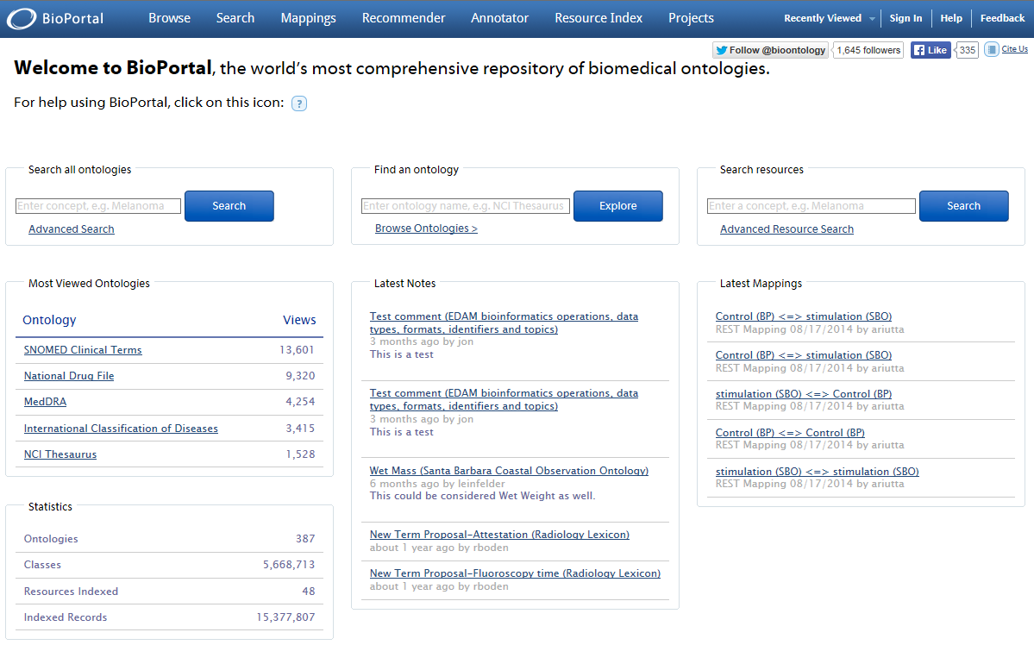
Retrieved Oct 2, 2014

Slide 39
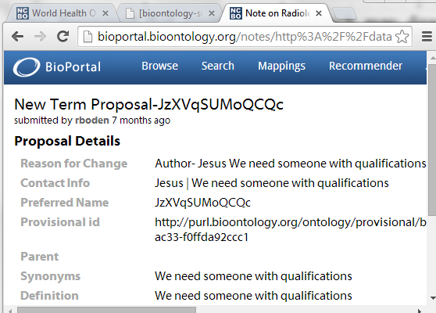
Retrieved June, 2014

Slide 40
Limitations
Conclusions limited to pain assessment.
Question whether data retrieved using the BioPortal website (this study) are of lower quality than through the REST services.
OBO Foundry and Ontological Realism principle adherence was used, and they are not universally accepted.
Possible underestimation of errors by first flagging results that for sure require manual evaluation, thus more errors might have been missed.
Another limitation is that this study does point out the kind of mistakes and how to find them semi-automatically, but is not conclusive on whether the root cause is in the source systems, the BioPortal, or a combination of both.

Slide 41
Recommendations
do not accept resources that violate standard subsumption principles,
display for each resource quality metrics, rather than mere quantity metrics, for instance the extent to which they follow the principles of ontological realism or the OBO Foundry, and
provide better documentation about the methods and algorithms used to present hierarchies and mappings, and about the internal quality assurance principles.

Slide 42
Acknowledgement
The work described is funded in part by
grant 1R01DE021917-01A1
from the National Institute of Dental and Craniofacial Research (NIDCR). The content of this presentation is solely the responsibility of the author and does not necessarily represent the official views of the NIDCR or the National Institutes of Health.

