Slide 1
Ontologies of Dynamical Systems and
Verifiable Ontology-based Computation:
Towards a Haskell-based Implementation of Referent Tracking
9th International Conference on Formal Ontology in Information Systems (FOIS 2016)
Annecy, France, July 6th-9th, 2016.
Thomas BITTNER¹, PhD
Jonathan P. BONA², PhD
Werner CEUSTERS², MD
¹ Department of Philosophy, School of Arts and Sciences, University at Buffalo
² Department of Biomedical Informatics, Jacobs School of Medicine, University at Buffalo

Slide 2
Content
Background: previous work on aggregation of biomedical data using ontology
Theoretical groundwork:
  Basic Formal Ontology (BFO)
  Referent Tracking (RT)
RT as dynamical system
Ontology-based computing in Haskell

Slide 3
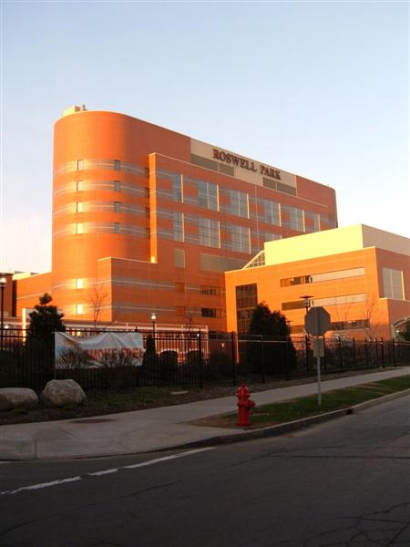
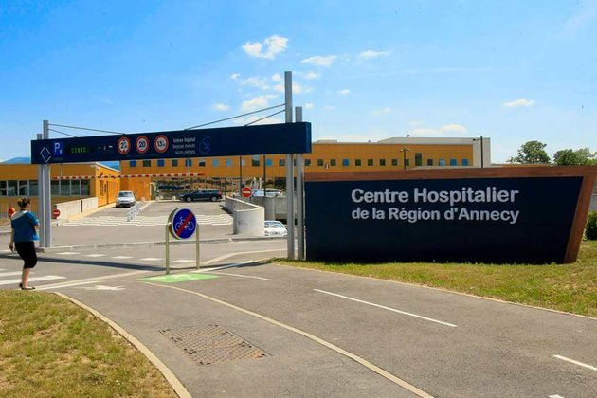
The long-term vision
Everything collected wherever, whenever and about whomever which is relevant to a medical problem in whomever, whenever and wherever, should be accessible without loss of relevant detail.
Notes:
We embrace a vision according to which any piece of electronic data relevant to the health
of individuals - wherever and for whatever reason or purpose generated - should instantly
be integrated into a constantly growing data pool. Health information systems (HIS)
should therefore be semantically interoperable and permanently linked in a network with
components that are aware of all relevant data available. Existing initiatives (Semantic
Web, Linked Open Data, the Internet of Things) provide valuable partial solutions to this
end.

Slide 4
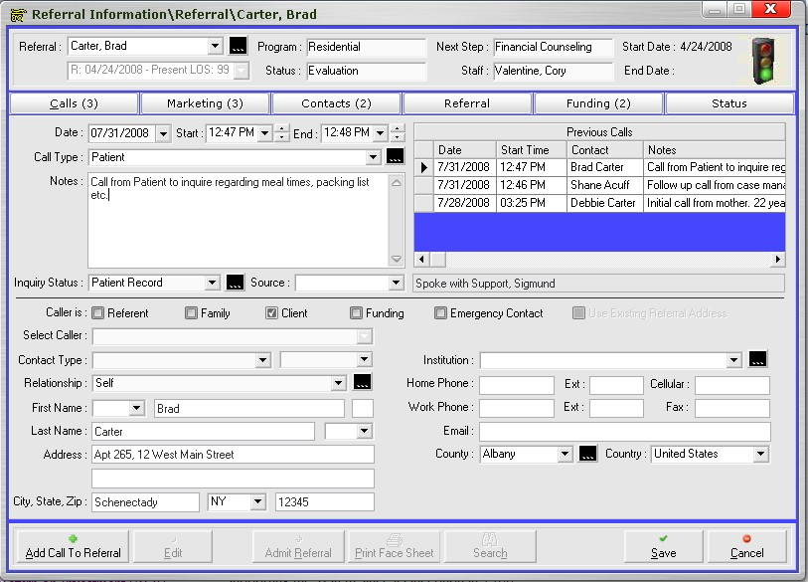
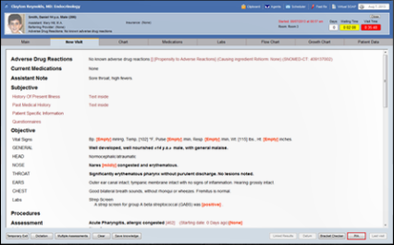
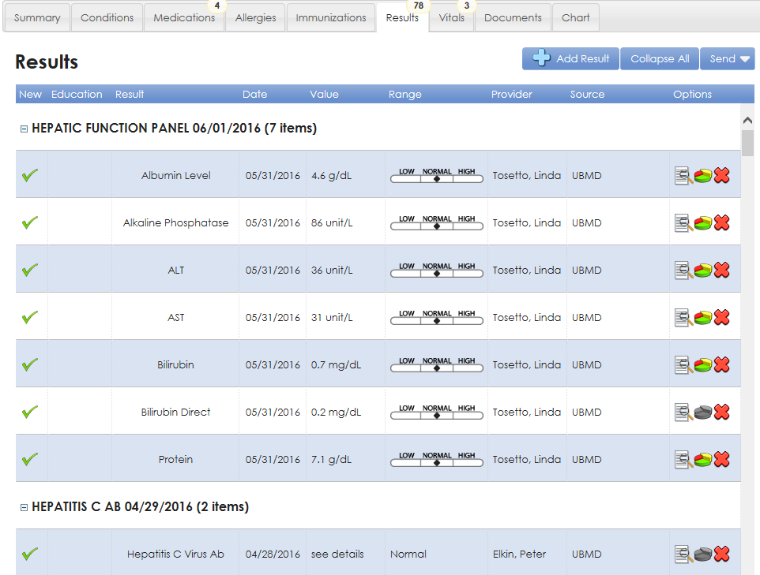

A paradigm to aggregate EHR data
https://www.sigmundsoftware.com/
http://www.praxisemr.com/
https://ubmd.followmyhealth.com

Slide 5
However !
https://www.sigmundsoftware.com/
http://www.praxisemr.com/
Lacks data for making analytics and DS work
https://ubmd.followmyhealth.com
Optimized for practice management and patient care
Optimized for analytics and decision support

Slide 6
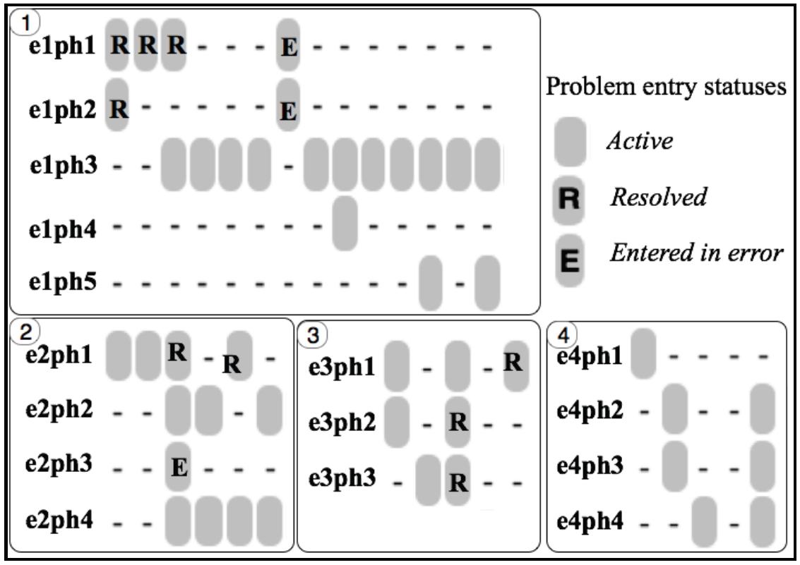
Idiosyncrasies in problem entry updates
e1ph1: Diabetes mellitus type II (NIDDM)
e1ph2: Diabetes Mellitus With Complication
e1ph3: Diabetes mellitus
e1ph4: DM (diabetes mellitus), type 1, uncontrolled
e1ph5: Diabetes mellitus with complication
e2ph1: Type 1 Diabetes Mellitus - Uncontrolled
e2ph2: Type II diabetes mellitus with ketoacidosis
e2ph3: Type 2 Diabetes Mellitus - Uncomplicated, Uncontrolled
e2ph4: Acanthosis nigricans
e3ph1: Closed Fracture Of The Shaft Of The Humerus
e3ph2: Closed Fracture Of Neck Of Femur - Transcervical
e3ph3: Closed Fracture Of The Humerus
e4ph1: Open Treatment Of Humeral Shaft Fracture w Plate/Screws
e4ph3: Fracture of left humerus
Bona J, Ceusters W. Replacing EHR structured data with explicit representations. International Conference on Biomedical Ontologies, ICBO 2015, Early career track, Lisbon, Portugal, July 27-30, 2015;85-86
Notes:
What is needed in addition are mechanisms to determine and represent not only (1)
how assertions (for instance diagnoses) relate to reality (diseases in patients) and how
changes in the pool of assertions relate to changes in reality and vice versa, but also (2)
the extent to which data are incomplete and inconsistent. As an example, we examined
Electronic Healthcare Records (EHR) of 570,000 patients from Western New York to
assess the extent to which diagnostic assertions in these records correspond to disorders
in the patients [3]. This analysis uncovered many ways in which the data fail to represent
explicitly what they are supposed to represent.

Slide 7
Prominent types of inconsistencies
Changes in reality not faithfully reflected in the medical record updates;
Updates in the records inadequately documented as to whether they reflect changes in reality or changes in caregivers understanding thereof;
Inconsistencies amongst observers;
Plain mistakes and ambiguities.
Attempted solution: ontology-based template for generating maximally complete and self-explanatory assertions.
Ceusters W, Hsu CY, Smith B. Clinical Data Wrangling using Ontological Realism and Referent Tracking. International Conference on Biomedical Ontologies, ICBO 2014, Houston, Texas, Oct 6-9, 2014;
CEUR Workshop Proceedings 2014;1237:27-32.

Slide 8
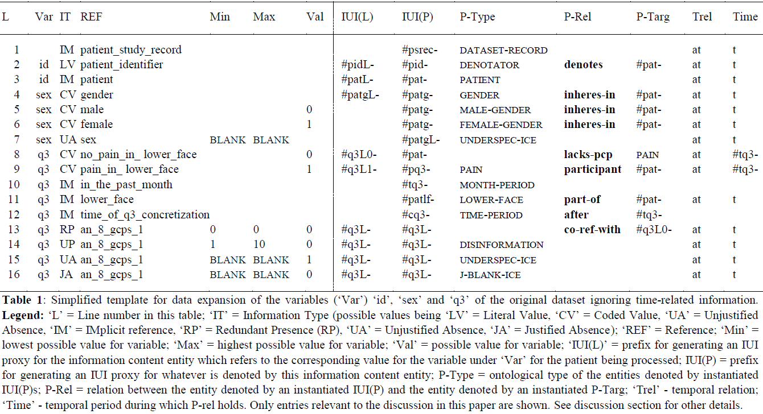
Template for generating maximally complete and self-explanatory assertions
‘conditional part’
‘RT-compatible part’

Slide 9
Insights obtained
It was demonstrated that the proposed framework could handle all idiosyncrasies encountered in the dataset used as test case.
however
It required a thorough understanding of and expertise in applying the underlying theories of the framework so as not to make any mistakes in designing the template.
Ceusters W, Hsu CY, Smith B. Clinical Data Wrangling using Ontological Realism and Referent Tracking. International Conference on Biomedical Ontologies, ICBO 2014, Houston, Texas, Oct 6-9, 2014;
CEUR Workshop Proceedings 2014;1237:27-32.

Slide 10
Research question for current work
Is it possible to embed the underlying theories in software applications that allow users without a deep understanding of these theories to build data wrangling templates which contain less mistakes?
Attempted solution uses two underlying theories:
  Ontological Realism
    With the implementation thereof in Basic Formal Ontology
  Referent Tracking

Slide 11


The theory: Ontological Realism
There is an external reality which is ‘objectively’ the way it is;
That reality is accessible to us;
We build in our brains cognitive representations of reality;
We communicate with others about what is there, and what we believe there is there.
Smith B, Kusnierczyk W, Schober D, Ceusters W. Towards a Reference Terminology for Ontology Research and Development in the Biomedical Domain. Proceedings of KR-MED 2006, Biomedical Ontology in Action, November 8, 2006, Baltimore MD, USA

Slide 12
Scientific discovery and application
data
organization
model development
observation &
measurement
add
verify
use
Δ = outcome
Generic
beliefs
application

Slide 13
Data and what it is about
Reality
Data
data
organization
model development
observation &
measurement
add
verify
use
Δ = outcome
Generic
beliefs
application

Slide 14



A first major distinction
What exists
What is generic
e.g. what is denoted by ‘planet’
What is specific and carries identity
e.g. what the images above are images of
Representation
OBJECT
PLANET
Earth Mars Jupiter
Ontology
isa
instanceOf
at t
http://space-facts.com/transparent-planet-pictures/
Referent Tracking

Slide 15
Data and what it is about
Reality
Data
data
organization
specific
isAbout
model development
generic
observation &
measurement
isAbout
add
verify
use
Δ = outcome
Generic
beliefs
application

Slide 16
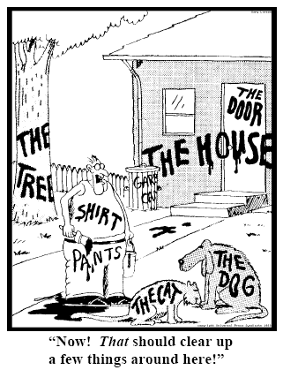
Representing specific entities
explicit reference to the individual entities relevant to the accurate description of some portion of reality, ...
Ceusters W, Smith B. Strategies for Referent Tracking in Electronic Health Records. J Biomed Inform. 2006 Jun;39(3):362-78.

Slide 17
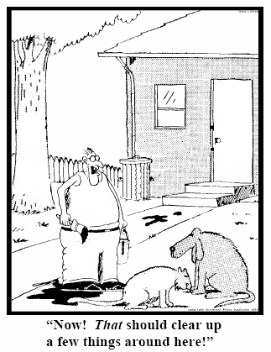
Method: IUI assignment
  Introduce an Instance Unique Identifier (IUI) for each relevant particular (individual) entity
78
235
5678
321
322
666
427
Ceusters W, Smith B. Strategies for Referent Tracking in Electronic Health Records. J Biomed Inform. 2006 Jun;39(3):362-78.

Slide 18
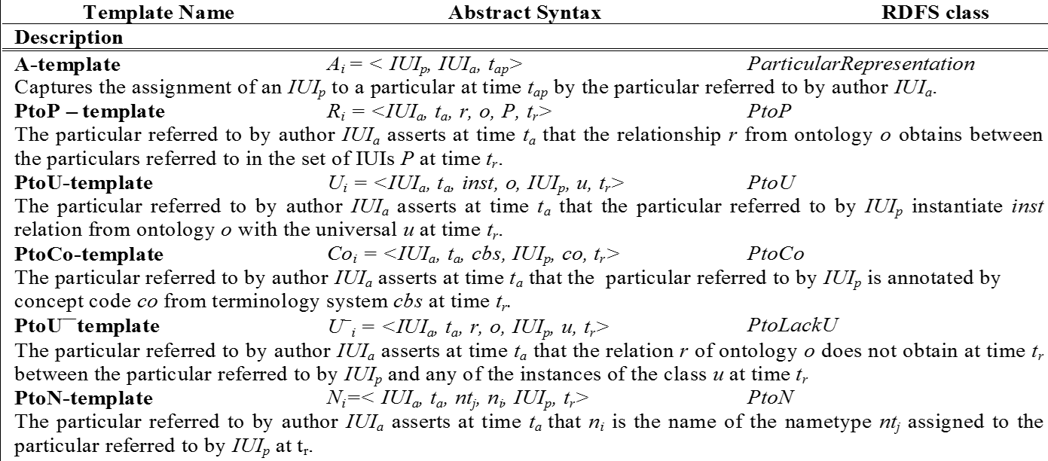
Elementary Referent Tracking tuple types
Assignment of unique identifier to a particular
Relationships between particulars taken from a realism-based relation ontology
Instantiation of a universal
Annotation using terms from a non-realist terminology
‘Negative findings’ such as absences, missing parts, preventions, …
Names for a particular

Slide 19
Meta-template: internal history keeping
RTS entries are assigned IUIs of their own
    (in the D-template is symbolized by IUITi)
Di = <IUId, IUITi, t, E, C, S>.
  IUId: the IUI of the entity annotating IUITi by means of the Di entry,
  E: either the symbol ‘I’ (for insertion) or any of the error type symbols,
  C: a symbol for the applicable reason for change
  t: the time the tuple denoted by IUITi is inserted or ‘retired’,
  S: a list of IUIs denoting the tuples, if any, that replace the retired one.

Slide 20
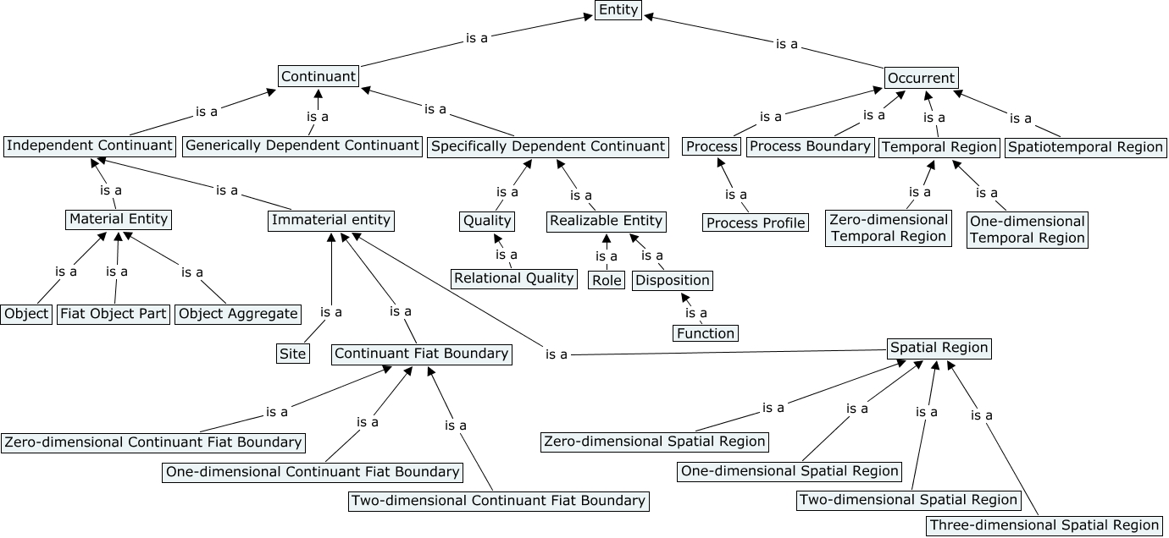
Basic Formal Ontology (BFO)
A 2nd major distinction

Slide 21
BFO entities relevant to Referent Tracking (RT) as representational system
Occurrent
Continuant
Relation
Generically Dependent Continuant
Quality
Universal
BFO:isa
BFO
R. Arp, B. Smith, and A. D. Spear, "Building ontologies with basic formal ontology," The MIT Press,, 2015, p. 1 online resource.

Slide 22
BFO entities relevant to Referent Tracking (RT) as representational system
Occurrent
Continuant
Relation
Generically Dependent Continuant
Quality
Universal
Representation
Representational Unit
Information Content Entity
BFO:isa
BFO
Smith B, Ceusters W. Aboutness: Towards Foundations for the Information Artifact Ontology. International Conference on Biomedical Ontologies, ICBO 2015, Lisbon, Portugal, July 27-30, 2015;47-51.
IAO

Slide 23
Reality according to Referent Tracking (RT)
RT:isa
Portion of Reality
RT:isa
RT:isa
RT:isa
Occurrent
Type
Continuant
Relation
RT:hasPart
Configuration
RT:subTypeOf
Generically Dependent Continuant
Quality
Universal
Representation
Defined
Class
Representational Unit
Information Content Entity
BFO:isa
Ceusters W, Manzoor S. How to track absolutely everything? In: Obrst L, Janssen T, Ceusters W (eds.) Ontologies and Semantic Technologies for the Intelligence Community. Frontiers in Artificial Intelligence and Applications. IOS Press Amsterdam, 2010;:13-36.
BFO
Smith B, Ceusters W. Aboutness: Towards Foundations for the Information Artifact Ontology. International Conference on Biomedical Ontologies, ICBO 2015, Lisbon, Portugal, July 27-30, 2015;47-51.
RT
IAO

Slide 24
What RT components are about
RT:isa
Portion of Reality
RT:isa
RT:isa
RT:isa
Occurrent
Type
Continuant
Relation
RT:hasPart
Configuration
RT:subTypeOf
Generically Dependent Continuant
IAO:is-about
Quality
IAO:is-about
Universal
Representation
Defined
Class
Representational Unit
RT Tuple
Information Content Entity
Denotator
BFO:isa
IUI
CUI
UUI
BFO
IAO:is-about
RT
IAO

Slide 25
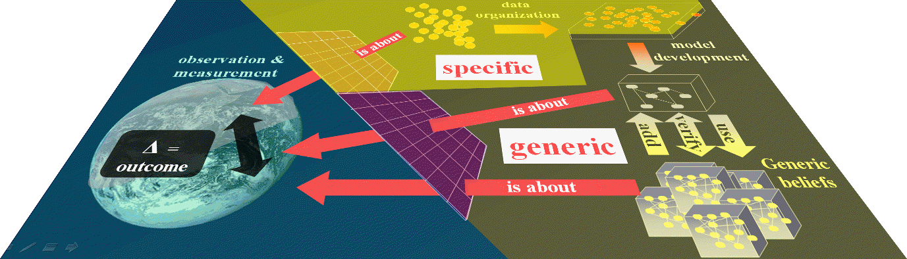
Referent Tracking based data warehousing
Total transparency and faithfulness
Ceusters W, Bona J. Representing SNOMED CT Concept Evolutions using Process Profiles. International Workshop on Ontology Modularity, Contextuality, and Evolution (WOMoCoE 2016), Annecy, France, July 6, 2016

Slide 26
Referent tracking for dynamic systems
A ‘predicate’ perspective on ontology

Slide 27
Referent tracking for dynamic systems
A ‘relational’ perspective on inherence:
→ the cross-product of a particular IC, a particular DC and a particular time

Slide 28
Referent tracking for dynamic systems
A ‘functional’ perspective:
at any particular time, there inheres in a particular IC a specific combination of specific DCs

Slide 29
Referent tracking for dynamic systems
configuration
RT:isA?
isA?

Slide 30
Referent tracking for dynamic systems
Processes represented as functions that map a state to another state

Slide 31
RT and the ontology of dynamic systems
referent

Slide 32
Computational realization of Ontology + RT
ontology underlying a dynamical system:
  explicate necessary and sufficient conditions that single out the physically/chemically/biologically/medically/... possible states, possible sequences of states, and associated processes.
referent tracking:
  necessary to implement decision procedures that compute whether or not such conditions are satisfied for a given state, sequence, and process.
  (Database lookup, solving equations, other computations …)
claim: the functional language Haskell can be used to
  specify an ontology that is expressive enough to describe medical reality as a dynamical system and,
  to realize computation (decision procedures) as executable formal specifications in ways that are provably correct with respect to the semantics specified in the underlying ontology.

Slide 33
‘Ontology-based computing’
Computation that:
is correct with respect to some formal specification, whereby
correctness can be verified formally using type inference in conjunction with relatively simple inductive proofs over recursive data structures;
adheres to an ontology if and only if it is syntactically and type-theoretic well-formed in a way that can be verified formally in a computationally efficient way before the program runs for the first time.

Slide 34
Ontology-based computing in Haskell
Haskell features functions as first-order primitives:
  Functions may be passed as arguments to and returned as results of other functions;
  Functions may form components of composite data structures and may be lists of functions;
  Functions may be stored in records, etc.;
Haskell has a strong static typing system;
Haskell supports explicit data flow by having immutable data structures and featuring lazy evaluation;
Haskell supports syntactic and semantic features that allow to separate pure from impure code in a logically well-defined manner.

Slide 35
Example: unique identification
Declare distinct identifier types for distinct types of PoRs:
  for universals: data UUI = UUI Int
  for particulars: data IUI = IUI Int
  for RT tuples: data INST_UI = INST_UI Int
  ...
Specify what it means for two variables to be bound to the same identifier:
  instance Eq UUI where UUI x == UUI y = x == y
  instance Eq IUI where IUI x == IUI y = x == y
  …
As a consequence, the expression ‘UUI x == IUI y, will not be evaluated as False but will not even compile because expressions that test the identity of non-comparable things are semantically not well-formed
{
define type constructors

Slide 36
Example: type functions
data CAT_Continuant a = CAT_Continuant a
data CAT_Occurrent a = CAT_Occurrent a
data CAT_I_Continuant a = CAT_I_Continuant a
data CAT_D_Continuant a = CAT_D_Continuant a
...
^{class CAT t where}
^{getUI :: (UI a) => (t a) -> a}
...
instance CAT CAT_Continuant where
^{getUI (CAT_Continuant a) = a}
instance CAT CAT_Occurrant where
^{getUI (CAT_ Occurrant a) = a}
^{... And so on for all CAT_...}

Slide 37
Example: working with subcategories
Defining what it means for one category to be a subcategory of the other:
    class (CAT s, CAT t) => SubCats t where
    subCat :: (UI a) => s a -> t a -> Bool
    subCat _ _ = True
asserting that the Continuant Category is a subcategory of Entity
    instance SubCatCAT_ContinuantCAT_Entity

Slide 38
Example: building the BFO hierarchy
Entity
Continuant
Occurrent
Process
…
class (CAT s, CAT t) => SubCat s t where
subCat :: (UI a) => s a -> t a -> Bool
^{subCat _ _ = True}
instance SubCat CAT_Continuant CAT_Entity
instance SubCat CAT_Occurrant CAT_Entity
instance SubCat CAT_Process CAT_Occurrant
Notes:
The members of the class CAT are ordered hierarchically by the subCat relation (isA)
SubCat is a type class with two type parameters bith of which are of type CAT. CAT is a type function that expects a parameter (UUI or IUI)the declaration 0f subCat ensures that the parameter of the type functions s and t are of the same type (either both are UUI or both are IUI)
The instance declarations then spell out explicitly between which CAT_... The subCat relation holds
…. This is developed step by step in the next four slides.

Slide 39
Lessons learned (1)
The goal of verifiable ontology-based computing:
  to ensure that a program passes a type checker only if it is logically and ontologically correct.
First results indicate that in the context of referent tracking systems it is possible to achieve this goal by using the type classes of the functional language Haskell.

Slide 40
Lessons learned (2)
Verifiable ontology-based computing is not a replacement for OWL-DL based ontologies and computation by deduction.
Verifiable ontology based computing is about integrating ontologies into programs and ensuring that programs adhere to an ontology.
It is not about developing ontologies.

Slide 41
Hypothesis for future work
Verifiable ontology-based computing in Haskell may open up possibilities to integrate into programs ontologies that can only be expressed in full first or higher order languages.

Slide 42
Acknowledgement
This work was supported in part by:
  Clinical and Translational Science Award, NIH 1 UL1 TR001412-01 from the National Institutes of Health
  SUNY Research Foundation award 689020 ‘Planning Grant to produce a road map to the creation of the SUNY-wide Centralized big-data repository (CIDR) of SUNY electronic health record data’.

