Slide 1
CTSI Core Competency Lectures in Biomedical Informatics
05/09/2017 | 5:00PM | How to Use Ontology to Analyze a Domain
05/09/2017 | 6:30PM | Structure of Research Data Files (How to do it Right and Wrong)
12/09/2017 | 5:00PM | Secondary Use of EHR Data for Research
12/09/2017 | 6:30PM | Clinical Decision Support
26/09/2017 | 5:00PM | Bioinformatics
26/09/2017 | 6:30PM | Bioinformatics of Drug Discovery
03/10/2017 | 5:00PM | How to Write Grants
03/10/2017 | 6:30PM | How to Get Published in High Impact Journals
10/10/2017 | 5:00PM | Health Terminologies
10/10/2017 | 6:30PM | Big Data Analytics
17/10/2017 | 5:00PM | Data Ethics and Responsible Data Sharing
17/10/2017 | 6:30PM | Protein Structure and Function Modeling

Slide 2
CTSI Core Competency Lectures in Biomedical Informatics Lecture 1 – September 5, 2017 Ontology
How to use ontology to analyze a domain
→ Werner Ceusters
Examples of using ontology to improve research
→ Alex Diehl
Ontological principles for creating research data files
→ Werner Ceusters

Slide 3
How to use ontology to analyze a domain? CTSI Core Competency Lectures in Biomedical Informatics part 1 – lecture 1 – September 5, 2017
Werner Ceusters

Slide 4
How to use ontology to analyze a domain?
What is ontology?
Why is it fundamental to use it?
Where does it fit in domain analysis?

Slide 5
Biomedical Informatics
Definition:
Biomedical informatics (BMI) is
the interdisciplinary field
that studies and pursues the effective uses of biomedical data, information, and knowledge
for scientific inquiry, problem solving, and decision making,
driven by efforts to improve human health.
CA Kulikowski, EH Shortliffe, LM Currie, PL Elkin, LE Hunter, TR Johnson, IJ Kalet, LA Lenert, MA Musen, JG Ozbolt, JW Smith, PZ Tarczy-Hornoch, JWilliamson; AMIA Board white paper: definition of biomedical informatics and specification of core competencies for graduate education in the discipline, Journal of the American Medical Informatics Association, Volume 19, Issue 6, 1 November 2012, Pages 931–938, https://doi.org/10.1136/amiajnl-2012-001053

Slide 6
Biomedical Informatics
Definition:
Biomedical informatics (BMI) is
the interdisciplinary field
that studies and pursues the effective uses of biomedical data, information, and knowledge
for scientific inquiry, problem solving, and decision making,
driven by efforts to improve human health.
CA Kulikowski, EH Shortliffe, LM Currie, PL Elkin, LE Hunter, TR Johnson, IJ Kalet, LA Lenert, MA Musen, JG Ozbolt, JW Smith, PZ Tarczy-Hornoch, JWilliamson; AMIA Board white paper: definition of biomedical informatics and specification of core competencies for graduate education in the discipline, Journal of the American Medical Informatics Association, Volume 19, Issue 6, 1 November 2012, Pages 931–938, https://doi.org/10.1136/amiajnl-2012-001053

Slide 7
Field (some definitions by Merriam-Webster)
an open land area free of woods and buildings
the place where a battle is fought
an area or division of an activity, subject, or profession
a space on which something is drawn or projected
the area visible through the lens of an optical instrument
a set of mathematical elements that is subject to two binary operations the second of which is distributive relative to the first and that constitutes a commutative group under the first operation and also under the second if the zero or unit element under the first is omitted
a series of drain tiles and an absorption area for septic-tank outflow
a particular area (as of a record in a database) in which the same type of information is regularly recorded
…
https://www.merriam-webster.com/dictionary/field, last retrieved: Sept 1, 2017

Slide 8
Field (some definitions by Merriam-Webster)
an open land area free of woods and buildings
the place where a battle is fought
an area or division of an activity, subject, or profession
a space on which something is drawn or projected
the area visible through the lens of an optical instrument
a set of mathematical elements that is subject to two binary operations the second of which is distributive relative to the first and that constitutes a commutative group under the first operation and also under the second if the zero or unit element under the first is omitted
a series of drain tiles and an absorption area for septic-tank outflow
a particular area (as of a record in a database) in which the same type of information is regularly recorded
…
https://www.merriam-webster.com/dictionary/field, last retrieved: Sept 1, 2017

Slide 9
Field (some definitions by Merriam-Webster)
an open land area free of woods and buildings
the place where a battle is fought
an area or division of an activity, subject, or profession
a space on which something is drawn or projected
the area visible through the lens of an optical instrument
a set of mathematical elements that is subject to two binary operations the second of which is distributive relative to the first and that constitutes a commutative group under the first operation and also under the second if the zero or unit element under the first is omitted
a series of drain tiles and an absorption area for septic-tank outflow
a particular area (as of a record in a database) in which the same type of information is regularly recorded
…
https://www.merriam-webster.com/dictionary/field, last retrieved: Sept 1, 2017

Slide 10
Field (some definitions by Merriam-Webster)
an open land area free of woods and buildings
the place where a battle is fought
an area or division of an activity, subject, or profession
a space on which something is drawn or projected
the area visible through the lens of an optical instrument
a set of mathematical elements that is subject to two binary operations the second of which is distributive relative to the first and that constitutes a commutative group under the first operation and also under the second if the zero or unit element under the first is omitted
a series of drain tiles and an absorption area for septic-tank outflow
a particular area (as of a record in a database) in which the same type of information is regularly recorded
…
https://www.merriam-webster.com/dictionary/field, last retrieved: Sept 1, 2017

Slide 11
Field (some definitions by Merriam-Webster)
an open land area free of woods and buildings
the place where a battle is fought
an area or division of an activity, subject, or profession
a space on which something is drawn or projected
the area visible through the lens of an optical instrument
a set of mathematical elements that is subject to two binary operations the second of which is distributive relative to the first and that constitutes a commutative group under the first operation and also under the second if the zero or unit element under the first is omitted
a series of drain tiles and an absorption area for septic-tank outflow
a particular area (as of a record in a database) in which the same type of information is regularly recorded
…
How do we know it is this one?
https://www.merriam-webster.com/dictionary/field, last retrieved: Sept 1, 2017

Slide 12
Biomedical Informatics
Definition:
Biomedical informatics (BMI) is
the interdisciplinary
that studies and pursues the effective uses of biomedical data, information, and knowledge
for scientific inquiry, problem solving, and decision making,
driven by efforts to improve human health.
field
place where a battle is fought
CA Kulikowski, EH Shortliffe, LM Currie, PL Elkin, LE Hunter, TR Johnson, IJ Kalet, LA Lenert, MA Musen, JG Ozbolt, JW Smith, PZ Tarczy-Hornoch, JWilliamson; AMIA Board white paper: definition of biomedical informatics and specification of core competencies for graduate education in the discipline, Journal of the American Medical Informatics Association, Volume 19, Issue 6, 1 November 2012, Pages 931–938, https://doi.org/10.1136/amiajnl-2012-001053

Slide 13
Biomedical Informatics
Definition:
Biomedical informatics (BMI) is
the interdisciplinary place where a battle is fought
that studies and pursues the effective uses of biomedical data, information, and knowledge
for scientific inquiry, problem solving, and decision making,
driven by efforts to improve human health.
place where a battle is fought
CA Kulikowski, EH Shortliffe, LM Currie, PL Elkin, LE Hunter, TR Johnson, IJ Kalet, LA Lenert, MA Musen, JG Ozbolt, JW Smith, PZ Tarczy-Hornoch, JWilliamson; AMIA Board white paper: definition of biomedical informatics and specification of core competencies for graduate education in the discipline, Journal of the American Medical Informatics Association, Volume 19, Issue 6, 1 November 2012, Pages 931–938, https://doi.org/10.1136/amiajnl-2012-001053

Slide 14
Biomedical Informatics
Definition:
Biomedical informatics (BMI) is
the interdisciplinary place where a battle is fought
that studies and pursues the effective uses of biomedical data, information, and knowledge
for scientific inquiry, problem solving, and decision making,
driven by efforts to improve human health.
CA Kulikowski, EH Shortliffe, LM Currie, PL Elkin, LE Hunter, TR Johnson, IJ Kalet, LA Lenert, MA Musen, JG Ozbolt, JW Smith, PZ Tarczy-Hornoch, JWilliamson; AMIA Board white paper: definition of biomedical informatics and specification of core competencies for graduate education in the discipline, Journal of the American Medical Informatics Association, Volume 19, Issue 6, 1 November 2012, Pages 931–938, https://doi.org/10.1136/amiajnl-2012-001053

Slide 15
‘Context’

Slide 16
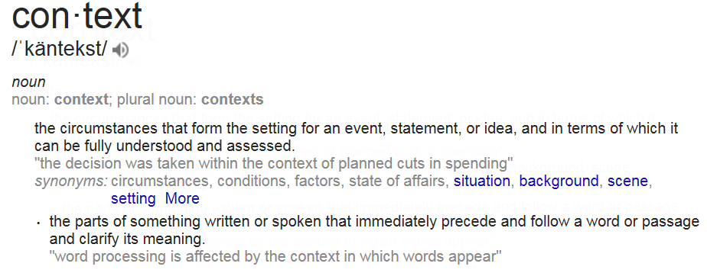
‘Context’
https://www.google.com/search?q=context+meaning

Slide 17
A major distinction
The circumstances that form the setting for an event, statement, or idea, and in terms of which it can be fully understood and assessed.
The parts of something written or spoken that immediately precede and follow a word or passage and clarify its meaning.

Slide 18
A major distinction
The circumstances that form the setting for an event, statement, or idea, and in terms of which it can be fully understood and assessed.
The parts of something written or spoken that immediately precede and follow a word or passage and clarify its meaning.

Slide 19
A major distinction
The circumstances that form the setting for an event, statement, or idea, and in terms of which it can be fully understood and assessed.
The parts of something written or spoken that immediately precede and follow a word or passage and clarify its meaning.
Beings & happenings
Descriptions

Slide 20
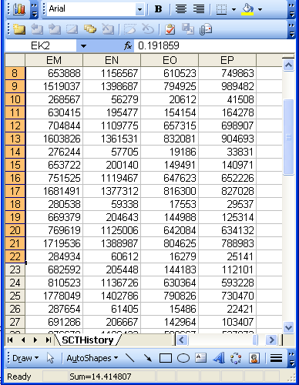
Beings, happenings and descriptions
(research) data
Beings & happenings
Descriptions

Slide 21
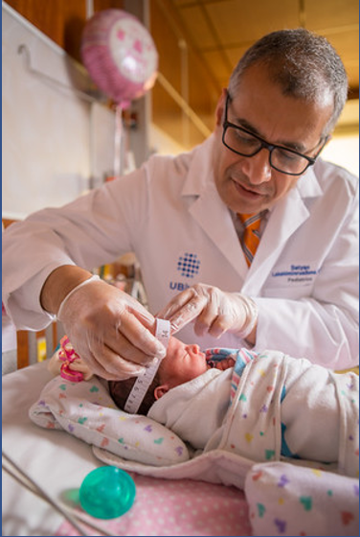
Beings, happenings and descriptions
(research) domain
(research) data
Beings & happenings
Descriptions
https://ubphoto.smugmug.com/Years/2017/17011-Medicine-Satyanarayana-Lakshminrusimha-Newborn-MFS/i-Vj8g6p2

Slide 22
Beings, happenings and descriptions
(research) domain
(research) data
Beings & happenings
Descriptions
https://ubphoto.smugmug.com/Years/2017/17011-Medicine-Satyanarayana-Lakshminrusimha-Newborn-MFS/i-Vj8g6p2

Slide 23
Three relevant disciplines
(research) domain
(research) data
Beings & happenings
Descriptions
https://ubphoto.smugmug.com/Years/2017/17011-Medicine-Satyanarayana-Lakshminrusimha-Newborn-MFS/i-Vj8g6p2

Slide 24
Three relevant disciplines: (1)
Data science:
‘an interdisciplinary field about scientific methods, processes, and systems to extract knowledge or insights from data in various forms, either structured or unstructured, similar to data mining’.
(research) data
https://en.wikipedia.org/wiki/Data_science
Beings & happenings
Descriptions

Slide 25
Three relevant disciplines: (2)
Statistics:
‘a branch of mathematics dealing with the collection, analysis, interpretation, presentation, and organization of data’.
(research) data
https://en.wikipedia.org/wiki/Statistics
Beings & happenings
Descriptions

Slide 26
Three relevant disciplines: (3)
Ontology:
The study of what type of entities exist and how entities relate to each other.
→ a branch of philosophy
A representation of the types of entities that (are believed to) exist and how they (are believed to) relate to each other.
→ computer science/informatics
+ philosophy
(research) data
Beings & happenings
Descriptions

Slide 27
Philosophy of science: use(ful/less)?
‘Philosophy of science is about as useful to scientists as ornithology is to birds’.
Attributed to Richard Feynman in Donald E. Simanek and John C. Holden, Science Askew: A Light-Hearted Look at the Scientific World (Philadelphia: Institute of Physics Publishing, 2002) , 215.
Feynman photo © Richard Hartt/Caltech archives

Slide 28
Philosophy of science: use(ful/less)?
‘Philosophy of science is about as useful to scientists as ornithology is to birds’.
Attributed to Richard Feynman in Donald E. Simanek and John C. Holden, Science Askew: A Light-Hearted Look at the Scientific World (Philadelphia: Institute of Physics Publishing, 2002) , 215.
Feynman photo © Richard Hartt/Caltech archives
‘Science can't be free of philosophy any more than baseball can be free of physics’.
Jeffrey L. Kasser, Ph.D. http://www.thegreatcourses.com/courses/philosophy-of-science.html#BVRRWidgetID

Slide 29
Three disciplines: difference in focus
(research) domain
(research) data
Ontology
Data science
Statistics
Beings & happenings
Descriptions
https://ubphoto.smugmug.com/Years/2017/17011-Medicine-Satyanarayana-Lakshminrusimha-Newborn-MFS/i-Vj8g6p2

Slide 30
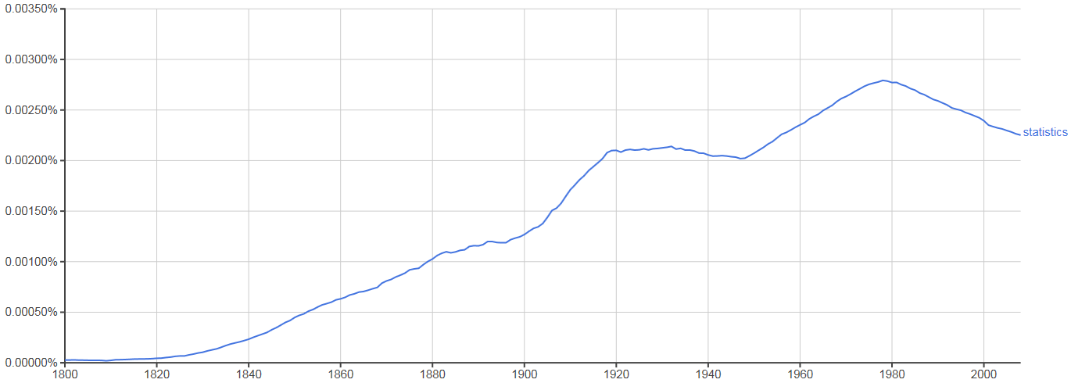
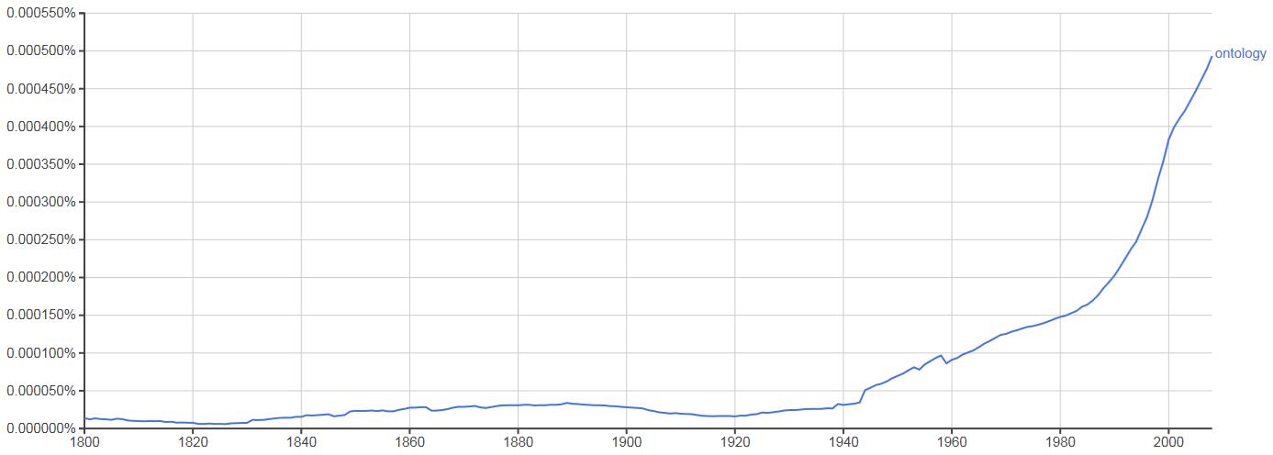
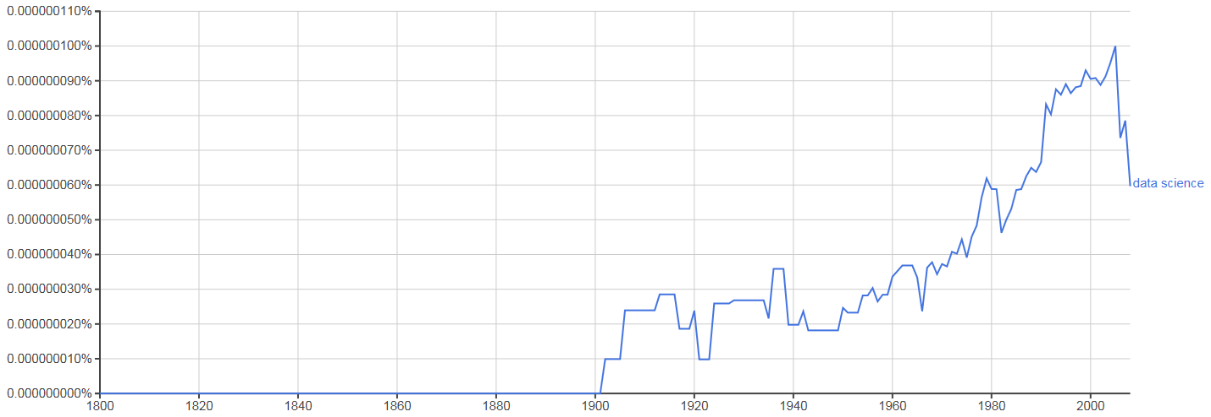
Occurrence in Google Books (until 2008)
‘Statistics’
‘Ontology’
‘Data science’

Slide 31
Focus of my programmatic research
How can data/information/… /ontologies be processed/structured in such a way that:
they are faithful representations of reality, and that
changes introduced in updates reflect faithfully corresponding changes in reality?
What are the requirements for formalisms/systems/… containing data/… satisfying (1a) and (1b) to allow users thereof acquiring a faithful representation of the changes in reality by merely looking at the changes in the data/… ?

Slide 32
You think?

Slide 33
Reviewers’ comments on my FOIS 2016 papers
‘Although it is not mentioned explicitly, it gives the impression that the authors assume that there is only one reality and that this reality can be faithfully modelled’;
‘The somewhat naive realism that seems to underly the work, namely, that there is an objective reality out there to be observed and recognized’;

Slide 34
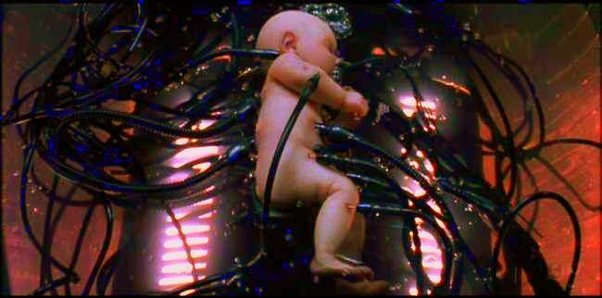
The Matrix

Slide 35
Reviewers’ comments on my FOIS 2016 papers
‘Although it is not mentioned explicitly, it gives the impression that the authors assume that there is only one reality and that this reality can be faithfully modelled’;
‘The somewhat naive realism that seems to underly the work, namely, that there is an objective reality out there to be observed and recognized’;
‘it is impossible to distinguish whether ontology modifications result from observed changes in reality or changes in understanding of reality’.

Slide 36
‘Ontology’
Helps scientists to determine and describe what sorts of entities their research is intended to be directed at.

Slide 37
‘Ontology’

Slide 38
One ontological position: Realism
Generic Realism (on some subject matter):
a, b, and c and so on exist,
and the fact that they exist and have properties such as F-ness, G-ness, and H-ness is (apart from mundane empirical dependencies of the sort sometimes encountered in everyday life) independent of anyone's beliefs, linguistic practices, conceptual schemes, and so on.
http://plato.stanford.edu/entries/realism/

Slide 39
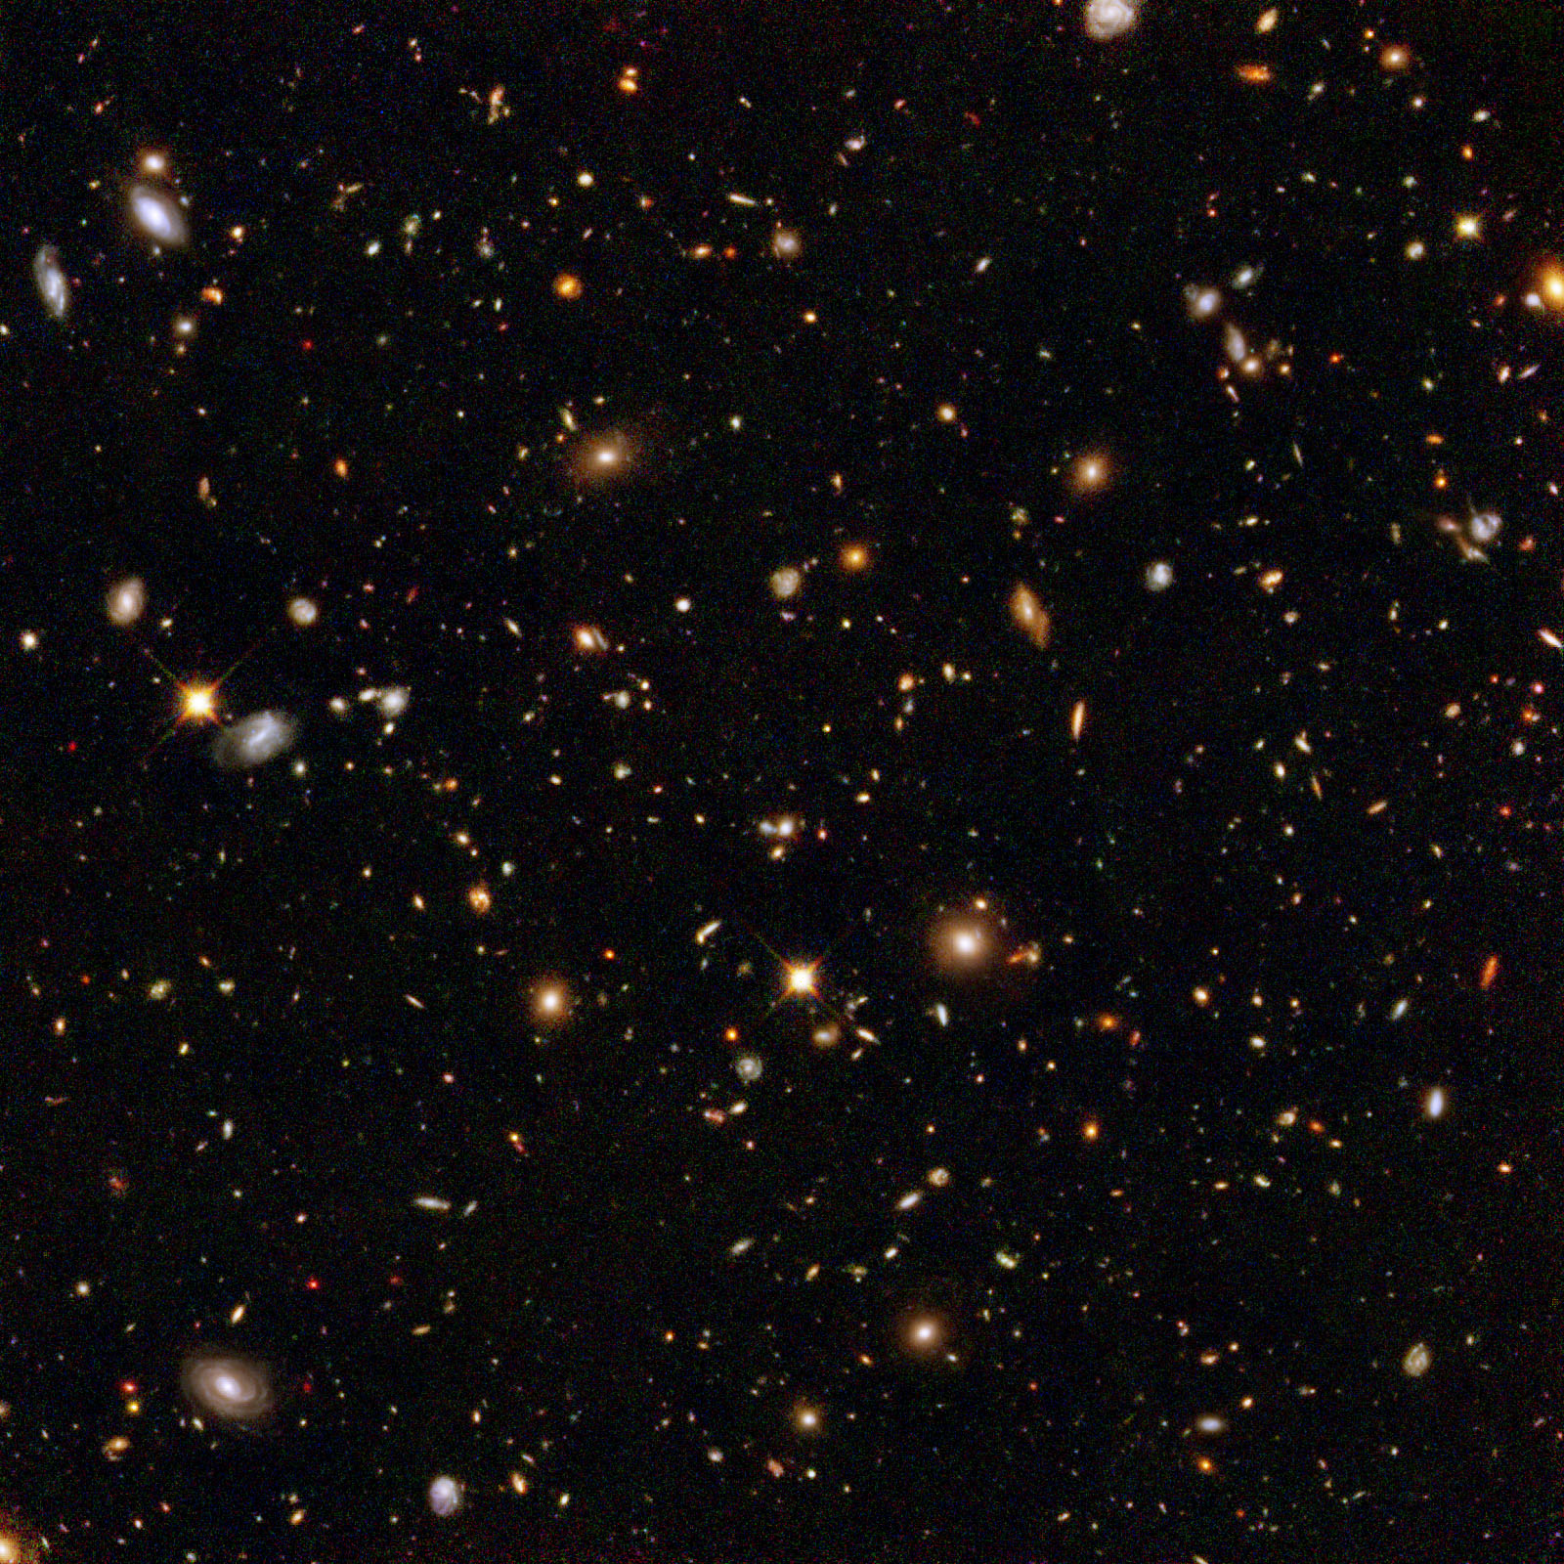
The basis of Ontological Realism (O.R.)
There is an external reality which is ‘objectively’ the way it is;
That reality is accessible to us;
We build in our brains cognitive representations of reality;
We communicate with others about what is there, and what we believe there is there.
Smith B, Kusnierczyk W, Schober D, Ceusters W. Towards a Reference Terminology for Ontology Research and Development in the Biomedical Domain. Proceedings of KR-MED 2006, Biomedical Ontology in Action, November 8, 2006, Baltimore MD, USA

Slide 40
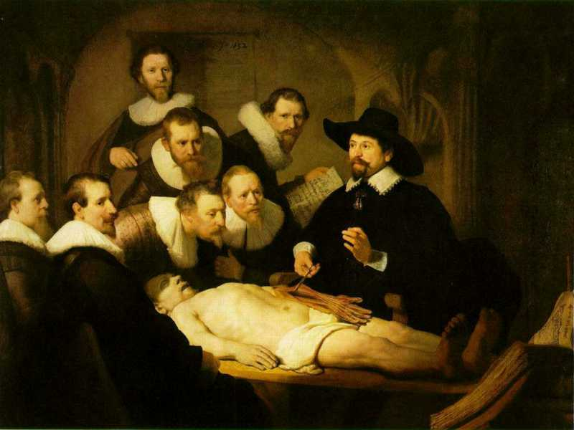

Slide 41
L3
Linguistic representations about (L1⁻), (L2) or (L3)
L2
Beliefs about (1)
Representations
First Order Reality
Entities (particular or generic) with objective existence which are not about anything
L1⁻

Slide 42
‘Research’
What researchers do when realizing their roles as scientists

Slide 43
Definition of ‘research’
careful or diligent search
studious inquiry or examination; especially :
investigation or experimentation
aimed at
- the discovery and interpretation of facts,
- revision of accepted theories or laws in the light of new facts,
- or practical application of such new or revised theories or laws
the collecting of information about a particular subject
http://www.merriam-webster.com/dictionary/research

Slide 44
The Scientific Method
principles and procedures for the systematic pursuit of knowledge involving:
the recognition and formulation of a problem,
the collection of data through observation and experiment, and
the formulation and testing of hypotheses.
http://www.merriam-webster.com/dictionary/scientific%20method

Slide 45
By ArchonMagnus - Own work, CC BY-SA 4.0, https://commons.wikimedia.org/w/index.php?curid=42164616

Slide 46
Make observations
What do I see in nature?
→ Ontology
By ArchonMagnus - Own work, CC BY-SA 4.0, https://commons.wikimedia.org/w/index.php?curid=42164616

Slide 47
Scientific Objectivity (1)
Objectivity as Faithfulness to Facts
Objectivity as Absence of Normative Commitments and the Value-Free Ideal

Slide 48
Four notions of ‘ontology’ as a study
(O1) the study of what there is,
(O2) the study of the most general features of what there is, and how the things there are relate to each other in the metaphysically most general ways,
(O3) the study of ontological commitment, i.e. what we or others are committed to,
(O4) the study of meta-ontology, i.e. saying what task it is that the discipline of ontology should aim to accomplish, if any, how the questions it aims to answer should be understood, and with what methodology they can be answered.
http://plato.stanford.edu/entries/logic-ontology/#DifConOnt

Slide 49
Four notions of ‘ontology’ as a study
(O1) the study of what there is,
(O2) the study of the most general features of what there is, and how the things there are relate to each other in the metaphysically most general ways,
(O3) the study of ontological commitment, i.e. what we or others are committed to,
(O4) the study of meta-ontology, i.e. saying what task it is that the discipline of ontology should aim to accomplish, if any, how the questions it aims to answer should be understood, and with what methodology they can be answered.
http://plato.stanford.edu/entries/logic-ontology/#DifConOnt

Slide 50
Scientific Objectivity (1)
Objectivity as Faithfulness to Facts
Objectivity as Absence of Normative Commitments and the Value-Free Ideal
Objectivity as Freedom from Personal Biases
Measurement and Quantification
Inductive and Statistical Inference

Slide 51
Scientific Objectivity (2)
Science is objective in that, or to the extent that:
its products—theories, laws, experimental results and observations—constitute accurate representations of the external world. The products of science are not tainted by human desires, goals, capabilities or experience.
product objectivity
the processes and methods that characterize it neither depend on contingent social and ethical values, nor on the individual bias of a scientist
→ process objectivity.
http://plato.stanford.edu/entries/scientific-objectivity

Slide 52
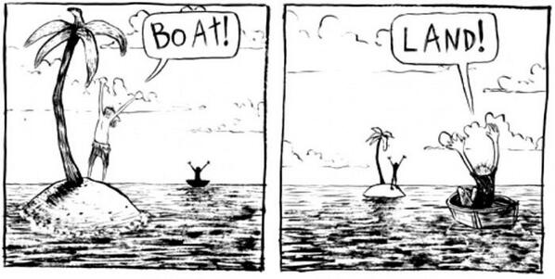
The view from nowhere
There are two kinds of qualities: ones that vary with the perspective one has or takes, and ones that remain constant through changes of perspective. The latter are the objective properties.
http://plato.stanford.edu/entries/scientific-objectivity

Slide 53
No scientific objectivity here
six
nine

Slide 54
No scientific objectivity here
nine
six

Slide 55
Is there scientific objectivity here?
sixty
nine
sixty
nine

Slide 56
Typical use of ontology as discipline
Creation of ontologies throughout their entire life cycle
Principles
based design
maintenance
Development
An ontology’s ideal lifecycle
Use
Implementation
Validation
Verification

Slide 57
An ideal ontology
A representation of some pre-existing domain of reality (a portion of reality) which
reflects the generic entities within its domain – and the relations between them – in such a way that there obtains a systematic correlation between reality and the representation itself,
is intelligible to a domain expert,
is formalized in a way that allows it to support automatic information processing.
Smith B, Kusnierczyk W, Schober D, Ceusters W. Towards a Reference Terminology for Ontology Research and Development in the Biomedical Domain. Proceedings of KR-MED 2006, Biomedical Ontology in Action, November 8, 2006, Baltimore MD, USA

Slide 58
Focus for scientists and researchers
Principles
based design
Principles
based design
maintenance
Development
An ontology’s ideal lifecycle
Use
Use
Implementation
Validation
Verification

Slide 59
An ideal dataset
A representation of some pre-existing portion of reality which
reflects the particulars within its domain – and the relations between them – in such a way that there obtains a systematic correlation between reality and the representation itself,
is intelligible to a domain expert,
is formalized in a way that allows it to support automatic information processing.
Smith B, Kusnierczyk W, Schober D, Ceusters W. Towards a Reference Terminology for Ontology Research and Development in the Biomedical Domain. Proceedings of KR-MED 2006, Biomedical Ontology in Action, November 8, 2006, Baltimore MD, USA

Slide 60
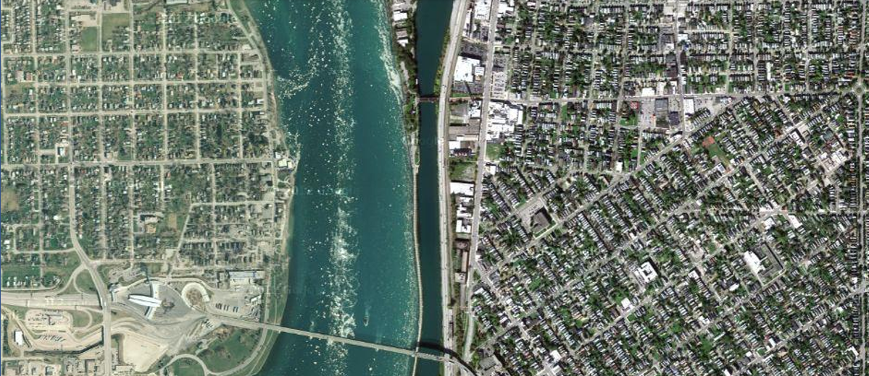
Some particulars north of the Peace Bridge
The Peace Bridge is (now) a kind of bridge
West avenue is (now) a kind of avenue

Slide 61
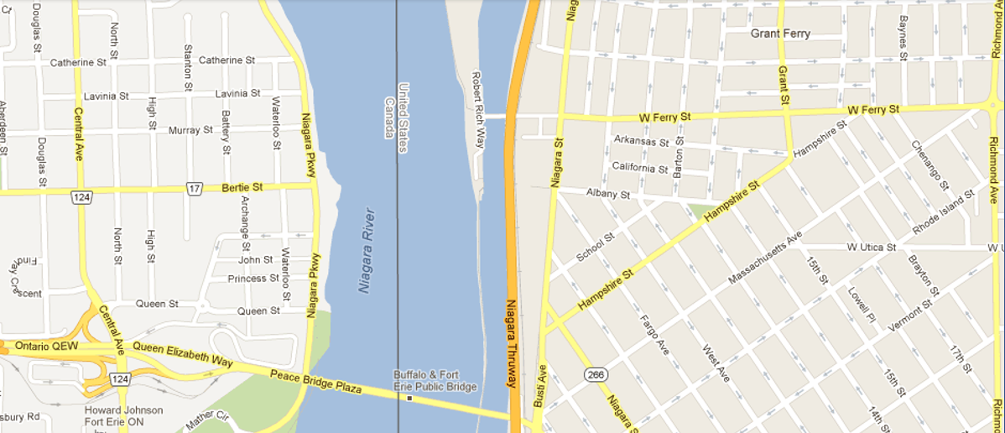
Representation of some of these particulars

Slide 62
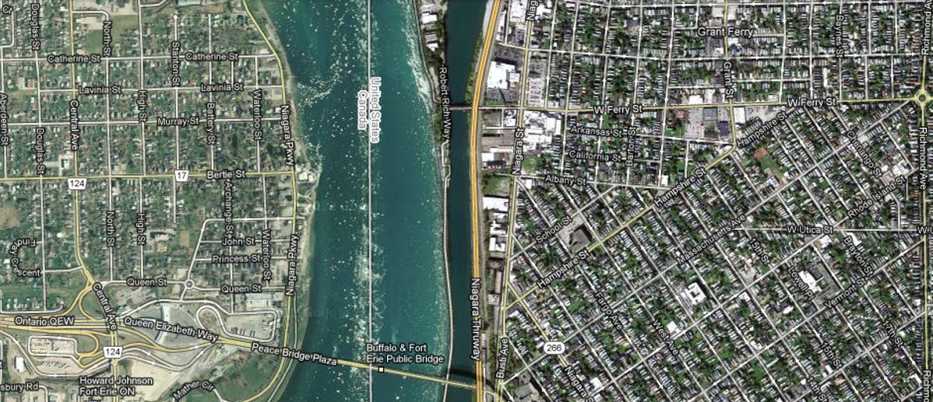
The goal of realism-based dataset creation
Faithful representation: perfect correspondence
between representation and what is represented

Slide 63
The goal of realism-based dataset creation
Is it?
Faithful representation: perfect correspondence
between representation and what is represented

Slide 64
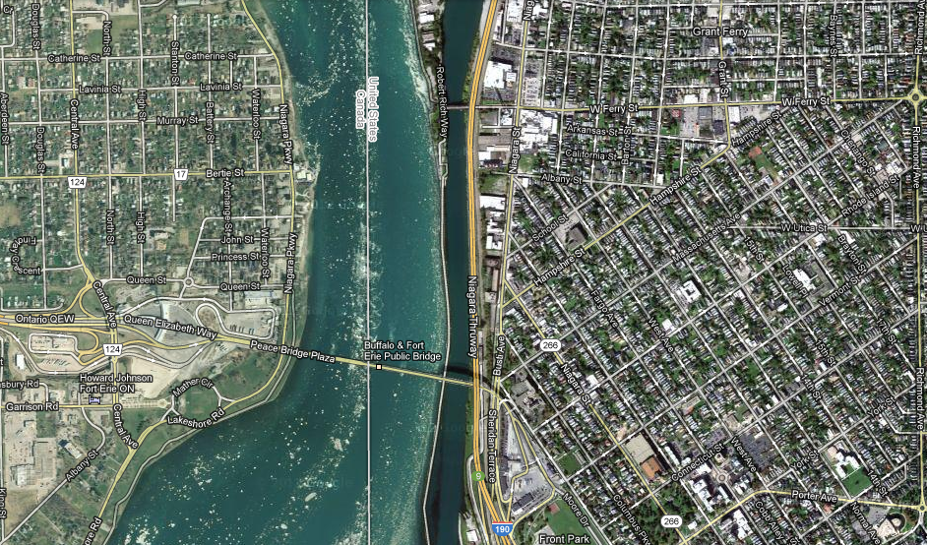
The goal of realism-based dataset creation

Slide 65
The goal of realism-based dataset creation
Getting there requires:
Principles
Understanding these principles
Applying these principles

Slide 66
Adequate taxonomy design and classification
Taxonomy design:
Identify examples of particulars (‘individuals’, ‘things’, ‘entities’, …) you want to classify;
Identify the various characteristics that are possessed by (all or some of) these individual entities;
Identify groups (classes) on the basis of combinations of characteristics that co-occur;
Organize the groups hierarchically (‘parent-child’) so that characteristics that apply to a ‘parent’ (‘grandparent’,…) group apply to ALL groups beneath it;
Name the groups with terms that have face value.
Classification:
Assign individual entities to the groups that correspond with the combination of characteristics they exhibit.

Slide 67
A large collection of individual entities
https://clipartfest.com/download/c2bd0a0071663cef17ac2126d73bf9350a9d15e2.html

Slide 68
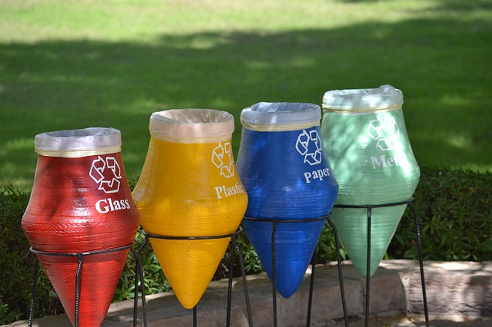
Groups based on material composition

Slide 69
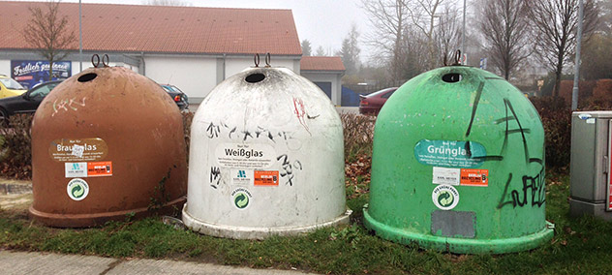
Groups for glass divided by color

Slide 72
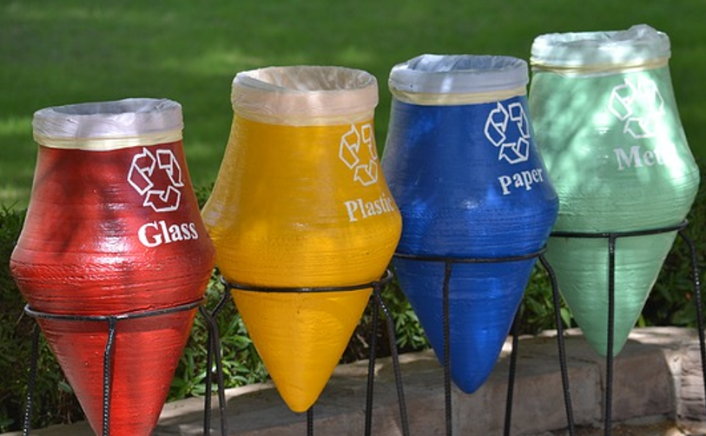

Slide 74
Be lazy: use what exists

Slide 75
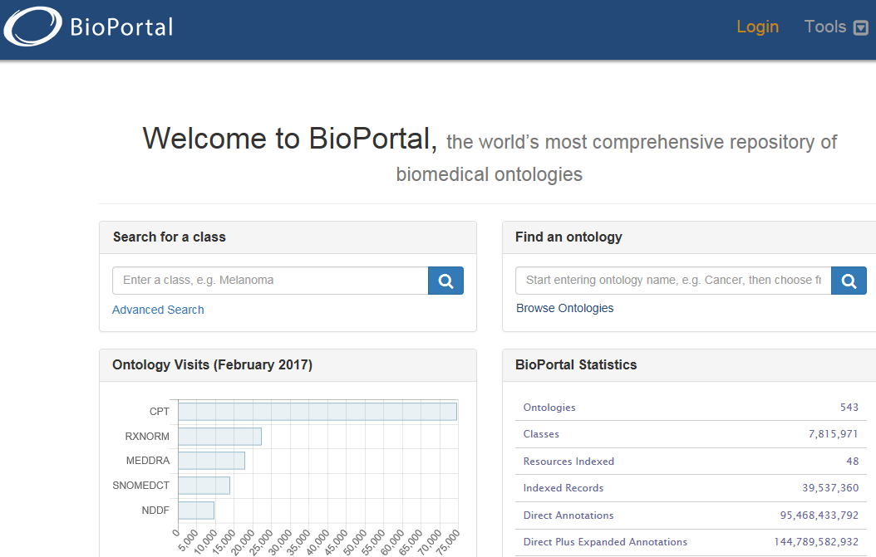
‘Computational biomedical ontologies’
https://bioportal.bioontology.org/

Slide 76
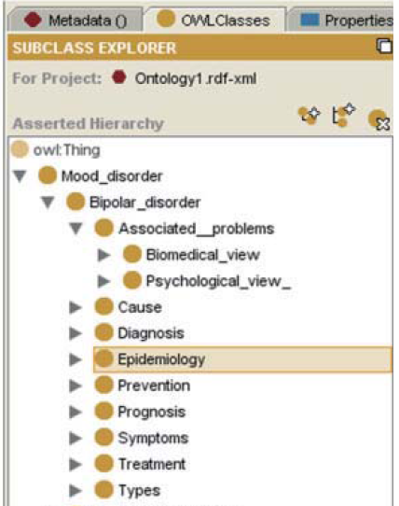
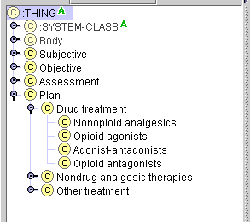
Be extremely critical when re-using. Some people do not understand the representation language they are using!

Slide 77
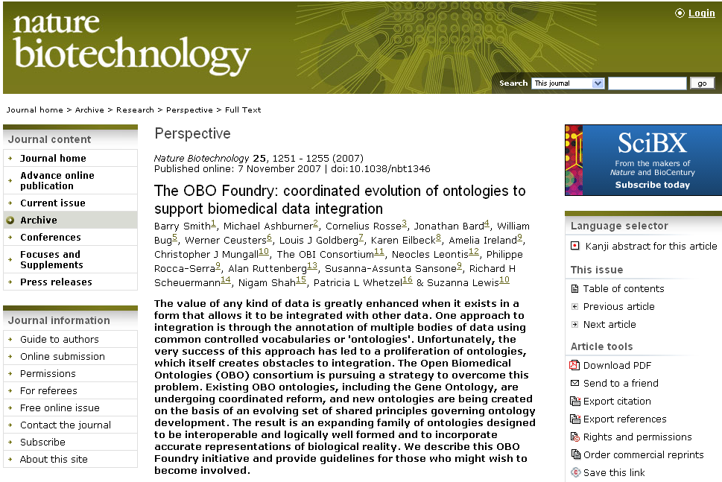
Be lazy in an intelligent way: Re-use what has been crafted following good principles

Slide 78
Basic Formal Ontology: what is out there … (… we want/need to deal with)?
portions of reality
relations
configurations
?
participation
me participating in my life
universals
entities
?
particulars
continuants
occurrents
me
my life
organism

Slide 79
A faithful representation of reality through BFO
dependent continuant
material
object
spacetime
region
spatial
region
temporal
region
history
t
t
instanceOf
t
participantOf at t
occupies
some temporal region
some quality
my life
my 4D STR
projectsOn
me
… at t
projectsOn at t
some spatial
region
located-in at t
BFO = Basic Formal Ontology

Slide 80
The model of the Ontology for General Medical Science
disease course
produces
bears
realized_in
part-of
etiological process
disorder
disease
pathological process
produces
diagnosis
interpretive process
signs & symptoms
abnormal bodily features
produces
participates_in
recognized_as
Notes:
font was too small, color inside green boxes was hardly readable

Slide 81
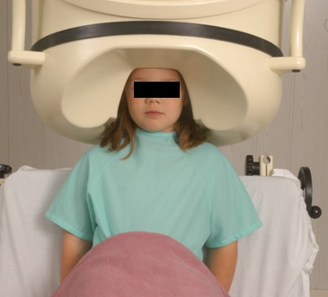
No conflation of diagnosis, disease, and disorder
The diagnosis is here
The disorder is there
The disease is there

Slide 82
Ontology of General Medical Science Key OGMS definitions
DISORDER | A causally relatively isolated combination of physical components that is (a) clinically abnormal and (b) maximal, in the sense that it is not a part of some larger such combination.
DISEASE | A DISPOSITION (i) to undergo PATHOLOGICAL PROCESSes that (ii) exists in an ORGANISM because of one or more DISORDERs in that ORGANISM.
DISEASE COURSE | The totality of all PROCESSes through which a given DISEASE instance is realized.
Scheuermann R, Ceusters W, Smith B. Toward an Ontological Treatment of Disease and Diagnosis. 2009 AMIA Summit on Translational Bioinformatics, San Francisco, California, March 15-17, 2009;: 116-120. Omnipress ISBN:0-9647743-7-2

Slide 83
Disorder related configurations
No disorder instance → no disease instance,
→ no pathological processes;
A disorder instance can eliminate the range of circumstances under which another disorder instance can lead to pathological processes → no disease instance;
Disorders of the same type in distinct patients, or in the same patient at distinct times, may lead to diseases of distinct types;
Diseases of the same type may unfold themselves in disease courses of distinct types;
Diseases of distinct types may unfold themselves in disease courses of the same type;
…

Slide 84
Ontology of General Medical Science Key OGMS definitions
DISORDER | A causally relatively isolated combination of physical components that is (a) clinically abnormal and (b) maximal, in the sense that it is not a part of some larger such combination.
DISEASE | A DISPOSITION (i) to undergo PATHOLOGICAL PROCESSes that (ii) exists in an ORGANISM because of one or more DISORDERs in that ORGANISM.
DISEASE COURSE | The totality of all PROCESSes through which a given DISEASE instance is realized.
DIAGNOSIS | A conclusion of an interpretive PROCESS that has as input a CLINICAL PICTURE of a given patient and as output an assertion (diagnostic statement) to the effect that the patient has a DISEASE of such and such a type.
Scheuermann R, Ceusters W, Smith B. Toward an Ontological Treatment of Disease and Diagnosis. 2009 AMIA Summit on Translational Bioinformatics, San Francisco, California, March 15-17, 2009;: 116-120. Omnipress ISBN:0-9647743-7-2

Slide 85
‘Findings’ / ‘observations’
On the side of the patient
Bodily features
Symptoms
Signs
Observed through physical examination
Observed through lab test
Diseases
Representations
Findings
Anamnestic findings
Clinical findings
Laboratory findings
Diagnoses

Slide 86
What are diagnoses in EHRs about? (What are the options?)
DISORDER | A causally relatively isolated combination of physical components that is (a) clinically abnormal and (b) maximal, in the sense that it is not a part of some larger such combination.
DISEASE | A DISPOSITION (i) to undergo PATHOLOGICAL PROCESSes that (ii) exists in an ORGANISM because of one or more DISORDERs in that ORGANISM.
DISEASE COURSE | The totality of all PROCESSes through which a given DISEASE instance is realized.
DIAGNOSIS | A conclusion of an interpretive PROCESS that has as input a CLINICAL PICTURE of a given patient and as output an assertion (diagnostic statement) to the effect that the patient has a DISEASE of such and such a type.
Scheuermann R, Ceusters W, Smith B. Toward an Ontological Treatment of Disease and Diagnosis. 2009 AMIA Summit on Translational Bioinformatics, San Francisco, California, March 15-17, 2009;: 116-120. Omnipress ISBN:0-9647743-7-2

Slide 87
What are diagnoses in EHRs about? (What are the options?)
DISORDER | A causally relatively isolated combination of physical components that is (a) clinically abnormal and (b) maximal, in the sense that it is not a part of some larger such combination.
DISEASE | A DISPOSITION (i) to undergo PATHOLOGICAL PROCESSes that (ii) exists in an ORGANISM because of one or more DISORDERs in that ORGANISM.
DISEASE COURSE | The totality of all PROCESSes through which a given DISEASE instance is realized.
DIAGNOSIS | A conclusion of an interpretive PROCESS that has as input a CLINICAL PICTURE of a given patient and as output an assertion (diagnostic statement) to the effect that the patient has a DISEASE of such and such a type.
781.2 Abnormality of gait

Slide 88
What are diagnoses in EHRs about? (What are the options?)
DISORDER | A causally relatively isolated combination of physical components that is (a) clinically abnormal and (b) maximal, in the sense that it is not a part of some larger such combination.
DISEASE | A DISPOSITION (i) to undergo PATHOLOGICAL PROCESSes that (ii) exists in an ORGANISM because of one or more DISORDERs in that ORGANISM.
DISEASE COURSE | The totality of all PROCESSes through which a given DISEASE instance is realized.
DIAGNOSIS | A conclusion of an interpretive PROCESS that has as input a CLINICAL PICTURE of a given patient and as output an assertion (diagnostic statement) to the effect that the patient has a DISEASE of such and such a type.
781.2 Abnormality of gait

Slide 89
What are diagnoses in EHRs about? (What are the options?)
DISORDER | A causally relatively isolated combination of physical components that is (a) clinically abnormal and (b) maximal, in the sense that it is not a part of some larger such combination.
DISEASE | A DISPOSITION (i) to undergo PATHOLOGICAL PROCESSes that (ii) exists in an ORGANISM because of one or more DISORDERs in that ORGANISM.
DISEASE COURSE | The totality of all PROCESSes through which a given DISEASE instance is realized.
DIAGNOSIS | A conclusion of an interpretive PROCESS that has as input a CLINICAL PICTURE of a given patient and as output an assertion (diagnostic statement) to the effect that the patient has a DISEASE of such and such a type.
256.0 - Hyperestrogenism

Slide 90
What are diagnoses in EHRs about? (What are the options?)
DISORDER | A causally relatively isolated combination of physical components that is (a) clinically abnormal and (b) maximal, in the sense that it is not a part of some larger such combination.
DISEASE | A DISPOSITION (i) to undergo PATHOLOGICAL PROCESSes that (ii) exists in an ORGANISM because of one or more DISORDERs in that ORGANISM.
DISEASE COURSE | The totality of all PROCESSes through which a given DISEASE instance is realized.
DIAGNOSIS | A conclusion of an interpretive PROCESS that has as input a CLINICAL PICTURE of a given patient and as output an assertion (diagnostic statement) to the effect that the patient has a DISEASE of such and such a type.
256.0 - Hyperestrogenism

Slide 91
What are diagnoses in EHRs about? (What are the options?)
DISORDER | A causally relatively isolated combination of physical components that is (a) clinically abnormal and (b) maximal, in the sense that it is not a part of some larger such combination.
DISEASE | A DISPOSITION (i) to undergo PATHOLOGICAL PROCESSes that (ii) exists in an ORGANISM because of one or more DISORDERs in that ORGANISM.
DISEASE COURSE | The totality of all PROCESSes through which a given DISEASE instance is realized.
DIAGNOSIS | A conclusion of an interpretive PROCESS that has as input a CLINICAL PICTURE of a given patient and as output an assertion (diagnostic statement) to the effect that the patient has a DISEASE of such and such a type.
250.23 Diabetes with hyperosmolarity, type I, uncontrolled

Slide 92
What are diagnoses in EHRs about? (What are the options?)
DISORDER | A causally relatively isolated combination of physical components that is (a) clinically abnormal and (b) maximal, in the sense that it is not a part of some larger such combination.
DISEASE | A DISPOSITION (i) to undergo PATHOLOGICAL PROCESSes that (ii) exists in an ORGANISM because of one or more DISORDERs in that ORGANISM.
DISEASE COURSE | The totality of all PROCESSes through which a given DISEASE instance is realized.
DIAGNOSIS | A conclusion of an interpretive PROCESS that has as input a CLINICAL PICTURE of a given patient and as output an assertion (diagnostic statement) to the effect that the patient has a DISEASE of such and such a type.
250.23 Diabetes with hyperosmolarity, type I, uncontrolled

Slide 93
What are diagnoses in EHRs about? (What are the options?)
DISORDER | A causally relatively isolated combination of physical components that is (a) clinically abnormal and (b) maximal, in the sense that it is not a part of some larger such combination.
DISEASE | A DISPOSITION (i) to undergo PATHOLOGICAL PROCESSes that (ii) exists in an ORGANISM because of one or more DISORDERs in that ORGANISM.
DISEASE COURSE | The totality of all PROCESSes through which a given DISEASE instance is realized.
DIAGNOSIS | A conclusion of an interpretive PROCESS that has as input a CLINICAL PICTURE of a given patient and as output an assertion (diagnostic statement) to the effect that the patient has a DISEASE of such and such a type.
749.01 - Cleft palate, unilateral, complete

Slide 94
What are diagnoses in EHRs about? (What are the options?)
DISORDER | A causally relatively isolated combination of physical components that is (a) clinically abnormal and (b) maximal, in the sense that it is not a part of some larger such combination.
DISEASE | A DISPOSITION (i) to undergo PATHOLOGICAL PROCESSes that (ii) exists in an ORGANISM because of one or more DISORDERs in that ORGANISM.
DISEASE COURSE | The totality of all PROCESSes through which a given DISEASE instance is realized.
DIAGNOSIS | A conclusion of an interpretive PROCESS that has as input a CLINICAL PICTURE of a given patient and as output an assertion (diagnostic statement) to the effect that the patient has a DISEASE of such and such a type.
749.01 - Cleft palate, unilateral, complete

Slide 95
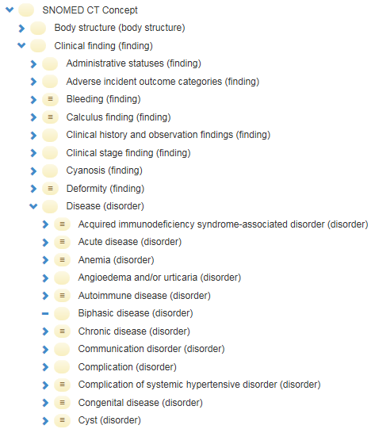
SNOMED CT

Slide 96
SNOMED CT: Elevated liver enzymes level due to cystic fibrosis (disorder)
Relationship | Destination | Type
Is a | Elevated liver enzymes level (finding) | Stated
Due to | Cystic fibrosis (disorder) | Stated
Is a | Elevated liver enzymes level (finding) | Inferred
Due to | Cystic fibrosis (disorder) | Inferred
Interprets | Measurement of liver enzyme (procedure) | Inferred
Has interpretation | Outside reference range (qualifier value) | Inferred
Has interpretation | Above reference range (qualifier value) | Inferred
Interprets | Measurement procedure (procedure) | Inferred

Slide 97
Minimal ontological principles for research
Identify the particulars you want to collect data about;
Identify the types these particulars are instances of;
Organize the types in a taxonomy using high quality ontologies;
Represent the relationships that hold between the particulars;
Verify repeatedly you are not confusing reality with descriptions/hypotheses/…;
Do 1-5 for cited literature/measurement instruments you will rely on;
Do not only consult a biomedical statistician before designing a study, but also a biomedical ontologist.

