Slide 1
Assessing the quality of
BMI research papers
Lecture in BMS516: Fundamentals of Biomedical Research. II
Dec 6, 2021 online, JSMBS, University at Buffalo
Werner CEUSTERS, MD
Departments of Biomedical Informatics and Psychiatry,
UB Institute for Healthcare Informatics,
Ontology Research Group, Center of Excellence in Bioinformatics and Life Sciences,
University at Buffalo, NY, USA

Slide 2
Today’s learning outcomes
Being able to assess the extent to which a scientific paper in the area of biomedical informatics contains all information to appropriately evaluate the quality and reproducibility of the research therein described.
Identify types of bias.

Slide 3
Quasi-mandatory sections of high-quality research papers

Slide 4
Introduction / Background
General problem statement:
  What is the problem precisely.
  Why it needed to be addressed.
    Values: scientific, epistemic, contextual

Slide 5
Value types
Scientific values:
  Accuracy, simplicity, …
Epistemic (or cognitive) values:
  predictive accuracy, scope, unification, explanatory power, coherence with other accepted theories, …
Contextual (non-cognitive) values:
  moral, personal, social, political and cultural values such as pleasure, justice and equality, conservation of the natural environment, diversity, …
http://plato.stanford.edu/entries/scientific-objectivity

Slide 6
Impact of value(s) on science
the choice of a scientific research problem;
the gathering of evidence in relation to the problem;
the acceptance of a scientific hypothesis or theory as an adequate answer to the problem on the basis of the evidence;
the proliferation and application of scientific research results.
(Weber 1917 [1988]).
http://plato.stanford.edu/entries/scientific-objectivity

Slide 7
Introduction / Background
General problem statement:
  What is the problem precisely.
  Why it needed to be addressed.
    Values: scientific, epistemic, contextual
What parts of the problem were addressed.
How does the work adds to the established knowledge?
    Existing literature.
    Gaps in (a)
    How the work reported on fills (part of) these gaps.

Slide 8
Research design and methods

Slide 9
Key = Scientific Objectivity!
Objectivity as Faithfulness to Facts
Objectivity as Absence of Normative Commitments and the Value-Free Ideal
Objectivity as Freedom from Personal Biases
  Measurement and Quantification
  Inductive and Statistical Inference

Slide 10
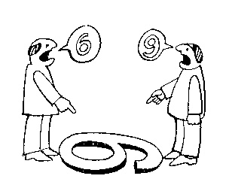
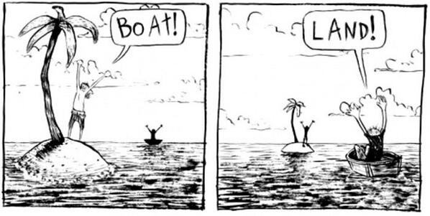
The view from nowhere
There are two kinds of qualities: ones that vary with the perspective one has or takes, and ones that remain constant through changes of perspective. The latter are the objective properties.
http://plato.stanford.edu/entries/scientific-objectivity

Slide 11
Research design and methods (1)
Research question(s)
Study design components, logic and motivation
Hypotheses
  General null and alternative hypotheses
  Statistical null and alternative hypotheses
  Theoretical and operational definition
    Thorough description of parameters and how measured
  Theoretical and operational linkage
    A priori explanation on the basis of existing knowledge why the null hypothesis is likely to be rejected.

Slide 12
Research design and methods (2)
  Description of the population
  Study Sample description:
      Sample size analysis / Power study, Inclusion and exclusion criteria, Sampling methods, Randomization, Blinding, Controls, …
Detailed description of variables
    Data collection protocol
        Methods to minimize missing data
        Procedures to ensure validity and reliability
Data Analysis Strategies
        Anticipated measurement errors
        Statistical assumptions and corresponding tests

Slide 13
Other sections (where applicable)
Ethics and Human Subjects Issues
  Procedures to combat conflict of interest
  Timeframes
Strengths and weaknesses of the study
Budget and motivation for expenses
References
Appendices

Slide 14
Distinct research purpose → distinct design
to describe and understand some phenomenon in its natural context
  → Descriptive Study
to look for an association among variables by studying the situation without managing any intervention
  → Observational or Epidemiological Study
to determine the effect of a specified intervention (e.g., protocol, method, or treatment) managed by the investigator
  → Experimental Trial
to validate a test, tool or diagnostic method
  → Diagnostic, Validity or Reliability Study
Adapted from: Research Design Algorithm developed by the American Dietetic Association, 2010

Slide 15
Framing the research question
Two general strategies:
hypothesis testing:
  researchers construct a null hypothesis (“no effect” or “no difference”) and an alternative hypothesis;
  evidence is sought to disprove the null and/or support the alternative hypothesis.
Estimation:
  Compute differences in some outcome for two different events with appropriate precision;
  Appropriate precision is measured by the width of a confidence interval of the difference between the outcomes in the two groups.
Evans SR. Fundamentals of clinical trial design. Journal of experimental stroke & translational medicine. 2010;3(1):19-27.

Slide 16
Specific strategy: PICO(TT) Framework
P | Patient Population of patients Problem | What is the best way to briefly describe this patient population or situation? E.g. pregnant women over 40 with preeclampsia, adolescent boys 13-15, etc.
I | Intervention (therapy or test) | What is the intervention? E.g. a drug, a questionnaire, a test, a procedure, etc.
C | Comparison | Is there an alternative intervention to compare to? E.g. placebo, current standard of care, another therapy, etc.
O | Outcome | Include specific patient-oriented outcomes E.g. morbidity, quality of life, etc.
T | Time for completion | Used to identify the time/duration for your data collection or for assessing your outcome. I.e. how long before you are to see that the intervention is having a positive impact OR the time in which the intervention will be delivered
T | Type of study | What is the ideal study design to answer this question? What type of study design do you realistically anticipate finding? E.g. randomized-controlled trial, systematic reviews, etc.

Slide 17
Evidence Based Medicine question types
Intervention/Therapy
Etiology
Diagnosis
Prognosis/Prediction
Meaning
https://www.aaacn.org/sites/default/files/documents/misc-docs/1e_PICOT_Questions_template.pdf

Slide 18
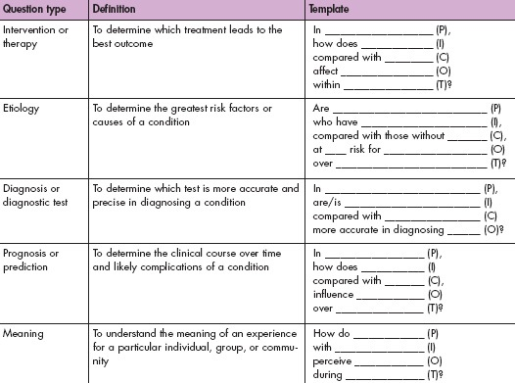
https://www.aaacn.org/sites/default/files/documents/misc-docs/1e_PICOT_Questions_template.pdf

Slide 19
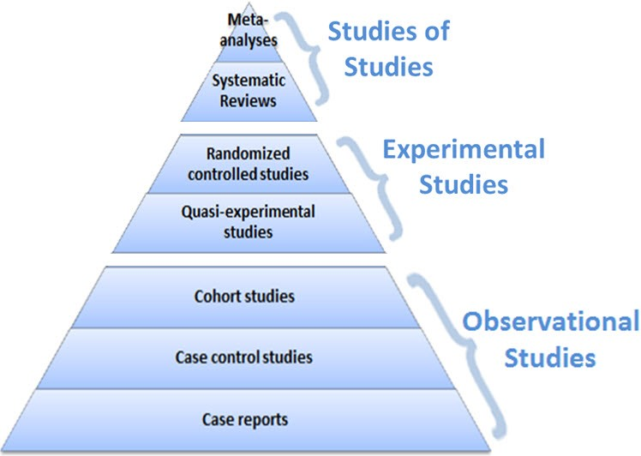
Design partially determines level of evidence
Evidence
level
https://guides.library.vcu.edu/humphrey/journal-club

Slide 20
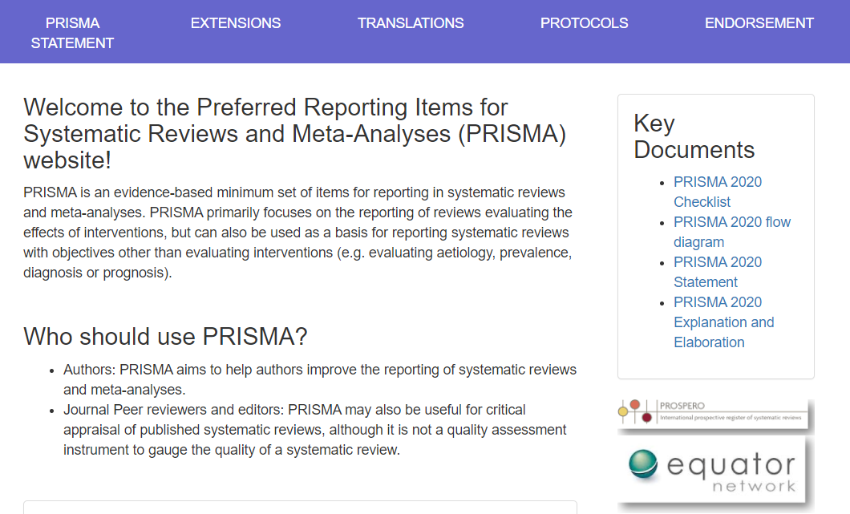
http://www.prisma-statement.org/

Slide 21
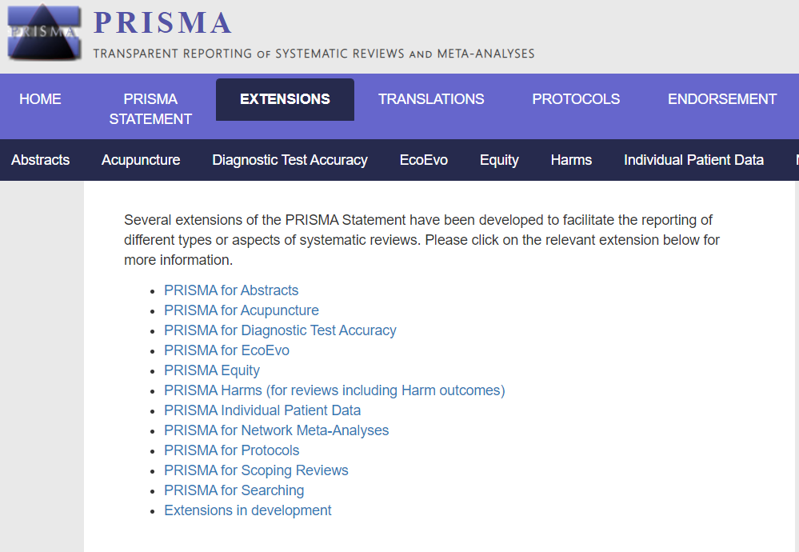
http://www.prisma-statement.org/Extensions/

Slide 22
Bias
In the work?
In the reporting ?

Slide 23
Precision and accuracy of representations
Precision
  The degree to which distinct representations (references) about the same portion of reality (the referent) are similar when derived under similar circumstances.
Accuracy
  The degree to which a representation actually represents what it was intended to represent.
  How close is a representation to the truth?

Slide 24
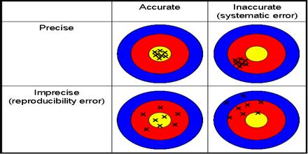
‘Classical’ picture

Slide 25
Validity and reliability of representational methods/procedures
Validity
  The extent to which a method or procedure allows or is able to derive representations of what is intended to be represented.
Reliability
  The degree to which a method or procedure allows or is able to derive similar representations under similar circumstances.

Slide 26
Validity
Internal validity
  The method produces an accurate representation for the portion of reality under scrutiny.
External validity
  The method produces for all similar portions of reality representations which with respect to these portions of reality are accurate to the same degree.
  → generalizability

Slide 27
Reliability Validity of method
Relations between reliability, validity, accuracy and precision.

Slide 28
Error
Error: the difference between the representation and the referent

Slide 29
Error types
Random error:
  An error of a sort we can’t predict (even if we tried with all means possible)
  Only caused by chance.
Systematic error:
  An error due to any cause other than sampling variability.

Slide 30
Error types
Random error:
  An error of a sort we can’t predict (even if we tried with all means possible)
  Only caused by chance.
→ contributes to reduction in precision
Systematic error:
  An error due to any cause other than sampling variability.
  → contributes to reduction in accuracy

Slide 31
Validity
Internal validity
  The method produces an accurate representation for the portion of reality under scrutiny.
External validity
  The method produces for all similar portions of reality representations which with respect to these portions of reality are accurate to the same degree.
  → generalizability
  Similarity of portions of reality can only be guaranteed by absence of sampling error.

Slide 32
Bias
Most accurate, general determination:
Error introduced by lack of internal validity of a method which therefor produces inaccurate representations

Slide 33
Bias in biomedical informatics

Slide 34
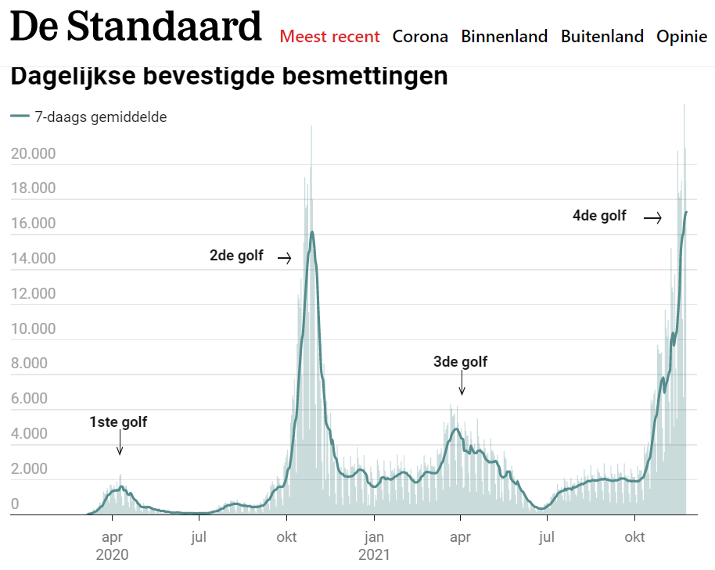
https://www.standaard.be/cnt/dmf20211129_94262897

Slide 35
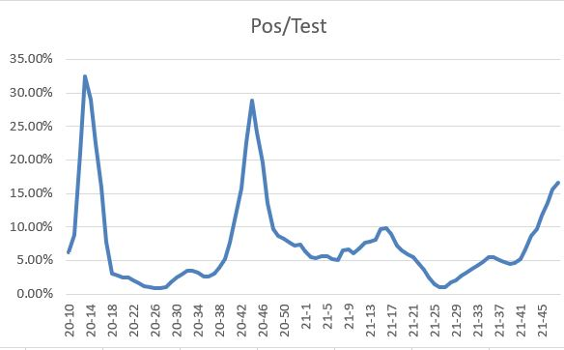

Slide 36
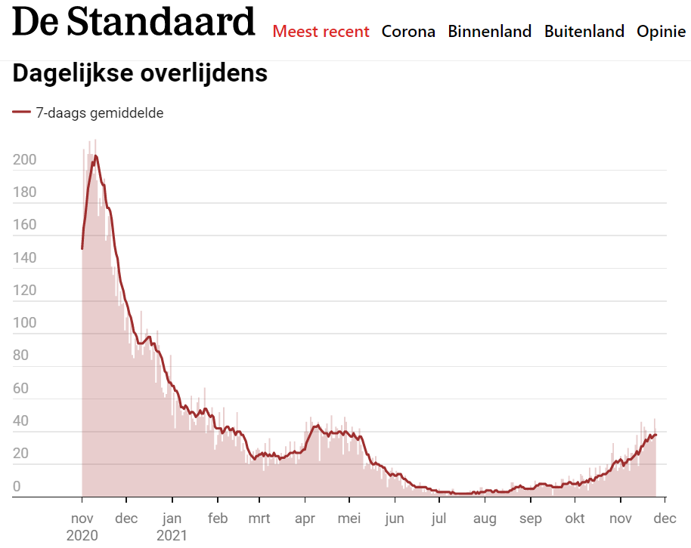

Slide 37
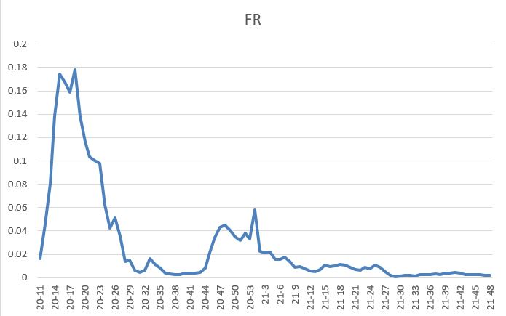

Slide 38
Does Health IT improves outcome?
Science Daily, August 31, 2011
Federal Investment in Electronic Health Records Likely to Reap Returns in Quality of Care, Study Finds
A study . . . involving more than 27,000 adults with diabetes found that those in physician practices using EHRs were significantly more likely to have health care and outcomes that align with accepted standards than those where physicians rely on paper records.
(Excerpted from www.sciencedaily.com/releases/2011/08/110831115930.htm.)

Slide 39
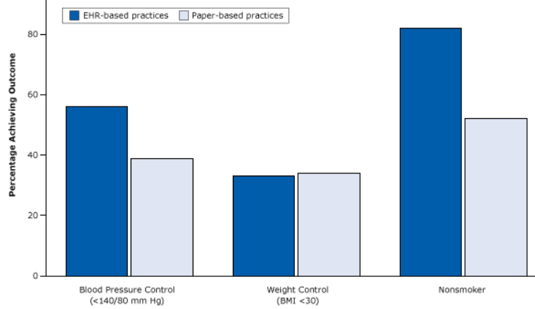
The ‘evidence’ …
https://www.cdc.gov/pcd/issues/2015/15_0187.htm

Slide 40
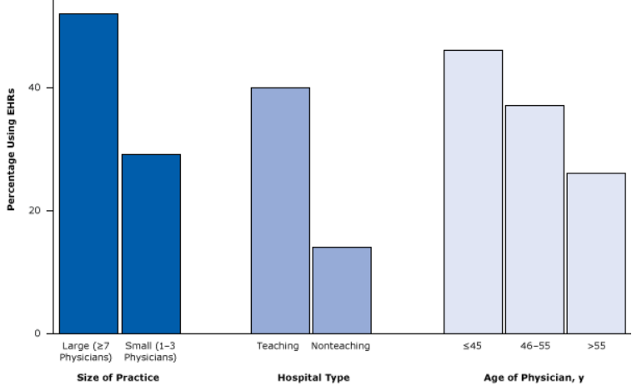
The bias
https://www.cdc.gov/pcd/issues/2015/15_0187.htm

Slide 41
Missing data in EHRs
EHRs are notorious for incompleteness of information
Completeness can be defined in various ways and patient records classified according to their degree of completeness.
  Weiskopf NG, Hripcsak G, Swaminathan S, Weng C. Defining and measuring completeness of electronic health records for secondary use. Journal of Biomedical Informatics. 2013 Oct;46(5):830-836.
Would there be bias in doing secondary data analysis when filtering for complete records?
→ Yes !!! It tends to select sicker patients.
Rusanov, A., Weiskopf, N.G., Wang, S. et al. Hidden in plain sight: bias towards sick patients when sampling patients with sufficient electronic health record data for research. BMC Med Inform Decis Mak 14, 51 (2014)

Slide 42
Sources of bias in EHR-based studies
Health care system bias, emanating from: Reimbursement system, pay for performance parameters
‎Role of general practitioner in the health care system; gatekeeping/nongatekeeping
‎Professional clinical guidelines
‎Ease of access by patients to their records
‎Data sharing between health care providers
‎Practice workload
‎Variations between electronic health record (EHR) system functionalities and lay-out
‎Coding systems and thesauruses
‎Knowledge and education regarding the use of EHR systems
‎Data extraction tools
‎Data processing—redatabasing
‎Research dataset preparation
‎Research methodologies
Verheij RA, Curcin V, Delaney BC, McGilchrist MM
Possible Sources of Bias in Primary Care Electronic Health Record Data Use and Reuse
J Med Internet Res 2018;20(5):e185

Slide 43
Biases in electronic health record data due to processes within the healthcare system: retrospective observational study
https://www.bmj.com/content/361/bmj.k1479
Objective: evaluate the impact of healthcare processes on the predictive value of EHR data.
Design: Retrospective observational study on 669 452 patients treated at the two hospitals over one year between 2005 and 2006.
Main outcome measures: the relative predictive accuracy of each laboratory test for three year survival, using the time of the day, day of the week, and ordering frequency of the test, compared to the value of the test result.
Results: the presence of a lab test order, regardless of any other info about the test result, is associated (P<0.001) with the odds of survival in 233 of 272 (86%) tests. When lab tests were ordered was more accurate than the test results in predicting survival in 118 of 174 tests (68%).
Conclusions: healthcare processes must be accounted for in analysis of observational health data. Without careful consideration to context, EHR data are unsuitable for many research questions.

Slide 44
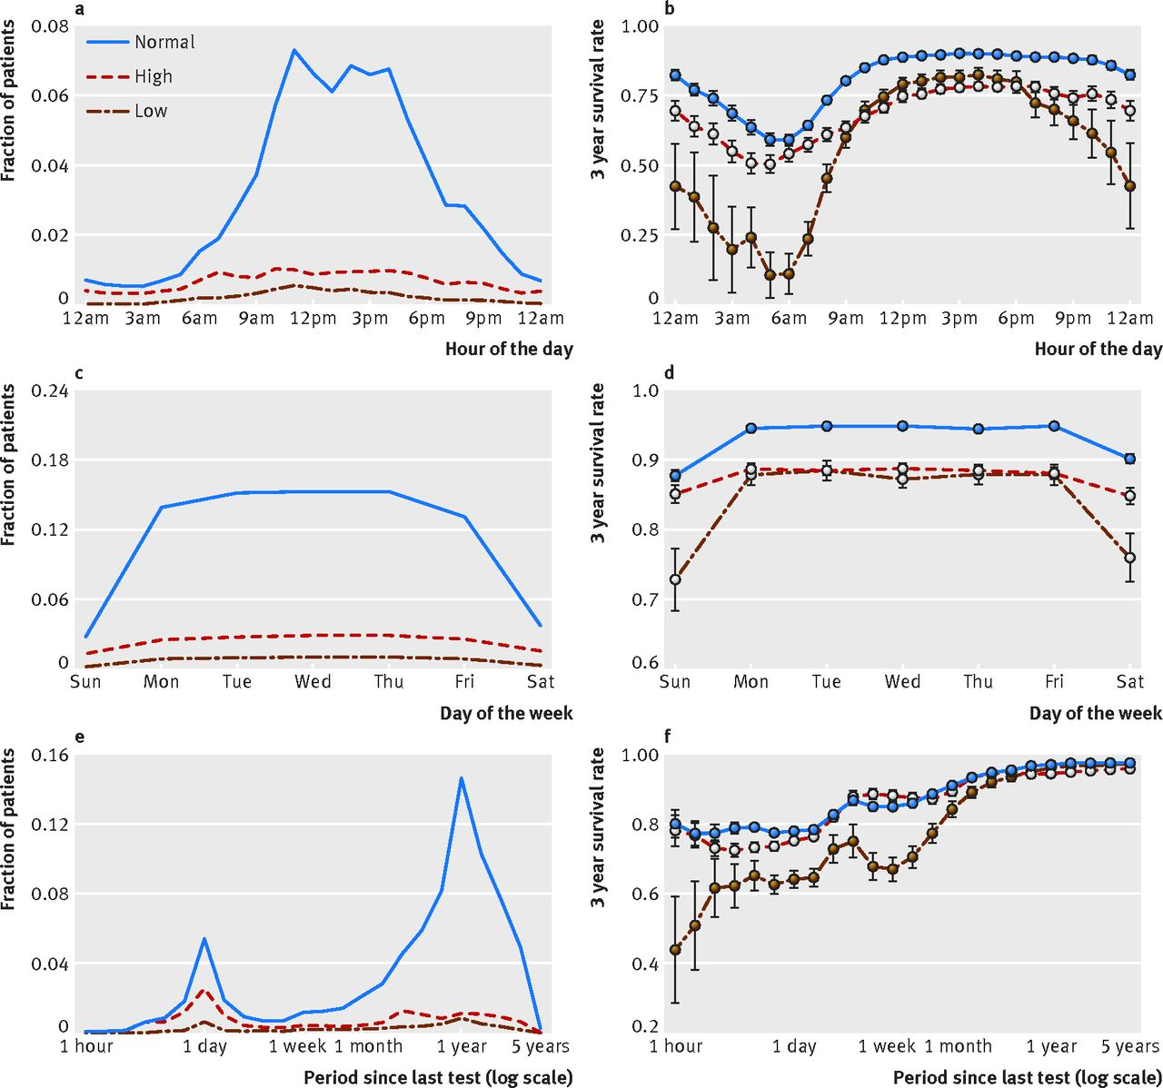
https://www.bmj.com/content/bmj/361/bmj.k1479/F3.large.jpg

Slide 45
Gene annotation bias impedes biomedical research
‘our results provide an evidence of a strong research bias in literature that focuses on well-annotated genes instead of those with the most significant disease relationship in terms of both expression and genetic variation.’
this experimental paradigm has led to a gene-centric disease research bias where hypotheses are confounded by the streetlight effect of looking for “answers where the light is better rather than where the truth is more likely to lie”’
‘the list of unannotated genes is simply ignored because pathway analysis tools cannot map them to any GO terms. Hence, the self-perpetuating cycle of inequality continues.’
Haynes, W.A., Tomczak, A. & Khatri, P. Gene annotation bias impedes biomedical research. Sci Rep 8, 1362 (2018). https://doi.org/10.1038/s41598-018-19333-x

Slide 46
Bias at warp speed: how AI may contribute to the disparities gap in the time of COVID-19
‘Furthermore, a systematic review study of COVID-19 prediction models uncovered that serious shortcomings, particularly in regard to potential biases, are alarmingly widespread. The PROBAST (Prediction model Risk Of Bias ASsessment Tool) study tool rated all 66 screened models at “high” or “unclear” risk of bias. The most frequent problems encountered were:
unrepresentative data samples,
high likelihood of model overfitting, and
imprecise reporting of study populations and intended model use.’
Eliane Röösli, Brian Rice, Tina Hernandez-Boussard
Journal of the American Medical Informatics Association, Volume 28, Issue 1, January 2021, Pages 190–192, https://doi.org/10.1093/jamia/ocaa210

Slide 47
Questions?

Slide 48
Guided exercise
https://jech.bmj.com/content/jech/58/8/635.full.pdf

Slide 49
What type of bias ?
For disease surveillance and registries
  health-care providers are more likely to report a case that results in severe illness and hospitalization than a mild case, even though a person with mild illness might be more likely to transmit infection to others because the person might not be confined at home or in the hospital.
  health-care providers are more likely to report cases when the disease is receiving media attention.

Slide 50
What type of bias ?
For disease surveillance and registries
  health-care providers are more likely to report a case that results in severe illness and hospitalization than a mild case, even though a person with mild illness might be more likely to transmit infection to others because the person might not be confined at home or in the hospital.
  health-care providers are more likely to report cases when the disease is receiving media attention.
Reporting bias

Slide 51
Consequence of the bias ?
For disease surveillance and registries
  health-care providers are more likely to report a case that results in severe illness and hospitalization than a mild case, even though a person with mild illness might be more likely to transmit infection to others because the person might not be confined at home or in the hospital.

Slide 52
Consequence of the bias ?
For disease surveillance and registries
  health-care providers are more likely to report a case that results in severe illness and hospitalization than a mild case, even though a person with mild illness might be more likely to transmit infection to others because the person might not be confined at home or in the hospital.
  inflated estimate of disease severity in such measures as the death-to-case ratio.

Slide 53
Consequence of the bias ?
For disease surveillance and registries
  health-care providers are more likely to report cases when the disease is receiving media attention.

Slide 54
Consequence of the bias ?
For disease surveillance and registries
  health-care providers are more likely to report cases when the disease is receiving media attention.
an underestimate of the baseline incidence of disease after media attention wanes

Slide 55
Which of these constitute bias ?
a systematic deviation of results or inferences from the truth or processes leading to such systematic deviation;
a systematic tendency in the collection, analysis, interpretation, publication, or review of data that can lead to conclusions that are systematically different from the truth.

Slide 56
Which of these constitute bias ?
a systematic deviation of results or inferences from the truth or processes leading to such systematic deviation;
a systematic tendency in the collection, analysis, interpretation, publication, or review of data that can lead to conclusions that are systematically different from the truth.
Both

Slide 57
What highest level type of bias?
systematic difference in the collection of data regarding the participants in a study (e.g., about exposures in a case-control study, or about health outcomes in a cohort study) that leads to an incorrect result (e.g., risk ratio or odds ratio) or inference.

Slide 58
What highest level type of bias?
systematic difference in the collection of data regarding the participants in a study (e.g., about exposures in a case-control study, or about health outcomes in a cohort study) that leads to an incorrect result (e.g., risk ratio or odds ratio) or inference.
Information bias

Slide 59
Danger for which types of bias?
Patient knows he has disease X.
He performs searches online from which he ‘learns’ the variety of symptoms that it may come with and what causes there might be.
By doing so, he comes across a patient recruitment website for a trial involving signs, symptoms and causes for disease X.
He believes he qualifies.

Slide 60
Danger for which types of bias?
Rumination bias
  = recall bias occurring if the presence of some outcome or effect influences the perception of its causes.
  he might confuse signs and symptoms he really has with signs and symptoms described.
Exposure submission bias
  = the presence of some outcome or effect influences the search for exposure to the putative cause.
  he might ascribe an event in his past which is similar to one of the listed causes, as the real cause for his disease.

Slide 61
What type of bias ?
  Cimetidine is indicated by gastric ulcer;
  Gastric ulcer is a risk factor for gastric cancer;
  More patients taking cimetidine showed to have gastric cancer than non-takers.
  →? Cimetidine causes gastric cancer.

Slide 62
What type of bias ?
  Cimetidine is indicated by gastric ulcer;
  Gastric ulcer is a risk factor for gastric cancer;
  More patients taking cimetidine showed to have gastric cancer than non-takers.
  →? Cimetidine causes gastric cancer.
Confounding: an apparent effect is attributed to the exposure of interest, whereas in fact it ought to have been attributed to some other factor.
Confounding by indication: the indication is the confounding factor.

Slide 63
Referral filter bias
‘Healthcare access bias may be due: […] to the healthcare organization if it is organized in increasing levels of complexity and [if] ‘‘difficult’’ cases are referred to tertiary care (referral filter bias)’
Potential source of the bias?

Slide 64
Referral filter bias
‘Healthcare access bias may be due: […] to the healthcare organization if it is organized in increasing levels of complexity and [if] ‘‘difficult’’ cases are referred to tertiary care (referral filter bias)’
Potential source of the bias?
  A patient is subjectively ‘difficult’ if it exceeds the competence/willingness to manage of the referrer, rather than objectively ‘difficult’.

Slide 65
New diagnostic test (NDT)
 | Existing diagnostic criteria
 | None satisfied | Few satisfied | Most satisfied | Fully satisfied
Disease X | 5% | 15% | 50% | 30%
NDT+ | 70% | 80% | 90% | 95%
NDT- | 30% | 20% | 10% | 5%
Not disease X | 50% | 30% | 15% | 5%
NDT+ | 1% | 3% | 5% | 7%
NDT- | 99% | 97% | 95% | 93%
Risk for what type of bias?

Slide 66
Spectrum bias
‘In the assessment of validity of a diagnostic test this bias is produced when researchers included only ‘‘clear’’ or ‘‘definite’’ cases, not representing the whole spectrum of disease presentation, and/or ‘‘clear’’ or healthy controls subjects, not representing the conditions in which a differential diagnosis should be carried out’
Being ‘diagnosed with X’ does not mean ‘you have X’.
Being diagnosed as ‘not having X’ does not mean ‘you don’t have X’.
  → misdiagnosis exists
  Comparing diagnosis with actual disease in a population gives you a probability of true diagnosis.
  A disease of type X can present itself differently in different patients
    Presentation of type A → probability of disease X 90% = ‘relatively clear case’
    Presentation of type B → probability of disease X 55% = ‘quite unclear case’
  The goal is a diagnostic test: one that works only with clear cases misses a lot of the patients with unclear cases.

Slide 67
What is a correct for term for this?
difference in the enrollment of participants in a study that leads to an incorrect result (e.g., risk ratio or odds ratio) or inference.

Slide 68
What is a correct term for this?
difference in the enrollment of participants in a study that leads to an incorrect result (e.g., risk ratio or odds ratio) or inference.
Error

Slide 69
What type(s) of error are involved here?
Purpose of study:
assessing whether blood pressure at time t1 is an indicator for developing some disease at a later time.

Slide 70
What type(s) of error are involved here?
Purpose of study:
assessing whether blood pressure at time t1 is an indicator for developing some disease at a later time.
Answer:
Blood pressure varies from moment to moment, so that every measurement of blood pressure reflects a degree of random variability → random error.
Therefor:
  Subjects who were classified as "high" on their initial measurement will include some who were "high" just by chance.
  Subjects classified as "low" will include some who were "low" just by chance. The resulting error in exposure measurement will muddy the contrast between the group outcomes compared to what would obtain if our "high" group contained only those who were truly "high" and low group contained only those who were truly "low".
Assuming that chance variability is independent of study outcomes, then the result is nondifferential misclassification bias, and the observed association will be weaker than the "true" association.
Thus, random error can produce systematic error, or bias.
VJ. Schoenbach J. Schildkraut, W. Rosamond, Sources of error, 2001. http://www.epidemiolog.net/

Slide 71
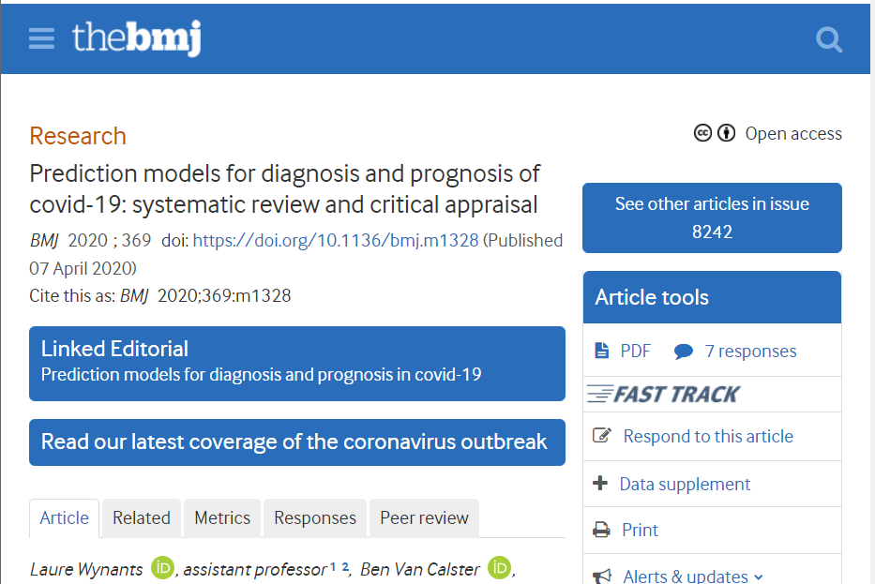
https://www.bmj.com/content/369/bmj.m1328

