Slide 1
Biomedical Informatics II
Ontology and Data Gathering
Lecture in BMS515: Fundamentals of Biomedical Research.
Dec 2, 2020
Room 1225A, JSMBS, University at Buffalo
Werner CEUSTERS, MD
Departments of Biomedical Informatics and Psychiatry,
UB Institute for Healthcare Informatics,
Ontology Research Group, Center of Excellence in Bioinformatics and Life Sciences,
University at Buffalo, NY, USA

Slide 2
Today’s learning outcomes (BMI-II)
Understanding the basic principles of science and research and being able to apply them to discover flaws in published research and prevent flaws in your own (future) research.
Understanding what ontology is and how it relates to science.
Being able to describe the most general ontological distinctions amongst entities and understanding why they matter in science and research.

Slide 3
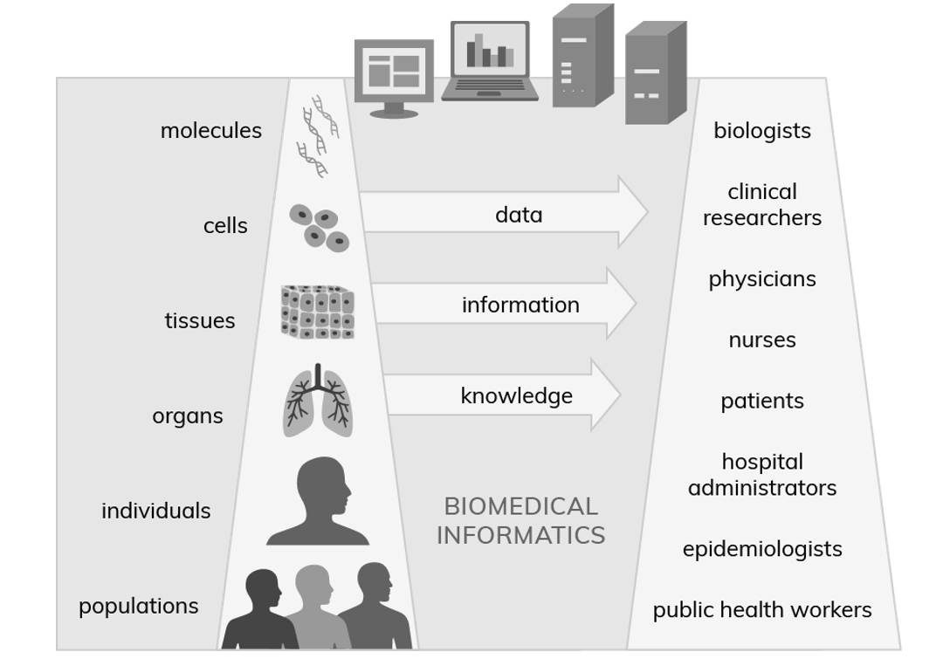

Where do data come from?
Adapted from
https://ibi.uky.edu/static_pages/biomedical_informatics
Adapted from
https://ibi.uky.edu/static_pages/biomedical_informatics

Slide 4



More accurately
4

Slide 5
Representations and what they are about
1st Order Reality
Information
bearers
Representation
5

Slide 6
Also representations are real
Reality
6

Slide 7
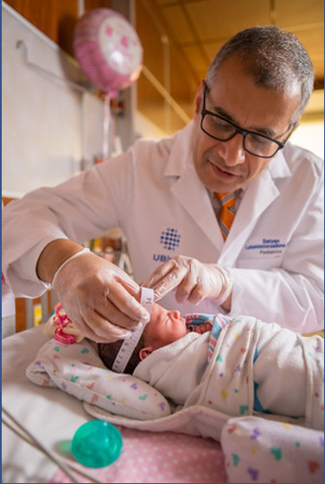
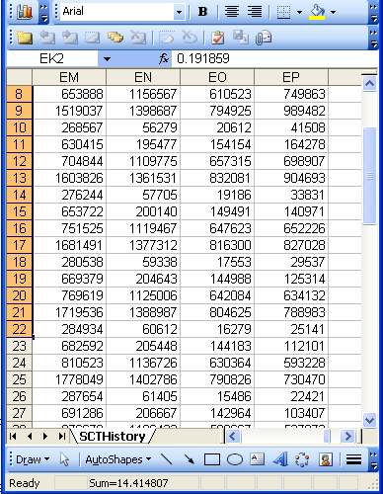
Beings, happenings and representations
(research) domain
(research) data
Ideally
perfectly
equivalent
Beings & happenings
Representations
https://ubphoto.smugmug.com/Years/2017/17011-Medicine-Satyanarayana-Lakshminrusimha-Newborn-MFS/i-Vj8g6p2

Slide 8
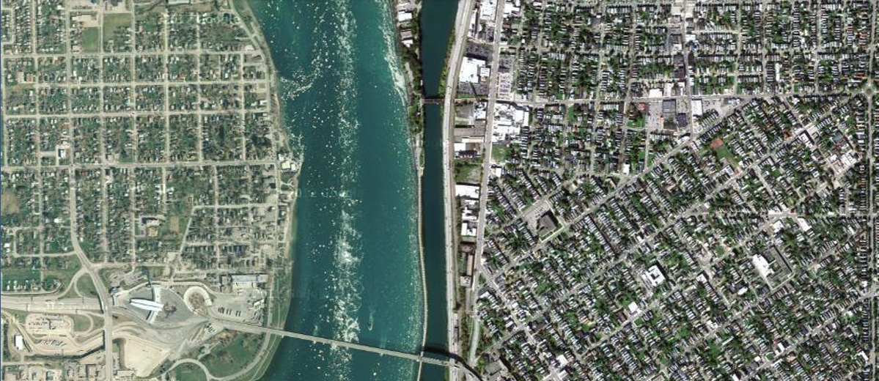
Some structures north of the Peace Bridge
The Peace Bridge
West avenue
First order reality:
What you see when flying over that part of Buffalo NY

Slide 9

Some structures north of the Peace Bridge
The Peace Bridge
West avenue
Second order reality:
The picture you took while flying over that part of Buffalo, NY

Slide 10
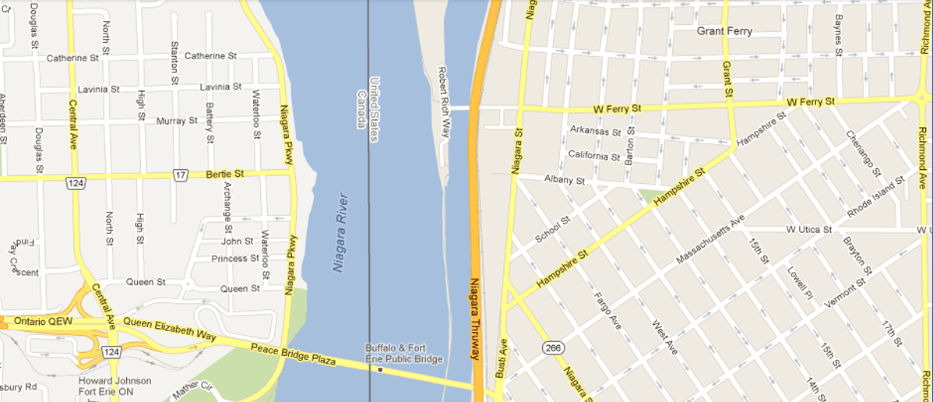
Representation of some of these structures
The Peace Bridge
West avenue
Second order reality:
A map of that area of Buffalo, NY

Slide 11
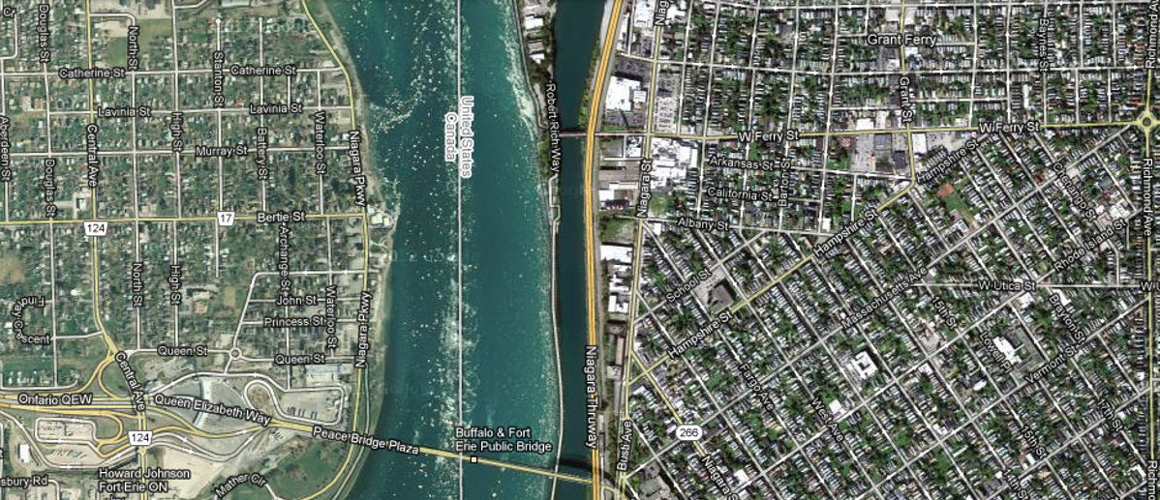
Faithful representation
Perfect correspondence
between first order reality and second order reality

Slide 12
Mismatches between reality and representation
First order reality
undiscovered
discovered
Representation
(2nd-order reality)
‘Fake news’
Scientific misunderstandings
Fantasies
Knowledge

Slide 13
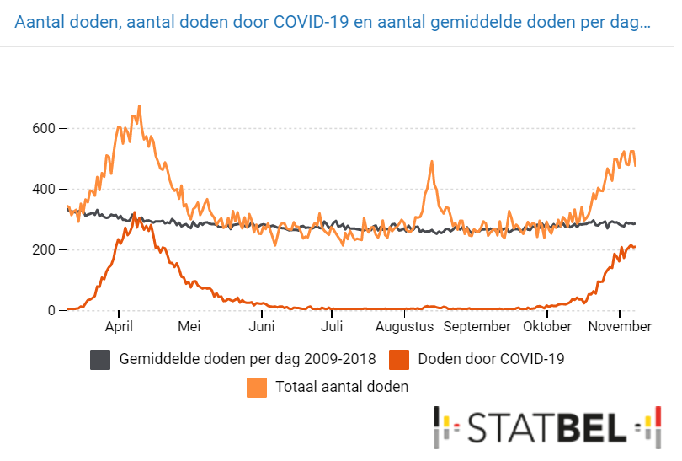
However!!!
A 2nd-order view on covid-19 in Belgium
Average deaths/day 2009-2018
Deaths ‘due to’ Covid-19
Total number of deaths
https://statbel.fgov.be/nl/visuals/mortaliteit
Retrieved: Nov 26, 2020
13

Slide 14
Key questions for any researcher
How can I collect, process and structure my representations (i.e. data, information and knowledge) in such a way so that:
they are faithful representations of reality, and
changes in reality lead to corresponding changes in my representations?
→ Your representations should be like Google maps stand to the reality depicted by the satellite images they are derived from.
What representational machinery (i.e. formalisms, systems, …) intended to contain representations satisfying (1a) and (1b) should I use to allow users thereof acquiring a faithful representation of the changes in reality by merely looking at the changes in the representations ?
  → This machinery should work like Zoom for on-line lectures.

Slide 15
Remember ...
1st Order Reality
Information
bearers
Representation
15

Slide 16
Caution required
1st Order Reality
Information
bearers
Representation
16

Slide 17
Filters and barriers might obfuscate reality
1st Order Reality
Information
bearers
Representation
interpretation
observation
belief
interpretation
Filters &
barriers
17

Slide 18




Discovery and scientific progress
1
2
3
4
5
6
7
8
9
Observable phenomena
Data points
Information
Beliefs
Published beliefs
2. Observability filter
4. Interpretation filter
6. Belief filter
8. Communication filter

Slide 19
Reality and representation
1
2
3
4
5
6
7
8
9
Observable phenomena
Data points
Information
Beliefs
Published beliefs
2. Observability filter
4. Interpretation filter
6. Belief filter
8. Communication filter
= truth?

Slide 20
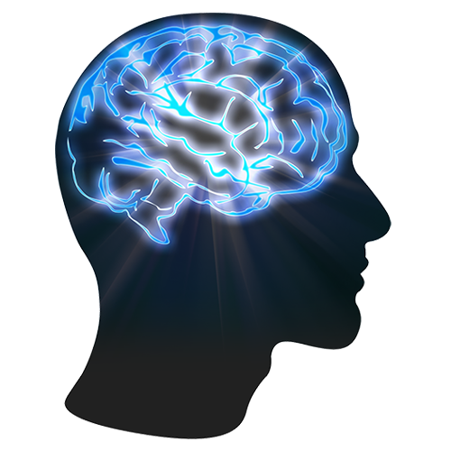
Three relevant disciplines (1)
Data science: ‘an inter-disciplinary field about scientific methods, processes, and systems to extract knowledge or insights from data in various forms, either structured or unstructured, similar to data mining’.
https://en.wikipedia.org/wiki/Data_science

Slide 21

AAAS: Machine learning 'causing science crisis'
Pallab Ghosh Science correspondent, BBC News, Washington 16 February 2019
Machine-learning techniques used by thousands of scientists to analyse data are producing results that are misleading and often completely wrong.
A growing amount of scientific research involves using machine learning software to analyse data that has already been collected.
But, according to Dr Allen, the answers they come up with are likely to be inaccurate or wrong because the software is identifying patterns that exist only in that data set and not the real world.
The “reproducibility crisis” in science refers to the alarming number of research results that are not repeated when another group of scientists tries the same experiment. It can mean that the initial results were wrong. One analysis suggested that up to 85% of all biomedical research carried out in the world is wasted effort.
https://www.bbc.com/news/science-environment-47267081

Slide 22
The problem of data-focused research
Is it?
Faithful representation: perfect correspondence
between representation and what is represented

Slide 23
Three relevant disciplines (2)
Statistics:
‘a branch of mathematics dealing with the collection, analysis, interpretation, presentation, and organization of data’.
https://en.wikipedia.org/wiki/Statistics

Slide 24
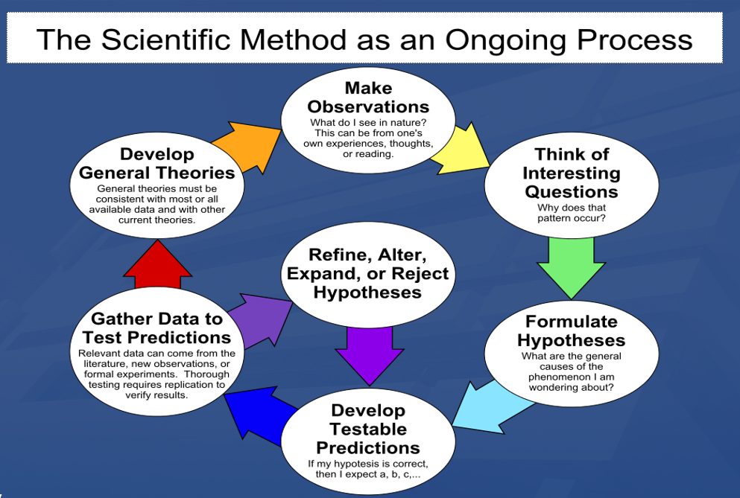
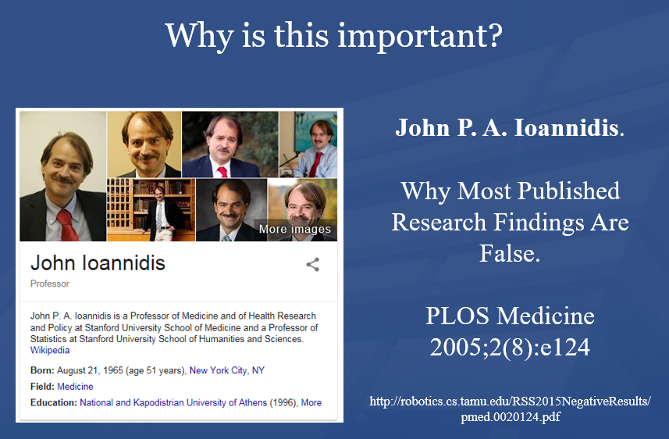
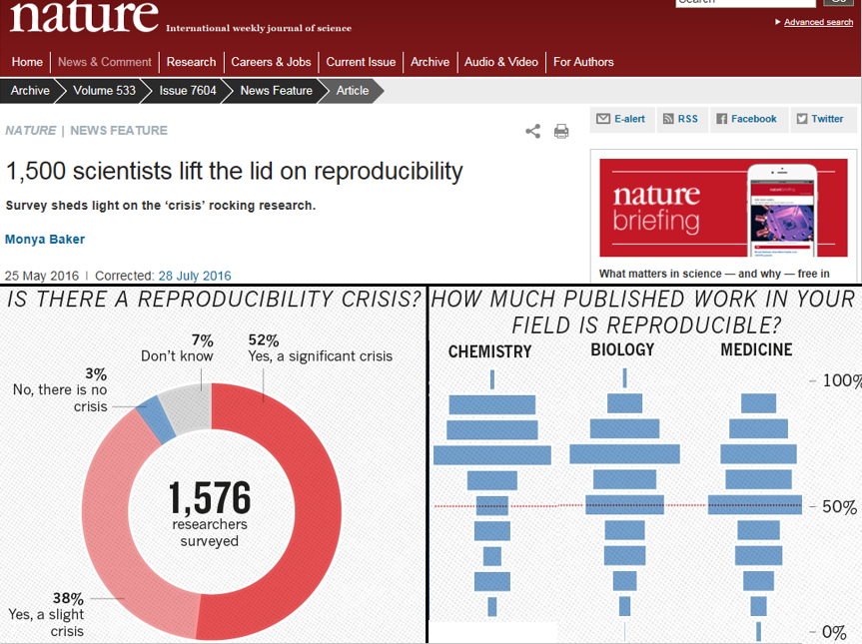
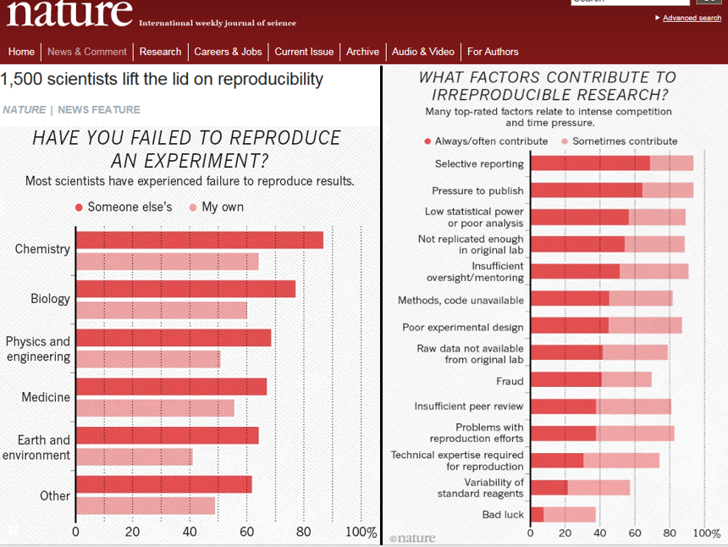
Remember

Slide 25
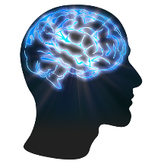
The biggest mistake in science one can make:
1
2
3
4
5
6
7
8
9
2
3
4
5
6
7
8
9

Slide 26

Canonical case: faithful representation
Reality
Representation
‘Earth’
‘Aarde’
‘La Terre’
…
denotes
means
represents

Slide 27
Delusions, fantasies, imaginations, …
Reality
Representation
‘unicorn’

Slide 28
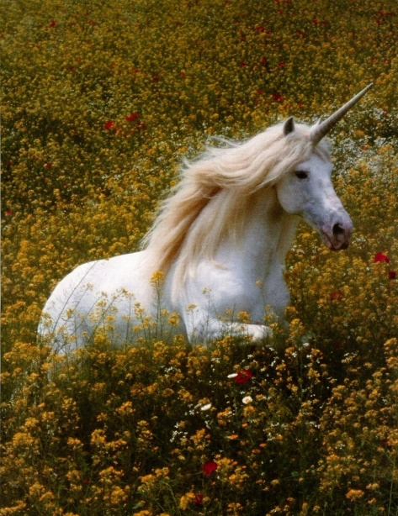
Delusions, fantasies, imaginations, …
Reality
Representation
‘unicorn’

Slide 29

Delusions, fantasies, imaginations, …
Terminology
Reality
Representation
‘unicorn’
Graphics

Slide 30
Delusions, fantasies, imaginations, …
Conceptualism
Terminology
Reality or
Imagination
Representation
‘unicorn’
Graphics
unicorn concept

Slide 31
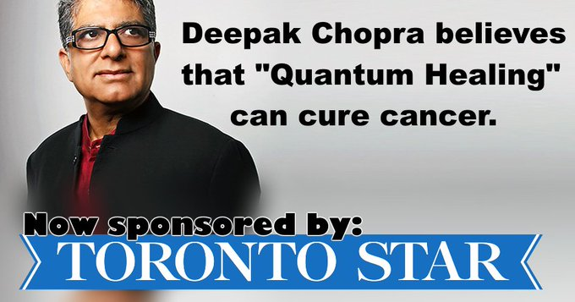
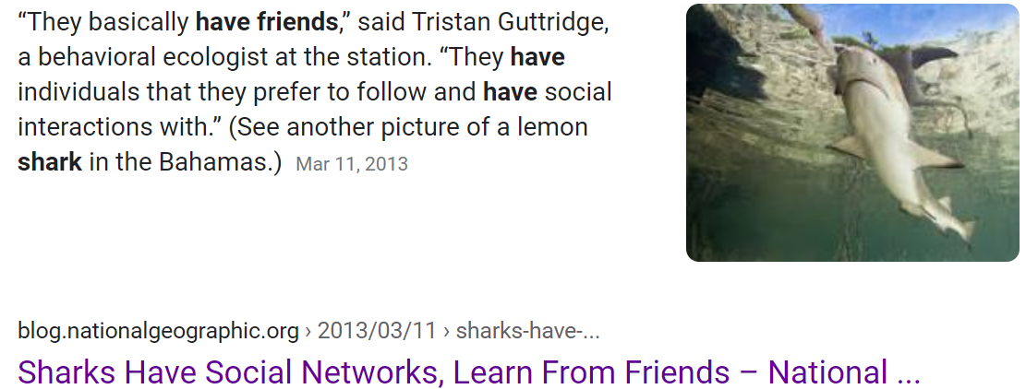
31

Slide 32
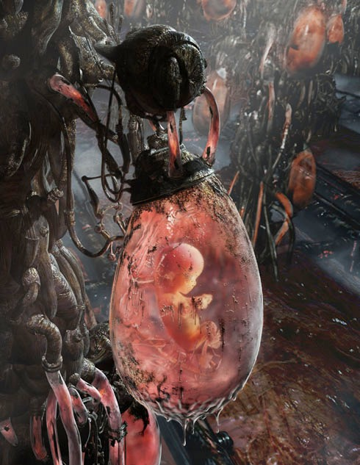

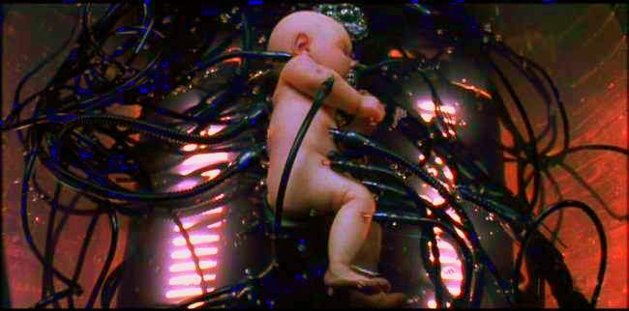
The Matrix

Slide 33
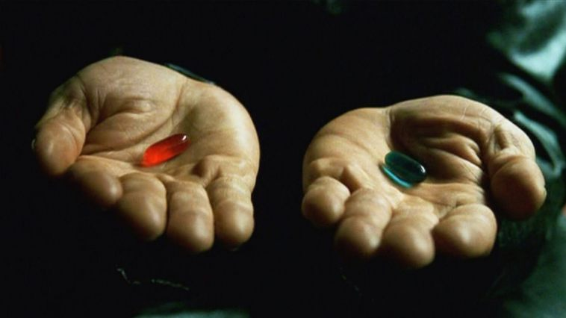
‘Ontology’
Helps scientists to determine and describe what sorts of entities their research is intended to be directed at.

Slide 34
Three relevant disciplines (3)
Ontology:
the study of the most general features of what there is, and how the things there are relate to each other in the metaphysically most general ways
http://plato.stanford.edu/entries/logic-ontology/#DifConOnt

Slide 35
Statistics
Data science
Ontology

Slide 36
‘Ontology’
In philosophy:
  Ontology (no plural) is the study of what entities exist and how they relate to each other;
  by some philosophers taken to be synonymous with ‘metaphysics’ while others draw distinctions in many distinct ways (the distinctions being irrelevant for this talk), but almost agreeing on the following classification:
    metaphysics → studies ‘how is the world?’
      general metaphysics → studies general principles and ‘laws’ about the world
        ontology → studies what type of entities exist in the world
      special metaphysics → focuses on specific principles and entities
  distinct from ‘epistemology’ which is the study of how we can come to know about what exists.
  distinct from ‘terminology’ which is the study of what terms mean and how to name things.

Slide 37
The Terminology / Ontology divide
Terminology:
  solves certain issues related to language use, i.e. with respect to how we talk about entities in reality (if any);
    Relations between terms / ‘concepts’
  does not provide an adequate means to represent independent of use what we talk about, i.e. how reality is structured;
    Women, Fire and Dangerous Things (Lakoff).
Ontology (of the right sort):
  Language and perception neutral view on reality.
    Relations between entities in first-order reality

Slide 38

Realism-based Ontology (RBO)
Referents
  are (meta-) physically the way they are,
  relate to each other in an objective way,
  follow ‘laws of nature’.
Window on reality
  restricted by:
  what is physically and technically observable,
  fit between what is measured and what we think is measured,
  fit between established knowledge and ‘laws of nature’.
References
  follow, ideally, the syntactic-semantic conventions of some representation language,
  are restricted by the expressivity of that language,
  reference collections need to come, for correct interpretation, with documentation outside the representation.

Slide 39
‘Ontology’ denotes ambiguously
In philosophy:
  Ontology (no plural) is the study of what entities exist and how they relate to each other;
In computer science and many biomedical informatics applications:
  An ontology (plural: ontologies) is a shared and agreed upon conceptualization of a domain;
Reality
Representation

Slide 40
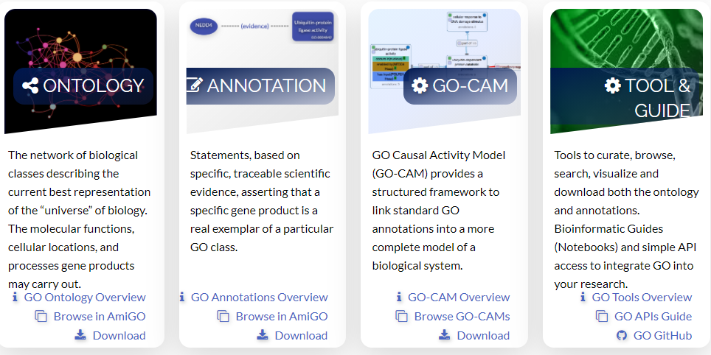
Example: the Gene ‘Ontology’
http://geneontology.org/

Slide 41
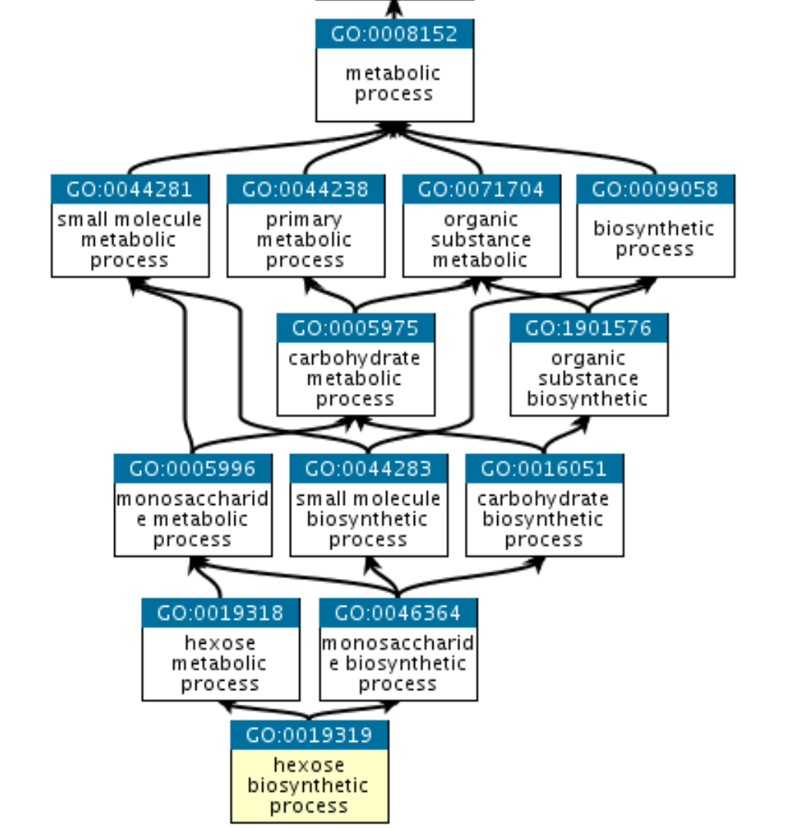
A tiny fragment of the Gene ‘Ontology’ (GO)
http://geneontology.org/

Slide 42
Ontologies and ‘ontologies’
‘ontologies’
Direct
usefulness
for
people
Terminological
systems
Knowledge representation
systems
Realism-based
Ontologies
Direct usefulness for computers
Inspired by: Rector, A.. “Clinical terminology: why is it so hard?” Methods of information in medicine 38 4-5 (1999): 239-52 .

Slide 43
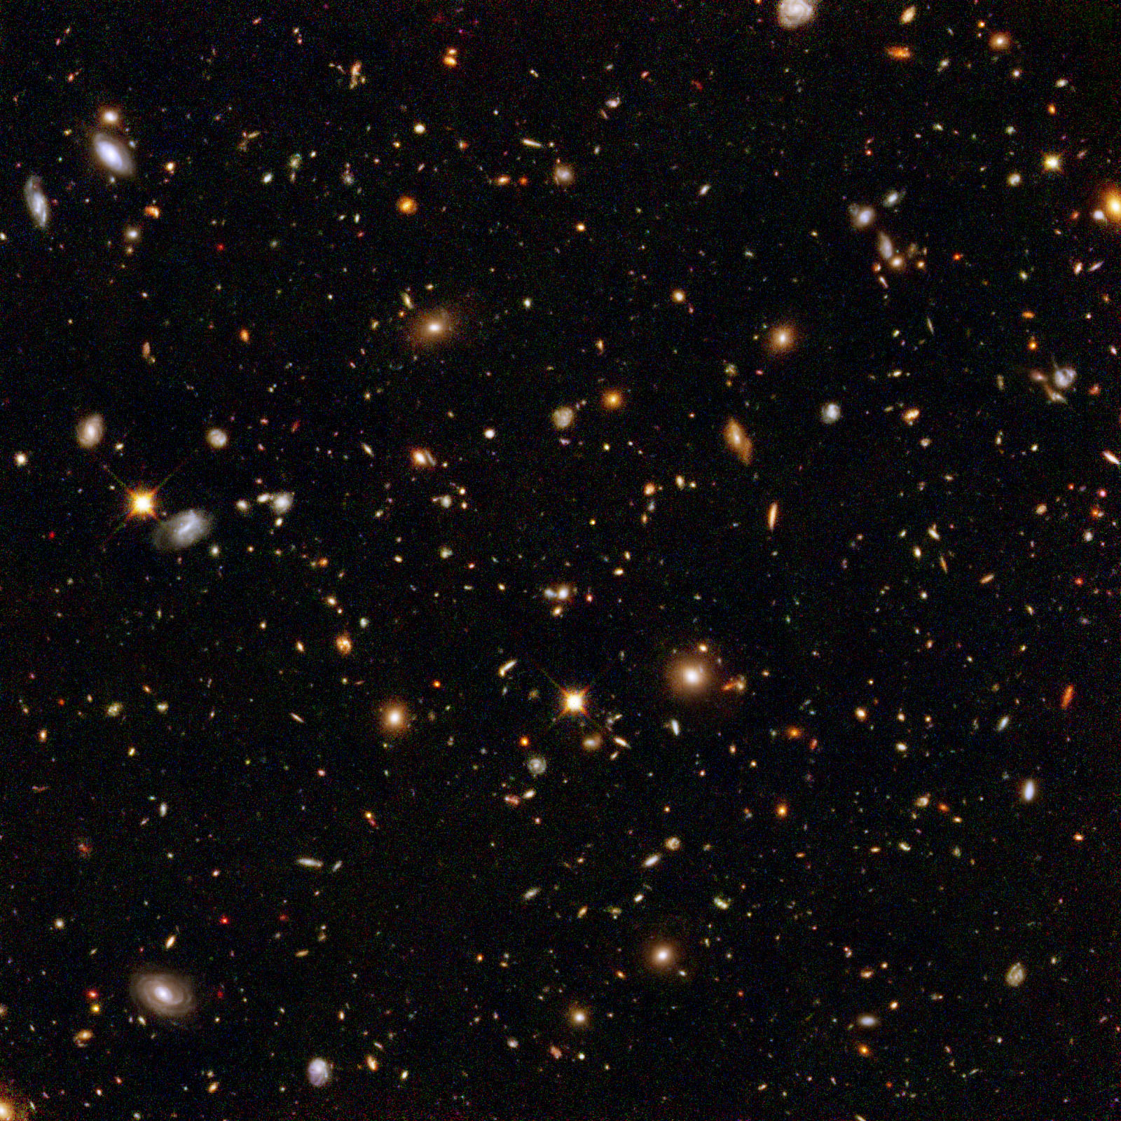
The basis of Ontological Realism (O.R.)
There is an external reality which is ‘objectively’ the way it is;
That reality is accessible to us;
We build in our brains cognitive representations of reality;
We communicate with others about what is there, and what we believe there is there.
Smith B, Kusnierczyk W, Schober D, Ceusters W. Towards a Reference Terminology for Ontology Research and Development in the Biomedical Domain. Proceedings of KR-MED 2006, Biomedical Ontology in Action, November 8, 2006, Baltimore MD, USA

Slide 44

Don’t be afraid of skepticism
Reviewers’ comments on my FOIS 2016 papers
‘Although it is not mentioned explicitly, it gives the impression that the authors assume that there is only one reality and that this reality can be faithfully modelled’;
‘The somewhat naive realism that seems to underly the work, namely, that there is an objective reality out there to be observed and recognized’.

Slide 45
Scientific Objectivity
Science is objective in that, or to the extent that:
its products—theories, laws, experimental results and observations—constitute accurate representations of the external world. The products of science are not tainted by human desires, goals, capabilities or experience.
  product objectivity
the processes and methods that characterize it neither depend on contingent social and ethical values, nor on the individual bias of a scientist
  → process objectivity.
http://plato.stanford.edu/entries/scientific-objectivity

Slide 46
The discipline of ‘Ontology’
Describing reality within a taxonomy of precisely defined entities
Independent Continuant Dependent Continuant
Material Entity Quality
Object Shape
Protein molecule Realizable entity Catalase molecule Disposition
Object Aggregate Function
Protein aggregate To decompose H₂O₂

Slide 47
The discipline of ‘Ontology’
Describing reality within a taxonomy of precisely defined entities
Theoretical ontology → work of ontologists
Independent Continuant Dependent Continuant
Material Entity Quality
Object Shape
Protein molecule Realizable entity Catalase molecule Disposition
Object Aggregate Function
Protein aggregate To decompose H₂O₂
Applied ontology → work of ontologists and domain experts

Slide 48
Without ontologists …
creating terms and definitions quickly runs awry:
  ‘Pain is a sensorial and emotional experience …’
    ‘knee pain’ → emotional experience in your knee?
  ‘13.1.2.4 Painful Trigeminal neuropathy attributed to MS plaque’ comes with the clarification ‘Trigeminal neuropathy induced by MS plaque’;
    The term suggests an opinion on the side of the clinician,
    The description suggests a causal relation on the side of the patient.

Slide 49
The discipline of ‘Ontology’
Describing reality within a taxonomy of precisely defined entities
Theoretical ontology → work of ontologists
Independent Continuant Dependent Continuant
Material Entity Quality
Object Shape
Protein molecule Realizable entity Catalase molecule Disposition
Object Aggregate Function
Protein aggregate To decompose H₂O₂
Applied ontology → work of ontologists and domain experts

Slide 50
Basic Ontological Distinctions

Slide 51
Basic ontological distinctions
Reality

Slide 52
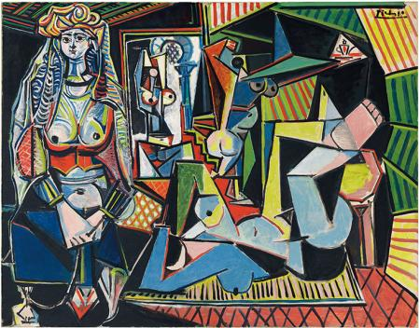

Slide 53
Basic ontological distinctions
Reality
portion of reality

Slide 54
Portions of reality
portions of reality
formal
relations
configurations
relationships
participation
me participating in my life
types
particulars
occurrents
processess
my life
defined classes
today
my friends
universals
continuants
Specifically dependent continuants
Human
Being
independent continuants
qualities
realizables
me
my teacher
role
my shape

Slide 55
The distinctions you should
NEVER FORGET !!!
Crucial distinctions made in Ontological Realism
ontology ←→ ontologies
reality ←→ representation
particulars ←→ types
continuants ←→ occurrents
dependent entities ←→ independent entities

Slide 56
Types ←→ particulars
Particulars
Types
concrete individual entities
(entities that exist in space and time and that exist only once)
counterparts in reality of (some of)
the general terms used in the formulation of scientific theories
Smith B, Ceusters W. Ontological Realism as a Methodology for Coordinated Evolution of Scientific Ontologies. Applied Ontology, 2010;5(3-4):139-188.

Slide 57
Types ←→ particulars
for every universal there is or has been at least one instance
some type
instanceOf …
entities on either site cannot ‘cross’ this boundary
every particular is an instance of at least one universal
some particular

Slide 58



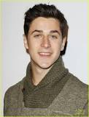
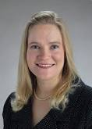
Types ←→ particulars
Human being
instance of at t
particulars

Slide 59
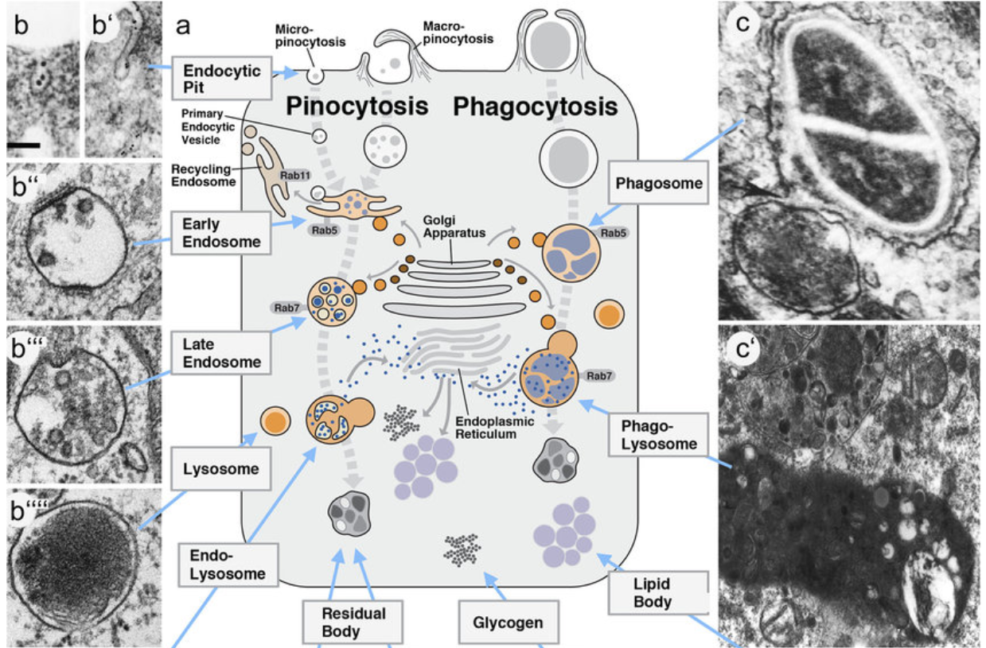
Hartenstein, V., Martinez, P. Phagocytosis in cellular defense and nutrition: a food-centered approach to the evolution of macrophages. Cell Tissue Res 377, 527–547 (2019). https://doi.org/10.1007/s00441-019-03096-6

Slide 60
Particulars are the objects of classification …
isa
Organism
isa
Vertebrate
isa
Mammal
Human being
instance of at t
particulars

Slide 61
Continuants ←→ Occurrents
 | Continuant | Occurrent
Particulars that at any time they exist,
exist
in total
Particulars that at any time they exist,
exist only
partially
Smith B, Ceusters W. Ontological Realism as a Methodology for Coordinated Evolution of Scientific Ontologies. Applied Ontology, 2010;5(3-4):139-188.

Slide 62
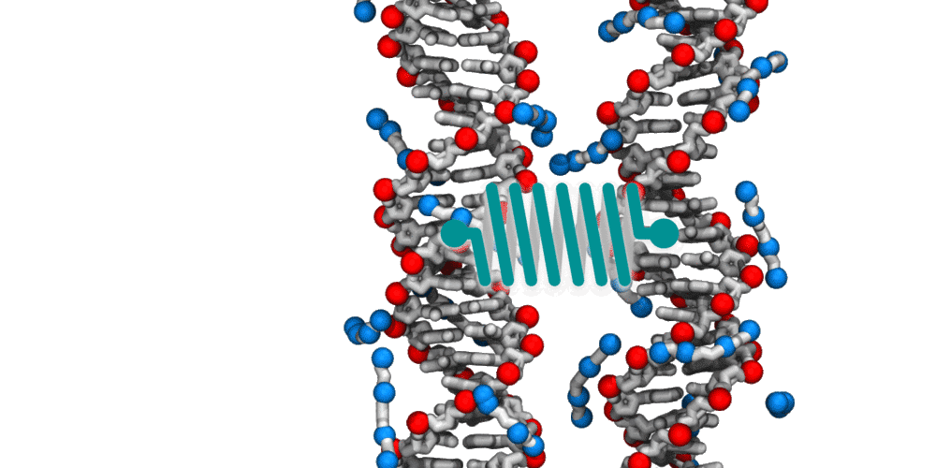
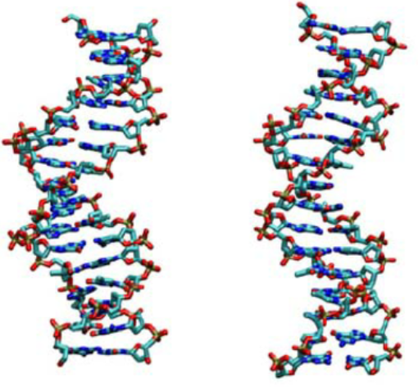
An ontological square
 | Continuant | Occurrent
Types | DNA molecule | DNA interaction
Particulars
https://www.researchgate.net/figure/A-Snapshots-of-undertwisted-left-and-overtwisted-right-dsDNA-and-dsRNA-extracted_fig1_282872571
https://news.illinois.edu/view/6367/341997

Slide 63
An ontological square
 | Continuant | Occurrent
Types | DNA molecule | DNA interaction
Particulars
Instance
of at t
Instance of
https://www.researchgate.net/figure/A-Snapshots-of-undertwisted-left-and-overtwisted-right-dsDNA-and-dsRNA-extracted_fig1_282872571
https://news.illinois.edu/view/6367/341997

Slide 64
The importance of temporal indexing for continuants
benign
tumor
malignant
tumor
stomach
instanceOf at t₂
instanceOf at t₁
instanceOf at t₂
instanceOf at t₁
partOf at t₁
this-4
this-1’s stomach
partOf at t₂

Slide 65
The importance of temporal indexing
benign
tumor
malignant
tumor
stomach
instanceOf at t₂
instanceOf at t₁
instanceOf at t₂
instanceOf at t₁
this-4
partOf at t₁
this-1’s stomach
this-5
partOf at t₂

Slide 66




Continuants preserve identity while changing
human
being
me
me
t
Instance-of
in 1960
child
Instance-of
since 1980
adult
living
creature
animal
caterpillar
butterfly

Slide 67
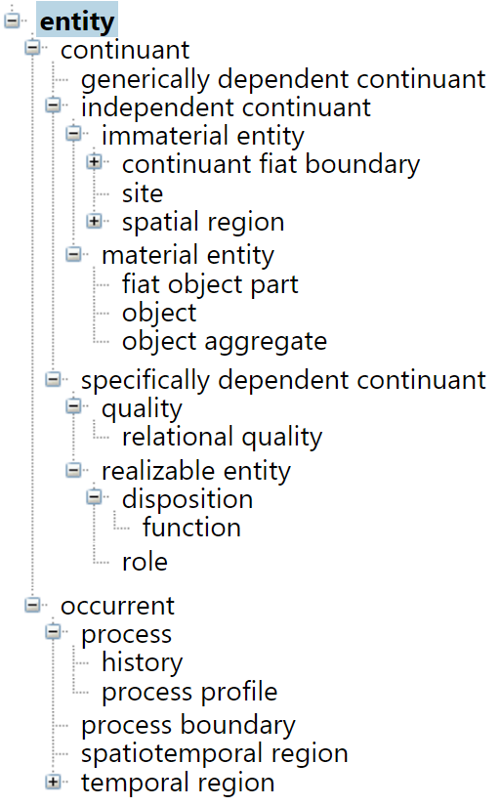
Dependent particulars
←→
Independent particulars
A dependent particular cannot exist without the independent particular upon which it depends.

Slide 68
color
anatomical structure
is_a
is_a
red
eye
Instance-of at t
Instance-of at t
the particular case of redness (of a particular fly eye)
an instance of an eye (in a particular fly)
Depends_on at t

Slide 69
Some relations between PoRs
Particular-level relations
  Your heart (instance-level) continuant_part_of your body at t
  Your heart beating (instance-level) has_participant your heart at t
Particular-type relations
  John’s heart instantiates human heart at t.
  John’s heart beating instantiates human heart beating.
Type-level relations
  human heart continuant_part­_of human body
  human heart beating process has_occurrent_part beat profile

Slide 70
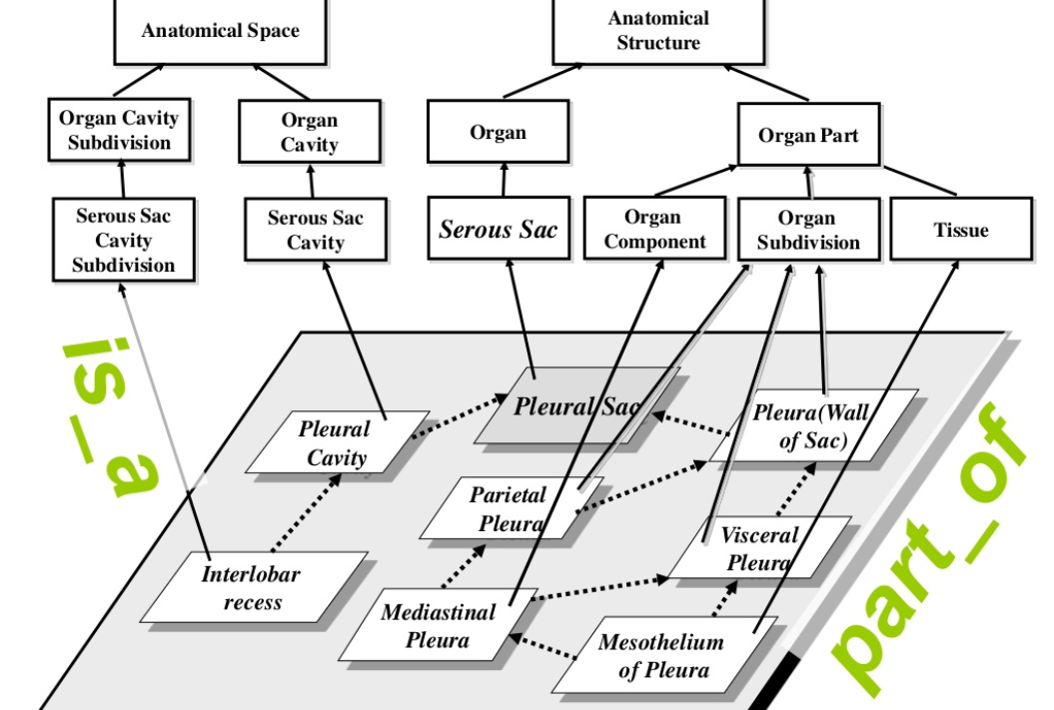
Foundational Model of Anatomy

Slide 71
derives_from
C
c at t
C₁
c₁ at t₁
time
C'
c' at t
ovum
zygote derives_from
sperm

Slide 72
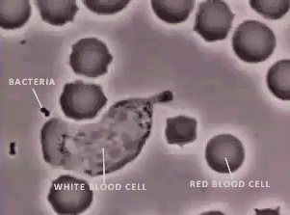
https://embryology.med.unsw.edu.au/embryology/index.php/Movie_-_Neutrophil_chasing_bacteria
David Rogers at Vanderbilt

