Slide 1
Psychiatric Disorders and their (?) classification Lecture in BMS199: New Frontiers in Biomedical Sciences: everyday medicine Oct 12, 2017 Department of Biomedical Informatics, University at Buffalo
Werner CEUSTERS, MD
Ontology Research Group, Center of Excellence in Bioinformatics and Life Sciences,
UB Institute for Healthcare Informatics,
Departments of Biomedical Informatics and Psychiatry,
University at Buffalo, NY, USA

Slide 2
Perspective offered in these Thursday recitations

Slide 3
Biomedical Informatics
Definition:
Biomedical informatics (BMI) is
the interdisciplinary field
that studies and pursues the effective uses of biomedical data, information, and knowledge
for scientific inquiry, problem solving, and decision making,
driven by efforts to improve human health.
CA Kulikowski, EH Shortliffe, LM Currie, PL Elkin, LE Hunter, TR Johnson, IJ Kalet, LA Lenert, MA Musen, JG Ozbolt, JW Smith, PZ Tarczy-Hornoch, JWilliamson; AMIA Board white paper: definition of biomedical informatics and specification of core competencies for graduate education in the discipline, Journal of the American Medical Informatics Association, Volume 19, Issue 6, 1 November 2012, Pages 931–938, https://doi.org/10.1136/amiajnl-2012-001053

Slide 4
Current mainstream informatics thinking
knowledge
information
data

Slide 5
Current mainstream informatics thinking
?
knowledge
information
data

Slide 6
Current mainstream informatics thinking
wisdom
knowledge
information
data

Slide 7
Where do data come from?
knowledge
information
data
Questions not often enough asked:
What part of our data corresponds with something out there in reality ?
What part of reality is not captured by our data, but should because it is relevant ?
Reality
What is there on the side of the patient

Slide 8
Where do data come from?
knowledge
information
data
Questions not often enough asked:
What part of our data corresponds with something out there in reality ?
What part of reality is not captured by our data, but should because it is relevant ?
Ontology
Reality
What is there on the side of the patient

Slide 9
Ontology and classification

Slide 10
‘Ontology’
In philosophy:
Ontology (no plural) is the study of what entities exist and how they relate to each other;

Slide 11
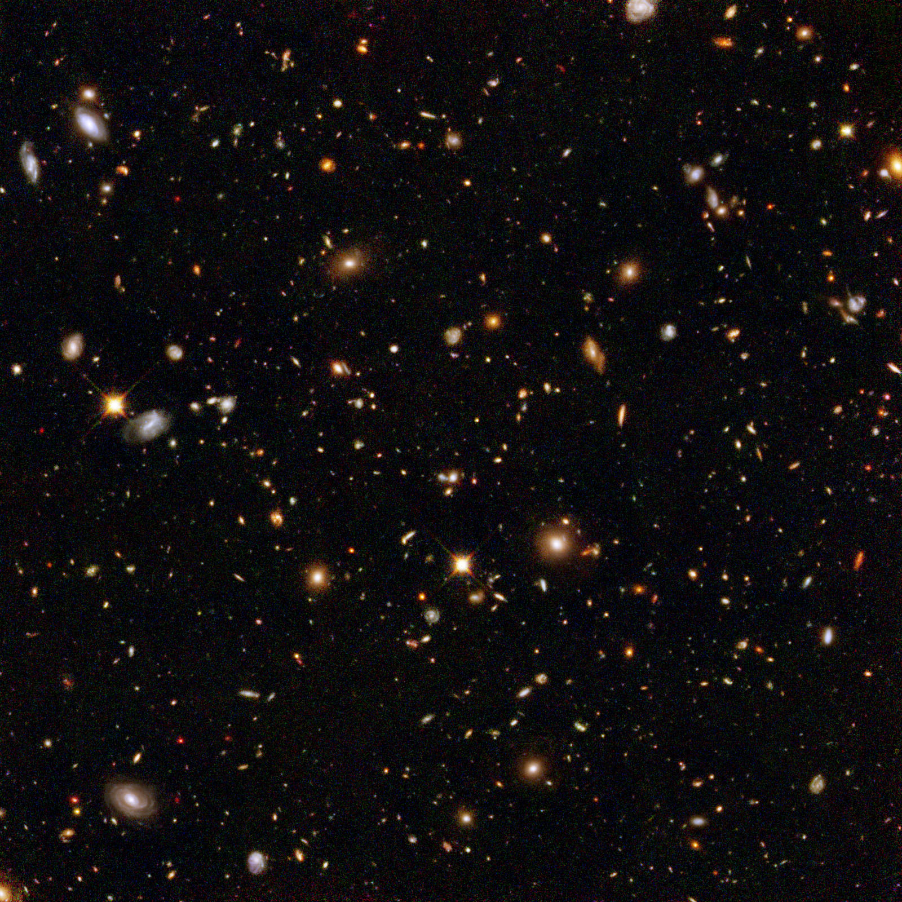
Ontological Realism
There is an external reality which is ‘objectively’ the way it is;
That reality is accessible to us;
We build in our brains cognitive representations of reality;
We communicate with others about what is there, and what we believe there is there.
Smith B, Kusnierczyk W, Schober D, Ceusters W. Towards a Reference Terminology for Ontology Research and Development in the Biomedical Domain. Proceedings of KR-MED 2006, Biomedical Ontology in Action, November 8, 2006, Baltimore MD, USA

Slide 12
Scientific Realism
Our best scientific theories give true or approximately true descriptions of observable and unobservable aspects of a mind-independent world.
http://plato.stanford.edu/entries/scientific-realism/#WhaSciRea

Slide 13
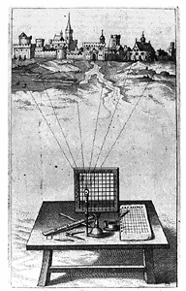
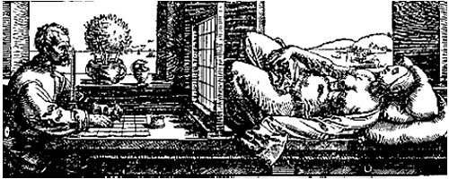
A useful parallel: Alberti’s grid
reality
Ontological
theory
representation

Slide 14
Where it began: classification systems and taxonomies

Slide 15
Adequate taxonomy design and classification
Taxonomy design:
Identify examples of particulars (‘individuals’, ‘things’, ‘entities’, …) you want to classify;
Identify the various characteristics that are possessed by (all or some of) these individual entities;
Identify groups (classes) on the basis of combinations of characteristics that co-occur;
Organize the groups hierarchically (‘parent-child’) so that characteristics that apply to a ‘parent’ (‘grandparent’,…) group apply to ALL groups beneath it;
Name the groups with terms that have face value.
Classification:
Assign individual entities to the groups that correspond with the combination of characteristics they exhibit.

Slide 16
A large collection of individual entities
https://clipartfest.com/download/c2bd0a0071663cef17ac2126d73bf9350a9d15e2.html

Slide 17
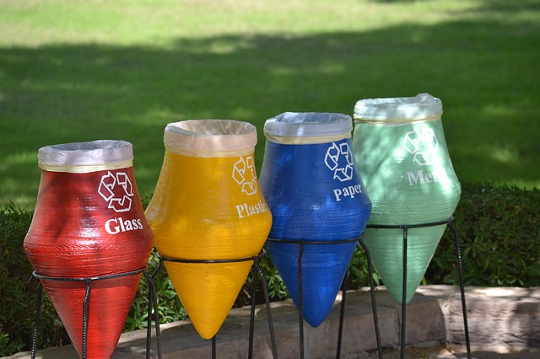
Groups based on material composition

Slide 18
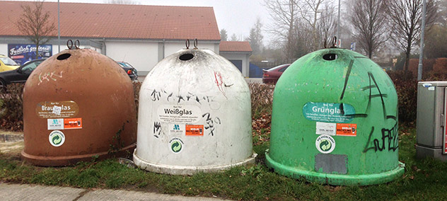
Groups for glass divided by color

Slide 21
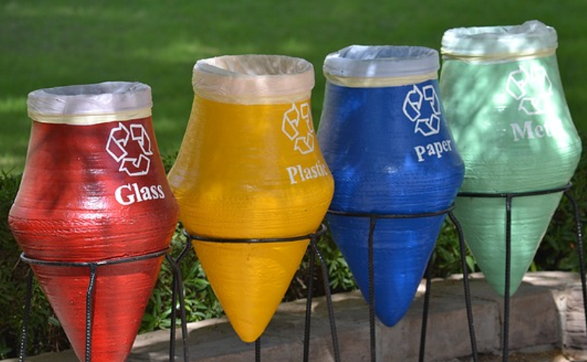

Slide 23
Linnaeus: classification of animals
http://www.robinsonlibrary.com/science/natural/biography/graphics/linnaeus2.jpg
http://s3.amazonaws.com/engrade-myfiles/4042767483300984/kingdom_taxonomy.png

Slide 24
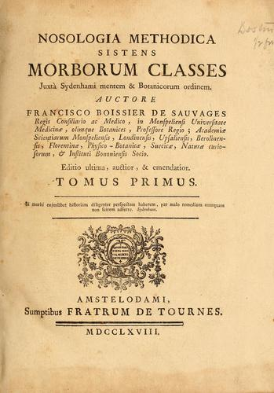
François Boissier de Sauvages de Lacroix
Public Domain, https://commons.wikimedia.org/w/index.php?curid=338615

Slide 25
Nosologia Methodica sistens Morborum Classes
Disease class 1
Disease class 2
…
Disease
order 1.1
Disease
order 1.2
Disease
order 2.1
Disease
order 2.2
…
…
Disease
genus 1.1.1
Disease
genus 1.1.2
Disease
genus 2.1.1
Disease
genus 2.1.2
…
…
Disease
species 1.1.1.1
Disease
species 1.1.1.2
Disease
species 2.1.1.1
…
…

Slide 26
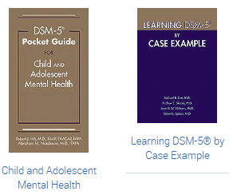
‘Essential Guides to DSM-5’
https://www.appi.org/products/dsm-manual-of-mental-disorders

Slide 28
Differing views on what are mental disorders

Slide 29
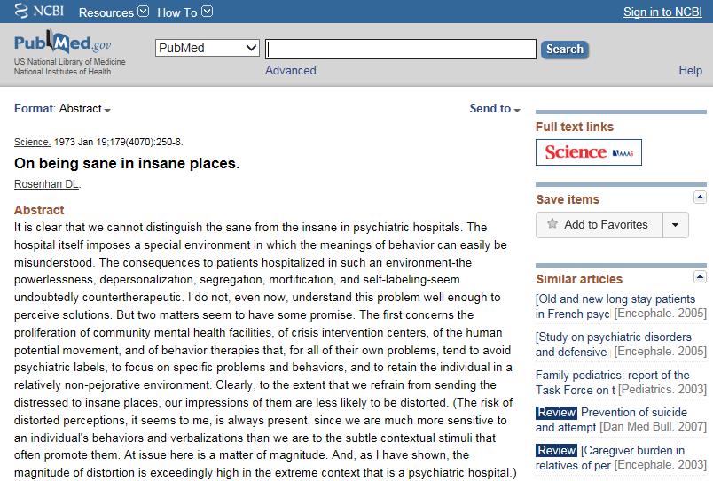

Slide 30
Some argue: mental disorders do not exist
Their answer:
‘there are no biological abnormalities responsible for so-called mental illness, mental disease, or mental disorder, therefore mental illness has no biological existence.
Perhaps more importantly, however, mental illness also has no non-biological existence,
except in the sense that the term is used to indicate disapproval of some aspect of a person's mentality.’
Lawrence Stevens, J.D, 1999
The Antipsychiatry Coalition

Slide 31
The “Myth of Mental Illness”
Szasz: ‘mental illness is a myth whose function it is to disguise and thus render more palatable the bitter pill of moral conflicts in human relations’
Szasz TS: The Myth of Mental Illness. American Psychologist 1960, 15:113-118.

Slide 32
‘Mental Disorders Are Not Diseases’
“I maintain
that the mind is not the brain,
that mental functions are not reducible to brain functions, and
that mental diseases are not brain diseases,
indeed, that mental diseases are not diseases at all.
When I assert the latter, I do not imply that distressing personal experiences and deviant behaviors do not exist. Anxiety, depression, and conflict do exist--in fact, are intrinsic to the human condition--but they are not diseases in the pathological sense.”
Thomas S. Szasz (MD), Mental Disorders Are Not Diseases.
USA Today (Magazine) January 2000

Slide 33
Differing views on mental disorder
The social-constructivist position:
mental disorder is a value-laden social construct with no counterpart in biomedical reality.
The objectivist position:
mental disorders are natural entities that could be understood in biological terms.
The hybrid position:
Mental disorder is harmful dysfunction.
the social definition of "harm" is counterbalanced by a factual component of a malfunctioning internal mechanism causing objective dysfunction.
Jablensky A: Does psychiatry need an overarching concept of "mental disorder"? World Psychiatry 2007, 6:157-158.

Slide 34
The ‘categorical – dimensional’ debate on the classification of mental disorders
Rough distinction:
“Categorical”: ‘mental disorders’ can be classified as single, discrete and mutually exclusive types, of which a particular patient does or does not exhibit an instance.
“Dimensional”: any particular ‘mental disorder’ in a patient is an instance of just one single type and differences between cases are a matter of ‘scale’.
‘Rough’, because
the literature is huge and vague
descriptions are (philosophically) very incoherent

Slide 35
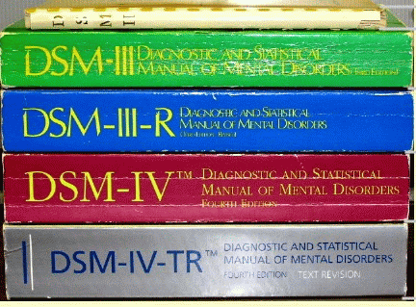
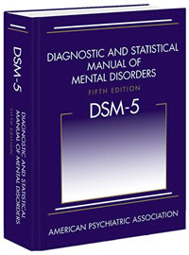
The categorical view
Recognizes various mental disorder types;
Accepts that disorders are manifested through signs and symptoms, either ‘marker’ or ‘constitutional’;
Provides diagnostic criteria to guide the clinician in making a diagnosis.

Slide 36
DSM under fire (1)
severely ill inpatients often meet criteria for more than one DSM-IV personality disorder
→ suggests a high rate of co-morbidity, however in absence of any medical or etiologic reason for such a situation
many outpatients do not meet the criteria for any of the specific categories identified in DSM-IV;
patients with the same categorical diagnosis often vary substantially with respect to which diagnostic criteria were used to make the diagnosis, so that two patients with the same diagnosis can manifest very different signs and symptoms;

Slide 37
DSM under fire (2)
frequent revision of the diagnostic thresholds separating what is normal from what is disordered
→ it is as if given disorders would appear and disappear in course of time;
a number of the diagnostic categories mentioned in DSM-IV lack any developing scientific base for an understanding of the corresponding disorder types

Slide 38
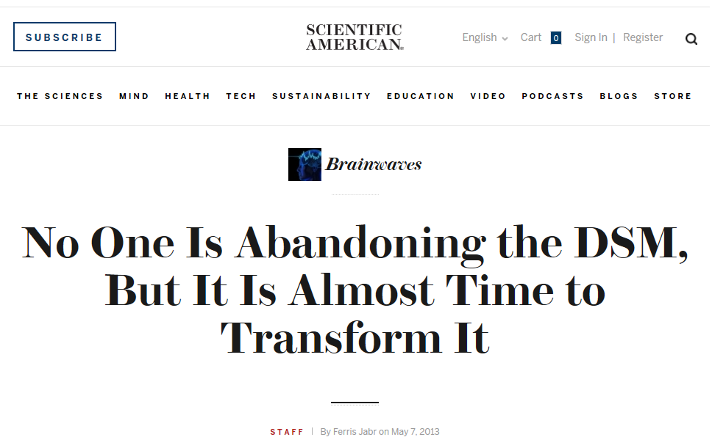

Slide 39
Research Domain Criteria RDoC

Slide 40
Most recent evolution

Slide 41
Research Domain Criteria (RDoC)
2008 NIMH Strategic Plan:
‘objectives include redefining mental disorders into observable and measurable components that are more closely aligned with the biology of the brain; fostering broad sharing of data and resources [supporting] researchers in ways that inspire creativity and innovation’.
Explicitly based on premise that mental disorder are disorders of brain circuits.
“The tools of clinical neuroscience [...] can be used to identify dysfunction in neural circuits” (Morris & Cuthbert 2012).
Goal to support translational neuroscience in mental health research.

Slide 42
Motivations for RDoC
Failure of DSM-ICD, a categorical approach, to offer insight into underlying etiology and causal mechanisms common to all instances of same diagnosis;
Inability to predict effective treatments;
Lack of universal biomarkers for DSM-ICD categories;
Heterogeneity of DSM-ICD populations;
E.g., in 2011 two major pharmaceutical companies stopped research into psychiatric drugs (Cowen 2011).

Slide 43
RDoC’s ‘matrix’
Domain | ————— Units of Analysis —————
 | Genes | Molecules | Cells | Circuits | Physiology | Behavior | Self-Reports | (Paradigms)
Negative Valence Systems Positive Valence Systems Cognitive Systems Working Memory Systems for Social Processes Arousal and Regulatory Systems
Expandable in:
number of domains and units of analysis,
Subtyping of domains and units of analysis.
Interestingly: no mention of mental disorders at all!
http://www.nimh.nih.gov/research-priorities/rdoc/nimh-research-domain-criteria-rdoc.shtml

Slide 45
Cognitive Systems > Auditory Perception
Genes: BDNF
Molecules: Acetylcholine, GABA, Glutamate, NMDA, Serotonin
Cells: Cochlear hair cells, Cortical and limbic inhibitory interneurons, Ribbon synapses
Circuits:
Nodes in Circuits: A1, Anterior insula, Brainstem, Cochlea, Inferior colliculus, MGN, STG
Circuits: Corticofugal Dorsal/ventral streams
Physiology: Adaptation/ habituation, Auditory steady-state response (ASSR), fMRI, Intracortical EEG, Metabolic changes, Mismatch negativity (MMN), N1, Neural oscillations, P3a, P50, startle and PPI
Behavior: Perceptual identification, Perceptual learning, Perceptual priming, Spatial localization, Stimulus detection
Self-Report: Auditory hallucinations, Hyperacusis
Paradigms: Action-Perception loops, Auditory masking, auditory scene perception (e.g., streaming), Categorization, Cross-modal interactions, …

Slide 46
Cognitive Systems > Auditory Perception
Genes: BDNF
Molecules: Acetylcholine, GABA, Glutamate, NMDA, Serotonin
Cells: Cochlear hair cells, Cortical and limbic inhibitory interneurons, Ribbon synapses
Circuits:
Nodes in Circuits: A1, Anterior insula, Brainstem, Cochlea, Inferior colliculus, MGN, STG
Circuits: Corticofugal Dorsal/ventral streams
Physiology: Adaptation/ habituation, Auditory steady-state response (ASSR), fMRI, Intracortical EEG, Metabolic changes, Mismatch negativity (MMN), N1, Neural oscillations, P3a, P50, startle and PPI
Behavior: Perceptual identification, Perceptual learning, Perceptual priming, Spatial localization, Stimulus detection
Self-Report: Auditory hallucinations, Hyperacusis
Paradigms: Action-Perception loops, Auditory masking, auditory scene perception (e.g., streaming), Categorization, Cross-modal interactions, …

Slide 47
Brain Derived Neurotrophic Factor (BDNF)

Slide 48
Acetylcholine

Slide 49
Cross-modal interactions

