Slide 1
BMI708 – Spring 2021 Advanced Topics in Biomedical Ontology (class number 24641) Class 8 – Oct 20, 2021 SNOMED CT and the principles of the Information Artifact Ontology.
Werner CEUSTERS^{1,2}
¹ Department of Biomedical Informatics, University at Buffalo, USA
² Department of Psychiatry, University at Buffalo, USA

Slide 2
Issues with last week’s topics?

Slide 3
Issues with any of the required readings?
R7. Fumiaki Toyoshima, Adrien Barton, Olivier Grenier.
Foundations for an Ontology of Belief, Desire and Intention. 11th International Conference on Formal Ontology in Information Systems (FOIS 2020), Sep 2021, Bolzano, Italy. pp.140-154, ff10.3233/faia200667ff. ffhal-03041527f. https://hal.archives-ouvertes.fr/hal-03041527/document
R8. Smith B, Ceusters W.
Aboutness: Towards Foundations for the Information Artifact Ontology.
International Conference on Biomedical Ontologies, ICBO 2015, Lisbon, Portugal, July 27-30, 2015;47-51
http://ceur-ws.org/Vol-1515/regular10.pdf

Slide 4
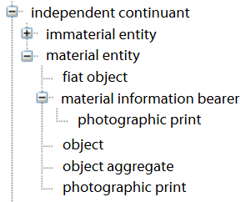
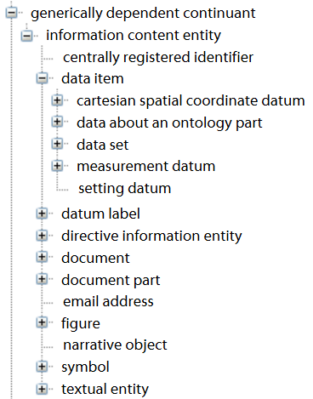
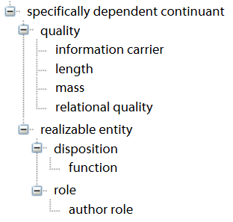
Information Artifact Ontology (Release 2015-02-23 on BioPortal)
core entities

Slide 5
OBI: Ontology for Biomedical Investigations
objective
specification
(ICEs)
specimen
collection
objective
material
transformation
objective
data
transformation
objective
assay
objective
specimen
collecting
material
processing
data
processing
drawing a
conclusion
based on data
processes
assay
inputs &
outputs
material
entity
processed
specimen
information
content entity
specimen
data item
data item
Core terms

Slide 6
Original ICE definition
Formerly:
INFORMATION CONTENT ENTITY =def.
an ENTITY which
is (1) GENERICALLY DEPENDENT
on (2) some MATERIAL ENTITY and which
(3) stands in a relation of ABOUTNESS to some ENTITY.

Slide 7
Generic dependence in BFO2020 (1)
generically-depends-on:
is time indexed,
has domain: generically-dependent-continuant, and
has range: independent-continuant but not spatial-region"
(forall (a b t)
(if (generically-depends-on a b t)
(and (instance-of a generically-dependent-continuant t)
(and (instance-of b independent-continuant t)
(not (instance-of b spatial-region t)))
(instance-of t temporal-region t))
)))

Slide 8
Generic dependence in BFO2020 (2)
b g-depends on c at t means:
b is a generically dependent continuant (GDC)
c is an independent continuant (IC)
there inheres in c at t a specifically dependent continuant s which concretizes b at t
(forall (b c t)
(if (generically-depends-on b c t)
(exists (s tp)
(and (temporal-part-of tp t)
(inheres-in s c)
(concretizes s b tp))))))

Slide 9
Generically dependent continuant
A generically dependent continuant is at all times at which it exists concretized by something.
(forall (t g)
(if (instance-of g generically-dependent-continuant t) (exists (s tp)
(and (temporal-part-of tp t)
(concretizes s g tp))))))

Slide 10
GDCs require SDCs
Generically
dependent
continuant
Instance of at
BMI708-2021
syllabus
concretizes at
Instance of at
BMI708-2021
syllabus copy 1
Specifically
dependent
continuant
concretizes at
Instance of at
BMI708-2021
syllabus copy 2
Independent
Continuant
Instance of at
inheres in at
inheres in at
g-depends-on at
Instance of at
g-depends-on at

Slide 11
Concretization (1)
concretizes is time indexed and
has domain: specifically-dependent-continuant or process,
and range: generically-dependent-continuant.
(forall (a b t)
(if (concretizes a b t)
(and (or (instance-of a SDC t)
(instance-of a process t))
(instance-of b GDC t)
(instance-of t temporal-region t)))))

Slide 12
Concretization (2)
If a specifically-dependent-continuant concretizes a gdc then the gdc generically-depends-on the bearer of the sdc.
(forall (g b sdc)
(if (and (exists (t) (instance-of g GDC t))
(exists (t) (instance-of sdc SDC t))
(exists (t) (instance-of b IC t)))
(forall (t)
(if (and (concretizes sdc g t)
(inheres-in sdc b))
(generically-depends-on g b t))))))

Slide 13
Concretization (3a)
If a GDC participates in a process p then,
if it is concretized as a process, that process is part of p, and,
if concretized as an SDC, then the bearer of that sdc participates in the process.

Slide 14
Concretization (3b)
(forall (gdc p t)
(if (and (instance-of gdc generically-dependent-continuant t) (participates-in gdc p t))
(exists (tp b)
(and (temporal-part-of tp t)
(concretizes b gdc tp)
(or (and (instance-of b specifically-dependent-continuant tp) (exists (ic)
(and (specifically-depends-on b ic)
(participates-in ic p tp))))
(and (occurrent-part-of b p)
(exists-at b tp))))))))

Slide 15
Qualities that concretize ICE are Information Quality Entities
information quality entity (iqe) =def.
a quality that is the concretization of some information content entity (ice)
(Smith, B., Malyuta, T., Rudnicki, R., et al. (2013). Iao-intel: An ontology of information artifacts in the intelligence domain. Paper presented at the STIDS.)
Examples:
this DNA sequence is concretized in this specific ordering (pattern) of nucleotides in this molecule;
this sentence is concretized in this pattern of ink marks on this piece of paper (or also in this pattern of neuronal connections in this brain)
IQEs are called ‘information carriers’ in the IAO.

Slide 16
Questions left unanswered in the IAO though partially addressed elsewhere.
What is aboutness?
Are the ICEs concretized in a textbook of medicine in the same way about something as the ICEs concretized in a James Bond novel?
How does aboutness compare to reference and denotation?
What are representations?
What is information?
Is the very sentence on this slide of this PP presentation ‘Obama is President of the US’ information ?
Will this sentence be information when this PP is viewed in 2017?
…

Slide 17
Proposal to address these questions
information content entity =def.
an entity which is
(1) generically dependent on
(2) some material entity and which
(3) is_about some portion of reality.
where
x is_about y means:
x refers to or is cognitively directed towards y.
Domain: representations;
Range: portions of reality.
Axiom: if x is_about y then y exists (veridicality).

Slide 18
Enlarging the range of aboutness to portions of reality ¹
Thus including:
universals, for instance in the ICE concretized by the string there are no instances of dinosaur which survive,
relations, for instance in the ICE concretized by the string the part-whole relation is transitive,
other ICEs, for instance when someone asserts that what someone else just stated is false, and
configurations, for instance in the ICE concretized by Barack Obama is the current President of the USA.
¹ Ceusters W. An Information Artifact Ontology Perspective on Data Collections and Associated Representational Artifacts. Medical Informatics Europe Conference (MIE 2012), Pisa, Italy, August 26-29, 2012,
Stud Health Technol Inform 2012;180:68-72

Slide 19
Portions of Reality (PoRs)
Configurations
PoRs
U1
p1
U2
p2
U3
p3
Universals
Entities
Relations

Slide 20
Cognitive directedness
Information artifacts do not bear information in and of themselves, but only because cognitive subjects associate representations of certain sorts with the patterns which they manifest.
the doctrine of the ‘primacy of the intentional’
Chisholm, R. M. (1984). The primacy of the intentional. Synthese, 61(1), 89-109. doi: Doi 10.1007/Bf00485490
Information = grounded representation
the entry 72 beats per minute is about what it is about because of what the nurse himself directly observed when he measured the patient’s pulse.
Mis-information = ungrounded representation
Le Verrier wrote ‘about’ ‘Vulcan’. This intended reference depended on a certain – false - belief on Le Verrier’s part in the existence of an intra-Mercurial planet.
Mis-information is not a special kind of information!

Slide 21
Representations
Representation: an idea, image, record, or description which refers to (is of or about), or is intended to refer to, some entity or entities external to the representation.
Smith, B., Kusnierczyk, W., Schober, D., & Ceusters, W. (2006). Towards a reference terminology for ontology research and development in the biomedical domain Kr-med 2006, biomedical ontology in action. Baltimore MD, USA
Formal definitions:
representation =def. a quality which is_about or is intended to be about a portion of reality (por).
mental quality =def. a quality which specifically depends on an anatomical structure in the cognitive system of an organism.
cognitive representation =def. a representation which is a mental quality.
Ceusters, W., & Smith, B. (2010). Foundations for a realist ontology of mental disease. Journal of Biomedical Semantics, 1(10), 1-23. doi: 10.1186/2041-1480-1-10

Slide 22
Representational unit
Informal definition:
the smallest constituent sub-representations, including icons, names, simple word forms, or the sorts of alphanumeric identifiers we might find in patient records.
Smith, B., Kusnierczyk, W., Schober, D., & Ceusters, W. (2006). Towards a reference terminology for ontology research and development in the biomedical domain Kr-med 2006, biomedical ontology in action. Baltimore MD, USA

Slide 23
Types of Representational Units
Referring representational unit (RRU): an RU which is both intended to be about something and does indeed succeed in this intent. ‘Paris’
Non-referring representational unit (NRU): an RU which, for whatever reason, fails to be about anything. ‘Middle Earth’
Unrecognized non-referring representational unit (UNRU): an NRU which, although non-referring, is intended and believed to be about something; ‘Vulcan’ (as used by Le Verrier in 1860)
Recognized non-referring representational unit (RNRU): an NRU which was once (or never) intended and believed to be about something, but which, as a result of advances in knowledge, is no longer believed to be so; ‘Vulcan’ (as used in Star Trek)
Representational unit component (RUC): a component of a representational artifact that is not intended by the artifact’s authors to refer in isolation; ‘Le’ in ‘Le Verrier’
Ceusters, W., & Smith, B. (2010). Foundations for a realist ontology of mental disease.
Journal of Biomedical Semantics, 1(10), 1-23. doi:10.1186/2041-1480-1-10

Slide 24
Case study
Written on a piece of paper in 2012
Obama is President of the United States

Slide 25
Case study
Written on a piece of paper in 2012
Obama is President of the United States

Slide 26
Case study
Written on a piece of paper in 2012
Obama is President of the United States

Slide 27
Case study
Written on a piece of paper in 2012
Obama is President of the United States
PORTION OF REALITY (CONFIGURATION)

Slide 28
Case study
Written on a piece of paper in 2012
Obama is President of Russia

Slide 29
Case study
Written on a piece of paper in 2012
Obama is President of Russia

Slide 30
Case study
Written on a piece of paper today
Obama is President of Russia

Slide 31
Proposed new relationships (1)
x is_a_direct_cognitive_representation_of y means:
x is a cognitive representation in some subject s
& x is_about y
& x comes into existence as a result of a causal process initiated by y and in a way appropriate to y, in the cognitive system of s.

Slide 32
Proposed new relationships (2)
x is_a_representation_of y =def.
x is a representa­tion
& x is_about y
x is_conformant_to y =def.
x is an information quality entity
& y is a cognitive representa­tion
& there is some GDC g such that x concretizes g and y concretizes g.
Example: x is a sentence on a piece of paper, y is the belief of the author of the sentence who wrote the sentence as an expression of her belief, and g is the ICE (the content) that belief and sentence share.

Slide 33
Remarks (1)
No requirement that the subject of a veridical representation knows what the portion of reality is that his representation is about.
A cat can see a mass cytometer
The case of believers in the Higgs boson before there was evidence for its existence
shows that there is no requirement that aboutness must imply that the subject knows that what he is representing exists
he must merely believe that it exists.

Slide 34
Remarks (2)
It is a requirement that the target of aboutness be a portion of reality (POR)
But no requirement that the relevant POR exists at the time when the associated cognitive representation exists.
Thus a patient can contemplate a past disorder, for instance by regretting his not having accepted the advice of some clinician.

Slide 35
A proposal by William (“Bill”) R. Hogan

Slide 36
Generically dependent continuant
Fictional representation
ICE
Representation in error
Prediction
Plan
Fact
Misinformation content entity
Deception
Erroneous ICE
Reproduced from William (“Bill”) R. Hogan

Slide 37
Fictional Representation
A generically dependent continuant that fails in aboutness to any portion of reality, but is intended as such and is clearly noted as such
That is, the creator of the representation purposely intends to fail in aboutness to reality and is completely open and forthright about this intention
Purpose is often:
Entertainment
Making political, cultural, social, etc. statements and arguments
Persuasion
Examples: spattergroit, Gandalf, Captain Kirk, Chewbacca, etc.
Reproduced from William (“Bill”) R. Hogan

Slide 38
Fact
An information content entity that is about one or more entities as they existed in reality at the time of, or prior to, the creation of the representation.
A representation of one or more entities as they existed in reality at the time of, or prior to, the creation of the representation.
Succeeds completely in ”aboutness” at level of individual reference.
Succeeds completely in “aboutness” at level of compound expression (i.e., at the configuration level).
Reproduced from William (“Bill”) R. Hogan

Slide 39
Prediction
An information content entity that is about one or more entities and that describes what its creator believes will be the relationships among these entities at a point in time later to the creation of the representation
Reproduced from William (“Bill”) R. Hogan

Slide 40
Plan
An information content entity that is about one or more entities and that describes what its creator intends to make the relationships among these entities at a point in time later to the creation of the representation
Reproduced from William (“Bill”) R. Hogan

Slide 41
Misinformation Content Entity
An information content entity that is about one or more entities as they existed in reality at the time of, or prior to, the creation of the representation, but that fails in aboutness at either the level of individual expression, the level of compound expression, or both
Could be either
A mistake (erroneous information)
An intentional misrepresentation (deception)
Reproduced from William (“Bill”) R. Hogan

Slide 42
Erroneous ICE
A misinformation content entity that fails in aboutness despite the intention of its creator to succeed in aboutness on all levels (individual reference and compound expression)
Reproduced from William (“Bill”) R. Hogan

Slide 43
Deception
A misinformation content entity that fails in aboutness because its creator intended it to fail in aboutness in some way (individual reference, compound expression, or both) and purposely hid this intention in order to make one or more other persons believe this ICE to be completely correct in all levels of aboutness
Reproduced from William (“Bill”) R. Hogan

Slide 44
GDC in Error
A generically dependent continuant that is intended to be about some portion of reality but fails completely in aboutness at both the level of individual reference (denotation) and the level of compound expression (configuration)
Example: Percival Lowell in the 1930s posited the existence of what he called ‘Planet X’
That and all subsequent usages of ‘Planet X’ fail to refer to anything in reality
The best evidence for an undiscovered planet is still quite indirect, and now uses the term ‘Planet 9’. Whether ‘Planet 9’ refers to reality is still a subject of scientific inquiry.
Reproduced from William (“Bill”) R. Hogan

Slide 45
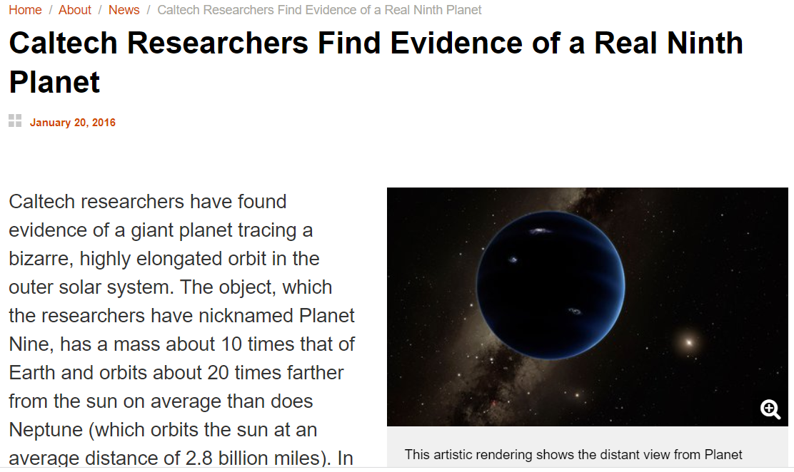
https://www.caltech.edu/about/news/caltech-researchers-find-evidence-real-ninth-planet-49523

Slide 46
https://www.nbcnews.com/science/space/astronomers-are-still-looking-elusive-planet-9-rcna1872

Slide 47
What is Snomed CT about if about anything at all?

Slide 48
Concepts and confusions in SNOMED CT
‘concept’:
‘a clinical idea to which a unique concept identifier has been assigned’; ‘the meaning of a concept can be determined from relationships to other concepts and from associated descriptions that include human readable terms’
the term is also stated to be a homonym for:
‘concept identifier’ as well as for
‘the real-world referent(s) of the concept identifier, that is, the class of entities in reality that the concept identifier represents’

Slide 49
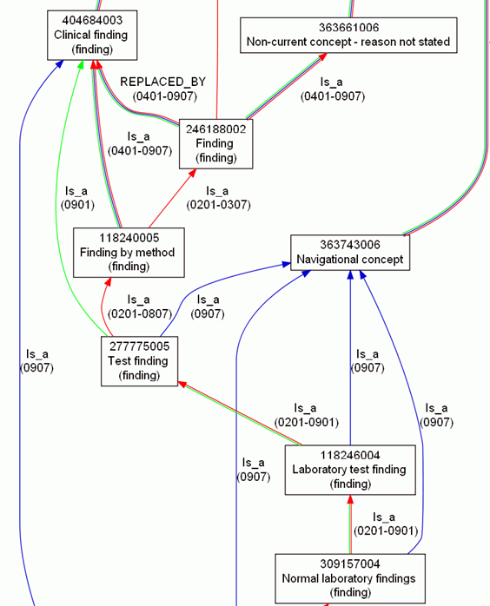
Consequence: more confusion
What is
inside
versus
outside SNOMED CT?

Slide 50
Inside versus outside an ontology
What is
inside
versus
outside SNOMED CT?

Slide 51
Inside versus outside an ontology
What is
inside
versus
outside SNOMED CT?

Slide 52
Inside versus outside an ontology
What is
inside
versus
outside SNOMED CT?
Clear shift in meaning, incompatible with SNOMED CT’s change policy

Slide 53
Inside versus outside an ontology
What is
inside
versus
outside SNOMED CT?
‘halfway’ concept:
denotes external entities but viewed through internal organization

Slide 54
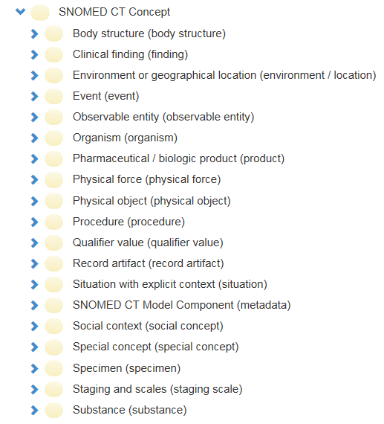
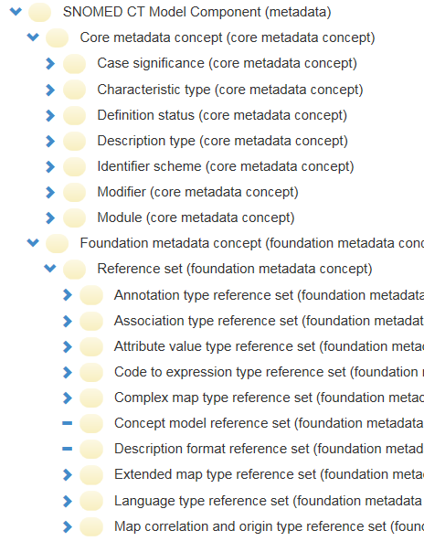
SNOMED CT inside versus outside

Slide 55
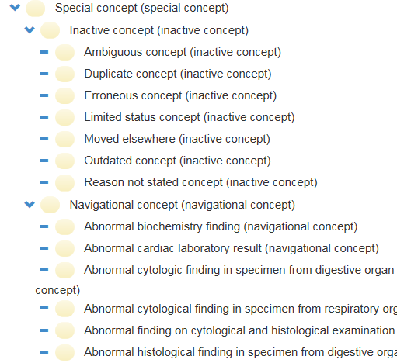
SNOMED CT inside versus outside

Slide 56
Core definitions for information and representation
information content entity (ice) =def. an entity which is (1) generically dependent on (2) some material entity and which (3) stands in a relation of aboutness to some portion of reality.
information quality entity (iqe) =def. a quality that is the concretization of some information content entity.
artifact =def. a material entity created or modified or selected by some agent to realize a certain function or role.
information artifact =def. an artifact whose function is to bear an information quality entity.
representation =def. a quality which is_about or is intended to be about a portion of reality.
mental quality =def. a quality which specifically_depends_on an anatomical structure in the cognitive system of an organism.
cognitive representation =def. a representation which is a mental quality.
representational unit (ru) = def. a smallest constituent sub-representation, including icons, names, simple word forms, or the sorts of alphanumeric identifiers we might find in patient records.
Smith B, Ceusters W. Aboutness: Towards Foundations for the Information Artifact Ontology. International Conference on Biomedical Ontologies, ICBO 2015, Lisbon, Portugal, July 27-30, 2015;47-51.

Slide 57
Information and representation
isAbout
continuant
Portion of Reality
GDC
SDC
material entity
ICE
quality
function
artifact
GenDepOn
IQE
function to bear
an IQE
isConcretizationOf
Information artifact
representation
inhererOf
isA
isAbout or isIntendedToBeAbout
representational unit
Smith B, Ceusters W. Aboutness: Towards Foundations for the Information Artifact Ontology. International Conference on Biomedical Ontologies, ICBO 2015, Lisbon, Portugal, July 27-30, 2015;47-51.

Slide 58
SNOMED CT parts as ICEs
Portion of Reality
~isA
isAbout
Something around discomforting pain
ICE
isA
isA
isAbout
SNOMED CT
concept identifier
SNOMED CT
FSN
instanceOf at t₁
instanceOf at t₂
SNOMED CT:
301381004
SNOMED CT:
‘Discomforting present pain (finding)’

Slide 59
SNOMED CT parts as …
Portion of Reality
~isA
isAbout
Something around discomforting pain
ICE
isA
isA
isAbout
?
SNOMED CT
concept identifier
SNOMED CT
FSN
instanceOf at t₁
instanceOf at t₂
SNOMED CT:
301381004
SNOMED CT:
‘Discomforting present pain (finding)’
conceptID | Effective Time | Active | ModuleID | Definitional Status
301381004 | 20020131 | 1 | 900000000000207008 | 900000000000074008
301381004 | 20080131 | 0 | 900000000000207008 | 900000000000074008

Slide 60
SNOMED CT parts as IQEs
Quality
Portion of Reality
~isA
isA
isAbout
Something around discomforting pain
IQE
ICE
instanceOf at t1
isA
isA
isAbout
instanceOf at t1
Q301381004 (2)
SNOMED CT
concept identifier
SNOMED CT
FSN
instanceOf at t₁
instanceOf at t₂
Q301381004 (1)
SNOMED CT:
301381004
SNOMED CT:
‘Discomforting present pain (finding)’
inheresIn at t1
concretizationOf at t1
inheresIn at t1
GenDepOn at t1
conceptID | Effective Time | Active | ModuleID | Definitional Status
301381004 | 20020131 | 1 | 900000000000207008 | 900000000000074008
301381004 | 20080131 | 0 | 900000000000207008 | 900000000000074008

Slide 61
https://user.medunigraz.at/stefan.schulz/presentations/2020_SNOMED_CT_and_Basic_Formal_Ontology_Convergence_or_Contradiction.pptx

Slide 62
Peter Hendler’s philosophical nonsense
2019-07-15 10:02
‘Past, current, and future medical science can never know "things in the real world". All of the historical "diseases" that no longer exist because of subsequent scientific studies prove that.’
‘A good example today is the "concept" of "Systemic Lupus Erythematosis". This term is quite useful and necessary today. But is is only a concept. It is NOT something in the real world.’
‘We might in the future discover that Sjogrens, and perhaps other diseases should in fact all be given a new concept name and grouped together.’
https://confluence.ihtsdotools.org/mag/discussions/bfo-and-snomed

Slide 63
What he confuses
Terms
Concepts
Clinical ideas
Diseases, disorders, disease courses
Diagnoses
Particulars
Universals
…

Slide 64
Basic Formal Ontology vs. SNOMED (Oct. 2020)
Scope | Clinically relevant entities in a broad range of abstractions
Focus | Clinical medicine, health care, social care, biomedical research
Size | Very huge
Top level divisions | Flat, mostly disjoint top level concepts under “SNOMED CT concept”. However, things like (material entities, processes) can be found in several upper level hierarchies
Nodes represent | “Clinical ideas”, i.e. intensional meanings that extend to classes of potentially clinically relevant entities
Relations | Binary relations (“linkage concepts”),
Formal representation | Description logics OWL EL
Naming | Artificial, self-explaining labels (EN, ES, ...) called Fully Specified Names, real-world terms (quasi-synonyms) and numeric concept IDs
Textual scope notes | Low coverage of textual definitions, underspecification of many primitive concepts due to lack of textual scope notes
References to external sources / standards | Standards, clinical literature for the curation of terminology content, e.g, Gray's anatomy, TA, FMA, and others for the body structure. Other examples, such as classifications for many clinical conditions, e.g. fracture, ulcers, etc.
Hierarchies | Multiple (is-a, interpreted as OWL subclasses). Top-level categories, classes directly under SNOMED CT root node, are considered as disjoint classes (except 'physical object' and 'pharmaceutical / biologic product'). The rest are multiple but still following the disjointness from the top-level categories.
Equivalence axioms | 32 % (varying from ~100 % to 0 % by top hierarchy, see Appendix 1)
https://user.medunigraz.at/stefan.schulz/presentations/2020_SNOMED_CT_and_Basic_Formal_Ontology_Convergence_or_Contradiction.pptx

Slide 65
Not solved! Is precise the ambiguity!
https://user.medunigraz.at/stefan.schulz/presentations/2020_SNOMED_CT_and_Basic_Formal_Ontology_Convergence_or_Contradiction.pptx

Slide 66
SNOMED CT finding hierarchy
Boundary issues
between diseases and findings (hierarchy)
No clear boundary between disease and disorder (wording)
Ontological bipartition:
morphological abnormalities as material (?) continuants
“other things” in Finding / Disorder hierarchies
Findings hierarchy could be accepted as syncretistic
Because there are dispositions subsuming processes etc.
But then it would never fit under any formal ontology
Findings hierarchy could be remodelled
High cost and unclear benefit
Findings hierarchy could be re-interpreted
No disruption if interpreted as “clinical processes or states”
https://user.medunigraz.at/stefan.schulz/presentations/2020_SNOMED_CT_and_Basic_Formal_Ontology_Convergence_or_Contradiction.pptx

Slide 67
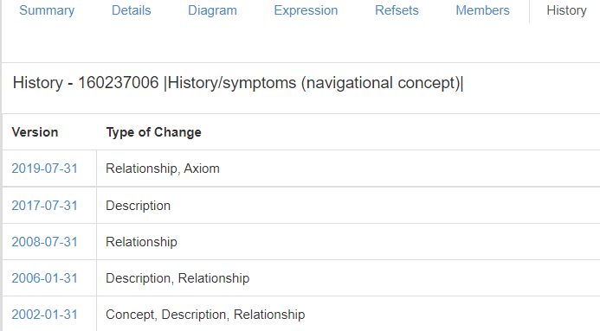
Bad philosophy troubles Snomed CT since the conversion to Snomed RT
https://browser.ihtsdotools.org/?perspective=full&conceptId1=160237006&edition=MAIN/2021-07-31&release=&languages=en

Slide 68
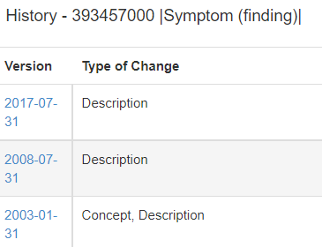
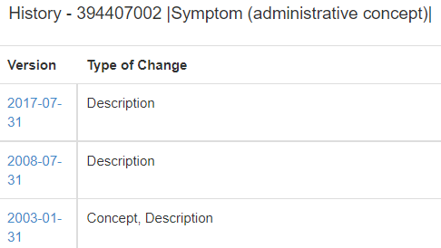
https://browser.ihtsdotools.org/?perspective=full&conceptId1=394407002&edition=MAIN/2021-07-31&release=&languages=en
https://browser.ihtsdotools.org/?perspective=full&conceptId1=394647002&edition=MAIN/2021-07-31&release=&languages=en

Slide 69
‘Symptom’ and ‘sign’ for OGMS
Sign =def. – A bodily feature of a patient that is observed in a physical examination and is deemed by the clinician to be of clinical significance.
‘We can distinguish a further use of ‘sign’ in the context ‘sign of ’. Two clinicians may observe the same clinically abnormal bodily feature, e.g. a hand tremor, in a single patient but interpret it differently, either as a ‘sign of’ a distinct disorder (where the patient has two disorders) or of one disorder but about which they differ in opinion about the relevant disease type (e.g. hyperthyroidism or Parkinson’s).’
Symptom =def. – A bodily feature of a patient that is observed by the patient and is hypothesized by the patient to be a realization of a disease.
‘Again we can distinguish the special usage ‘symptom of ’: a clinician may attribute a symptom as being a symptom of some specific disease.’
Richard H. Scheuermann, Werner Ceusters, and Barry Smith, “Toward an Ontological Treatment of Disease and Diagnosis”,
Proceedings of the 2009 AMIA Summit on Translational Bioinformatics, 2009, 116-120

Slide 70
Exercise in representation
A sore throat is a shared symptom of many illnesses.
The first symptom of COVID-19 is fever.
Difficulty swallowing, facial weakness or numbness, or double vision is a symptom of a tumor in the brain stem.
Fatigue is a disabling, multifaceted symptom that is highly prevalent and stubbornly persistent in fibromyalgia.
Actor Alan Alda went for a brain scan after experiencing this early sign (acting out dreams), eventually leading to his Parkinson's diagnosis.

