Slide 1
Advanced Topics in
Biomedical Ontology
PHI 637 SEM / BMI 708 SEM
Werner Ceusters and Barry Smith

Slide 2
Lecture 9
Werner Ceusters
Principles for
ontology change management
in biomedical information systems

Slide 3
Class outline
Realism-based ontology change management.
Change management in SNOMED CT.
Post-hoc application of realism-based change management to SNOMED CT.
Formalization of realism-based change management through the Information Artifact Ontology.
Assignment.

Slide 4
Realism-based ontology change management

Slide 5
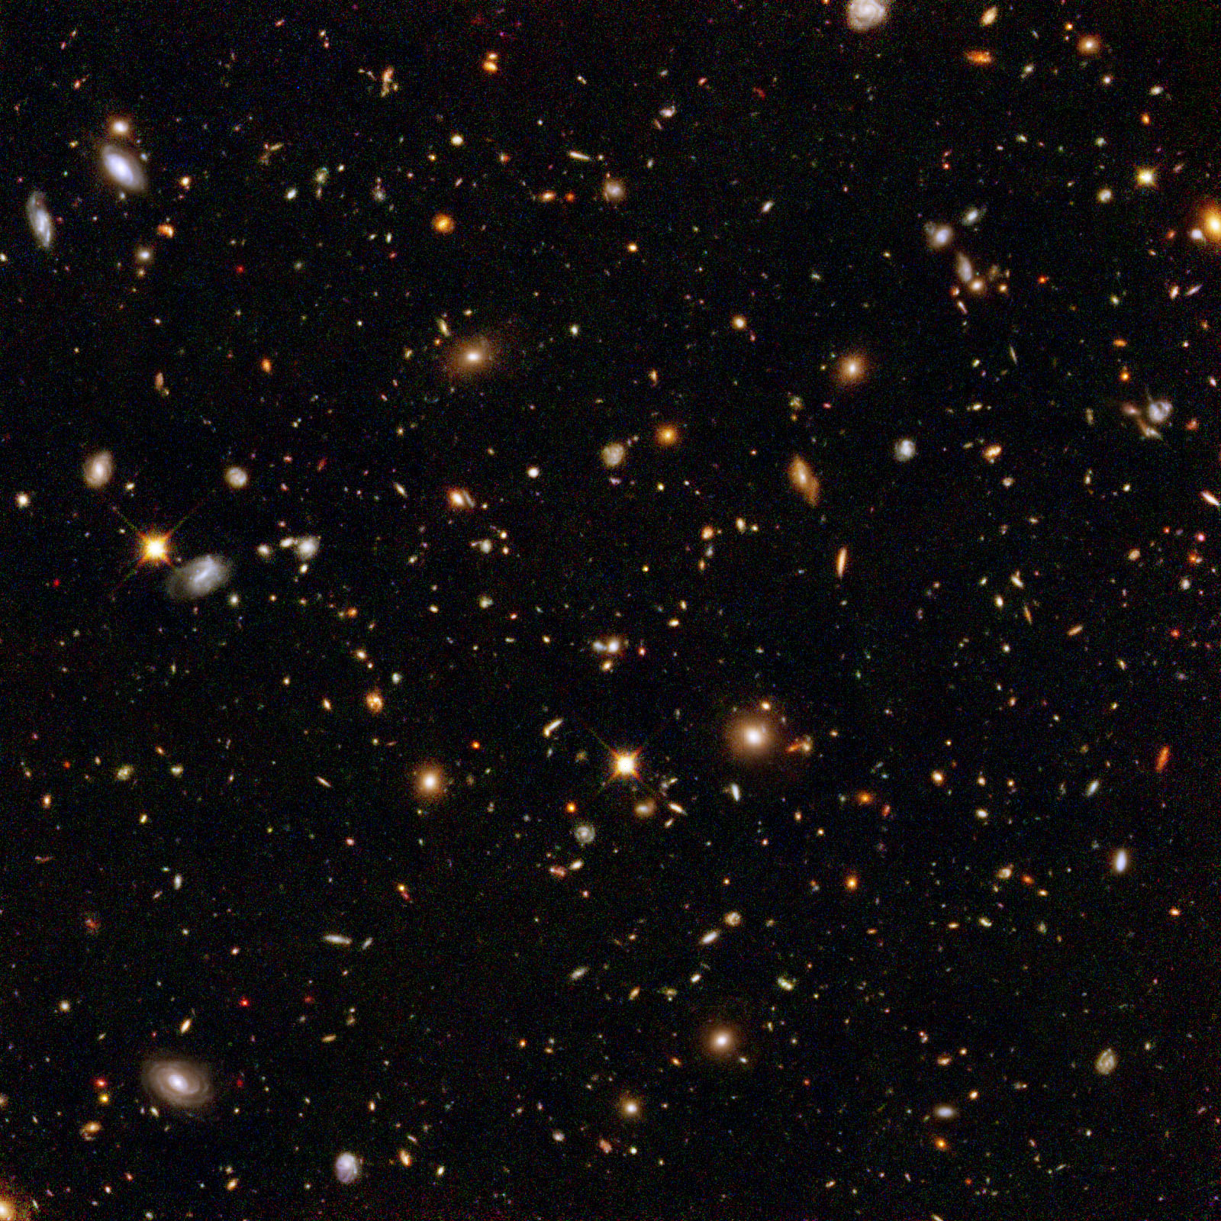

Ontological Realism claims about reality:
There is an external reality which is ‘objectively’ the way it is;
That reality is accessible to us;
We build in our brains cognitive representations of reality;
We communicate with others about what is there, and what we believe there is there.
Smith B, Kusnierczyk W, Schober D, Ceusters W. Towards a Reference Terminology for Ontology Research and Development in the Biomedical Domain. Proceedings of KR-MED 2006, Biomedical Ontology in Action, November 8, 2006, Baltimore MD, USA

Slide 6
Uncontroversial, yet cumbersome
in light of the principles of Ontological Realism and Basic Formal Ontology
Being
Believing
Communicating

Slide 7
Uncontroversial, yet cumbersome
in light of the principles of Ontological Realism and Basic Formal Ontology
Ontology
Classification /
conceptualization
Being
Believing
Communicating
Terminology

Slide 8
Ontological Realism’s aim for representations:

Slide 9
Ontological Realism’s aim for representations:
A representation should be faithful (veridical) with respect to the part of the reality that it covers
Smith B, Ceusters W. Ontological Realism as a Methodology for Coordinated Evolution of Scientific Ontologies. Applied Ontology, 2010;5(3-4):139-188.

Slide 10


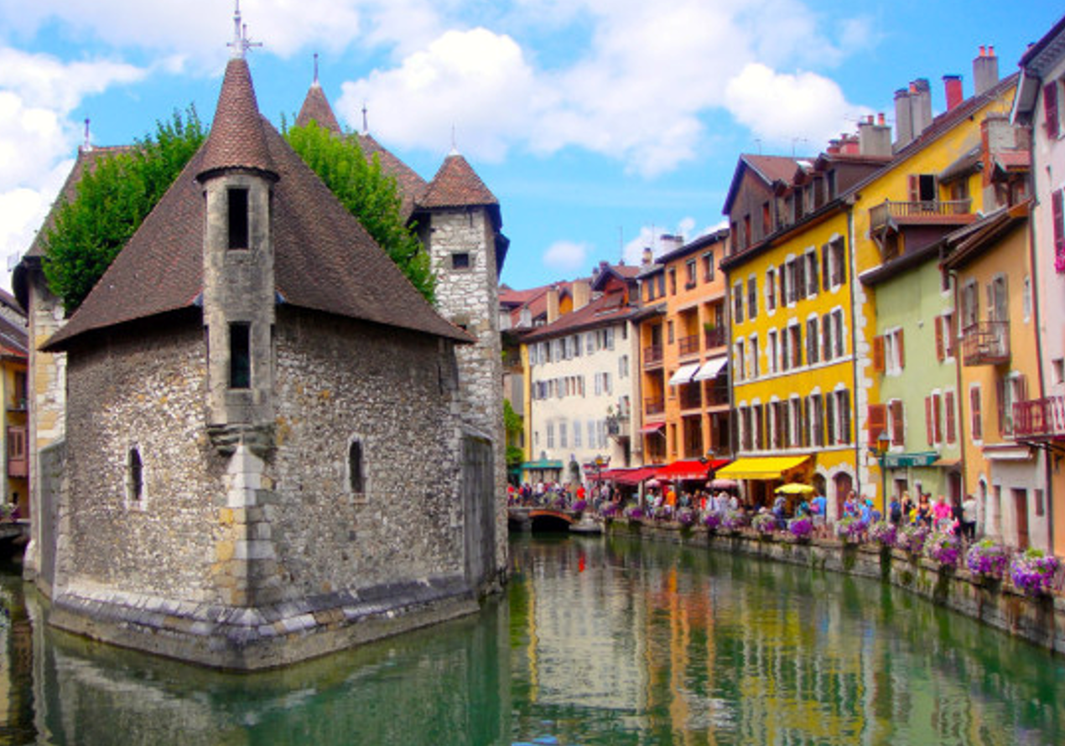
Ontological Realism’s aim for representations:
A representation should be faithful (veridical) with respect to the part of the reality that it covers
Smith B, Ceusters W. Ontological Realism as a Methodology for Coordinated Evolution of Scientific Ontologies. Applied Ontology, 2010;5(3-4):139-188.

Slide 11




Ontological Realism
A representation should be faithful (veridical) with respect to the part of the reality that it covers
?
Smith B, Ceusters W. Ontological Realism as a Methodology for Coordinated Evolution of Scientific Ontologies. Applied Ontology, 2010;5(3-4):139-188.

Slide 12

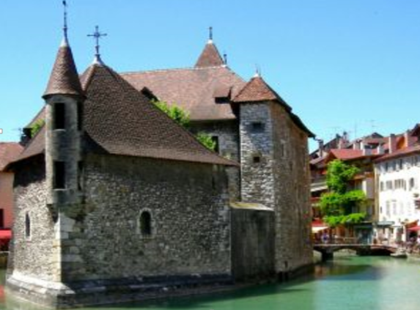
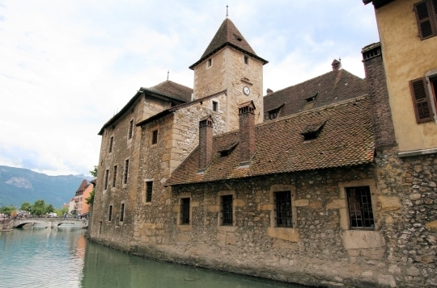
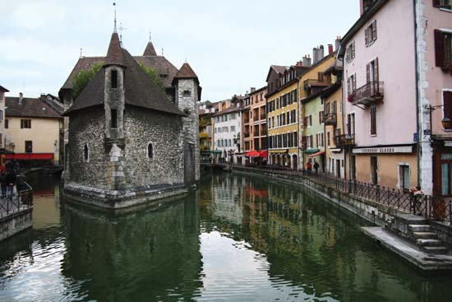
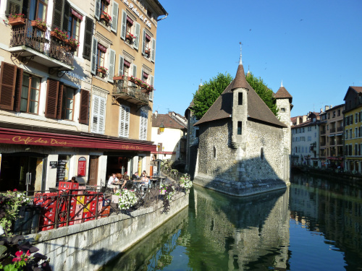
One reality ←→ distinct veridical perspectives

Slide 13

Reality changes
Requires accurate representation of what exactly it is that changes
Same (identical) flowers that change color
or
different flowers altogether?

Slide 14


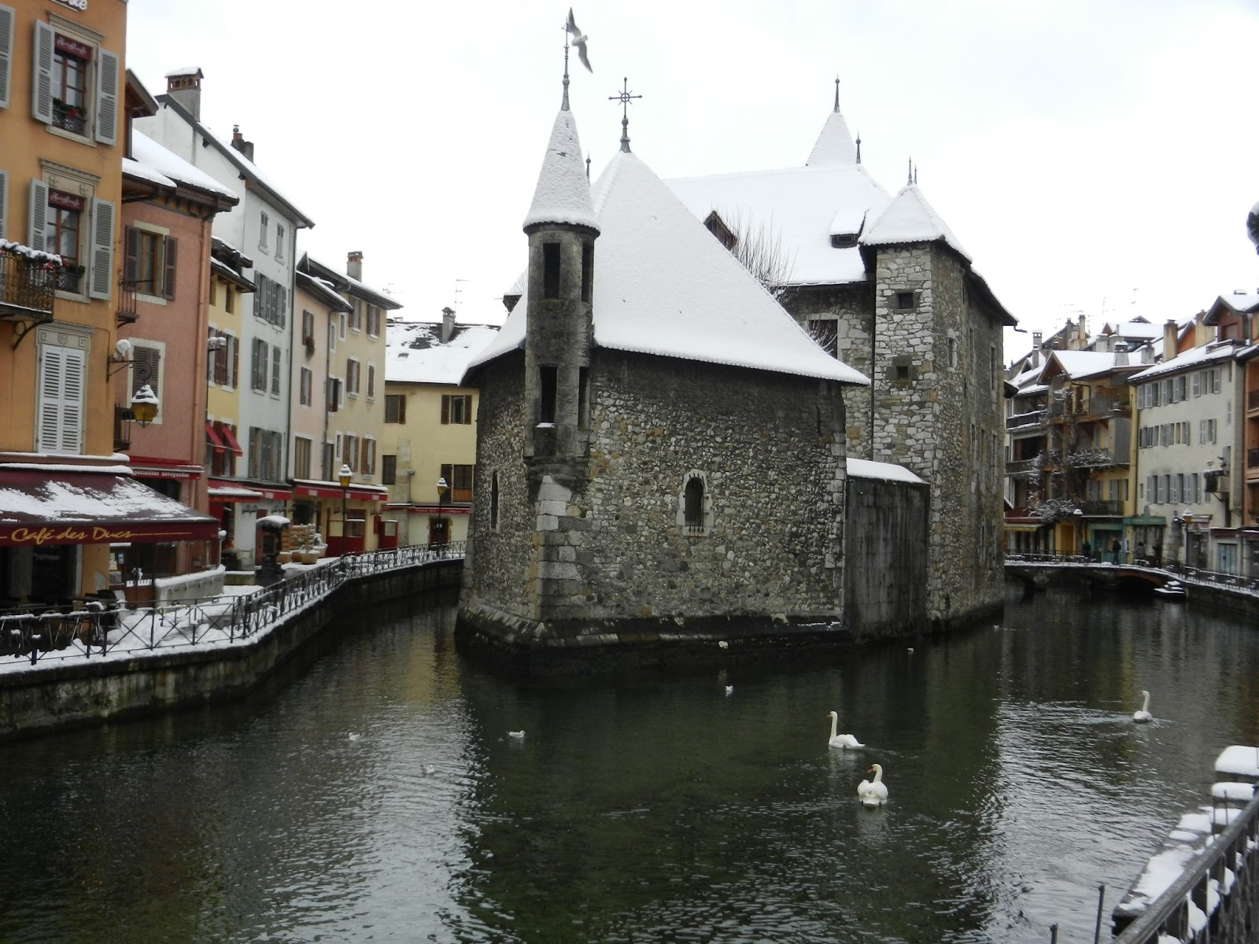
Temporal veridicality in tokens
This portion of snow covers this surface at t₁
This portion of snow covers this surface at t₂

Slide 15
Temporal veridicality in tokens and types
This portion of snow covers this surface at t₁
The disposition of snow to cover surfaces
This portion of snow covers this surface at t₂

Slide 16
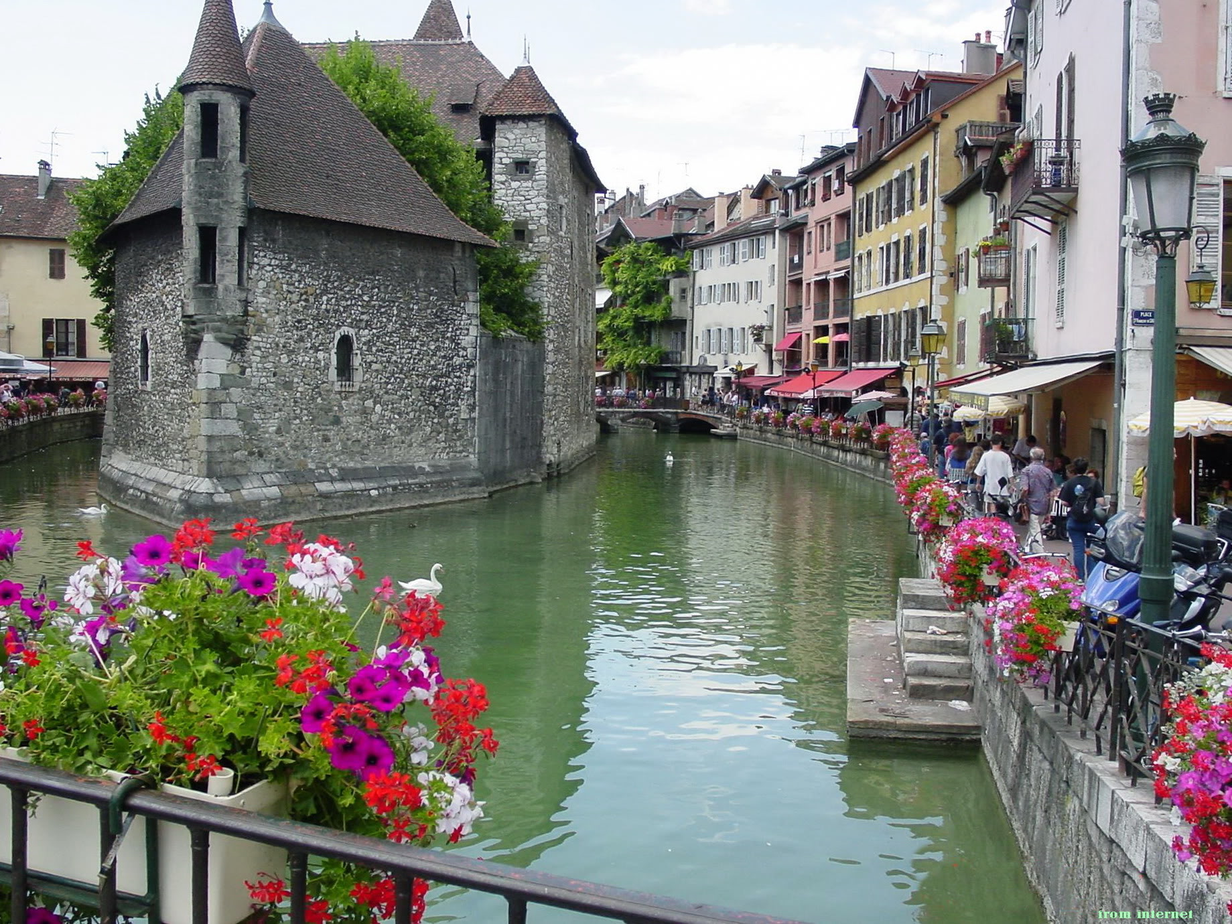

Representations in temporal sync with reality
t₁
t₂
t₃
t

Slide 17
Scientific Realism
Our best scientific theories give true or approximately true descriptions of observable and unobservable aspects of a mind-independent world.
http://plato.stanford.edu/entries/scientific-realism/#WhaSciRea

Slide 18
Representational artifacts
Ideally built out of representational units and relationships that mirror the entities and their relationships in reality.
 | Non-Formalized | Formalized
Primarily about particulars | Progress notes, discharge letters, medical summaries, maps | Inventories, referent tracking database
Primarily about universals and defined classes | Medical textbooks, scientific theories | Ontologies, terminologies,

Slide 19
Scientific Realism
Our best scientific theories give true or approximately true descriptions of observable and unobservable aspects of a mind-independent world.
A reference ontology is an ontology that is created in such a way as to serve the representation of what are assumed to be corresponding types in reality.
http://plato.stanford.edu/entries/scientific-realism/#WhaSciRea
Ontological Realism
Smith B, Ceusters W.
Ontological Realism as a Methodology for Coordinated Evolution of Scientific Ontologies.
Applied Ontology, 2010;5(3-4):139-188.

Slide 20
Central research questions
How can ontologies be designed in such a way that:
they are faithful representations of reality, and that
changes introduced in updates reflect faithfully corresponding changes in reality?
What are the requirements for formalisms able to concretize ontologies satisfying (1a) and (1b) to allow users thereof acquiring a faithful representation of the changes in reality by merely looking at the changes in the ontology?

Slide 21
Some characteristics of representational units
each unit is assumed by the creators of the representation to be veridical, i.e. to conform to some relevant portion of reality (POR) as conceived on the best current scientific understanding;
several units may correspond to the same POR by presenting different though still veridical views or perspectives;
what is to be represented by the units in a representation depends on the purposes which the representation is designed to serve.

Slide 22
What influences the development of ontologies?
Level of biomedical reality:
  Persons, diseases, pathological structures and formations,... do exist as particulars (p, d, ps, pf, ... ) and universals (P, D, PS, PF, ...), and are related in specific ways prior to our perception;
  Biomedical reality changes:
    d’s, p’s, ... come and go; D’s, P’s, ...
Level of biomedical science and case perception:
  Mirrors reality only partially.
  Evolves over time towards better understanding.

Slide 23
What influences the development of ontologies?
Level of concretizations:
  Mirrors biomedical science and case perception only partially:
    Editing mistakes;
    Leaving out diseases or pathological behaviours for non-biomedical reasons:
      Smoking;
    Adding non-pathological behaviour as a disease:
      Homosexuality;
    Leaving out wat is considered not relevant.

Slide 24
Reality versus representations, both in evolution
t
U1
U2
Reality
p3
5 represented configurations:
  (2) the coming into existence of 2 universals (U1, U2),
  (1) the coming into existence of particular p3 as an instance of U1,
  (1) the instantiation of U2 by p3,
  (1) the going out of existence of p3.

Slide 25
Reality versus representations, both in evolution
t
U1
U2
Reality
p3
5 represented configurations:
  (2) the coming into existence of 2 universals (U1, U2),
  (1) the coming into existence of particular p3 as an instance of U1,
  (1) the instantiation of U2 by p3,
  (1) the going out of existence of p3.
At least 2 other events must have happened. Which ones?

Slide 26
Reality versus representations, both in evolution
t
U1
U2
Reality
p3
5 represented configurations:
  (2) the coming into existence of 2 universals (U1, U2),
  (1) the coming into existence of particular p3 as an instance of U1,
  (1) the instantiation of U2 by p3,
  (1) the going out of existence of p3.
At least 2 other events must have happened. Which ones?
  (1) the coming into existence of some particular as an instance of U1,
  (2) either that particular becoming an instance of U2, OR the coming into existence of a third particular as an instance of U2.

Slide 27
Reality versus representations, both in evolution
t
U1
U2
Reality
p3
IUI-#3
O-#0
O-#2
Representation
O-#1
= ‘denotes’
= what constitutes the meaning of representational units
…. Therefore: O-#0 is meaningless

Slide 28
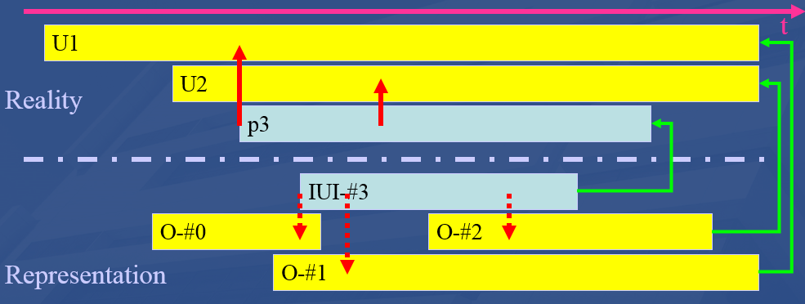
Reality versus representations, both in evolution
‘Representation’:
  can be beliefs (B) and communicated representations (CR);
  Bs and CRs usually don’t contradict each other;
    some exceptions: lying, deception, priorities in updates, …
Schema shows the case for universals and instantiations, but the phases are equally valid for configurations and axioms.

Slide 29
Milestones in scientific discovery and case assessment.
U1
t
U2
p3
IUI-#3
O-#0
O-#2
O-#1

Slide 30
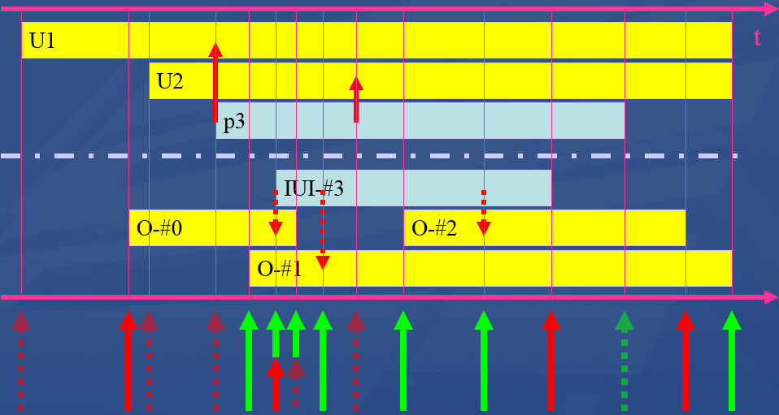
Milestones in scientific discovery and case assessment.
Discovery
Being lucky
Misrepresentation
Being ignorant

Slide 31
Representation versus reality in ontologies
U1
t
U2
p3
IUI-#3
O-#0
O-#2
O-#1
Total ignorance. A disease already exists, but unnoticed thus far.

Slide 32
Representation versus reality in ontologies
U1
t
U2
p3
IUI-#3
O-#0
O-#2
O-#1
False belief in the existence of a type, e.g. ‘diabolic possession’

Slide 33
Representation versus reality in ontologies
U1
t
U2
p3
IUI-#3
O-#0
O-#2
O-#1
The coming into existence of a new universal remains unnoticed: ‘AIDS’ existed before being discovered.

Slide 34
Representation versus reality in ontologies
U1
t
U2
p3
IUI-#3
O-#0
O-#2
O-#1
An advance in science: the existence of U1 is acknowledged.

Slide 35
Representation versus reality in an EHR
U1
t
U2
p3
IUI-#3
O-#0
O-#2
O-#1
The existence of John Doe’s aberrant behavior is acknowledged, however, believed to be an instance of what in reality is a fantasy: diabolic possession.

Slide 36
Representation versus reality in ontologies
U1
t
U2
p3
IUI-#3
O-#0
O-#2
O-#1
Another advance in science: the false belief O-#0 is rightfully abandoned, necessitating therefore to reconsider of what p3 must be believed to be an instance of.

Slide 37
Representation versus reality in ontologies
U1
t
U2
p3
IUI-#3
O-#0
O-#2
O-#1
Advance in science: “AIDS” is discovered as a new disease entity.

Slide 38
Representation versus reality in ontologies
U1
t
U2
p3
IUI-#3
O-#0
O-#2
O-#1
For ‘utilitarian’ reasons, lobbyists succeed in smoking to be removed from an ontology as risk factor for cancer.

Slide 39
A possible ontology evolution
V1
O-#0

Slide 40
A possible ontology evolution
V2
V1
O-#0 & O-#1
O-#0

Slide 41
A possible ontology evolution
V3
V2
V1
O-#0 & O-#1 & O-#0 isA O-#1
O-#0 & O-#1
O-#0

Slide 42
A possible ontology evolution
V4
V3
V2
V1
O-#1
O-#0 & O-#1 & O-#0 isA O-#1
O-#0 & O-#1
O-#0

Slide 43
A possible ontology evolution
V5
V4
V3
V2
V1
O-#2 & O-#1 & O-#2 isA O-#1
O-#1
O-#0 & O-#1 & O-#0 isA O-#1
O-#0 & O-#1
O-#0

Slide 44
A possible ontology evolution
V6
V5
V4
V3
V2
V1
O-#1 & O-#2 isA O-#1
O-#2 & O-#1 & O-#2 isA O-#1
O-#1
O-#0 & O-#1 & O-#0 isA O-#1
O-#0 & O-#1
O-#0

Slide 45
Ontology – reality correspondence
V6
V5
V4
V3
V2
V1
O-#1 & O-#2 isA O-#1
O-#2 & O-#1 & O-#2 isA O-#1
O-#1 (& O-#2 & O-#2 isA O-#1)
O-#0 & O-#1 & O-#0 isA O-#1 (& O-#2 & ..)
O-#0 & O-#1 (& O-#2 & O-#2 isA O-#1)
O-#0 (& O-#1)
See class 12: ontology quality

Slide 46
Sorts of changes in ontologies: the simplistic main view
Ontology versions exhibit differences of the following sorts:
  Add a subtree
  Delete a subtree
  Move a subtree to a different location
  Move a set of sibling classes to a different location
  Create a new abstraction and move a set of siblings down in a class hierarchy, creating a new superclass.
  Delete a class, moving its subclasses to become subclasses of its superclass.
  Split a class
  Merge classes
These distinctions don’t tell us the motivations behind the changes
Noy, N.F., Kunnatur, S., Klein, M., and Musen, M.A. Tracking changes during ontology evolution. In Proceeding of the 3rd International Semantic Web Conference (ISWC2004), Hiroshima, Japan, November 2004.

Slide 47
An “optimal” ontology (1)
Because ontologies, as conceived on realist terms,
  are artifacts created for some purpose (e.g. to serve as controlled vocabulary, or to provide domain knowledge to a software application),
  are at the same time intended to mirror reality,
  should allow reasoning which is efficient from a computational point of view,
we argue that an optimal ontology should constitute a representation of all and only those portions of reality that are relevant for its purpose.

Slide 48
An “optimal” ontology (2)
Each term in such an ontology would designate
  (1) a single portion of reality (POR), which is
  (2) relevant to the purposes of the ontology and such that
  (3) the authors of the ontology intended to use this term to designate this POR, and
  (4) there would be no PORs objectively relevant to these purposes that are not referred to in the ontology
  (5) there would be no relevant PORs designated more than once.

Slide 49
But things may go wrong …
assertion errors:
  ontology developers may be in error as to what is the case in their target domain;
relevance errors:
  they may be in error as to what is objectively relevant to a given purpose;
encoding errors:
  they may not successfully translate their underlying cognitive representations, so that particular representational units fail to point to the intended PORs.

Slide 50
Key requirement for versioning
Any change in an ontology or data repository should be associated with the reason for that change to be able to assess later what kind of mistake has been made !

Slide 51
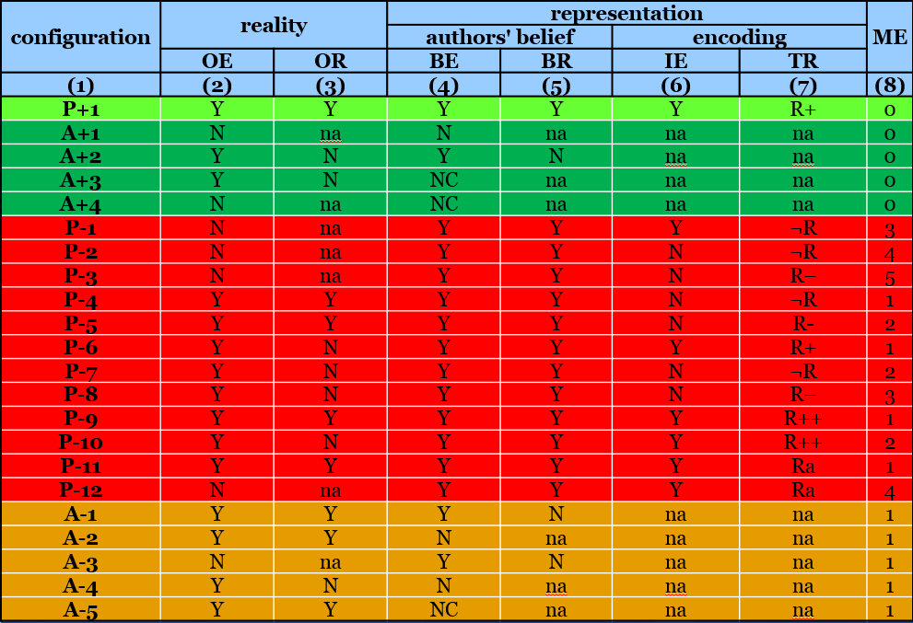
RU – reality correspondence types
1st version (2006):
Ceusters W, Smith B. A Realism-Based Approach to the Evolution of Biomedical Ontologies. Proceedings of AMIA 2006, Washington DC, 2006;:121-125.
1st revision (2009):
Ceusters W. Applying Evolutionary Terminology Auditing to the Gene Ontology. Journal of Biomedical Informatics 2009;42:518–529.
2nd revision (2014):
Seppãlã S, Smith B, Ceusters W. Applying the realism-based ontology versioning method for tracking changes in the Basic Formal Ontology. Formal Ontology in Information Systems. Proceedings of the Eight International Conference (FOIS 2014), Amsterdam: IOS Press, 2014;:227-240.

Slide 52
RU – reality correspondence types
configuration | reality |  | representation |  |  |  | ME
 |  |  | authors' belief |  | encoding
 | OE | OR | BE | BR | IE | TR
(1) | (2) | (3) | (4) | (5) | (6) | (7) | (8)
Reality:
  OE: Objective existence
  OE: Objective relevance
          Representation:
            BE: Author’s belief in existence
            BR: Author’s belief in relevance
              IE: Author’s intended encoding
              TR: Type of reference

Slide 53
configuration | reality |  | representation |  |  |  | ME
 |  |  | authors' belief |  | encoding
 | OE | OR | BE | BR | IE | TR
(1) | (2) | (3) | (4) | (5) | (6) | (7) | (8)
P+1
A+1
A+2
A+3
A+4
P-1
P-2
P-3
P-4
P-5
P-6
P-7
P-8
P-9
P-10
P-11
P-12
A-1
A-2
A-3
A-4
A-5
Configuration types
    P: present in the ontology
      P+: justifiably present
      P–: unjustifiably present
    A: absent from the ontology
      A+: justifiably absent
      A–: unjustifiably absent

Slide 54
configuration | reality |  | representation |  |  |  | ME
 |  |  | authors' belief |  | encoding
 | OE | OR | BE | BR | IE | TR
(1) | (2) | (3) | (4) | (5) | (6) | (7) | (8)
P+1
A+1
A+2
A+3
A+4
P-1
P-2
P-3
P-4
P-5
P-6
P-7
P-8
P-9
P-10
P-11
P-12
A-1
A-2
A-3
A-4
A-5
Configuration types
    1+4+12+5=22 possible configurations based on (mis)matches between reality, beliefs, and encodings

Slide 55
configuration | reality |  | representation |  |  |  | ME
 |  |  | authors' belief |  | encoding
 | OE | OR | BE | BR | IE | TR
(1) | (2) | (3) | (4) | (5) | (6) | (7) | (8)
P+1 | Y | Y | Y | Y | Y | R+ | 0
A+1 | N | na | N | na | na | na | 0
A+2 | Y | N | Y | N | na | na | 0
A+3 | Y | N | NC | na | na | na | 0
A+4 | N | na | NC | na | na | na | 0
P-1 | N | na | Y | Y | Y | ¬R | 3
P-2 | N | na | Y | Y | N | ¬R | 4
P-3 | N | na | Y | Y | N | R– | 5
P-4 | Y | Y | Y | Y | N | ¬R | 1
P-5 | Y | Y | Y | Y | N | R- | 2
P-6 | Y | N | Y | Y | Y | R+ | 1
P-7 | Y | N | Y | Y | N | ¬R | 2
P-8 | Y | N | Y | Y | N | R– | 3
P-9 | Y | Y | Y | Y | Y | R++ | 1
P-10 | Y | N | Y | Y | Y | R++ | 2
P-11 | Y | Y | Y | Y | Y | Ra | 1
P-12 | N | na | Y | Y | Y | Ra | 4
A-1 | Y | Y | Y | N | na | na | 1
A-2 | Y | Y | N | na | na | na | 1
A-3 | N | na | Y | N | na | na | 1
A-4 | Y | N | N | na | na | na | 1
A-5 | Y | Y | NC | na | na | na | 1
OE/BE value pairs
Y/Y: correct assertion of the existence of a POR;
Y/N: lack of awareness of a POR, reflecting an assertion error;
N/N: correct assertion that some putative POR does not exist ;
N/Y: the false belief that some putative POR exists;
Y/NC: not considering that some POR exists;
N/NC: not considering that some putative POR does not exist.

Slide 56
configuration | reality |  | representation |  |  |  | ME
 |  |  | authors' belief |  | encoding
 | OE | OR | BE | BR | IE | TR
(1) | (2) | (3) | (4) | (5) | (6) | (7) | (8)
P+1 | G1 | Y | Y | Y | Y | Y | R+ | 0
A+1 | G2 | N | na | N | na | na | na | 0
A+2 | G3 | Y | N | Y | N | na | na | 0
A+3 | G4 | Y | N | NC | na | na | na | 0
A+4 | G4 | N | na | NC | na | na | na | 0
P-1 | G5 | N | na | Y | Y | Y | ¬R | 3
P-2 | G6 | N | na | Y | Y | N | ¬R | 4
P-3 | G7 | N | na | Y | Y | N | R– | 5
P-4 | G6 | Y | Y | Y | Y | N | ¬R | 1
P-5 | G7 | Y | Y | Y | Y | N | R- | 2
P-6 | G1 | Y | N | Y | Y | Y | R+ | 1
P-7 | G6 | Y | N | Y | Y | N | ¬R | 2
P-8 | G7 | Y | N | Y | Y | N | R– | 3
P-9 | G8 | Y | Y | Y | Y | Y | R++ | 1
P-10 | G8 | Y | N | Y | Y | Y | R++ | 2
P-11 | G9 | Y | Y | Y | Y | Y | Ra | 1
P-12 | G9 | N | na | Y | Y | Y | Ra | 4
A-1 | G3 | Y | Y | Y | N | na | na | 1
A-2 | G2 | Y | Y | N | na | na | na | 1
A-3 | G3 | N | na | Y | N | na | na | 1
A-4 | G2 | Y | N | N | na | na | na | 1
A-5 | G4 | Y | Y | NC | na | na | na | 1
Ignoring reality
Only 9 configurations
Distinctions lost:
Justified versus unjustified absences
Correct representation versus one case of unjustified presence

Slide 57
configuration | reality |  | representation |  |  |  | ME
 |  |  | authors' belief |  | encoding
 | OE | OR | BE | BR | IE | TR
(1) | (2) | (3) | (4) | (5) | (6) | (7) | (8)
P+1 | Y | Y | Y | Y | Y | R+ | 0
A+1 | N | na | N | na | na | na | 0
A+2 | Y | N | Y | N | na | na | 0
A+3 | Y | N | NC | na | na | na | 0
A+4 | N | na | NC | na | na | na | 0
P-1 | N | na | Y | Y | Y | ¬R | 3
P-2 | N | na | Y | Y | N | ¬R | 4
P-3 | N | na | Y | Y | N | R– | 5
P-4 | Y | Y | Y | Y | N | ¬R | 1
P-5 | Y | Y | Y | Y | N | R- | 2
P-6 | Y | N | Y | Y | Y | R+ | 1
P-7 | Y | N | Y | Y | N | ¬R | 2
P-8 | Y | N | Y | Y | N | R– | 3
P-9 | Y | Y | Y | Y | Y | R++ | 1
P-10 | Y | N | Y | Y | Y | R++ | 2
P-11 | Y | Y | Y | Y | Y | Ra | 1
P-12 | N | na | Y | Y | Y | Ra | 4
A-1 | Y | Y | Y | N | na | na | 1
A-2 | Y | Y | N | na | na | na | 1
A-3 | N | na | Y | N | na | na | 1
A-4 | Y | N | N | na | na | na | 1
A-5 | Y | Y | NC | na | na | na | 1
2
4
1
3
‘na’ = not applicable
If there is no POR of a specific sort, relevance is not applicable.
If an author does not believe in some POR, believed relevance is not applicable.
If an author did not consider (‘nc’) existence of some POR, believed relevance is not applicable.
If believed relevance is either negative or not applicable, encoding is not applicable.

Slide 58
configuration | reality |  | representation |  |  |  | ME
 |  |  | authors' belief |  | encoding
 | OE | OR | BE | BR | IE | TR
(1) | (2) | (3) | (4) | (5) | (6) | (7) | (8)
P+1 | Y | Y | Y | Y | Y | R+ | 0
A+1 | N | na | N | na | na | na | 0
A+2 | Y | N | Y | N | na | na | 0
A+3 | Y | N | NC | na | na | na | 0
A+4 | N | na | NC | na | na | na | 0
P-1 | N | na | Y | Y | Y | ¬R | 3
P-2 | N | na | Y | Y | N | ¬R | 4
P-3 | N | na | Y | Y | N | R– | 5
P-4 | Y | Y | Y | Y | N | ¬R | 1
P-5 | Y | Y | Y | Y | N | R- | 2
P-6 | Y | N | Y | Y | Y | R+ | 1
P-7 | Y | N | Y | Y | N | ¬R | 2
P-8 | Y | N | Y | Y | N | R– | 3
P-9 | Y | Y | Y | Y | Y | R++ | 1
P-10 | Y | N | Y | Y | Y | R++ | 2
P-11 | Y | Y | Y | Y | Y | Ra | 1
P-12 | N | na | Y | Y | Y | Ra | 4
A-1 | Y | Y | Y | N | na | na | 1
A-2 | Y | Y | N | na | na | na | 1
A-3 | N | na | Y | N | na | na | 1
A-4 | Y | N | N | na | na | na | 1
A-5 | Y | Y | NC | na | na | na | 1
Modes of reference:
R+ | : faithful reference to correct referent
¬R | : no referent exist
R– | : reference to wrong referent
R++ | : redundant reference
Ra | : ambiguous reference

Slide 59
configuration | reality |  | representation |  |  |  | ME
 |  |  | authors' belief |  | encoding
 | OE | OR | BE | BR | IE | TR
(1) | (2) | (3) | (4) | (5) | (6) | (7) | (8)
P+1 | Y | Y | Y | Y | Y | R+ | 0
A+1 | N | na | N | na | na | na | 0
A+2 | Y | N | Y | N | na | na | 0
A+3 | Y | N | NC | na | na | na | 0
A+4 | N | na | NC | na | na | na | 0
P-1 | N | na | Y | Y | Y | ¬R | 3
P-2 | N | na | Y | Y | N | ¬R | 4
P-3 | N | na | Y | Y | N | R– | 5
P-4 | Y | Y | Y | Y | N | ¬R | 1
P-5 | Y | Y | Y | Y | N | R- | 2
P-6 | Y | N | Y | Y | Y | R+ | 1
P-7 | Y | N | Y | Y | N | ¬R | 2
P-8 | Y | N | Y | Y | N | R– | 3
P-9 | Y | Y | Y | Y | Y | R++ | 1
P-10 | Y | N | Y | Y | Y | R++ | 2
P-11 | Y | Y | Y | Y | Y | Ra | 1
P-12 | N | na | Y | Y | Y | Ra | 4
A-1 | Y | Y | Y | N | na | na | 1
A-2 | Y | Y | N | na | na | na | 1
A-3 | N | na | Y | N | na | na | 1
A-4 | Y | N | N | na | na | na | 1
A-5 | Y | Y | NC | na | na | na | 1
Magnitude of error: see class 12

Slide 60
configuration | reality |  | representation |  |  |  | ME
 |  |  | authors' belief |  | encoding
 | OE | OR | BE | BR | IE | TR
(1) | (2) | (3) | (4) | (5) | (6) | (7) | (8)
P+1 | Y | Y | Y | Y | Y | R+ | 0
A+1 | N | na | N | na | na | na | 0
A+2 | Y | N | Y | N | na | na | 0
A+3 | Y | N | NC | na | na | na | 0
A+4 | N | na | NC | na | na | na | 0
P-1 | N | na | Y | Y | Y | ¬R | 3
P-2 | N | na | Y | Y | N | ¬R | 4
P-3 | N | na | Y | Y | N | R– | 5
P-4 | Y | Y | Y | Y | N | ¬R | 1
P-5 | Y | Y | Y | Y | N | R- | 2
P-6 | Y | N | Y | Y | Y | R+ | 1
P-7 | Y | N | Y | Y | N | ¬R | 2
P-8 | Y | N | Y | Y | N | R– | 3
P-9 | Y | Y | Y | Y | Y | R++ | 1
P-10 | Y | N | Y | Y | Y | R++ | 2
P-11 | Y | Y | Y | Y | Y | Ra | 1
P-12 | N | na | Y | Y | Y | Ra | 4
A-1 | Y | Y | Y | N | na | na | 1
A-2 | Y | Y | N | na | na | na | 1
A-3 | N | na | Y | N | na | na | 1
A-4 | Y | N | N | na | na | na | 1
A-5 | Y | Y | NC | na | na | na | 1
Evolution example:
A POR ceases to exist, but ontology is not updated: P+1 → P-1

Slide 61
Updating is an active process
authors assume in good faith that:
  all included representational units are of the P+1 type, and,
  all they are aware of, but not included, of A+1 or A+2.
If they become aware of a mistake, they make a change under the assumption that their changes are also towards the P+1, A+1, or A+2 cases.
Thus at that time, they know:
  of what configuration type the previous entry must have been under the belief what the current configuration is, and,
  the reason for the change.

Slide 62
configuration | reality |  | representation |  |  |  | ME
 |  |  | authors' belief |  | encoding
 | OE | OR | BE | BR | IE | TR
(1) | (2) | (3) | (4) | (5) | (6) | (7) | (8)
P+1 | Y | Y | Y | Y | Y | R+ | 0
A+1 | N | na | N | na | na | na | 0
A+2 | Y | N | Y | N | na | na | 0
A+3 | Y | N | NC | na | na | na | 0
A+4 | N | na | NC | na | na | na | 0
P-1 | N | na | Y | Y | Y | ¬R | 3
P-2 | N | na | Y | Y | N | ¬R | 4
P-3 | N | na | Y | Y | N | R– | 5
P-4 | Y | Y | Y | Y | N | ¬R | 1
P-5 | Y | Y | Y | Y | N | R- | 2
P-6 | Y | N | Y | Y | Y | R+ | 1
P-7 | Y | N | Y | Y | N | ¬R | 2
P-8 | Y | N | Y | Y | N | R– | 3
P-9 | Y | Y | Y | Y | Y | R++ | 1
P-10 | Y | N | Y | Y | Y | R++ | 2
P-11 | Y | Y | Y | Y | Y | Ra | 1
P-12 | N | na | Y | Y | Y | Ra | 4
A-1 | Y | Y | Y | N | na | na | 1
A-2 | Y | Y | N | na | na | na | 1
A-3 | N | na | Y | N | na | na | 1
A-4 | Y | N | N | na | na | na | 1
A-5 | Y | Y | NC | na | na | na | 1
Evolution example:
The Higg’s boson was discovered and added to the ontology:
A-5 → P+1

Slide 63
Post-hoc application of realism-based ontology management to the Basic Formal Ontology
Seppãlã S, Smith B, Ceusters W.
Applying the realism-based ontology versioning method for tracking changes in the Basic Formal Ontology.
Formal Ontology in Information Systems. Proceedings of the Eight International Conference (FOIS 2014), Amsterdam: IOS Press, 227-240.

Slide 64
A Qualitative Versioning Method
Considers representational elements (REs):
  Representational units (RUs) (e.g. categories);
  Representational configurations (RCs):
  ➔ ‘entity type + relation + entity type’ triples
  (e.g. ‘process is_a occurrent’).
Keeps track of changes:
  Between successive versions of the ontology;
  By tagging each RE in the earlier version as a match or mismatch with the corresponding POR/latest version;
  Changes explained by 22 configurations based on
  6 types of errors.
Seppãlã S, Smith B, Ceusters W. Applying the realism-based ontology versioning method for tracking changes in the Basic Formal Ontology. Formal Ontology in Information Systems. Proceedings of the Eight International Conference (FOIS 2014), Amsterdam: IOS Press, 227-240.

Slide 65
Changes in BFO
# of REs | Configuration patterns | Explanations
81 | P+1 P+1 P+1 | No changes (e.g. ‘continuant’, ‘realizable entity’)
46 | A–5 A–5 P+1 | REs that were not considered at all were introduced in the last version (e.g. ‘continuant fiat boundray’)
40 | P–6 P–6 A+2 | REs previously considered objectively relevant are now considered not relevant (e.g. ‘BFO1-process’)
13 | A–1 A–1 P+1 | REs that were not believed to be relevant were introduced in the last version (e.g. ‘material entity’, ‘immaterial entity’)
12 | P–12 P–12 A+1 | REs that referred ambiguously were deleted in the latest version because the POR does in fact not objectively exist (e.g. dependent continuant’, ‘realizable entity is_a dependent continuant’ )
11 | A–5 P+1 P+1 | REs that were not considered at all were introduced in newer versions (e.g. ‘continuant fiat boundray is_a immaterial entity’)
5 | P–1 P–1 A+1 | REs were deleted in the latest version because the POR does in fact not objectively exist and the REs did not refer to anything (e.g. ‘processual context’)
2 | A+4 P–12 A+1 | REs that were not considered at all were introduced in a newer version and subsequently deleted because the POR did in fact not objectively exist (e.g. ‘GDC is_a dependent continuant’)
Seppãlã S, Smith B, Ceusters W. Applying the realism-based ontology versioning method for tracking changes in the Basic Formal Ontology. Formal Ontology in Information Systems. Proceedings of the Eight International Conference (FOIS 2014), Amsterdam: IOS Press, 227-240.
Notes:
Results at t3 reveal 8 configuration patterns & 7 explanations for the changes unergone by BFO, of which 4 result from our extension of the evaluation schema.
The last case shows how the introduction of the new NC value allows to give different explanations to the justified absence of some elements in BFO 1.0 and 2.0 at t3.

Slide 66
Principles for determining the configurations
Principle of Consistency with Established Science
  ➔ Assumes the latest version of BFO is most faithful to reality.
Reference Ontology Principle
  ➔ include only general terms denoting universals in reality and assertions of relations between their instances.
Principle of Obsoletion
  ➔ obsolete terms that fail in designation.
Principle of Inertia of Existence
  ➔ entities in the latest version of BFO have always existed, exist now and will always exist in the future (OE).
Principle of Inertia of Relevance
  ➔ entities marked as OR in the latest version of BFO have been relevant throughout their entire existence.
Seppãlã S, Smith B, Ceusters W. Applying the realism-based ontology versioning method for tracking changes in the Basic Formal Ontology. Formal Ontology in Information Systems. Proceedings of the Eight International Conference (FOIS 2014), Amsterdam: IOS Press, 227-240.

Slide 67
Explanations of Changes
Based on 6 types of errors:
Assertion errors: the previous version wrongly asserted the existence of some portion of reality (POR).
Relevance errors: the previous version wrongly considered some POR to be objectively relevant to the purposes of the ontology.
Omission errors: a relevant POR failed to be represented.
Encoding errors: some term in the previous version failed to refer to the intended POR due to encoding errors, such as spelling mistakes.
Redundancy errors: two or more distinct terms in a previous version referred to the same POR.
Ambiguity error: one RE denotes more than one POR.
Seppãlã S, Smith B, Ceusters W. Applying the realism-based ontology versioning method for tracking changes in the Basic Formal Ontology. Formal Ontology in Information Systems. Proceedings of the Eight International Conference (FOIS 2014), Amsterdam: IOS Press, 227-240.
Notes:
Changes characterized as involving the correction of 5 types of errors.

Slide 68
Conclusion
Identifying the motivations for changes (assigning the right configuration) is hard to do a posteriori.
For a reliable assessment of the successive versions of an ontology, the method should be applied:
  In collaboration with its authors,
  During the revision process.
The resulting quality assessment tables can be used to systematically complement the specifications with more detailed explanations on the changes.
Seppãlã S, Smith B, Ceusters W. Applying the realism-based ontology versioning method for tracking changes in the Basic Formal Ontology. Formal Ontology in Information Systems. Proceedings of the Eight International Conference (FOIS 2014), Amsterdam: IOS Press, 227-240.
Notes:
What we can conclude from this study.
3. Once these quality assessment tables are established for each version, the authors can systematically complement the specifications with more detailed explanations.

Slide 69
Change management in
SNOMED CT

Slide 70
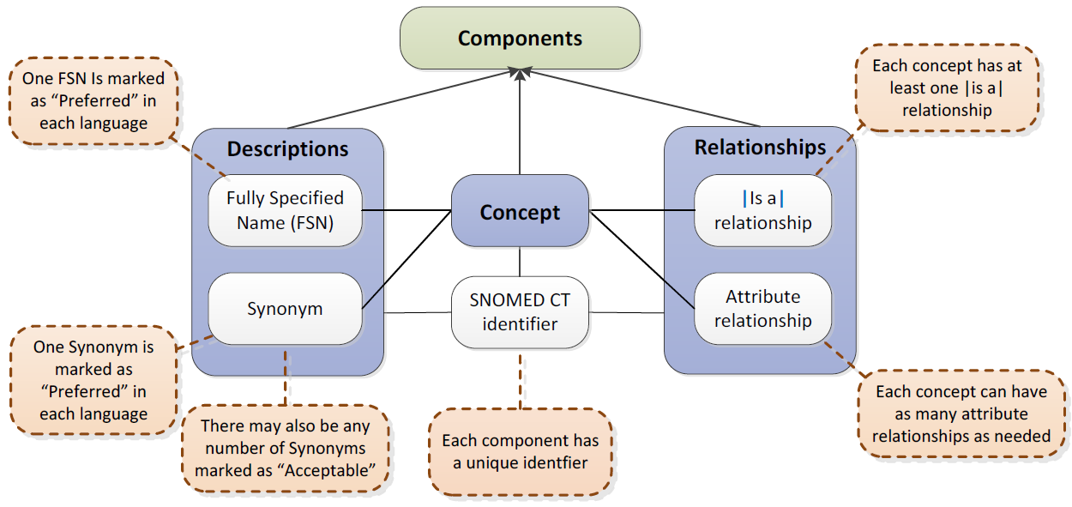
SNOMED CT structure
IHTSDO. SNOMED CT Starter Guide July 2014

Slide 71
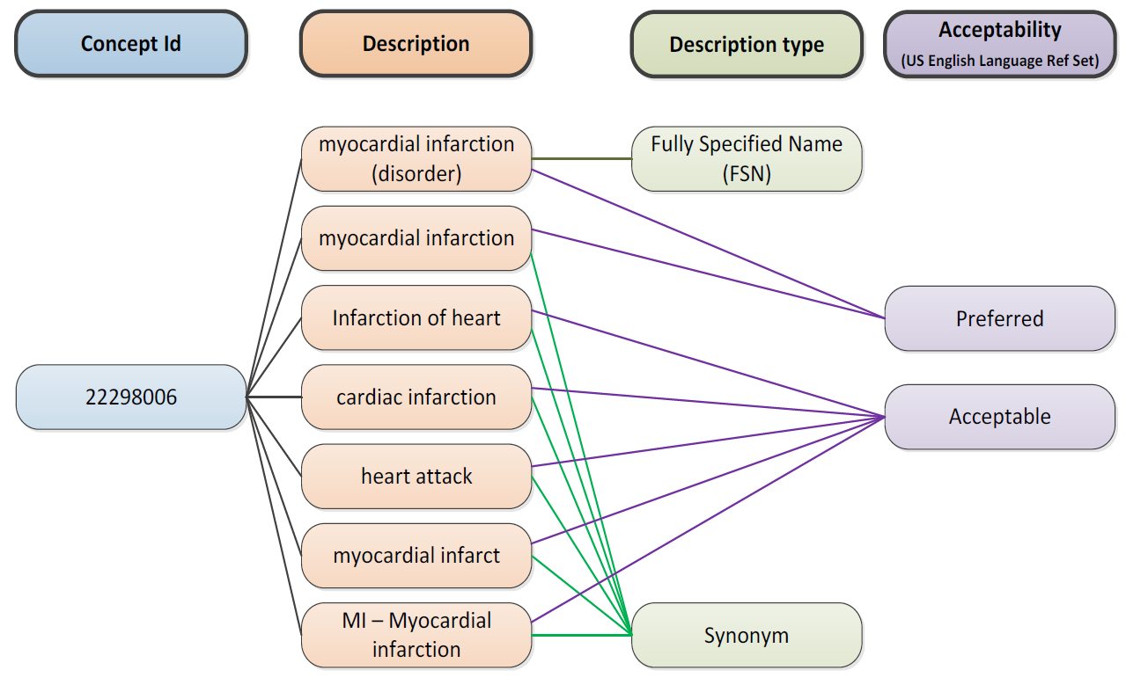
SNOMED CT Descriptions
IHTSDO. SNOMED CT Starter Guide July 2014

Slide 72
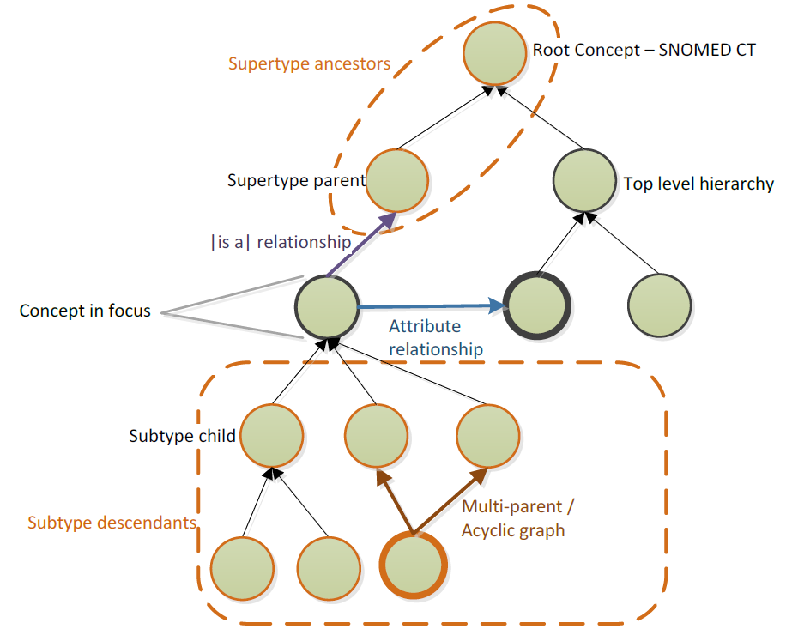
SNOMED CT Relationships

Slide 73
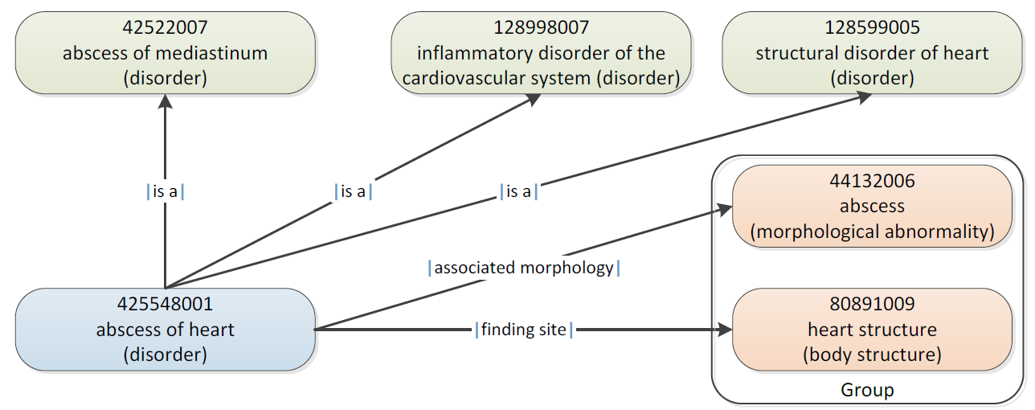
SNOMED CT Defining relationships
IHTSDO. SNOMED CT Starter Guide July 2014

Slide 74
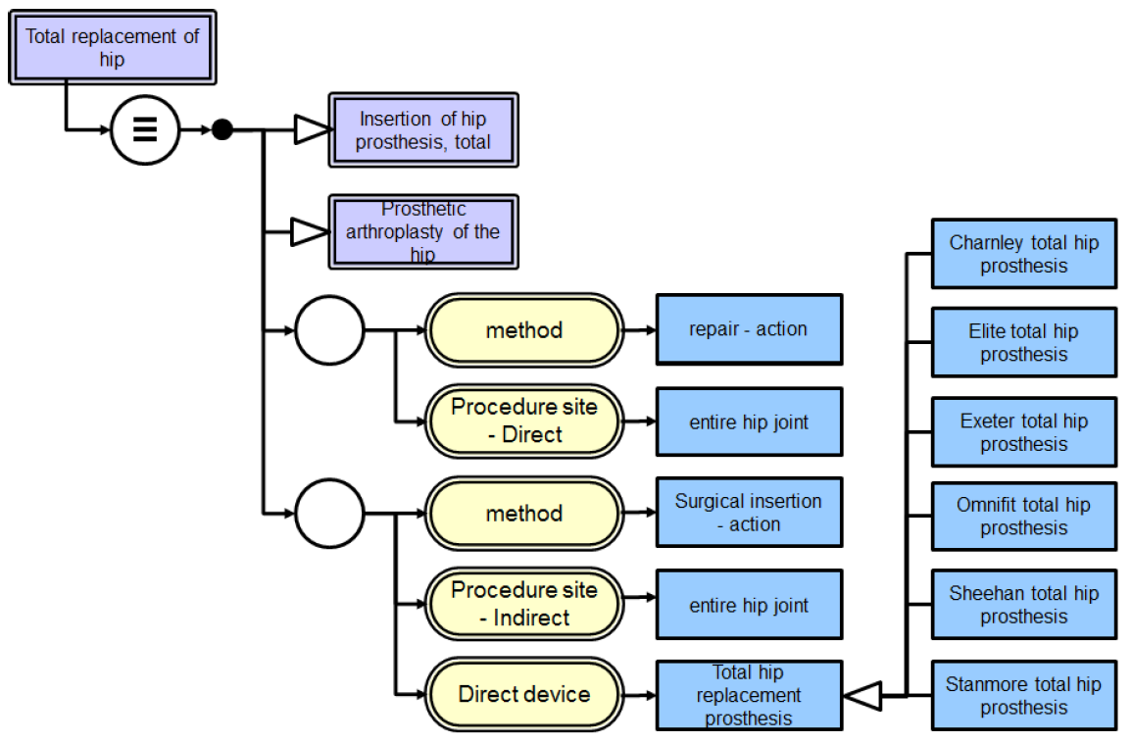
SNOMED CT’s DL
IHTSDO. SNOMED CT Starter Guide July 2014

Slide 75
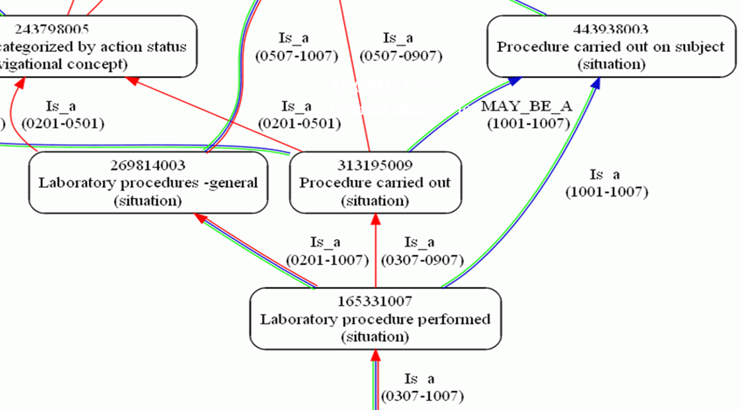
Cell phenotyping performed
SNOMED CT:
Indirect changes to:
Ceusters W. Applying Evolutionary Terminology Auditing to SNOMED CT. In American Medical Informatics Association 2010 Annual Symposium (AMIA 2010) Proceedings, Washington DC, November 13-17, 2010:96-100.

Slide 76
Cell phenotyping performed
SNOMED CT:
Indirect changes to:
Activation
De-activation
Ceusters W. Applying Evolutionary Terminology Auditing to SNOMED CT. In American Medical Informatics Association 2010 Annual Symposium (AMIA 2010) Proceedings, Washington DC, November 13-17, 2010:96-100.

Slide 77
Changes in SNOMED CT (RF2) concepts and relationships
conceptID | Effective Time | Active | ModuleID | Definitional Status
301381004 | 20020131 | 1 | 900000000000207008 | 900000000000074008
301381004 | 20080131 | 0 | 900000000000207008 | 900000000000074008
FSN = ‘Discomforting present pain (finding)’

Slide 78
Changes in SNOMED CT (RF2) concepts and relationships
conceptID | Effective Time | Active | ModuleID | Definitional Status
301381004 | 20020131 | 1 | 900000000000207008 | 900000000000074008
301381004 | 20080131 | 0 | 900000000000207008 | 900000000000074008
FSN = ‘Discomforting present pain (finding)’
RelID | Effective Time | Active | Attribute | Target
126300024 | 20020131 | 1 | Is a | Pain (finding)
126300024 | 20040131 | 0 | Is a | Pain (finding)
126301023 | 20020131 | 1 | Is a | Finding of present pain intensity (finding)
126301023 | 20080131 | 0 | Is a | Finding of present pain intensity (finding)
657858027 | 20020131 | 1 | Finding site | Structure of nervous system (body structure)
657858027 | 20060131 | 0 | Finding site | Structure of nervous system (body structure)
2260209021 | 20030731 | 1 | Interprets | Nervous system function (observable entity)
2260209021 | 20050131 | 0 | Interprets | Nervous system function (observable entity)
2458913020 | 20040131 | 1 | Is a | Discomfort (finding)
2458913020 | 20080131 | 0 | Is a | Discomfort (finding)
2858465020 | 20060131 | 1 | Finding site | Anatomical structure (body structure)
2858465020 | 20080131 | 0 | Finding site | Anatomical structure (body structure)

Slide 79
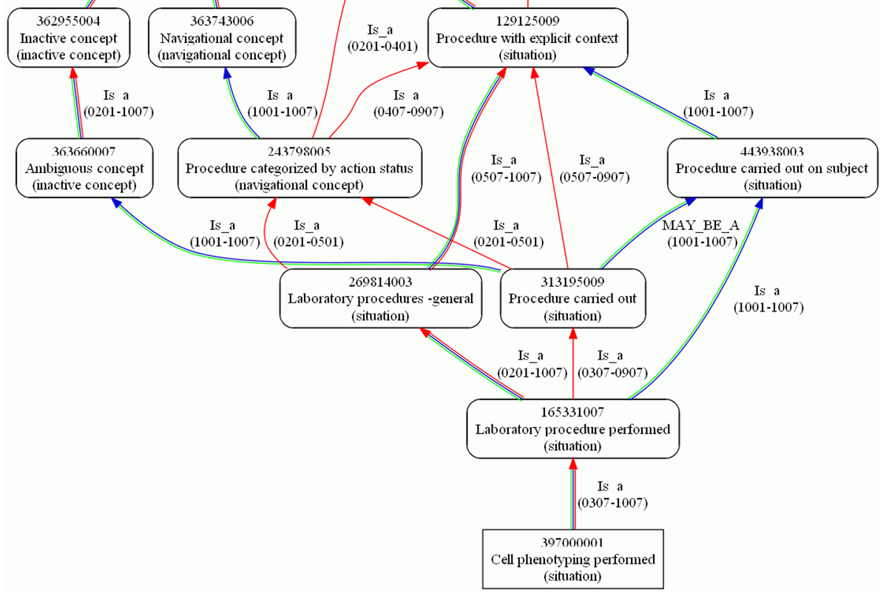
Cell phenotyping performed
SNOMED CT:
Indirect changes to:
Ceusters W. Applying Evolutionary Terminology Auditing to SNOMED CT. In American Medical Informatics Association 2010 Annual Symposium (AMIA 2010) Proceedings, Washington DC, November 13-17, 2010:96-100.

Slide 80
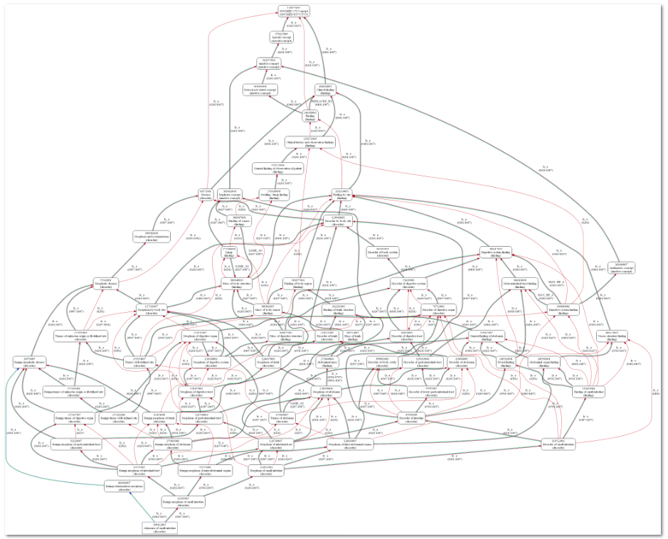
Adenoma of small intestine
SNOMED CT:
Indirect changes to:
Ceusters W. Applying Evolutionary Terminology Auditing to SNOMED CT. In American Medical Informatics Association 2010 Annual Symposium (AMIA 2010) Proceedings, Washington DC, November 13-17, 2010:96-100.

Slide 81
SNOMED CT concept (in)activations
 | From Concept file |  | From 2016 'snapshot' file
Version | Activated In | Deactivated in | Active since | Inactive since
20020131 | 278183 | 47833 | 185564 | 47673
20020731 | 7485 | 1747 | 9950 | 1725
20030131 | 7806 | 5834 | 7151 | 5569
20030731 | 8124 | 1905 | 7684 | 1888
20040131 | 4573 | 2008 | 3899 | 1990
20040731 | 4599 | 1580 | 7462 | 1471
20050131 | 2817 | 897 | 6699 | 891
20050731 | 1722 | 438 | 4148 | 433
20060131 | 2422 | 718 | 6687 | 710
20060731 | 2125 | 1035 | 2295 | 1029
20070131 | 3036 | 1363 | 4717 | 1351
20070731 | 2325 | 907 | 4153 | 902
20080131 | 2073 | 1071 | 3403 | 1070
20080731 | 5126 | 889 | 11747 | 884
20090131 | 3745 | 9221 | 4214 | 9221
20090731 | 1337 | 3657 | 4773 | 3655
20100131 | 1744 | 18293 | 3702 | 18292
20100731 | 1157 | 289 | 2288 | 288
20110131 | 1906 | 211 | 3363 | 210
20110731 | 1969 | 189 | 2162 | 187
20120131 | 319 | 108 | 340 | 108
20120731 | 794 | 281 | 1124 | 279
20130131 | 1673 | 114 | 1841 | 112
20130731 | 1124 | 304 | 1307 | 304
20140131 | 2229 | 2466 | 2593 | 2466
20140731 | 12610 | 349 | 12580 | 348
20150131 | 3287 | 1131 | 3671 | 1131
20150731 | 4458 | 399 | 5309 | 399
20160131 | 3115 | 726 | 4620 | 726
SUMS | 373883 | 105963 | 319446 | 105312
Changes in concepts are enormous and not straightforward.
Ceusters w, Bona J. Analyzing SNOMED CT’s Historical Data: Pitfalls and Possibilities. In: American Medical Informatics Association 2016 Annual Symposium Proceedings, Chicago IL, November 12-16, 2016;361-370.
Research based on the January 2016 version of SNOMED CT

Slide 82
SNOMED CT concept (in)activations
 | From Concept file |  | From 2016 'snapshot' file
Version | Activated In | Deactivated in | Active since | Inactive since
20020131 | 278183 | 47833 | 185564 | 47673
20020731 | 7485 | 1747 | 9950 | 1725
20030131 | 7806 | 5834 | 7151 | 5569
20030731 | 8124 | 1905 | 7684 | 1888
20040131 | 4573 | 2008 | 3899 | 1990
20040731 | 4599 | 1580 | 7462 | 1471
20050131 | 2817 | 897 | 6699 | 891
20050731 | 1722 | 438 | 4148 | 433
20060131 | 2422 | 718 | 6687 | 710
20060731 | 2125 | 1035 | 2295 | 1029
20070131 | 3036 | 1363 | 4717 | 1351
20070731 | 2325 | 907 | 4153 | 902
20080131 | 2073 | 1071 | 3403 | 1070
20080731 | 5126 | 889 | 11747 | 884
20090131 | 3745 | 9221 | 4214 | 9221
20090731 | 1337 | 3657 | 4773 | 3655
20100131 | 1744 | 18293 | 3702 | 18292
20100731 | 1157 | 289 | 2288 | 288
20110131 | 1906 | 211 | 3363 | 210
20110731 | 1969 | 189 | 2162 | 187
20120131 | 319 | 108 | 340 | 108
20120731 | 794 | 281 | 1124 | 279
20130131 | 1673 | 114 | 1841 | 112
20130731 | 1124 | 304 | 1307 | 304
20140131 | 2229 | 2466 | 2593 | 2466
20140731 | 12610 | 349 | 12580 | 348
20150131 | 3287 | 1131 | 3671 | 1131
20150731 | 4458 | 399 | 5309 | 399
20160131 | 3115 | 726 | 4620 | 726
SUMS | 373883 | 105963 | 319446 | 105312
Whereas in 2002 14.7% of total concepts were inactive, it was already 24.8% in January 2016.
Ceusters w, Bona J. Analyzing SNOMED CT’s Historical Data: Pitfalls and Possibilities. In: American Medical Informatics Association 2016 Annual Symposium Proceedings, Chicago IL, November 12-16, 2016;361-370.
Research based on the January 2016 version of SNOMED CT

Slide 83
SNOMED CT concept (in)activations
 | From Concept file |  | From 2016 'snapshot' file
Version | Activated In | Deactivated in | Active since | Inactive since
20020131 | 278183 | 47833 | 185564 | 47673
20020731 | 7485 | 1747 | 9950 | 1725
20030131 | 7806 | 5834 | 7151 | 5569
20030731 | 8124 | 1905 | 7684 | 1888
20040131 | 4573 | 2008 | 3899 | 1990
20040731 | 4599 | 1580 | 7462 | 1471
20050131 | 2817 | 897 | 6699 | 891
20050731 | 1722 | 438 | 4148 | 433
20060131 | 2422 | 718 | 6687 | 710
20060731 | 2125 | 1035 | 2295 | 1029
20070131 | 3036 | 1363 | 4717 | 1351
20070731 | 2325 | 907 | 4153 | 902
20080131 | 2073 | 1071 | 3403 | 1070
20080731 | 5126 | 889 | 11747 | 884
20090131 | 3745 | 9221 | 4214 | 9221
20090731 | 1337 | 3657 | 4773 | 3655
20100131 | 1744 | 18293 | 3702 | 18292
20100731 | 1157 | 289 | 2288 | 288
20110131 | 1906 | 211 | 3363 | 210
20110731 | 1969 | 189 | 2162 | 187
20120131 | 319 | 108 | 340 | 108
20120731 | 794 | 281 | 1124 | 279
20130131 | 1673 | 114 | 1841 | 112
20130731 | 1124 | 304 | 1307 | 304
20140131 | 2229 | 2466 | 2593 | 2466
20140731 | 12610 | 349 | 12580 | 348
20150131 | 3287 | 1131 | 3671 | 1131
20150731 | 4458 | 399 | 5309 | 399
20160131 | 3115 | 726 | 4620 | 726
SUMS | 373883 | 105963 | 319446 | 105312
All versions exhibit activations and inactivations, but only few versions come with more inactivations than activations.
Ceusters w, Bona J. Analyzing SNOMED CT’s Historical Data: Pitfalls and Possibilities. In: American Medical Informatics Association 2016 Annual Symposium Proceedings, Chicago IL, November 12-16, 2016;361-370.
Research based on the January 2016 version of SNOMED CT

Slide 84
SNOMED CT concept (in)activations
 | From Concept file |  | From 2016 'snapshot' file
Version | Activated In | Deactivated in | Active since | Inactive since
20020131 | 278183 | 47833 | 185564 | 47673
20020731 | 7485 | 1747 | 9950 | 1725
20030131 | 7806 | 5834 | 7151 | 5569
20030731 | 8124 | 1905 | 7684 | 1888
20040131 | 4573 | 2008 | 3899 | 1990
20040731 | 4599 | 1580 | 7462 | 1471
20050131 | 2817 | 897 | 6699 | 891
20050731 | 1722 | 438 | 4148 | 433
20060131 | 2422 | 718 | 6687 | 710
20060731 | 2125 | 1035 | 2295 | 1029
20070131 | 3036 | 1363 | 4717 | 1351
20070731 | 2325 | 907 | 4153 | 902
20080131 | 2073 | 1071 | 3403 | 1070
20080731 | 5126 | 889 | 11747 | 884
20090131 | 3745 | 9221 | 4214 | 9221
20090731 | 1337 | 3657 | 4773 | 3655
20100131 | 1744 | 18293 | 3702 | 18292
20100731 | 1157 | 289 | 2288 | 288
20110131 | 1906 | 211 | 3363 | 210
20110731 | 1969 | 189 | 2162 | 187
20120131 | 319 | 108 | 340 | 108
20120731 | 794 | 281 | 1124 | 279
20130131 | 1673 | 114 | 1841 | 112
20130731 | 1124 | 304 | 1307 | 304
20140131 | 2229 | 2466 | 2593 | 2466
20140731 | 12610 | 349 | 12580 | 348
20150131 | 3287 | 1131 | 3671 | 1131
20150731 | 4458 | 399 | 5309 | 399
20160131 | 3115 | 726 | 4620 | 726
SUMS | 373883 | 105963 | 319446 | 105312
Of the 278,183 active concepts in 2002, only 66.7% was (still) active in January 2016.
Ceusters w, Bona J. Analyzing SNOMED CT’s Historical Data: Pitfalls and Possibilities. In: American Medical Informatics Association 2016 Annual Symposium Proceedings, Chicago IL, November 12-16, 2016;361-370.
Research based on the January 2016 version of SNOMED CT

Slide 85
SNOMED CT concept (in)activations
 | From Concept file |  | From 2016 'snapshot' file
Version | Activated In | Deactivated in | Active since | Inactive since
20020131 | 278183 | 47833 | 185564 | 47673
20020731 | 7485 | 1747 | 9950 | 1725
20030131 | 7806 | 5834 | 7151 | 5569
20030731 | 8124 | 1905 | 7684 | 1888
20040131 | 4573 | 2008 | 3899 | 1990
20040731 | 4599 | 1580 | 7462 | 1471
20050131 | 2817 | 897 | 6699 | 891
20050731 | 1722 | 438 | 4148 | 433
20060131 | 2422 | 718 | 6687 | 710
20060731 | 2125 | 1035 | 2295 | 1029
20070131 | 3036 | 1363 | 4717 | 1351
20070731 | 2325 | 907 | 4153 | 902
20080131 | 2073 | 1071 | 3403 | 1070
20080731 | 5126 | 889 | 11747 | 884
20090131 | 3745 | 9221 | 4214 | 9221
20090731 | 1337 | 3657 | 4773 | 3655
20100131 | 1744 | 18293 | 3702 | 18292
20100731 | 1157 | 289 | 2288 | 288
20110131 | 1906 | 211 | 3363 | 210
20110731 | 1969 | 189 | 2162 | 187
20120131 | 319 | 108 | 340 | 108
20120731 | 794 | 281 | 1124 | 279
20130131 | 1673 | 114 | 1841 | 112
20130731 | 1124 | 304 | 1307 | 304
20140131 | 2229 | 2466 | 2593 | 2466
20140731 | 12610 | 349 | 12580 | 348
20150131 | 3287 | 1131 | 3671 | 1131
20150731 | 4458 | 399 | 5309 | 399
20160131 | 3115 | 726 | 4620 | 726
SUMS | 373883 | 105963 | 319446 | 105312
Of the 47,833 inactive concepts in 2002, 160 became re-activated between 2002 and 2016.
Ceusters w, Bona J. Analyzing SNOMED CT’s Historical Data: Pitfalls and Possibilities. In: American Medical Informatics Association 2016 Annual Symposium Proceedings, Chicago IL, November 12-16, 2016;361-370.
Research based on the January 2016 version of SNOMED CT

Slide 86
SNOMED CT concept (in)activations
 | From Concept file |  | From 2016 'snapshot' file
Version | Activated In | Deactivated in | Active since | Inactive since
20020131 | 278183 | 47833 | 185564 | 47673
20020731 | 7485 | 1747 | 9950 | 1725
20030131 | 7806 | 5834 | 7151 | 5569
20030731 | 8124 | 1905 | 7684 | 1888
20040131 | 4573 | 2008 | 3899 | 1990
20040731 | 4599 | 1580 | 7462 | 1471
20050131 | 2817 | 897 | 6699 | 891
20050731 | 1722 | 438 | 4148 | 433
20060131 | 2422 | 718 | 6687 | 710
20060731 | 2125 | 1035 | 2295 | 1029
20070131 | 3036 | 1363 | 4717 | 1351
20070731 | 2325 | 907 | 4153 | 902
20080131 | 2073 | 1071 | 3403 | 1070
20080731 | 5126 | 889 | 11747 | 884
20090131 | 3745 | 9221 | 4214 | 9221
20090731 | 1337 | 3657 | 4773 | 3655
20100131 | 1744 | 18293 | 3702 | 18292
20100731 | 1157 | 289 | 2288 | 288
20110131 | 1906 | 211 | 3363 | 210
20110731 | 1969 | 189 | 2162 | 187
20120131 | 319 | 108 | 340 | 108
20120731 | 794 | 281 | 1124 | 279
20130131 | 1673 | 114 | 1841 | 112
20130731 | 1124 | 304 | 1307 | 304
20140131 | 2229 | 2466 | 2593 | 2466
20140731 | 12610 | 349 | 12580 | 348
20150131 | 3287 | 1131 | 3671 | 1131
20150731 | 4458 | 399 | 5309 | 399
20160131 | 3115 | 726 | 4620 | 726
SUMS | 373883 | 105963 | 319446 | 105312
Of all inactivated concepts, 651 became reactivated.
Ceusters w, Bona J. Analyzing SNOMED CT’s Historical Data: Pitfalls and Possibilities. In: American Medical Informatics Association 2016 Annual Symposium Proceedings, Chicago IL, November 12-16, 2016;361-370.
Research based on the January 2016 version of SNOMED CT

Slide 87
SNOMED CT concept (in)activations
 | From Concept file |  | From 2016 'snapshot' file
Version | Activated In | Deactivated in | Active since | Inactive since
20020131 | 278183 | 47833 | 185564 | 47673
20020731 | 7485 | 1747 | 9950 | 1725
20030131 | 7806 | 5834 | 7151 | 5569
20030731 | 8124 | 1905 | 7684 | 1888
20040131 | 4573 | 2008 | 3899 | 1990
20040731 | 4599 | 1580 | 7462 | 1471
20050131 | 2817 | 897 | 6699 | 891
20050731 | 1722 | 438 | 4148 | 433
20060131 | 2422 | 718 | 6687 | 710
20060731 | 2125 | 1035 | 2295 | 1029
20070131 | 3036 | 1363 | 4717 | 1351
20070731 | 2325 | 907 | 4153 | 902
20080131 | 2073 | 1071 | 3403 | 1070
20080731 | 5126 | 889 | 11747 | 884
20090131 | 3745 | 9221 | 4214 | 9221
20090731 | 1337 | 3657 | 4773 | 3655
20100131 | 1744 | 18293 | 3702 | 18292
20100731 | 1157 | 289 | 2288 | 288
20110131 | 1906 | 211 | 3363 | 210
20110731 | 1969 | 189 | 2162 | 187
20120131 | 319 | 108 | 340 | 108
20120731 | 794 | 281 | 1124 | 279
20130131 | 1673 | 114 | 1841 | 112
20130731 | 1124 | 304 | 1307 | 304
20140131 | 2229 | 2466 | 2593 | 2466
20140731 | 12610 | 349 | 12580 | 348
20150131 | 3287 | 1131 | 3671 | 1131
20150731 | 4458 | 399 | 5309 | 399
20160131 | 3115 | 726 | 4620 | 726
SUMS | 373883 | 105963 | 319446 | 105312
A total of 153,830 activations and deactivations effectuated since the first version, resulted in:
an increase of 41,263 active concepts (→ a growth of merely 14.8%), with
an efficiency of only 26.9%.
Research based on the January 2016 version of SNOMED CT

Slide 88
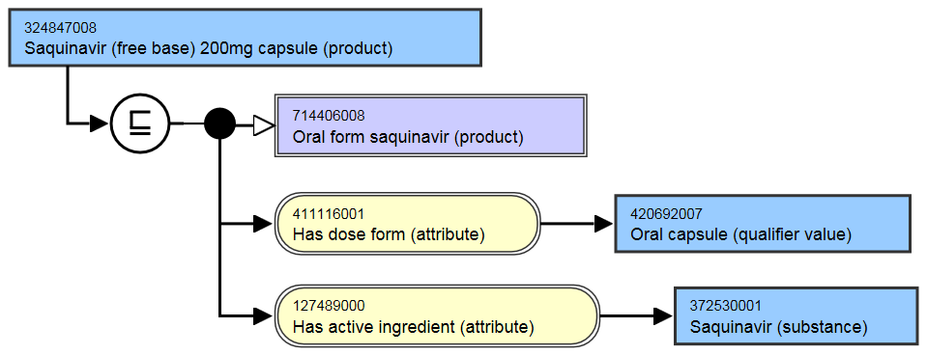
Several concepts exhibit multiple (in)activations: e.g. the history of Saquinovir
ConceptID | Version | Active
324847008 | 20020131 | 1
324847008 | 20030131 | 0
324847008 | 20040131 | 1
324847008 | 20040731 | 0
324847008 | 20050131 | 1
324847008 | 20050731 | 0
324847008 | 20070131 | 1

Slide 89
Several concepts exhibit multiple (in)activations: e.g. the history of Saquinovir
ConceptID | Version | Active
324847008 | 20020131 | 1
324847008 | 20030131 | 0
324847008 | 20040131 | 1
324847008 | 20040731 | 0
324847008 | 20050131 | 1
324847008 | 20050731 | 0
324847008 | 20070131 | 1
They changed their mind 7 times!

Slide 90
History of ‘Saquinavir 200mg capsule’
ConceptID | Version | Active
324847008 | 20020131 | 1
324847008 | 20030131 | 0
324847008 | 20040131 | 1
324847008 | 20040731 | 0
324847008 | 20050131 | 1
324847008 | 20050731 | 0
324847008 | 20070131 | 1

Slide 91
Changes in descriptions
descriptionID | Effective Time | Active | Description Type | Term
410015012 | 20020131 | 1 | Synonym | Asthenia [D]
410015012 | 20020731 | 0 | Synonym | Asthenia [D]
666971011 | 20020131 | 1 | FSN | Asthenia [D] (finding)
666971011 | 20030131 | 0 | FSN | Asthenia [D] (finding)
1237162017 | 20020731 | 1 | Synonym | Asthenia [D]
1472277017 | 20030131 | 1 | FSN | [D]Asthenia (context-dependent category)
1472277017 | 20060731 | 0 | FSN | [D]Asthenia (context-dependent category)
1489933012 | 20030131 | 1 | Synonym | [D]Asthenia
2610401019 | 20060731 | 1 | FSN | [D]Asthenia (situation)

Slide 92
Some changes in descriptions are related to changes in the hierarchy
descriptionID | Effective Time | Active | Description Type | Term
410015012 | 20020131 | 1 | Synonym | Asthenia [D]
410015012 | 20020731 | 0 | Synonym | Asthenia [D]
666971011 | 20020131 | 1 | FSN | Asthenia [D] (finding)
666971011 | 20030131 | 0 | FSN | Asthenia [D] (finding)
1237162017 | 20020731 | 1 | Synonym | Asthenia [D]
1472277017 | 20030131 | 1 | FSN | [D]Asthenia (context-dependent category)
1472277017 | 20060731 | 0 | FSN | [D]Asthenia (context-dependent category)
1489933012 | 20030131 | 1 | Synonym | [D]Asthenia
2610401019 | 20060731 | 1 | FSN | [D]Asthenia (situation)
‘Semantic tags’

Slide 93
‘Semantic tags’ (per SNOMED CT documentation)
Descriptions provide for each concept a Fully Specified Name (FSN) most of which ‘end with a semantic tag in parentheses and which indicates the semantic category to which the concept belongs (e.g. clinical finding, disorder, procedure, organism, person, etc.)’ [4, p41].
IHTSDO. International Health Terminology Standards Development Organization - SNOMED CT® Technical Implementation Guide - January 2015 International Release (US English). 2015. p. 757.

Slide 94
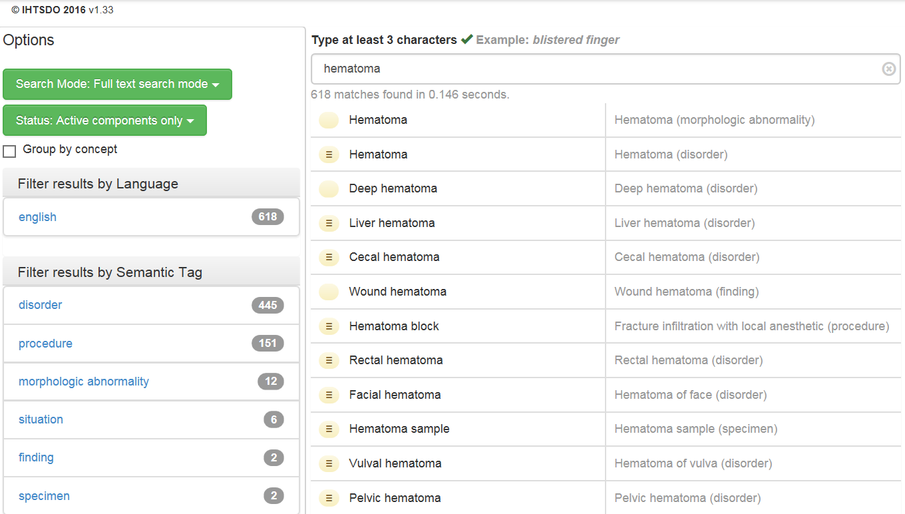
Semantic tags
…

Slide 95
‘Semantic tags’ (per SNOMED CT documentation)
Descriptions provide for each concept a Fully Specified Name (FSN) most of which ‘end with a semantic tag in parentheses and which indicates the semantic category to which the concept belongs (e.g. clinical finding, disorder, procedure, organism, person, etc.)’ [4, p41].
‘the semantic tag helps to disambiguate different concepts which may be referred to by the same commonly used word or phrase’ [4, p41].
IHTSDO. International Health Terminology Standards Development Organization - SNOMED CT® Technical Implementation Guide - January 2015 International Release (US English). 2015. p. 757.

Slide 96
‘Semantic tags’ (per SNOMED CT documentation)
Descriptions provide for each concept a Fully Specified Name (FSN) most of which ‘end with a semantic tag in parentheses and which indicates the semantic category to which the concept belongs (e.g. clinical finding, disorder, procedure, organism, person, etc.)’ [4, p41].
‘the semantic tag helps to disambiguate different concepts which may be referred to by the same commonly used word or phrase’ [4, p41].
For example, it is the semantic tag ‘morphologic abnormality’ in the FSN ‘Hematoma (morphologic abnormality)’ that disambiguates the concept to which this FSN is assigned from a second concept with FSN ‘Hematoma (disorder)’. The former is intended to be used for what ‘a pathologist sees at the tissue level’, while the latter ‘represents the clinical diagnosis that a clinician makes when they decide that a person has a “hematoma”’ [4, p41].
IHTSDO. International Health Terminology Standards Development Organization - SNOMED CT® Technical Implementation Guide - January 2015 International Release (US English). 2015. p. 757.

Slide 97
Semantic tags

Slide 98
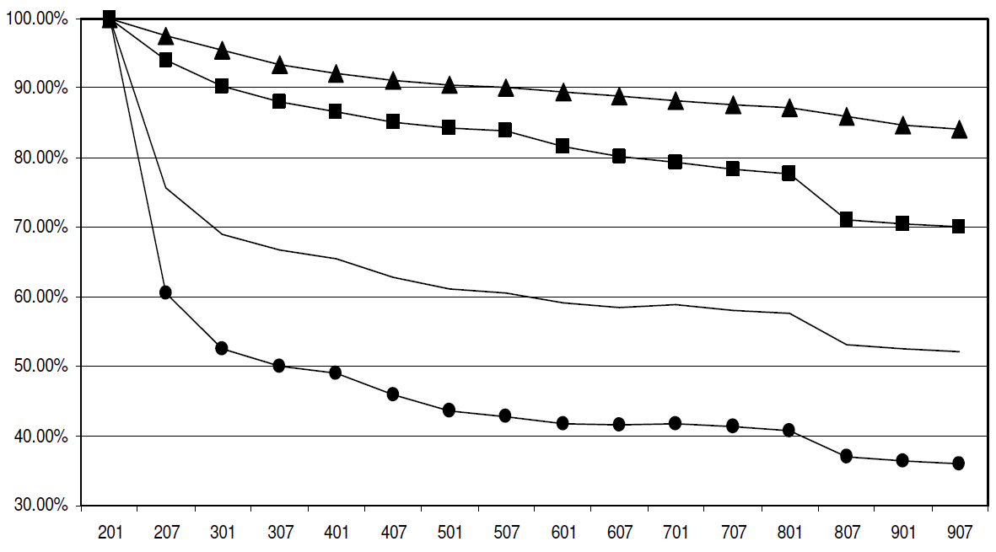
Ungraceful degradation of assertions in SNOMED CT (2002 – 2009)
concepts
terms
all
relationships
Ceusters W. Applying Evolutionary Terminology Auditing to SNOMED CT. In American Medical Informatics Association 2010 Annual Symposium (AMIA 2010) Proceedings, Washington DC, November 13-17, 2010:96-100.

Slide 99
Concepts and confusions in SNOMED CT
‘concept’:
  ‘a clinical idea to which a unique concept identifier has been assigned’; ‘the meaning of a concept can be determined from relationships to other concepts and from associated descriptions that include human readable terms’
the term is also stated to be a homonym for:
  ‘concept identifier’ as well as for
  ‘the real-world referent(s) of the concept identifier, that is, the class of entities in reality that the concept identifier represents’

Slide 100
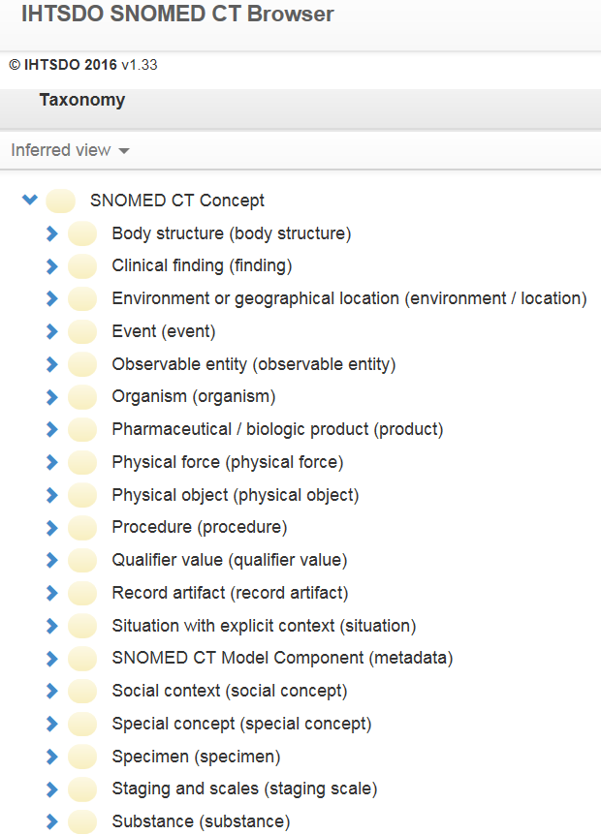
SNOMED CT’s top categories
denote (roughly):
Entities on the side of the patient

Slide 101
SNOMED CT’s top categories
denote (roughly):
Entities on the side of the patient
Entities to describe entities on the side of the patient

Slide 102
SNOMED CT’s top categories
denote (roughly):
Entities on the side of the patient
Entities to describe entities on the side of the patient
Entities on the side of SNOMED CT as descriptive tool

Slide 103
SNOMED CT’s top categories
denote (roughly):
Entities on the side of the patient
Entities to describe entities on the side of the patient
Entities on the side of SNOMED CT as descriptive tool
A hodge podge of A and B

Slide 104
SNOMED CT’s top categories
Describe
  The structure of SNOMED CT
  Changes introduced in any of the SNOMED CT components
Entities on the side of SNOMED CT as descriptive tool

Slide 105
Cell phenotyping performed
You remember:
Activation
De-activation
Ceusters W. Applying Evolutionary Terminology Auditing to SNOMED CT. In American Medical Informatics Association 2010 Annual Symposium (AMIA 2010) Proceedings, Washington DC, November 13-17, 2010:96-100.

Slide 106
Cell phenotyping performed
You remember:
Activation
De-activation
Ceusters W. Applying Evolutionary Terminology Auditing to SNOMED CT. In American Medical Informatics Association 2010 Annual Symposium (AMIA 2010) Proceedings, Washington DC, November 13-17, 2010:96-100.

Slide 107
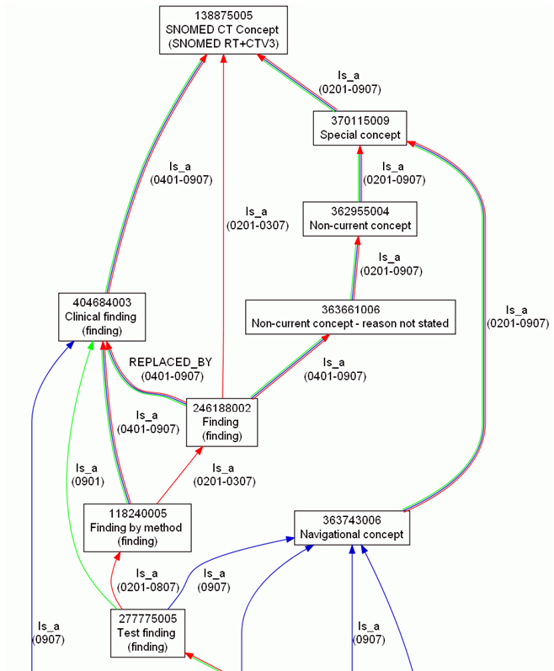
Concept evolution in SNOMED CT
Ceusters W. Applying Evolutionary Terminology Auditing to SNOMED CT. In American Medical Informatics Association 2010 Annual Symposium (AMIA 2010) Proceedings, Washington DC, November 13-17, 2010:96-100.

Slide 108
Historical association reference set types
HARS name | Use
Possibly equivalent to (P) | From an ambiguous concept to one or more active concepts that represents one of the possible meanings of the inactive concept.
Moved to (T) | From a component to a namespace to which the component has been moved
Moved from (F) | From a namespace to the original component Identifier in its previous namespace.
Replaced by (R) | From an erroneous or obsolete inactive component to a single active replacement component.
Same as (S) | From a duplicate component to the active component that this component duplicates.
Was a (W) | From an inactive classification concept such as "not otherwise specified" to the active concept that was formerly its most proximal supertype.
Alternative (Z) | From an inactive classification concept derived from ICD-9 Chapter XVI 'Symptoms signs and ill-defined conditions' with the most similar active concept.
Refers to | From an inactive description which is inappropriate to the concept it is directly linked to but instead should refer to the concept referenced.

Slide 109
Component inactivation set types for concepts
CIRS value | Concept status and motivation
Duplicate (D) | inactive because it has the same meaning as another Concept
Outdated (O) | inactive because it is an outdated concept that is no longer used.
Ambiguous (A) | inactive because it is inherently ambiguous either because of an incomplete FSN or because it has several associated terms that are not regarded as synonymous or partial synonymous.
Erroneous (E) | inactive because it contains an error
Limited (L) | active prior to Jan 2010, inactive since then because of unstable meaning within SNOMED CT
moved to (M) | inactive because moved to another namespace.
Pending move | active but in the process of being moved to another namespace

Slide 110
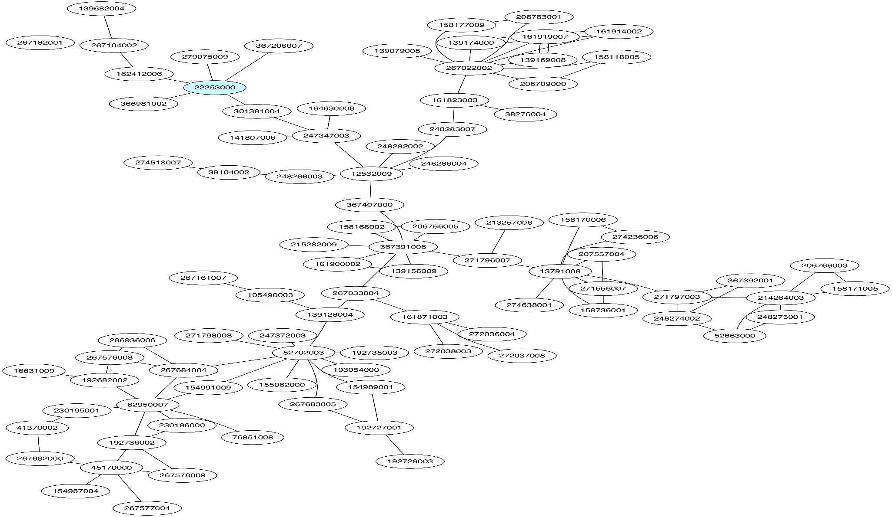
Generation of clusters from HARS
Start
Pain (Finding)
General symptom
(Finding)
Malaise (Finding)
Malaise/Lethargy (Finding)
Lethargy (Finding)
Asthenia (Finding)
Chronic Fatigue Syndrome (disorder)
Encephalomyelitis (disorder)

Slide 111
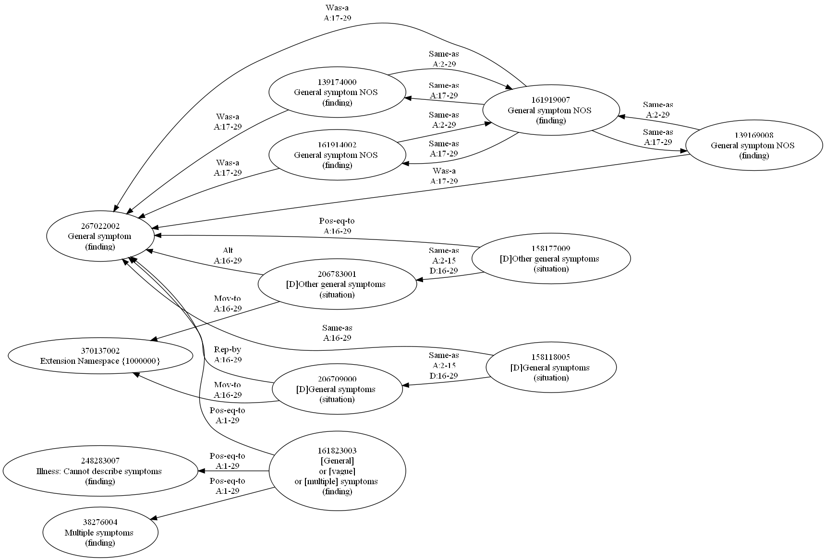
Graphic representation of (part of) a cluster involving ‘general symptoms’

Slide 112
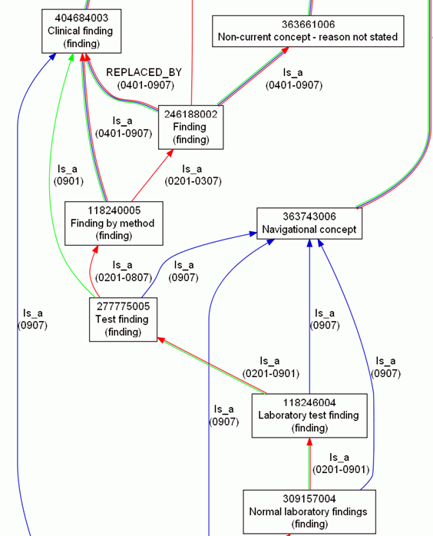
SNOMED CT suffers from a confusion
What is
inside
versus
outside SNOMED CT?

Slide 113
Inside versus outside an ontology
What is
inside
versus
outside SNOMED CT?

Slide 114
Inside versus outside an ontology
What is
inside
versus
outside SNOMED CT?

Slide 115
Inside versus outside an ontology
What is
inside
versus
outside SNOMED CT?
Clear shift in meaning, incompatible with SNOMED CT’s change policy

Slide 116
Inside versus outside an ontology
What is
inside
versus
outside SNOMED CT?
‘halfway’ concept:
denotes external entities but viewed through internal organization

Slide 117
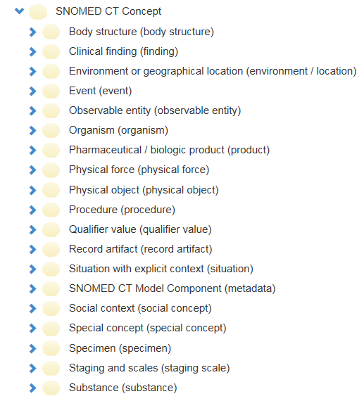
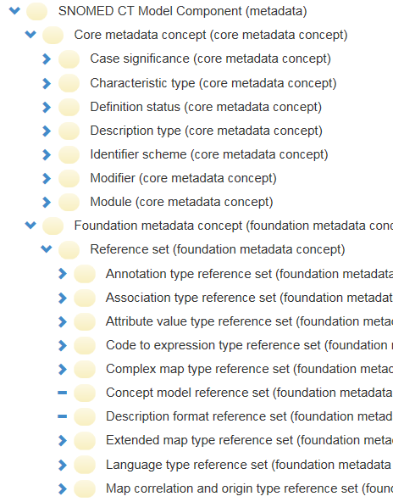
SNOMED CT inside versus outside

Slide 118
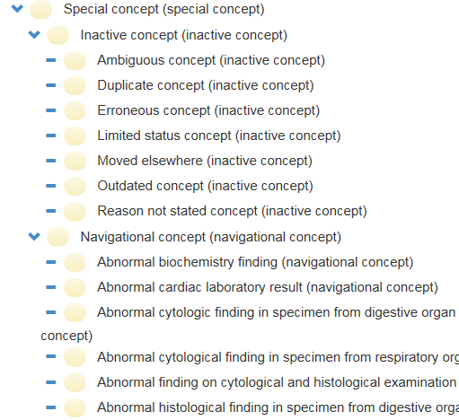
SNOMED CT inside versus outside

Slide 119
Post-hoc application of realism-based change management to SNOMED CT

Slide 120
Exercise: mapping ‘reasons for change’ to ETA
CT | (Existing) concept made … | N | Error Type
0 | active: in current use | 2,010
1 | inactive: ‘retired’ without a specified reason | 1,993
2 | inactive: withdrawn because duplication | 9,711
3 | inactive because no longer recognized as a valid clinical concept (outdated) | 1,348
4 | inactive because inherently ambiguous. | 5,829
5 | inactive because found to contain a mistake | 1,204
6 | active with limited clinical value (classification concept or an administrative definition) | 4,461
10 | inactive because moved elsewhere | 14,406
11 | pending move
 | TOTAL | 40,962
Ceusters W. Applying Evolutionary Terminology Auditing to SNOMED CT. In American Medical Informatics Association 2010 Annual Symposium (AMIA 2010) Proceedings, Washington DC, November 13-17, 2010:96-100.

Slide 121
Mapping ‘reasons for change’ to ETA
 | reality |  | representation
 |  |  | authors' belief |  | encoding
 | OE | OR | BE | BR | IE | TR
(1) | (2) | (3) | (4) | (5) | (6) | (7)
P+1 | Y | Y | Y | Y | Y | R+
A+1 | N | na | N | na | na | na
A+2 | Y | N | Y | N | na | na
A+3 | Y | N | NC | na | na | na
A+4 | N | na | NC | na | na | na
P-1 | N | na | Y | Y | Y | ¬R
P-2 | N | na | Y | Y | N | ¬R
P-3 | N | na | Y | Y | N | R–
P-4 | Y | Y | Y | Y | N | ¬R
P-5 | Y | Y | Y | Y | N | R-
P-6 | Y | N | Y | Y | Y | R+
P-7 | Y | N | Y | Y | N | ¬R
P-8 | Y | N | Y | Y | N | R–
P-9 | Y | Y | Y | Y | Y | R++
P-10 | Y | N | Y | Y | Y | R++
P-11 | Y | Y | Y | Y | Y | Ra
P-12 | N | na | Y | Y | Y | Ra
A-1 | Y | Y | Y | N | na | na
A-2 | Y | Y | N | na | na | na
A-3 | N | na | Y | N | na | na
A-4 | Y | N | N | na | na | na
A-5 | Y | Y | NC | na | na | na
(Existing) concept made … | Error Type
active: in current use | ?

Slide 122
Mapping ‘reasons for change’ to ETA
 | reality |  | representation
 |  |  | authors' belief |  | encoding
 | OE | OR | BE | BR | IE | TR
(1) | (2) | (3) | (4) | (5) | (6) | (7)
P+1 | Y | Y | Y | Y | Y | R+
A+1 | N | na | N | na | na | na
A+2 | Y | N | Y | N | na | na
A+3 | Y | N | NC | na | na | na
A+4 | N | na | NC | na | na | na
P-1 | N | na | Y | Y | Y | ¬R
P-2 | N | na | Y | Y | N | ¬R
P-3 | N | na | Y | Y | N | R–
P-4 | Y | Y | Y | Y | N | ¬R
P-5 | Y | Y | Y | Y | N | R-
P-6 | Y | N | Y | Y | Y | R+
P-7 | Y | N | Y | Y | N | ¬R
P-8 | Y | N | Y | Y | N | R–
P-9 | Y | Y | Y | Y | Y | R++
P-10 | Y | N | Y | Y | Y | R++
P-11 | Y | Y | Y | Y | Y | Ra
P-12 | N | na | Y | Y | Y | Ra
A-1 | Y | Y | Y | N | na | na
A-2 | Y | Y | N | na | na | na
A-3 | N | na | Y | N | na | na
A-4 | Y | N | N | na | na | na
A-5 | Y | Y | NC | na | na | na
(Existing) concept made … | Error Type
active: in current use | A-1

Slide 123
Mapping ‘reasons for change’ to ETA
 | reality |  | representation
 |  |  | authors' belief |  | encoding
 | OE | OR | BE | BR | IE | TR
(1) | (2) | (3) | (4) | (5) | (6) | (7)
P+1 | Y | Y | Y | Y | Y | R+
A+1 | N | na | N | na | na | na
A+2 | Y | N | Y | N | na | na
A+3 | Y | N | NC | na | na | na
A+4 | N | na | NC | na | na | na
P-1 | N | na | Y | Y | Y | ¬R
P-2 | N | na | Y | Y | N | ¬R
P-3 | N | na | Y | Y | N | R–
P-4 | Y | Y | Y | Y | N | ¬R
P-5 | Y | Y | Y | Y | N | R-
P-6 | Y | N | Y | Y | Y | R+
P-7 | Y | N | Y | Y | N | ¬R
P-8 | Y | N | Y | Y | N | R–
P-9 | Y | Y | Y | Y | Y | R++
P-10 | Y | N | Y | Y | Y | R++
P-11 | Y | Y | Y | Y | Y | Ra
P-12 | N | na | Y | Y | Y | Ra
A-1 | Y | Y | Y | N | na | na
A-2 | Y | Y | N | na | na | na
A-3 | N | na | Y | N | na | na
A-4 | Y | N | N | na | na | na
A-5 | Y | Y | NC | na | na | na
(Existing) concept made … | Error Type
inactive: ‘retired’ without a specified reason | ?

Slide 124
Mapping ‘reasons for change’ to ETA
 | reality |  | representation
 |  |  | authors' belief |  | encoding
 | OE | OR | BE | BR | IE | TR
(1) | (2) | (3) | (4) | (5) | (6) | (7)
P+1 | Y | Y | Y | Y | Y | R+
A+1 | N | na | N | na | na | na
A+2 | Y | N | Y | N | na | na
A+3 | Y | N | NC | na | na | na
A+4 | N | na | NC | na | na | na
P-1 | N | na | Y | Y | Y | ¬R
P-2 | N | na | Y | Y | N | ¬R
P-3 | N | na | Y | Y | N | R–
P-4 | Y | Y | Y | Y | N | ¬R
P-5 | Y | Y | Y | Y | N | R-
P-6 | Y | N | Y | Y | Y | R+
P-7 | Y | N | Y | Y | N | ¬R
P-8 | Y | N | Y | Y | N | R–
P-9 | Y | Y | Y | Y | Y | R++
P-10 | Y | N | Y | Y | Y | R++
P-11 | Y | Y | Y | Y | Y | Ra
P-12 | N | na | Y | Y | Y | Ra
A-1 | Y | Y | Y | N | na | na
A-2 | Y | Y | N | na | na | na
A-3 | N | na | Y | N | na | na
A-4 | Y | N | N | na | na | na
A-5 | Y | Y | NC | na | na | na
(Existing) concept made … | Error Type
inactive: ‘retired’ without a specified reason | P-1

Slide 125
Mapping ‘reasons for change’ to ETA
 | reality |  | representation
 |  |  | authors' belief |  | encoding
 | OE | OR | BE | BR | IE | TR
(1) | (2) | (3) | (4) | (5) | (6) | (7)
P+1 | Y | Y | Y | Y | Y | R+
A+1 | N | na | N | na | na | na
A+2 | Y | N | Y | N | na | na
A+3 | Y | N | NC | na | na | na
A+4 | N | na | NC | na | na | na
P-1 | N | na | Y | Y | Y | ¬R
P-2 | N | na | Y | Y | N | ¬R
P-3 | N | na | Y | Y | N | R–
P-4 | Y | Y | Y | Y | N | ¬R
P-5 | Y | Y | Y | Y | N | R-
P-6 | Y | N | Y | Y | Y | R+
P-7 | Y | N | Y | Y | N | ¬R
P-8 | Y | N | Y | Y | N | R–
P-9 | Y | Y | Y | Y | Y | R++
P-10 | Y | N | Y | Y | Y | R++
P-11 | Y | Y | Y | Y | Y | Ra
P-12 | N | na | Y | Y | Y | Ra
A-1 | Y | Y | Y | N | na | na
A-2 | Y | Y | N | na | na | na
A-3 | N | na | Y | N | na | na
A-4 | Y | N | N | na | na | na
A-5 | Y | Y | NC | na | na | na
(Existing) concept made … | Error Type
inactive: withdrawn because duplication | ?

Slide 126
Mapping ‘reasons for change’ to ETA
 | reality |  | representation
 |  |  | authors' belief |  | encoding
 | OE | OR | BE | BR | IE | TR
(1) | (2) | (3) | (4) | (5) | (6) | (7)
P+1 | Y | Y | Y | Y | Y | R+
A+1 | N | na | N | na | na | na
A+2 | Y | N | Y | N | na | na
A+3 | Y | N | NC | na | na | na
A+4 | N | na | NC | na | na | na
P-1 | N | na | Y | Y | Y | ¬R
P-2 | N | na | Y | Y | N | ¬R
P-3 | N | na | Y | Y | N | R–
P-4 | Y | Y | Y | Y | N | ¬R
P-5 | Y | Y | Y | Y | N | R-
P-6 | Y | N | Y | Y | Y | R+
P-7 | Y | N | Y | Y | N | ¬R
P-8 | Y | N | Y | Y | N | R–
P-9 | Y | Y | Y | Y | Y | R++
P-10 | Y | N | Y | Y | Y | R++
P-11 | Y | Y | Y | Y | Y | Ra
P-12 | N | na | Y | Y | Y | Ra
A-1 | Y | Y | Y | N | na | na
A-2 | Y | Y | N | na | na | na
A-3 | N | na | Y | N | na | na
A-4 | Y | N | N | na | na | na
A-5 | Y | Y | NC | na | na | na
(Existing) concept made … | Error Type
inactive: withdrawn because duplication | P-9

Slide 127
Mapping ‘reasons for change’ to ETA
 | reality |  | representation
 |  |  | authors' belief |  | encoding
 | OE | OR | BE | BR | IE | TR
(1) | (2) | (3) | (4) | (5) | (6) | (7)
P+1 | Y | Y | Y | Y | Y | R+
A+1 | N | na | N | na | na | na
A+2 | Y | N | Y | N | na | na
A+3 | Y | N | NC | na | na | na
A+4 | N | na | NC | na | na | na
P-1 | N | na | Y | Y | Y | ¬R
P-2 | N | na | Y | Y | N | ¬R
P-3 | N | na | Y | Y | N | R–
P-4 | Y | Y | Y | Y | N | ¬R
P-5 | Y | Y | Y | Y | N | R-
P-6 | Y | N | Y | Y | Y | R+
P-7 | Y | N | Y | Y | N | ¬R
P-8 | Y | N | Y | Y | N | R–
P-9 | Y | Y | Y | Y | Y | R++
P-10 | Y | N | Y | Y | Y | R++
P-11 | Y | Y | Y | Y | Y | Ra
P-12 | N | na | Y | Y | Y | Ra
A-1 | Y | Y | Y | N | na | na
A-2 | Y | Y | N | na | na | na
A-3 | N | na | Y | N | na | na
A-4 | Y | N | N | na | na | na
A-5 | Y | Y | NC | na | na | na
(Existing) concept made … | Error Type
inactive because no longer recognized as a valid clinical concept (outdated) | ?

Slide 128
Mapping ‘reasons for change’ to ETA
 | reality |  | representation
 |  |  | authors' belief |  | encoding
 | OE | OR | BE | BR | IE | TR
(1) | (2) | (3) | (4) | (5) | (6) | (7)
P+1 | Y | Y | Y | Y | Y | R+
A+1 | N | na | N | na | na | na
A+2 | Y | N | Y | N | na | na
A+3 | Y | N | NC | na | na | na
A+4 | N | na | NC | na | na | na
P-1 | N | na | Y | Y | Y | ¬R
P-2 | N | na | Y | Y | N | ¬R
P-3 | N | na | Y | Y | N | R–
P-4 | Y | Y | Y | Y | N | ¬R
P-5 | Y | Y | Y | Y | N | R-
P-6 | Y | N | Y | Y | Y | R+
P-7 | Y | N | Y | Y | N | ¬R
P-8 | Y | N | Y | Y | N | R–
P-9 | Y | Y | Y | Y | Y | R++
P-10 | Y | N | Y | Y | Y | R++
P-11 | Y | Y | Y | Y | Y | Ra
P-12 | N | na | Y | Y | Y | Ra
A-1 | Y | Y | Y | N | na | na
A-2 | Y | Y | N | na | na | na
A-3 | N | na | Y | N | na | na
A-4 | Y | N | N | na | na | na
A-5 | Y | Y | NC | na | na | na
(Existing) concept made … | Error Type
inactive because no longer recognized as a valid clinical concept (outdated) | P-1

Slide 129
Mapping ‘reasons for change’ to ETA
 | reality |  | representation
 |  |  | authors' belief |  | encoding
 | OE | OR | BE | BR | IE | TR
(1) | (2) | (3) | (4) | (5) | (6) | (7)
P+1 | Y | Y | Y | Y | Y | R+
A+1 | N | na | N | na | na | na
A+2 | Y | N | Y | N | na | na
A+3 | Y | N | NC | na | na | na
A+4 | N | na | NC | na | na | na
P-1 | N | na | Y | Y | Y | ¬R
P-2 | N | na | Y | Y | N | ¬R
P-3 | N | na | Y | Y | N | R–
P-4 | Y | Y | Y | Y | N | ¬R
P-5 | Y | Y | Y | Y | N | R-
P-6 | Y | N | Y | Y | Y | R+
P-7 | Y | N | Y | Y | N | ¬R
P-8 | Y | N | Y | Y | N | R–
P-9 | Y | Y | Y | Y | Y | R++
P-10 | Y | N | Y | Y | Y | R++
P-11 | Y | Y | Y | Y | Y | Ra
P-12 | N | na | Y | Y | Y | Ra
A-1 | Y | Y | Y | N | na | na
A-2 | Y | Y | N | na | na | na
A-3 | N | na | Y | N | na | na
A-4 | Y | N | N | na | na | na
A-5 | Y | Y | NC | na | na | na
(Existing) concept made … | Error Type
inactive because inherently ambiguous. | ?

Slide 130
Mapping ‘reasons for change’ to ETA
 | reality |  | representation
 |  |  | authors' belief |  | encoding
 | OE | OR | BE | BR | IE | TR
(1) | (2) | (3) | (4) | (5) | (6) | (7)
P+1 | Y | Y | Y | Y | Y | R+
A+1 | N | na | N | na | na | na
A+2 | Y | N | Y | N | na | na
A+3 | Y | N | NC | na | na | na
A+4 | N | na | NC | na | na | na
P-1 | N | na | Y | Y | Y | ¬R
P-2 | N | na | Y | Y | N | ¬R
P-3 | N | na | Y | Y | N | R–
P-4 | Y | Y | Y | Y | N | ¬R
P-5 | Y | Y | Y | Y | N | R-
P-6 | Y | N | Y | Y | Y | R+
P-7 | Y | N | Y | Y | N | ¬R
P-8 | Y | N | Y | Y | N | R–
P-9 | Y | Y | Y | Y | Y | R++
P-10 | Y | N | Y | Y | Y | R++
P-11 | Y | Y | Y | Y | Y | Ra
P-12 | N | na | Y | Y | Y | Ra
A-1 | Y | Y | Y | N | na | na
A-2 | Y | Y | N | na | na | na
A-3 | N | na | Y | N | na | na
A-4 | Y | N | N | na | na | na
A-5 | Y | Y | NC | na | na | na
(Existing) concept made … | Error Type
inactive because inherently ambiguous. | P-11

Slide 131
Mapping ‘reasons for change’ to ETA
 | reality |  | representation
 |  |  | authors' belief |  | encoding
 | OE | OR | BE | BR | IE | TR
(1) | (2) | (3) | (4) | (5) | (6) | (7)
P+1 | Y | Y | Y | Y | Y | R+
A+1 | N | na | N | na | na | na
A+2 | Y | N | Y | N | na | na
A+3 | Y | N | NC | na | na | na
A+4 | N | na | NC | na | na | na
P-1 | N | na | Y | Y | Y | ¬R
P-2 | N | na | Y | Y | N | ¬R
P-3 | N | na | Y | Y | N | R–
P-4 | Y | Y | Y | Y | N | ¬R
P-5 | Y | Y | Y | Y | N | R-
P-6 | Y | N | Y | Y | Y | R+
P-7 | Y | N | Y | Y | N | ¬R
P-8 | Y | N | Y | Y | N | R–
P-9 | Y | Y | Y | Y | Y | R++
P-10 | Y | N | Y | Y | Y | R++
P-11 | Y | Y | Y | Y | Y | Ra
P-12 | N | na | Y | Y | Y | Ra
A-1 | Y | Y | Y | N | na | na
A-2 | Y | Y | N | na | na | na
A-3 | N | na | Y | N | na | na
A-4 | Y | N | N | na | na | na
A-5 | Y | Y | NC | na | na | na
(Existing) concept made … | Error Type
inactive because found to contain a mistake | ?

Slide 132
Mapping ‘reasons for change’ to ETA
 | reality |  | representation
 |  |  | authors' belief |  | encoding
 | OE | OR | BE | BR | IE | TR
(1) | (2) | (3) | (4) | (5) | (6) | (7)
P+1 | Y | Y | Y | Y | Y | R+
A+1 | N | na | N | na | na | na
A+2 | Y | N | Y | N | na | na
A+3 | Y | N | NC | na | na | na
A+4 | N | na | NC | na | na | na
P-1 | N | na | Y | Y | Y | ¬R
P-2 | N | na | Y | Y | N | ¬R
P-3 | N | na | Y | Y | N | R–
P-4 | Y | Y | Y | Y | N | ¬R
P-5 | Y | Y | Y | Y | N | R-
P-6 | Y | N | Y | Y | Y | R+
P-7 | Y | N | Y | Y | N | ¬R
P-8 | Y | N | Y | Y | N | R–
P-9 | Y | Y | Y | Y | Y | R++
P-10 | Y | N | Y | Y | Y | R++
P-11 | Y | Y | Y | Y | Y | Ra
P-12 | N | na | Y | Y | Y | Ra
A-1 | Y | Y | Y | N | na | na
A-2 | Y | Y | N | na | na | na
A-3 | N | na | Y | N | na | na
A-4 | Y | N | N | na | na | na
A-5 | Y | Y | NC | na | na | na
(Existing) concept made … | Error Type
inactive because found to contain a mistake | P-1

Slide 133
Mapping ‘reasons for change’ to ETA
 | reality |  | representation
 |  |  | authors' belief |  | encoding
 | OE | OR | BE | BR | IE | TR
(1) | (2) | (3) | (4) | (5) | (6) | (7)
P+1 | Y | Y | Y | Y | Y | R+
A+1 | N | na | N | na | na | na
A+2 | Y | N | Y | N | na | na
A+3 | Y | N | NC | na | na | na
A+4 | N | na | NC | na | na | na
P-1 | N | na | Y | Y | Y | ¬R
P-2 | N | na | Y | Y | N | ¬R
P-3 | N | na | Y | Y | N | R–
P-4 | Y | Y | Y | Y | N | ¬R
P-5 | Y | Y | Y | Y | N | R-
P-6 | Y | N | Y | Y | Y | R+
P-7 | Y | N | Y | Y | N | ¬R
P-8 | Y | N | Y | Y | N | R–
P-9 | Y | Y | Y | Y | Y | R++
P-10 | Y | N | Y | Y | Y | R++
P-11 | Y | Y | Y | Y | Y | Ra
P-12 | N | na | Y | Y | Y | Ra
A-1 | Y | Y | Y | N | na | na
A-2 | Y | Y | N | na | na | na
A-3 | N | na | Y | N | na | na
A-4 | Y | N | N | na | na | na
A-5 | Y | Y | NC | na | na | na
(Existing) concept made … | Error Type
active with limited clinical value (classification concept or an administrative definition) | ?

Slide 134
Mapping ‘reasons for change’ to ETA
 | reality |  | representation
 |  |  | authors' belief |  | encoding
 | OE | OR | BE | BR | IE | TR
(1) | (2) | (3) | (4) | (5) | (6) | (7)
P+1 | Y | Y | Y | Y | Y | R+
A+1 | N | na | N | na | na | na
A+2 | Y | N | Y | N | na | na
A+3 | Y | N | NC | na | na | na
A+4 | N | na | NC | na | na | na
P-1 | N | na | Y | Y | Y | ¬R
P-2 | N | na | Y | Y | N | ¬R
P-3 | N | na | Y | Y | N | R–
P-4 | Y | Y | Y | Y | N | ¬R
P-5 | Y | Y | Y | Y | N | R-
P-6 | Y | N | Y | Y | Y | R+
P-7 | Y | N | Y | Y | N | ¬R
P-8 | Y | N | Y | Y | N | R–
P-9 | Y | Y | Y | Y | Y | R++
P-10 | Y | N | Y | Y | Y | R++
P-11 | Y | Y | Y | Y | Y | Ra
P-12 | N | na | Y | Y | Y | Ra
A-1 | Y | Y | Y | N | na | na
A-2 | Y | Y | N | na | na | na
A-3 | N | na | Y | N | na | na
A-4 | Y | N | N | na | na | na
A-5 | Y | Y | NC | na | na | na
(Existing) concept made … | Error Type
active with limited clinical value (classification concept or an administrative definition) | A-1

Slide 135
Mapping ‘reasons for change’ to ETA
 | reality |  | representation
 |  |  | authors' belief |  | encoding
 | OE | OR | BE | BR | IE | TR
(1) | (2) | (3) | (4) | (5) | (6) | (7)
P+1 | Y | Y | Y | Y | Y | R+
A+1 | N | na | N | na | na | na
A+2 | Y | N | Y | N | na | na
A+3 | Y | N | NC | na | na | na
A+4 | N | na | NC | na | na | na
P-1 | N | na | Y | Y | Y | ¬R
P-2 | N | na | Y | Y | N | ¬R
P-3 | N | na | Y | Y | N | R–
P-4 | Y | Y | Y | Y | N | ¬R
P-5 | Y | Y | Y | Y | N | R-
P-6 | Y | N | Y | Y | Y | R+
P-7 | Y | N | Y | Y | N | ¬R
P-8 | Y | N | Y | Y | N | R–
P-9 | Y | Y | Y | Y | Y | R++
P-10 | Y | N | Y | Y | Y | R++
P-11 | Y | Y | Y | Y | Y | Ra
P-12 | N | na | Y | Y | Y | Ra
A-1 | Y | Y | Y | N | na | na
A-2 | Y | Y | N | na | na | na
A-3 | N | na | Y | N | na | na
A-4 | Y | N | N | na | na | na
A-5 | Y | Y | NC | na | na | na
(Existing) concept made … | Error Type
inactive because moved elsewhere | ?

Slide 136
Mapping ‘reasons for change’ to ETA
 | reality |  | representation
 |  |  | authors' belief |  | encoding
 | OE | OR | BE | BR | IE | TR
(1) | (2) | (3) | (4) | (5) | (6) | (7)
P+1 | Y | Y | Y | Y | Y | R+
A+1 | N | na | N | na | na | na
A+2 | Y | N | Y | N | na | na
A+3 | Y | N | NC | na | na | na
A+4 | N | na | NC | na | na | na
P-1 | N | na | Y | Y | Y | ¬R
P-2 | N | na | Y | Y | N | ¬R
P-3 | N | na | Y | Y | N | R–
P-4 | Y | Y | Y | Y | N | ¬R
P-5 | Y | Y | Y | Y | N | R-
P-6 | Y | N | Y | Y | Y | R+
P-7 | Y | N | Y | Y | N | ¬R
P-8 | Y | N | Y | Y | N | R–
P-9 | Y | Y | Y | Y | Y | R++
P-10 | Y | N | Y | Y | Y | R++
P-11 | Y | Y | Y | Y | Y | Ra
P-12 | N | na | Y | Y | Y | Ra
A-1 | Y | Y | Y | N | na | na
A-2 | Y | Y | N | na | na | na
A-3 | N | na | Y | N | na | na
A-4 | Y | N | N | na | na | na
A-5 | Y | Y | NC | na | na | na
(Existing) concept made … | Error Type
inactive because moved elsewhere | P-6

Slide 137
Mapping ‘reasons for change’ to ETA
 | reality |  | representation
 |  |  | authors' belief |  | encoding
 | OE | OR | BE | BR | IE | TR
(1) | (2) | (3) | (4) | (5) | (6) | (7)
P+1 | Y | Y | Y | Y | Y | R+
A+1 | N | na | N | na | na | na
A+2 | Y | N | Y | N | na | na
A+3 | Y | N | NC | na | na | na
A+4 | N | na | NC | na | na | na
P-1 | N | na | Y | Y | Y | ¬R
P-2 | N | na | Y | Y | N | ¬R
P-3 | N | na | Y | Y | N | R–
P-4 | Y | Y | Y | Y | N | ¬R
P-5 | Y | Y | Y | Y | N | R-
P-6 | Y | N | Y | Y | Y | R+
P-7 | Y | N | Y | Y | N | ¬R
P-8 | Y | N | Y | Y | N | R–
P-9 | Y | Y | Y | Y | Y | R++
P-10 | Y | N | Y | Y | Y | R++
P-11 | Y | Y | Y | Y | Y | Ra
P-12 | N | na | Y | Y | Y | Ra
A-1 | Y | Y | Y | N | na | na
A-2 | Y | Y | N | na | na | na
A-3 | N | na | Y | N | na | na
A-4 | Y | N | N | na | na | na
A-5 | Y | Y | NC | na | na | na
(Existing) concept made … | Error Type
pending move | ?

Slide 138
Mapping ‘reasons for change’ to ETA
 | reality |  | representation
 |  |  | authors' belief |  | encoding
 | OE | OR | BE | BR | IE | TR
(1) | (2) | (3) | (4) | (5) | (6) | (7)
P+1 | Y | Y | Y | Y | Y | R+
A+1 | N | na | N | na | na | na
A+2 | Y | N | Y | N | na | na
A+3 | Y | N | NC | na | na | na
A+4 | N | na | NC | na | na | na
P-1 | N | na | Y | Y | Y | ¬R
P-2 | N | na | Y | Y | N | ¬R
P-3 | N | na | Y | Y | N | R–
P-4 | Y | Y | Y | Y | N | ¬R
P-5 | Y | Y | Y | Y | N | R-
P-6 | Y | N | Y | Y | Y | R+
P-7 | Y | N | Y | Y | N | ¬R
P-8 | Y | N | Y | Y | N | R–
P-9 | Y | Y | Y | Y | Y | R++
P-10 | Y | N | Y | Y | Y | R++
P-11 | Y | Y | Y | Y | Y | Ra
P-12 | N | na | Y | Y | Y | Ra
A-1 | Y | Y | Y | N | na | na
A-2 | Y | Y | N | na | na | na
A-3 | N | na | Y | N | na | na
A-4 | Y | N | N | na | na | na
A-5 | Y | Y | NC | na | na | na
(Existing) concept made … | Error Type
pending move | P-6

Slide 139
Mapping ‘reasons for change’ to ETA
CT | (Existing) concept made … | N | Error Type
0 | active: in current use | 2,010 | A-1
1 | inactive: ‘retired’ without a specified reason | 1,993 | P-1
2 | inactive: withdrawn because duplication | 9,711 | P-9
3 | inactive because no longer recognized as a valid clinical concept (outdated) | 1,348 | P-1
4 | inactive because inherently ambiguous. | 5,829 | P-4
5 | inactive because found to contain a mistake | 1,204 | P-1
6 | active with limited clinical value (classification concept or an administrative definition) | 4,461 | A-1
10 | inactive because moved elsewhere | 14,406 | P-6
11 | pending move |  | P-6
 | TOTAL | 40,962
Ceusters W. Applying Evolutionary Terminology Auditing to SNOMED CT. In American Medical Informatics Association 2010 Annual Symposium (AMIA 2010) Proceedings, Washington DC, November 13-17, 2010:96-100.

Slide 140
ETA not enough discriminative?
 | reality |  | representation
 |  |  | authors' belief |  | encoding
 | OE | OR | BE | BR | IE | TR
(1) | (2) | (3) | (4) | (5) | (6) | (7)
P+1 | Y | Y | Y | Y | Y | R+
A+1 | N | na | N | na | na | na
A+2 | Y | N | Y | N | na | na
A+3 | Y | N | NC | na | na | na
A+4 | N | na | NC | na | na | na
P-1 | N | na | Y | Y | Y | ¬R
P-2 | N | na | Y | Y | N | ¬R
P-3 | N | na | Y | Y | N | R–
P-4 | Y | Y | Y | Y | N | ¬R
P-5 | Y | Y | Y | Y | N | R-
P-6 | Y | N | Y | Y | Y | R+
P-7 | Y | N | Y | Y | N | ¬R
P-8 | Y | N | Y | Y | N | R–
P-9 | Y | Y | Y | Y | Y | R++
P-10 | Y | N | Y | Y | Y | R++
P-11 | Y | Y | Y | Y | Y | Ra
P-12 | N | na | Y | Y | Y | Ra
A-1 | Y | Y | Y | N | na | na
A-2 | Y | Y | N | na | na | na
A-3 | N | na | Y | N | na | na
A-4 | Y | N | N | na | na | na
A-5 | Y | Y | NC | na | na | na
(Existing) concept made … | Error Type
inactive: ‘retired’ without a specified reason | P-1
inactive because found to contain a mistake | P-1
inactive because no longer recognized as a valid clinical concept (outdated) | P-1
Rather SOMED CT’s reasons not specific enough!

Slide 141
Formalization of realism-based change management through the
Information Artifact Ontology
Ceusters W, Bona J. Representing SNOMED CT Concept Evolutions using Process Profiles. International Workshop on Ontology Modularity, Contextuality, and Evolution (WOMoCoE 2016), Annecy, France, July 6, 2016

Slide 142
Core definitions for information and representation
information content entity (ice) =def. an entity which is (1) generically dependent on (2) some material entity and which (3) stands in a relation of aboutness to some portion of reality.
information quality entity (iqe) =def. a quality that is the concretization of some information content entity.
artifact =def. a material entity created or modified or selected by some agent to realize a certain function or role.
information artifact =def. an artifact whose function is to bear an information quality entity.
representation =def. a quality which is_about or is intended to be about a portion of reality.
mental quality =def. a quality which specifically_depends_on an anatomical structure in the cognitive system of an organism.
cognitive representation =def. a representation which is a mental quality.
representational unit (ru) = def. a smallest constituent sub-representation, including icons, names, simple word forms, or the sorts of alphanumeric identifiers we might find in patient records.
Smith B, Ceusters W. Aboutness: Towards Foundations for the Information Artifact Ontology. International Conference on Biomedical Ontologies, ICBO 2015, Lisbon, Portugal, July 27-30, 2015;47-51.

Slide 143
Information and representation
isAbout
continuant
Portion of Reality
GDC
SDC
material entity
ICE
quality
function
artifact
GenDepOn
IQE
function to bear
an IQE
isConcretizationOf
Information artifact
representation
inhererOf
isA
isAbout or isIntendedToBeAbout
representational unit
Smith B, Ceusters W. Aboutness: Towards Foundations for the Information Artifact Ontology. International Conference on Biomedical Ontologies, ICBO 2015, Lisbon, Portugal, July 27-30, 2015;47-51.

Slide 144
SNOMED CT parts as ICEs
Portion of Reality
~isA
isAbout
Something around discomforting pain
ICE
isA
isA
isAbout
SNOMED CT
concept identifier
SNOMED CT
FSN
instanceOf at t₁
instanceOf at t₂
SNOMED CT:
301381004
SNOMED CT:
‘Discomforting present pain (finding)’

Slide 145
SNOMED CT parts as …
Portion of Reality
~isA
isAbout
Something around discomforting pain
ICE
isA
isA
isAbout
?
SNOMED CT
concept identifier
SNOMED CT
FSN
instanceOf at t₁
instanceOf at t₂
SNOMED CT:
301381004
SNOMED CT:
‘Discomforting present pain (finding)’
conceptID | Effective Time | Active | ModuleID | Definitional Status
301381004 | 20020131 | 1 | 900000000000207008 | 900000000000074008
301381004 | 20080131 | 0 | 900000000000207008 | 900000000000074008
Ceusters W, Bona J. Representing SNOMED CT Concept Evolutions using Process Profiles. International Workshop on Ontology Modularity, Contextuality, and Evolution (WOMoCoE 2016), Annecy, France, July 6, 2016

Slide 146
SNOMED CT parts as IQEs
Quality
Portion of Reality
~isA
isA
isAbout
Something around discomforting pain
IQE
ICE
instanceOf at t1
isA
isA
isAbout
instanceOf at t1
Q301381004 (2)
SNOMED CT
concept identifier
SNOMED CT
FSN
instanceOf at t₁
instanceOf at t₂
Q301381004 (1)
SNOMED CT:
301381004
SNOMED CT:
‘Discomforting present pain (finding)’
inheresIn at t1
concretizationOf at t1
inheresIn at t1
GenDepOn at t1
conceptID | Effective Time | Active | ModuleID | Definitional Status
301381004 | 20020131 | 1 | 900000000000207008 | 900000000000074008
301381004 | 20080131 | 0 | 900000000000207008 | 900000000000074008

Slide 147
Strings out of context
Portion of Reality
~isA
isAbout
Something around discomforting pain
ICE
isA
isA
isAbout
?
SNOMED CT
concept identifier
SNOMED CT
FSN
instanceOf at t₁
instanceOf at t₂
SNOMED CT:
301381004
SNOMED CT:
‘Discomforting present pain (finding)’
301381004
301381004
Ceusters W, Bona J. Representing SNOMED CT Concept Evolutions using Process Profiles. International Workshop on Ontology Modularity, Contextuality, and Evolution (WOMoCoE 2016), Annecy, France, July 6, 2016

Slide 148
Strings out of context
Quality
GDC
isA
instanceOf at t1
IQE
isA
instanceOf at t1
Numeric
pattern
Q301381004 (2)
Q301381004 (1)
instanceOf at t₁
inheresIn at t1
inheresIn at t1
Numeric pattern:
301381004
concretizationOf at t1
301381004
301381004
GenDepOn at t1

Slide 149
What remains valid in light of, f.i., ‘Active’?
?
Quality
Portion of Reality
~isA
isA
isAbout
Something around discomforting pain
IQE
ICE
instanceOf at t1
isA
isA
isAbout
instanceOf at t1
Q301381004 (2)
SNOMED CT
concept identifier
SNOMED CT
FSN
instanceOf at t₁
instanceOf at t₂
Q301381004 (1)
SNOMED CT:
301381004
SNOMED CT:
‘Discomforting present pain (finding)’
inheresIn at t1
concretizationOf at t1
inheresIn at t1
GenDepOn at t1
conceptID | Effective Time | Active | ModuleID | Definitional Status
301381004 | 20020131 | 1 | 900000000000207008 | 900000000000074008
301381004 | 20080131 | 0 | 900000000000207008 | 900000000000074008

Slide 150
How to formalize changes over time ?
Quality
Portion of Reality
~isA
isA
isAbout
Something around discomforting pain
IQE
ICE
instanceOf at t1
isA
isA
isAbout
instanceOf at t1
Q301381004 (2)
SNOMED CT
concept identifier
SNOMED CT
FSN
?
instanceOf at t₁
instanceOf at t₂
Q301381004 (1)
SNOMED CT:
301381004
SNOMED CT:
‘Discomforting present pain (finding)’
inheresIn at t1
concretizationOf at t1
inheresIn at t1
GenDepOn at t1
conceptID | Effective Time | Active | ModuleID | Definitional Status
301381004 | 20020131 | 1 | 900000000000207008 | 900000000000074008
301381004 | 20080131 | 0 | 900000000000207008 | 900000000000074008

Slide 151
Similarity with process profiles
(1) Attributions in BFO
spatial region r has volume w | r instance_of universal region with volume w
height quality q has value 2 meters at t | q projects onto a one-dimensional spatial region r at t and r instance of universal 2 meter long one-dimensional spatial region
temporal region t has duration d | t instance_of universal temporal region with duration d
temperature quality q has value 63° Celsius | q instance_of universal 63° Celsius temperature quality
process p has duration d | process p spans temporal region t and t instance_of universal temporal region with duration d
motion p of object o has trajectory with shape s | the sequence of locations occupied by object o at successive instants of time forms a spatiotemporal region t and t instance_of universal spatiotemporal region with shape s

Slide 152
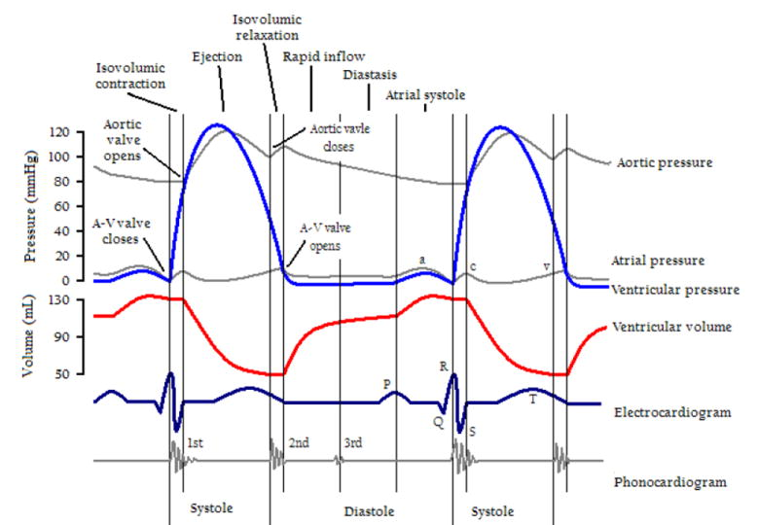
Similarity with process profiles
(2) change of quality instantiations
Smith B. Classifying processes: an essay in applied ontology. Ratio 25 (4):463-488 (2012)

Slide 153
Process Profile Representations (PPR)
S | FSN | Attr. | Value | Value label | Process Profile Representation (PPR)
C1 | GS NOS | Dstatus | DSP-05 |  | DDDDDDDDDDDDDDDDDDDDDDDDDDDDD
C1 | GS NOS | Reason | CIP-15 |  | DDDDDDDDDDDDDDDDLLLLLLLLLLLLL
C1 | GS NOS | FSN | T-367 | GS NOS (finding) | _____________AAAAAAAAAAAAAAAA
C1 | GS NOS | Same-as | C4 | GS NOS (finding) | _AAAAAAAAAAAAAAAAAAAAAAAAAAAA
C1 | GS NOS | Was-a | C5 | GS (finding) | ________________AAAAAAAAAAAAA
C2 | GS NOS | Dstatus | DSP-05 |  | DDDDDDDDDDDDDDDDDDDDDDDDDDDDD
C2 | GS NOS | Reason | CIP-15 |  | DDDDDDDDDDDDDDDDLLLLLLLLLLLLL
C2 | GS NOS | FSN | T-367 | GS NOS (finding) | _____________AAAAAAAAAAAAAAAA
C2 | GS NOS | Same-as | C4 | GS NOS (finding) | _AAAAAAAAAAAAAAAAAAAAAAAAAAAA
C2 | GS NOS | Was-a | C5 | GS (finding) | ________________AAAAAAAAAAAAA
C3 | GS NOS | Dstatus | DSP-05 |  | DDDDDDDDDDDDDDDDDDDDDDDDDDDDD
C3 | GS NOS | Reason | CIP-15 |  | DDDDDDDDDDDDDDDDLLLLLLLLLLLLL
C3 | GS NOS | FSN | T-367 | GS NOS (finding) | _____________AAAAAAAAAAAAAAAA
C3 | GS NOS | Same-as | C4 | GS NOS (finding) | _AAAAAAAAAAAAAAAAAAAAAAAAAAAA
C3 | GS NOS | Was-a | C5 | GS (finding) | ________________AAAAAAAAAAAAA
historyOf

Slide 154
Research question
Do assertions which are about changes in SNOMED CT exhibit patterns that would allow the detection of mistakes in assertions about external reality that have thus far not been discovered?
In other words:
  what can we learn about SNOMED CT’s mistakes committed in the past to detect still existing mistakes and prevent new ones?

Slide 155
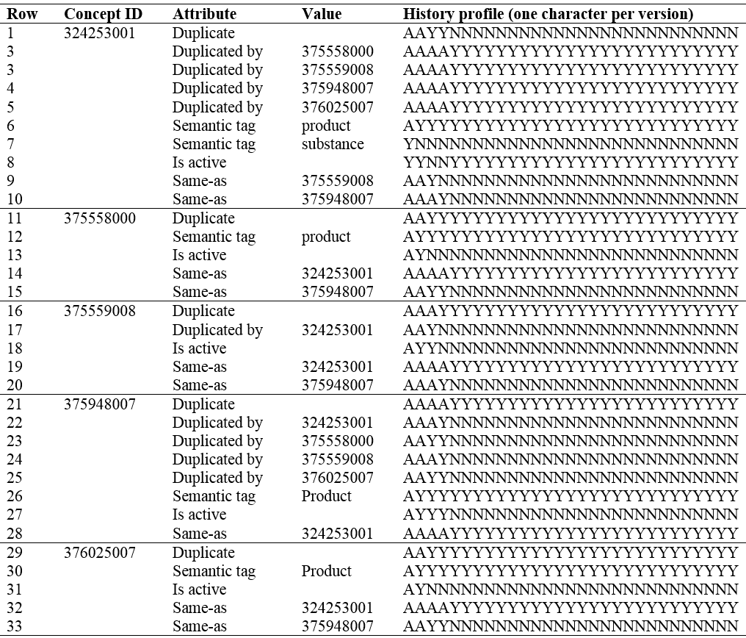
Construction of History Profiles for clusters
Azithromycin 200mg/5mL oral suspension (product)
Azithromycin dihydrate 200mg/5mL suspension (product)
Azithromycin dihydrate 200mg/ 5 mL suspension (product)
Azithromycin dihydrate 200mg/5 mL suspension (product)
Azithromycin dihydrate 200mg/5 mL powder (product)

Slide 156
Construction of History Profiles for clusters
Azithromycin 200mg/5mL oral suspension (product)
Azithromycin dihydrate 200mg/5mL suspension (product)
Azithromycin dihydrate 200mg/ 5 mL suspension (product)
Azithromycin dihydrate 200mg/5 mL suspension (product)
Concept 375559008 not present in 1st version, but introduced as active in the 2nd version.
Azithromycin dihydrate 200mg/5 mL powder (product)

Slide 157
Construction of History Profiles for clusters
Azithromycin 200mg/5mL oral suspension (product)
Azithromycin dihydrate 200mg/5mL suspension (product)
Azithromycin dihydrate 200mg/ 5 mL suspension (product)
Azithromycin dihydrate 200mg/5 mL suspension (product)
Concept 375559008 in the 3rd version recognized as being duplicated by 324253001
Azithromycin dihydrate 200mg/5 mL powder (product)

Slide 158
Construction of History Profiles for clusters
Azithromycin 200mg/5mL oral suspension (product)
Concept 324253001 deactivated in 3rd version and declared to be the same as 375559008
Azithromycin dihydrate 200mg/5mL suspension (product)
Azithromycin dihydrate 200mg/ 5 mL suspension (product)
Azithromycin dihydrate 200mg/5 mL suspension (product)
Concept 375559008 in the 3rd version recognized as being duplicated by 324253001
Azithromycin dihydrate 200mg/5 mL powder (product)

Slide 159
Certain profile stages (should) occur in tandem
Azithromycin 200mg/5mL oral suspension (product)
It is not possible for a concept to duplicate one and be duplicated at the same time
Azithromycin dihydrate 200mg/5mL suspension (product)
Azithromycin dihydrate 200mg/ 5 mL suspension (product)
Azithromycin dihydrate 200mg/5 mL suspension (product)
Azithromycin dihydrate 200mg/5 mL powder (product)

Slide 160
Certain profile stages (should) occur in tandem
Azithromycin 200mg/5mL oral suspension (product)
Azithromycin dihydrate 200mg/5mL suspension (product)
Azithromycin dihydrate 200mg/ 5 mL suspension (product)
If a concept is the same as another one, it is inactive.
Azithromycin dihydrate 200mg/5 mL suspension (product)
Azithromycin dihydrate 200mg/5 mL powder (product)

Slide 161
Results for HARS and CIRS
Expected patterns do not always occur (1):
  C1 ‘possibly equivalent to’ C2/C3/… expected to go together with C1 being ambiguous
    Not true for 4 concepts
  1,449 cases where a concept is stated to be duplicate without a corresponding same-as association,
  3,453 cases in which a same-as association was created without a duplicate assertion.

Slide 162
Results for HARS and CIRS
Expected patterns do not always occur (2):
  cases in which concepts are stated to be duplicates, yet denote clearly distinct entities.
  ‘34759008: Urethral catheter, device (physical object)’ is stated to be duplicated by 73 other concepts,
  each duplicate denotes nevertheless a more precisely specified type of catheter, for example:
    ‘349499005: Bard 10mL balloon 22Ch 1658 2-way all-silicone male length urethral Foley catheter‘, and
    ‘349501002: Bard 10mL balloon 24Ch 1265LV 2-way Teflon coated male urethral Foley catheter’.
  Several of these catheters are by means of other concepts, listed as descendants of ‘34759008’.

Slide 163
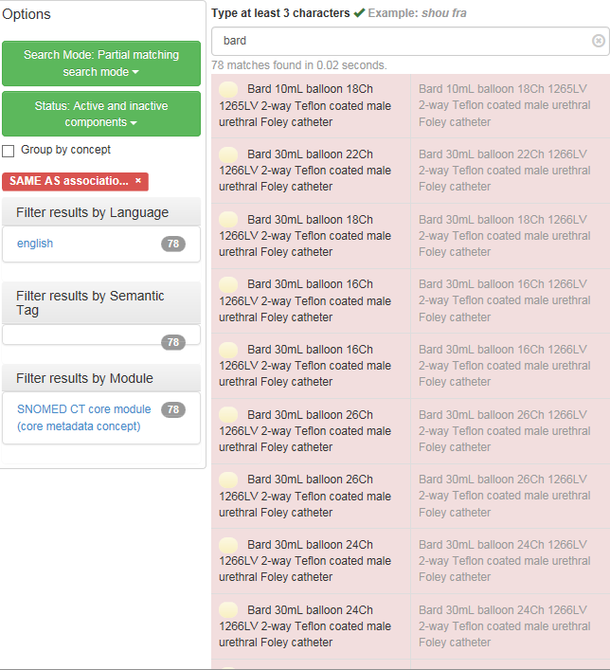

Was the brand name an issue rather than duplication?

Slide 164
Results for HARS and CIRS
Reasons for inactivations not always clear:
  E.g.:
    ‘391651001: Gluten-free/wheat-free baguette (product)’
    ‘407775004 : Gluten-free/wheat-free baguette (product)’
ConceptID | Attribute | Value | History profile (one character per version)
391651001 | AMB |  | AAAAYYYYYYYYYYYYYYYYYYYYYYYYY
 | Is active |  | AAYYNNNNNNNNNNNNNNNNNNNNNNNNN
 | Poss-equivalent-to | 407775004 | AAAAYYYYYYYYYYYYYYYYYYYYYYYYY
407775004 | Semantic tag | product | AAAAYYYYYYYYYYYYYYYYYYYYYYYYY
 | Is active |  | AAAAYYYYYYYYYYYYYYYYYYYYYYYYY

Slide 165
Recommendations towards the IHTSDO
Formalize the relationships between semantic tags and SNOMED CT concept hierarchies,
Ceusters w, Bona J. Analyzing SNOMED CT’s Historical Data: Pitfalls and Possibilities. In: American Medical Informatics Association 2016 Annual Symposium Proceedings, Chicago IL, November 12-16, 2016;361-370.

Slide 166
Recommendations towards the IHTSDO
Formalize the relationships between semantic tags and SNOMED CT concept hierarchies,
Implement in the authoring environment mechanisms to prevent and detect incoherent and missing CIRS and HARS records, and
Ceusters w, Bona J. Analyzing SNOMED CT’s Historical Data: Pitfalls and Possibilities. In: American Medical Informatics Association 2016 Annual Symposium Proceedings, Chicago IL, November 12-16, 2016;361-370.

Slide 167
Recommendations towards the IHTSDO
Formalize the relationships between semantic tags and SNOMED CT concept hierarchies,
Implement in the authoring environment mechanisms to prevent and detect incoherent and missing CIRS and HARS records, and
Provide reasons for not only inactivations, but also activations, which reflect whether changes are
  purely internal in SNOMED CT (e.g. because of changes in the concept model) or
  external (changes in the covered domains).
Ceusters w, Bona J. Analyzing SNOMED CT’s Historical Data: Pitfalls and Possibilities. In: American Medical Informatics Association 2016 Annual Symposium Proceedings, Chicago IL, November 12-16, 2016;361-370.

Slide 168
Assignment

Slide 169
Assignment
Improve your project ontology by implementing a method for change management.
Due Nov 2, 2017.
10% of final score.

Slide 170
History of ‘Saquinavir 200mg capsule’
Alternative
ConceptID | Version | Active
324847008 | 20020131 | 1
324847008 | 20030131 | 0
324847008 | 20040131 | 1
324847008 | 20040731 | 0
324847008 | 20050131 | 1
324847008 | 20050731 | 0
324847008 | 20070131 | 1

