Slide 1
BMI508 / PHI598 – Fall 2018
Biomedical Ontology
Ontology of Disease
Werner CEUSTERS^{1,2}
¹ Department of Biomedical Informatics, University at Buffalo, USA
² Department of Psychiatry, University at Buffalo, USA

Slide 2
Disease from the clinical perspective: the diagnostic process

Slide 3

Notes:
Photos of Medicine Clinical Associate Professor, Anthony Martinez, with a patient in Buffalo General Hospital
Photograph: Douglas Levere
From: https://ubphoto.smugmug.com/Years/2014/14061-Photos-of-Medicine/i-shnhQPC

Slide 4
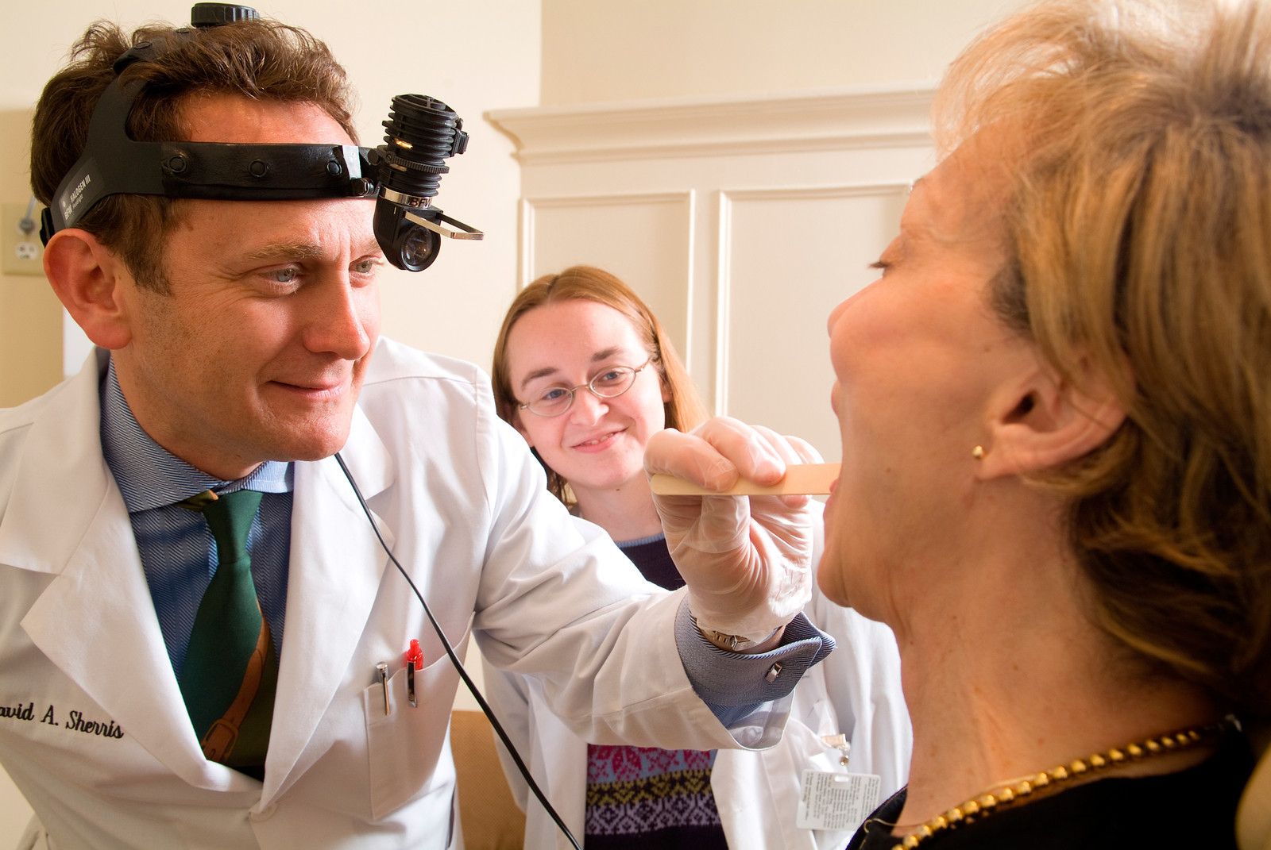
Notes:
Otolaryngology Chair David Sherris examining a patient
Photographer: Douglas Levere
From https://ubphoto.smugmug.com/Years/2007/20265-Photo-of-Otolaryngology/i-Hsd6WFj

Slide 5



Slide 6
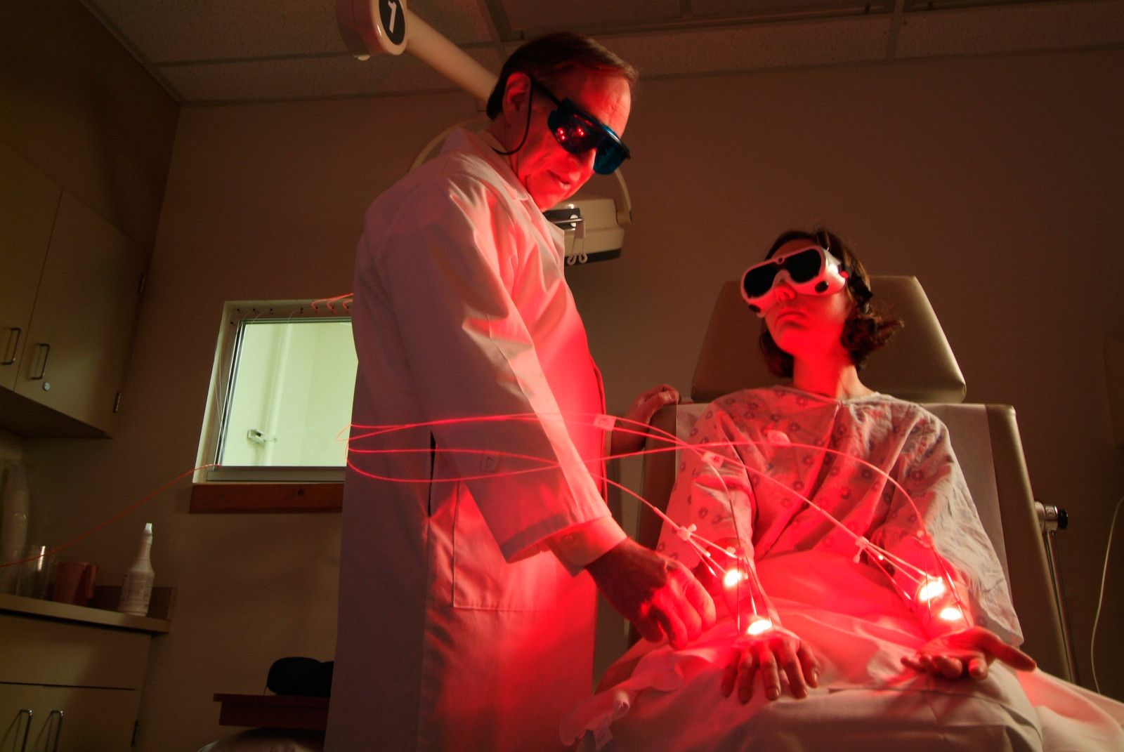
Notes:
Photodynamic Therapy for Non-Melanoma Skin Cancer J Natl Compr Canc Netw 2007;5:531-540
Allan Oseroff with a patient at Roswell Park Cancer Institute
Photographer: Douglas Levere
From https://ubphoto.smugmug.com/Years/2006/20124-Allan-Oseroffs-Office/i-KcMMttr

Slide 7
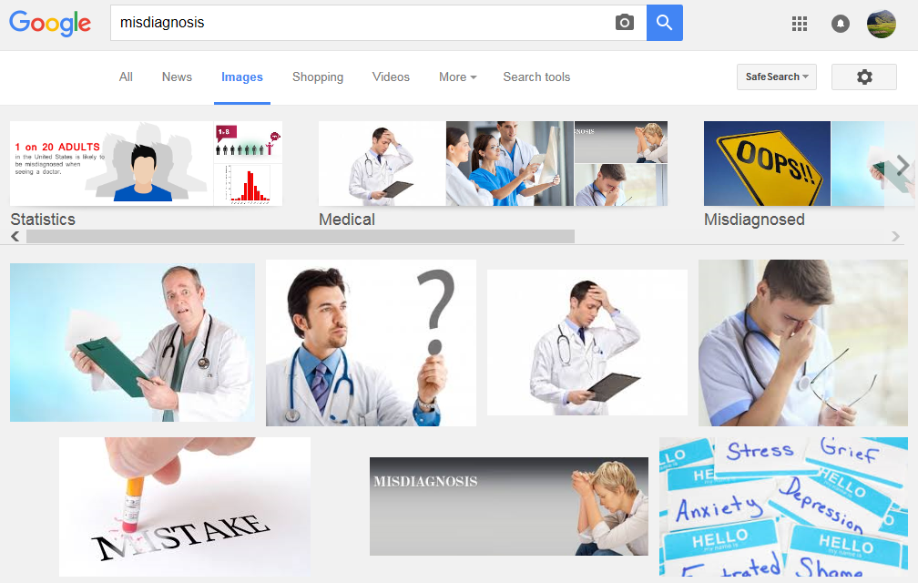
Misdiagnosis

Slide 8
Improving Diagnosis in Health Care
Erin P. Balogh, Bryan T. Miller, and John R. Ball, Editors;
Committee on Diagnostic Error in Health Care;
Improving diagnosis in health care.
National Academies of Sciences, Engineering, and Medicine. 2015. Washington, DC: The National Academies Press.
http://nap.edu/21794

Slide 9
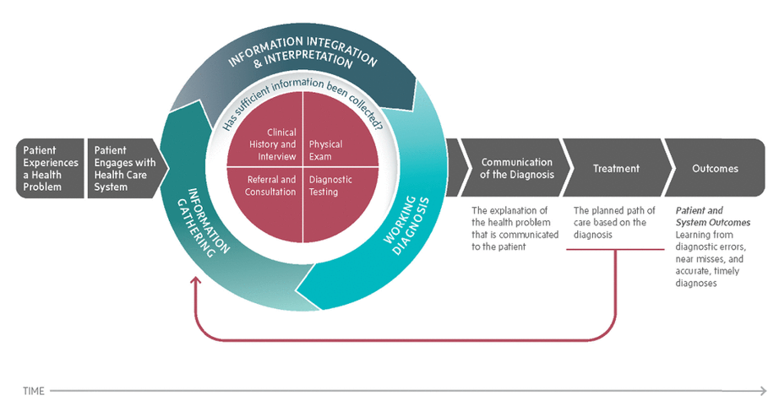
The diagnostic process
http://nap.edu/21794

Slide 10
Diagnostic errors
At least 5 percent of U.S. adults who seek outpatient care each year experience a diagnostic error.
Postmortem examination has shown that diagnostic errors contribute to approximately 10 percent of patient deaths.
Medical record reviews suggest that diagnostic errors account for 6 to 17 percent of hospital adverse events;
Are the leading type of paid medical malpractice claims,
are almost twice as likely to have resulted in the patient’s death compared to other claims, and
represent the highest proportion of total payments.
http://nap.edu/21794

Slide 11
Terminology/Ontology (1)
‘diagnostic error’ / ‘delayed diagnosis’ / ‘missed diagnosis’ ‘misdiagnosis’
‘diagnostic error’ versus ‘diagnosis error’
‘In part, the various definitions that have arisen reflect the intrinsic dualistic nature of the term “diagnosis,” which has been used to refer both to a process and to the result of that process’.
  Similar examples:
    poisoning (process) vs. poisoning (result)
    writing (process) vs writing (result)
http://nap.edu/21794

Slide 12
Terminology/Ontology (2)
The committee’s patient-centered definition of diagnostic error is as follows:
Diagnostic error =def.
the failure to
(a) establish an accurate and timely explanation of the patient’s health problem(s)
or
(b) communicate that explanation to the patient.
http://nap.edu/21794

Slide 13
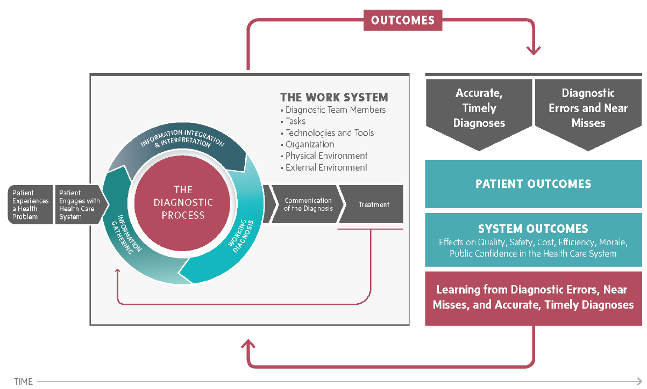
Outcomes from the diagnostic process
http://nap.edu/21794

Slide 14
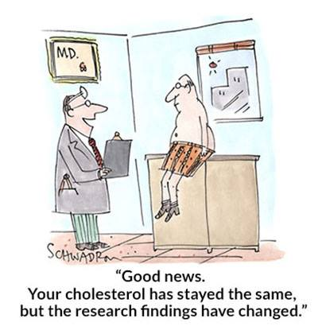
https://www.facebook.com/advisor.healthcare/photos/pb.1593184380929079.-2207520000.1463376332./1655624751351708/?type=3&theater
Notes:
Cartoonist: Harley Schwadron

Slide 15
Something awkward ?
The committee’s patient-centered definition of diagnostic error is:
Diagnostic error =def.
the failure to
(a) establish an accurate and timely explanation of the patient’s health problem(s)
or
(b) communicate that explanation to the patient.
http://nap.edu/21794

Slide 16
Something awkward ?
The committee’s patient-centered definition of diagnostic error is:
Diagnostic error =def.
the failure to
(a) establish an accurate and timely explanation of the patient’s health problem(s)
or
(b) communicate that explanation to the patient.
p1 or p2 don’t happen
Diagnosing process plus Interpretive process (p1)
If p1 produces a result r, communication process (p2) of r
http://nap.edu/21794

Slide 17
Something awkward ?
What if:
    the patient does not have health problems (but pretends to have such problems)?
    no explanation can be found within the current state of the art?
    the patient does not understand a word of what is said?

Slide 18
Compare with IASP definition for ‘pain’
(IASP = International Association for the Study of Pain)
‘an unpleasant sensory and emotional experience associated with actual or potential tissue damage, or described in terms of such damage’;
This definition presupposes:
  that there is a common phenomenology (‘unpleasant sensory and emotional experience’) to all instances of pain,
  that there are three distinct subtypes of pain involving, respectively:
    actual tissue damage,
    what is called ‘potential tissue damage’, and
    a description involving reference to tissue damage.
Smith B, Ceusters W, Goldberg LJ, Ohrbach R. Towards an Ontology of Pain.
In: Mitsu Okada (ed.), Proceedings of the Conference on Logic and Ontology, Tokyo: Keio University Press, February 2011:23-32

Slide 19
For sure awkward is the following assertion provided by the committee:
‘The committee’s definition is two-pronged;
if there is a failure in either part of the definition, a diagnostic error results.’
http://nap.edu/21794

Slide 20
Idiosyncrasies of …
The diagnostic process:
  Diagnosis may be recorded when there is only a suspicion of disease;
  Some overlapping clinical conditions are difficult to distinguish reliably;
  Patients may only partially fit diagnostic criteria;
  Patients in whom diagnostic testing is done are still more likely to have disease even if the result of the test is negative.
Reporting a diagnosis:
  Repeated diagnosis codes over time may represent a new event or a follow-up to an earlier event;
  First diagnosis in a database is not necessarily an incident case of disease.
Hersh, WR, Weiner, MG, et al. (2013).
Caveats for the use of operational electronic health record data in comparative effectiveness research. Medical Care. 51(Suppl 3): S30-S37.

Slide 21
Ontologically interesting items
The diagnostic process:
  Diagnosis may be recorded when there is only a suspicion of disease;
  Some overlapping clinical conditions are difficult to distinguish reliably;
  Patients may only partially fit diagnostic criteria;
  Patients in whom diagnostic testing is done are still more likely to have disease even if the result of the test is negative.
Reporting a diagnosis:
  Repeating diagnosis codes over time may represent a new event or a follow-up to an earlier event;
  First diagnosis in a database does not necessarily entail an actual corresponding case of disease.
Hersh, WR, Weiner, MG, et al. (2013).
Caveats for the use of operational electronic health record data in comparative effectiveness research. Medical Care. 51(Suppl 3): S30-S37.

Slide 22
The diagnostic process
‘(Health) Problem’
http://nap.edu/21794

Slide 23
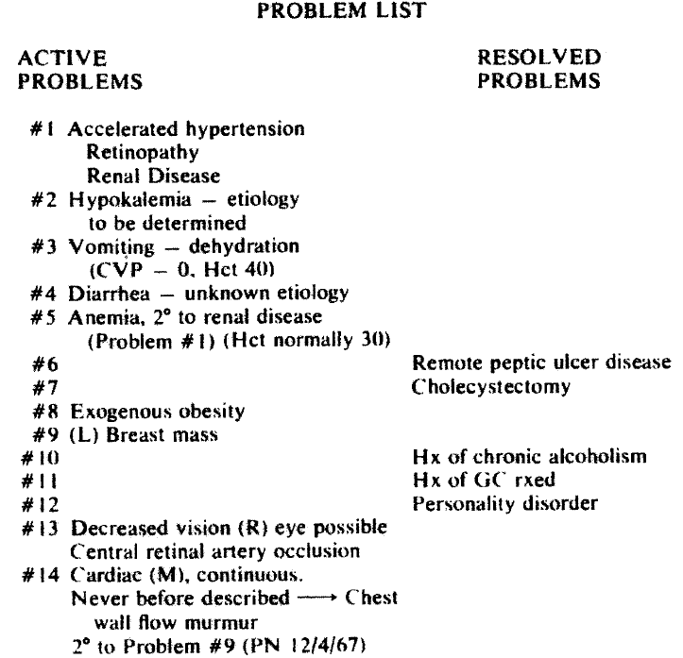
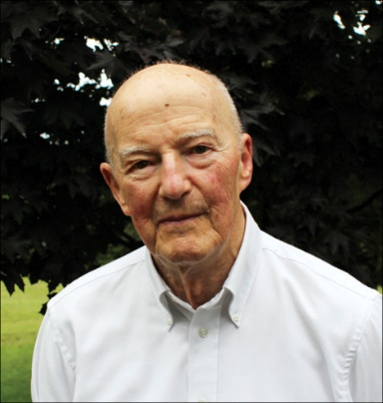
L. Weed.
Medical records that guide and teach.
New England Journal of Medicine 278 (1968), 593-600.

Slide 24
Notes:
Photos of Medicine Clinical Associate Professor, Anthony Martinez, with a patient in Buffalo General Hospital
Photograph: Douglas Levere
From: https://ubphoto.smugmug.com/Years/2014/14061-Photos-of-Medicine/i-shnhQPC

Slide 25
What is a (health) problem?
‘A problem can be anything – a symptom, an abnormality, a treatment, or anything else which has been observed of the patient.’

Slide 26
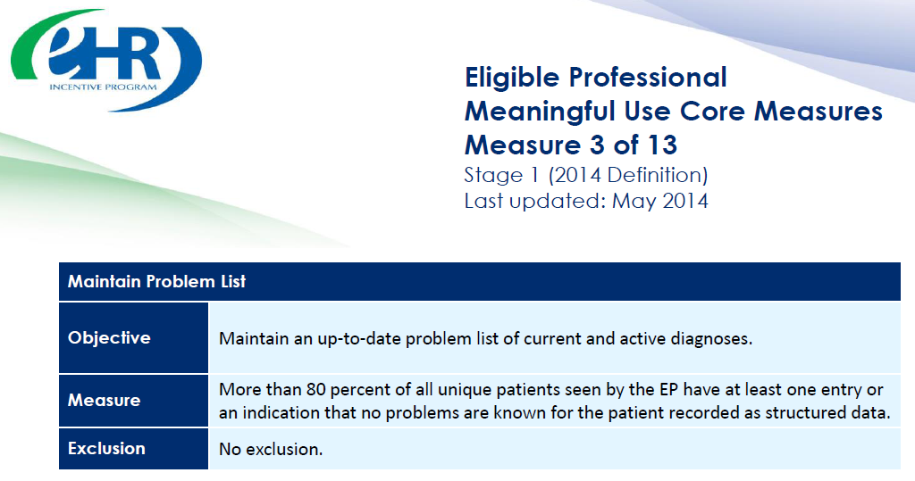

https://www.cms.gov/Regulations-and-Guidance/Legislation/EHRIncentivePrograms/downloads/3_Maintain_Problem_ListEP.pdf

Slide 27
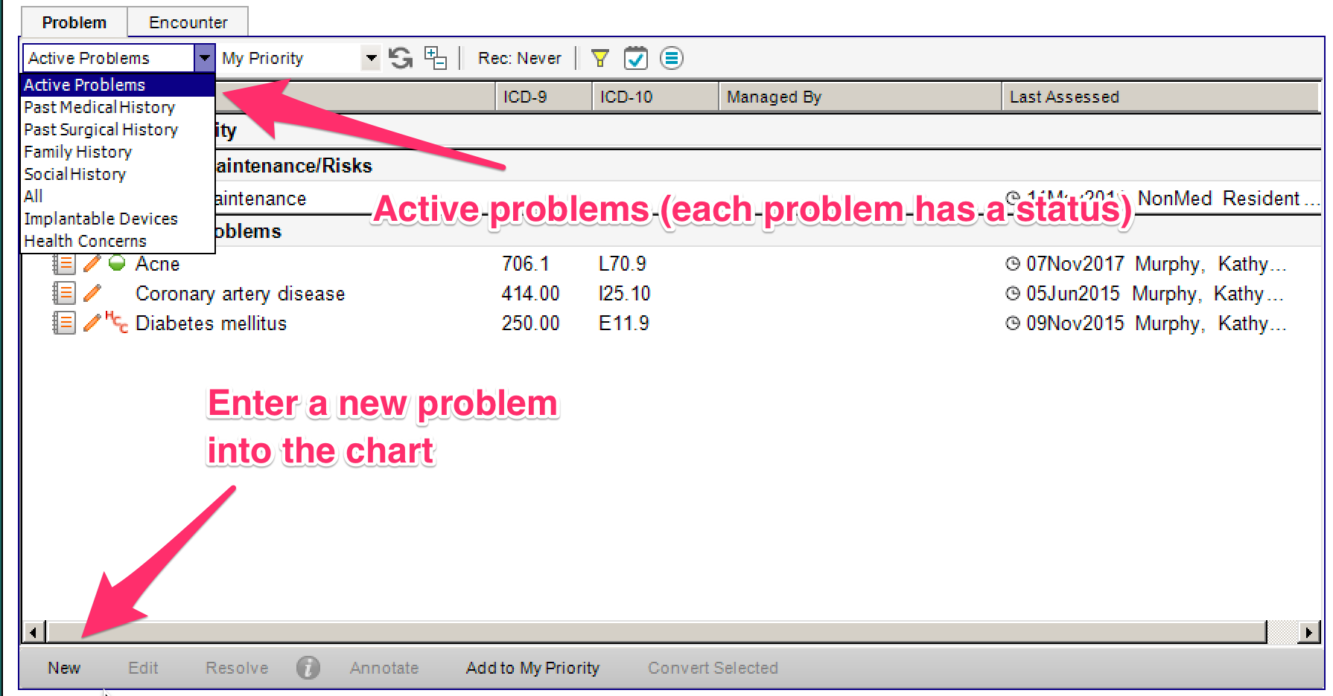

Slide 28
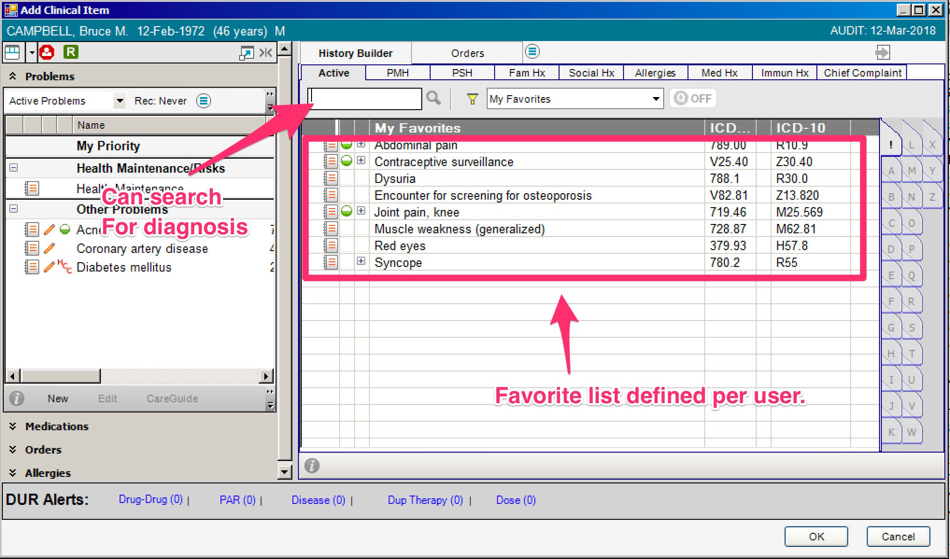

Slide 29
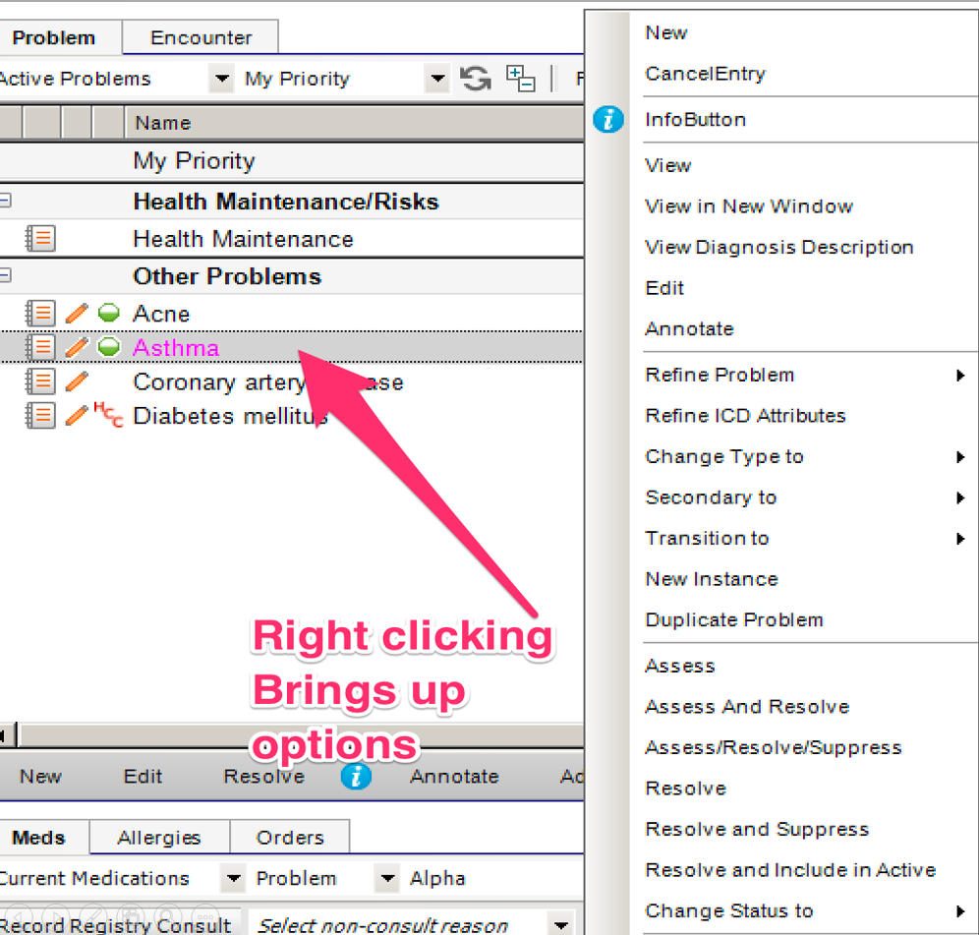
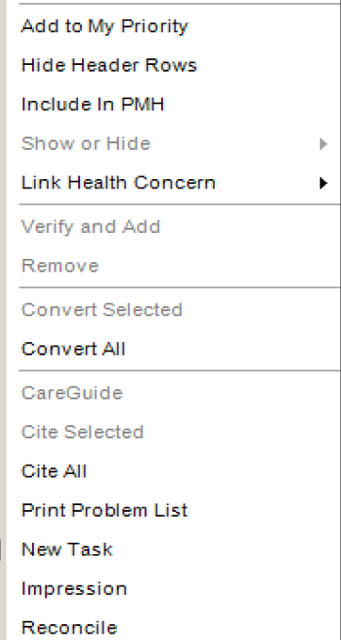
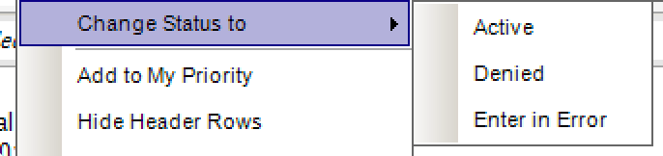
Reality
Representation

Slide 30
Transitioning a problem

Slide 31
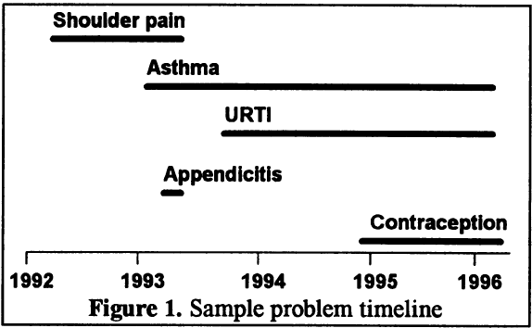
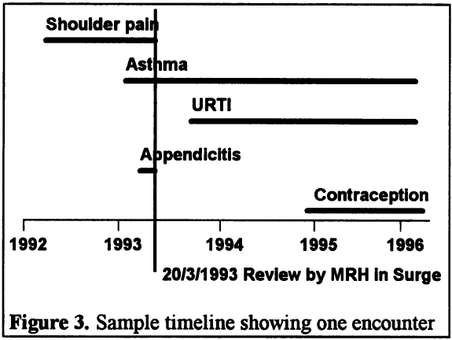
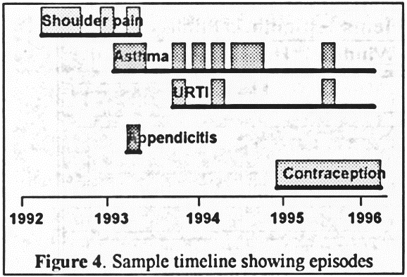
Problems
Encounters
Episodes
Salmon P, Rappaport A, Bainbridge M, Hayes G, Williams J. Taking the problem oriented medical record forward. Proc AMIA Annu Fall Symp. 1996:463-7.

Slide 32
A small research project
Problem
Type
Problem
Status
Problem
Category
Problem
Header
Problem
Instance
Encounter
~6,000,000
~6,000,000
Transition
Patient
~500,000
Problem Header
Change Record
Ceusters W, Blaisure J. Caveats for the use of the active problem list as ground truth for decision support. EFMI Special Topic Conference on Decision Support Systems and Education (EFMI STC-2018), Zagreb, Kroatia, Oct 14-16, 2018

Slide 33
Results
Problem
Type
Problem
Status
Problem
Category
Problem
Header
Problem
Instance
Encounter
~370,000
~6,000,000
~765,000
Transition
Patient
~23,000
~500,000
~80,000
Problem Header
Change Record
~395,000 rec. / ~664,000 ch.

Slide 34
Change count distributions
Changes | Frequency | Cumulative %
1 | 349,361 | 94.52%
2 | 16,325 | 98.94%
3 | 3,426 | 99.86%
4 | 312 | 99.95%
5 | 147 | 99.99%
6 | 14 | 99.99%
7 to 34 | 26 | 100.00%
Transitions | Frequency | %
1 | 21819 | 94.202%
2 | 1154 | 4.982%
3 | 150 | 0.648%
4 | 34 | 0.147%
5 | 4 | 0.017%
6 | 1 | 0.004%

Slide 35
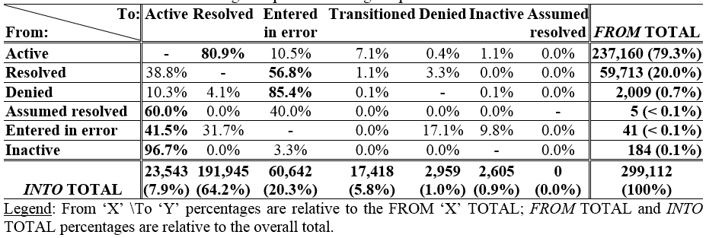
Problem status changes

Slide 36
Active / Resolved
 |  |  |  | EHR update event
PtID | PrID | Problem | 0 | 1 | 2 | 3 | 4 | 5 | 6 | 7 | 8 | 9 | 10 | 11 | 12 | 13 | 14 | 15
B1 | 1 | Cerumen Impaction In Both Ears | N | D |  | D | D | D | D | R | A
 | 2 | Impacted cerumen of right ear |  |  |  |  |  |  |  |  |  | N
B2 | 1 | Cerumen Impaction | N | D | R | A | R | A | R | A | D | D
C1 | 1 | Acute Sinusitis | N | D | D | R | A | R | A | D | R | A
C2 | 1 | Acute Sinusitis | N | D | D | D | D | D | R | A | D | D | R | A | R | A | D
Legend: ‘PtID’: patient identifier; ‘PrID’: problem header identifier; ‘N’: Problem header added and marked active; ‘D’: problem documentation added; ‘A’: problem header marked active; ‘R’: problem resolved; Arrow: problem ‘transitioned’ into the problem pointed at by the arrow. Solid background: problem ‘active’.

Slide 37
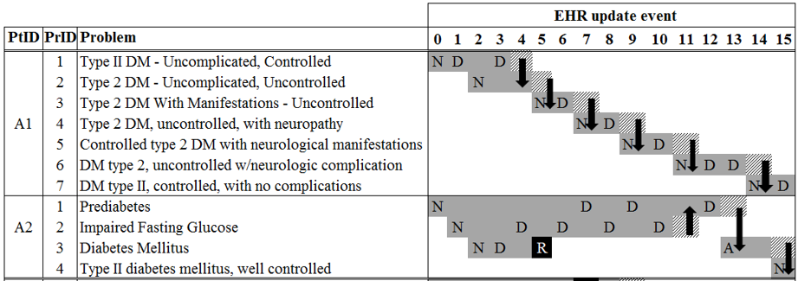
Transitions in two diabetes patients

Slide 38
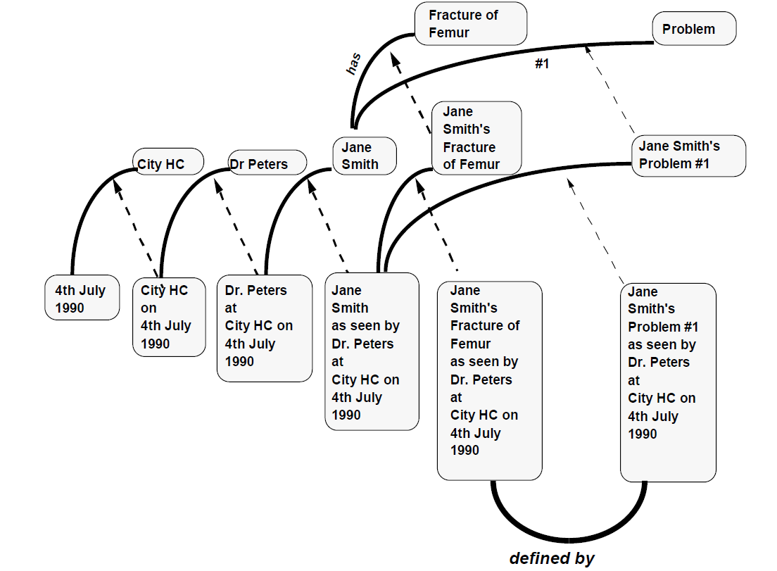
Rector AL, Nowlan WA, Kay S, Goble CA, Howkins TJ.
A framework for modelling the electronic medical record. Methods Inf Med. 1993 Apr;32(2):109-19.

Slide 39
What is a ‘problem’?
‘ We treat problems as fundamentally different from observations of diagnoses, signs and symptoms. Problems belong to the second level of the medical record consisting of meta-observations about the underlying observations. As Weed indicated, a problem can be anything – a symptom, an abnormality, a treatment, or anything else which has been observed of the patient. However, this is not because “problem” is a superordinate concept subsuming all other medical statements; rather it is because problems are based on meta-observations about other medical statements.
In other words, it is not correct to say that signs, symptoms, diagnoses, treatments, social complaints, etc. are all kinds of problems in the sense that pneumonia is a kind of infection or that signs and symptoms are both kinds of indicants. Problems behave entirely different from signs, symptoms, and diagnoses. For example, it is reasonable to say that the problem was originally thought to be chest pain, then diagnosed as pneumonia and later found to be a myocardial infarction. The same problem is said to persist through all three definitions’.
Rector AL, Nowlan WA, Kay S. Foundations for an electronic medical record. Methods Inf Med. 1991 Aug;30(3):179-86.

Slide 40
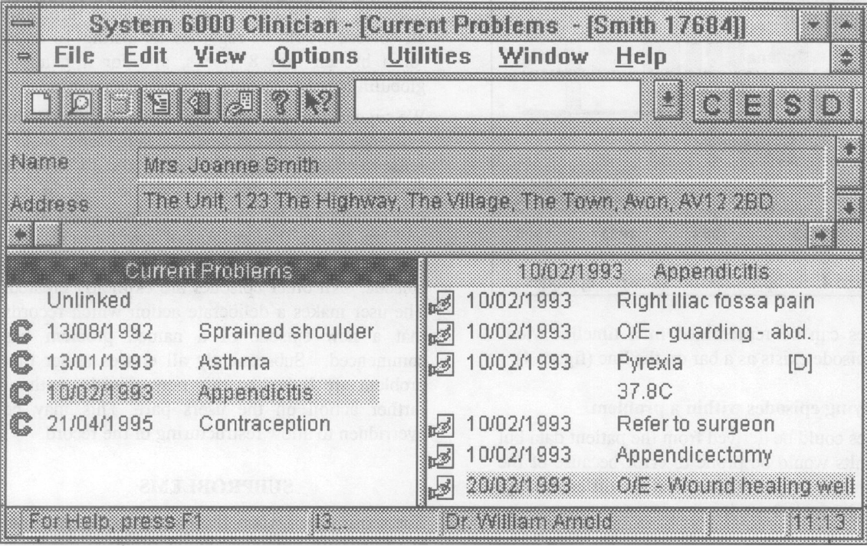

Slide 41
OMOP

Slide 42
Conclusions
Poor reality / representation correspondence:
  Impossible co-morbidity assertions;
  Resolved disorders appear again:
    ‘problem’ as type rather than particular, or,
    ‘problem’ as assertion rather than first-order entity;
  Use of ‘inactive’ poorly related to presence or absence of disease entity.
User-interface itself is conducive to reality and representation confusion.
Secondary use for knowledge acquisition and decision report requires much caution.

Slide 43
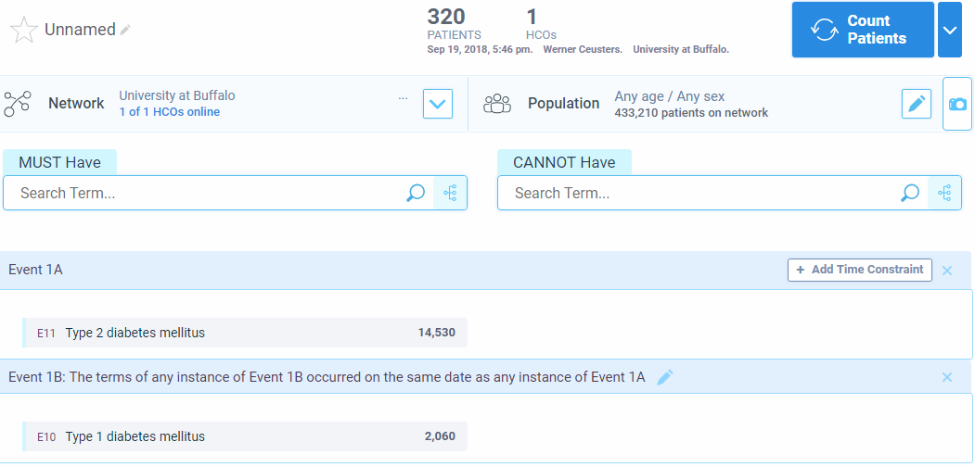
Note: 1A and 1B any time: 650 patients

Slide 44
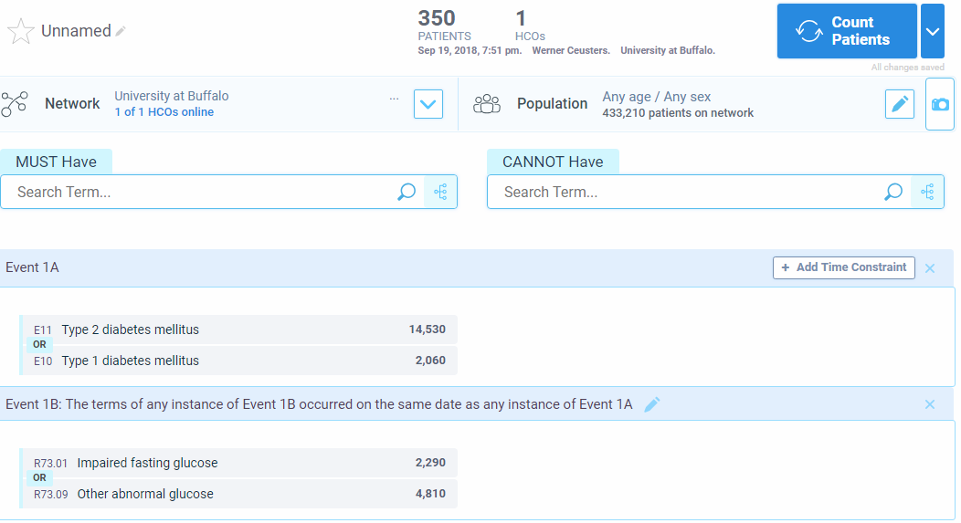

Slide 45
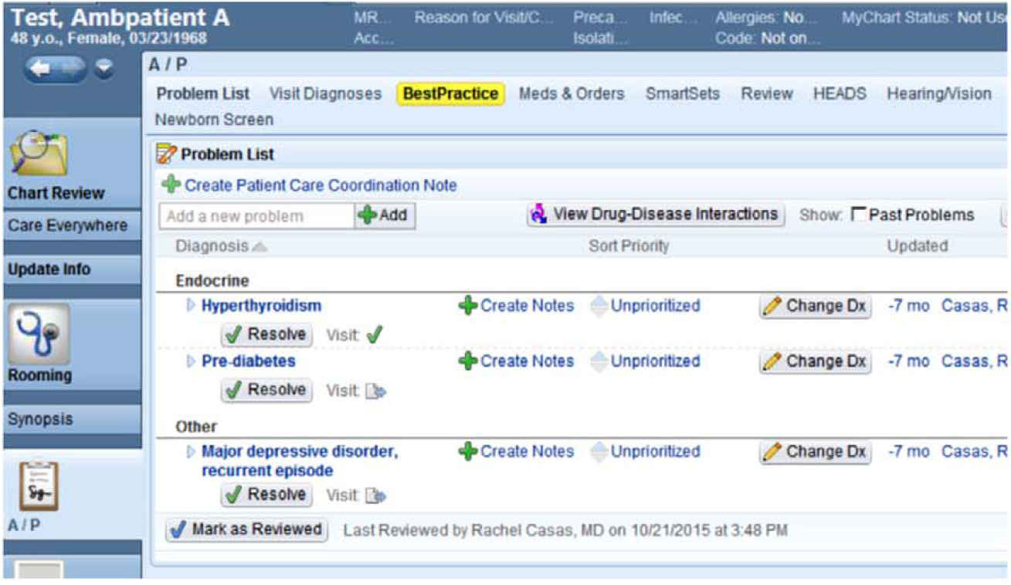
Chowdhry SM, Mishuris RG, Mann D. Problem-oriented charting: A review. Int J Med Inform. 2017 Jul;103:95-102.

Slide 46
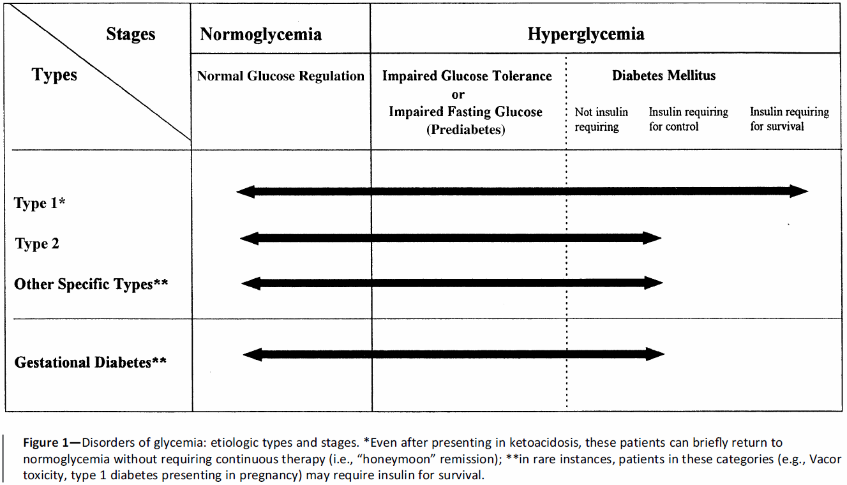
care.diabetesjournals.org/content/37/Supplement_1/S81

Slide 47
Future work: towards an OGMS-based
Referent Tracking Interpretation

Slide 48
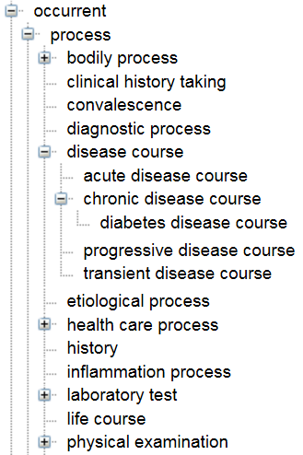
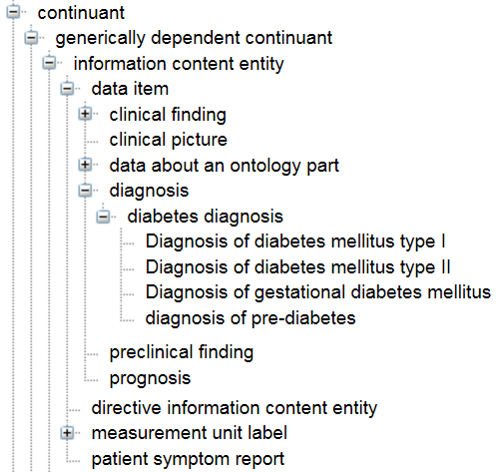
Bad: Diabetes Diagnosis Ontology

Slide 49
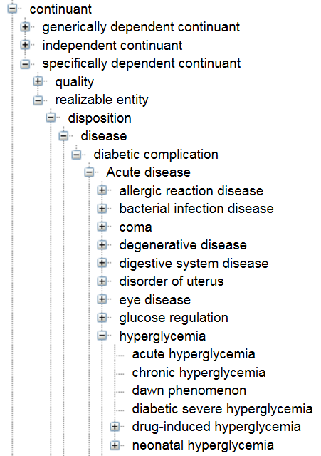
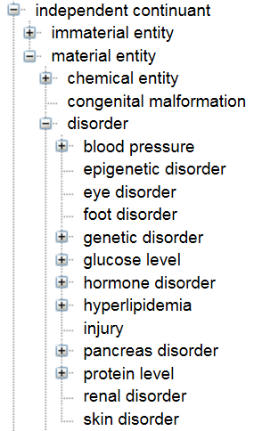
Diabetes Diagnosis Ontology

Slide 50
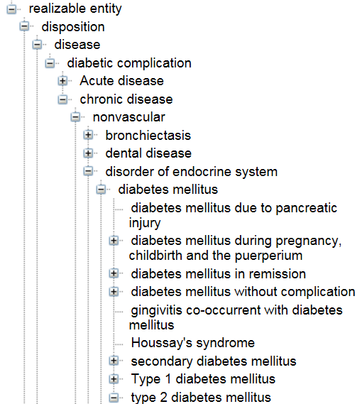
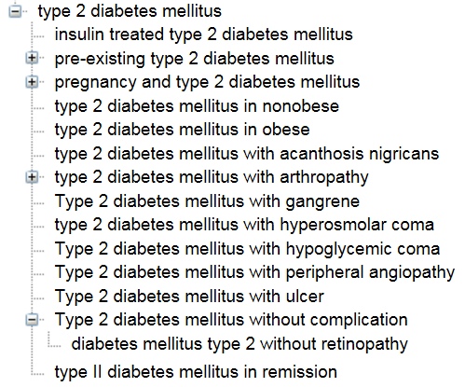
Diabetes Diagnosis Ontology

Slide 51
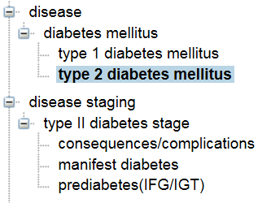
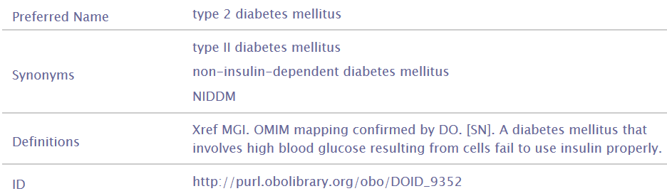
Ridiculous: BioMedBridges Diabetes Ontology

Slide 52
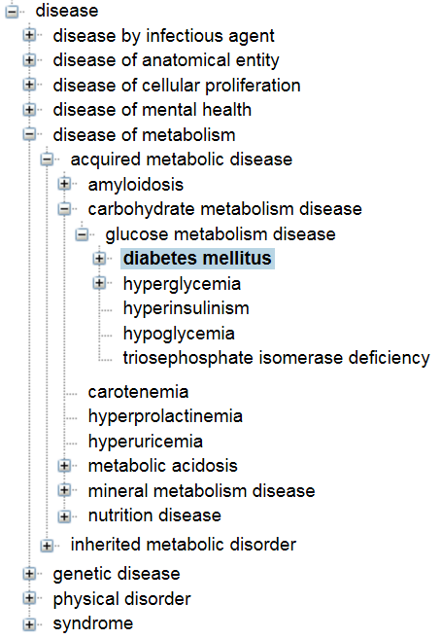
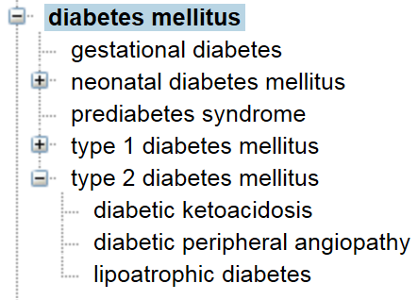
Utterly stupid: Human Disease Ontology
All April 5

Slide 53
ICD-10-CM
E11 Type 2 diabetes mellitus
E11.0 Type 2 diabetes mellitus with hyperosmolarity
E11.1 Type 2 diabetes mellitus with ketoacidosis
E11.2 Type 2 diabetes mellitus with kidney complications
E11.3 Type 2 diabetes mellitus with ophthalmic complications
E11.4 Type 2 diabetes mellitus with neurological complications
E11.5 Type 2 diabetes mellitus with circulatory complications
E11.6 Type 2 diabetes mellitus with other specified complications
E11.61 Type 2 diabetes mellitus with diabetic arthropathy
E11.62 Type 2 diabetes mellitus with skin complications
E11.63 Type 2 diabetes mellitus with oral complications
E11.64 Type 2 diabetes mellitus with hypoglycemia
E11.8 Type 2 diabetes mellitus with unspecified complications
E11.9 Type 2 diabetes mellitus without complications

Slide 54
SNOMED CT January 2018
Diabetes mellitus type 2
Diabetes mellitus type 2 in nonobese (disorder)
Diabetes mellitus type 2 in obese (disorder)
Hypoglycemic coma co-occurrent and due to diabetes mellitus type II (disorder)
Insulin treated type 2 diabetes mellitus (disorder)
Pre-existing type 2 diabetes mellitus (disorder)
Pre-existing type 2 diabetes mellitus in pregnancy (disorder)
Pregnancy and type 2 diabetes mellitus (disorder)
Pre-existing type 2 diabetes mellitus in pregnancy (disorder)
Type 2 diabetes mellitus with acanthosis nigricans (disorder)
Type 2 diabetes mellitus with hyperosmolar coma (disorder)
Type II diabetes mellitus in remission (disorder)
Type II diabetes mellitus with arthropathy (disorder)
Type II diabetes mellitus with neuropathic arthropathy (disorder)
Type II diabetes mellitus with gangrene (disorder)
Type II diabetes mellitus with peripheral angiopathy (disorder)
Type II diabetes mellitus with ulcer (disorder)
Type II diabetes mellitus without complication (disorder)
Diabetes mellitus type 2 without retinopathy (disorder)

Slide 55
Prominent types of inconsistencies
Changes in reality not faithfully reflected in the medical record updates;
Updates in the records inadequately documented as to whether they reflect changes in reality or changes in caregivers understanding thereof;
Inconsistencies amongst observers;
Plain mistakes and ambiguities.
Beginnings of a solution: an ontology for general medical science
Ceusters W, Hsu CY, Smith B. Clinical Data Wrangling using Ontological Realism and Referent Tracking. International Conference on Biomedical Ontologies, ICBO 2014, Houston, Texas, Oct 6-9, 2014;
CEUR Workshop Proceedings 2014;1237:27-32.

Slide 56
Ontology for General Medical Science
OGMS
Scheuermann R, Ceusters W, Smith B. Toward an Ontological Treatment of Disease and Diagnosis. 2009 AMIA Summit on Translational Bioinformatics, San Francisco, California, March 15-17, 2009;: 116-120. Omnipress ISBN:0-9647743-7-2

Slide 57
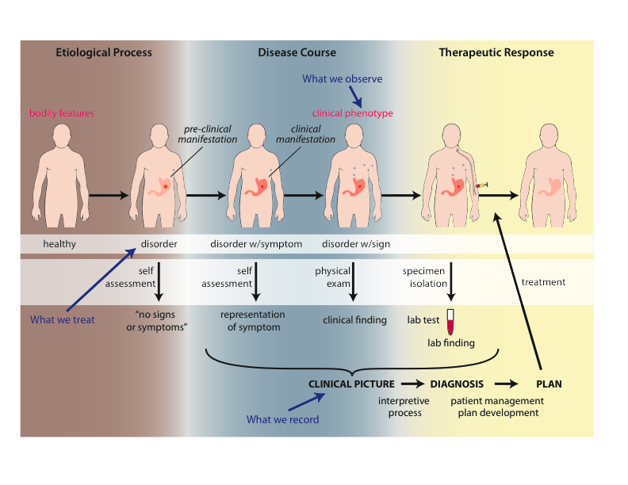
Big Picture

Slide 58
Motivation
Clarity about:
    disease etiology and progression;
    disease on the side of the patient and the diagnostic process on the side of the clinician or healthcare system;
    phenotype and signs/symptoms;
    how the entities relate to each other.
Better support for use of evidence in the context of patient care, clinical research and translational research;
    Includes use of medical record information in support for clinical and translation research.
Extensibility.

Slide 59
Motivation
Four distinct classificatory tasks
of people (patients, carriers, …)
of diseases (cases, instances, problems, …)
of courses of disease (symptoms, treatments…)
of representations (records, observations, data, diagnoses…)
International Classification of Diseases (ICD) confuses 1. & 2.
HL7, most standard terminologies, confuse 2. and 4

Slide 60
Examples of unprincipled classification
International Classification of Diseases (ICD):
V01: Contact with or exposure to communicable diseases
V02: Carrier or suspected carrier of infectious diseases
V03: Need for prophylactic vaccination and inoculation against bacterial diseases
V08: [Asymptomatic] human immunodeficiency virus (HIV) infection status
V09: Infection with drug-resistant microorganisms
V10: Personal history of malignant neoplasm (i.e. cancer)
V16: Family history of malignant neoplasm

Slide 61
Health Level 7 (HL7)
Reference Information Model (RIM) Philosophy
“The truth about the real world is constructed through a combination and arbitration of attributed statements ...
“As such, there is no distinction between an activity and its documentation.”
https://www.hl7.org/fhir/v3/ActClass/index.html. Accessed, Sept 12, 2016.

Slide 62
Goals of OGMS
To serve as a consistent, logically well-defined extensible framework (ontology) for the representation of:
    features of disease;
    clinical processes;
    results of tests and diagnostic processes.

Slide 63
Goals of OGMS
What are the fundamental types of things for which we need ontological categories (what’s the domain)?
  disease initiation, progression, pathogenesis, signs, symptoms, assessments, clinical and laboratory findings, disease diagnosis, treatment, treatment response and outcome;
  normal phenotype, homeostatic (normal) profile.
Notes:
Answer the following questions.

Slide 64
Goals of OGMS
What are the fundamental relationships:
  between the process of observing, the results of the observation and what is being observed;
  between signs/symptoms and disease (no absolutes?);
  between clinical and pre-clinical pathological processes, their manifestations and their representations in the EHR.
Notes:
Answer the following questions.

Slide 65
Goals of OGMS
How should ontologies be developed - intelligent design or natural selection (evolution)?
What is the relationship between
  the ontologies,
  the terminologies and
  the information models?
Notes:
Answer the following questions.

Slide 66
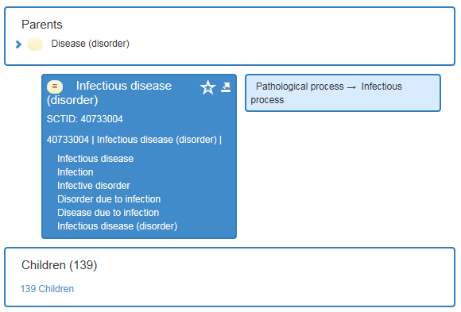
Ontology / Terminology
Notes:
http://browser.ihtsdotools.org/?perspective=full&conceptId1=40733004&edition=en-edition&release=v20160731&server=http://browser.ihtsdotools.org/api/snomed&langRefset=900000000000509007

Slide 67
Ontology / Terminology
Notes:
http://browser.ihtsdotools.org/?perspective=full&conceptId1=40733004&edition=en-edition&release=v20160731&server=http://browser.ihtsdotools.org/api/snomed&langRefset=900000000000509007

Slide 68
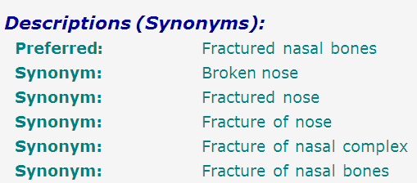
SNOMED-CT: abundance of false synonymy
bones
nose
fracture

Slide 69
EHR Information Models (simplified)
diagnosis
finding
finding
patient
patient
encounter
drug
drug
diagnosis

Slide 70
Constraints
We need to be accurate;
We need to be practical (reproducibility vs dogma).
  What can we expect the clinicians to understand and provide?
  Is the distinction between chronic and progressive easily determined?
We need to leverage and harmonize existing and emerging standards.

Slide 71
Outcomes Assessment
What are the criteria by which we can judge whether we have good categories and good definitions?
  The degree to which ordinary clinicians can understand and reproducibly apply the definitions.
  The degree to which entities can be easily mapped between humans and animal models.
  The degree to which the categories can accommodate new diagnostic technologies (e.g. proteomics).
  The degree to which electronic medical record data can be integrated with clinical and translational research data.

Slide 72
Approach
Propose terms and provide definitions for a representational framework drawing on best practices in ontology development as promulgated within the OBO Foundry for:
  Etiological process
  Disorder
  Disease
  Pathological process
  Sign
  Risk factor
  Symptom
  Laboratory finding
  Diagnosis
  Pre-disposition
  Clinically abnormal
  Biomarker
Notes:
Answer the following questions.

Slide 73
Approach
a disease is a disposition rooted in a physical disorder in the organism and realized in pathological processes.
produces
bears
realized_in
etiological process
disorder
disposition
pathological process
produces
diagnosis
interpretive process
signs & symptoms
abnormal bodily features
produces
participates_in
recognized_as
Notes:
font was too small, color inside green boxes was hardly readable

Slide 74
Cirrhosis - environmental exposure
Etiological process - phenobarbitol-induced hepatic cell death
  produces
Disorder - necrotic liver
  bears
Disposition (disease) - cirrhosis
  realized_in
Pathological process - abnormal tissue repair with cell proliferation and fibrosis that exceed a certain threshold; hypoxia-induced cell death
  produces
Abnormal bodily features
  recognized_as
Symptoms - fatigue, anorexia
Signs - jaundice, splenomegaly
Symptoms & Signs
  used_in
Interpretive process
  produces
Hypothesis - rule out cirrhosis
  suggests
Laboratory tests
  produces
Test results – documentation of elevated liver enzymes in serum
  used_in
Interpretive process
  produces
Result - diagnosis that patient X has a disorder that bears the disease cirrhosis

Slide 75
Foundational Terms (1)
Disorder =def. – A causally linked combination of physical components of the extended organism that is
  (a) clinically abnormal and
  (b) maximal, in the sense that it is not a part of some larger such combination.

Slide 76
Basic Formal Ontology
Continuant
Occurrent
(Process)
Independent
Continuant
(molecule,
cell, organ,
organism)
Dependent
Continuant
(quality,
function,
disease)
..... ..... .... .....

Slide 77
Physical Disorder
  – independent continuant
    objects
    fiat object parts
    object aggregates
    A causally linked combination of physical components of the extended organism.

Slide 78
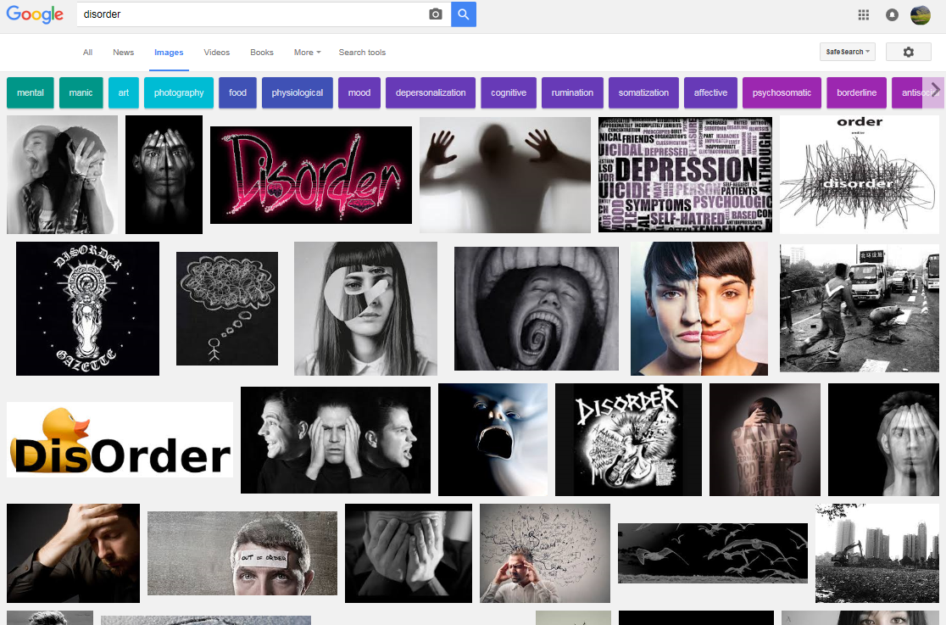

Slide 79
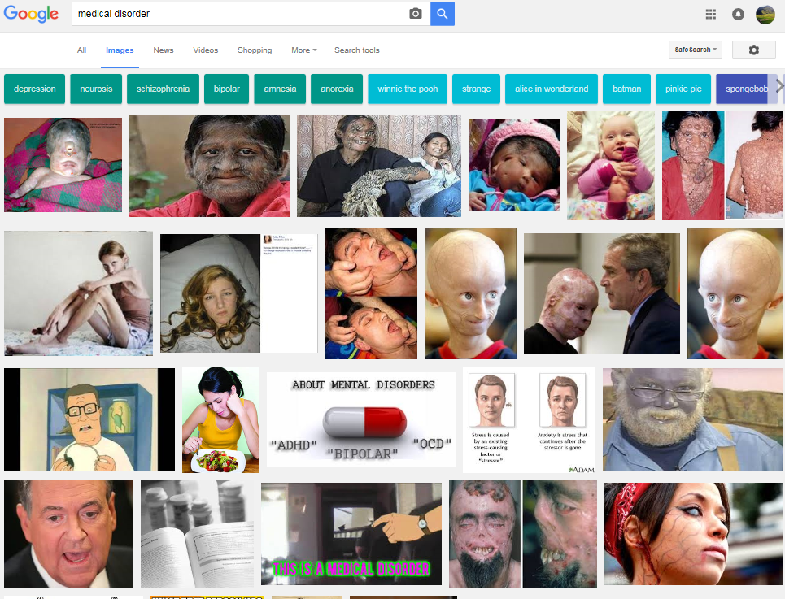

Slide 80
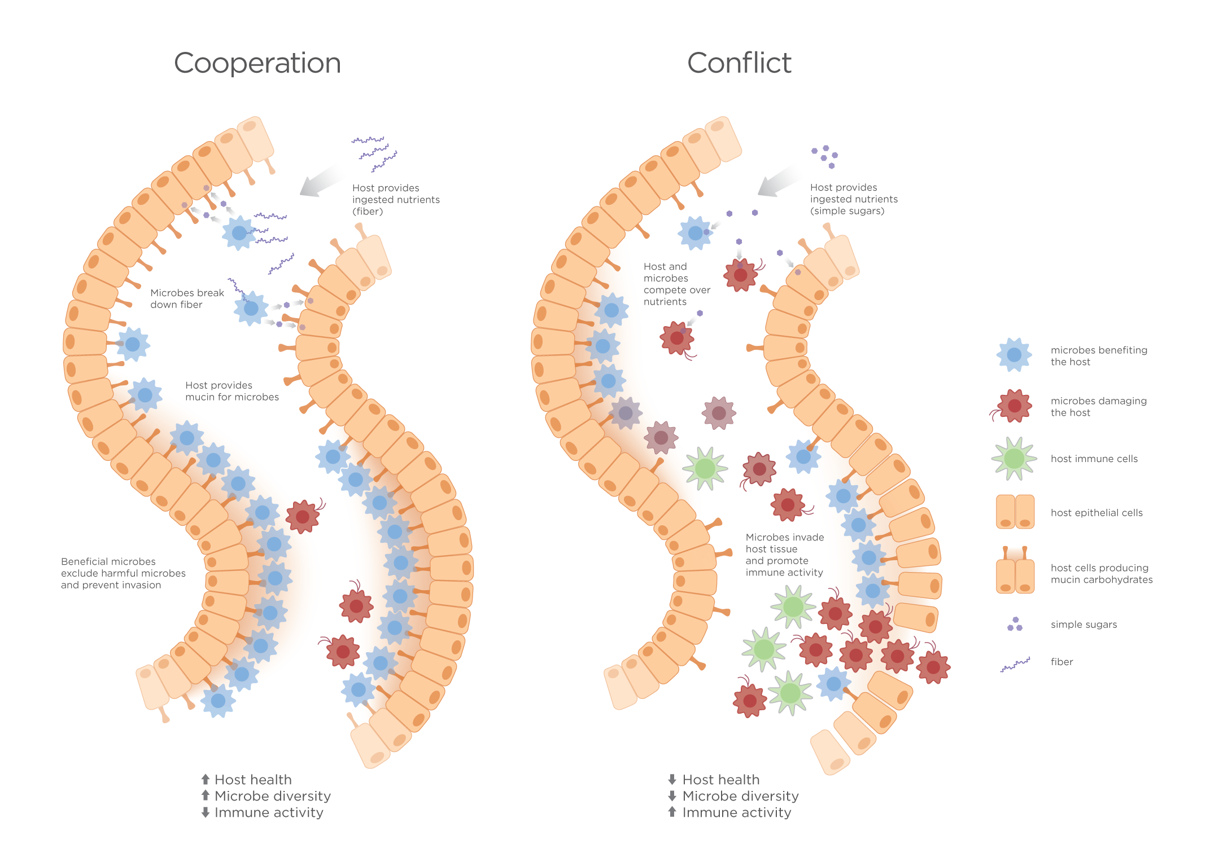
Extended organism
Harth R. War and peace in the human gut: probing the microbiome
https://biodesign.asu.edu/sites/default/files/news/AthenaHostcooperation7.png

Slide 81
Clinically abnormal
something is clinically abnormal if:
  is not part of the life plan for an organism of the relevant type (unlike aging or pregnancy),
  is causally linked to an elevated risk either of pain or other feelings of illness, or of death or dysfunction, and
  is such that the elevated risk exceeds a certain threshold level.

Slide 82
Foundational Terms (2)
Disorder =def. – A causally linked combination of physical components of the extended organism that is
  (a) clinically abnormal and
  (b) maximal, in the sense that it is not a part of some larger such combination.
Pathological Process =def. – A bodily process that is a manifestation of a disorder and is clinically abnormal.

Slide 83
Basic Formal Ontology
Continuant
Occurrent
(Process)
Independent
Continuant
(molecule,
cell, organ,
organism)
Dependent
Continuant
(quality,
function,
disease)
..... ..... .... .....

Slide 84
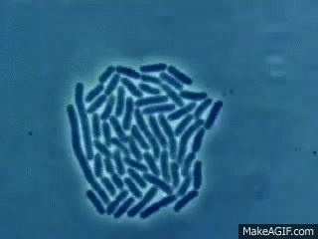

Slide 85
Foundational Terms (3)
Disorder =def. – A causally linked combination of physical components of the extended organism that is (a) clinically abnormal and (b) maximal, in the sense that it is not a part of some larger such combination.
Pathological Process =def. – A bodily process that is a manifestation of a disorder and is clinically abnormal.
Disease =def. – A disposition (i) to undergo pathological processes that (ii) exists in an organism because of one or more disorders in that organism.

Slide 86
Continuant
Independent
Continuant
Dependent
Continuant
Non-realizable
Dependent
Continuant
(quality)
Realizable
Dependent
Continuant
(function, role,
disposition)
..... .....

Slide 87
Realizable dependent continuants
plan
function
role
disposition
capability
tendency
continuants

Slide 88
Their realizations
execution
expression
exercise
realization
application
course
occurrents

Slide 89
Disposition
- of a glass vase, to shatter if dropped
- of a human, to eat
- of a banana, to ripen
- of John, to lose hair
dispositions must have some physical basis

Slide 90
Disposition
if it ceases to exist, then its bearer and/or its immediate surrounding environment is physically changed;
its realization occurs when its bearer is in some special physical circumstances;
its realization is what it is in virtue of the bearer’s physical make-up.

Slide 91
Dispositions are realized in processes
dependent
continuant
occurrent
process
disposition
ripening
to ripen
disposition of this
fruit: to ripen
process of ripening
in this fruit

Slide 92
independent
continuant
dependent
continuant
occurrent
disposition
process
integumentary
system
process of going bald
to go bald
John’s
integumentary
system
John’s
disposition:
to go bald
John’s going
bald

Slide 93
Dependence
on the instance level
a depends_on b =def. a is necessarily such that if b ceases to exist than a ceases to exist
on the type level
A depends_on B =def. for every instance a of A, there is some instance b of B such that a depends_on b.

Slide 94
realization depends_on realizable
Continuant
Occurrent
Independent
Continuant
bearer
Dependent
Continuant
disposition
Process of
realization
.... ..... .......

Slide 95
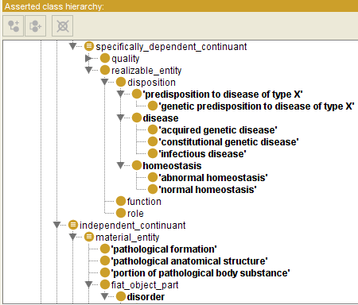

Slide 96
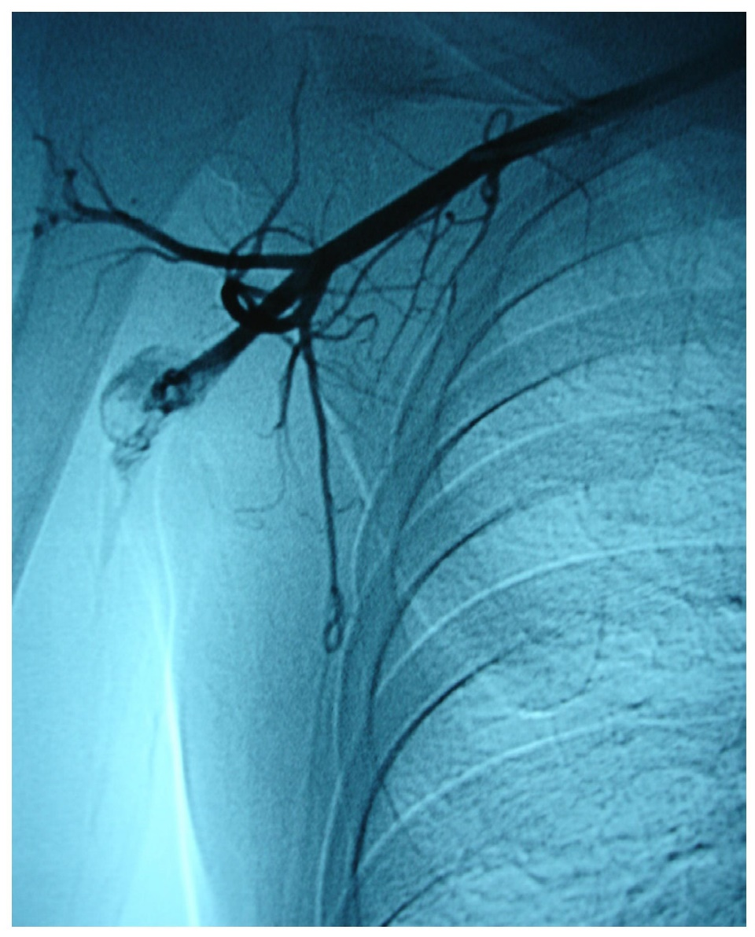
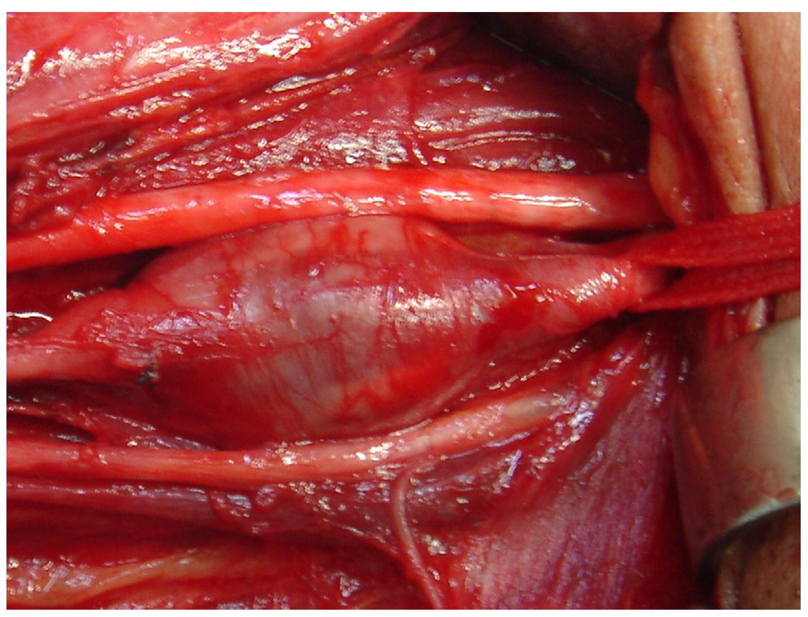
Arterial aneurysm
Jornal Vascular Brasileiro Print version ISSN 1677-5449
J. vasc. bras. vol.12 no.4 Porto Alegre Oct./Dec. 2013 Epub Dec 15, 2013
http://dx.doi.org/10.1590/jvb.2013.054
Subclavian and axillary arterial aneurysms: two case reports
Fernando Pinho Esteves¹ , André Ventura Ferreira¹ , Vanessa Prado dos Santos² , Gabriel Santos Novaes¹ , Álvaro Razuk Filho¹ , Roberto Augusto Caffaro¹

Slide 97
Arterial Aneurysm
Disposition – atherosclerosis
  realized in
Pathological process – fatty material collects within the walls of arteries
  produces
Disorder – artery with weakened wall
  bears
Disposition – of artery to become distended
  realized_in
Pathological process – process of distending
  produces
Disorder – arterial aneurysm
  bears
Disposition – of artery to rupture
  realized in
Pathological process – (catastrophic event) of rupturing
  produces
Disorder – ruptured artery, arterial system with dangerously low blood pressure
  bears
Disposition – circulatory failure
  realized in
Pathological process – exsanguination, failure of homeostasis
  produces
Death

Slide 98
coronary heart disease
disease associated with early lesions and small fibrous plaques
disease associated with asymptomatic (‘silent’) infarction
disease associated with surface disruption of plaque
unstable angina
stable angina
instantiates at t₂
instantiates at t₃
instantiates at t₄
instantiates at t₅
instantiates at t₁
John’s coronary heart disease
time

Slide 99
independent
continuant
dependent
continuant
occurrent
disposition
process
heart
disease course
coronary heart disease
John’s heart
John’s coronary
heart disease
course of John’s
coronary heart disease

Slide 100
Disease course
The totality of all PROCESSes through which a given DISEASE instance is realized.

Slide 101
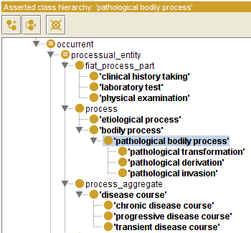

Slide 102
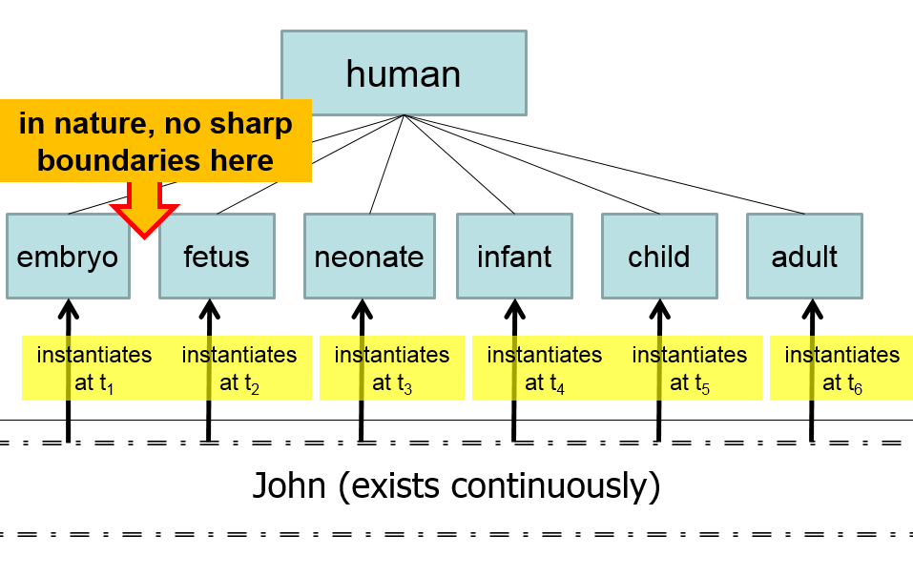
Compare with

Slide 103
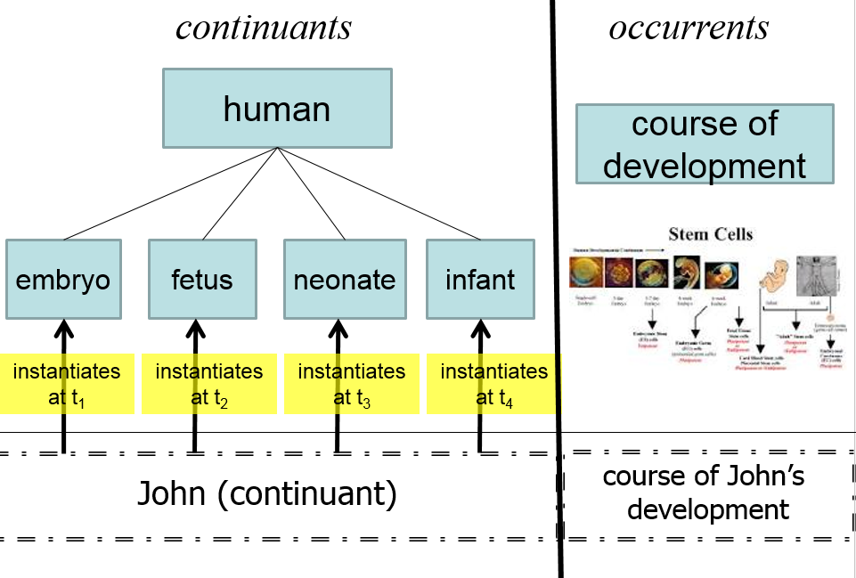

Slide 104
Questions
How does one deal with the ever changing nature of the physical disorder?
How does one deal with the evolution of the disposition?
Is an infectious disorder still an infectious disorder even after the pathogenic organism has been sterilized?
Notes:
Answer the following questions.

Slide 105
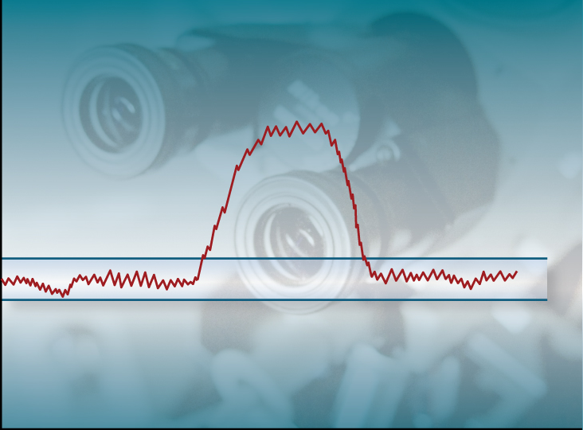
Acute Influenza Infection Process
Immune response
Pathogen sterilization
State
Viral replication
& tissue destruction
Normal Homeostatic
Range
Etiological
Event
Time

Slide 106

Normal Adaptation
State
Etiological
Event
Normal Homeostatic
Range
Normal Homeostatic
Range
Time

Slide 107
Acute Pathological Process
State
Etiological
Event
Normal Homeostatic
Range
Time

Slide 108
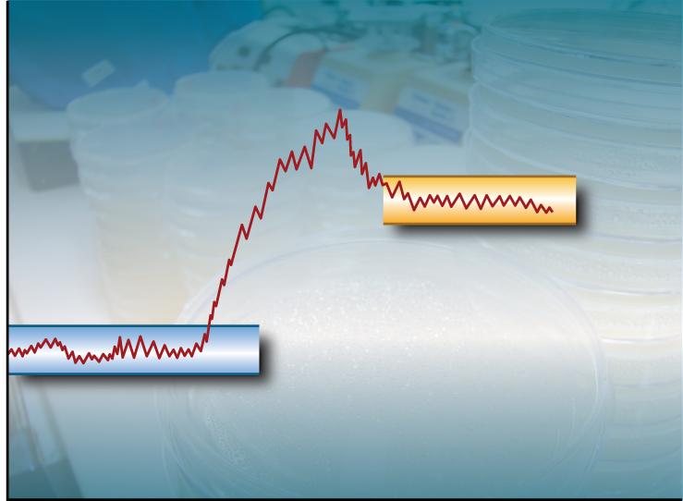
Chronic Pathological Process
State
Abnormal
Homeostatic
Range
Etiological
Event
Normal Homeostatic
Range
Time

Slide 109

Progressive Pathological Process
State
Etiological
Event
Normal Homeostatic
Range
Time

Slide 110
Etiology
Etiological Process =def. – A process in an organism that leads to a subsequent disorder.
Examples:
  toxic chemical exposure resulting in a mutation in the genomic DNA of a cell;
  infection of a human with a pathogenic virus;
  inheritance of two defective copies of a metabolic gene.
The etiological process creates the physical basis of that disposition to pathological processes which is the disease.

Slide 111
Dispositions and Predispositions
All diseases are dispositions; not all dispositions are diseases.
A predisposition is a disposition.
Predisposition to Disease of Type X =def. – A disposition in an organism that constitutes an increased risk of the organism’s subsequently developing the disease X.
Hereditary Non-polyposis Colorectal Cancer (HNPCC) is caused by a:
  disorder (mutation) in a DNA mismatch repair gene that
  disposes to the acquisition of additional mutations from defective DNA repair processes, and thus
  predisposition to the development of colon cancer.

Slide 112
Hereditary Non-polyposis Colorectal Cancer HNPCC - genetic pre-disposition
Etiological process - inheritance of a mutant mismatch repair gene
  produces
Disorder - chromosome 3 with abnormal hMLH1
  bears
Disposition (disease) - Lynch syndrome
  realized_in
Pathological process - abnormal repair of DNA mismatches
  produces
Disorder - mutations in proto-oncogenes and tumor suppressor genes with microsatellite repeats (e.g. TGF-beta R2)
  bears
Disposition (disease) - non-polyposis colon cancer

Slide 113

Hemorrhagic stroke
http://www.tomfit247.com/2013/05/stroke-what-is-it-what-causes-it-and.html

Slide 114
Hemorrhagic stroke
Disorder – cerebral arterial aneurysm
  bears
Disposition – of weakened artery to rupture
  realized in
Pathological process – rupturing of weakened blood vessel
  produces
Disorder – Intraparenchymal cerebral hemorrhage
  bears
Disposition (disease) – to increased intra-cranial pressure
  realized in
Pathological process – increasing intra-cranial pressure, compression of brain structures
  produces
Disorder – Cerebral ischemia, Cerebral neuronal death
  bears
Disposition (disease) – stroke
  realized in
Symptoms – weakness/paralysis, loss of sensation, etc

Slide 115
Definitions - Clinical Evaluation Terms
(on the side of the patient!)
‘bodily feature’ - an abbreviation for a physical component, a bodily quality, or a bodily process.
Sign =def. – A bodily feature of a patient that is observed in a physical examination and is deemed by the clinician to be of clinical significance. (Objectively observable features)
Symptom =def. – A bodily feature of a patient that is observed by the patient and is hypothesized by the patient to be a realization of a disease. (a restricted family of phenomena (including pain, nausea, anger, drowsiness), which are of their nature experienced in the first person)
Laboratory Test =def. – A measurement assay that has as input a patient-derived specimen, and as output a result representing a quality of the specimen.
Laboratory Finding =def. – A representation of a quality of a specimen that is the output of a laboratory test and that can support an inference to an assertion about some quality of the patient.

Slide 116
Definitions - manifestations
Manifestation of a Disease =def. – A bodily feature of a patient that is (a) a deviation from clinical normality that exists in virtue of the realization of a disease and (b) is observable.
  Observability includes observable through elicitation of response or through the use of special instruments.
Preclinical Manifestation of a Disease =def. – A manifestation of a disease that exists prior to its becoming detectable in a clinical history taking or physical examination.
Clinical Manifestation of a Disease =def. – A manifestation of a disease that is detectable in a clinical history taking or physical examination.
Phenotype =def. – A (combination of) bodily feature(s) of an organism determined by the interaction of its genetic make-up and environment.
Clinical Phenotype =def. – A clinically abnormal phenotype.

Slide 117




RO and RT make 4 crucial distinctions
1
Reality ←→ representation

Slide 118
RO and RT make 4 crucial distinctions
Ontology ←→ an ontology
2

Slide 119
RO and RT make 4 crucial distinctions
3

Slide 120
RO and RT make 4 crucial distinctions
4

Slide 121
Research question
Can these principles be applied to assess the extent to which the transactions registered in the EHR’s database resulting from managing the problem list provide insight in:
the adequacy of the clinical user interface to capture
what the clinician had in mind, with the goal
to reconstruct the clinical reality of the patient?

Slide 122
Big Picture

Slide 123
‘Findings’ / ‘observations’
On the side of the patient
Bodily features
  Symptoms
  Signs
    Observed through physical examination
    Observed through lab test

Slide 124
‘Findings’ / ‘observations’
On the side of the patient
Bodily features
  Symptoms
  Signs
    Observed through physical examination
    Observed through lab test
Phenotype =def. – A (combination of) bodily
feature(s) of an organism determined by the
interaction of its genetic make-up and environment.
Clinical Phenotype =def. – A clinically abnormal
phenotype.

Slide 125
‘Findings’ / ‘observations’
On the side of the patient
Bodily features
  Symptoms
  Signs
    Observed through physical examination
    Observed through lab test
Representations
Findings
  Anamnestic findings
    Clinical findings
    Laboratory findings

Slide 126
‘Findings’ / ‘observations’
On the side of the patient
Bodily features
  Symptoms
  Signs
    Observed through physical examination
    Observed through lab test
    Clinical phenotype
Representations
Findings
  Anamnestic findings
    Clinical findings
    Laboratory findings
    Clinical picture

Slide 127
Clinical picture
Clinical Picture =def. – A representation of a clinical phenotype that is inferred from the combination of laboratory, image and clinical findings about a given patient.

Slide 128
‘Findings’ / ‘observations’
On the side of the patient
Bodily features
  Symptoms
  Signs
    Observed through physical examination
    Observed through lab test
Diseases
Representations
Findings
  Anamnestic findings
    Clinical findings
    Laboratory findings
Diagnoses

Slide 129
Diagnosis
Clinical Picture =def. – A representation of a clinical phenotype that is inferred from the combination of laboratory, image and clinical findings about a given patient.
Diagnosis =def. – A conclusion of an interpretive process that has as input a clinical picture of a given patient and as output an assertion to the effect that the patient has a disease of such and such a type.

Slide 130


Slide 131
Generically Dependent Continuants
Generically
Dependent
Continuant
if one bearer ceases to exist, then the entity can survive, because there are other bearers
(copyability)
the pdf file on my laptop
the DNA (sequence) in this chromosome
Information
Object
Gene
Sequence

Slide 132


Slide 133



Slide 134


No conflation of diagnosis, disease, and disorder
The diagnosis is here
The disorder is there
The disease is there

Slide 135
No conflation of diagnosis, disease, and disorder
produces
bears
realized_in
etiological process
disorder
disease
pathological process
produces
diagnosis
interpretive process
signs & symptoms
abnormal bodily features
produces
participates_in
recognized_as
Notes:
font was too small, color inside green boxes was hardly readable

Slide 136
Application of OGMS in medical documentation

Slide 137
Key OGMS definitions
DISORDER
DISEASE
DISEASE COURSE
DIAGNOSIS
Scheuermann R, Ceusters W, Smith B. Toward an Ontological Treatment of Disease and Diagnosis. 2009 AMIA Summit on Translational Bioinformatics, San Francisco, California, March 15-17, 2009;: 116-120. Omnipress ISBN:0-9647743-7-2

Slide 138
Key OGMS definitions
DISORDER | A causally relatively isolated combination of physical components that is (a) clinically abnormal and (b) maximal, in the sense that it is not a part of some larger such combination.
DISEASE
DISEASE COURSE
DIAGNOSIS
Scheuermann R, Ceusters W, Smith B. Toward an Ontological Treatment of Disease and Diagnosis. 2009 AMIA Summit on Translational Bioinformatics, San Francisco, California, March 15-17, 2009;: 116-120. Omnipress ISBN:0-9647743-7-2

Slide 139
Key OGMS definitions
DISORDER | A causally relatively isolated combination of physical components that is (a) clinically abnormal and (b) maximal, in the sense that it is not a part of some larger such combination.
DISEASE | A DISPOSITION (i) to undergo PATHOLOGICAL PROCESSes that (ii) exists in an ORGANISM because of one or more DISORDERs in that ORGANISM.
DISEASE COURSE
DIAGNOSIS
Scheuermann R, Ceusters W, Smith B. Toward an Ontological Treatment of Disease and Diagnosis. 2009 AMIA Summit on Translational Bioinformatics, San Francisco, California, March 15-17, 2009;: 116-120. Omnipress ISBN:0-9647743-7-2

Slide 140
Key OGMS definitions
DISORDER | A causally relatively isolated combination of physical components that is (a) clinically abnormal and (b) maximal, in the sense that it is not a part of some larger such combination.
DISEASE | A DISPOSITION (i) to undergo PATHOLOGICAL PROCESSes that (ii) exists in an ORGANISM because of one or more DISORDERs in that ORGANISM.
DISEASE COURSE | The totality of all PROCESSes through which a given DISEASE instance is realized.
DIAGNOSIS
Scheuermann R, Ceusters W, Smith B. Toward an Ontological Treatment of Disease and Diagnosis. 2009 AMIA Summit on Translational Bioinformatics, San Francisco, California, March 15-17, 2009;: 116-120. Omnipress ISBN:0-9647743-7-2

Slide 141
Key OGMS definitions
DISORDER | A causally relatively isolated combination of physical components that is (a) clinically abnormal and (b) maximal, in the sense that it is not a part of some larger such combination.
DISEASE | A DISPOSITION (i) to undergo PATHOLOGICAL PROCESSes that (ii) exists in an ORGANISM because of one or more DISORDERs in that ORGANISM.
DISEASE COURSE | The totality of all PROCESSes through which a given DISEASE instance is realized.
DIAGNOSIS | A conclusion of an interpretive PROCESS that has as input a CLINICAL PICTURE of a given patient and as output an assertion (diagnostic statement) to the effect that the patient has a DISEASE of such and such a type.
Scheuermann R, Ceusters W, Smith B. Toward an Ontological Treatment of Disease and Diagnosis. 2009 AMIA Summit on Translational Bioinformatics, San Francisco, California, March 15-17, 2009;: 116-120. Omnipress ISBN:0-9647743-7-2

Slide 142
Disorder related configurations
No disorder instance → no disease instance,
→ no pathological processes;
A disorder instance can eliminate the range of circumstances under which another disorder instance can lead to pathological processes → no disease instance;
Disorders of the same type in distinct patients, or in the same patient at distinct times, may lead to diseases of distinct types;
Diseases of the same type may unfold themselves in disease courses of distinct types;
Diseases of distinct types may unfold themselves in disease courses of the same type;
…

Slide 143
What are diagnoses in EHRs about?
(What are the options?)
DISORDER | A causally relatively isolated combination of physical components that is (a) clinically abnormal and (b) maximal, in the sense that it is not a part of some larger such combination.
DISEASE | A DISPOSITION (i) to undergo PATHOLOGICAL PROCESSes that (ii) exists in an ORGANISM because of one or more DISORDERs in that ORGANISM.
DISEASE COURSE | The totality of all PROCESSes through which a given DISEASE instance is realized.
DIAGNOSIS | A conclusion of an interpretive PROCESS that has as input a CLINICAL PICTURE of a given patient and as output an assertion (diagnostic statement) to the effect that the patient has a DISEASE of such and such a type.
Scheuermann R, Ceusters W, Smith B. Toward an Ontological Treatment of Disease and Diagnosis. 2009 AMIA Summit on Translational Bioinformatics, San Francisco, California, March 15-17, 2009;: 116-120. Omnipress ISBN:0-9647743-7-2

Slide 144
What are diagnoses in EHRs about?
(What are the options?)
DISORDER | A causally relatively isolated combination of physical components that is (a) clinically abnormal and (b) maximal, in the sense that it is not a part of some larger such combination.
DISEASE | A DISPOSITION (i) to undergo PATHOLOGICAL PROCESSes that (ii) exists in an ORGANISM because of one or more DISORDERs in that ORGANISM.
DISEASE COURSE | The totality of all PROCESSes through which a given DISEASE instance is realized.
DIAGNOSIS | A conclusion of an interpretive PROCESS that has as input a CLINICAL PICTURE of a given patient and as output an assertion (diagnostic statement) to the effect that the patient has a DISEASE of such and such a type.
781.2 Abnormality of gait

Slide 145
What are diagnoses in EHRs about?
(What are the options?)
DISORDER | A causally relatively isolated combination of physical components that is (a) clinically abnormal and (b) maximal, in the sense that it is not a part of some larger such combination.
DISEASE | A DISPOSITION (i) to undergo PATHOLOGICAL PROCESSes that (ii) exists in an ORGANISM because of one or more DISORDERs in that ORGANISM.
DISEASE COURSE | The totality of all PROCESSes through which a given DISEASE instance is realized.
DIAGNOSIS | A conclusion of an interpretive PROCESS that has as input a CLINICAL PICTURE of a given patient and as output an assertion (diagnostic statement) to the effect that the patient has a DISEASE of such and such a type.
781.2 Abnormality of gait

Slide 146
What are diagnoses in EHRs about?
(What are the options?)
DISORDER | A causally relatively isolated combination of physical components that is (a) clinically abnormal and (b) maximal, in the sense that it is not a part of some larger such combination.
DISEASE | A DISPOSITION (i) to undergo PATHOLOGICAL PROCESSes that (ii) exists in an ORGANISM because of one or more DISORDERs in that ORGANISM.
DISEASE COURSE | The totality of all PROCESSes through which a given DISEASE instance is realized.
DIAGNOSIS | A conclusion of an interpretive PROCESS that has as input a CLINICAL PICTURE of a given patient and as output an assertion (diagnostic statement) to the effect that the patient has a DISEASE of such and such a type.
256.0 - Hyperestrogenism

Slide 147
What are diagnoses in EHRs about?
(What are the options?)
DISORDER | A causally relatively isolated combination of physical components that is (a) clinically abnormal and (b) maximal, in the sense that it is not a part of some larger such combination.
DISEASE | A DISPOSITION (i) to undergo PATHOLOGICAL PROCESSes that (ii) exists in an ORGANISM because of one or more DISORDERs in that ORGANISM.
DISEASE COURSE | The totality of all PROCESSes through which a given DISEASE instance is realized.
DIAGNOSIS | A conclusion of an interpretive PROCESS that has as input a CLINICAL PICTURE of a given patient and as output an assertion (diagnostic statement) to the effect that the patient has a DISEASE of such and such a type.
256.0 - Hyperestrogenism

Slide 148
What are diagnoses in EHRs about?
(What are the options?)
DISORDER | A causally relatively isolated combination of physical components that is (a) clinically abnormal and (b) maximal, in the sense that it is not a part of some larger such combination.
DISEASE | A DISPOSITION (i) to undergo PATHOLOGICAL PROCESSes that (ii) exists in an ORGANISM because of one or more DISORDERs in that ORGANISM.
DISEASE COURSE | The totality of all PROCESSes through which a given DISEASE instance is realized.
DIAGNOSIS | A conclusion of an interpretive PROCESS that has as input a CLINICAL PICTURE of a given patient and as output an assertion (diagnostic statement) to the effect that the patient has a DISEASE of such and such a type.
250.23 Diabetes with hyperosmolarity, type I, uncontrolled

Slide 149
What are diagnoses in EHRs about?
(What are the options?)
DISORDER | A causally relatively isolated combination of physical components that is (a) clinically abnormal and (b) maximal, in the sense that it is not a part of some larger such combination.
DISEASE | A DISPOSITION (i) to undergo PATHOLOGICAL PROCESSes that (ii) exists in an ORGANISM because of one or more DISORDERs in that ORGANISM.
DISEASE COURSE | The totality of all PROCESSes through which a given DISEASE instance is realized.
DIAGNOSIS | A conclusion of an interpretive PROCESS that has as input a CLINICAL PICTURE of a given patient and as output an assertion (diagnostic statement) to the effect that the patient has a DISEASE of such and such a type.
250.23 Diabetes with hyperosmolarity, type I, uncontrolled

Slide 150
What are diagnoses in EHRs about?
(What are the options?)
DISORDER | A causally relatively isolated combination of physical components that is (a) clinically abnormal and (b) maximal, in the sense that it is not a part of some larger such combination.
DISEASE | A DISPOSITION (i) to undergo PATHOLOGICAL PROCESSes that (ii) exists in an ORGANISM because of one or more DISORDERs in that ORGANISM.
DISEASE COURSE | The totality of all PROCESSes through which a given DISEASE instance is realized.
DIAGNOSIS | A conclusion of an interpretive PROCESS that has as input a CLINICAL PICTURE of a given patient and as output an assertion (diagnostic statement) to the effect that the patient has a DISEASE of such and such a type.
749.01 - Cleft palate, unilateral, complete

Slide 151
What are diagnoses in EHRs about?
(What are the options?)
DISORDER | A causally relatively isolated combination of physical components that is (a) clinically abnormal and (b) maximal, in the sense that it is not a part of some larger such combination.
DISEASE | A DISPOSITION (i) to undergo PATHOLOGICAL PROCESSes that (ii) exists in an ORGANISM because of one or more DISORDERs in that ORGANISM.
DISEASE COURSE | The totality of all PROCESSes through which a given DISEASE instance is realized.
DIAGNOSIS | A conclusion of an interpretive PROCESS that has as input a CLINICAL PICTURE of a given patient and as output an assertion (diagnostic statement) to the effect that the patient has a DISEASE of such and such a type.
749.01 - Cleft palate, unilateral, complete

Slide 152
What are diagnoses in EHRs about?
(What are the options?)
DISORDER | A causally relatively isolated combination of physical components that is (a) clinically abnormal and (b) maximal, in the sense that it is not a part of some larger such combination.
DISEASE | A DISPOSITION (i) to undergo PATHOLOGICAL PROCESSes that (ii) exists in an ORGANISM because of one or more DISORDERs in that ORGANISM.
DISEASE COURSE | The totality of all PROCESSes through which a given DISEASE instance is realized.
DIAGNOSIS | A conclusion of an interpretive PROCESS that has as input a CLINICAL PICTURE of a given patient and as output an assertion (diagnostic statement) to the effect that the patient has a DISEASE of such and such a type.
V65.5 - Person with feared complaint in whom no diagnosis was made

Slide 153
What are diagnoses in EHRs about?
(What are the options?)
DISORDER | A causally relatively isolated combination of physical components that is (a) clinically abnormal and (b) maximal, in the sense that it is not a part of some larger such combination.
DISEASE | A DISPOSITION (i) to undergo PATHOLOGICAL PROCESSes that (ii) exists in an ORGANISM because of one or more DISORDERs in that ORGANISM.
DISEASE COURSE | The totality of all PROCESSes through which a given DISEASE instance is realized.
DIAGNOSIS | A conclusion of an interpretive PROCESS that has as input a CLINICAL PICTURE of a given patient and as output an assertion (diagnostic statement) to the effect that the patient has a DISEASE of such and such a type.
V65.5 - Person with feared complaint in whom no diagnosis was made

Slide 154

In this study, we take the first step in this direction, by designing an OWL2 diabetes diagnosis ontology (DDO). Protégé 5 software was used for the construction of the ontology. DDO is developed within the framework of the basic formal ontology and the ontology for general medical science
to represent entities in the domain of diabetes, and it follows the design principles recommended by the Open Biomedical Ontology Foundry. Currently, DDO contains 6444 concepts, 48 properties, 13,551 annotations, and 27,127 axioms. DDO can serve as a diabetes knowledge base and supports automatic reasoning. It represents a major step toward the development of a new generation of patient-centric decision support tools.

Slide 155

Claiming to follow OGMS
Following OGMS

