Slide 1
BMI508 / PHI598 – Fall 2018
Biomedical Ontology
Ontology and Information Engineering in the Healthcare Domain
Werner CEUSTERS^{1,2}
¹ Department of Biomedical Informatics, University at Buffalo, USA
² Department of Psychiatry, University at Buffalo, USA

Slide 2

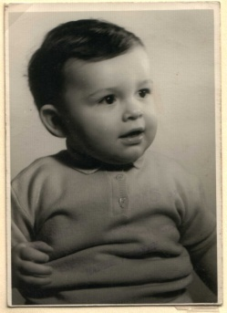
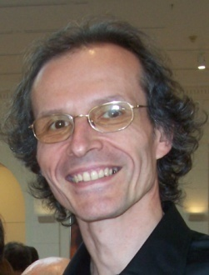



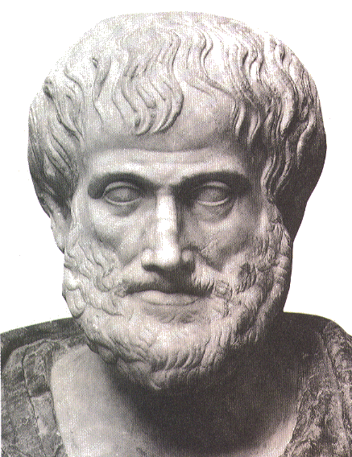








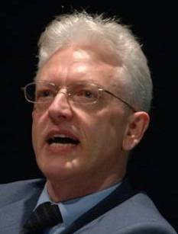


Short professional history
2014
2012
1977
1959 -
2006
1989
2004
1992
2002
1995
1998
1993

Slide 3
Biomedical Informatics
Definition:
Biomedical informatics (BMI) is
the interdisciplinary field
that studies and pursues the effective uses of biomedical data, information, and knowledge
for scientific inquiry, problem solving, and decision making,
driven by efforts to improve human health.
CA Kulikowski, EH Shortliffe, LM Currie, PL Elkin, LE Hunter, TR Johnson, IJ Kalet, LA Lenert, MA Musen, JG Ozbolt, JW Smith, PZ Tarczy-Hornoch, JWilliamson; AMIA Board white paper: definition of biomedical informatics and specification of core competencies for graduate education in the discipline, Journal of the American Medical Informatics Association, Volume 19, Issue 6, 1 November 2012, Pages 931–938, https://doi.org/10.1136/amiajnl-2012-001053

Slide 4
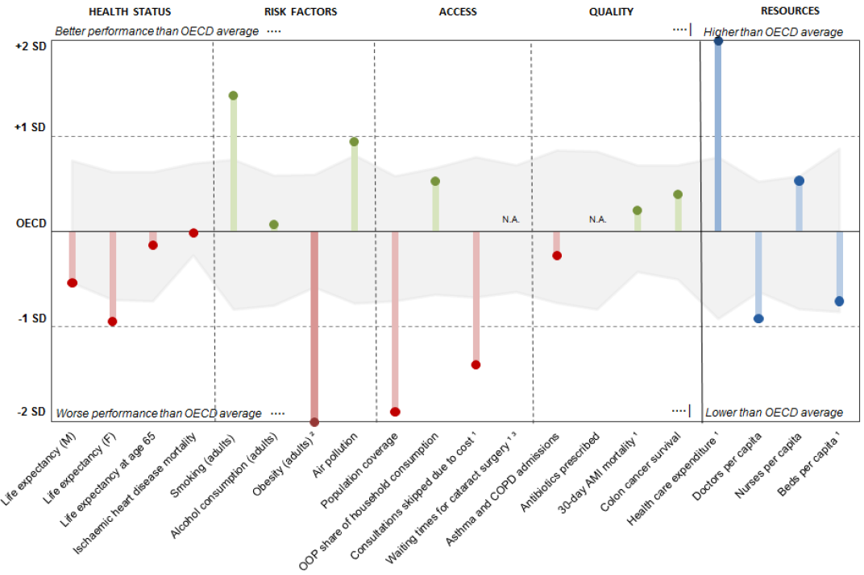
Health status US / OECD
How good is healthcare in the US?
Health at a Glance 2017:
USA/OECD Indicators

Slide 5
USA compared to OECD
Health status: life expectancy at birth was in 1970 one year above the OECD, but now almost two years below average.
Risk factors: 38% of adults obese (OECD average 19.4%), 70% overweight or obese.
Access: US trails many other OECD countries in access to care indicators. Only 91% of the population covered by insurance (2nd lowest coverage rate).
  22% of Americans skipped consultations due to cost (OECD average of 9.1%).
Quality: for most quality of care indicators, the United States performs close to the OECD average.
Resources: health spending averages $9,892 per person (adjusted for local costs), almost double than in all other countries.
Health at a Glance 2017: USA/OECD Indicators

Slide 6
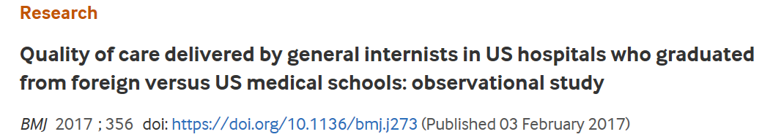
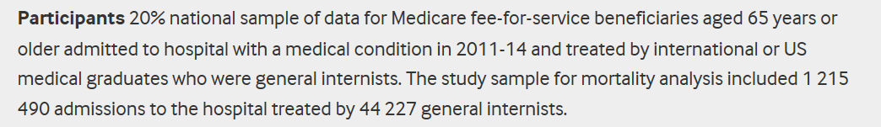
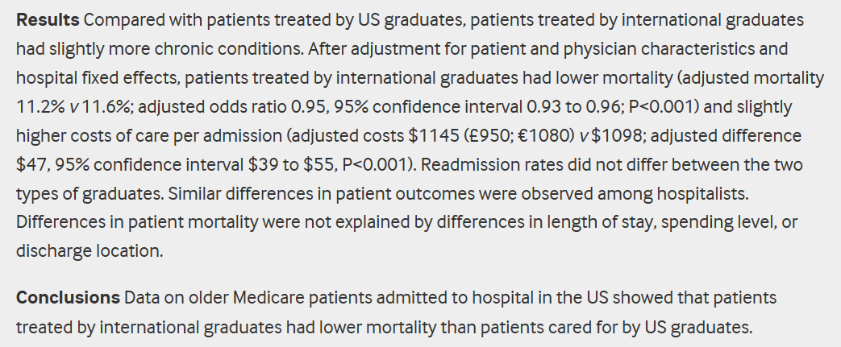

Slide 7
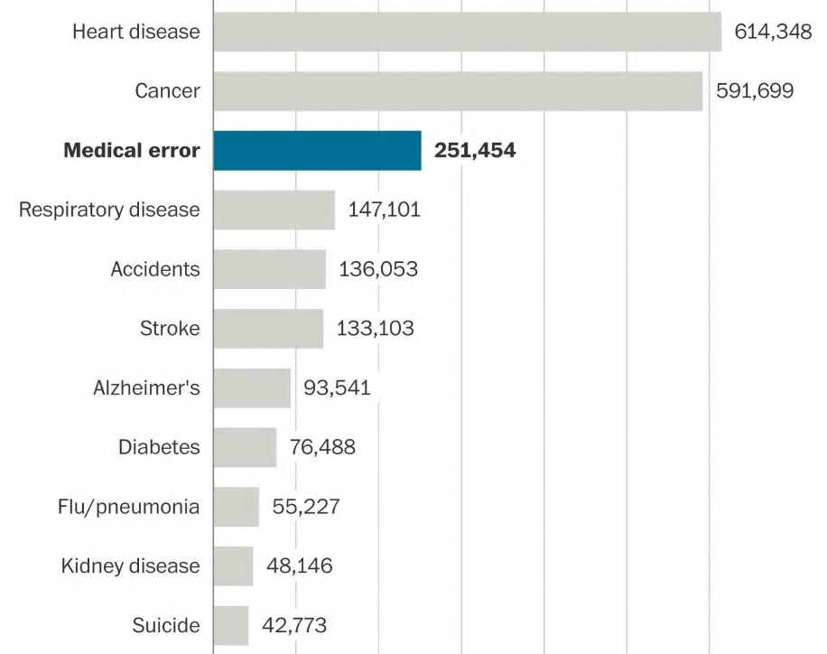
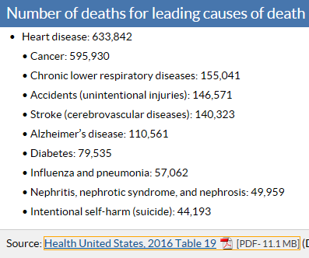
US causes of death
CDC
Martin A Makary & Michael Daniel
Medical error—the third leading cause of death in the US
BMJ 2016; 353 doi: https://doi.org/10.1136/bmj.i2139 (Published 03 May 2016)

Slide 8
Causes of medical errors
Flaws in clinical reasoning
Clinical reasoning is based on ‘dual processing model’
  rapid, intuitive component (Type 1),
  slower, logical and analytical component (Type 2).
Errors in type 1 might come from the associative nature of memory, which can lead to cognitive biases.
Norman GR, Monteiro SD, Sherbino J, Ilgen JS, Schmidt HG, Mamede S.
The causes of errors in clinical reasoning: cognitive biases, knowledge deficits, and dual process thinking.
Acad Med. 2017;92(1):23–30.

Slide 9
Causes of medical errors
Flaws in clinical reasoning
Clinical reasoning is based on ‘dual processing model’
  rapid, intuitive component (Type 1),
  slower, logical and analytical component (Type 2).
Errors in type 1 might come from the associative nature of memory, which can lead to cognitive biases.
Errors in type 2 may result from the limited capacity of working memory.
Strategies to recognize bias [strangely] don’t seem to reduce medical errors. Increasing knowledge does.
Norman GR, Monteiro SD, Sherbino J, Ilgen JS, Schmidt HG, Mamede S.
The causes of errors in clinical reasoning: cognitive biases, knowledge deficits, and dual process thinking.
Acad Med. 2017;92(1):23–30.

Slide 10
Biomedical Informatics
Definition:
Biomedical informatics (BMI) is
the interdisciplinary field
that studies and pursues the effective uses of biomedical data, information, and knowledge
for scientific inquiry, problem solving, and decision making,
driven by efforts to improve human health.
CA Kulikowski, EH Shortliffe, LM Currie, PL Elkin, LE Hunter, TR Johnson, IJ Kalet, LA Lenert, MA Musen, JG Ozbolt, JW Smith, PZ Tarczy-Hornoch, JWilliamson; AMIA Board white paper: definition of biomedical informatics and specification of core competencies for graduate education in the discipline, Journal of the American Medical Informatics Association, Volume 19, Issue 6, 1 November 2012, Pages 931–938, https://doi.org/10.1136/amiajnl-2012-001053

Slide 11
Interdisciplinary Nature of Biomedical Informatics: the main stream view
Computer Science (hardware)
Computer Science (software)
Cognitive Science
& Decision Making
Bioengineering
Biomedical
Informatics
Management
Sciences
Epidemiology
And Statistics
Basic Biomedical
Sciences
Clinical
Sciences

Slide 12
Biomedical Informatics
Definition:
Biomedical informatics (BMI) is
the interdisciplinary field
that studies and pursues the effective uses of biomedical data, information, and knowledge
for scientific inquiry, problem solving, and decision making,
driven by efforts to improve human health.
CA Kulikowski, EH Shortliffe, LM Currie, PL Elkin, LE Hunter, TR Johnson, IJ Kalet, LA Lenert, MA Musen, JG Ozbolt, JW Smith, PZ Tarczy-Hornoch, JWilliamson; AMIA Board white paper: definition of biomedical informatics and specification of core competencies for graduate education in the discipline, Journal of the American Medical Informatics Association, Volume 19, Issue 6, 1 November 2012, Pages 931–938, https://doi.org/10.1136/amiajnl-2012-001053

Slide 13
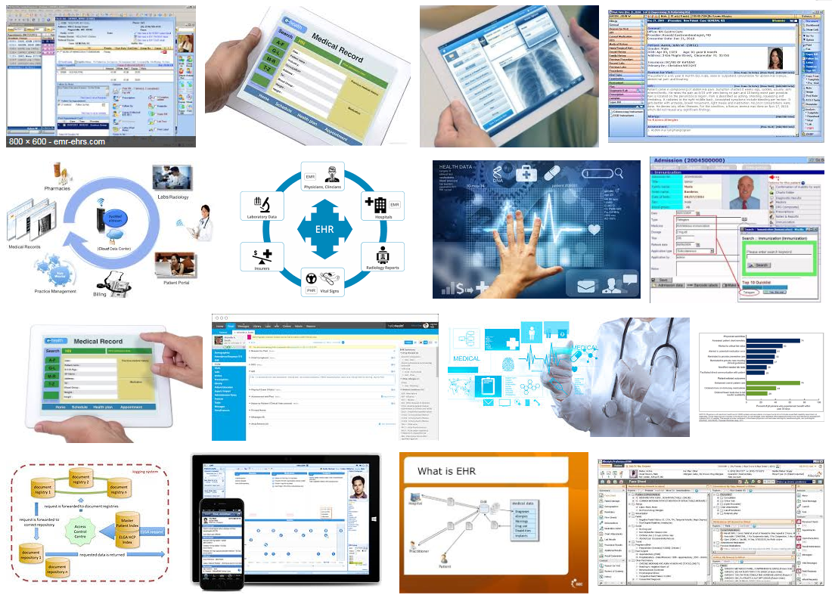
Electronic health records

Slide 14
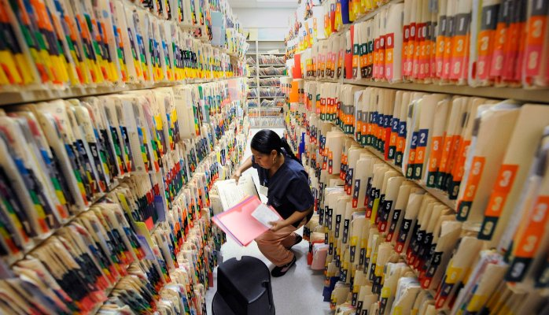
What it tried to solve first

Slide 15
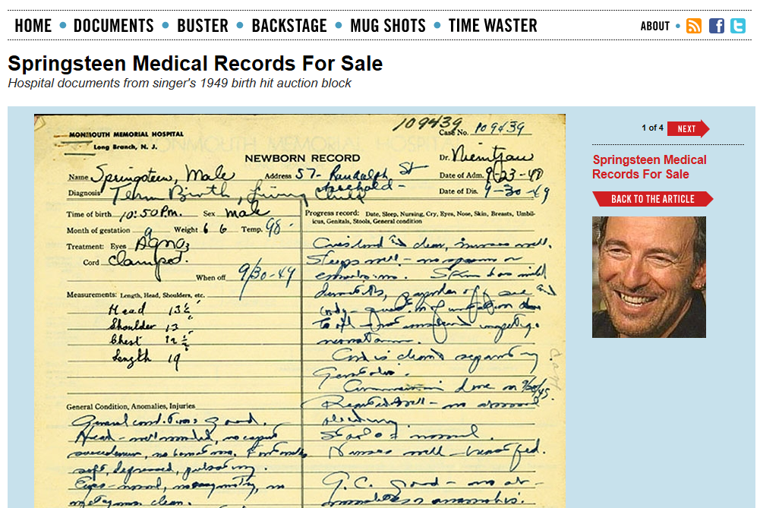
http://www.thesmokinggun.com/file/springsteen-medical-records-sale

Slide 16
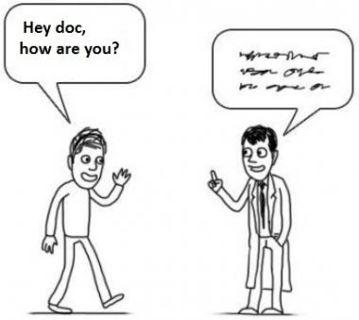

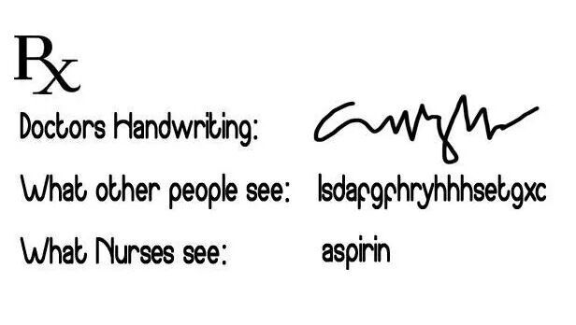
What it solved next
http://topyaps.com/doctors-handwriting

Slide 17
Biomedical Informatics
Definition:
Biomedical informatics (BMI) is
the interdisciplinary field
that studies and pursues the effective uses of biomedical data, information, and knowledge
for scientific inquiry, problem solving, and decision making,
driven by efforts to improve human health.
CA Kulikowski, EH Shortliffe, LM Currie, PL Elkin, LE Hunter, TR Johnson, IJ Kalet, LA Lenert, MA Musen, JG Ozbolt, JW Smith, PZ Tarczy-Hornoch, JWilliamson; AMIA Board white paper: definition of biomedical informatics and specification of core competencies for graduate education in the discipline, Journal of the American Medical Informatics Association, Volume 19, Issue 6, 1 November 2012, Pages 931–938, https://doi.org/10.1136/amiajnl-2012-001053

Slide 18
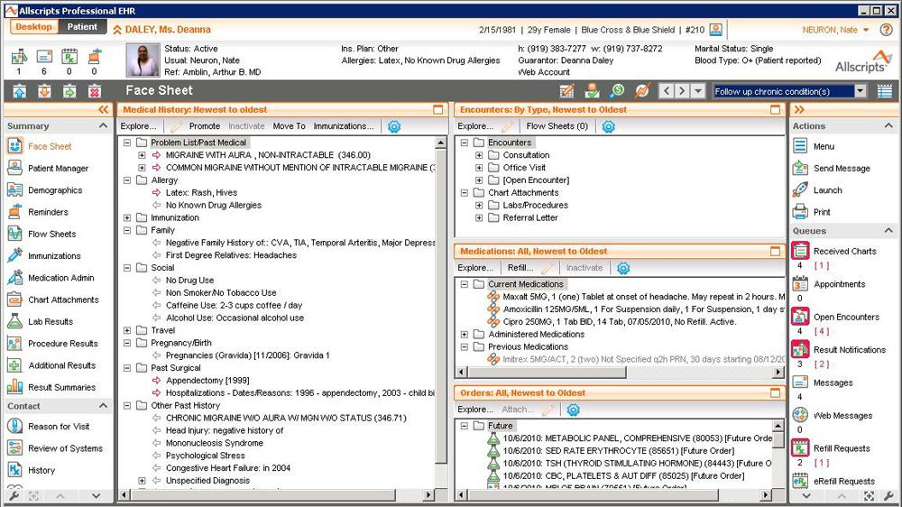

Slide 19
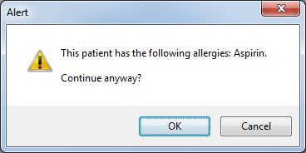

Slide 20
Is
Biomedical Informatics
the Holy Grail
for better healthcare?

Slide 21
EHRs: attention to functionality (US)
← Billing
← Practice management
← Lab results
← ePrescribing
← Regulations
← Clinical

Slide 22
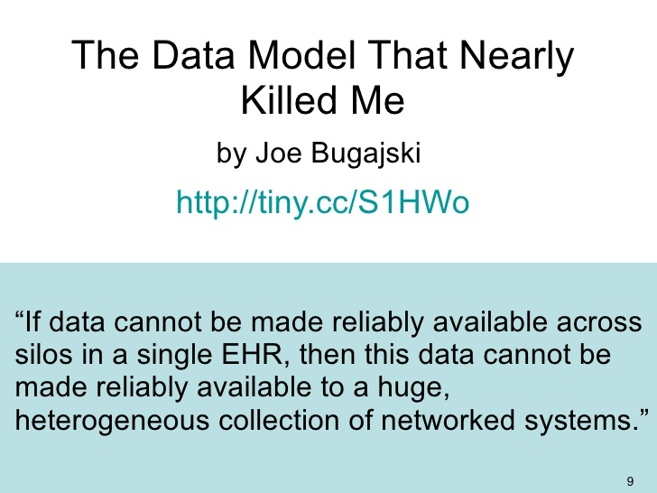

Slide 23
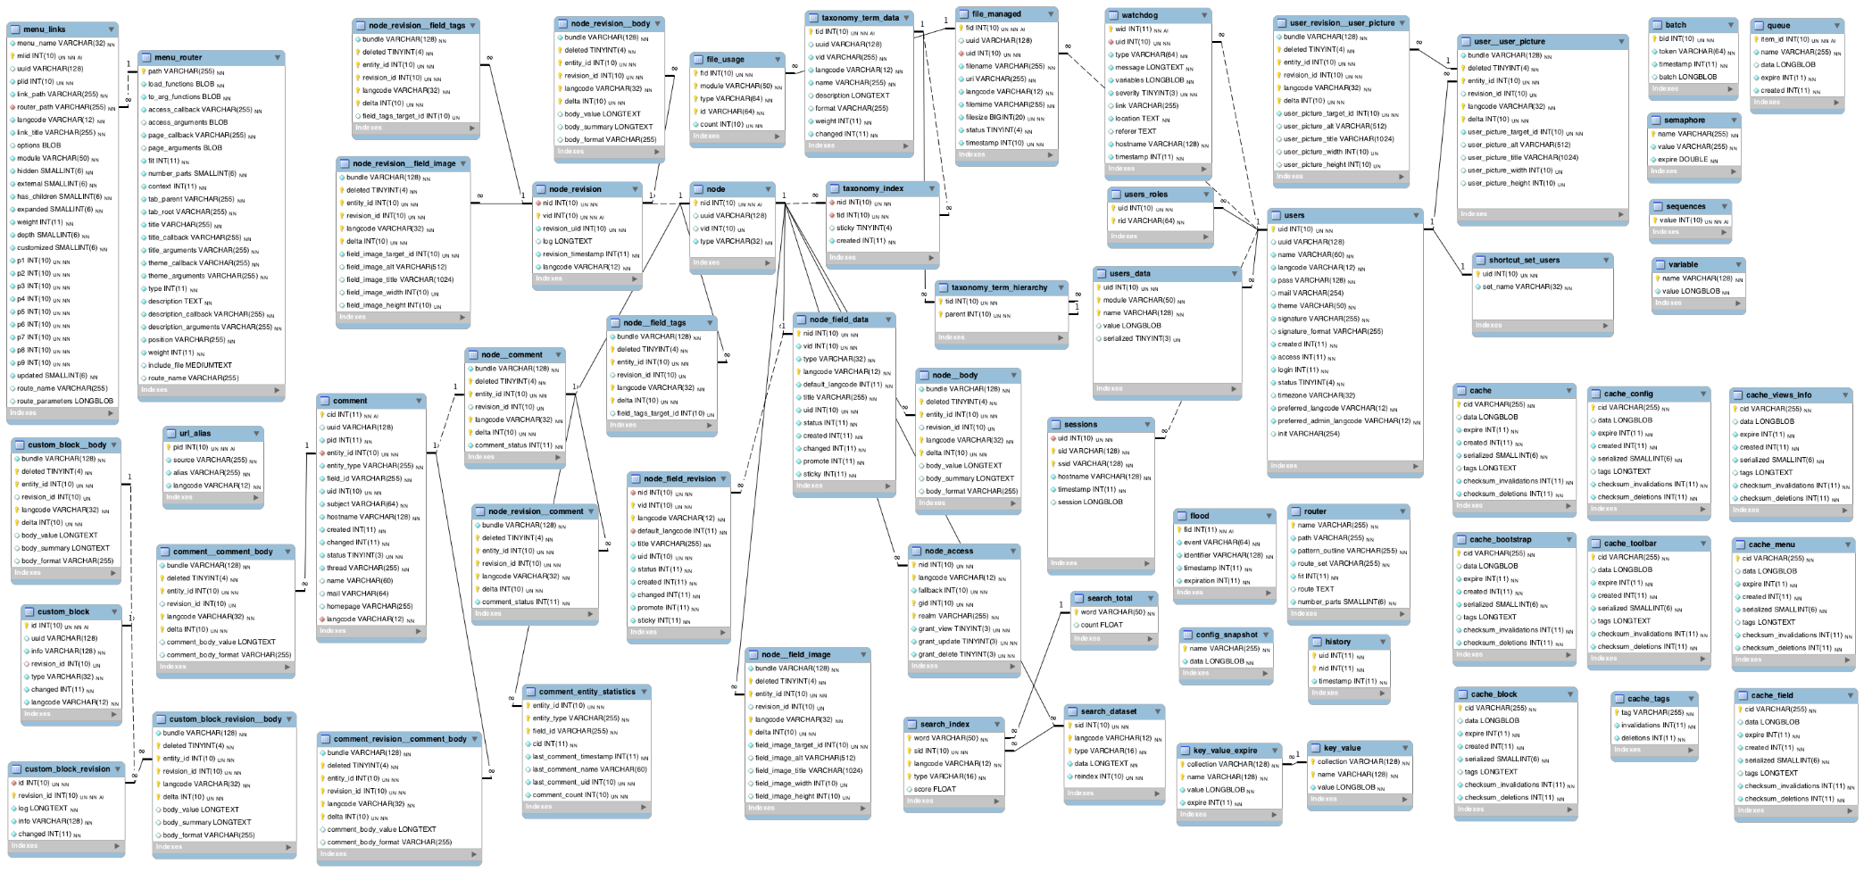

Slide 24



Slide 25
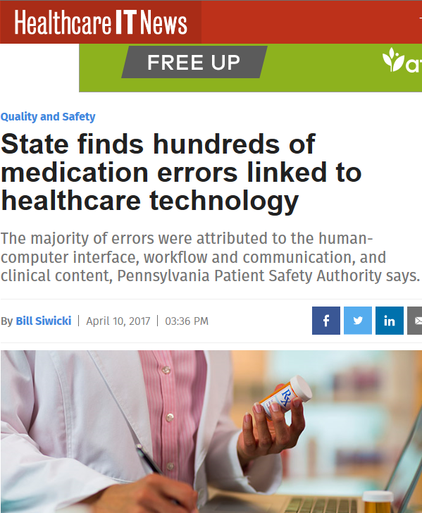
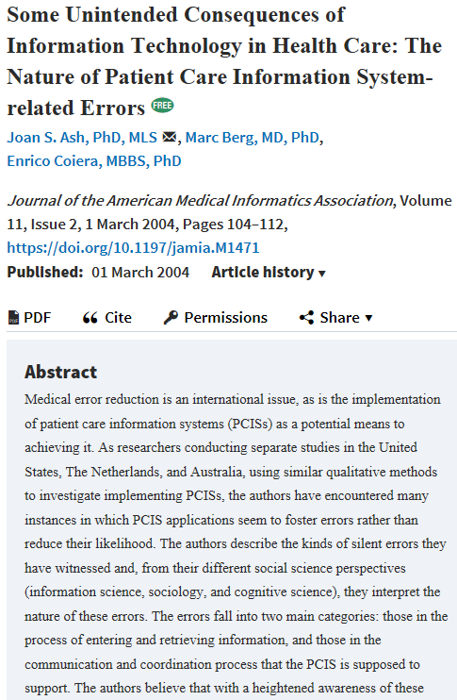
Biomedical Informatics to the rescue ?

Slide 26
Goals of Biomedical Ontology in
Healthcare Information Technology (HIT)
supporting the creation and use of adequate biomedical terminology.
supporting the creation of adequate coding and classification systems.
solving the semantic interoperability problem for heterogeneous biomedical information systems.
improving biomedical decision support applications.

Slide 27
Necessary components for ontologies
Classes amongst which there are relations;
A vocabulary, i.e. a list of terms associated with the ontology’s classes and relations;
Textual definitions and descriptions that provide additional information about what a class or relation denotes;
Formal definitions and axioms that provide in a way ‘understandable’ to specialized software what is considered to be true within the domain covered by the ontology.
Adapted from: R. Hoehndorf, P.N. Schofield, and G.V. Gkoutos. The role of ontologies in biological and biomedical research: a functional perspective. Brief Bioinform. 2015 Nov; 16(6): 1069–1080.

Slide 28
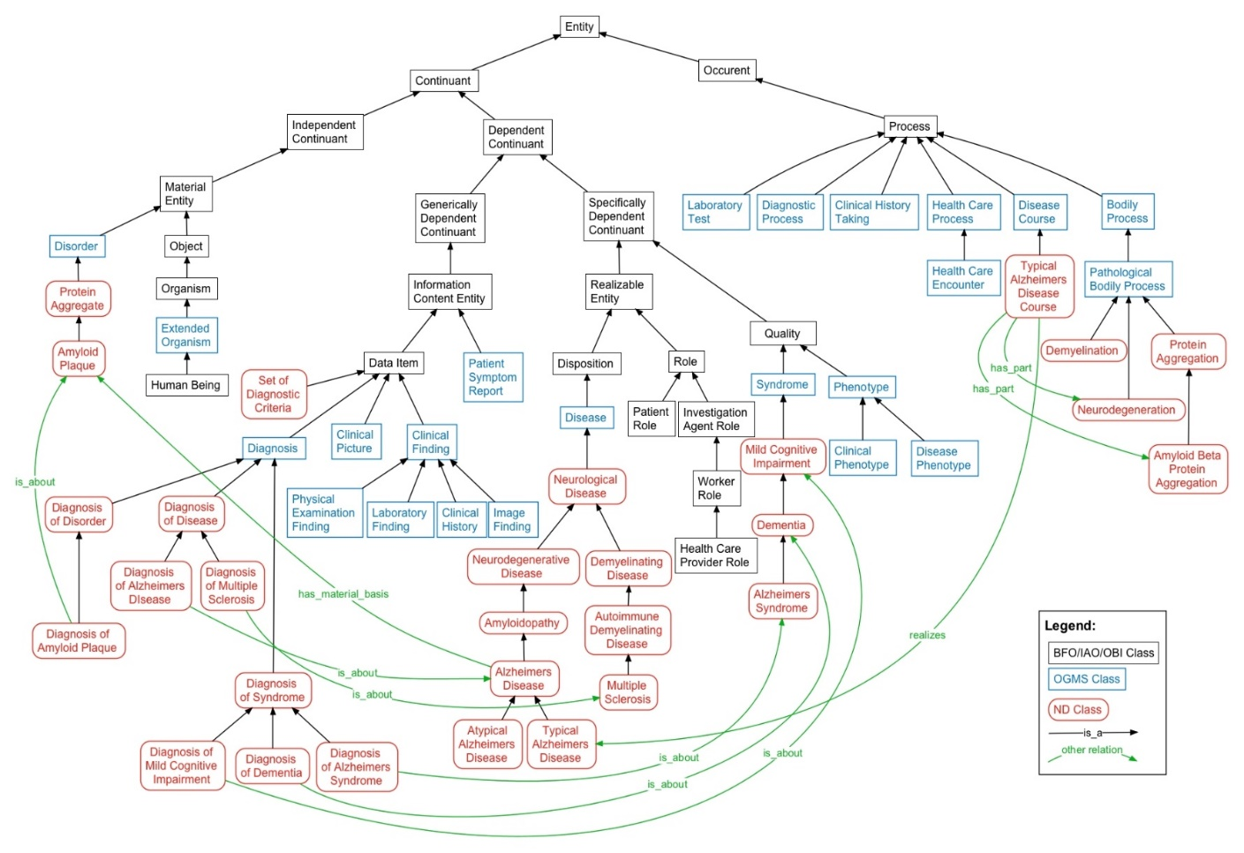
Necessary components for ontologies
Classes amongst which there are relations;
Adapted from: R. Hoehndorf, P.N. Schofield, and G.V. Gkoutos. The role of ontologies in biological and biomedical research: a functional perspective. Brief Bioinform. 2015 Nov; 16(6): 1069–1080.

Slide 29
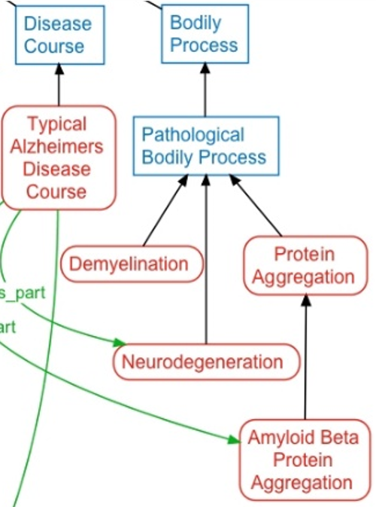
Necessary components for ontologies
Classes amongst which there are relations;
A vocabulary, i.e. a list of terms associated with the ontology’s classes and relations;
Adapted from: R. Hoehndorf, P.N. Schofield, and G.V. Gkoutos. The role of ontologies in biological and biomedical research: a functional perspective. Brief Bioinform. 2015 Nov; 16(6): 1069–1080.

Slide 30
Necessary components for ontologies
Classes amongst which there are relations;
A vocabulary, i.e. a list of terms associated with the ontology’s classes and relations;
Textual definitions and descriptions that provide additional information about what a class or relation denotes;
  e.g.: Disease (OGMS): A disposition (i) to undergo pathological processes that (ii) exists in an organism because of one or more disorders in that organism.
Adapted from: R. Hoehndorf, P.N. Schofield, and G.V. Gkoutos. The role of ontologies in biological and biomedical research: a functional perspective. Brief Bioinform. 2015 Nov; 16(6): 1069–1080.

Slide 31
Uses of (biomedical) ontologies
Classes amongst which there are relations;
A vocabulary, i.e. a list of terms associated with the ontology’s classes and relations;
Textual definitions and descriptions that provide additional information about what a class or relation denotes;
Human annotation of data (literature, databases, electronic healthcare record data, …) for better integration, use and reuse.
Adapted from: R. Hoehndorf, P.N. Schofield, and G.V. Gkoutos. The role of ontologies in biological and biomedical research: a functional perspective. Brief Bioinform. 2015 Nov; 16(6): 1069–1080.

Slide 32
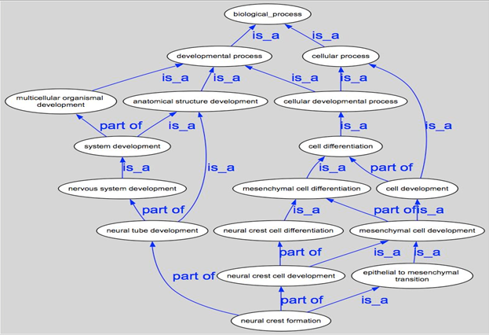
Using ontologies to annotate data collections

Slide 33
The positive effects of appropriate annotations
more precise and comparable semantics of what data items in distinct data collections denote
identification of ontological relations prior to statistical correlation:
  ch1 and ch4
  ch1 and ch5
  ch1 and ch2
  …

Slide 34
Uses of (biomedical) ontologies
Providing decision support under operational conditions:
Using correct codes for billing,
Practice management,
Reducing medical errors:
Diagnostic mistakes,
Erroneous treatment decisions,
Communication errors,
…
Classes amongst which there are relations;
A vocabulary, i.e. a list of terms associated with the ontology’s classes and relations;
Textual definitions and descriptions that provide additional information about what a class or relation denotes;
Formal definitions and axioms that provide in a way ‘understandable’ to specialized software what is considered to be true within the domain covered by the ontology.
Adapted from: R. Hoehndorf, P.N. Schofield, and G.V. Gkoutos. The role of ontologies in biological and biomedical research: a functional perspective. Brief Bioinform. 2015 Nov; 16(6): 1069–1080.

Slide 35
Goals of Realism-based Biomedical Ontology in HIT
supporting the identification of what sorts of biomedical entities exist, how they relate to each other and how they are best represented.
supporting the creation and use of adequate biomedical terminology.
supporting the creation of adequate coding and classification systems.
solving the semantic interoperability problem for heterogeneous biomedical information systems.
improving biomedical decision support applications.
assisting in the education of healthcare workers.
…

Slide 36
Biomedical Informatics
Realism-based Ontology | Inter-disciplinary | Data, Information, Knowledge | Science, Problem Solving, Decision Making | Improving Health
Entity identification
Terminologies
Classification Systems
Semantic Interoperability
Decision Support
Education

Slide 37
Biomedical Informatics
Realism-based Ontology | Inter-disciplinary | Data, Information, Knowledge | Science, Problem Solving, Decision Making | Improving Health
Entity identification
Terminologies
Classification Systems
Semantic Interoperability
Decision Support
Education
Success rests on 4 essential distinctions!
‘ontology’ ←→ ‘an ontology’
reality ←→ representation
particulars ←→ universals
continuants ←→ occurrents

Slide 38
Biomedical Informatics
Realism-based Ontology | Inter-disciplinary | Data, Information, Knowledge | Science, Problem Solving, Decision Making | Improving Health
Entity identification
Terminologies
Classification Systems
Semantic Interoperability
Decision Support
Education
Success rests on 4 essential distinctions!
‘ontology’ ←→ ‘an ontology’
reality ←→ representation
particulars ←→ universals
continuants ←→ occurrents

Slide 39
‘Ontology’ ?
‘Ontology’
  A branch of philosophy in which scholars study …
‘An ontology’
  A representational artifact which represents …

Slide 40
Interdisciplinary Nature of Biomedical Informatics: the main stream view
Computer Science (hardware)
Computer Science (software)
Cognitive Science
& Decision Making
Bioengineering
Biomedical
Informatics
Management
Sciences
Epidemiology
And Statistics
Basic Biomedical
Sciences
Clinical
Sciences

Slide 41
Interdisciplinary Nature of Biomedical Informatics:
UB Department of BMI’s view
Computer Science (hardware)
Informatics
Human factors
ergonomics
Computer Science (software)
Cognitive Science
& Decision Making
Bioengineering
Biomedical
Informatics
Management
Sciences
Epidemiology
And Statistics
Philosophy
Basic Biomedical
Sciences
Clinical
Sciences
Philosophy
Of Science
(Biomedical)
Ontology

Slide 42
Biomedical Informatics in Perspective
Basic
Research
Biomedical Informatics Methods, Techniques, and Theories
Sociotechnical and Human Centered
Design
Imaging
Informatics
Clinical
Informatics
Public Health Informatics
Bioinformatics
Applied
Research
and
Practice

Slide 43
Biomedical Informatics in Perspective
Basic
Research
Biomedical Informatics Methods, Techniques, and Theories
Sociotechnical and Human Centered
Design
Imaging
Informatics
Clinical
Informatics
Public Health Informatics
Bioinformatics
Applied
Research
and
Practice
Molecular and
Cellular
Processes
Tissues and
Organs
Individuals
(Patients)
Populations
And Society
Healthcare
workforce

Slide 44
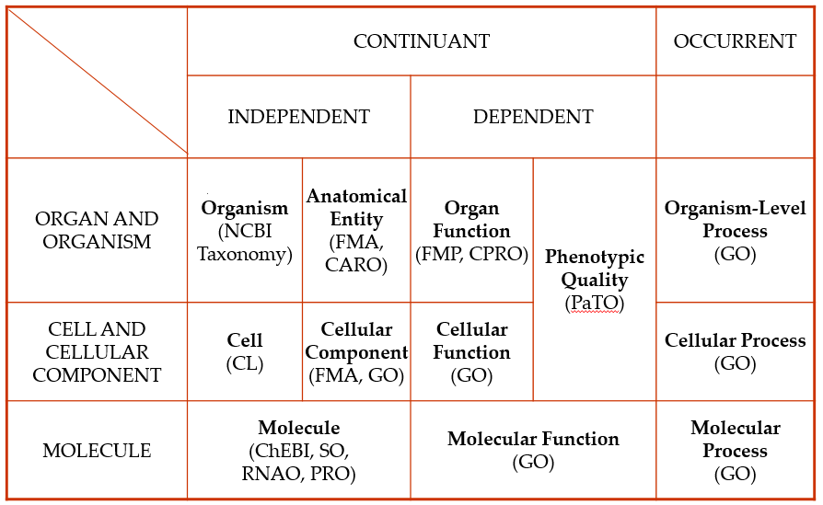
Biomedical Informatics in Perspective
Basic
Research
Biomedical Informatics Methods, Techniques, and Theories
Sociotechnical and Human Centered
Design
Imaging
Informatics
Clinical
Informatics
Public Health Informatics
Bioinformatics
Applied
Research
and
Practice
Molecular and
Cellular
Processes
Tissues and
Organs
Individuals
(Patients)
Populations
And Society
Healthcare
workforce

Slide 45
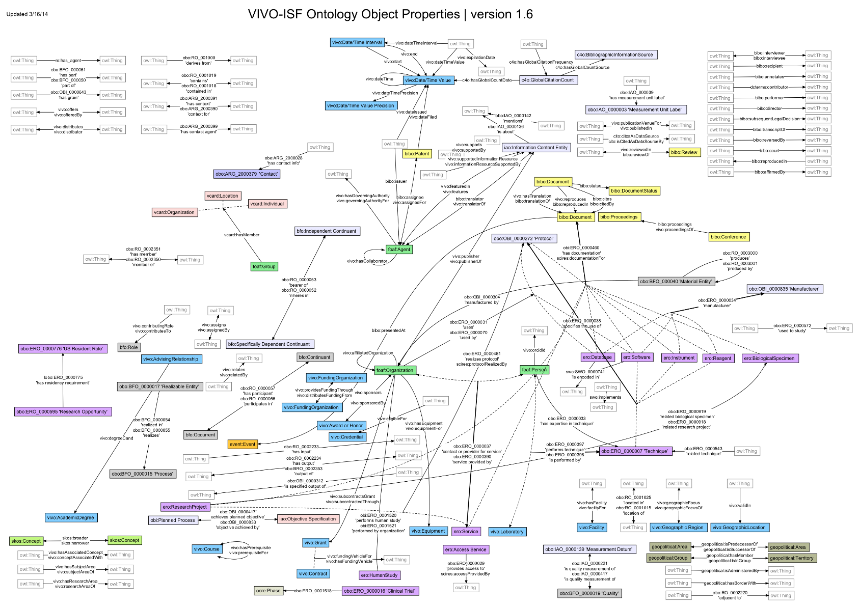
Ontology as representations
Classes amongst which there are relations;
A vocabulary, i.e. a list of terms associated with the ontology’s classes and relations;
Textual definitions and descriptions that provide additional information about what a class or relation denotes;
Formal definitions and axioms that provide in a way ‘understandable’ to specialized software what is considered to be true within the domain covered by the ontology.

Slide 46
Biomedical Informatics
Realism-based Ontology | Inter-disciplinary | Data, Information, Knowledge | Science, Problem Solving, Decision Making | Improving Health
Entity identification
Terminologies
Classification Systems
Semantic Interoperability
Decision Support
Education
Success rests on 4 essential distinctions!
‘ontology’ ←→ ‘an ontology’
reality ←→ representation
particulars ←→ universals
continuants ←→ occurrents

Slide 47
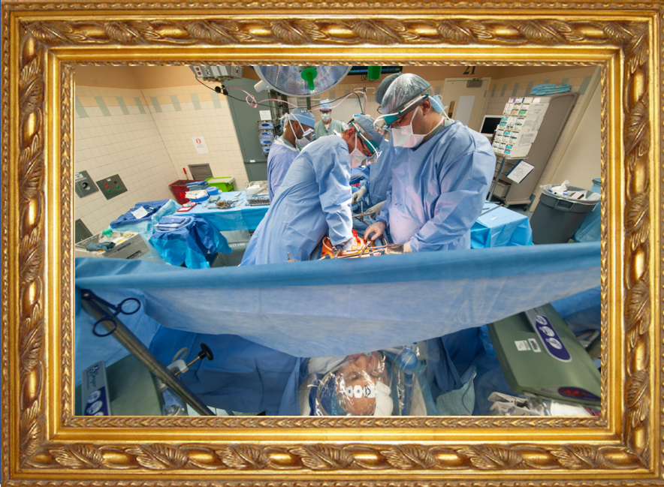

Reality ←→ Representation

Slide 48
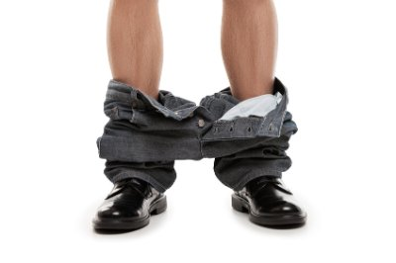
Reality ←→ Representation

Slide 49
Reviewers’ comments
‘Although it is not mentioned explicitly, it gives the impression that the authors assume that there is only one reality and that this reality can be faithfully modelled’ (reviewer 3, WOMOCoE);
‘The somewhat naive realism that seems to underly the work, namely, that there is an objective reality out there to be observed and recognized’
  (reviewer 3, FOIS main).
Ceusters W, Bona J. Representing SNOMED CT Concept Evolutions using Process Profiles. International Workshop on Ontology Modularity, Contextuality, and Evolution (WOMoCoE 2016), Annecy, France, July 6, 2016

Slide 50


Slide 51


You think?
Is there really somebody in the room here who claims that it is not the case that:
I am standing here talking,
there is a brownish rectangle projected on the screen,
the rectangle pictures what people would take for an open window,
the ‘window’ is projected over an image of the Palais de l’Ile?

Slide 52
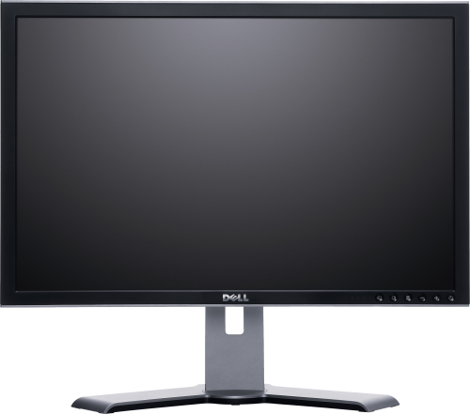
Realist ontology claims:
There is one objective reality and an ontology should be a faithful representation of the part of that reality that it covers
Smith B, Ceusters W. Ontological Realism as a Methodology for Coordinated Evolution of Scientific Ontologies. Applied Ontology, 2010;5(3-4):139-188.

Slide 53




Realist ontology
There is one objective reality and an ontology should be a faithful representation of the part of that reality that it covers
?
Smith B, Ceusters W. Ontological Realism as a Methodology for Coordinated Evolution of Scientific Ontologies. Applied Ontology, 2010;5(3-4):139-188.

Slide 54





One reality ←→ distinct veridical perspectives

Slide 55
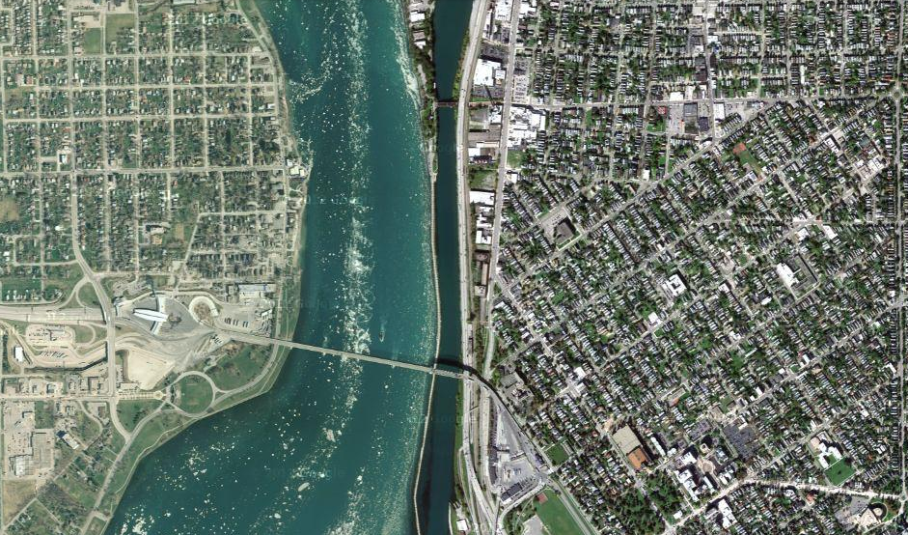
Satellite view

Slide 56
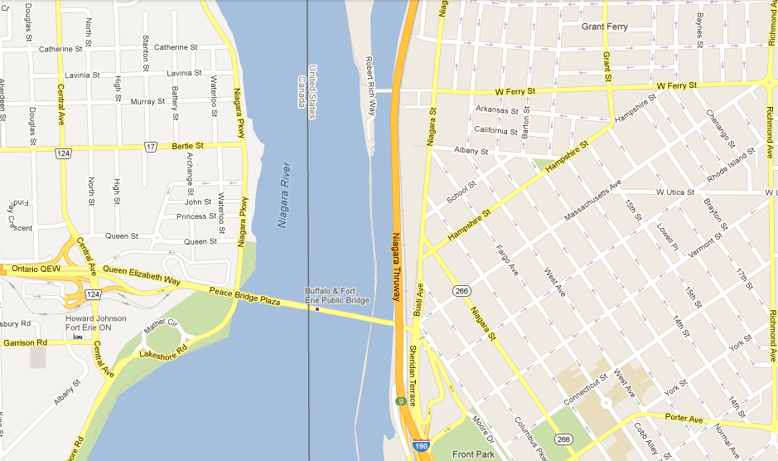
Map

Slide 57
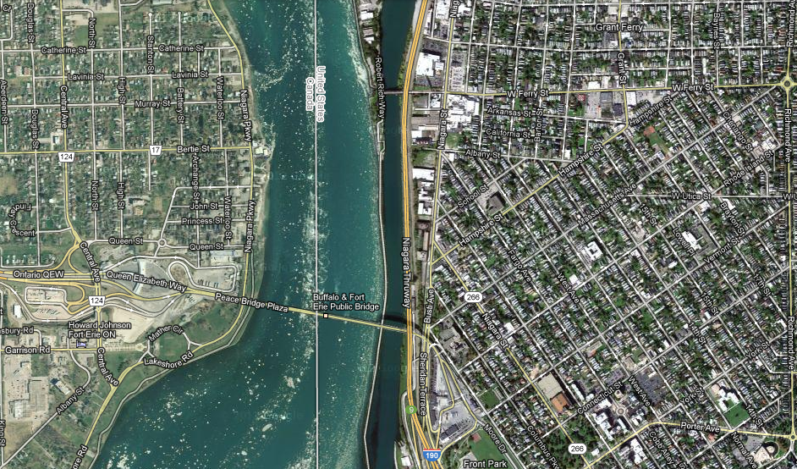
Map overlay

Slide 58
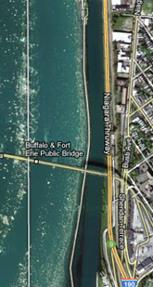
Map ←→ Reality
A message to map makers: “Highways are not painted red, rivers don’t have county lines running down the middle, and you can’t see contour lines on a mountain”
W. Kent. Data and Reality. North-Holland, Amsterdam, the Netherlands, 1978.

Slide 59



Reality changes → requires time indexing

Slide 60
Reality changes
Requires also accurate representation of what exactly it is that changes
Same (identical) flowers that change color
or
different flowers altogether?

Slide 61




Veridicality in tokens
This portion of snow covers this surface at t₁
This portion of snow covers this surface at t₂

Slide 62
Veridicality in tokens and types
This portion of snow covers this surface at t₁
The disposition of snow to cover surfaces
This portion of snow covers this surface at t₂

Slide 63
Remember: ‘Biomedical Informatics’
Definition:
Biomedical informatics (BMI) is
the interdisciplinary field
that studies and pursues the effective uses of biomedical data, information, and knowledge
for scientific inquiry, problem solving, and decision making,
driven by efforts to improve human health.
CA Kulikowski, EH Shortliffe, LM Currie, PL Elkin, LE Hunter, TR Johnson, IJ Kalet, LA Lenert, MA Musen, JG Ozbolt, JW Smith, PZ Tarczy-Hornoch, JWilliamson; AMIA Board white paper: definition of biomedical informatics and specification of core competencies for graduate education in the discipline, Journal of the American Medical Informatics Association, Volume 19, Issue 6, 1 November 2012, Pages 931–938, https://doi.org/10.1136/amiajnl-2012-001053

Slide 64
Current mainstream informatics thinking
knowledge
information
data

Slide 65
Current mainstream informatics thinking
?
knowledge
information
data

Slide 66
Current mainstream informatics thinking
wisdom
knowledge
information
data

Slide 67
Where do data come from?
knowledge
information
data
Representation
What is there on the side of the patient
Reality

Slide 68

Generalization: data generation and use
data
organization
model development
observation &
measurement
further R&D
(instrument and
study optimization)
add
verify
use
Δ = outcome
Generic
beliefs
application

Slide 69
Where do data come from?
knowledge
information
data
Questions not often enough asked:
What parts of our data correspond with something out there in reality ?
What parts of reality are not captured by our data, but should because they are relevant ?
Reality
What is there on the side of the patient

Slide 70
Where do data come from?
knowledge
information
data
Questions not often enough asked:
What parts of our data correspond with something out there in reality ?
What parts of reality are not captured by our data, but should because they are relevant ?
Ontology
Reality
What is there on the side of the patient

Slide 71
Generalization: data generation and use
data
organization
model development
observation &
measurement
further R&D
(instrument and
study optimization)
add
verify
use
Δ = outcome
Generic
beliefs
application

Slide 72
Reality as benchmark for data organization and representation
data
organization
model development
observation &
measurement
further R&D
(instrument and
study optimization)
add
verify
use
Δ = outcome
Generic
beliefs
application

Slide 73
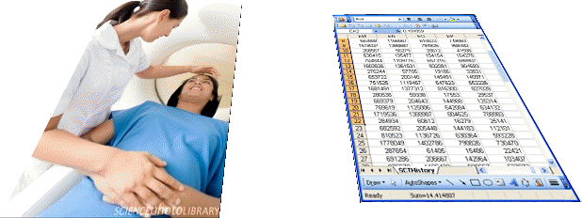
Realism-based Ontology (RBO)
Referents
  are (meta-) physically the way they are,
  relate to each other in an objective way,
  follow ‘laws of nature’.
Window on reality
  restricted by:
  what is physically and technically observable,
  fit between what is measured and what we think is measured,
  fit between established knowledge and ‘laws of nature’.
References
  follow, ideally, the syntactic-semantic conventions of some representation language,
  are restricted by the expressivity of that language,
  reference collections need to come, for correct interpretation, with documentation outside the representation.

Slide 74
Biomedical Informatics
Realism-based Ontology | Inter-disciplinary | Data, Information, Knowledge | Science, Problem Solving, Decision Making | Improving Health
Entity identification
Terminologies
Classification Systems
Semantic Interoperability
Decision Support
Education
Success rests on 4 essential distinctions!
‘ontology’ ←→ ‘an ontology’
reality ←→ representation
particulars ←→ universals
continuants ←→ occurrents

Slide 75
Types versus particulars
Types
Particulars
counterparts in reality of (some of)
the general terms used in the formulation of scientific theories
concrete individual entities
(entities that exist in space and time and that exist only once)
Smith B, Ceusters W. Ontological Realism as a Methodology for Coordinated Evolution of Scientific Ontologies. Applied Ontology, 2010;5(3-4):139-188.

Slide 76
‘Types’
‘concepts’
‘kinds’
‘universals’
‘categories’
‘classes’
‘prototypes’
…
In realism-based ontology:
  Universals: human being
  Defined classes: human being in Buffalo

Slide 77




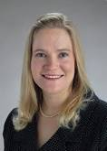
Types versus particulars
Human being
instance of at t
particulars

Slide 78
Instances are the objects of classification …
isa
Organism
isa
Vertebrate
isa
Mammal
Human being
instance of at t
particulars

Slide 79
… unlike Haslam’s ‘Kinds of Kinds’
Non-arbitrary basis for drawing a categorical distinction
No Yes
Haslam N. Kinds of Kinds: A Conceptual Taxonomy of Psychiatric Categories. Philosophy, Psychiatry, & Psychology, 9 (2002), 203-218
Non-kind
This basis is an objective discontinuity
‘severity’
‘neuroticism’
No Yes
The discontinuity is sharp and binary
Practical kind
‘essential hypertension’
‘depression’
No Yes
Fuzzy kind
The discontinuity is constituted by an ‘essence’
‘borderline personality’
No Yes
Discrete kind
Natural kind
‘melancholia’
‘Williams syndrome’

Slide 80
Instances are the objects of classification …
isa
Organism
isa
Vertebrate
isa
Mammal
Human being
instance of at t
particulars

Slide 81
Biomedical Informatics
Realism-based Ontology | Inter-disciplinary | Data, Information, Knowledge | Science, Problem Solving, Decision Making | Improving Health
Entity identification
Terminologies
Classification Systems
Semantic Interoperability
Decision Support
Education
Success rests on 4 essential distinctions!
‘ontology’ ←→ ‘an ontology’
reality ←→ representation
particulars ←→ universals
continuants ←→ occurrents

Slide 82
Continuants ←→ Occurrents
 | Continuant | Occurrent
Entities that at any time they exist,
exist
in total
Entities that at any time they exist,
exist only
partially
Smith B, Ceusters W. Ontological Realism as a Methodology for Coordinated Evolution of Scientific Ontologies. Applied Ontology, 2010;5(3-4):139-188.

Slide 83
An ontological square
 | Continuant | Occurrent
Types | Tooth | Teeth grinding
Particulars | My left maxillary first molar | My teeth grinding

Slide 84
An ontological square
 | Continuant | Occurrent
Types | Tooth | Teeth grinding
Particulars | My left maxillary first molar | My teeth grinding
Instance
of at t
Instance
of

Slide 85
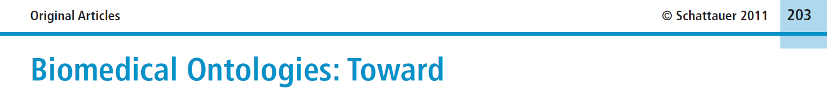


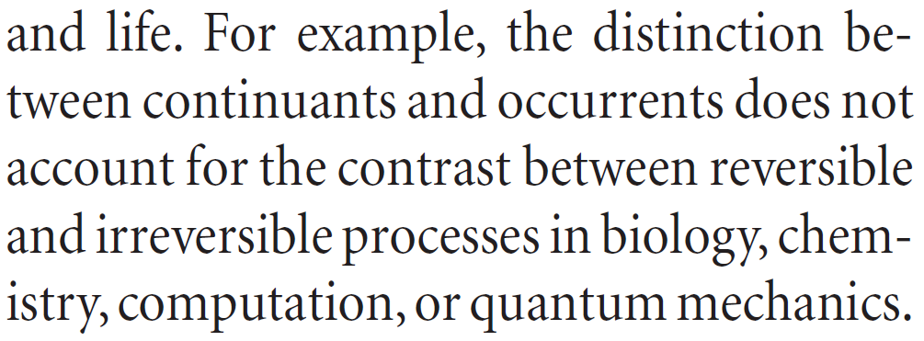
Simple, yet seemingly hard to grasp …
Methods Inf Med 2011; 50: 203-216
Page 205

Slide 86
How could the distinction account for it ?
Continuant | Occurrent
‘the distinction between
continuants and occurrents does not account for the contrast between reversible
and irreversible processes’
Irreversible Process
Reversible Process
Maojo V, Crespo J, Garcia-Remesal M, de la Iglesia D, Pérez-Rey D, Kulikowski C.
Biomedical Ontologies: Toward scientific debate.
Methods Inf Med 2011; 50 (3):203-216.

Slide 87
Isa definition differs for continuants and processes
c instance_of C at t - a primitive relation between a continuant instance and a class which it instantiates at a specific time
C is_a C₁ = [definition] for all c, t, if c instance_of C at t then c instance_of C₁ at t.
p instance_of P - a primitive relation between a process instance and a class which it instantiates holding independently of time
P is_a P₁ = [definition] for all p, if p instance_of P then p instance_of P₁.
Smith B, Ceusters W, Klagges B, Koehler J, Kumar A, Lomax J, Mungall C, Neuhaus F, Rector A, Rosse C. Relations in biomedical ontologies, Genome Biology 2005, 6:R46.

Slide 88
Be careful with naming occurrent particulars!
Occurrents
Which teeth grinding am I referring to?
Yesterdays?
This one?
Teeth grinding
Instance
of
My teeth grinding

Slide 89
Therefor: use instance unique identifiers (IUI)
Continuants
Occurrents
Tooth
Teeth grinding
Instance
of
at t1 & t2
Instance
of
My left maxillary first molar
#1
#2
at t1
at t2
Participant in

Slide 90
Be careful with naming continuant particulars!
Continuants
Occurrents
Piece of enamel
Tooth
Teeth grinding
Continuants can change whereas occurrents never change, because they are changes.
Instance
of
at t0
Instance
of
at t1 & t2
Instance
of
My left maxillary first molar
#1
#2
at t1
at t2
Participant in

Slide 91
Therefor: use instance unique identifiers (IUI)
Continuants
Occurrents
Human
being
Piece of enamel
Tooth
Teeth grinding
isa
left maxillary first molar
Instance
of
Instance of
at t0, t1, t2
Instance of
at t0
Instance of
at t1 & t2
#1
#2
Werner
Ceusters
at t1
at t2
#3
Part of at
t0, t1, t2
Participant in

Slide 92
Important Distinctions
Realism-based Ontology | Reality Representation | Particulars Universals | Continuants Occurrents
Entity identification
Terminologies
Classification Systems
Semantic Interoperability
Decision Support
Education
This goes wrong without this!

Slide 93
Important Distinctions
Realism-based Ontology | Reality Representation | Particulars Universals | Continuants Occurrents
Entity identification
Terminologies
Classification Systems
Semantic Interoperability
Decision Support
Education
This goes wrong without this!

Slide 94

Shopping for ‘chicken’

Slide 95
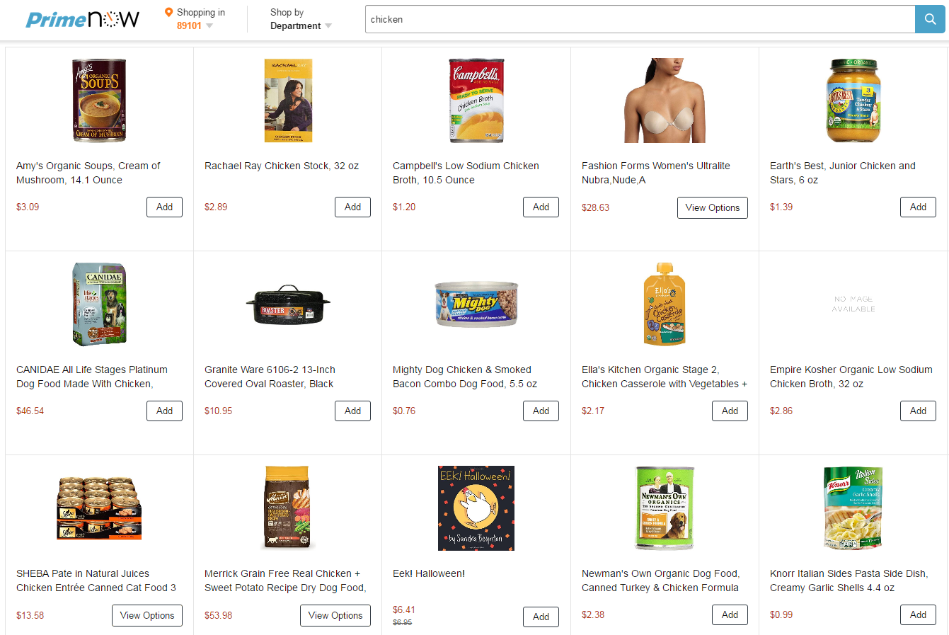
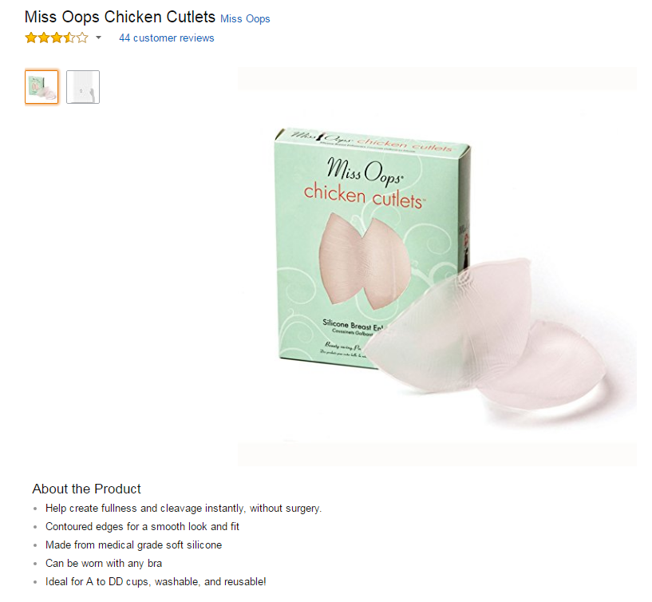

Slide 96



Slide 97

Border’s classification of medicine: what’s wrong ?
Medicine
  Mental health
  Internal medicine
    Endocrinology
      Oversized endocrinology
    Gastro-enterology
    ...
  Pediatrics
  ...
  Oversized medicine
Refer to the size of the books that do not fit on a normal Border’s Bookshop shelf

Slide 98
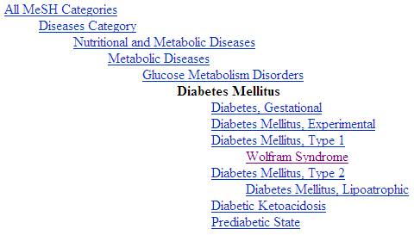
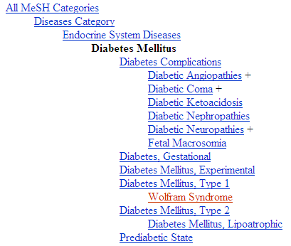
Diabetes Mellitus in MeSH 2008
MeSH: not always fine for drilling down to find more specific disorders
?
Different set of more specific terms when different path from the top is taken.

Slide 99
Important Distinctions
Realism-based Ontology | Reality Representation | Particulars Universals | Continuants Occurrents
Entity identification
Terminologies
Classification Systems
Semantic Interoperability
Decision Support
Education
This goes wrong without this!

Slide 100
MeSH: perhaps fine for drilling down to find more specific disorders
All MeSH Categories
Diseases Category
Nervous System Diseases
Female Urogenital Diseases
and Pregnancy Complications
Eye Diseases
Male Urogenital
Diseases
Cranial Nerve
Diseases
Female Urogenital Diseases
Optic Nerve
Diseases
Neurodegenerative
Diseases
Optic Nerve
Diseases
Eye Diseases,
Hereditary
Heredodegenerative
Disorders,
Nervous System
Urologic Diseases
Optic Atrophy
Kidney Diseases
Optic Atrophies,
Hereditary
Diabetes Insipidus
Wolfram Syndrome

Slide 101

Don’t use it for coding patients’ diagnoses!
All MeSH Categories
???
Diseases Category
Nervous System Diseases
Female Urogenital Diseases
and Pregnancy Complications
Eye Diseases
Male Urogenital
Diseases
Cranial Nerve
Diseases
Female Urogenital Diseases
…
Neurodegenerative
Diseases
Optic Nerve
Diseases
Optic Nerve
Diseases
Eye Diseases,
Hereditary
has
Heredodegenerative
Disorders,
Nervous System
Urologic Diseases
Optic Atrophy
Kidney Diseases
Optic Atrophies,
Hereditary
Diabetes Insipidus
has
Wolfram Syndrome

Slide 102
Important Distinctions
Realism-based Ontology | Reality Representation | Particulars Universals | Continuants Occurrents
Entity identification
Terminologies
Classification Systems
Semantic Interoperability
Decision Support
Education
This goes wrong without this!

Slide 103
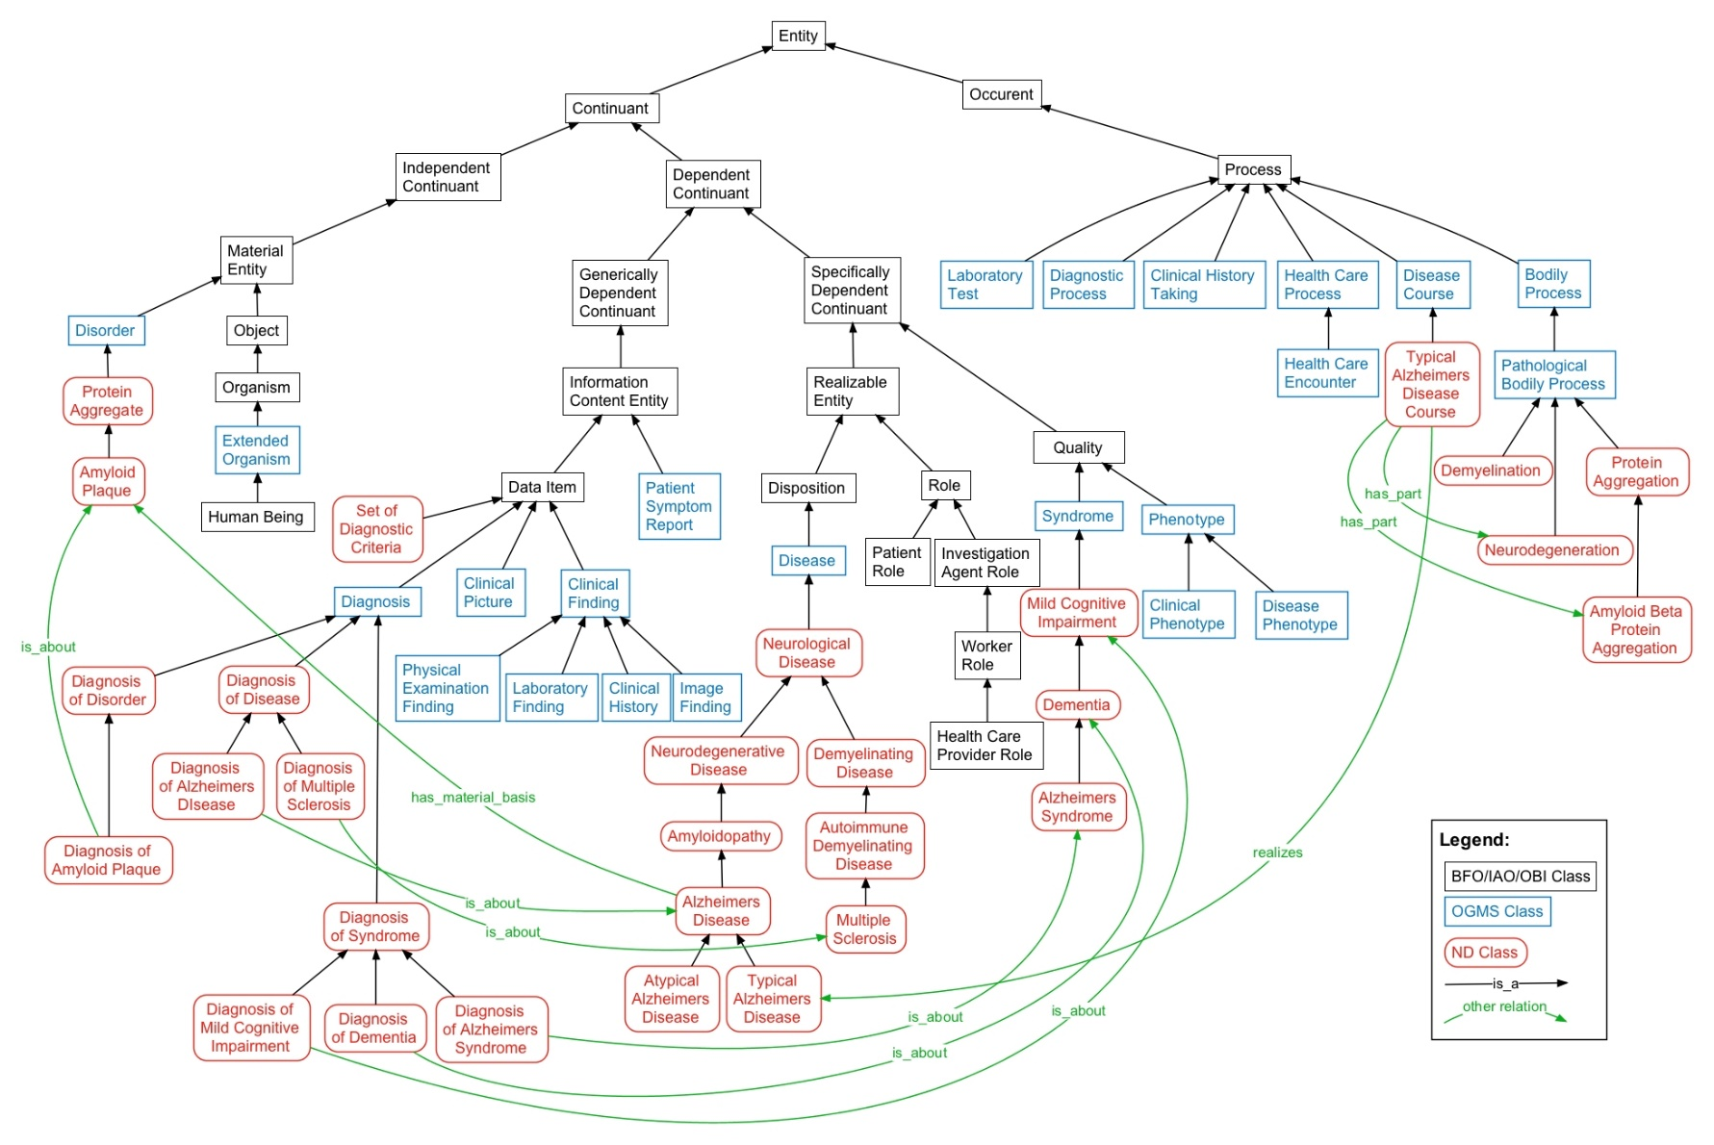
Neurological disease ontology (NDO)

Slide 104
Considered to be true in NDO
Bodily processes exist,
Neurodegeneration exists,
All neurodegenerations are pathological processes,
A typical Alzheimers disease course exist,
All typical Alzheimers disease courses have some part which is a neurodegeneration,
…

Slide 105
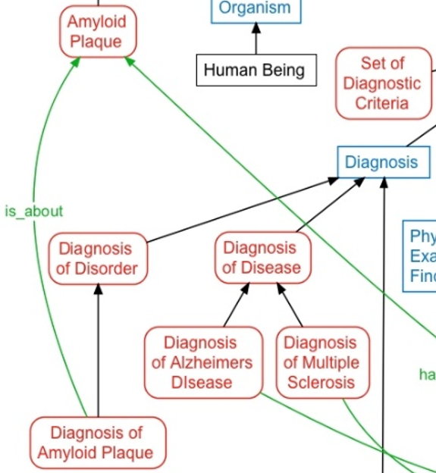
Considered to be true in NDO
?

Slide 106
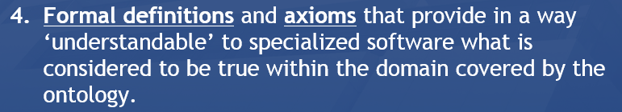
Considered to be true in NDO
Here is a problem!
And therefore, this will go wrong

Slide 107
Considered to be true in NDO
Here is a problem!
To see it, you need …

Slide 108
Important Distinctions
Realism-based Ontology | Reality Representation | Particulars Universals | Continuants Occurrents
Entity identification
Terminologies
Classification Systems
Semantic Interoperability
Decision Support
Education
This goes wrong without this!

Slide 109
Important Distinctions
Realism-based Ontology | Reality Representation | Particulars Universals | Continuants Occurrents
Entity identification
Terminologies
Classification Systems
Semantic Interoperability
Decision Support
Education
This goes wrong without this!

Slide 110

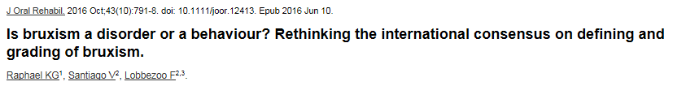
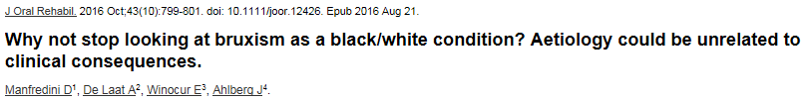
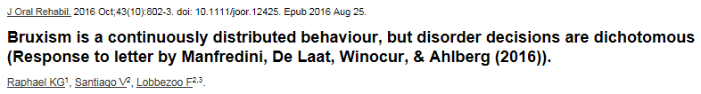
Bruxism experts clench their teeth
Ceusters W, Smith B. On Defining Bruxism. Medical Informatics Europe (MIE2018), Goteborg, Sweden, April 24-26, 2018. Stud Health Technol Inform. 2018;247:551-555.

Slide 111
Who is fighting who? (alphabetically, first author)
 | P1 | P2 | P3 | P4
1 | Ahlberg J |  | Ahlberg J
2 |  |  | De Laat A
3 | De Leeuw R
4 | Glaros AG
5 | Kato T
6 | Koyano K
7 | Lavigne GJ
8 | Lobbezoo F | Lobbezoo F |  | Lobbezoo F
9 | Manfredini D |  | Manfredini D
10 |  | Raphael KG |  | Raphael KG
11 |  | Santiago V |  | Santiago V
12 | Svensson P
13 | Winocur E |  | Winocur E

Slide 112
Proposed definition for Bruxism in P1
Bruxism is a repetitive jaw-muscle activity characterized by
  clenching or grinding of the teeth and/or
  by bracing or thrusting of the mandible.
Bruxism has two distinct circadian manifestations:
it can occur
  during sleep (indicated as sleep bruxism) or
  during wakefulness (indicated as awake bruxism).
Lobbezoo F, Ahlberg J, Glaros AG, Kato T, Koyano K, Lavigne GJ, et al.
Bruxism defined and graded: an international consensus.
J Oral Rehabil. 2013 Jan;40(1):2-4.

Slide 113
Applying the particular / type distinction
Examples:
  Bruxism is a continuously distributed behavior [P4, p802]
  Sleep Bruxism is best viewed as quantifiable activity occurring on a continuum [P2, p795].

Slide 114
Applying the particular / type distinction
Examples:
  Bruxism is a continuously distributed behavior [P4, p802]
  Sleep Bruxism is best viewed as quantifiable activity occurring on a continuum [P2, p795].
These are statements about types:
Bruxism
isa
Behavior

Slide 115
Applying the particular / type distinction
Examples:
  Bruxism is a continuously distributed behavior [P4, p802]
  Sleep Bruxism is best viewed as quantifiable activity occurring on a continuum [P2, p795].
These are statements about types:
Bruxism
isa
Behavior
Instance of
John’s #4 = John’s repetitive jaw muscle activity of last night
John’s #4

Slide 116
Applying the particular / type distinction
Examples:
  Bruxism is a continuously distributed behavior [P4, p802]
  Sleep Bruxism is best viewed as quantifiable activity occurring on a continuum [P2, p795].
These are statements about types:
Bruxism
isa
Behavior
Instance of
Instance of
John’s #4

Slide 117
What about this ?
Bruxism is a continuously distributed behavior [P4, p802]
Continuously distributed behavior
isa
Bruxism
Instance of
Instance of ???
John’s #4
John’s #4 = John’s repetitive jaw muscle activity of last night

Slide 118
Ignoring the particular / type distinction
Bruxism is a continuously distributed behavior [P4, p802]
Continuously distributed behavior
isa
Bruxism
Instance of
Type of particulars
John’s #4
John’s #4 = John’s repetitive jaw muscle activity of last night

Slide 119
Ignoring the particular / type distinction
Bruxism is a continuously distributed behavior [P4, p802]
Continuously distributed behavior
isa
Bruxism
Instance of
John’s #4
Type of types
John’s #4 = John’s repetitive jaw muscle activity of last night

Slide 120
Types whose particulars are distributed over a continuum (1)
Body temperature
isa
Pathologically low
body temperature
Normal
body temperature
Pathologically high
body temperature
isa
35.2°C BT
35.8°C BT
36.9°C BT
37.2°C BT
38.9°C BT
40.2°C BT

Slide 121
Types whose particulars are distributed over a continuum (1)
Body temperature
isa
Pathologically low
body temperature
Normal
body temperature
Pathologically high
body temperature
isa
35.2°C BT
35.8°C BT
36.9°C BT
37.2°C BT
38.9°C BT
40.2°C BT
… at t2
instance of
… at t1
… at t3
John’s #24

Slide 122
Types whose particulars are distributed over a continuum (2)
Body temperature
isa
Pathologically low
body temperature
Normal
body temperature
Pathologically high
body temperature
isa
35.2°C BT
35.8°C BT
36.9°C BT
37.2°C BT
38.9°C BT
40.2°C BT
instance of
at t4
John’s BT
Mary’s BT
Joe’s BT
Suzy’s BT

Slide 123
Similarly
Behavior
Normal
behavior
Pathological
behavior
Bruxism
Bruxism without
clinical consequences
Treatment/prevention
demanding bruxism

Slide 124
Is this possible ?
at t13
instance of
at t14
John’s bruxism

Slide 125
No! This would be ignoring the continuant / occurrent distinction !
at t13
instance of
at t14
John’s bruxism

Slide 126
Accounting for the occurrent/continuant distinction: occurrents don’t change.
With the ontology fixed this way, the choice of which of these three would be called ‘bruxism’ (proper) is a pure terminological decision.

Slide 127
Important Distinctions
Realism-based Ontology | Reality Representation | Particulars Universals | Continuants Occurrents
Entity identification
Terminologies
Classification Systems
Semantic Interoperability
Decision Support
Education
This goes wrong without this!

Slide 128
Analysis conclusion
There are two reasons why experts in a given scientific discipline can disagree about what to conclude from observations they all consider accurate:
    the science in that domain is not yet sufficiently well developed, or
    the associated terminology is ill-defined or not consistently adhered to, so that what appear to be disagreements are in fact just beliefs about different portions of reality which are erroneously assumed to be the same.
Although the bruxism experts themselves contend that (1) is the main source of problems,
we believe that the fault lies primarily under (2).
Ceusters W, Smith B. On Defining Bruxism. Medical Informatics Europe (MIE2018), Goteborg, Sweden, April 24-26, 2018. Stud Health Technol Inform. 2018;247:551-555.

Slide 129
Important Distinctions
Realism-based Ontology | Reality Representation | Particulars Universals | Continuants Occurrents
Entity identification
Terminologies
Classification Systems
Semantic Interoperability
Decision Support
Education
This goes wrong without this!

Slide 130
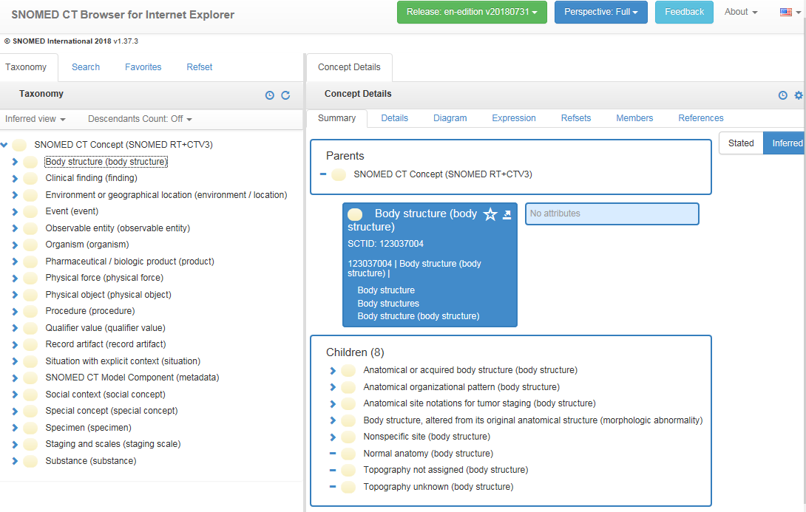
SNOMED CT

Slide 131
Concepts and confusions in SNOMED CT
‘concept’:
  ‘a clinical idea to which a unique concept identifier has been assigned’; ‘the meaning of a concept can be determined from relationships to other concepts and from associated descriptions that include human readable terms’
the term is also stated to be a homonym for:
  ‘concept identifier’ as well as for
  ‘the real-world referent(s) of the concept identifier, that is, the class of entities in reality that the concept identifier represents’

Slide 132
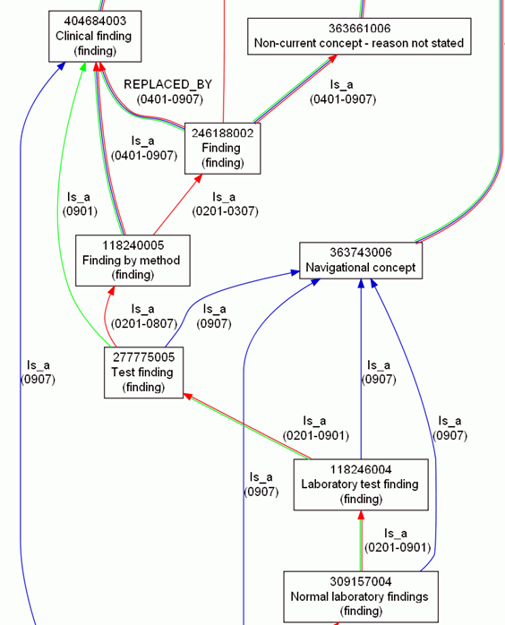
Consequence: more confusion
What is
inside
versus
outside SNOMED CT?

Slide 133
Inside versus outside an ontology
What is
inside
versus
outside SNOMED CT?

Slide 134
Inside versus outside an ontology
What is
inside
versus
outside SNOMED CT?

Slide 135
Inside versus outside an ontology
What is
inside
versus
outside SNOMED CT?
Clear shift in meaning, incompatible with SNOMED CT’s change policy

Slide 136
Inside versus outside an ontology
What is
inside
versus
outside SNOMED CT?
‘halfway’ concept:
denotes external entities but viewed through internal organization

Slide 137
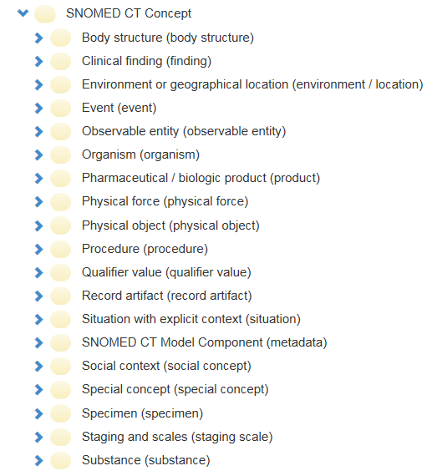

SNOMED CT inside versus outside

Slide 138

SNOMED CT inside versus outside

Slide 139
Important Distinctions
Realism-based Ontology | Reality Representation | Particulars Universals | Continuants Occurrents
Entity identification
Terminologies
Classification Systems
Semantic Interoperability
Decision Support
Education
This goes wrong without this!

Slide 140
Important Distinctions
Realism-based Ontology | Reality Representation | Particulars Universals | Continuants Occurrents
Entity identification
Terminologies
Classification Systems
Semantic Interoperability
Decision Support
Education
This goes wrong without this!

Slide 141


Semantic interoperability
Everything collected wherever, whenever and about whomever which is relevant to a medical problem in whomever, whenever and wherever, should be accessible without loss of relevant detail.

Slide 142


Slide 143


Slide 144



Slide 145
Data aggregation and use
Operational
systems
IHI Clinical
Integrated
Data Repository
Secondary
use
Cohort selection
EHR
Data Marts
EHR
EHR
EHR
Cost effectiveness
research
Common Data Models
Bio Bank
Decision support
Health
Insurers
Referent Tracking
Data Repository
Quality assurance
Health
Insurers
Health
Insurers

Slide 146
Data aggregation and use
Operational
systems
IHI Clinical
Integrated
Data Repository
Secondary
use
Cohort selection
EHR
Data Marts
EHR
EHR
EHR
Cost effectiveness
research
Common Data Models
Bio Bank
Decision support
Health
Insurers
Referent Tracking
Data Repository
Quality assurance
Health
Insurers
Health
Insurers

Slide 147


Ontology and Referent Tracking: division of labor
instance-of at t
caused
by
#105

Slide 148


Common Data Models for Secondary Use
The Observational Medical Outcomes Partnership (OMOP)
Health Care Systems Research Network (HCSRN)
The National Patient-Centered Clinical Research Network (PCORNet)

Slide 149

Methodology
OMOP
RBO
?
Are counts reliable?
Ceusters W, Blaisure J. A Realism-Based View on Counts in OMOP’s Common Data Model.
14th International Conference on Wearable, micro & Nano Technologies (pHealth 2017), Eindhoven, The Netherlands, May 14-16, 2017.
Studies in Health Technology and Informatics 2017;237:55-62.

Slide 150
Results
Three sorts of count errors, resp. due to:
  cardinality and attribute restrictions,
  inconsistent normalization,
  confusing data with what it is about.
Ceusters W, Blaisure J. A Realism-Based View on Counts in OMOP’s Common Data Model.
14th International Conference on Wearable, micro & Nano Technologies (pHealth 2017), Eindhoven, The Netherlands, May 14-16, 2017.
Studies in Health Technology and Informatics 2017;237:55-62.

Slide 151
PERSON table
Allows for each unique patient only
  one location,
  one gender,
  one primary care provider, and
  one care site.
Although:
  ‘patients over time can have distinct locations, genders’;
  ‘it is the responsibility of the data holder to select the one value to use in the CDM’.
What criteria to use?
What with the multiple observation periods?

Slide 152

Person versus Provider

Slide 153

Condition-occurrences versus eras

Slide 154
Conventions
Condition Era records will be derived from the CONDITION_OCCURRENCE table using a standardized algorithm.
Each Condition Era corresponds to one or many CONDITION_OCCURRENCE records that form a continuous interval and contain the same drug condition-occurrence.
The condition_concept_id field contains Concepts that are identical to those of the CONDITION_OCCURRENCE table records that make up the Condition Era.
The Condition Era Start Date is the start date of the first Condition Occurrence.
The Condition Era End Date is the end date of the last Condition Occurrence.

Slide 155
An erroneous example
‘a Condition Era representing ICD-9 code 410.01
  (Acute Myocardial Infarction (AMI) of anterolateral wall, initial episode)
  would be aggregated to a Condition Era representing ICD-9 code 410.41
  (AMI inferior wall, initial episode)
  occurring within 30 days
  as both of these ICD-9 codes annotate to the same Condition Concept, Acute Myocardial Infarction, within the MedDRA hierarchy’.
Reisinger SJ, Ryan PB, O'Hara DJ, Powell GE, Painter JL, Pattishall EN, et al. Development and evaluation of a common data model enabling active drug safety surveillance using disparate healthcare databases.
J Am Med Inform Assoc. 2010 Nov-Dec;17(6):652-62, p656

Slide 156

http://myheart.net/articles/stemi/

Slide 157

feline
isa
isa
panther
tiger
Instance-of
Instance-of
Only one feline in this cage?

Slide 158

Some suggestions (1)
Basic Formal Ontology
person
patient role
provider role

Slide 159
Analysis conclusions
The fit-for-purpose paradigm of the OMOP CDM (and CDMs in general) hampers faithful data analysis.
A realism-based approach is able:
  to identify the root causes,
  to propose improvements.
A dilemma?
  For each purposes a specific CDM?
  Thorough education in the principles of ontological realism?
Ceusters W, Blaisure J. A Realism-Based View on Counts in OMOP’s Common Data Model.
14th International Conference on Wearable, micro & Nano Technologies (pHealth 2017), Eindhoven, The Netherlands, May 14-16, 2017.
Studies in Health Technology and Informatics 2017;237:55-62.

Slide 160
Important Distinctions
Realism-based Ontology | Reality Representation | Particulars Universals | Continuants Occurrents
Entity identification
Terminologies
Classification Systems
Semantic Interoperability
Decision Support
Education
This goes wrong without this!

