Slide 1
BMI508 – Fall 2018
Biomedical Ontology
Principles for upgrading to new
(versions of) ontologies in biomedical information systems
Werner CEUSTERS^{1,2}
¹ Department of Biomedical Informatics, University at Buffalo, USA
² Department of Psychiatry, University at Buffalo, USA

Slide 2
Changes in Biomedical Ontologies
Because of:
Better understanding of reality (scientific discovery);
Changes in biomedical reality become recognized:
  Coming into existence of new (sub-)types in the domain
    HIV, aids, Avian Flu, …;
  Changes in the sorts of relations that obtain between instances of certain types and instances of other types:
    Geographic spread of organisms,
    Virulence and susceptibility;
Re-assessments of what is relevant;
Changes in representation model and syntax;
Correction of editorial mistakes.

Slide 3
Changes in
SNOMED CT

Slide 4
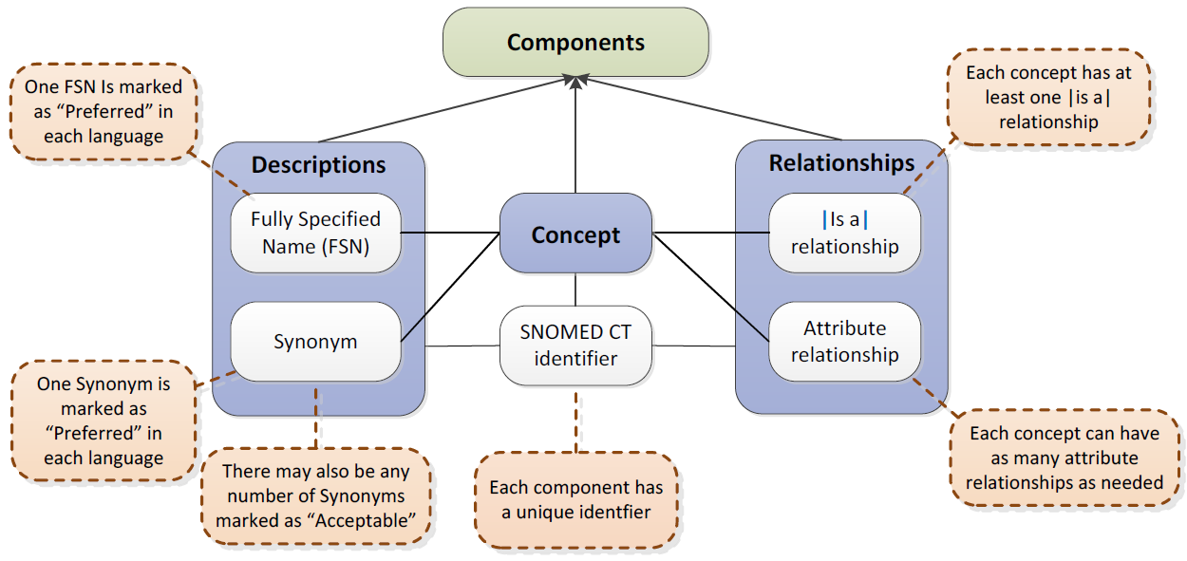
SNOMED CT structure
IHTSDO. SNOMED CT Starter Guide July 2014

Slide 5
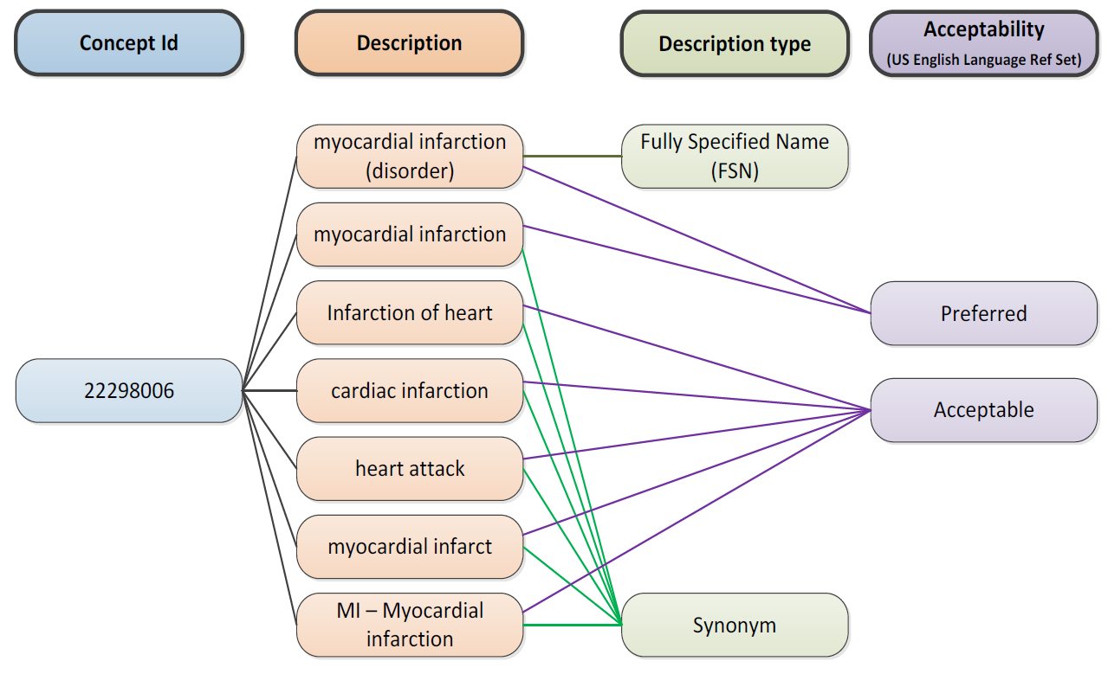
SNOMED CT Descriptions
IHTSDO. SNOMED CT Starter Guide July 2014

Slide 6
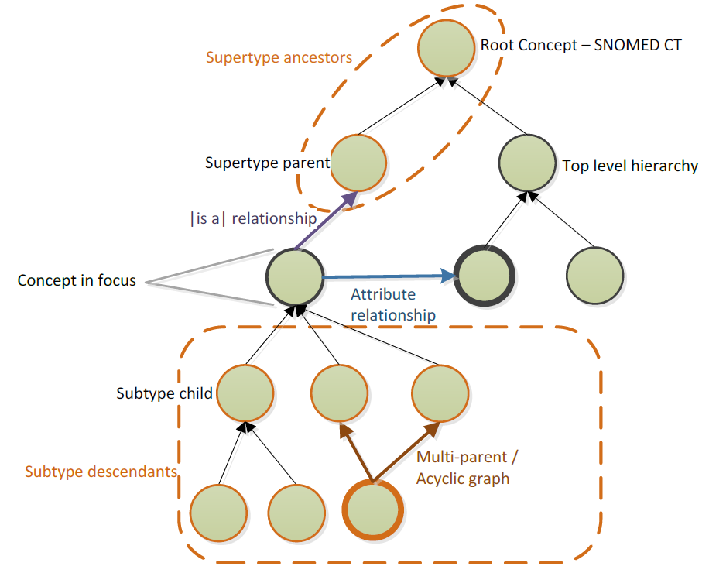
SNOMED CT Relationships

Slide 7
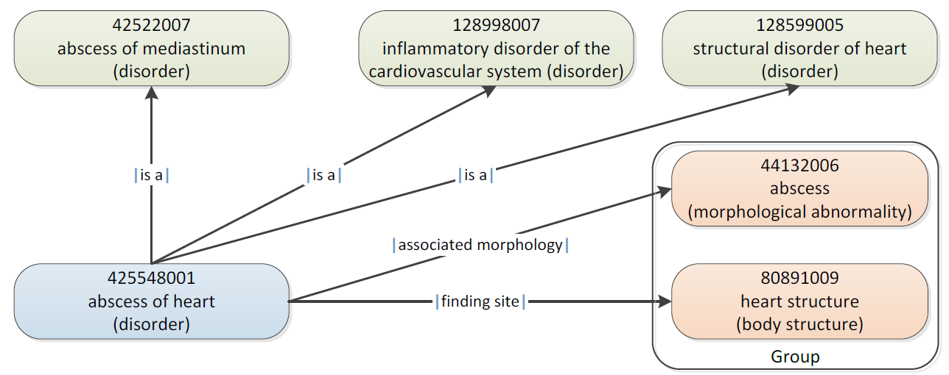
SNOMED CT Defining relationships
IHTSDO. SNOMED CT Starter Guide July 2014

Slide 8
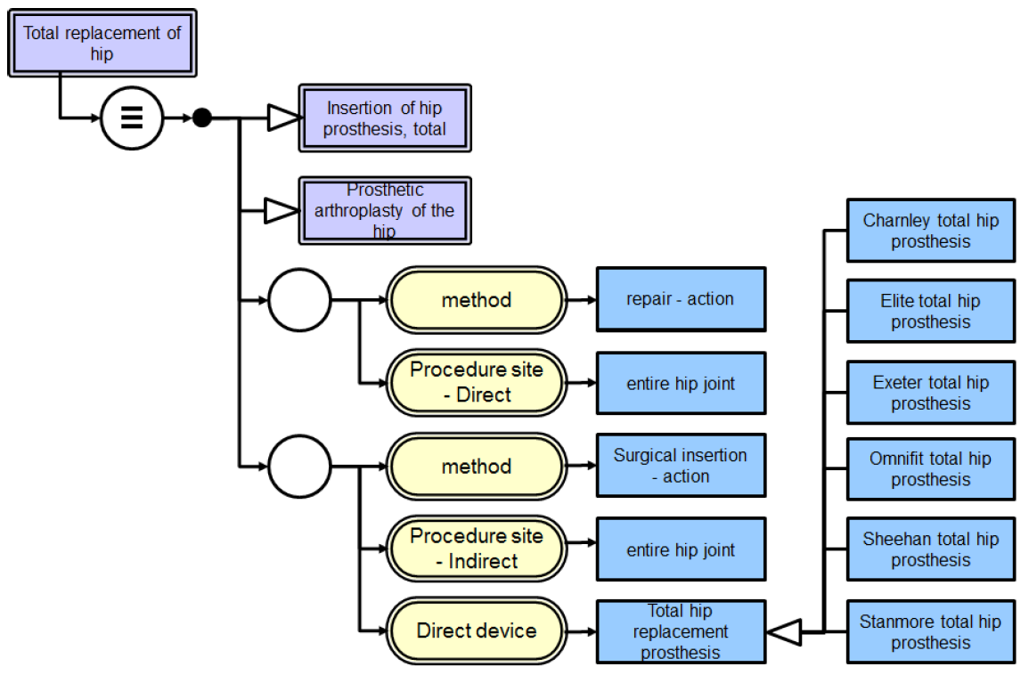
SNOMED CT’s DL
IHTSDO. SNOMED CT Starter Guide July 2014

Slide 9
Changes in SNOMED CT (RF2) concepts and relationships
conceptID | Effective Time | Active | ModuleID | Definitional Status
301381004 | 20020131 | 1 | 900000000000207008 | 900000000000074008
301381004 | 20080131 | 0 | 900000000000207008 | 900000000000074008
FSN = ‘Discomforting present pain (finding)’

Slide 10
Changes in SNOMED CT (RF2) concepts and relationships
conceptID | Effective Time | Active | ModuleID | Definitional Status
301381004 | 20020131 | 1 | 900000000000207008 | 900000000000074008
301381004 | 20080131 | 0 | 900000000000207008 | 900000000000074008
FSN = ‘Discomforting present pain (finding)’
RelID | Effective Time | Active | Attribute | Target
126300024 | 20020131 | 1 | Is a | Pain (finding)
126300024 | 20040131 | 0 | Is a | Pain (finding)
126301023 | 20020131 | 1 | Is a | Finding of present pain intensity (finding)
126301023 | 20080131 | 0 | Is a | Finding of present pain intensity (finding)
657858027 | 20020131 | 1 | Finding site | Structure of nervous system (body structure)
657858027 | 20060131 | 0 | Finding site | Structure of nervous system (body structure)
2260209021 | 20030731 | 1 | Interprets | Nervous system function (observable entity)
2260209021 | 20050131 | 0 | Interprets | Nervous system function (observable entity)
2458913020 | 20040131 | 1 | Is a | Discomfort (finding)
2458913020 | 20080131 | 0 | Is a | Discomfort (finding)
2858465020 | 20060131 | 1 | Finding site | Anatomical structure (body structure)
2858465020 | 20080131 | 0 | Finding site | Anatomical structure (body structure)

Slide 11
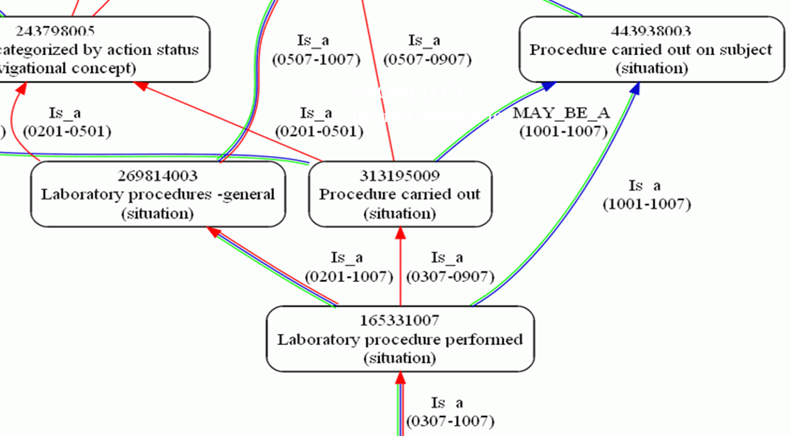
Cell phenotyping performed
SNOMED CT:
Indirect changes to:
Ceusters W. Applying Evolutionary Terminology Auditing to SNOMED CT. In American Medical Informatics Association 2010 Annual Symposium (AMIA 2010) Proceedings, Washington DC, November 13-17, 2010:96-100.

Slide 12
Cell phenotyping performed
SNOMED CT:
Indirect changes to:
Activation
De-activation
Ceusters W. Applying Evolutionary Terminology Auditing to SNOMED CT. In American Medical Informatics Association 2010 Annual Symposium (AMIA 2010) Proceedings, Washington DC, November 13-17, 2010:96-100.

Slide 13
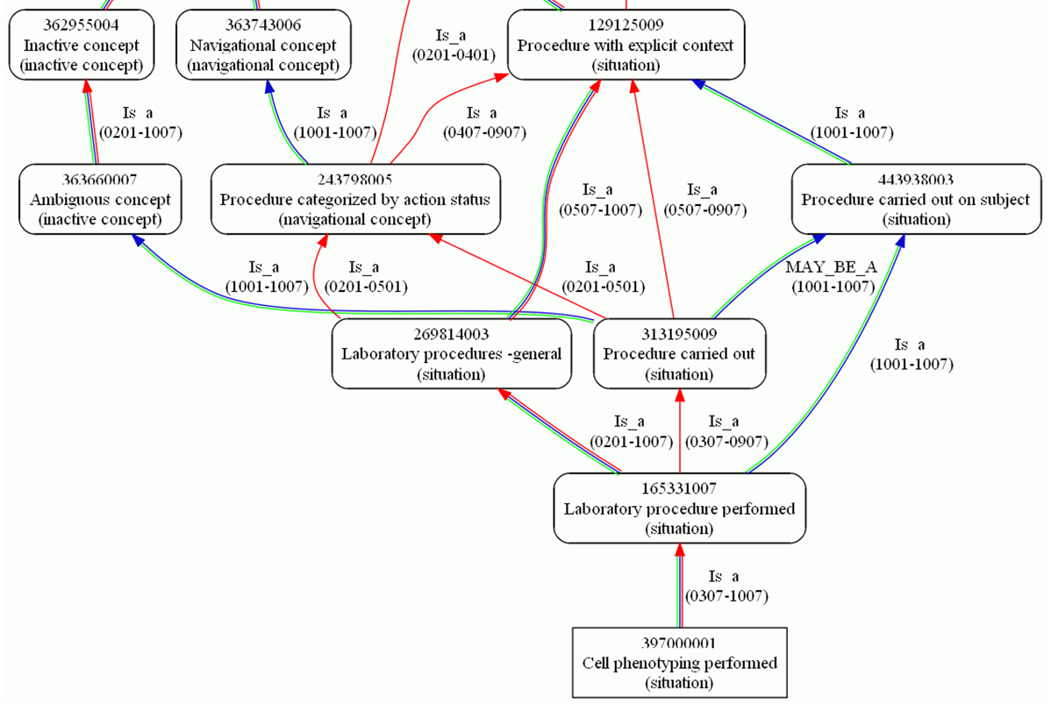
Cell phenotyping performed
SNOMED CT:
Indirect changes to:
Ceusters W. Applying Evolutionary Terminology Auditing to SNOMED CT. In American Medical Informatics Association 2010 Annual Symposium (AMIA 2010) Proceedings, Washington DC, November 13-17, 2010:96-100.

Slide 14
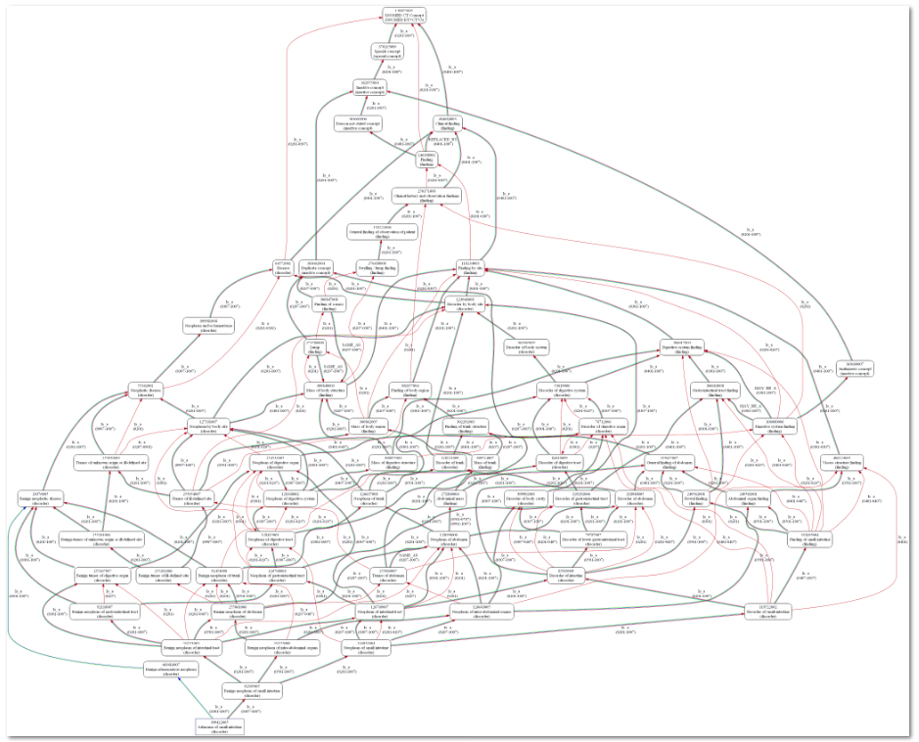
Adenoma of small intestine
SNOMED CT:
Indirect changes to:
Ceusters W. Applying Evolutionary Terminology Auditing to SNOMED CT. In American Medical Informatics Association 2010 Annual Symposium (AMIA 2010) Proceedings, Washington DC, November 13-17, 2010:96-100.

Slide 15
SNOMED CT concept (in)activations
 | From Concept file |  | From 2016 'snapshot' file
Version | Activated In | Deactivated in | Active since | Inactive since
20020131 | 278183 | 47833 | 185564 | 47673
20020731 | 7485 | 1747 | 9950 | 1725
20030131 | 7806 | 5834 | 7151 | 5569
20030731 | 8124 | 1905 | 7684 | 1888
20040131 | 4573 | 2008 | 3899 | 1990
20040731 | 4599 | 1580 | 7462 | 1471
20050131 | 2817 | 897 | 6699 | 891
20050731 | 1722 | 438 | 4148 | 433
20060131 | 2422 | 718 | 6687 | 710
20060731 | 2125 | 1035 | 2295 | 1029
20070131 | 3036 | 1363 | 4717 | 1351
20070731 | 2325 | 907 | 4153 | 902
20080131 | 2073 | 1071 | 3403 | 1070
20080731 | 5126 | 889 | 11747 | 884
20090131 | 3745 | 9221 | 4214 | 9221
20090731 | 1337 | 3657 | 4773 | 3655
20100131 | 1744 | 18293 | 3702 | 18292
20100731 | 1157 | 289 | 2288 | 288
20110131 | 1906 | 211 | 3363 | 210
20110731 | 1969 | 189 | 2162 | 187
20120131 | 319 | 108 | 340 | 108
20120731 | 794 | 281 | 1124 | 279
20130131 | 1673 | 114 | 1841 | 112
20130731 | 1124 | 304 | 1307 | 304
20140131 | 2229 | 2466 | 2593 | 2466
20140731 | 12610 | 349 | 12580 | 348
20150131 | 3287 | 1131 | 3671 | 1131
20150731 | 4458 | 399 | 5309 | 399
20160131 | 3115 | 726 | 4620 | 726
SUMS | 373883 | 105963 | 319446 | 105312
Changes in concepts are enormous and not straightforward.
Ceusters w, Bona J. Analyzing SNOMED CT’s Historical Data: Pitfalls and Possibilities. In: American Medical Informatics Association 2016 Annual Symposium Proceedings, Chicago IL, November 12-16, 2016;361-370.
Research based on the January 2016 version of SNOMED CT

Slide 16
SNOMED CT concept (in)activations
 | From Concept file |  | From 2016 'snapshot' file
Version | Activated In | Deactivated in | Active since | Inactive since
20020131 | 278183 | 47833 | 185564 | 47673
20020731 | 7485 | 1747 | 9950 | 1725
20030131 | 7806 | 5834 | 7151 | 5569
20030731 | 8124 | 1905 | 7684 | 1888
20040131 | 4573 | 2008 | 3899 | 1990
20040731 | 4599 | 1580 | 7462 | 1471
20050131 | 2817 | 897 | 6699 | 891
20050731 | 1722 | 438 | 4148 | 433
20060131 | 2422 | 718 | 6687 | 710
20060731 | 2125 | 1035 | 2295 | 1029
20070131 | 3036 | 1363 | 4717 | 1351
20070731 | 2325 | 907 | 4153 | 902
20080131 | 2073 | 1071 | 3403 | 1070
20080731 | 5126 | 889 | 11747 | 884
20090131 | 3745 | 9221 | 4214 | 9221
20090731 | 1337 | 3657 | 4773 | 3655
20100131 | 1744 | 18293 | 3702 | 18292
20100731 | 1157 | 289 | 2288 | 288
20110131 | 1906 | 211 | 3363 | 210
20110731 | 1969 | 189 | 2162 | 187
20120131 | 319 | 108 | 340 | 108
20120731 | 794 | 281 | 1124 | 279
20130131 | 1673 | 114 | 1841 | 112
20130731 | 1124 | 304 | 1307 | 304
20140131 | 2229 | 2466 | 2593 | 2466
20140731 | 12610 | 349 | 12580 | 348
20150131 | 3287 | 1131 | 3671 | 1131
20150731 | 4458 | 399 | 5309 | 399
20160131 | 3115 | 726 | 4620 | 726
SUMS | 373883 | 105963 | 319446 | 105312
Whereas in 2002 14.7% of total concepts were inactive, it was already 24.8% in January 2016.
Ceusters w, Bona J. Analyzing SNOMED CT’s Historical Data: Pitfalls and Possibilities. In: American Medical Informatics Association 2016 Annual Symposium Proceedings, Chicago IL, November 12-16, 2016;361-370.
Research based on the January 2016 version of SNOMED CT

Slide 17
SNOMED CT concept (in)activations
 | From Concept file |  | From 2016 'snapshot' file
Version | Activated In | Deactivated in | Active since | Inactive since
20020131 | 278183 | 47833 | 185564 | 47673
20020731 | 7485 | 1747 | 9950 | 1725
20030131 | 7806 | 5834 | 7151 | 5569
20030731 | 8124 | 1905 | 7684 | 1888
20040131 | 4573 | 2008 | 3899 | 1990
20040731 | 4599 | 1580 | 7462 | 1471
20050131 | 2817 | 897 | 6699 | 891
20050731 | 1722 | 438 | 4148 | 433
20060131 | 2422 | 718 | 6687 | 710
20060731 | 2125 | 1035 | 2295 | 1029
20070131 | 3036 | 1363 | 4717 | 1351
20070731 | 2325 | 907 | 4153 | 902
20080131 | 2073 | 1071 | 3403 | 1070
20080731 | 5126 | 889 | 11747 | 884
20090131 | 3745 | 9221 | 4214 | 9221
20090731 | 1337 | 3657 | 4773 | 3655
20100131 | 1744 | 18293 | 3702 | 18292
20100731 | 1157 | 289 | 2288 | 288
20110131 | 1906 | 211 | 3363 | 210
20110731 | 1969 | 189 | 2162 | 187
20120131 | 319 | 108 | 340 | 108
20120731 | 794 | 281 | 1124 | 279
20130131 | 1673 | 114 | 1841 | 112
20130731 | 1124 | 304 | 1307 | 304
20140131 | 2229 | 2466 | 2593 | 2466
20140731 | 12610 | 349 | 12580 | 348
20150131 | 3287 | 1131 | 3671 | 1131
20150731 | 4458 | 399 | 5309 | 399
20160131 | 3115 | 726 | 4620 | 726
SUMS | 373883 | 105963 | 319446 | 105312
All versions exhibit activations and inactivations, but only few versions come with more inactivations than activations.
Ceusters w, Bona J. Analyzing SNOMED CT’s Historical Data: Pitfalls and Possibilities. In: American Medical Informatics Association 2016 Annual Symposium Proceedings, Chicago IL, November 12-16, 2016;361-370.
Research based on the January 2016 version of SNOMED CT

Slide 18
SNOMED CT concept (in)activations
 | From Concept file |  | From 2016 'snapshot' file
Version | Activated In | Deactivated in | Active since | Inactive since
20020131 | 278183 | 47833 | 185564 | 47673
20020731 | 7485 | 1747 | 9950 | 1725
20030131 | 7806 | 5834 | 7151 | 5569
20030731 | 8124 | 1905 | 7684 | 1888
20040131 | 4573 | 2008 | 3899 | 1990
20040731 | 4599 | 1580 | 7462 | 1471
20050131 | 2817 | 897 | 6699 | 891
20050731 | 1722 | 438 | 4148 | 433
20060131 | 2422 | 718 | 6687 | 710
20060731 | 2125 | 1035 | 2295 | 1029
20070131 | 3036 | 1363 | 4717 | 1351
20070731 | 2325 | 907 | 4153 | 902
20080131 | 2073 | 1071 | 3403 | 1070
20080731 | 5126 | 889 | 11747 | 884
20090131 | 3745 | 9221 | 4214 | 9221
20090731 | 1337 | 3657 | 4773 | 3655
20100131 | 1744 | 18293 | 3702 | 18292
20100731 | 1157 | 289 | 2288 | 288
20110131 | 1906 | 211 | 3363 | 210
20110731 | 1969 | 189 | 2162 | 187
20120131 | 319 | 108 | 340 | 108
20120731 | 794 | 281 | 1124 | 279
20130131 | 1673 | 114 | 1841 | 112
20130731 | 1124 | 304 | 1307 | 304
20140131 | 2229 | 2466 | 2593 | 2466
20140731 | 12610 | 349 | 12580 | 348
20150131 | 3287 | 1131 | 3671 | 1131
20150731 | 4458 | 399 | 5309 | 399
20160131 | 3115 | 726 | 4620 | 726
SUMS | 373883 | 105963 | 319446 | 105312
Of the 278,183 active concepts in 2002, only 66.7% was (still) active in January 2016.
Ceusters w, Bona J. Analyzing SNOMED CT’s Historical Data: Pitfalls and Possibilities. In: American Medical Informatics Association 2016 Annual Symposium Proceedings, Chicago IL, November 12-16, 2016;361-370.
Research based on the January 2016 version of SNOMED CT

Slide 19
SNOMED CT concept (in)activations
 | From Concept file |  | From 2016 'snapshot' file
Version | Activated In | Deactivated in | Active since | Inactive since
20020131 | 278183 | 47833 | 185564 | 47673
20020731 | 7485 | 1747 | 9950 | 1725
20030131 | 7806 | 5834 | 7151 | 5569
20030731 | 8124 | 1905 | 7684 | 1888
20040131 | 4573 | 2008 | 3899 | 1990
20040731 | 4599 | 1580 | 7462 | 1471
20050131 | 2817 | 897 | 6699 | 891
20050731 | 1722 | 438 | 4148 | 433
20060131 | 2422 | 718 | 6687 | 710
20060731 | 2125 | 1035 | 2295 | 1029
20070131 | 3036 | 1363 | 4717 | 1351
20070731 | 2325 | 907 | 4153 | 902
20080131 | 2073 | 1071 | 3403 | 1070
20080731 | 5126 | 889 | 11747 | 884
20090131 | 3745 | 9221 | 4214 | 9221
20090731 | 1337 | 3657 | 4773 | 3655
20100131 | 1744 | 18293 | 3702 | 18292
20100731 | 1157 | 289 | 2288 | 288
20110131 | 1906 | 211 | 3363 | 210
20110731 | 1969 | 189 | 2162 | 187
20120131 | 319 | 108 | 340 | 108
20120731 | 794 | 281 | 1124 | 279
20130131 | 1673 | 114 | 1841 | 112
20130731 | 1124 | 304 | 1307 | 304
20140131 | 2229 | 2466 | 2593 | 2466
20140731 | 12610 | 349 | 12580 | 348
20150131 | 3287 | 1131 | 3671 | 1131
20150731 | 4458 | 399 | 5309 | 399
20160131 | 3115 | 726 | 4620 | 726
SUMS | 373883 | 105963 | 319446 | 105312
Of the 47,833 inactive concepts in 2002, 160 became re-activated between 2002 and 2016.
Ceusters w, Bona J. Analyzing SNOMED CT’s Historical Data: Pitfalls and Possibilities. In: American Medical Informatics Association 2016 Annual Symposium Proceedings, Chicago IL, November 12-16, 2016;361-370.
Research based on the January 2016 version of SNOMED CT

Slide 20
SNOMED CT concept (in)activations
 | From Concept file |  | From 2016 'snapshot' file
Version | Activated In | Deactivated in | Active since | Inactive since
20020131 | 278183 | 47833 | 185564 | 47673
20020731 | 7485 | 1747 | 9950 | 1725
20030131 | 7806 | 5834 | 7151 | 5569
20030731 | 8124 | 1905 | 7684 | 1888
20040131 | 4573 | 2008 | 3899 | 1990
20040731 | 4599 | 1580 | 7462 | 1471
20050131 | 2817 | 897 | 6699 | 891
20050731 | 1722 | 438 | 4148 | 433
20060131 | 2422 | 718 | 6687 | 710
20060731 | 2125 | 1035 | 2295 | 1029
20070131 | 3036 | 1363 | 4717 | 1351
20070731 | 2325 | 907 | 4153 | 902
20080131 | 2073 | 1071 | 3403 | 1070
20080731 | 5126 | 889 | 11747 | 884
20090131 | 3745 | 9221 | 4214 | 9221
20090731 | 1337 | 3657 | 4773 | 3655
20100131 | 1744 | 18293 | 3702 | 18292
20100731 | 1157 | 289 | 2288 | 288
20110131 | 1906 | 211 | 3363 | 210
20110731 | 1969 | 189 | 2162 | 187
20120131 | 319 | 108 | 340 | 108
20120731 | 794 | 281 | 1124 | 279
20130131 | 1673 | 114 | 1841 | 112
20130731 | 1124 | 304 | 1307 | 304
20140131 | 2229 | 2466 | 2593 | 2466
20140731 | 12610 | 349 | 12580 | 348
20150131 | 3287 | 1131 | 3671 | 1131
20150731 | 4458 | 399 | 5309 | 399
20160131 | 3115 | 726 | 4620 | 726
SUMS | 373883 | 105963 | 319446 | 105312
Of all inactivated concepts, 651 became reactivated.
Ceusters w, Bona J. Analyzing SNOMED CT’s Historical Data: Pitfalls and Possibilities. In: American Medical Informatics Association 2016 Annual Symposium Proceedings, Chicago IL, November 12-16, 2016;361-370.
Research based on the January 2016 version of SNOMED CT

Slide 21
SNOMED CT concept (in)activations
 | From Concept file |  | From 2016 'snapshot' file
Version | Activated In | Deactivated in | Active since | Inactive since
20020131 | 278183 | 47833 | 185564 | 47673
20020731 | 7485 | 1747 | 9950 | 1725
20030131 | 7806 | 5834 | 7151 | 5569
20030731 | 8124 | 1905 | 7684 | 1888
20040131 | 4573 | 2008 | 3899 | 1990
20040731 | 4599 | 1580 | 7462 | 1471
20050131 | 2817 | 897 | 6699 | 891
20050731 | 1722 | 438 | 4148 | 433
20060131 | 2422 | 718 | 6687 | 710
20060731 | 2125 | 1035 | 2295 | 1029
20070131 | 3036 | 1363 | 4717 | 1351
20070731 | 2325 | 907 | 4153 | 902
20080131 | 2073 | 1071 | 3403 | 1070
20080731 | 5126 | 889 | 11747 | 884
20090131 | 3745 | 9221 | 4214 | 9221
20090731 | 1337 | 3657 | 4773 | 3655
20100131 | 1744 | 18293 | 3702 | 18292
20100731 | 1157 | 289 | 2288 | 288
20110131 | 1906 | 211 | 3363 | 210
20110731 | 1969 | 189 | 2162 | 187
20120131 | 319 | 108 | 340 | 108
20120731 | 794 | 281 | 1124 | 279
20130131 | 1673 | 114 | 1841 | 112
20130731 | 1124 | 304 | 1307 | 304
20140131 | 2229 | 2466 | 2593 | 2466
20140731 | 12610 | 349 | 12580 | 348
20150131 | 3287 | 1131 | 3671 | 1131
20150731 | 4458 | 399 | 5309 | 399
20160131 | 3115 | 726 | 4620 | 726
SUMS | 373883 | 105963 | 319446 | 105312
A total of 153,830 activations and deactivations effectuated since the first version, resulted in:
an increase of 41,263 active concepts (→ a growth of merely 14.8%), with
an efficiency of only 26.9%.
Research based on the January 2016 version of SNOMED CT

Slide 22
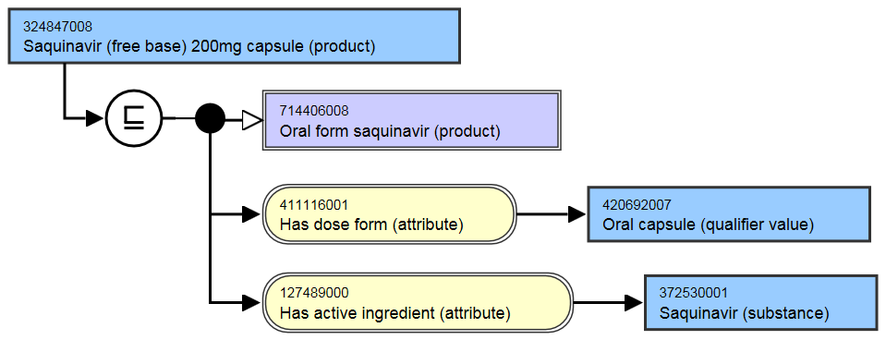
Several concepts exhibit multiple (in)activations: e.g. the history of Saquinovir
ConceptID | Version | Active
324847008 | 20020131 | 1
324847008 | 20030131 | 0
324847008 | 20040131 | 1
324847008 | 20040731 | 0
324847008 | 20050131 | 1
324847008 | 20050731 | 0
324847008 | 20070131 | 1

Slide 23
Several concepts exhibit multiple (in)activations: e.g. the history of Saquinovir
ConceptID | Version | Active
324847008 | 20020131 | 1
324847008 | 20030131 | 0
324847008 | 20040131 | 1
324847008 | 20040731 | 0
324847008 | 20050131 | 1
324847008 | 20050731 | 0
324847008 | 20070131 | 1
They changed their mind 7 times!

Slide 24
History of ‘Saquinavir 200mg capsule’
ConceptID | Version | Active
324847008 | 20020131 | 1
324847008 | 20030131 | 0
324847008 | 20040131 | 1
324847008 | 20040731 | 0
324847008 | 20050131 | 1
324847008 | 20050731 | 0
324847008 | 20070131 | 1

Slide 25
Changes in descriptions
descriptionID | Effective Time | Active | Description Type | Term
410015012 | 20020131 | 1 | Synonym | Asthenia [D]
410015012 | 20020731 | 0 | Synonym | Asthenia [D]
666971011 | 20020131 | 1 | FSN | Asthenia [D] (finding)
666971011 | 20030131 | 0 | FSN | Asthenia [D] (finding)
1237162017 | 20020731 | 1 | Synonym | Asthenia [D]
1472277017 | 20030131 | 1 | FSN | [D]Asthenia (context-dependent category)
1472277017 | 20060731 | 0 | FSN | [D]Asthenia (context-dependent category)
1489933012 | 20030131 | 1 | Synonym | [D]Asthenia
2610401019 | 20060731 | 1 | FSN | [D]Asthenia (situation)

Slide 26
Some changes in descriptions are related to changes in the hierarchy
descriptionID | Effective Time | Active | Description Type | Term
410015012 | 20020131 | 1 | Synonym | Asthenia [D]
410015012 | 20020731 | 0 | Synonym | Asthenia [D]
666971011 | 20020131 | 1 | FSN | Asthenia [D] (finding)
666971011 | 20030131 | 0 | FSN | Asthenia [D] (finding)
1237162017 | 20020731 | 1 | Synonym | Asthenia [D]
1472277017 | 20030131 | 1 | FSN | [D]Asthenia (context-dependent category)
1472277017 | 20060731 | 0 | FSN | [D]Asthenia (context-dependent category)
1489933012 | 20030131 | 1 | Synonym | [D]Asthenia
2610401019 | 20060731 | 1 | FSN | [D]Asthenia (situation)
‘Semantic tags’

Slide 27
‘Semantic tags’ (per SNOMED CT documentation)
Descriptions provide for each concept a Fully Specified Name (FSN) most of which ‘end with a semantic tag in parentheses and which indicates the semantic category to which the concept belongs (e.g. clinical finding, disorder, procedure, organism, person, etc.)’ [4, p41].
IHTSDO. International Health Terminology Standards Development Organization - SNOMED CT® Technical Implementation Guide - January 2015 International Release (US English). 2015. p. 757.

Slide 28
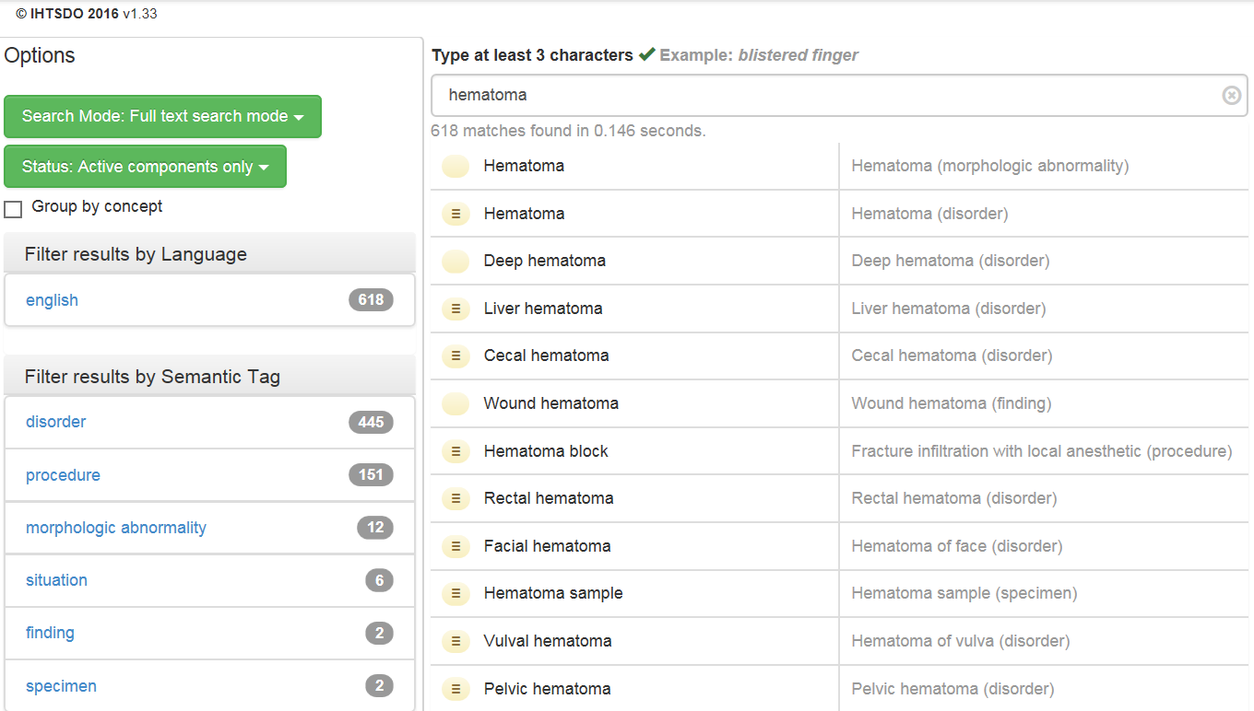
Semantic tags
…

Slide 29
‘Semantic tags’ (per SNOMED CT documentation)
Descriptions provide for each concept a Fully Specified Name (FSN) most of which ‘end with a semantic tag in parentheses and which indicates the semantic category to which the concept belongs (e.g. clinical finding, disorder, procedure, organism, person, etc.)’ [4, p41].
‘the semantic tag helps to disambiguate different concepts which may be referred to by the same commonly used word or phrase’ [4, p41].
IHTSDO. International Health Terminology Standards Development Organization - SNOMED CT® Technical Implementation Guide - January 2015 International Release (US English). 2015. p. 757.

Slide 30
‘Semantic tags’ (per SNOMED CT documentation)
Descriptions provide for each concept a Fully Specified Name (FSN) most of which ‘end with a semantic tag in parentheses and which indicates the semantic category to which the concept belongs (e.g. clinical finding, disorder, procedure, organism, person, etc.)’ [4, p41].
‘the semantic tag helps to disambiguate different concepts which may be referred to by the same commonly used word or phrase’ [4, p41].
For example, it is the semantic tag ‘morphologic abnormality’ in the FSN ‘Hematoma (morphologic abnormality)’ that disambiguates the concept to which this FSN is assigned from a second concept with FSN ‘Hematoma (disorder)’. The former is intended to be used for what ‘a pathologist sees at the tissue level’, while the latter ‘represents the clinical diagnosis that a clinician makes when they decide that a person has a “hematoma”’ [4, p41].
IHTSDO. International Health Terminology Standards Development Organization - SNOMED CT® Technical Implementation Guide - January 2015 International Release (US English). 2015. p. 757.

Slide 31
Semantic tags

Slide 32
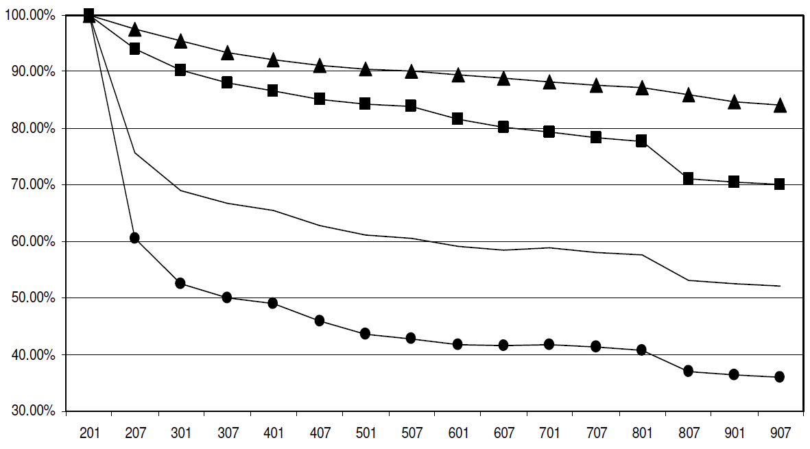
Ungraceful degradation of assertions in SNOMED CT (2002 – 2009)
concepts
terms
all
relationships
Ceusters W. Applying Evolutionary Terminology Auditing to SNOMED CT. In American Medical Informatics Association 2010 Annual Symposium (AMIA 2010) Proceedings, Washington DC, November 13-17, 2010:96-100.

Slide 33
Concepts and confusions in SNOMED CT
‘concept’:
  ‘a clinical idea to which a unique concept identifier has been assigned’; ‘the meaning of a concept can be determined from relationships to other concepts and from associated descriptions that include human readable terms’
the term is also stated to be a homonym for:
  ‘concept identifier’ as well as for
  ‘the real-world referent(s) of the concept identifier, that is, the class of entities in reality that the concept identifier represents’

Slide 34
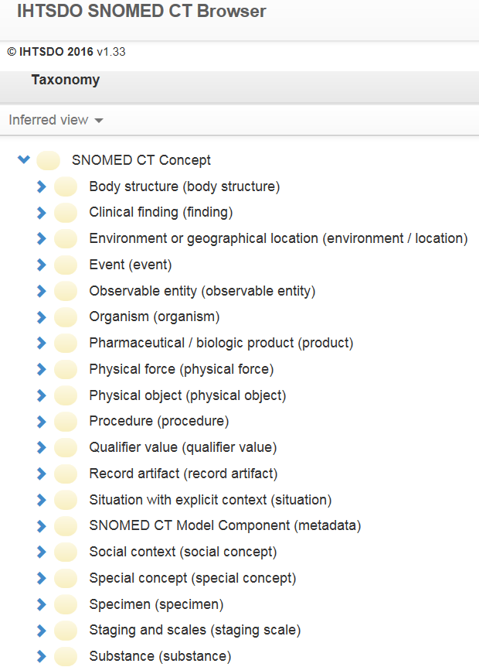
SNOMED CT’s top categories
denote (roughly):
Entities on the side of the patient

Slide 35
SNOMED CT’s top categories
denote (roughly):
Entities on the side of the patient
Entities to describe entities on the side of the patient

Slide 36
SNOMED CT’s top categories
denote (roughly):
Entities on the side of the patient
Entities to describe entities on the side of the patient
Entities on the side of SNOMED CT as descriptive tool

Slide 37
SNOMED CT’s top categories
denote (roughly):
Entities on the side of the patient
Entities to describe entities on the side of the patient
Entities on the side of SNOMED CT as descriptive tool
A hodge podge of A and B

Slide 38
SNOMED CT’s top categories
Describe
  The structure of SNOMED CT
  Changes introduced in any of the SNOMED CT components
Entities on the side of SNOMED CT as descriptive tool

Slide 39
Cell phenotyping performed
You remember:
Activation
De-activation
Ceusters W. Applying Evolutionary Terminology Auditing to SNOMED CT. In American Medical Informatics Association 2010 Annual Symposium (AMIA 2010) Proceedings, Washington DC, November 13-17, 2010:96-100.

Slide 40
Cell phenotyping performed
You remember:
Activation
De-activation
Ceusters W. Applying Evolutionary Terminology Auditing to SNOMED CT. In American Medical Informatics Association 2010 Annual Symposium (AMIA 2010) Proceedings, Washington DC, November 13-17, 2010:96-100.

Slide 41
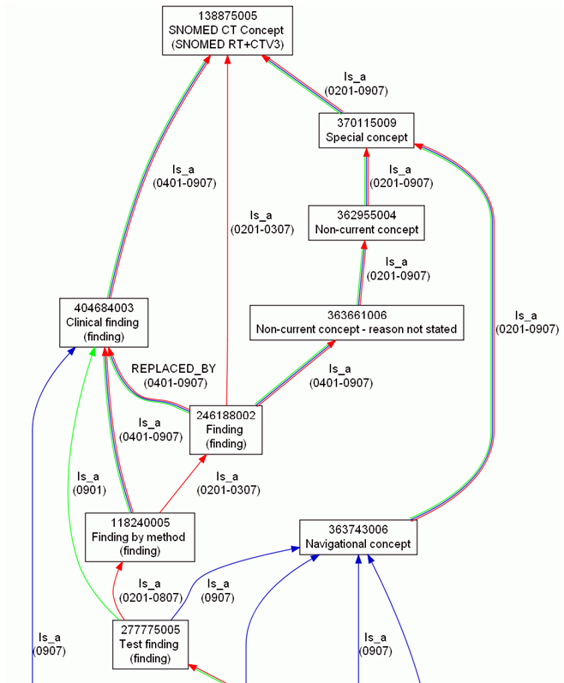
Concept evolution in SNOMED CT
Ceusters W. Applying Evolutionary Terminology Auditing to SNOMED CT. In American Medical Informatics Association 2010 Annual Symposium (AMIA 2010) Proceedings, Washington DC, November 13-17, 2010:96-100.

Slide 42
When to install a new version of SNOMED CT?

Slide 43
When to install a new version of SNOMED CT?
Observations:
    SNOMED CT undergoes considerable changes over time
    applications use typically only a small subset of it
    integrating new SNOMED CT versions is troublesome
Questions:
    does within the scope of a specific application a new version of SNOMED CT contain more - and of better quality - knowledge than its predecessor or is it a mere reformulation of the same amount of knowledge?
    if the former, can this be computed in order to find out when it is worthwhile to upgrade to a new version?
Ceusters W. SNOMED CT Revisions and Coded Data Repositories: When to Upgrade?
In AMIA 2011 Annual Symposium Proceedings, Washington DC, October 22-26, 2011:197-206

Slide 44
Methodology (1)
Study a subset of 883 SNOMED CT concepts used within a cancer clinic for encoding synoptic pathology reports and tumor registry data and for querying a biospecimen repository (source concepts - SC);
  motivation: real application use case.
Compute for each source concept the transitive closure set (target concepts - TC) of the Is a relation and all historical relations for each SNOMED CT version from January 2002 to July 2010, together with their concept status and path length to the source concept;
  motivation: information content is partially based on the graph structure,
  result: the 883 SCs were linked by means of 15,689 relationships to 1,415 TCs.

Slide 45
Transitive closure sets for
Surgical margins involved by tumor (finding)
Rel-ID | Version |  |  |  |  |  |  |  |  |  |  |  |  |  |  |  |  |  | Rel-Type | Target Concept
 | 1 | 2 | 3 | 4 | 5 | 6 | 7 | 8 | 9 | 10 | 11 | 12 | 13 | 14 | 15 | 16 | 17 | 18
H-18608 | 6 | 6 | 7 | 4 | 4 | 4 | 4 | 4 | 4 | 4 | 4 | 4 | 4 | 4 | 4 | 4 | 4 | 4 | Is a | SNOMED CT Concept (SNOMED RT+CTV3)
H-23694 | 5 | 5 | 6 |  |  |  |  |  |  |  |  |  |  |  |  |  |  |  | Is a | Finding (finding)
H-18607 | 4 | 4 | 5 |  |  |  |  |  |  |  |  |  |  |  |  |  |  |  | Is a | Finding by method (finding)
H-12792 | 3 | 3 | 4 |  |  |  |  |  |  |  |  |  |  |  |  |  |  |  | Is a | Test finding (navigational concept)
H-12789 | 3 | 3 | 3 |  |  |  |  |  |  |  |  |  |  |  |  |  |  |  | Is a | Laboratory test finding (navigational concept)
H-07371 | 2 | 2 | 2 |  |  |  |  |  |  |  |  |  |  |  |  |  |  |  | Is a | Sample finding (finding)
H-07373 | 2 | 2 |  |  |  |  |  |  |  |  |  |  |  |  |  |  |  |  | Is a | Morphologic finding (finding)
220039029 | 1 | 1 |  |  |  |  |  |  |  |  |  |  |  |  |  |  |  |  | Is a | Clinical sample finding (finding)
H-07370 |  |  | 3 |  |  |  |  |  |  |  |  |  |  |  |  |  |  |  | Is a | Histopathology finding (finding)
H-07368 |  |  | 2 |  |  |  |  |  |  |  |  |  |  |  |  |  |  |  | Is a | General pathology (finding)
H-07369 |  |  | 2 |  |  |  |  |  |  |  |  |  |  |  |  |  |  |  | Is a | Laboratory finding present (navigational concept)
2030386023 |  |  | 1 |  |  |  |  |  |  |  |  |  |  |  |  |  |  |  | Is a | Pathology examination findings present (finding)
2030387025 |  |  | 1 |  |  |  |  |  |  |  |  |  |  |  |  |  |  |  | Is a | Surgical margin finding (finding)
…

Slide 46
Computations over SNOMED CT’s
‘historical relationships’
C1→C2 | C2→C3 | C1→C3
Is a | Is a | Is a
Is a | IsA | IsA
IsA | Is a | IsA
IsA | IsA | IsA
SAME AS | Is a | IsA
SAME AS | IsA | IsA
Is a | SAME AS | IsA
IsA | SAME AS | IsA

Slide 47
Transitive closure sets for
Surgical margins involved by tumor (finding)
Rel-ID | Version |  |  |  |  |  |  |  |  |  |  |  |  |  |  |  |  |  | Rel-Type | Target Concept
 | 1 | 2 | 3 | 4 | 5 | 6 | 7 | 8 | 9 | 10 | 11 | 12 | 13 | 14 | 15 | 16 | 17 | 18
H-18608 | 6 | 6 | 7 | 4 | 4 | 4 | 4 | 4 | 4 | 4 | 4 | 4 | 4 | 4 | 4 | 4 | 4 | 4 | Is a | SNOMED CT Concept (SNOMED RT+CTV3)
H-23694 | 5 | 5 | 6 |  |  |  |  |  |  |  |  |  |  |  |  |  |  |  | Is a | Finding (finding)
H-18182 |  |  |  | 8 | 8 | 8 | 8 | 8 | 8 | 8 | 8 | 8 | 8 | 8 | 7 | 6 | 6 | 6 | IsA | SNOMED CT Concept (SNOMED RT+CTV3)
H-27662 |  |  |  | 7 |  |  |  |  |  |  |  |  |  |  |  |  |  |  | IsA | Finding (finding)
H-23376 |  |  |  | 6 | 6 | 6 | 6 | 6 | 6 | 6 | 6 | 6 | 6 | 6 |  |  |  |  | IsA | Finding by method (finding)
H-18183 |  |  |  | 5 | 5 | 5 | 5 | 5 | 5 | 5 | 5 | 5 | 5 | 5 | 5 |  |  |  | IsA | Test finding (navigational concept)
H-07379 |  |  |  | 4 | 4 | 4 | 4 | 4 | 4 | 4 | 4 | 4 | 4 | 4 | 4 | 3 | 3 | 3 | IsA | Histopathology finding (finding)
H-12412 |  |  |  | 4 | 4 | 4 | 4 | 4 | 4 | 4 | 4 | 4 | 4 | 4 | 4 |  |  |  | IsA | Laboratory test finding (navigational concept)
H-07380 |  |  |  | 4 | 4 | 4 | 4 | 4 | 4 | 4 | 4 | 4 | 4 | 4 | 4 |  |  |  | IsA | Sample finding (finding)
H-12418 |  |  |  | 4 | 4 | 4 | 4 | 4 | 4 | 4 | 4 | 4 | 4 | 4 | 4 |  |  |  | IsA | Morphologic finding (finding)
H-07378 |  |  |  | 3 | 3 | 3 | 3 | 3 | 3 | 3 | 3 | 3 | 3 | 3 | 3 | 3 | 3 | 3 | IsA | General pathology (finding)
H-12793 |  |  |  | 3 | 3 | 3 | 3 | 3 | 3 | 3 | 3 | 3 | 3 | 3 | 3 | 3 | 3 | 3 | Is a | Special concept (special concept)
H-07377 |  |  |  | 3 | 3 | 3 | 3 | 3 | 3 | 3 | 3 | 3 | 3 | 3 | 3 |  |  |  | IsA | Clinical sample finding (finding)
H-07381 |  |  |  | 3 | 3 | 3 | 3 | 3 | 3 | 3 | 3 | 3 | 3 | 3 | 3 |  |  |  | IsA | Laboratory finding present (navigational concept)
H-07374 |  |  |  | 2 | 2 | 2 | 2 | 2 | 2 | 2 | 2 | 2 | 2 | 2 | 2 | 2 | 2 | 2 | Is a | Inactive concept (inactive concept)
H-07382 |  |  |  | 2 | 2 | 2 | 2 | 2 | 2 | 2 | 2 | 2 | 2 | 2 | 2 | 2 | 2 | 2 | IsA | Pathology examination findings present (finding)
H-07384 |  |  |  | 2 | 2 | 2 | 2 | 2 | 2 | 2 | 2 | 2 | 2 | 2 | 2 | 2 | 2 | 2 | IsA | Surgical margin finding (finding)
2228147020 |  |  |  | 1 | 1 | 1 | 1 | 1 | 1 | 1 | 1 | 1 | 1 | 1 | 1 | 1 | 1 | 1 | Is a | Duplicate concept (inactive concept)
2295897028 |  |  |  | 1 | 1 | 1 | 1 | 1 | 1 | 1 | 1 | 1 | 1 | 1 | 1 | 1 | 1 | 1 | SAME AS | Surgical margin involved by tumor (finding)
H-18186 |  |  |  |  | 7 | 7 | 7 | 7 | 7 | 7 | 7 | 7 | 7 | 7 | 6 | 5 | 5 | 5 | IsA | Clinical finding (finding)
H-12417 |  |  |  |  |  |  |  |  |  |  |  |  |  |  |  | 4 | 4 | 4 | IsA | Evaluation finding (finding)

Slide 48
Methodology (2)
compute for each TC in each version of SNOMED CT the genericity:
    i.e. the number of times a TC appears in the paths from all SCs to the root.
7
4
1
2
2

Slide 49
Methodology (2)
compute for each SC in each version its information content:
    i.e. the sum of the values obtained by dividing the genericity of each TC on a path from the SC to the top by the respective path lengths from SC to TC.
        2/1 + 1/1+
        2/1 + 7/2 =
        4/2 + 4.5
        4/2 +
        7/3 +
        7/3 +
        7/2 =
        16.16
7
4
1
2
2

Slide 50
IC for SC ‘pN1b: Metastasis in internal mammary lymph nodes with microscopic disease detected by sentinel lymph node dissection but not clinically apparent (breast) (finding)’.
Target Concepts | v1 | v2 | v3 | v4 | v5 | v6 | v7 | v8 | v9 | v10 | v11 | v12 | v13 | v14 | v15 | v16 | v17 | v18
SNOMED CT Concept (SNOMED RT+CTV3) | 0 | 58 | 56 | 103 | 139 | 104 | 104 | 104 | 93 | 93 | 93 | 93 | 93 | 93 | 93 | 93 | 93 | 93
Staging and scales (staging scale) | 0 | 9 | 0 | 0 | 0 | 0 | 0 | 0 | 0 | 0 | 0 | 0 | 0 | 0 | 0 | 0 | 0 | 0
Tumor staging (tumor staging) | 0 | 10 | 0 | 0 | 0 | 0 | 0 | 0 | 0 | 0 | 0 | 0 | 0 | 0 | 0 | 0 | 0 | 0
Cancer staging (tumor staging) | 0 | 5 | 0 | 0 | 0 | 0 | 0 | 0 | 0 | 0 | 0 | 0 | 0 | 0 | 0 | 0 | 0 | 0
Tumor-node-metastasis (TNM) tumor staging system (tumor staging) | 0 | 11 | 0 | 0 | 0 | 0 | 0 | 0 | 0 | 0 | 0 | 0 | 0 | 0 | 0 | 0 | 0 | 0
[cut]
Finding (finding) | 0 | 0 | 19 | 57 | 0 | 0 | 0 | 0 | 0 | 0 | 0 | 0 | 0 | 0 | 0 | 0 | 0 | 0
Clinical history and observation findings (finding) | 0 | 0 | 16 | 54 | 0 | 54 | 54 | 54 | 46 | 46 | 46 | 46 | 46 | 46 | 46 | 46 | 46 | 46
Clinical finding (finding) | 0 | 0 | 19 | 64 | 0 | 0 | 0 | 0 | 0 | 0 | 0 | 0 | 0 | 0 | 0 | 0 | 0 | 0
Tumor finding (finding) | 0 | 0 | 22 | 80 | 81 | 81 | 81 | 81 | 65 | 65 | 65 | 65 | 65 | 65 | 65 | 65 | 65 | 65
Node category finding (finding) | 0 | 0 | 5 | 10 | 11 | 11 | 11 | 11 | 11 | 11 | 11 | 11 | 11 | 11 | 11 | 11 | 11 | 11
Tumor stage finding (finding) | 0 | 0 | 18 | 0 | 0 | 0 | 0 | 0 | 56 | 56 | 56 | 56 | 56 | 56 | 56 | 56 | 56 | 56
Tumor-node-metastasis (TNM) tumor staging finding (finding) | 0 | 0 | 22 | 71 | 73 | 73 | 73 | 73 | 73 | 73 | 73 | 73 | 73 | 73 | 73 | 73 | 73 | 73
pN category finding (finding) | 0 | 0 | 6 | 14 | 15 | 15 | 15 | 15 | 15 | 15 | 15 | 15 | 15 | 15 | 15 | 15 | 15 | 15
N1 category (finding) | 0 | 0 | 3 | 7 | 8 | 8 | 8 | 0 | 0 | 0 | 0 | 0 | 0 | 0 | 0 | 0 | 0 | 0
Breast TNM finding (finding) | 0 | 0 | 10 | 10 | 12 | 12 | 12 | 12 | 12 | 12 | 12 | 12 | 12 | 12 | 12 | 12 | 12 | 12
Clinical finding (finding) | 0 | 0 | 0 | 0 | 88 | 63 | 63 | 63 | 55 | 55 | 55 | 55 | 55 | 55 | 55 | 55 | 55 | 55
Finding of lesion (finding) | 0 | 0 | 0 | 0 | 0 | 65 | 65 | 65 | 54 | 54 | 54 | 54 | 54 | 54 | 54 | 54 | 54 | 54
pN1b category (finding) | 0 | 0 | 0 | 0 | 0 | 0 | 0 | 0 | 0 | 0 | 0 | 0 | 0 | 0 | 0 | 0 | 4 | 4
Total Information content | 0 | 123 | 203 | 484 | 440 | 500 | 500 | 492 | 493 | 493 | 493 | 493 | 493 | 493 | 493 | 493 | 498 | 498

Slide 51
Methodology (3)
compute the relevant information content of a version as the sum of the information contents of all SCs in that version.

Slide 52
Hypothesis
the evolution of the information content of the versions over time can be used as an indicator to decide whether to upgrade to a new version.
IC evolution of 18 SNOMED CT versions relative to the 883 SCs

Slide 53
Methodology (4)
intermediate inspection of the transitive closure sets reveals that the evolution thereof contains indicators for mistakes and corrections thereof:
Target Concepts | v1 | v2 | v3 | v4 | v5 | v6 | v7 | v8 | v9 | v10 | v11 | v12 | v13 | v14 | v15 | v16 | v17 | v18
SNOMED CT Concept (SNOMED RT+CTV3) | 0 | 58 | 56 | 103 | 139 | 104 | 104 | 104 | 93 | 93 | 93 | 93 | 93 | 93 | 93 | 93 | 93 | 93
[cut]
Finding (finding) | 0 | 0 | 19 | 57 | 0 | 0 | 0 | 0 | 0 | 0 | 0 | 0 | 0 | 0 | 0 | 0 | 0 | 0
Clinical history and observation findings (finding) | 0 | 0 | 16 | 54 | 0 | 54 | 54 | 54 | 46 | 46 | 46 | 46 | 46 | 46 | 46 | 46 | 46 | 46
Clinical finding (finding) | 0 | 0 | 19 | 64 | 0 | 0 | 0 | 0 | 0 | 0 | 0 | 0 | 0 | 0 | 0 | 0 | 0 | 0
Tumor finding (finding) | 0 | 0 | 22 | 80 | 81 | 81 | 81 | 81 | 65 | 65 | 65 | 65 | 65 | 65 | 65 | 65 | 65 | 65
Node category finding (finding) | 0 | 0 | 5 | 10 | 11 | 11 | 11 | 11 | 11 | 11 | 11 | 11 | 11 | 11 | 11 | 11 | 11 | 11
Tumor stage finding (finding) | 0 | 0 | 18 | 0 | 0 | 0 | 0 | 0 | 56 | 56 | 56 | 56 | 56 | 56 | 56 | 56 | 56 | 56
pN category finding (finding) | 0 | 0 | 6 | 14 | 15 | 15 | 15 | 15 | 15 | 15 | 15 | 15 | 15 | 15 | 15 | 15 | 15 | 15
N1 category (finding) | 0 | 0 | 3 | 7 | 8 | 8 | 8 | 0 | 0 | 0 | 0 | 0 | 0 | 0 | 0 | 0 | 0 | 0
Breast TNM finding (finding) | 0 | 0 | 10 | 10 | 12 | 12 | 12 | 12 | 12 | 12 | 12 | 12 | 12 | 12 | 12 | 12 | 12 | 12
Clinical finding (finding) | 0 | 0 | 0 | 0 | 88 | 63 | 63 | 63 | 55 | 55 | 55 | 55 | 55 | 55 | 55 | 55 | 55 | 55
Finding of lesion (finding) | 0 | 0 | 0 | 0 | 0 | 65 | 65 | 65 | 54 | 54 | 54 | 54 | 54 | 54 | 54 | 54 | 54 | 54
pN1b category (finding) | 0 | 0 | 0 | 0 | 0 | 0 | 0 | 0 | 0 | 0 | 0 | 0 | 0 | 0 | 0 | 0 | 4 | 4
Total Information content | 0 | 123 | 203 | 484 | 440 | 500 | 500 | 492 | 493 | 493 | 493 | 493 | 493 | 493 | 493 | 493 | 498 | 498

Slide 54
Appearances and disappearances of TCs
 | TimePattern
Relation | Contiguous |  |  |  | Non-contiguous
present in no. |  |  |  |  | Two blocks |  |  |  | Three blocks
of versions | B | BS | SBS | SB | BSB | BSBS | SBSBS | SBSB | BSBSB | SBSBSB | Totals | %
18 | 4316 |  |  |  |  |  |  |  |  |  | 4316 | 27.51%
17 |  | 4 |  | 333 | 37 |  |  |  |  |  | 374 | 2.38%
16 |  | 1 |  | 957 | 22 |  |  | 2 |  |  | 982 | 6.26%
15 |  | 9 | 4 | 2804 | 2 | 5 |  | 111 |  |  | 2935 | 18.71%
14 |  | 17 | 49 | 712 | 17 | 1 |  | 210 |  |  | 1006 | 6.41%
13 |  | 58 | 159 | 471 | 10 | 6 |  |  |  |  | 704 | 4.49%
12 |  | 13 | 362 | 344 |  | 2 |  | 3 |  |  | 724 | 4.61%
11 |  | 8 | 70 | 649 | 7 | 1 |  | 24 | 1 |  | 760 | 4.84%
10 |  | 21 | 22 | 38 | 10 |  |  | 5 |  |  | 96 | 0.61%
9 |  | 251 | 11 | 98 |  |  | 1 | 1 |  |  | 362 | 2.31%
8 |  | 3 | 25 | 112 | 8 |  |  | 4 |  |  | 152 | 0.97%
7 |  | 27 | 9 | 6 | 1 |  |  | 1 |  | 1 | 45 | 0.29%
6 |  | 13 | 35 | 13 |  |  |  |  |  |  | 61 | 0.39%
5 |  | 48 | 60 | 316 |  |  |  | 1 |  |  | 425 | 2.71%
4 |  | 8 | 160 | 75 | 1 | 2 |  | 1 |  |  | 247 | 1.57%
3 |  | 225 | 41 | 307 |  | 2 |  |  |  |  | 575 | 3.66%
2 |  | 280 | 386 | 184 |  |  |  |  |  |  | 850 | 5.42%
1 |  | 224 | 779 | 72 |  |  |  |  |  |  | 1075 | 6.85%
Totals | 4316 | 1210 | 2172 | 7491 | 115 | 19 | 1 | 363 | 1 | 1 | 15689 | 100.00%
 | 15189 |  |  |  | 500 |  |  |  |  |  | 15689 | 100.00%

Slide 55
How to read this table
Of the 45 relations that are present in 7 versions, 27 exhibits a ‘BS’ pattern, 9 a ‘SBS’ pattern, …
  ‘B’ stands for ‘block’ thus present, ‘S’ for ‘space’, thus absent
Example (the one ‘SBSBSB’ in the sample):
  000004003334400001 Ulcerative colitis Is a Inflammatory bowel disease
    numbers indicate path distance from SC to TC in each of the 18 versions studied (‘0’ = absence)
 | TimePattern
Relation | Contiguous |  |  |  | Non-contiguous
present in no. |  |  |  |  | Two blocks |  |  |  | Three blocks
of versions | B | BS | SBS | SB | BSB | BSBS | SBSBS | SBSB | BSBSB | SBSBSB | Totals | %
18 | 4316 |  |  |  |  |  |  |  |  |  | 4316 | 27.51%
17 |  | 4 |  | 333 | 37 |  |  |  |  |  | 374 | 2.38%
16 |  | 1 |  | 957 | 22 |  |  | 2 |  |  | 982 | 6.26%
15 |  | 9 | 4 | 2804 | 2 | 5 |  | 111 |  |  | 2935 | 18.71%
14 |  | 17 | 49 | 712 | 17 | 1 |  | 210 |  |  | 1006 | 6.41%
13 |  | 58 | 159 | 471 | 10 | 6 |  |  |  |  | 704 | 4.49%
12 |  | 13 | 362 | 344 |  | 2 |  | 3 |  |  | 724 | 4.61%
11 |  | 8 | 70 | 649 | 7 | 1 |  | 24 | 1 |  | 760 | 4.84%
10 |  | 21 | 22 | 38 | 10 |  |  | 5 |  |  | 96 | 0.61%
9 |  | 251 | 11 | 98 |  |  | 1 | 1 |  |  | 362 | 2.31%
8 |  | 3 | 25 | 112 | 8 |  |  | 4 |  |  | 152 | 0.97%
7 |  | 27 | 9 | 6 | 1 |  |  | 1 |  | 1 | 45 | 0.29%

Slide 56
Intermediate Findings
in some versions target concepts for the source concept disappeared from the transitive closure set while reappearing in later versions.
when target concepts permanently disappeared from the transitive closure set, this could not always be explained by the retirement of the target concept within the corresponding version.
  Indicates a mistake or correction of a mistake
    → suspicious event.

Slide 57
Methodology (5)
Mark each SC / TC pair as being the seat (or not) of a suspicious event on the basis of the concept status of the TC:
  if a TC is retired and the SC/TC pair disappears, then no suspicious event
  if a pair appears or disappears otherwise, there is a suspicious event
If a change is marked in some version as being a suspicious event, it stays marked as such until in some later version – if at all – another change occurs that no longer meets the requirements for being suspicious.
Compute for each version tallies for all such events over all previous versions until another change was effected.

Slide 58
Evolution of suspicious events
N Binary %
Unmarked 15689
Stay unmarked 11182 71.27%
Become suspicious 4507 28.73%
Stay suspicious 1812 40.20%
Become unmarked 2695 59.80%
Stay unmarked 2296 85.19%
Become suspicious 399 14.81%
Stay suspicious 332 83.21%
Become unmarked 67 16.79%
Stay unmarked 66 98.51%
Become suspicious 1 1.49%
Stay suspicious 0 0.00%
Become unmarked 1 100.00%

Slide 59
Hypothesis
the evolution of the information content of the versions over time can be used as an indicator to decide whether to upgrade to a new version.
the evolution of the suspicious event tallies over time, i.e. the suspicious event perseverance, yields a second indicator for migrating to a new version of SNOMED CT.

Slide 60
Evolution of suspicious event perseverance
Evolution of suspicious event perseverance of all source concept/target concept.

Slide 61
First selection of indicators for upgrade
Upgrade from V_{x} to V_{x+n} if:
  the information content of V_{x+n} is greater than of V_{x}
  or
  the suspicious event perseverance is lower in V_{x+n} than in V_{x}

Slide 62
Results
Version |  | Information content | Suspicious event perseverance
v1 | January 2002 | 79,424.5499 | 
v2 | July 2002 | 88,838.2435 | 
v3 | January 2003 | 127,864.0057 | 
v4 | July 2003 | 368,261.2260 | 
v5 | January 2004 | 360,409.8979 | 
v6 | July 2004 | 388,775.7097 | 
v7 | January 2005 | 390,637.7034 | 
v8 | July 2005 | 401,196.6372 | 
v9 | January 2006 | 389,021.8138 | 
v10 | July 2006 | 387,226.2485 | 
v11 | January 2007 | 386,714.4974 | 
v12 | July 2007 | 386,816.9581 | 
v13 | January 2008 | 386,803.0803 | 
v14 | July 2008 | 386,075.3172 | 
v15 | January 2009 | 384,952.4653 | 
v16 | July 2009 | 384,960.7605 | 
v17 | January 2010 | 385,449.7811 | 
v18 | July 2010 | 385,052.7645 | 
Information content evolution
Suspicious event perseverance

Slide 63
configuration | reality |  | representation |  |  |  | ME
 |  |  | authors' belief |  | encoding
 | OE | OR | BE | BR | IE | TR
(1) | (2) | (3) | (4) | (5) | (6) | (7) | (8)
P+1 | Y | Y | Y | Y | Y | R+ | 0
A+1 | N | na | N | na | na | na | 0
A+2 | Y | N | Y | N | na | na | 0
A+3 | Y | N | NC | na | na | na | 0
A+4 | N | na | NC | na | na | na | 0
P-1 | N | na | Y | Y | Y | ¬R | 3
P-2 | N | na | Y | Y | N | ¬R | 4
P-3 | N | na | Y | Y | N | R– | 5
P-4 | Y | Y | Y | Y | N | ¬R | 1
P-5 | Y | Y | Y | Y | N | R- | 2
P-6 | Y | N | Y | Y | Y | R+ | 1
P-7 | Y | N | Y | Y | N | ¬R | 2
P-8 | Y | N | Y | Y | N | R– | 3
P-9 | Y | Y | Y | Y | Y | R++ | 1
P-10 | Y | N | Y | Y | Y | R++ | 2
P-11 | Y | Y | Y | Y | Y | Ra | 1
P-12 | N | na | Y | Y | Y | Ra | 4
A-1 | Y | Y | Y | N | na | na | 1
A-2 | Y | Y | N | na | na | na | 1
A-3 | N | na | Y | N | na | na | 1
A-4 | Y | N | N | na | na | na | 1
A-5 | Y | Y | NC | na | na | na | 1

Slide 64
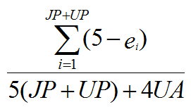
Evaluation
Use a more recent version of SNOMED CT as gold standard for earlier versions, expressing differences in terms of justified presence (JP), justified absence (JA), unjustified presence (UP) and unjustified absence (UA) yielding 17 combinations – change in reality, change in understanding, editorial mistake correction – to each of which corresponds an error value (e_{i}). The overall quality of an earlier version with respect to a chosen later version is then computed by means of formula:
Ceusters W. Applying Evolutionary Terminology Auditing to SNOMED CT. American Medical Informatics Association 2010 Annual Symposium (AMIA 2010) Proceedings. Washington DC, 2010. p. 96-100.

Slide 65
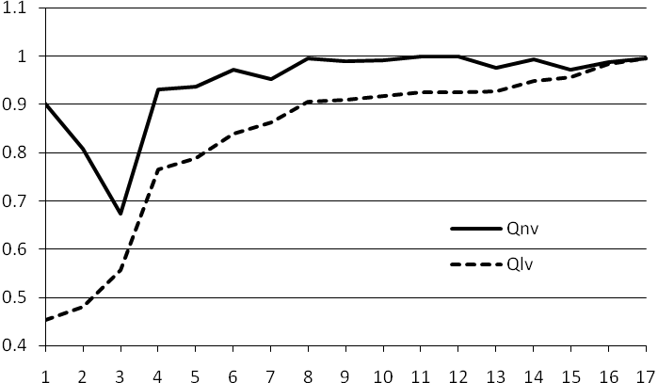
‘next’ and ‘last’ version quality improvement
when the difference between two consecutive points on the Qnv curve shows a large increase, as is the case between v3 and v4, then this means that it is worth upgrading to the next version, thus v5.

Slide 66
Comparison with ‘next’ and ‘last’ version quality improvement
Version |  | Information content | Suspicious event perseverance | ‘Next version’ quality improvement | ‘Last version’ quality improvement
 |  |  |  |  | LQV | 5% | 10% | 15% | 20% | 25%
v1 | January 2002 | 79,424.5499 |  | 0.902158875 | 0.45334
v2 | July 2002 | 88,838.2435 |  | 0.807276754 | 0.47980 | Y
v3 | January 2003 | 127,864.0057 |  | 0.674182895 | 0.55653 | Y | Y | Y | Y
v4 | July 2003 | 368,261.2260 |  | 0.930927215 | 0.76591 | Y | Y | Y | Y | Y
v5 | January 2004 | 360,409.8979 |  | 0.936412939 | 0.78907
v6 | July 2004 | 388,775.7097 |  | 0.970773297 | 0.83995 | Y
v7 | January 2005 | 390,637.7034 |  | 0.952138559 | 0.86259 |  | Y
v8 | July 2005 | 401,196.6372 |  | 0.995326645 | 0.90446 | Y |  | Y
v9 | January 2006 | 389,021.8138 |  | 0.988407635 | 0.90854
v10 | July 2006 | 387,226.2485 |  | 0.992040473 | 0.91776
v11 | January 2007 | 386,714.4974 |  | 0.999406567 | 0.92518 |  |  |  | Y
v12 | July 2007 | 386,816.9581 |  | 0.998631853 | 0.92567
v13 | January 2008 | 386,803.0803 |  | 0.976249334 | 0.92638
v14 | July 2008 | 386,075.3172 |  | 0.992155217 | 0.94874
v15 | January 2009 | 384,952.4653 |  | 0.971849459 | 0.95583 | Y | Y
v16 | July 2009 | 384,960.7605 |  | 0.987649670 | 0.98262 |  |  |  |  | Y
v17 | January 2010 | 385,449.7811 |  | 0.994921958 | 0.99492
v18 | July 2010 | 385,052.7645 |  | - | -

Slide 67
Conclusions (1)
the information content strategy approximates closely the 5% Qlv quality increase requirement, except:
  (1) unnecessary upgrades in January 2005 and July 2007, and
  (2) a failure to upgrade in January 2009 which is corrected in January 2010.
Combining this strategy with the suspicious event perseverance strategy would have led to an upgrade in July 2008 instead of January 2009.

Slide 68
Conclusions (2)
This is promising since:
  it is a completely automatic process;
  IC and SEP can be calculated with each new version, while Qnv gives a delay of one version and Qlv provides a post-hoc assessment;
  the method can be used for internal QA by SNOMED authors.
Limitations:
  for sure: transitive closure computations require serious computer resources;
  just one test case processed thus far;
  not: the uncertainty about whether a suspicious event is a mistake or a correction thereof: the perseverance matters.

Slide 69
Acknowledgements
The work described was funded in part by grant R21LM009824 from the National Library of Medicine. The content of this paper is solely the responsibility of the author and does not necessarily represent the official views of the NLM or the NIH.

