Slide 1
Biomedical Ontology
PHI 548 / BMI 508
Werner Ceusters and Barry Smith

Slide 2
Lecture 8
Representing Types and
Representing Instances
Werner Ceusters

Slide 3
Lecture 8
Part 1
Referent Tracking
Werner Ceusters

Slide 4
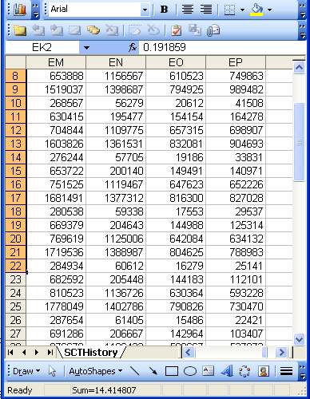
The focus on (big) data …

Slide 5
Current mainstream thinking
wisdom
(- representation)
knowledge
- representation
information
- representation
data
- representation

Slide 6
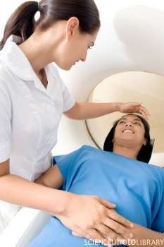
… makes one forget what data – ideally – are about
Referents
References

Slide 7
Current mainstream thinking
wisdom
(- representation)
References
knowledge
- representation
information
- representation
data
- representation
Questions not often enough asked:
What part of our data corresponds with something out there in reality ?
What part of reality is not captured by our data, but should because it is relevant ?
Reality
What is there on the side of the patient
Referents

Slide 8
A non-trivial relation
Referents
References

Slide 9

For instance: source and impact of changes
What are differences in data about the same entities in reality at different points in time due to?

Slide 10
For instance: source and impact of changes
What are differences in data about the same entities in reality at different points in time due to?
  changes in first-order reality ?
  changes in our understanding of reality ?
  inaccurate observations ?
  differences in perspectives ?
  registration mistakes ?
Ceusters W, Smith B. A Realism-Based Approach to the Evolution of Biomedical Ontologies. AMIA 2006 Proceedings, Washington DC, 2006;:121-125. http://www.referent-tracking.com/RTU/sendfile/?file=CeustersAMIA2006FINAL.pdf

Slide 11
What makes it non-trivial?
Referents
  are (meta-) physically the way they are,
  relate to each other in an objective way,
  follow ‘laws of nature’.
Window on reality
  restricted by:
  what is physically and technically observable,
  fit between what is measured and what we think is measured,
  fit between established knowledge and ‘laws of nature’.
References
  follow, ideally, the syntactic-semantic conventions of some representation language,
  are restricted by the expressivity of that language,
  reference collections need to come, for correct interpretation, with documentation outside the representation.
Correspondence with levels of reality?
L1: what is real L2: beliefs L3: representations

Slide 12
Generic versus specific entities
Generic
Specific
L3. Representation
INFORMATION CONTENT ENTITY
‘WC has migraine’
L2. Beliefs (knowledge)
DIAGNOSIS
my doctor’s
diagnosis
L1.
First-order reality
LAPTOP
HUMAN BEING
my doctor’s computer
my doctor
DISEASE
me
my migraine
MIGRAINE
HEADACHE
my headache
Ontology
Referent Tracking

Slide 13
Generic versus specific entities
Generic
Specific
L3. Representation
INFORMATION CONTENT ENTITY
‘WC has migraine’
L2. Beliefs (knowledge)
DIAGNOSIS
my doctor’s
diagnosis
L1.
First-order reality
LAPTOP
HUMAN BEING
my doctor’s computer
my doctor
DISEASE
me
my migraine
MIGRAINE
HEADACHE
my headache
Ontology
Referent Tracking
Underrepresented majority in information systems!

Slide 14

Some early insights
The story of Jane Smith an old case, well known in the literature ...
Rector AL, Nowlan WA, Kay S, Goble CA, Howkins TJ.
A framework for modelling the electronic medical record.
Methods Inf Med. 1993 Apr;32(2):109-19.

Slide 15
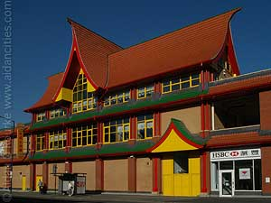
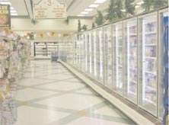

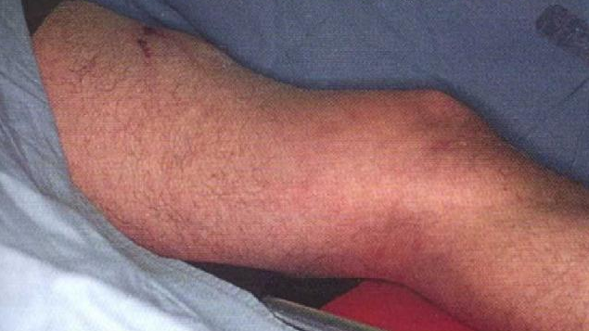
July 4th, 1990: Jane goes shopping:
Jane’s favourite supermarket
The freezer section of Jane’s favourite supermarket
The only available warning sign used outside
A very suspiciously shaped upper leg

Slide 16
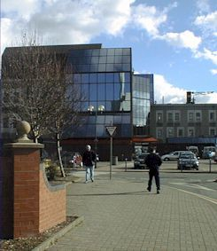
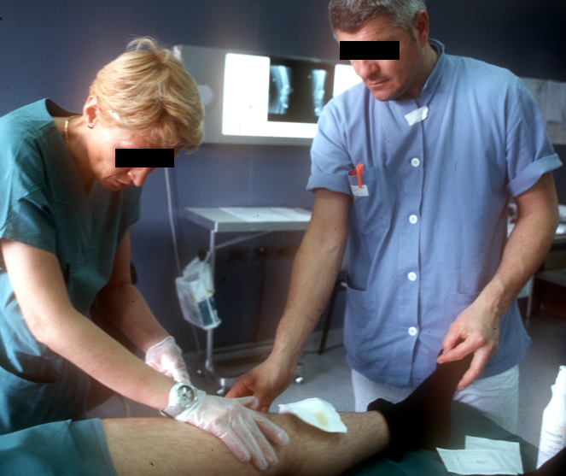
A visit to the hospital
City Health Centre
(City HC) Dr. Peters
Dr. Longley

Slide 17
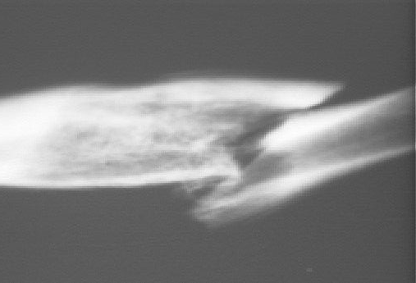
Diagnosis: a severe spiral fracture of the femur

Slide 18
Problem list in an EHR
PtID
Date
ObsCode
Narrative
5572
04/07/1990
26442006
closed fracture of shaft of femur
5572
04/07/1990
81134009
Fracture, closed, spiral
5572
12/07/1990
26442006
closed fracture of shaft of femur
5572
12/07/1990
9001224
Accident in public building (supermarket)
5572
04/07/1990
79001
Essential hypertension
0939
24/12/1991
255174002
benign polyp of biliary tract
2309
21/03/1992
26442006
closed fracture of shaft of femur
2309
21/03/1992
9001224
Accident in public building (supermarket)
47804
03/04/1993
58298795
Other lesion on other specified region
5572
17/05/1993
79001
Essential hypertension
298
22/08/1993
2909872
Closed fracture of radial head
298
22/08/1993
9001224
Accident in public building (supermarket)
5572
01/04/1997
26442006
closed fracture of shaft of femur
5572
01/04/1997
79001
Essential hypertension
0939
20/12/1998
255087006
malignant polyp of biliary tract

Slide 19
Problem list in an EHR
PtID
Date
ObsCode
Narrative
5572
04/07/1990
26442006
closed fracture of shaft of femur
5572
04/07/1990
81134009
Fracture, closed, spiral
5572
12/07/1990
26442006
closed fracture of shaft of femur
5572
12/07/1990
9001224
Accident in public building (supermarket)
5572
04/07/1990
79001
Essential hypertension
0939
24/12/1991
255174002
benign polyp of biliary tract
2309
21/03/1992
26442006
closed fracture of shaft of femur
Same patient, same date,
2 different fracture codes: same (numerically identical) fracture ?
2309
21/03/1992
9001224
Accident in public building (supermarket)
47804
03/04/1993
58298795
Other lesion on other specified region
5572
17/05/1993
79001
Essential hypertension
298
22/08/1993
2909872
Closed fracture of radial head
298
22/08/1993
9001224
Accident in public building (supermarket)
5572
01/04/1997
26442006
closed fracture of shaft of femur
5572
01/04/1997
79001
Essential hypertension
0939
20/12/1998
255087006
malignant polyp of biliary tract

Slide 20
Problem list in an EHR
PtID
Date
ObsCode
Narrative
5572
04/07/1990
26442006
closed fracture of shaft of femur
5572
04/07/1990
81134009
Fracture, closed, spiral
5572
12/07/1990
26442006
closed fracture of shaft of femur
5572
12/07/1990
9001224
Accident in public building (supermarket)
5572
04/07/1990
79001
Essential hypertension
Same patient, different dates, same fracture codes: same (numerically identical) fracture ?
0939
24/12/1991
255174002
benign polyp of biliary tract
2309
21/03/1992
26442006
closed fracture of shaft of femur
2309
21/03/1992
9001224
Accident in public building (supermarket)
47804
03/04/1993
58298795
Other lesion on other specified region
5572
17/05/1993
79001
Essential hypertension
298
22/08/1993
2909872
Closed fracture of radial head
298
22/08/1993
9001224
Accident in public building (supermarket)
5572
01/04/1997
26442006
closed fracture of shaft of femur
5572
01/04/1997
79001
Essential hypertension
0939
20/12/1998
255087006
malignant polyp of biliary tract

Slide 21
Problem list in an EHR
PtID
Date
ObsCode
Narrative
5572
04/07/1990
26442006
closed fracture of shaft of femur
5572
04/07/1990
81134009
Fracture, closed, spiral
5572
12/07/1990
26442006
closed fracture of shaft of femur
5572
12/07/1990
9001224
Accident in public building (supermarket)
5572
04/07/1990
79001
Essential hypertension
0939
24/12/1991
255174002
benign polyp of biliary tract
2309
21/03/1992
26442006
closed fracture of shaft of femur
2309
21/03/1992
9001224
Accident in public building (supermarket)
47804
03/04/1993
Different patients, same fracture codes:
Same (numerically identical) fracture ?
58298795
Other lesion on other specified region
5572
17/05/1993
79001
Essential hypertension
298
22/08/1993
2909872
Closed fracture of radial head
298
22/08/1993
9001224
Accident in public building (supermarket)
5572
01/04/1997
26442006
closed fracture of shaft of femur
5572
01/04/1997
79001
Essential hypertension
0939
20/12/1998
255087006
malignant polyp of biliary tract

Slide 22
Problem list in an EHR
PtID
Date
ObsCode
Narrative
5572
04/07/1990
26442006
closed fracture of shaft of femur
5572
04/07/1990
81134009
Fracture, closed, spiral
5572
12/07/1990
26442006
closed fracture of shaft of femur
5572
12/07/1990
9001224
Accident in public building (supermarket)
5572
04/07/1990
79001
Essential hypertension
0939
24/12/1991
255174002
benign polyp of biliary tract
2309
21/03/1992
26442006
closed fracture of shaft of femur
2309
21/03/1992
9001224
Accident in public building (supermarket)
47804
Same patient, different dates,
Different codes. Same (numerically
identical) polyp ?
03/04/1993
58298795
Other lesion on other specified region
5572
17/05/1993
79001
Essential hypertension
298
22/08/1993
2909872
Closed fracture of radial head
298
22/08/1993
9001224
Accident in public building (supermarket)
5572
01/04/1997
26442006
closed fracture of shaft of femur
5572
01/04/1997
79001
Essential hypertension
0939
20/12/1998
255087006
malignant polyp of biliary tract

Slide 23
Problem list in an EHR
PtID
Date
ObsCode
Narrative
Same patient, same hypertension code:
Same (numerically identical) hypertension ?
5572
04/07/1990
26442006
closed fracture of shaft of femur
5572
04/07/1990
81134009
Fracture, closed, spiral
5572
12/07/1990
26442006
closed fracture of shaft of femur
5572
12/07/1990
9001224
Accident in public building (supermarket)
5572
04/07/1990
79001
Essential hypertension
0939
24/12/1991
255174002
benign polyp of biliary tract
2309
21/03/1992
26442006
closed fracture of shaft of femur
2309
21/03/1992
9001224
Accident in public building (supermarket)
47804
03/04/1993
58298795
Other lesion on other specified region
5572
17/05/1993
79001
Essential hypertension
298
22/08/1993
2909872
Closed fracture of radial head
298
22/08/1993
9001224
Accident in public building (supermarket)
5572
01/04/1997
26442006
closed fracture of shaft of femur
5572
01/04/1997
79001
Essential hypertension
0939
20/12/1998
255087006
malignant polyp of biliary tract

Slide 24
Problem list in an EHR
Different patients. Same supermarket? Maybe the same (irrelevant ?) freezer section ?
Or different supermarkets, but always in the freezer sections ?
PtID
Date
ObsCode
Narrative
5572
04/07/1990
26442006
closed fracture of shaft of femur
5572
04/07/1990
81134009
Fracture, closed, spiral
5572
12/07/1990
26442006
closed fracture of shaft of femur
5572
12/07/1990
9001224
Accident in public building (supermarket)
5572
04/07/1990
79001
Essential hypertension
0939
24/12/1991
255174002
benign polyp of biliary tract
2309
21/03/1992
26442006
closed fracture of shaft of femur
2309
21/03/1992
9001224
Accident in public building (supermarket)
47804
03/04/1993
58298795
Other lesion on other specified region
5572
17/05/1993
79001
Essential hypertension
298
22/08/1993
2909872
Closed fracture of radial head
298
22/08/1993
9001224
Accident in public building (supermarket)
5572
01/04/1997
26442006
closed fracture of shaft of femur
5572
01/04/1997
79001
Essential hypertension
0939
20/12/1998
255087006
malignant polyp of biliary tract

Slide 25
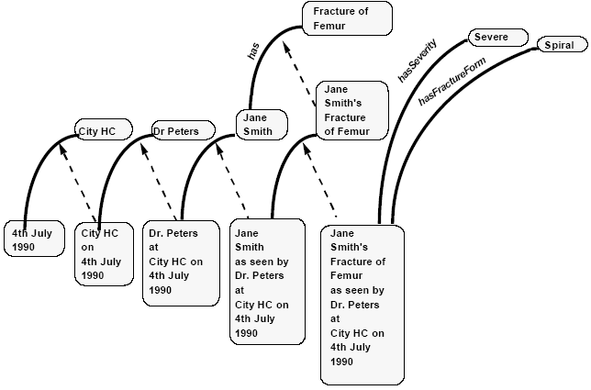
CityHC’s representation formalism
(for statements in records)
Categories: “represent concepts and are analogous to classes in other formalisms”
Individuals: “concrete instances of categories which persist in space and time”
Occurrences: “are specific occurrences of individuals and must be situated in space and time. The most important
group of occurrences are observations — i.e. agents’ observations of individuals.”
Rector AL, Nowlan WA, Kay S, Goble CA, Howkins TJ.
A framework for modelling the electronic medical record.
Methods Inf Med. 1993 Apr;32(2):109-19.

Slide 26
Main problem areas for CityHC’s EHR:
Statements refer only very implicitly to the concrete entities about which they give information.
Idiosyncracies of concept-based terminologies
  tell us only that some instance of the class the codes refer to, is refered to in the statement, but not what instance precisely.
  Are usually confused about classes and individuals.
    “Country” and “Belgium”.
Mixing up the act of observation and the thing observed.
Mixing up statements and the entities these statements refer to.

Slide 27
Consequences
Very difficult to:
  Count the number of (numerically) different diseases
    Bad statistics on incidence, prevalence, ...
    Bad basis for health cost containment
  Relate (numerically same or different) causal factors to disorders:
      Dangerous public places (specific work floors, swimming pools),
      dogs with rabies,
      HIV contaminated blood from donors,
      food from unhygienic source, ...
    Hampers prevention
  ...

Slide 28


Ultimate goal of Referent Tracking
A digital copy of the world

Slide 29
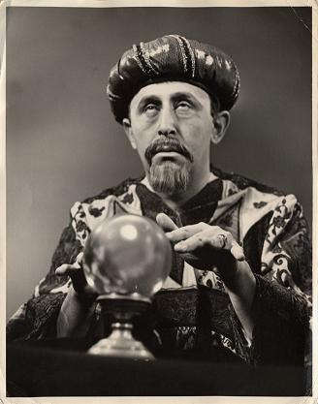

In fact … the ultimate crystal ball

Slide 30


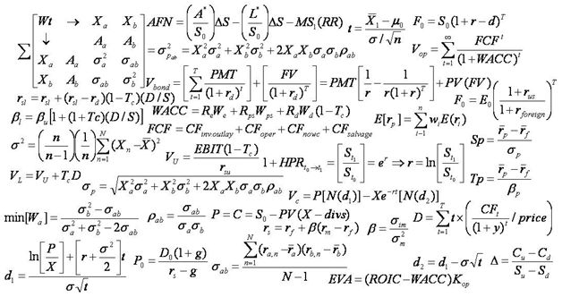
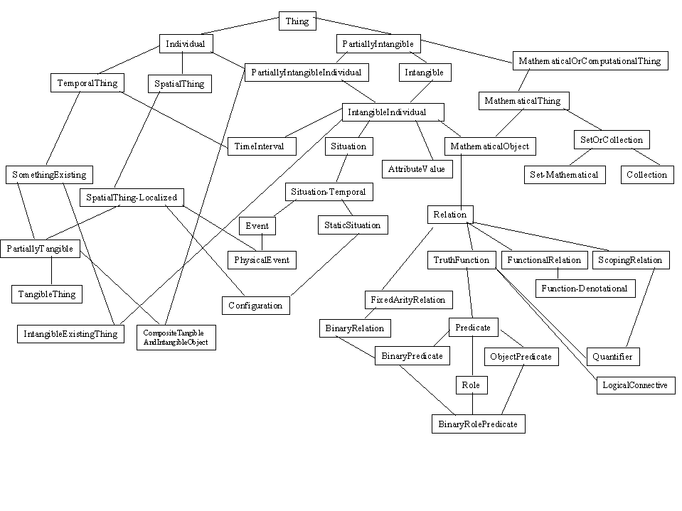
Two major representational components
formulae representing ‘laws of nature’
symbols denoting what these ‘laws’ govern

Slide 31
Representations mimicking reality
→ The Time Lords’ Matrix on the planet Gallifrey (Dr. Who, 1976)

Slide 32


Major problem: the ‘binding’ wall
How to do it right ?
gives you a cartoon of the world

Slide 33
Requirements for this digital copy
R1: A faithful representation of reality
R2 … of everything that is digitally registered,
        what is generic → scientific theories
        what is specific → what individual entities exist and how they relate ontologically rather than statistically
R3: … throughout reality’s entire history,
R4 … which is computable in order to …
        … allow queries over the world’s past and present,
        … make predictions,
        … fill in gaps,
        … identify mistakes,
        … understand ‘the why’ about realities
        ...

Slide 34
What is out there …
(… we want/need to deal with)?
portions of reality
relations
configurations
?
participation
me participating in my life
universals
entities
?
particulars
continuants
occurrents
me
my life
organism

Slide 35
A faithful representation of reality through BFO
dependent continuant
material
object
spacetime
region
spatial
region
temporal
region
history
t
t
instanceOf
t
participantOf at t
occupies
some temporal region
some quality
my life
my 4D STR
projectsOn
me
… at t
projectsOn at t
some spatial
region
located-in at t
BFO = Basic Formal Ontology

Slide 36
BFO is adequate for R1 … R3
Generic entities
Particulars
Time indexing

Slide 37
We can do better, can’t we?
Categories: “represent concepts and are analogous to classes in other formalisms”
Individuals: “concrete instances of categories which persist in space and time”
Occurrences: “are specific occurrences of individuals and must be situated in space and time. The most important
group of occurrences are observations — i.e. agents’ observations of individuals.”
Rector AL, Nowlan WA, Kay S, Goble CA, Howkins TJ.
A framework for modelling the electronic medical record.
Methods Inf Med. 1993 Apr;32(2):109-19.

Slide 38
An appropriate ontological analysis
Universals
continuants
EHR system
City HC’s EHR system
HC
City HC
Freezer section
The freezer section of Jane’s favourite supermarket
Jane Smith
Person
Dr. Peters
Dr. Longley
Femur
Jane’s left femur
Jane’s left femur
Fracture
Jane’s left femur fracture
Image
Jane’s fracture’s image
t
occurrents
Jane’s falling
Jane’s fracture as seen by Dr. Peters
Jane’s fracture as seen by Dr. Longley
Instances of
Jane’s fracture
Jane’s femur breaking
Dr. Peter’s examination of Jane’s fracture
Dr. Peter’s ordering of an X-ray
Shooting the pictures of Jane’s leg
Jane’s fracture’s healing
Dr. Peter’s diagnosis making
Dr. Longley’s examination of Jane’ s fracture
Freezer section dismantled
Jane dies

Slide 39
Ontological recategorisation
Fracture
Of Femur
Severe
Spiral
Jane
Smith’s
Fracture
Of Femur
Jane
Smith’s
Fracture
Of Femur’s
severity
Jane
Smith’s
Fracture
Of Femur’s
shape
Jane
Smith
CityHC
Dr. Peters
City HC
exists on
4th July
1990
Dr. Peters
located at
City HC on
4th July
1990
Jane Smith’s
consultation
with
Dr. Peters at
City HC on
4th July
1990
Dr. Peters’
assessment of
Jane Smith’s
fracture of
femur
at
City HC on
4th July
1990

Slide 40
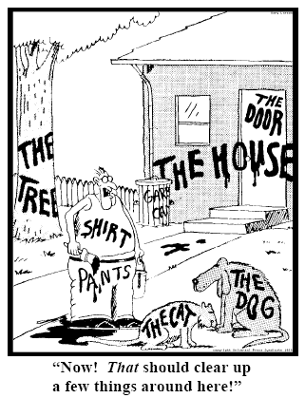
Representing specific entities
explicit reference to the individual entities relevant to the accurate description of some portion of reality, ...
Ceusters W, Smith B. Strategies for Referent Tracking in Electronic Health Records. J Biomed Inform. 2006 Jun;39(3):362-78.

Slide 41
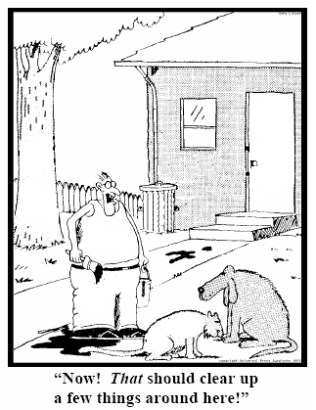
Method: IUI assignment
  Introduce an Instance Unique Identifier (IUI) for each relevant particular (individual) entity
78
235
5678
321
322
666
427
Ceusters W, Smith B. Strategies for Referent Tracking in Electronic Health Records. J Biomed Inform. 2006 Jun;39(3):362-78.

Slide 42
Referent Tracking System Components
Referent Tracking Software
    Manipulation of statements about facts and beliefs
Referent Tracking Datastore:
    IUI repository
    A collection of globally unique singular identifiers denoting particulars
    Referent Tracking Database
    A collection of facts and beliefs about the particulars denoted in the IUI repository
Manzoor S, Ceusters W, Rudnicki R. Implementation of a Referent Tracking System. International Journal of Healthcare Information Systems and Informatics 2007;2(4):41-58.

Slide 43
Key mechanism: IUI assignment
= an act carried out by the first ‘cognitive agent’ feeling the need to acknowledge the existence of a particular it has information about by labelling it with a universally unique singular identifier.
‘cognitive agent’:
  A person;
  An organisation;
  A device or software agent, e.g.
    Bank note printer,
    Image analysis software.

Slide 44
Criteria for IUI assignment (1)
The particular’s existence must be determined:
  Easy for persons in front of you, tools, ...
  Easy for ‘planned acts’: they do not exist before the plan is executed !
    Only the plan exists and possibly the statements made about the future execution of the plan
  More difficult: a subject’s intensions, emotions
    But the statements observers make about them do exist !
  However:
    no need to know what the particular exactly is, i.e. which universal it instantiates
    No need to be able to point to it precisely
      A member of a specific organization
      But: this is not a matter of choice, not ‘any’ out of ...

Slide 45
Criteria for IUI assignment (2)
The particular’s existence may not already have been determined ‘as the existence of something else’:
    Morning star and evening star / Himalaya
    ➔ 2 observers not knowing they observed the same thing
May not have already been assigned a IUI.
It must be relevant to do so:
    Personal decision, (scientific) community guideline, ...
    Possibilities offered by the annotation system
    If a IUI has been assigned by somebody, everybody else making statements about the particular should use it

Slide 46
Assertion of assignments
IUI assignment is an act of which the execution has to be asserted in the IUI-repository:
  <d_{a}, A_{i}, t_{d}>
    d_{a} IUI of the registering agent
    A_{i} the assertion of the assignment <p_{a}, p_{p}, t_{ap}>
        p_{a} IUI of the author of the assertion
        p_{p} IUI of the particular
        t_{ap} time of the assignment
    t_{d} time of registering A_{i} in the IUI-repository
Neither t_{d} or t_{ap} give any information about when #p_{p} started to exist ! That might be asserted in statements providing information about #p_{p} .

Slide 47
Referent Tracking assertions
Use these identifiers in expressions using a language that acknowledges the structure of reality:
e.g.: a yellow ball:
then not : yellow(#1) and ball(#1)
rather: #1: the ball #2: #1’s yellow
Then still not:
  ball(#1) and yellow(#2) and hascolor(#1, #2)
  but rather:
  instance-of(#1, ball, since t1)
  instance-of(#2, yellow, since t2)
  inheres-in(#1, #2, since t2)

Slide 48
The shift envisioned
From:
  ‘this man is a 40 year old patient with a stomach tumor’
To (something like):
  ‘this-1 on which depend this-2 and this-3 has this-4’, where
    this-1 instanceOf human being …
    this-2 instanceOf age-of-40-years …
    this-2 qualityOf this-1 …
    this-3 instanceOf patient-role …
    this-3 roleOf this-1 …
    this-4 instanceOf tumor …
    this-4 partOf this-5 …
    this-5 instanceOf stomach …
    this-5 partOf this-1 …
    …

Slide 49
The shift envisioned
From:
  ‘this man is a 40 year old patient with a stomach tumor’
To (something like):
  ‘this-1 on which depend this-2 and this-3 has this-4’, where
    this-1 instanceOf human being …
    this-2 instanceOf age-of-40-years …
    this-2 qualityOf this-1 …
    this-3 instanceOf patient-role …
    this-3 roleOf this-1 …
    this-4 instanceOf tumor …
    this-4 partOf this-5 …
    this-5 instanceOf stomach …
    this-5 partOf this-1 …
    …
denotators for particulars

Slide 50
The shift envisioned
From:
  ‘this man is a 40 year old patient with a stomach tumor’
To (something like):
  ‘this-1 on which depend this-2 and this-3 has this-4’, where
    this-1 instanceOf human being …
    this-2 instanceOf age-of-40-years …
    this-2 qualityOf this-1 …
    this-3 instanceOf patient-role …
    this-3 roleOf this-1 …
    this-4 instanceOf tumor …
    this-4 partOf this-5 …
    this-5 instanceOf stomach …
    this-5 partOf this-1 …
    …
denotators for appropriate relations

Slide 51
The shift envisioned
From:
  ‘this man is a 40 year old patient with a stomach tumor’
To (something like):
  ‘this-1 on which depend this-2 and this-3 has this-4’, where
    this-1 instanceOf human being …
    this-2 instanceOf age-of-40-years …
    this-2 qualityOf this-1 …
    this-3 instanceOf patient-role …
    this-3 roleOf this-1 …
    this-4 instanceOf tumor …
    this-4 partOf this-5 …
    this-5 instanceOf stomach …
    this-5 partOf this-1 …
    …
denotators for universals or particulars

Slide 52
The shift envisioned
From:
  ‘this man is a 40 year old patient with a stomach tumor’
To (something like):
  ‘this-1 on which depend this-2 and this-3 has this-4’, where
    this-1 instanceOf human being …
    this-2 instanceOf age-of-40-years …
    this-2 qualityOf this-1 …
    this-3 instanceOf patient-role …
    this-3 roleOf this-1 …
    this-4 instanceOf tumor …
    this-4 partOf this-5 …
    this-5 instanceOf stomach …
    this-5 partOf this-1 …
    …
time stamp in
case of referenced continuants

Slide 53
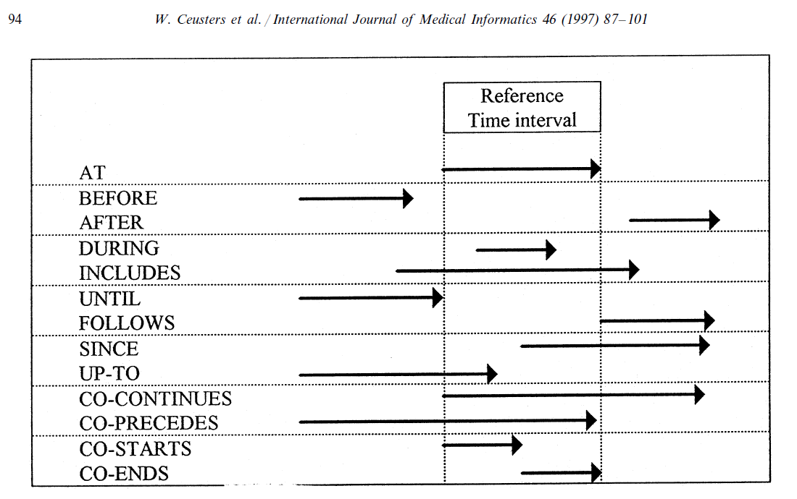
Representation of relation with time intervals

Slide 54
Representation in the EHR
Relevant particulars referred to using IUIs
Relationships that obtain between particulars at time t expressed using relations from OBO-Foundry ontology
Statements describing for each particular, at time t:
  Of what universal from an ontology it is an instance of
  AND/OR (if one insists):
  By means of what concept from a concept-based system it can sensibly be described
Fracture
Of Femur
particulars
Severe
Spiral
Jane
Smith’s
Fracture
Of Femur
Jane
Smith’s
Fracture
Of Femur’s
severity
Jane
Smith’s
Fracture
Of Femur’s
shape
CityHC
Dr. Peters
Jane
Smith
Jane Smith’s
consultation
with
Dr. Peters at
City HC on
4th July
1990
Dr. Peters’
assessment of
Jane Smith’s
fracture of
femur
at
City HC on
4th July
1990
4th July 1990

Slide 55
Elementary Referent Tracking tuple types
Relationships between particulars taken from a realism-based relation ontology
Instantiation of a universal
Annotation using terms from a non-realist terminology
‘Negative findings’ such as absences, missing parts, preventions, …
Names for a particular

Slide 56
Dealing with mistakes
RTS entries are assigned IUIs of their own which in the restructured D-template is symbolized by IUI_{ti}.
D_{i} = <IUI_{d}, IUI_{ti}, t, E, C, S>.
  IUI_{d}: the IUI of the entity annotating IUI_{ti} by means of the D_{i} entry,
  E: either the symbol ‘I’ (for insertion) or any of the error type symbols,
  C: a symbol for the applicable reason for change
  t: the time the tuple denoted by IUI_{ti} is inserted or ‘retired’,
  S: a list of IUIs denoting the tuples, if any, that replace the retired one.

Slide 57
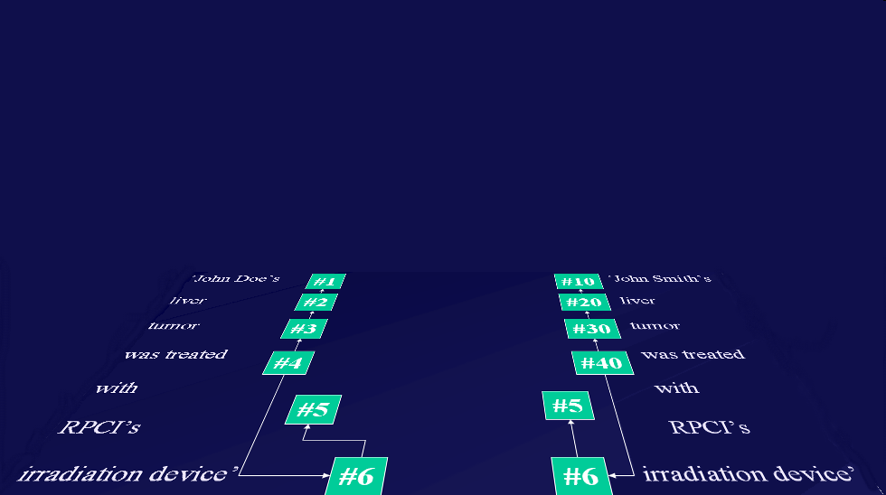
Ontology and Referent Tracking: division of labor
instance-of at t
caused
by
#105

Slide 58
Referent Tracking:
An application in adverse event representation

Slide 59
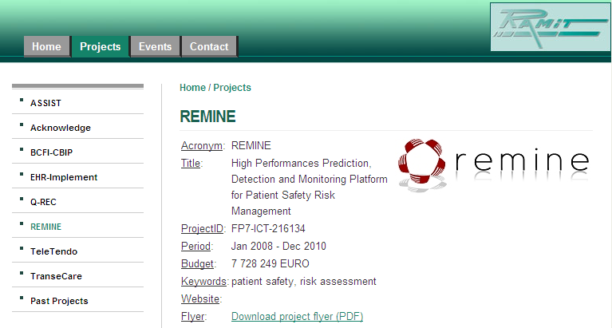
Ontology for Risks Against Patient Safety
Ceusters W, Capolupo M, De Moor G, Devlies J, Smith B.
An Evolutionary Approach to Realism-Based Adverse Event Representations.
Methods of Information in Medicine, 2011;50(1):62-73.

Slide 60
Representing particular adverse event cases
Is the generic representation of the portion of reality adequate enough for the description of particular cases?
Example: a patient
  born at time t₀
  undergoing anti-inflammatory treatment and physiotherapy since t₂
  for an arthrosis present since t₁
  develops a stomach ulcer at t₃.
60
Notes:
60

Slide 61
Anti-inflammatory treatment with ulcer development
IUI | Description of particular | Properties
#1 | the patient who is treated | #1 member_of C1 since t₂
#2 | #1’s treatment | #2 instance_of C3 #2 has_participant #1 since t₂ #2 has_agent #3 since t₂
#3 | the physician responsible for #2 | #3 member_of C4 since t₂
#4 | #1’s arthrosis | #4 member_of C5 since t₁
#5 | #1’s anti-inflammatory treatment | #5 part_of #2 #5 member_of C2 since t₃
#6 | #1’s physiotherapy | #6 part_of #2
#7 | #1’s stomach | #7 member_of C6 since t₂
#8 | #7’s structure integrity | #8 instance_of C8 since t₀ #8 inheres_in #7 since t₀
#9 | #1’s stomach ulcer | #9 part_of #7 since t₃
#10 | coming into existence of #9 | #10 has_participant #9 at t₃
#11 | change brought about by #9 | #11 has_agent #9 since t₃ #11 has_participant #8 since t₃ #11 instance_of C10 (harm) at t₃
#12 | noticing the presence of #9 | #12 has_participant #9 at t_{3+x} #12 has_agent #3 at t_{3+x}
#13 | cognitive representation in #3 about #9 | #13 is_about #9 since t_{3+x}
61
Notes:
61

Slide 62
Time line and dependencies (1)
t₀
t₁
t₂
t₃
#1
the patient (#1) who is treated
#7
#1’s stomach
#8
#7’s structure integrity
C8
structure integrity
At t₀, the patient is born, and since that time, his stomach is part of him and a structure integrity (C8) inheres in it:
  #1 instance-of person since t₀
  #7 part-of #1 since t₀
  #8 instance_of C8 since t₀
  #8 inheres_in #7 since t₀
62
Notes:
62

Slide 63
Time line and dependencies (2)
t₀
t₁
t₂
t₃
#1
the patient who is treated
#7
#1’s stomach
#8
#7’s structure integrity
C8
structure integrity
#4
#1’s arthrosis
C5
underlying disease
At t₁, the patient acquires arthrosis:
  #4 member_of C5 since t₁
  #4 inheres_in #1 since t₁
63
Notes:
63

Slide 64
Time line and dependencies (3)
t₀
t₁
t₂
t₃
#1
the patient who is treated
C1
subject of care
#7
#1’s stomach
C6
involved structure
#8
#7’s structure integrity
C8
structure integrity
#4
#1’s arthrosis
C5
underlying disease
#2
#1’s treatment
C3
act of care
#6
#1’s physiotherapy
#5
#1’s anti-inflammatory treatment
At t₂, the patient consults #3 who starts treatment. It is then that the patient becomes a member of the class subject of care (C1) and his stomach a member of the class involved structure (C6)
#3
the physician responsible for #2
C4
care giver
64
Notes:
64

Slide 65
Time line and dependencies …
t₀
t₁
t₂
t₃
#1
the patient who is treated
C1
subject of care
#7
#1’s stomach
C6
involved structure
#8
#7’s structure integrity
C8
structure integrity
#4
#1’s arthrosis
C5
underlying disease
#2
#1’s treatment
C3
act of care
#6
#1’s physiotherapy
#5
#1’s anti-inflammatory treatment
C2
act under scrutiny
#9
#1’s stomach ulcer
#11
change brought about by #9
C10
harm
#12
noticing #9
#13
cognitive representation in #3 about #9
#3
the physician responsible for #2
C4
care giver
65
Notes:
65

Slide 66
Referent Tracking:
An application in dataset disambiguation

Slide 67
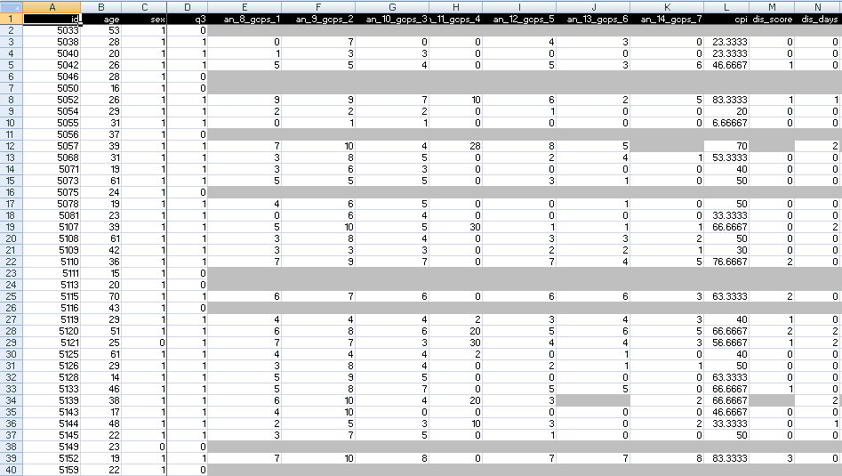
A colleague shares his research data set

Slide 68
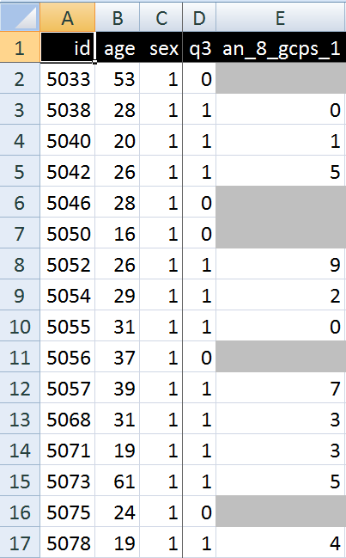
A closer look
What are you going to ask him right away?
What do these various values stand for and how do they relate to each other?
  Might this mean that patient #5057 had only once sex at the age of 39?

Slide 69
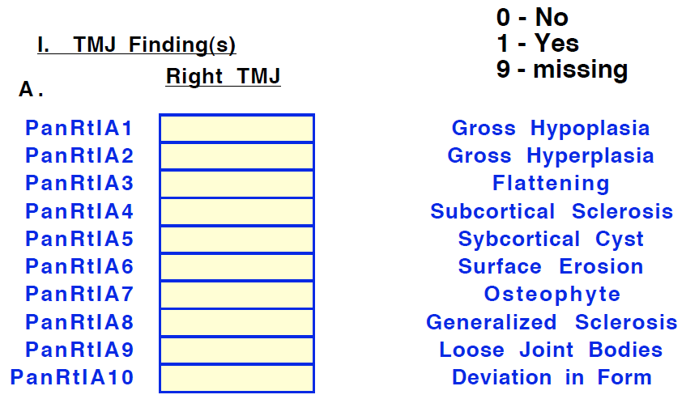
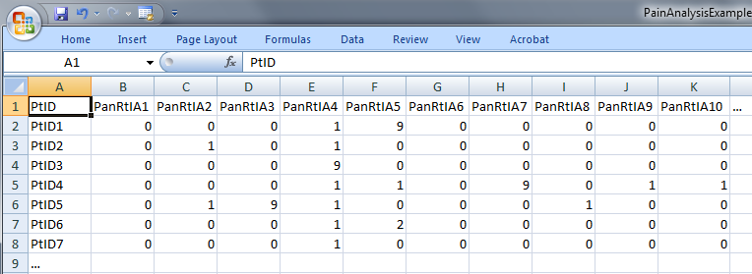
Step 1: ‘meaning’ of values in data collections
‘The patient with patient identifier ‘PtID4’ is stated to have had a panoramic X-ray of the mouth which is interpreted to show subcortical sclerosis of that patient’s condylar head of the right temporomandibular joint’
meaning
1

Slide 70
Step 2 (1): list the entities denoted
1(The patient) with 2(patient identifier ‘PtID4’) 3(is stated) 4(to have had) a 5(panoramic X-ray) of 6(the mouth) which 7(is interpreted) to 8(show) 9(subcortical sclerosis of 10(that patient’s condylar head of the 11(right temporomandibular joint)))’
CLASS | INSTANCE IDENTIFIER
person | IUI-1
patient identifier | IUI-2
assertion | IUI-3
technically investigating | IUI-4
panoramic X-ray | IUI-5
mouth | IUI-6
interpreting | IUI-7
seeing | IUI-8
diagnosis | IUI-9
condylar head of right TMJ | IUI-10
right TMJ | IUI-11
notes: colors have no meaning here, just provide easy reference,
this first list can be different, any such differences being resolved in step 3

Slide 71
Step 2 (2): provide directly referential descriptions
CLASS | INSTANCE IDENTIFIER | DIRECTLY REFERENTIAL DESCRIPTIONS
person | IUI-1 | the person to whom IUI-2 is assigned
patient identifier | IUI-2 | the patient identifier of IUI-1
assertion | IUI-3 | 'the patient with patient identifier PtID4 has had a panoramic X-ray of the mouth which is interpreted to show subcortical sclerosis of that patient’s right temporomandibular joint'
technically investigating | IUI-4 | the technically investigating of IUI-6
panoramic X-ray | IUI-5 | the panoramic X-ray that resulted from IUI-4
mouth | IUI-6 | the mouth of IUI-1
interpreting | IUI-7 | the interpreting of the signs exhibited by IUI-5
seeing | IUI-8 | the seeing of IUI-5 which led to IUI-7
diagnosis | IUI-9 | the diagnosis expressed by means of IUI-3
condylar head of right TMJ | IUI-10 | the condylar head of the right TMJ of IUI-1
right TMJ | IUI-11 | the right TMJ of IUI-1

Slide 72
Step 3: identify further entities that ontologically must exist for each entity under scrutiny to exist.
assigner role | IUI-12 | the assigner role played by the entity while it performed IUI-21
assigning | IUI-21 | the assigning of IUI-2 to IUI-1 by the entity with role IUI-12
asserting | IUI-20 | the asserting of IUI-3 by the entity with asserter role IUI-13
asserter role | IUI-13 | the asserter role played by the entity while it performed IUI-20
investigator role | IUI-14 | the investigator role played by the entity while it performed IUI-4
panoramic X-ray machine | IUI-15 | the panoramic X-ray machine used for performing IUI-4
image bearer | IUI-16 | the image bearer in which IUI-5 is concretized and that participated in IUI-8
interpreter role | IUI-17 | the interpreter role played by the entity while it performed IUI-7
perceptor role | IUI-18 | the perceptor role played by the entity while it performed IUI-8
diagnostic criteria | IUI-19 | the diagnostic criteria used by the entity that performed IUI-7 to come to IUI-9
study subject role | IUI-22 | the study subject role which inheres in IUI-1

Slide 73
Step 3: some remarks
interpreter role, perceptor role, …
  reference to roles rather than the entity in which the roles inhere because it may be the same entity and one should not assign several IUIs to the same entity
each description follows similar principles as Aristotelian definitions but is about particulars rather than universals

Slide 74
Step 4: classify all entities in terms of realism-based ontologies
CLASS | HIGHER CLASS
person | BFO: Object
patient identifier | IAO: Information Content Entity
assertion | IAO: Information Content Entity
technically investigating | OBI: Assay
panoramic X-ray | IAO: Image
mouth | FMA: Mouth
interpreting | MFO: Assessing
seeing | BFO: Process
diagnosis | IAO: Information Content Entity
condylar head of right TMJ | FMA: Right condylar process of mandible
right TMJ | FMA: Right temporomandibular joint
assigner role | BFO: Role
assigning | BFO: Process
study subject role | OBI: Study subject role
requires more ontological and philosophical skills than domain expertise or expertise with Protégé,
not just term matching

Slide 75
Step 5: specify relationships between these entities
For instance:
  at least during the taking of the X-ray the study subject role inheres in the patient being investigated:
    IUI-23 inheres-in IUI-1 during t1
  the patient participates at that time in the investigation
    IUI-4 has-participant IUI-1 during t1
These relations need to follow the principles of the Relation Ontology.
Smith B, Ceusters W, Klagges B, Koehler J, Kumar A, Lomax J, Mungall C, Neuhaus F, Rector A, Rosse C. Relations in biomedical ontologies, Genome Biology 2005, 6:R46.

Slide 76
Step 6: outline all possible configurations of such entities for the sentence to be true (a one semester course on its own)
Such outlines are collections of relational expressions of the sort just described,
Variant configurations for the example:
  perceptor and interpreter are the same or distinct human beings,
  the X-ray machine is unreliable and produced artifacts which the interpreter thought to be signs motivating his diagnosis, while the patient has indeed the disorder specified by the diagnosis (the clinician was lucky)
  …

Slide 77
Methodology (2): for each dataset
Build a formal template which describes:
  the results of steps 4-6 of the 1st order analysis,
  the relationships between:
    the 1st order entities and the corresponding data items in the data set,
    data items themselves.
Build a prototype able to generate on the basis of the template for each subject (patient) in the dataset an RT-compatible representation of his 1st and 2nd order entities.

Slide 78
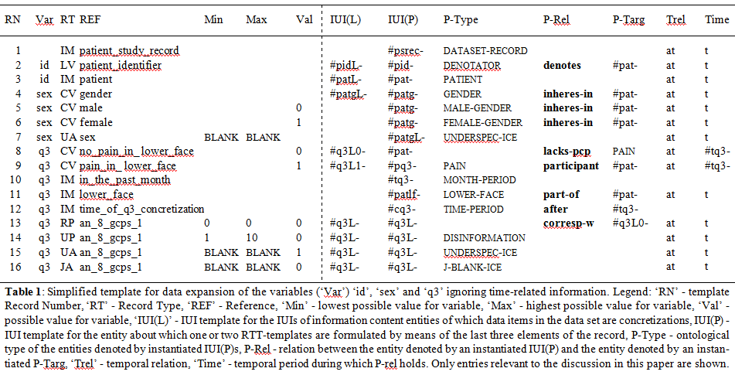
The template

Slide 79
Partial Template for 3 variables (in the ‘German’ dataset)
RN | Var | RT | REF | Min | Max | Val
1 |  | IM | patient_study_record
2 | id | LV | patient_identifier
3 | id | IM | patient
4 | sex | CV | gender
5 | sex | CV | male |  |  | 0
6 | sex | CV | female |  |  | 1
7 | sex | UA | sex | BLANK | BLANK
8 | q3 | CV | no_pain_in_ lower_face |  |  | 0
9 | q3 | CV | pain_in_ lower_face |  |  | 1
10 | q3 | IM | in_the_past_month
11 | q3 | IM | lower_face
12 | q3 | IM | time_of_q3_concretization
13 | q3 | RP | an_8_gcps_1 | 0 | 0 | 0
14 | q3 | UP | an_8_gcps_1 | 1 | 10 | 0
15 | q3 | UA | an_8_gcps_1 | BLANK | BLANK | 1
16 | q3 | JA | an_8_gcps_1 | BLANK | BLANK | 0

Slide 80
3 variables in the ‘German’ dataset
RN | Var | RT | REF | Min | Max | Val
1 |  | IM | patient_study_record
2 | id | LV | patient_identifier
3 | id | IM | patient
4 | sex | CV | gender
5 | sex | CV | male |  |  | 0
6 | sex | CV | female |  |  | 1
7 | sex | UA | sex | BLANK | BLANK
8 | q3 | CV | no_pain_in_ lower_face |  |  | 0
9 | q3 | CV | pain_in_ lower_face |  |  | 1
10 | q3 | IM | in_the_past_month
11 | q3 | IM | lower_face
12 | q3 | IM | time_of_q3_concretization
13 | q3 | RP | an_8_gcps_1 | 0 | 0 | 0
14 | q3 | UP | an_8_gcps_1 | 1 | 10 | 0
15 | q3 | UA | an_8_gcps_1 | BLANK | BLANK | 1
16 | q3 | JA | an_8_gcps_1 | BLANK | BLANK | 0
Answer to the question: ‘Have you had pain in the face, jaw, temple, in front of the ear or in the ear in the past month?’
Answer to the question: ‘’ How would you rate your facial pain on a 0 to 10 scale at the present time, that is right now, where 0 is "no pain" and 10 is "pain as bad as could be"?

Slide 81
Record Types in the template
RN | Var | RT | REF | Min | Max | Val
1 |  | IM | patient_study_record
2 | id | LV | patient_identifier
3 | id | IM | patient
4 | sex | CV | gender
5 | sex | CV | male |  |  | 0
6 | sex | CV | female |  |  | 1
7 | sex | UA | sex | BLANK | BLANK
8 | q3 | CV | no_pain_in_ lower_face |  |  | 0
9 | q3 | CV | pain_in_ lower_face |  |  | 1
10 | q3 | IM | in_the_past_month
11 | q3 | IM | lower_face
12 | q3 | IM | time_of_q3_concretization
13 | q3 | RP | an_8_gcps_1 | 0 | 0 | 0
14 | q3 | UP | an_8_gcps_1 | 1 | 10 | 0
15 | q3 | UA | an_8_gcps_1 | BLANK | BLANK | 1
16 | q3 | JA | an_8_gcps_1 | BLANK | BLANK | 0
LV: Literal value
CV: Coded Value
IM: Implicit
JA: Justified Absence
UA: Unjustified Absence
UP: Unjustified Presence
RP: Redundant Presence

Slide 82
Condition-based xA/xP determination
RN | Var | RT | REF | Min | Max | Val
7 | sex | UA | sex | BLANK | BLANK
13 | q3 | RP | an_8_gcps_1 | 0 | 0 | 0
14 | q3 | UP | an_8_gcps_1 | 1 | 10 | 0
15 | q3 | UA | an_8_gcps_1 | BLANK | BLANK | 1
16 | q3 | JA | an_8_gcps_1 | BLANK | BLANK | 0
If
the value of REF is either outside the range of Min/Max or ‘BLANK’
and
the value for Var is as indicated by Val, including no value at all,
then
the presence or absence of the corresponding data item is of a sort indicated by RT.

Slide 83
Conditional selection of descriptions

Slide 84
RT compatible part of the template
RN | IUI(L) | IUI(P) | P-Type | P-Rel | P-Targ | Trel | Time
1 |  | #psrec- | dataset-record |  |  | at | t
2 | #pidL- | #pid- | denotator | denotes | #pat- | at | t
3 | #patL- | #pat- | patient |  |  | at | t
4 | #patgL- | #patg- | gender | inheres-in | #pat- | at | t
5 |  | #patg- | male-gender | inheres-in | #pat- | at | t
6 |  | #patg- | female-gender | inheres-in | #pat- | at | t
7 |  | #patgL- | underspec-ice |  |  | at | t
8 | #q3L0- | #pat- |  | lacks-pcp | pain | at | #tq3-
9 | #q3L1- | #pq3- | pain | participant | #pat- | at | #tq3-
10 |  | #tq3- | month-period
11 |  | #patlf- | lower-face | part-of | #pat- | at | t
12 |  | #cq3- | time-period | after | #tq3-
13 | #q3L- | #q3L- |  | corresp-w | #q3L0- | at | t
14 | #q3L- | #q3L- | disinformation |  |  | at | t
15 | #q3L- | #q3L- | underspec-ice |  |  | at | t
16 | #q3L- | #q3L- | j-blank-ice |  |  | at | t

Slide 85
RT compatible part of the template
RN | IUI(L) | IUI(P) | P-Type | P-Rel | P-Targ | Trel | Time
1 |  | #psrec- | dataset-record |  |  | at | t
2 | #pidL- | #pid- | denotator | denotes | #pat- | at | t
3 | #patL- | #pat- | patient |  |  | at | t
4 | #patgL- | #patg- | gender | inheres-in | #pat- | at | t
5 |  | #patg- | male-gender | inheres-in | #pat- | at | t
6 |  | #patg- | female-gender | inheres-in | #pat- | at | t
7 |  | #patgL- | underspec-ice |  |  | at | t
8 | #q3L0- | #pat- |  | lacks-pcp | pain | at | #tq3-
9 | #q3L1- | #pq3- | pain | participant | #pat- | at | #tq3-
10 |  | #tq3- | month-period
11 |  | #patlf- | lower-face | part-of | #pat- | at | t
12 |  | #cq3- | time-period | after | #tq3-
13 | #q3L- | #q3L- |  | corresp-w | #q3L0- | at | t
14 | #q3L- | #q3L- | disinformation |  |  | at | t
15 | #q3L- | #q3L- | underspec-ice |  |  | at | t
16 | #q3L- | #q3L- | j-blank-ice |  |  | at | t
denotes (when instantiated) the gender of the patient
denotes (when instantiated) the data item concretized in the dataset in relation to the gender of the patient

Slide 86
RT compatible part of the template
RN | IUI(L) | IUI(P) | P-Type | P-Rel | P-Targ | Trel | Time
1 |  | #psrec- | dataset-record |  |  | at | t
2 | #pidL- | #pid- | denotator | denotes | #pat- | at | t
3 | #patL- | #pat- | patient |  |  | at | t
4 | #patgL- | #patg- | gender | inheres-in | #pat- | at | t
5 |  | #patg- | male-gender | inheres-in | #pat- | at | t
6 |  | #patg- | female-gender | inheres-in | #pat- | at | t
7 |  | #patgL- | underspec-ice |  |  | at | t
8 | #q3L0- | #pat- |  | lacks-pcp | pain | at | #tq3-
9 | #q3L1- | #pq3- | pain | participant | #pat- | at | #tq3-
10 |  | #tq3- | month-period
11 |  | #patlf- | lower-face | part-of | #pat- | at | t
12 |  | #cq3- | time-period | after | #tq3-
13 | #q3L- | #q3L- |  | corresp-w | #q3L0- | at | t
14 | #q3L- | #q3L- | disinformation |  |  | at | t
15 | #q3L- | #q3L- | underspec-ice |  |  | at | t
16 | #q3L- | #q3L- | j-blank-ice |  |  | at | t

Slide 87
Work in progress: IAO (?) related types
UNDERSPECIFIED-ICE
  ICE which describes a portion of reality at determinable rather than determinate level
DISINFORMATION
  GDC which provides erroneous information
J-BLANK-ICE
  GDC which conveys there should not be an ICE concretized.

