Slide 1
Biomedical Ontology for Biomedical Informaticists.
Lecture in BMI501: Survey of Biomedical Informatics – Sept 26, 2018
Department of Biomedical Informatics, University at Buffalo
Werner CEUSTERS, MD
Ontology Research Group, Center of Excellence in Bioinformatics and Life Sciences,
UB Institute for Healthcare Informatics,
Departments of Biomedical Informatics and Psychiatry,
University at Buffalo, NY, USA

Slide 2
Context of this lecture
Thesis: mainstream ontology design approaches fail in achieving their objectives:
  various sorts of mistakes in ontologies,
  inability to use ontologies adequately in information systems,
  failure to integrate data repositories even if these ontologies are appropriately designed.
Root causes:
  inadequacy of their conceptual semantic foundations,
  lack of knowledge about ontology as a philosophical discipline.
Proposed solution:
  Better use of ontology (the philosophical discipline) to design ontologies (specific sorts of representational artifacts) and integrate them in information systems.

Slide 3
What you should NEVER FORGET !!!
(major take home message)
Crucial distinctions made in Ontological Realism
ontology ←→ ontologies
reality ←→ representation
particulars ←→ types
continuants ←→ occurrents

Slide 4
Keeping this in mind, you will be able to:
do justice to the differences between general truths and individual facts:
    e.g. tumors are disorders versus this person has now a tumor.
do justice to the differences between representations and what they are about:
    ‘tumors are disorders’ versus tumors being disorders,
    ‘this person has now a tumor’ versus this person having now a tumor.
create ontologies that contain only representations of general truths,
create information systems that contain representations of individual facts (perhaps in combination with general truths).
see that representations are not always faithful to reality.
use Ontological Realism as a tool to create faithful representations.

Slide 5
Components of this lecture
Test on lecture pre-readings;
Highlighting the activities in biomedical informatics that require good insight in ontology;
Contributions of philosophy to science and research relevant for biomedical informaticists;
What is ‘ontology’ and what are ‘ontologies’;
Principles of high quality ontology design and examples of violations thereof in heavily used systems;
Ontological Realism as an example of a discipline based on these principles.

Slide 6
Test on pre-lecture readings

Slide 7
Pre-lecture test (1)
What is wrong in this statement:
Early versions of computational ontologies such as the Gene Ontology (GO), the Unified Medical Language System (UMLS) and the National Cancer Institute Thesaurus were criticized by some classical ontologists because of deficiencies in how they related to classical formalisms for representing reality in terms of categories and their instances [40–42].
  From: Maojo V, Crespo J, Garcia-Remesal M, de la Iglesia D, Pérez-Rey D, Kulikowski C. Biomedical Ontologies: Toward scientific debate. Methods Inf Med 2011; 50 (3): 203–216.

Slide 8
Pre-lecture test (2)
The BFO divides occurrents into two types: instantaneous and extended (over time). And, it defines continuants as falling into two categories: independent and dependent. Examples of independents are a cell, a bacterium, an organism (or a person), whereas examples of dependents are functions, qualities, etc [46, 51].
These philosophical specifications for ontological entities are, unfortunately, not necessarily consistent with scientific needs and practice. How can cells or viruses be entirely independent entities, even within a controlled laboratory environment?
      From: Maojo V, Crespo J, Garcia-Remesal M, de la Iglesia D, Pérez-Rey D, Kulikowski C. Biomedical Ontologies: Toward scientific debate. Methods Inf Med 2011; 50 (3): 203–216.
What does the 2nd paragraph tell about the authors of this statement?

Slide 9
Pre-lecture test (3)
What mistake is committed in the following statement?
For example, the distinction between continuants and occurrents does not account for the contrast between reversible and irreversible processes in biology, chemistry, computation, or quantum mechanics.
  From: Maojo V, Crespo J, Garcia-Remesal M, de la Iglesia D, Pérez-Rey D, Kulikowski C. Biomedical Ontologies: Toward scientific debate. Methods Inf Med 2011; 50 (3): 203–216.

Slide 10
Pre-lecture test (4)
True or false, and why?
A challenge for designers of biomedical ontologies is how to include the necessary representational power needed to represent biologically complex systems.
  From: Maojo V, Crespo J, Garcia-Remesal M, de la Iglesia D, Pérez-Rey D, Kulikowski C. Biomedical Ontologies: Toward scientific debate. Methods Inf Med 2011; 50 (3): 203–216.

Slide 11
What is biomedical informatics?

Slide 12
Biomedical Informatics
Definition:
Biomedical informatics (BMI) is
the interdisciplinary field
that studies and pursues the effective uses of biomedical data, information, and knowledge
for scientific inquiry, problem solving, and decision making,
driven by efforts to improve human health.
CA Kulikowski, EH Shortliffe, LM Currie, PL Elkin, LE Hunter, TR Johnson, IJ Kalet, LA Lenert, MA Musen, JG Ozbolt, JW Smith, PZ Tarczy-Hornoch, JWilliamson; AMIA Board white paper: definition of biomedical informatics and specification of core competencies for graduate education in the discipline, Journal of the American Medical Informatics Association, Volume 19, Issue 6, 1 November 2012, Pages 931–938, https://doi.org/10.1136/amiajnl-2012-001053

Slide 13
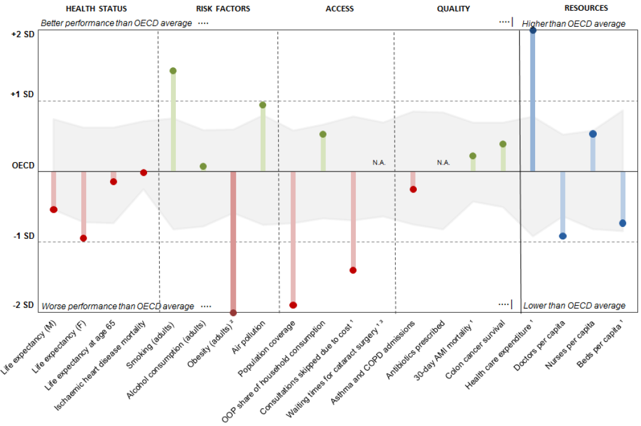
Health status US / OECD
How good is healthcare in the US?
Health at a Glance 2017:
USA/OECD Indicators

Slide 14
Biomedical Informatics
Definition:
Biomedical informatics (BMI) is
the interdisciplinary field
that studies and pursues the effective uses of biomedical data, information, and knowledge
for scientific inquiry, problem solving, and decision making,
driven by efforts to improve human health.
CA Kulikowski, EH Shortliffe, LM Currie, PL Elkin, LE Hunter, TR Johnson, IJ Kalet, LA Lenert, MA Musen, JG Ozbolt, JW Smith, PZ Tarczy-Hornoch, JWilliamson; AMIA Board white paper: definition of biomedical informatics and specification of core competencies for graduate education in the discipline, Journal of the American Medical Informatics Association, Volume 19, Issue 6, 1 November 2012, Pages 931–938, https://doi.org/10.1136/amiajnl-2012-001053

Slide 15
Interdisciplinary Nature of Biomedical Informatics: the mainstream view
Computer Science (hardware)
Computer Science (software)
Cognitive Science
& Decision Making
Bioengineering
Biomedical
Informatics
Management
Sciences
Epidemiology
And Statistics
Basic Biomedical
Sciences
Clinical
Sciences

Slide 16
Biomedical Informatics
Definition:
Biomedical informatics (BMI) is
the interdisciplinary field
that studies and pursues the effective uses of biomedical data, information, and knowledge
for scientific inquiry, problem solving, and decision making,
driven by efforts to improve human health.
CA Kulikowski, EH Shortliffe, LM Currie, PL Elkin, LE Hunter, TR Johnson, IJ Kalet, LA Lenert, MA Musen, JG Ozbolt, JW Smith, PZ Tarczy-Hornoch, JWilliamson; AMIA Board white paper: definition of biomedical informatics and specification of core competencies for graduate education in the discipline, Journal of the American Medical Informatics Association, Volume 19, Issue 6, 1 November 2012, Pages 931–938, https://doi.org/10.1136/amiajnl-2012-001053

Slide 17
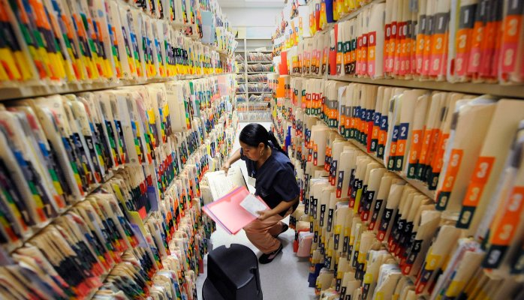
What it tried to solve first

Slide 18
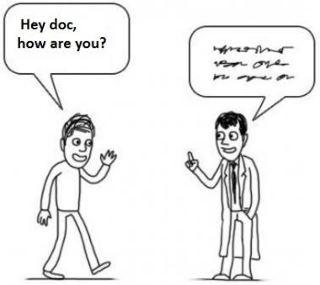

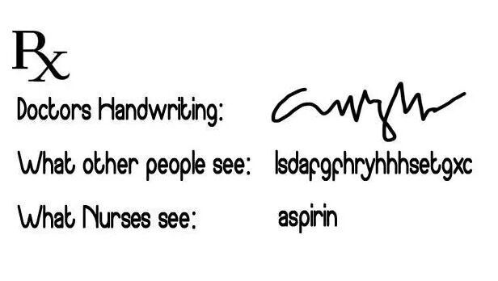
What it solved next
http://topyaps.com/doctors-handwriting

Slide 19
Biomedical Informatics
Definition:
Biomedical informatics (BMI) is
the interdisciplinary field
that studies and pursues the effective uses of biomedical data, information, and knowledge
for scientific inquiry, problem solving, and decision making,
driven by efforts to improve human health.
CA Kulikowski, EH Shortliffe, LM Currie, PL Elkin, LE Hunter, TR Johnson, IJ Kalet, LA Lenert, MA Musen, JG Ozbolt, JW Smith, PZ Tarczy-Hornoch, JWilliamson; AMIA Board white paper: definition of biomedical informatics and specification of core competencies for graduate education in the discipline, Journal of the American Medical Informatics Association, Volume 19, Issue 6, 1 November 2012, Pages 931–938, https://doi.org/10.1136/amiajnl-2012-001053

Slide 20
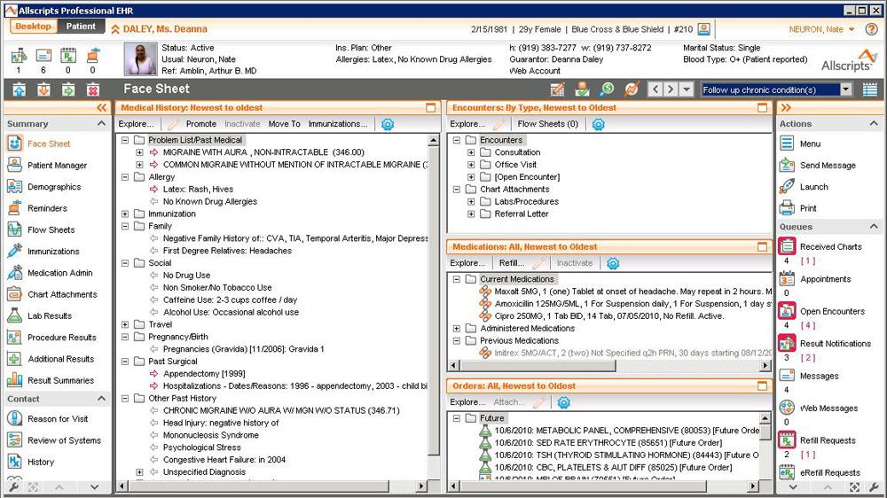

Slide 21
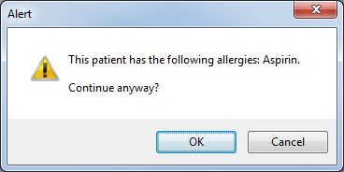

Slide 22
Biomedical Informatics
Definition:
Biomedical informatics (BMI) is
the interdisciplinary field
that studies and pursues the effective uses of biomedical data, information, and knowledge
for scientific inquiry, problem solving, and decision making,
driven by efforts to improve human health.
CA Kulikowski, EH Shortliffe, LM Currie, PL Elkin, LE Hunter, TR Johnson, IJ Kalet, LA Lenert, MA Musen, JG Ozbolt, JW Smith, PZ Tarczy-Hornoch, JWilliamson; AMIA Board white paper: definition of biomedical informatics and specification of core competencies for graduate education in the discipline, Journal of the American Medical Informatics Association, Volume 19, Issue 6, 1 November 2012, Pages 931–938, https://doi.org/10.1136/amiajnl-2012-001053

Slide 23
Definition of ‘science’
keywords
3a : knowledge or a system of knowledge covering general truths or the operation of general laws especially as obtained and tested through the scientific method.
3b : such knowledge or such a system of knowledge concerned with the physical world and its phenomena: natural science.
http://www.merriam-webster.com/dictionary/science

Slide 24
Definition of ‘science’
keywords
3a : knowledge or a system of knowledge covering general truths or the operation of general laws especially as obtained and tested through the scientific method.
3b : such knowledge or such a system of knowledge concerned with the physical world and its phenomena: natural science.
http://www.merriam-webster.com/dictionary/science

Slide 25
Definition of ‘research’
careful or diligent search.
studious inquiry or examination; especially :
investigation or experimentation
aimed at
- the discovery and interpretation of facts,
- revision of accepted theories or laws in the light of new facts,
- or practical application of such new or revised theories or laws.
the collecting of information about a particular subject.
http://www.merriam-webster.com/dictionary/research

Slide 26
Definition of ‘research’
Keywords?
careful or diligent search.
studious inquiry or examination; especially :
investigation or experimentation
aimed at
- the discovery and interpretation of facts,
- revision of accepted theories or laws in the light of new facts,
- or practical application of such new or revised theories or laws.
the collecting of information about a particular subject.
http://www.merriam-webster.com/dictionary/research

Slide 27
Definition of ‘research’
keywords
careful or diligent search.
studious inquiry or examination; especially :
investigation or experimentation
aimed at
- the discovery and interpretation of facts,
- revision of accepted theories or laws in the light of new facts,
- or practical application of such new or revised theories or laws.
the collecting of information about a particular subject.
http://www.merriam-webster.com/dictionary/research

Slide 28
Definition of ‘research’
keywords
careful or diligent search
studious inquiry or examination; especially :
investigation or experimentation
aimed at
- the discovery and interpretation of facts,
- revision of accepted theories or laws in the light of new facts,
- or practical application of such new or revised theories or laws
the collecting of information about a particular subject
http://www.merriam-webster.com/dictionary/research

Slide 29
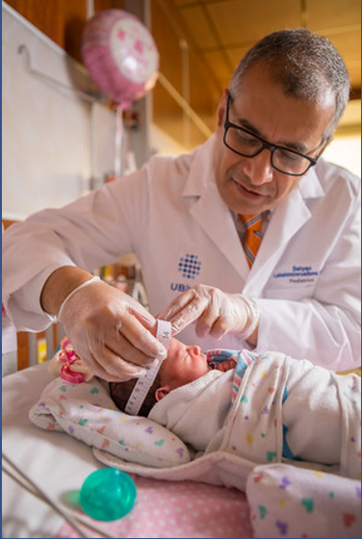
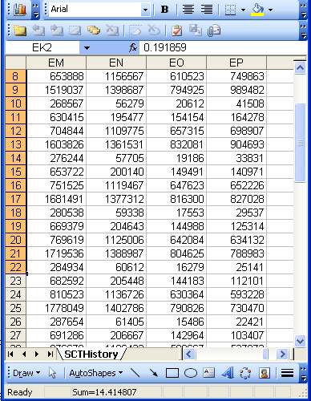
Beings, happenings and descriptions
(research) domain
(research) data
Beings & happenings
Descriptions
https://ubphoto.smugmug.com/Years/2017/17011-Medicine-Satyanarayana-Lakshminrusimha-Newborn-MFS/i-Vj8g6p2

Slide 30
Beings, happenings and descriptions
(research) domain
(research) data
Beings & happenings
Descriptions
https://ubphoto.smugmug.com/Years/2017/17011-Medicine-Satyanarayana-Lakshminrusimha-Newborn-MFS/i-Vj8g6p2

Slide 31
Three relevant disciplines
(research) domain
(research) data
Beings & happenings
Descriptions
https://ubphoto.smugmug.com/Years/2017/17011-Medicine-Satyanarayana-Lakshminrusimha-Newborn-MFS/i-Vj8g6p2

Slide 32
Three relevant disciplines: (1)
Data science:
‘an interdisciplinary field about scientific methods, processes, and systems to extract knowledge or insights from data in various forms, either structured or unstructured, similar to data mining’.
(research) data
https://en.wikipedia.org/wiki/Data_science
Beings & happenings
Descriptions

Slide 33
Three relevant disciplines: (2)
Statistics:
‘a branch of mathematics dealing with the collection, analysis, interpretation, presentation, and organization of data’.
(research) data
https://en.wikipedia.org/wiki/Statistics
Beings & happenings
Descriptions

Slide 34
Three relevant disciplines: (3)
Several branches of philosophy:
Philosophy of science
Ontology
(research) data
Beings & happenings
Descriptions

Slide 35

Philosophy of science: use(ful/less)?
‘Philosophy of science is about as useful to scientists as ornithology is to birds’.
    Attributed to Richard Feynman in Donald E. Simanek and John C. Holden, Science Askew: A Light-Hearted Look at the Scientific World (Philadelphia: Institute of Physics Publishing, 2002) , 215.
Feynman photo © Richard Hartt/Caltech archives

Slide 36

Philosophy of science: use(ful/less)?
‘Philosophy of science is about as useful to scientists as ornithology is to birds’.
    Attributed to Richard Feynman in Donald E. Simanek and John C. Holden, Science Askew: A Light-Hearted Look at the Scientific World (Philadelphia: Institute of Physics Publishing, 2002) , 215.
Feynman photo © Richard Hartt/Caltech archives
‘Science can't be free of philosophy any more than baseball can be free of physics’.
    Jeffrey L. Kasser, Ph.D. http://www.thegreatcourses.com/courses/philosophy-of-science.html#BVRRWidgetID

Slide 37
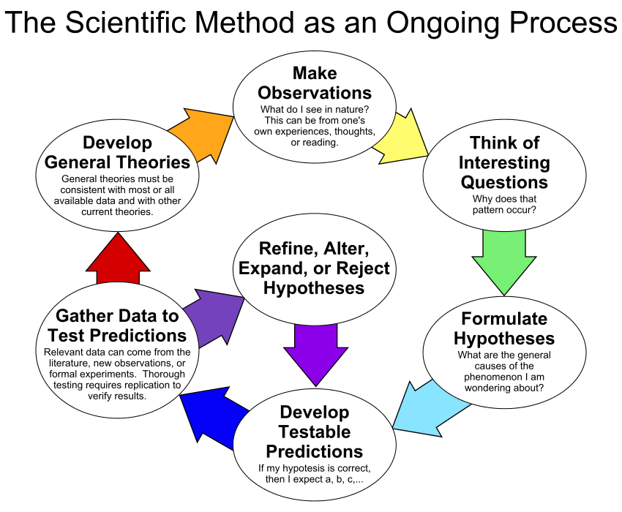
By ArchonMagnus - Own work, CC BY-SA 4.0, https://commons.wikimedia.org/w/index.php?curid=42164616

Slide 38
Scientific Objectivity (1)
Objectivity as Faithfulness to Facts
Objectivity as Absence of Normative Commitments and the Value-Free Ideal

Slide 39
Scientific Objectivity (1)
Objectivity as Faithfulness to Facts
Objectivity as Absence of Normative Commitments and the Value-Free Ideal
Objectivity as Freedom from Personal Biases
  Measurement and Quantification
  Inductive and Statistical Inference

Slide 40
Scientific Objectivity (2)
Science is objective in that, or to the extent that:
its products—theories, laws, experimental results and observations—constitute accurate representations of the external world. The products of science are not tainted by human desires, goals, capabilities or experience.
  product objectivity
the processes and methods that characterize it neither depend on contingent social and ethical values, nor on the individual bias of a scientist
  → process objectivity.
http://plato.stanford.edu/entries/scientific-objectivity

Slide 41
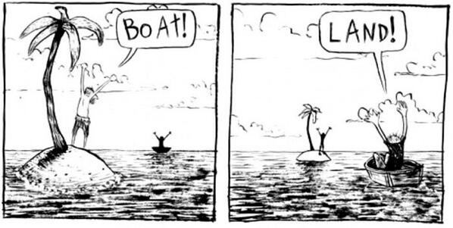
The view from nowhere
There are two kinds of qualities: ones that vary with the perspective one has or takes, and ones that remain constant through/despite changes of perspective. The latter are the objective properties.
http://plato.stanford.edu/entries/scientific-objectivity

Slide 42
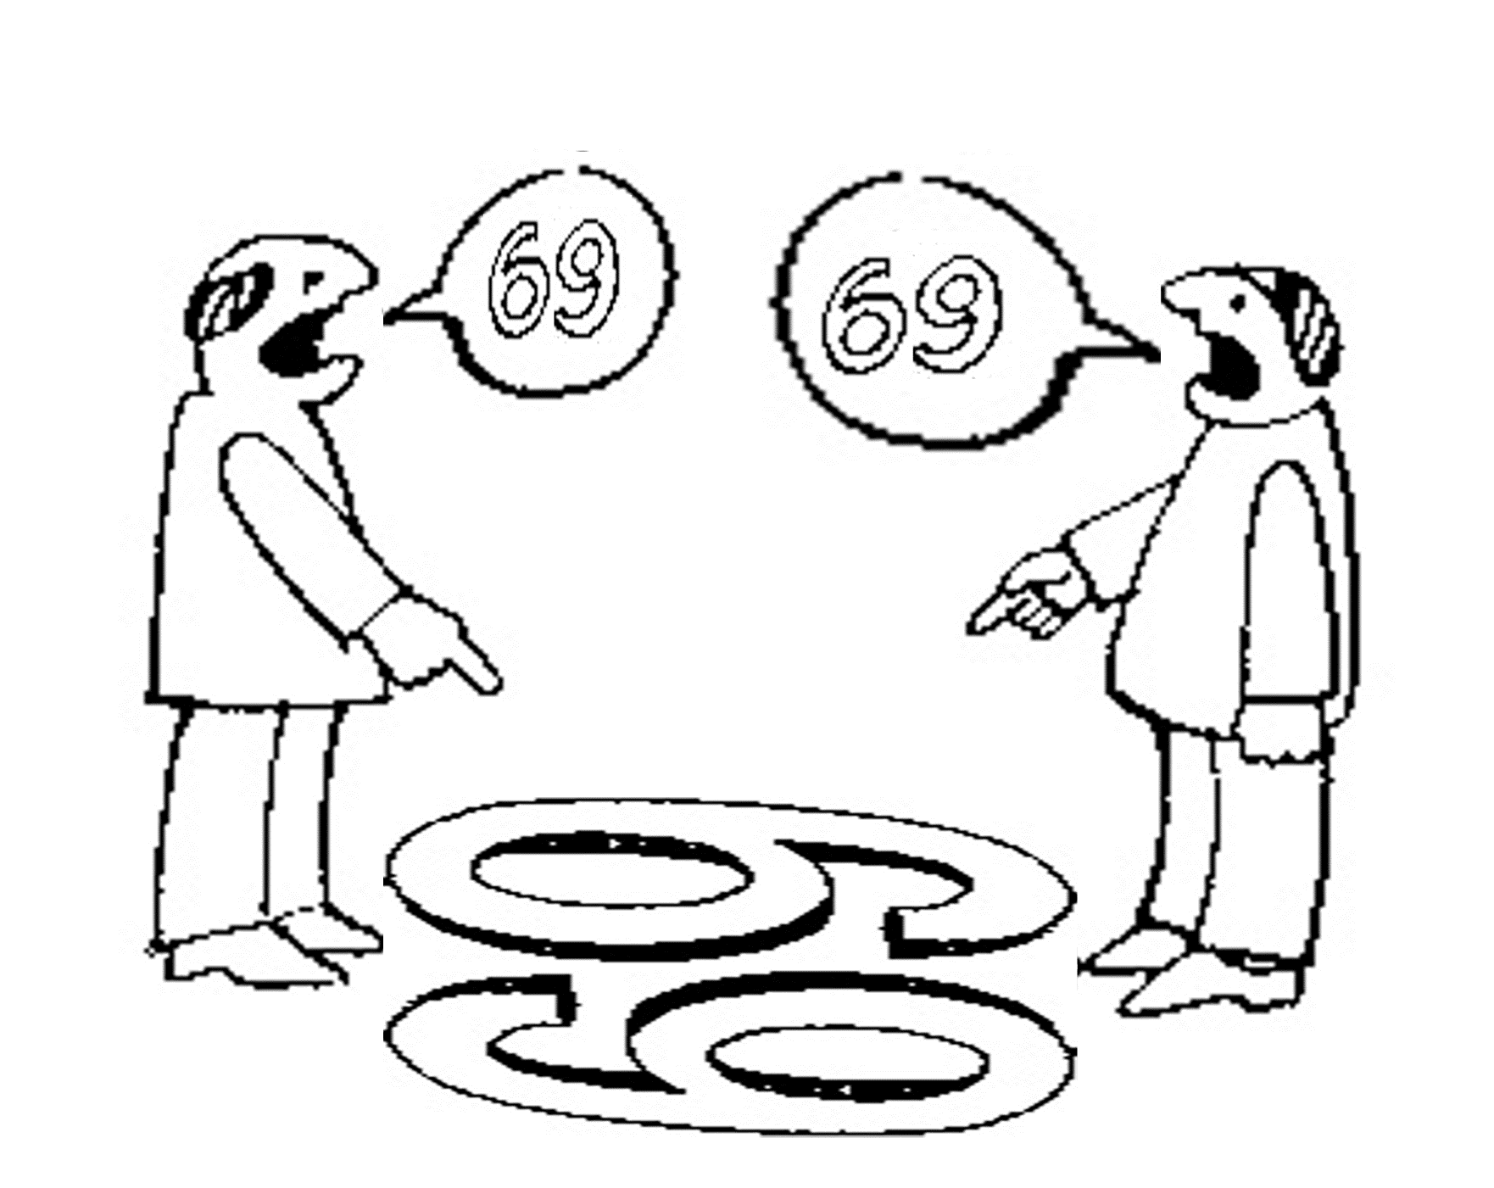
Which of the two quality types are taken as basis here?
six
nine

Slide 43
Which of the two quality types are taken as basis here?
nine
six

Slide 44
And here?
sixty
nine
sixty
nine

Slide 45
Is
Biomedical Informatics
the Holy Grail
for better healthcare?

Slide 46
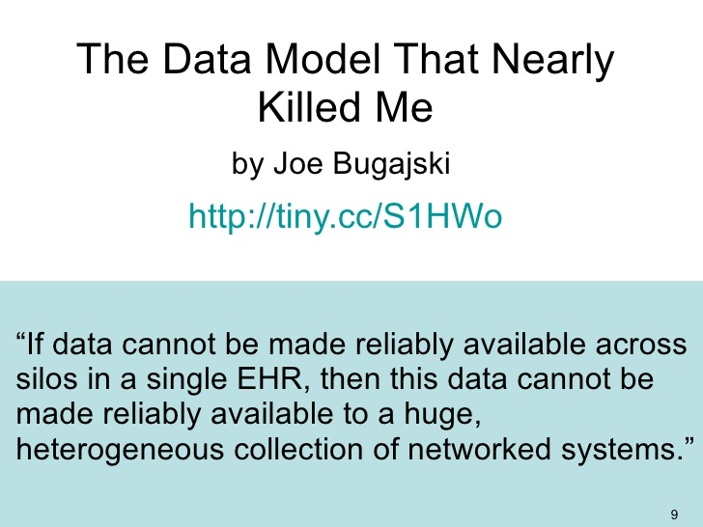

Slide 47
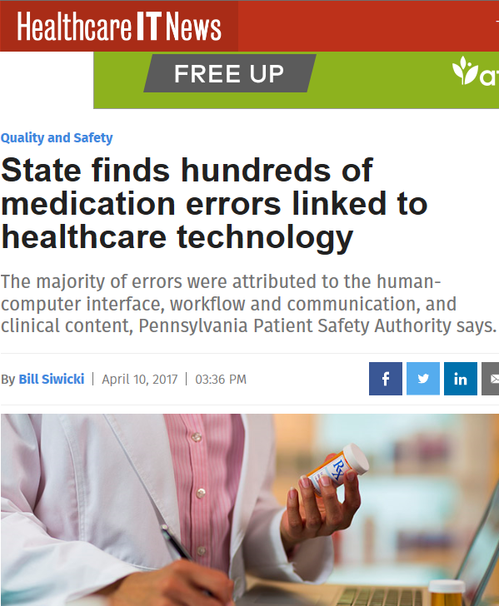
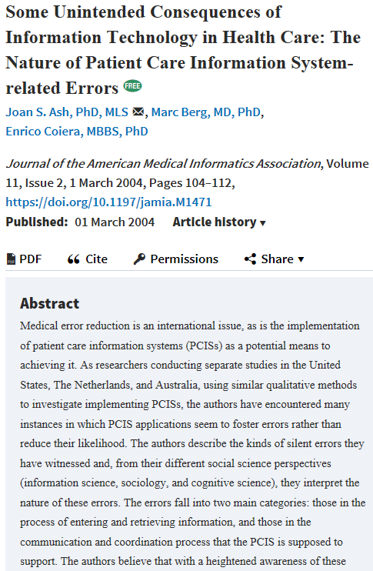
Biomedical Informatics to the rescue ?

Slide 48
In all these aspects of biomedical informatics, ontology can play a crucial role!

Slide 49
Early goals of Biomedical Ontology in
Healthcare Information Technology (HIT)
supporting the creation and use of adequate biomedical terminology.
supporting the creation of adequate coding and classification systems.

Slide 50
Adequate taxonomy design and classification
Taxonomy design:
Identify examples of particulars (‘individuals’, ‘things’, ‘entities’, …) you want to classify;
Identify the various characteristics that are possessed by (all or some of) these individual entities;
Identify groups (classes) on the basis of combinations of characteristics that co-occur;
Organize the groups hierarchically (‘parent-child’) so that characteristics that apply to a ‘parent’ (‘grandparent’,…) group apply to ALL groups beneath it;
Name the groups with terms that have face value.
Classification:
Assign individual entities to the groups that correspond with the combination of characteristics they exhibit.

Slide 51
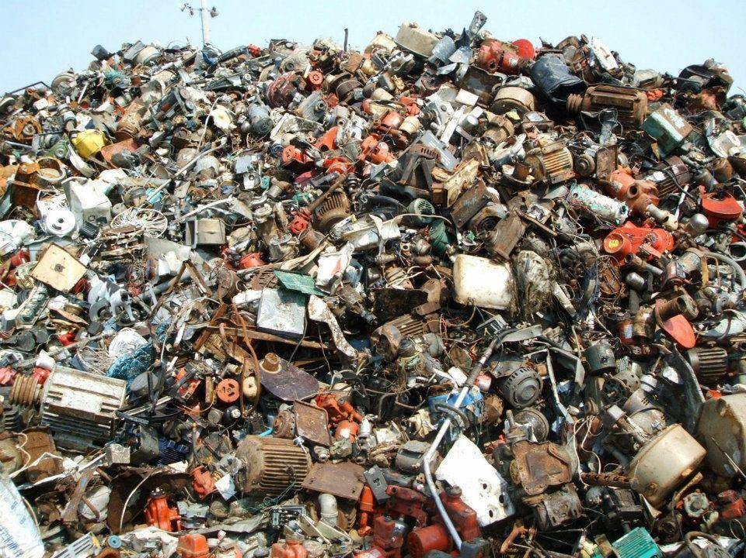
A large collection of individual entities
https://clipartfest.com/download/c2bd0a0071663cef17ac2126d73bf9350a9d15e2.html

Slide 52
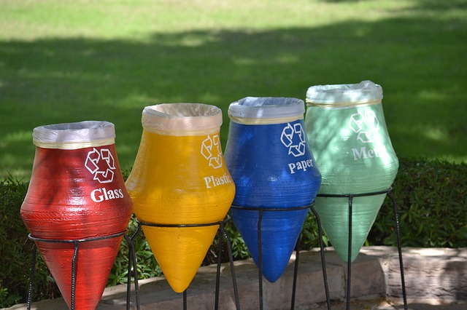
Groups based on material composition

Slide 53
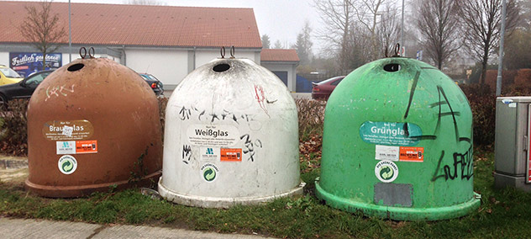
Groups for glass divided by color

Slide 54


Slide 55


Slide 56
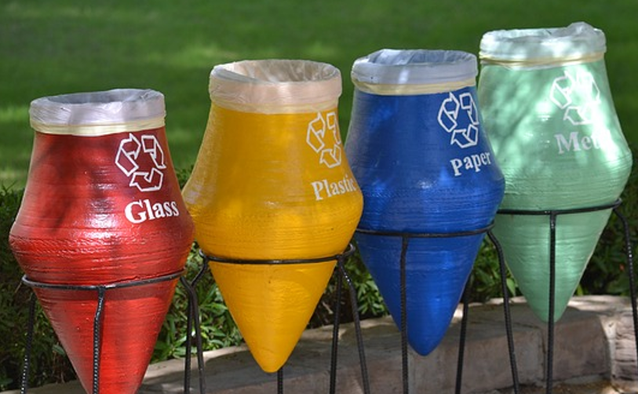


Slide 57


Slide 58
Goals of Biomedical Ontology in
Healthcare Information Technology (HIT)
supporting the creation and use of adequate biomedical terminology.
supporting the creation of adequate coding and classification systems.
solving the semantic interoperability problem for heterogeneous biomedical information systems.
improving biomedical decision support applications.

Slide 59
In all these aspects of biomedical informatics, ontology can play a crucial role.
Only realism-based ontology will do so adequately!

Slide 60
Additional Goals of Realism-based Biomedical Ontology in HIT
supporting the identification of what sorts of biomedical entities exist, how they relate to each other and how they are best represented.
supporting the creation and use of adequate biomedical terminology.
supporting the creation of adequate coding and classification systems.
solving the semantic interoperability problem for heterogeneous biomedical information systems.
improving biomedical decision support applications.
assisting in the education of healthcare workers.
…

Slide 61
Biomedical Informatics
Realism-based Ontology | Inter-disciplinary | Data, Information, Knowledge | Science, Problem Solving, Decision Making | Improving Health
Entity identification
Terminologies
Classification Systems
Semantic Interoperability
Decision Support
Education

Slide 62
Biomedical Informatics
Realism-based Ontology | Inter-disciplinary | Data, Information, Knowledge | Science, Problem Solving, Decision Making | Improving Health
Entity identification
Terminologies
Classification Systems
Semantic Interoperability
Decision Support
Education
Success rests on 4 essential distinctions!
‘ontology’ ←→ ‘an ontology’
reality ←→ representation
particulars ←→ universals
continuants ←→ occurrents

Slide 63
Biomedical Informatics
Realism-based Ontology | Inter-disciplinary | Data, Information, Knowledge | Science, Problem Solving, Decision Making | Improving Health
Entity identification
Terminologies
Classification Systems
Semantic Interoperability
Decision Support
Education
Success rests on 4 essential distinctions!
‘ontology’ ←→ ‘an ontology’
reality ←→ representation
particulars ←→ universals
continuants ←→ occurrents

Slide 64
‘Ontology’
In philosophy:
  Ontology (no plural) is the study of what entities exist and how they relate to each other;

Slide 65
‘Ontology’
In philosophy:
  Ontology (no plural) is the study of what entities exist and how they relate to each other;
  by some philosophers taken to be synonymous with ‘metaphysics’ while others draw distinctions in many distinct ways (the distinctions being irrelevant for this talk), but almost agreeing on the following classification:
    metaphysics → studies ‘how is the world?’
      general metaphysics → studies general principles and ‘laws’ about the world
        ontology → studies what type of entities exist in the world
      special metaphysics → focuses on specific principles and entities
  distinct from ‘epistemology’ which is the study of how we can come to know about what exists.
  distinct from ‘terminology’ which is the study of what terms mean and how to name things.

Slide 66
The Terminology / Ontology divide
Terminology:
  solves certain issues related to language use, i.e. with respect to how we talk about entities in reality (if any);
    Relations between terms / ‘concepts’
  does not provide an adequate means to represent independent of use what we talk about, i.e. how reality is structured;
    Women, Fire and Dangerous Things (Lakoff).
Ontology (of the right sort):
  Language and perception neutral view on reality.
    Relations between entities in first-order reality
This is the ‘terminology / ontology divide’

Slide 67
Take a good look
In philosophy:
  Ontology (no plural) is the study of what entities exist and how they relate to each other;
  by some philosophers taken to be synonymous with ‘metaphysics’ while others draw distinctions in many distinct ways (the distinctions being irrelevant for this talk), but almost agreeing on the following classification:
    metaphysics → studies ‘how is the world?’
      general metaphysics → studies general principles and ‘laws’ about the world
        ontology → studies what type of entities exist in the world
      special metaphysics → focuses on specific principles and entities
  distinct from ‘epistemology’ which is the study of how we can come to know about what exists.
  distinct from ‘terminology’ which is the study of what terms mean and how to name things.

Slide 68
Distinct questions. What type are they of?
Terminological:
  what does ‘pain’ mean ?
Metaphysical:
  what have all pains in common in virtue of which they are pains?
Ontological:
  what type of entity is pain?
Onto-terminological:
  what, if anything at all, does ‘pain’ denote?
Epistemological:
  how can we find out whether something is pain?

Slide 69
Unfortunately, ‘ontology’ denotes ambiguously
In philosophy:
  Ontology (no plural) is the study of what entities exist and how they relate to each other;
In computer science and many biomedical informatics applications:
  An ontology (plural: ontologies) is a shared and agreed upon conceptualization of a domain;

Slide 70
Computer science approach to ontology
Ontology
Authoring Tools
create
Domain
Ontologies
Reasoners
Semantic
Applications
use

Slide 71
Computer science approach to ontology
Ontology
Authoring Tools
the logic in reasoners:
guarantees consistent reasoning,
does not guarantee the faithfulness of the representation.
create
Domain
Ontologies
Reasoners
Semantic
Applications
use

Slide 72
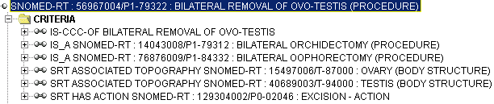
Consistent reasoning with nonsensical representations
Ceusters W, Smith B, Flanagan J. Ontology and Medical Terminology: why Descriptions Logics are not enough. Proceedings of the conference Towards an Electronic Patient Record (TEPR 2003),
San Antonio, 10-14 May 2003 (electronic publication 5pp)

Slide 73
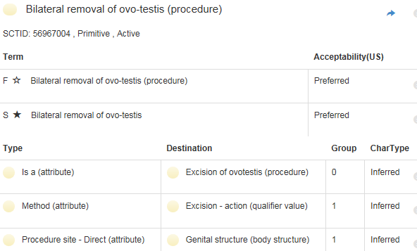
Correction
http://browser.ihtsdotools.org/
Oct 14, 2015

Slide 74

Philosophical approach to ontology
Ontological Realism: uses ontology as philosophical discipline to build ontologies as faithful representations of reality.

Slide 75
Interdisciplinary Nature of Biomedical Informatics: the main stream view
Computer Science (hardware)
Computer Science (software)
Cognitive Science
& Decision Making
Bioengineering
Biomedical
Informatics
Management
Sciences
Epidemiology
And Statistics
Basic Biomedical
Sciences
Clinical
Sciences

Slide 76
Interdisciplinary Nature of Biomedical Informatics:
UB Department of BMI’s view
Computer Science (hardware)
Informatics
Human factors
ergonomics
Computer Science (software)
Cognitive Science
& Decision Making
Bioengineering
Biomedical
Informatics
Management
Sciences
Epidemiology
And Statistics
Philosophy
Basic Biomedical
Sciences
Clinical
Sciences
Philosophy
Of Science
(Biomedical)
Ontology

Slide 77
Biomedical Informatics
Realism-based Ontology | Inter-disciplinary | Data, Information, Knowledge | Science, Problem Solving, Decision Making | Improving Health
Entity identification
Terminologies
Classification Systems
Semantic Interoperability
Decision Support
Education
Success rests on 4 essential distinctions!
‘ontology’ ←→ ‘an ontology’
reality ←→ representation
particulars ←→ universals
continuants ←→ occurrents

Slide 78
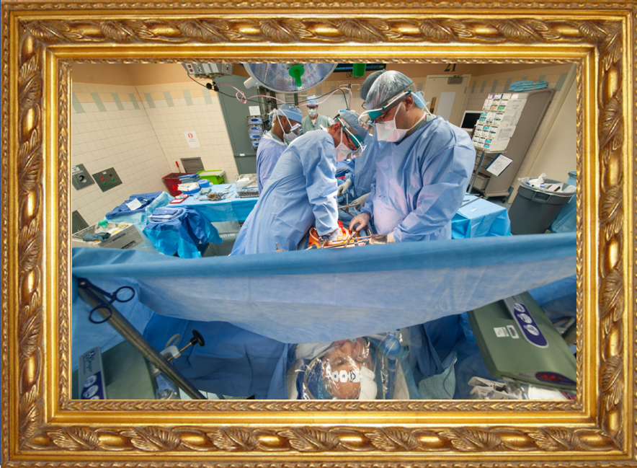

Reality ←→ Representation

Slide 79
Reality ←→ Representation
(research) domain
(research) data
Beings & happenings
Descriptions

Slide 80
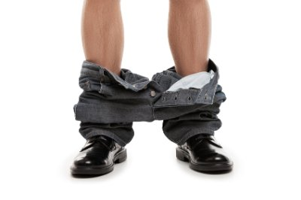
Reality ←→ Representation

Slide 81
Reviewers’ comments
‘Although it is not mentioned explicitly, it gives the impression that the authors assume that there is only one reality and that this reality can be faithfully modelled’ (reviewer 3, WOMOCoE);
‘The somewhat naive realism that seems to underly the work, namely, that there is an objective reality out there to be observed and recognized’
  (reviewer 3, FOIS main).
Ceusters W, Bona J. Representing SNOMED CT Concept Evolutions using Process Profiles. International Workshop on Ontology Modularity, Contextuality, and Evolution (WOMoCoE 2016), Annecy, France, July 6, 2016

Slide 82
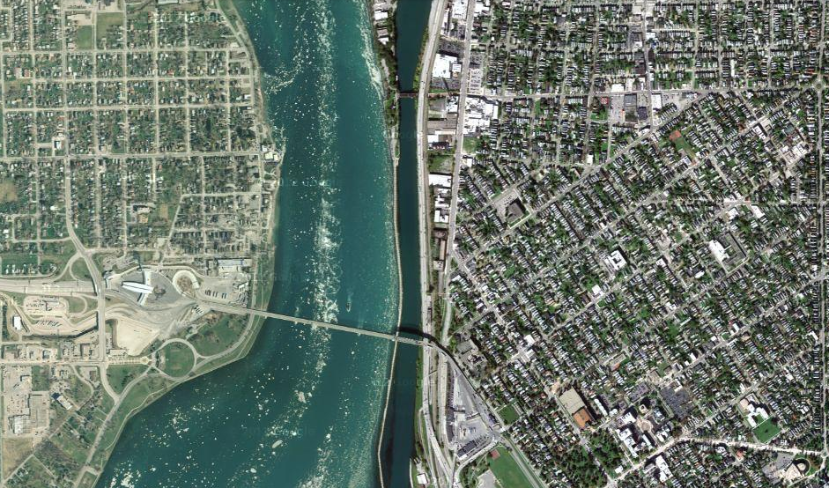
Satellite view

Slide 83
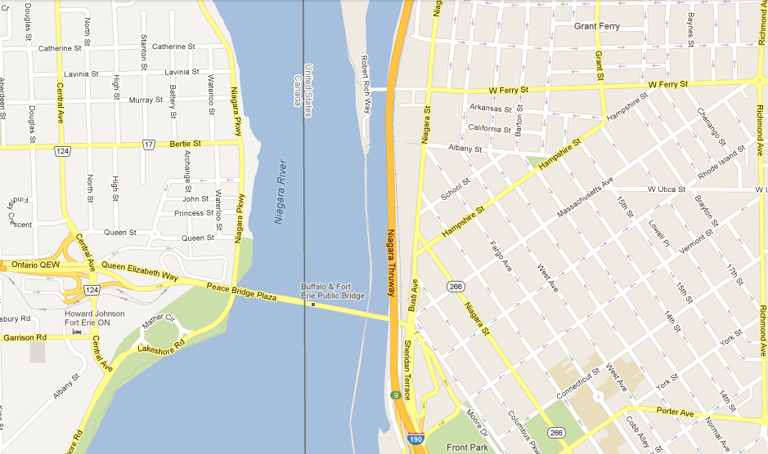
Map

Slide 84
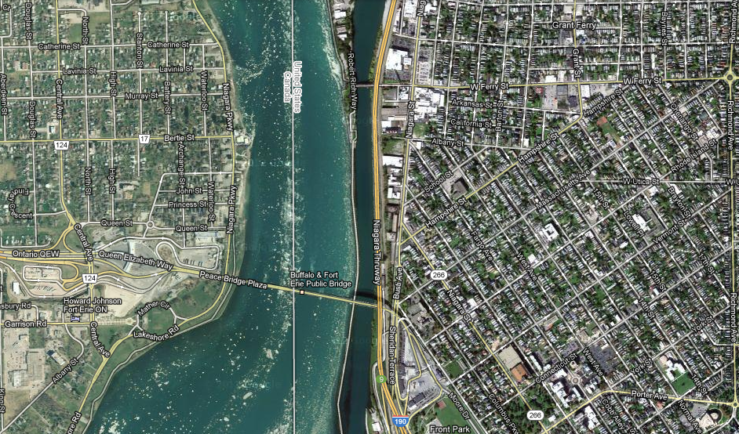
Map overlay

Slide 85
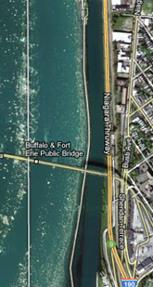
Map ←→ Reality
A message to map makers: “Highways are not painted red, rivers don’t have county lines running down the middle, and you can’t see contour lines on a mountain”
W. Kent. Data and Reality. North-Holland, Amsterdam, the Netherlands, 1978.

Slide 86
Main data ←→ reality views
Nominalism:
  there are no generic entities in reality: there is no personhood, there are only individual persons.
Conceptualism:
  generalizations are in our ‘minds’. Personhood is a concept construed in our ‘mind’ that allows us to reason about persons without any particular person in mind.
Realism:
  generic entities do exist and are called ‘universals’. Each particular person is an instance of the universal we call ‘person’.

Slide 87
Main data ←→ reality views
Nominalism:
  there are no generic entities in reality: there is no personhood, there are only individual persons.
Conceptualism: ← mainstream approach
  generalizations are in our ‘minds’. Personhood is a concept construed in our ‘mind’ that allows us to reason about persons without any particular person in mind.
Realism: ← our approach
  generic entities do exist and are called ‘universals’. Each particular person is an instance of the universal we call ‘person’.

Slide 88
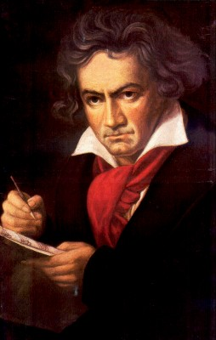
The semantic/semiotic triangle:
(the sandbox of the conceptualist)
Ludwig van Beethoven
that great German composer that became deaf
…
concept
term
referent
‘Beethoven’

Slide 89
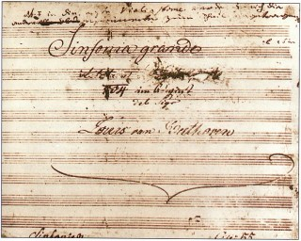
The semantic triangle works sometimes fine
Beethoven’s symphony dedicated to Bonaparte
the symphony played after the Munich Olympics massacre
…
concept
term
referent
‘Eroica’
‘Beethoven's Symphony No. 3’
‘Beethoven's Opus 55’

Slide 90
Sometimes the semantic triangle fails
the symphony Beethoven wrote after the tenth
…
concept
term
referent
‘Beethoven's Symphony No. 11’

Slide 91
Sometimes the semantic triangle fails
the symphony Beethoven wrote after the tenth
…
some hold this term has meaning
concept
term
referent
‘Beethoven's Symphony No. 11’

Slide 92

Sometimes the semantic triangle fails
the one assembled by Barry Cooper from fragmentary sketches
Beethoven’s hypothetical symphony
…
concept
term
referent
‘Beethoven's Symphony No. 10’

Slide 93
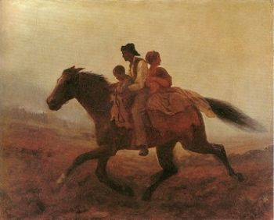
Prehistoric ‘psychiatry’: drapetomania
disease which causes slaves to suffer from an unexplainable propensity to run away
…
concept
term
referent
painting by Eastman Johnson. A Ride for Liberty: The Fugitive Slaves. 1860.
‘drapetomania’

Slide 94
SNOMED about diseases and concepts (until 2010)
‘Disorders are concepts in which there is an explicit or implicit pathological process causing a state of disease which tends to exist for a significant length of time under ordinary circumstances.’
And also: “Concepts are unique units of thought”.
Thus: Disorders are unique units of thoughts in which there is a pathological process …???
And thus: to eradicate all diseases in the world at once we simply should stop thinking ?

Slide 95
Remember: ‘Biomedical Informatics’
Definition:
Biomedical informatics (BMI) is
the interdisciplinary field
that studies and pursues the effective uses of biomedical data, information, and knowledge
for scientific inquiry, problem solving, and decision making,
driven by efforts to improve human health.
CA Kulikowski, EH Shortliffe, LM Currie, PL Elkin, LE Hunter, TR Johnson, IJ Kalet, LA Lenert, MA Musen, JG Ozbolt, JW Smith, PZ Tarczy-Hornoch, JWilliamson; AMIA Board white paper: definition of biomedical informatics and specification of core competencies for graduate education in the discipline, Journal of the American Medical Informatics Association, Volume 19, Issue 6, 1 November 2012, Pages 931–938, https://doi.org/10.1136/amiajnl-2012-001053

Slide 96
Current mainstream informatics thinking
knowledge
information
data

Slide 97
Current mainstream informatics thinking
?
knowledge
information
data

Slide 98
Current mainstream informatics thinking
wisdom
knowledge
information
data

Slide 99
Where do data come from?
knowledge
information
data
Representation
What is there on the side of the patient
Reality

Slide 100
Where do data come from?
knowledge
information
data
Questions not often enough asked:
What parts of our data correspond with something out there in reality ?
What parts of reality are not captured by our data, but should because they are relevant ?
Reality
What is there on the side of the patient

Slide 101
Where do data come from?
knowledge
information
data
Questions not often enough asked:
What parts of our data correspond with something out there in reality ?
What parts of reality are not captured by our data, but should because they are relevant ?
Ontology
Reality
What is there on the side of the patient

Slide 102
Where do data come from?
References
knowledge
information
data
Questions not often enough asked:
What part of our data corresponds with something out there in reality ?
What part of reality is not captured by our data, but should because it is relevant ?
Ontology
- representation
Reality
What is there on the side of the patient
Referents

Slide 103
Also representations are real!
References
knowledge
information
data
Questions not often enough asked:
What part of our data corresponds with something out there in reality ?
What part of reality is not captured by our data, but should because it is relevant ?
Ontology
- representation
Reality
What is there on the side of the patient
Referents

Slide 104
Generalization: data generation and use
data
organization
model development
observation &
measurement
further R&D
(instrument and
study optimization)
add
verify
use
Δ = outcome
Generic
beliefs
application

Slide 105
Reality as benchmark for data organization and representation
data
organization
model development
observation &
measurement
further R&D
(instrument and
study optimization)
add
verify
use
Δ = outcome
Generic
beliefs
application

Slide 106

Realism-based Ontology (RBO)
Referents
  are (meta-) physically the way they are,
  relate to each other in an objective way,
  follow ‘laws of nature’.
Window on reality
  restricted by:
  what is physically and technically observable,
  fit between what is measured and what we think is measured,
  fit between established knowledge and ‘laws of nature’.
References
  follow, ideally, the syntactic-semantic conventions of some representation language,
  are restricted by the expressivity of that language,
  reference collections need to come, for correct interpretation, with documentation outside the representation.

Slide 107
Biomedical Informatics
Realism-based Ontology | Inter-disciplinary | Data, Information, Knowledge | Science, Problem Solving, Decision Making | Improving Health
Entity identification
Terminologies
Classification Systems
Semantic Interoperability
Decision Support
Education
Success rests on 4 essential distinctions!
‘ontology’ ←→ ‘an ontology’
reality ←→ representation
particulars ←→ universals
continuants ←→ occurrents

Slide 108
Types versus particulars
Types
Particulars
counterparts in reality of (some of)
the general terms used in the formulation of scientific theories
concrete individual entities
(entities that exist in space and time and that exist only once)
Smith B, Ceusters W. Ontological Realism as a Methodology for Coordinated Evolution of Scientific Ontologies. Applied Ontology, 2010;5(3-4):139-188.

Slide 109
‘Types’
‘concepts’
‘kinds’
‘universals’
‘categories’
‘classes’
‘prototypes’
…
In realism-based ontology:
  Universals: human being
  Defined classes: human being in Buffalo

Slide 110
Types versus particulars
for every universal there is or has been at least one instance
some type
instanceOf …
entities on either site cannot ‘cross’ this boundary
every particular is an instance of at least one universal
some particular

Slide 111




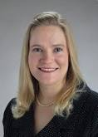
Types versus particulars
Human being
instance of at t
particulars

Slide 112
Types versus particulars
Photograph
instance of at t
particulars

Slide 113
Instances are the objects of classification …
isa
Organism
isa
Vertebrate
isa
Mammal
Human being
instance of at t
particulars

Slide 114
Instances are the objects of classification …
isa
Organism
isa
Vertebrate
isa
Mammal
Human being
instance of at t
particulars

Slide 115
Conceptualism versus Ontological Realism
First order reality
concept
universal
term
referent
representational
unit
particular
Conceptualism
Ontological Realism

Slide 116
Ontological Realism offers three ways of relating, without assigning beliefs (concepts) a central status
drapetomania
slave
running away
mental disorder
propensity
How beliefs are / can
be related
How terms are related
How referents (in
reality) are related

Slide 117
Biomedical Informatics
Realism-based Ontology | Inter-disciplinary | Data, Information, Knowledge | Science, Problem Solving, Decision Making | Improving Health
Entity identification
Terminologies
Classification Systems
Semantic Interoperability
Decision Support
Education
Success rests on 4 essential distinctions!
‘ontology’ ←→ ‘an ontology’
reality ←→ representation
particulars ←→ universals
continuants ←→ occurrents

Slide 118
Continuants ←→ Occurrents
 | Continuant | Occurrent
Entities that at any time they exist,
exist
in total
Entities that at any time they exist,
exist only
partially
Smith B, Ceusters W. Ontological Realism as a Methodology for Coordinated Evolution of Scientific Ontologies. Applied Ontology, 2010;5(3-4):139-188.

Slide 119
An ontological square
 | Continuant | Occurrent
Types | Tooth | Teeth grinding
Particulars | My left maxillary first molar | My teeth grinding

Slide 120
An ontological square
 | Continuant | Occurrent
Types | Tooth | Teeth grinding
Particulars | My left maxillary first molar | My teeth grinding
Instance
of at t
Instance
of

Slide 121
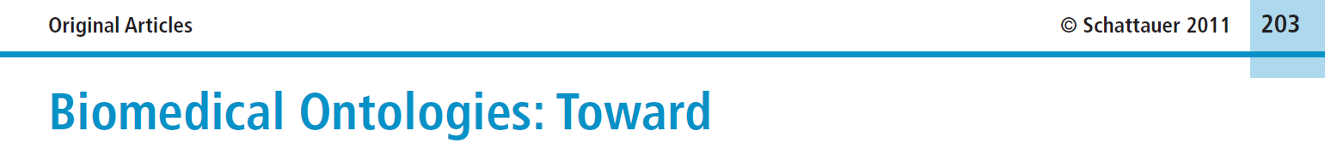


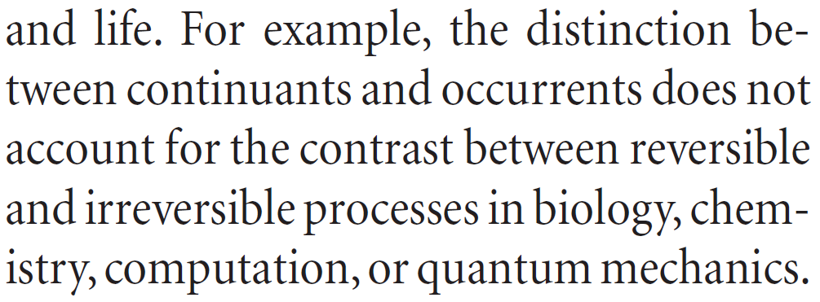
Simple, yet seemingly hard to grasp …
Methods Inf Med 2011; 50: 203-216
Page 205

Slide 122
How could the distinction account for it ?
Continuant | Occurrent
‘the distinction between
continuants and occurrents does not account for the contrast between reversible
and irreversible processes’
Irreversible Process
Reversible Process
Maojo V, Crespo J, Garcia-Remesal M, de la Iglesia D, Pérez-Rey D, Kulikowski C.
Biomedical Ontologies: Toward scientific debate.
Methods Inf Med 2011; 50 (3):203-216.

Slide 123
The importance of temporal indexing
benign
tumor
malignant
tumor
stomach
instanceOf at t₂
instanceOf at t₁
instanceOf at t₂
instanceOf at t₁
partOf at t₁
this-4
this-1’s stomach
partOf at t₂

Slide 124
The importance of temporal indexing
benign
tumor
malignant
tumor
stomach
instanceOf at t₂
instanceOf at t₁
instanceOf at t₂
instanceOf at t₁
this-4
partOf at t₁
this-1’s stomach
this-5
partOf at t₂

Slide 125




Continuants preserve identity while changing
human
being
me
me
t
Instance-of
in 1960
child
Instance-of
since 1980
adult
living
creature
animal
caterpillar
butterfly

Slide 126
What happens if you don’t pay attention to these distinctions?

Slide 127

Shopping for ‘chicken’

Slide 128

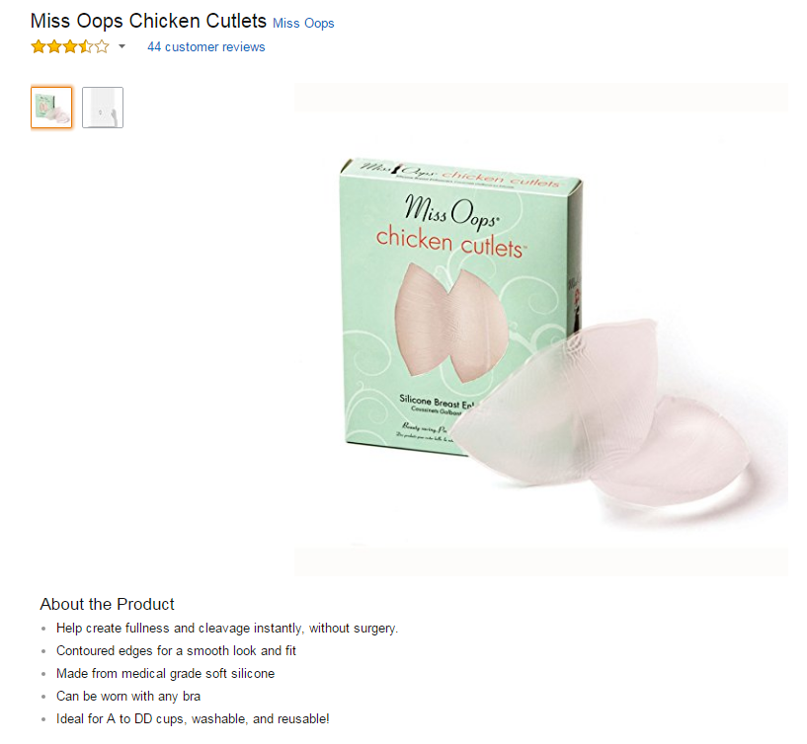

Slide 129



Slide 130
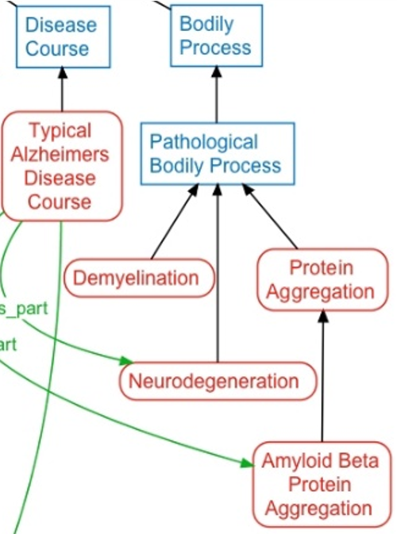
Considered to be true in NDO
Bodily processes exist,
Neurodegeneration exists,
All neurodegenerations are pathological processes,
A typical Alzheimers disease course exist,
All typical Alzheimers disease courses have some part which is a neurodegeneration,
…

Slide 131
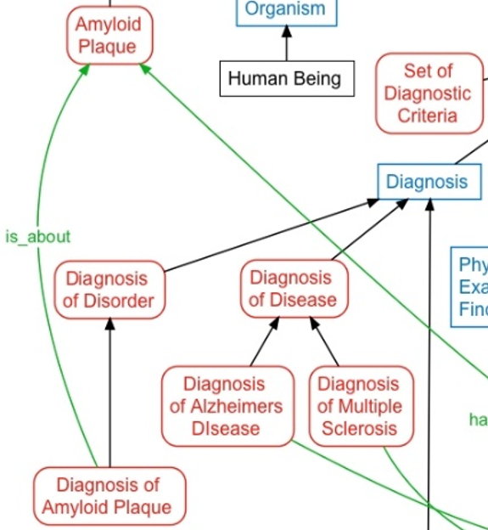
Considered to be true in NDO
?

Slide 132

Border’s classification of medicine: what’s wrong ?
Medicine
  Mental health
  Internal medicine
    Endocrinology
      Oversized endocrinology
    Gastro-enterology
    ...
  Pediatrics
  ...
  Oversized medicine
Refer to the size of the books that do not fit on a normal Border’s Bookshop shelf

Slide 133
What type of mistake in ICHD?
‘13.1.2.4 Painful trigeminal neuropathy attributed to MS plaque’
‘attributed to’ relates to somebody’s opinion about what is the case, not to what is the case.
  the mistake: a feature on the side of the clinician – his (not) knowing - is taken to be a feature on the side of the patient.
Similar mistakes:
  ‘Probable migraine’
  ‘facial pain of unknown origin’ (not in ICHD).

Slide 134
Geographic Locations: a good hierarchy ?
Africa [Z01.058] +
Americas [Z01.107] +
Antarctic Regions [Z01.158]
Arctic Regions [Z01.208]
Asia [Z01.252] +
Atlantic Islands [Z01.295] +
Australia [Z01.338] +
Cities [Z01.433] +
Europe [Z01.542] +
Historical Geographic Locations [Z01.586] +
Indian Ocean Islands [Z01.600] +
Oceania [Z01.678] +
Oceans and Seas [Z01.756] +
Pacific Islands [Z01.782] +
mereological mess:
mixture of geographic entities with socio-political entities
mixture of space and time

Slide 135
Geographic Locations [Z01]
Africa [Z01.058] +
Americas [Z01.107] +
Antarctic Regions [Z01.158]
Arctic Regions [Z01.208]
Asia [Z01.252] +
Atlantic Islands [Z01.295] +
Australia [Z01.338] +
Cities [Z01.433] +
Europe [Z01.542] +
Historical Geographic Locations [Z01.586] +
Indian Ocean Islands [Z01.600] +
Oceania [Z01.678] +
Oceans and Seas [Z01.756] +
Pacific Islands [Z01.782] +
Ancient Lands [Z01.586.035] +
Austria-Hungary [Z01.586.117]
Commonwealth of Independent States [Z01.586.200] +
Czechoslovakia [Z01.586.250] +
European Union [Z01.586.300]
Germany [Z01.586.315] +
Korea [Z01.586.407]
Middle East [Z01.586.500] +
New Guinea [Z01.586.650]
Ottoman Empire [Z01.586.687]
Prussia [Z01.586.725]
Russia (Pre-1917) [Z01.586.800]
USSR [Z01.586.950] +
Yugoslavia [Z01.586.980] +

Slide 136
Geographic Locations [Z01]
Africa [Z01.058] +
Americas [Z01.107] +
Antarctic Regions [Z01.158]
Arctic Regions [Z01.208]
Asia [Z01.252] +
Atlantic Islands [Z01.295] +
Australia [Z01.338] +
Cities [Z01.433] +
Europe [Z01.542] +
Historical Geographic Locations [Z01.586] +
Indian Ocean Islands [Z01.600] +
Oceania [Z01.678] +
Oceans and Seas [Z01.756] +
Pacific Islands [Z01.782] +
Ancient Lands [Z01.586.035] +
Austria-Hungary [Z01.586.117]
Commonwealth of Independent States [Z01.586.200] +
Czechoslovakia [Z01.586.250] +
European Union [Z01.586.300]
Germany [Z01.586.315] +
Korea [Z01.586.407]
Middle East [Z01.586.500] +
New Guinea [Z01.586.650]
Ottoman Empire [Z01.586.687]
Prussia [Z01.586.725]
Russia (Pre-1917) [Z01.586.800]
USSR [Z01.586.950] +
Yugoslavia [Z01.586.980] +

Slide 137
Principle
A hierarchical structure should not represent distinct hierarchical relations unless they are formally characterized

Slide 138
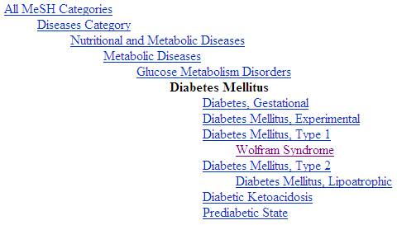
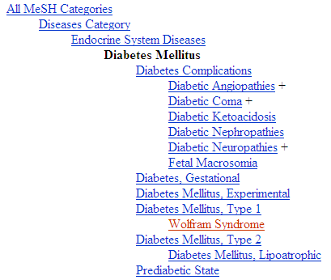
Diabetes Mellitus in MeSH 2008
?
Different set of more specific terms when different path from the top is taken.

Slide 139
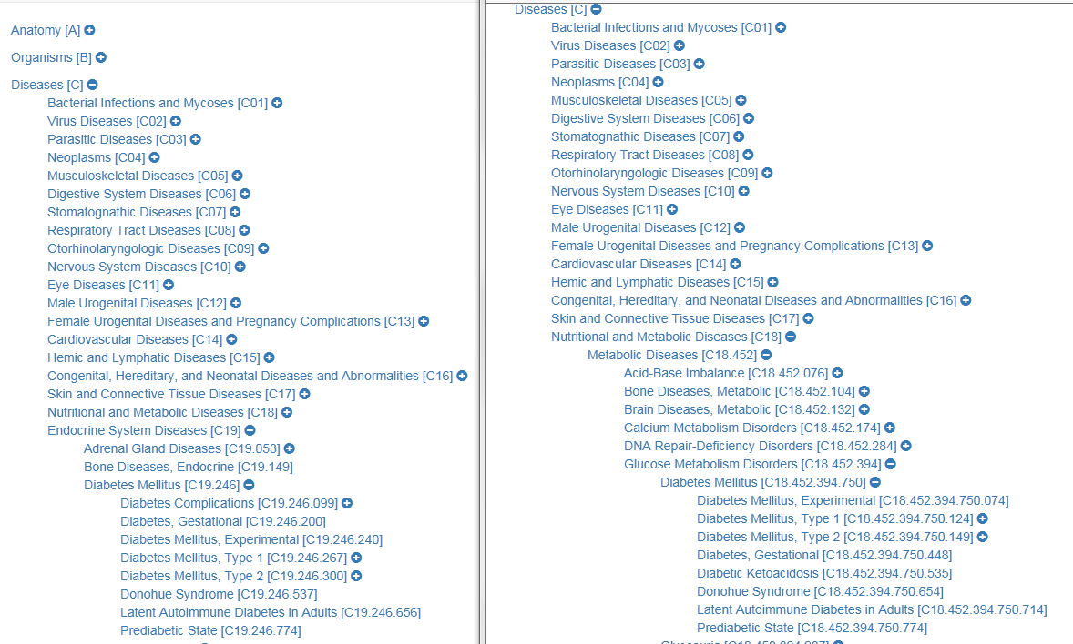
DM in MeSH 2018 (Sept 25)

Slide 140
DM in MeSH 2018 (Sept 25)

Slide 141
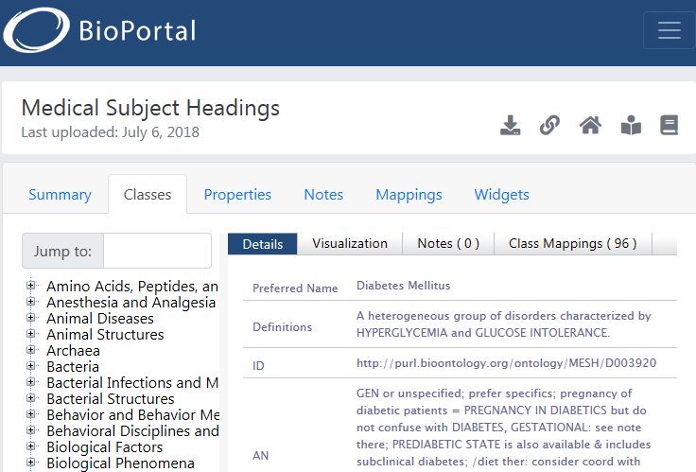
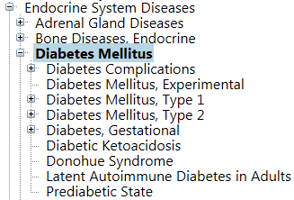
One of the biggest collections of biomedical informatics junk!!
}
Expressed in OWL, but clearly violating the semantics of OWL!

Slide 142
MeSH: some paths from top to Wolfram Syndrome
All MeSH Categories
Diseases Category
Nervous System Diseases
Female Urogenital Diseases
and Pregnancy Complications
Eye Diseases
Male Urogenital
Diseases
Cranial Nerve
Diseases
Female Urogenital Diseases
Optic Nerve
Diseases
Neurodegenerative
Diseases
Optic Nerve
Diseases
Eye Diseases,
Hereditary
Heredodegenerative
Disorders,
Nervous System
Urologic Diseases
Optic Atrophy
Kidney Diseases
Optic Atrophies,
Hereditary
Diabetes Insipidus
Wolfram Syndrome

Slide 143

What would it mean if used in the context of a patient ?
All MeSH Categories
???
Diseases Category
Nervous System Diseases
Female Urogenital Diseases
and Pregnancy Complications
Eye Diseases
Male Urogenital
Diseases
Cranial Nerve
Diseases
Female Urogenital Diseases
…
Neurodegenerative
Diseases
Optic Nerve
Diseases
Optic Nerve
Diseases
Eye Diseases,
Hereditary
has
Heredodegenerative
Disorders,
Nervous System
Urologic Diseases
Optic Atrophy
Kidney Diseases
Optic Atrophies,
Hereditary
Diabetes Insipidus
has
Wolfram Syndrome

Slide 144
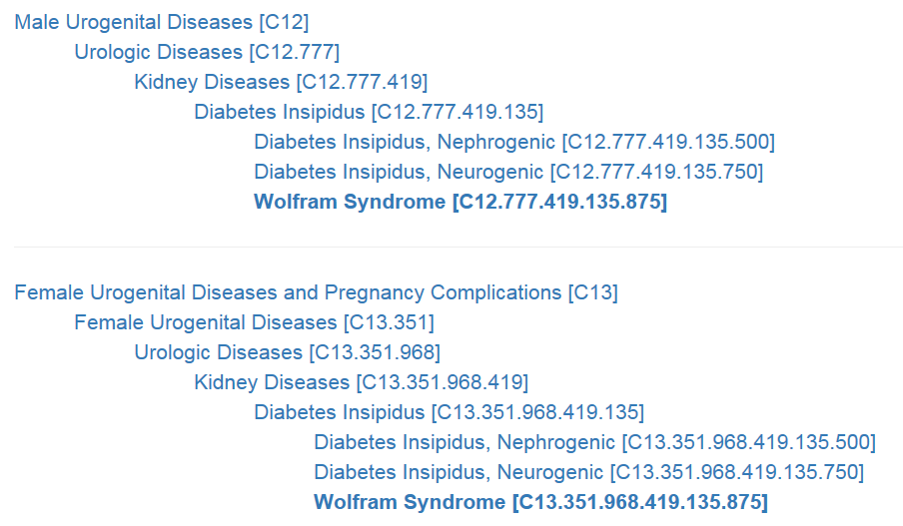
From MeSH, Sept 25, 2018

Slide 145
Principle
If a particular (individual) is related in a specific way to a ‘class’, it should also be related in the same way to all the ‘superclasses’ of that class
  Technically: “… to all the classes that subsume that class”

Slide 146

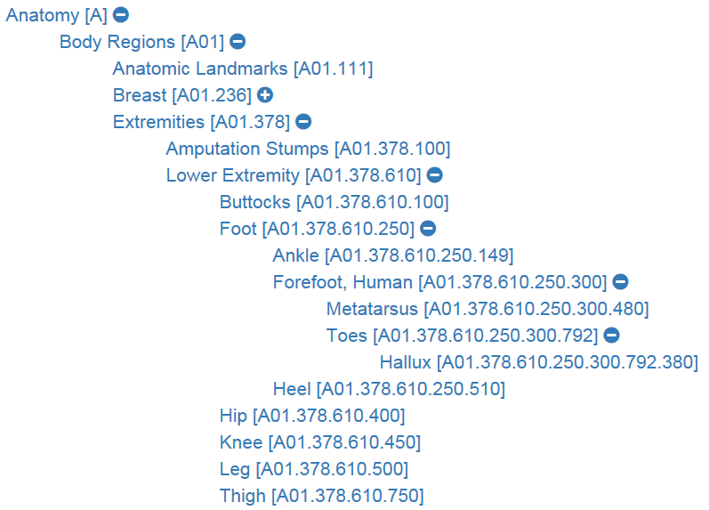
What’s bad practice ?
https://meshb.nlm.nih.gov/treeView
(Sept 25, 2018)

Slide 147
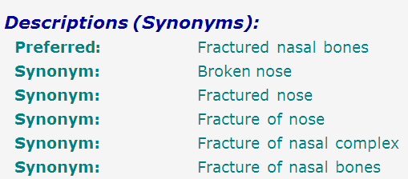
SNOMED-CT: what is wrong here?
bones
nose
fracture
false synonymy

Slide 148
Coding / Classification confusion
P + X
P + Y
P + Z
A patient with a fractured nasal bone
A patient with a fractured nasal bone
=
=
A patient with a broken nose
A patient with a broken nose
=
=
A patient with a fracture of the nose
A patient with a fracture of the nose

Slide 149
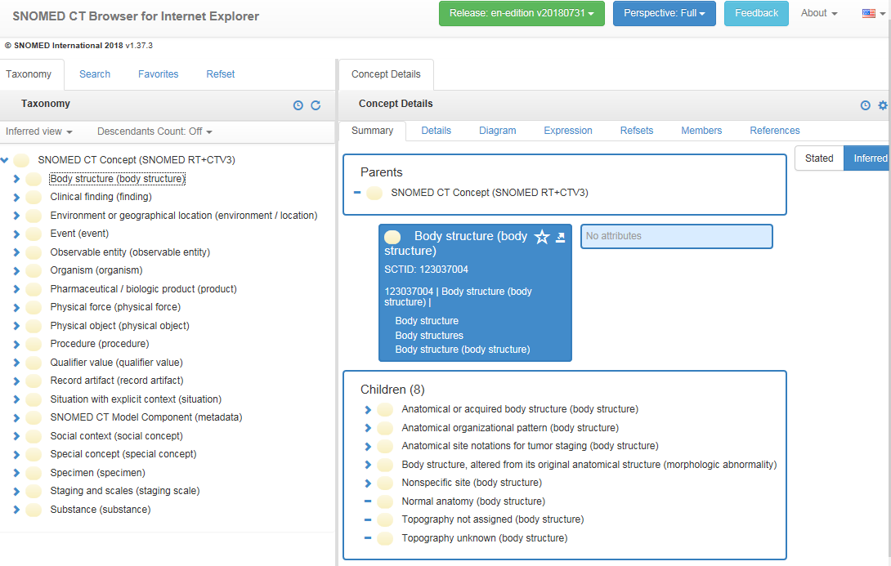
SNOMED CT

Slide 150
Concepts and confusions in SNOMED CT
‘concept’:
  ‘a clinical idea to which a unique concept identifier has been assigned’; ‘the meaning of a concept can be determined from relationships to other concepts and from associated descriptions that include human readable terms’
the term is also stated to be a homonym for:
  ‘concept identifier’ as well as for
  ‘the real-world referent(s) of the concept identifier, that is, the class of entities in reality that the concept identifier represents’

Slide 151
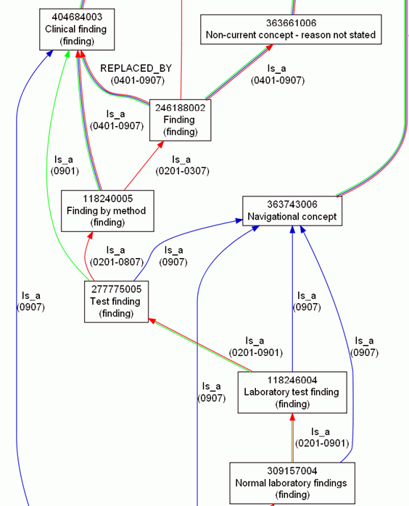
Consequence: more confusion
What is
inside
versus
outside SNOMED CT?

Slide 152
Inside versus outside an ontology
What is
inside
versus
outside SNOMED CT?

Slide 153
Inside versus outside an ontology
What is
inside
versus
outside SNOMED CT?

Slide 154
Inside versus outside an ontology
What is
inside
versus
outside SNOMED CT?
Clear shift in meaning, incompatible with SNOMED CT’s change policy

Slide 155
Inside versus outside an ontology
What is
inside
versus
outside SNOMED CT?
‘halfway’ concept:
denotes external entities but viewed through internal organization

Slide 156
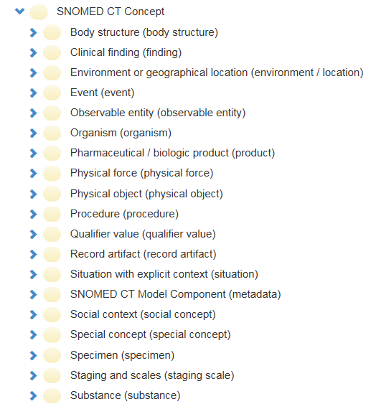
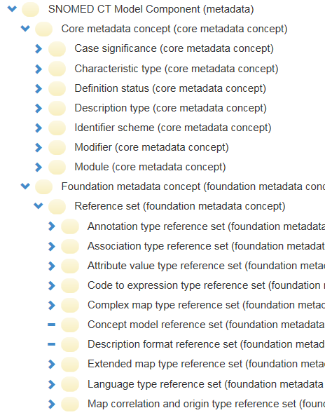
SNOMED CT inside versus outside

Slide 157
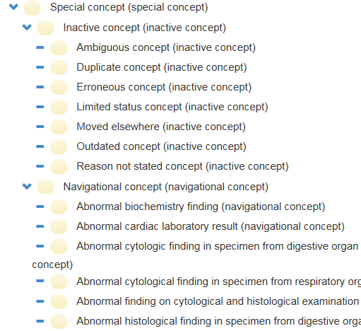
SNOMED CT inside versus outside

Slide 158
‘Adverse events’
  ReMINE’s notion of adverse event
  an ‘incident [that] occurred during the past and [is] documented in a database of adverse events’
      Stefano Arici, Paolo Bertele. ReMINE Deliverable D4.1 – RAPS Taxonomy: approach and definition. V1.0 (Final) August 8, 2008. (p21)
… which is a ‘perdurant’ - ibidem (p26)
… ‘that occurs to a patient’ - ibidem (p23)
  an expectation of some future happening that can be prevented - ibidem (p23)

Slide 159
Terminologists agree, ontologists think …
Can something which is an incident be at the same time an expectation ?
Can something which is an incident a time t, later become an adverse event simply because it [?] has been entered in a database ?
Can adverse events really occur in software ?
…

Slide 160
Terminological versus Ontological approach
The terminologist defines:
  ‘a clinical drug is a pharmaceutical product given to (or taken by) a patient with a therapeutic or diagnostic intent’. (RxNorm)
The (good, real) ontologist thinks:
  Does ‘given’ includes ‘prescribed’?
  Is manufactured with the intent to … not better?
    Are newly marketed products – available in the pharmacy, but not yet prescribed – not clinical drugs?
    Are products stolen from a pharmacy not clinical drugs?
    What about such products taken by persons that are not patients?
      e.g. children mistaking tablets for candies.

Slide 161
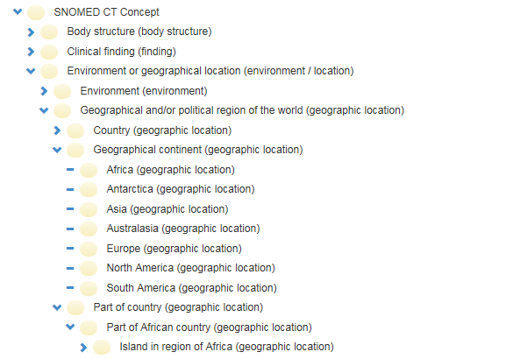
Error:
confusing particulars with types
http://browser.ihtsdotools.org/
Oct 14, 2015

Slide 162
Do you see the ambiguity ?
‘Persistent idiopathic facial pain (PIFP)’
  = ‘persistent facial pain with varying presentations …’
persistent
facial pain
presentation
type1
presentation
type2
presentation
type3
types
t₂
t₃
t₁
t₁
t₁
t₂
t₂
t₃
t₁
t₃
parti-
culars
t₁
t₂
t₂
t₁
t₃
t₂
t₃
t₃
my pain
her pain
his pain

Slide 163
Make it clear whether assertions are about particulars or types
‘Persistent idiopathic facial pain (PIFP)’
  = ‘persistent facial pain with varying presentations …’
  if the description is about types, then the three particular pains fall under PIFP.
  if the description is about (arbitrary) particulars, then only her pain falls under PIFP.

Slide 164
What you should NEVER FORGET !!!
(major take home message)
Crucial distinctions made in Ontological Realism
ontology ←→ ontologies
reality ←→ representation
particulars ←→ types
continuants ←→ occurrents

