Slide 1
Water quality reporting in Buffalo, NY. Lecture in BMI199: What is Biomedical Informatics? Dec 1, 2020 online, University at Buffalo
Werner CEUSTERS, MD
Departments of Biomedical Informatics and Psychiatry,
UB Institute for Healthcare Informatics,
Ontology Research Group, Center of Excellence in Bioinformatics and Life Sciences,
University at Buffalo, NY, USA

Slide 2
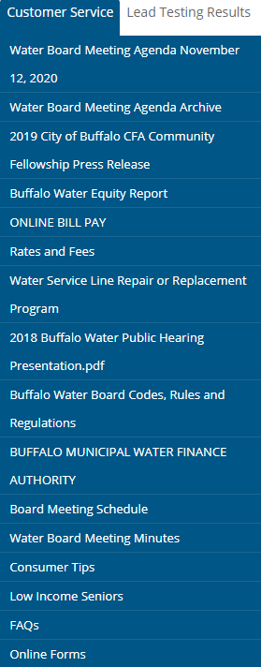
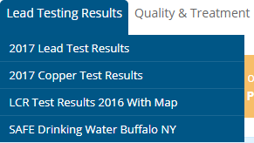
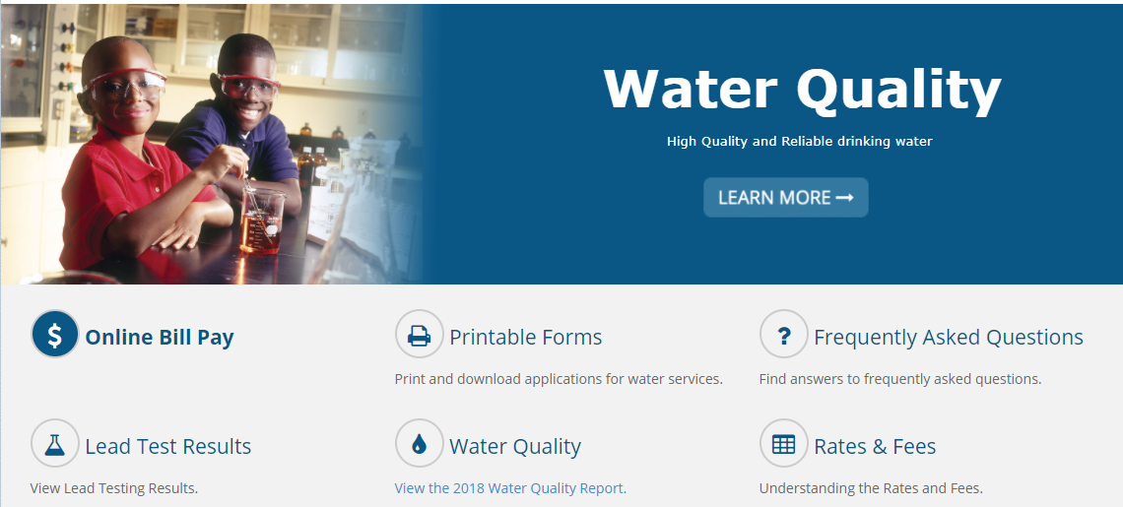
Buffalo Water
https://buffalowater.org/

Slide 3
Some 2019 Buffalo water trivia
Treated over 24.8 billion gallons,
= 68 million gallons / day
= 262 gallon /day / citizen in served area (260,000)
maximum on February 5, 2019: 80.5 million gallons.

Slide 4
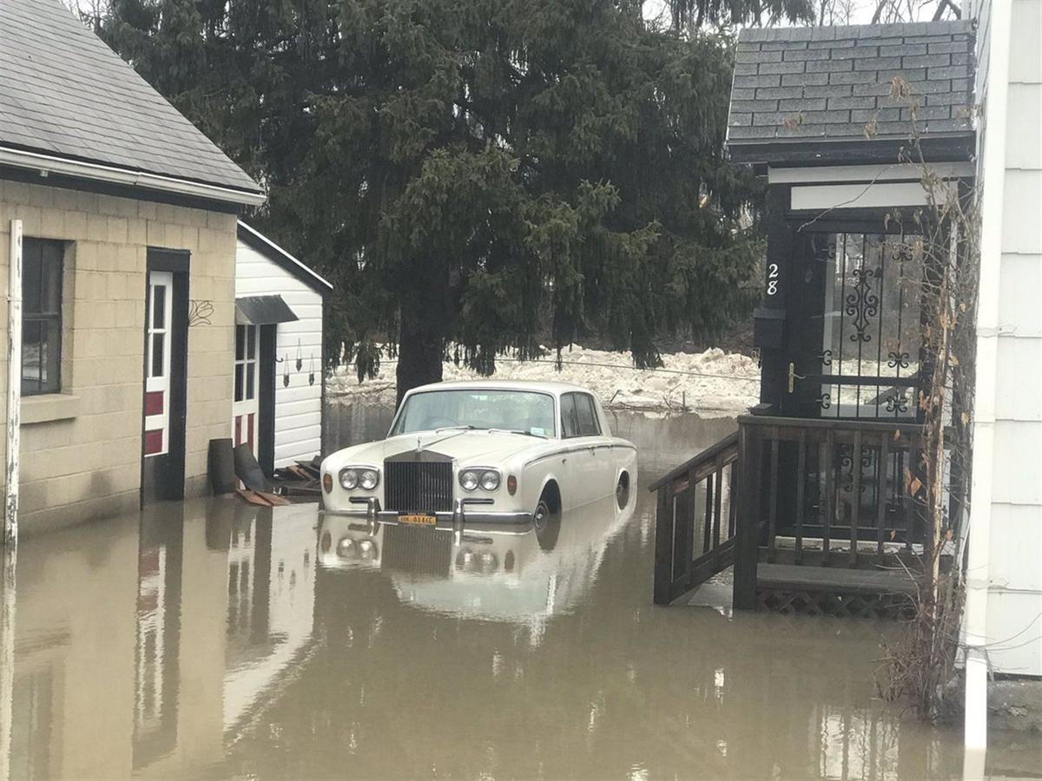
Feb 5 2019

Slide 5
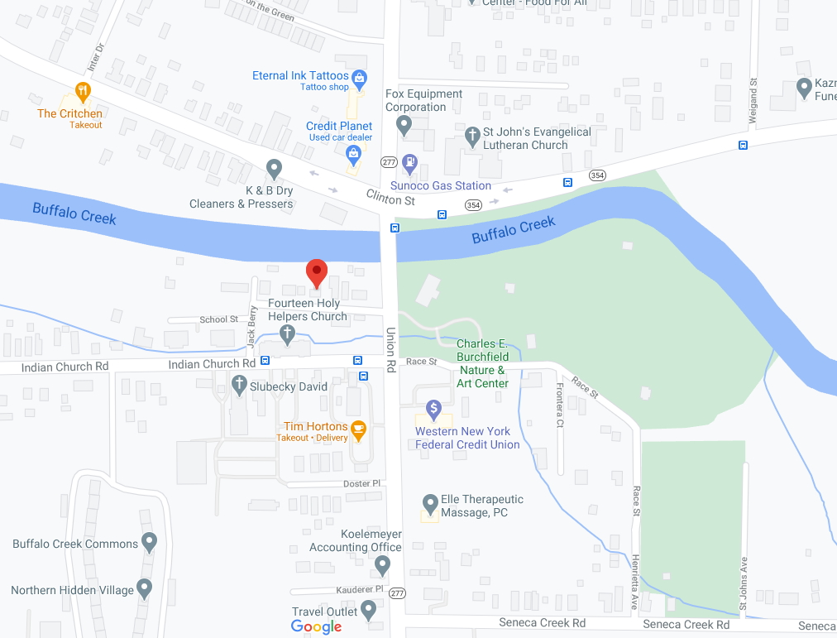

Slide 6
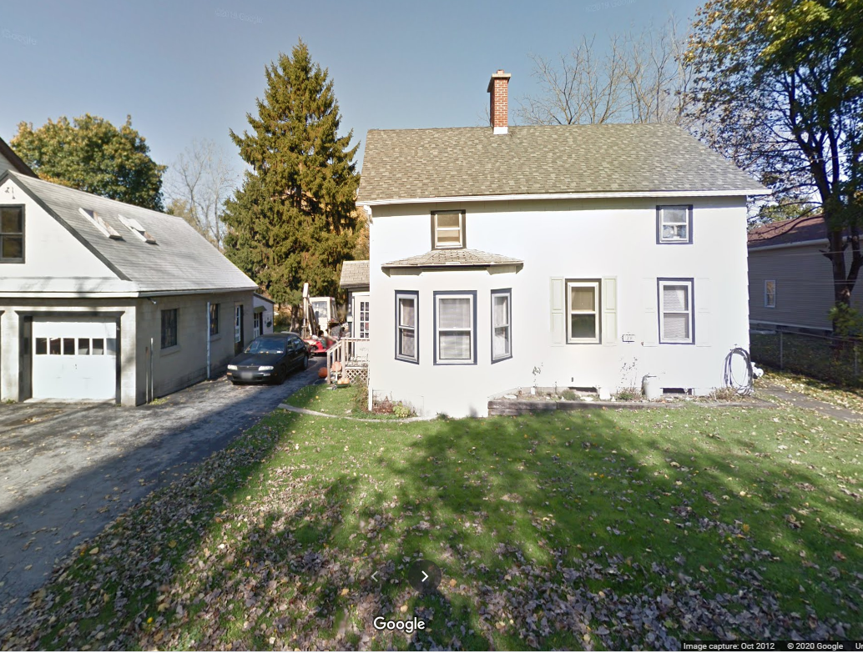

Slide 7
Some 2019 Buffalo water trivia
Treated over 24.8 billion gallons,
= 68 million gallons / day
= 262 gallon per Buffalo citizen
maximum on February 5, 2019: 80.5 million gallons.
825 miles of water main pipe (not including hydrant laterals and service connections),
23,860 valves,
80,000 service connections and
7,966 fire hydrants.

Slide 8
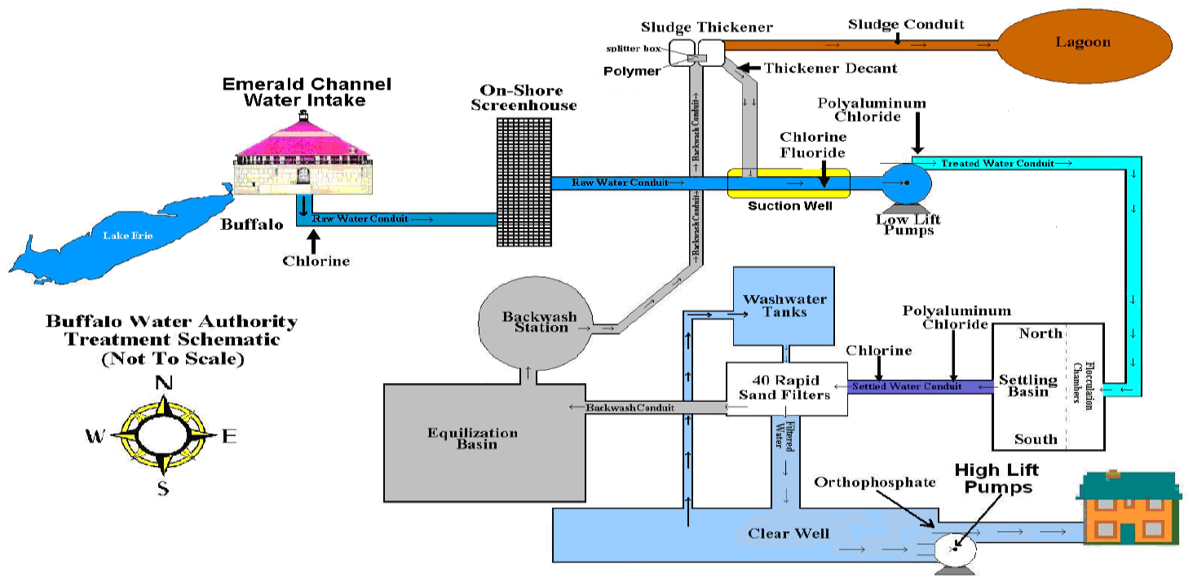
Buffalo’s water treatment system
https://buffalowater.org/quality/treatment/watertreatmentschematic/

Slide 9
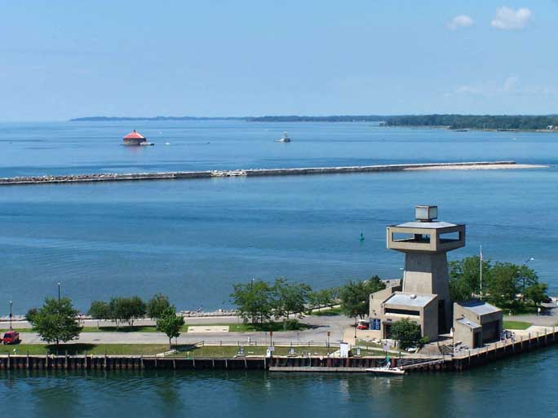
https://buffaloah.com/a/water/waterintake/

Slide 10
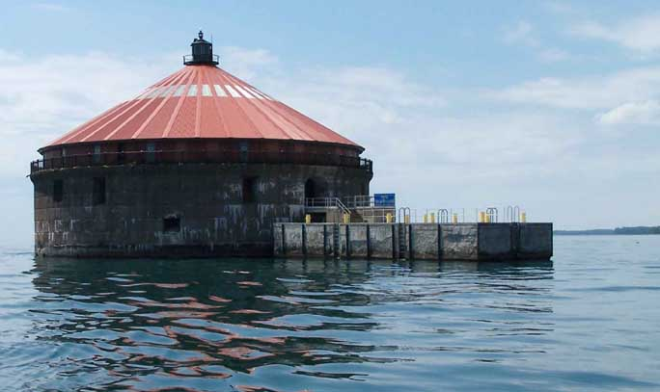
Emerald channel water intake
https://buffaloah.com/a/water/waterintake/

Slide 11
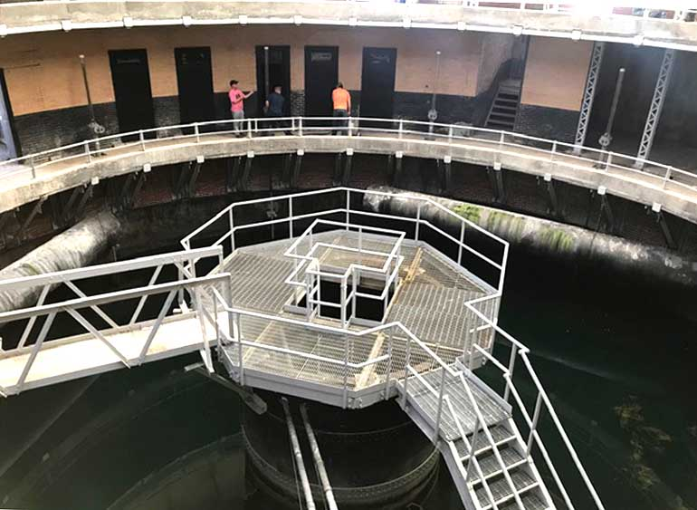
https://buffaloah.com/a/water/waterintake/

Slide 12
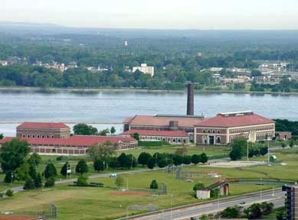
Col. Ward Pumping station
https://buffaloah.com/a/porter/ward/ward.html

Slide 13
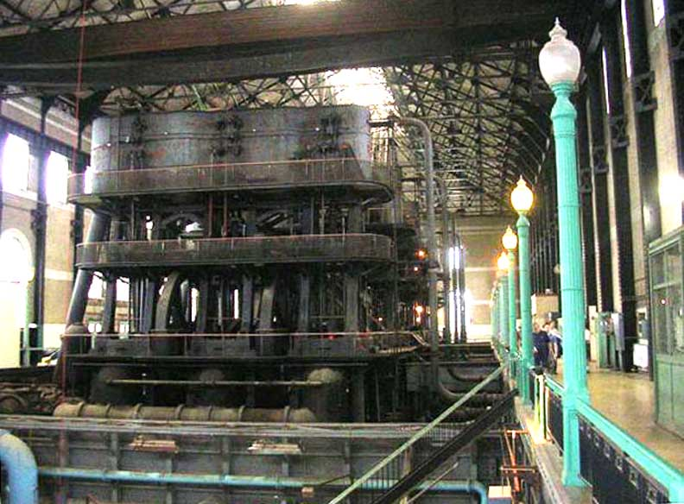
https://buffaloah.com/a/porter/ward/int06/index.html

Slide 14
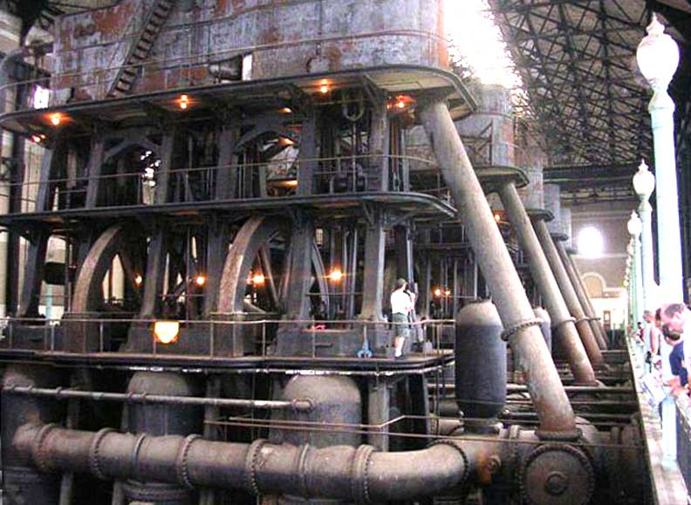
https://buffaloah.com/a/porter/ward/int06/index.html

Slide 15
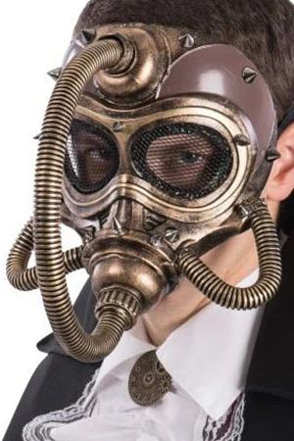
‘Steam pumps’, not ‘steampunk’
https://www.pinterest.com/pin/627478160554455896/

Slide 16
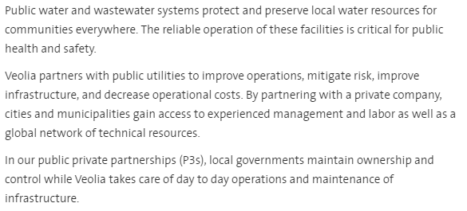
https://www.veolianorthamerica.com/what-we-do/water-capabilities/public-water-wastewater-systems

Slide 17
Water quality control
https://buffalowater.org/about/departments/laboratory/

Slide 18
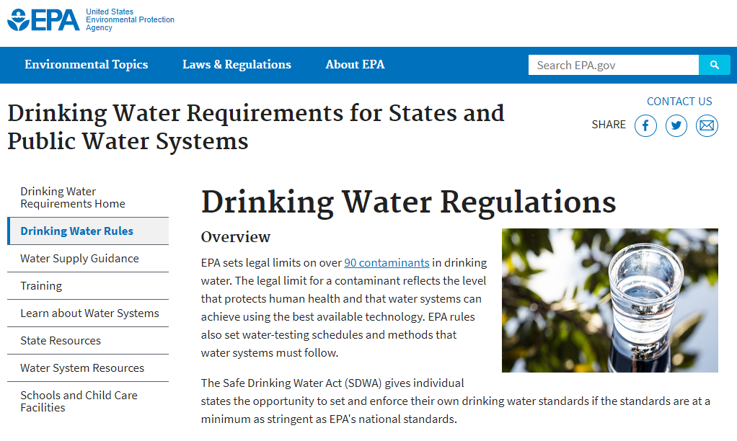
https://www.epa.gov/dwreginfo/drinking-water-regulations

Slide 19
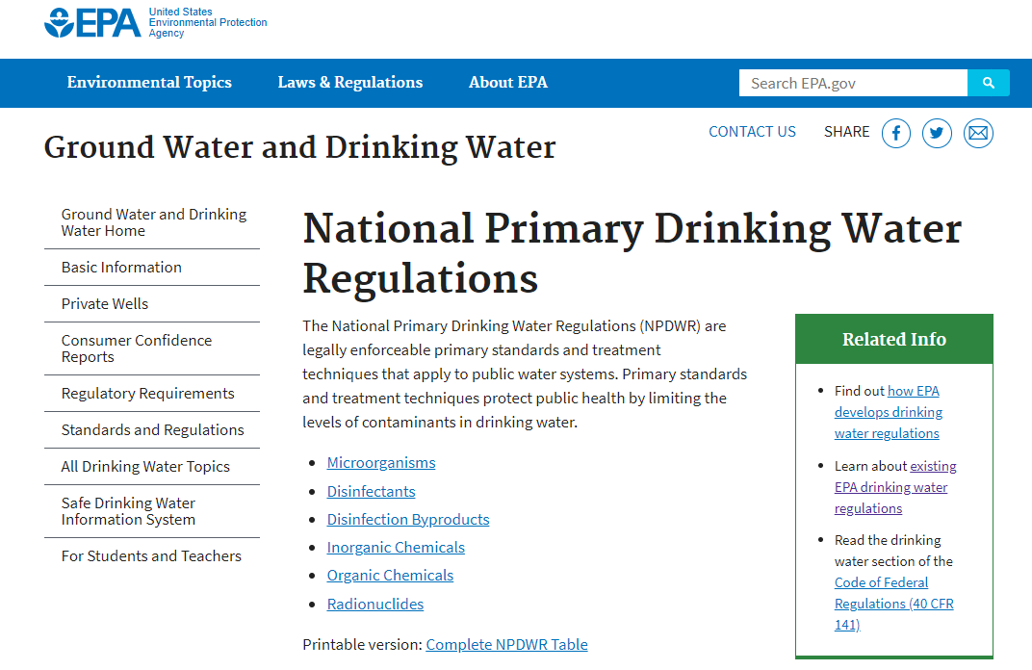
https://www.epa.gov/ground-water-and-drinking-water/national-primary-drinking-water-regulations

Slide 20
Assignment A12
Access https://buffalowater.org/Quality/WaterQualityReports/.
From ALL reports between and including 2000-2001 and 2019-2020:
Accumulate the levels of Barium, Copper, Fluoride, Lead, and Nitrate in a spreadsheet,
Identify when regulations were violated,
Produce and interpret graphs showing the changes in concentration levels of these chemicals over the past 20 years,
Report on problems encountered with respect to information gathering, extraction, reformatting and interpretation.

Slide 21
Inorganic contaminants regulations
Contaminant | MCLG (mg/L)
Antimony | 0.006
Arsenic | 0
Asbestos (fiber > 10 micrometers) | 7 million fibers per liter (MFL)
Barium | 2
Beryllium | 0.004
Cadmium | 0.005
Chromium (total) | 0.1
Copper | 1.3
Cyanide (as free cyanide) | 0.2
Fluoride | 4
Lead | zero
Mercury (inorganic) | 0.002
Nitrate (measured as Nitrogen) | 10
Nitrite (measured as Nitrogen) | 1
Selenium | 0.05
Thallium | 0.0005

Slide 22
Assignment A12
Task description:
Data and graphs must be made in Excel
Interpretations, procedures, difficulties encountered and conclusions must be made in a Word document.
Files submitted must be named ‘A12-XXX.docx’ and ‘A12-XXX.xlsx’ (‘XXX’ replaced by your Ubitname) and be properly formatted as files of these types.
Send your work by email to wceusters@gmail.com not later than Monday Dec 7– 9AM.

