Slide 1
Being successful with assignments Lecture in BMI199: What is Biomedical Informatics? Sept 12, 2019 5 Diefendorf, University at Buffalo
Werner CEUSTERS, MD
Departments of Biomedical Informatics and Psychiatry,
UB Institute for Healthcare Informatics,
Ontology Research Group, Center of Excellence in Bioinformatics and Life Sciences,
University at Buffalo, NY, USA

Slide 2
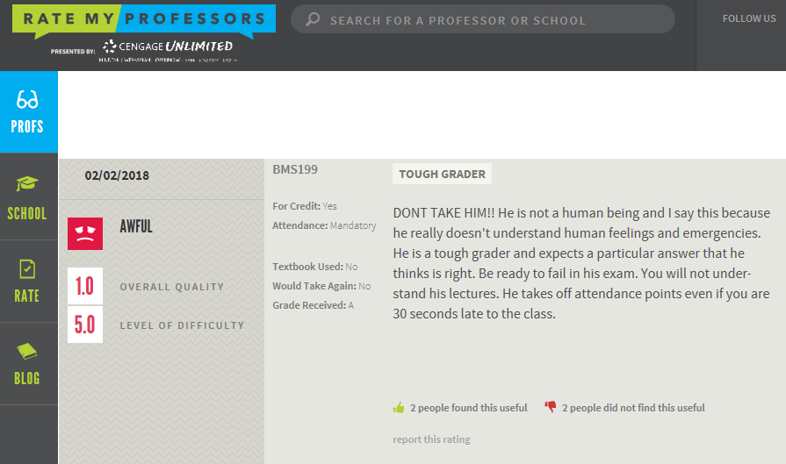
An opinion

Slide 3
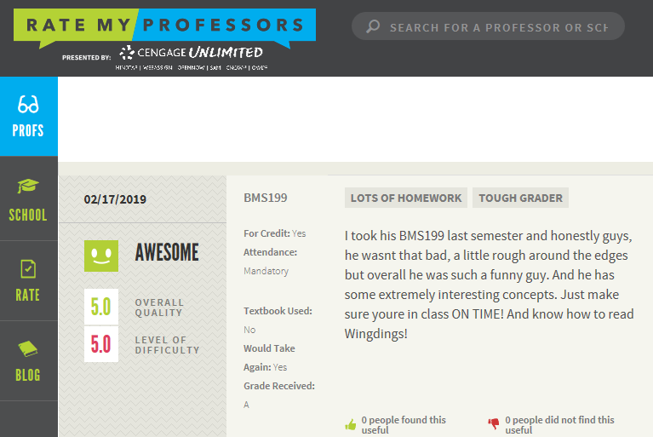
Another opinion

Slide 4
Form
Submit only electronically through email at:
wceusters@gmail.com
All submissions in format readable by either Microsoft Word or Microsoft Excel, depending on assignment.
File names:
‘C’
Number of week assignment due
‘-’
Your last name and first name
Example: C4-CeustersWerner.docx / C4-CeustersWerner.xlsx

Slide 5
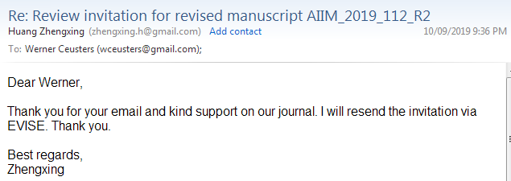
Assignments due
By
Wednesday 1pm
the week after assignment is given!
‘Sent date’ in my mailer counts as proof

Slide 6
What graders are looking for
Facts
Arguments
Opinions

Slide 7
Essential features of responses
For describing facts:
Correctness,
To the point,
Preciseness.
For arguments:
Based on facts,
Preciseness,
Adequate reasoning (logic).
For opinions:
Explicit declaration,
Compelling rhetorics.

Slide 8
Correctness / Preciseness
Question:
8 + 5 = ?
Answer:
12, 13 or 14.

Slide 9
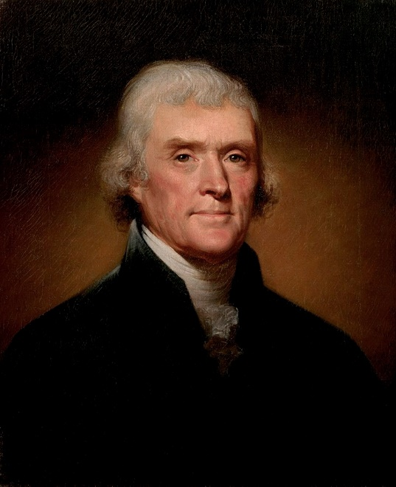
Preciseness
Who is this ?
Acceptable answer:
‘Thomas Jefferson’

Slide 10
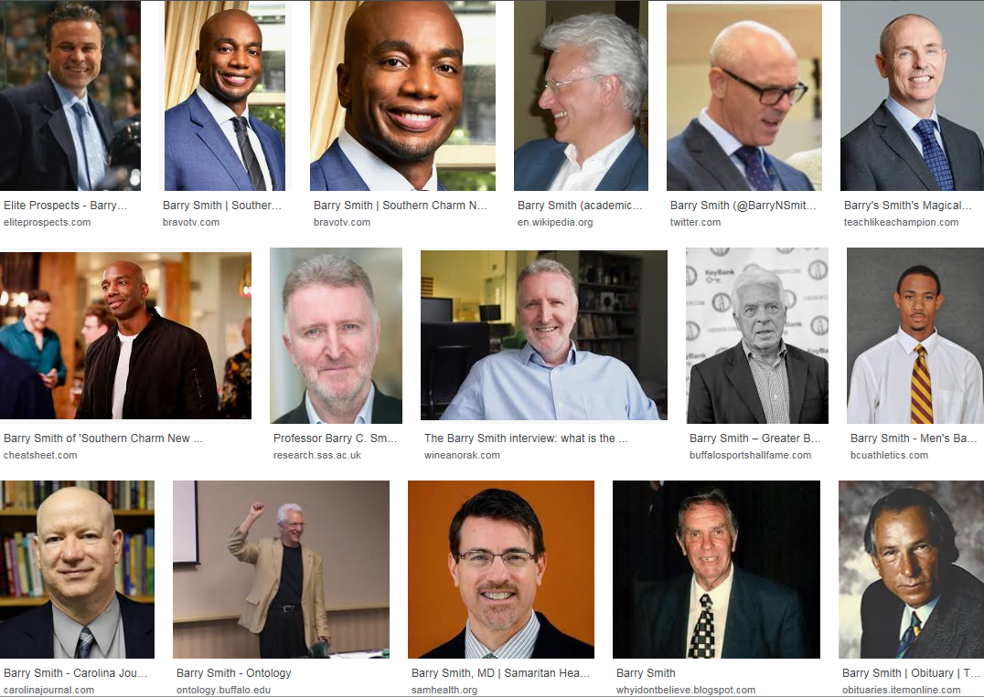
However: ‘Barry Smith’

Slide 11
Preciseness
Is this Thomas Jefferson?
Acceptable answer:
‘No’

Slide 12
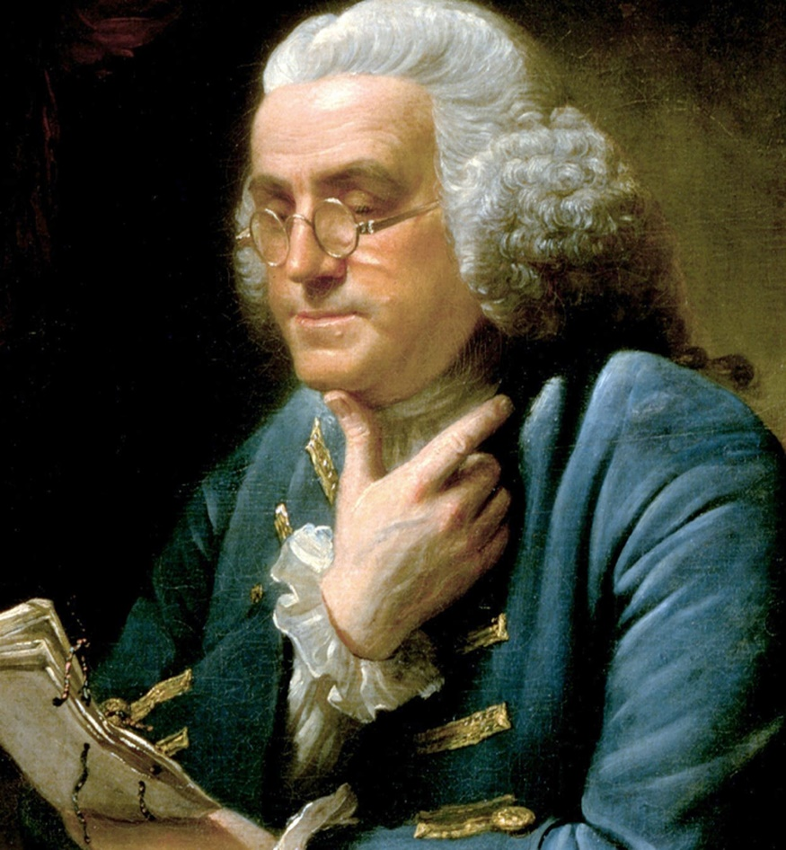
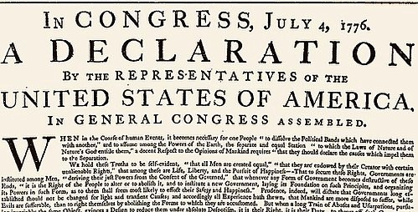
‘All men are created equal’

Slide 13
Assignment due next week: C4…
Watch https://www.youtube.com/watch?v=b694exl_oZo
As well as https://www.youtube.com/watch?v=CgOcEZinQ2I&feature=share&list=FLwikA_t8e6TSJW-L-lAHkKw
Draft a proposal for criteria that would allow one to say that something is alive, taking into account that one ‘something’ might be very distinct from another ‘something’ and that for distinct ‘somethings’ the criteria might be different. Consider in your proposal arguments in favor and against the hypothesis that general criteria for life can be construed.

