Slide 1

Faithfulness of
Electronic Healthcare Record Data: a Shared Responsibility!
Grand Round of the Department of Biomedical Informatics
January 9, 2019 – Buffalo, NY, USA
Werner CEUSTERS, MD
Department of Biomedical Informatics, Division of Biomedical Ontology
and
UB Institute for Healthcare Informatics,
University at Buffalo

Slide 2
Talk layout
Why this topic ? Why me?
EHR Functionalities and expectations
EHR-related morbidity
Secondary use and data quality
What now?

Slide 3
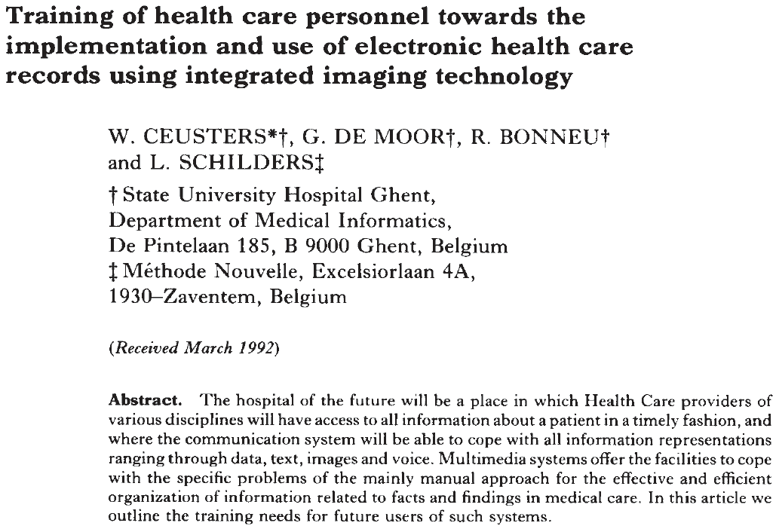

Slide 4
Pubmed – [EHR] OR [EMR] count
(January 3, 2019)

Slide 5
EHRs: attention to functionality (US)
← Billing
← Practice management
← Lab results
← ePrescribing
← Regulations
← Clinical

Slide 6
EHRs: attention to functionality (US)
W.Europe
← Billing
← Practice management
← Lab results
← ePrescribing
← Regulations
← Clinical
③
②
①

Slide 7
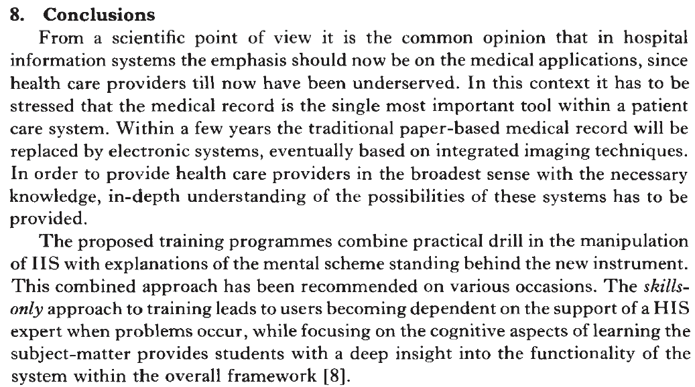

Slide 8
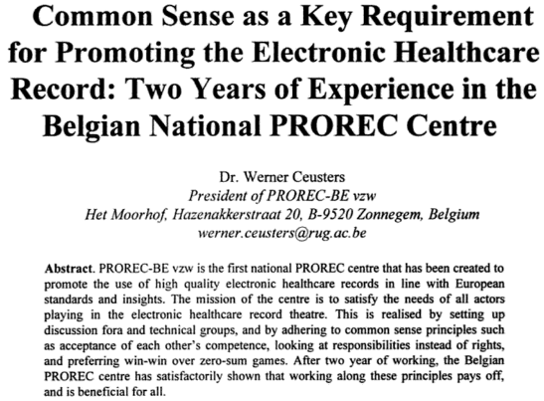
1996

Slide 9


Slide 10
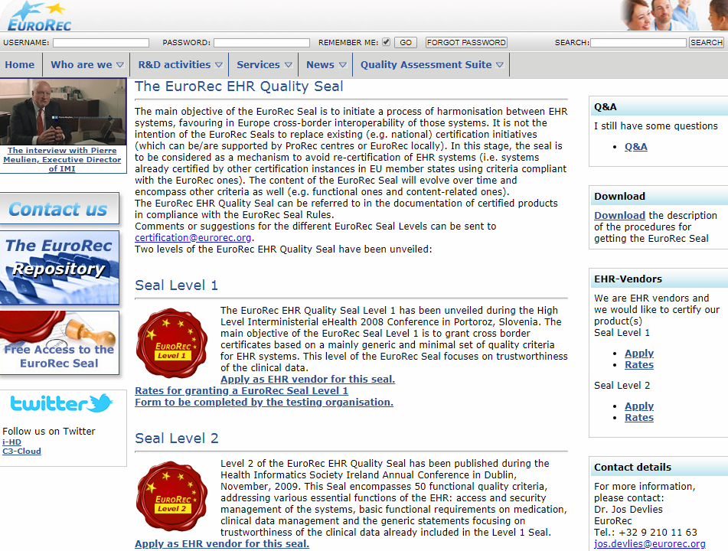

Slide 11
Pubmed – [EHR] OR [EMR] count
(January 3, 2019)

Slide 12
Pubmed – [EHR] OR [EMR] count
(January 3, 2019)

Slide 13
Was I right?

Slide 14

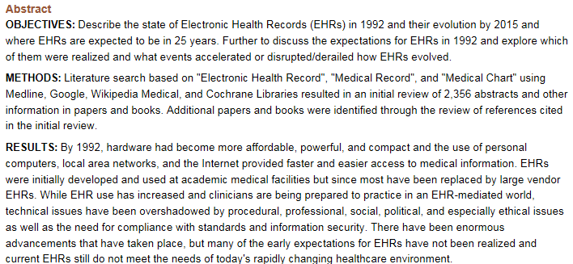

Slide 15
Functionality and Effectiveness

Slide 16
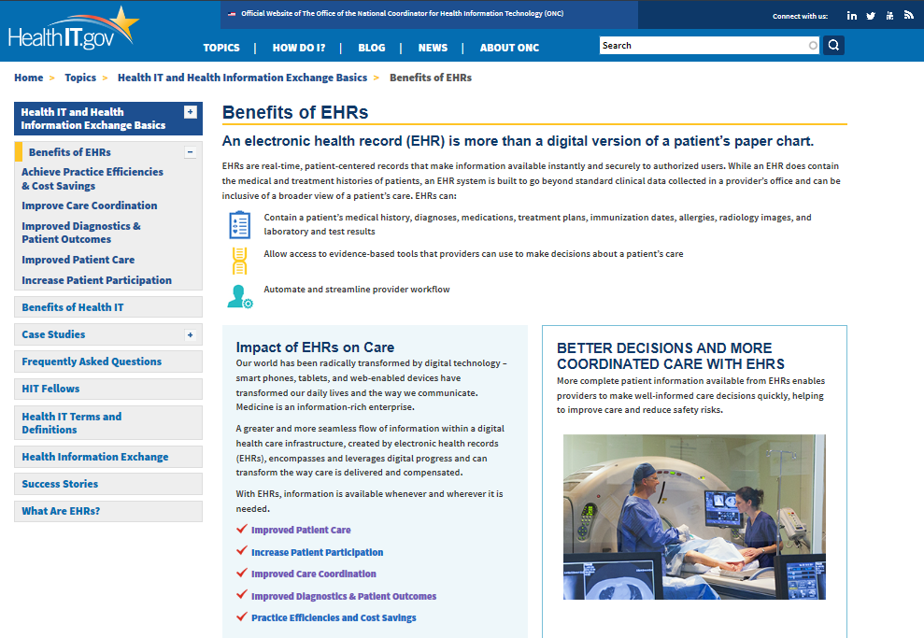
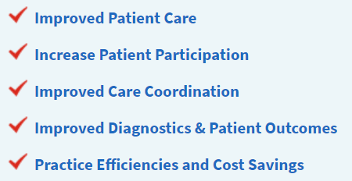
https://www.healthit.gov

Slide 17
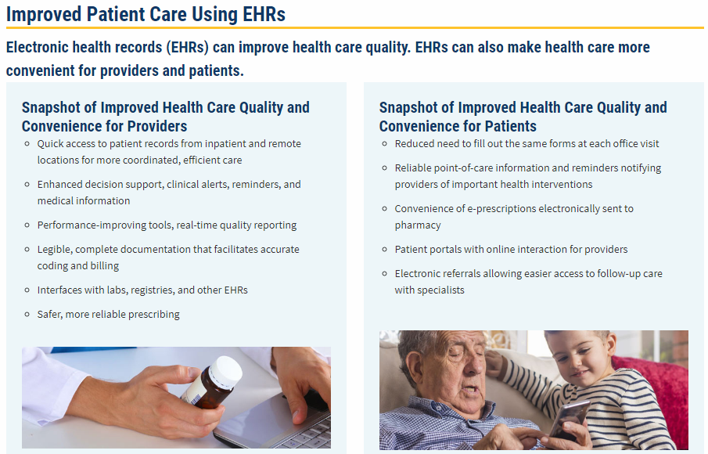

Slide 18
True or wishful thinking?

Slide 19

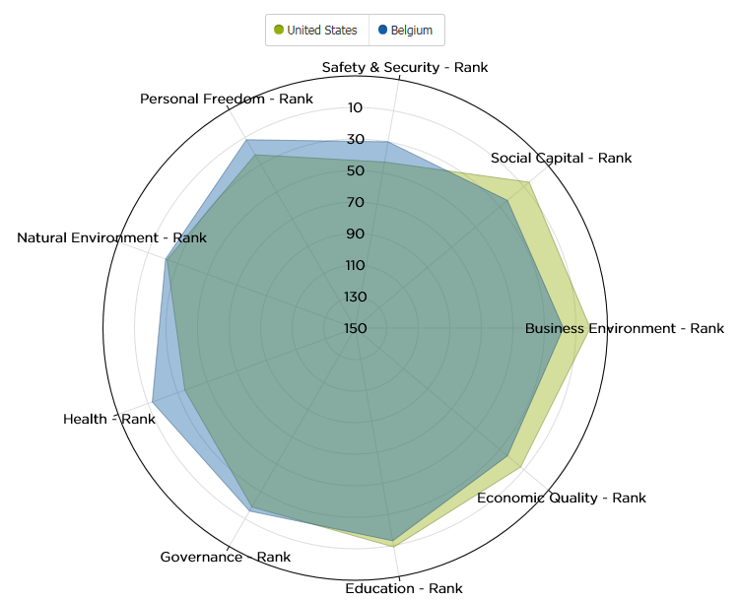

Slide 20
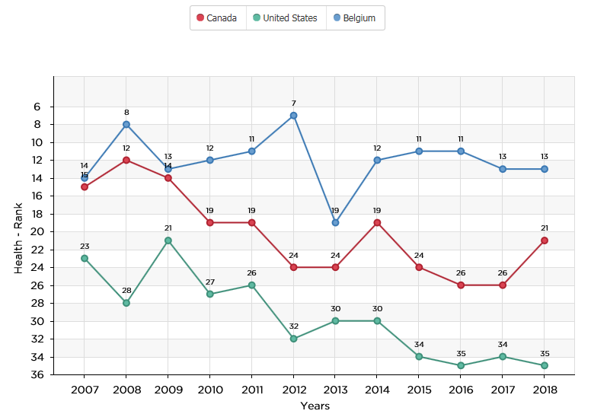
Rank

Slide 21
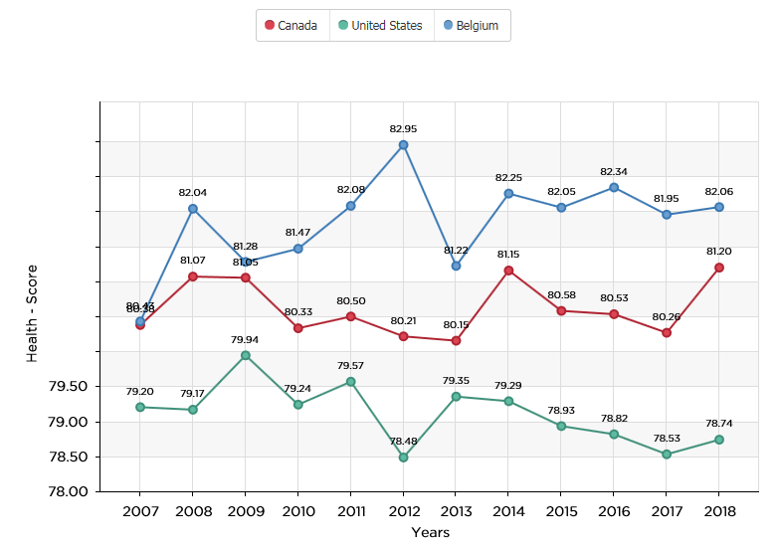
Score

Slide 22
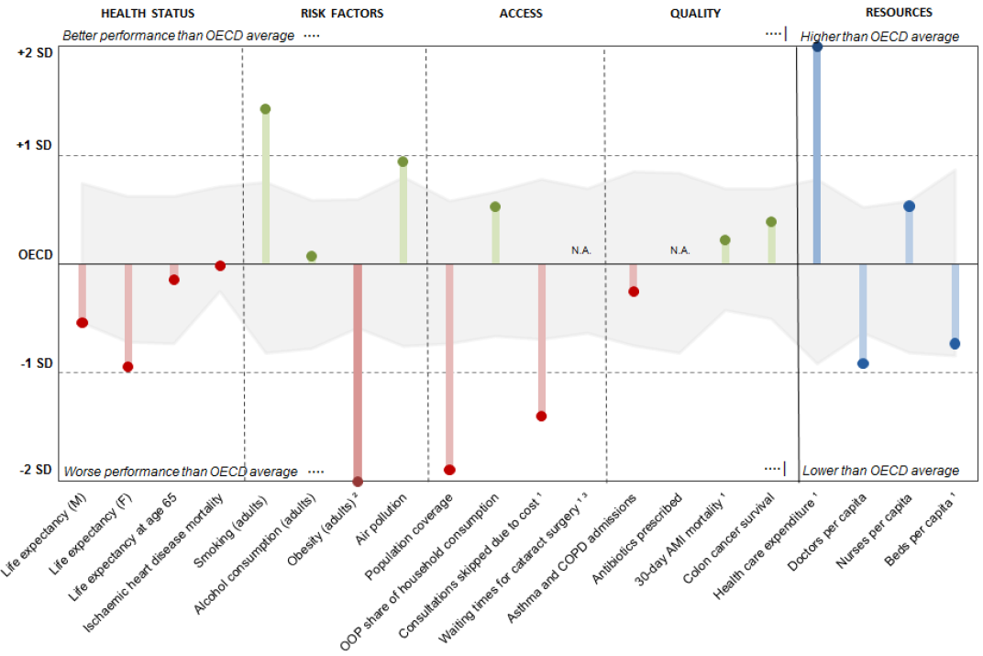
Health status US / OECD
How good is healthcare in the US?
Health at a Glance 2017:
USA/OECD Indicators

Slide 23
USA compared to OECD
Health status: life expectancy at birth was in 1970 one year above the OECD, but now almost two years below average.
Risk factors: 38% of adults obese (OECD average 19.4%), 70% overweight or obese.
Access: US trails many other OECD countries in access to care indicators. Only 91% of the population covered by insurance (2nd lowest coverage rate).
  22% of Americans skipped consultations due to cost (OECD average of 9.1%).
Quality: for most quality of care indicators, the United States performs close to the OECD average.
Resources: health spending averages $9 892 per person (adjusted for local costs), almost double than in all other countries.
Health at a Glance 2017: USA/OECD Indicators

Slide 24
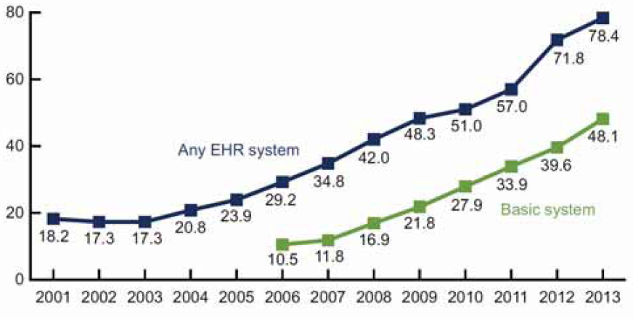
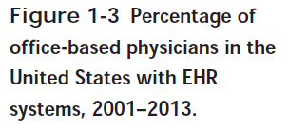
https://www.pearsonhighered.com/content/dam/region-na/us/higher-ed/en/custom-product/gartee-electronic-health-records-3e/pdf/gartee3e-ch1.pdf

Slide 25
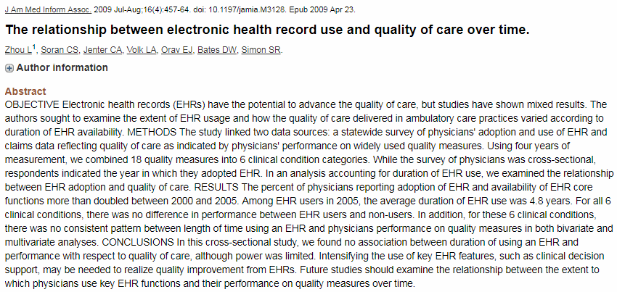
True or wishful thinking?

Slide 26
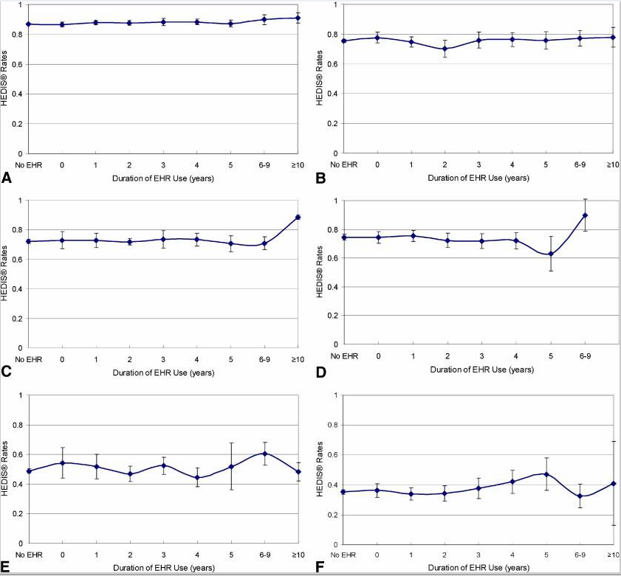
HEDIS® Quality Measures
▶A. Cancer Screening.
▶B. Diabetes Care.
▶C. Asthma Care.
▶D. Well Child and Adolescent Visit
▶E. Behavioral and Mental Health.
▶F. Women's Health.

Slide 27
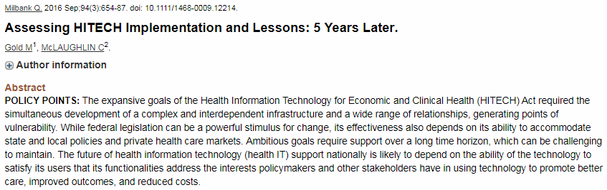
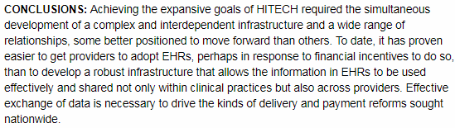

Slide 28
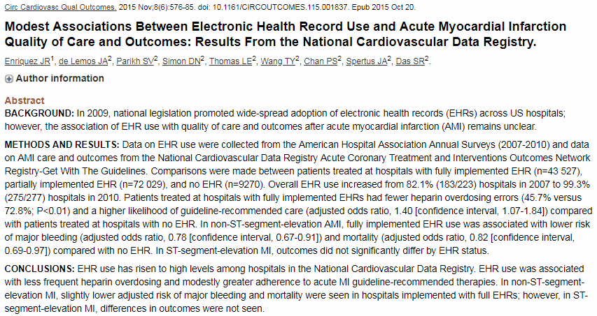
EHR use and patient outcomes

Slide 29
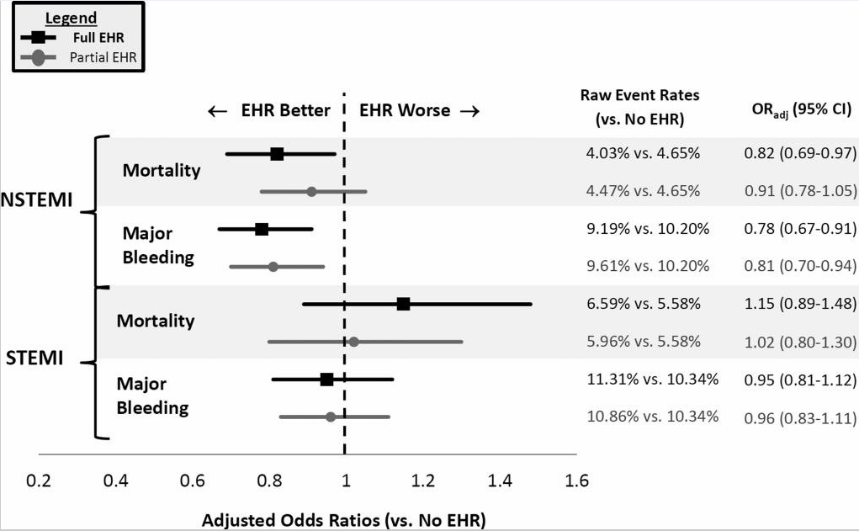
EHR use and MI outcomes

Slide 30
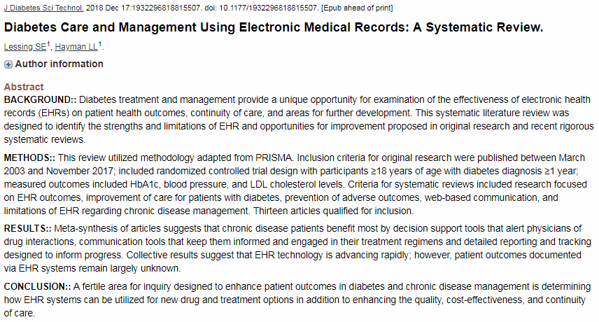
EHR and chronic disease management

Slide 31
Systematic review of 13 studies
chronic disease patients benefit most by:
  decision support tools that alert physicians of drug interactions,
  communication tools that keep them informed and engaged in their treatment regimens and
  detailed reporting and tracking designed to inform progress.
Collective results suggest that EHR technology is advancing rapidly;
however, patient outcomes documented via EHR systems remain largely unknown.
Lessing SE¹, Hayman LL. Diabetes Care and Management Using Electronic Medical Records: A Systematic Review.
J Diabetes Sci Technol. 2018 Dec 17.

Slide 32
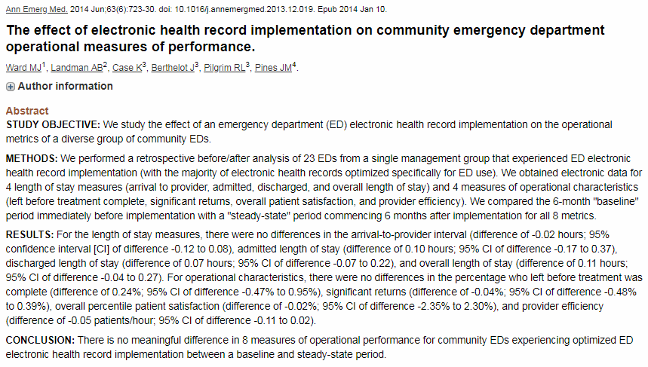
Impact on ICUs

Slide 33
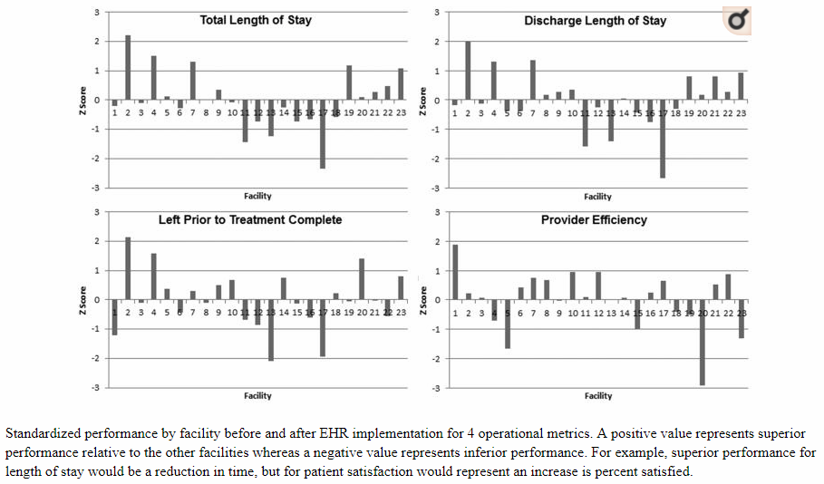
Ann Emerg Med. 2014 Jun;63(6):723-30. doi: 10.1016/j.annemergmed.2013.12.019. Epub 2014 Jan 10.
The effect of electronic health record implementation on community emergency departmentoperational measures of performance.
Ward MJ¹, Landman AB², Case K³, Berthelot J³, Pilgrim RL³, Pines JM⁴.

Slide 34
Ann Emerg Med. 2014 Jun;63(6):723-30. doi: 10.1016/j.annemergmed.2013.12.019. Epub 2014 Jan 10.
The effect of electronic health record implementation on community emergency departmentoperational measures of performance.
Ward MJ¹, Landman AB², Case K³, Berthelot J³, Pilgrim RL³, Pines JM⁴.

Slide 35
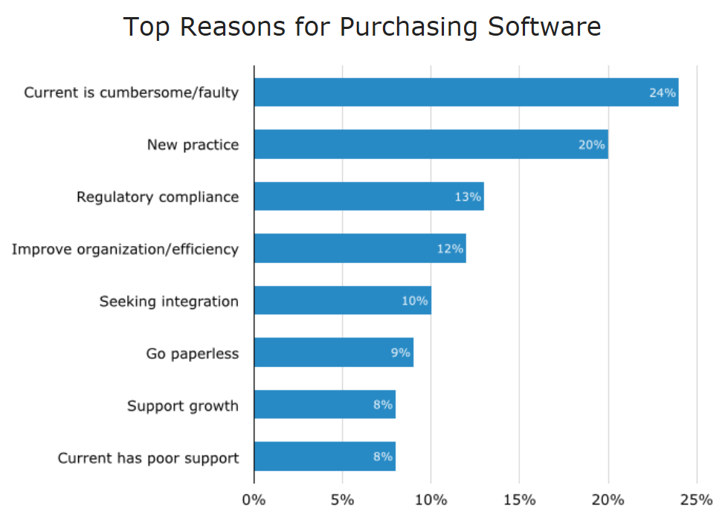
https://www.softwareadvice.com/resources/ehr-software-buyer-trends-2015/

Slide 36
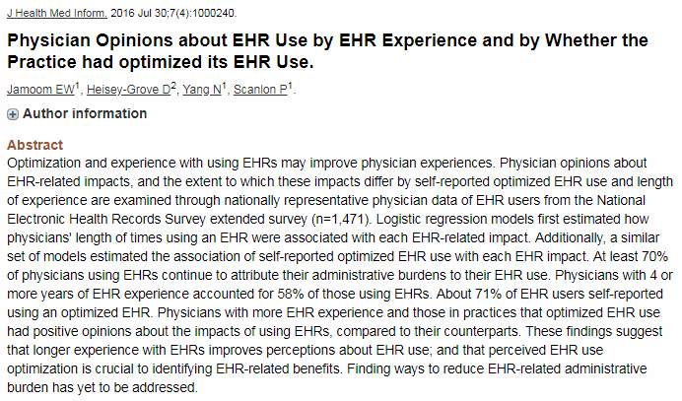
Importance of optimization of EHR

Slide 37
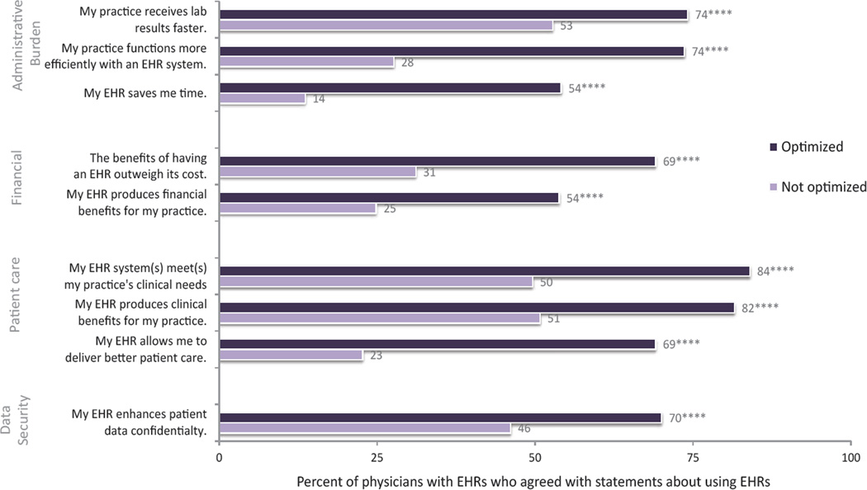
Physician satisfaction with EHR

Slide 38
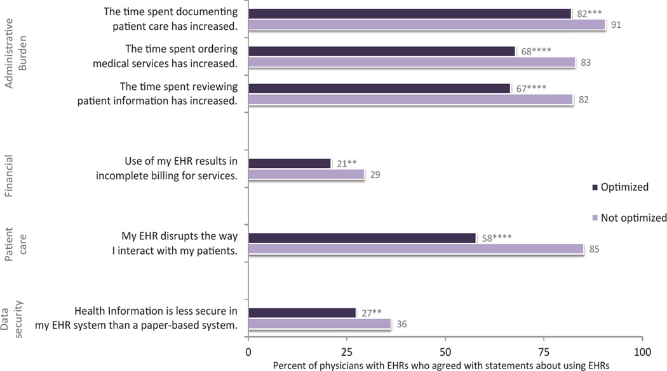
Physician dissatisfaction with EHR

Slide 39
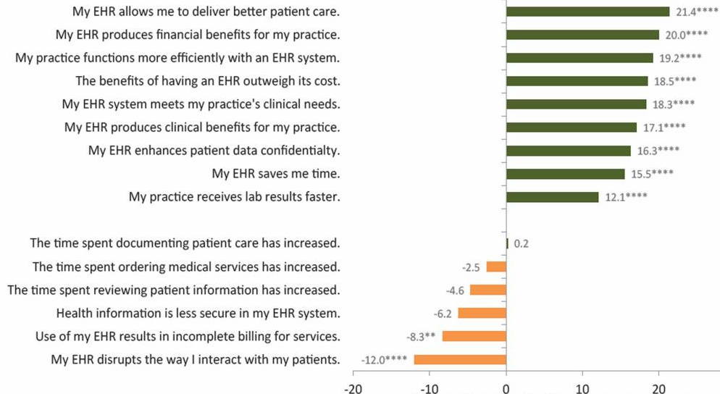
% difference EHR use < or > 4 year

Slide 40
Reasons cited for not allowing students to document in the EHR.
Reasons for not allowing student documentation
(37% of 97 institutions, EM clerkship):
80% | Medical school or hospital rule forbidding student documentation
60% | Concern for medical liability
53% | Inability for student notes to support medical billing
38% | Lack of computer workspace/access
15% | No documentation educational objective for the clerkship
11% | Lack of ability to review notes and provide feedback

Slide 41
Reasons cited for not allowing students to document in the EHR.
95% EM clerkships reviewed student notes for feedback:
Fewer than half of notes reviewed (70%)
Half to three-quarters of notes reviewed (23%)
Three quarters or more reviewed (7%)
Feedback provided by faculty (92%)
Feedback provided by clerkship director (40%)
Feedback provided by residents (64%)
Oral feedback only provided (75%)
Oral and written feedback given (25%)
Documentation considered in final grade (58%)

Slide 42
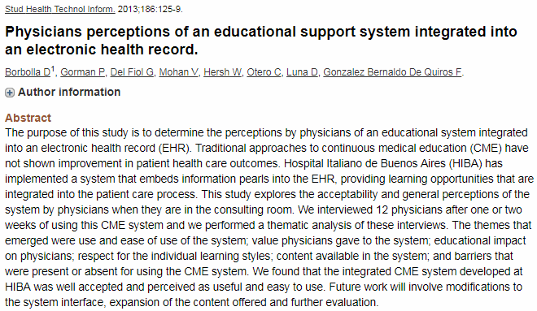

Slide 43
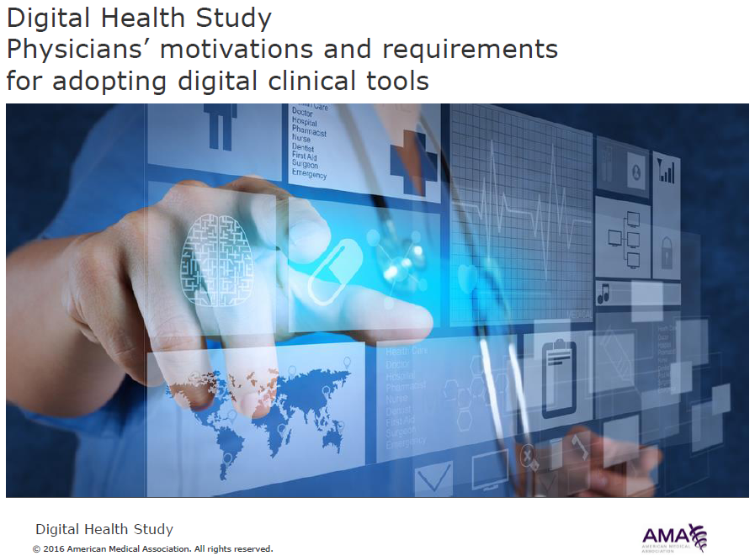

Slide 44
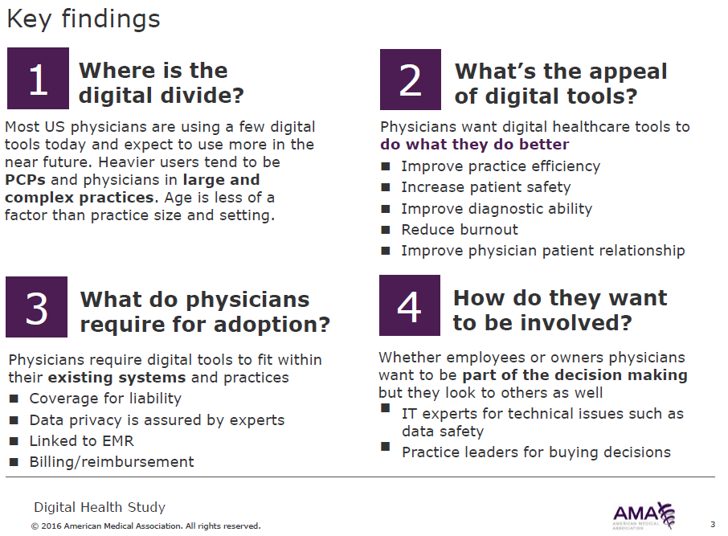

Slide 45
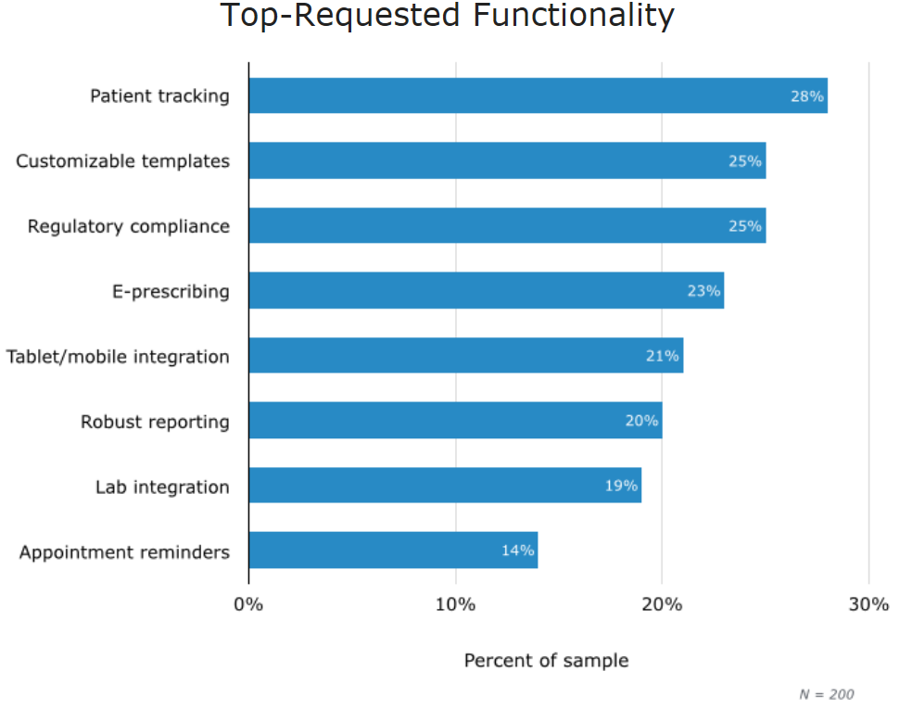
https://www.softwareadvice.com/resources/ehr-software-buyer-trends-2015/

Slide 46
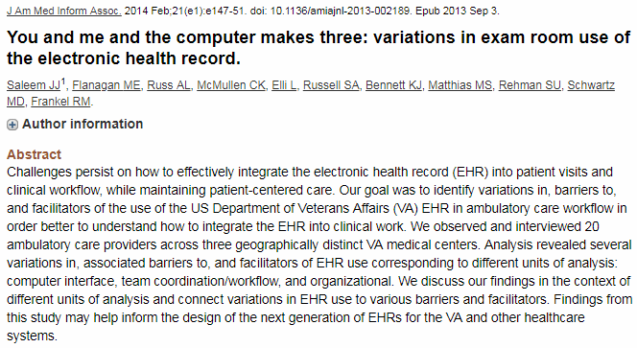

Slide 47
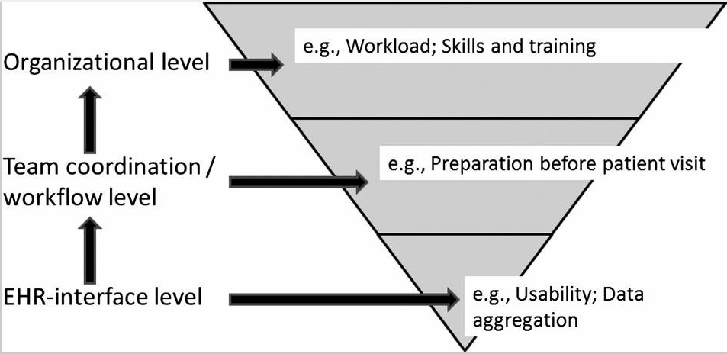

Slide 48
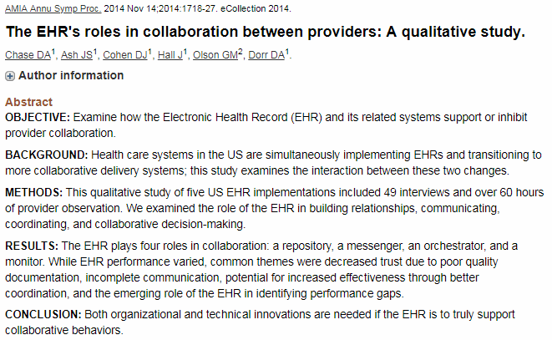

Slide 49
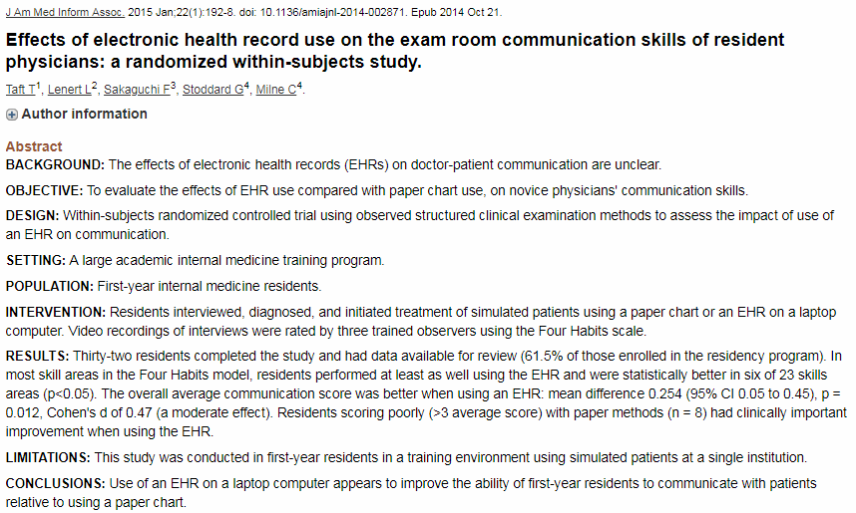

Slide 50
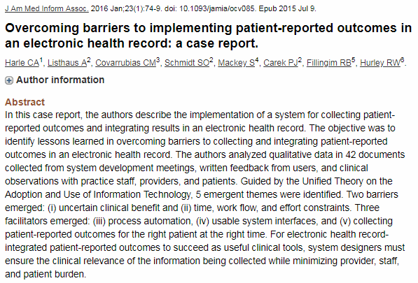

Slide 51
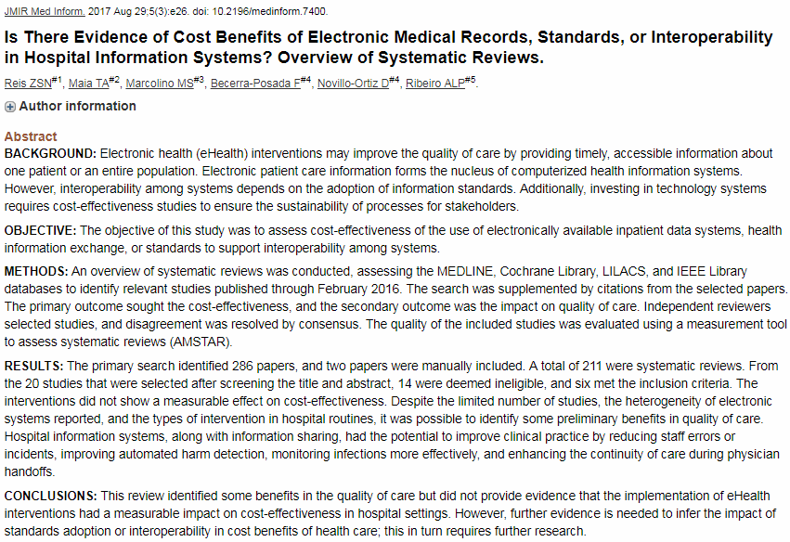

Slide 52
EHRs are good for you

Slide 53
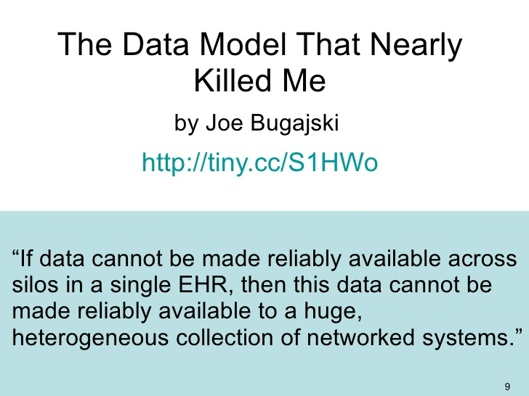

Slide 54
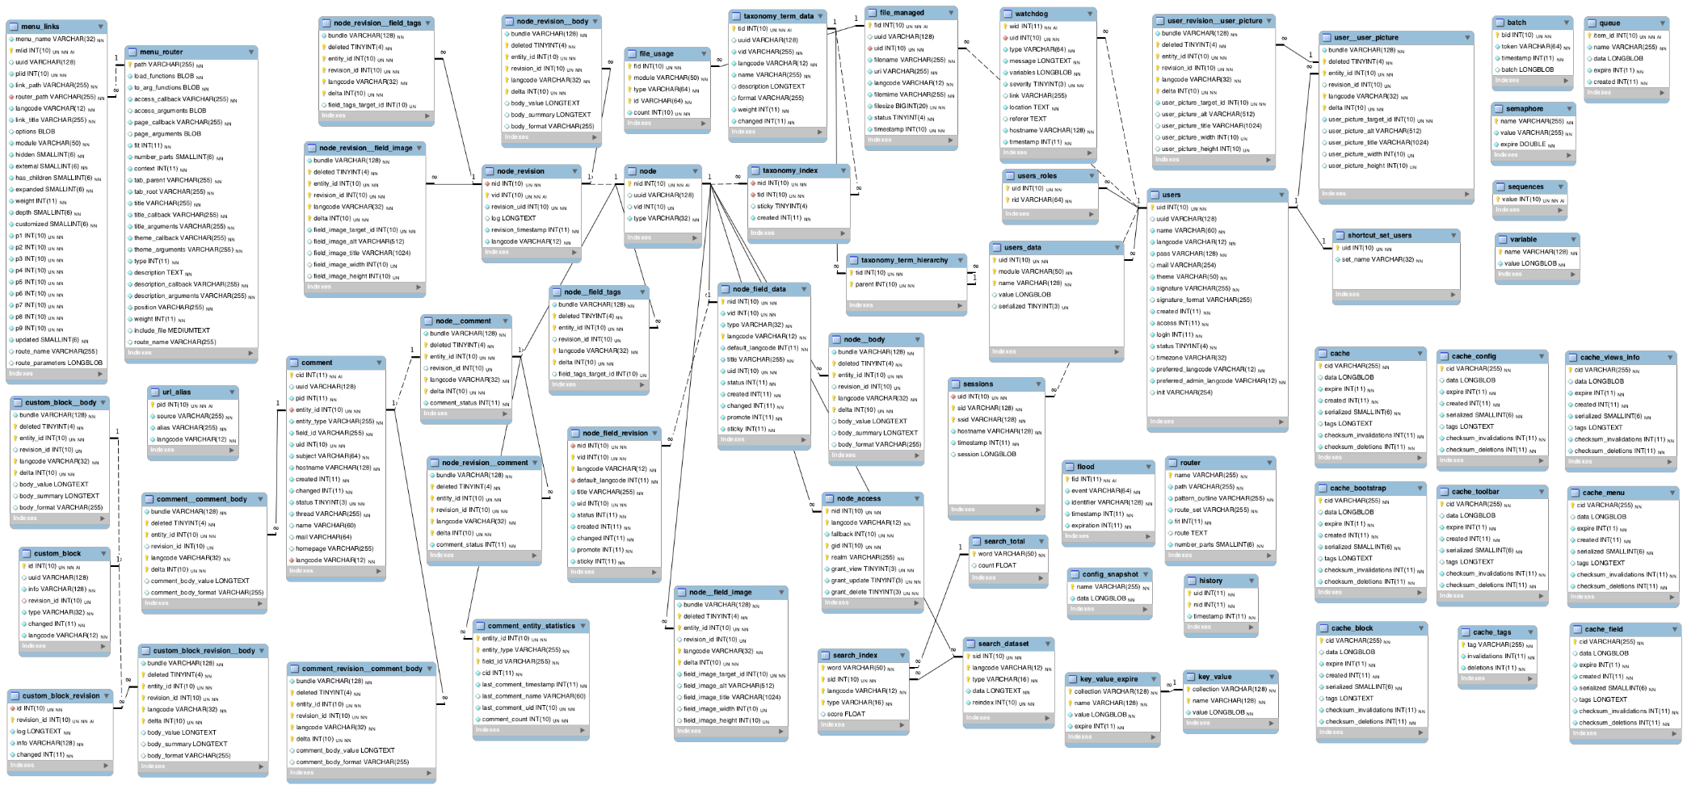

Slide 55
A usability and safety analysis of electronic health records: a multi-center study.
System feedback | 54 | 93.5 | 74.5 | 82.4
Suboptimal clinical decision support or error prevention | 70.8 | 97.4 | 91.7 | 93.6
No feedback to user about system actions | 7.8 | 1 | 5.6 | 2.9
Automation or conversion with no clear feedback | 18 | 1.4 | 0 | 2.4
Wrong feedback about system actions | 3.4 | 0.2 | 2.7 | 1.1
Visual display | 28.9 | 2.9 | 13.8 | 9.7
Suboptimal interface between applications | 37.1 | 7.4 | 49.2 | 36.7
Hard to find or confusing information display | 34.3 | 31.5 | 32 | 33
Wrong information displayed | 26.4 | 59.3 | 13.1 | 26.8
Alert difficult to interpret | 2.2 | 1.8 | 5.7 | 3.5
Data entry | 13 | 2.3 | 10.6 | 6.2
Confusing data entry (where to put info) | 36.5 | 29.6 | 59.6 | 45.8
Work-around needed | 36.5 | 22.7 | 30.9 | 30.8
Unable to enter desired information | 27 | 47.7 | 9.5 | 23.4
Workflow support | 4.1 | 1.3 | 1.1 | 1.7
Mismatch between mental model and actual system | 15 | 56 | 40 | 38.2
Lack of support for communication | 70 | 8 | 20 | 32.7
Suboptimal teamwork support | 15 | 36 | 40 | 29.1
J Am Med Inform Assoc. 2018 Sep 1;25(9):1197-1201. Ratwani RM^{1,2}, Savage E¹, Will A¹, Arnold R³, Khairat S⁴, Miller K¹, Fairbanks RJ^{1,2}, Hodgkins M⁵, Hettinger AZ^{1,2}.
Notes:
Based on 9000 patient safety reports related to medications. 2 EPIC sites, 1 Cerner.

Slide 56
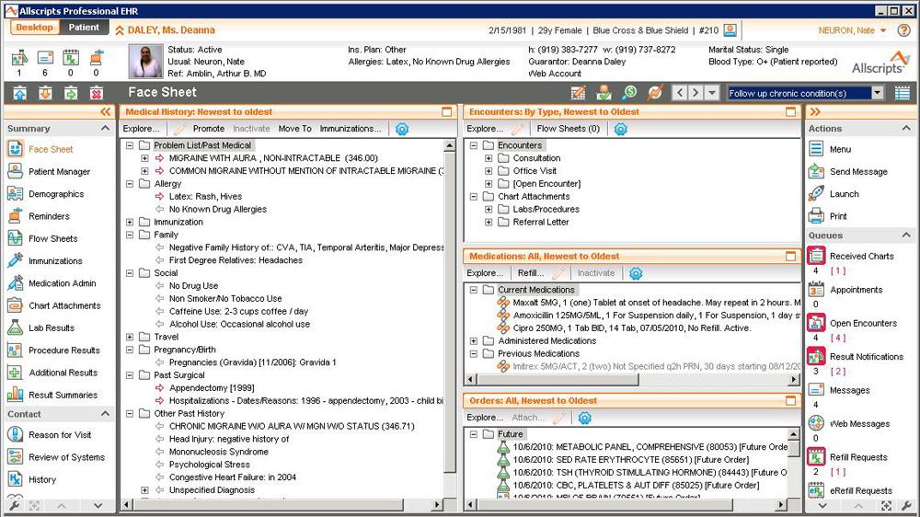
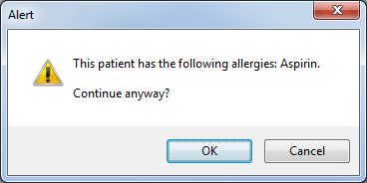

Slide 57
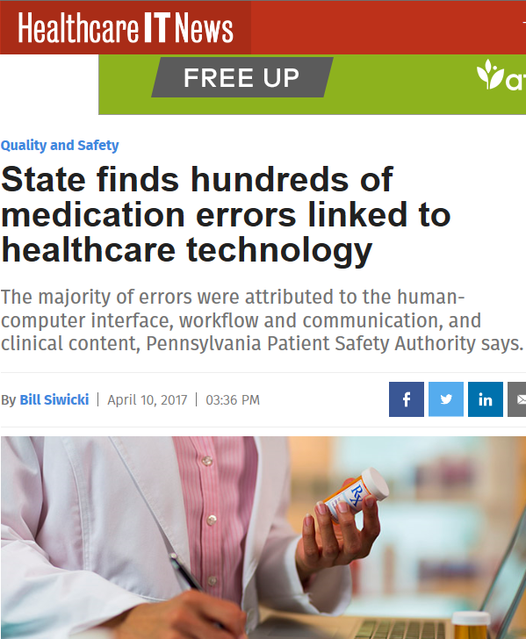
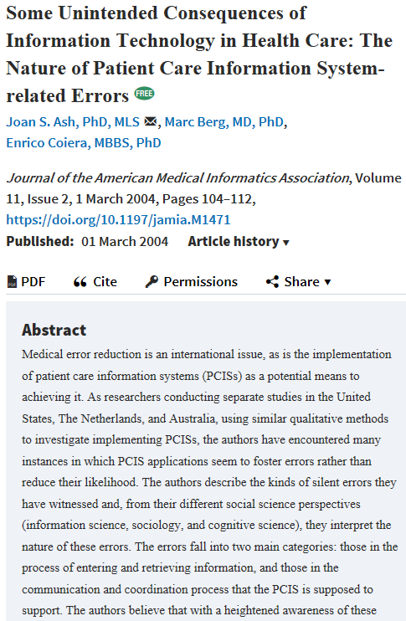

Slide 58
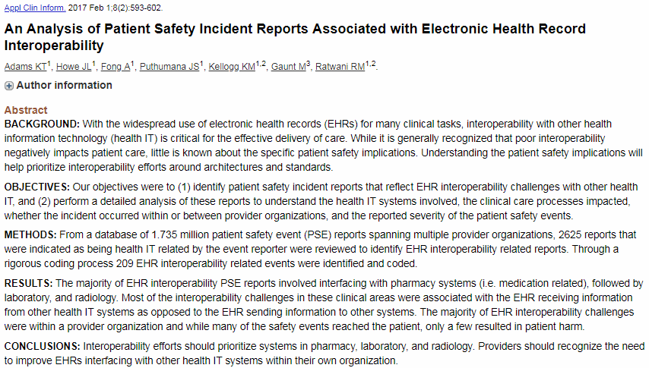

Slide 59
Secondary use
Issues of data quality

Slide 60
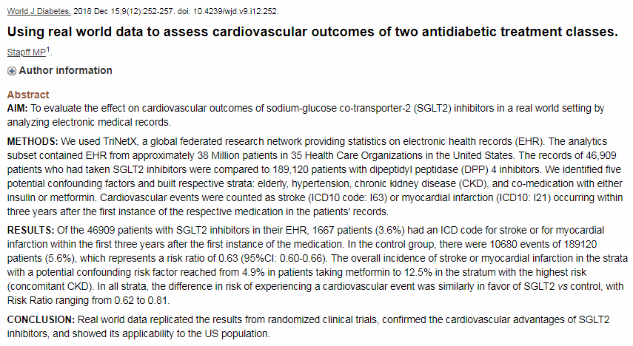
TriNetX data confirm RCT results

Slide 61
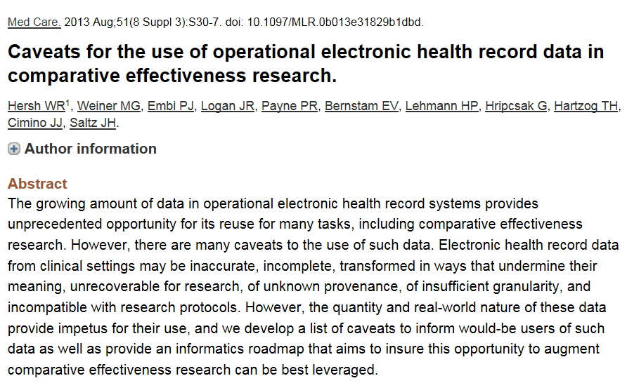

Slide 62
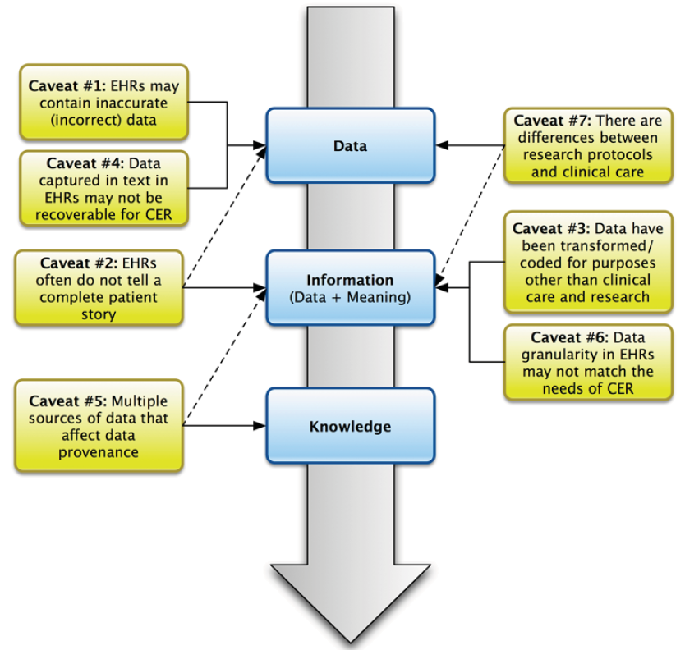
W.R Hersh, M.G. Weiner, P.J. Embi, J.R. Logan, P.R. Payne, E.V. Bernstam, H.P. Lehmann, G. Hripcsak, T.H. Hartzog, J.J. Cimino, J.H. Saltz.
Caveats for the use of operational electronic health record data in comparative effectiveness research,
Medical care 51 (2013), 30-37.

Slide 63

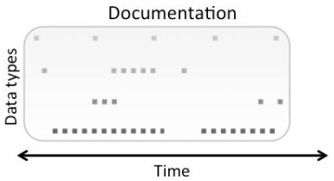
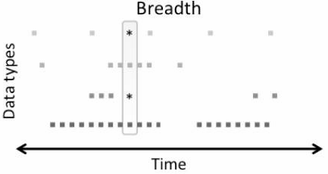


all observations made about a patient
all desired types (for 2^{ndary} use) of data
a preset number or frequency over time
sufficient to predict a phenomenon of interest

Slide 64

Incidence and prevalence calculations for care planning

Slide 65

Possible Assumptions for Observable person-time in EHR Databases (OE)
Clin Epidemiol. 2018 Dec 17;11:1-15.
Measuring prevalence and incidence of chronic conditions in claims and electronic health recorddatabases.
Rassen JA¹, Bartels DB², Schneeweiss S^{1,3,4}, Patrick AR¹, Murk W^{1,5}.

Slide 66
Design choices for incidence
Incidence numerator | (N/A) | The number of patients who did have the disease observed in the POI, were at risk for onset of disease, and did not have disease observed in the lookback time.
Cumulative incidence denominator | At-risk, Day 1 population | The number of patients who were at risk for onset of disease and who contributed an observable person-day on the first day of the POI.
 | At-risk, complete-period population | The number of patients who were at risk for onset of disease and who contributed all possible observable person-days within the POI.
 | At-risk, any-time population | The number of patients who were at risk for onset of disease and who contributed all ≥1 person-days within the POI.
 | At-risk sufficient-time population | The number of patients who were at risk for onset of disease and who contributed at least “n” observable person-days within the POI; n≥1.
Incidence rate denominator | Person-time at risk | The amount of observable person-time in the POI at risk for onset of disease.
Clin Epidemiol. 2018 Dec 17;11:1-15.
Measuring prevalence and incidence of chronic conditions in claims and electronic health recorddatabases.
Rassen JA¹, Bartels DB², Schneeweiss S^{1,3,4}, Patrick AR¹, Murk W^{1,5}.

Slide 67
Incidence/prevalence design choices from EHR - data
Observability: 3
Lookback time: 2
Lookback-observability requirement: 2
              Prevalence Incidence
Numerator 2 1 (cumulative: 4!)
Denominator 4 1
Combined 96 12 (48)
Clin Epidemiol. 2018 Dec 17;11:1-15.
Measuring prevalence and incidence of chronic conditions in claims and electronic health recorddatabases.
Rassen JA¹, Bartels DB², Schneeweiss S^{1,3,4}, Patrick AR¹, Murk W^{1,5}.

Slide 68

Effects of different look-back choices
Clin Epidemiol. 2018 Dec 17;11:1-15.
Measuring prevalence and incidence of chronic conditions in claims and electronic health recorddatabases.
Rassen JA¹, Bartels DB², Schneeweiss S^{1,3,4}, Patrick AR¹, Murk W^{1,5}.
Notes:
Case 1: 1-year lookback; Day 1 population. Case 2: 2-year lookback; Day 1 population. Case 3: all-time lookback; Day 1 population. Case 4: all-time lookback; complete-time population. Shaded regions indicate 95% confidence intervals.

Slide 69


Slide 70


Slide 71

NDF
NDF
NDF
NDF
Notes:
NDF: no data field

Slide 72
Feasibility of real-time capture of routine clinical data in the electronic health record: a hospital-based, observational service-evaluation study.
Used Cerner’s PowerChart application to develop a SNOMED-based electronic PowerForm comprising a user-friendly interface for real-time entry of clinical data during consultation.
PowerForms were used in 360 (61%) of these patients, the rate increasing from 42% in June 2016 to 77% in January 2017.
The average consultation time, measured in the substudy of 44 patients, was 13.97±3.5 min using the PowerForm (n=22) compared with 14.22±2.95 min using conventional paper documentation (n=22).
BMJ Open. 2018 Mar 8;8(3):e019790. Bodagh N¹, Archbold RA¹, Weerackody R¹, Hawking MKD², Barnes MR³, Lee AM⁴, Janjuha S¹, Gutteridge C¹, Robson J², Timmis A^{1,5}.

Slide 73

Clinical Reasoning ←→ Documentation

Slide 74
Findings despite few studies (n=23)
4 key themes:
  purposes of electronic clinical notes,
  clinicians' reasoning for note-entry and reading/retrieval,
  clinicians' strategies for note-entry,
  and clinicians' strategies for note-retrieval/reading.
Findings:
  although patient care is the primary note purpose, non-clinical purposes have become more common,
  what clinicians document is affected by EHR interfaces,
  "assessment and plan" is the most read note section,
  what clinicians read is affected by external stimuli, care/information goals, and what they know about the patient.
Colicchio TK¹, Cimino JJ¹. Clinicians' reasoning as reflected in electronic clinical note-entry and reading/retrieval: a systematic review and qualitative synthesis. J Am Med Inform Assoc. 2018 Dec 20.

Slide 75
Digging in our own data

Slide 76


Slide 77
Data aggregation and use
Operational
systems
IHI Clinical
Integrated
Data Repository
Secondary
use
Cohort selection
EHR
Data Marts
EHR
EHR
EHR
Cost effectiveness
research
Bio Bank
Decision support
Health
Insurers
Quality assurance
Health
Insurers
Health
Insurers

Slide 78
Data aggregation and use
Operational
systems
IHI Clinical
Integrated
Data Repository
Secondary
use
Cohort selection
EHR
Data Marts
EHR
EHR
EHR
Cost effectiveness
research
Common Data Models
Bio Bank
Decision support
Health
Insurers
Quality assurance
Health
Insurers
Health
Insurers

Slide 79


Common Data Models for Secondary Use
The Observational Medical Outcomes Partnership (OMOP)
Health Care Systems Research Network (HCSRN)
The National Patient-Centered Clinical Research Network (PCORNet)

Slide 80
CDMs introduce mistakes
Blaisure J, Ceusters W. Business Rules to Improve Secondary Data Use of Electronic Healthcare Systems. Informatics for Health 2017, Manchester Central, UK, April 24-26, 2017. Stud Health Technol Inform. 2017;235:303-307.
Ceusters W, Blaisure J. A Realism-Based View on Counts in OMOP’s Common Data Model. 14th International Conference on Wearable, micro & Nano Technologies (pHealth 2017), Eindhoven, The Netherlands, May 14-16, 2017. Studies in Health Technology and Informatics 2017;237:55-62.
Blaisure J, Ceusters W. Improving the Fitness for Purpose of Common Data Models through Realism Based Ontology. AMIA 2017 Annual Symposium, Washington DC, Nov 04-08, 2017. AMIA Annu Symp Proc. 2017; 2017: 440–447.

Slide 81
Data aggregation and use
Operational
systems
IHI Clinical
Integrated
Data Repository
Secondary
use
Cohort selection
EHR
Data Marts
EHR
EHR
EHR
Cost effectiveness
research
Common Data Models
Bio Bank
Decision support
Health
Insurers
Realist Ontology (RO) & Referent Tracking (RT)- based
Data Repository
Health
Insurers
Quality assurance
Health
Insurers

Slide 82




RO and RT make 4 crucial distinctions
1
Reality ←→ representation

Slide 83
RO and RT make 4 crucial distinctions
Ontology ←→ an ontology
2

Slide 84
RO and RT make 4 crucial distinctions
3

Slide 85
RO and RT make 4 crucial distinctions
4

Slide 86
Research question
Can these principles be applied to assess the extent to which the transactions registered in the EHR’s database resulting from managing the problem list provide insight in:
the adequacy of the clinical user interface to capture
what the clinician had in mind, with the goal
to reconstruct the clinical reality of the patient?
Ceusters W, Blaisure J. Caveats for the use of the active problem list as ground truth for decision support. EFMI Special Topic Conference on Decision Support Systems and Education (EFMI STC-2018), Zagreb, Kroatia, Oct 14-16, 2018. Stud Health Technol Inform. 2018;255:10-14.

Slide 87


https://www.cms.gov/Regulations-and-Guidance/Legislation/EHRIncentivePrograms/downloads/3_Maintain_Problem_ListEP.pdf

Slide 88


L. Weed.
Medical records that guide and teach.
New England Journal of Medicine 278 (1968), 593-600.

Slide 89


Slide 90


Slide 91





Slide 92
Transitioning a problem

Slide 93



Problems
Encounters
Episodes
Salmon P, Rappaport A, Bainbridge M, Hayes G, Williams J. Taking the problem oriented medical record forward. Proc AMIA Annu Fall Symp. 1996:463-7.

Slide 94
Methodology
Problem
Type
Problem
Status
Problem
Category
Problem
Header
Problem
Instance
Encounter
~6,000,000
~6,000,000
Transition
Patient
~500,000
Problem Header
Change Record

Slide 95
Results
Problem
Type
Problem
Status
Problem
Category
Problem
Header
Problem
Instance
Encounter
~370,000
~6,000,000
~765,000
Transition
Patient
~23,000
~500,000
~80,000
Problem Header
Change Record
~395,000 rec. / ~664,000 ch.

Slide 96
Change count distributions
Changes | Frequency | Cumulative %
1 | 349,361 | 94.52%
2 | 16,325 | 98.94%
3 | 3,426 | 99.86%
4 | 312 | 99.95%
5 | 147 | 99.99%
6 | 14 | 99.99%
7 to 34 | 26 | 100.00%
Transitions | Frequency | %
1 | 21819 | 94.202%
2 | 1154 | 4.982%
3 | 150 | 0.648%
4 | 34 | 0.147%
5 | 4 | 0.017%
6 | 1 | 0.004%
Ceusters W, Blaisure J. Caveats for the use of the active problem list as ground truth for decision support. EFMI Special Topic Conference on Decision Support Systems and Education (EFMI STC-2018), Zagreb, Kroatia, Oct 14-16, 2018. Stud Health Technol Inform. 2018;255:10-14.

Slide 97

Problem status changes
Ceusters W, Blaisure J. Caveats for the use of the active problem list as ground truth for decision support. EFMI Special Topic Conference on Decision Support Systems and Education (EFMI STC-2018), Zagreb, Kroatia, Oct 14-16, 2018. Stud Health Technol Inform. 2018;255:10-14.

Slide 98
Active / Resolved
 |  |  |  | EHR update event
PtID | PrID | Problem | 0 | 1 | 2 | 3 | 4 | 5 | 6 | 7 | 8 | 9 | 10 | 11 | 12 | 13 | 14 | 15
B1 | 1 | Cerumen Impaction In Both Ears | N | D |  | D | D | D | D | R | A
 | 2 | Impacted cerumen of right ear |  |  |  |  |  |  |  |  |  | N
B2 | 1 | Cerumen Impaction | N | D | R | A | R | A | R | A | D | D
C1 | 1 | Acute Sinusitis | N | D | D | R | A | R | A | D | R | A
C2 | 1 | Acute Sinusitis | N | D | D | D | D | D | R | A | D | D | R | A | R | A | D
Legend: ‘PtID’: patient identifier; ‘PrID’: problem header identifier; ‘N’: Problem header added and marked active; ‘D’: problem documentation added; ‘A’: problem header marked active; ‘R’: problem resolved; Arrow: problem ‘transitioned’ into the problem pointed at by the arrow. Solid background: problem ‘active’.

Slide 99

Transitions in two diabetes patients
Ceusters W, Blaisure J. Caveats for the use of the active problem list as ground truth for decision support. EFMI Special Topic Conference on Decision Support Systems and Education (EFMI STC-2018), Zagreb, Kroatia, Oct 14-16, 2018. Stud Health Technol Inform. 2018;255:10-14.

Slide 100

Note: 1A and 1B any time: 650 patients

Slide 101


Slide 102
Future work: towards an OGMS-based
Referent Tracking Interpretation

Slide 103
Conclusions of this analysis
Poor reality / representation correspondence:
  Impossible co-morbidity assertions;
  Resolved disorders appear again:
    ‘problem’ as type rather than particular, or,
    ‘problem’ as assertion rather than first-order entity;
  Use of ‘inactive’ poorly related to presence or absence of disease entity.
User-interface itself is conducive to reality and representation confusion.
Secondary use for knowledge acquisition and decision report requires much caution.
Ceusters W, Blaisure J. Caveats for the use of the active problem list as ground truth for decision support. EFMI Special Topic Conference on Decision Support Systems and Education (EFMI STC-2018), Zagreb, Kroatia, Oct 14-16, 2018. Stud Health Technol Inform. 2018;255:10-14.

Slide 104

Wish list for BMI?

Slide 105


Slide 106


https://www.healthcareitnews.com/news/next-gen-ehrs-epic-allscripts-and-others-reveal-future-electronic-health-records

