Slide 1

Ontology and Psychiatry:
Do Mental Disorders Still Exist?
Grand Round of the Department of Biomedical Informatics
February 23, 2017 – Buffalo, NY, USA
Werner CEUSTERS, MD
Department of Biomedical Informatics, Division of Biomedical Ontology
and
UB Institute for Healthcare Informatics,
University at Buffalo

Slide 2
Acknowledgments
Daniel Antonius, PhD, Dept of Psychiatry, Director, Division of Forensic Psychiatry;
Alex Diehl, PhD, Dept of Biomedical Informatics (BMI);
Mark Jensen, PhD student, BMI;
Rasmus Rosenberg Larsen, PhD student, Dept. of Philosophy;
Evan Murphy, Research Assistant at UB's Division of Behavioral Medicine.

Slide 3
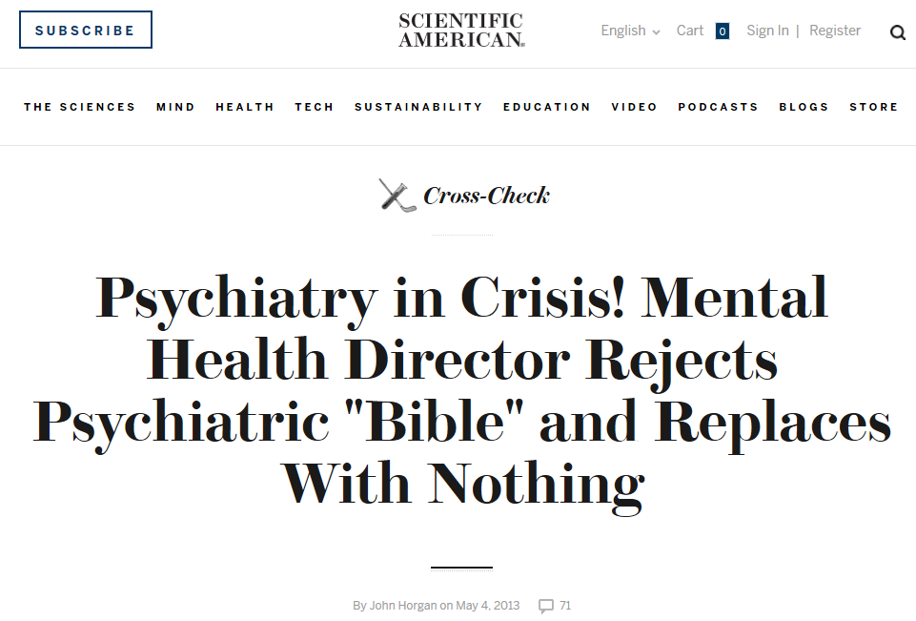

Slide 4
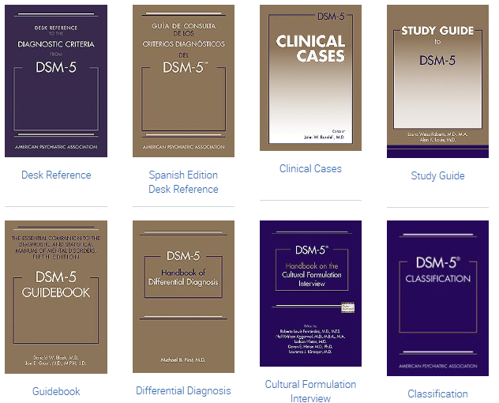
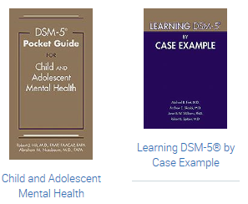

‘Essential Guides to DSM-5’
https://www.appi.org/products/dsm-manual-of-mental-disorders

Slide 5
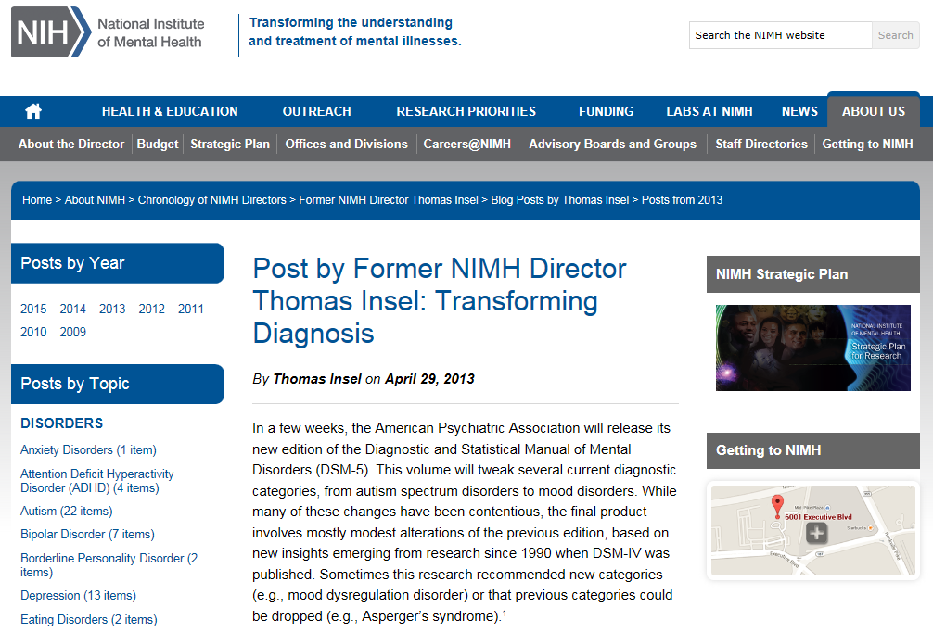

Slide 6

The weakness is its lack of validity. Unlike our definitions of ischemic heart disease, lymphoma, or AIDS, the DSM diagnoses are based on a consensus about clusters of clinical symptoms, not any objective laboratory measure. In the rest of medicine, this would be equivalent to creating diagnostic systems based on the nature of chest pain or the quality of fever. Indeed, symptom-based diagnosis, once common in other areas of medicine, has been largely replaced in the past half century as we have understood that symptoms alone rarely indicate the best choice of treatment.

Slide 7
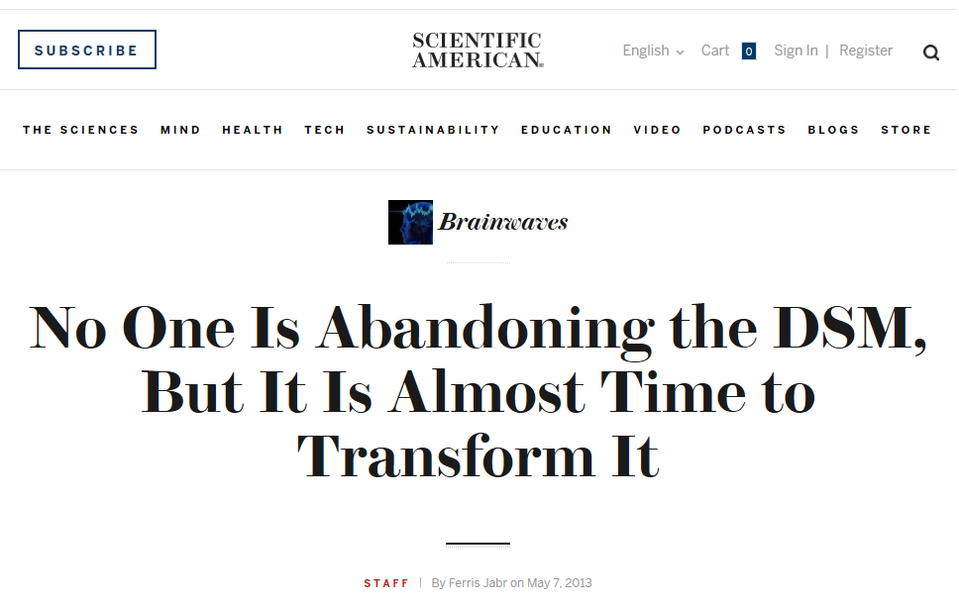

Slide 8
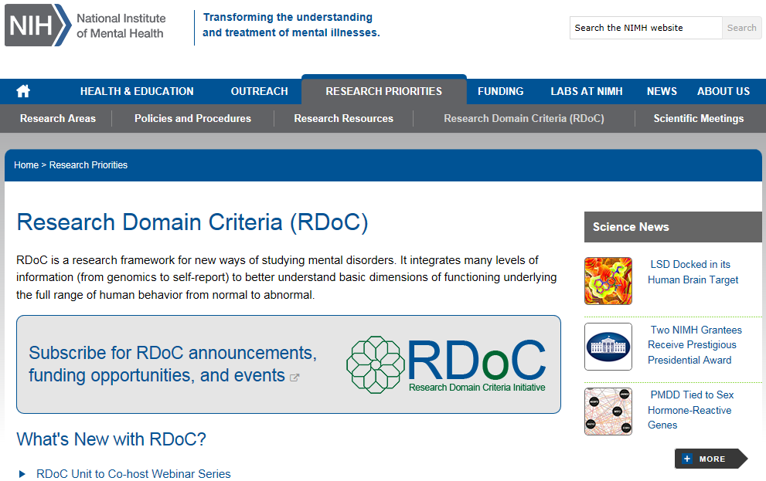
Most recent evolution

Slide 9
Research Domain Criteria (RDoC)
2008 NIMH Strategic Plan:
  ‘objectives include redefining mental disorders into observable and measurable components that are more closely aligned with the biology of the brain; fostering broad sharing of data and resources [supporting] researchers in ways that inspire creativity and innovation’.
Explicitly based on premise that mental disorder are disorders of brain circuits.
“The tools of clinical neuroscience [...] can be used to identify dysfunction in neural circuits” (Morris & Cuthbert 2012).
Goal to support translational neuroscience in mental health research.

Slide 10
Motivations for RDoC
Failure of DSM-ICD, a categorical approach, to offer insight into underlying etiology and causal mechanisms common to all instances of same diagnosis;
Inability to predict effective treatments;
Lack of universal biomarkers for DSM-ICD categories;
Heterogeneity of DSM-ICD populations;
E.g., in 2011 two major pharmaceutical companies stopped research into psychiatric drugs (Cowen 2011).

Slide 11
RDoC’s ‘matrix’
Domain | ————— Units of Analysis —————
 | Genes | Molecules | Cells | Circuits | Physiology | Behavior | Self-Reports | (Paradigms)
Negative Valence Systems Positive Valence Systems Cognitive Systems Working Memory Systems for Social Processes Arousal and Regulatory Systems
Expandable in:
  number of domains and units of analysis,
  Subtyping of domains and units of analysis.
Interestingly: no mention of mental disorders at all!
http://www.nimh.nih.gov/research-priorities/rdoc/nimh-research-domain-criteria-rdoc.shtml

Slide 12
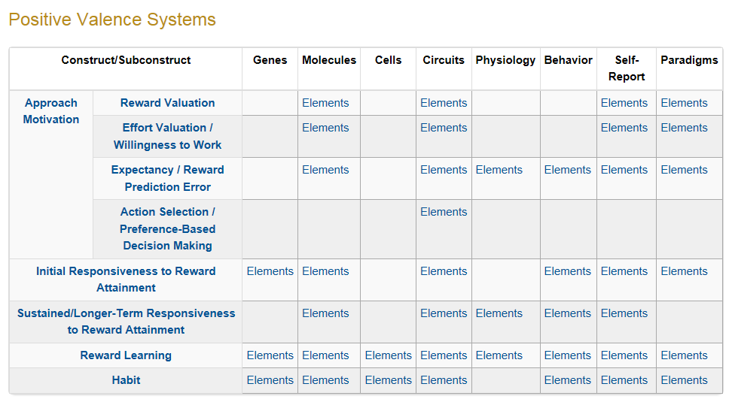

Slide 13
Goal of this talk
An ontologist’s view on the evolution of lines of thought about mental disorders,
  what mental disorders are, if they exist at all,
  if they exist, how to classify them, and
  how to diagnose and treat them.
Illustrating that also the new RDoC approach requires the contribution of ontologists.

Slide 14
Talk structure
Short introduction to what ‘ontologist’s view’ means and on what premises such view is designed.
Apply it on arguments used by proponents and opponents with respect to mental disorders.
Identify a few issues with the current RDoC setup.

Slide 15
Relevant disciplines and theories
Ontology (no plural) is the study of what entities exist and how they relate to each other;
by some philosophers taken to be synonymous with ‘metaphysics’ while others draw distinctions in many distinct ways but almost agreeing on the following classification:
  metaphysics → studies ‘how is the world?’
    general metaphysics → studies general principles and ‘laws’ about the world
      ontology → studies what type of entities exist in the world
    special metaphysics → focuses on specific principles and entities
‘epistemology’: the study of how we can come to know about what exists.
‘terminology’ (as part of ‘semantics’): the study of what terms mean and how to name things.

Slide 16
Scientific Realism
Our best scientific theories give true or approximately true descriptions of observable and unobservable aspects of a mind-independent world.
http://plato.stanford.edu/entries/scientific-realism/#WhaSciRea

Slide 17
Scientific Realism
Three dimensions:
Metaphysically: commits to the mind-independent existence of the world investigated by the sciences.
Semantically: commits to a literal interpretation of scientific claims about the world. Claims about scientific entities, processes, properties, and relations, whether they be observable or unobservable, should be construed literally as having truth values, whether true or false.
Epistemologically: commits to the idea that theoretical claims (interpreted literally as describing a mind-independent reality) constitute knowledge of the world.
http://plato.stanford.edu/entries/scientific-realism/#WhaSciRea

Slide 18
Four notions of ‘ontology’ as a study
(O1) the study of ontological commitment, i.e. what we or others are committed to,
(O2) the study of what there is,
(O3) the study of the most general features of what there is, and how the things there are relate to each other in the metaphysically most general ways,
(O4) the study of meta-ontology, i.e. saying what task it is that the discipline of ontology should aim to accomplish, if any, how the questions it aims to answer should be understood, and with what methodology they can be answered.
http://plato.stanford.edu/entries/logic-ontology/#DifConOnt

Slide 19
Elements of Basic Formal Ontology
portions of reality
relations
configurations
participation
me participating in my life
universals
entities
particulars
continuants
occurrents
me
my life
organism

Slide 20
Scientific Objectivity (1)
Objectivity as Faithfulness to Facts.
Objectivity as Absence of Normative Commitments and the Value-Free Ideal.
Objectivity as Freedom from Personal Biases.
  Measurement and Quantification.
  Inductive and Statistical Inference.

Slide 21
Scientific Objectivity (2)
Science is objective in that, or to the extent that:
its products—theories, laws, experimental results and observations—constitute accurate representations of the external world. The products of science are not tainted by human desires, goals, capabilities or experience.
  product objectivity
the processes and methods that characterize it neither depend on contingent social and ethical values, nor on the individual bias of a scientist
  → process objectivity.
http://plato.stanford.edu/entries/scientific-objectivity

Slide 22
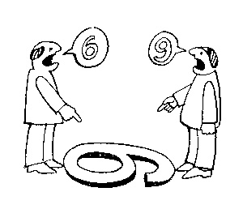
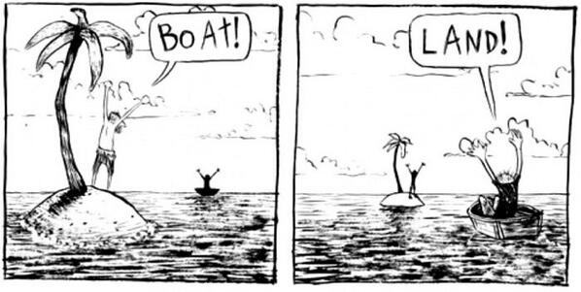
The view from nowhere
There are two kinds of qualities: ones that vary with the perspective one has or takes, and ones that remain constant through changes of perspective. The latter are the objective properties.
http://plato.stanford.edu/entries/scientific-objectivity

Slide 23



The view from nowhere

Slide 24
Value types
Scientific values:
  Accuracy, simplicity, …
Epistemic (or cognitive) values:
  predictive accuracy, scope, unification, explanatory power, coherence with other accepted theories, …
Contextual (non-cognitive) values:
  moral, personal, social, political and cultural values such as pleasure, justice and equality, conservation of the natural environment, diversity, …
http://plato.stanford.edu/entries/scientific-objectivity

Slide 25
Three theses
Value-Free Ideal (VFI):
    Scientists should strive to minimize the influence of contextual values on scientific reasoning, e.g., in gathering evidence and assessing/accepting scientific theories.
    scientific objectivity is characterized by absence of contextual values and by exclusive commitment to epistemic values in scientific reasoning.
Value-Neutrality Thesis (VNT):
    Scientists can—at least in principle—gather evidence and assess/accept theories without making contextual value judgments.
Value-Laden Thesis (VLT):
    Scientists cannot gather evidence and assess/accept theories without making contextual value judgments.
http://plato.stanford.edu/entries/scientific-objectivity

Slide 26
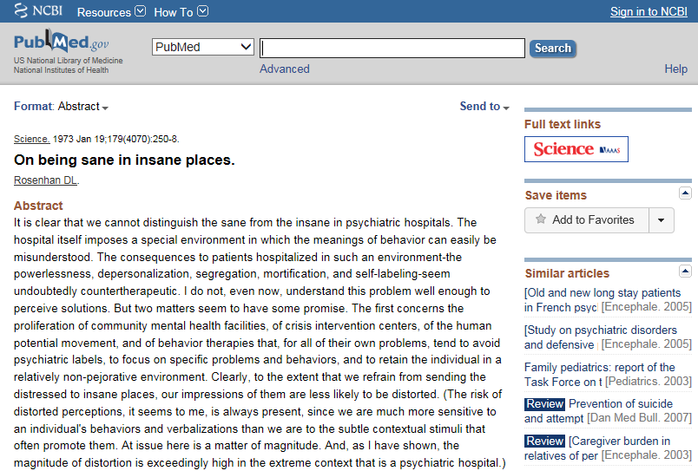

Slide 27

Some argue: mental disorders do not exist
Their answer:
  ‘there are no biological abnormalities responsible for so-called mental illness, mental disease, or mental disorder, therefore mental illness has no biological existence.
  Perhaps more importantly, however, mental illness also has no non-biological existence,
  except in the sense that the term is used to indicate disapproval of some aspect of a person's mentality.’
  Lawrence Stevens, J.D, 1999
The
Antipsychiatry
Coalition

Slide 28
‘No biological abnormalities responsible for so-called mental illness’
Some of their arguments:
  ‘an impartial reading of the recent literature does not provide the hoped-for clarification of the catecholamine hypotheses, nor does compelling evidence emerge for other biological differences that may characterize the brains of patients with mental disease’.
      S. Kety & S. Matthysse. The New Harvard Guide to Psychiatry, Harvard Univ. Press, p. 148,1988.
  ‘Many questions remain about the biology of mental disorders. In fact, research has yet to identify specific biological causes for any of these disorders. ... Mental disorders are classified on the basis of symptoms because there are as yet no biological markers or laboratory tests for them’.
      The Biology of Mental Disorders, U.S. Gov't Printing Office, 1992, pp. 13-14, 46-47.

Slide 29
The “Myth of Mental Illness”
Szasz: ‘mental illness is a myth whose function it is to disguise and thus render more palatable the bitter pill of moral conflicts in human relations’
  Szasz TS: The Myth of Mental Illness. American Psychologist 1960, 15:113-118.

Slide 30
‘Mental Disorders Are Not Diseases’
“I maintain
  that the mind is not the brain,
  that mental functions are not reducible to brain functions, and
  that mental diseases are not brain diseases,
  indeed, that mental diseases are not diseases at all.
When I assert the latter, I do not imply that distressing personal experiences and deviant behaviors do not exist. Anxiety, depression, and conflict do exist--in fact, are intrinsic to the human condition--but they are not diseases in the pathological sense.”
Thomas S. Szasz (MD), Mental Disorders Are Not Diseases.
USA Today (Magazine) January 2000

Slide 31
Our interpretation of Szasz (1)
the group of persons ‘known to manifest various peculiarities or disorders of thinking and behavior’ and about which it is therefore said that they have a mental illness, consists of two subgroups:
  (1) those for which there is an underlying brain disorder perhaps not yet discoverable by what the state of the art is able to offer; and
  (2) those who exhibit in their behavior a ‘deviance … from certain psychosocial, ethical, or legal norms’ as judged by themselves, by clinicians, or by others.

Slide 32
Our interpretation of Szasz (2)
  those for which there is an underlying brain disorder perhaps not yet discoverable by what the state of the art is able to offer
  would be better described as having a brain disorder,
those who exhibit in their behavior a ‘deviance … from certain psychosocial, ethical, or legal norms’ as judged by themselves, by clinicians, or by others
  while they might indeed have ‘problems of living’, and thus be suffering, are not suffering because of some disorder of a special, mental kind.

Slide 33
Differing views on mental disorder
The social-constructivist position:
  mental disorder is a value-laden social construct with no counterpart in biomedical reality.
The objectivist position:
  mental disorders are natural entities that could be understood in biological terms.
The hybrid position:
  Mental disorder is harmful dysfunction.
    the social definition of "harm" is counterbalanced by a factual component of a malfunctioning internal mechanism causing objective dysfunction.
Jablensky A: Does psychiatry need an overarching concept of "mental disorder"? World Psychiatry 2007, 6:157-158.

Slide 34
A terminological and ontological problem (1)
  WHO: Lexicon of psychiatric and mental health terms. Second ed. Geneva: WHO; 1994.
  ‘mental disorder’: an imprecise term designating any disorder of the mind, acquired or congenital
  organic mental disorder: a range of mental disorders grouped together on the basis of their having in common a demonstrable etiology in cerebral disease, brain injury, or other insult, leading to cerebral dysfunction.
Does WHO rule out the existence of mental disorders which are not due to brain disorder?

Slide 35
The old debate on the “body-mind problem”…
Dualistic views in Philosophy of Mind:
  asserts the separate existence of mind and body
  comes in various flavours:
    Ontological dualism
      Substance dualism
      Property dualism
      Predicate dualism
    Interaction dualism
Monistic views in Philosophy of Mind:
    Behaviourism
    Identity theory
    Functionalism
    Non-reductive physicalism
…

Slide 36
… and its impact on Psychiatry
Mental health professionals continue to employ a mind-brain dichotomy when reasoning about clinical cases.
The more a behavioral problem is seen as originating in “psychological” processes, the more a patient tends to be viewed as responsible and blameworthy for his or her symptoms;
conversely, the more behaviors are attributed to neurobiological causes, the less likely patients are to be viewed as responsible and blameworthy.
Miresco MJ, Kirmayer LJ.
The Persistence of Mind-Brain Dualism in Psychiatric Reasoning About Clinical Scenarios.
Am J Psychiatry 2006; 163:913–918
But:
  Conducted in one institution.
  Based on a questionnaire with voluntary submission, thus risk for major bias.

Slide 37
A terminological and ontological problem (2)
Adoption of a generic, presumably universal, definition of "mental disorder" would be premature. It may cause more harm than good to psychiatry.
  Jablensky A: Does psychiatry need an overarching concept of "mental disorder"? World Psychiatry 2007, 6:157-158.

Slide 38
Jablensky’s arguments (1)
A terminological argument
  Neither disease nor health has ever been strictly and unambiguously defined in terms of finite sets of observable referential phenomena.
Arguments of utility:
  the medical person is least concerned with what healthy and sick mean in general ... we do not need the concept of ‘illness in general’ at all
    Jaspers K. General psychopathology. Birmingham: Birmingham University Press; 1963.
  doctors do not concern themselves with maximizing the evolutionary advantages of the human race as a whole, but with aiding individuals
    Toon PD. Defining "disease" - classification must be distinguished from evaluation. J Med Ethics. 1981;7:197–201.

Slide 39
Jablensky’s arguments (2)
Ontological argument:
  we now know that no such general and uniform concept exists.
    Jaspers K. General psychopathology ,Birmingham: Birmingham University Press; 1963.
Epistemological argument:
  the emergence of molecular genetic classifications of large groups of diseases, and the concomitant availability of genetic diagnostic tests, raise the possibility that the entire taxonomy of human disease may eventually be revised.

Slide 40
The ‘categorical – dimensional’ debate on the classification of mental disorders
Rough distinction:
  “Categorical”: ‘mental disorders’ can be classified as single, discrete and mutually exclusive types, of which a particular patient does or does not exhibit an instance.
  “Dimensional”: any particular ‘mental disorder’ in a patient is an instance of just one single type and differences between cases are a matter of ‘scale’.
‘Rough’, because
  the literature is huge and vague
  descriptions are (philosophically) very incoherent

Slide 41
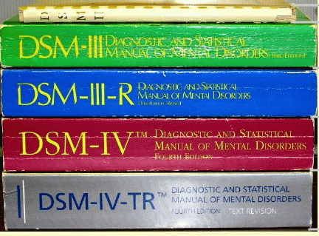
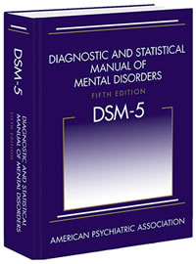
The categorical view
Recognizes various mental disorder types;
Accepts that disorders are manifested through signs and symptoms, either ‘marker’ or ‘constitutional’;
Provides diagnostic criteria to guide the clinician in making a diagnosis.

Slide 42
Evolution of the DSM (1)
Psychodynamic period: I and II, 1952-1980
  no sharp distinction between normal and abnormal.
  psychosis / neurosis scale
  all disorders viewed as reactions (leading to behavior) to environmental events,
  everyone is more or less abnormal,
  inclusion in the manual presumes abnormality.
DSM-II contained “homosexuality” as mental disorder which was removed in 1973 by vote.

Slide 43
Evolution of the DSM (2)
Adoption of biomedical model: III, IV 1980 -
  Clear distinction between normal/abnormal
  Introduction of diagnostic criteria
  Latest version is from 2000
DSM-V: since 2013
  Move towards dimensional approach

Slide 44
DSM under fire (1)
severely ill inpatients often meet criteria for more than one DSM-IV personality disorder
  → suggests a high rate of co-morbidity, however in absence of any medical or etiologic reason for such a situation
many outpatients do not meet the criteria for any of the specific categories identified in DSM-IV;
patients with the same categorical diagnosis often vary substantially with respect to which diagnostic criteria were used to make the diagnosis, so that two patients with the same diagnosis can manifest very different signs and symptoms;

Slide 45
DSM under fire (2)
frequent revision of the diagnostic thresholds separating what is normal from what is disordered
  → it is as if given disorders would appear and disappear in course of time;
a number of the diagnostic categories mentioned in DSM-IV lack any developing scientific base for an understanding of the corresponding disorder types

Slide 46
The Dimensional Approach (1)
Mental processes and behavior follow traits/phenomena which are to be seen as continuous variables along continua on which all members of the population can be located. These continua extend to both normal and pathological phenotypes.
These traits are on a par with properties such as temperature, weight, …
  → Homo sapiens is not further subdivided in subspecies according to weight, temperature, …

Slide 47

Is there empirical evidence for this boundary ?
And if not, do these mountains exist ?

Slide 48
Attempts to resolve the problem (1)
Mental disorders as ‘practical kinds’
  ‘stable patterns that can be identified with varying levels of reliability and validity’ and which are justified by their usefulness for specific purposes – such as giving an appropriate treatment
Zachar, P. 2000b. Psychiatric disorders are not natural kinds. Philosophy, Psychiatry and Psychology 7:167–94.

Slide 49
Basis: ‘epistemic value commitments’
‘values involved in making and advancing epistemologically-relevant claims, such as scientific ones’:
Coherence
Consistency
Comprehensiveness
Fecundity
Simplicity
Instrumental efficacy
Originality
Relevance
Precision
JZ. Sadler. Epistemic Value Commitments in the Debate over Categorical vs. Dimensional Personality Diagnosis. Philosophy, Psychiatry, & Psychology 3.3 (1996) 203-222

Slide 50
Attempts to resolve the problem (2)
Non-arbitrary basis for drawing a categorical distinction
No Yes
Haslam N. Kinds of Kinds: A Conceptual Taxonomy of Psychiatric Categories. Philosophy, Psychiatry, & Psychology, 9 (2002), 203-218
Non-kind
This basis is an objective discontinuity
‘severity’
‘neuroticism’
No Yes
The discontinuity is sharp and binary
Practical kind
‘essential hypertension’
‘depression’
No Yes
Fuzzy kind
The discontinuity is constituted by an ‘essence’
‘borderline personality’
No Yes
Discrete kind
Natural kind
‘melancholia’
‘Williams syndrome’

Slide 51
The Dimensional Approach (2)
“Diagnostic categories defined by their syndromes should be regarded as valid only if they have been shown to be discrete entities with natural boundaries that separate them from other disorders.”
“there is no empirical evidence for natural boundaries between major syndromes” … “the categorical approach is fundamentally flawed”
Kendell R, Jablensky A. Distinguishing between the validity and utility of psychiatric diagnoses. Am J Psychiatry 2003; 160:4–12.
Cloninger CR: A new conceptual paradigm from genetics and psychobiology for the science of mental health. Aust N Z J Psychiatry 33:174–186, 1999.

Slide 52
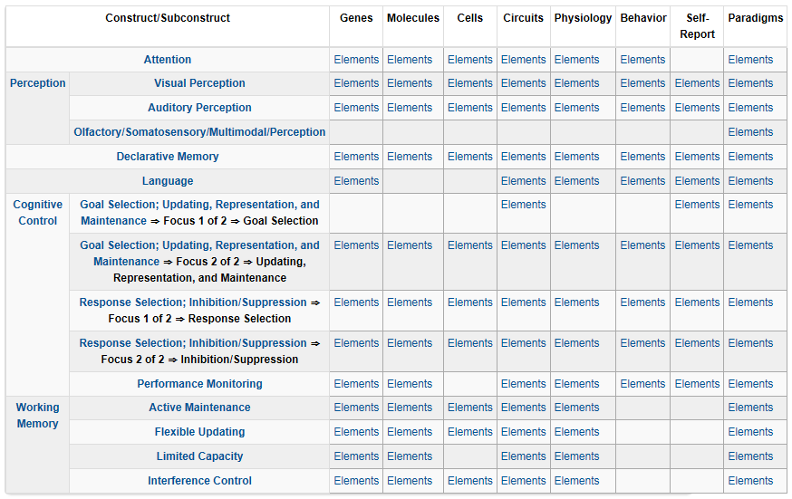
RDoC Matrix for the Cognitive domain

Slide 53
Cognitive Systems > Auditory Perception
Genes: BDNF
Molecules: Acetylcholine, GABA, Glutamate, NMDA, Serotonin
Cells: Cochlear hair cells, Cortical and limbic inhibitory interneurons, Ribbon synapses
Circuits:
  Nodes in Circuits: A1, Anterior insula, Brainstem, Cochlea, Inferior colliculus, MGN, STG
  Circuits: Corticofugal Dorsal/ventral streams
Physiology: Adaptation/ habituation, Auditory steady-state response (ASSR), fMRI, Intracortical EEG, Metabolic changes, Mismatch negativity (MMN), N1, Neural oscillations, P3a, P50, startle and PPI
Behavior: Perceptual identification, Perceptual learning, Perceptual priming, Spatial localization, Stimulus detection
Self-Report: Auditory hallucinations, Hyperacusis
Paradigms: Action-Perception loops, Auditory masking, auditory scene perception (e.g., streaming), Categorization, Cross-modal interactions, …

Slide 54
Cognitive Systems > Auditory Perception
Genes: BDNF
Molecules: Acetylcholine, GABA, Glutamate, NMDA, Serotonin
Cells: Cochlear hair cells, Cortical and limbic inhibitory interneurons, Ribbon synapses
Circuits:
  Nodes in Circuits: A1, Anterior insula, Brainstem, Cochlea, Inferior colliculus, MGN, STG
  Circuits: Corticofugal Dorsal/ventral streams
Physiology: Adaptation/ habituation, Auditory steady-state response (ASSR), fMRI, Intracortical EEG, Metabolic changes, Mismatch negativity (MMN), N1, Neural oscillations, P3a, P50, startle and PPI
Behavior: Perceptual identification, Perceptual learning, Perceptual priming, Spatial localization, Stimulus detection
Self-Report: Auditory hallucinations, Hyperacusis
Paradigms: Action-Perception loops, Auditory masking, auditory scene perception (e.g., streaming), Categorization, Cross-modal interactions, …

Slide 55
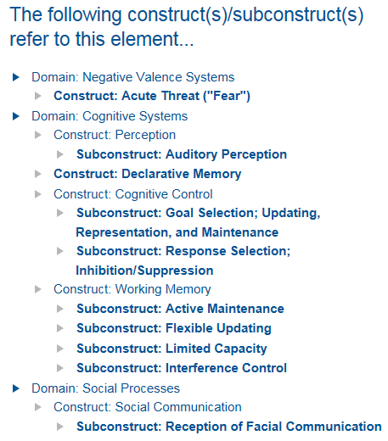
Brain Derived Neurotrophic Factor (BDNF)

Slide 56
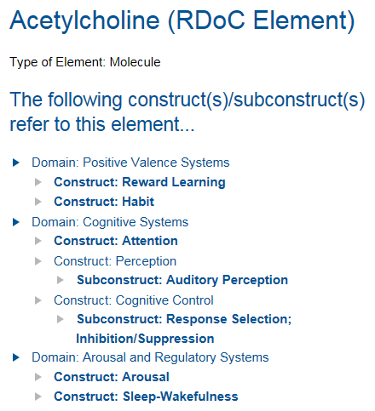
Acetylcholine

Slide 57
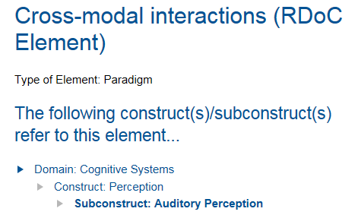
Cross-modal interactions

Slide 58
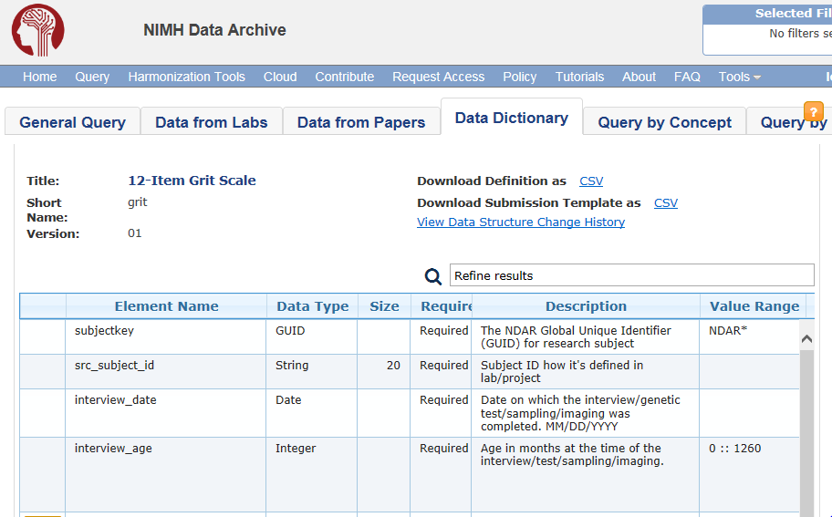
‘Interview age’ ?
https://ndar.nih.gov/data_structure.html?short_name=grit01

Slide 59
‘Interview age’ under the Grit perspective
Label: interview age
Theoretical definition (?):
    Age in months at the time of the interview / test / sampling / imaging.
Operational definition (?):
    Age is rounded to chronological month. If the research participant is 15-days-old at time of interview, the appropriate value would be 0 months. If the participant is 16-days-old, the value would be 1 month.
    Range: 0 -1260 [0 – 105 years]
https://ndar.nih.gov/data_structure.html?short_name=grit01

Slide 60
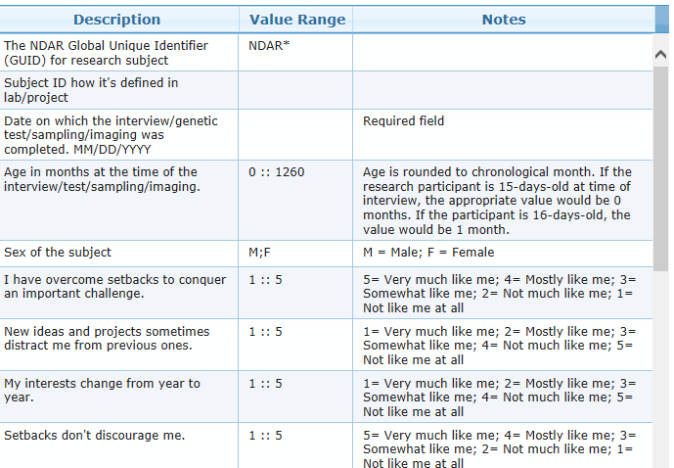
https://ndar.nih.gov/data_structure.html?short_name=grit01

Slide 61
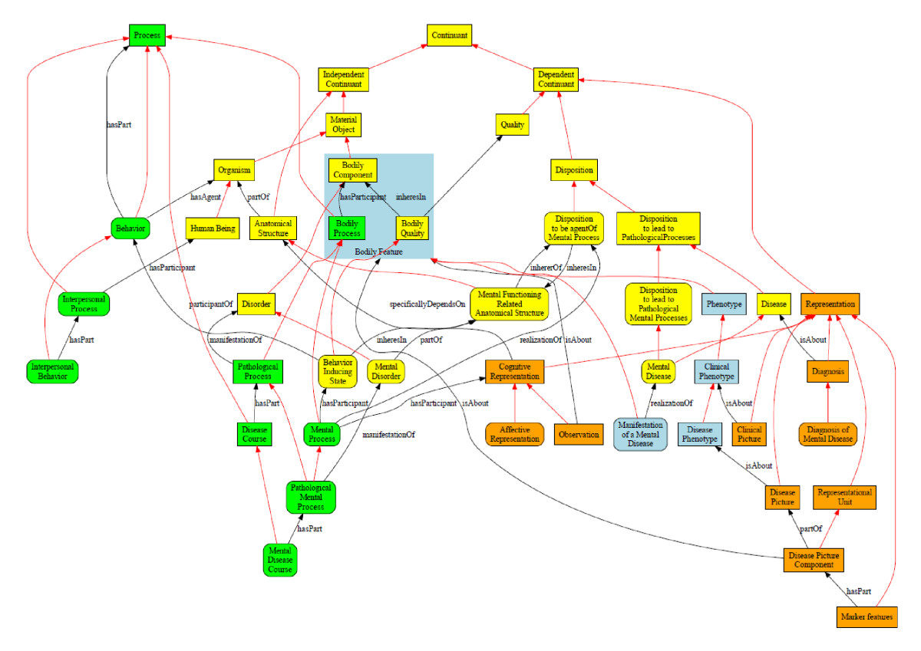
Werner Ceusters and Barry Smith
Foundations for a realist ontology of mental disease
Journal of Biomedical Semantics20101:10 DOI: 10.1186/2041-1480-1-10

