Slide 1
Biomedical Ontology Rotations in UB’s Department of Biomedical Informatics: to boldly go where no MD has gone before.
Werner CEUSTERS, MD
Department of Biomedical Informatics,
Jacobs School of Medicine, University at Buffalo
Buffalo, NY – USA
Wednesday, September 14, 2006

Slide 2
‘Ontology’ ???

Slide 3
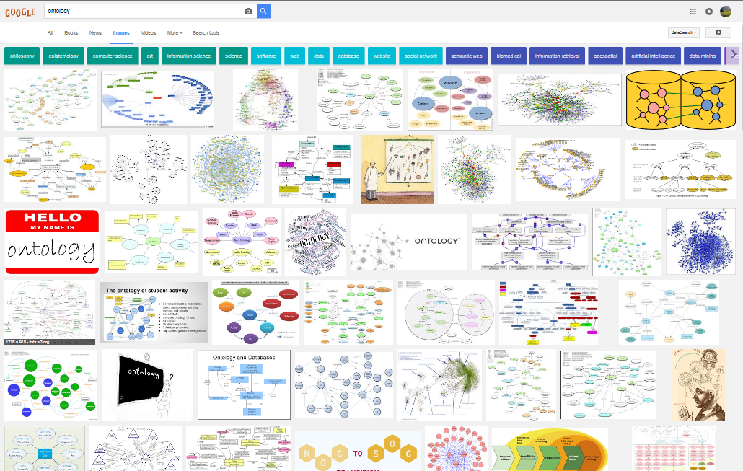
Ontology

Slide 4
Most prominent associations
philosophy
epistemology
computer science
art
information science
science
software
web
data
database
website
social network
semantic web
biomedical
information retrieval
geospatial
artificial intelligence
data mining
medical
tourism
health
education
health care
agriculture
research
process
security
architecture
context
risk
network
knowledge
user profile

Slide 5
How? Collocational analysis of terms.
Araceli Alonso, Chrystel Millon, Geoffrey Williams.
Collocational networks and their application to an E-Advanced Learner's Dictionary of Verbs in Science (DicSci) Nov 2011.

Slide 6
Ontology: where it comes from
philosophy
epistemology
computer science
art
information science
science
software
web
data
database
website
social network
semantic web
biomedical
information retrieval
geospatial
artificial intelligence
data mining
medical
tourism
health
education
health care
agriculture
research
process
security
architecture
context
risk
network
knowledge
user profile

Slide 7
Ontology: where it is hijacked
philosophy
epistemology
computer science
art
information science
science
software
web
data
database
website
social network
semantic web
biomedical
information retrieval
geospatial
artificial intelligence
data mining
medical
tourism
health
education
health care
agriculture
research
process
security
architecture
context
risk
network
knowledge
user profile

Slide 8
Ontology: where it is applied
philosophy
epistemology
computer science
art
information science
science
software
web
data
database
website
social network
semantic web
biomedical
information retrieval
geospatial
artificial intelligence
data mining
medical
tourism
health
education
health care
agriculture
research
process
security
architecture
context
risk
network
knowledge
user profile

Slide 9
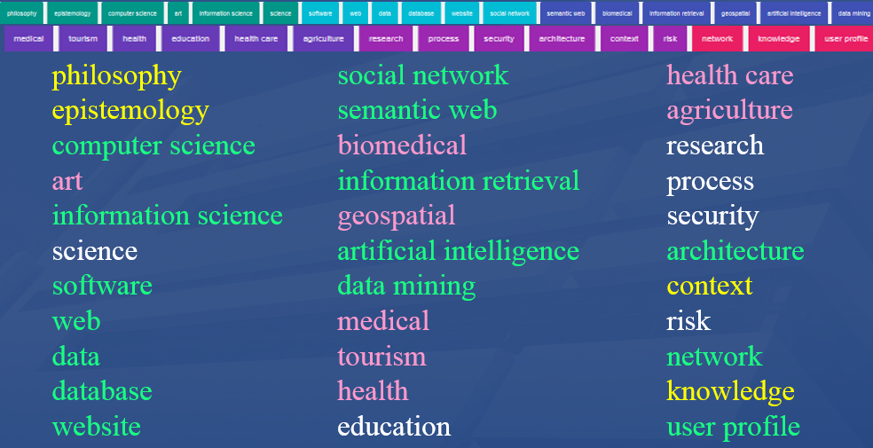
Origin / Technology / Application
What these words denote, and,
what the denoted things are,
statistics can inspire you about, but cannot tell you !!!

Slide 10
Remember this slide?
A closer look on Google’s associations for ‘thinking’

Slide 11
Google’s associations for ‘thinking’
1
woman
boy
kid
child
black man
baby
2
business
math
3
student
scientist
teacher
nurse
business person
4
silhouette
character
pose
5
snoopy
stick man
spongebob
mickey mouse
6
anime
comic
photography
7
computer
robot
balloon
8
feeling
concept
visual
cognitive

Slide 12
Google’s associations for ‘thinking’
1
woman
boy
kid
child
black man
baby
2
business
math
3
student
scientist
teacher
nurse
business person
4
silhouette
character
pose
5
snoopy
stick man
spongebob
mickey mouse
6
anime
comic
photography
7
computer
robot
balloon
8
feeling
concept
visual
cognitive
All things which are of any of these kinds, are human beings

Slide 13
Google’s associations for ‘thinking’
1
woman
boy
kid
child
black man
baby
2
business
math
3
student
scientist
teacher
nurse
business person
4
silhouette
character
pose
5
snoopy
stick man
spongebob
mickey mouse
6
anime
comic
photography
7
computer
robot
balloon
8
feeling
concept
visual
cognitive
All these things are roles that can be realized by human beings

Slide 14
Google’s associations for ‘thinking’
1
woman
boy
kid
child
black man
baby
2
business
math
3
student
scientist
teacher
nurse
business person
4
silhouette
character
pose
5
snoopy
stick man
spongebob
mickey mouse
6
anime
comic
photography
7
computer
robot
balloon
8
feeling
concept
visual
cognitive
All (but one) of these things are unique. There is only one of them!

Slide 15
Google’s associations for ‘thinking’
1
woman
boy
kid
child
black man
baby
2
business
math
3
student
scientist
teacher
nurse
business person
4
silhouette
character
pose
5
snoopy
stick man
spongebob
mickey mouse
6
anime
comic
photography
7
computer
robot
balloon
8
feeling
concept
visual
cognitive
Oddities

Slide 16
‘Ontology’
In philosophy:
Ontology (no plural) is the study of what entities exist and how they relate to each other;
In computer science:
An ontology (plural: ontologies) is a logically consistent, shared and agreed upon conceptualization of a domain;
In our department:
An ontology (plural: ontologies) is a representational artifact, comprising a taxonomy as proper part, whose representational units are intended to designate some combination of universals, defined classes, and certain relations between them that together constitute some portion of reality.
An ontology

Slide 17
Reality
this portion of
IsRepresentationOf
this
Representational artifact

Slide 18
Two distinct ‘Manneke Pis’
Representational artifact
Of this !
Not of this !
Brussels
Geraardsbergen

Slide 19
As an image, this is a representation of …?

Slide 20
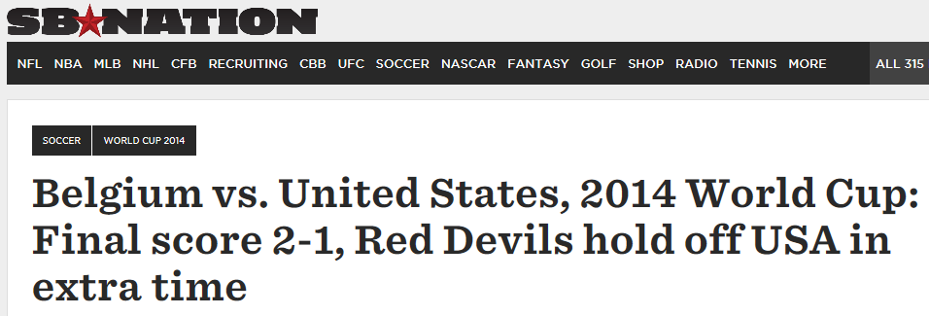
What is this a representation of ?
of the Brussels Manneke Pis
of Manhattan

Slide 21
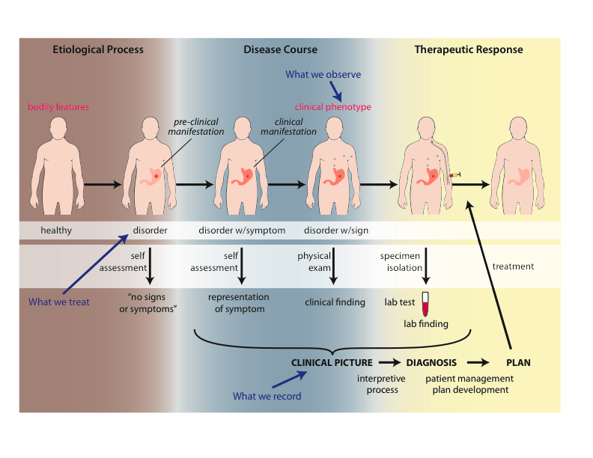
Representations in the Ontology for General Medical Science
Scheuermann R, Ceusters W, Smith B. Toward an Ontological Treatment of Disease and Diagnosis. 2009 AMIA Summit on Translational Bioinformatics, San Francisco, California, March 15-17, 2009;: 116-120. Omnipress ISBN:0-9647743-7-2

Slide 22
‘Ontology’
In philosophy:
Ontology (no plural) is the study of what entities exist and how they relate to each other;
In computer science:
An ontology (plural: ontologies) is a logically consistent, shared and agreed upon conceptualization of a domain;
In our department:
An ontology (plural: ontologies) is a representational artifact, comprising a taxonomy as proper part, whose representational units are intended to designate some combination of universals, defined classes, and certain relations between them that together constitute some portion of reality.
An ontology

Slide 23
What a taxonomy looks like …
http://www.frontiersin.org/files/Articles/26297/fgene-03-00197-r2/image_m/fgene-03-00197-g002.jpg

Slide 24
… which explains (roughly) the Google image collection when searching for ‘ontology’

Slide 25
Focus of research in our Division of Biomedical Informatics
How can ontologies be designed in such a way that:
they are faithful presentations of reality, and that
changes introduced in updates reflect faithfully corresponding changes in reality?
What are the requirements for formalisms able to concretize ontologies satisfying (1a) and (1b) to allow users thereof acquiring a faithful representation of the changes in reality by merely looking at the changes in the ontology?

Slide 26
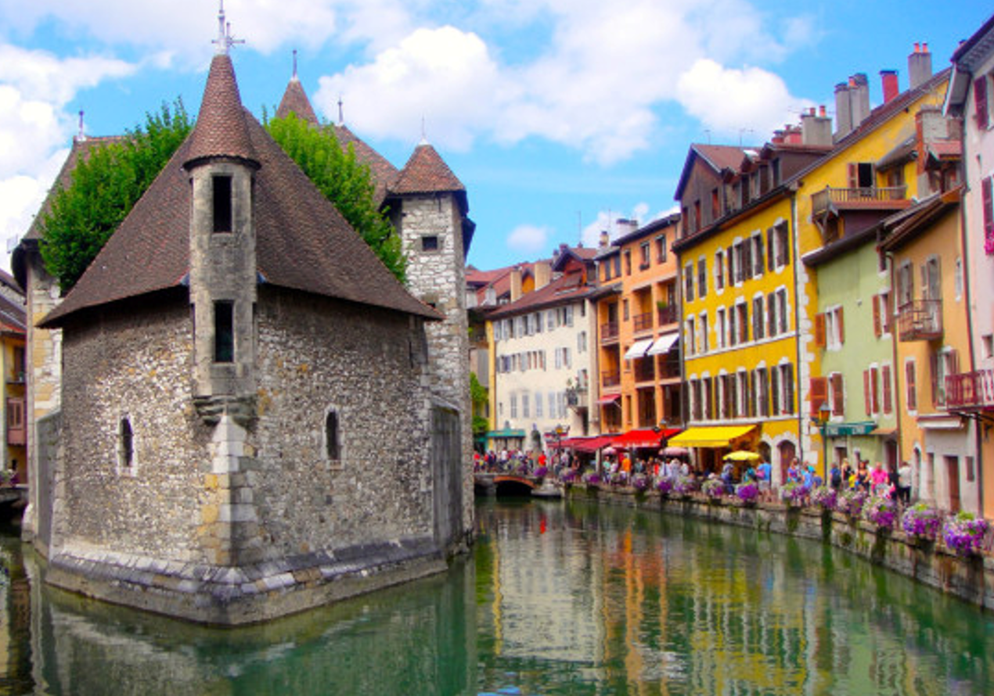
On the objectivity of reality
Is there really somebody in the room here who claims that it is not the case that:
I am standing here talking,
there is a brownish rectangle projected on the screen,
the rectangle pictures what people would take for an open window,
the ‘window’ is projected over an image of the Palais de l’Ile?

Slide 27
Realist ontology claims:
There is one objective reality and an ontology should be a faithful representation of the part of that reality that it covers
Smith B, Ceusters W. Ontological Realism as a Methodology for Coordinated Evolution of Scientific Ontologies. Applied Ontology, 2010;5(3-4):139-188.

Slide 28
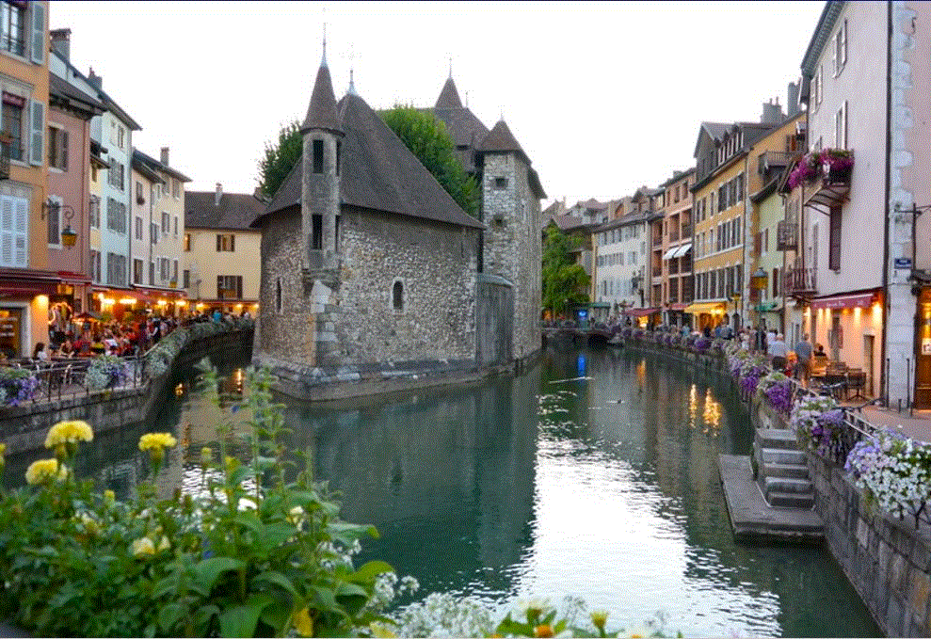
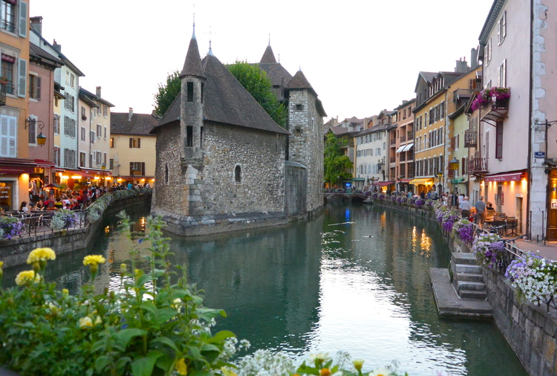
Realist ontology
There is one objective reality and an ontology should be a faithful representation of the part of that reality that it covers
?
Smith B, Ceusters W. Ontological Realism as a Methodology for Coordinated Evolution of Scientific Ontologies. Applied Ontology, 2010;5(3-4):139-188.

Slide 29
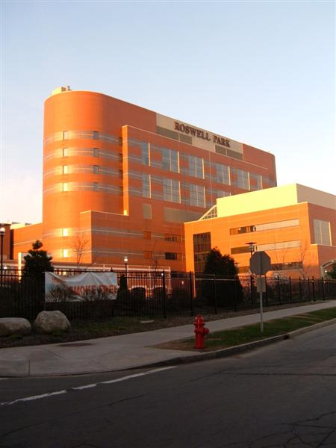
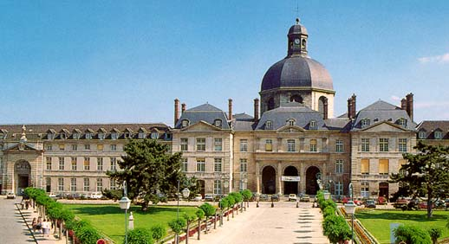
Importance of realism-based ontology in healthcare: an old vision.
Everything collected wherever, whenever and about whomever which is relevant to a medical problem in whomever, whenever and wherever, should be accessible without loss of relevant detail.

Slide 30
Importance of realism-based ontology in healthcare: an old vision.
Everything collected wherever, whenever and about whomever which is relevant to a medical problem in whomever, whenever and wherever, should be accessible without loss of relevant detail.

Slide 31
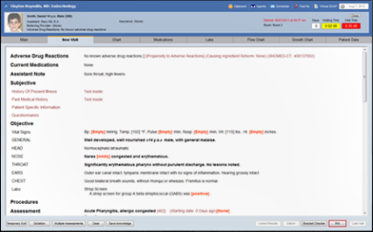
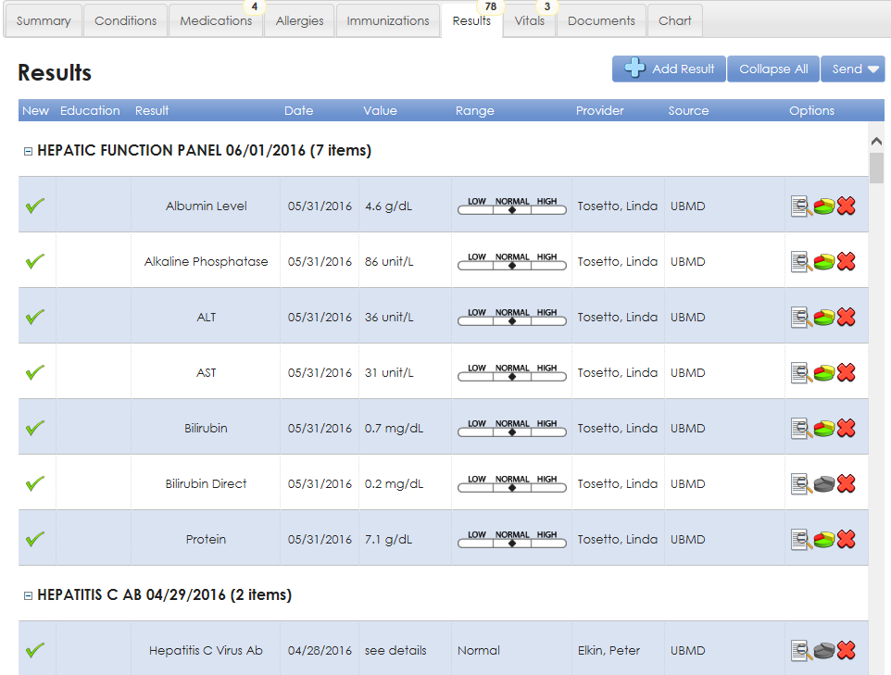
Relevance determination requires a global view
https://www.sigmundsoftware.com/
http://www.praxisemr.com/
https://ubmd.followmyhealth.com

Slide 32
However !
https://www.sigmundsoftware.com/
http://www.praxisemr.com/
Data are lacking for making analytics and DS work
https://ubmd.followmyhealth.com
Optimized for practice management and patient care
Optimized for analytics and decision support

Slide 33
Rotations in Biomedical Ontology Theoretical component
Very basic introduction to:
Biomedical terminologies and classifications
Ontological Realism and Basic Formal Ontology
Ontology for General Medical Science

Slide 34
Rotations in Biomedical Ontology Theoretical component
Very basic introduction to:
Biomedical terminologies and classifications
Ontological Realism and Basic Formal Ontology
Ontology for General Medical Science
Methods:
Lectures
Self-study
Discussion
Participation in daily activities

Slide 35
Rotations in Biomedical Ontology Practical component
Topic determined by interest of the student:
Build a tiny ontology within a domain of interest
Explore some problematic issue related to
Electronic healthcare records
Diagnostic (e.g. ICD) or procedure classification systems (e.g. CPT)
Medical decision support or reasoning
Apply ontology to improve scientific writing skills (and detect ambiguities in the writings of others)
…
Ideally resulting in some publication.

