Slide 1
Patient data analysis and ontologies.
December 19/22, 2016
University at Buffalo, South Campus
Werner CEUSTERS, MD
Ontology Research Group, Center of Excellence in Bioinformatics and Life Sciences,
UB Institute for Healthcare Informatics,
Departments of Biomedical Informatics and Psychiatry,
University at Buffalo, NY, USA

Slide 2
Students’ need addressed
Use of electronic healthcare records (EHRs)
with not only billing in mind,
but also
optimal individual patient care and
secondary use of data for research

Slide 3
Aim of this session
Introduce you to some ontological principles that will help you in
recognizing and dealing with idiosyncrasies in EHRs
to improve healthcare data quality

Slide 4
What you MUST know at the end
Distinction between data and what data are about;
Distinction between terminologies, ontologies and data repositories;
Distinction between disease, disorder and diagnosis from the perspective of the Ontology of General Medical Science;
The role of EHR data in the research enterprise.

Slide 5
What you SHOULD know at the end
Principles of the Semantic/Semiotic Triangle and flaws in the theory as applied to medical terminology
Basic categories of the Ontology of General Medical Science

Slide 6
What would be fantastic to know
The principles for how to use the categories in the Basic Formal Ontology as a guide on how to assess prior dependencies between research variables.

Slide 7
1. Primary and secondary use of health records

Slide 8

Primary use of health records
Notes:
Photos of Medicine Clinical Associate Professor, Anthony Martinez, with a patient in Buffalo General Hospital
Photograph: Douglas Levere
From: https://ubphoto.smugmug.com/Years/2014/14061-Photos-of-Medicine/i-shnhQPC

Slide 9
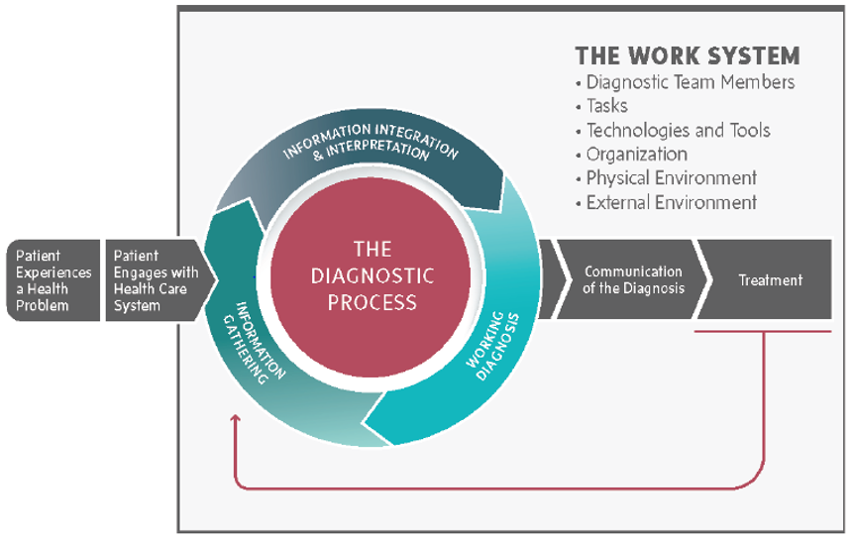
Outcomes from the diagnostic process
http://nap.edu/21794

Slide 10
The ‘old’ paper-based health record
Notes:
Photos of Medicine Clinical Associate Professor, Anthony Martinez, with a patient in Buffalo General Hospital
Photograph: Douglas Levere
From: https://ubphoto.smugmug.com/Years/2014/14061-Photos-of-Medicine/i-shnhQPC

Slide 11
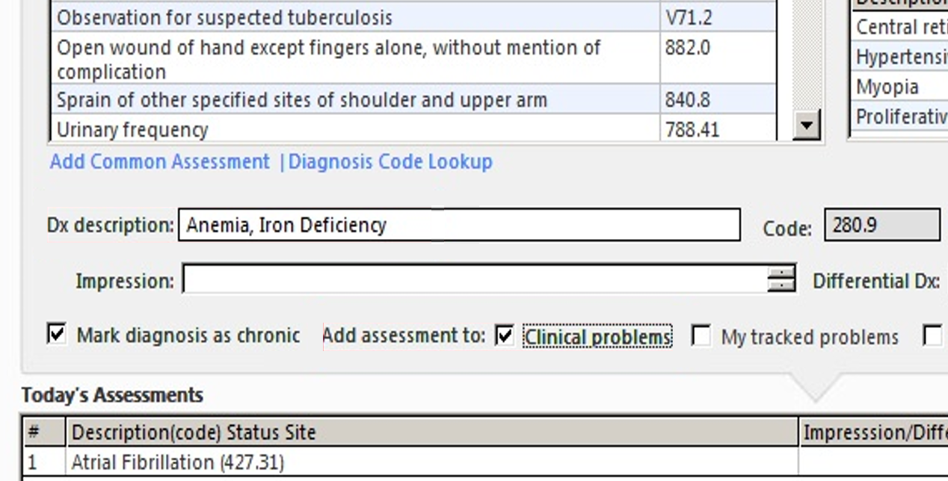
Electronic health records
http://incerio.com/planning-nextgen-version-5-8-upgrade-things-know-diagnosis-module/

Slide 12
Can you spot the many problematic issues?
http://incerio.com/planning-nextgen-version-5-8-upgrade-things-know-diagnosis-module/

Slide 13

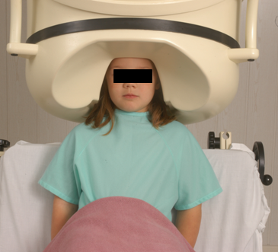

Clinical data registration and primary use
Register in EHR
observation &
measurement
One patient at a time!
Register in EHR
Δ = outcome
diagnosis
and
treatment
application
interpretation

Slide 14
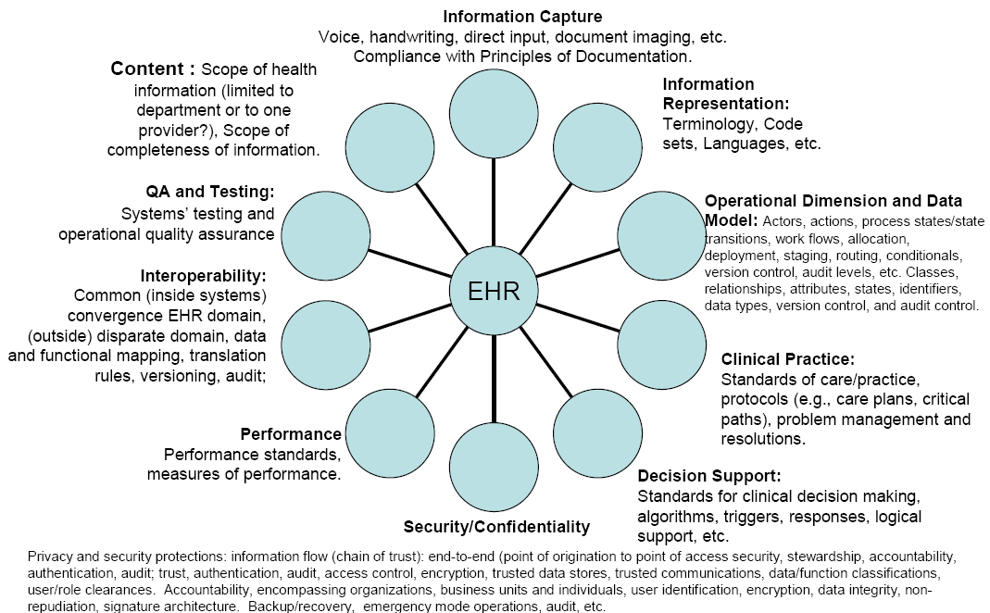
Developers’ view on the EHR
http://cmapspublic2.ihmc.us/rid=1GM0728VN-15TD0DN-12W4/ehr10dimensions.png

Slide 15
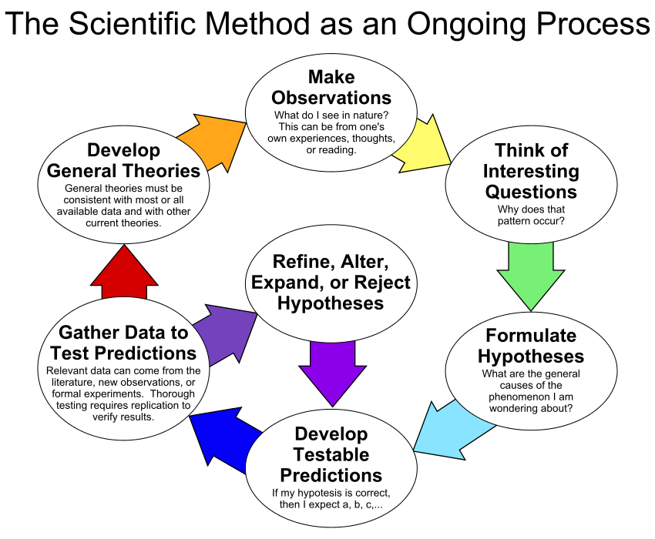
By ArchonMagnus - Own work, CC BY-SA 4.0, https://commons.wikimedia.org/w/index.php?curid=42164616

Slide 16
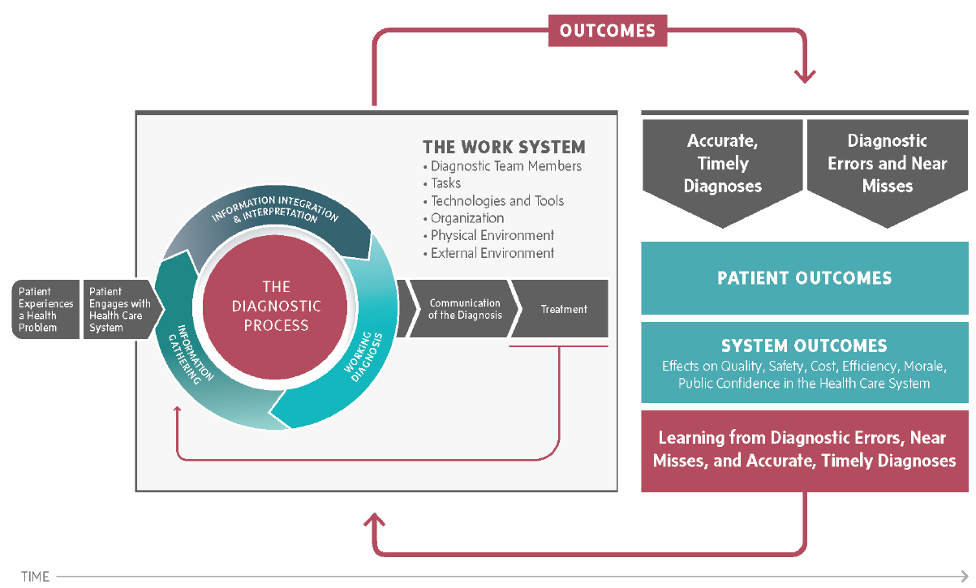
Outcomes from the diagnostic process
http://nap.edu/21794

Slide 17
Can EHR data be used for such research?
= secondary use of EHR data

Slide 18
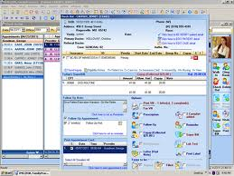
Can EHR data be used for such research?
= secondary use of EHR data
Register in EHR
observation &
measurement
research
Focus on
population
Δ = outcome
Diagnostic criteria
Best treatment
Cost effectiveness

Slide 19
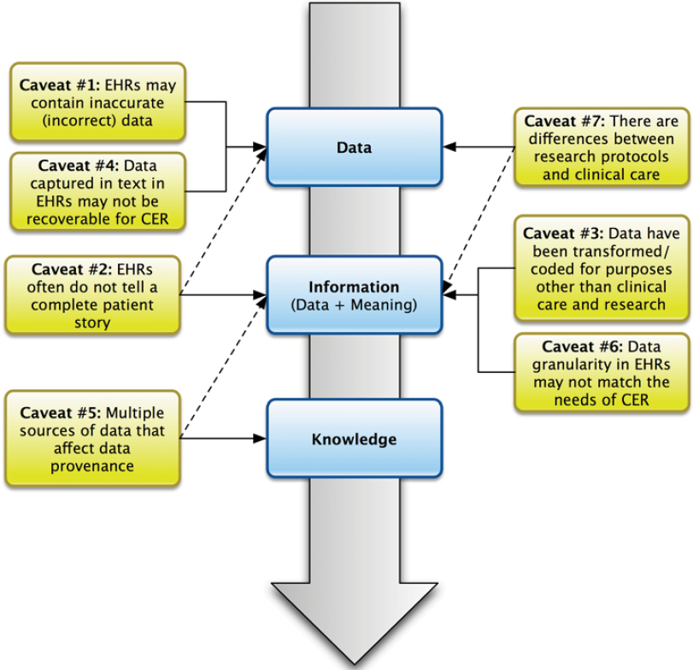
Caveats for secondary use of EHR data
Hersh, WR, Weiner, MG, et al. (2013). Caveats for the use of operational electronic health record data in comparative effectiveness research. Medical Care. 51(Suppl 3): S30-S37.

Slide 20
Caveats for secondary use of EHR data
Hersh, WR, Weiner, MG, et al. (2013). Caveats for the use of operational electronic health record data in comparative effectiveness research. Medical Care. 51(Suppl 3): S30-S37.

Slide 21
Idiosyncrasies of …
The diagnostic process:
  Diagnosis may be recorded when there is only a suspicion of disease;
  Some overlapping clinical conditions are difficult to distinguish reliably;
  Patients may only partially fit diagnostic criteria;
  Patients in whom diagnostic testing is done are still more likely to have disease even if the result of the test is negative.
Reporting a diagnosis:
  Repeated diagnosis codes over time may represent a new event or a follow-up to an earlier event;
  First diagnosis in a database is not necessarily an incident case of disease.
Hersh, WR, Weiner, MG, et al. (2013).
Caveats for the use of operational electronic health record data in comparative effectiveness research. Medical Care. 51(Suppl 3): S30-S37.

Slide 22
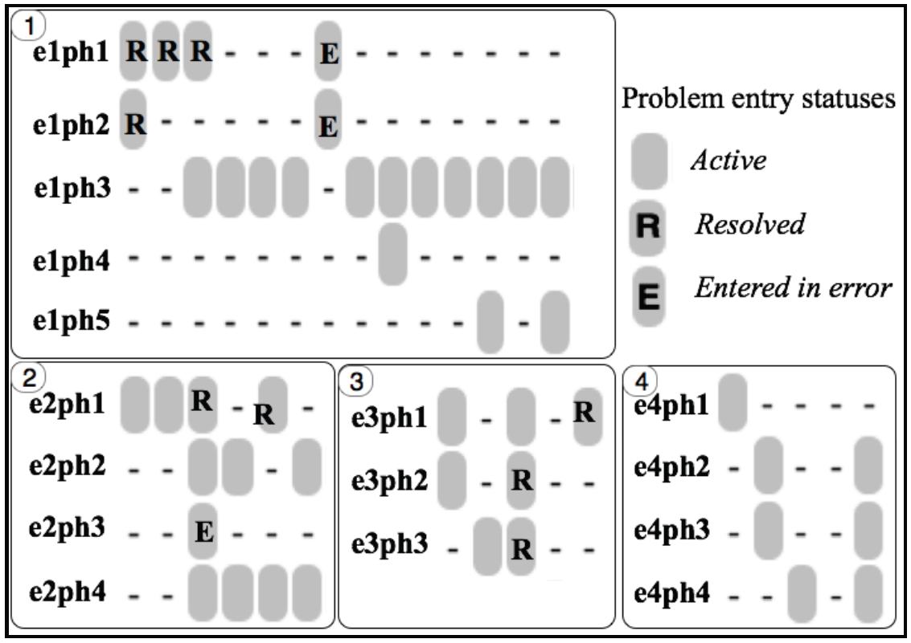
Idiosyncrasies in problem entry updates
e1ph1: Diabetes mellitus type II (NIDDM)
e1ph2: Diabetes Mellitus With Complication
e1ph3: Diabetes mellitus
e1ph4: DM (diabetes mellitus), type 1, uncontrolled
e1ph5: Diabetes mellitus with complication
e2ph1: Type 1 Diabetes Mellitus - Uncontrolled
e2ph2: Type II diabetes mellitus with ketoacidosis
e2ph3: Type 2 Diabetes Mellitus - Uncomplicated, Uncontrolled
e2ph4: Acanthosis nigricans
e3ph1: Closed Fracture Of The Shaft Of The Humerus
e3ph2: Closed Fracture Of Neck Of Femur - Transcervical
e3ph3: Closed Fracture Of The Humerus
e4ph1: Open Treatment Of Humeral Shaft Fracture w Plate/Screws
e4ph3: Fracture of left humerus
Bona J, Ceusters W. Replacing EHR structured data with explicit representations. International Conference on Biomedical Ontologies, ICBO 2015, Early career track, Lisbon, Portugal, July 27-30, 2015;85-86
Notes:
What is needed in addition are mechanisms to determine and represent not only (1)
how assertions (for instance diagnoses) relate to reality (diseases in patients) and how
changes in the pool of assertions relate to changes in reality and vice versa, but also (2)
the extent to which data are incomplete and inconsistent. As an example, we examined
Electronic Healthcare Records (EHR) of 570,000 patients from Western New York to
assess the extent to which diagnostic assertions in these records correspond to disorders
in the patients [3]. This analysis uncovered many ways in which the data fail to represent
explicitly what they are supposed to represent.

Slide 23
Major problem for secondary use
The information model behind current EHRs is optimized for individual patient care, reflecting ‘care models’, without being a faithful model of how medical reality is structured in its entirety.
Register in EHR
observation &
measurement
research
Δ = outcome
Diagnostic criteria
Best treatment
Cost effectiveness

Slide 24
EHR Information Models (simplified)
diagnosis
finding
finding
patient
patient
encounter
drug
drug
diagnosis

Slide 25
Observation / Claim
Patient data,
as currently gathered through EHRs,
communicated over RHIOs, and
collected and aggregated in data warehouses,
have minimal, if not missing at all, background information,
and
are insufficiently precise to allow the construction of a completely accurate view on what is (and has been) the case in reality.

Slide 26
Current approaches to data management and analysis ignore too much where data come from
2. Data ←→ What data are about

Slide 27
Standard approach in data analysis
Cases | Characteristics
 | ch1 | ch2 | ch3 | ch4 | ch5 | ch6 | ...
case1
case2
case3
case4
case5
case6
...
phenotypic
genotypic
treatment
outcome …

Slide 28
Standard approach in data analysis (1)
Cases | Characteristics
 | ch1 | ch2 | ch3 | ch4 | ch5 | ch6 | ...
case1
case2
case3
case4
case5
case6
...
finding correlations
phenotypic
genotypic
treatment
outcome …

Slide 29
Standard approach in data analysis (2)
Cases | Characteristics
 | ch1 | ch2 | ch3 | ch4 | ch5 | ch6 | ...
case1
case2
case3
case4
case5
case6
...
{
finding correlations
therefore
expectation
phenotypic
genotypic
treatment
outcome …

Slide 30
Standard approach in data analysis (3)
Cases | Characteristics
 | ch1 | ch2 | ch3 | ch4 | ch5 | ch6 | ...
case1
case2
case3
case4
case5
case6
...
generalization ?
{
finding correlations
therefore
expectation
phenotypic
genotypic
treatment
outcome …

Slide 31

Correlation with reality
What type of relationship is there between data items and the part of reality they are obtained from?
What, if anything at all, do variable names in header rows correspond to?
Do correlations between data items mimic the relationships between the entities in reality the data items are obtained from?

Slide 32
Developers’ view on the EHR
http://cmapspublic2.ihmc.us/rid=1GM0728VN-15TD0DN-12W4/ehr10dimensions.png

Slide 33

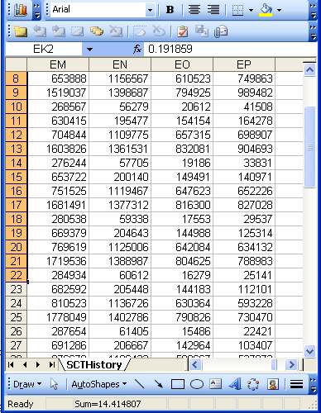
A non-trivial relation
Referents
References

Slide 34

For instance: source and impact of changes
Are differences in data about the same entities in reality at different points in time due to:
Ceusters W, Smith B. A Realism-Based Approach to the Evolution of Biomedical Ontologies. AMIA 2006 Proceedings, Washington DC, 2006;:121-125. http://www.referent-tracking.com/RTU/sendfile/?file=CeustersAMIA2006FINAL.pdf

Slide 35
For instance: source and impact of changes
Are differences in data about the same entities in reality at different points in time due to:
  changes in first-order reality ?
  changes in our understanding of reality ?
  inaccurate observations ?
  differences in perspectives ?
  registration mistakes ?
Ceusters W, Smith B. A Realism-Based Approach to the Evolution of Biomedical Ontologies. AMIA 2006 Proceedings, Washington DC, 2006;:121-125. http://www.referent-tracking.com/RTU/sendfile/?file=CeustersAMIA2006FINAL.pdf

Slide 36
What makes it non-trivial?
Referents
  are (meta-) physically the way they are,
  relate to each other in an objective way,
  follow laws of nature.
Window on reality
  restricted by:
  what is physically and technically observable,
  fit between what is measured and what we think is measured,
  fit between established knowledge and laws of nature.
References
  follow, ideally, the syntactic-semantic conventions of some representation language,
  are restricted by the expressivity of that language,
  to be interpreted correctly, reference collections need external documentation.

Slide 37
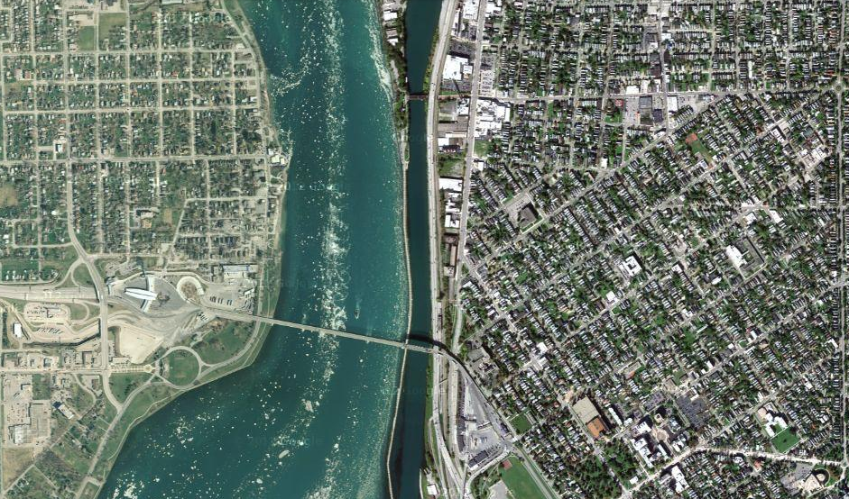
Satellite view

Slide 38
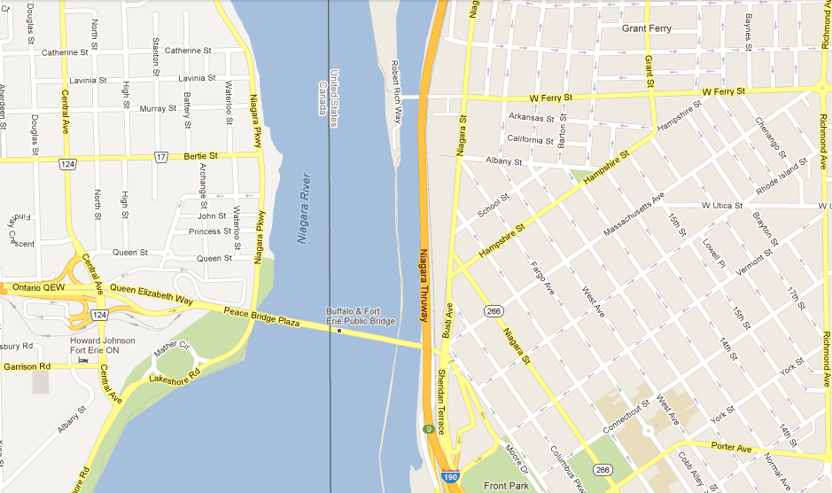
Map

Slide 39
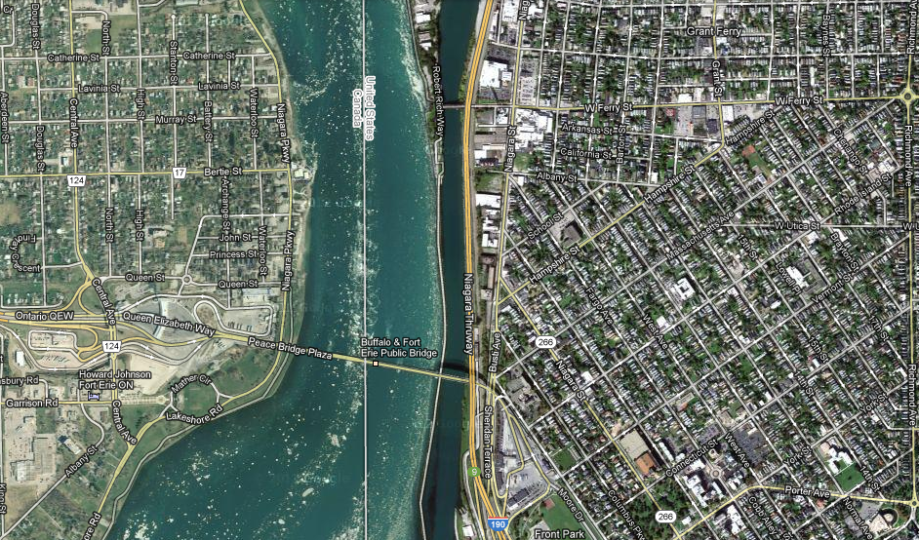
Map overlay

Slide 40
3. Different perspectives on the relation between data (language in general) and what is referred to.

Slide 41
Developers’ view on the EHR
http://cmapspublic2.ihmc.us/rid=1GM0728VN-15TD0DN-12W4/ehr10dimensions.png

Slide 42
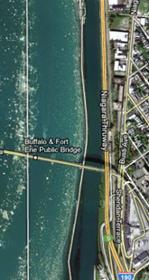
Map ←→ Reality
A message to map makers: “Highways are not painted red, rivers don’t have county lines running down the middle, and you can’t see contour lines on a mountain”
W. Kent. Data and Reality. North-Holland, Amsterdam, the Netherlands, 1978.

Slide 43
Main data ←→ reality views
Nominalism:
Conceptualism:
Realism:
These views differ in the way they accept the existence of ‘generic entities’

Slide 44





Generic entities
person
nose
Individual entities

Slide 45
Main data ←→ reality views
Nominalism:
  there are no generic entities in reality: there is no ‘personhood’, there are only individual persons.
Conceptualism:
  generalizations are in our minds. ‘personhood’ is a concept construed in our mind that allows us to reason about persons without any particular person in mind.
Realism:
  generic entities do exist and are called ‘universals’. Each particular person is an instance of the universal we call ‘person’.

Slide 46
Main data ←→ reality views
Nominalism:
  there are no generic entities in reality: there is no ‘personhood’, there are only individual persons.
Conceptualism: ← mainstream approach
  generalizations are in our minds. ‘personhood’ is a concept construed in our mind that allows us to reason about persons without any particular person in mind.
Realism: ← our approach
  generic entities do exist and are called ‘universals’. Each particular person is an instance of the universal we call ‘person’.

Slide 47
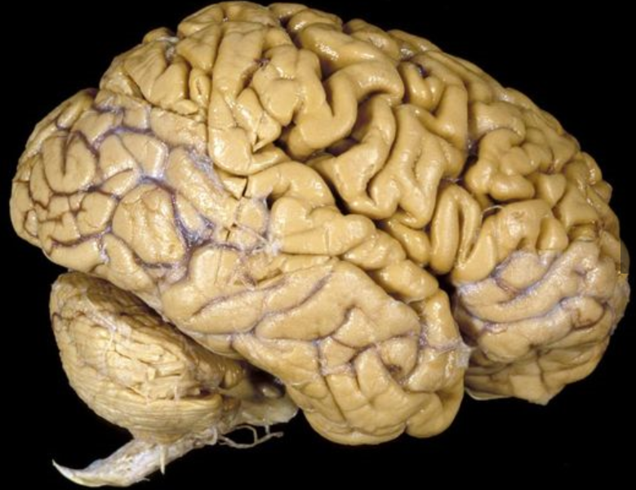
The semantic/semiotic triangle
Organ in the skull
Central nervous sytem
…
concept
term
referent
‘brain’

Slide 48
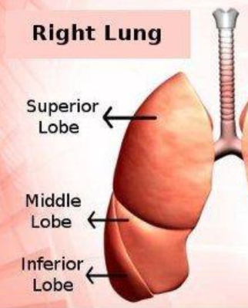
The semantic triangle works sometimes fine
The lobe of the right lung which is between the superior and inferior lobe…
concept
term
referent
‘middle lobe of right lung’

Slide 49
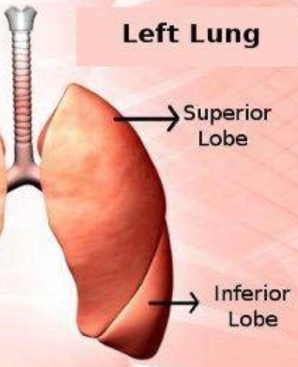
Sometimes the semantic triangle fails
The lobe of the left lung which is between the superior and inferior lobe…
concept
term
referent
‘middle lobe of left lung’

Slide 50

Prehistoric ‘psychiatry’: drapetomania
disease which causes slaves to suffer from an unexplainable propensity to run away
…
concept
term
referent
painting by Eastman Johnson. A Ride for Liberty: The Fugitive Slaves. 1860.
‘drapetomania’

Slide 51
SNOMED about diseases and concepts (until 2010)
‘Disorders are concepts in which there is an explicit or implicit pathological process causing a state of disease which tends to exist for a significant length of time under ordinary circumstances.’
And also: “Concepts are unique units of thought”.
      College of American Pathologists. SNOMED Clinical Terms® User Guide. January 2003 Release.
Thus: Disorders are unique units of thoughts in which there is a pathological process …???
And thus: to eradicate all diseases in the world at once we simply should stop thinking ?

Slide 52
4. Ontological Realism

Slide 53
Developers’ view on the EHR
http://cmapspublic2.ihmc.us/rid=1GM0728VN-15TD0DN-12W4/ehr10dimensions.png

Slide 54

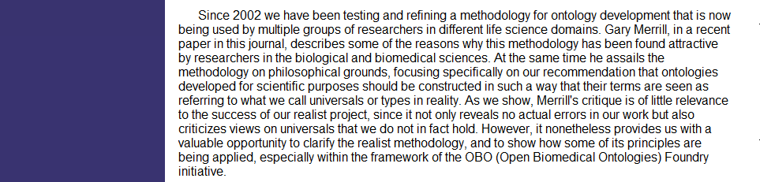
An alternative: Ontological Realism

Slide 55
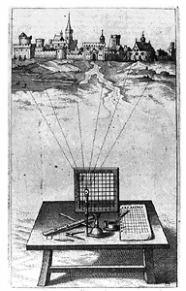
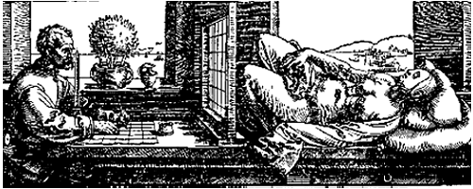
A useful parallel: Alberti’s grid
reality
Ontological
theory
representation

Slide 56
Conceptualism versus Ontological Realism
First order reality
concept
universal
term
referent
representational
unit
particular
Conceptualism
Ontological Realism

Slide 57
‘Ontology’
In philosophy:
  Ontology (no plural) is the study of what entities exist and how they relate to each other;
  by some philosophers taken to be synonymous with ‘metaphysics’ while others draw distinctions in many distinct ways (the distinctions being irrelevant for this talk), but almost agreeing on the following classification:
    metaphysics → studies ‘how is the world?’
      general metaphysics → studies general principles and ‘laws’ about the world
        ontology → studies what type of entities exist in the world
      special metaphysics → focuses on specific principles and entities
  distinct from ‘epistemology’ which is the study of how we can come to know about what exists.
  distinct from ‘terminology’ which is the study of what terms mean and how to name things.

Slide 58
‘Ontology’
In philosophy:
  Ontology (no plural) is the study of what entities exist and how they relate to each other;
In computer science and many biomedical informatics applications:
  An ontology (plural: ontologies) is a shared and agreed upon conceptualization of a domain;

Slide 59
Distinct questions. What type are they of?
Terminological:
  what does ‘pain’ mean ?
Metaphysical:
  what have all pains in common in virtue of which they are pains?
Ontological:
  what type of entity is pain?
Onto-terminological:
  what, if anything at all, does ‘pain’ denote?
Epistemological:
  how can we find out whether something is pain?

Slide 60

The basis of Ontological Realism (O.R.)
There is an external reality which is ‘objectively’ the way it is;
That reality is accessible to us;
We build in our brains cognitive representations of reality;
We communicate with others about what is there, and what we believe there is there.
Smith B, Kusnierczyk W, Schober D, Ceusters W. Towards a Reference Terminology for Ontology Research and Development in the Biomedical Domain. Proceedings of KR-MED 2006, Biomedical Ontology in Action, November 8, 2006, Baltimore MD, USA

Slide 61
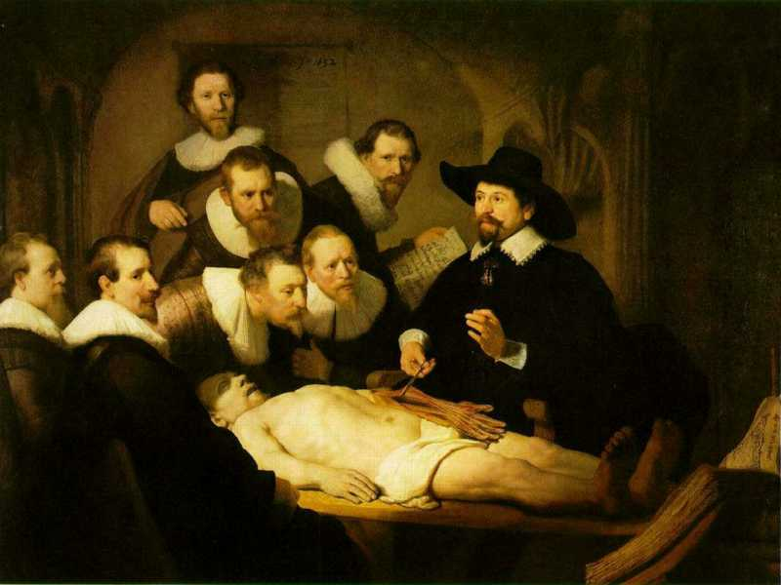
L3
Linguistic representations about (L1⁻), (L2) or (L3)
L2
Beliefs about (1)
Representations
First Order Reality
Entities (particular or generic) with objective existence which are not about anything
L1⁻

Slide 62
What is out there …
(… we want/need to deal with)?
portions of reality
relations
configurations
?
participation
me participating in my life
universals
entities
?
particulars
continuants
occurrents
me
my life
organism

Slide 63
Universal versus particular
person
instance of …
particulars

Slide 64
Ontological Realism in OBO Foundry ontologies
Continuant
has_participant
Occurrent
e.g. pathological
process
is_a
is_a
Independent
Continuant
e.g. organism
Dependent
Continuant
e.g. patient
role
inheres_in
instance_of
universals
.... ..... .......
particulars

Slide 65




Continuants preserve identity while changing
human
being
me
me
t
Instance-of
in 1960
child
Instance-of
since 1980
adult
living
creature
animal
caterpillar
butterfly

Slide 66
5. Ontology of General Medical Science
(OGMS)

Slide 67
Example: The dimensions/axes of the
Ontology of General Medical Science (OGMS)
produces
bears
realized_in
etiological process
disorder
disease
pathological process
produces
diagnosis
interpretive process
signs & symptoms
abnormal bodily features
produces
participates_in
recognized_as
Scheuermann R, Ceusters W, Smith B. Toward an Ontological Treatment of Disease and Diagnosis. 2009 AMIA Summit on Translational Bioinformatics, San Francisco, California, March 15-17, 2009;: 116-120.
http://www.referent-tracking.com/RTU/sendfile/?file=AMIA-0075-T2009.pdf
http://code.google.com/p/ogms/
Notes:
font was too small, color inside green boxes was hardly readable

Slide 68
Key OGMS definitions
DISORDER | A causally relatively isolated combination of physical components that is (a) clinically abnormal and (b) maximal, in the sense that it is not a part of some larger such combination.
DISEASE
DISEASE COURSE
DIAGNOSIS
Scheuermann R, Ceusters W, Smith B. Toward an Ontological Treatment of Disease and Diagnosis. 2009 AMIA Summit on Translational Bioinformatics, San Francisco, California, March 15-17, 2009;: 116-120. Omnipress ISBN:0-9647743-7-2

Slide 69
Basic Formal Ontology
Continuant
Occurrent
(Process)
Independent
Continuant
(molecule,
cell, organ,
organism)
Dependent
Continuant
(quality,
function,
disease)
..... ..... .... .....

Slide 70
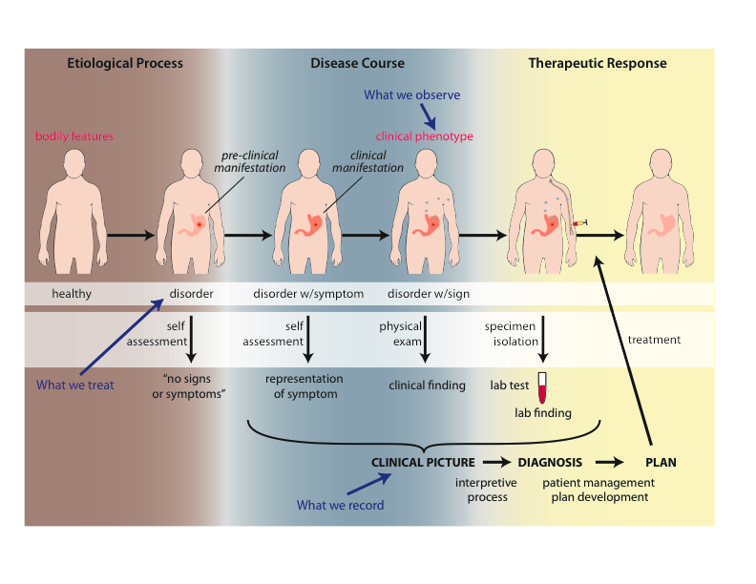
Physical Disorder
  – independent continuant
    objects
    fiat object parts
    object aggregates
    A causally linked combination of physical components of the extended organism.

Slide 71
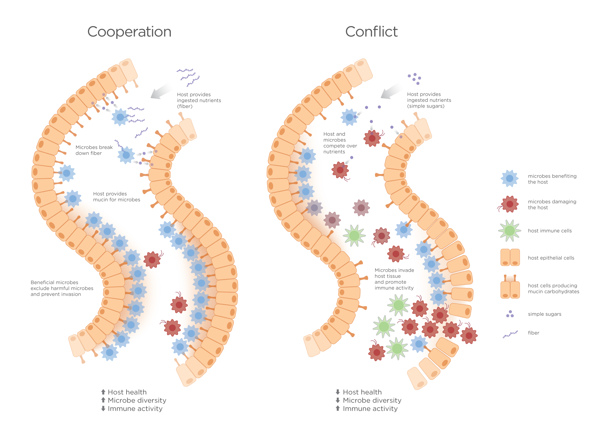
Extended organism
Harth R. War and peace in the human gut: probing the microbiome
https://biodesign.asu.edu/sites/default/files/news/AthenaHostcooperation7.png

Slide 72
Clinically abnormal
something is clinically abnormal if:
  is not part of the life plan for an organism of the relevant type (unlike aging or pregnancy),
  is causally linked to an elevated risk either of pain or other feelings of illness, or of death or dysfunction, and
  is such that the elevated risk exceeds a certain threshold level.

Slide 73
Key OGMS definitions
DISORDER | A causally relatively isolated combination of physical components that is (a) clinically abnormal and (b) maximal, in the sense that it is not a part of some larger such combination.
DISEASE | A DISPOSITION (i) to undergo PATHOLOGICAL PROCESSes that (ii) exists in an ORGANISM because of one or more DISORDERs in that ORGANISM.
DISEASE COURSE
DIAGNOSIS
Scheuermann R, Ceusters W, Smith B. Toward an Ontological Treatment of Disease and Diagnosis. 2009 AMIA Summit on Translational Bioinformatics, San Francisco, California, March 15-17, 2009;: 116-120. Omnipress ISBN:0-9647743-7-2

Slide 74
Continuant
Independent
Continuant
Dependent
Continuant
Non-realizable
Dependent
Continuant
(quality)
Realizable
Dependent
Continuant
(function, role,
disposition)
..... .....

Slide 75
Realizable dependent continuants
plan
function
role
disposition
capability
tendency
continuants

Slide 76
Their realizations
execution
expression
exercise
realization
application
course
occurrents

Slide 77
Disposition
- of a glass vase, to shatter if dropped
- of a human, to eat
- of a banana, to ripen
- of John, to lose hair
dispositions must have some physical basis

Slide 78
Disposition
if it ceases to exist, then its bearer and/or its immediate surrounding environment is physically changed;
its realization occurs when its bearer is in some special physical circumstances;
its realization is what it is in virtue of the bearer’s physical make-up.

Slide 79
Dispositions are realized in processes
dependent
continuant
occurrent
process
disposition
ripening
to ripen
disposition of this
fruit: to ripen
process of ripening
in this fruit

Slide 80
independent
continuant
dependent
continuant
occurrent
disposition
process
integumentary
system
process of going bald
to go bald
John’s
integumentary
system
John’s
disposition:
to go bald
John’s going
bald

Slide 81
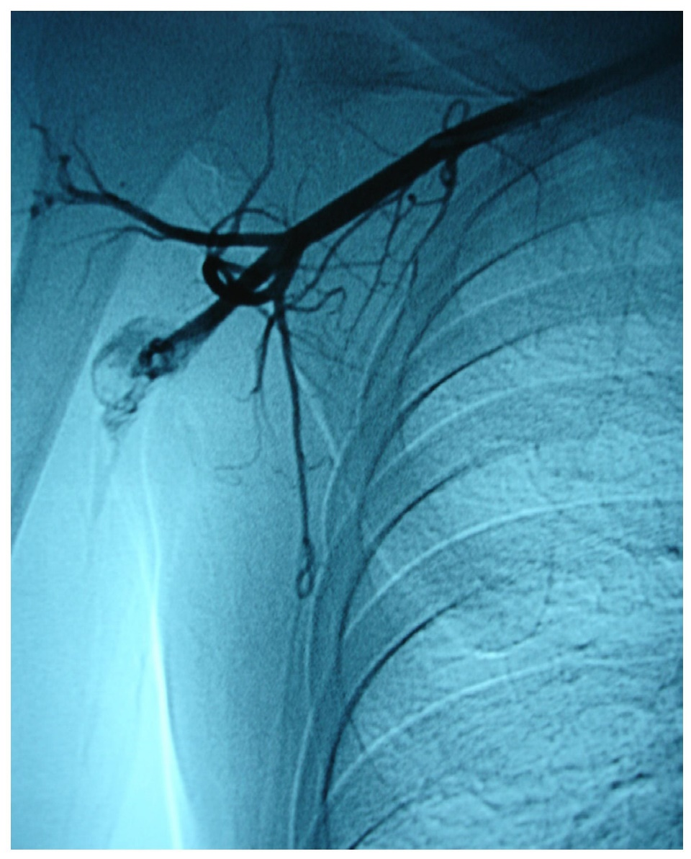
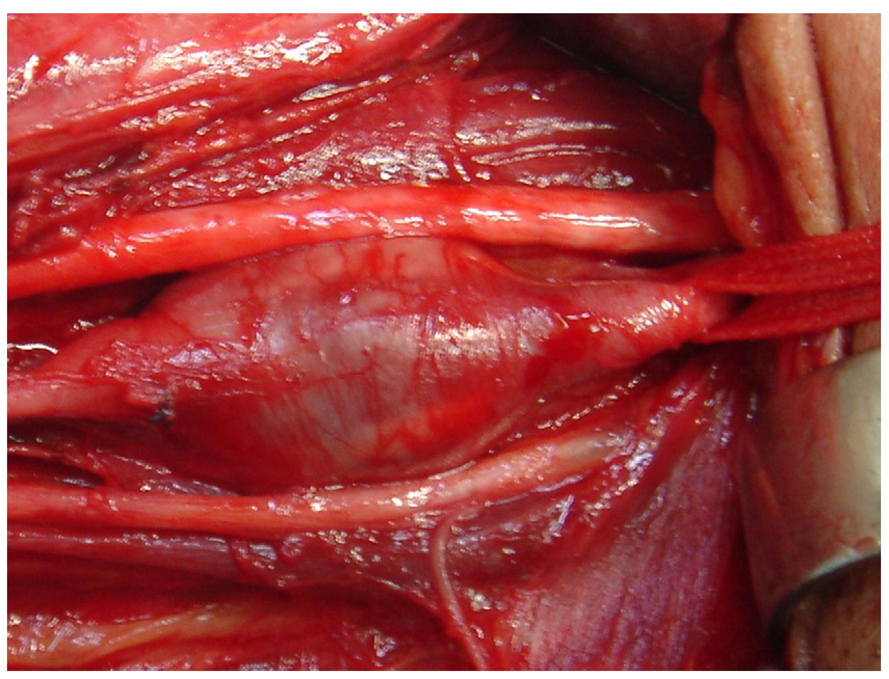
Arterial aneurysm
Jornal Vascular Brasileiro Print version ISSN 1677-5449
J. vasc. bras. vol.12 no.4 Porto Alegre Oct./Dec. 2013 Epub Dec 15, 2013
http://dx.doi.org/10.1590/jvb.2013.054
Subclavian and axillary arterial aneurysms: two case reports
Fernando Pinho Esteves¹ , André Ventura Ferreira¹ , Vanessa Prado dos Santos² , Gabriel Santos Novaes¹ , Álvaro Razuk Filho¹ , Roberto Augusto Caffaro¹

Slide 82
Arterial aneurysm
Disposition – atherosclerosis
  realized in
Pathological process – fatty material collects within the walls of arteries
  produces
Disorder – artery with weakened wall
  bears
Disposition – of artery to become distended
  realized_in
Pathological process – process of distending
  produces
Disorder – arterial aneurysm
  bears
Disposition – of artery to rupture
  realized in
Pathological process – (catastrophic event) of rupturing
  produces
Disorder – ruptured artery, arterial system with dangerously low blood pressure
  bears
Disposition – circulatory failure
  realized in
Pathological process – exsanguination, failure of homeostasis
  produces
Death

Slide 83
Key OGMS definitions
DISORDER | A causally relatively isolated combination of physical components that is (a) clinically abnormal and (b) maximal, in the sense that it is not a part of some larger such combination.
DISEASE | A DISPOSITION (i) to undergo PATHOLOGICAL PROCESSes that (ii) exists in an ORGANISM because of one or more DISORDERs in that ORGANISM.
DISEASE COURSE | The totality of all PROCESSes through which a given DISEASE instance is realized.
DIAGNOSIS
Scheuermann R, Ceusters W, Smith B. Toward an Ontological Treatment of Disease and Diagnosis. 2009 AMIA Summit on Translational Bioinformatics, San Francisco, California, March 15-17, 2009;: 116-120. Omnipress ISBN:0-9647743-7-2

Slide 84
coronary heart disease
disease associated with early lesions and small fibrous plaques
disease associated with asymptomatic (‘silent’) infarction
disease associated with surface disruption of plaque
unstable angina
stable angina
instantiates at t₂
instantiates at t₃
instantiates at t₄
instantiates at t₅
instantiates at t₁
John’s coronary heart disease
time

Slide 85
independent
continuant
dependent
continuant
occurrent
disposition
process
heart
disease course
coronary heart disease
John’s heart
John’s coronary
heart disease
course of John’s
coronary heart disease

Slide 86
Key OGMS definitions
DISORDER | A causally relatively isolated combination of physical components that is (a) clinically abnormal and (b) maximal, in the sense that it is not a part of some larger such combination.
DISEASE | A DISPOSITION (i) to undergo PATHOLOGICAL PROCESSes that (ii) exists in an ORGANISM because of one or more DISORDERs in that ORGANISM.
DISEASE COURSE | The totality of all PROCESSes through which a given DISEASE instance is realized.
DIAGNOSIS | A conclusion of an interpretive PROCESS that has as input a CLINICAL PICTURE of a given patient and as output an assertion (diagnostic statement) to the effect that the patient has a DISEASE of such and such a type.
Scheuermann R, Ceusters W, Smith B. Toward an Ontological Treatment of Disease and Diagnosis. 2009 AMIA Summit on Translational Bioinformatics, San Francisco, California, March 15-17, 2009;: 116-120. Omnipress ISBN:0-9647743-7-2

Slide 87
Disorder related configurations
No disorder instance → no disease instance,
→ no pathological processes;
A disorder instance can eliminate the range of circumstances under which another disorder instance can lead to pathological processes → no disease instance;
Disorders of the same type in distinct patients, or in the same patient at distinct times, may lead to diseases of distinct types;
Diseases of the same type may lead to disease courses of distinct types;
Diseases of distinct types may lead to disease courses of the same type;
…

Slide 88
What are diagnoses in EHRs about?
(What are the options?)
DISORDER | A causally relatively isolated combination of physical components that is (a) clinically abnormal and (b) maximal, in the sense that it is not a part of some larger such combination.
DISEASE | A DISPOSITION (i) to undergo PATHOLOGICAL PROCESSes that (ii) exists in an ORGANISM because of one or more DISORDERs in that ORGANISM.
DISEASE COURSE | The totality of all PROCESSes through which a given DISEASE instance is realized.
DIAGNOSIS | A conclusion of an interpretive PROCESS that has as input a CLINICAL PICTURE of a given patient and as output an assertion (diagnostic statement) to the effect that the patient has a DISEASE of such and such a type.
Scheuermann R, Ceusters W, Smith B. Toward an Ontological Treatment of Disease and Diagnosis. 2009 AMIA Summit on Translational Bioinformatics, San Francisco, California, March 15-17, 2009;: 116-120. Omnipress ISBN:0-9647743-7-2

Slide 89
What are diagnoses in EHRs about?
(What are the options?)
DISORDER | A causally relatively isolated combination of physical components that is (a) clinically abnormal and (b) maximal, in the sense that it is not a part of some larger such combination.
DISEASE | A DISPOSITION (i) to undergo PATHOLOGICAL PROCESSes that (ii) exists in an ORGANISM because of one or more DISORDERs in that ORGANISM.
DISEASE COURSE | The totality of all PROCESSes through which a given DISEASE instance is realized.
DIAGNOSIS | A conclusion of an interpretive PROCESS that has as input a CLINICAL PICTURE of a given patient and as output an assertion (diagnostic statement) to the effect that the patient has a DISEASE of such and such a type.
781.2 Abnormality of gait

Slide 90
What are diagnoses in EHRs about?
(What are the options?)
DISORDER | A causally relatively isolated combination of physical components that is (a) clinically abnormal and (b) maximal, in the sense that it is not a part of some larger such combination.
DISEASE | A DISPOSITION (i) to undergo PATHOLOGICAL PROCESSes that (ii) exists in an ORGANISM because of one or more DISORDERs in that ORGANISM.
DISEASE COURSE | The totality of all PROCESSes through which a given DISEASE instance is realized.
DIAGNOSIS | A conclusion of an interpretive PROCESS that has as input a CLINICAL PICTURE of a given patient and as output an assertion (diagnostic statement) to the effect that the patient has a DISEASE of such and such a type.
781.2 Abnormality of gait

Slide 91
What are diagnoses in EHRs about?
(What are the options?)
DISORDER | A causally relatively isolated combination of physical components that is (a) clinically abnormal and (b) maximal, in the sense that it is not a part of some larger such combination.
DISEASE | A DISPOSITION (i) to undergo PATHOLOGICAL PROCESSes that (ii) exists in an ORGANISM because of one or more DISORDERs in that ORGANISM.
DISEASE COURSE | The totality of all PROCESSes through which a given DISEASE instance is realized.
DIAGNOSIS | A conclusion of an interpretive PROCESS that has as input a CLINICAL PICTURE of a given patient and as output an assertion (diagnostic statement) to the effect that the patient has a DISEASE of such and such a type.
256.0 - Hyperestrogenism

Slide 92
What are diagnoses in EHRs about?
(What are the options?)
DISORDER | A causally relatively isolated combination of physical components that is (a) clinically abnormal and (b) maximal, in the sense that it is not a part of some larger such combination.
DISEASE | A DISPOSITION (i) to undergo PATHOLOGICAL PROCESSes that (ii) exists in an ORGANISM because of one or more DISORDERs in that ORGANISM.
DISEASE COURSE | The totality of all PROCESSes through which a given DISEASE instance is realized.
DIAGNOSIS | A conclusion of an interpretive PROCESS that has as input a CLINICAL PICTURE of a given patient and as output an assertion (diagnostic statement) to the effect that the patient has a DISEASE of such and such a type.
256.0 - Hyperestrogenism

Slide 93
What are diagnoses in EHRs about?
(What are the options?)
DISORDER | A causally relatively isolated combination of physical components that is (a) clinically abnormal and (b) maximal, in the sense that it is not a part of some larger such combination.
DISEASE | A DISPOSITION (i) to undergo PATHOLOGICAL PROCESSes that (ii) exists in an ORGANISM because of one or more DISORDERs in that ORGANISM.
DISEASE COURSE | The totality of all PROCESSes through which a given DISEASE instance is realized.
DIAGNOSIS | A conclusion of an interpretive PROCESS that has as input a CLINICAL PICTURE of a given patient and as output an assertion (diagnostic statement) to the effect that the patient has a DISEASE of such and such a type.
250.23 Diabetes with hyperosmolarity, type I, uncontrolled

Slide 94
What are diagnoses in EHRs about?
(What are the options?)
DISORDER | A causally relatively isolated combination of physical components that is (a) clinically abnormal and (b) maximal, in the sense that it is not a part of some larger such combination.
DISEASE | A DISPOSITION (i) to undergo PATHOLOGICAL PROCESSes that (ii) exists in an ORGANISM because of one or more DISORDERs in that ORGANISM.
DISEASE COURSE | The totality of all PROCESSes through which a given DISEASE instance is realized.
DIAGNOSIS | A conclusion of an interpretive PROCESS that has as input a CLINICAL PICTURE of a given patient and as output an assertion (diagnostic statement) to the effect that the patient has a DISEASE of such and such a type.
250.23 Diabetes with hyperosmolarity, type I, uncontrolled

Slide 95
What are diagnoses in EHRs about?
(What are the options?)
DISORDER | A causally relatively isolated combination of physical components that is (a) clinically abnormal and (b) maximal, in the sense that it is not a part of some larger such combination.
DISEASE | A DISPOSITION (i) to undergo PATHOLOGICAL PROCESSes that (ii) exists in an ORGANISM because of one or more DISORDERs in that ORGANISM.
DISEASE COURSE | The totality of all PROCESSes through which a given DISEASE instance is realized.
DIAGNOSIS | A conclusion of an interpretive PROCESS that has as input a CLINICAL PICTURE of a given patient and as output an assertion (diagnostic statement) to the effect that the patient has a DISEASE of such and such a type.
749.01 - Cleft palate, unilateral, complete

Slide 96
What are diagnoses in EHRs about?
(What are the options?)
DISORDER | A causally relatively isolated combination of physical components that is (a) clinically abnormal and (b) maximal, in the sense that it is not a part of some larger such combination.
DISEASE | A DISPOSITION (i) to undergo PATHOLOGICAL PROCESSes that (ii) exists in an ORGANISM because of one or more DISORDERs in that ORGANISM.
DISEASE COURSE | The totality of all PROCESSes through which a given DISEASE instance is realized.
DIAGNOSIS | A conclusion of an interpretive PROCESS that has as input a CLINICAL PICTURE of a given patient and as output an assertion (diagnostic statement) to the effect that the patient has a DISEASE of such and such a type.
749.01 - Cleft palate, unilateral, complete

Slide 97
What are diagnoses in EHRs about?
(What are the options?)
DISORDER | A causally relatively isolated combination of physical components that is (a) clinically abnormal and (b) maximal, in the sense that it is not a part of some larger such combination.
DISEASE | A DISPOSITION (i) to undergo PATHOLOGICAL PROCESSes that (ii) exists in an ORGANISM because of one or more DISORDERs in that ORGANISM.
DISEASE COURSE | The totality of all PROCESSes through which a given DISEASE instance is realized.
DIAGNOSIS | A conclusion of an interpretive PROCESS that has as input a CLINICAL PICTURE of a given patient and as output an assertion (diagnostic statement) to the effect that the patient has a DISEASE of such and such a type.
V65.5 - Person with feared complaint in whom no diagnosis was made

Slide 98
What are diagnoses in EHRs about?
(What are the options?)
DISORDER | A causally relatively isolated combination of physical components that is (a) clinically abnormal and (b) maximal, in the sense that it is not a part of some larger such combination.
DISEASE | A DISPOSITION (i) to undergo PATHOLOGICAL PROCESSes that (ii) exists in an ORGANISM because of one or more DISORDERs in that ORGANISM.
DISEASE COURSE | The totality of all PROCESSes through which a given DISEASE instance is realized.
DIAGNOSIS | A conclusion of an interpretive PROCESS that has as input a CLINICAL PICTURE of a given patient and as output an assertion (diagnostic statement) to the effect that the patient has a DISEASE of such and such a type.
V65.5 - Person with feared complaint in whom no diagnosis was made

Slide 99
6. Diagnostic coding versus disorder coding

Slide 100
Data must be unambiguous and faithful to reality …
Referents
organized in reality
References organized
in a data collection

Slide 101
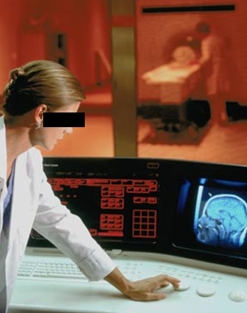
Example: Conflation of diagnosis and disease/disorder
The diagnosis is here
The disorder is there
The disease is there

Slide 102
Can you spot the many problematic issues?
http://incerio.com/planning-nextgen-version-5-8-upgrade-things-know-diagnosis-module/

Slide 103
The distinctions applied to diabetes management
Generic
Specific
3. Representation
‘person’
‘drug’
‘insulin’
‘W. Ceusters’
‘my sugar’
2. Beliefs (knowledge)
DIAGNOSIS
my doctor’s
work plan
my doctor’s
diagnosis
INDICATION
1.
First-order reality
PATHOLOGICAL
STRUCTURE
my doctor
my doctor’s computer
PERSON
DISEASE
me
my NIDDM
DRUG
PORTION OF
INSULIN
my blood glucose
level
MOLECULE
Basic Formal Ontology
Referent Tracking

Slide 104
Coding systems used naively preserve certain ambiguities
PtID
Date
ObsCode
Narrative
5572
04/07/1990
26442006
closed fracture of shaft of femur
5572
04/07/1990
81134009
Fracture, closed, spiral
5572
12/07/1990
26442006
closed fracture of shaft of femur
5572
12/07/1990
9001224
Accident in public building (supermarket)
5572
04/07/1990
79001
Essential hypertension
0939
24/12/1991
255174002
benign polyp of biliary tract
2309
21/03/1992
26442006
closed fracture of shaft of femur
2309
21/03/1992
9001224
Accident in public building (supermarket)
47804
03/04/1993
58298795
Other lesion on other specified region
5572
17/05/1993
79001
Essential hypertension
298
22/08/1993
2909872
Closed fracture of radial head
298
22/08/1993
9001224
Accident in public building (supermarket)
5572
01/04/1997
26442006
closed fracture of shaft of femur
5572
01/04/1997
79001
Essential hypertension
0939
20/12/1998
255087006
malignant polyp of biliary tract

Slide 105
Codes for ‘types’ AND identifiers for instances
PtID
Date
ObsCode
Narrative
5572
04/07/1990
26442006
IUI-001
closed fracture of shaft of femur
5572
04/07/1990
81134009
IUI-001
Fracture, closed, spiral
5572
12/07/1990
26442006
IUI-001
closed fracture of shaft of femur
5572
12/07/1990
9001224
IUI-007
Accident in public building (supermarket)
5572
04/07/1990
79001
IUI-005
Essential hypertension
0939
24/12/1991
255174002
IUI-004
benign polyp of biliary tract
2309
21/03/1992
26442006
IUI-002
closed fracture of shaft of femur
2309
21/03/1992
9001224
IUI-007
Accident in public building (supermarket)
47804
03/04/1993
58298795
IUI-006
Other lesion on other specified region
5572
17/05/1993
79001
IUI-005
Essential hypertension
298
22/08/1993
2909872
IUI-003
Closed fracture of radial head
298
22/08/1993
9001224
IUI-007
Accident in public building (supermarket)
5572
01/04/1997
26442006
IUI-012
closed fracture of shaft of femur
5572
01/04/1997
79001
7 distinct disorders
IUI-005
Essential hypertension
0939
20/12/1998
255087006
IUI-004
malignant polyp of biliary tract

Slide 106
Take home messages
Statements, even scientific jargon, as well as data collections can make sense and be about something, without each part thereof making sense or being about something.
  (a + b)² = a² + 2ab + b² is true whatever a and b are,
  c² = a² + b² is sometimes true, for instance if a, b, and c are the lengths of certain sides of a rectangular triangle.
For data collections to be interpretable and comparable, each part of it needs to be documented as to what it intends to denote.
Ontological Realism is a method to achieve this.

