Slide 1
MIROT: Minimal Information to be Referenced by an Ontology Term Clinical Terminology Shock and Awe Fifth Annual Workshop of the Clinical and Translational Science Ontology Group Buffalo, NY - September 7-8, 2016
Werner CEUSTERS, MD
Department of Biomedical Informatics,
Jacobs School of Medicine, University at Buffalo
Buffalo, NY - USA

Slide 2
Focus of my programmatic research
How can data/information/… /ontologies be processed/structured in such a way that:
they are faithful representations of reality, and that
changes introduced in updates reflect faithfully corresponding changes in reality?
What are the requirements for formalisms/systems/… containing data/… satisfying (1a) and (1b) to allow users thereof acquiring a faithful representation of the changes in reality by merely looking at the changes in the data/… ?

Slide 3
You think?

Slide 4
Reviewers’ comments on my FOIS 2016 papers
‘Although it is not mentioned explicitly, it gives the impression that the authors assume that there is only one reality and that this reality can be faithfully modelled’;
‘The somewhat naive realism that seems to underly the work, namely, that there is an objective reality out there to be observed and recognized’;
‘it is impossible to distinguish whether ontology modifications result from observed changes in reality or changes in understanding of reality. ’

Slide 5
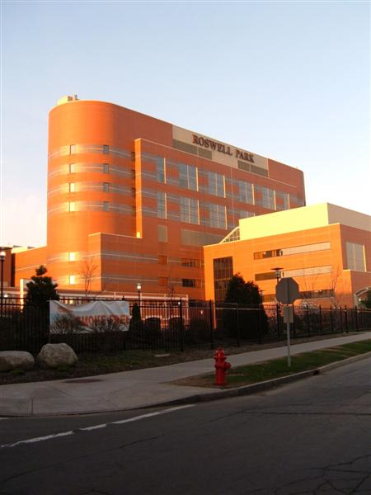
My motivation: an old vision
Everything collected wherever, whenever and about whomever which is relevant to a medical problem in whomever, whenever and wherever, should be accessible without loss of relevant detail.

Slide 6
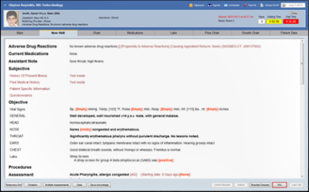
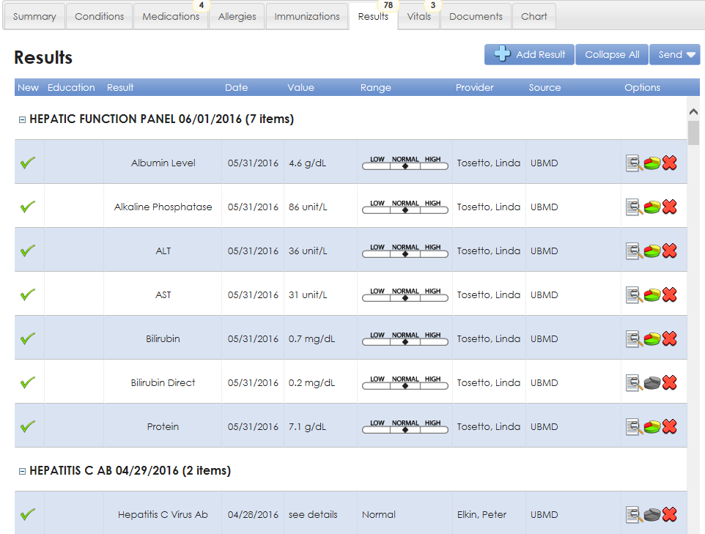
Relevance determination requires a global view
https://www.sigmundsoftware.com/
http://www.praxisemr.com/
https://ubmd.followmyhealth.com

Slide 7
However !
https://www.sigmundsoftware.com/
http://www.praxisemr.com/
Lacks data for making analytics and DS work
https://ubmd.followmyhealth.com
Optimized for practice management and patient care
Optimized for analytics and decision support

Slide 8
Idiosyncrasies in relation to diagnoses
Diagnostic uncertainty
Diagnosis may be recorded when there is only a suspicion of disease
Some overlapping clinical conditions are difficult to distinguish reliably
Patients may only partially fit diagnostic criteria
Patients in whom diagnostic testing is done but is negative are still more likely to have disease
Diagnostic timing
Repeated diagnosis codes over time may represent a new event or a follow-up to an earlier event
First diagnosis in a database is not necessarily an incident case of disease
Hersh, WR, Weiner, MG, et al. (2013).
Caveats for the use of operational electronic health record data in comparative effectiveness research. Medical Care. 51(Suppl 3): S30-S37.

Slide 9
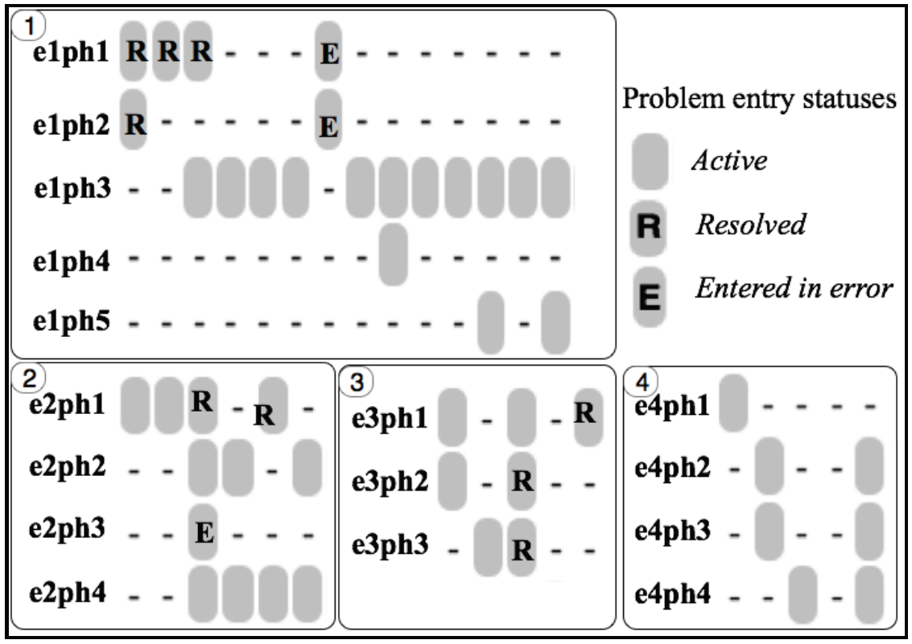
Idiosyncrasies in problem entry updates
e1ph1: Diabetes mellitus type II (NIDDM)
e1ph2: Diabetes Mellitus With Complication
e1ph3: Diabetes mellitus
e1ph4: DM (diabetes mellitus), type 1, uncontrolled
e1ph5: Diabetes mellitus with complication
e2ph1: Type 1 Diabetes Mellitus - Uncontrolled
e2ph2: Type II diabetes mellitus with ketoacidosis
e2ph3: Type 2 Diabetes Mellitus - Uncomplicated, Uncontrolled
e2ph4: Acanthosis nigricans
e3ph1: Closed Fracture Of The Shaft Of The Humerus
e3ph2: Closed Fracture Of Neck Of Femur - Transcervical
e3ph3: Closed Fracture Of The Humerus
e4ph1: Open Treatment Of Humeral Shaft Fracture w Plate/Screws
e4ph3: Fracture of left humerus
Bona J, Ceusters W. Replacing EHR structured data with explicit representations. International Conference on Biomedical Ontologies, ICBO 2015, Early career track, Lisbon, Portugal, July 27-30, 2015;85-86
Notes:
What is needed in addition are mechanisms to determine and represent not only (1)
how assertions (for instance diagnoses) relate to reality (diseases in patients) and how
changes in the pool of assertions relate to changes in reality and vice versa, but also (2)
the extent to which data are incomplete and inconsistent. As an example, we examined
Electronic Healthcare Records (EHR) of 570,000 patients from Western New York to
assess the extent to which diagnostic assertions in these records correspond to disorders
in the patients [3]. This analysis uncovered many ways in which the data fail to represent
explicitly what they are supposed to represent.

Slide 10
Prominent types of inconsistencies
Changes in reality not faithfully reflected in the medical record updates;
Updates in the records inadequately documented as to whether they reflect changes in reality or changes in caregivers understanding thereof;
Inconsistencies amongst observers;
Plain mistakes and ambiguities.
Attempted solution: ontology-based template for generating maximally complete and self-explanatory assertions.
Ceusters W, Hsu CY, Smith B. Clinical Data Wrangling using Ontological Realism and Referent Tracking. International Conference on Biomedical Ontologies, ICBO 2014, Houston, Texas, Oct 6-9, 2014;
CEUR Workshop Proceedings 2014;1237:27-32.

Slide 11
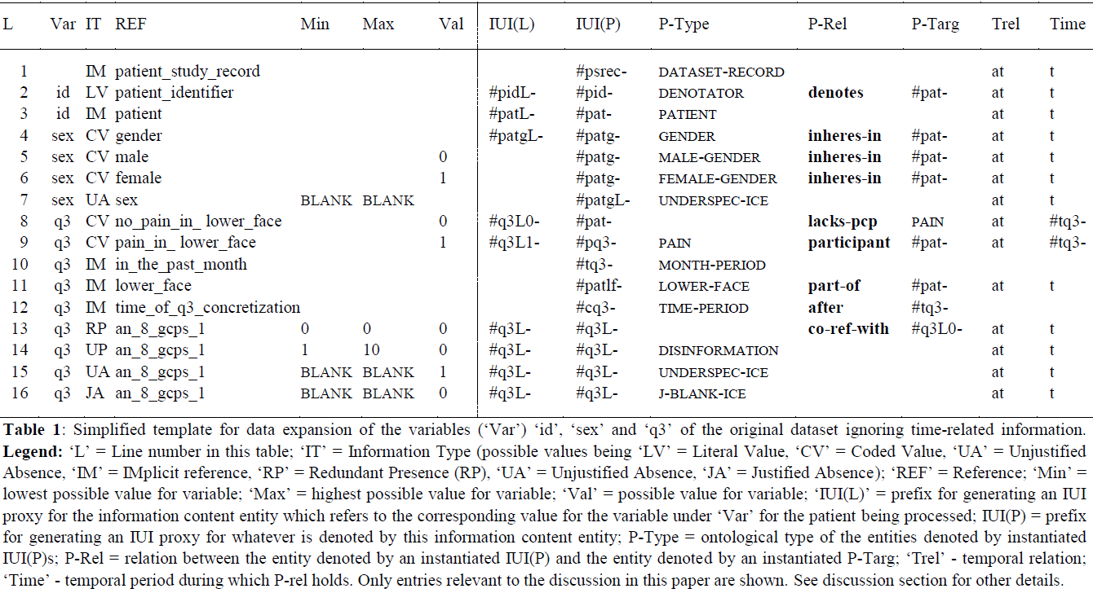
ICBO 2014: Template for generating maximally complete and self-explanatory assertions
‘conditional part’
‘RT-compatible part’

Slide 12
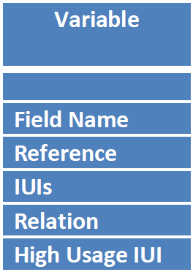
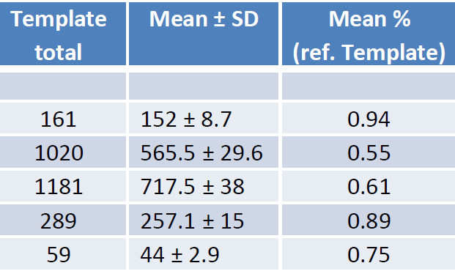
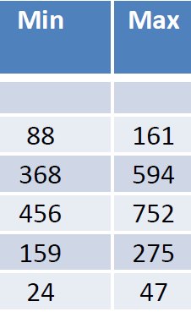
Creating a controlled data explosion
For one dataset with 161 variables:
Between 456 and 752 IUIs generated per patient (average 717),
On average 257 relationships expressed between IUIs per patient.

Slide 13
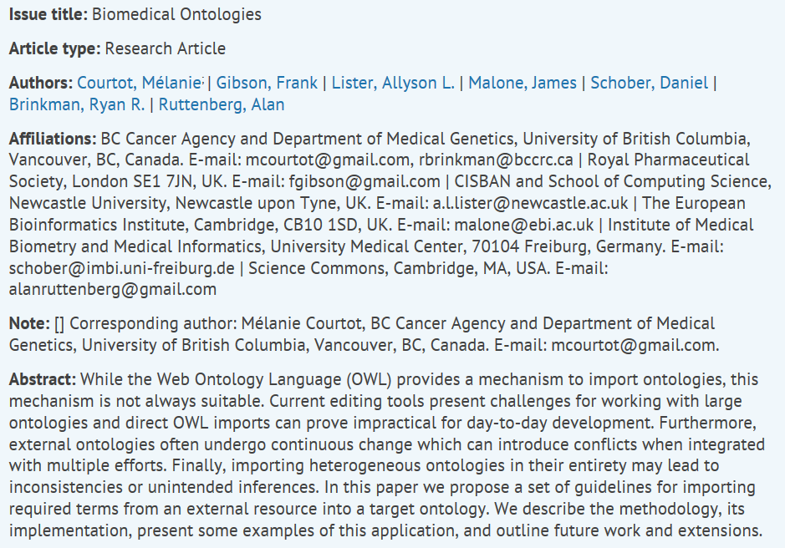
MIREOT: The minimum information to reference an external ontology term

Slide 14
MIREOT guidelines
Minimal information that allows to unambiguously identify a term:
URI of the class imported
URI of the source ontology
Position in the target ontology
Additional information:
Label
Definition
Other annotations, e.g. “human-readable” information

Slide 15
MIREOT modifications in Protégé Plugin
Import all of the annotations;
because vital information about some components are included in annotations other than “rdfs:label” and “iao:definition”;
Keep the axioms in the main ontology;
to decrease the friction of development for Protégé users while still maintaining necessary provenance information;
Report only the most recent source ontology information;
to prevent confusion based on multiple “iao:imported from” annotations that do not allow one to distinguish from which ontology a component was imported directly;
Save the ontology URL as the IRI in the case of ontologies that do not have an IRI;
to preserve the provenance of the imported component somehow.
Hanna J, Cheng C, Crow A, Hall R, Liu J, Pendurthi T, Schmidt T, Jennings S, Brochhausen M, Hogan W:
Simplifying MIREOT; a MIREOT Protege Plugin.
Boston, USA: Proceedings of the ISWC 2012 Posters & Demonstrations Track; 2012:11–15. http://ceur-ws.org/Vol-914/paper_48.pdf.

Slide 16
Insights obtained
It was demonstrated that the proposed framework could handle all idiosyncrasies encountered in the dataset used as test case.
however
It required a thorough understanding of and expertise in applying the underlying theories of the framework so as not to make any mistakes in designing the template.
Ceusters W, Hsu CY, Smith B. Clinical Data Wrangling using Ontological Realism and Referent Tracking. International Conference on Biomedical Ontologies, ICBO 2014, Houston, Texas, Oct 6-9, 2014;
CEUR Workshop Proceedings 2014;1237:27-32.

Slide 17
Insights obtained
Underlying theories: ontological realism, BFO, Referent Tracking
Are they too difficult?
It was demonstrated that the proposed framework could handle all idiosyncrasies encountered in the dataset used as test case.
however
It required a thorough understanding of and expertise in applying the underlying theories of the framework so as not to make any mistakes in designing the template.
Ceusters W, Hsu CY, Smith B. Clinical Data Wrangling using Ontological Realism and Referent Tracking. International Conference on Biomedical Ontologies, ICBO 2014, Houston, Texas, Oct 6-9, 2014;
CEUR Workshop Proceedings 2014;1237:27-32.

Slide 18
NCBO - 2005
The End of a Cottage Industry:
The coming industrial revolution for biomedical ontologies.
Mark Musen

Slide 19
A thousand flowers are blooming!
Ontologies are being developed by interested groups from every sector of academia, industry, and government
Many of these ontologies have been proven to be extraordinarily useful to wide communities
We finally have tools and representation languages that can enable us to create durable and maintainable ontologies with rich semantic content
Mark Musen. The End of a Cottage Industry:
The coming industrial revolution for biomedical ontologies.

Slide 20
The danger
Cottage industry
Industrial revolution
Consumerism
Mass production
Quality sacrifice

Slide 21
To avoid the danger

Slide 24
Alexa McCray. Conceptualizing the World: Lessons from History. IMIA WG6, Rome, 2005.

Slide 25
Ingvar Johansson. Comments on A.T. McCray, “Conceptualizing the World: Lessons from History”. IMIA WG6, Rome, 2005.

Slide 26
Ingvar Johansson. Comments on A.T. McCray, “Conceptualizing the World: Lessons from History”. IMIA WG6, Rome, 2005.

Slide 27
D. Pisanelli versus J. Rogers – Rome 2005
Ontologies are the basic infrastructures for modern interoperable information systems and are the groundwork for implementing the semantic web
Domenico Pisanelli. A Journey through the Cavities of the Human Body. IMIA WG6 Conference, Rome, Italy, April 29 – May 2, 2005.
Ontologies are a required basic infrastructure for the interoperable information systems of our dreams, and would be the groundwork for implementing the semantic web, were it not for...
... the cognitive limitations of ordinary adult users
Jeremy Rogers. Commentary on Pisanelli.

Slide 28
Jeremy Rogers (Manchester) – Rome 2005

Slide 29
Jeremy Rogers (Manchester) – Rome 2005

Slide 30
Galen in the BioPortal

Slide 31
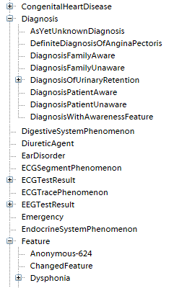
Galen hierarchy in the BioPortal

Slide 32
Mark Musen. Who will Classify the Classifications? Differing Views of Biomedical Ontology. IMIA WG6, Rome, 2005.

Slide 33
Mark Musen. Who will Classify the Classifications? Differing Views of Biomedical Ontology. IMIA WG6, Rome, 2005.

Slide 34
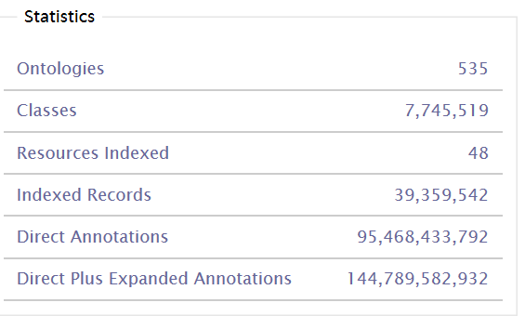
BioPortal statistics, Sept 6, 2016.
http://bioportal.bioontology.org/

Slide 35
Recent overview on quality of BioPortal Ontologies
Clear discrepancy between logical consistency (generally very good) and faithfulness to reality (generally very poor)

Slide 36
Mark Musen. The End of a Cottage Industry:
The coming industrial revolution for biomedical ontologies.

Slide 37
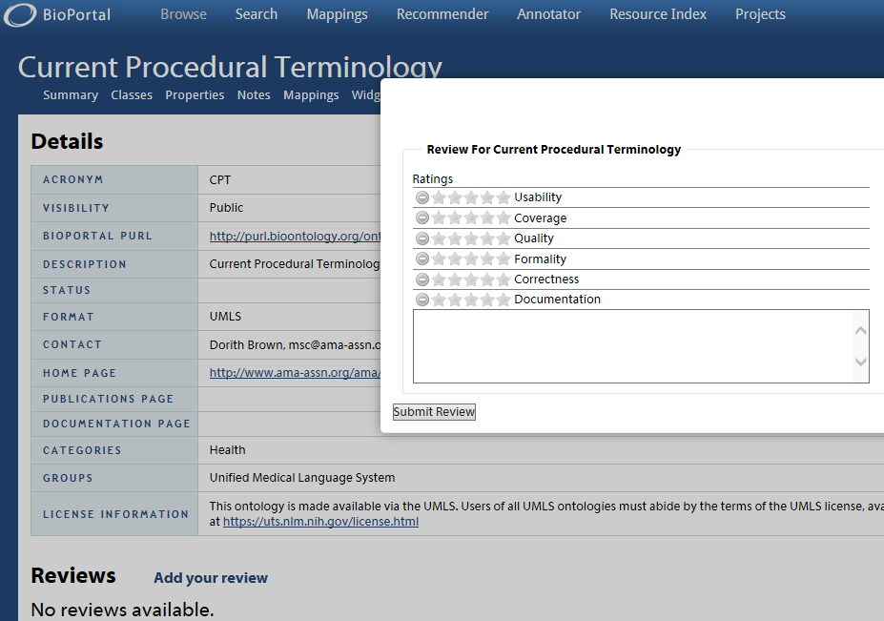

Slide 38
Are ‘we’
– the ontology inquisition – successful?

Slide 39
In this study, we take the first step in this direction, by designing an OWL2 diabetes diagnosis ontology (DDO). Protégé 5 software was used for the construction of the ontology. DDO is developed within the framework of the basic formal ontology and the ontology for general medical science
to represent entities in the domain of diabetes, and it follows the design principles recommended by the Open Biomedical Ontology Foundry. Currently, DDO contains 6444 concepts, 48 properties, 13,551 annotations, and 27,127 axioms. DDO can serve as a diabetes knowledge base and supports automatic reasoning. It represents a major step toward the development of a new generation of patient-centric decision support tools.

Slide 40
Development process
DDO: a diabetes mellitus diagnosis ontology
Shaker El-Sappagh and Farman Ali²
Applied Informatics20163:5
DOI: 10.1186/s40535-016-0021-2

Slide 42
Erroneous mappings

Slide 43
We seriously need to address quality at all levels.
Everything collected wherever, whenever and about whomever which is relevant to a medical problem in whomever, whenever and wherever, should be accessible without loss of relevant detail.

Slide 44
Why national eHealth programs need dead philosophers: Wittgensteinian reflections on policymakers' reluctance to learn from history.
The Milbank Quarterly: Multidisciplinary Journal of Population Health and Health Policy, 2011, 89(4), 533-63

Slide 45
Why national eHealth programs need dead philosophers: Wittgensteinian reflections on policymakers' reluctance to learn from history.
Findings:
A national eHealth program is best conceptualized not as a blueprint and implementation plan for a state-of-the-art technical system but as a series of overlapping, conflicting, and mutually misunderstood language games that combine to produce a situation of ambiguity, paradox, incompleteness, and confusion.
Conclusion:
The complexity of contemporary health care, combined with the multiple stakeholders in large technology initiatives, means that national eHealth programs require considerably more thinking through than has sometimes occurred. We need fewer grand plans and more learning communities. The onus, therefore, is on academics to develop ways of drawing judiciously on the richness of case studies to inform and influence eHealth policy, which necessarily occurs in a simplified decision environment.
The Milbank Quarterly: Multidisciplinary Journal of Population Health and Health Policy, 2011, 89(4), 533-63

Slide 46
Not just governments
Class Name: Equipment Class Description: Materiel that is neither intended for consumption nor an unexploded piece of ordnance. (From MIM, class: Equipment)
https://www.sisostds.org/DesktopModules/Bring2mind/DMX/Download.aspx?Command=Core_Download&EntryId=44479&PortalId=0&TabId=105

Slide 47
Why national eHealth programs need dead philosophers: Wittgensteinian reflections on policymakers' reluctance to learn from history.
The Milbank Quarterly: Multidisciplinary Journal of Population Health and Health Policy, 2011, 89(4), 533-63

Slide 48
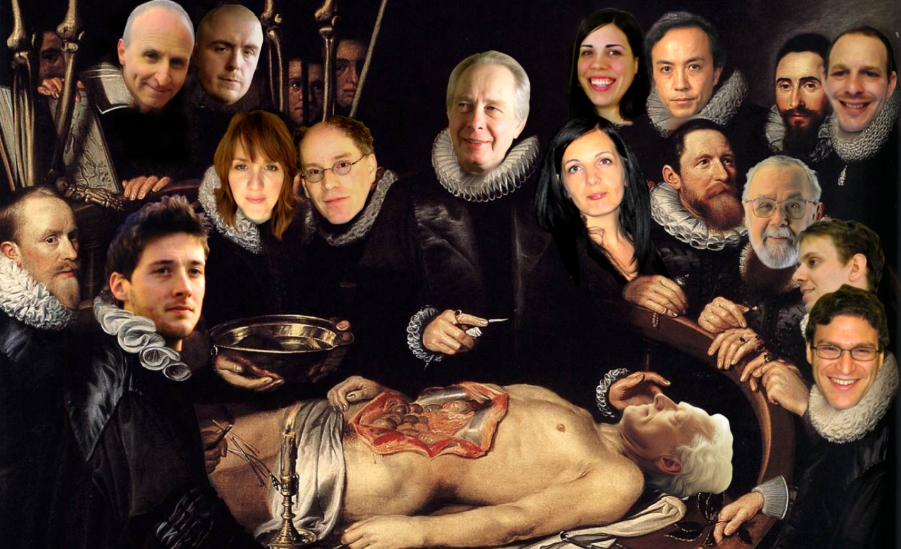
Why national eHealth programs need dead philosophers: Wittgensteinian reflections on policymakers' reluctance to learn from history.
Poster design by Catherine Nolan
http://www.buffalo.edu/content/cas/philosophy/news-events/events/_jcr_content/par/download/file.res/PANTC%202014%20Conference%20Poster%20final-1.pdf

Slide 49
A wide range of data quality perspectives
http://www.dqglossary.com/data%20quality_.html

Slide 50
Data quality … really ?
Thomas C. Redman (Navesink Consulting Group, Little Silver, NJ) .
Data quality: the field guide.
Digital Press Newton, MA, USA ©2001, ISBN:1-55558-251-6

Slide 51
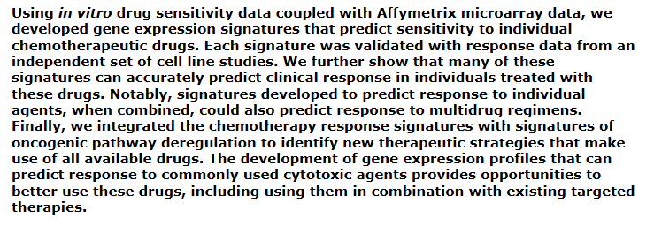
Planning: grants, publications and fame
Nature Medicine - 12, 1294 - 1300 (2006)

Slide 52
We wish to retract this article because we have been unable to reproduce certain crucial experiments showing validation of signatures for predicting response to chemotherapies, including docetaxel and topotecan. Although we believe that the underlying approach to developing predictive signatures is valid, a corruption of several validation data sets precludes conclusions regarding these signatures. As these results are fundamental to the conclusions of the paper, we formally retract the paper. We deeply regret the impact of this action on the work of other investigators.
Nature Medicine would also like to note that several of the earlier correction dates were either omitted or incorrect. The corrigenda published online 10 May 2007, 10 October 2007 and 21 July 2008 mistakenly omitted the earlier correction date of 27 October 2006. The correction in July 2008 went online on 21 July 2008 but was incorrectly noted in the corrigendum as having gone online 18 July 2008.

Slide 53
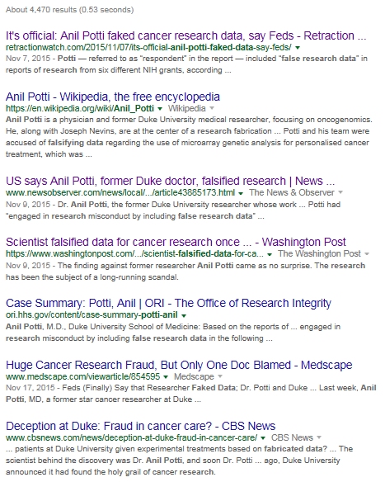
The publications and fame part worked

Slide 54
Data quality … really ?
Thomas C. Redman (Navesink Consulting Group, Little Silver, NJ) .
Data quality: the field guide.
Digital Press Newton, MA, USA ©2001, ISBN:1-55558-251-6

Slide 55
Data quality … reality!
Almost there:
the data are deemed of high quality if they correctly represent the real-world construct to which they refer.
Elisa Bertino, Chenyun Dai, .Murat Kantarcioglu. The Challenge of Assuring Data Trustworthiness, Database Systems for Advanced Applications, Lecture Notes in Computer Science, 2009, Volume 5463/2009, 22-33.
An information system is to provide a representation of an application domain (also termed the real-world system) as perceived by the user.
Anchoring Data Quality Dimensions in Ontological Foundations Y Wand and RY. Wang. November 1996/Vol. 39, No. 11 COMMUNICATIONS OF THE ACM

Slide 56
Data quality … reality!
Almost there:
the data are deemed of high quality if they correctly represent the real-world construct to which they refer.
Elisa Bertino, Chenyun Dai, .Murat Kantarcioglu. The Challenge of Assuring Data Trustworthiness, Database Systems for Advanced Applications, Lecture Notes in Computer Science, 2009, Volume 5463/2009, 22-33.
An information system is to provide a representation of an application domain (also termed the real-world system) as perceived by the user.
Anchoring Data Quality Dimensions in Ontological Foundations Y Wand and RY. Wang. November 1996/Vol. 39, No. 11 COMMUNICATIONS OF THE ACM

Slide 57
Data quality … reality!
Almost there:
the data are deemed of high quality if they correctly represent the real-world construct to which they refer.
Elisa Bertino, Chenyun Dai, .Murat Kantarcioglu. The Challenge of Assuring Data Trustworthiness, Database Systems for Advanced Applications, Lecture Notes in Computer Science, 2009, Volume 5463/2009, 22-33.
An information system is to provide a representation of an application domain (also termed the real-world system) as perceived by the user.
Extremely close:
1978 - 2000 - 2012

Slide 58
William Kent in ‘Data and Reality’
p35, 3rd edition, 2012.

Slide 59
Fight against arbitrariness and ambiguity

Slide 60
1978 → 2012
p13, 3rd edition, 2012.

Slide 61
Some Data Quality Dimensions
Dimension | # cited | Dimension | # cited | Dimension | # cited
Accuracy | 25 | Format | 4 | Comparability | 2
Reliability | 22 | Interpretability | 4 | Conciseness | 2
Timeliness | 19 | Content | 3 | Freedom from bias | 2
Relevance | 16 | Efficiency | 3 | Informativeness | 2
Completeness | 15 | Importance | 3 | Level of detail | 2
Currency | 9 | Sufficiency | 3 | Quantitativeness | 2
Consistency | 8 | Usableness | 3 | Scope | 2
Flexibility | 5 | Usefulness | 3 | Understandability | 2
Precision | 5 | Clarity | 2
Wang, R.Y., Storey, V.C., and Firth, C.P.
A framework for analysis of data quality research.
IEEE Trans. on Knowl. Data Eng. 7, 4 (1995), pp. 623–640.

Slide 62
ISO 25012:2008(E) Data quality
Irfan Rafique, Philip Lew, Maissom Qanber Abbasi and Zhang Li.
Information Quality Evaluation Framework: Extending ISO 25012 Data Quality Model.
International Journal of Computer, Electrical, Automation, Control and Information Engineering Vol:6, No:5, 2012.

Slide 63
Linked data quality dimensions
Filip Radulovic , Nandana Mihindukulasooriya, Raúl García-Castro and Asunción Gómez Pérez
A comprehensive quality model for Linked Data
http://www.semantic-web-journal.net/content/comprehensive-quality-model-linked-data-0. 2016

Slide 64
From data Q(uality) to information Q
Partial table
Debattista, J., Lange, C., Auer, S.: daQ, an Ontology for Dataset Quality Information.
In: Proceedings of the Workshop on Linked Data on the Web, co-located with the 23rd International
World Wide Web Conference (WWW 2014), Seoul, Korea, April 8, 2014. (2014)

Slide 65
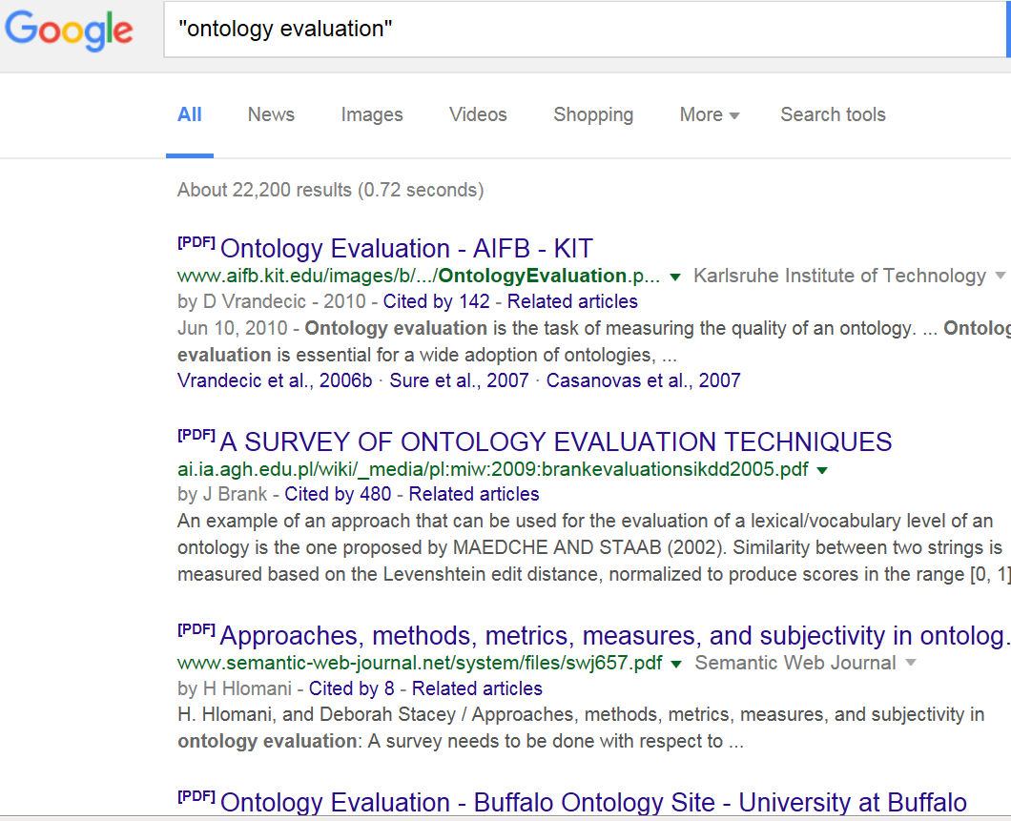

Slide 66
Some Ontology Quality Dimensions
Accuracy/validity | Redundancy
Cohesiveness | Naturalness
Complexity | Precision/completeness
Semantic consistency | Verifiability
Structural consistency | Volatility
Currency | Authority
Besiki Stvilia.
A model for ontology quality evaluation. First Monday, Volume 12 Number 12 - 3 December 2007 http://firstmonday.org/ojs/index.php/fm/article/view/2043/1905

Slide 67
Ontology auditing and effects
For example, it was agreed that Serum specimen from blood product is missing a parent Blood specimen from blood product that
should be added.
Y. Wang, M. Halper, D. Wei, et al.
Auditing complex concepts of SNOMED using a refined hierarchical abstraction network
J. Biomed. Inform., 45 (1) (2012), pp. 1–14
July 2016 version

Slide 68
The beginnings of a laudable idea
Debattista, J., Lange, C., Auer, S.: daQ, an Ontology for Dataset Quality Information.
In: Proceedings of the Workshop on Linked Data on the Web, co-located with the 23rd International
World Wide Web Conference (WWW 2014), Seoul, Korea, April 8, 2014. (2014)

Slide 69
Conclusion: we need both

Slide 70
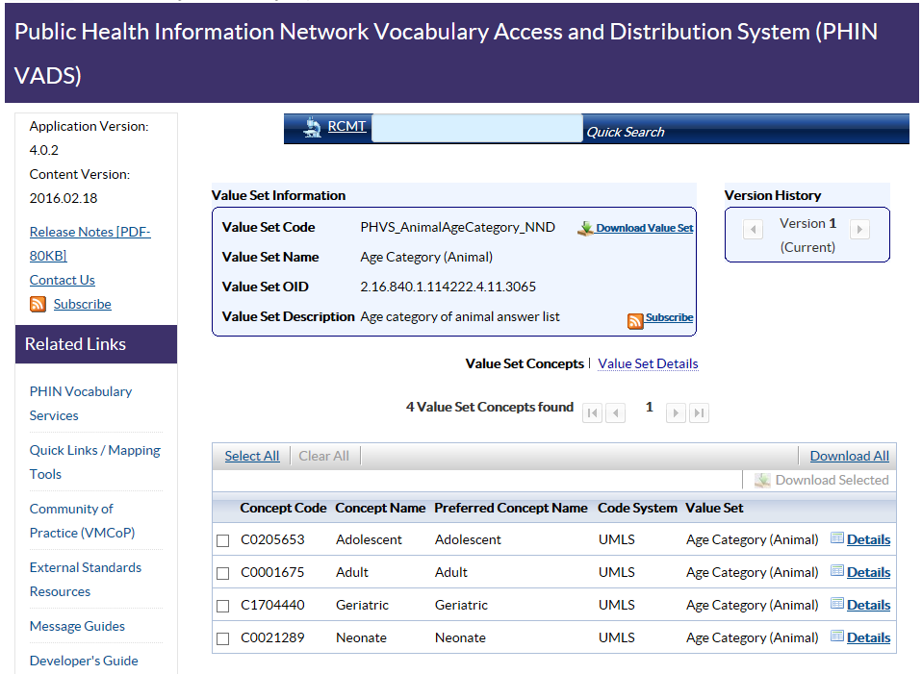
Notes:
https://phinvads.cdc.gov/vads/ViewValueSet.action?id=F6D34BBC-617F-DD11-B38D-00188B398520

Slide 71
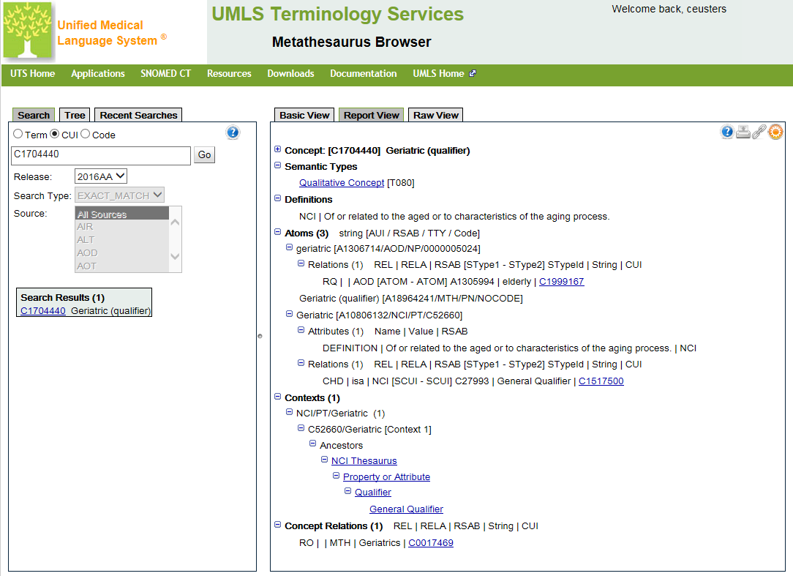
Notes:
https://uts.nlm.nih.gov/metathesaurus.html#C1704440;0;1;CUI;2016AA;EXACT_MATCH;CUI;*;

