Slide 1

Diagnoses in Electronic Healthcare Records:
What do they mean?
School of Informatics and Computing Colloquia Series, Indiana University.
Indianapolis, IN 46202 - Nov 14, 2014: 10 AM.
Werner CEUSTERS, MD
Professor, Department of Biomedical Informatics and
Department of Psychiatry, University at Buffalo
Director, National Center for Ontological Research
Director of Research, UB Institute for Healthcare Informatics

Slide 2
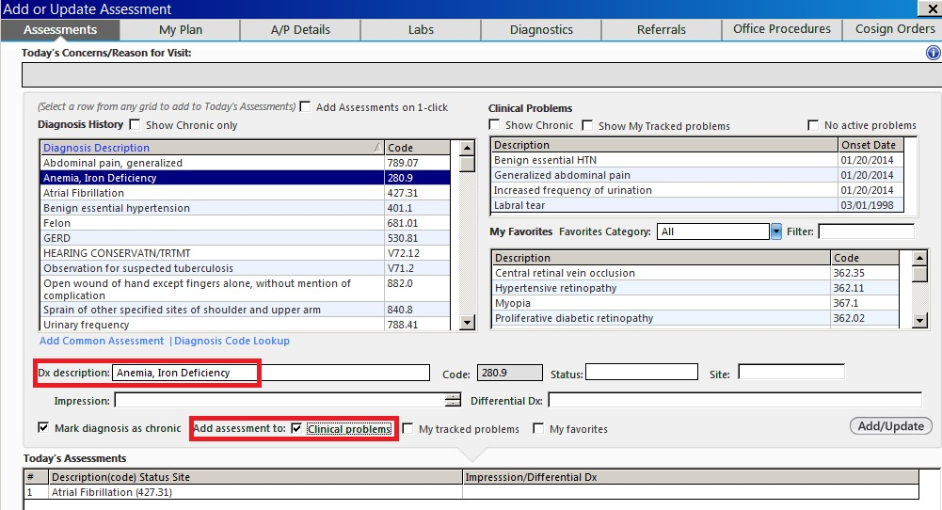
http://incerio.com/planning-nextgen-version-5-8-upgrade-things-know-diagnosis-module/

Slide 3
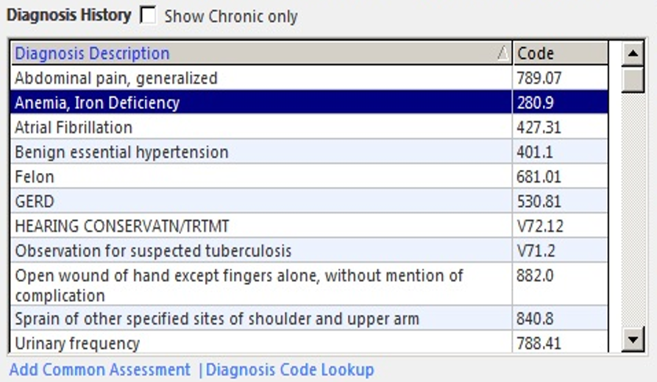
http://incerio.com/planning-nextgen-version-5-8-upgrade-things-know-diagnosis-module/

Slide 4
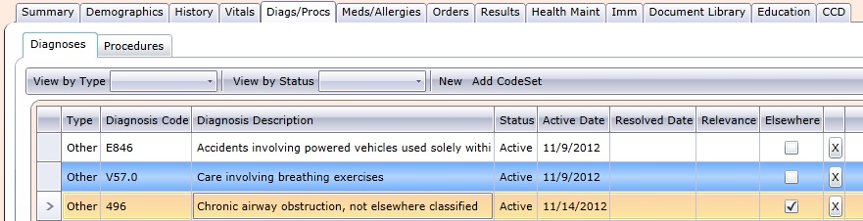
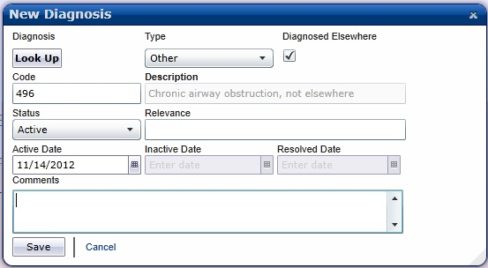
http://www.thecomputersupportpeople.com/Products/McKesson_Practice_Choice_PM_EHR/Affordable_Easy_Powerful_Practice_Choice_PM_EHR.html

Slide 5
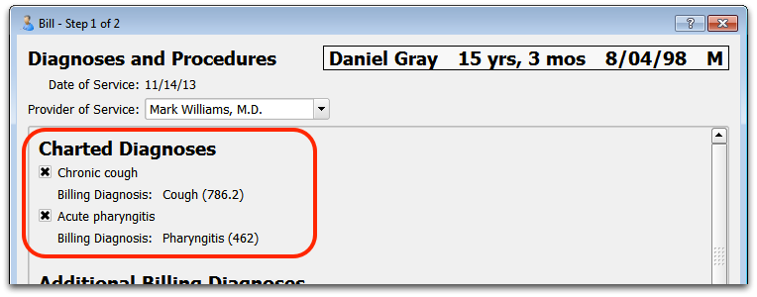
http://learn.pcc.com/Content/RecentChanges/PCCEHR6.19.htm

Slide 6
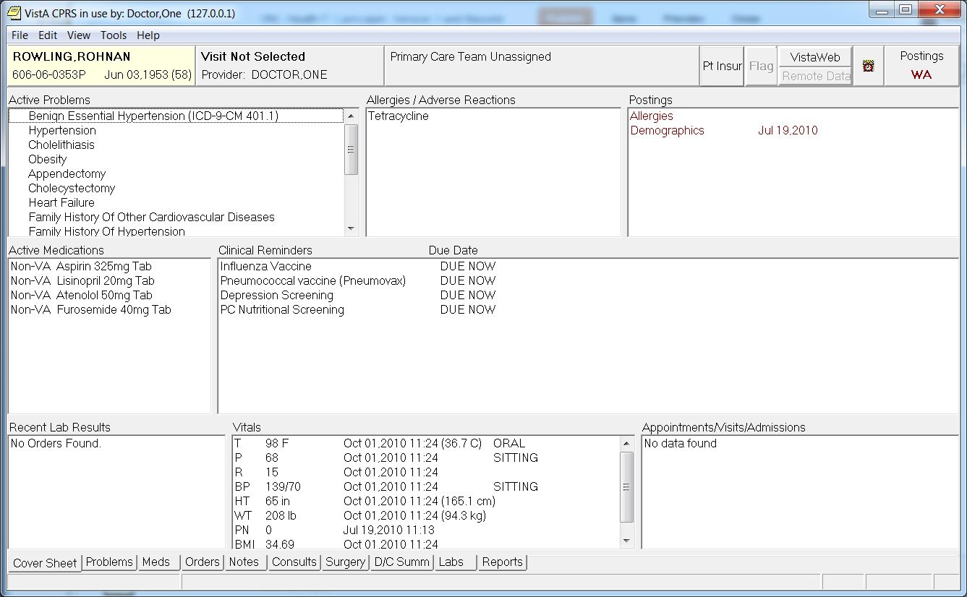

Slide 7
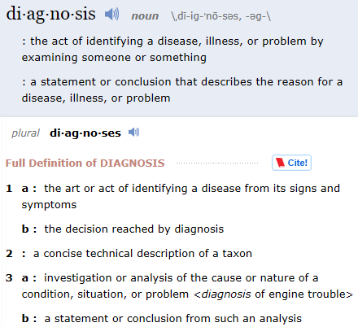
What does ‘diagnosis’ mean ?
http://www.merriam-webster.com/dictionary/diagnosis

Slide 8
Some observations
(from previous slides and past experience)
The word ‘diagnosis’ – even in a medical context – is used for a variety of entities of distinct sorts;
When the word is used, it is often obscure what it denotes precisely;
Dictionaries and terminologies often contribute to the confusion rather than solve it;
EHR systems, as currently implemented, are completely off track, exhibit an ‘everything goes’ design, and make secondary use of diagnostic data nearly impossible.

Slide 9
The root cause
Obliviousness with respect to the ontology of reality in:
(biomedical, healthcare) education,
terminology design,
standards development,
information system implementation,
documentation (including research papers, case reports, …)
…

Slide 10
The context of this talk
Biomedical ‘Ontology’ is still a hype, and as a consequence, there is a lot of junk out there.
Building correct ontologies – correct = faithful to reality – is extremely hard, and the very idea itself under debate,
    Brochhausen M, Burgun-Parenthoine A, Ceusters W, Hasman A, Leong TY, Musen M, Oliveira J, Peleg M, Rector A, Schulz S. Discussion of “Biomedical Ontologies: Toward Scientific Debate”, Methods of Information in Medicine, 2011;50(3):217-36.
Even when there would be correct ontologies as well as terminologies accurately based on them, then still they can’t properly be used because of:
  Inadequacies of mainstream information systems’ data models,
  Limited reasoning capabilities of mainstream semantic technologies.

Slide 11
Purpose of this talk
Give a rough idea about what it takes to build faithful ontologies and information systems,
Demonstrate how extremely difficult it is, more specifically to make explicit all the assumptions human beings automatically make,
  Remember: ontologies are for machines, not people!
Underline the interdisciplinary nature of the enterprise:
  Computer science, Biomedicine, Philosophy
Create awareness that mere collaboration amongst mono-specialists from each of these disciplines is not sufficient but that multi-specialist individuals are required.

Slide 12
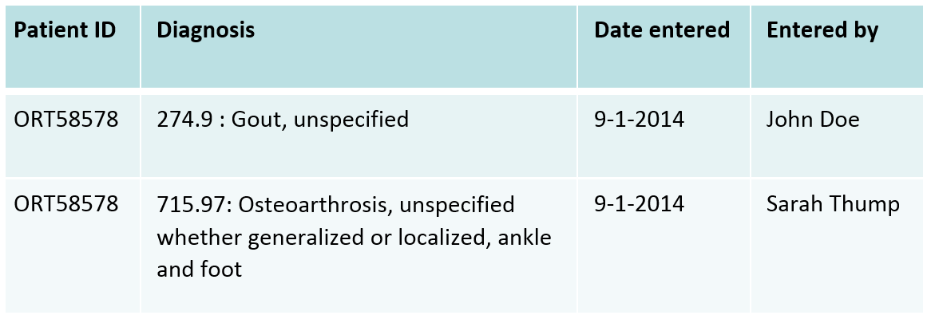
How to achieve this?
By showing what it takes for a machine to fully grasp this:
As well as for ‘triple-skilled’ human beings.

Slide 13
Intellectual experiment
Context:
  An EHR with a problem list shows in a spreadsheet for a specific patient two diagnostic entries entered at the same date, but by distinct providers:
    It is assumed that the patient with ID ORT58578 has only one disorder.
Task:
  List the different kinds of Referent Tracking statements that would represent this situation.
Players:
  Me and Bill Hogan, University of Florida.

Slide 14
Basis: Ontology of General Medical Science (OGMS)
produces
bears
realized_in
etiological process
disorder
disease
pathological process
produces
diagnosis
interpretive process
signs & symptoms
abnormal bodily features
produces
participates_in
recognized_as
Scheuermann R, Ceusters W, Smith B. Toward an Ontological Treatment of Disease and Diagnosis. 2009 AMIA Summit on Translational Bioinformatics, San Francisco, California, March 15-17, 2009;: 116-120.
http://www.referent-tracking.com/RTU/sendfile/?file=AMIA-0075-T2009.pdf
http://code.google.com/p/ogms/
Notes:
font was too small, color inside green boxes was hardly readable

Slide 15
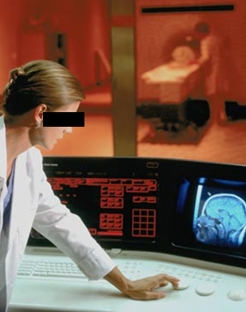
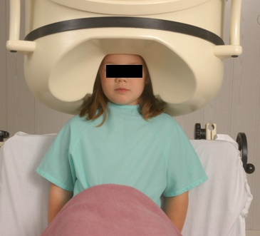
No conflation of diagnosis, disease, and disorder
The diagnosis is here
The disorder is there
The disease is there

Slide 16
Some fundamentals

Slide 17
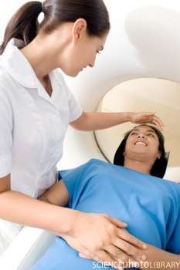
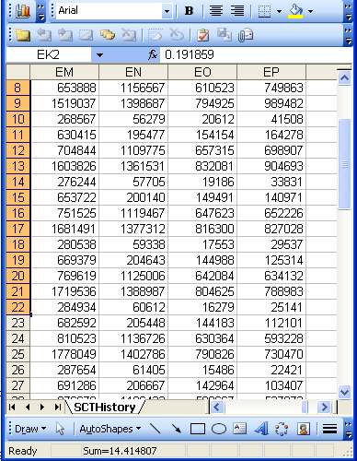
Data and Reality
Referents
References

Slide 18
A non-trivial relation
Referents
References

Slide 19
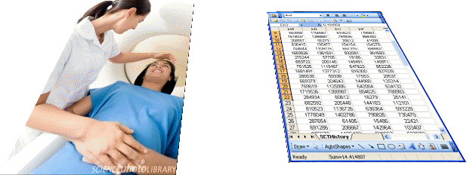
What makes it non-trivial?
Referents
  are (meta-) physically the way they are,
  relate to each other in an objective way,
  follow laws of nature.
Window on reality
  restricted by:
  what is physically and technically observable,
  fit between what is measured and what we think is measured,
  fit between established knowledge and laws of nature.
References
  follow, ideally, the syntactic-semantic conventions of some representation language,
  are restricted by the expressivity of that language,
  to be interpreted correctly, reference collections need external documentation.

Slide 20
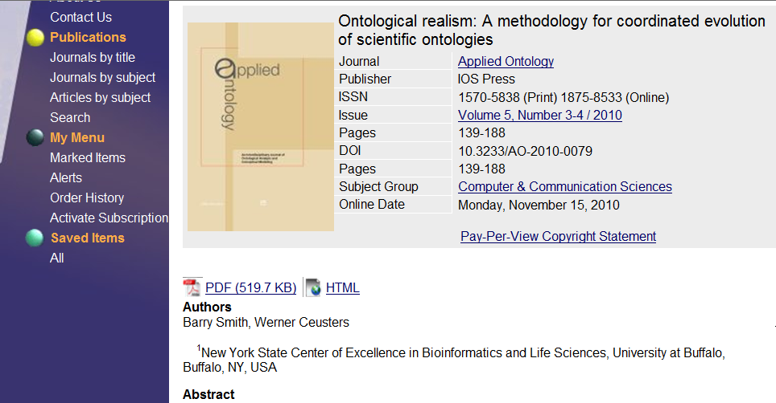
What is able to grasp this ?
Ontological Realism

Slide 21
‘Ontology’
In philosophy:
  Ontology (no plural) is the study of what entities exist and how they relate to each other;
  by some philosophers taken to be synonymous with ‘metaphysics’ while others draw distinctions in many distinct ways (the distinctions being irrelevant for this talk), but almost agreeing on the following classification:
    metaphysics → studies ‘how is the world?’
      general metaphysics → studies general principles and ‘laws’ about the world
        ontology → studies what type of entities exist in the world
      special metaphysics → focuses on specific principles and entities
  distinct from ‘epistemology’ which is the study of how we can come to know about what exists.
  distinct from ‘terminology’ which is the study of what terms mean and how to name things.

Slide 22
‘Ontology’
In philosophy:
  Ontology (no plural) is the study of what entities exist and how they relate to each other;
In computer science and many biomedical informatics applications:
  An ontology (plural: ontologies) is a shared and agreed upon conceptualization of a domain;

Slide 23
Computer science approach to ontology
Ontology
Authoring Tools
create
Domain
Ontologies
Reasoners
Semantic
Applications
use

Slide 24
Computer science approach to ontology
Ontology
Authoring Tools
the logic in reasoners:
guarantees consistent reasoning,
does not guarantee the faithfulness of the representation.
create
Domain
Ontologies
Reasoners
Semantic
Applications
use

Slide 25

Philosophical approach to ontology
Ontological Realism: uses ontology as philosophical discipline to build ontologies as faithful representations of reality.

Slide 26
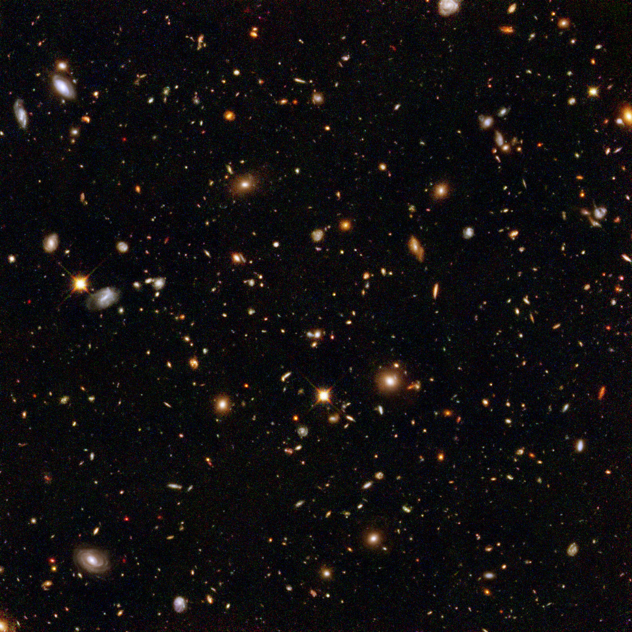
The basis of Ontological Realism (O.R.)
There is an external reality which is ‘objectively’ the way it is;
That reality is accessible to us;
We build in our brains cognitive representations of reality;
We communicate with others about what is there, and what we believe there is there.
Smith B, Kusnierczyk W, Schober D, Ceusters W. Towards a Reference Terminology for Ontology Research and Development in the Biomedical Domain. Proceedings of KR-MED 2006, Biomedical Ontology in Action, November 8, 2006, Baltimore MD, USA

Slide 27
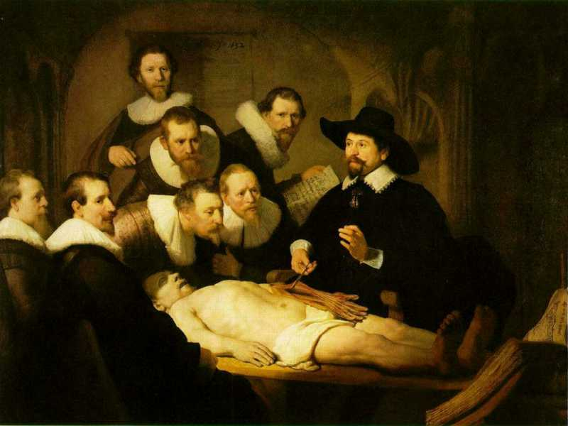
L3
Linguistic representations about (L1⁻), (L2) or (L3)
L2
Beliefs about (1)
Representations
First Order Reality
Entities (particular or generic) with objective existence which are not about anything
L1⁻

Slide 28
What is out there …
(… we want/need to deal with)?
portions of reality
relations
configurations
?
participation
me participating in my life
universals
entities
?
particulars
continuants
occurrents
me
my life
organism

Slide 29
Generic versus specific entities
Generic
Generic
Specific
Specific
L3. Representation
pain classification
EHR
ICHD
my EHR
L2. Beliefs (knowledge)
DIAGNOSIS
my doctor’s
work plan
my doctor’s
diagnosis
INDICATION
L1.
First-order reality
PATHOLOGICAL
STRUCTURE
my doctor
my doctor’s computer
PERSON
me
DRUG
DISEASE
my migraine
MIGRAINE
HEADACHE
my headache
MOLECULE
Basic Formal Ontology
Referent Tracking

Slide 30
Basic Formal Ontology (BFO)
Generic entities
Particulars
Time indexing

Slide 31
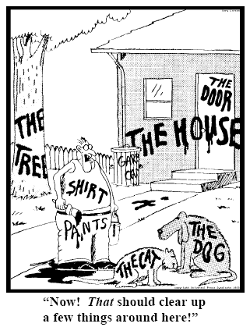
Representing specific entities
explicit reference to the individual entities relevant to the accurate description of some portion of reality, ...
Ceusters W, Smith B. Strategies for Referent Tracking in Electronic Health Records. J Biomed Inform. 2006 Jun;39(3):362-78.

Slide 32
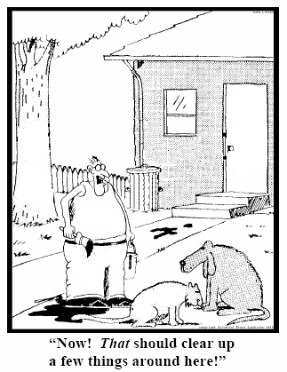
Method: IUI assignment
  Introduce an Instance Unique Identifier (IUI) for each relevant particular (individual) entity
→ Referent Tracking
78
235
5678
321
322
666
427
Ceusters W, Smith B. Strategies for Referent Tracking in Electronic Health Records. J Biomed Inform. 2006 Jun;39(3):362-78.

Slide 33
Referent Tracking assertions
Use these identifiers in expressions using a language that acknowledges the structure of reality:
e.g.: a yellow ball:
then not : yellow(#1) and ball(#1)
rather: #1: the ball #2: #1’s yellow
Then still not:
  ball(#1) and yellow(#2) and hascolor(#1, #2)
  but rather:
  instance-of(#1, ball, since t1)
  instance-of(#2, yellow, since t2)
  inheres-in(#1, #2, since t2)

Slide 34
The shift envisioned
From:
  ‘a guy accepts a phone from somebody in a red car’
To (very roughly):
  ‘this-1, which is in this-2 in which inheres this-3, and this-4 are agents in this-5 in which participates this-6’, where
    this-1 instanceOf human being …
    this-2 instanceOf car …
    this-3 qualityOf this-2 …
    this-3 instanceOf red …
    this-1 containedIn this-2 …
    this-4 instanceOf human being …
    this-5 instanceOf transfer-of-possession …
    this-1 agentOf this-5 …
    this-4 agentOf this-5 …
    …

Slide 35
The shift envisioned
From:
  ‘a guy accepts a phone from somebody in a red car’
To (very roughly):
  ‘this-1, which is in this-2 in which inheres this-3, and this-4 are agents in this-5 in which participates this-6’, where
    this-1 instanceOf human being …
    this-2 instanceOf car …
    this-3 qualityOf this-2 …
    this-3 instanceOf red …
    this-1 containedIn this-2 …
    this-4 instanceOf human being …
    this-5 instanceOf transfer-of-possession …
    this-1 agentOf this-5 …
    this-4 agentOf this-5 …
    …
denotators for particulars

Slide 36
The shift envisioned
From:
  ‘a guy accepts a phone from somebody in a red car’
To (very roughly):
  ‘this-1, which is in this-2 in which inheres this-3, and this-4 are agents in this-5 in which participates this-6’, where
    this-1 instanceOf human being …
    this-2 instanceOf car …
    this-3 qualityOf this-2 …
    this-3 instanceOf red …
    this-1 containedIn this-2 …
    this-4 instanceOf human being …
    this-5 instanceOf transfer-of-possession …
    this-1 agentOf this-5 …
    this-4 agentOf this-5 …
    …
denotators for appropriate relations

Slide 37
The shift envisioned
From:
  ‘a guy accepts a phone from somebody in a red car’
To (very roughly):
  ‘this-1, which is in this-2 in which inheres this-3, and this-4 are agents in this-5 in which participates this-6’, where
    this-1 instanceOf human being …
    this-2 instanceOf car …
    this-3 qualityOf this-2 …
    this-3 instanceOf red …
    this-1 containedIn this-2 …
    this-4 instanceOf human being …
    this-5 instanceOf transfer-of-possession …
    this-1 agentOf this-5 …
    this-4 agentOf this-5 …
    …
denotators for universals or particulars

Slide 38
The shift envisioned
From:
  ‘a guy accepts a phone from somebody in a red car’
To (very roughly):
  ‘this-1, which is in this-2 in which inheres this-3, and this-4 are agents in this-5 in which participates this-6’, where
    this-1 instanceOf human being …
    this-2 instanceOf car …
    this-3 qualityOf this-2 …
    this-3 instanceOf red …
    this-1 containedIn this-2 …
    this-4 instanceOf human being …
    this-5 instanceOf transfer-of-possession …
    this-1 agentOf this-5 …
    this-4 agentOf this-5 …
    …
time stamp in
case of continuants

Slide 39
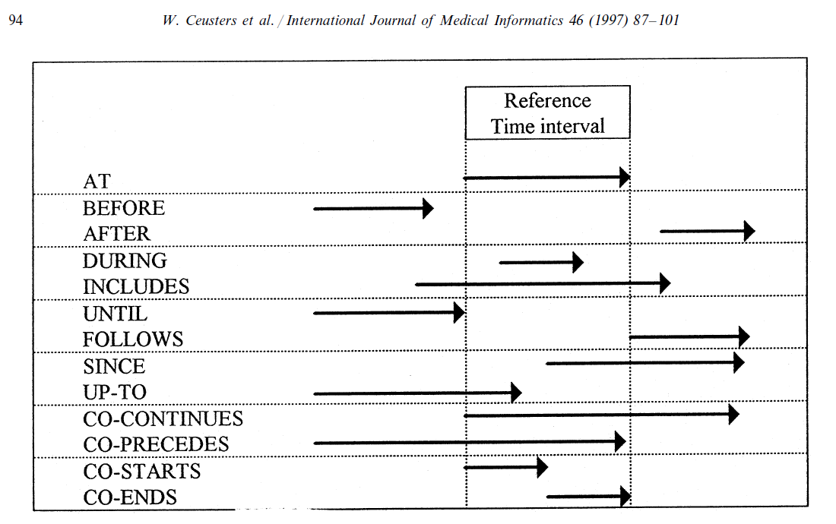
Representation of relation with time intervals

Slide 40
Back to our problem:
What must be the case and can be the case for the following table to make sense, and
How can Referent Tracking and Ontology make that clear?
What follows is an incomplete analysis, examples being taken to make the case for this particular presentation.

Slide 41
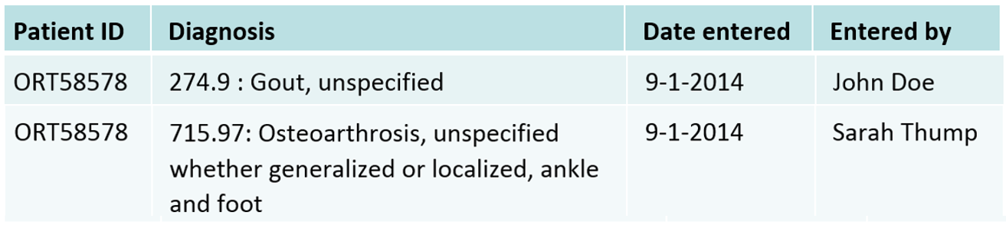
This spreadsheet
IUI | Lifespan | Particular Description | Relationships
#1 | t1 | the information content entity which is concretized in the spreadsheet you are looking at | #1 | instance-of | INFORMATION CONTENT ENTITY | at | t1
Assume this is on a blackboard

Slide 42
This spreadsheet
IUI | Lifespan | Particular Description | Relationships |  |  |  |  | Comments
#1 | t1 | the information content entity which is concretized in the spreadsheet you might be looking at is a concretization | #1 | instance-of | INFORMATION CONTENT ENTITY | at | t1 | An ICE is about something. Two concretizations of different ICE might look exactly the same, but be about distinct portions of reality.
#2 | t2 | the portion of chalk on the blackboard which make up what we call 'that spreadsheet' | #2 | instance-of | MATERIAL ENTITY | at | t2 | We present the case in which the spreadsheet is on a blackbord rather than a Powerpoint slide.
#3 |  | the pattern of chalk lines, spaces, characters, etc., in that portion of chalk | #3 | instance-of | QUALITY | at | t2 | This quality exists as long as the spreadsheet is on the blackboard.
 |  |  | #3 | inheres-in | #2 | at | t2 | It inheres in the bearer all the time the bearer exists.
 | t3 | the temporal region during which #1 is concretized in #3 | #3 | concretizes | #1 | at | t3 | but concretizes the spreadsheets' ICE when complete
 |  |  | t3 | part-of | t1 |  |  | that ICE might be concretized at other times elsewhere.

Slide 43
Who are the two data rows about?
#4 | t4 | the material entity (in BFO sense) whose ID is ‘ORT58578’ in the spreadsheet | #4 | instance-of | MATERIAL ENTITY | at | t4 | Instances of human beings don't exist all the time as human beings
 | t5 | the temporal region during which #4 is an instance of HUMAN BEING | #4 | instance-of | HUMAN BEING | at | t5
 |  |  | t5 | part-of | t4

Slide 44
What are the two data rows about?
(1) a diagnosis: d1 | #10 | t13 | the diagnosis which is concretized in the first two cells of the 2nd row of the concretization of #1 in front of your eyes | #10 | instance-of | DIAGNOSIS | at | t13
 | #11 | t14 | the quality through which #10 is concretized | #11 | concretizes | #10 | since | t15
 |  | t15 | the temporal region during which #10 is concretized in #11
(2) another diagnosis: d2 | #12 | t16 | the diagnosis concretized in the first two cells of the 3rd row of the concretization of #1 in front of your eyes | #12 | instance-of | DIAGNOSIS | at | t16
 | #13 | t17 | the quality through which #12 is concretized | #13 | concretizes | #12 | since | t18
 |  | t18 | the temporal region during which #12 is concretized in #13
(3) who 'entered' d1 and d2 | #14 | t19 | the person whose name is ‘John Doe’ in the spreadsheet | #14 | instance-of | HUMAN BEING | at | t19
 | #15 | t20 | the person whose name is ‘Sarah Thump’ in the spreadsheet | #15 | instance-of | HUMAN BEING | at | t20
(4) when d1 and d2 were entered |  | t21 | the temporal region expressed by both 3rd cells in row 2 and row 3

Slide 45
What must exist for the diagnoses d1 and d2 to exist?
produces
bears
realized_in
etiological process
disorder
disease
pathological process
produces
diagnosis
interpretive process
signs & symptoms
abnormal bodily features
produces
participates_in
recognized_as
Scheuermann R, Ceusters W, Smith B. Toward an Ontological Treatment of Disease and Diagnosis. 2009 AMIA Summit on Translational Bioinformatics, San Francisco, California, March 15-17, 2009;: 116-120.
http://www.referent-tracking.com/RTU/sendfile/?file=AMIA-0075-T2009.pdf
http://code.google.com/p/ogms/
Notes:
font was too small, color inside green boxes was hardly readable

Slide 46
What must exist for the diagnoses d1 and d2 to exist?
(1) what they are based on | #16 | t22 | the clinical picture about #4 available to #14 and #15 | #16 | instance-of | CLINICAL PICTURE | at | t22
 | #17 | t23 | part of the life of #4 which is described in #16 | #17 | instance-of | BODILY PROCESS
 |  |  |  | #17 | has-participant | #4 | at | t23
 |  |  |  | t23 | during | t4
(2) what created them | #18 | t24 | the interpretive process which resulted in #10 | #18 | creates | #10 | co-ends | t24
 |  |  |  | #18 | instance-of | BODILY PROCESS
 |  |  |  | #18 | has-agent | #14 | at | t24
 |  |  |  | #18 | has-input | #16 | co-starts | t24
 | #19 | t25 | the interpretive process which resulted in #12 | #19 | creates | #12 | co-ends | t25
 |  |  |  | #19 | instance-of | BODILY PROCESS
 |  |  |  | #19 | has-agent | #15 | at | t25
 |  |  |  | #19 | has-input | #16 | co-starts | t25

Slide 47
What should the diagnoses be about?
#20 | t26 | the disease in #4 | #20 | instance-of | DISEASE | at | t26
 |  |  | #20 | inheres-in | #4 | at | t8 | we assume there is only one disease present which is born by one disorder
 |  |  | t26 | part-of | t5 |  |  | diseases can start in entities before they transform into human beings

Slide 48
What is asserted in the diagnoses?
a DISEASE (type) reference | #21 | t27 | the ICE concretized in the 2nd cell of the 2nd row | #21 | instance-of | ICD-9-CM CODE AND LABEL | at | t27
 | #22 | t28 | the quality through which #21 is concretized | #22 | concretizes | #21 | since | t29
 |  | t29 | the temporal region during which #21 is concretized in #22
 |  |  |  | #22 | is-about | GOUT | since | t29
 | #23 | t30 | the ICE concretized in the 2nd cell of the 3rd row | #23 | instance-of | ICD-9-CM CODE AND LABEL | at | t30
 | #24 | t31 | the quality through which #23 is concretized | #24 | concretizes | #23 | since | t32
 |  | t32 | the temporal region during which #23 is concretized in #24
 |  |  |  | #24 | is-about | OSTEOARTHROSIS | since | t32
in reference to the patient |  |  |  | #11 | is-about | #4 | at | t15
 |  |  |  | t15 | after | t24
 |  |  |  | #13 | is-about | #4 | at | t18
 |  |  |  | t18 | after | t24
 |  |  |  | #11 | is-about | #20 | at | t15
 |  |  |  | #13 | is-about | #20 | at | t18

Slide 49
What is asserted about the diagnoses?
first, what must exist | #25 | t33 | the process of, as we say 'entering d1 in the EHR system' | #25 | instance-of | PROCESS
 |  |  |  | #25 | creates | #26 | co-ends | t33
 | #26 | t34 | the quality of some part of some hard disk which concretizes d1 | #26 | concretizes | #10 | co-ends | t33
 | #27 | t35 | the process of, as we say 'entering d2 in the EHR system' | #27 | instance-of | PROCESS
 |  |  |  | #27 | creates | #28 | co-ends | t35
 | #28 | t36 | the quality of some part of some hard disk which concretizes d1 | #28 | concretizes | #12 | co-ends | t35
who 'entered the diagnoses' |  |  |  | #14 | agent-of | #25 | at | t33
 |  |  |  | #15 | agent-of | #27 | at | t35
when, roughly, they were entered |  |  |  | t33 | part-of | t21
 |  |  |  | t35 | part-of | t21

Slide 50
Advantages
Clear identification (= denotation) of:
  everything about which assertions are made,
  everything about these assertions,
  everything about the representation of (1) and (2) in the RT system (not addressed in this presentation) ;
Completely unambiguous (within the limits of the ontologies used),
    including unambiguity about what is ambiguous in the source assertions;
Maximally explicit and self-explanatory.
            Ceusters W, Hsu CY, Smith B. Clinical Data Wrangling using Ontological Realism and Referent Tracking. International Conference on Biomedical Ontologies, ICBO 2014, Houston, Texas, Oct 6-9, 2014.
Very simple data model.

Slide 51
Disadvantages
Extremely verbose in abstract syntax,
    can be accounted for in dedicated data models;
Higher order reasoning,
    can be reduced to (still full) first-order reasoning through layered approaches,
    RCC8-style temporal reasoning.

Slide 52
How to use this practically?
Basis for Extract-Transformation-Load (ETL) procedures in data warehousing;
Strong data stewardship required:
  Only part of the ambiguities in EHR systems can be recovered automatically,
  Recall and precision of automatic disambiguation;
Incentive for better EHR information models in the future?

