Slide 1

What can
Ontological Realism and Referent Tracking contribute to computer vision?
1st International Workshop on Computer vision + Ontology Applied Cross-disciplinary Technologies
Sunday, September 7, 2014, 2-3 pm - Zurich, Switzerland
Werner CEUSTERS, MD
Professor, Department of Biomedical Informatics, University at Buffalo
Director, National Center for Ontological Research
Director of Research, UB Institute for Healthcare Informatics

Slide 2

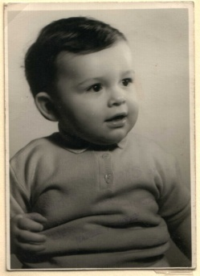
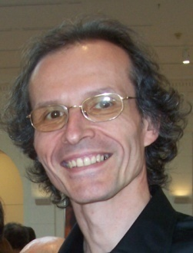



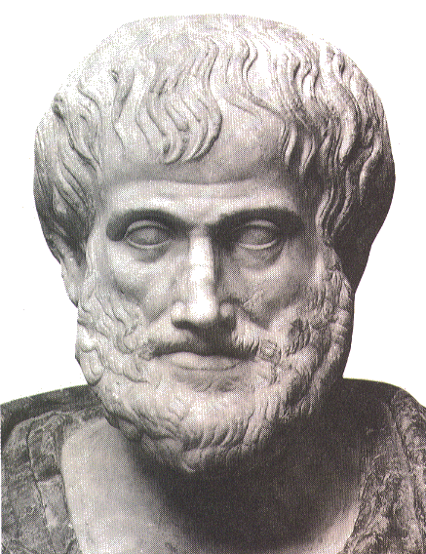







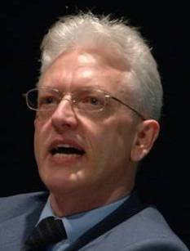


Short personal history
2012
1977
1959 -
2006
1989
2004
1992
2002
1995
1998
1993

Slide 3
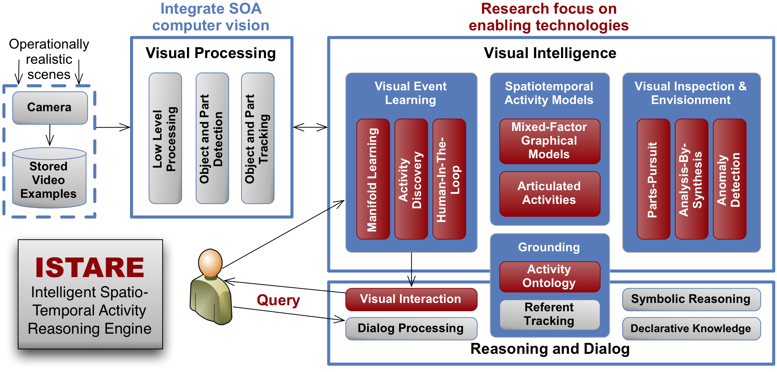

Mind’s Eye’s ISTARE project
query

Slide 4
Presentation context
Thesis: mainstream ontology design approaches fail in achieving their objectives:
  various sorts of mistakes in ontologies,
  inability to use ontologies adequately in information systems,
  failure to integrate data repositories even if these ontologies are appropriately designed.
Root causes:
  inadequacy of their conceptual semantic foundations,
  lack of knowledge about ontology as a philosophical discipline.
Proposed solution:
  Better use of ontology (the philosophical discipline) to design ontologies (specific sorts of representational artifacts).

Slide 5
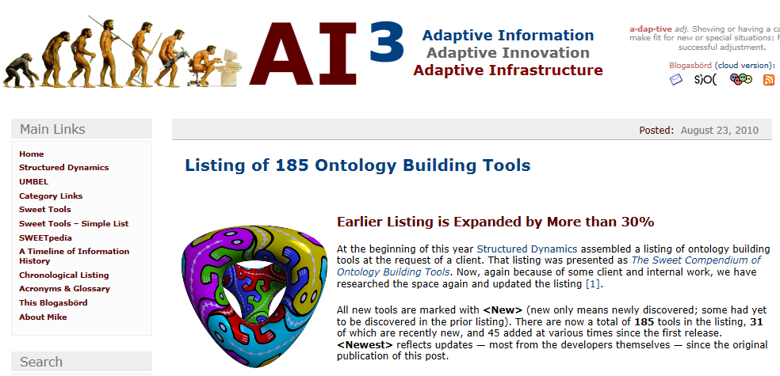
‘Ontology’ is popular
http://www.mkbergman.com/904/listing-of-185-ontology-building-tools/

Slide 6
‘Ontology’
High expectations and bold claims
Regarding the possible domain knowledge representation formalisms, ontologies have been particularly favored due to the significant advantages they present.
In particular, they achieve to exhibit a coherent domain knowledge representation model, provide machine-processable semantics definitions and allow automatic analysis and further processing of the extracted semantic descriptions
Georgios Th. Papadopoulos , Vasileios Mezaris , Ioannis Kompatsiaris , Michael G. Strintzis, Ontology-driven semantic video analysis using visual information objects, Proceedings of the semantic and digital media technologies 2nd international conference on Semantic Multimedia, December 05-07, 2007, Genoa, Italy

Slide 7
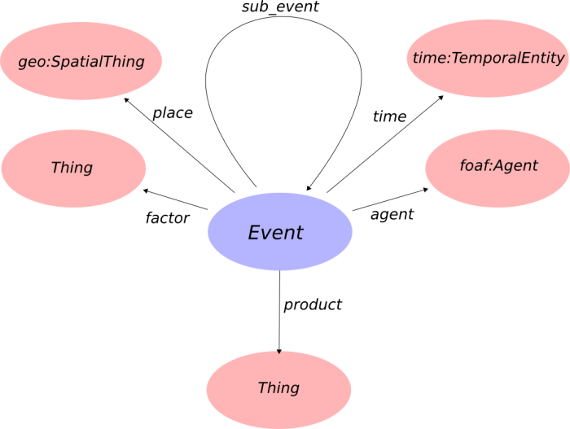
The Event Ontology:
Provides semantics?
Class: event:Factor - stable -
Factor - Everything used as a factor in an event
http://motools.sourceforge.net/event/event.html

Slide 8
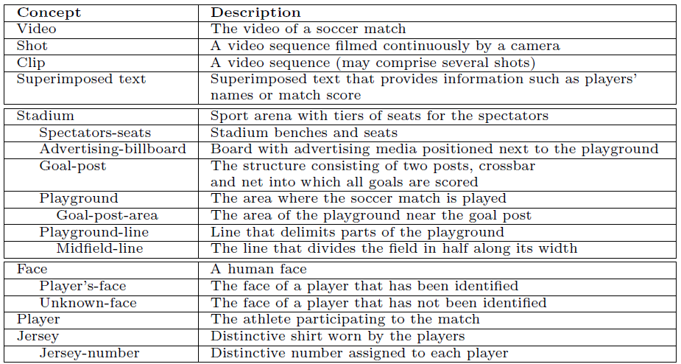
Ontologies are coherent ?
Multimedia Tools and Applications , June 2010, Volume 48,2, pp 313-337 ,7 Aug 2009 , Semantic annotation of soccer videos by visual instance clustering and spatial/temporal reasoning in ontologies. Lamberto Ballan, Marco Bertini, Alberto Del Bimbo, Giuseppe Serra

Slide 9
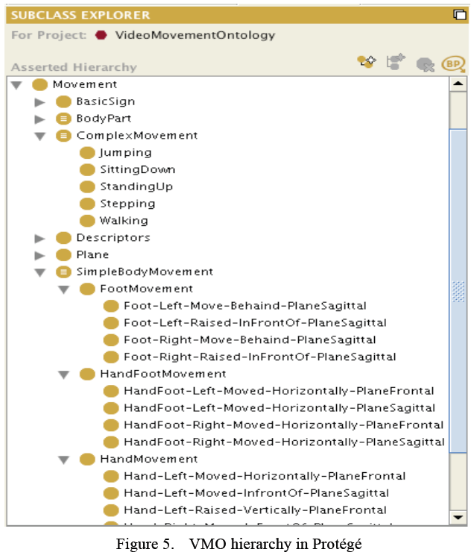
Formal ?
Perhaps, but then representing what Salvador Dali sees rather than what scientists see.
Saad, Sawsan, Dominique De Beul, Said Mahmoudi, and Pierre Manneback. "An ontology for video human movement representation based on benesh notation." In Multimedia Computing and Systems (ICMCS), 2012 International Conference on, pp. 77-82. IEEE, 2012.

Slide 10

Another bold claim (?): this is art
http://painting.about.com/od/famouspainters/ig/famous-paintings/Ad-Reinhardt-.htm

Slide 11
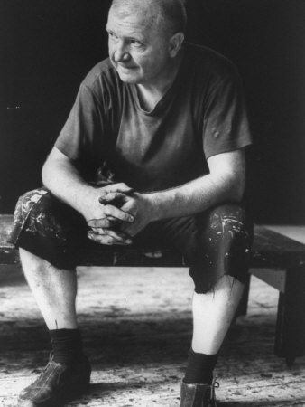
Is this art? Depends on who the creator is.
http://ludwig-mies-vanderrohe.blogspot.com/2011/07/ad-reinhardt-abstract-expressionist.html
Adolph ‘Ad’ Frederick Reinhardt
✳ Buffalo, NY 12/24/1913
† Manhattan, NY 8/30/1967
http://painting.about.com/od/famouspainters/ig/famous-paintings/Ad-Reinhardt-.htm

Slide 12
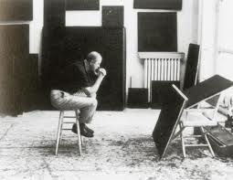
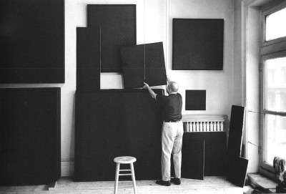
There is something wrong, irresponsible and mindless about color; something impossible to control. Control and rationality are part of my morality.
-- Ad Reinhardt in 1960
http://thesingleroad.blogspot.com/2011_02_01_archive.html
http://minimalissimo.com/2012/10/black-paintings/

Slide 13
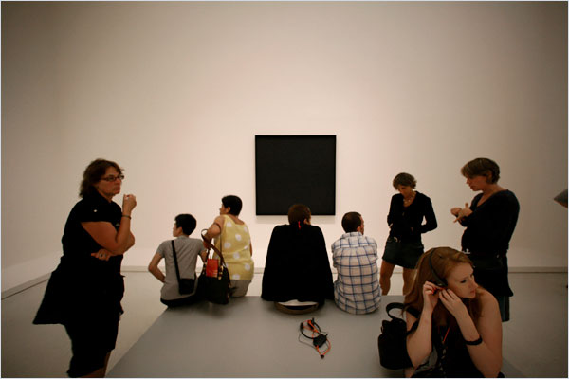
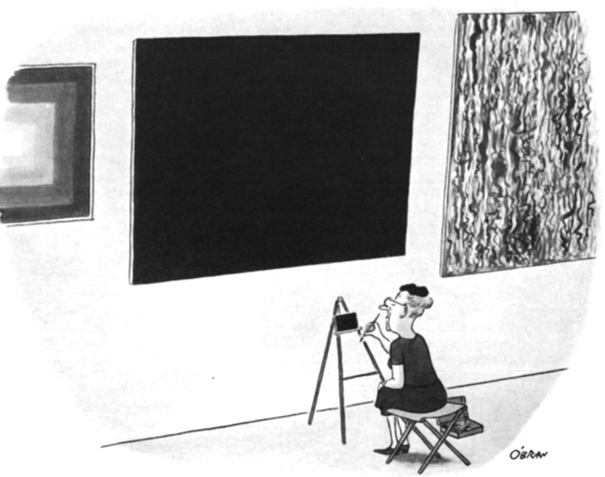
Are these right ways to understand this?
http://www.nytimes.com/slideshow/2008/08/01/arts/0801-BLACK_index.html?_r=0
William O’Brian, August 19, 1967
http://www.newyorker.com/online/blogs/culture/2013/12/slide-show-ad-reinhardts-cartoons-make-an-appearance-at-at-david-zwirner.html#slide_ss_0=1

Slide 14
There is something wrong, irresponsible and mindless about mainstream ontology and its application in video analysis; something impossible to control. Control and rationality are part of my morality. -- Werner Ceusters in 2014
A life-event is a set of actions, including at least one public service, which, when executed in its appropriate workflow, fulfils a need of a citizen arising from a new life situation.
Trochidis, I., Tambouris, E. and Tarabanis, K. (2006), “Identifying Common Workflow Patterns in Life-Events and Business Episodes”, The second International Conference on e-Government, 234-243.
Ilias Trochidis, Efthimios Tambouris, Konstantinos Tarabanis, "An Ontology for Modeling Life-Events," scc, pp.719-720, IEEE International Conference on Services Computing (SCC 2007), 2007

Slide 15

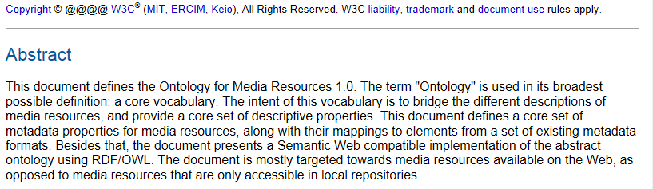
‘Ontology’ and ontology
http://dev.w3.org/2008/video/mediaann/mediaont-1.0/mediaont-1.0.html

Slide 16
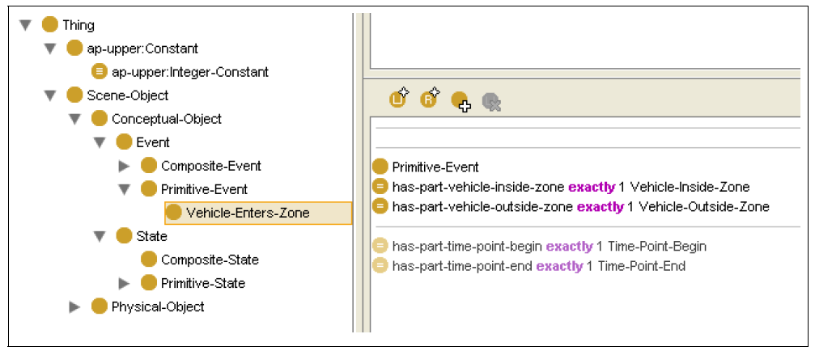
What is conceptual about a vehicle entering a zone ?
Lecture Notes in Computer Science Volume 5858, 2009, pp 93-107
Generation of Rules from Ontologies for High-Level Scene Interpretation
Wilfried Bohlken, Bernd Neumann

Slide 17
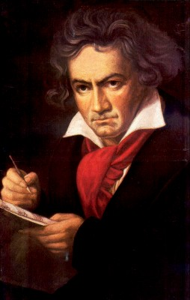
The focus on vocabularies led to concept-based ontologies which are inspired by the semantic/semiotic triangle
Ludwig van Beethoven
that great German composer that became deaf
…
concept
term
referent
‘Beethoven’

Slide 18
Semantic triangle useful in explaining …
synonymy
homonymy

Slide 19
Major problems with the theory
What qualifies as concepts ?
How to organize concepts appropriately ?

Slide 20
Problem: one can create terms and ‘meaningful’ concepts to trick people
the symphony Beethoven wrote after the tenth
…
concept
term
referent
‘Beethoven's Symphony No. 11’

Slide 21
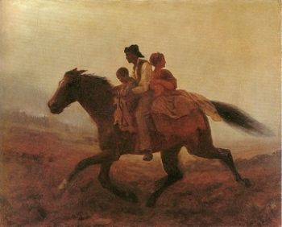
Or worse …
Prehistoric ‘psychiatry’: drapetomania
disease which causes slaves to suffer from an unexplainable propensity to run away
…
concept
term
referent
painting by Eastman Johnson. A Ride for Liberty: The Fugitive Slaves. 1860.
‘drapetomania’

Slide 22
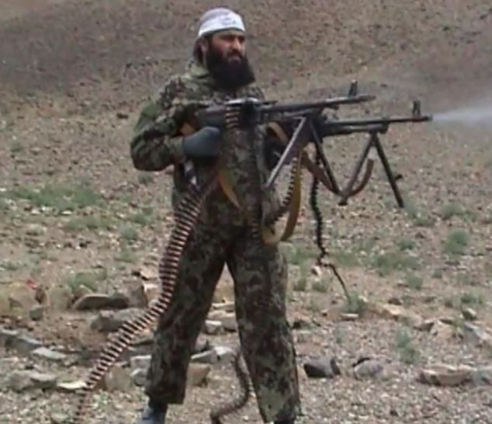

Visual reality versus visual fiction
Notes:
http://www.dailymail.co.uk/news/article-2180269/Brute-strength-Taliban-fighter-caught-camera-brandishing-TWO-machine-guns-once.html
http://screencrush.com/rambo-tv-series/

Slide 23
Major problems with the theory
What qualifies as concepts ?
How to organize concepts appropriately ?
→ Too close to language, too much cultural biases, no solid foundations.
Smith B., Ceusters W, Temmerman R. Wüsteria. In: Engelbrecht R. et al. (eds.) Medical Informatics Europe, IOS Press, Amsterdam, 2005;:647-652

Slide 24
Take-home message
Concept-based terminology (and standardisation thereof) is there as a mechanism to improve understanding of messages by humans.
It is NOT the right device
  to explain why reality is what it is, how it is organised, etc., (although it is needed to allow communication),
  to reason about reality,
  to make machines understand what is real,
  to integrate across different views, languages, conceptualisations, ...

Slide 25
Naïve ‘ontology’ design and some simple principles that are often violated
(less simple principles follow later)

Slide 26
No limits on what we can think …
‘ We start with the notion of objects and distinguish Mobile Objects from Contextual Objects.
Objects have properties or attributes; logically we can think of these as one-argument predications.
They also stand in relations to other objects; we can think of these as predications with two or more arguments. ’
Nevatia, R., Hobbs, J. & Bolles, B. (2004). An Ontology for Video Event Representation. Computer Vision and Pattern Recognition, : IEEE. ISBN: 0-7695-2158-4

Slide 27
Principle
A representation should not mix object language and meta language
  object language describes the referents in the subject domain
  meta language describes the object language.

Slide 28
Geographic Locations: a good hierarchy ?
Africa [Z01.058] +
Americas [Z01.107] +
Antarctic Regions [Z01.158]
Arctic Regions [Z01.208]
Asia [Z01.252] +
Atlantic Islands [Z01.295] +
Australia [Z01.338] +
Cities [Z01.433] +
Europe [Z01.542] +
Historical Geographic Locations [Z01.586] +
Indian Ocean Islands [Z01.600] +
Oceania [Z01.678] +
Oceans and Seas [Z01.756] +
Pacific Islands [Z01.782] +
mereological mess
mixture of geographic entities with socio-political entities
mixture of space and time

Slide 29
MeSH: Geographic Locations [Z01] (2013)
Africa [Z01.058] +
Americas [Z01.107] +
Antarctic Regions [Z01.158]
Arctic Regions [Z01.208]
Asia [Z01.252] +
Atlantic Islands [Z01.295] +
Australia [Z01.338] +
Cities [Z01.433] +
Europe [Z01.542] +
Historical Geographic Locations [Z01.586] +
Indian Ocean Islands [Z01.600] +
Oceania [Z01.678] +
Oceans and Seas [Z01.756] +
Pacific Islands [Z01.782] +
Ancient Lands [Z01.586.035] +
Austria-Hungary [Z01.586.117]
Commonwealth of Independent States [Z01.586.200] +
Czechoslovakia [Z01.586.250] +
European Union [Z01.586.300]
Germany [Z01.586.315] +
Korea [Z01.586.407]
Middle East [Z01.586.500] +
New Guinea [Z01.586.650]
Ottoman Empire [Z01.586.687]
Prussia [Z01.586.725]
Russia (Pre-1917) [Z01.586.800]
USSR [Z01.586.950] +
Yugoslavia [Z01.586.980] +

Slide 30
Principle
A hierarchical structure should not represent distinct hierarchical relations unless they are formally characterized

Slide 31
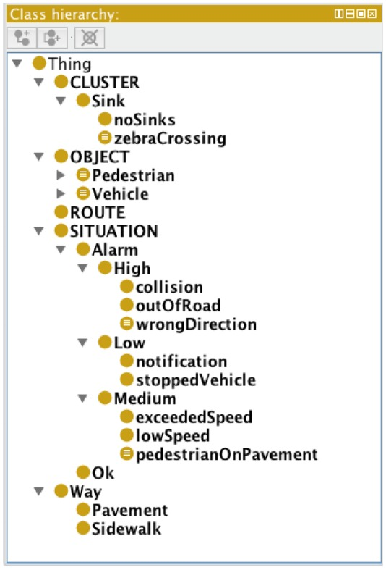
Principle: documentation should be consistent with representation
Routes: these are zones (normally strips) of the scene where objects habitually pass through. Each route can be considered as a cluster of similar trajectories.
Sinks and Sources: these are zones where objects usually appear (sources) or disappear (sinks). It is worth noting that, since cameras only detect objects in motion, a sink could be also a place where an object stops.
Sensors (Basel). 2012; 12(8): 10407–10429. A Semantic Autonomous Video Surveillance System for Dense Camera Networks in Smart Cities. Lorena Calavia,* Carlos Baladrón, Javier M. Aguiar, Belén Carro, and Antonio Sánchez-Esguevillas

Slide 32
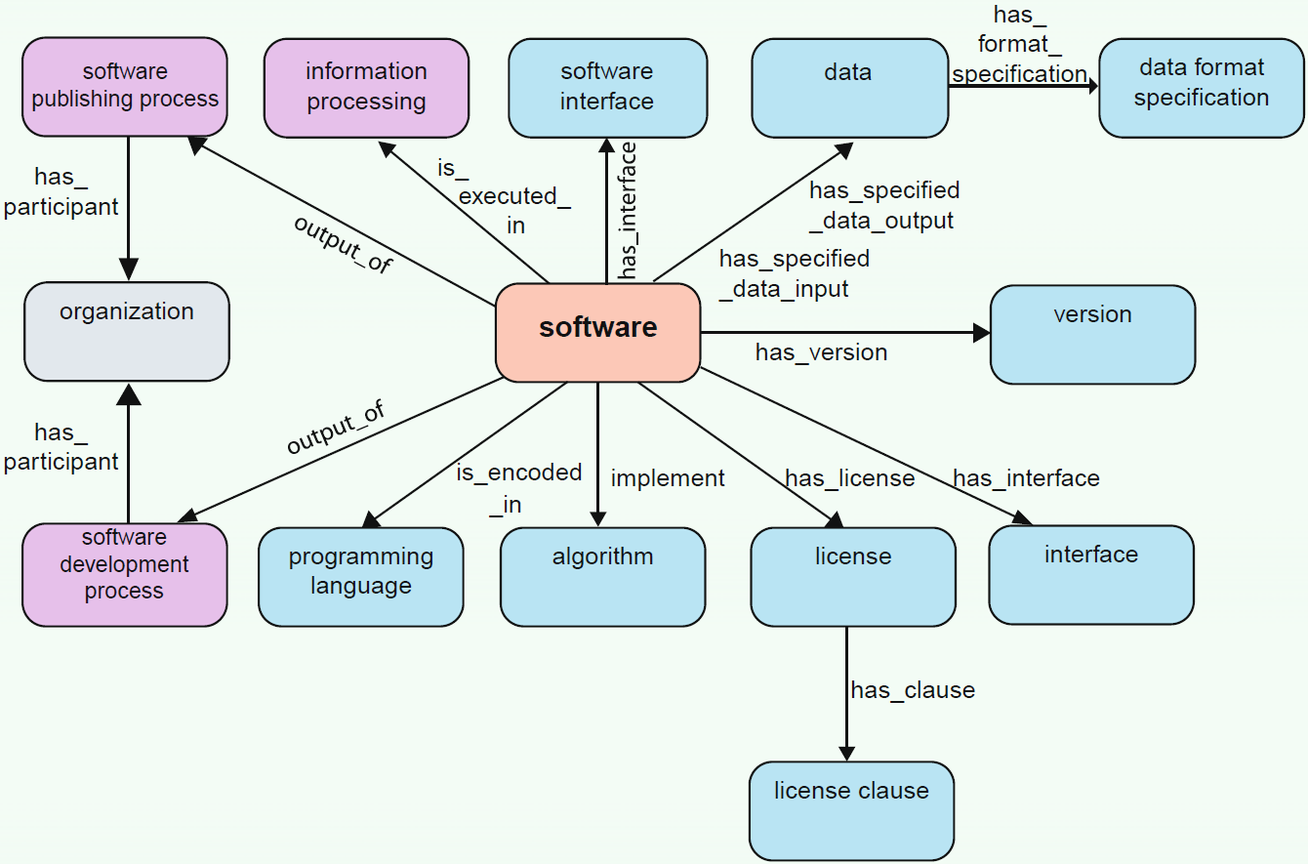
Indicators of sloppy analysis
The SWO’s ‘schema’.
Malone et al. Journal of Biomedical Semantics 2014 5:25 doi:10.1186/2041-1480-5-25

Slide 33
The problems we are facing
Most ontologies are nonsense representations rather than specific sorts of knowledge representations:
  What is represented is not consistent with reality,
  Poor documentation and discrepancies between documentation and formal representation,
People use Protégé (and other tools) without:
  appropriate analysis of the domain,
  sufficient knowledge about the underlying representation language.
Limited to zero re-usability
Inconsistencies with other ontologies.

Slide 34
Need for a holistic and principled approach
Ontology
Authoring Tools
Computer Science approach to ‘ontology’
create
Domain
Ontologies
Reasoners
Semantic
Applications
‘Philosophical’ approach to ontology
use

Slide 35
Some elements of a holistic approach
Improvement of current efforts in:
  (1) Ontology design
    Faithful representation should come first
    Cutting corners because of computational issues is sin;
  (2) Ontology authoring tools
    These should implement the principles of (1)
  (3) Information system (IS) design
    IS should model both information and what the information is about

Slide 36
A multi-disciplinary approach to ontology
In philosophy:
  Ontology (no plural) is the study of what entities exist and how they relate to each other;
In mainstream computer science and informatics:
  An ontology (plural: ontologies) is a shared and agreed upon conceptualization of a domain;
The ‘realist’ view within UB’s Ontology Research Group combines the two:
  We use Ontological Realism, a specific theory of ontology, as the basis for building high quality ontologies, using reality as benchmark.
Smith B, Ceusters W. Ontological Realism as a Methodology for Coordinated Evolution of Scientific Ontologies.
Applied Ontology, 2010;5(3-4):139-188.

Slide 37
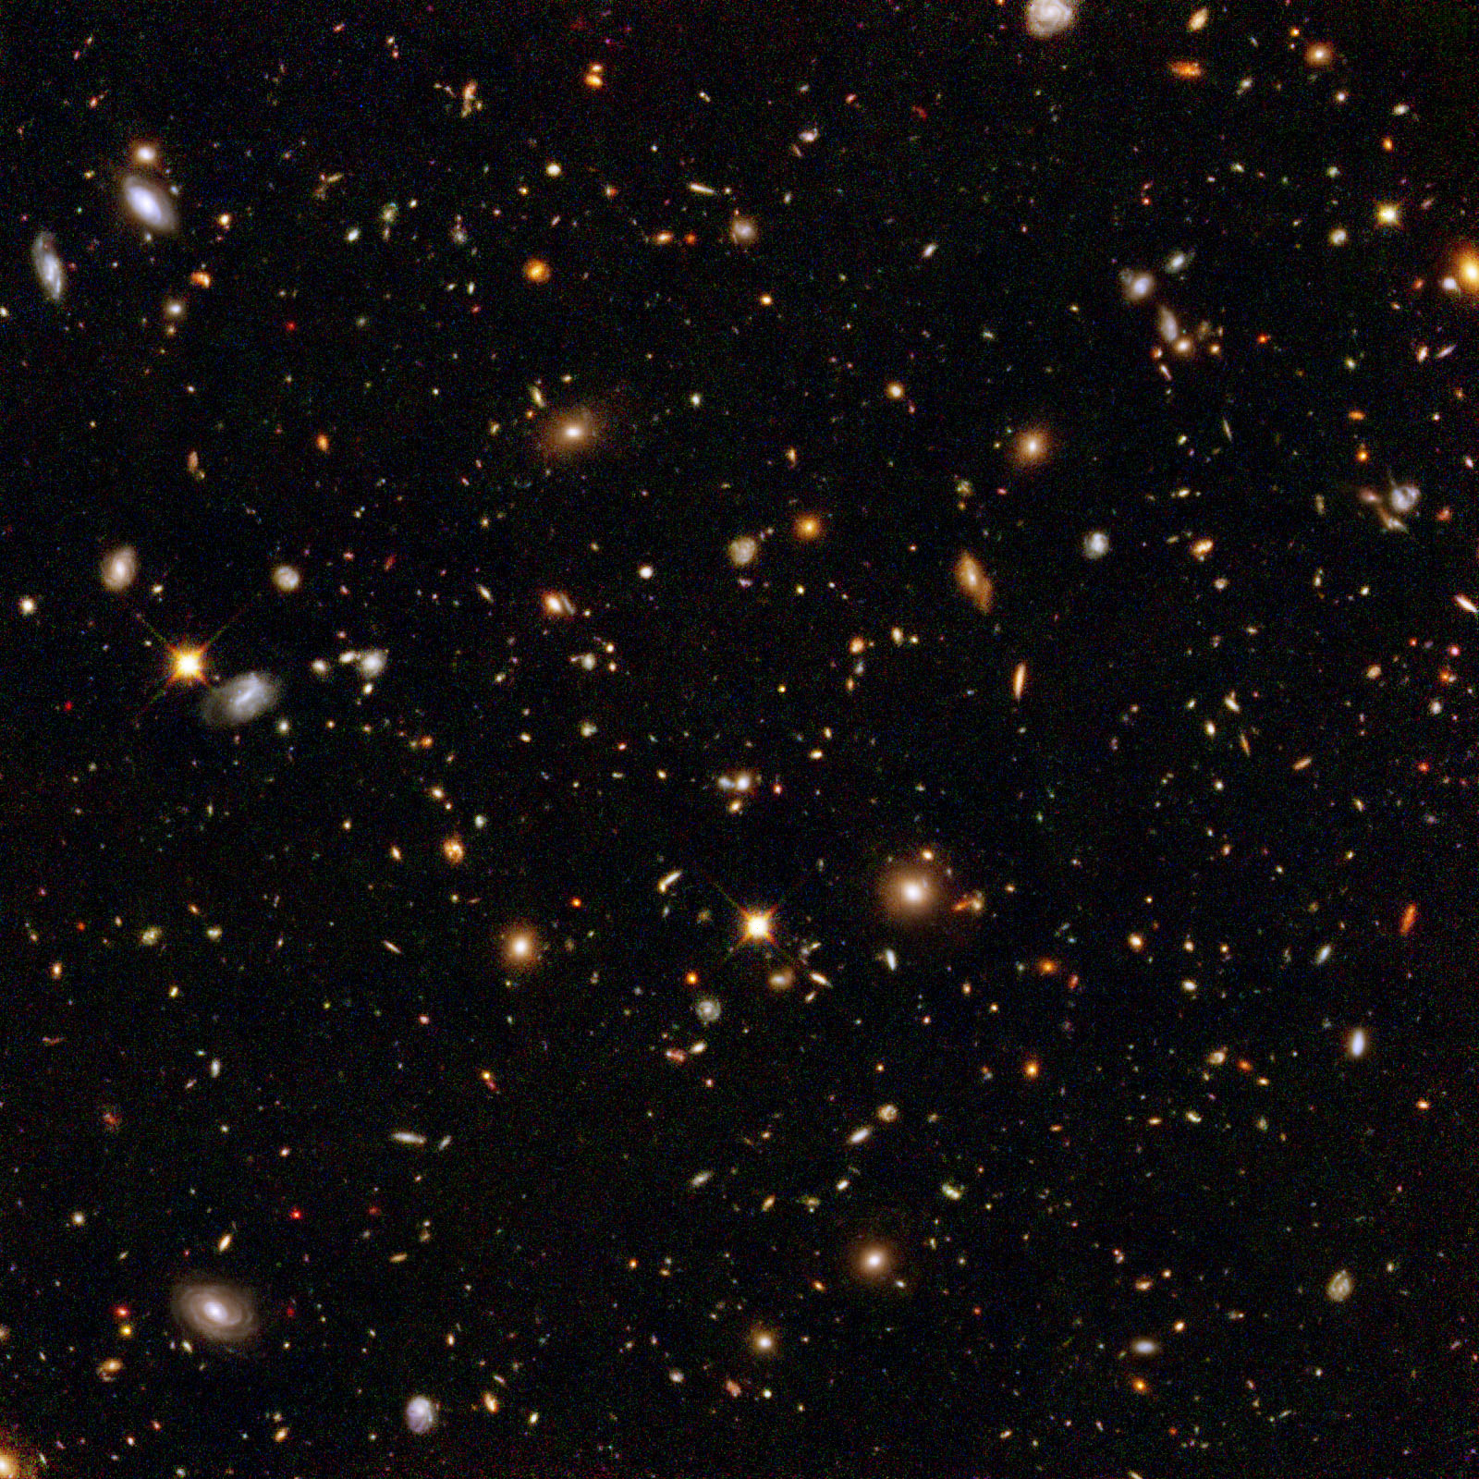


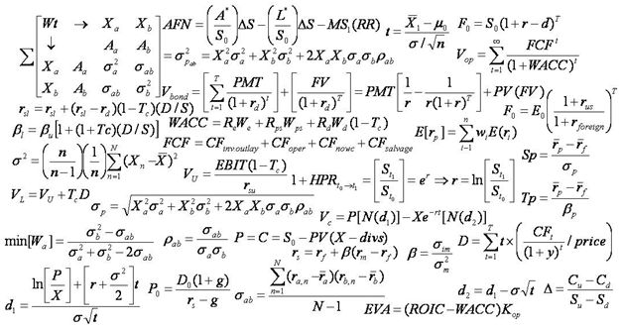
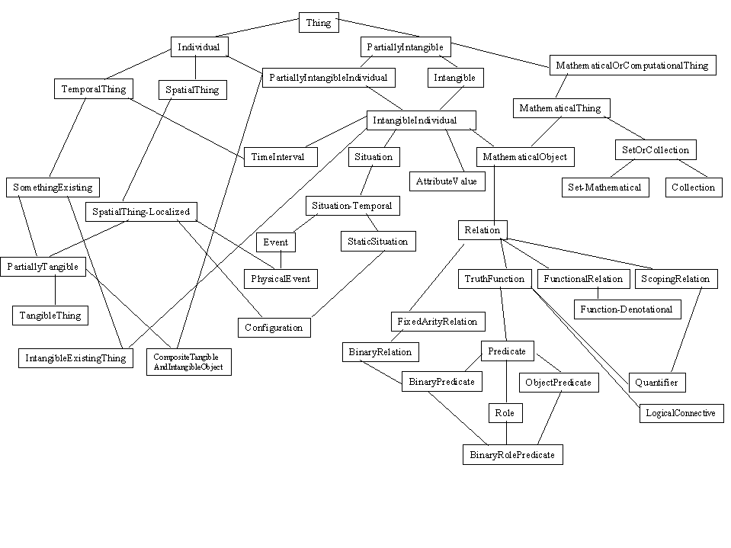
The vision behind Ontological Realism (1)

Slide 38
The vision behind Ontological Realism (2)
→ The Time Lords’ Matrix on the planet Gallifrey (Dr. Who, 1976)

Slide 39
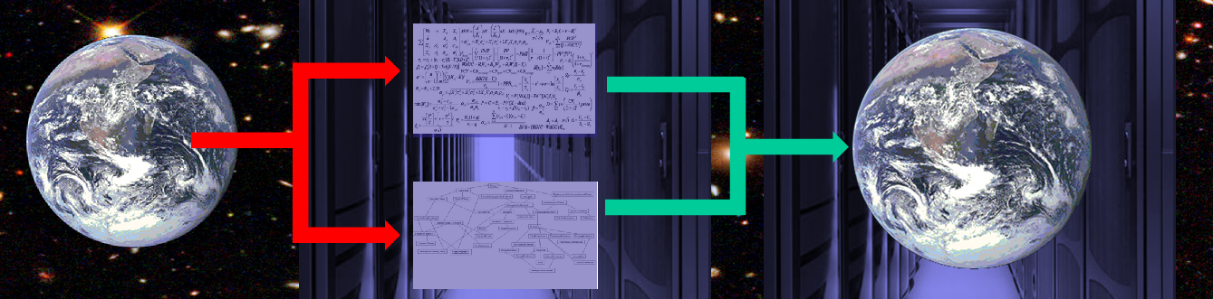
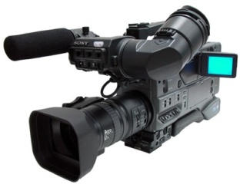

Additional constraint in video analysis
‘man enters building’
‘woman picks up box’
…

Slide 40
Assumptions of Ontological Realism
There is an external reality which is ‘objectively’ the way it is;
That reality is accessible to us;
We build in our brains cognitive representations of reality;
We use language to communicate with others about what is there, and what we believe is there.
Smith B, Ceusters W. Ontological Realism as a Methodology for Coordinated Evolution of Scientific Ontologies. Applied Ontology, 2010;5(3-4):139-188

Slide 41
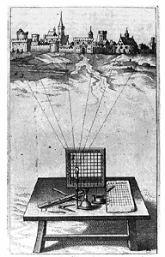
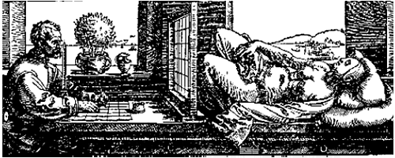
Foundation 1:
Ontology as if it were Alberti’s grid
reality
Ontological
theory
representation

Slide 42
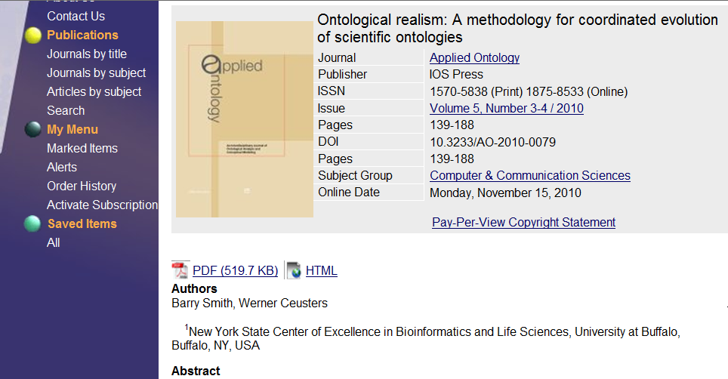


Slide 43
It offers three ways of relating
drapetomania
slave
running away
mental disorder
propensity
How beliefs are / can
be related
How terms are related
How referents (in
reality) are related

Slide 44
What Ontological Realism recognizes in reality
portions of reality
relations
configurations
?
agency
I am the agent of my life
entities
?
particulars
continuants
occurrents
universals
me
my life
human being

Slide 45
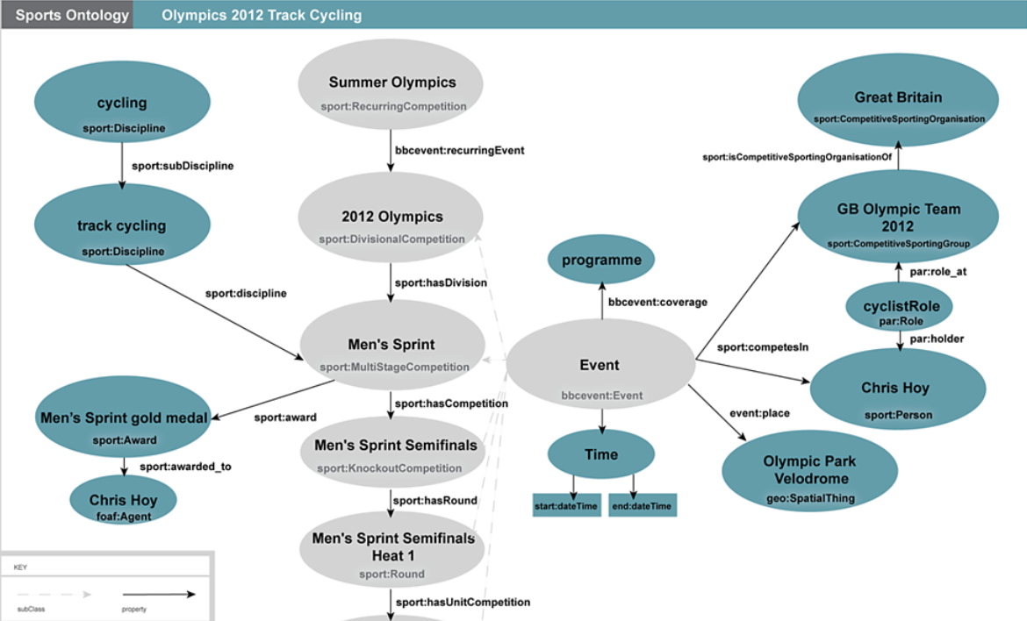
Error: confusing particulars with types
http://www.bbc.co.uk/ontologies/sport
The BBC sports ontology

Slide 46
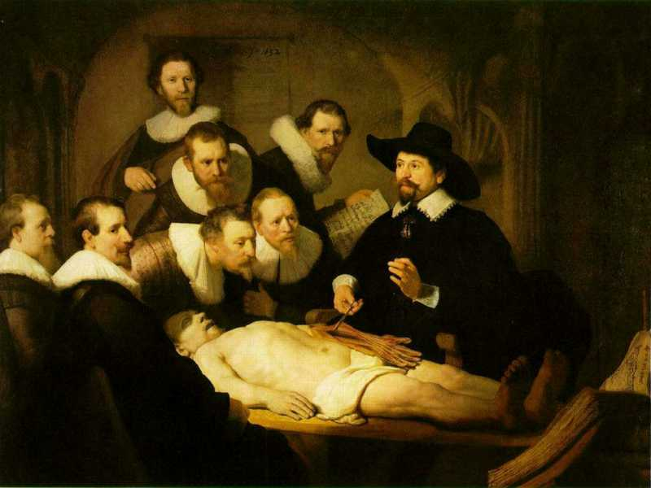
Three levels of reality in Ontological Realism
L3: accessible representations about (1), (2) or (3)
L2: beliefs, some of which are about (1), (2) or (3)
L1: entities with objective existence,
some of which (L1⁻) are not about anything

Slide 47
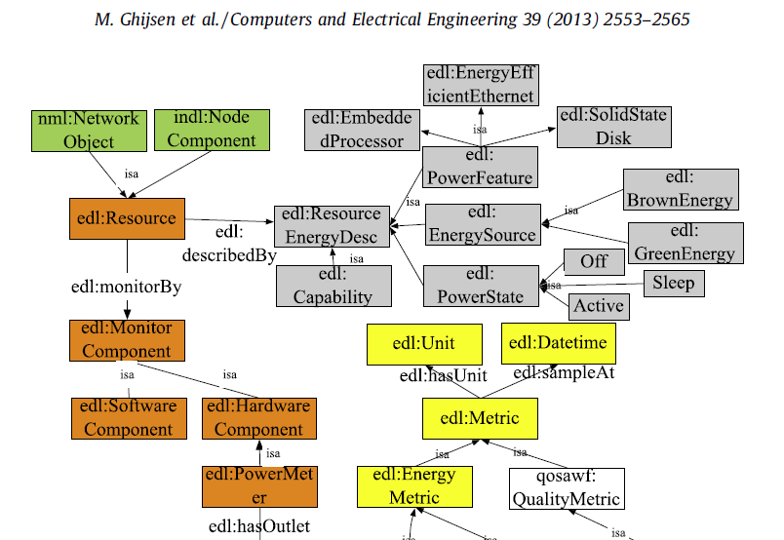
Error: confusing information (L3) with what it is about

Slide 48
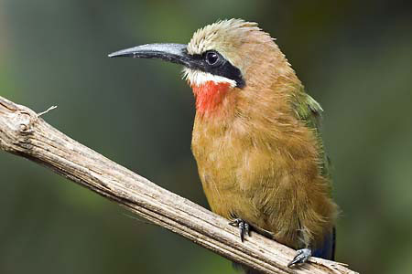

Distorted views on reality through lenses
L1 L3
Notes:
http://www.prepressure.com/design/basics/resolution

Slide 49
Action verbs and Ontological Realism
Many caveats:
  the way matters are expressed in natural language (L3) does not correspond faithfully with the way matters are (L1)
‘approach’
x orbiting around y
x taking distance from y ?
x approaching y ?
x taking distance from y ?
→ x’s process didn’t change
→ ‘to approach’ is a verb, but it does not represent a process, rather implies a process.

Slide 50
Action verbs and Ontological Realism
Approaching following a forced path

Slide 51
Required ontology coverage for computer vision: reality of …
marks of interest
video files
natural language
how do human beings move
how are human beings different from animals and inanimate objects
what makes entities being of certain types
what must exist for something else to exist
what is of interest
…
what can be captured
how do actions of marks project on manifolds
in what way correspond motions of manifolds to actions of marks
what manifolds and changes correspond to marks of interest
to what extent are distinctions in marks preserved in video
…
what terms are used to denote marks and actions they engage in
how must terms be stringed together to form meaningful sentences
how to preserve perceived distinctions despite the intrinsic ambiguity of language
…

Slide 52
Available ontology components
Basic Formal Ontology
→ Generic top-level ontology
Relation Ontology (part of BFO 2.0)
→ Relations between particulars
Information artifact Ontology
→ Covers L3 (with extensions also bearers of L3)
Foundational Model of Anatomy
→ Human anatomy
Referent Tracking
  → To relate particulars to each other and to universals
UCORE – SL
C2 Core Ontology
Biometrics Ontology

Slide 53
The Basic Formal Ontology
Is an ontology of particulars,
  despite the Representational Units (RU) denoting universals;
Its hierarchical structure is based on the following definition:
  U is_a U1 =def. for all i, (t, )
  if i instance_of U (at t)
  then i instance_of U1 (at t).

Slide 54
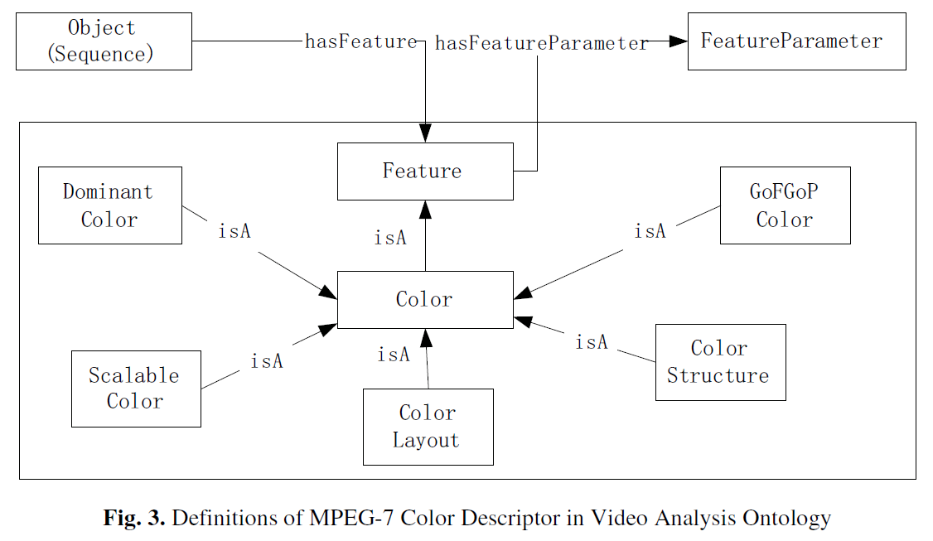
Error: overloading the isA relation
Lecture Notes in Computer Science Volume 4918, 2008, pp 237-250
Video Semantic Content Analysis Framework Based on Ontology Combined MPEG-7
Liang Bai, Songyang Lao, Weiming Zhang, Gareth J. F. Jones, Alan F. Smeaton

Slide 55
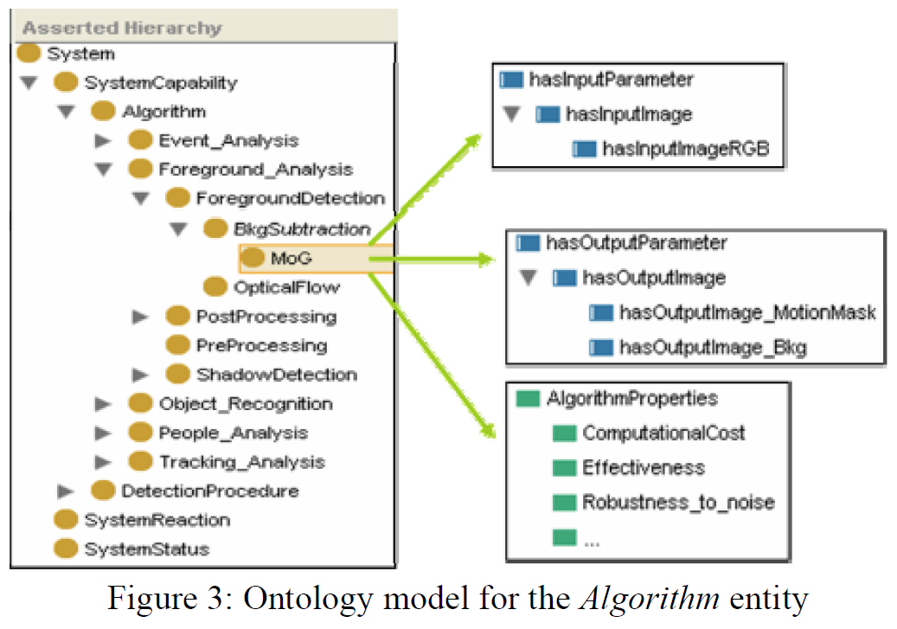
Error: overloading the isA relation
J. SanMiguel, J. Martinez, and A. Garcia. An ontology for event detection and its application in surveillance video. IEEE Proc. of AVSS, pages 220-225, Sept. 2009.

Slide 56
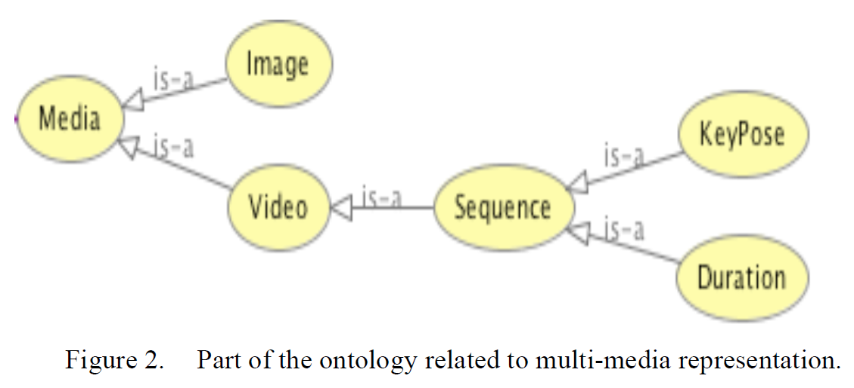
Error: using isA in non-transitive way
Saad, Sawsan, Dominique De Beul, Said Mahmoudi, and Pierre Manneback. "An ontology for video human movement representation based on benesh notation." In Multimedia Computing and Systems (ICMCS), 2012 International Conference on, pp. 77-82. IEEE, 2012.

Slide 57
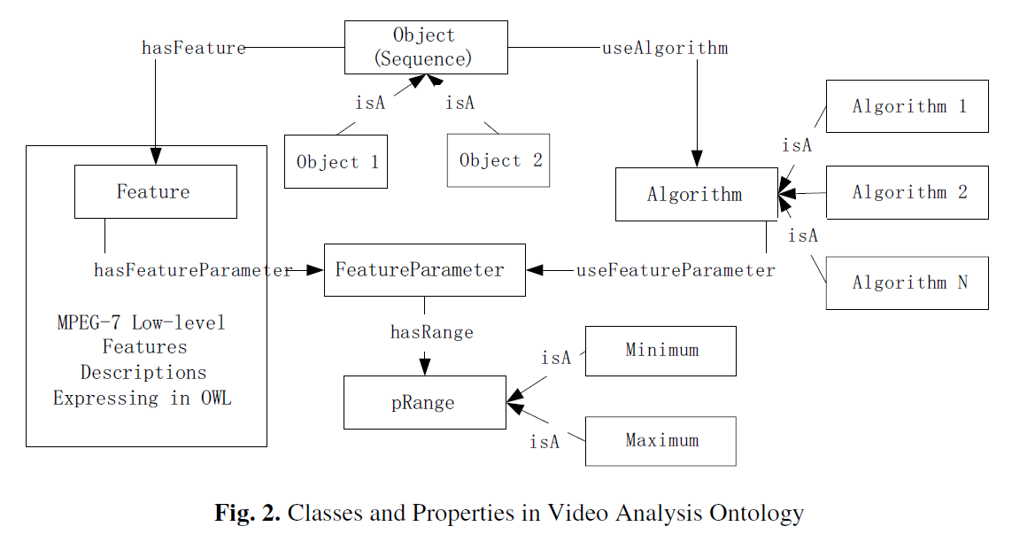
Error: confusing isA with instanceOf
Lecture Notes in Computer Science Volume 4918, 2008, pp 237-250
Video Semantic Content Analysis Framework Based on Ontology Combined MPEG-7
Liang Bai, Songyang Lao, Weiming Zhang, Gareth J. F. Jones, Alan F. Smeaton

Slide 58
The Basic Formal Ontology
Is an ontology of particulars,
  despite the Representational Units (RU) denoting universals;
Its hierarchical structure is based on the following definition:
  U is_a U1 =def. for all i, (t, ) if i instance_of U (at t) then i instance_of U1 (at t).
Is a reference ontology for reference ontologies in specific domains;
  these ontologies may also contain representational elements defined on the basis of representational units.

Slide 59
Sorts of relations (defined in the Relation Ontology)
Unconstrained
reasoning
UtoU: isa, partOf, …
U1
U2
PtoU: instanceOf, lacks,
denotes…
OWL-DL reasoning
PtoP: partOf, denotes, subclassOf, …
P1
P2

Slide 60
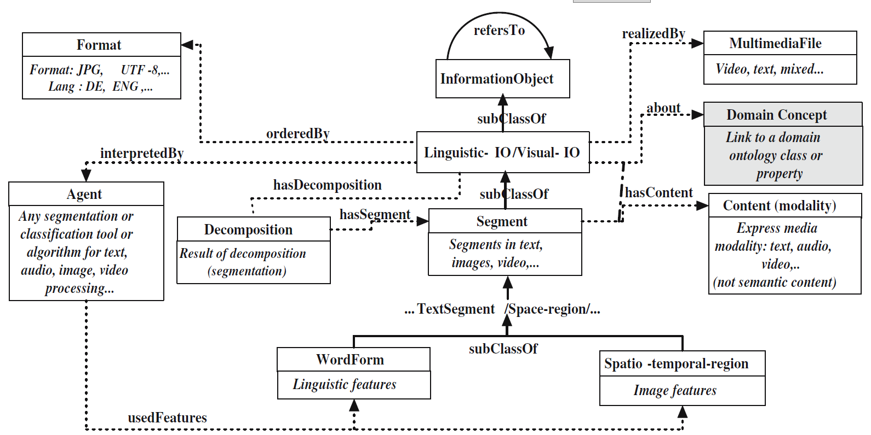
Error: using some/some instead of all/some
Georgios Th. Papadopoulos , Vasileios Mezaris , Ioannis Kompatsiaris , Michael G. Strintzis, Ontology-driven semantic video analysis using visual information objects, Proceedings of the semantic and digital media technologies 2nd international conference on Semantic Multimedia, December 05-07, 2007, Genoa, Italy

Slide 61
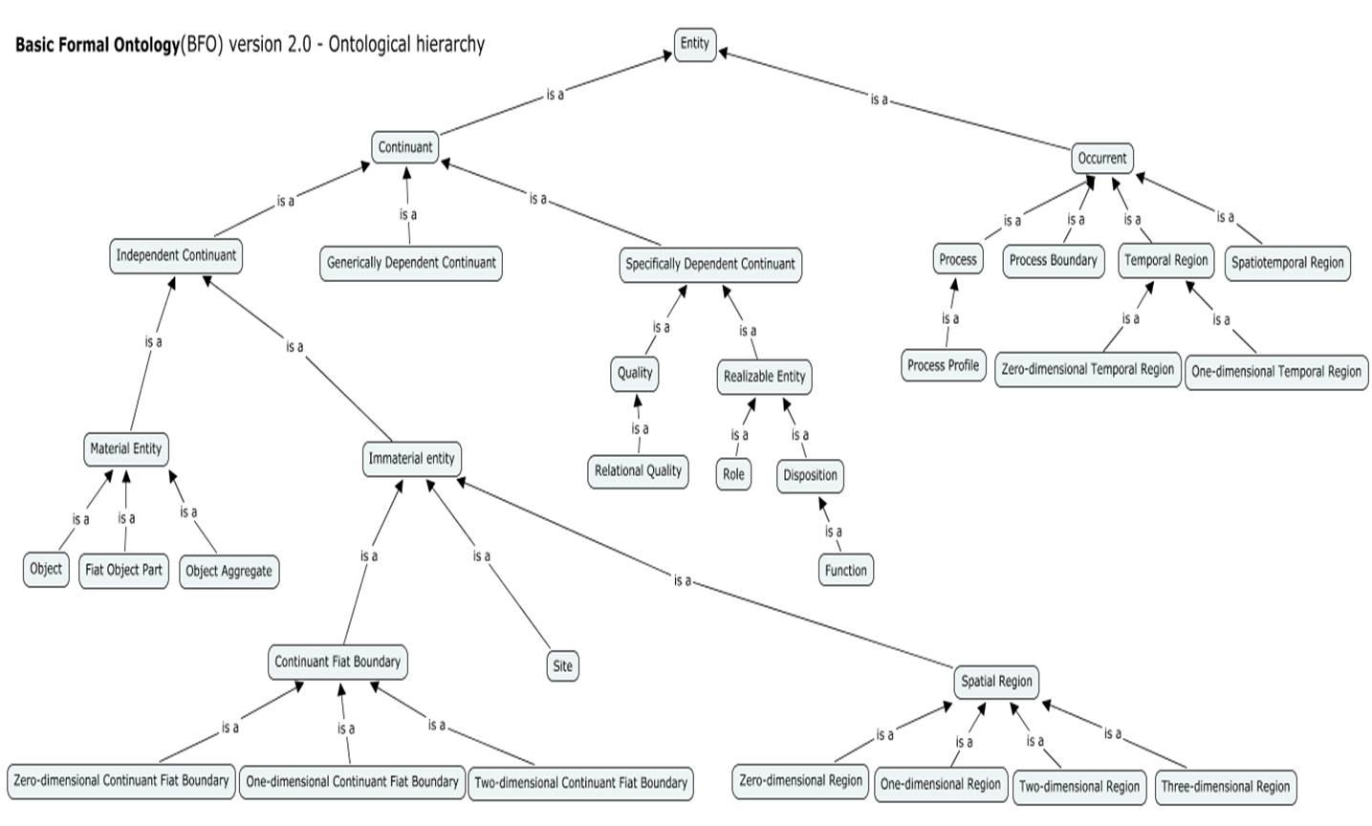
Basic Formal Ontology (BFO 2.0)

Slide 62
Relevant First-Order Distinctions (BFO 1.1)

Slide 63
Information Artifact Ontology
Continuant
  Independent Continuant
    hard drive
    car
  Dependent Continuant
    Generically Dependent Continuant
      Information Artifact (L3)
        Video file
        Annotation
        Digital image
        Ontology
    Specifically Dependent Continuant

Slide 64
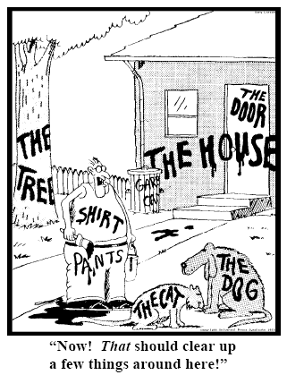
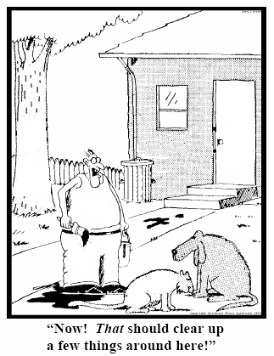
Referent Tracking
explicit reference to the concrete individual entities relevant to accurate descriptions
235
5678
321
322
666
427
Ceusters W, Smith B. Strategies for Referent Tracking in Electronic Health Records. J Biomed Inform. 2006 Jun;39(3):362-78.

Slide 65
Fundamental goals of Referent Tracking
Use these identifiers in expressions using a language that acknowledges the structure of reality:
e.g.: a red truck:
then not : red(#1) and truck(#1)
rather: #1: the truck #2: #1’s redness
Then still not:
  truck(#1) and red(#2) and hascolor(#1, #2)
  but rather:
  instance-of(#1, truck, since t1)
  instance-of(#2, red, since t2)
  inheres-in(#1, #2, since t2)
Strong foundations in realism-based ontology

Slide 66
The shift envisioned
From:
  ‘a guy accepts a phone from somebody in a red car’
To (very roughly):
  ‘this-1, which is in this-2 in which inheres this-3, and this-4 are agents in this-5 in which participates this-6’, where
    this-1 instanceOf human being …
    this-2 instanceOf car …
    this-3 qualityOf this-2 …
    this-3 instanceOf red …
    this-1 containedIn this-2 …
    this-4 instanceOf human being …
    this-5 instanceOf transfer-of-possession …
    this-1 agentOf this-5 …
    this-4 agentOf this-5 …
    …

Slide 67
The shift envisioned
From:
  ‘a guy accepts a phone from somebody in a red car’
To (very roughly):
  ‘this-1, which is in this-2 in which inheres this-3, and this-4 are agents in this-5 in which participates this-6’, where
    this-1 instanceOf human being …
    this-2 instanceOf car …
    this-3 qualityOf this-2 …
    this-3 instanceOf red …
    this-1 containedIn this-2 …
    this-4 instanceOf human being …
    this-5 instanceOf transfer-of-possession …
    this-1 agentOf this-5 …
    this-4 agentOf this-5 …
    …
denotators for particulars

Slide 68
The shift envisioned
From:
  ‘a guy accepts a phone from somebody in a red car’
To (very roughly):
  ‘this-1, which is in this-2 in which inheres this-3, and this-4 are agents in this-5 in which participates this-6’, where
    this-1 instanceOf human being …
    this-2 instanceOf car …
    this-3 qualityOf this-2 …
    this-3 instanceOf red …
    this-1 containedIn this-2 …
    this-4 instanceOf human being …
    this-5 instanceOf transfer-of-possession …
    this-1 agentOf this-5 …
    this-4 agentOf this-5 …
    …
denotators for appropriate relations

Slide 69
The shift envisioned
From:
  ‘a guy accepts a phone from somebody in a red car’
To (very roughly):
  ‘this-1, which is in this-2 in which inheres this-3, and this-4 are agents in this-5 in which participates this-6’, where
    this-1 instanceOf human being …
    this-2 instanceOf car …
    this-3 qualityOf this-2 …
    this-3 instanceOf red …
    this-1 containedIn this-2 …
    this-4 instanceOf human being …
    this-5 instanceOf transfer-of-possession …
    this-1 agentOf this-5 …
    this-4 agentOf this-5 …
    …
denotators for universals or particulars

Slide 70
The shift envisioned
From:
  ‘a guy accepts a phone from somebody in a red car’
To (very roughly):
  ‘this-1, which is in this-2 in which inheres this-3, and this-4 are agents in this-5 in which participates this-6’, where
    this-1 instanceOf human being …
    this-2 instanceOf car …
    this-3 qualityOf this-2 …
    this-3 instanceOf red …
    this-1 containedIn this-2 …
    this-4 instanceOf human being …
    this-5 instanceOf transfer-of-possession …
    this-1 agentOf this-5 …
    this-4 agentOf this-5 …
    …
time stamp in
case of continuants

Slide 71
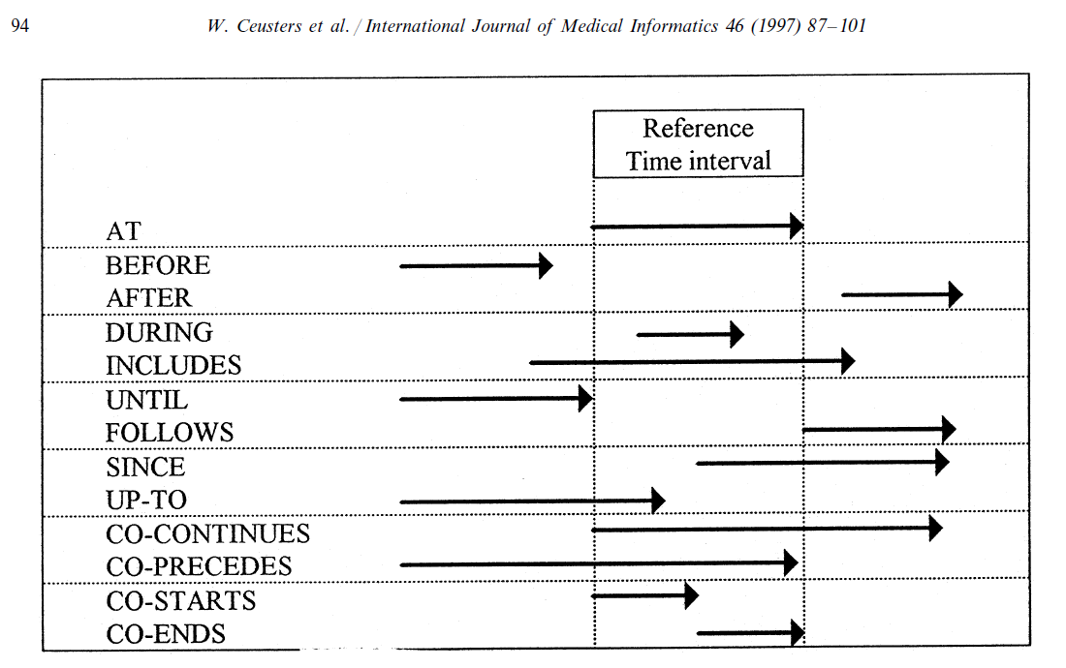
RCC equally valid for representation of time

Slide 72
Example: representation with Horn clauses
Of generic laws:
  uu_rel5(newtonianDisplacement, hasAgent, materialEntity).
  uu_rel5(newtonianDisplacement, isAlong, path).
  uu_rel5(upwardMotion, isAlong, upwardPath).
  uu_rel5(downwardMotion, isAlong, downwardPath).
  at a time
  uu_rel3(lifting, hasPart, upwardMotion).
  time transparent

Slide 73
Example: representation with Horn clauses
Of specific facts:
  rel3(myJumping, instanceOf, makingSingleJump)
  rel5(me, agentOf, myJumping, at, now)
  rel5(me, instanceOf, humanBeing, at, myLifeTime)

Slide 74
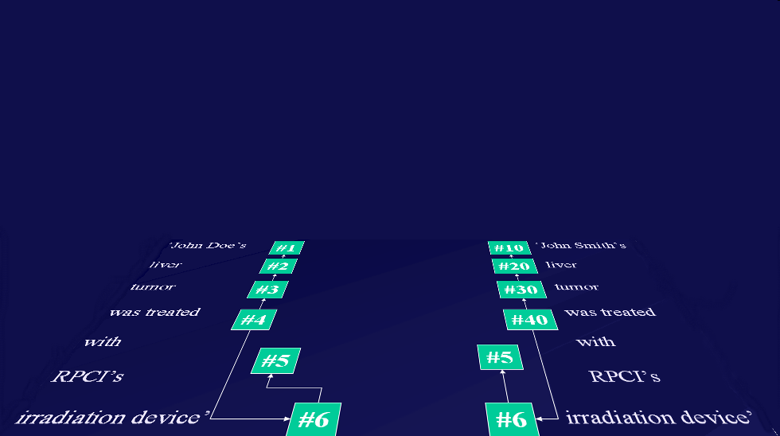
Relevance: the way RT-compatible systems ought to interact with representations of generic portions of reality
instance-of at t
caused
by
#105

Slide 75
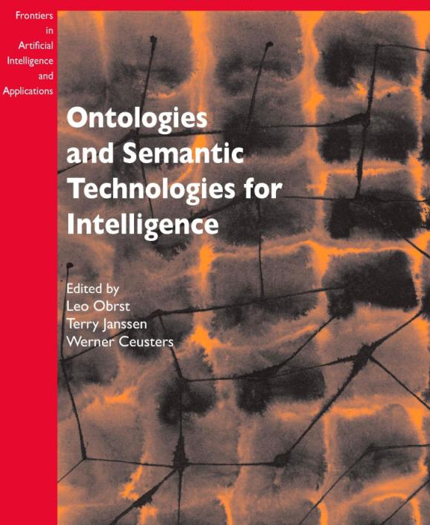
Ceusters W, Manzoor S. How to track absolutely everything? In: Obrst L, Janssen T, Ceusters W (eds.) Ontologies and Semantic Technologies for the Intelligence Community. Frontiers in Artificial Intelligence and Applications. IOS Press Amsterdam, 2010;:13-36.

Slide 76
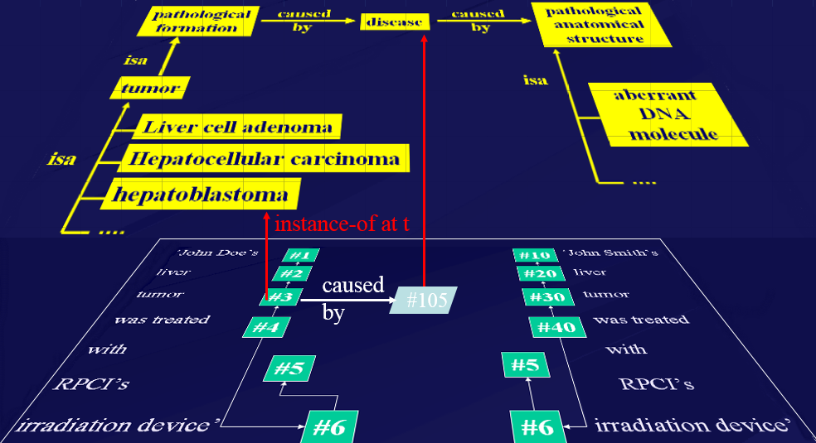
We need to do more on ontology education
Get people’s attention
Train them how to look at ontology appropriately

Slide 77

Is it worth it?
http://www.arcadja.com/auctions/en/reinhardt_ad/artist/24077/

Slide 78

For sale
Ad Reinhardt, Buffalo/New York 1913 – 1967 New York
IRIS MYSTIQUE
1957. Oil on canvas in artist's frame.
96,5 x 45 cm (without frame), 102 x 51 cm (framed) (38 x 17 ¾ in. (without frame), 40 ⅛ x 20 ⅛ in. (framed)) Inscribed on the reverse : Ad Reinhardt Portrait d‘Iris Clert 1957 Oil Collection Ahrenberg Chexbres. On the stretcher a label of the Pace Gallery, New York.
Relined..
EUR 250.000 – 350.000 / US $ 324,000 – 453,000
We would like to thank Anna Reinhardt, New York, for kindly providing additional information
Provenance: Theodor Ahrenberg, Chexbres (Acquired in 1961 from the Galerie Iris Clert, Paris) / Pace Gallery, New York (1997) / Private collection, Berlin
Exhibitions: Les 41 presentent: Iris Clert. Paris, Galerie Iris Clert, 1961 (no. cat.) / Kompass New York. Frankfurt, Kunstverein, 1968, cat. no. 50, ill. / Der Sammler Theodor Ahrenberg und das Atelier in Chexbres. 15 Jahre mit Kunst and Künstlern 1960 - 1975. Düsseldorf, Kunsthalle, 1977, Kat-no. 289, full-page ill., o.S
Literature and Illustration: Exh. cat. Norman Lewis. Black Paintings 1944-1977. New York, Studio Museum of Harlem, 1998, ill. p. 17 pl. 9 (not exhibited)
http://www.arcadja.com/auctions/en/reinhardt_ad/artist/24077/

Slide 79
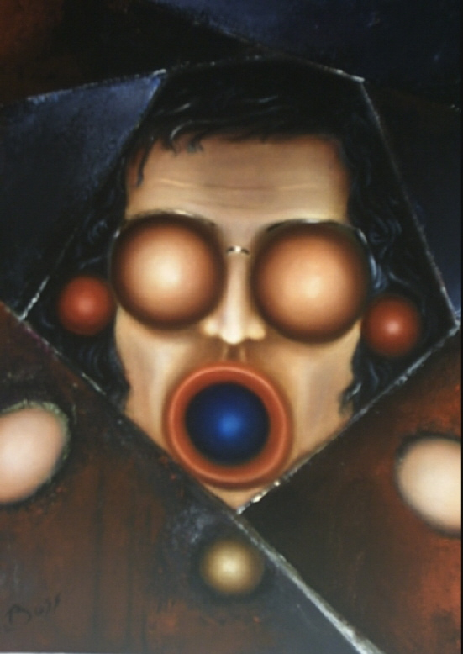
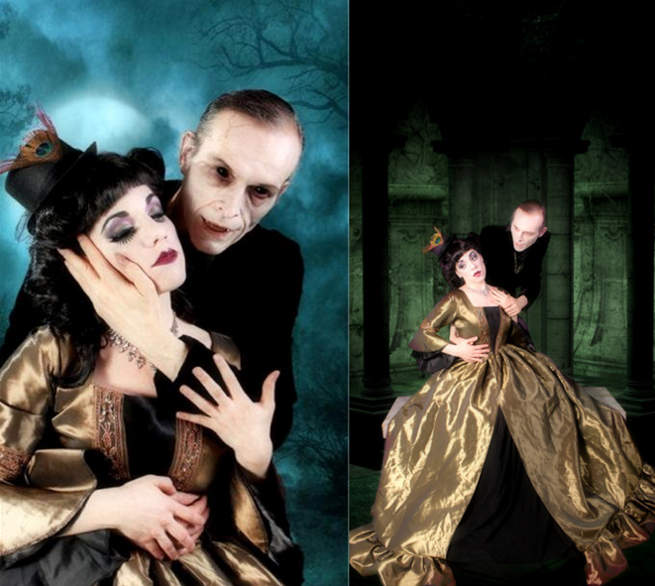
But then, art is perhaps more worth than reality
(Your servant through the lenses of two artists)
DBoss
Laura Dark

