Slide 1

ACTTION-APS Pain Taxonomy Meeting
Ontology, TMD and beyond;
Principles for Taxonomy Development
July 18-19, 2014
Westin Annapolis, Annapolis, MD
Werner CEUSTERS, MD
Professor and Division Chief, Dept of Biomedical Informatics
Director, CoE in Bioinformatics and Life Sciences, Ontology Research Group
Director of Research, UB Institute for Healthcare Informatics
University at Buffalo, NY, USA

Slide 2
Miami 2009: International Consensus Workshop: Convergence on an Orofacial Pain Taxonomy
The following consecutive steps were proposed:
  study the terminology and ontology of pain as currently defined,
  find ways to make individual data collections more useful for international research,
  develop an ontology for integrating knowledge and data concerning TMD and its relationship to complex disorders, and
  expand this ontology to cover all pain-related disorders.

Slide 3
MeSH: some paths from top to Wolfram Syndrome
All MeSH Categories
Diseases Category
Nervous System Diseases
Female Urogenital Diseases
and Pregnancy Complications
Eye Diseases
Male Urogenital
Diseases
Cranial Nerve
Diseases
Female Urogenital Diseases
Optic Nerve
Diseases
Neurodegenerative
Diseases
Optic Nerve
Diseases
Eye Diseases,
Hereditary
Heredodegenerative
Disorders,
Nervous System
Urologic Diseases
Optic Atrophy
Kidney Diseases
Optic Atrophies,
Hereditary
Diabetes Insipidus
Wolfram Syndrome

Slide 4

What would it mean if used in the context of a patient ?
All MeSH Categories
???
Diseases Category
Nervous System Diseases
Female Urogenital Diseases
and Pregnancy Complications
Eye Diseases
Male Urogenital
Diseases
Cranial Nerve
Diseases
Female Urogenital Diseases
…
Neurodegenerative
Diseases
Optic Nerve
Diseases
Optic Nerve
Diseases
Eye Diseases,
Hereditary
has
Heredodegenerative
Disorders,
Nervous System
Urologic Diseases
Optic Atrophy
Kidney Diseases
Optic Atrophies,
Hereditary
Diabetes Insipidus
has
Wolfram Syndrome

Slide 5
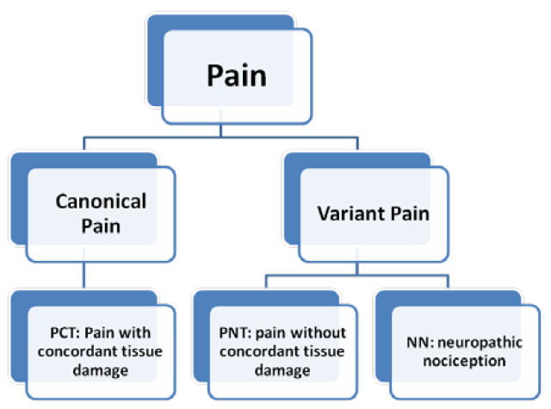
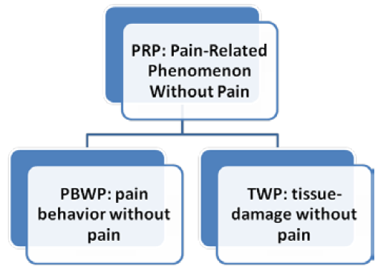
IASP definition of pain → 5 pain-related phenomena
Smith B, Ceusters W, Goldberg LJ, Ohrbach R. Towards an Ontology of Pain. In: Mitsu Okada (ed.), Proceedings of the Conference on Logic and Ontology, Tokyo: Keio University Press, February 2011:23-32.

Slide 6
Inconsistency between taxonomy and definitions
13.1. Trigeminal Neuralgia
  13.1.2 Painful Trigeminal Neuropathy
ICHD definitions:
  ‘neuralgia’ = pain in the distribution of nerve(s)
  ‘pain’ = a sensorial and emotional experience ...
  ‘neuropathy’ = a disturbance of function or pathological change in a nerve.
Several mismatches:
  (1) and (2): neuralgia is a sensorial and emotional experience in the distribution of nerve(s) ?
  (1) and (3): with much of goodwill, one could accept neuralgia to be a kind of neuropathy, but chapter 13 claims the opposite for the trigeminal case.
a kind of?

Slide 7
‘Ontology’ as philosophical discipline
In philosophy:
  metaphysics → studies ‘how is the world?’
    general metaphysics → studies general principles and ‘laws’ about the world
      ontology → studies what type of entities exist in the world
    special metaphysics → focuses on specific principles and entities
  distinct from ‘epistemology’ which is the study of how we can come to know about what exists.
  distinct from ‘terminology’ which is the study of what terms mean and how to name things.

Slide 8
Relevance of ontology as philosophical science
Vr = Mr + Es + Er
    Vr = real value Mr = measured value
    Es = systematic error Er = random error
Ontological analysis helps here in determining:
  The plausibility for Vr to exist,
  What entities are involved in bringing about Es and Er,
  If Vr exists, how does it relate to Es and Er entities.
In addition to, if multiple (putative) Vr’s of distinct types are measured:
  How these types relate to each other in a taxonomy,
  How choices in taxonomy design have impact on Es and/or Er.

Slide 9
‘Ontology’ in computer science and informatics
An ontology (plural: ontologies) is
  a shared and agreed upon conceptualization of a domain
  represented in a formal language that allows for
  the computational classification of instances in terms of a taxonomy;

Slide 10
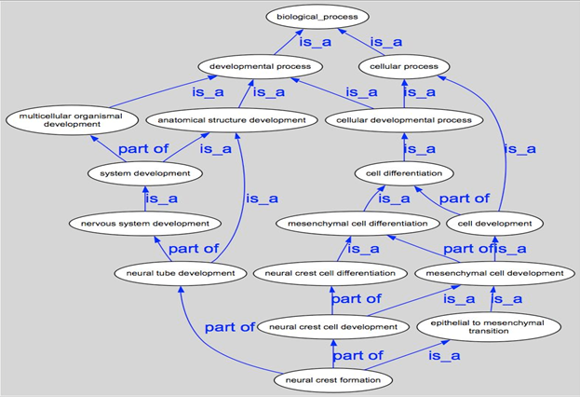
If we have a good ontology of a form like this …

Slide 11
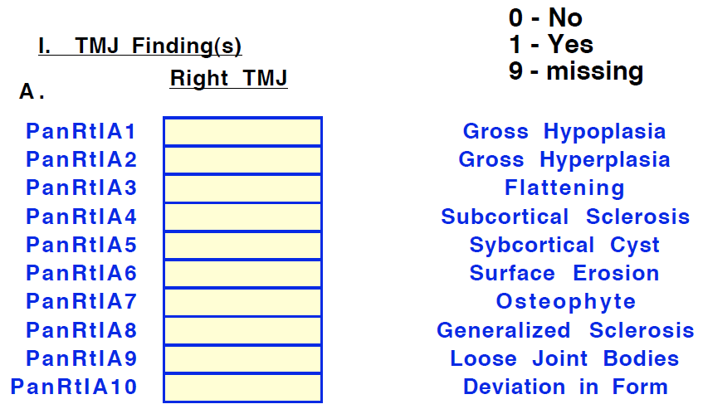
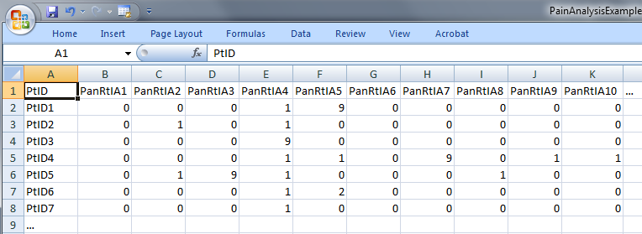
We can use it to give unambiguous ‘meaning’ to values in data collections
‘The patient with patient identifier ‘PtID4’ is stated to have had a panoramic X-ray of the mouth which is interpreted to show subcortical sclerosis of that patient’s condylar head of the right temporomandibular joint’
meaning
1

Slide 12
We can use it to map data collections

Slide 13
And enjoy positive effects of appropriate mappings
more precise and comparable semantics of what data items in (distinct) data collections denote
identification of ontological relations prior to statistical correlation:
  ch1 and ch4
  ch1 and ch5
  ch1 and ch2
  …

Slide 14
‘Ontology’ in computer science and informatics
An ontology (plural: ontologies) is
  a shared and agreed upon conceptualization of a domain
  represented in a formal language that allows for
  the computational classification of instances in terms of a taxonomy;
Caveat:
  the focus is on formal representation and computation,
  NOT on the faithfulness of the conceptualization to the reality it is assumed to represent!

Slide 15
Most common foundation for taxonomies
concept
term
referent

Slide 16
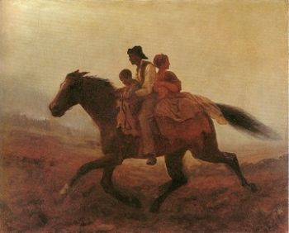
Prehistoric (1884) ‘psychiatry’: drapetomania
disease which causes slaves to suffer from an unexplainable propensity to run away
…
concept
term
referent
painting by Eastman Johnson. A Ride for Liberty: The Fugitive Slaves. 1860.
‘drapetomania’

Slide 17
‘Realism-based Ontology’
In philosophy:
  Ontology (no plural) is the study of what entities exist and how they relate to each other;
In computer science and many biomedical informatics applications:
  An ontology (plural: ontologies) is a shared and agreed upon conceptualization of a domain represented in a formal language that allows for the computational classification of instances in terms of a taxonomy;
Apply the principles of ontology as philosophical discipline as part of the methodology to develop the taxonomy of ontologies in the informatics sense.

Slide 18
Existing (‘free for use’) realism-based ontologies
RELATION TO TIME GRANULARITY | CONTINUANT |  |  |  | OCCURRENT
 | INDEPENDENT |  | DEPENDENT
ORGAN AND ORGANISM | Organism (NCBI Taxonomy) | Anatomical Entity (FMA, CARO) | Organ Function (FMP, CPRO) | Phenotypic Quality (PaTO) | Biological Process (GO)
CELL AND CELLULAR COMPONENT | Cell (CL) | Cellular Component (FMA, GO) | Cellular Function (GO)
MOLECULE | Molecule (ChEBI, SO, RnaO, PrO) |  | Molecular Function (GO) |  | Molecular Process (GO)
18
Notes:
18

Slide 19
It offers three ways of relating
drapetomania
slave
running away
mental disorder
propensity
How beliefs are / can
be related
How terms are related
How referents (in
reality) are related

Slide 20
Example: The dimensions/axes of the
Ontology of General Medical Science (OGMS)
produces
bears
realized_in
etiological process
disorder
disease
pathological process
produces
diagnosis
interpretive process
signs & symptoms
abnormal bodily features
produces
participates_in
recognized_as
Scheuermann R, Ceusters W, Smith B. Toward an Ontological Treatment of Disease and Diagnosis. 2009 AMIA Summit on Translational Bioinformatics, San Francisco, California, March 15-17, 2009;: 116-120.
http://www.referent-tracking.com/RTU/sendfile/?file=AMIA-0075-T2009.pdf
http://code.google.com/p/ogms/
Notes:
font was too small, color inside green boxes was hardly readable

Slide 21

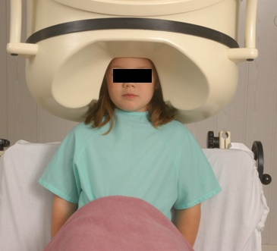
No conflation of diagnosis, disease, and disorder
The diagnosis is here
The disorder is there
The disease is there

Slide 22
Cirrhosis - environmental exposure
Etiological process - phenobarbitol-induced hepatic cell death
  produces
Disorder - necrotic liver
  bears
Disposition (disease) - cirrhosis
  realized_in
Pathological process - abnormal tissue repair with cell proliferation and fibrosis that exceed a certain threshold; hypoxia-induced cell death
  produces
Abnormal bodily features
  recognized_as
Symptoms - fatigue, anorexia
Signs - jaundice, splenomegaly
Symptoms & Signs
  used_in
Interpretive process
  produces
Hypothesis - rule out cirrhosis
  suggests
Laboratory tests
  produces
Test results – documentation of elevated liver enzymes in serum
  used_in
Interpretive process
  produces
Result - diagnosis that patient X has a disorder that bears the disease cirrhosis

Slide 23
Some principles for ontology-based taxonomies
P1: Be explicit whether assertions are about particulars or types
P2: Be precise about the sort of particulars to be classified using the classification
P3: Particulars that correctly can be classified at a certain class level, and thus are instances of the corresponding type, should also be instance of all the types that correspond with higher level classes.
P4: Keep knowledge separate from what the knowledge is about.
P5: Class descriptions should be consistent with class labels.
P6: Use Aristotelian definitions.
P7: Clinical criteria do not replace Aristotelian definitions.
Are all violated in (at least) Chapter 13 of ICHD

Slide 24
(P1) Are assertions about particulars or types?
‘Persistent idiopathic facial pain (PIFP)’
  = ‘persistent facial pain with varying presentations …’
persistent
facial pain
presentation
type1
presentation
type2
presentation
type3
types
t₂
t₃
t₁
t₁
t₁
t₂
t₂
t₃
t₁
t₃
parti-
culars
t₁
t₂
t₂
t₁
t₃
t₂
t₃
t₃
my pain
her pain
his pain

Slide 25
(P1) Are assertions about particulars or types?
‘Persistent idiopathic facial pain (PIFP)’
  = ‘persistent facial pain with varying presentations …’
  if the description is about types, then the three particular pains fall under PIFP.
  if the description is about (arbitrary) particulars, then only her pain falls under PIFP.

Slide 26
(P2) Sort of particulars to be classified
What is classified in ICHD?
  disorders? ‘The International Classification of Headache Disorders’
  headaches? ‘Many questions not needed in order to classify primary headaches…’
  patients? ‘The second edition will hopefully further promote unity in the way we classify, diagnose and treat headache patients throughout the world.’
  palsies?
  syndromes?
can be assumed from some heading names

Slide 27
(P3) Maintain a strict subsumption hierarchy
13.1. Trigeminal Neuralgia
  13.1.2 Painful Trigeminal Neuropathy
ICHD definitions:
  ‘neuralgia’ = pain in the distribution of nerve(s)
  ‘pain’ = a sensorial and emotional experience ...
  ‘neuropathy’ = a disturbance of function or pathological change in a nerve.
Several mismatches:
  (1) and (2): neuralgia is a sensorial and emotional experience in the distribution of nerve(s) ?
  (1) and (3): with much of goodwill, one could accept neuropathy to subsume neuralgia, but chapter 13 claims the opposite for the trigeminal case.
subsumes?

Slide 28
(P4) Separate knowledge from what it is about.
‘13.1.2.4 Painful trigeminal neuropathy attributed to MS plaque’
‘attributed to’ relates to somebody’s opinion about what is the case, not to what is the case.
  the mistake: a feature on the side of the clinician – his (not) knowing - is taken to be a feature on the side of the patient.
Similar mistakes:
  ‘Probable migraine’
  ‘facial pain of unknown origin’ (not in ICHD).

Slide 29
(P5) Class descriptions should be consistent with class labels
‘13.1.2.4 Painful Trigeminal neuropathy attributed to MS plaque’:
  described as ‘Trigeminal neuropathy induced by MS plaque’.
    attributed ←→ induced
    reference to pain missing in the description

Slide 30
(P6) Use Aristotelian definitions.
A
  B isa A which X
    C isa B which Y
    D isa C which Z
Make sure that X holds for C and that both X and Y hold for D.
Use this also in label formation to prevent, f.i.,
  ‘13.3 Nervus Intermedius (Facial Nerve) Neuralgia’ ‘13.3.2. Secondary Nervus Intermedius Neuropathy attributed to Herpes Zoster’

Slide 31
(P7) Clinical criteria do not replace Aristotelian definitions
‘13.1.1.1 Classical trigeminal neuralgia, purely paroxysmal’, has the criterion ‘at least three attacks of facial pain fulfilling criteria B-E’.
This does not mean: a patient with 2 such attacks does not exhibit this type of neuralgia;
It rather means: do not diagnose the patient (yet) as exhibiting this type of neuralgia.
If ‘chronic pain’ is defined as ‘pain lasting longer than three months’, at what point in time starts a patient to have that type of pain?

Slide 32
Acknowledgement
The work described is funded in part by
grant 1R01DE021917-01A1
from the National Institute of Dental and Craniofacial Research (NIDCR). The content of this presentation is solely the responsibility of the author and does not necessarily represent the official views of the NIDCR or the National Institutes of Health.

Slide 33
Conclusion
Realism-based ontology has a lot to offer to build faithful representations.
It is hard !
Pain classifications, and as thus far ALL OTHER classifications made by domain experts, would benefit from it.
  domain experts are not ontologists.
Old habits, main stream thinking, and guru-ism hamper the advance of science.

