Slide 1
Referent Tracking Tutorial Applications of Referent Tracking Part 1 of 2: Demographics
July 30, 2019
William R. Hogan, MD, MS
Professor, Health Outcomes and Biomedical Informatics
Director of Biomedical Informatics, Clinical and Translational Science Institute

Slide 2
Motivation
Demographics are important
But there are problems:
No interoperability – few standards widely adopted
Current approaches have flaws

Slide 3
The Importance of Demographics
Ubiquitous in information systems in:
Health care
Banking
Retail
Government (especially census)
Useful for:
Identifying people
Comparing populations
Linking records from multiple databases

Slide 4
The “Person Table”
Id | Birth date | Sex | Gender | Marital status | Race* | Pref. Lang.
123456 | 07/04/1962 | Male | Masculine | Married | White | en
234567 | 02/02/1935 | Female | Feminine | Widowed | Black | en
345678 | 03/03/1990 | Female | Feminine | Divorced | Oriental | en
456789 | 04/04/2005 | Male | Masculine | Single, never married | Hispanic | es
567890 |  | Unknown | Unknown | Other | Unknown
How do you convert this type of data into RT tuples?
*As taken directly from UAMS’ registration system, lest anyone have concerns of particular prejudices, insensitivities, etc.

Slide 5
Follow the RT analysis process
As applied to existing, non-RT-compliant data
Which, at its essence, boils down to: For the non-RT data to be a correct representation of reality…
What entities must exist or have existed?
In what relationships must those entities have stood?
And for both questions, when?

Slide 6
Important! The Analysis Standardly Proceeds via the Following Steps
Identify all the particulars that are explicitly referenced by the data element in question and add them to the “Particular List”
For the next entity on the Particular List:
Identify its BFO category
Then
If its BFO category is an independent continuant, go to next entity
If its BFO category is dependent continuant, identify the independent continuant on which it depends and add it to the Particular List (if relevant)
If its BFO category is occurrent, identify the continuants which participate in it, and add the relevant ones to the Particular List
Identify the relationships that hold among all particulars

Slide 7
The RT Analysis Procedure (continued)
Identify any pertinent negative assertions required for the data to be true (e.g., the patient has not had a cough in the last 2 weeks since he began experiencing shortness of breath)
Identify names associated with the particulars (e.g., proper names of people, organizations, geographical locations)
Identify any concepts or terms with which the particulars are associated

Slide 8
For the first record…
Id | Birth date | Sex | Gender | Marital status
123456 | 07/04/1962 | Male | Masculine | Married
There is a human being that the record is about (IUI-2)
There is the temporal interval over which that human being has existed (t₂)
The rest we will break down in steps

Slide 9
Birth Date: Particulars and Instantiations
Particular | Designator | Type
Birth event of person with ID 123456 | IUI-3 | Birth event
Temporal instant occupied by 123456’s birth | t₃ | Temporal instant
Day containing birth instant (07/04/1962 EDT) | t₄ | Temporal interval
Name of day containing birth instant | IUI-4 | ISO8601 formatted textual name

Slide 10
Birth date: relations among particulars
Particular 1 | Relation | Particular 2 | Holds at | Description
IUI-2 | agent of | IUI-3 | t₃ | 123456 is agent of birth at t3
IUI-3 | occupies | t₃ | -- | Birth occupies temporal instant
t₃ | during | t₄ | -- | Birth instant during 07/04/1962 EDT
IUI-4 | denotes | t₄ | t₈ | Name of day (in ISO8601 format) denotes 07/04/1962 EDT

Slide 11
Sex, Gender, and Marital “Status”: Particulars, Instantiations, and Time
Particular | Designator | Type | When exists
Person 123456’s phenotypic sex quality | IUI-5 | Male sex | t₅
Person 123456’s gender role | IUI-6 | Masculine gender | t₆
Person 123456’s party to a marriage contract role | IUI-7 | Party to a marriage contract role | t₇

Slide 12
Sex, gender, and marital “status”: relations among particulars
Particular 1 | Relation | Particular 2 | Holds at | Description
IUI-2 | bearer of | IUI-5 | t₅ | 123456 bearer of his sex quality at t5
IUI-2 | bearer of | IUI-6 | t₆ | 123456 bearer of his gender role at t6
IUI-2 | bearer of | IUI-7 | t₇ | 123456 bearer of his marriage contract role at t7
t₃ | during | t₅ | -- | Birth instant during interval sex quality exists
t₇ | after | t₃ | -- | Marriage contract interval after birth instant

Slide 13
Down to brass tacks: using RT tuples to record this information

Slide 14
The A tuple: Assigning an IUI
A < iui_{a}, iui_{p}, t_{ap} >
iui_{a}: denotes the entity assigning iui_{p}
iui_{p}: denotes the entity to which IUI is assigned
t_{ap} : denotes the time at which this IUI assignment was made
(Assignment or A tuple)

Slide 15
A tuples for our demographics data
IUI_{t}
IUI-100
IUI-101
IUI-102
IUI-103
IUI-104
IUI-105
IUI-106
IUI_{a} | IUI_{p} | t_{ap} | Comment
IUI-1 | IUI-1 | t₀ | Avoid infinite regress
IUI-1 | IUI-2 | t₁ | Assign IUI to person 123456
IUI-1 | IUI-3 | t₁ | Assign IUI to person’s birth event
IUI-1 | IUI-4 | t₁ | Assign IUI to ISO8601 name of 07/02/1964 EDT
IUI-1 | IUI-5 | t₁ | Assign IUI to person’s phenotypic sex quality
IUI-1 | IUI-6 | t₁ | Assign IUI to person’s gender role
IUI-1 | IUI-7 | t₁ | Assign IUI to person’s “party to a marriage contract” role
Note! The RT system also assigns each tuple an IUI.

Slide 16
Reminder: temporal references
Temporal reference | Type of temporal region | Description
t₀ | Instant | Time at which person #1 assigned IUI-1 to him/herself
t₁ | Instant | Time at which person #1 assigned IUIs and asserted PtoU and PtoP tuples
t₂ | Interval | Interval occupied by patient 123456’s history
t₃ | Instant | Instant occupied by patient 123456’s birth
t₄ | Interval | July 4th, 1962 Eastern Daylight Time
t₅ | Interval | Interval during which 123456’s phenotypic sex exists
t₆ | Interval | Interval during which 123456’s gender role exists
t₇ | Interval | Interval during which 123456’s marriage contract role exists

Slide 17
The Particular to Universal (PtoU) tuple
PtoU< iui_{a}, t_{a}, iui_{p}, r, uui, iui_{o}, t_{r} >
The particular denoted by iui_{a} asserts at time t_{a} that the particular denoted by iui_{p} is related by r to the type denoted by uui (taken from the ontology denoted by iui_{o}) at t_{r}
(Particular-to-universal or PtoU tuple)
The relation will typically, but not always, be instance-of. For example, we might often use is-about when talking about ICEs.

Slide 18
PtoU tuples for our demographics data
IUI_{t} | IUI_{a} | t_{a} | IUI_{p} | r | UUI | IUI_{o} | t_{r}
IUI-110 | IUI-1 | t₁ | IUI-2 | instance of | Person | OBI | t₂
IUI-111 | IUI-1 | t₁ | IUI-3 | instance of | Birth | UBERON | ₋₋
IUI-112 | IUI-1 | t₁ | IUI-4 | instance of | Name | IAO | t₈
IUI-113 | IUI-1 | t₁ | IUI-5 | instance of | Male sex quality | UBERON | t₅
IUI-114 | IUI-1 | t₁ | IUI-6 | instance of | Masculine gender role | OMRSE | t₆
IUI-115 | IUI-1 | t₁ | IUI-7 | instance of | Party to a marriage contract role | OMRSE | t₇

Slide 19
The Particular to Particular (PtoP) tuple
PtoP< iui_{a}, t_{a}, r, p, iui_{o}, t_{r} >
The particular denoted by iui_{a} asserts at time t_{a} that the relation r (taken from the ontology denoted by iui_{o}) holds between the particulars denoted by the list of particular references p at t_{r}
(Particular-to-particular or PtoP tuple)

Slide 20
PtoP tuples
IUI-t | IUI-a | t_{a} | r | p list | IUI_{o} | t_{r}
IUI-120 | IUI-1 | t₁ | agent of | IUI-2, IUI-3 | RO | t₃
IUI-121 | IUI-1 | t₁ | bearer of | IUI-2, IUI-5 | RO | t₅
IUI-122 | IUI-1 | t₁ | bearer of | IUI-2, IUI-6 | RO | t₆
IUI-123 | IUI-1 | t₁ | bearer of | IUI-2, IUI-7 | RO | t₇
IUI-124 | IUI-1 | t₁ | occupies-temporal-region | IUI-3, t₃ | RO | ₋₋

Slide 21
Relationships among temporal references
IUI_{t} | IUI_{a} | t_{a} | r | p list | IUI_{o} | Explanation
IUI-130 | IUI-1 | t₁ | during | t₃, t₄ | RO | Birth instant during 7/4/1962 EDT
IUI-131 | IUI-1 | t₁ | includes | t₅, t₃ | RO | Interval during which phenotypic sex quality exists includes instant of birth
IUI-132 | IUI-1 | t₁ | co-ends | t₅, t₂ | RO | Phenotypic sex quality begins to exist after person begins to exist
IUI-133 | IUI-1 | t₁ | during | t₆, t₂ | RO | Gender role begins to exist after person begins to exist
IUI-134 | IUI-1 | t₁ | after | t₇, t₃ | RO | Marriage role begins to exist after birth
IUI-135 | IUI-1 | t₁ | includes | t₇, t₁ | RO | Marriage role exists before/after time of data recording

Slide 22
The Particular to Name (PtoN) tuple
PtoN< iui_{a}, t_{a}, IUI_{c}, IUI_{p}, n, nt, t_{r} >
The particular denoted by iui_{a} asserts at time t_{a} that the particular denoted by IUI_{c} uses the name n of type nt to refer to the particular denoted by IUI_{p} at t_{r}
(Particular-to-name or PtoN tuple)

Slide 23
PtoN tuples
IUI-t | IUI-a | t_{a} | IUI_{c} | IUI_{p} | n | nt | t_{r}
IUI-140 | IUI-1 | t₁ |  | IUI-4 | 1964-07-02T-0400 | ISO8601 Date | t₈
IUI-141 | IUI-1 | t₁ |  | IUI-2 | 123456 | Identifier

Slide 24
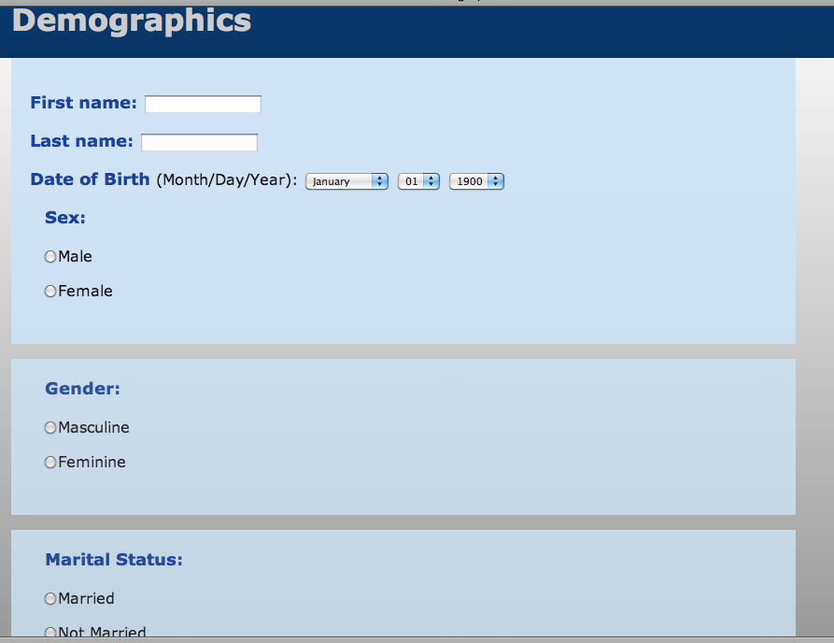
Referent Tracking Implementation; No Special Data Entry
http://demappon.info/Demographics.php

Slide 25
Ontology Development Motivated by this Work
Ontology for Medically Related Social Entities
Reference ontology
Gender role and subtypes
Party to a marriage contract role
Demographics Application Ontology
Application ontology
All class URIs are MIREOTed from PATO, OMRSE, AGCT-MO, etc.
Brings diverse entities from reference ontologies into one place to facilitate demographics applications

Slide 26
Problems With Current Approaches
No ontological distinctions
All demographics are “attributes” related to the person in exactly the same way
Require fields/attributes/properties that are specific to demographics
Do not represent the entities involved as first-order entities
Even semantic web uses data type properties
Cannot say anything else about birth, birthday, gender, martial status, or changes over time
Confuse sex and gender

Slide 27
Interoperability in Current Approaches
Requires shared field/attribute names as well as standard codes for coded attributes specific to demographics
Semantic web:
Different URIs for same property
FOAF: http://xmlns.com/foaf/0.1/birthday
vCARD: http://www.w3.org/2006/vcard/ns#bday
For gender in FOAF, no interoperability of values
Any string is compliant: “M”, “m”, “male”, “mael”, “masculine” are all valid
So how can we reliably query for persons of male gender?

Slide 28
Gender vs. Sex
Gender | Refers to the socially constructed roles, behaviours, activities, and attributes that a given society considers appropriate for men and women. | Social Role
Sex | Refers to the biological and physiological characteristics that define men and women. | Biological Quality
Quoted from: http://www.who.int/gender/whatisgender/en/index.html

Slide 29
Phenotypic vs. Genotypic Sex
 | Canonical | Non-Canonical
Anatomical sex | Male sex Female sex | Hermaphroditic sex Transsexual male Transsexual female
Chromosomal (or karyotypic) sex | XY XX | XO XXY XYY XXX Mosaic
There are individuals with XY karyotype who are anatomically female.

Slide 30
Our Method for Analysis
Identify the relevant particulars in reality
Determine the types they instantiate
Identify the relations that hold among them
Create new representations of types in ontologies as needed

Slide 31
Birth Date: Particulars and Instantiations
Particular | Type
John Doe | Person
John Doe’s birth | Birth event
Instant of John Doe’s birth | Temporal instant
Day containing J.D. birth instant | Temporal interval
Name of day containing birth instant | Textual name

Slide 32
Birth Date: Relations Among Particulars
Person 123456 is the agent of his birth at instant of birth:
jd agent_of jd_birth at jd_birth_instant
Person 123456’s birth occurs at the instant of birth:
jd_birth occupies_temporal_region jd_birth_instant
The instant of birth is during birth date:
jd_birth_instant during jd_birth_date
The birth date has a name according to the Gregorian calendar system:
“1970-01-01” denotes jd_birth_date (at t₂)
We handle date of death in exactly the same manner.

Slide 33
Sex
Particulars:
jd_sex: Person 123456’s anatomical sex quality
t1: Instant sex quality began to exist
Instantiations:
jd_sex instance_of Male sex since t1
t1 instance_of Temporal instant
Relations:
jd bearer_of jd_sex since t1
t1 before jd_birth_instant

Slide 34
Gender
Particulars:
jd_gender: Person 123456’s gender role
t2: Instant role began to exist
t3: Instant Person 123456 began to exist
Instantiations:
jd_gender instance_of Male gender since t2
t2, t3 instance_of Temporal instant
Relations:
jd bearer_of jd_gender since t2
t2 after t3

Slide 35
Marital Status
Particulars:
jd_mc_role: Person 123456’s party to marriage contract role
t3: Instant at which marriage contract begins to exist
Instantiations:
jd_mc_role instance_of Party to a marriage contract since t3
t3 instance_of Temporal instant
Relations:
jd bearer_of jd_mc_role since t3
The paper also shows how to represent the fact that no such a role inheres in a person to capture “single”

Slide 36
Referent Tracking Implementation; No Special Data Entry
http://demappon.info/Demographics.php

Slide 37
Ontology Development Motivated by this Work
Ontology for Medically Related Social Entities
Reference ontology
Gender role and subtypes
Party to a marriage contract role
Demographics Application Ontology
Application ontology
All class URIs are MIREOTed from PATO, OMRSE, AGCT-MO, etc.
Brings diverse entities from reference ontologies into one place to facilitate demographics applications

Slide 38
Conclusions
The realist approach:
Eliminates confusions
Explicitly represents particulars like party to contract roles
Can say additional things about them
Facilitates representing changes in these entities over time
Requires no new relations, “attributes”, “properties”, etc.
Does not complicate data entry
Application ontology approach has utility for demographics, at least
Due to the diverse nature of entities involved: biological qualities, social roles, legal entities, temporal regions

Slide 39
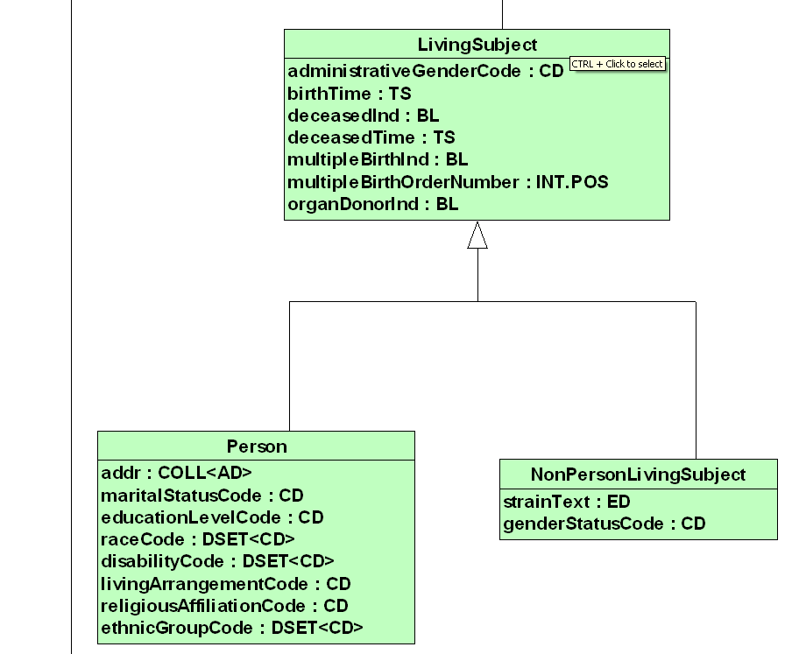
Information Model

Slide 40
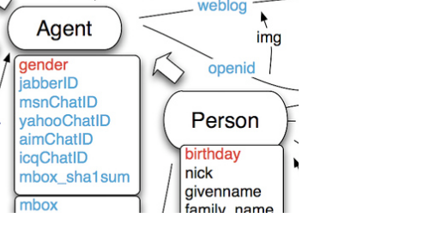
Semantic Web
Friend of a friend (FOAF)
vCARD RDF
vCARD
birthday
formatted name
revision

Slide 41
Demographics per “Meaningful Use”
 | Eligible Providers | Eligible Hospitals
Preferred language | X | X
Gender | X | X
Race | X | X
Ethnicity | X | X
Date of birth | X | X
Date of death |  | X
Preliminary cause of death |  | X

Slide 42
Demographics in Section 4302 of Affordable Care Act
Race
Ethnicity
Primary language
Sex
Disability status
Relative to MU:
“Primary” vs. “preferred” language
Sex vs. gender

Slide 43
Birth Date: Relations Among Particulars
Person 123456 is the agent of his birth at instant of birth:
jd agent_of jd_birth at jd_birth_instant
Person 123456’s birth occurs at the instant of birth:
jd_birth occupies_temporal_region jd_birth_instant
The instant of birth is during birth date:
jd_birth_instant during jd_birth_date
The birth date has a name according to the Gregorian calendar system:
“1970-01-01” denotes jd_birth_date (at t₂)
We can handle date of death easily in exactly the same manner.

Slide 44
Sex, Gender, and Marital Status: Relations among Particulars
Person 123456 is the bearer of his male sex quality over t2
jd bearer_of jd_sex at t2
t2 before t5
Person 123456 is the bearer of his male gender role over t3
jd bearer_of jd_gender at t3
t2 after t3
Person 123456 is the bearer of his marriage contract role over t3
jd bearer_of jd_mc_role at t3

Slide 45
Gender
Particulars:
jd_gender: Person 123456’s gender role
t2: Instant role began to exist
t3: Instant Person 123456 began to exist
Instantiations:
jd_gender instance_of Male gender since t2
t2, t3 instance_of Temporal instant
Relations:
jd bearer_of jd_gender since t2
t2 after t3

Slide 46
Marital Status
Particulars:
jd_mc_role: Person 123456’s party to marriage contract role
t3: Instant at which marriage contract begins to exist
Instantiations:
jd_mc_role instance_of Party to a marriage contract since t3
t3 instance_of Temporal instant
Relations:
jd bearer_of jd_mc_role since t3

Slide 47
Copyright Notice
This work is licensed under a Creative Commons Attribution-ShareAlike 4.0 International License
http://creativecommons.org/licenses/by-sa/4.0/

