Slide 1

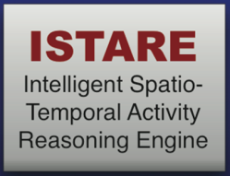
DARPA Mind's Eye Site Visit
Ontological Realism in ISTARE
May 16, 2011, 10 AM – 4 PM
UB North Campus, 224 Bell Hall
W. Ceusters
Ontology Research Group, NYS Center of Excellence in Bioinformatics & Life Sciences
Department of Psychiatry, University at Buffalo

Slide 2
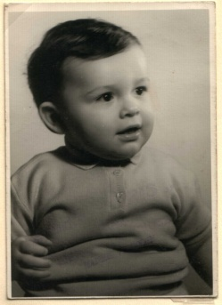
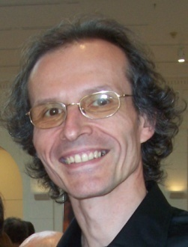









Short personal history
1977
1959 - 2011
2006
1989
2004
1992
2002
1995
1998
1993

Slide 3
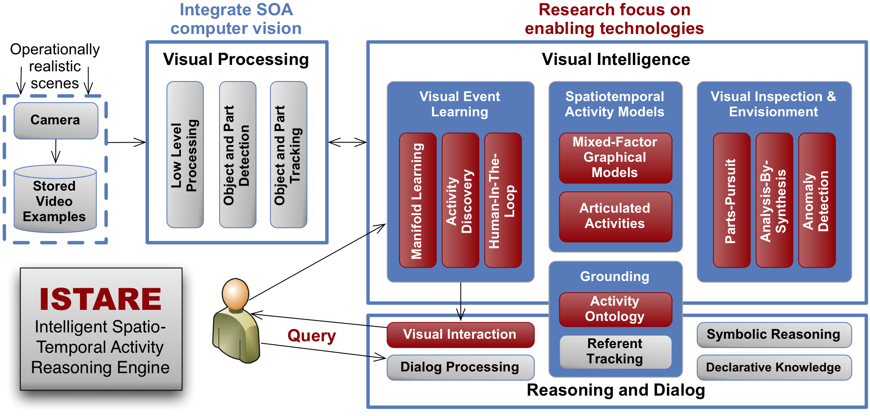

Role of the ‘Brain’ Unit
query

Slide 4
A multi-disciplinary approach to ontology
In philosophy:
  Ontology (no plural) is the study of what entities exist and how they relate to each other;
In mainstream computer science and informatics:
  An ontology (plural: ontologies) is a shared and agreed upon conceptualization of a domain;
Our ‘realist’ view within the Ontology Research Group combines the two:
  We use Ontological Realism, a specific theory of ontology, as the basis for building high quality ontologies, using reality as benchmark.
Smith B, Ceusters W. Ontological Realism as a Methodology for Coordinated Evolution of Scientific Ontologies.
Applied Ontology, 2010;5(3-4):139-188.

Slide 5
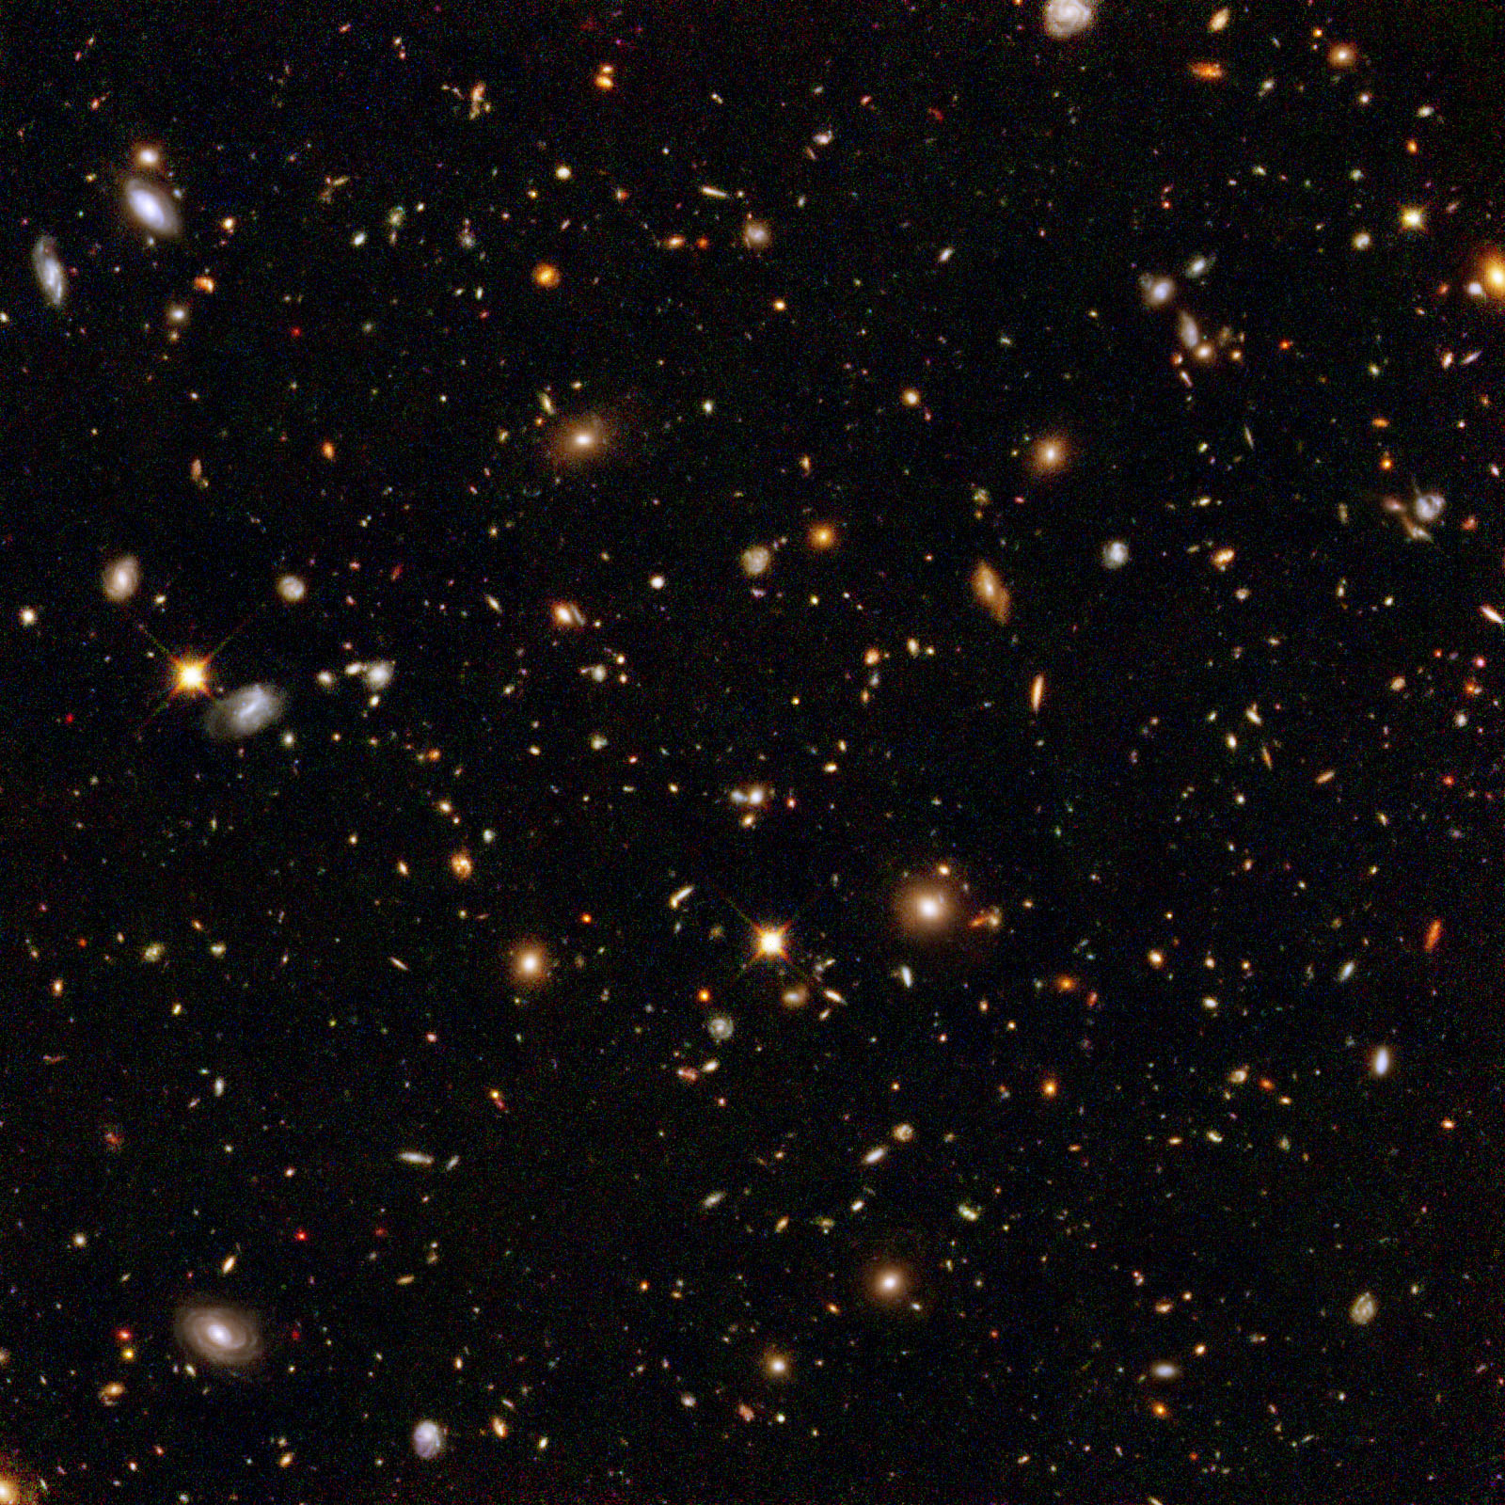

Assumptions of Ontological Realism
There is an external reality which is ‘objectively’ the way it is;
That reality is accessible to us;
We build in our brains cognitive representations of reality;
We use language to communicate with others about what is there, and what we believe is there.
Smith B, Ceusters W. Ontological Realism as a Methodology for Coordinated Evolution of Scientific Ontologies. Applied Ontology, 2010;5(3-4):139-188

Slide 6
What Ontological Realism recognizes in reality
portions of reality
relations
configurations
?
agency
I am the agent of my life
entities
?
continuants
particulars
me
occurrents
universals
my life
human being

Slide 7
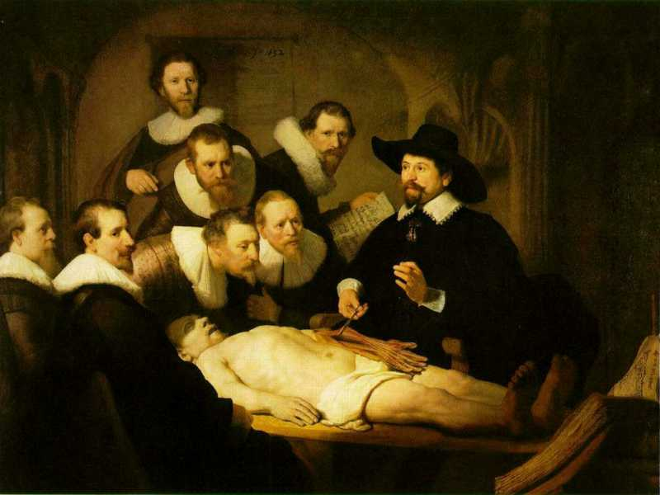
Three levels of reality in Ontological Realism
L3: accessible representations about (1), (2) or (3)
L2: beliefs, some of which are about (1), (2) or (3)
L1: entities with objective existence,
some of which (L1⁻) are not about anything

Slide 8
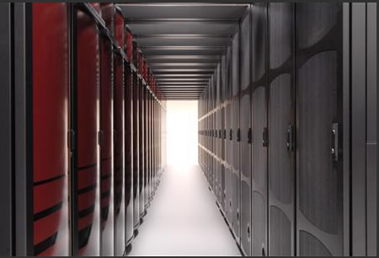
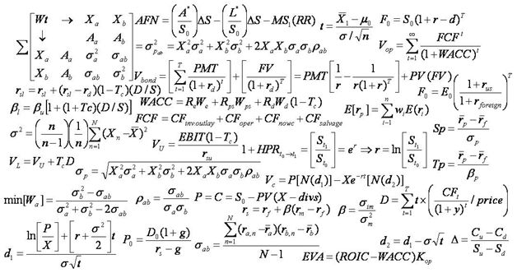
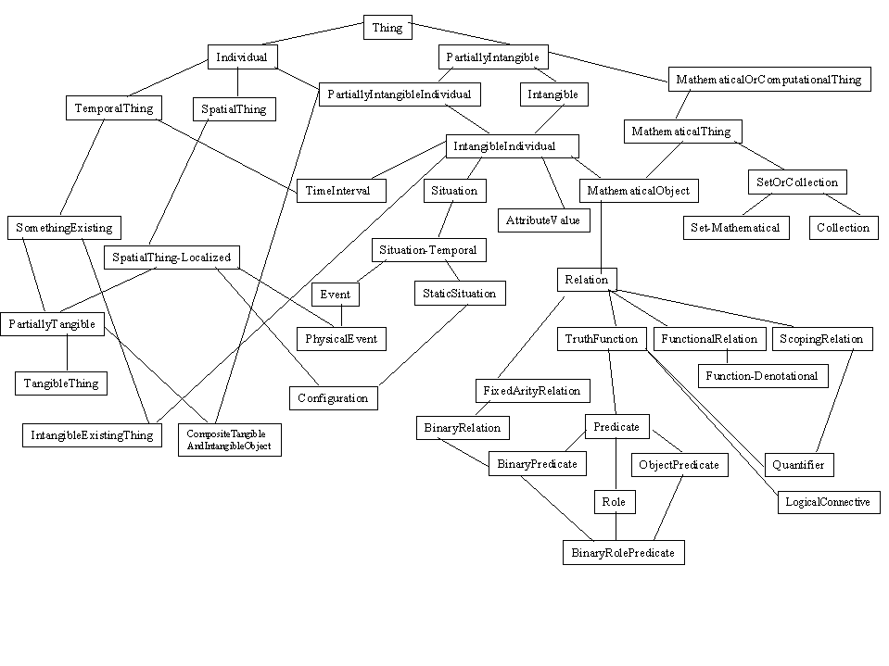
The vision behind Ontological Realism (1)

Slide 9
The vision behind Ontological Realism (2)
→ The Time Lords’ Matrix on the planet Gallifrey (Dr. Who, 1976)

Slide 10
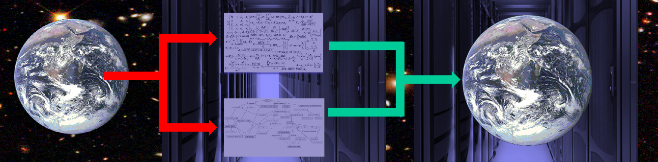


Mind’s Eye’s additional constraints
‘man enters building’
‘woman picks up box’
…

Slide 11
Required ontology coverage: reality of …
marks of interest
video files
natural language
how do human beings move
how are human beings different from animals and inanimate objects
what makes entities being of certain types
what must exist for something else to exist
what is of interest
…
what can be captured
how do actions of marks project on manifolds
in what way correspond motions of manifolds to actions of marks
what manifolds and changes correspond to marks of interest
to what extent are distinctions in marks preserved in video
…
what terms are used to denote marks and actions they engage in
how must terms be stringed together to form meaningful sentences
how to preserve perceived distinctions despite the intrinsic ambiguity of language
…

Slide 12
Available ontology components
Basic Formal Ontology
Relation Ontology
Information artifact Ontology
Foundational Model of Anatomy
Referent Tracking
  → basis for a DOD Global Graph initiative ?
UCORE – SL
C2 Core Ontology
Biometrics Ontology

Slide 13
The Basic Formal Ontology
L3: accessible representations about (1), (2) or (3)
Basic Formal Ontology
An organized structure composed of Representational Units (RU) each one denoting a universal
L2: beliefs, some of which are about (1), (2) or (3)
L1: entities with objective existence,
some of which (L1⁻) are not about anything

Slide 14
The Basic Formal Ontology
Is an ontology of particulars,
  despite the RUs denoting universals;
Its hierarchical structure is based on the following definition:
  U is_a U1 =def. for all i, (t, ) if i instance_of U (at t) then i instance_of U1 (at t).
Is a reference ontology for reference ontologies in specific domains;
  these ontologies may also contain representational elements defined on the basis of representational units.

Slide 15
Sorts of relations (defined in the Relation Ontology)
Unconstrained
reasoning
UtoU: isa, partOf, …
U1
U2
PtoU: instanceOf, lacks,
denotes…
OWL-DL reasoning
PtoP: partOf, denotes, subclassOf, …
P1
P2

Slide 16
ISTARE implementation of BFO
subType(independentContinuant, isa, continuant, bfo_bfo).
subType(materialEntity, isa, independentContinuant, bfo_bfo).
subType(object, isa, materialEntity, bfo_bfo).
subType(spatialRegion, isa, continuant, bfo_bfo).
subType(twoDimensionalSpatialRegion, isa, spatialRegion, bfo_bfo).
subType(threeDimensionalSpatialRegion, isa, spatialRegion, bfo_bfo).
subType(path, isa, threeDimensionalSpatialRegion, bfo_bfo).
subType(dependentContinuant, isa, continuant, bfo_bfo).
subType(genericallyDependentContinuant, isa, dependentContinuant, bfo_bfo).
subType(informationContentEntity, isa, genericallyDependentContinuant, iao_bfo).
subType(specificallyDependentContinuant, isa, dependentContinuant, bfo_bfo).
subType(quality, isa, specificallyDependentContinuant, bfo_bfo).
subType(shape, isa, quality, bfo_bfo).
…

Slide 17
Taxonomy traversal
subType(SubType, subTypeOf, Type, _):-
  subType(SubType, isa, Type, _),!.
subType(SubType, subTypeOf, SuperType, _):-
  subType(SubType, isa, Type, _),!,
  subType(Type, subTypeOf, SuperType, _).
Horn-clauses: universal quantification in the head, existential quantification for all variables introduced in the body.

Slide 18
Relevant First-Order Distinctions

Slide 19
Information Artifact Ontology
Continuant
  Independent Continuant
    hard drive
    car
  Dependent Continuant
    Generically Dependent Continuant
      Information Artifact (L3)
        Video file
        Annotation
        Digital image
        Ontology
    Specifically Dependent Continuant

Slide 20
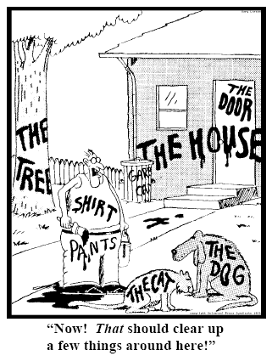
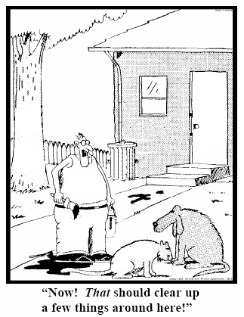
Referent Tracking
explicit reference to the concrete individual entities relevant to accurate descriptions
235
5678
321
322
666
427
Ceusters W, Smith B. Strategies for Referent Tracking in Electronic Health Records. J Biomed Inform. 2006 Jun;39(3):362-78.

Slide 21
Fundamental goals of ‘our’ Referent Tracking
Use these identifiers in expressions using a language that acknowledges the structure of reality:
e.g.: a red truck:
then not : red(#1) and truck(#1)
rather: #1: the truck #2: #1’s redness
Then still not:
  truck(#1) and red(#2) and hascolor(#1, #2)
  but rather:
  instance-of(#1, truck, since t1)
  instance-of(#2, red, since t2)
  inheres-in(#1, #2, since t2)
Strong foundations
in realism-based
ontology

Slide 22
The shift envisioned
From:
  ‘a guy accepts a phone from somebody in a red car’
To (very roughly):
  ‘this-1, which is in this-2 in which inheres this-3, and this-4 are agents in this-5 in which participates this-6’, where
    this-1 instanceOf human being …
    this-2 instanceOf car …
    this-3 qualityOf this-2 …
    this-3 instanceOf red …
    this-1 containedIn this-2 …
    this-4 instanceOf human being …
    this-5 instanceOf transfer-of-possession …
    this-1 agentOf this-5 …
    this-4 agentOf this-5 …
    …

Slide 23
The shift envisioned
From:
  ‘a guy accepts a phone from somebody in a red car’
To (very roughly):
  ‘this-1, which is in this-2 in which inheres this-3, and this-4 are agents in this-5 in which participates this-6’, where
    this-1 instanceOf human being …
    this-2 instanceOf car …
    this-3 qualityOf this-2 …
    this-3 instanceOf red …
    this-1 containedIn this-2 …
    this-4 instanceOf human being …
    this-5 instanceOf transfer-of-possession …
    this-1 agentOf this-5 …
    this-4 agentOf this-5 …
    …
denotators for particulars

Slide 24
The shift envisioned
From:
  ‘a guy accepts a phone from somebody in a red car’
To (very roughly):
  ‘this-1, which is in this-2 in which inheres this-3, and this-4 are agents in this-5 in which participates this-6’, where
    this-1 instanceOf human being …
    this-2 instanceOf car …
    this-3 qualityOf this-2 …
    this-3 instanceOf red …
    this-1 containedIn this-2 …
    this-4 instanceOf human being …
    this-5 instanceOf transfer-of-possession …
    this-1 agentOf this-5 …
    this-4 agentOf this-5 …
    …
denotators for appropriate relations

Slide 25
The shift envisioned
From:
  ‘a guy accepts a phone from somebody in a red car’
To (very roughly):
  ‘this-1, which is in this-2 in which inheres this-3, and this-4 are agents in this-5 in which participates this-6’, where
    this-1 instanceOf human being …
    this-2 instanceOf car …
    this-3 qualityOf this-2 …
    this-3 instanceOf red …
    this-1 containedIn this-2 …
    this-4 instanceOf human being …
    this-5 instanceOf transfer-of-possession …
    this-1 agentOf this-5 …
    this-4 agentOf this-5 …
    …
denotators for universals or particulars

Slide 26
The shift envisioned
From:
  ‘a guy accepts a phone from somebody in a red car’
To (very roughly):
  ‘this-1, which is in this-2 in which inheres this-3, and this-4 are agents in this-5 in which participates this-6’, where
    this-1 instanceOf human being …
    this-2 instanceOf car …
    this-3 qualityOf this-2 …
    this-3 instanceOf red …
    this-1 containedIn this-2 …
    this-4 instanceOf human being …
    this-5 instanceOf transfer-of-possession …
    this-1 agentOf this-5 …
    this-4 agentOf this-5 …
    …
time stamp in
case of continuants

Slide 27
Implementation
Of generic facts:
  uu_rel5(newtonianDisplacement, hasAgent, materialEntity).
  uu_rel5(newtonianDisplacement, isAlong, path).
  uu_rel5(upwardMotion, isAlong, upwardPath).
  uu_rel5(downwardMotion, isAlong, downwardPath).
  at a time
  uu_rel3(lifting, hasPart, upwardMotion).
  time transparent

Slide 28
Implementation
Of specific facts:
  rel3(myJumping, instanceOf, makingSingleJump)
  rel5(me, agentOf, myJumping, at, now)
  rel5(me, instanceOf, humanBeing, at, myLifeTime)

Slide 29
RCC8: conceptual neighborhood
If rel₁ at t₁, what possible relations at t₂ ?
TPP
NTPP
EQ
DC
EC
PO
TPPI
NTPPI
Randell, D., Cui, Z., Cohn, A.: A Spatial Logic based on Regions and Connection.
In: Proceedings of the International Conference on Knowledge Representation and Reasoning, pp. 165–176 (1992)

Slide 30
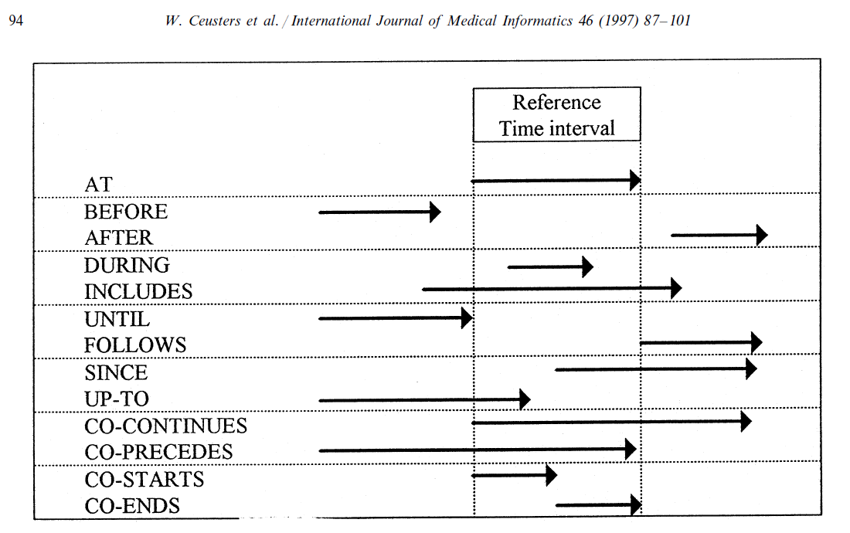
RCC equally valid for representation of time

Slide 31
Implementation
Time:
  rel3(ConnectedTemporalRegion1, instanceOf, connectedTemporalRegion):-
  repr(_, rel3(ConnectedTemporalRegion1, partOf, ConnectedTemporalRegion2)),
  repr(_, rel3(ConnectedTemporalRegion2, partOf, ConnectedTemporalRegion3)),
  eval(rel3(ConnectedTemporalRegion1, partOf, ConnectedTemporalRegion3)).
Spatial regions:
  rel5(C1, properPartOf, C3, at, C1C3Time):-
  eval(rel5(C1, properPartOf, C2, at, C1C2Time)),
  eval(rel5(C2, properPartOf, C3, at, C2C3Time)),
  eval(rel3(C1C3Time, partOf, C1C2Time)),
  eval(rel3(C1C3Time, partOf, C2C3Time)).
→ bridge to motion classes

Slide 32
Basic ‘Motion Classes’: adds change
Ends
DC
EC
PO
TPP
NTPP
EQ
TPPI
NTPPI
Starts
DC
External
Hit
Reach
EC
Split
Peripheral
PO
Leave
Leave or Reach
TPP
Internal
Expand
NTPP
EQ
Shrink
Internal
TPPI
Internal
NTPPI
Zina Ibrahim, and Ahmed Y. Tawfik, An Abstract Theory and Ontology of Motion Based on the Regions Connection Calculus, Symposium of Abstraction, Reformulation and Approximation (SARA 2007), LNAI, Springer, 2007.

Slide 33
RCC8/MC14 and action verbs
‘approach’

Slide 34
RCC8/MC14 and action verbs
‘approach’
Invariant:
  shrink of the region between the entities involved in an approach

Slide 35
RCC8/MC14 and action verbs
approach
carry
dig
fall
give
hit
lift
push
run
touch
arrive
catch
drop
flee
go
hold
move
put down
snatch
turn
attach
chase
enter
fly
hand
kick
open
raise
stop
walk
bounce
close
exchange
follow
haul
jump
pass
receive
take
bury
collide
exit
get
have
leave
pick up
replace
throw
all can be expressed in terms of mc14 (with the addition of direction and some other features)
from mc to the verbs: requires additional information on the nature of the entities involved
  to be encoded in the ontology

Slide 36
Link with low- and mid-level processing
Output of ‘detectors’ (e.g. human, footfall, bike, …) correspond with the head of clauses in the ontology reasoner:
  rel3(Footfall, instanceOf, footfall):-
  rel3(MakingSingleJump, instanceOf, makingSingleJump):-
  rel3(Walking, instanceOf, canonicalHumanWalking):-
  rel5(IndependentContinuant, instanceOf, humanBeing, at, HBInterval):-
  …

Slide 37
Implementation example
rel3(Footfall, instanceOf, footfall):-
timeName(Footfall, hasExistencePeriod, temporalInterval, Period1),
name(Footfall, hasAgent, Foot),
eval(rel5(Foot, agentOf, Footfall, at, Period1)),
name(Foot, _, HumanBeing),
timeName(_, _, temporalInterval, Period3),
eval(rel5(Foot, tangentialProperPartOf, HumanBeing, at, Period3)),
eval(rel3(Period1, partOf, Period3)),
eval(rel5(Foot, instanceOf, foot, partOf, Period3)),
timeName(_, _, temporalInterval, Period4),
eval(rel5(HumanBeing, instanceOf, humanBeing, at, Period4)),
eval(rel3(Period1, partOf, Period4)),
name(Footfall, culminationOf, DownwardMotion),
eval(rel3(Footfall, culminationOf, DownwardMotion)),
name(DownwardMotion, hasExistencePeriod, Period2),
eval(rel3(DownwardMotion, instanceOf, downwardMotion)),
eval(rel5(Foot, agentOf, DownwardMotion, at, Period2)),
name(someSurface, _, Surface),
timeName(_, _, temporalInterval, Period5),
eval(rel5(Surface, instanceOf, upperSurface, at, Period5)),
eval(rel5(Foot, adjacentTo, Surface, coContinues, Period2)),
eval(rel3(Period2, partOf, Period5)).

Slide 38
Action verbs and Ontological Realism
Many caveats:
  the way matters are expressed in natural language does not correspond faithfully with the way matters are
‘approach’
x orbiting around y
x taking distance from y ?
x approaching y ?
x taking distance from y ?
→ x’s process didn’t change
→ ‘to approach’ is a verb, but it does not represent a process, rather implies a process.

Slide 39
Action verbs and Ontological Realism
Approaching following a forced path

Slide 40
RCC8/MC14 & video as 2D+T representation of 3D+T
man entering building: the first-order view

Slide 41
RCC8/MC14 & video as 2D+T representation of 3D+T
man entering building: the video view

Slide 42
RCC8/MC14 & video as 2D+T representation of 3D+T
egg crashing on wall: the video view
Requires additional mapping from the motion of manifolds in the video to the corresponding motion of the corresponding entities in reality

Slide 43
Capture through representations of ‘laws of nature’
For example, the very same process cannot happen at different times:
        rel5(Process, Rel, Continuant, at, T1):-
        repr(_, rel5(Process, Rel, Continuant, at, T1)),
        repr(_, rel5(Process, Rel, Continuant, at, p(X))),
        not(equal(T1, p(X))),
        replaceAll(p(X), T1).
        rel5(Continuant, agentOf, Process, at, T1):-
        repr(_, rel5(Continuant, Rel, Process, at, T1)),
        repr(_, rel5(Continuant, Rel, Process, at, p(X))),
        not(equal(T1, p(X))),
        replaceAll(p(X), T1).

