Slide 1
Axiomatizing SNOMED CT disorders: Should there be room for interpretation?
Werner Ceusters & Anuwat Pengput
Department of Biomedical Informatics
University at Buffalo
wceusters@gmail.com

Slide 2
SNOMED CT structure
No upper ontology
Building blocks:
concepts and terms
Pragmatics based
Clinical perspective
Mix of object and subject language
2
https://enonic.com/blog/what-is-snomed-ct

Slide 3
SNOMED CT browser
https://browser.ihtsdotools.org/?perspective=full&conceptId1=404684003&edition=MAIN/2023-06-30&release=&languages=en
3

Slide 4
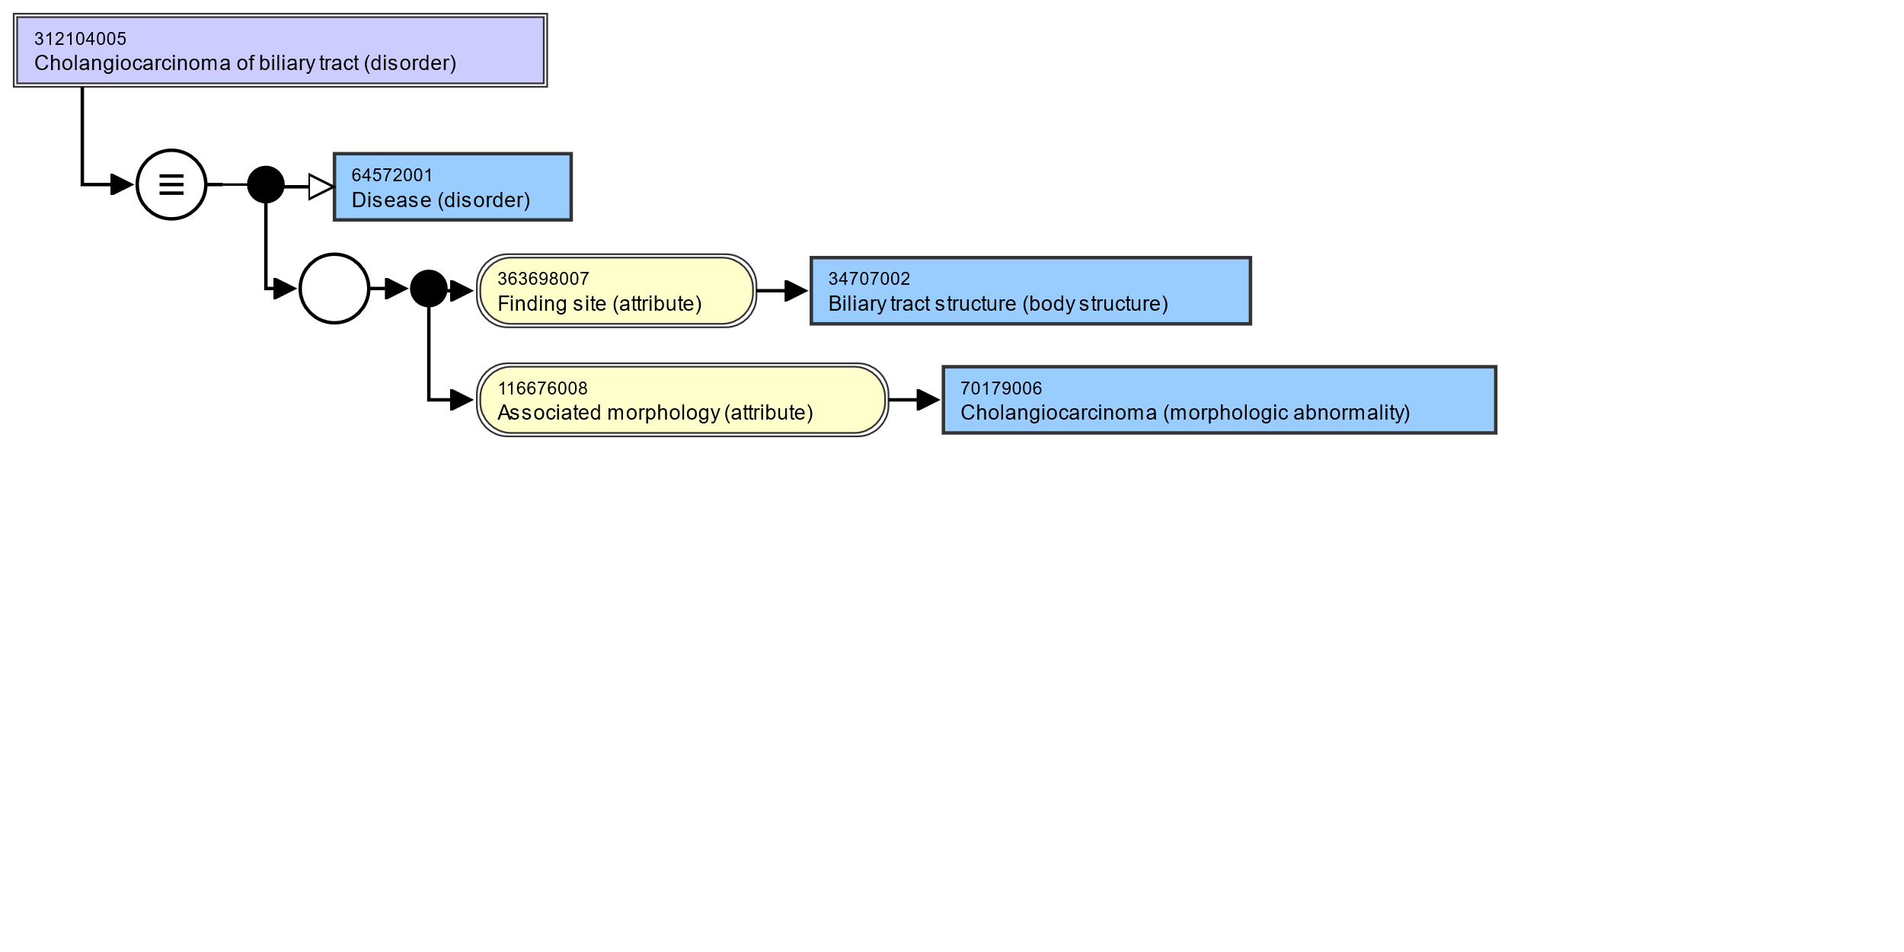
SNOMED CT’s Description Logic: EL++ Example: Cholangiocarcinoma of biliary tract - asserted
EquivalentClasses(
:312104005 |Cholangiocarcinoma of biliary tract (disorder)|
ObjectIntersectionOf(
:64572001 |Disease (disorder)|
ObjectSomeValuesFrom(
:609096000 |Role group (attribute)|
ObjectIntersectionOf(
ObjectSomeValuesFrom(
:116676008 |Associated morphology (attribute)|
:70179006 |Cholangiocarcinoma (morphologic abnormality)|)
ObjectSomeValuesFrom(
:363698007 |Finding site (attribute)|
:34707002 |Biliary tract structure (body structure)|)))))
4

Slide 5
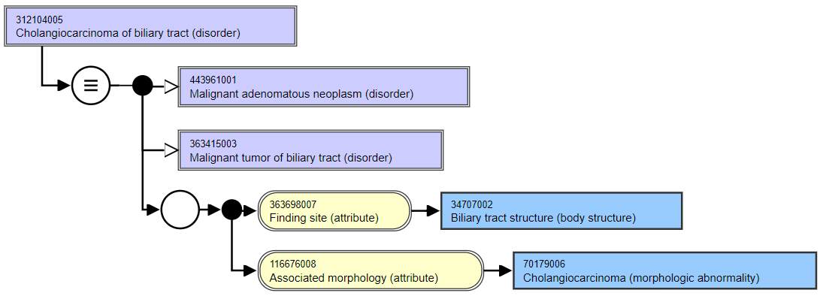
Cholangiocarcinoma of biliary tract
Asserted
Inferred
5

Slide 6
In Snomed CT, all Disease (disorder) concepts are subsumed by Clinical finding (finding)
Finding:
May be normal (but not necessarily)
May exist only at a single point in time (e.g. a serum sodium level)
Cannot be temporally separate from the observation (one cannot observe them and say they are absent, nor can they be present when they cannot be observed)
Cannot be defined only in terms of an underlying pathological process that is present, when the observation itself is not present
Disorder:
Always and necessarily abnormal
Have temporal persistence (may be under treatment, in remission, or inactive, even though they are still present)
May be present as a propensity for certain abnormal states to occur, even when treatment mitigates or resolves those abnormal states
Necessarily have an underlying pathological process
6
https://confluence.ihtsdotools.org/display/DOCEG/Clinical+Finding+and+Disorder

Slide 7
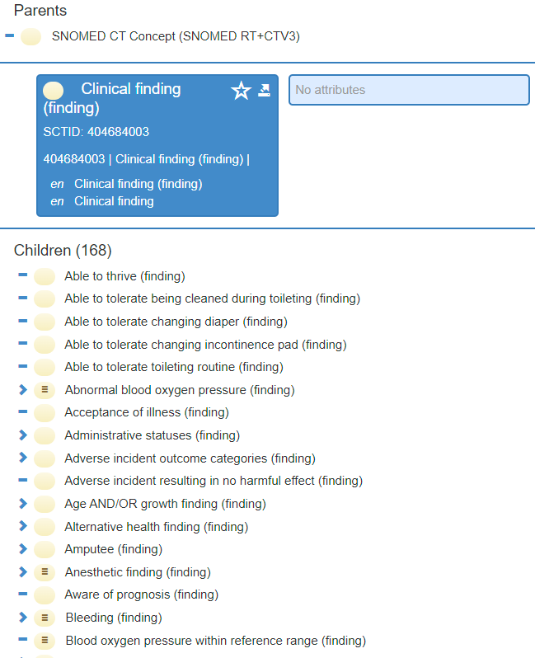
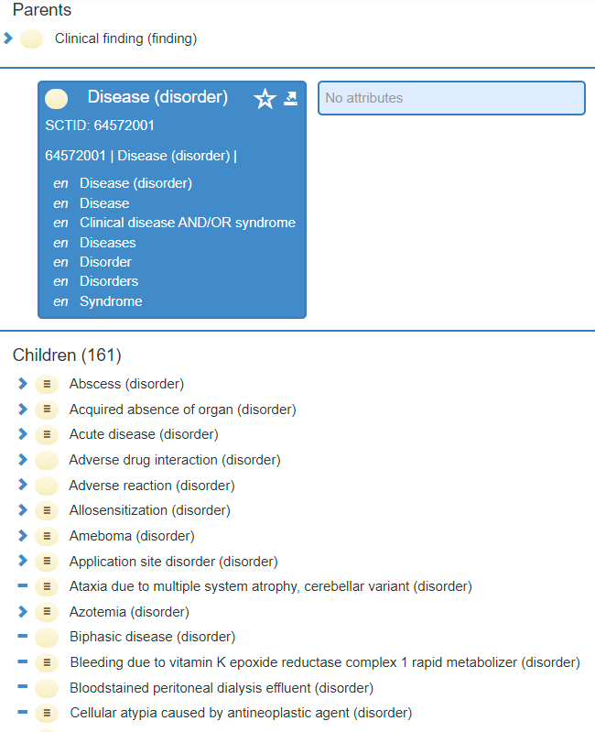
Finding versus diseas
7

Slide 8
Associative attributes in SNOMED CT concepts subsumed by ‘disease (disorder)’.
Finding site | 81.12% | specifies the body site affected by a condition.
Associated morphology | 67.22% | specifies the morphologic changes seen at the tissue or cellular level that are characteristic features of a disease.
Pathological process | 24.53% | provides information about the underlying pathological process of a disorder, i.e. it describes the process that results in the structural or morphologic change.
Due to | 20.18% | relates a clinical finding directly to a cause such as another clinical finding or a procedure.
Causative agent | 18.69% | Identifies the direct causative agent of a disease such as an organism, substance or physical force. (Note: This attribute is not used for vectors, such as mosquitos transmitting malaria).
Occurrence | 17.53% | refers to a specific period of life during which a condition first presents.
Interprets | 9.26% | refers to the entity being evaluated or interpreted, when an evaluation, interpretation or judgment is intrinsic to the meaning of a concept.
Has interpretation | 6.83% | when grouped with the attribute interprets, designates the judgment aspect being evaluated or interpreted for a concept. (e.g. presence, absence etc.)
Clinical course | 6.27% | represents both the onset and course of a disease.
Associated with | 1.42% | represents a clinically relevant association between concepts without either asserting or excluding a causal or sequential relationship between the two.
8

Slide 9
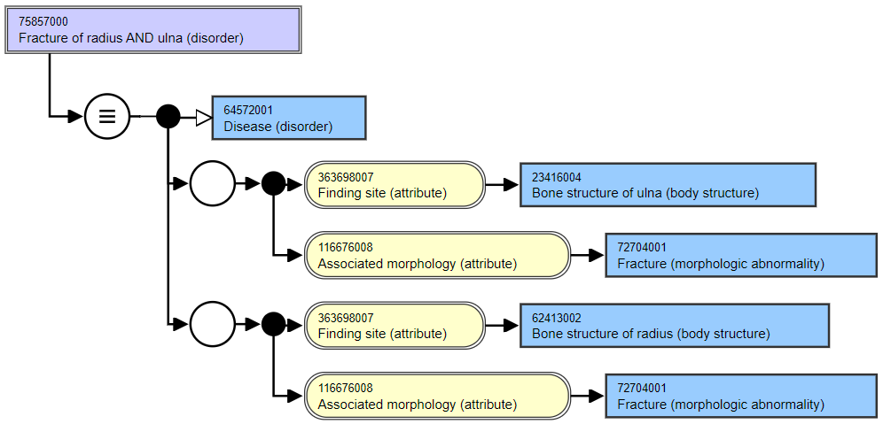
Role groups in Snomed CT (1)
Asserted
Asserted
9

Slide 10
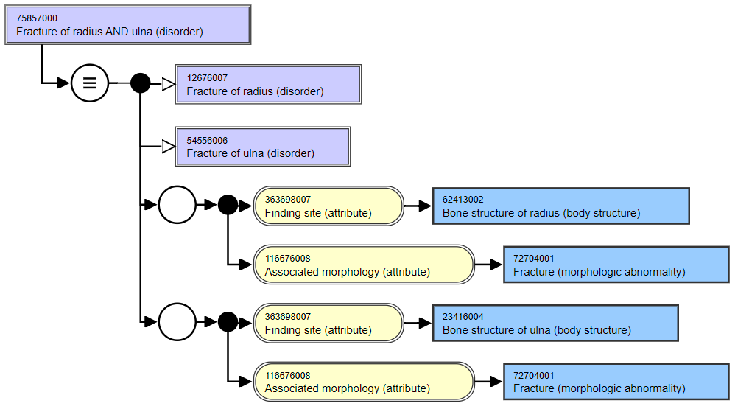
Role groups in Snomed CT (2): consequence by design
Inferred
10

Slide 11
The Basic Formal Ontology (BFO)
Ontological realism
Building blocks: universals and particulars
Universal top ontology
ISO-standard ISO/IEC 21838-2:2021
Fully axiomatized in First Order Logic
11

Slide 12
The many faces of ‘BFO’
BFO text definitions:
Object is a Material Entity =Def.
for all x, t, if x is an instance of Object at t then x is an instance of Material Entity at t
BFO2020 axiomatization:
(not (exists (x) (and (universal x) (particular x))))
(forall (i u t) (if (instance-of i u t)
(and (particular i) (universal u) (instance-of t temporal-region t)))
(universal object)
(forall (t x) (if (instance-of x object t) (instance-of x material-entity t)))
BFO-OWL:
<owl:Class rdf:about="http://purl.obolibrary.org/obo/BFO_0000030">
<rdfs:label xml:lang="en">object</rdfs:label>
<rdfs:subClassOf rdf:resource="http://purl.obolibrary.org/obo/BFO_0000040"/>
</owl:Class>
12
Fabian Neuhaus: BFO-FOL for Domain Ontologies. https://ncorwiki.buffalo.edu/index.php/Basic_Formal_Ontology_Summit_Meeting/abstracts

Slide 13
The Ontology of General Medical Science (OGMS)
BFO as top ontology
Key distinctions:
disorder
disease
disease course
diagnosis
pathological process
bodily feature
…
Axiomatization in progress
13
Scheuermann R, Ceusters W, Smith B. Toward an Ontological Treatment of Disease and Diagnosis.
2009 AMIA Summit on Translational Bioinformatics, San Francisco, California, March 15-17, 2009;: 116-120. Omnipress ISBN:0-9647743-7-2 (paper).

Slide 14
Core OGMS definitions
Etiological Process | A process in an organism that leads to a subsequent disorder.
Disorder | A causally relatively isolated combination of physical components that is (a) clinically abnormal and (b) maximal, in the sense that it is not a part of some larger such combination.
Pathological Process | A bodily process that is a manifestation of a disorder.
Disease | A disposition to undergo pathological processes that exists in an organism because of one or more disorders in that organism.
Disease Course | The totality of all processes through which a given disease instance is realized.
Diagnosis | A conclusion of an interpretive process that has as input a clinical picture of a given patient and as output an assertion to the effect that the patient has a disease of such and such a type.
14
Scheuermann R, Ceusters W, Smith B. Toward an Ontological Treatment of Disease and Diagnosis.
2009 AMIA Summit on Translational Bioinformatics, San Francisco, California, March 15-17, 2009;: 116-120. Omnipress ISBN:0-9647743-7-2 (paper).

Slide 15
Motivation for Snomed CT ‘+’ BFO/OGMS: terminological richness + ontological rigor
Hierarchy | Active Concepts | Distribution | Descriptions | Relationships
Body structure (body structure) | 41,169 | 11.37% | 150,599 | 114,046
Clinical finding (finding) | 119,550 | 33.01% | 543,694 | 1,555,277
Environment or geographical location (environment / location) | 1,863 | 0.51% | 5,140 | 2,207
Event (event) | 3,236 | 0.89% | 26,869 | 9,727
Observable entity (observable entity) | 10,581 | 2.92% | 35,488 | 29,255
Organism (organism) | 33,302 | 9.19% | 128,492 | 54,201
Pharmaceutical / biologic product (product) | 25,284 | 6.98% | 175,673 | 290,848
Physical force (physical force) | 171 | 0.05% | 493 | 198
Physical object (physical object) | 13,794 | 3.81% | 41,145 | 36,231
Procedure (procedure) | 59,112 | 16.32% | 269,381 | 969,147
Qualifier value (qualifier value) | 11,094 | 3.06% | 40,296 | 18,981
Record artifact (record artifact) | 443 | 0.12% | 1,769 | 607
SNOMED CT Model Component (metadata) | 1,870 | 0.52% | 4,697 | 2,702
Situation with explicit context (situation) | 4,959 | 1.37% | 39,514 | 81,464
Social context (social concept) | 4,430 | 1.22% | 21,883 | 7,027
Special concept (special concept) | 636 | 0.18% | 5,876 | 6,749
Specimen (specimen) | 1,772 | 0.49% | 5,346 | 12,964
Staging and scales (staging scale) | 1,578 | 0.44% | 5,781 | 2,514
Substance (substance) | 27,364 | 7.55% | 99,173 | 78,637
Total | 362,209 | 100.00% | 1,602,433 | 3,272,790
15
https://browser.ihtsdotools.org/qa/#/SNOMEDCT/general-release-statistics (release 2023/06/30)

Slide 16
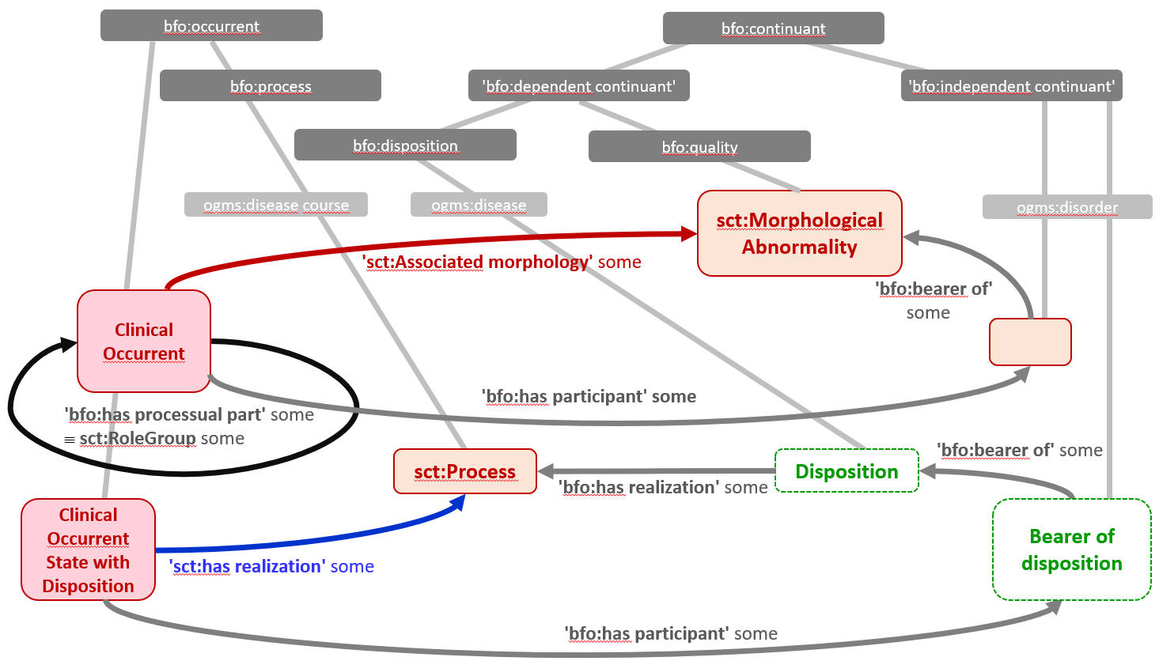
Third party attempts to map SNOMED CT to BFO/OGMS
‘Not possible!’: Hogan W. Aligning the top-level of SNOMED-CT with Basic Formal Ontology. Nature Preceedings. 2008. doi: 10.1038/npre.2008.2373.1.
‘sct:Cholangiocarcinoma of biliary tract’ equivalentTo ‘sct:clinical occurrent’ and
bfo:has-occurrent-part some ((‘sct:Finding site’ some ‘sct:Biliary tract structure’) and (‘sct:Associated morphology’ some sct:Cholangiocarcinoma))
El-Sappagh, S., Franda, F., Ali, F. et al. SNOMED CT standard ontology based on the ontology for general medical science. BMC Med Inform Decis Mak 18, 76 (2018). https://doi.org/10.1186/s12911-018-0651-5
Schulz S. SNOMED CT x BFO: can the gap between legacy terminology and foundational ontology be bridged? ICBO/FOIS; September 16, 2021; Bolzano, Italy2021.
16

Slide 17
Our proposal: one logical model-theoretic framework
Domain of discourse contains three most elementary individuals:
Ontologically repeatable: universal (from BFO) class (from SNOMED CT)
Ontologically unique: particular (from BFO)
Basic assumption:
Although classes cannot directly be mapped to universals, their non-repeatable counterparts are reliably describable from both BFO’s and SNOMED CT’s perspective
This requires two separate ‘of-type’ relations:
For universals: (forall (i u t) (if (instance-of i u t)
(and (particular i) (universal u)
(instance-of t temporal-region t)))
For concepts: (forall (x y) (if (individual-of x y) (and (particular x) (class y)))
17

Slide 18
Snomed CT → BFO/OGMS translation example
(forall (x y z)
(if (and (individual-of x sct-disease)
(sct-finding-site x y)
(individual-of y sct-biliary-tract-structure)
(sct-associated-morphology x z)
(individual-of z sct-cholangiocarcinoma))
(exists (p t) (and (continuant-part-of p z t)
(located-in p y t)
(instance-of z ogms-disorder t)
(instance-of y ogms-bodily-component t)))))
}
pure Snomed CT talk
(except for ‘individual-of’)
}
pure BFO/OGMS talk
(or other RBOs)
18

Slide 19
Snomed CT → BFO/OGMS translation example: some specific challenges.
(forall (x y z) (if
(and (individual-of x sct-disease) (exists (p t) (and (continuant-part-of p z t)
(sct-finding-site x y) (located-in p y t)
(individual-of y sct-biliary-tract-structure) (instance-of z ogms-disorder t)
(sct-associated-morphology x z) (instance-of y ogms-bodily-component t)))))
(individual-of z sct-cholangiocarcinoma))
What would x be in the consequent ?
19

Slide 20
Snomed CT → BFO/OGMS translation example: some specific challenges.
(forall (x y z) (if
(and (individual-of x sct-disease) (exists (p t) (and (continuant-part-of p z t)
(sct-finding-site x y) (located-in p y t)
(individual-of y sct-biliary-tract-structure) (instance-of z ogms-disorder t)
(sct-associated-morphology x z) (instance-of y ogms-bodily-component t)))
(individual-of z sct-cholangiocarcinoma)) (iff (instance-of x ogms-disease t) (material-basis-of z x t))
(iff (instance-of x ogms-disease-course t) (exists (d)
(and (instance-of d ogms-disease t)
(realizes x d)
(material-basis-of z d t))))
(iff (instance-of x ogms-disorder t) (= x z) ))))
What would x be in the consequent ?
20

Slide 21
Snomed CT → BFO/OGMS translation example: some specific challenges.
(forall (x y z) (if
(and (individual-of x sct-disease) (exists (p t) (and (continuant-part-of p z t)
(sct-finding-site x y) (located-in p y t)
(individual-of y sct-biliary-tract-structure) (instance-of z ogms-disorder t)
(sct-associated-morphology x z) (instance-of y ogms-bodily-component t)))))
(individual-of z sct-cholangiocarcinoma))
What would x be in the consequent ?
Interpretation of ‘sct-finding-site’:
Completely inside y?
Broken through y’s outer boundary?
21

Slide 22
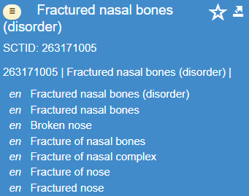
Snomed CT ‘disease (disorder)’→ BFO/OGMS translation: main challenges.
Only 2% of Snomed CT concepts have text definitions;
The fully specified name (FSN) of the majority of concepts lack face value in light of the (sub-)hierarchies they belong to;
For some concepts, some terms contradict
what the FSN denotes;
Inaccurate descriptions of associative relations:
Well-defined model in terms of own hierarchy
Lots of room for interpretation under BFO/OGMS
…
It is feasible, but how big a job?
Relatively straightforward for the antecedent part
Consequent part requires to find patterns!
22

Slide 23
1. Disease concepts without attributes
Roughly 10%.
Requires manual inspection (or simple NLP):
‘tumor of …’ → ogms-disorder
‘chronic …’ → ogms-disease-course, or
‘ogms-disease bfo:has-realization ogms:chronic-disease-course’
Schulz’s reinterpretation proposal won’t change much here:
Some might resolve to part of a disease course,
Some Snomed CT would consider ‘states’, but that is not (yet?) acceptable for BFO.
23

Slide 24
2. Finding site (83%)
bfo:material-entiy finding-site bfo:material-entiy → continuant-part-of
located-in
bfo:material-entiy finding-site bfo:site → located-in
Exceptions: concurrent use of associated-morphology with certain ranges!
24

Slide 25
3. Finding sites for ‘what is not there’ (1)
EquivalentClasses(
:1258935001 |Congenital complete absence of left upper limb (disorder)|
ObjectIntersectionOf(
:64572001 |Disease (disorder)|
ObjectSomeValuesFrom(
:609096000 |Role group (attribute)|
ObjectIntersectionOf(
ObjectSomeValuesFrom(:116676008 |Associated morphology (attribute)|
:782173000 |Agenesis (morphologic abnormality)|)
ObjectSomeValuesFrom(:246454002 |Occurrence (attribute)|
:255399007 |Congenital (qualifier value)|)
ObjectSomeValuesFrom(:363698007 |Finding site (attribute)|
:362729008 |Entire left upper extremity (body structure)|)
ObjectSomeValuesFrom(:370135005 |Pathological process (attribute)|
:308490002 |Pathological developmental process (qualifier value)|)
))))
25

Slide 26
3. Finding sites for ‘what is not there’ (2)
(forall (x y z)
(if (and (individual-of x sct-disease)
(sct-finding-site x y)
(individual-of y sct-entire-left-upper-extremity)
(sct-associated-morphology x z)
(individual-of z sct-agenesis))
(forall (p t)
(if (is-about x p)
(not (proper-continuant-part-of y p t))))
Works only for body part types of which an organism has only one instance.
26

Slide 27
4. Finding site for processes
Bfo:process finding-site bfo:site OR bfo:material-entity → occurs-in
has-participant
Which one of the two depends on the type of process.
27

Slide 28
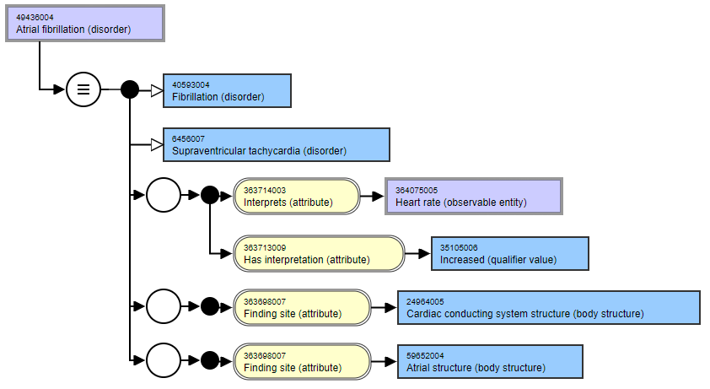
5. Multiple finding sites: requires caution for mistakes in Snomed CT
?
28

Slide 29
5. Multiple finding sites: requires caution for mistakes in Snomed CT (2)
(forall (x y z)
(if (and (individual-of x sct-fibrillation)
(sct-finding-site x y)
(individual-of y sct-atrial-structure)
(sct-finding-site x z)
(individual-of z sct-cardiac-conducting-system-structure))
(exists (do di t1 t2)
(and (instance-of do ogms-disorder t1) (continuant-part-of do z t1)
(instance-of di ogms-disease t1) (material-basis-of do di t1)
(realizes x di)
(instance-of x ogms-pathological-process t2) (has-participant x y t2))))))
29

Slide 30
6. Pathological process
Used in the definition of 17,026 (21%) sct:disorders,
Range of 19 distinct sct:qualifier value of 6 sorts:
hypersensitivity including allergy,
maldevelopment,
malignant proliferation of a primary neoplasm,
inflammation,
Infection,
parasitic growth.
Only one relatively solid pattern found thus far (next slide).
30

Slide 31
7. Pathological process (attribute) with range infectious process (qualifier value)
A sct:disease (disorder) may be represented as ogms:disease course IF:
there is only one role group AND
the disorder has sct:pathological process sct-infectious process AND
the disorder has sct:causative agent with range any subtype of virus or bacterium AND
There is NO sct:finding site in the SNOMED CT definition.
When there is at least one finding site → disease, disease course or pathological process.
31

Slide 32
Conclusion
Feasible but major effort;
Best approached for specific applications, one step at a time’
ICBO2023: family history of cholangiocarcinoma;
Barriers:
Shaky ontological basis of Snomed CT,
Majority of Snomed CT terms are polysemous from an OGMS perspective.
Indecisiveness of Snomed authors on major changes.
32

