Slide 1
Ontological Foundations for Tracking Data Quality through the Internet of Things.
EFMI STC2016: Transforming Healthcare with the Internet of Things
Paris, France, April 17-19, 2016
Werner CEUSTERS^{a,b,c,d}, MD and Jonathan P BONA^{c}, PhD
Ontology Research Group, Center of Excellence in Bioinformatics and Life Sciencesª;
UB Institute for Healthcare Informatics^{b},
Departments of Biomedical Informatics^{c} and Psychiatry^{d},
University at Buffalo, NY, USA

Slide 2
Ontological Foundations for Tracking Data Quality through the Internet of Things.
EFMI STC2016: Transforming Healthcare with the Internet of Things
Paris, France, April 17-19, 2016
Werner CEUSTERS^{a,b,c,d}, MD and Jonathan P BONA^{c}, PhD
Ontology Research Group, Center of Excellence in Bioinformatics and Life Sciencesª;
UB Institute for Healthcare Informatics^{b},
Departments of Biomedical Informatics^{c} and Psychiatry^{d},
University at Buffalo, NY, USA

Slide 3

Ontological Foundations
‘Ontology’
As mass noun:
    the study of what entities exist and how they relate to each other;
As count noun:
    a representational artifact, comprising a taxonomy as proper part, whose representations are intended to designate some combination of universals, defined classes and certain relations between them.
MIT Press 2015

Slide 4


The theory: Ontological Realism
There is an external reality which is ‘objectively’ the way it is;
That reality is accessible to us;
We build in our brains cognitive representations of reality;
We communicate with others about what is there, and what we believe there is there.
Smith B, Kusnierczyk W, Schober D, Ceusters W. Towards a Reference Terminology for Ontology Research and Development in the Biomedical Domain. Proceedings of KR-MED 2006, Biomedical Ontology in Action, November 8, 2006, Baltimore MD, USA

Slide 5
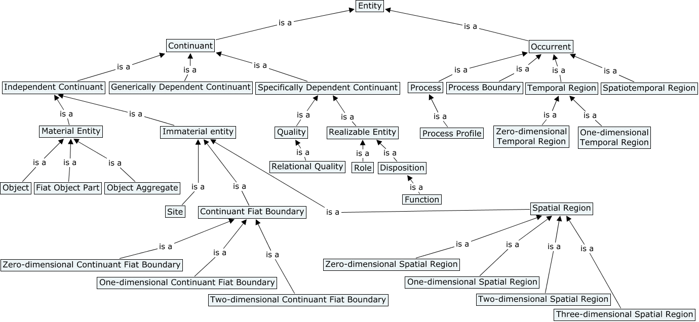
The representation: Basic Formal Ontology (BFO)

Slide 6
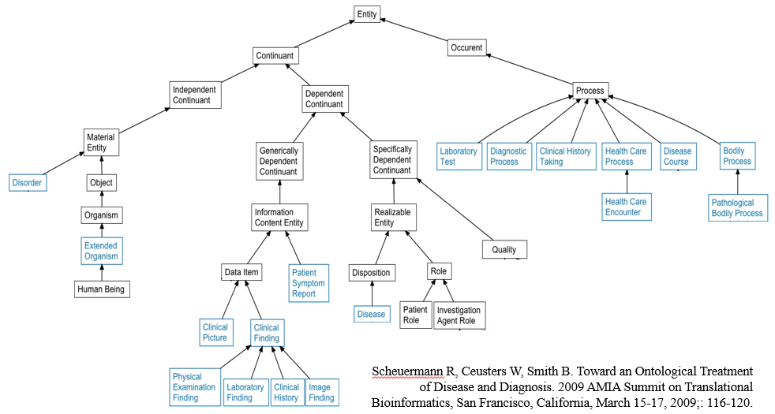
BFO as basis for other ontologies
BFO
OGMS

Slide 7
BFO and Ontology of Biomedical Investigations (OBI)
objective
specification
(ICE)
specimen
collection
objective
material
transformation
objective
data
transformation
objective
assay
objective
specimen
collecting
material
processing
data
processing
drawing a
conclusion
based on data
process
assay
material
entity
specimen
processed
specimen
data item
data item
information
content entity

Slide 8
Ontological Foundations for Tracking Data Quality through the Internet of Things.
EFMI STC2016: Transforming Healthcare with the Internet of Things
Paris, France, April 17-19, 2016
Werner CEUSTERS^{a,b,c,d}, MD and Jonathan P BONA^{c}, PhD
Ontology Research Group, Center of Excellence in Bioinformatics and Life Sciencesª;
UB Institute for Healthcare Informatics^{b},
Departments of Biomedical Informatics^{c} and Psychiatry^{d},
University at Buffalo, NY, USA

Slide 9
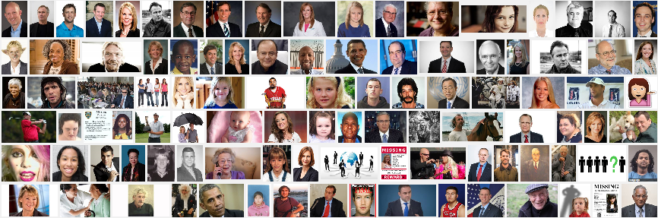
What is to be tracked are particulars
person
universals
instance of …
particulars

Slide 10
What is to be tracked are particulars
person
image
… very accurately!
universals
instance of …
particulars

Slide 11
Referent Tracking
The importance of time indexing
continuants
occurrents
dependent continuant
material
object
spacetime
region
spatial
region
temporal
region
history
t
t
instanceOf
t
participantOf at t
occupies
some temporal region
some quality
my life
my 4D STR
projectsOn
me
… at t
projectsOn at t
some spatial
region
located-in at t

Slide 12


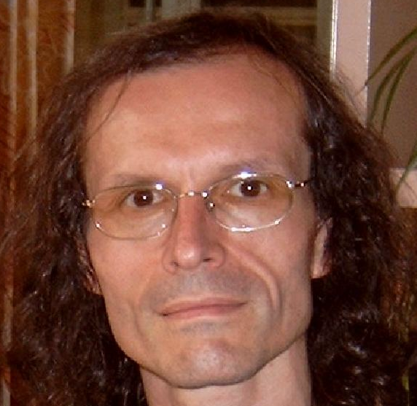

Continuants preserve identity while changing
human
being
me
me
t
Instance-of
in 1960
child
Instance-of
since 1980
adult
living
creature
animal
caterpillar
butterfly

Slide 13
Ambiguities: are assertions about particulars or types?
‘Persistent idiopathic facial pain (PIFP)’
  = ‘persistent facial pain with varying presentations …’
persistent
facial pain
presentation
type1
presentation
type2
presentation
type3
types
t₂
t₃
t₁
t₁
t₁
t₂
t₂
t₃
t₁
t₃
parti-
culars
t₁
t₂
t₂
t₁
t₃
t₂
t₃
t₃
my pain
her pain
his pain

Slide 14
Ambiguities: are assertions about particulars or types?
‘Persistent idiopathic facial pain (PIFP)’
  = ‘persistent facial pain with varying presentations …’
  if the description is about types, then the three particular pains fall under PIFP.
  if the description is about (arbitrary) particulars, then only her pain falls under PIFP.

Slide 15
Ontological Foundations for Tracking Data Quality through the Internet of Things.
EFMI STC2016: Transforming Healthcare with the Internet of Things
Paris, France, April 17-19, 2016
Werner CEUSTERS^{a,b,c,d}, MD and Jonathan P BONA^{c}, PhD
Ontology Research Group, Center of Excellence in Bioinformatics and Life Sciencesª;
UB Institute for Healthcare Informatics^{b},
Departments of Biomedical Informatics^{c} and Psychiatry^{d},
University at Buffalo, NY, USA

Slide 16
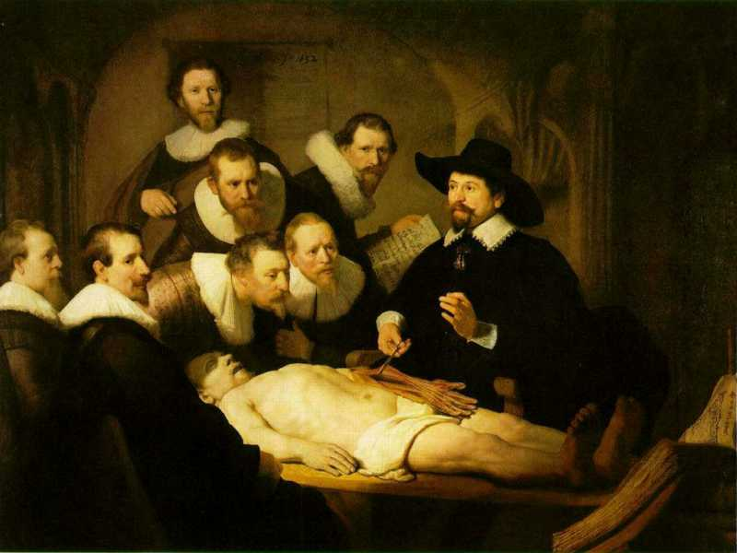
L3
Data about (L1⁻), (L2) or (L3)
L2
Beliefs about (1)
Representations
First Order Reality
Entities (particular or generic) with objective existence which are not about anything
L1⁻

Slide 17
Requirements for (health) data quality
Representational dimension: reality ←→ data
  accuracy precision consistency
  currency time-indexing granularity
  understandability comprehensiveness

Slide 18
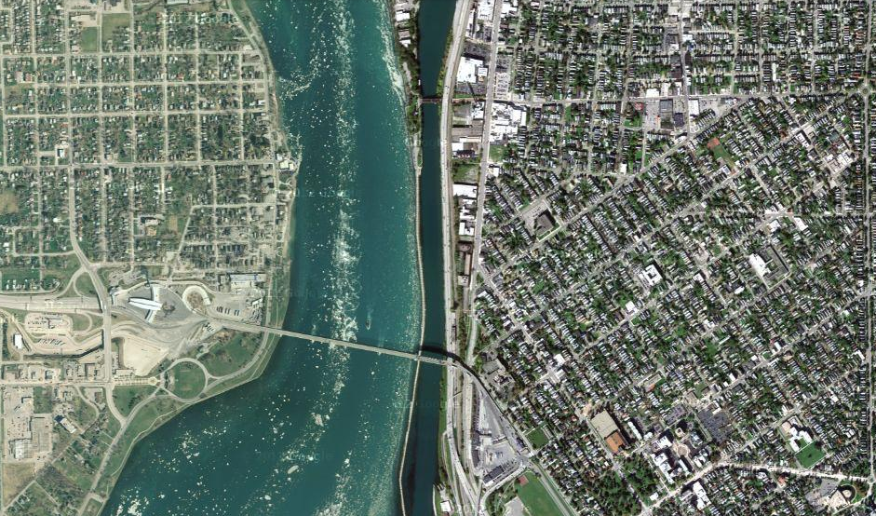
Reality (imagine)

Slide 19
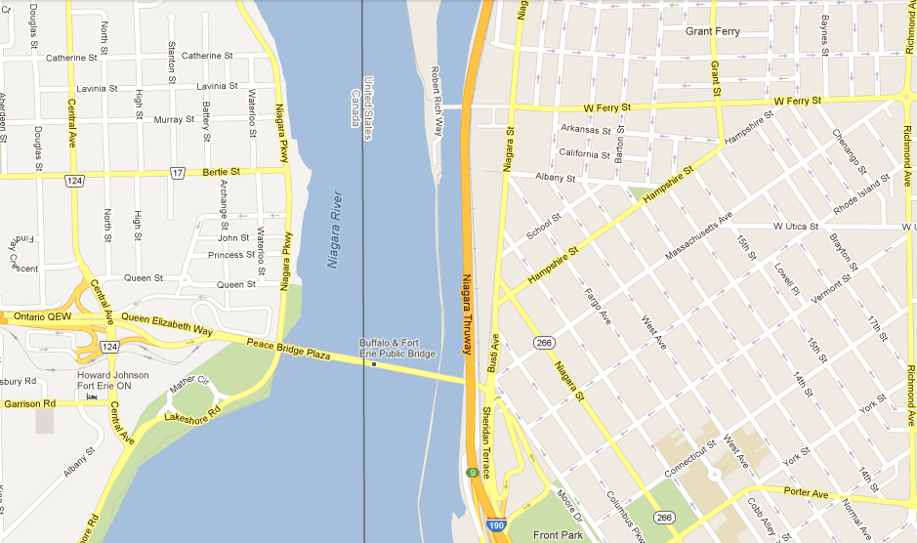
Map = data

Slide 20
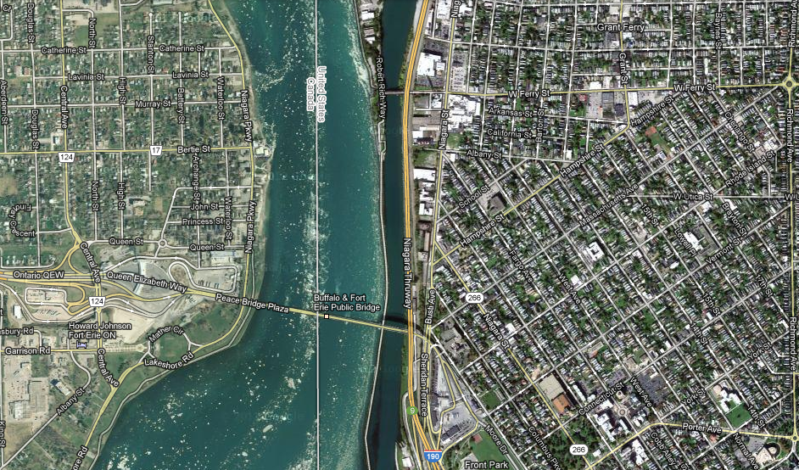
Map overlay

Slide 21
Requirements for (health) data quality
Representational dimension
  accuracy precision consistency
  currency time-indexing granularity
  understandability comprehensiveness
Functional dimension
  timeliness relevancy accessibility
  usability semantic interoperability
  reliability simplicity

Slide 22
Ontological Foundations for Tracking Data Quality through the Internet of Things.
EFMI STC2016: Transforming Healthcare with the Internet of Things
Paris, France, April 17-19, 2016
Werner CEUSTERS^{a,b,c,d}, MD and Jonathan P BONA^{c}, PhD
Ontology Research Group, Center of Excellence in Bioinformatics and Life Sciencesª;
UB Institute for Healthcare Informatics^{b},
Departments of Biomedical Informatics^{c} and Psychiatry^{d},
University at Buffalo, NY, USA

Slide 23


Internet of Things
a dynamic global network infrastructure with self-configuring capabilities where physical and virtual "things" have identities, physical attributes, virtual personalities and use intelligent interfaces, and are seamlessly integrated into the information network.
"things" are … active participants in … processes where they are enabled to interact and communicate among themselves and with the environment by exchanging data and information "sensed" about the environment, while reacting autonomously to the "real/physical world" events and influencing it by running processes that trigger actions and create services with or without direct human intervention.
http://cordis.europa.eu/fp7/ict/enet/rfid-iot_en.html

Slide 24


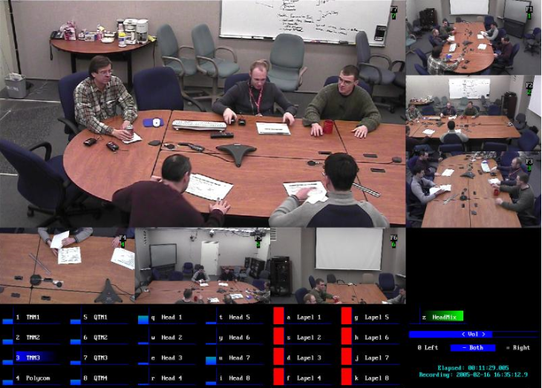
NIST: Smart Spaces Project
http://www.nist.gov/smartspace/index.html

Slide 25

IoT for Health

Slide 26
Internet of Things:
Similar perspective as Ontological Realism
a dynamic global network infrastructure with self-configuring capabilities where physical and virtual "things" have identities, physical attributes, virtual personalities and use intelligent interfaces, and are seamlessly integrated into the information network.
"things" are … active participants in … processes where they are enabled to interact and communicate among themselves and with the environment by exchanging data and information "sensed" about the environment, while reacting autonomously to the "real/physical world" events and influencing it by running processes that trigger actions and create services with or without direct human intervention.
http://cordis.europa.eu/fp7/ict/enet/rfid-iot_en.html

Slide 27
The basis of Ontological Realism
There is an external reality which is ‘objectively’ the way it is;
Smith B, Kusnierczyk W, Schober D, Ceusters W. Towards a Reference Terminology for Ontology Research and Development in the Biomedical Domain. Proceedings of KR-MED 2006, Biomedical Ontology in Action, November 8, 2006, Baltimore MD, USA

Slide 28
Internet of Things:
Similar perspective as Ontological Realism
a dynamic global network infrastructure with self-configuring capabilities where physical and virtual "things" have identities, physical attributes, virtual personalities and use intelligent interfaces, and are seamlessly integrated into the information network.
"things" are … active participants in … processes where they are enabled to interact and communicate among themselves and with the environment by exchanging data and information "sensed" about the environment, while reacting autonomously to the "real/physical world" events and influencing it by running processes that trigger actions and create services with or without direct human intervention.
http://cordis.europa.eu/fp7/ict/enet/rfid-iot_en.html

Slide 29
The basis of Ontological Realism
There is an external reality which is ‘objectively’ the way it is;
That reality is accessible to us, and by extension: sensors;
Smith B, Kusnierczyk W, Schober D, Ceusters W. Towards a Reference Terminology for Ontology Research and Development in the Biomedical Domain. Proceedings of KR-MED 2006, Biomedical Ontology in Action, November 8, 2006, Baltimore MD, USA

Slide 30
Internet of Things:
Similar perspective as Ontological Realism
a dynamic global network infrastructure with self-configuring capabilities where physical and virtual "things" have identities, physical attributes, virtual personalities and use intelligent interfaces, and are seamlessly integrated into the information network.
"things" are … active participants in … processes where they are enabled to interact and communicate among themselves and with the environment by exchanging data and information "sensed" about the environment, while reacting autonomously to the "real/physical world" events and influencing it by running processes that trigger actions and create services with or without direct human intervention.
http://cordis.europa.eu/fp7/ict/enet/rfid-iot_en.html

Slide 31
The basis of Ontological Realism
There is an external reality which is ‘objectively’ the way it is;
That reality is accessible to us, and by extension: sensors;
IoT agents build in their memories representations of reality;
Smith B, Kusnierczyk W, Schober D, Ceusters W. Towards a Reference Terminology for Ontology Research and Development in the Biomedical Domain. Proceedings of KR-MED 2006, Biomedical Ontology in Action, November 8, 2006, Baltimore MD, USA

Slide 32
Internet of Things:
Similar perspective as Ontological Realism
a dynamic global network infrastructure with self-configuring capabilities where physical and virtual "things" have identities, physical attributes, virtual personalities and use intelligent interfaces, and are seamlessly integrated into the information network.
"things" are … active participants in … processes where they are enabled to interact and communicate among themselves and with the environment by exchanging data and information "sensed" about the environment, while reacting autonomously to the "real/physical world" events and influencing it by running processes that trigger actions and create services with or without direct human intervention.
http://cordis.europa.eu/fp7/ict/enet/rfid-iot_en.html

Slide 33
The basis of Ontological Realism
There is an external reality which is ‘objectively’ the way it is;
That reality is accessible to us, and by extension: sensors;
IoT agents build in their memories representations of reality;
They communicate with others about what they sensed to be there.
Smith B, Kusnierczyk W, Schober D, Ceusters W. Towards a Reference Terminology for Ontology Research and Development in the Biomedical Domain. Proceedings of KR-MED 2006, Biomedical Ontology in Action, November 8, 2006, Baltimore MD, USA

Slide 34
Internet of Things:
Similar perspective as Referent Tracking
a dynamic global network infrastructure with self-configuring capabilities where physical and virtual "things" have identities, physical attributes, virtual personalities and use intelligent interfaces, and are seamlessly integrated into the information network.
"things" are … active participants in … processes where they are enabled to interact and communicate among themselves and with the environment by exchanging data and information "sensed" about the environment, while reacting autonomously to the "real/physical world" events and influencing it by running processes that trigger actions and create services with or without direct human intervention.
http://cordis.europa.eu/fp7/ict/enet/rfid-iot_en.html

Slide 35
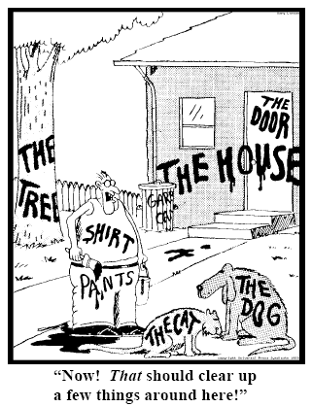
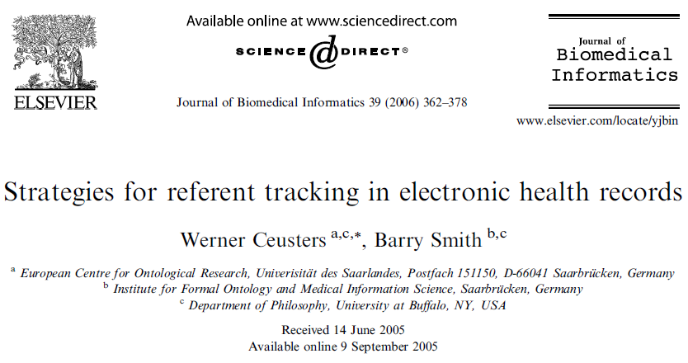
Denoting particulars
explicit reference to the individual entities relevant to the accurate description of some portion of reality
Ceusters W, Smith B. Strategies for Referent Tracking in Electronic Health Records. J Biomed Inform. 2006 Jun;39(3):362-78.

Slide 36
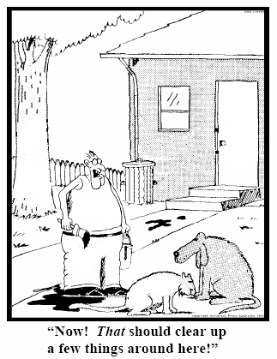
Method: IUI assignment
  Introduce an Instance Unique Identifier (IUI) for each relevant particular (individual) entity
78
235
5678
321
322
666
427
Ceusters W, Smith B. Strategies for Referent Tracking in Electronic Health Records. J Biomed Inform. 2006 Jun;39(3):362-78.

Slide 37
Internet of Things:
Similar perspective as Referent Tracking
a dynamic global network infrastructure with self-configuring capabilities where physical and virtual "things" have identities, physical attributes, virtual personalities and use intelligent interfaces, and are seamlessly integrated into the information network.
"things" are … active participants in … processes where they are enabled to interact and communicate among themselves and with the environment by exchanging data and information "sensed" about the environment, while reacting autonomously to the "real/physical world" events and influencing it by running processes that trigger actions and create services with or without direct human intervention.
http://cordis.europa.eu/fp7/ict/enet/rfid-iot_en.html

Slide 38
Referent Tracking System Components
Referent Tracking Software
    Manipulation of statements about facts and beliefs
Referent Tracking Datastore:
    IUI repository
    A collection of globally unique singular identifiers denoting particulars
    Referent Tracking Database
    A collection of facts and beliefs about the particulars denoted in the IUI repository
Manzoor S, Ceusters W, Rudnicki R. Implementation of a Referent Tracking System. International Journal of Healthcare Information Systems and Informatics 2007;2(4):41-58.

Slide 39
Simplified Referent Tracking syntax
From:
  ‘the nurse took the patient’s temperature’
To (very roughly):
  ‘#1 is agent of #2 in which participated #3 which inheres in #4’, where
    #1 instanceOf nurse since t1
    #2 instanceOf temperature assay
    #3 instanceOf temperature since t2
    #4 instanceOf patient since t3
    #1 agentOf #2 at t4
    #3 participantOf #2 at t4
    #3 inheresIn #4 since t2
    …
denotators for particulars

Slide 40
Simplified Referent Tracking syntax
From:
  ‘the nurse took the patient’s temperature’
To (very roughly):
  ‘#1 is agent of #2 in which participated #3 which inheres in #4’, where
    #1 instanceOf nurse since t1
    #2 instanceOf temperature assay
    #3 instanceOf temperature since t2
    #4 instanceOf patient since t3
    #1 agentOf #2 at t4
    #3 participantOf #2 at t4
    #3 inheresIn #4 since t2
    …
denotators for appropriate relations

Slide 41
Simplified Referent Tracking syntax
From:
  ‘the nurse took the patient’s temperature’
To (very roughly):
  ‘#1 is agent of #2 in which participated #3 which inheres in #4’, where
    #1 instanceOf nurse since t1
    #2 instanceOf temperature assay
    #3 instanceOf temperature since t2
    #4 instanceOf patient since t3
    #1 agentOf #2 at t4
    #3 participantOf #2 at t4
    #3 inheresIn #4 since t2
    …
denotators for universals or particulars

Slide 42
Simplified Referent Tracking syntax
From:
  ‘the nurse took the patient’s temperature’
To (very roughly):
  ‘#1 is agent of #2 in which participated #3 which inheres in #4’, where
    #1 instanceOf nurse since t1
    #2 instanceOf temperature assay
    #3 instanceOf temperature since t2
    #4 instanceOf patient since t3
    #1 agentOf #2 at t4
    #3 participantOf #2 at t4
    #3 inheresIn #4 since t2
    …
time index when continuants represented

Slide 43
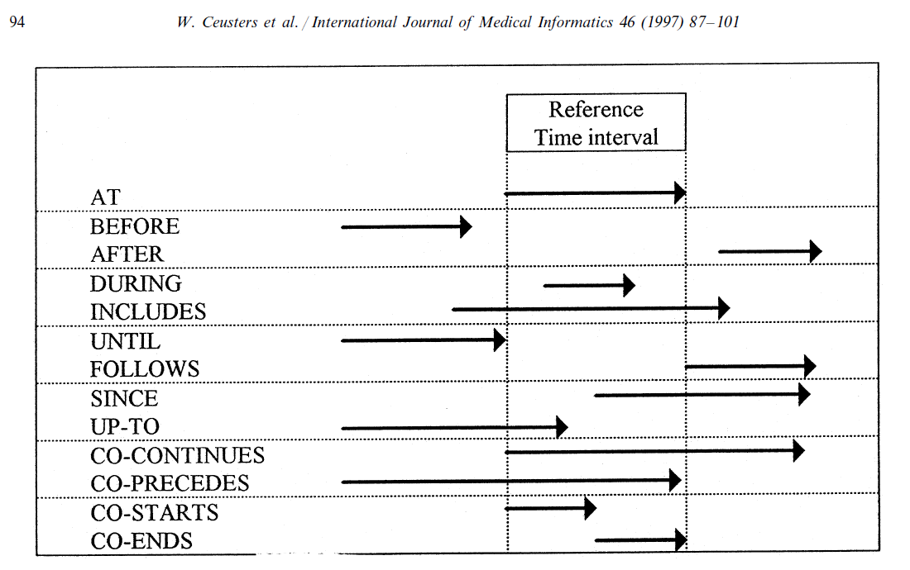
Representation of relation with time intervals

Slide 44
IoT for Health

Slide 45

IoT for Health

Slide 46

IoT for Health
http://www.telegraph.co.uk/news/weather/10206640/Eiffel-illuminations-French-landmark-struck-by-lightning-storm.html

Slide 47

IoT for Health

Slide 48
Two sides of a coin
Multitude of sensors can monitor individual particulars from distinct perspectives, resulting in:
  availability of distinct representations about the same particulars;
Multitude of distinct representations about the same particulars can be used as quality control for the sensor devices.
→ Use ontological realism and referent tracking for coherent and consistent representations
→ Use reasoners for quality control

Slide 49
Essential Universals and Defined Classes
Type | Definition (D) or Elucidation (E)
Assay U | (E) planned process to produce information about a material entity by physically examining it or its proxies [OBI]
Bodily feature DC | (D) bodily component, bodily quality, or bodily process. [OGMS]
Caregiver DC | (D) Human Being in which there inheres a Caregiver Role [RemAEO]
Device U | (E) Object which manifests causal unity via engineered assembly of components & of a type instances of which are maximal relative to this criterion of causal unity. [BFO]
Interpretive process U | (D) cognitive process (in brains or through software implementations) which brings into being, sustains or destroys cognitive representations on the basis of an observation [OMH]
IoT for Health DC | (D) Object aggregate which is part of the IoT and is composed out of Devices and other Objects that generate or analyze Observations within a community of Subjects of Care. [RemAEO]
Sensor Device DC | (D) Device in which inheres the Functions to perform Assays and to generate Observations
Site U | (E) 3-dimensional Immaterial Entity that is bounded by a material entity or is a 3-dimensional immaterial part thereof. [BFO]
Subject of care DC | (D) Human Being undergoing Acts of Care [RemAEO]
Observation DC | (D) Representation resulting from an assay [IAO]
Representation DC | (D) Quality which is_about or is intended to be about a Portion of Reality [IAO]

Slide 50
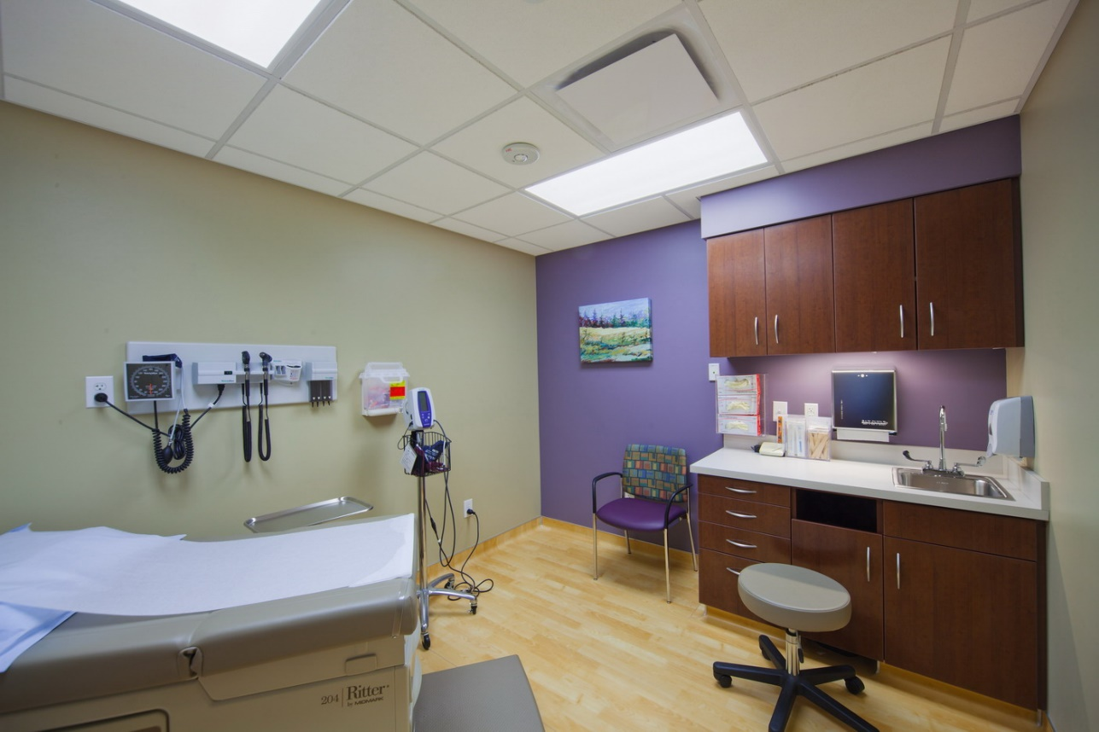
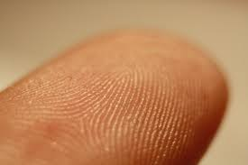
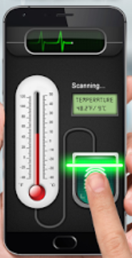


Example scenario: the players
site
Subject
of care
Bodily component
sensordevice
instanceOf at t_{x}
device
caregiver
#3
#11
#4
#9
#2
#1
#6

Slide 51
Example scenario: the temperature assay
assay
instanceOf
#7
#9
#6
#1

Slide 52
Further assertions
#100: #101: #102: #103: #104: #105: #106: #107: #108: #109: #110: #111: #112: #113: #114: #115: #116: #117: #118: | #1 instanceOf Human Being since t1 #1 instanceOf SubjectOfCare since t2 #2 instanceOf Device includes t2 #2 locatedOn #1 since t2 #4 instanceOf Sensor Device includes t #4 locatedIn #3 includes t #3 instanceOf Site includes t #4 partOf #5 includes t #5 instanceOf IoT For Health includes t #2 locatedIn #3 since t3 #4 authorOf #109 at t3 #6 instanceOf Caregiver includes t #7 instanceOf Assay #1 specifiedInputOf #7 during t4 #6 participantOf #7 during t4 #9 participantOf #7 during t4 #9 instanceOf Sensor Device includes t4 #9 locatedIn #3 at t6 #9 partOf #5 since t5

Slide 53
Discussion and conclusion
Related research:
A lot of reported research on privacy and security re IoT for Health, but not on data quality or anomaly detection
Use of ontology for IoT for Health is reported on, but again mainly for security
Ontology for biomedical informatics in general is very popular, but data quality
Limitations for the applicability of our approach:
Required BFO compatible ontologies are available, but refinement is needed
High threshold for becoming proficient in OR and RT
Limitations of the (too) popular OWL
Need for higher order reasoners.

