Slide 1
October 24, 2022 - Ontology Day
Mutualistic integration of
Referent Tracking and
BFO2020-style FOL axiomatization
Werner CEUSTERS^{1,2}
¹ Department of Biomedical Informatics, University at Buffalo, USA
² Department of Psychiatry, University at Buffalo, USA

Slide 2
1. Basics of Referent Tracking (RT)
2. RT and BFO2020 axiomatization

Slide 3
What is ‘referent tracking’?
In general:
  ‘referent’:
    an entity denoted by some reference in a representation;
  ‘reference’:
    a representation that denotes some entity;
  ‘referent tracking’:
    keeping track of how entities stand in relation to each other by keeping track of how their references are used in representations.

Slide 4
RT issues in language
Various forms with non-standard definitions:
  Reference resolution
  Co-reference resolution
  Anaphora resolution
Examples:
  ‘I bought two fish, removed their scales, and ate them’.
  ‘Jane was in the library. When Suzy came in, she laughed.’
  ‘Margaret saw the diamond sparkling in the sun and adored its beauty’.
  → What was eaten? Who laughed? The beauty of what was adored?

Slide 5
RT issues in EHRs: the ‘problem list’
PtID
Date
ObsCode
Narrative
5572
04/07/1990
26442006
closed fracture of shaft of femur
5572
04/07/1990
81134009
Fracture, closed, spiral
5572
12/07/1990
26442006
closed fracture of shaft of femur
5572
12/07/1990
9001224
Accident in public building (supermarket)
5572
04/07/1990
79001
Essential hypertension
0939
24/12/1991
255174002
benign polyp of biliary tract
2309
21/03/1992
26442006
closed fracture of shaft of femur
2309
21/03/1992
9001224
Accident in public building (supermarket)
47804
03/04/1993
58298795
Other lesion on other specified region
5572
17/05/1993
79001
Essential hypertension
298
22/08/1993
2909872
Closed fracture of radial head
298
22/08/1993
9001224
Accident in public building (supermarket)
5572
01/04/1997
26442006
closed fracture of shaft of femur
5572
01/04/1997
79001
Essential hypertension
0939
20/12/1998
255087006
malignant polyp of biliary tract

Slide 6
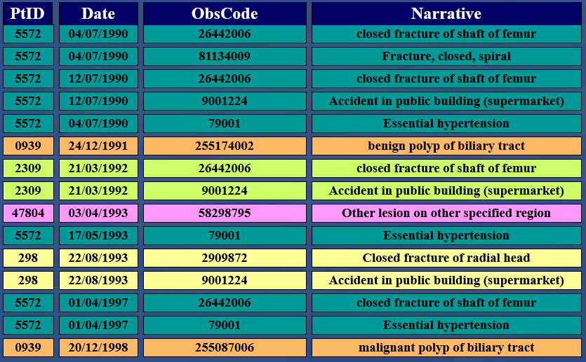
Predicate logic analogue
has-disorder(john, fracture, date1)
or?
has-diagnosis(john, fracture, date1)
To what entity precisely is ‘fracture’ ascribed?

Slide 7
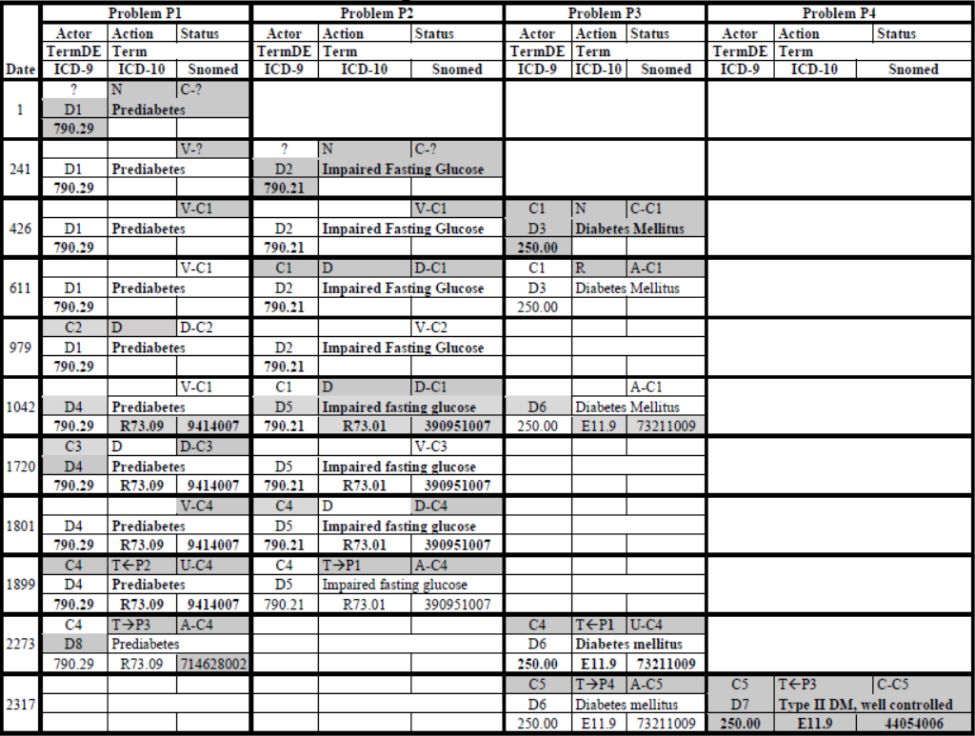

Slide 8
Common practice: types as proxies for particulars (1)
What might be the case
What you see in the record
benign
tumor
malignant
tumor
stomach
t1 t2
instanceOf at t₂
instanceOf at t₁
instanceOf at t₂
instanceOf at t₁
continuant-part-of at t₁
this-4
this-1’s stomach
continuant-part-of at t₂

Slide 9
Common practice: types as proxies for particulars (2)
What might also be the case
What you see in the record
benign
tumor
malignant
tumor
stomach
t1 t2
instanceOf at t₂
instanceOf at t₁
instanceOf at t₂
instanceOf at t₁
this-4
continuant-part-of at t₁
this-1’s stomach
this-5
continuant-part-of at t₂

Slide 10
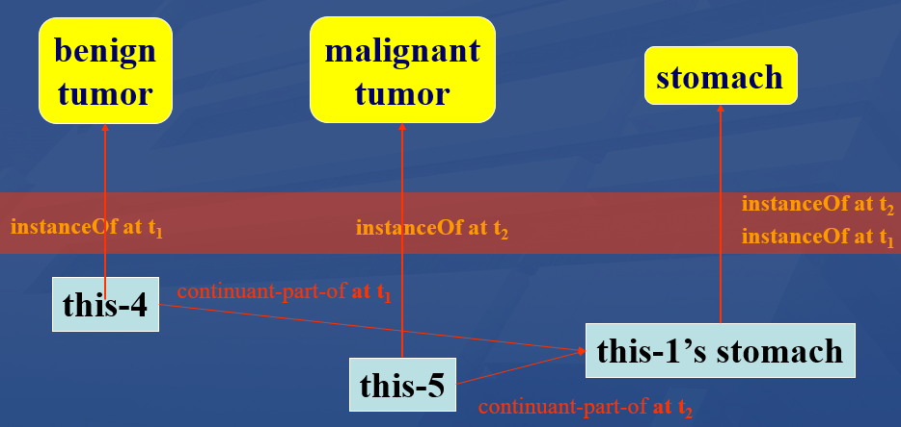
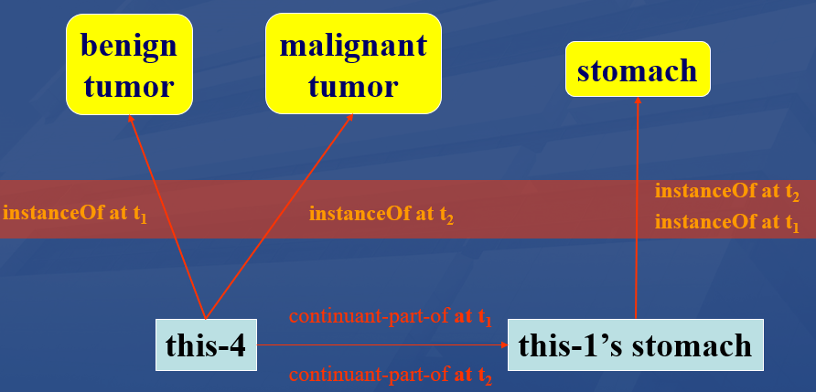
Types as proxies for particulars: a very bad practice !!!
References on the basis of types only cannot always differentiate between distinct configurations of the intended referents!
Two tumors
One tumor

Slide 11
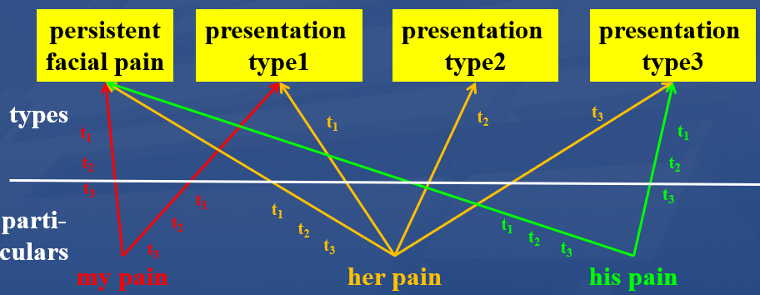
Not only medical records but also many biomedical terminologies suffer from an unwarranted focus on types
‘Persistent idiopathic facial pain (PIFP)’
  = ‘persistent facial pain with varying presentations …’
Which of the three instances of pain qualify for PIFP?
Depends on the definition’s interpretation: about types or about particulars?

Slide 12
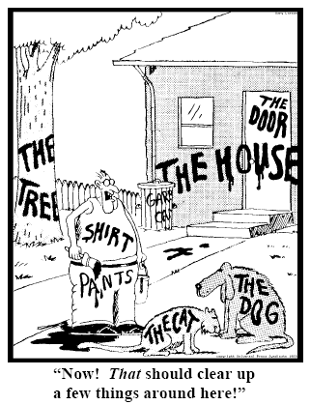
Essence of Referent Tracking
explicit reference to the individual entities
relevant to the accurate description of some
portion of reality, ...
Ceusters W, Smith B. Strategies for Referent Tracking in Electronic Health Records. J Biomed Inform. 2006 Jun;39(3):362-78.

Slide 13
IUI = Instance Unique Identifier
There is for any particular only one identifier within all systems in which the entity is represented
Globally and Singularly Unique Identifier for a Particular
there is for any particular only one identifier within a given representation system
Basic rule for RT-based information systems:
accept only assertions about explicitly identified particulars!

Slide 14
Predicate logic analogue for RT
part-of(this-4, this-1, date1)
part-of(this-5, this-1, date2)
instance-of(this-4, benign-tumor, date-1)
instance-of(this-5, malignant-tumor, date-2)
part-of(this-4, this-1, date1)
instance-of(this-4, benign-tumor, date-1)
instance-of(this-4, malignant-tumor, date-2)

Slide 15
Essentials of Referent Tracking
Deciding what particulars should receive a universally unique identifier (IUI);
Finding out whether or not a particular has already been assigned an IUI (each particular should receive maximally one IUI);
Generating an IUI;
Using IUIs in information systems, i.e. issues concerning the syntax and semantics of statements containing IUIs;
Determining the truth values of statements in which IUIs are used;
Correcting errors in the assignment of IUIs and in other assertions in tuples.

Slide 16
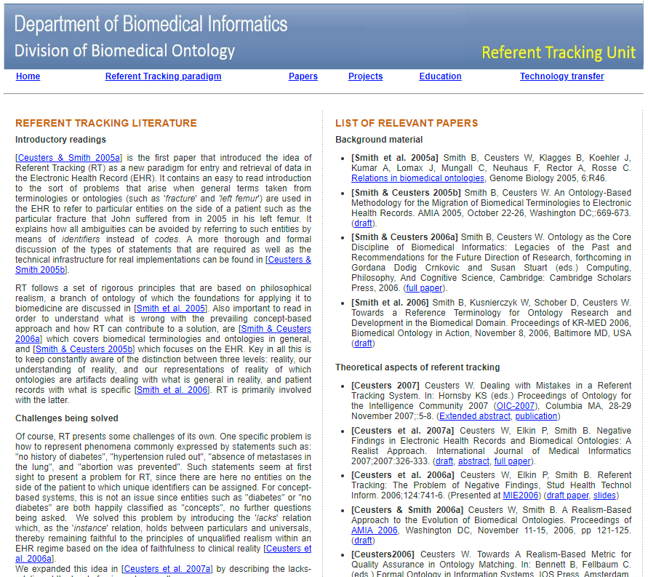

http://www.referent-tracking.com/RTU/papers.html

Slide 17
Reasoning support with mutual benefits
(just one example of each)
Axioms help identify errors in (combinations of) assertions.
Assertions help identify poorly informative axioms in ontologies.

Slide 18
Examples of Referent Tracking assertions
  #1 participantOf #2 at t1
  #2 instanceOf DiagnosticProcess
  #1 participantOf #3 at t2
  #3 instanceOf History
  #1 participantOf #4 at t3
  #4 instanceOf SurgicalProcedure
  #4 precededBy #2
Note: RT tuples in this and next slide follow the BFO 2.0 conventions, NOT BFO2020!

Slide 19
Capacities for reasoners
Axioms → benefit for RT
  #1 participantOf #2 at t1
  #2 instanceOf DiagnosticProcess
  #1 participantOf #3 at t2
  #3 instanceOf History
  #1 participantOf #4 at t3
  #4 instanceOf SurgicalProcedure
  #4 precededBy #2
  #4 occurrentPartOf #3
  t3 temporalPartOf t2

Slide 20
BFO2020 axiomatization
Example (in CLIF):
(cl:comment "Definition of specifically dependent continuant. [akq-1]"
(forall (s)
(iff (exists (t)
(instance-of s specifically-dependent-continuant t))
(exists (c t)
(and (instance-of s continuant t)
(instance-of c independent-continuant t)
(not (instance-of c spatial-region t))
(specifically-depends-on s c))))))

Slide 21
Parser: converts FOL → CNF → Kowalski-rules
% Definition of specifically dependent continuant. [akq-1]
r(469,1,[138],[],"akq-1",kow(if([[instance-of,B,specifically-dependent-continuant,A]]),then([instance-of,B,continuant,[e,138,[B]]]))).
r(470,1,[137,138],[],"akq-1",kow(if([[instance-of,B,specifically-dependent-continuant,A]]),then([instance-of,[e,137,[B]],independent-continuant,[e,138,[B]]]))).
r(471,2,[],[137,138],"akq-1",kow(if([[instance-of,B,specifically-dependent-continuant,A],[instance-of,[e,137,[B]],spatial-region,[e,138,[B]]]]),false)).
r(472,1,[137],[],"akq-1",kow(if([[instance-of,B,specifically-dependent-continuant,A]]),then([specifically-depends-on,B,[e,137,[B]]]))).
r(473,3,[139],[],"akq-1",kow(if([[instance-of,A,independent-continuant,B],[instance-of,C,continuant,B],[specifically-depends-on,C,A]]),then_or([[instance-of,A,spatial-region,B],[instance-of,C,specifically-dependent-continuant,[e,139,[C]]]]))).

Slide 22
Reasoner input
Kowalski-rule base from axiomatized ontologies,
Assertions in referent tracking style:
  Example:
    t([true,instance-of, john, object, t]).
    t([true,proper-continuant-part-of, tumor-of-john, john, t1]).
    t([true,instance-of, tumor-of-john, benign-tumor, t1]).
    t([true,instance-of, tumor-of-john, cancer, t2]).

Slide 23
Reasoner at work …
BFO2020 Style CLIF reasoner, Version Oct22, 2022
Copyright: Werner Ceusters. All rights reserved.
PRE-PROCESSING
Checking start conditions ...OK!
Optimizing Kowalski input ...
Reading data input ...
Total facts: 4
REASONING
modus ponendo ponens ...
Total facts: 316
modus ponendo tollens ...
% 1,240,643 inferences, 0.188 CPU in 0.183 seconds (102% CPU, 6616763 Lips)
Listing remaining alternatives ...
modus tollendo ponens ...

Slide 24
… oh bugger
BFO2020 Style CLIF reasoner, Version Oct22, 2022
Copyright: Werner Ceusters. All rights reserved.
PRE-PROCESSING
Checking start conditions ...OK!
Optimizing Kowalski input ...
Reading data input ...
Total facts: 4
REASONING
modus ponendo ponens ...
Total facts: 316
modus ponendo tollens ...
% 1,240,643 inferences, 0.188 CPU in 0.183 seconds (102% CPU, 6616763 Lips)
Listing remaining alternatives ...
modus tollendo ponens ...
INCONSISTENCY FOUND: []
Rule: 128
Axiom: ilw-1
[]
Inconsistent facts: [[specifically-depends-on,tumor-of-john,[e,137,[tumor-of-john]]],[instance-of,tumor-of-john,independent-continuant,t1]]
Saving inconsistency proof to CLIFreasoner-inconsistency-proof.csv
Writing skolem constants to CLIFreasoner-skolems.txt
Press any character key to finish.

Slide 25
Inconsistency proof
FactID | T/F | predicate | Arg1 | Arg2 | Arg3 |  | Rule | Axiom | Mode | Triggers
400 | ERROR | inconsistency |  |  |  | ← | 128 | ilw-1 | inc | 92 | 192
192 | TRUE | specifically-depends-on | tumor-of-john | sk25 |  | ← | 472 | akq-1 | mpp | 176
176 | TRUE | instance-of | tumor-of-john | specifically-dependent-continuant | t2 | ← | 828 | qix-1 | mpp | 79
92 | TRUE | instance-of | tumor-of-john | independent-continuant | t1 | ← | 811 | faf-1 | mpp | 48
79 | TRUE | instance-of | tumor-of-john | realizable-entity | t2 | ← | 800 | fxd-1 | mpp | 60
60 | TRUE | instance-of | tumor-of-john | disposition | t2 | ← | 216 | ogms-dis-2 | mpp | 8
48 | TRUE | instance-of | tumor-of-john | material-entity | t1 | ← | 219 | ogms-diso-2 | mpp | 12
12 | TRUE | instance-of | tumor-of-john | disorder | t1 | ← | 218 | ogms-btu-2 | mpp | 3
8 | TRUE | instance-of | tumor-of-john | disease | t2 | ← | 217 | ogms-can-2 | mpp | 4
4 | TRUE | instance-of | tumor-of-john | cancer | t2 | ← | 0 | unmarked | input
3 | TRUE | instance-of | tumor-of-john | benign-tumor | t1 | ← | 0 | unmarked | input
(cl:comment "Any continuant that doesn't s-depend or g-depend on something is an independant continuant [ilw-1]"
(forall (c1)
(iff (exists (t) (instance-of c1 independent-continuant t))
(and (exists (t) (instance-of c1 continuant t))
(not (exists (c2 t) (or (specifically-depends-on c1 c2)
(generically-depends-on c1 c2 t))))))))

Slide 26
Relevant OGMS fragment
(cl:comment "diseases are dispositions [ogms-dis-2]"
(forall (t x)
(if (instance-of x disease t)
(instance-of x disposition t))))
(cl:comment "cancer is a disease [ogms-can-2]"
(forall (t x)
(if (instance-of x cancer t)
(instance-of x disease t))))
(cl:comment "benign tumors are disorders [ogms-btu-2]"
(forall (t x)
(if (instance-of x benign-tumor t)
(instance-of x disorder t))))
(cl:comment "disorders are material entities [ogms-diso-2]"
(forall (t x)
(if (instance-of x disorder t)
(instance-of x material-entity t))))
From BFO:
Dispositions, being SDCs, s-depend on something and therefor cannot be independent continuants, i.e. what material-entities are.

Slide 27
Identification of non-informative axioms
RT → benefit for axiomatization
sk54 [e,9,[[e,97,[room1,[e,90,[my-brain,room1,t2]],[e,91,[my-brain,room1,t2]]]]]]
sk53 [e,97,[room1,[e,90,[my-brain,room1,t2]],[e,91,[my-brain,room1,t2]]]]
sk52 [e,9,[[e,97,[room2,[e,87,[[e,90,[me,room2,t2]],[e,91,[me,room2,t2]]]],[e,91,[me,room2,t2]]]]]]
sk51 [e,97,[room2,[e,87,[[e,90,[me,room2,t2]],[e,91,[me,room2,t2]]]],[e,91,[me,room2,t2]]]]
sk50 [e,9,[[e,109,[[e,61,[[e,20,[me]]]],[e,62,[[e,20,[me]]]]]]]]
sk49 [e,109,[[e,61,[[e,20,[me]]]],[e,62,[[e,20,[me]]]]]]
sk48 [e,9,[[e,114,[[e,20,[me]],[e,100,[[e,20,[me]]]]]]]]
sk47 [e,114,[[e,20,[me]],[e,100,[[e,20,[me]]]]]]
sk46 [e,159,[[e,146,[t2]],[e,146,[t2]]]]
sk45 [e,159,[[e,10,[me]],[e,10,[me]]]]
sk44 [e,52,[[e,20,[me]],[e,20,[me]]]]
sk43 [e,53,[[e,45,[[e,20,[me]]]],[e,45,[[e,20,[me]]]]]]
sk42 [e,4,[room2,room2,t2]]
sk41 [e,4,[room1,room1,t2]]
sk40 [e,4,[my-brain,my-brain,[e,91,[me,room2,t2]]]]
sk39 [e,4,[my-brain,my-brain,t2]]
sk38 [e,9,[t2]]
sk37 [e,9,[[e,91,[me,room2,t2]]]]
sk36 [e,9,[[e,91,[my-brain,room1,t2]]]]
sk35 [e,9,[[e,146,[t2]]]]
sk34 [e,9,[[e,104,[t2]]]]
sk33 [e,9,[[e,26,[room2]]]]
sk32 [e,9,[[e,26,[room1]]]]
sk31 [e,9,[[e,10,[me]]]]
sk30 [e,9,[[e,154,[t2,[e,144,[t2]]]]]]
sk29 [e,9,[[e,111,[[e,90,[me,room2,t2]]]]]]
sk28 [e,9,[[e,46,[[e,20,[me]]]]]]
sk27 [e,9,[[e,62,[[e,20,[me]]]]]]
Generation of skolem constants from skolem functions:
Some are created in abundance, e.g. [e,9,… ]
Why?

Slide 28
There is always something that exists [nis-1]
(forall (t)
(if (instance-of t temporal-region t)
(exists (u i)
(and (not (= i t)) (universal u) (particular i) (instance-of i u t))))))
r(63,1,[8,9],[],"nis-1",kow(if([[instance-of,A,temporal-region,A]]),then([instance-of,[e,9,[A]],[e,8,[A]],A]))).
r(64,1,[9],[],"nis-1",kow(if([[instance-of,A,temporal-region,A]]),then([particular,[e,9,[A]]]))).
r(65,1,[8],[],"nis-1",kow(if([[instance-of,A,temporal-region,A]]),then([universal,[e,8,[A]]]))).
r(66,2,[],[9],"nis-1",kow(if([[identical,[e,9,[A]],A],[instance-of,A,temporal-region,A]]),false)).

