Slide 1
MEDICAL INFORMATICS EUROPE 2018
April 25, 2018, Gothenburg, Sweden.
On Defining Bruxism
Werner CEUSTERS^{1,2} and Barry SMITH^{1,3}
¹ Department of Biomedical Informatics, University at Buffalo, USA
² Department of Psychiatry, University at Buffalo, USA
³ Department of Philosophy, University at Buffalo.

Slide 2
Talk overview
Ontology 1.00000001;
Why bruxism experts clenched their teeth and damaged their ecological foot print;
How ontology 1.00000001 could have saved trees.

Slide 3
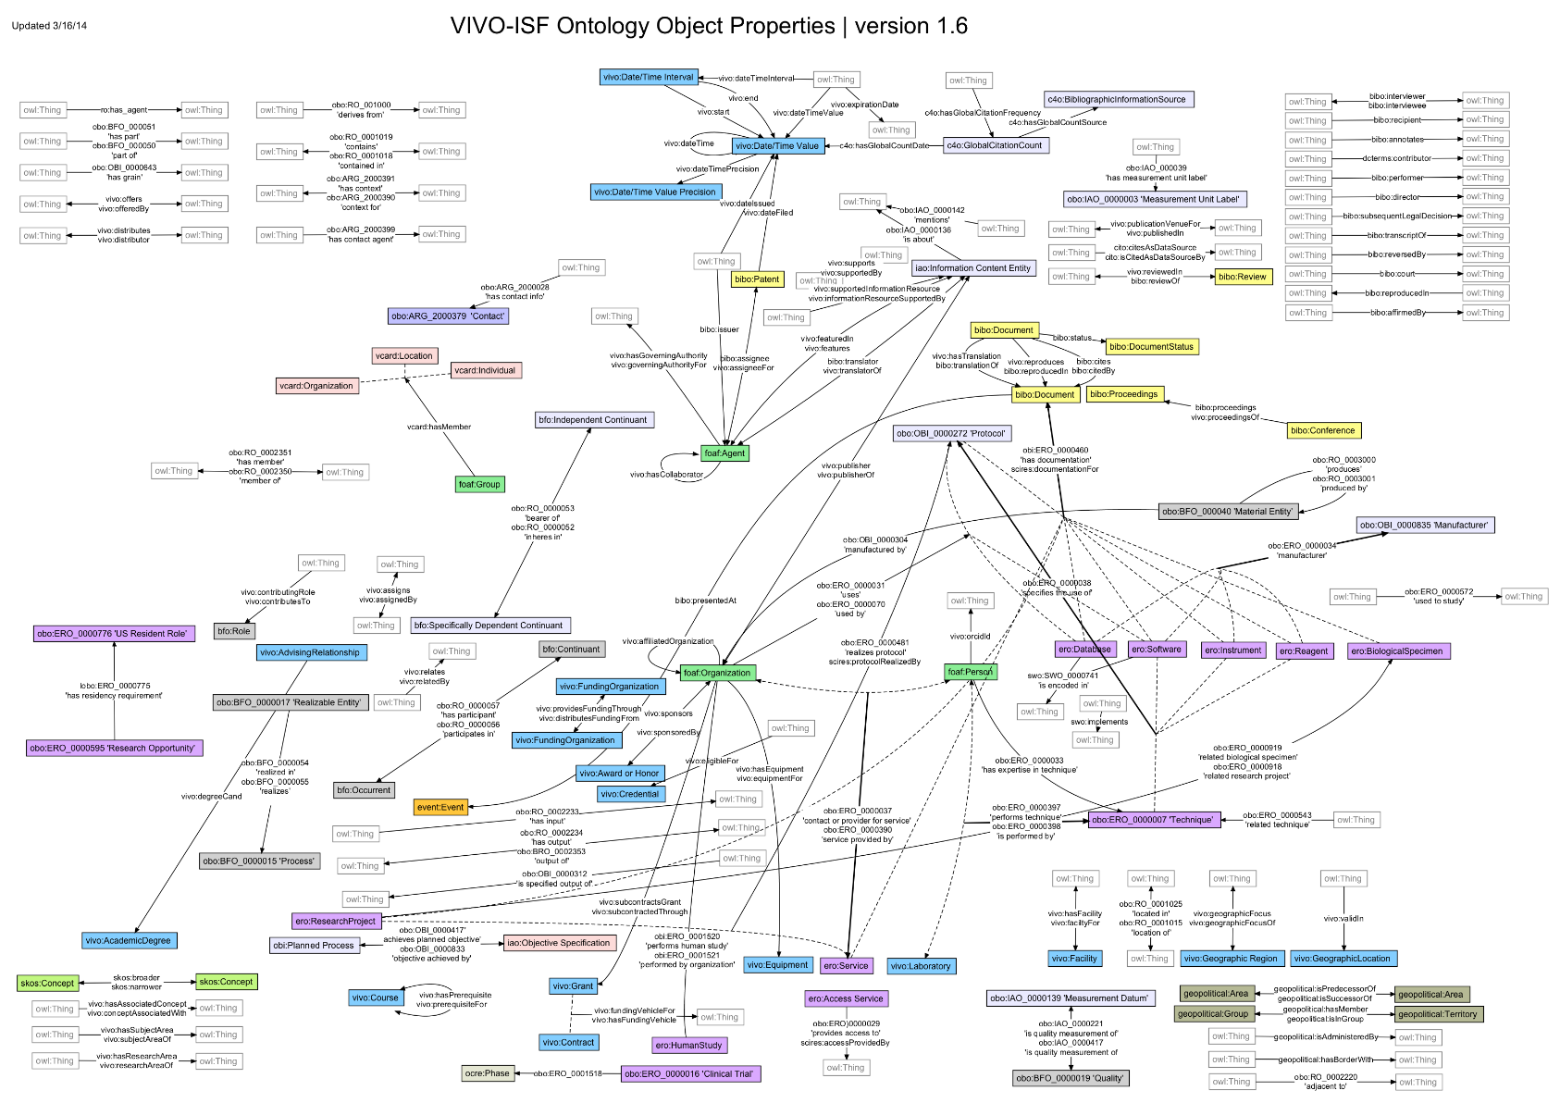
Ontology isn’t just about this …

Slide 4

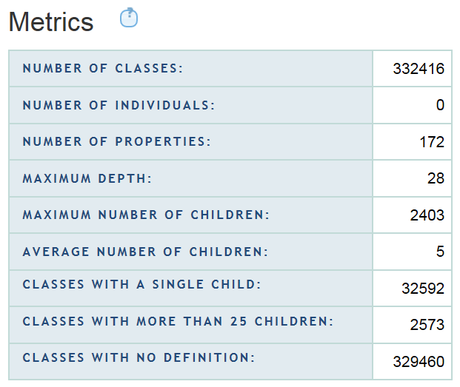
Nor is it size that matters…

Slide 5
Often, what matters is this distinction …
 | Continuant | Occurrent
Smith B, Ceusters W. Ontological Realism as a Methodology for Coordinated Evolution of Scientific Ontologies. Applied Ontology, 2010;5(3-4):139-188.

Slide 6
Often, what matters is this distinction …
 | Continuant | Occurrent
Entities that at any time they exist,
exist
in total
Entities that at any time they exist,
exist only
partially
Smith B, Ceusters W. Ontological Realism as a Methodology for Coordinated Evolution of Scientific Ontologies. Applied Ontology, 2010;5(3-4):139-188.

Slide 7
… and this distinction
Types
Particulars
counterparts in reality of (some of)
the general terms used in the formulation of scientific theories
concrete individual entities
(entities that exist in space and time and that exist only once)
Smith B, Ceusters W. Ontological Realism as a Methodology for Coordinated Evolution of Scientific Ontologies. Applied Ontology, 2010;5(3-4):139-188.

Slide 8
An ontological square
 | Continuant | Occurrent
Types | Tooth | Teeth grinding
Particulars | My left maxillary first molar | My teeth grinding

Slide 9
An ontological square
 | Continuant | Occurrent
Types | Tooth | Teeth grinding
Particulars | My left maxillary first molar | My teeth grinding
Instance
of at t
Instance
of

Slide 10
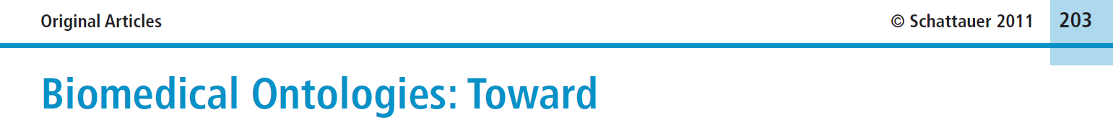


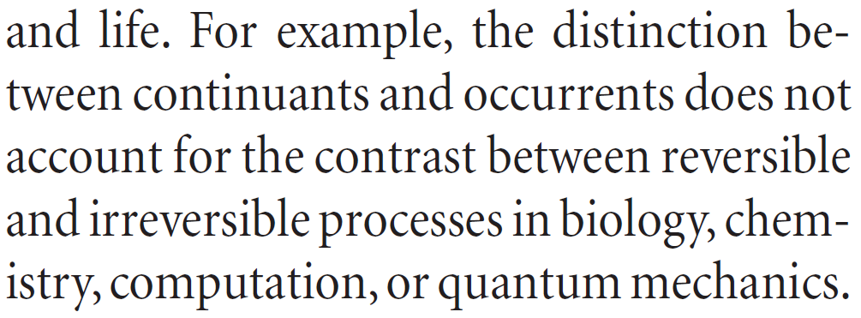
Simple, yet seemingly hard to grasp …
Methods Inf Med 2011; 50: 203-216
Page 205

Slide 11
How could the distinction account for it ?
Continuant | Occurrent
‘the distinction between
continuants and occurrents does not account for the contrast between reversible
and irreversible processes’
Irreversible Process
Reversible Process
Maojo V, Crespo J, Garcia-Remesal M, de la Iglesia D, Pérez-Rey D, Kulikowski C.
Biomedical Ontologies: Toward scientific debate.
Methods Inf Med 2011; 50 (3):203-216.

Slide 12
Be careful with naming occurrent particulars!
Occurrents
Which teeth grinding am I referring to?
Yesterdays?
This one?
Teeth grinding
Instance
of
My teeth grinding

Slide 13
Therefor: use instance unique identifiers (IUI)
Continuants
Occurrents
Tooth
Teeth grinding
Instance
of
at t1 & t2
Instance
of
My left maxillary first molar
#1
#2
at t1
at t2
Participant in

Slide 14
Be careful with naming continuant particulars!
Continuants
Occurrents
Piece of enamel
Tooth
Teeth grinding
Continuants can change whereas occurrents never change, because they are changes.
Instance
of
at t0
Instance
of
at t1 & t2
Instance
of
My left maxillary first molar
#1
#2
at t1
at t2
Participant in

Slide 15
Therefor: use instance unique identifiers (IUI)
Continuants
Occurrents
Human
being
Piece of enamel
Tooth
Teeth grinding
isa
left maxillary first molar
Instance
of
Instance of
at t0, t1, t2
Instance of
at t0
Instance of
at t1 & t2
#1
#2
Werner
Ceusters
at t1
at t2
#3
Part of at
t0, t1, t2
Participant in

Slide 16
Talk overview
Why bruxism experts clenched their teeth and damaged their ecological foot print;

Slide 17

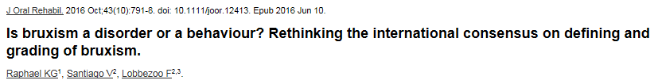
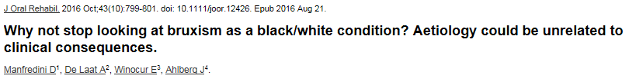
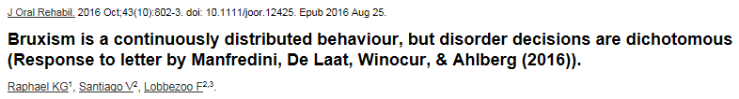
Bruxism experts clench their teeth

Slide 18
Who is fighting who? (alphabetically, first author)
 | P1 | P2 | P3 | P4
1 | Ahlberg J |  | Ahlberg J
2 |  |  | De Laat A
3 | De Leeuw R
4 | Glaros AG
5 | Kato T
6 | Koyano K
7 | Lavigne GJ
8 | Lobbezoo F | Lobbezoo F |  | Lobbezoo F
9 | Manfredini D |  | Manfredini D
10 |  | Raphael KG |  | Raphael KG
11 |  | Santiago V |  | Santiago V
12 | Svensson P
13 | Winocur E |  | Winocur E

Slide 19
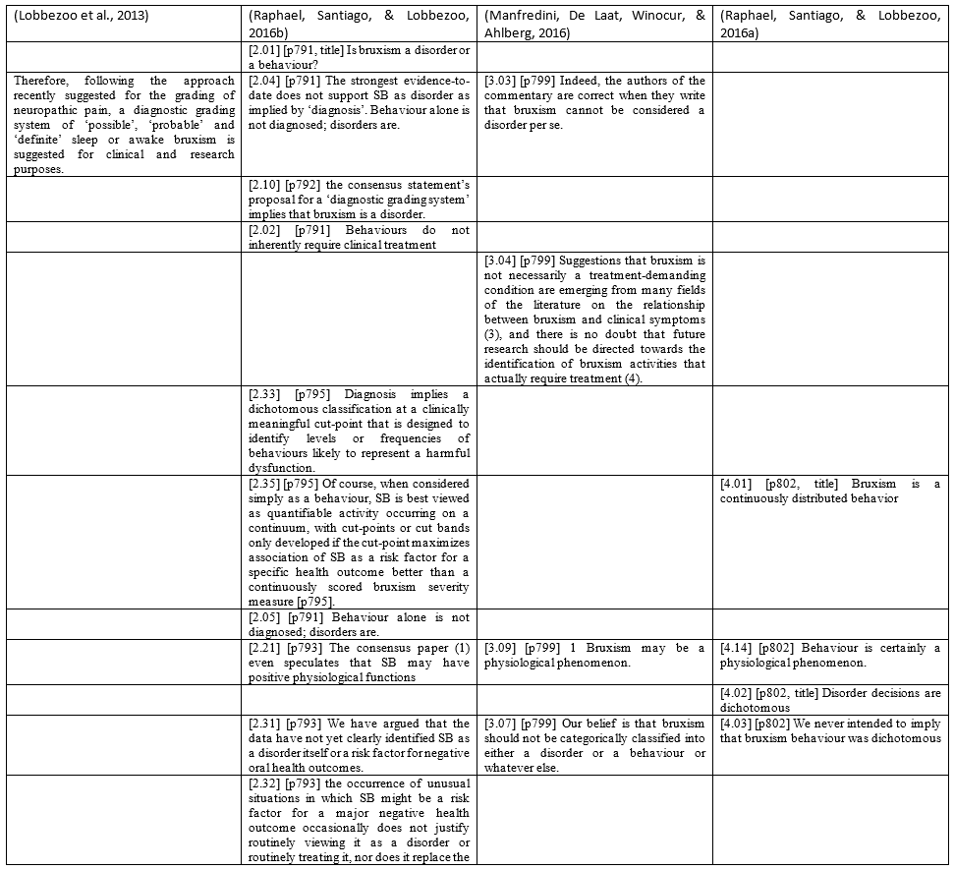
Discourse analysis
P1 P2 P3 P4

Slide 20
Discourse analysis
refutation
P1 P2 P3 P4

Slide 21
Discourse analysis
agreement
P1 P2 P3 P4

Slide 22
Discourse analysis
elaboration
P1 P2 P3 P4

Slide 23
Discourse analysis
elucidation
P1 P2 P3 P4

Slide 24
Proposed definition for Bruxism in P1
Bruxism is a repetitive jaw-muscle activity characterized by
  clenching or grinding of the teeth and/or
  by bracing or thrusting of the mandible.
Bruxism has two distinct circadian manifestations:
it can occur
  during sleep (indicated as sleep bruxism) or
  during wakefulness (indicated as awake bruxism).
Lobbezoo F, Ahlberg J, Glaros AG, Kato T, Koyano K, Lavigne GJ, et al.
Bruxism defined and graded: an international consensus.
J Oral Rehabil. 2013 Jan;40(1):2-4.

Slide 25
Proposed grading system in P1
Diagnostic grading system of
  ‘possible’,
  ‘probable’ and
  ‘definite’,
both for
  sleep bruxism, and
  awake bruxism
both for
  clinical purposes, and
  research purposes.
Lobbezoo F, Ahlberg J, Glaros AG, Kato T, Koyano K, Lavigne GJ, et al.
Bruxism defined and graded: an international consensus.
J Oral Rehabil. 2013 Jan;40(1):2-4.

Slide 26
Core of the debate (1)
P2 reconsiders P1:
  Proposing a diagnostic grading system implies that bruxism is a disorder, where the definition does not say it is.
  Bruxism is best viewed as quantifiable activity occurring on a continuum.
P3 challenges P2, defending P1:
  P2 is too strongly oriented towards the definition of bruxism as a behavior.
  All bruxism forms may potentially be a phenomenon without any clinical consequences or a treatment/prevention-demanding disorder.
  Bruxism should be viewed as a disorder, viz. a condition that requires to be managed or prevented, only when it has consequences.

Slide 27
Core of the debate (2)
P4 claims P3 misunderstands:
  The primary issue raised in their letter may derive from a semantic misunderstanding.
P4 clarifies P2:
  Bruxism is a continuously distributed behavior.
  Stating that (sleep) bruxism is a ‘behavior’ in no way precludes the possibility (at some to-be-specified and validated cut point) of it being more than a behavior, either a risk factor or disorder.

Slide 28
Talk overview
How ontology 1.00000001 could have saved trees.

Slide 29
Applying the particular / type distinction
Examples:
  Bruxism is a continuously distributed behavior [P4, p802]
  Sleep Bruxism is best viewed as quantifiable activity occurring on a continuum [P2, p795].

Slide 30
Applying the particular / type distinction
Examples:
  Bruxism is a continuously distributed behavior [P4, p802]
  Sleep Bruxism is best viewed as quantifiable activity occurring on a continuum [P2, p795].
These are statements about types:
Bruxism
isa
Behavior

Slide 31
Applying the particular / type distinction
Examples:
  Bruxism is a continuously distributed behavior [P4, p802]
  Sleep Bruxism is best viewed as quantifiable activity occurring on a continuum [P2, p795].
These are statements about types:
Bruxism
isa
Behavior
Instance of
John’s #4 = John’s repetitive jaw muscle activity of last night
John’s #4

Slide 32
Applying the particular / type distinction
Examples:
  Bruxism is a continuously distributed behavior [P4, p802]
  Sleep Bruxism is best viewed as quantifiable activity occurring on a continuum [P2, p795].
These are statements about types:
Bruxism
isa
Behavior
Instance of
Instance of
John’s #4

Slide 33
Ignoring the particular / type distinction
Bruxism is a continuously distributed behavior [P4, p802]
Continuously distributed behavior
isa
Bruxism
Instance of
Instance of ???
John’s #4
John’s #4 = John’s repetitive jaw muscle activity of last night

Slide 34
Ignoring the particular / type distinction
Bruxism is a continuously distributed behavior [P4, p802]
Continuously distributed behavior
isa
Bruxism
Instance of
Type of particulars
John’s #4
John’s #4 = John’s repetitive jaw muscle activity of last night

Slide 35
Ignoring the particular / type distinction
Bruxism is a continuously distributed behavior [P4, p802]
Continuously distributed behavior
isa
Bruxism
Instance of
John’s #4
Type of types
John’s #4 = John’s repetitive jaw muscle activity of last night

Slide 36
Types whose particulars are distributed over a continuum (1)
Body temperature
isa
Pathologically low
body temperature
Normal
body temperature
Pathologically high
body temperature
isa
35.2°C BT
35.8°C BT
36.9°C BT
37.2°C BT
38.9°C BT
40.2°C BT

Slide 37
Types whose particulars are distributed over a continuum (1)
Body temperature
isa
Pathologically low
body temperature
Normal
body temperature
Pathologically high
body temperature
isa
35.2°C BT
35.8°C BT
36.9°C BT
37.2°C BT
38.9°C BT
40.2°C BT
… at t2
instance of
… at t1
… at t3
John’s #24

Slide 38
Types whose particulars are distributed over a continuum (2)
Body temperature
isa
Pathologically low
body temperature
Normal
body temperature
Pathologically high
body temperature
isa
35.2°C BT
35.8°C BT
36.9°C BT
37.2°C BT
38.9°C BT
40.2°C BT
instance of
at t4
John’s BT
Mary’s BT
Joe’s BT
Suzy’s BT

Slide 39
Similarly
Behavior
Normal
behavior
Pathological
behavior
Bruxism
Bruxism without
clinical consequences
Treatment/prevention
demanding bruxism

Slide 40
Is this possible ?
at t13
instance of
at t14
John’s bruxism

Slide 41
No! This would be ignoring the continuant / occurrent distinction !
at t13
instance of
at t14
John’s bruxism

Slide 42
Accounting for the occurrent/continuant distinction: occurrents don’t change.
With the ontology fixed this way, the choice of which of these three would be called ‘bruxism’ (proper) is a pure terminological decision.

Slide 43
Conclusion
There are two reasons why experts in a given scientific discipline can disagree about what to conclude from observations they all consider accurate:
    the science in that domain is not yet sufficiently well developed, or
    the associated terminology is ill-defined or not consistently adhered to, so that what appear to be disagreements are in fact just beliefs about different portions of reality which are erroneously assumed to be the same.
Although the bruxism experts themselves contend that (1) is the main source of problems,
we believe that the fault lies primarily under (2).

