Slide 1
17th World Congress of Medical and Health Informatics MEDINFO 2019 August 27, 2019, Lyon, France. Expanding Evolutionary Terminology Auditing with Historic Formal and Linguistic Intensions: a Case Study in SNOMED CT
Werner CEUSTERS^{1,2} and Sarah MULLIN¹
¹ Department of Biomedical Informatics, University at Buffalo, USA
² Department of Psychiatry, University at Buffalo, USA

Slide 2
‘If history repeats itself, and the unexpected always happens, how incapable must Man be of learning from experience.’
→ George Bernard Shaw ←

Slide 3
‘If history repeats itself, and the unexpected always happens in SNOMED CT, how incapable must its authors be of learning from experience.’
→…???... ←

Slide 4
Goal of this presentation
Provide insight in techniques for early detection, if not prevention, of the unexpected to happen again in SNOMED CT, so that nobody will ever paraphrase Shaw’s quote this way.

Slide 5
SNOMED CT structure
IHTSDO. SNOMED CT Starter Guide July 2014

Slide 6
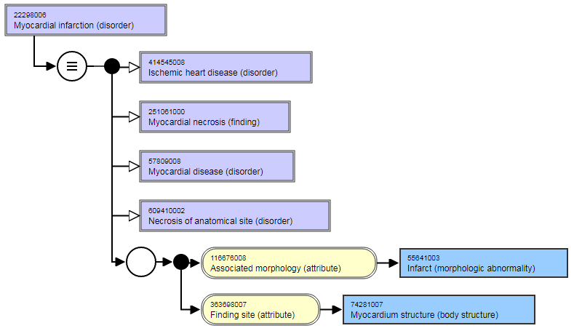
Example: myocardial infarction
Descriptions
Relationships
Myocardial infarction (disorder)
Concept
Heart attack
…
22298006

Slide 7
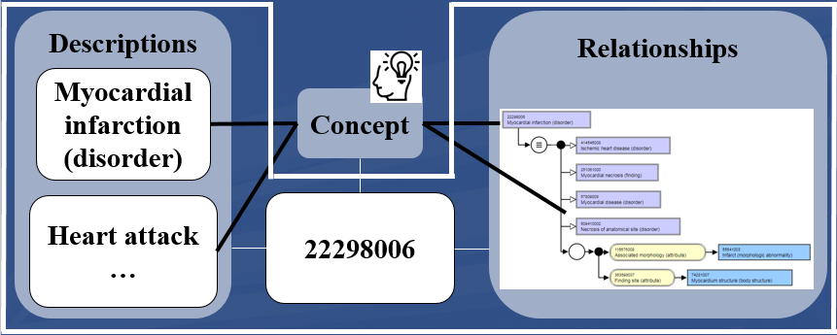
SNOMED’s ‘code permanence’ principle
‘ Once assigned a meaning, a code must not change its meaning. Refinements, due to changes in the state of knowledge, may lead to inactivation of codes from SNOMED CT. An inactivated code may be replaced by a new, more precisely defined code’
SNOMED International, SNOMED CT Editorial Guide 2019, p231.
Based on: J.J. Cimino. Desiderata for Controlled Medical Vocabularies in the Twenty-First Century. Methods of Information in Medicine 1998:37:394-403.

Slide 8
Changes in SNOMED CT (RF2) concepts
conceptID | Effective Time | Active | ModuleID | Definitional Status
301381004 | 20020131 | 1 | 900000000000207008 | 900000000000074008
301381004 | 20080131 | 0 | 900000000000207008 | 900000000000074008
FSN = ‘Discomforting present pain (finding)’

Slide 9
Changes in SNOMED CT (RF2) concepts and relationships
conceptID | Effective Time | Active | ModuleID | Definitional Status
301381004 | 20020131 | 1 | 900000000000207008 | 900000000000074008
301381004 | 20080131 | 0 | 900000000000207008 | 900000000000074008
FSN = ‘Discomforting present pain (finding)’
RelID | Effective Time | Active | Attribute | Target
126300024 | 20020131 | 1 | Is a | Pain (finding)
126300024 | 20040131 | 0 | Is a | Pain (finding)
126301023 | 20020131 | 1 | Is a | Finding of present pain intensity (finding)
126301023 | 20080131 | 0 | Is a | Finding of present pain intensity (finding)
657858027 | 20020131 | 1 | Finding site | Structure of nervous system (body structure)
657858027 | 20060131 | 0 | Finding site | Structure of nervous system (body structure)
2260209021 | 20030731 | 1 | Interprets | Nervous system function (observable entity)
2260209021 | 20050131 | 0 | Interprets | Nervous system function (observable entity)
2458913020 | 20040131 | 1 | Is a | Discomfort (finding)
2458913020 | 20080131 | 0 | Is a | Discomfort (finding)
2858465020 | 20060131 | 1 | Finding site | Anatomical structure (body structure)
2858465020 | 20080131 | 0 | Finding site | Anatomical structure (body structure)
2002-2004
2004-2008

Slide 10
Changes in SNOMED CT (RF2) concepts and relationships
conceptID | Effective Time | Active | ModuleID | Definitional Status
301381004 | 20020131 | 1 | 900000000000207008 | 900000000000074008
301381004 | 20080131 | 0 | 900000000000207008 | 900000000000074008
FSN = ‘Discomforting present pain (finding)’
RelID | Effective Time | Active | Attribute | Target
126300024 | 20020131 | 1 | Is a | Pain (finding)
126300024 | 20040131 | 0 | Is a | Pain (finding)
126301023 | 20020131 | 1 | Is a | Finding of present pain intensity (finding)
126301023 | 20080131 | 0 | Is a | Finding of present pain intensity (finding)
657858027 | 20020131 | 1 | Finding site | Structure of nervous system (body structure)
657858027 | 20060131 | 0 | Finding site | Structure of nervous system (body structure)
2260209021 | 20030731 | 1 | Interprets | Nervous system function (observable entity)
2260209021 | 20050131 | 0 | Interprets | Nervous system function (observable entity)
2458913020 | 20040131 | 1 | Is a | Discomfort (finding)
2458913020 | 20080131 | 0 | Is a | Discomfort (finding)
2858465020 | 20060131 | 1 | Finding site | Anatomical structure (body structure)
2858465020 | 20080131 | 0 | Finding site | Anatomical structure (body structure)
2002-2006
2006-2008

Slide 11
Changes in SNOMED CT (RF2) descriptions (Fully Specified Names)
conceptID | Effective Time | Active | ModuleID | Definitional Status
373981005 | 20020731 | 1 | 900000000000207008 | 900000000000074008
373981005 | 20180731 | 1 | 900000000000207008 | 900000000000073002
Fully specified names
DescID | EffectiveTime | Active | Term
1199281013 | 20020731 | 1 | Triazolam 0.125mg tablet (product)
1199281013 | 20170731 | 0 | Triazolam 0.125mg tablet (product)
3489748013 | 20170731 | 1 | Product containing triazolam 0.125 mg/1 each oral tablet (clinical drug)
3489748013 | 20180131 | 0 | Product containing triazolam 0.125 mg/1 each oral tablet (clinical drug)
3567783017 | 20180131 | 1 | Product containing only triazolam 0.125 mg/1 each oral tablet (clinical drug)
3567783017 | 20180731 | 0 | Product containing only triazolam 0.125 mg/1 each oral tablet (clinical drug)
3700098019 | 20180731 | 1 | Product containing precisely triazolam 125 microgram/1 each conventional release oral tablet (clinical drug)

Slide 12
Changes in FSNs’ semantic tags
conceptID | Most recent FSN up to July 2018 | Changes in semantic tags
66076007 | Chewable tablet (qualifier value) | (substance) | (product) | (qualifier value)
66402002 | Peritoneal dialysis education (procedure) | (procedure) | (regime/therapy) | (procedure)
68433009 | Childhood (finding) | (function) | (observable entity) | (finding)
69736008 | Vocational assessment (procedure) | (procedure)(regime/therapy) | (regime/therapy) | (procedure)
70409003 | Mouthwash (qualifier value) | (substance) | (product) | (qualifier value)
70444001 | Recessive gene (substance) | (function) | (observable entity) | (substance)
70790008 | Absence of nausea and vomiting (situation) | (finding) | (context-dependent category) | (situation)
73669007 | Kung fu (qualifier value) | (qualifier value) | (observable entity) | (qualifier value)
73905001 | Sees flickering lights (finding) | (qualifier value) | (observable entity) | (finding)
Ceusters w, Bona J. Analyzing SNOMED CT’s Historical Data: Pitfalls and Possibilities. In: American Medical Informatics Association 2016 Annual Symposium Proceedings, Chicago IL, November 12-16, 2016;361-370

Slide 13
Remember: SNOMED’s ‘code permanence’ principle
‘ Once assigned a meaning, a code must not change its meaning. Refinements, due to changes in the state of knowledge, may lead to inactivation of codes from SNOMED CT. An inactivated code may be replaced by a new, more precisely defined code’
SNOMED International, SNOMED CT Editorial Guide 2019, p231.
Based on: J.J. Cimino. Desiderata for Controlled Medical Vocabularies in the Twenty-First Century. Methods of Information in Medicine 1998:37:394-403.
Changes in SNOMED CT are caused by much more than just ‘changes in the state of knowledge’:
mistakes, impreciseness, ambiguities, …
changes in SNOMED CT concept model and editorial rules,
…

Slide 14
SNOMED CT changes not only because of ‘changes in the state of knowledge’
Concept Status
‘Historical relationships’
"SAME AS",
"REPLACED BY",
"WAS A",
"MAYBE A",
"MOVED TO",
"MOVED FROM"
0
active in current use
6
active with limited clinical value (classification concept or an administrative definition)
1
inactive: ‘retired’ without a specified reason
10
inactive because moved elsewhere
2
inactive: withdrawn because duplication
3
inactive because no longer recognized as a valid clinical concept (outdated)
4
inactive because inherently ambiguous.
5
inactive because found to contain a mistake
SNOMED CT® Technical Reference Guide – January 2007 Release, p43.

Slide 15
Key research question
Can documented changes in SNOMED CT’s history be used to find (1) inadequate FSNs and (2) missing or erroneous relationships and concepts in the most recent version (or ideally, before such version is released) ?
Methodology
Combining the knowledge representation view of ‘concept meanings’ with the ontological realism view embedded in Evolutionary Terminology Auditing.

Slide 16
Evolutionary Terminology Auditing
configuration | reality |  | representation |  |  |  | ME
 |  |  | authors' belief |  | encoding
 | OE | OR | BE | BR | IE | TR
(1) | (2) | (3) | (4) | (5) | (6) | (7) | (8)
Reality:
OE: Objective existence
OE: Objective relevance
Representation:
BE: Author’s belief in existence
BR: Author’s belief in relevance
IE: Author’s intended encoding
TR: Type of reference
Ceusters W, Smith B. A Realism-Based Approach to the Evolution of Biomedical Ontologies. Proceedings of AMIA 2006, Washington DC, 2006;:121-125.
Ceusters W. Applying Evolutionary Terminology Auditing to the Gene Ontology. Journal of Biomedical Informatics 2009;42:518–529.
Seppãlã S, Smith B, Ceusters W. Applying the realism-based ontology versioning method for tracking changes in the Basic Formal Ontology. Formal Ontology in Information Systems. Proceedings of the Eight International Conference (FOIS 2014), Amsterdam: IOS Press, 2014;:227-240.
Limbaugh D, Kasmir D, Ceusters W, Smith B. Warranted Diagnosis. International Conference on Biomedical Ontology (ICBO 2019), Buffalo NY, July 30 - Aug 2, 2019

Slide 17
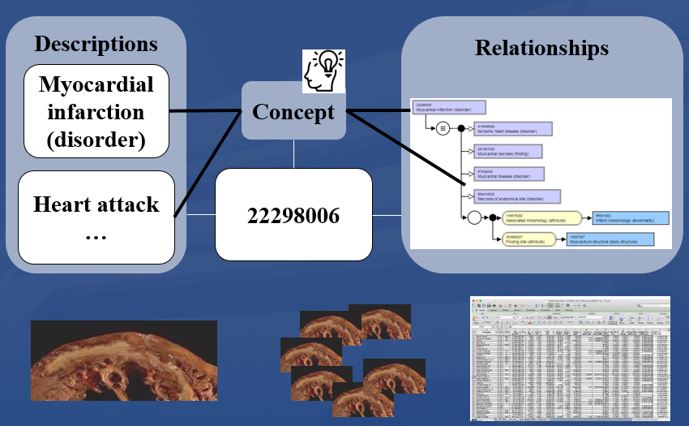
Evolutionary Terminology Auditing
configuration | reality |  | representation |  |  |  | ME
 |  |  | authors' belief |  | encoding
 | OE | OR | BE | BR | IE | TR
(1) | (2) | (3) | (4) | (5) | (6) | (7) | (8)

Slide 18
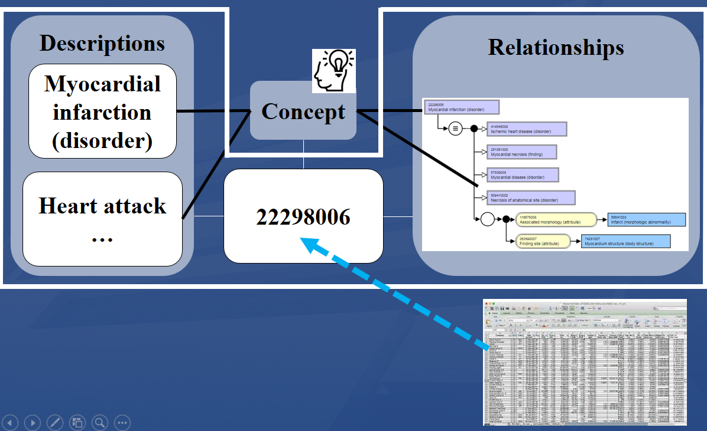
The knowledge representation view on meaning
Meaning of a SNOMED CT concept =def.: what is conveyed by means of three aspects:
a linguistic intension (LI)
as conveyed through its label(s),
a formal intension (FI),
i.e. the properties implied by it
as exhibited, for instance, by
means of the formal relations it holds with other concepts, and
an extension,
i.e. the collection of data elements in, for instance, electronic medical record systems annotated with the concept.
S. Wang, S. Schlobach, and M. Klein, Concept drift and how to identify it, Journal of Web Semantics 9 (2011), 247-265.

Slide 19
E.g.: SNOMED CT’s editorial rules to inactivate a concept
Linguistic intension issue:
Changing the FSN changes the meaning,
The FSN is ambiguous,
Changing the common name to the scientific name.
Formal intension issue:
Moving to a different top-level hierarchy,
Changes in state of knowledge.
Mismatch between formal and linguistic intension:
The FSN meaning is more specific than the modeling (unless concept not fully defined),
Modeling is more specific than the FSN meaning,
Ancestors and descendants (if any) of the concept are inconsistent with what is implied by the FSN.
SNOMED International, SNOMED CT Editorial Guide July 2019

Slide 20
Measuring ‘concept drift’
Is the opposite of ‘code permanence’,
Is determining:
whether changes in the concept’s labels lead to different interpretations,
whether the formal intension is kept constant, and
whether the same sorts of data elements (e.g. in EHRs) are annotated irrespective of version.
S. Wang, S. Schlobach, and M. Klein, Concept drift and how to identify it, Journal of Web Semantics 9 (2011), 247-265.

Slide 21
‘Historic signature’ of a SNOMED CT component (concepts, isa, FSNs)
373981005 | -111111111111111111111111111111111
1199281013 | -111111111111111111111111111111000
3489748013 | -------------------------------100
3567783017 | --------------------------------10
3700098019 | ---------------------------------1

Slide 22
Concept drift determination using linguistic intentions

Slide 23
Method
For each concept:
Compute the historic signatures of all its FSNs over time,
Mark for each change from one FSN to the next one:
whether a reason for the change was specified in one or other SNOMED CT reference set,
whether it occurred in the term proper, in the semantic tag (ST), or in both,
whether it was purely syntactical or involved a possible meaning change.
Criteria for a semantic change:
a change of semantic tag,
a simple rule-based string transformation algorithm applied to different terms of the same concept does not return the same transformation.

Slide 24
Results
 |  | Concepts with Semantic Tag changes
 |  | 0 | 1 | 2 | 3 | Total
Concepts with Term Proper changes | 0 | 333,712 | 33,697 | 3,833 | 56 | 371,298
 | 1 | 23,631 | 3,026 | 468 | 19 | 27,144
 | 2 | 1,748 | 1,704 | 1,186 | 0 | 4,638
 | 3 | 46 | 145 | 82 | 0 | 273
 | 4 | 1 | 1 | 5 | 0 | 7
Total |  | 359,138 | 38,573 | 5,574 | 75 | 403,360
Only 19% of changes are documented in a reference set.
Of the remaining 81%, 91% could be eliminated through our term transformation algorithm, thereby still leaving over 48,000 term changes to be manually inspected.

Slide 25
Evaluation of non-semantic tag changes
Manual inspection of random sample of 200 concepts with non-documented FSN change: only 15 constitute a semantic change or undocumented ambiguity.
Examples:
SCTID: 374142001
1 | Product containing miglitol 25 mg/1 each oral tablet (clinical drug)
2 | Product containing only miglitol 25 mg/1 each oral tablet (clinical drug)
3 | Product containing precisely miglitol 25 milligram/1 each conventional release oral tablet (clinical drug)
SCTID: 100191000119105
1 | Acquired asymmetry of prostate (finding)
2 | Asymmetry of prostate (finding)
SCTID: 102549009
1 | Night cramps (finding)
2 | Cramp in lower leg associated with rest (finding)
SCTID: 106109006
1 | Number of previous abortions (finding)
2 | Number of previous induced termination of pregnancy (finding)
SCTID: 302828001
1 | Syringoma (disorder)
2 | Syringoma of skin (disorder)

Slide 26
Recommendations for SNOMED CT
Do a better job in documenting reasons for change:
Do it for every term change,
Expand the codes for reasons of change towards more detail,
Bring the reasons in line with the editorial rules.

Slide 27
Concept drift determination using formal intentions
27

Slide 28
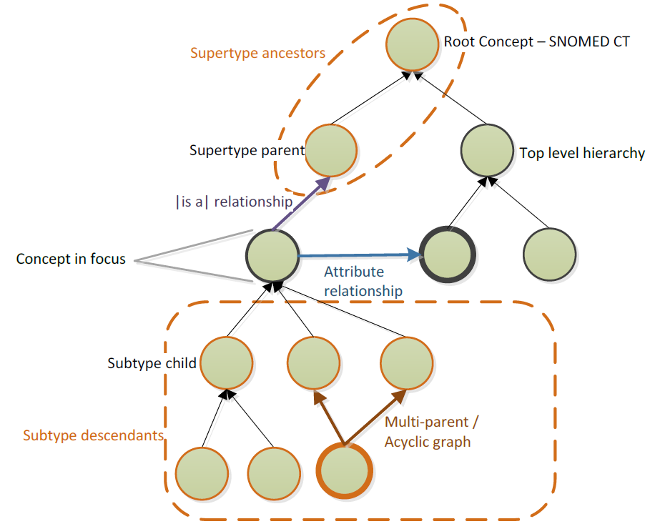
Definitions for formal intensions (1)
Formal intension of concept C in version Vn (FIn):
the collection of all subsumers in C’s transitive closure in Vn.

Slide 29
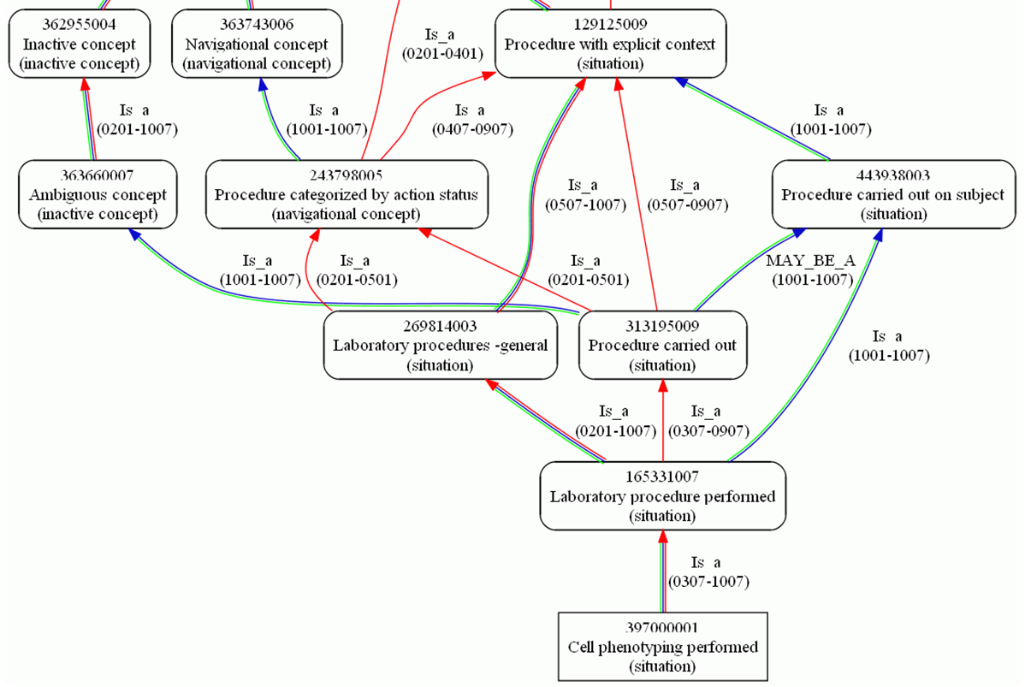
Definitions for formal intensions (2)
Historic formal intension of concept C (HFI):
the union of any subsumer of C ever encountered in some version.

Slide 30
Transitive closure history (34 versions) for concept ‘10001005’ with most recent FSN: ‘Bacterial sepsis (disorder)’: 15 subsumers
Historic signature |  |  |  |  | Subsumer | Most recent FSN of subsumer
1111 | 111111111 | 11 | 111111111 | 1111111111 | 91302008 | Sepsis (disorder)
1111 | 111111111 | 11 | 111111111 | 1111111111 | 87628006 | Bacterial infectious disease (disorder)
1111 | 111111111 | 11 | 111111111 | 1111111111 | 64572001 | Disease (disorder)
1111 | 111111111 | 11 | 111111111 | 1111111111 | 40733004 | Infectious disease (disorder)
1111 | 111111111 | 11 | 111111111 | !!!!!!!!!! | 105592009 | Septicemia (disorder)
---- | 111111111 | 11 | 111111111 | 1111111111 | 404684003 | Clinical finding (finding)
---- | --------- | 11 | 111111111 | 0000000000 | 431950004 | Bloodstream finding (finding)
---- | --------- | 11 | 111111111 | 0000000000 | 431193003 | Infection of bloodstream (disorder)
---- | --------- | 11 | 111111111 | 0000000000 | 301811001 | Bacterial infection by site (disorder)
---- | --------- | 11 | 111111111 | 0000000000 | 301810000 | Infection by site (disorder)
---- | --------- | 11 | 111111111 | 0000000000 | 123946008 | Disorder by body site (disorder)
---- | --------- | 11 | 111111111 | 0000000000 | 118234003 | Finding by site (finding)
---- | --------- | -- | 111111111 | 0000000000 | 434156008 | Infectious agent in bloodstream (finding)
---- | --------- | -- | --------- | 1111111111 | 238149007 | Syst. Inflamm. response syndrome (disorder)
---- | --------- | -- | --------- | 1111111111 | 128139000 | Inflammatory disorder (disorder)
Present
Deactivated (target concept inactive)
Not yet present
Deactivated (target concept active)

Slide 31
Definitions for formal intensions (3)
Formal intension of concept C in version Vn (FIn):
the collection of all subsumers in C’s transitive closure in Vn.
Historic formal intension of concept C (HFI):
the union of any subsumer of C ever encountered in some version.
Rigid formal properties set of concept C (RFP):
the subset of transitive closure subsumers of C that is present in all versions in which C is active.

Slide 32
Transitive closure history (34 versions) for concept ‘10001005’ with most recent FSN: ‘Bacterial sepsis (disorder)’
Historic signature |  |  |  |  | Subsumer | Most recent FSN of subsumer
1111 | 111111111 | 11 | 111111111 | 1111111111 | 91302008 | Sepsis (disorder)
1111 | 111111111 | 11 | 111111111 | 1111111111 | 87628006 | Bacterial infectious disease (disorder)
1111 | 111111111 | 11 | 111111111 | 1111111111 | 64572001 | Disease (disorder)
1111 | 111111111 | 11 | 111111111 | 1111111111 | 40733004 | Infectious disease (disorder)
1111 | 111111111 | 11 | 111111111 | !!!!!!!!!! | 105592009 | Septicemia (disorder)
---- | 111111111 | 11 | 111111111 | 1111111111 | 404684003 | Clinical finding (finding)
---- | --------- | 11 | 111111111 | 0000000000 | 431950004 | Bloodstream finding (finding)
---- | --------- | 11 | 111111111 | 0000000000 | 431193003 | Infection of bloodstream (disorder)
---- | --------- | 11 | 111111111 | 0000000000 | 301811001 | Bacterial infection by site (disorder)
---- | --------- | 11 | 111111111 | 0000000000 | 301810000 | Infection by site (disorder)
---- | --------- | 11 | 111111111 | 0000000000 | 123946008 | Disorder by body site (disorder)
---- | --------- | 11 | 111111111 | 0000000000 | 118234003 | Finding by site (finding)
---- | --------- | -- | 111111111 | 0000000000 | 434156008 | Infectious agent in bloodstream (finding)
---- | --------- | -- | --------- | 1111111111 | 238149007 | Syst. Inflamm. response syndrome (disorder)
---- | --------- | -- | --------- | 1111111111 | 128139000 | Inflammatory disorder (disorder)
Rigid formal properties (RFP) set: 5 subsumers.

Slide 33
Definitions for formal intensions (3)
Formal intension of concept C in version Vn (FIn):
the collection of all subsumers in C’s transitive closure in Vn.
Historic formal intension of concept C (HFI):
the union of any subsumer of C ever encountered in some version.
Rigid formal properties set of concept C (RFP):
the subset of transitive closure subsumers of C that is present in all versions in which C is active.
Stable history segment of concept C (SHSC):
a segment of C’s history during which its FIn remains constant over successive versions.

Slide 34
Transitive closure history (34 versions) for concept ‘10001005’ with most recent FSN: ‘Bacterial sepsis (disorder)’
Historic signature |  |  |  |  | Subsumer | Most recent FSN of subsumer
1111 | 111111111 | 11 | 111111111 | 1111111111 | 91302008 | Sepsis (disorder)
1111 | 111111111 | 11 | 111111111 | 1111111111 | 87628006 | Bacterial infectious disease (disorder)
1111 | 111111111 | 11 | 111111111 | 1111111111 | 64572001 | Disease (disorder)
1111 | 111111111 | 11 | 111111111 | 1111111111 | 40733004 | Infectious disease (disorder)
1111 | 111111111 | 11 | 111111111 | !!!!!!!!!! | 105592009 | Septicemia (disorder)
---- | 111111111 | 11 | 111111111 | 1111111111 | 404684003 | Clinical finding (finding)
---- | --------- | 11 | 111111111 | 0000000000 | 431950004 | Bloodstream finding (finding)
---- | --------- | 11 | 111111111 | 0000000000 | 431193003 | Infection of bloodstream (disorder)
---- | --------- | 11 | 111111111 | 0000000000 | 301811001 | Bacterial infection by site (disorder)
---- | --------- | 11 | 111111111 | 0000000000 | 301810000 | Infection by site (disorder)
---- | --------- | 11 | 111111111 | 0000000000 | 123946008 | Disorder by body site (disorder)
---- | --------- | 11 | 111111111 | 0000000000 | 118234003 | Finding by site (finding)
---- | --------- | -- | 111111111 | 0000000000 | 434156008 | Infectious agent in bloodstream (finding)
---- | --------- | -- | --------- | 1111111111 | 238149007 | Syst. Inflamm. response syndrome (disorder)
---- | --------- | -- | --------- | 1111111111 | 128139000 | Inflammatory disorder (disorder)
5 stable history segments

Slide 35
‘Suspiciously gapped’ CSP
Concepts C1 and C2 form a concept-subsumer pair (CSP) if and only if C2 is in the historic transitive closure set of C1.
A CSP is suspiciously gapped for any C2 which becomes reactivated after having been deactivated: during the gap, the subsumer was thus unjustifiably absent (‘missing’).
 | concept-subsumer pair
Historic Signature | C1 | C2
---1111000000001111111100000000000 | Abrasion of head (disorder | Disorder of skin of head (disorder)
------1100001111111000000000000000 | Removal of dressing of skin of feet (procedure) | Procedure on lower leg (procedure)
------1111111111111111110000111111 | Avulsion of mandibular attached gingiva (disorder) | Gingivae finding (finding)

Slide 36
‘Suspiciously gapped’ CSP
‘History repeats itself, first as tragedy, second as farce.’
→ Karl Marx ←
 | concept-subsumer pair
Historic Signature | C1 | C2
---1111000000001111111100000000000 | Abrasion of head (disorder | Disorder of skin of head (disorder)
------1100001111111000000000000000 | Removal of dressing of skin of feet (procedure) | Procedure on lower leg (procedure)
------1111111111111111110000111111 | Avulsion of mandibular attached gingiva (disorder) | Gingivae finding (finding)

Slide 37
‘Suspiciously annulled’ CSP
Historic signature |  |  |  |  | Subsumer | Most recent FSN of subsumer
1111 | 111111111 | 11 | 111111111 | 1111111111 | 91302008 | Sepsis (disorder)
1111 | 111111111 | 11 | 111111111 | 1111111111 | 87628006 | Bacterial infectious disease (disorder)
1111 | 111111111 | 11 | 111111111 | 1111111111 | 64572001 | Disease (disorder)
1111 | 111111111 | 11 | 111111111 | 1111111111 | 40733004 | Infectious disease (disorder)
1111 | 111111111 | 11 | 111111111 | !!!!!!!!!! | 105592009 | Septicemia (disorder)
---- | 111111111 | 11 | 111111111 | 1111111111 | 404684003 | Clinical finding (finding)
---- | --------- | 11 | 111111111 | 0000000000 | 431950004 | Bloodstream finding (finding)
---- | --------- | 11 | 111111111 | 0000000000 | 431193003 | Infection of bloodstream (disorder)
---- | --------- | 11 | 111111111 | 0000000000 | 301811001 | Bacterial infection by site (disorder)
---- | --------- | 11 | 111111111 | 0000000000 | 301810000 | Infection by site (disorder)
---- | --------- | 11 | 111111111 | 0000000000 | 123946008 | Disorder by body site (disorder)
---- | --------- | 11 | 111111111 | 0000000000 | 118234003 | Finding by site (finding)
---- | --------- | -- | 111111111 | 0000000000 | 434156008 | Infectious agent in bloodstream (finding)
---- | --------- | -- | --------- | 1111111111 | 238149007 | Syst. Inflamm. response syndrome (disorder)
---- | --------- | -- | --------- | 1111111111 | 128139000 | Inflammatory disorder (disorder)
A CSP is suspiciously annulled in S whenever there is for C1 a stable history segment S for which:
the historic signature of that CSP contains only ‘0’s, and
there is at least one other CSP of C1 of which the historic signature contains only ‘!’ in S.

Slide 38
SNOMED CT’s concept turnover 2002 – 2018 (34 versions)
Descriptive Statistic | ACTIVE | LIFETIME
Mean | 0.845 | 25.836
Median | 1 | 34
Mode | 1 | 34
Standard Deviation | 0.362 | 11.417
Minimum (Min) | 0 | 1
Maximum (Max) | 1 | 34
Confidence Level(95.0%) | 0.001 | 0.035
Concepts with Max | 340,639 | 224,447
Concepts with Min | 62,721 | 9,689
N Active with Max | 340,639 | 224,447
N Active with Min | 0 | 6,505

Slide 39
Descriptive stats for HFI variables (1)
Descriptive Statistic | HFI | SHSC | RFP | RFP% of HFI | Susp. annuled | Susp. gapped
Mean | 22.708 | 6.249 | 9.975 | 49.935 | 1.384 | 0.381
Median | 17 | 5 | 7 | 43 | 0 | 0
Mode | 7 | 2 | 4 | 100 | 0 | 0
Standard Deviation | 17.784 | 3.861 | 10.026 | 30.703 | 5.627 | 17.164
Minimum (Min) | 1 | 1 | 0 | 0 | 0 | 0
Maximum (Max) | 152 | 25 | 125 | 100 | 326 | 6,643
Confidence Level(95.0%) | 0.055 | 0.012 | 0.031 | 0.095 | 0.017 | 0.053
Concepts with Max | 1 | 15 | 1 | 61,001 | 1 | 1
Concepts with Min | 204 | 7,961 | 9,241 | 9,241 | 300,868 | 395,777
N Active with Max | 1 | 15 | 1 | 51,936 | 1 | 1
N Active with Min | 180 | 7,961 | 8,274 | 8,274 | 238,147 | 333,066
35057008
Nonvenomous insect bite of penis with infection (disorder)

Slide 40
Descriptive stats for HFI variables (2)
Descriptive Statistic | HFI | SHSC | RFP | RFP% of HFI | Susp. annuled | Susp. gapped
Mean | 22.708 | 6.249 | 9.975 | 49.935 | 1.384 | 0.381
Median | 17 | 5 | 7 | 43 | 0 | 0
Mode | 7 | 2 | 4 | 100 | 0 | 0
Standard Deviation | 17.784 | 3.861 | 10.026 | 30.703 | 5.627 | 17.164
Minimum (Min) | 1 | 1 | 0 | 0 | 0 | 0
Maximum (Max) | 152 | 25 | 125 | 100 | 326 | 6,643
Confidence Level(95.0%) | 0.055 | 0.012 | 0.031 | 0.095 | 0.017 | 0.053
Concepts with Max | 1 | 15 | 1 | 61,001 | 1 | 1
Concepts with Min | 204 | 7,961 | 9,241 | 9,241 | 300,868 | 395,777
N Active with Max | 1 | 15 | 1 | 51,936 | 1 | 1
N Active with Min | 180 | 7,961 | 8,274 | 8,274 | 238,147 | 333,066

Slide 41
Descriptive stats for HFI variables (3)
Descriptive Statistic | HFI | SHSC | RFP | RFP% of HFI | Susp. annuled | Susp. gapped
Mean | 22.708 | 6.249 | 9.975 | 49.935 | 1.384 | 0.381
Standard Deviation | 17.784 | 3.861 | 10.026 | 30.703 | 5.627 | 17.164
Minimum (Min) | 1 | 1 | 0 | 0 | 0 | 0
Maximum (Max) | 152 | 25 | 125 | 100 | 326 | 6,643
Concepts with Max | 1 | 15 | 1 | 61,001 | 1 | 1
Concepts with Min | 204 | 7,961 | 9,241 | 9,241 | 300,868 | 395,777
N Active with Max | 1 | 15 | 1 | 51,936 | 1 | 1
N Active with Min | 180 | 7,961 | 8,274 | 8,274 | 238,147 | 333,066
30% of active concepts have at least one suspiciously annulled formal property. (340,639-238,147/340,639),
7,573 (2.2%) active concepts have at least one suspiciously gapped subsumer (340,639-333,066/340,639).
2,706 concepts exhibited both features.

Slide 42
Sample analysis (2 x 100 concepts)
Manual inspection of samples for possible missing subsumers:
83% positive in case of suspicious gap,
91% positive in case of suspicious annulment.

Slide 43
Examples of missing subsumers
88425004: Congenital anomaly of nervous system (disorder)
 | 299735001: Neurological lesion (finding)
 | 102957003: Neurological finding (finding)
87290003: Congenital anomaly of head (disorder)
 | 204223000: Ear, face and neck congenital anomalies (disorder)
83502000: Operation on tendon sheath (procedure)
 | 118667007: Procedure on skeletal muscular system (procedure)
11381005: Acne (disorder)
 | 95320005: Disorder of skin (disorder)
 | 80659006: Disorder of skin and/or subcutaneous tissue (disorder)
 | 106076001: Skin finding (finding)
 | 301857004: Finding of body region (finding)
 | 19660004: Disorder of soft tissue (disorder)
19838004: In-vitro immunologic test (procedure)
 | 103693007: Diagnostic procedure (procedure)
 | 362961001: Procedure by intent (procedure)
 | 127789004: Laboratory procedure categorized by method (procedure)

Slide 44
Recommendations for SNOMED CT
Prior to each release, generate for all concepts their historic transitive closure set,
Inspect all concepts c which have at least one suspiciously annulled concept-subsumer pair (CSP) in their set: the justified removal of subsumer x of c might have caused the unjustified removal of subsumer y of x as a subsumer of c,
For all concepts deleted since the prior release, inspect whether their former descendents lost CSPs in their FHI,
Do the same, after reclassification, for all concepts whose stated definition was changed since the latest release.

Slide 45
Conclusions
SNOMED CT’s history mechanism can be used to prevent mistakes in the future:
with great success using suspiciously gapped and annulled concept-subsumer pairs in the historic transitive closure set,
rather poorly for linguistic intension changes because of, mainly, poor documentation.
SNOMED CT’s adherence to code permanence can be quantified but this criterion is not sufficiently applied.
It cannot be computed whether for any given concept a semantic tag is changed because of a local mistake in the interpretation of that concept or a global change at the level of the concept model.

Slide 46
‘Success does not consist in never making mistakes but in never making the same one a second time.’
→ George Bernard Shaw ←

