Slide 1

An alternative terminology for pain assessment
Second International Workshop on Definitions in Ontologies (IWOOD 2014)
October 7, 2014 – Cooley Center, Houston, TX isPartOf at October 7,2014
International Conference on Biomedical Ontology
October 6-9, 2014 – Cooley Center, Houston, TX
Werner CEUSTERS, MD
Professor, Department of Biomedical Informatics, University at Buffalo
Director, National Center for Ontological Research
Director of Research, UB Institute for Healthcare Informatics

Slide 2
Background (1)
July 2008, Toronto:
  the International RDC/TMD Consortium Network identified a need to incorporate the RDC/TMD diagnostic taxonomy into a comprehensive orofacial pain taxonomy.
April, 2009, Miami:
  ‘The International Consensus Workshop: Convergence on an Orofacial Pain Taxonomy’ participants decided that an adequate treatment of the ontology of pain in general, and orofacial pain in particular, together with an appropriate terminology, is mandatory to advance the state of the art in diagnosis, treatment and prevention.
Ohrbach R, List T, Goulet J, Svensson P. Recommendations from the International Consensus Workshop: Convergence on an Orofacial Pain Taxonomy. Journal of Oral Rehabilitation. 2010.

Slide 3
Background (2)
The following consecutive steps were proposed:
  study the terminology and ontology of pain as currently defined,
  find ways to make individual data collections more useful for international research,
  develop an ontology for integrating knowledge and data over all the known basic and clinical science domains concerning TMD and its relationship to complex disorders, and
  expand this ontology to cover all pain-related disorders.

Slide 4
OPMQoL project: Specific Aims
describe the portions of reality covered by five datasets by means of a realism-based ontology (OPMQoL),
design bridging axioms required to express the data dictionaries of the datasets in terms of the OPMQoL and translate these axioms in the query languages used by the underlying databases,
validate OPMQoL by querying the datasets with and without using the ontology and by comparing the results in function of the clinical question identified,
document the development and validation approach in a way that other groups can re-use and expand OPMQoL, and use our approach in other domains.

Slide 5
Design strategy for OPMQoL
Create application ontologies for what is covered in the datasets as well as for the assessment instruments (questionnaires, etc.) used in the development of these datasets,
Build a reference ontology for pain following the principles of Ontological Realism, thus paying attention to what science in the pain domain has discovered.
Smith B, Ceusters W. Ontological Realism as a Methodology for Coordinated Evolution of Scientific Ontologies. Applied Ontology, 2010.
Smith B, Ceusters W, Goldberg LJ, Ohrbach R. Towards an Ontology of Pain. In: Mitsu Okada (ed.), Proceedings of the Conference on Logic and Ontology, Tokyo: Keio University Press, February 2011:23-32.

Slide 6

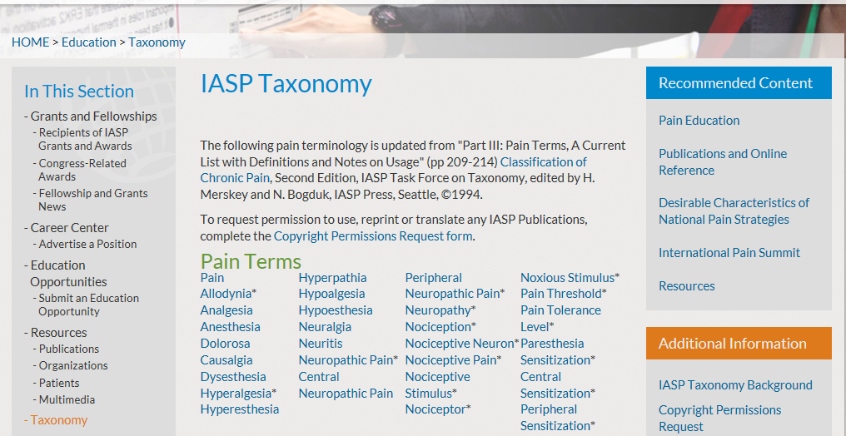
http://www.iasp-pain.org/Education/Content.aspx?ItemNumber=1698&navItemNumber=576

Slide 7
IASP Pain assessment terminology
Allodynia: pain due to a stimulus that does not normally provoke pain. Note: The stimulus leads to an unexpectedly painful response.
Analgesia: absence of pain in response to stimulation which would normally be painful.
Dysesthesia: an unpleasant abnormal sensation, whether spontaneous or evoked. Note: Special cases of dysesthesia include hyperalgesia and allodynia.
Hyperalgesia: increased pain from a stimulus that normally provokes pain.
Hyperesthesia: increased sensitivity to stimulation, excluding the special senses. Note: Hyperesthesia includes both allodynia and hyperalgesia, but the more specific terms should be used wherever they are applicable.
Hyperpathia: a painful syndrome characterized by an abnormally painful reaction to a stimulus.
Hypoalgesia: diminished pain in response to a normally painful stimulus.
Hypoesthesia: decreased sensitivity to stimulation, excluding the special senses.
Paresthesia: an abnormal sensation, whether spontaneous or evoked. Note: it has been agreed to recommend that paresthesia be used to describe an abnormal sensation that is not unpleasant while dysesthesia be used preferentially for an abnormal sensation that is considered to be unpleasant. There is a sense in which, since paresthesia refers to abnormal sensations in general, it might include dysesthesia,

Slide 8
Derived hierarchy from these definitions
This is not the sort of taxonomic backbone acceptable for realism-based ontologies.
Smith B, Kusnierczyk W, Schober D, Ceusters W. Towards a Reference Terminology for Ontology Research and Development in the Biomedical Domain. Proceedings of KR-MED 2006, Biomedical Ontology in Action, November 8, 2006, Baltimore MD, USA

Slide 9
Purpose of work
Requirements for terms to be eligible as representational units in a realism-based ontology such as OPMQoL:
  denote entities that can be classified following the principles of Ontological Realism,
  be defined using Aristotelian definitions which specify the necessary and sufficient conditions for class membership,
  lead to a taxonomy based on single inheritance.
Goal of the work reported on here:
  assess the adherence of the IASP pain assessment definitions to this second condition and
  find ways for remediation if non-compliance is found.

Slide 10
Methodology (1)
1. Identify and organize the discriminating features mentioned in the IASP definitions
Variable | Values
Stimulus application | Y(es)
modus M level Threshold | B(elow), O(n), A(bove)
Pain level Threshold | B(elow), O(n), A(bove)
Response to stimulus | Y(es), N(o)
modus M Response | Y(es), N(o)
modus M Intensity | L(ess), C(oncordant), H(igh)
Unpleasant response | Y(es), N(o)
Pain Response | Y(es), N(o)
Pain Intensity | L(ess), C(oncordant), H(igh)

Slide 11
Methodology (2)
2. Identify and represent all theoretically possible stimulus/response combinations
Example for bimodal above (but not ‘on’) threshold stimulation
S | Stimulus given | Y | Y | Y | Y | Y | Y | Y | Y | Y | Y | Y | Y | Y | Y | Y | Y | Y | Y | Y | Y
MT | Modus M threshold | A | A | A | A | A | A | A | A | A | A | A | A | A | A | A | A | A | A | A | A
PT | Pain Threshold | A | A | A | A | A | A | A | A | A | A | A | A | A | A | A | A | A | A | A | A
R | Response | N | Y | Y | Y | Y | Y | Y | Y | Y | Y | Y | Y | Y | Y | Y | Y | Y | Y | Y | Y
MR | Modus M response | N | N | N | N | N | Y | Y | Y | Y | Y | Y | Y | Y | Y | Y | Y | Y | Y | Y | Y
MI | Modus M response Intensity | - | - | - | - | - | L | L | L | L | L | C | C | C | C | C | H | H | H | H | H
U | Unpleasant response | N | Y | Y | Y | Y | N | Y | Y | Y | Y | N | Y | Y | Y | Y | N | Y | Y | Y | Y
PR | Pain Response | - | N | Y | Y | Y | - | N | Y | Y | Y | - | N | Y | Y | Y | - | N | Y | Y | Y
PI | Pain Response Intensity | - | - | L | C | H | - | - | L | C | H | - | - | L | C | H | - | - | L | C | H

Slide 12
Methodology (2)
Intervariable dependencies:
  each stimulus, whether somatosensory (‘modus M’) or pain sensitivity, falls under one of three disjoint categories: (1) below threshold, (2) on threshold, or (3) above threshold;
  modus M and pain stimuli may be given selectively or together: (1) sub-threshold (for both pain and modus M), (2-3) modus M- or pain-selective, and (4) bimodal;
  if there is no response to a stimulus, then there are no values for the intensity of modus M sensation and pain;
  if a response is present, it may be either (4a) selective, or (4b) combining either a modus M and non-painful unpleasant response, or a modus M and painful response;
  all pain responses are unpleasant (per IASP definition);
  an unpleasant response does not need to be painful.
→ 130 combinations

Slide 13
Methodology (3)
3. Assess each combination for whether it can figure as an exemplar for each of the pain assessment terms.
Example for the IASP-definition of ‘allodynia’ without taking the note into account.
S | Stimulus given | Y | Y | Y | Y | Y | Y | Y | Y | Y | Y
MT | Modus M threshold | B | B | O | O | O | O | A | A | A | A
PT | Pain Threshold | B | B | B | B | B | B | B | B | B | B
R | Response | Y | Y | Y | Y | Y | Y | Y | Y | Y | Y
MR | Modus M response | N | Y | N | Y | Y | Y | N | Y | Y | Y
MI | Modus M response Intensity | - | H | - | L | C | H | - | L | C | H
U | Unpleasant response | Y | Y | Y | Y | Y | Y | Y | Y | Y | Y
PR | Pain Response | Y | Y | Y | Y | Y | Y | Y | Y | Y | Y
PI | Pain Response Intensity | H | H | H | H | H | H | H | H | H | H
ALLO-D |  | Y | Y | Y | Y | Y | Y | Y | Y | Y | Y

Slide 14
Methodology (3)
Issue:
  some definitions and notes are unclear about inclusion and exclusion criteria;
  → create meaningful subgroups which from a terminological and ontological perspective are perfectly plausible, despite perhaps not being intended by the IASP.

Slide 15
Methodology (3)
Acronym | Term (plus meaning) | N
CONC | Normal case | 9
ALLO-D | allodynia (definition): unexpected evoked pain | 10
ALLO-N | allodynia (note): unexpected more intense evoked pain | 30
ANAL | analgesia: unexpected absence of evoked pain | 40
DYS-E | evoked dysesthesia | 80
DYS-EP | painful evoked dysesthesia | 50
DYS-EU | non-painful evoked dysesthesia | 30
HYPERA | hyperalgesia: unexpected more intense evoked pain | 20
HYPERE | hyperesthesia = increased sensitivity to stimulation | 81
HYPERE-I | unexpected more intense evoked sensation | 42
HYPERE-IP | unexpected more intense evoked pain | 20
HYPERE-IM | unexpected more intense evoked modus M | 26
HYPERE-P | unexpected presence of evoked sensation | 49
HYPERE-PU | unexpected evoked unpleasant sensation other than pain | 30
HYPERE-PP | unexpected pain | 10
HYPERE-PM | unexpected modus M | 13
HYPERP | hyperpathia | 30
HYPOALG | hypoalgesia | 20
HYPOE | hypoesthesia = decreased sensitivity to stimulation | 58
HYPOE-P | decreased sensitivity to pain stimulation | 40
HYPOE-PL | less pain to pain stimulation | 20
HYPOE-PA | non painful unpleasant response to pain stimulation | 20
HYPOE-M | decreased sensitivity to modus M stimulation | 26
HYPOE-BI | decreased sensitivity to both kinds of stimulation | 8
PAR-D-E | evoked paresthesia (definition) | 81
PAR-D-EP | painful evoked paresthesia | 30
PAR-D-EU | non-painful unpleasant evoked paresthesia | 30
PAR-D-EN | non-painful not unpleasant evoked paresthesia | 39
PAR-N-E | evoked paresthesia (note) | 19

Slide 16
Methodology (4)
This information was in a fourth step used to compute the exact overlap between these terms in function of positive and negative co-occurrence.
This step answers thus for each term pair ‘A B’ the question which and how many of the possible stimulus/response combinations can occur in the pair combinations A+/B+, A+/B-, A-/B+,A-/B- where ‘+’ and ‘-’ indicate that the stimulus/response combination can, resp. cannot occur under the definition of the term.

Slide 17
Results (1)
The traditional terminology:
    ambiguous definitions and application recommendations,
    interpretations which are perhaps not intended;
‘hyperesthesia’, ‘hypoesthesia’ and ‘paresthesia’ are very problematic;
‘abnormal’ sensation in paresthesia definition is unclear:
    only anything what is not expected, or,
    also as, f.i., feeling an itch - a form of unpleasant sensation - when giving a pressure stimulus with or without there being a pressure sensation.
The note for paresthesia, in contrast, tells us that only ‘not unpleasant’ sensations should count as qualifying.
    But, may the resulting sensation be alien to the given stimulus - would an erotic feeling induced by providing a pressure stimulus to the hand count as such a non-unpleasant abnormal sensation? –
    or may it be special cases of hypo- and hyperesthesia?

Slide 18
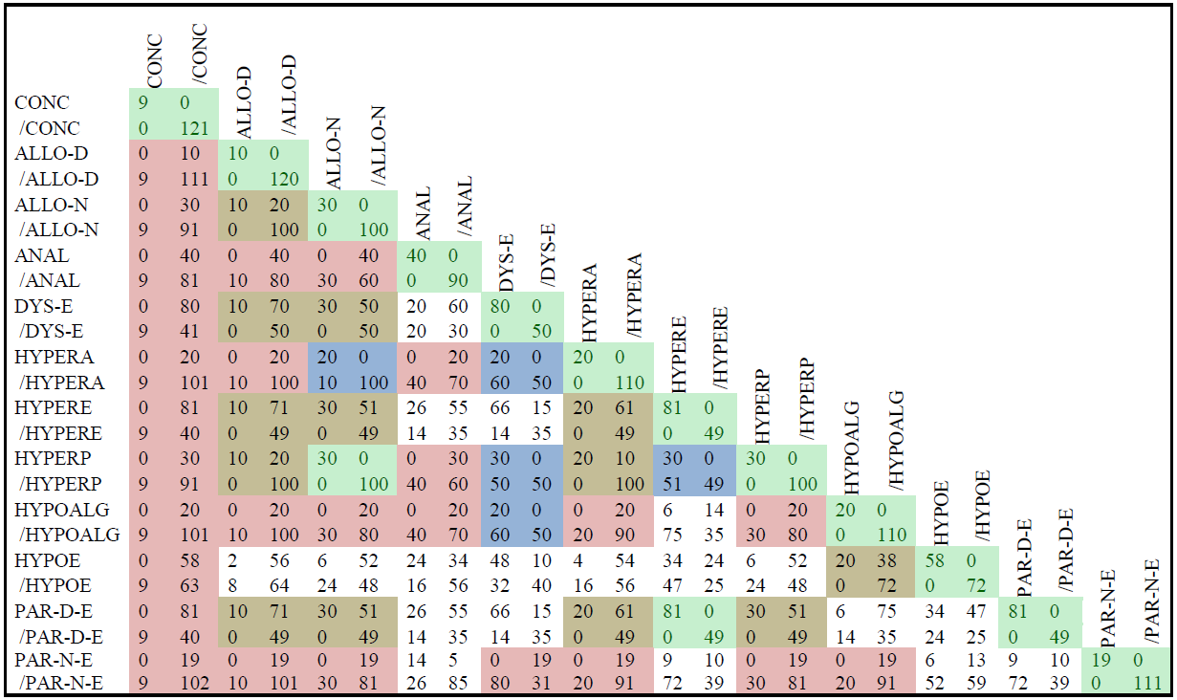
Results (2)
Only positives disjoint
Only pos/neg disjoint
Only neg/pos disjoint
Perfectly disjoint
Total overlap

Slide 19
Results (3)
An ideal terminology would be such that the classes defined are mutually disjoint.
For 12 (n) classes as is the case here, there are 66 possible overlaps ( n*(n-1)/2 ) between any pair of these classes, not counting overlap of a class with itself.
There is no overlap in only 2 cases of these 66:
(1) for hyperpathia versus allodynia (taking the note into account), and
(2) for hyperesthesia and paresthesia (when the note is not taken into account).

Slide 20
An alternative using 6 variables
Response expectation:
  Concordant - Discordant
Main finding:
  Absence – Presence - Configuration
Sensation expectation:
  Concordant - Discordant
Sensation intensity:
  hypOresponsive - hypErresponsive
Sensation mode:
  Modal – Unpleasant - Painful
Stimulation type:
  Subthreshold - Pain-specific
  Modus-specific - Bimodal
‘modal’: there is only a modal response which is not unpleasant or painful,
‘unpleasant’: the response is unpleasant but not painful, irrespective of whether there is a modal response as well,
‘painful’: there is only a painful response.
‘Subthreshold’: subthreshold stimulation for both pain and modus M,
‘bimodal’: an above threshold stimulation for both modus M and pain.

Slide 21
Alternative variables dependencies
(example)
When stimulus intensity is ‘subthreshold’, there is either
  (1) no response
    → response expectation is ‘concordant’,
    → main finding is ‘absence’,
    → all other variables have no value,
  (2) a response is present
    → response expectation and sensation expectation are both ‘discordant’,
    → main finding is ‘presence’,
    → sensation intensity to ‘hyper-responsive’.
The dependencies lower the total number of possibilities to 26, excluding the combinations with the value ‘configuration’ for main finding which are constructed by the boolean AND-ing and OR-ing of concordant and discordant situations.

Slide 22
An advantage of this setup
The terms for this terminology are all of the form:
    ‘(Response expectation) (Main finding) of (Sensation expectation) (Sensation intensity) (Sensation mode) sensation after (Stimulation type) stimulation’
  whereby the variables in italics are replaced by the terms for the allowed values, and the words in bold are constant.
  e.g.: ‘concordant absence of sensation after subthreshold stimulation’
  ‘discordant presence of discordant hyper-responsive modal sensation after subthreshold stimulation’.
Easy implementation for structured reporting.
Why would one invent extra names?

Slide 23
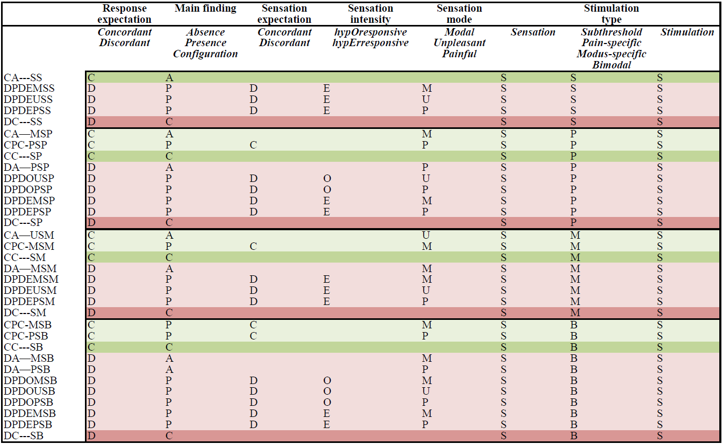

Slide 24
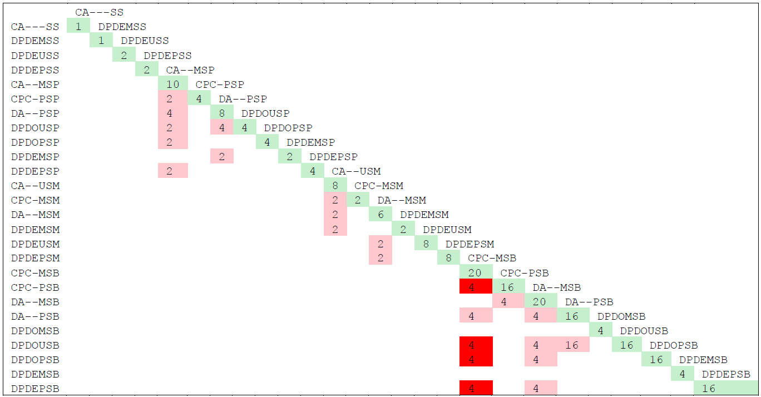
Reduction in overlap

Slide 25
Conclusion
The IASP terms do not satisfy the criteria for direct integration in a realism-based ontology.
A new terminology for stimulus based pain and somatosensory status assessment is proposed which exhibits less shortcomings in terms of overlap than the traditional terminology.
This is because in contrast to the traditional approach, this proposal does not underestimate the various stimulus/response combinations that may occur.

Slide 26
Acknowledgement
The work described is funded in part by
grant 1R01DE021917-01A1
from the National Institute of Dental and Craniofacial Research (NIDCR). The content of this presentation is solely the responsibility of the author and does not necessarily represent the official views of the NIDCR or the National Institutes of Health.

