Slide 1

Aboutness: Towards Foundations for the
Information Artifact Ontology
International Conference on Biomedical Ontology
July 29, 2015 – Lisbon, Portugal
Barry SMITH and Werner CEUSTERS
Department of Philosophy and Department of Biomedical Informatics
University at Buffalo

Slide 2
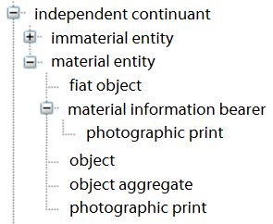
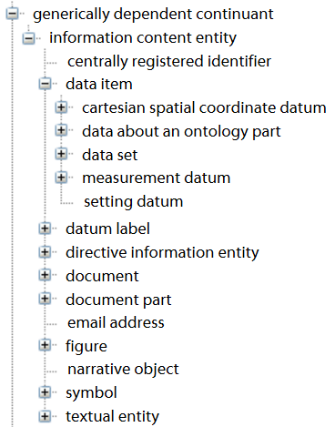
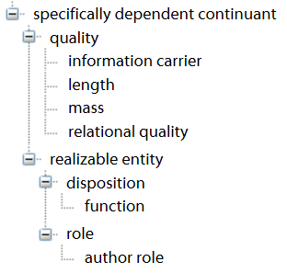
Information Artifact Ontology
(Release 2015-02-23 on BioPortal)
core entities

Slide 3
Information Content Entity
A journal article
A law
A price
A musical score
That which is communicated when I send an email
…

Slide 4
Specific dependence
a specifically depends on b = def.
a exists
and necessarily (if a exists then B exists)
for example:
    your headache is specifically dependent on your specific head
specifically dependent continuants (SDCs) cannot migrate from one bearer to another

Slide 5
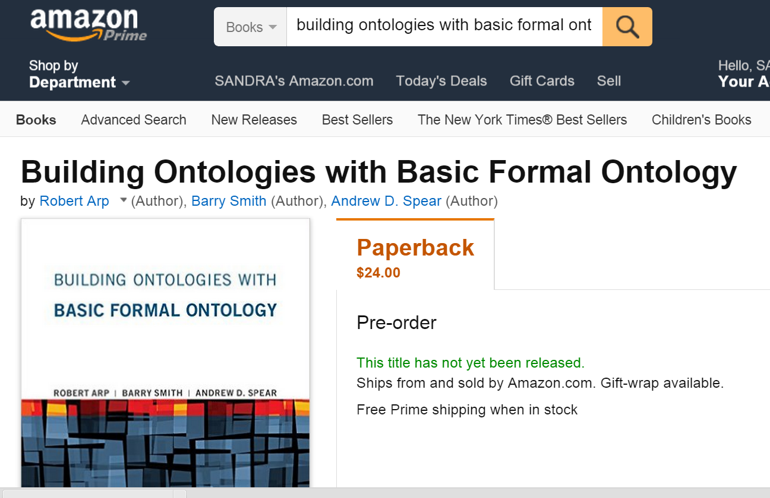
The MIT Press

Slide 6
Generic dependence
a generically depends on b = def.
a exists and b exists
and:
for some universal B, b instance_of B and necessarily
(if a exists then some B exists)
→ Generic dependence obtains where the first entity is dependent, not on some specific second entity, but rather merely on there being some second entity of the appropriate type.
Smith, B et al. (2015). Basic formal ontology 2.0 draft specification and user manual. from http://bfo.googlecode.com/svn/trunk/docs/bfo2-reference/BFO2-Reference.docx

Slide 7
Migration
specifically dependent continuants (SDCs) cannot migrate from one bearer to another
generically dependent continuants (GDCs) can migrate from one bearer to another
as when you copy a pdf file from one hard drive to another

Slide 8
Information Content Entity
Current IAO definition:
A generically dependent continuant that is about some thing (OWL version, 2015-02-23)
Earlier version:
  information content entity =def. an entity which is (1) generically dependent on (2) some material entity and which (3) stands in a relation of aboutness to some entity.
  (http://stids.c4i.gmu.edu/presentations/STIDS2013_Tutorial1_p2_Smith.pdf slide 77)

Slide 9
Information Content Entity
Current IAO definition:
A generically dependent continuant that is about some thing (OWL version, 2015-02-23)
Earlier version:
  information content entity =def. an entity which is (1) generically dependent on (2) some material entity and which (3) stands in a relation of aboutness to some entity.
  (http://stids.c4i.gmu.edu/presentations/STIDS2013_Tutorial1_p2_Smith.pdf slide 77)

Slide 10
Concretizations
A generically dependent entity is in each case concretized in some specifically dependent entity, more specifically in some BFO:quality (for example a pattern of ink marks)
x concretizes y at t means (= elucidation):
x is a quality & y is a generically dependent continuant
& for some material entity z,
x specifically_depends_on z at t &
y generically_depends_on z at t
& if y migrates from bearer z to another bearer w then
a copy of x will be created in w.

Slide 11
OBI represents all aspects of an investigation focusing on (planned) processes, their inputs and outputs, and their objectives
objective
specification
(ICE)
specimen
collection
objective
material
transformation
objective
data
transformation
objective
assay
objective
specimen
collecting
material
processing
data
processing
drawing a
conclusion
based on data
process
assay
inputs &
outputs
material
entity
processed
specimen
information
content entity
specimen
data item
data item
Core terms

Slide 12
OBI: Ontology for Biomedical Investigations
objective
specificatiosn
(ICEs)
specimen
collection
objective
material
transformation
objective
data
transformation
objective
assay
objective
specimen
collecting
material
processing
data
processing
drawing a
conclusion
based on data
processes
assay
inputs &
outputs
material
entity
processed
specimen
information
content entity
specimen
data item
data item
Core terms

Slide 13
objective
specifications
(ICEs)
specimen
collection
objective
material
transformation
objective
data
transformation
objective
assay
objective
inputs &
outputs
data item
data item
information
content entity
Core terms

Slide 14


objective
specifications
(ICEs)
specimen
collection
objective
material
transformation
objective
data
transformation
objective
assay
objective
inputs &
outputs
data item
data item
information
content entity
Core terms

Slide 15
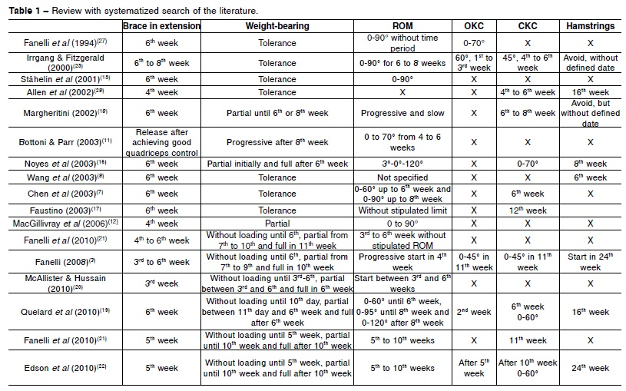
objective
specifications
(ICEs)
specimen
collection
objective
material
transformation
objective
data
transformation
objective
assay
objective
inputs &
outputs
data item
data item
information
content entity
Core terms

Slide 16
objective
specifications
(ICEs)
specimen
collection
objective
material
transformation
objective
data
transformation
objective
assay
objective
inputs &
outputs
data item
data item
information
content entity
as GDCs
as concretizations
Core terms

Slide 17

objective
specifications
(ICEs)
specimen
collection
objective
material
transformation
objective
data
transformation
objective
assay
objective
inputs &
outputs
data item
data item
information
content entity
as GDCs
as concretizations
Core terms

Slide 18
Qualities that concretize ICE are
Information Quality Entities
information quality entity (iqe) =def.
a quality that is the concretization of some information content entity (ice)
(Smith, B., Malyuta, T., Rudnicki, R., et al. (2013). Iao-intel: An ontology of information artifacts in the intelligence domain. Paper presented at the STIDS.)
Examples:
this DNA sequence is concretized in this specific ordering (pattern) of nucleotides in this molecule;
this sentence is concretized in this pattern of ink marks on this piece of paper (or also in this pattern of neuronal connections in this brain)
IQEs are called ‘information carriers’ in the IAO.

Slide 19
Questions left unanswered in the IAO though partially addressed elsewhere.
What is aboutness?
  Are the ICEs concretized in a textbook of medicine in the same way about something as the ICEs concretized in a James Bond novel?
How does aboutness compare to reference and denotation?
What are representations?
What is information?
    Is the very sentence on this slide of this PP presentation ‘Obama is President of the US’ information ?
    Will this sentence be information when this PP is viewed in 2017?
…

Slide 20
Proposal to address these questions
  information content entity =def.
  an entity which is
  (1) generically dependent on
  (2) some material entity and which
  (3) is_about some portion of reality.
where
x is_about y means:
x refers to or is cognitively directed towards y.
Domain: representations;
Range: portions of reality.
Axiom: if x is_about y then y exists (veridicality).

Slide 21
Enlarging the range of aboutness to portions of reality ¹
Thus including:
universals, for instance in the ICE concretized by the string there are no instances of dinosaur which survive,
relations, for instance in the ICE concretized by the string the part-whole relation is transitive,
other ICEs, for instance when someone asserts that what someone else just stated is false, and
configurations, for instance in the ICE concretized by Barack Obama is the current President of the USA.
  ¹ Ceusters W. An Information Artifact Ontology Perspective on Data Collections and Associated Representational Artifacts. Medical Informatics Europe Conference (MIE 2012), Pisa, Italy, August 26-29, 2012,
  Stud Health Technol Inform 2012;180:68-72

Slide 22
Cognitive directedness
Information artifacts do not bear information in and of themselves, but only because cognitive subjects associate representations of certain sorts with the patterns which they manifest.
  the doctrine of the ‘primacy of the intentional’
    Chisholm, R. M. (1984). The primacy of the intentional. Synthese, 61(1), 89-109. doi: Doi 10.1007/Bf00485490
Information = grounded representation
  the entry 72 beats per minute is about what it is about because of what the nurse himself directly observed when he measured the patient’s pulse.
Mis-information = ungrounded representation
  Le Verrier wrote ‘about’ ‘Vulcan’. This intended reference depended on a certain – false - belief on Le Verrier’s part in the existence of an intra-Mercurial planet.
Mis-information is not a special kind of information!

Slide 23
Representations
Representation: an idea, image, record, or description which refers to (is of or about), or is intended to refer to, some entity or entities external to the representation.
Smith, B., Kusnierczyk, W., Schober, D., & Ceusters, W. (2006). Towards a reference terminology for ontology research and development in the biomedical domain Kr-med 2006, biomedical ontology in action. Baltimore MD, USA
Formal definitions:
  representation =def. a quality which is_about or is intended to be about a portion of reality (por).
  mental quality =def. a quality which specifically depends on an anatomical structure in the cognitive system of an organism.
  cognitive representation =def. a representation which is a mental quality.
Ceusters, W., & Smith, B. (2010). Foundations for a realist ontology of mental disease. Journal of Biomedical Semantics, 1(10), 1-23. doi: 10.1186/2041-1480-1-10

Slide 24
Representational unit
Informal definition:
  the smallest constituent sub-representations, including icons, names, simple word forms, or the sorts of alphanumeric identifiers we might find in patient records.
  Smith, B., Kusnierczyk, W., Schober, D., & Ceusters, W. (2006). Towards a reference terminology for ontology research and development in the biomedical domain Kr-med 2006, biomedical ontology in action. Baltimore MD, USA

Slide 25
Types of Representational Units
Referring representational unit (RRU): an RU which is both intended to be about something and does indeed succeed in this intent. ‘Paris’
Non-referring representational unit (NRU): an RU which, for whatever reason, fails to be about anything. ‘Middle Earth’
Unrecognized non-referring representational unit (UNRU): an NRU which, although non-referring, is intended and believed to be about something; ‘Vulcan’ (as used by Le Verrier in 1860)
Recognized non-referring representational unit (RNRU): an NRU which was once intended and believed to be about something, but which, as a result of advances in knowledge, is no longer believed to be so; ‘Vulcan’ (as used in Star Trek)
Representational unit component (RUC): a component of a representational artifact that is not intended by the artifact’s authors to refer in isolation; ‘Le’ in ‘Le Verrier’
Ceusters, W., & Smith, B. (2010). Foundations for a realist ontology of mental disease.
Journal of Biomedical Semantics, 1(10), 1-23. doi:10.1186/2041-1480-1-10

Slide 26
Types of Representational Units
Referring representational unit (RRU): ‘Paris’
Non-referring representational unit (NRU ‘Middle Earth’
Unrecognized non-referring representational unit (UNRU): ‘Vulcan’ (as used by Le Verrier in 1860)
Recognized non-referring representational unit (RNRU): ‘Vulcan’ (as used in Star Trek)
Representational unit component (RUC): ‘Le’ in ‘Le Verrier’
Ceusters, W., & Smith, B. (2010). Foundations for a realist ontology of mental disease.
Journal of Biomedical Semantics, 1(10), 1-23. doi:10.1186/2041-1480-1-10

Slide 27
Case study
Written on a piece of paper today
Obama is President of the United States

Slide 28
Case study
Written on a piece of paper today
Obama is President of the United States

Slide 29
Case study
Written on a piece of paper today
Obama is President of the United States

Slide 30
Case study
Written on a piece of paper today
Obama is President of the United States
PORTION OF REALITY (CONFIGURATION)

Slide 31
Case study
Written on a piece of paper today
Obama is President of Russia

Slide 32
Case study
Written on a piece of paper today
Obama is President of Russia

Slide 33
Case study
Written on a piece of paper today
Obama is President of Russia

Slide 34
Proposed new relationships (1)
x is_a_direct_cognitive_representation_of y means:
x is a cognitive representation in some subject s
& x is_about y
& x comes into existence as a result of a causal process initiated by y and in a way appropriate to y, in the cognitive system of s.

Slide 35
Proposed new relationships (2)
x is_a_representation_of y =def.
x is a representa­tion
& x is_about y
x is_conformant_to y =def.
x is an information quality entity
& y is a cognitive representa­tion
& there is some GDC g such that x concretizes g and y concretizes g.
Example: x is a sentence on a piece of paper, y is the belief of the author of the sentence who wrote the sentence as an expression of her belief, and g is the ICE (the content) that belief and sentence share.

Slide 36
Remarks (1)
No requirement that the subject of a veridical representation knows what the portion of reality is that his representation is about.
    A cat can see a mass cytometer
The case of believers in the Higgs boson before there was evidence for its existence
shows that there is no requirement that aboutness must imply that the subject knows that what he is representing exists
he must merely believe that it exists.

Slide 37
Remarks (2)
It is a requirement that the target of aboutness be a portion of reality (POR)
But no requirement that the relevant POR exists at the time when the associated cognitive representation exists.
    Thus a patient can contemplate a past disorder, for instance by regretting his not having accepted the advice of some clinician.

Slide 38
Acknowledgement
We are grateful to
            Tatiana Malyuta
            Ron Rudnicki
            Alan Ruttenberg

Slide 39
Information Artifact
artifact =def. a material entity created or modified or selected by some agent to realize a certain function or role
(Examples: a key, a lock, a screwdriver)
information artifact =def. an artifact whose function is to bear an information quality entity.
(Examples: a hard drive, a traffic sign, a printed form, a passport, a currency note, an RFID chip, a SIM card)

