Slide 1

Clinical Data Wrangling using
Ontological Realism and Referent Tracking
International Conference on Biomedical Ontology
October 6-9, 2014 – Cooley Center, Houston, TX
Werner CEUSTERS, MD
Chiun Yu HSU, PhD and Barry SMITH, PhD
Professor, Department of Biomedical Informatics, University at Buffalo
Director, National Center for Ontological Research
Director of Research, UB Institute for Healthcare Informatics

Slide 2
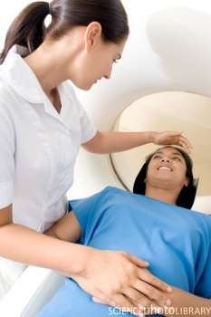
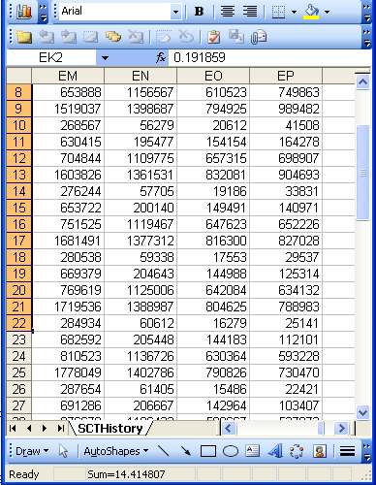
Data and Reality
Referents
References

Slide 3
A non-trivial relation
Referents
References

Slide 4
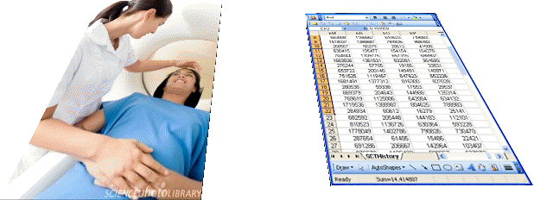
What makes it non-trivial?
Referents
  are (meta-) physically the way they are,
  relate to each other in an objective way,
  follow laws of nature.
Window on reality
  restricted by:
  what is physically and technically observable,
  fit between what is measured and what we think is measured,
  fit between established knowledge and laws of nature.
References
  follow, ideally, the syntactic-semantic conventions of some representation language,
  are restricted by the expressivity of that language,
  to be interpreted correctly, reference collections need external documentation.

Slide 5
What makes it non-trivial?
Referents
  are (meta-) physically the way they are,
  relate to each other in an objective way,
  follow laws of nature.
Window on reality
  restricted by:
  what is physically and technically observable,
  fit between what is measured and what we think is measured,
  fit between established knowledge and laws of nature.
References
  follow, ideally, the syntactic-semantic conventions of some representation language,
  are restricted by the expressivity of that language,
  to be interpreted correctly, reference collections need external documentation.
L1: what is real L2: beliefs L3: representations

Slide 6
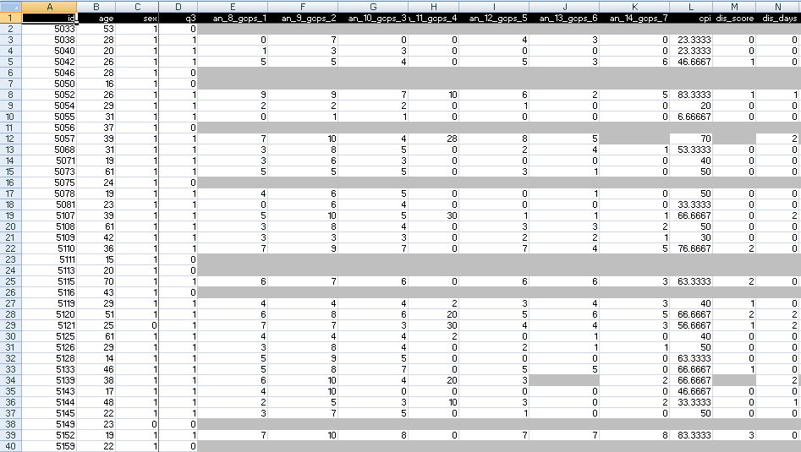
A colleague shares his research data set

Slide 7
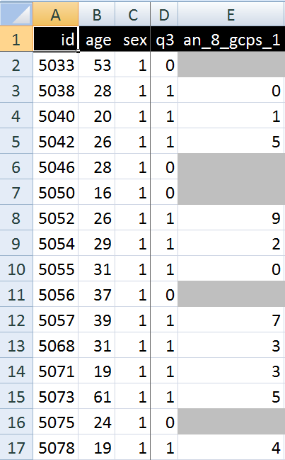
A closer look
What are you going to ask him first of all?
What do these various values stand for and how do they relate to each other?
  Might this mean that patient #5057 at the age of 39 had only once had sex?

Slide 8
Supporting documentation: ‘codebook’
Field Name | Description | Type | Missing Value | Range |  | Coding Values
id | Subject id | numeric | none | [5033,6387]
age | Subject’s age | Numeric | None | [14,85] |  | Age in years
sex | Subject’s gender | 0/1 | none |  |  | 0 – male, 1 - female
q3 | Have you had pain in the face, jaw, temple, in front of the ear or in the ear in the past month? | 0/1 | none |  |  | 0 – no, 1 - yes
The next 12 variables are from the Graded Chronic Pain Status in the RDC/TMD
an_8_gcps_1 | How would you rate your facial pain on a 0 to 10 scale at the present time, that is right now, where 0 is "no pain" and 10 is "pain as bad as could be"? | numeric | “.” | 0-10 | 0 – no pain to 10 - Pain as bad as could be
an_9_gcps_2 | In the past six months, how intense was your worst pain rated on a 0 to 10 scale where 0 is "no pain" and 10 is "pain as bad as could be"? | numeric | “.” | 0-10 | 0 – no pain to 10 - Pain as bad as could be

Slide 9
Further questions
Field Name | Description | Type | Missing Value | Range |  | Coding Values
id | Subject id | numeric | none | [5033,6387]
age | Subject’s age | Numeric | None | [14,85] |  | Age in years
sex | Subject’s gender | 0/1 | none |  |  | 0 – male, 1 - female
q3 | Have you had pain in the face, jaw, temple, in front of the ear or in the ear in the past month? | 0/1 | none |  |  | 0 – no, 1 - yes
The next 12 variables are from the Graded Chronic Pain Status in the RDC/TMD
an_8_gcps_1 | How would you rate your facial pain on a 0 to 10 scale at the present time, that is right now, where 0 is "no pain" and 10 is "pain as bad as could be"? | numeric | “.” | 0-10 | 0 – no pain to 10 - Pain as bad as could be
an_9_gcps_2 | In the past six months, how intense was your worst pain rated on a 0 to 10 scale where 0 is "no pain" and 10 is "pain as bad as could be"? | numeric | “.” | 0-10 | 0 – no pain to 10 - Pain as bad as could be
Is this accidental or a consequence of inclusion criteria ?

Slide 10
Further questions
Field Name | Description | Type | Missing Value | Range |  | Coding Values
id | Subject id | numeric | none | [5033,6387]
age | Subject’s age | Numeric | None | [14,85] |  | Age in years
sex | Subject’s gender | 0/1 | none |  |  | 0 – male, 1 - female
q3 | Have you had pain in the face, jaw, temple, in front of the ear or in the ear in the past month? | 0/1 | none |  |  | 0 – no, 1 - yes
The next 12 variables are from the Graded Chronic Pain Status in the RDC/TMD
an_8_gcps_1 | How would you rate your facial pain on a 0 to 10 scale at the present time, that is right now, where 0 is "no pain" and 10 is "pain as bad as could be"? | numeric | “.” | 0-10 | 0 – no pain to 10 - Pain as bad as could be
an_9_gcps_2 | In the past six months, how intense was your worst pain rated on a 0 to 10 scale where 0 is "no pain" and 10 is "pain as bad as could be"? | numeric | “.” | 0-10 | 0 – no pain to 10 - Pain as bad as could be
Is the present time included in the past six months?

Slide 11
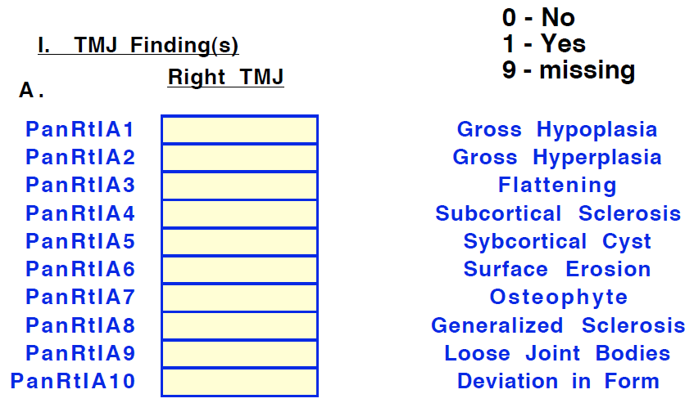
Les rigorous codebook

Slide 12
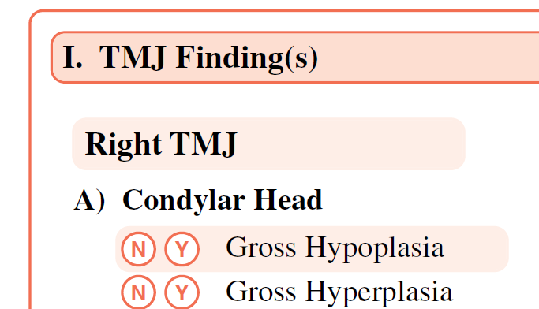
Lost in translation

Slide 13
Dependencies in SAS files
/* No arthralgia or presence */
/* of coarse crepitus, then */
/* arthralgia diagnosis */
/* not present */
if aralgl1=0 or
( e50plt in (2,12) or e5cllt in (2,12 )
or e7lrt in (2,12) or e7llt in (2,12 )
or e7lprot in (2,12)
) then
aralgl=O;
← Absence of symptom
← Absence of diagnosis or diagnosis of absence of arthralgia?

Slide 14
Dependencies in SAS files
Missing values (unjustified absence)
if not(q3 in (O,l)) then q3=.;
if not(q14a in (0,1) then q14a=.;
if not (q14b in (0,1,8) then q14b=.;
if q14a eq 0 then q14b=8;
Not applicable values (justified absence)
if e50plt in (0,2,3 ) then e50pmslt=88;

Slide 15
Vision
Data repositories should be :
maximally explicit → each such repository should contain explicit reference to any and all the entities, including their interrelationships, that must exist for an assertion encoded in the repository to be a faithful representation of the corresponding part of reality.
maximally self-explanatory → the data in the repository should be presented in such a way that a researcher seeking to query/analyze the repository does not need to concern himself with any idiosyncrasies of and inconsistencies between datasets, or codes or formats, that were combined or used to build the repository.
How to get there?

Slide 16
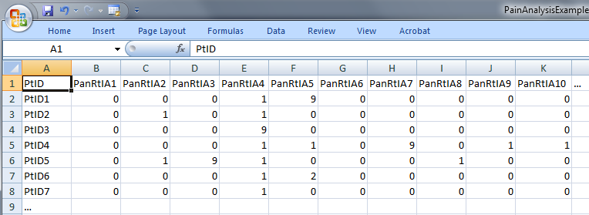
Step 1: ‘meaning’ of values in data collections
‘The patient with patient identifier ‘PtID4’ is stated to have had a panoramic X-ray of the mouth which is interpreted to show subcortical sclerosis of that patient’s condylar head of the right temporomandibular joint’
meaning
1

Slide 17
Step 2 (1): list the entities denoted and assign Instance Unique Identifiers (IUI)
1(The patient) with 2(patient identifier ‘PtID4’) 3(is stated) 4(to have had) a 5(panoramic X-ray) of 6(the mouth) which 7(is interpreted) to 8(show) 9(subcortical sclerosis of 10(that patient’s condylar head of the 11(right temporomandibular joint)))’
CLASS | INSTANCE IDENTIFIER
person | IUI-1
patient identifier | IUI-2
assertion | IUI-3
technically investigating | IUI-4
panoramic X-ray | IUI-5
mouth | IUI-6
interpreting | IUI-7
seeing | IUI-8
diagnosis | IUI-9
condylar head of right TMJ | IUI-10
right TMJ | IUI-11
notes: colors have no meaning here, just provide easy reference,
this first list can be different, any such differences being resolved in step 3

Slide 18
Step 2 (2): provide directly referential descriptions
CLASS | INSTANCE IDENTIFIER | DIRECTLY REFERENTIAL DESCRIPTIONS
person | IUI-1 | the person to whom IUI-2 is assigned
patient identifier | IUI-2 | the patient identifier of IUI-1
assertion | IUI-3 | 'the patient with patient identifier PtID4 has had a panoramic X-ray of the mouth which is interpreted to show subcortical sclerosis of that patient’s right temporomandibular joint'
technically investigating | IUI-4 | the technically investigating of IUI-6
panoramic X-ray | IUI-5 | the panoramic X-ray that resulted from IUI-4
mouth | IUI-6 | the mouth of IUI-1
interpreting | IUI-7 | the interpreting of the signs exhibited by IUI-5
seeing | IUI-8 | the seeing of IUI-5 which led to IUI-7
diagnosis | IUI-9 | the diagnosis expressed by means of IUI-3
condylar head of right TMJ | IUI-10 | the condylar head of the right TMJ of IUI-1
right TMJ | IUI-11 | the right TMJ of IUI-1

Slide 19
Step 3: identify further entities that ontologically must exist for each entity under scrutiny to exist.
assigner role | IUI-12 | the assigner role played by the entity while it performed IUI-21
assigning | IUI-21 | the assigning of IUI-2 to IUI-1 by the entity with role IUI-12
asserting | IUI-20 | the asserting of IUI-3 by the entity with asserter role IUI-13
asserter role | IUI-13 | the asserter role played by the entity while it performed IUI-20
investigator role | IUI-14 | the investigator role played by the entity while it performed IUI-4
panoramic X-ray machine | IUI-15 | the panoramic X-ray machine used for performing IUI-4
image bearer | IUI-16 | the image bearer in which IUI-5 is concretized and that participated in IUI-8
interpreter role | IUI-17 | the interpreter role played by the entity while it performed IUI-7
perceptor role | IUI-18 | the perceptor role played by the entity while it performed IUI-8
diagnostic criteria | IUI-19 | the diagnostic criteria used by the entity that performed IUI-7 to come to IUI-9
study subject role | IUI-22 | the study subject role which inheres in IUI-1

Slide 20
Step 3: some remarks
interpreter role, perceiver role, …
  reference to roles rather than the entity in which the roles inhere because it may be the same entity and one should not assign several IUIs to the same entity,
    It cannot always be avoided, but if it can be, it should be.
each description follows similar principles as Aristotelian definitions but is about particulars rather than universals.

Slide 21
Step 4: classify all entities in terms of – ideally but not necessary – realism-based ontologies
CLASS | HIGHER CLASS
person | BFO: Object
patient identifier | IAO: Information Content Entity
assertion | IAO: Information Content Entity
technically investigating | OBI: Assay
panoramic X-ray | IAO: Image
mouth | FMA: Mouth
interpreting | MFO: Assessing
seeing | BFO: Process
diagnosis | IAO: Information Content Entity
condylar head of right TMJ | FMA: Right condylar process of mandible
right TMJ | FMA: Right temporomandibular joint
assigner role | BFO: Role
assigning | BFO: Process
study subject role | OBI: Study subject role

Slide 22
Step 5: specify relationships between these entities
For instance:
  at least during the taking of the X-ray the study subject role inheres in the patient being investigated:
    IUI-23 inheres-in IUI-1 during t1
  the patient participates at that time in the investigation
    IUI-4 has-participant IUI-1 during t1
These relations need to follow the principles of the Relation Ontology.
Smith B, Ceusters W, Klagges B, Koehler J, Kumar A, Lomax J, Mungall C, Neuhaus F, Rector A, Rosse C. Relations in biomedical ontologies, Genome Biology 2005, 6:R46.

Slide 23
Step 6: outline all possible configurations of such entities for the sentence to be true
Such outlines are collections of relational expressions of the sort just described,
Variant configurations for the example:
  perceiver and interpreter are the same or distinct human beings,
  the X-ray machine is unreliable and produced artifacts which the interpreter thought to be signs motivating his diagnosis, while the patient has indeed the disorder specified by the diagnosis (the clinician was lucky)
  …

Slide 24
Then for each dataset
Build a formal template which describes:
  the results of steps 1-6 of the 1st order analysis,
  the relationships between:
    the 1st order entities and the corresponding data items in the data set,
    data items themselves.
Generate on the basis of the template for each subject (patient) in the dataset an RT-compatible representation of his 1st and 2nd order entities.

Slide 25
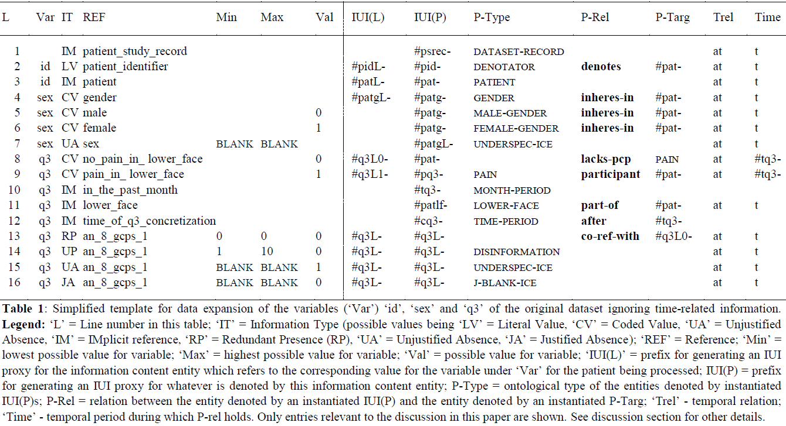
The template for one specific dataset
‘conditional part’
‘RT-compatible part’

Slide 26
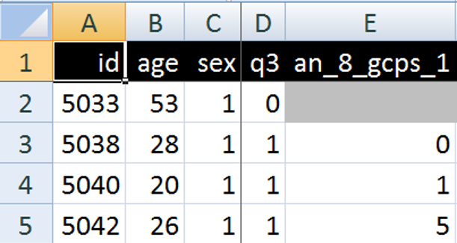
RT compatible part of the template
IUI(L) | IUI(P) | P-Type | P-Rel | P-Targ | Trel | Time
 | #psrec- | dataset-record |  |  | at | t
#pidL- | #pid- | denotator | denotes | #pat- | at | t
#patL- | #pat- | patient |  |  | at | t
#patgL- | #patg- | gender | inheres-in | #pat- | at | t
 | #patg- | male-gender | inheres-in | #pat- | at | t
 | #patg- | female-gender | inheres-in | #pat- | at | t
 | #patgL- | underspec-ice |  |  | at | t

Slide 27
Instantiated RT-part of the template
IUI(L) | IUI(P) | P-Type | P-Rel | P-Targ | Trel | Time
 | #psrec-5033 | dataset-record |  |  | at | t
#pidL-5033 | #pid-5033 | denotator | denotes | #pat-5033 | at | t
#patL-5033 | #pat-5033 | patient |  |  | at | t
#patgL-5033 | #patg-5033 | gender | inheres-in | #pat-5033 | at | t
 | #patg-5033 | male-gender | inheres-in | #pat-5033 | at | t
 | #patg-5033 | female-gender | inheres-in | #pat-5033 | at | t
 | #patgL-5033 | underspec-ice |  |  | at | t

Slide 28
Data versus what it is about
IUI(L) | IUI(P) | P-Type | P-Rel | P-Targ | Trel | Time
 | #psrec-5033 | dataset-record |  |  | at | t
#pidL-5033 | #pid-5033 | denotator | denotes | #pat-5033 | at | t
#patL-5033 | #pat-5033 | patient |  |  | at | t
#patgL-5033 | #patg-5033 | gender | inheres-in | #pat-5033 | at | t
 | #patg-5033 | male-gender | inheres-in | #pat-5033 | at | t
 | #patg-5033 | female-gender | inheres-in | #pat-5033 | at | t
 | #patgL-5033 | underspec-ice |  |  | at | t
IUI denoting the Information Content Entity (ICE) of which the contents of this row is a concretization.

Slide 29
Data versus what it is about
IUI(L) | IUI(P) | P-Type | P-Rel | P-Targ | Trel | Time
 | #psrec-5033 | dataset-record |  |  | at | t
#pidL-5033 | #pid-5033 | denotator | denotes | #pat-5033 | at | t
#patL-5033 | #pat-5033 | patient |  |  | at | t
#patgL-5033 | #patg-5033 | gender | inheres-in | #pat-5033 | at | t
 | #patg-5033 | male-gender | inheres-in | #pat-5033 | at | t
 | #patg-5033 | female-gender | inheres-in | #pat-5033 | at | t
 | #patgL-5033 | underspec-ice |  |  | at | t
IUI denoting the Information Content Entity (ICE) of which the contents of this cell is a concretization.

Slide 30
Data versus what it is about
IUI(L) | IUI(P) | P-Type | P-Rel | P-Targ | Trel | Time
 | #psrec-5033 | dataset-record |  |  | at | t
#pidL-5033 | #pid-5033 | denotator | denotes | #pat-5033 | at | t
#patL-5033 | #pat-5033 | patient |  |  | at | t
#patgL-5033 | #patg-5033 | gender | inheres-in | #pat-5033 | at | t
 | #patg-5033 | male-gender | inheres-in | #pat-5033 | at | t
 | #patg-5033 | female-gender | inheres-in | #pat-5033 | at | t
 | #patgL-5033 | underspec-ice |  |  | at | t
IUI denoting the (real) person of which the content of this cell concretizes that person’s patient ID.

Slide 31
Data versus what it is about
IUI(L) | IUI(P) | P-Type | P-Rel | P-Targ | Trel | Time
 | #psrec-5033 | dataset-record |  |  | at | t
#pidL-5033 | #pid-5033 | denotator | denotes | #pat-5033 | at | t
#patL-5033 | #pat-5033 | patient |  |  | at | t
#patgL-5033 | #patg-5033 | gender | inheres-in | #pat-5033 | at | t
 | #patg-5033 | male-gender | inheres-in | #pat-5033 | at | t
 | #patg-5033 | female-gender | inheres-in | #pat-5033 | at | t
 | #patgL-5033 | underspec-ice |  |  | at | t
IUI denoting the gender of the (real) person.
The content of this cell concretizes what type of gender that person’s gender is an instance of.

Slide 32
Data versus what it is about
IUI(L) | IUI(P) | P-Type | P-Rel | P-Targ | Trel | Time
 | #psrec-5033 | dataset-record |  |  | at | t
#pidL-5033 | #pid-5033 | denotator | denotes | #pat-5033 | at | t
#patL-5033 | #pat-5033 | patient |  |  | at | t
#patgL-5033 | #patg-5033 | gender | inheres-in | #pat-5033 | at | t
 | #patg-5033 | male-gender | inheres-in | #pat-5033 | at | t
 | #patg-5033 | female-gender | inheres-in | #pat-5033 | at | t
 | #patgL-5033 | underspec-ice |  |  | at | t
IUI of the ICE of which the content of this cell concretizes what type of gender #patg-5033 is an instance of.

Slide 33
Interpretation of instantiated template
IUI(L) | IUI(P) | P-Type | P-Rel | P-Targ | Trel | Time
 | #psrec-5033 | dataset-record |  |  | at | t
#pidL-5033 | #pid-5033 | denotator | denotes | #pat-5033 | at | t
#patL-5033 | #pat-5033 | patient |  |  | at | t
#patgL-5033 | #patg-5033 | gender | inheres-in | #pat-5033 | at | t
 | #patg-5033 | male-gender | inheres-in | #pat-5033 | at | t
 | #patg-5033 | female-gender | inheres-in | #pat-5033 | at | t
 | #patgL-5033 | underspec-ice |  |  | at | t
#psrec-5033 instance-of Dataset-Record at t
(note: assignment of appropriate time-indexes not covered in these examples)

Slide 34
Interpretation of instantiated template
IUI(L) | IUI(P) | P-Type | P-Rel | P-Targ | Trel | Time
 | #psrec-5033 | dataset-record |  |  | at | t
#pidL-5033 | #pid-5033 | denotator | denotes | #pat-5033 | at | t
#patL-5033 | #pat-5033 | patient |  |  | at | t
#patgL-5033 | #patg-5033 | gender | inheres-in | #pat-5033 | at | t
 | #patg-5033 | male-gender | inheres-in | #pat-5033 | at | t
 | #patg-5033 | female-gender | inheres-in | #pat-5033 | at | t
 | #patgL-5033 | underspec-ice |  |  | at | t
#patg-5033 instance-of Gender at t
AND
#patg-5033 inheres-in #pat-5033 at t
(note: assignment of appropriate time-indexes not covered in these examples)

Slide 35
Interpretation of instantiated template
IUI(L) | IUI(P) | P-Type | P-Rel | P-Targ | Trel | Time
 | #psrec-5033 | dataset-record |  |  | at | t
#pidL-5033 | #pid-5033 | denotator | denotes | #pat-5033 | at | t
#patL-5033 | #pat-5033 | patient |  |  | at | t
#patgL-5033 | #patg-5033 | gender | inheres-in | #pat-5033 | at | t
 | #patg-5033 | male-gender | inheres-in | #pat-5033 | at | t
 | #patg-5033 | female-gender | inheres-in | #pat-5033 | at | t
 | #patgL-5033 | underspec-ice |  |  | at | t
Cannot both be true at the same time!
This template is never instantiated in total but only in part, which parts thereby being determined on the basis of
conditions specified in the conditional part of the
template (not shown here).
(note: assignment of appropriate time-indexes not covered in these examples)

Slide 36
Conditional part of template for 3 variables
L | Var | IT | REF | Min | Max | Val
1 |  | IM | patient_study_record
2 | id | LV | patient_identifier
3 | id | IM | patient
4 | sex | CV | gender
5 | sex | CV | male |  |  | 0
6 | sex | CV | female |  |  | 1
7 | sex | UA | sex | BLANK | BLANK
8 | q3 | CV | no_pain_in_ lower_face |  |  | 0
9 | q3 | CV | pain_in_ lower_face |  |  | 1
10 | q3 | IM | in_the_past_month
11 | q3 | IM | lower_face
12 | q3 | IM | time_of_q3_concretization
13 | q3 | RP | an_8_gcps_1 | 0 | 0 | 0
14 | q3 | UP | an_8_gcps_1 | 1 | 10 | 0
15 | q3 | UA | an_8_gcps_1 | BLANK | BLANK | 1
16 | q3 | JA | an_8_gcps_1 | BLANK | BLANK | 0

Slide 37
Names of variables
L | Var | IT | REF | Min | Max | Val
1 |  | IM | patient_study_record
2 | id | LV | patient_identifier
3 | id | IM | patient
4 | sex | CV | gender
5 | sex | CV | male |  |  | 0
6 | sex | CV | female |  |  | 1
7 | sex | UA | sex | BLANK | BLANK
8 | q3 | CV | no_pain_in_ lower_face |  |  | 0
9 | q3 | CV | pain_in_ lower_face |  |  | 1
10 | q3 | IM | in_the_past_month
11 | q3 | IM | lower_face
12 | q3 | IM | time_of_q3_concretization
13 | q3 | RP | an_8_gcps_1 | 0 | 0 | 0
14 | q3 | UP | an_8_gcps_1 | 1 | 10 | 0
15 | q3 | UA | an_8_gcps_1 | BLANK | BLANK | 1
16 | q3 | JA | an_8_gcps_1 | BLANK | BLANK | 0
Names of variables as they appear in the original dataset

Slide 38
Variable descriptions and dependencies
L | Var | IT | REF | Min | Max | Val
1 |  | IM | patient_study_record
2 | id | LV | patient_identifier
3 | id | IM | patient
4 | sex | CV | gender
5 | sex | CV | male |  |  | 0
6 | sex | CV | female |  |  | 1
7 | sex | UA | sex | BLANK | BLANK
8 | q3 | CV | no_pain_in_ lower_face |  |  | 0
9 | q3 | CV | pain_in_ lower_face |  |  | 1
10 | q3 | IM | in_the_past_month
11 | q3 | IM | lower_face
12 | q3 | IM | time_of_q3_concretization
13 | q3 | RP | an_8_gcps_1 | 0 | 0 | 0
14 | q3 | UP | an_8_gcps_1 | 1 | 10 | 0
15 | q3 | UA | an_8_gcps_1 | BLANK | BLANK | 1
16 | q3 | JA | an_8_gcps_1 | BLANK | BLANK | 0
Either a textual description for an entity (or configuration of entities) that must exist for the corresponding ‘var’ to make sense,
OR,
a variable name from the ‘Var’ column which stands in some relation to the ‘var’ in the REF-column

Slide 39
Variable names and value ranges
L | Var | IT | REF | Min | Max | Val
1 |  | IM | patient_study_record
2 | id | LV | patient_identifier
3 | id | IM | patient
4 | sex | CV | gender
5 | sex | CV | male |  |  | 0
6 | sex | CV | female |  |  | 1
7 | sex | UA | sex | BLANK | BLANK
8 | q3 | CV | no_pain_in_ lower_face |  |  | 0
9 | q3 | CV | pain_in_ lower_face |  |  | 1
10 | q3 | IM | in_the_past_month
11 | q3 | IM | lower_face
12 | q3 | IM | time_of_q3_concretization
13 | q3 | RP | an_8_gcps_1 | 0 | 0 | 0
14 | q3 | UP | an_8_gcps_1 | 1 | 10 | 0
15 | q3 | UA | an_8_gcps_1 | BLANK | BLANK | 1
16 | q3 | JA | an_8_gcps_1 | BLANK | BLANK | 0
Values and value ranges – for the ‘Var’-variable if ‘Val’ is empty OR for the ‘REF’-variable otherwise – as they may appear in the dataset.
Variable names as they appear in the original dataset

Slide 40
Information Types for variable/value combinations
L | Var | IT | REF | Min | Max | Val
1 |  | IM | patient_study_record
2 | id | LV | patient_identifier
3 | id | IM | patient
4 | sex | CV | gender
5 | sex | CV | male |  |  | 0
6 | sex | CV | female |  |  | 1
7 | sex | UA | sex | BLANK | BLANK
8 | q3 | CV | no_pain_in_ lower_face |  |  | 0
9 | q3 | CV | pain_in_ lower_face |  |  | 1
10 | q3 | IM | in_the_past_month
11 | q3 | IM | lower_face
12 | q3 | IM | time_of_q3_concretization
13 | q3 | RP | an_8_gcps_1 | 0 | 0 | 0
14 | q3 | UP | an_8_gcps_1 | 1 | 10 | 0
15 | q3 | UA | an_8_gcps_1 | BLANK | BLANK | 1
16 | q3 | JA | an_8_gcps_1 | BLANK | BLANK | 0
Indicator for the Information Type to which the ‘Var’ belongs as determined by the pattern instantiated through the contents of ‘REF’, ‘Min’, ‘Max’, and ‘Val’ on the same ‘L’(ine):
      LV: Literal value
      CV: Coded Value
      IM: Implicit
      JA: Justified Absence
      UA: Unjustified Absence
      UP: Unjustified Presence
      RP: Redundant Presence

Slide 41
Implicit information
L | Var | IT | REF | Min | Max | Val
1 |  | IM | patient_study_record
2 | id | LV | patient_identifier
3 | id | IM | patient
4 | sex | CV | gender
5 | sex | CV | male |  |  | 0
6 | sex | CV | female |  |  | 1
7 | sex | UA | sex | BLANK | BLANK
8 | q3 | CV | no_pain_in_ lower_face |  |  | 0
9 | q3 | CV | pain_in_ lower_face |  |  | 1
10 | q3 | IM | in_the_past_month
11 | q3 | IM | lower_face
12 | q3 | IM | time_of_q3_concretization
13 | q3 | RP | an_8_gcps_1 | 0 | 0 | 0
14 | q3 | UP | an_8_gcps_1 | 1 | 10 | 0
15 | q3 | UA | an_8_gcps_1 | BLANK | BLANK | 1
16 | q3 | JA | an_8_gcps_1 | BLANK | BLANK | 0

Slide 42
Condition-based IT determination (1)
L | Var | IT | REF | Min | Max | Val
8 | q3 | CV | no_pain_in_ lower_face |  |  | 0
9 | q3 | CV | pain_in_ lower_face |  |  | 1
11 | q3 | IM | lower_face
In case ‘REF’ does not contain a variable name from somewhere under ‘Var’:
If
the value for Var is as indicated by Val,
OR
there is no value for Var at all,
then
the presence or absence of the corresponding data item is of a sort indicated by IT.

Slide 43
Condition-based IT determination (2)
L | Var | IT | REF | Min | Max | Val
7 | sex | UA | sex | BLANK | BLANK
13 | q3 | RP | an_8_gcps_1 | 0 | 0 | 0
14 | q3 | UP | an_8_gcps_1 | 1 | 10 | 0
15 | q3 | UA | an_8_gcps_1 | BLANK | BLANK | 1
16 | q3 | JA | an_8_gcps_1 | BLANK | BLANK | 0
In case ‘REF’ does contain a variable name from somewhere under ‘Var’:
If the value of REF is either outside the range of Min/Max or ‘BLANK’
and
the value for Var is as indicated by Val, including no value at all,
then
the presence or absence of the corresponding data item is of a sort indicated by RT.

Slide 44
Condition-based IT determination (2)
L | Var | IT | REF | Min | Max | Val
7 | sex | UA | sex | BLANK | BLANK
13 | q3 | RP | an_8_gcps_1 | 0 | 0 | 0
14 | q3 | UP | an_8_gcps_1 | 1 | 10 | 0
15 | q3 | UA | an_8_gcps_1 | BLANK | BLANK | 1
16 | q3 | JA | an_8_gcps_1 | BLANK | BLANK | 0
Contains answer to the question: ‘’ How would you rate your facial pain on a 0 to 10 scale at the present time, that is right now, where 0 is "no pain" and 10 is "pain as bad as could be"?
Contains answer to the question: ‘Have you had pain in the face, jaw, temple, in front of the ear or in the ear in the past month?’

Slide 45
Condition-based IT determination (2)
L | Var | IT | REF | Min | Max | Val
7 | sex | UA | sex | BLANK | BLANK
13 | q3 | RP | an_8_gcps_1 | 0 | 0 | 0
14 | q3 | UP | an_8_gcps_1 | 1 | 10 | 0
15 | q3 | UA | an_8_gcps_1 | BLANK | BLANK | 1
16 | q3 | JA | an_8_gcps_1 | BLANK | BLANK | 0
Contains answer to the question: ‘’ How would you rate your facial pain on a 0 to 10 scale at the present time, that is right now, where 0 is "no pain" and 10 is "pain as bad as could be"?
Contains answer to the question: ‘Have you had pain in the face, jaw, temple, in front of the ear or in the ear in the past month?’
If the value for q3 is ‘0’ and the value for an_8_gcps_1 is ‘0’, then an_8_gcps_1 is redundantly present.

Slide 46
Condition-based IT determination (2)
L | Var | IT | REF | Min | Max | Val
7 | sex | UA | sex | BLANK | BLANK
13 | q3 | RP | an_8_gcps_1 | 0 | 0 | 0
14 | q3 | UP | an_8_gcps_1 | 1 | 10 | 0
15 | q3 | UA | an_8_gcps_1 | BLANK | BLANK | 1
16 | q3 | JA | an_8_gcps_1 | BLANK | BLANK | 0
Contains answer to the question: ‘’ How would you rate your facial pain on a 0 to 10 scale at the present time, that is right now, where 0 is "no pain" and 10 is "pain as bad as could be"?
Contains answer to the question: ‘Have you had pain in the face, jaw, temple, in front of the ear or in the ear in the past month?’
If the value for q3 is ‘0’ and the value for an_8_gcps_1 is between ‘1’ and ‘10’,
then an_8_gcps_1 is unjustifiably present.

Slide 47
Generating the appropriate RT assertions
‘conditional part’
‘RT-compatible part’

Slide 48
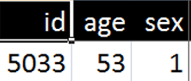
Generating the appropriate RT assertions
L | Var | IT | REF | Min | Max | Val
3 | id | IM | patient
4 | sex | CV | gender
5 | sex | CV | male |  |  | 0
6 | sex | CV | female |  |  | 1
7 | sex | UA | sex | BLANK | BLANK
L | IUI(L) | IUI(P) | P-Type | P-Rel | P-Tg | Tr | T
3 | #patL- | #pat- | patient |  |  | at | t
4 | #patgL- | #patg- | gender | inheres-in | #pat- | at | t
5 |  | #patg- | male-gender | inheres-in | #pat- | at | t
6 |  | #patg- | female-gender | inheres-in | #pat- | at | t
7 |  | #patgL- | underspec-ice |  |  | at | t

Slide 49
Unconditional generation
L | Var | IT | REF | Min | Max | Val
3 | id | IM | patient
4 | sex | CV | gender
5 | sex | CV | male |  |  | 0
6 | sex | CV | female |  |  | 1
7 | sex | UA | sex | BLANK | BLANK
L | IUI(L) | IUI(P) | P-Type | P-Rel | P-Tg | Tr | T
3 | #patL- | #pat- | patient |  |  | at | t
4 | #patgL- | #patg- | gender | inheres-in | #pat- | at | t
5 |  | #patg- | male-gender | inheres-in | #pat- | at | t
6 |  | #patg- | female-gender | inheres-in | #pat- | at | t
7 |  | #patgL- | underspec-ice |  |  | at | t
#pat-5033 instance-of Patient at t

Slide 50
Unconditional generation
L | Var | IT | REF | Min | Max | Val
3 | id | IM | patient
4 | sex | CV | gender
5 | sex | CV | male |  |  | 0
6 | sex | CV | female |  |  | 1
7 | sex | UA | sex | BLANK | BLANK
L | IUI(L) | IUI(P) | P-Type | P-Rel | P-Tg | Tr | T
3 | #patL- | #pat- | patient |  |  | at | t
4 | #patgL- | #patg- | gender | inheres-in | #pat- | at | t
5 |  | #patg- | male-gender | inheres-in | #pat- | at | t
6 |  | #patg- | female-gender | inheres-in | #pat- | at | t
7 |  | #patgL- | underspec-ice |  |  | at | t
#pat-5033 instance-of Patient at t
#patg-5033 instance-of Gender at t
#patg-5033 inheres-in #pat-5033 at t

Slide 51
No generation: condition not satisfied
L | Var | IT | REF | Min | Max | Val
3 | id | IM | patient
4 | sex | CV | gender
5 | sex | CV | male |  |  | 0
6 | sex | CV | female |  |  | 1
7 | sex | UA | sex | BLANK | BLANK
L | IUI(L) | IUI(P) | P-Type | P-Rel | P-Tg | Tr | T
3 | #patL- | #pat- | patient |  |  | at | t
4 | #patgL- | #patg- | gender | inheres-in | #pat- | at | t
5 |  | #patg- | male-gender | inheres-in | #pat- | at | t
6 |  | #patg- | female-gender | inheres-in | #pat- | at | t
7 |  | #patgL- | underspec-ice |  |  | at | t
#pat-5033 instance-of Patient at t
#patg-5033 instance-of Gender at t
#patg-5033 inheres-in #pat-5033 at t

Slide 52
Conditional generation
L | Var | IT | REF | Min | Max | Val
3 | id | IM | patient
4 | sex | CV | gender
5 | sex | CV | male |  |  | 0
6 | sex | CV | female |  |  | 1
7 | sex | UA | sex | BLANK | BLANK
L | IUI(L) | IUI(P) | P-Type | P-Rel | P-Tg | Tr | T
3 | #patL- | #pat- | patient |  |  | at | t
4 | #patgL- | #patg- | gender | inheres-in | #pat- | at | t
5 |  | #patg- | male-gender | inheres-in | #pat- | at | t
6 |  | #patg- | female-gender | inheres-in | #pat- | at | t
7 |  | #patgL- | underspec-ice |  |  | at | t
#pat-5033 instance-of Patient at t
#patg-5033 instance-of Female-Gender at t
#patg-5033 instance-of Gender at t
#patg-5033 inheres-in #pat-5033 at t

Slide 53
No generation: condition not satisfied
L | Var | IT | REF | Min | Max | Val
3 | id | IM | patient
4 | sex | CV | gender
5 | sex | CV | male |  |  | 0
6 | sex | CV | female |  |  | 1
7 | sex | UA | sex | BLANK | BLANK
L | IUI(L) | IUI(P) | P-Type | P-Rel | P-Tg | Tr | T
3 | #patL- | #pat- | patient |  |  | at | t
4 | #patgL- | #patg- | gender | inheres-in | #pat- | at | t
5 |  | #patg- | male-gender | inheres-in | #pat- | at | t
6 |  | #patg- | female-gender | inheres-in | #pat- | at | t
7 |  | #patgL- | underspec-ice |  |  | at | t
#pat-5033 instance-of Patient at t
#patg-5033 instance-of Female-Gender at t
#patg-5033 instance-of Gender at t
#patg-5033 inheres-in #pat-5033 at t

Slide 54
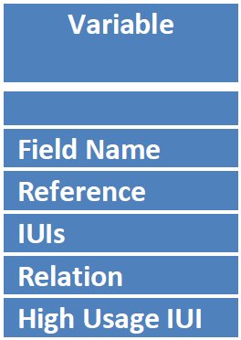
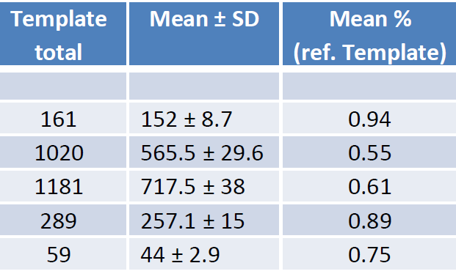
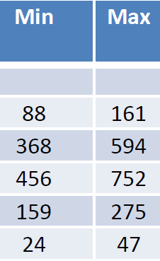
We are talking BIG data
For one dataset with 161 variables:
Between 456 and 752 IUIs generated per patient (average 717),
On average 257 relationships expressed between IUIs per patient.

Slide 55
Future work
Improvements to the Information Artifact Ontology:
  different types of (dis)information, missing information, contradictions, …
  notion of Information Structure Elements,
  account of meaning.
Better implementation.
Larger study:
  Many more possibilities may exists what would require adaptations of the template;
  Demonstrate self-explanatory nature through integration of data-repositories.

Slide 56
Acknowledgement
The work described is funded in part by
grant 1R01DE021917-01A1
from the National Institute of Dental and Craniofacial Research (NIDCR). The content of this presentation is solely the responsibility of the author and does not necessarily represent the official views of the NIDCR or the National Institutes of Health.

