Slide 1

An Ontological Approach for
Developing Orofacial Pain Taxonomies
Workshop on: Oral Neuropathic Pain: Consensus Guidelines: Can PDAP be improved?
March 21, 2017, San Francisco, Calif., USA
Werner CEUSTERS, MD
Department of Biomedical Informatics, Division of Biomedical Ontology,
Department of Psychiatry,
and
UB Institute for Healthcare Informatics,
University at Buffalo

Slide 2
Central question in the workshop brief …
‘PDAP’ is a term proposed following the principles of ontology to diagnose patients suffering from chronic intraoral pain. Other terms to describe this disorder with similar symptomology were ‘atypical odontalgia’ and ‘phantom tooth pain’. Is the term PDAP, and associated ontological process, appropriate because of the opinion that sufficient evidence exists to consider this disorder neuropathic in origin and therefore to classify it accordingly?
Aim of this workshop:
pro’s and con’s rationale for the use of PDAP and ontology verses alternative perspective of neuropathic pain,
discussion to develop group consensus on labelling and classifying such patients to allow for more clearly communication, for both patient care and research purposes, regarding this disorder.

Slide 3
Central focus in the workshop brief …
‘PDAP’ is a term proposed following the principles of ontology to diagnose patients suffering from chronic intraoral pain. Other terms to describe this disorder with similar symptomology were ‘atypical odontalgia’ and ‘phantom tooth pain’. Is the term PDAP, and associated ontological process, appropriate because of the opinion that sufficient evidence exists to consider this disorder neuropathic in origin and therefore to classify it accordingly?
Aim of this workshop:
pro’s and con’s rationale for the use of PDAP and ontology verses alternative perspective of neuropathic pain,
discussion to develop group consensus on labelling and classifying such patients to allow for more clearly communication, for both patient care and research purposes, regarding this disorder.

Slide 4
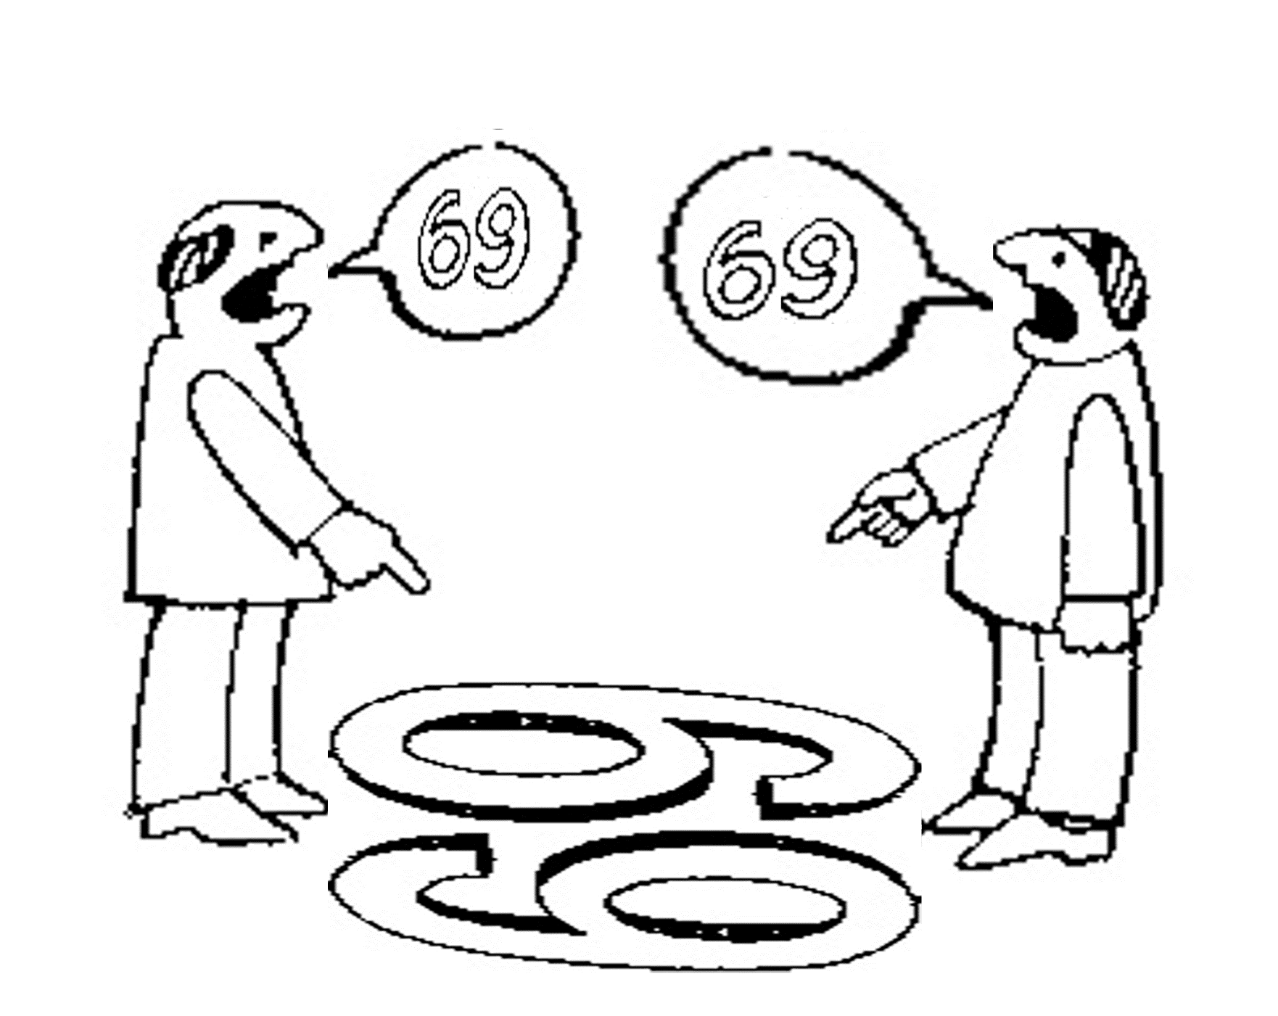
Are we arguing about something like these chaps?
six
nine
http://plato.stanford.edu/entries/scientific-objectivity

Slide 5

For instance?
PDAP: ‘persistent dento-alveolar pain disorder’
PNDAP: ‘persistent neuropathic dento-alveolar pain disorder’
nine
six
PDAP
PNDAP
In part from http://www.endodovgan.com/Endoinfo_Toothache.htm

Slide 6
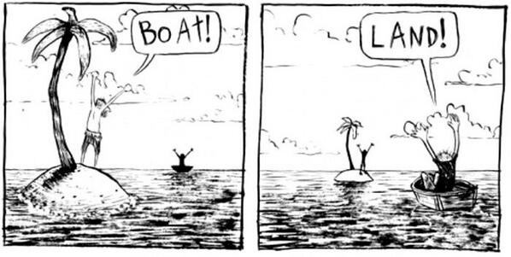
Differing views making both parties happy
… yet, the future for both parties looks bad.
http://plato.stanford.edu/entries/scientific-objectivity

Slide 7
Central question in the workshop brief comprises several separate questions
Is the term PDAP, and associated ontological process, appropriate because of the opinion that sufficient evidence exists to consider this disorder neuropathic in origin and therefore to classify it accordingly?
What is denoted by ‘this disorder’?
Is PDAP an appropriate term for what is denoted by ‘this disorder’?
Is the ontological process used appropriate:
    in itself?
    for the purposes of providing names
      to what is denoted by ‘this disorder’?
      to ‘things’ in general?
    to classify what is denoted by ‘this disorder’?
Has the mentioned opinion the power of a scientific theory to the effect that what is denoted by ‘this disorder’ is neuropathic in origin?
What other term would be more appropriate?

Slide 8
… which are to be answered multi-disciplinary
Is the term PDAP, and associated ontological process, appropriate because of the opinion that sufficient evidence exists to consider this disorder neuropathic in origin and therefore to classify it accordingly?
What is denoted by ‘this disorder’?
Is PDAP an appropriate term for what is denoted by ‘this disorder’?
Is the ontological process used appropriate:
    in itself?
    for the purposes of providing names
      to what is denoted by ‘this disorder’?
      to ‘things’ in general?
    to classify what is denoted by ‘this disorder’?
Has the mentioned opinion the power of a scientific theory to the effect that what is denoted by ‘this disorder’ is neuropathic in origin?
What other term would be more appropriate?

Slide 9
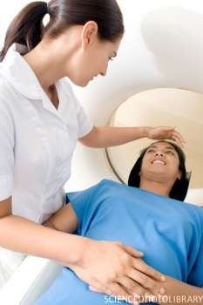
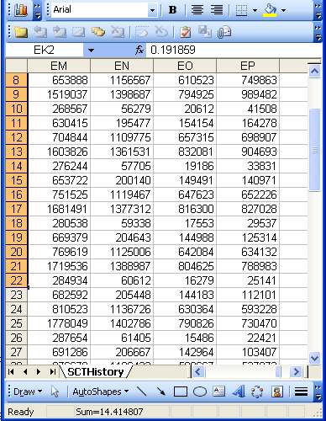
Because there is a non-trivial relation between representations and what they are about
Referents
Perspectives
References
Data

Slide 10
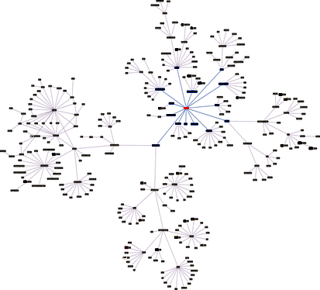
Because there is a non-trivial relation between representations and what they are about
Referents
Perspectives
References
Classifications

Slide 11
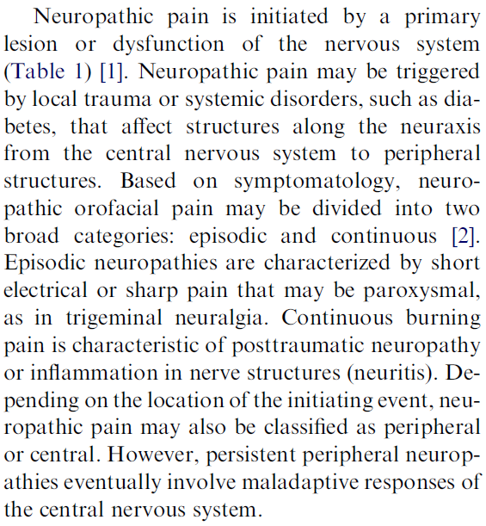
Because there is a non-trivial relation between representations and what they are about
Referents
Perspectives
References
Terms

Slide 12

What makes it non-trivial?
  are (meta-) physically the way they are,
  relate to each other in an objective way,
  follow laws of nature.
  what is physically and technically observable,
  fit between what is measured and what we think is measured,
  fit between established knowledge and laws of nature.
  follow, ideally, the syntactic-semantic conventions of some representation language,
  are restricted by the expressivity of that language,
  to be interpreted correctly, reference collections need external documentation.
Referents
Perspectives
restricted by:
References

Slide 13


Ontology
Referents
Perspectives
References
Lexicography
Science
Metaphysics
Terminology

Slide 14
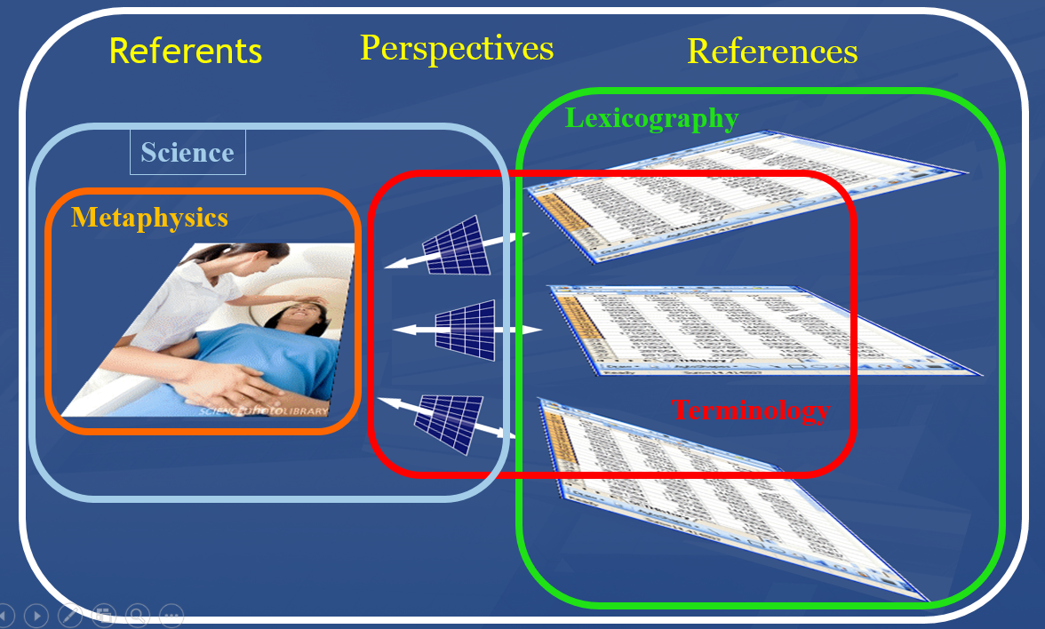
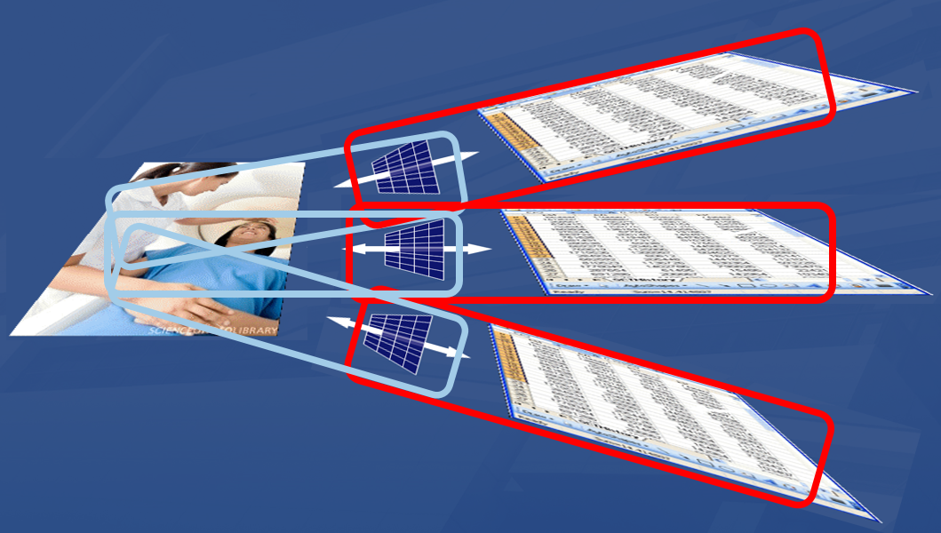
Ontology versus traditional classification
Ontology: holistic view on eveything
Traditional classification:
science + terminology with disconnects

Slide 15
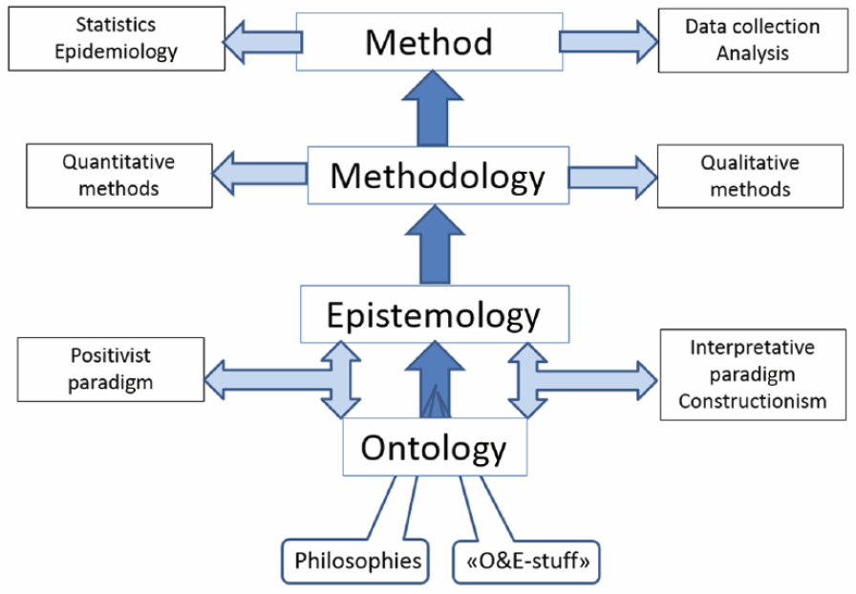
Reality and interpretation
Kirsti Malterud. Theory and interpretation in qualitative studies from general practice: Why and how?
Scandinavian Journal of Public Health, 2016; 44: 120–129

Slide 16
Questions that unarguably can be answered through terminology
Is the term PDAP, and associated ontological process, appropriate because of the opinion that sufficient evidence exists to consider this disorder neuropathic in origin and therefore to classify it accordingly?
What is denoted by ‘this disorder’?
Is PDAP an appropriate term for what is denoted by ‘this disorder’?
Is the ontological process used appropriate:
    in itself?
    for the purposes of providing names
      to what is denoted by ‘this disorder’?
      to ‘things’ in general?
    to classify what is denoted by ‘this disorder’?
Has the mentioned opinion the power of a scientific theory to the effect that what is denoted by ‘this disorder’ is neuropathic in origin?
What other term would be more appropriate?

Slide 17
Terminology
the set of practices and methods used for the collection, description and presentation of terms;
a vocabulary of a special subject field;
Sager, Juan (1990): A Practical Course in Terminology Processing. Amsterdam/Philadelphia: Benjamins

Slide 18
Three dimensions of terminology
Linguistic dimension
  existing linguistic forms as well as potential linguistic forms that can be created … ;
Communicative dimension
  use of terms as a means of transferring knowledge to different categories of recipients in a variety of communicative situations,
  compilation, processing and dissemination of terminological data in the form of specialized dictionaries, glossaries or terminological databases;
…
Sager, Juan (1990): A Practical Course in Terminology Processing. Amsterdam/Philadelphia: Benjamins

Slide 19
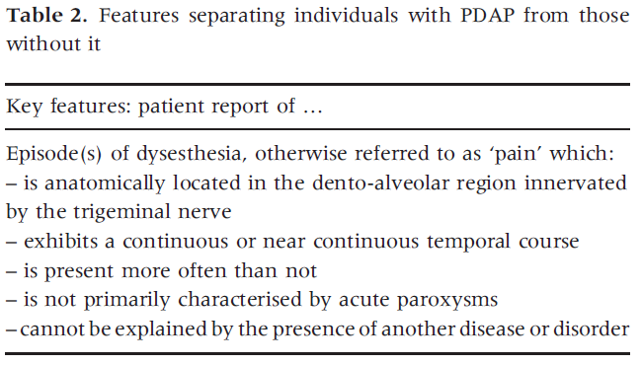
PDAP(D): persistent dento-alveolar pain disorder
Terminological
motivation:
nine
six
PDAP
PNDAP
Nixdorf D, Drangsholt M, Ettlin D, Gaul C, de Leeuw R, Svensson P, Zakrzewska J, DeLaat A, Ceusters W. Classifying orofacial pains: a new proposal of taxonomy based on ontology. Journal of Oral Rehabilitation 2012;39(3):161-169.
In part from http://www.endodovgan.com/Endoinfo_Toothache.htm

Slide 20
PNP: persistent neuropathic pain
Terminological
← motivation:
nine
six
PDAP
PNP
Neuropathic Orofacial Pain Rafael Benoliel and Eli Eliav Oral Maxillofacial Surgery Clinics, 2008-05-01, Volume 20, Issue 2, Pages 237-254,
In part from http://www.endodovgan.com/Endoinfo_Toothache.htm

Slide 21
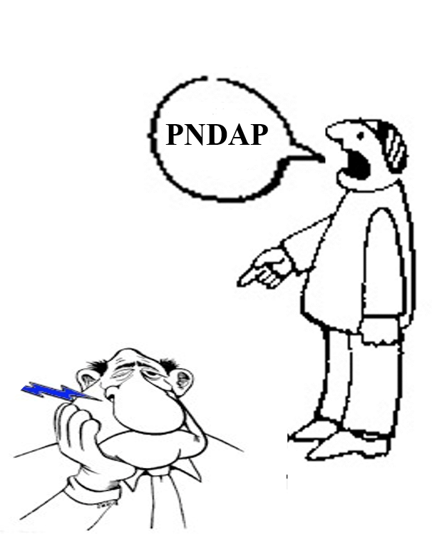
PNDAP as terminological subtype of PDAP
nine
six
PDAP
PNDAP
In part from http://www.endodovgan.com/Endoinfo_Toothache.htm

Slide 22
More questions terminologists claim to be answerable through their discipline
Is the term PDAP, and associated ontological process, appropriate because of the opinion that sufficient evidence exists to consider this disorder neuropathic in origin and therefore to classify it accordingly?
What is denoted by ‘this disorder’?
Is PDAP an appropriate term for what is denoted by ‘this disorder’?
Is the ontological process used appropriate:
    in itself?
    for the purposes of providing names
      to what is denoted by ‘this disorder’?
      to ‘things’ in general?
    to classify what is denoted by ‘this disorder’?
Has the mentioned opinion the power of a scientific theory to the effect that what is denoted by ‘this disorder’ is neuropathic in origin?
What other term would be more appropriate?

Slide 23
Terminology
the set of practices and methods used for the collection, description and presentation of terms;
a vocabulary of a special subject field;
a theory, i.e. the set of premises, arguments and conclusions required for explaining the relationships between concepts and terms which are fundamental for a coherent activity under (1).
Sager, Juan (1990): A Practical Course in Terminology Processing. Amsterdam/Philadelphia: Benjamins

Slide 24
Three dimensions of terminology
Linguistic dimension
  existing linguistic forms as well as potential linguistic forms that can be created in order to name new concepts;
Communicative dimension
  use of terms as a means of transferring knowledge to different categories of recipients in a variety of communicative situations,
  compilation, processing and dissemination of terminological data in the form of specialized dictionaries, glossaries or terminological databases;
Cognitive dimension
  how concepts are related and form structured knowledge units
  how concepts are (to be) represented by definitions and terms.
Sager, Juan (1990): A Practical Course in Terminology Processing. Amsterdam/Philadelphia: Benjamins

Slide 25
What terminologists denote and classify
PDAP: ‘persistent dento-alveolar pain disorder’
PNDAP: ‘persistent neuropathic dento-alveolar pain disorder’
nine
six
PDAP
PNDAP
In part from http://www.endodovgan.com/Endoinfo_Toothache.htm

Slide 26
What terminologists denote and classify
PDAP: ‘persistent dento-alveolar pain disorder’
PNDAP: ‘persistent neuropathic dento-alveolar pain disorder’
nine
six
PDAP
PNDAP
In part from http://www.endodovgan.com/Endoinfo_Toothache.htm

Slide 27
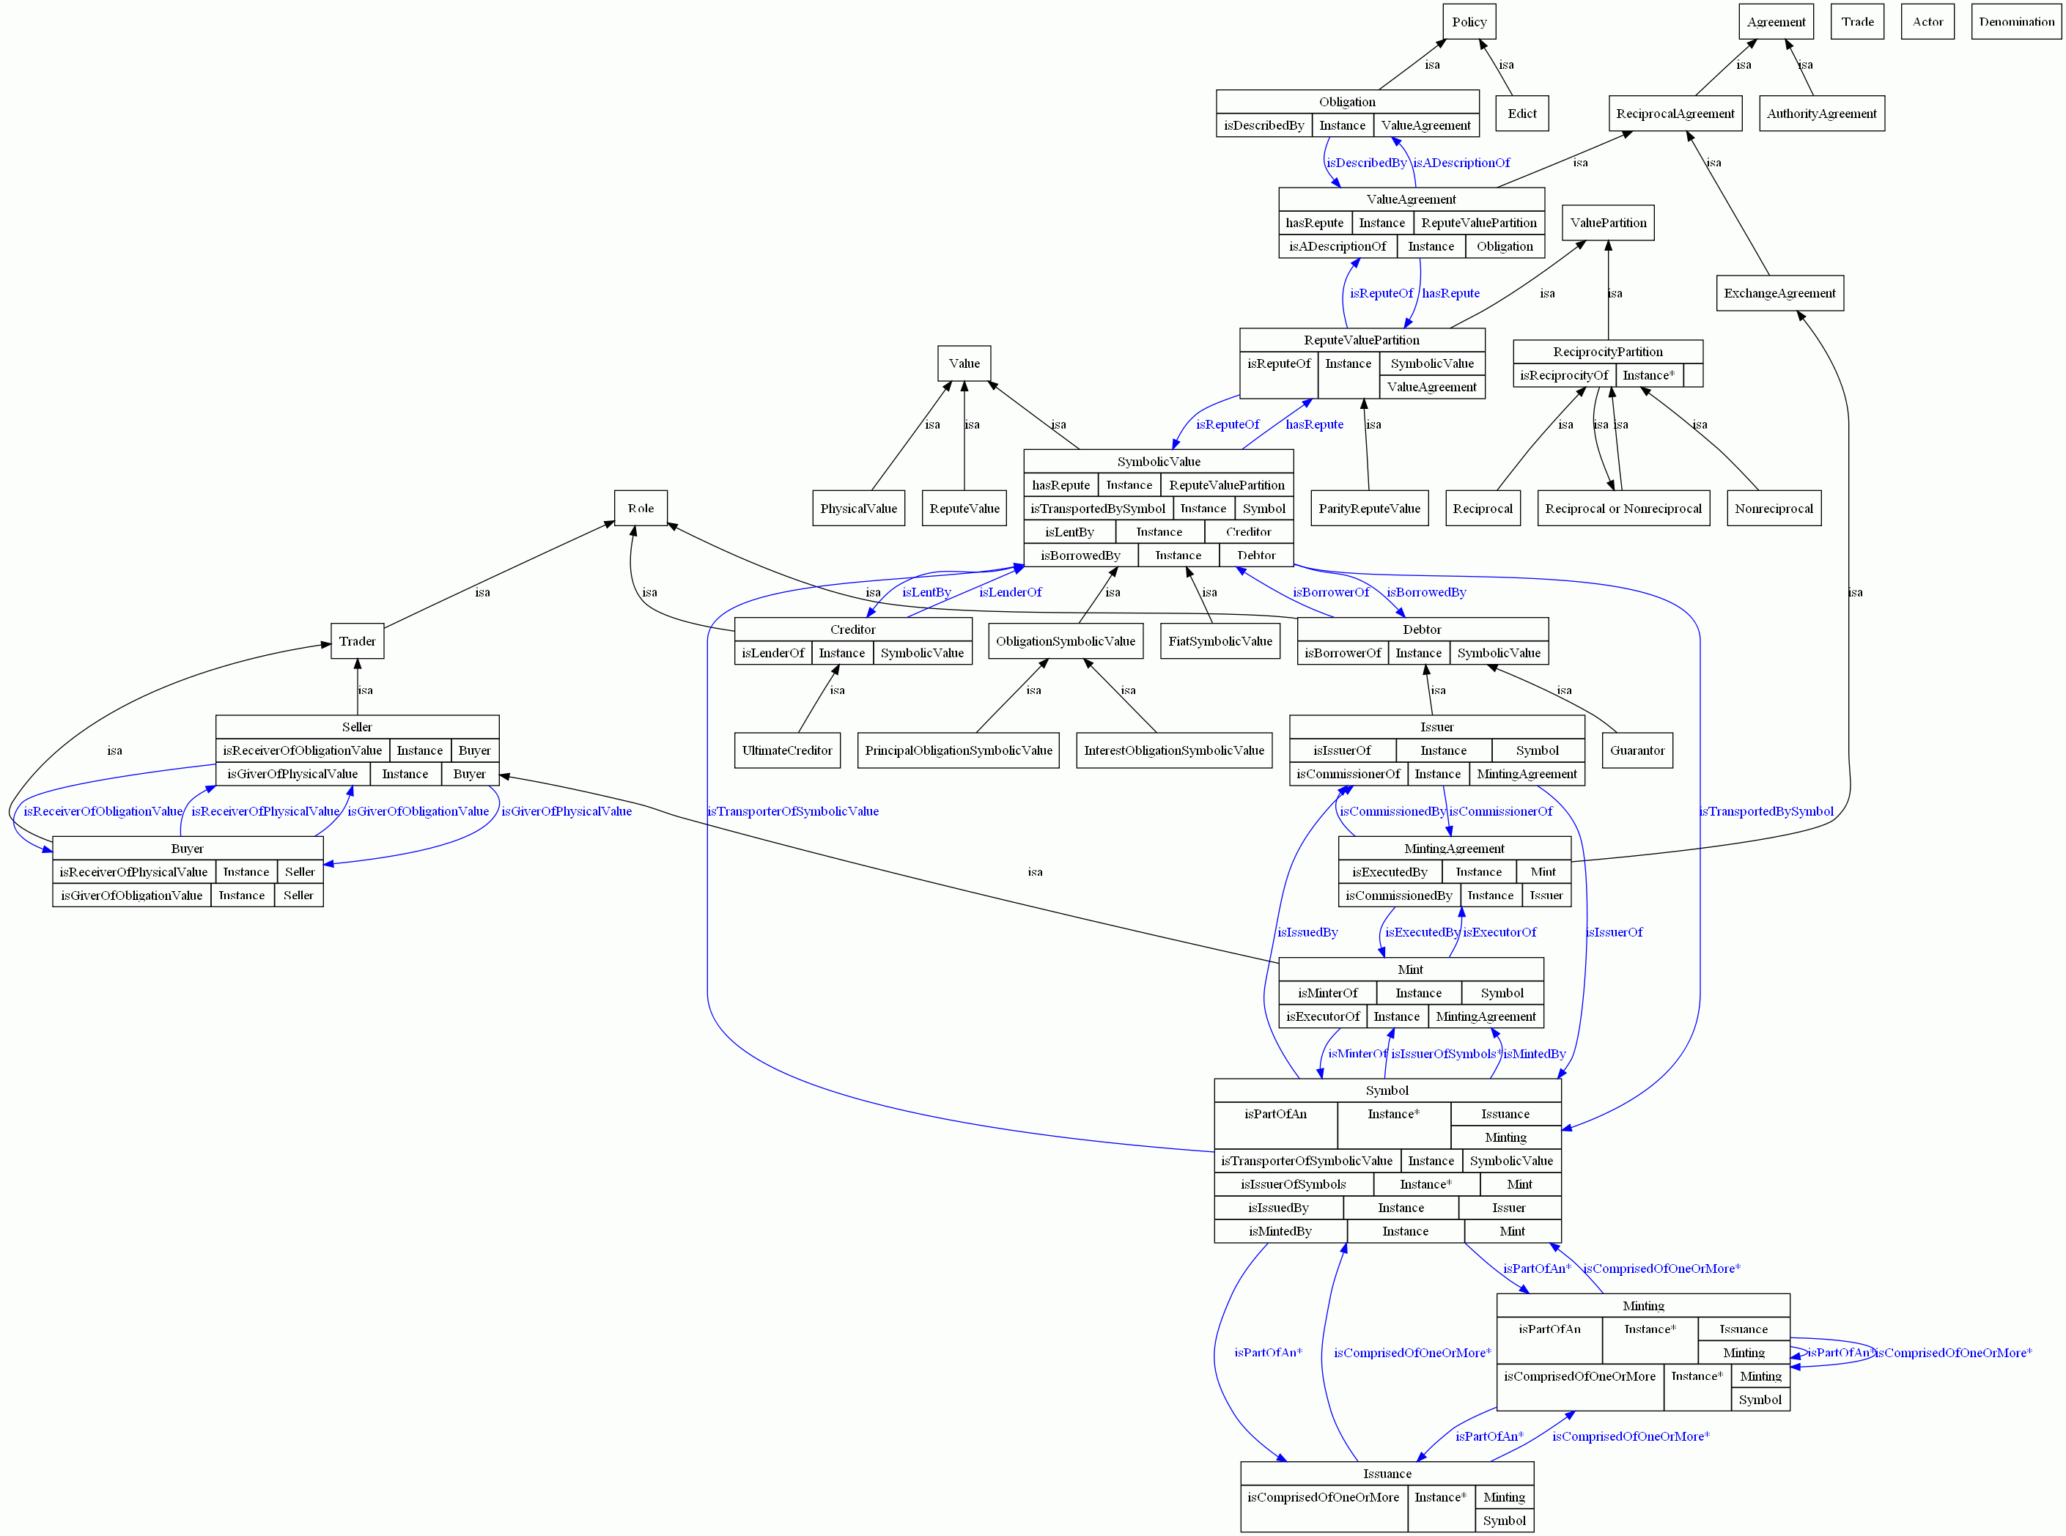
Classifying concepts
Cognitive dimension of terminology
  how concepts are related and form structured knowledge units
  how concepts are (to be) represented by definitions and terms.

Slide 28
‘concepts’: the weird things terminologists commit to
‘concept’ (ISO-1087:1990)
  ‘a unit of thought constituted through abstraction on the basis of properties common to a set of objects,
      (‘object’ = ‘anything perceivable or conceivable’, a ‘unicorn’ being given as a specific example of the latter)
  not bound to particular languages;
  influenced by social or cultural background’.
‘concept’ (ISO-1087-1:2000)
  ‘a unit of knowledge created by a unique combination of characteristics’,
      ‘characteristic’ = ‘abstraction of a property of an object or of a set of objects’.

Slide 29
Why not? → Star Trek terminology
Transporter, n. Transportation device that converts objects or persons to energy, sends that energy to the destination, and reconstitutes the objects/persons back into matter.
Tricorder, n. A hand-held Starfleet device combining sensors, records, and built-in computing capability.
Mind-meld, n. A telepathic union between two beings.
Cloaking device, n. A device which renders something invisible or undetectable.
…
https://blog.oup.com/2009/05/startrek_terminology/

Slide 30
Questions to be answered by science
Is the term PDAP, and associated ontological process, appropriate because of the opinion that sufficient evidence exists to consider this disorder neuropathic in origin and therefore to classify it accordingly?
What is denoted by ‘this disorder’?
Is PDAP an appropriate term for what is denoted by ‘this disorder’?
Is the ontological process used appropriate:
    in itself?
    for the purposes of providing names
      to what is denoted by ‘this disorder’?
      to ‘things’ in general?
    to classify what is denoted by ‘this disorder’?
Has the mentioned opinion the power of a scientific theory to the effect that what is denoted by ‘this disorder’ is neuropathic in origin?
What other term would be more appropriate?

Slide 31
Key in science: scientific objectivity
Objectivity as Faithfulness to Facts;
Objectivity as Absence of Normative Commitments and the Value-Free Ideal;
Objectivity as Freedom from Personal Biases:
  Measurement and Quantification;
  Inductive and Statistical Inference.

Slide 32
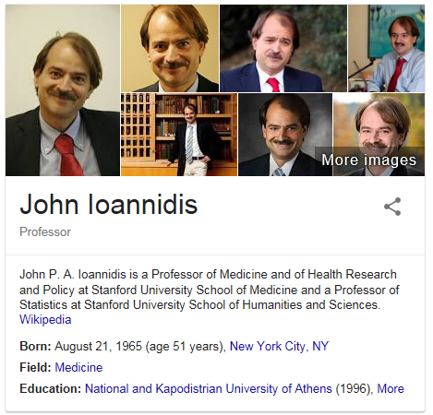
Why Most Published Research Findings Are False.
John P. A. Ioannidis.
Why Most Published Research Findings Are False.
PLOS Medicine 2005;2(8):e124
http://robotics.cs.tamu.edu/RSS2015NegativeResults/pmed.0020124.pdf

Slide 33
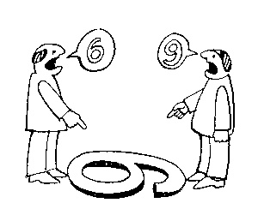
The view from nowhere
Two kinds of qualities:
ones that vary with the perspective one has or takes, and
ones that remain constant through changes of perspective: → the objective properties.
http://plato.stanford.edu/entries/scientific-objectivity

Slide 34
No scientific objectivity here
six
nine

Slide 35
No scientific objectivity here
nine
six

Slide 36
Is there scientific objectivity here?
sixty
nine
sixty
nine

Slide 37
What are the objective properties?
PDAP: ‘persistent dento-alveolar pain disorder’
PNDAP: ‘persistent neuropathic dento-alveolar pain disorder’
nine
six
PDAP
PNDAP
In part from http://www.endodovgan.com/Endoinfo_Toothache.htm

Slide 38
Questions in the domain of ontology
Is the term PDAP, and associated ontological process, appropriate because of the opinion that sufficient evidence exists to consider this disorder neuropathic in origin and therefore to classify it accordingly?
What is denoted by ‘this disorder’?
Is PDAP an appropriate term for what is denoted by ‘this disorder’?
Is the ontological process used appropriate:
    in itself?
    for the purposes of providing names
      to what is denoted by ‘this disorder’?
      to ‘things’ in general?
    to classify what is denoted by ‘this disorder’?
Has the mentioned opinion the power of a scientific theory to the effect that what is denoted by ‘this disorder’ is neuropathic in origin?
What other term would be more appropriate?

Slide 39
Four notions of ‘ontology’ as a study
(O1) the study of what there is,
(O2) the study of the most general features of what there is, and how the things there are relate to each other in the metaphysically most general ways,
(O3) the study of ontological commitment, i.e. what we or others are committed to → creation of ‘ontologies’;
(O4) the study of meta-ontology, i.e. saying what task it is that the discipline of ontology should aim to accomplish, if any, how the questions it aims to answer should be understood, and with what methodology they can be answered.
http://plato.stanford.edu/entries/logic-ontology/#DifConOnt

Slide 40
Four notions of ‘ontology’ as a study
(O1) the study of what there is,
(O2) the study of the most general features of what there is, and how the things there are relate to each other in the metaphysically most general ways,
(O3) the study of ontological commitment, i.e. what we or others are committed to → creation of ‘ontologies’;
Some people commit to weird things …

Slide 41
Four notions of ‘ontology’ as a study
(O1) the study of what there is,
(O2) the study of the most general features of what there is, and how the things there are relate to each other in the metaphysically most general ways,
(O3) the study of ontological commitment, i.e. what we or others are committed to → creation of ‘ontologies’;
Some people commit to weird things … (terminologists for instance)
therefor, and because of our endeavor, we need to be scientific realists.

Slide 42
Scientific Realism
Positive epistemic status towards certain aspects or components of scientific theories:
  strong position: they do have epistemic status;
  weak position: they are intended to have such status.
Aspects or components:
  (approximate) truth of (certain aspects of) scientific theories;
  successful reference of scientific terms to portions of reality;
  belief in the ontology of scientific theories.
Chakravartty, Anjan, "Scientific Realism", The Stanford Encyclopedia of Philosophy (Winter 2016 Edition), Edward N. Zalta (ed.), URL = <https://plato.stanford.edu/archives/win2016/entries/scientific-realism/>.

Slide 43
If this is a scientific theory:
‘PDAP’ is a term proposed following the principles of ontology to diagnose patients suffering from chronic intraoral pain. Other terms to describe this disorder with similar symptomology were ‘atypical odontalgia’ and ‘phantom tooth pain’. Is the term PDAP, and associated ontological process, appropriate because of the opinion that sufficient evidence exists to consider this disorder neuropathic in origin and therefore to classify it accordingly?
then, for the scientific realist:
neuropathic disorders exist
PDAPs exist
all PDAPs are neuropathic disorders
ON THE CONDITION
that one coherent ontology encompassing all entities used in the argumentation for that theory can be constructed!

Slide 44
Ontology for General Medical Science
produces
bears
realized_in
etiological process
disorder
disease
pathological process
produces
diagnosis
interpretive process
signs & symptoms
abnormal bodily features
produces
participates_in
recognized_as
Notes:
font was too small, color inside green boxes was hardly readable

Slide 45
‘Findings’ / ‘observations’
On the side of the patient
Bodily features
  Symptoms
  Signs
    Observed through physical examination
    Observed through lab test
Diseases
Representations
Findings
  Anamnestic findings
    Clinical findings
    Laboratory findings
Diagnoses

Slide 46
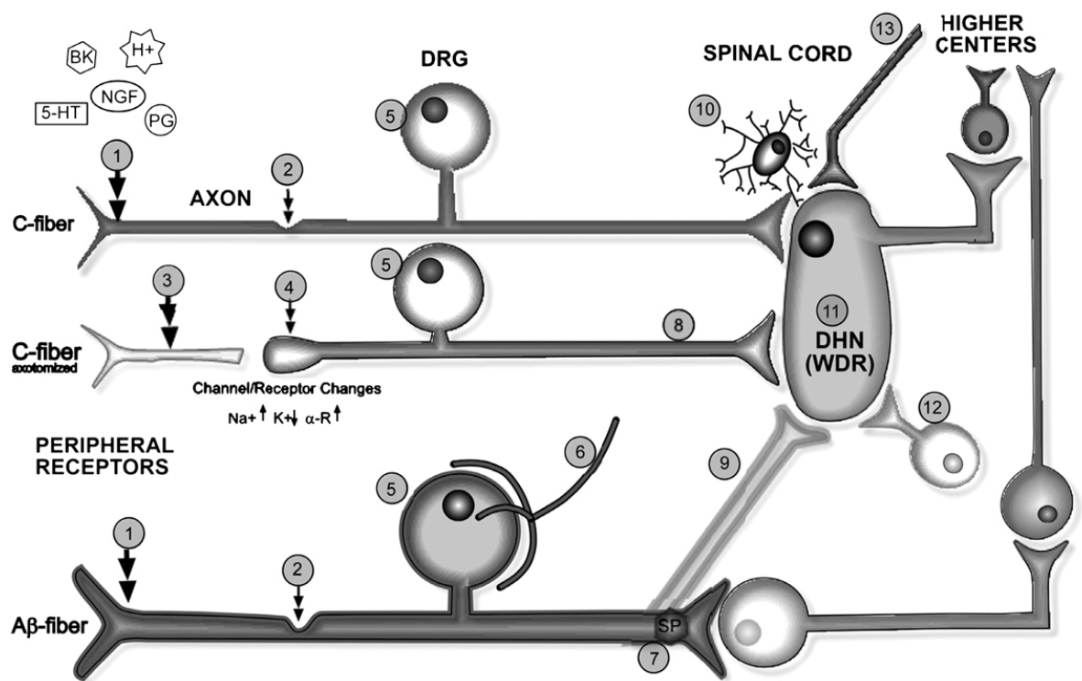
Neuropathic Orofacial Pain Rafael Benoliel and Eli Eliav Oral Maxillofacial Surgery Clinics, 2008-05-01, Volume 20, Issue 2, Pages 237-254,

Slide 47
Key OGMS definitions
DISORDER | A causally relatively isolated combination of physical components that is (a) clinically abnormal and (b) maximal, in the sense that it is not a part of some larger such combination.
DISEASE | A DISPOSITION (i) to undergo PATHOLOGICAL PROCESSes that (ii) exists in an ORGANISM because of one or more DISORDERs in that ORGANISM.
DISEASE COURSE | The totality of all PROCESSes through which a given DISEASE instance is realized.
DIAGNOSIS | A conclusion of an interpretive PROCESS that has as input a CLINICAL PICTURE of a given patient and as output an assertion (diagnostic statement) to the effect that the patient has a DISEASE of such and such a type.
Scheuermann R, Ceusters W, Smith B. Toward an Ontological Treatment of Disease and Diagnosis. 2009 AMIA Summit on Translational Bioinformatics, San Francisco, California, March 15-17, 2009;: 116-120. Omnipress ISBN:0-9647743-7-2

Slide 48
The confusing way in which pain-research results currently are reported makes adequate classification much more cumbersome than it should be.
The cause: a lack of adhering to ontological principles!

Slide 49
‘Chronic pain’ in ICD-11
‘Chronic pain was defined as persistent or recurrent pain lasting longer than 3 months.
This definition according to pain duration has the advantage that it is clear and operationalized.’
It is not clear, rather clearly wrong!
Confusion of ‘chronic pain’ with ‘diagnosis of chronic pain’.
Does a pain p diagnosed as ‘chronic primary pain’ becomes ‘chronic cancer pain’ after the cancer is discovered or are the latter 2 distinct diagnoses about p?
R.-D. Treede et al. A classification of chronic pain for ICD-11. Pain 156 (2015) 1003–1007

Slide 50
‘Pain’ vs. ‘pain condition’
‘Chronic pain is a frequent condition, …’
‘The most common chronic orofacial pains are temporomandibular disorders, which have been included in this subchapter of chronic pain.’
‘Pain may persist despite successful management of the condition that initially caused it, or because the underlying medical condition cannot be treated successfully. As such it may warrant specific diagnostic evaluation, therapy and pain rehabilitation.’
R.-D. Treede et al. A classification of chronic pain for ICD-11. Pain 156 (2015) 1003–1007
Antonia Barke, Winfried Rief, Rolf-Detlef Treede
A Classification of Chronic Pain Syndromes for ICD-11 https://videnomsmerter.files.wordpress.com/2016/10/poster_chronic_pain_classification_icd-11.pdf

Slide 51
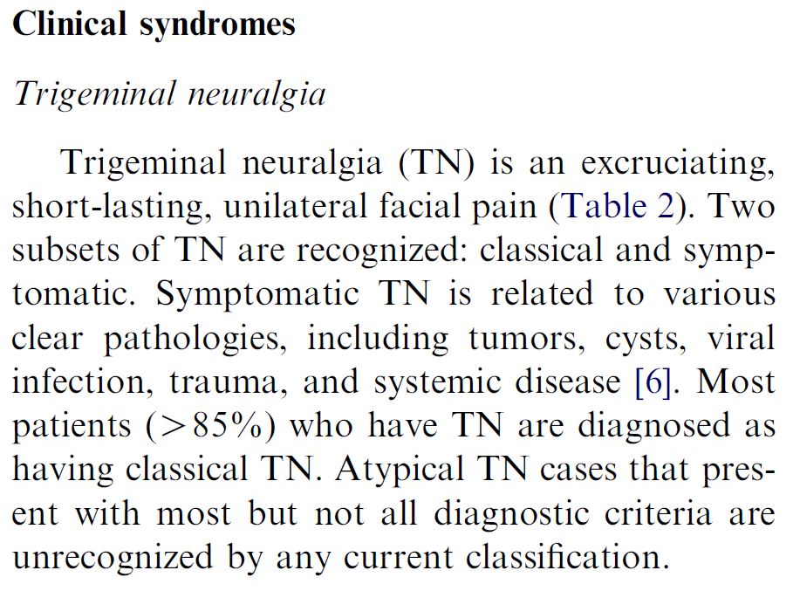
TN =
Disorder? Pain? Syndrome?
Neuropathic Orofacial Pain Rafael Benoliel and Eli Eliav Oral Maxillofacial Surgery Clinics, 2008-05-01, Volume 20, Issue 2, Pages 237-254,

Slide 52
On developing the
ACTTION-APS Pain Taxonomy (AAPT).
Methods
‘In order to develop the multi-dimensional framework and chronic pain taxonomy, AAPT held a consensus meeting in May, 2013, …
In order to facilitate the process, a set of foundational papers was distributed to all participants prior to the meeting and the agenda included background presentations addressing the following topics:
…;
the development and evolution of the Diagnostic and Statistical Manual (DSM) of Mental Disorders to illustrate a successful classification developed outside the area of pain;
…’
RB Fillingim et. al. The ACTTION-American Pain Society Pain Taxonomy (AAPT): An Evidence-Based and Multi-Dimensional Approach to Classifying Chronic Pain Conditions. J Pain. 2014 Mar; 15(3): 241–249.

Slide 53

The weakness is its lack of validity. Unlike our definitions of ischemic heart disease, lymphoma, or AIDS, the DSM diagnoses are based on a consensus about clusters of clinical symptoms, not any objective laboratory measure. In the rest of medicine, this would be equivalent to creating diagnostic systems based on the nature of chest pain or the quality of fever. Indeed, symptom-based diagnosis, once common in other areas of medicine, has been largely replaced in the past half century as we have understood that symptoms alone rarely indicate the best choice of treatment.

Slide 54
Is there evidence in evidence –based medicine?
‘The single most important characteristic of the taxonomy is that it be based on the best available evidence rather than based solely on consensus or expert opinion’.
JP. Ioannidis. Why Most Published Research Findings Are False. PLOS Medicine 2005;2(8):e124.
JP Ioannidis. Evidence-based medicine has been hijacked: a report to David Sackett. Journal of Clinical Epidemiology 2016 (73):82–86
Szucs D, Ioannidis JP. Empirical assessment of published effect sizes and power in the recent cognitive neuroscience and psychology literature. PLoS Biol. 2017 Mar 2;15(3):e2000797
  ‘Assuming a realistic range of prior probabilities for null hypotheses, false report probability is likely to exceed 50% for the whole literature. In light of our findings, the recently reported low replication success in psychology is realistic, and worse performance may be expected for cognitive neuroscience’.
RB Fillingim et. al. The ACTTION-American Pain Society Pain Taxonomy (AAPT): An Evidence-Based and Multi-Dimensional Approach to Classifying Chronic Pain Conditions. J Pain. 2014 Mar; 15(3): 241–249.

Slide 55
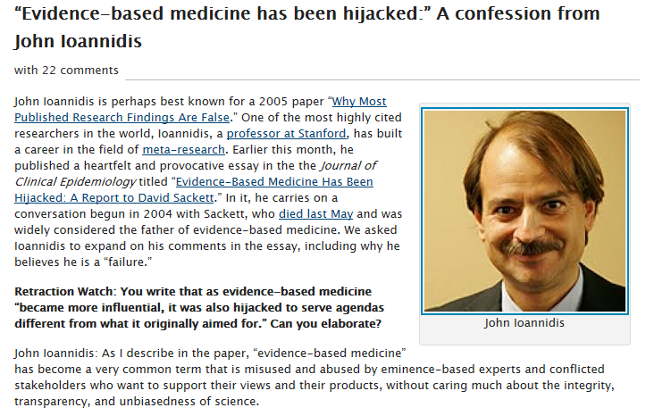
http://retractionwatch.com/2016/03/16/evidence-based-medicine-has-been-hijacked-a-confession-from-john-ioannidis/

