Slide 1

An Ontological Approach to
Orofacial Pain Taxonomy
Symposium on ‘Orofacial Pain Taxonomy: Building on the Success of the DC/TMD’
IADR/AADR/CADR General Session & Exhibition, March 22, 2017, San Francisco, Calif., USA
Werner CEUSTERS, MD
Department of Biomedical Informatics, Division of Biomedical Ontology,
Department of Psychiatry,
and
UB Institute for Healthcare Informatics,
University at Buffalo

Slide 2
Taxonomy design and classification
Taxonomy design:
Identify examples of individual entities (‘individuals’, ‘particulars’, ‘things’, ‘entities’, …) you want to classify;
Identify the various characteristics that are possessed by (all or some of) these individual entities;
Identify groups (classes) on the basis of combinations of characteristics that co-occur;
Organize the groups hierarchically (‘parent-child’) so that characteristics that apply to a ‘parent’ (‘grandparent’,…) group apply to ALL groups beneath it;
Name the groups with terms that have face value.
Classification:
Assign individual entities to the groups that correspond with the combination of characteristics they exhibit.

Slide 3

A large collection of individual entities
https://clipartfest.com/download/c2bd0a0071663cef17ac2126d73bf9350a9d15e2.html

Slide 4
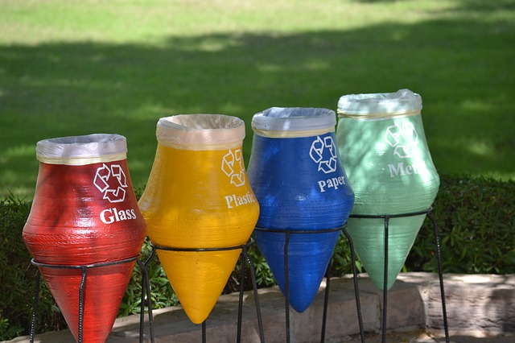
Groups based on material composition

Slide 5
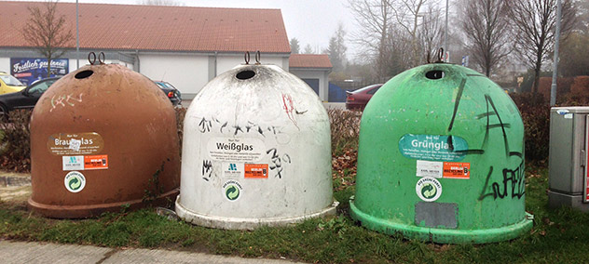
Groups for glass divided by color

Slide 6


Slide 7
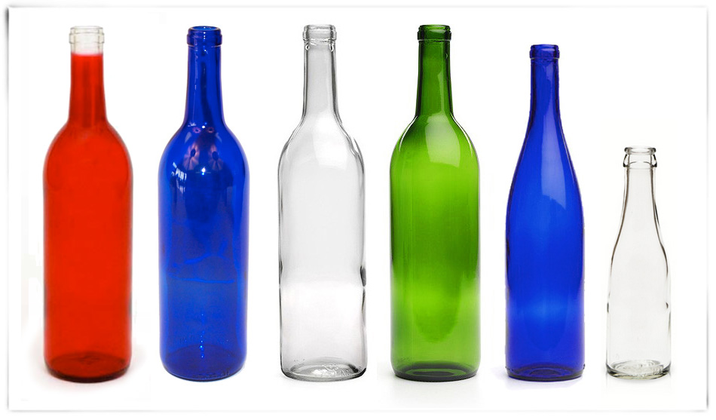

Slide 8
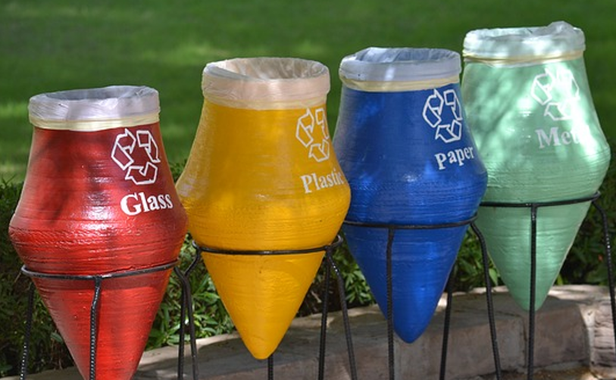


Slide 9
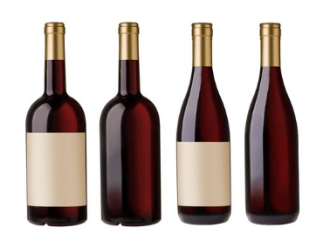

Slide 10
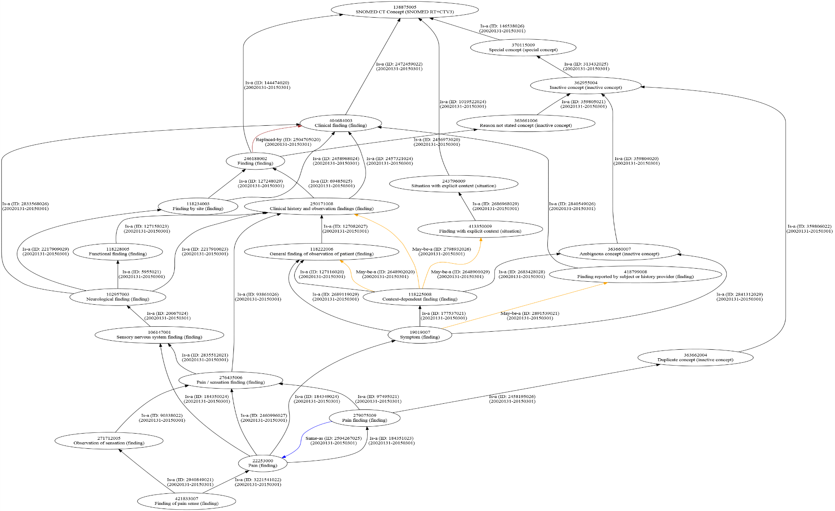
Taxonomies can become very complicated
← ‘Pain sensation’ in SNOMED CT

Slide 11
Taxonomy design and classification
Taxonomy design:
Identify examples of individual entities (‘individuals’, ‘particulars’, ‘things’, ‘entities’, …) you want to classify;
Identify the various characteristics that are possessed by (all or some of) these individual entities;
Identify groups (classes) on the basis of combinations of characteristics that co-occur;
Organize the groups hierarchically (‘parent-child’) so that characteristics that apply to a ‘parent’ (‘grandparent’,…) group apply to ALL groups beneath it;
Name the groups with terms that have face value.
Classification:
Assign individual entities to the groups that correspond with the combination of characteristics they exhibit.
Can be done automatically with the right tools

Slide 12
Formal Concept Analysis (FCA)
Goal of FCA: build lattice from data tables that represent binary relations between objects and attributes, thus tabulating pairs of the form ‘object g has attribute m’.
A formal concept is defined to be a pair (A, B), where
  A is a set of objects (called the extent) and
  B is a set of attributes (the intent)
such that
  the extent A consists of all objects that share the attributes in B, and dually
  the intent B consists of all attributes shared by the objects in A.
https://en.wikipedia.org/wiki/Formal_concept_analysis

Slide 13
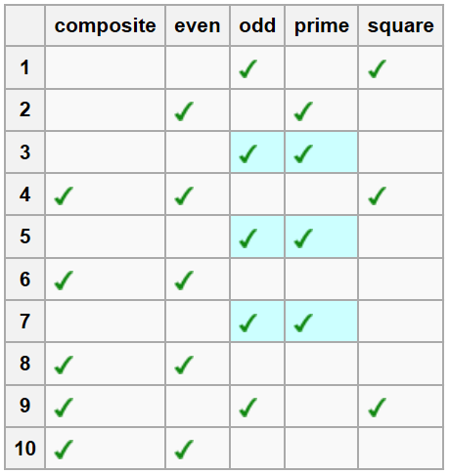
Easy example: FCA on the numbers 1 … 10
attributes
objects
https://en.wikipedia.org/wiki/Formal_concept_analysis

Slide 14
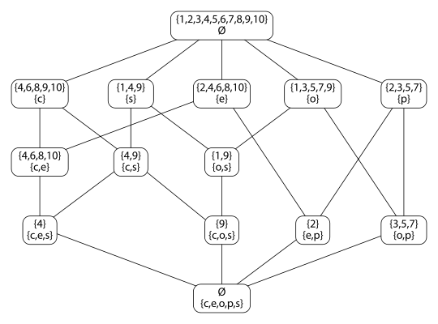
FCA lattice on the numbers 1 … 10
https://en.wikipedia.org/wiki/Formal_concept_analysis

Slide 15
FCA for calculating valid implications
Whenever a number 1…10 is odd, it is not even, and vice versa
https://en.wikipedia.org/wiki/Formal_concept_analysis

Slide 16
FCA for calculating valid implications
Whenever a number 1…10 is composite and odd, it is square.
https://en.wikipedia.org/wiki/Formal_concept_analysis

Slide 17
FCA for calculating approximate implications
80% of the numbers 1…10 that are even are also composite.
https://en.wikipedia.org/wiki/Formal_concept_analysis

Slide 18
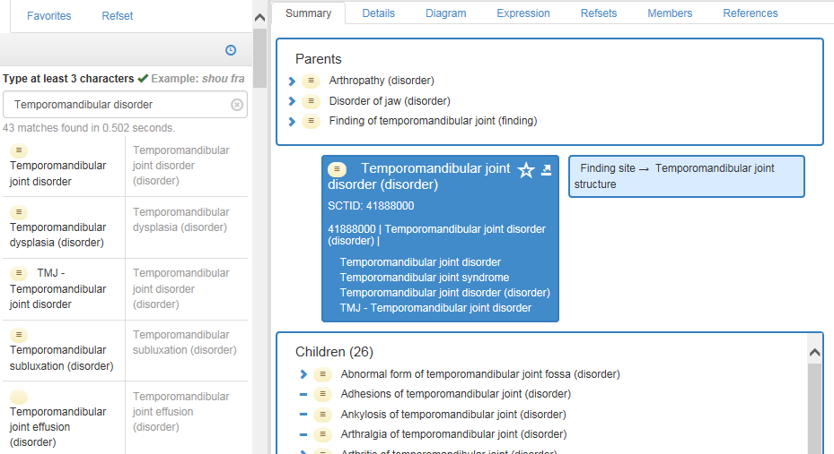
Another method: description logics
http://browser.ihtsdotools.org/

Slide 19
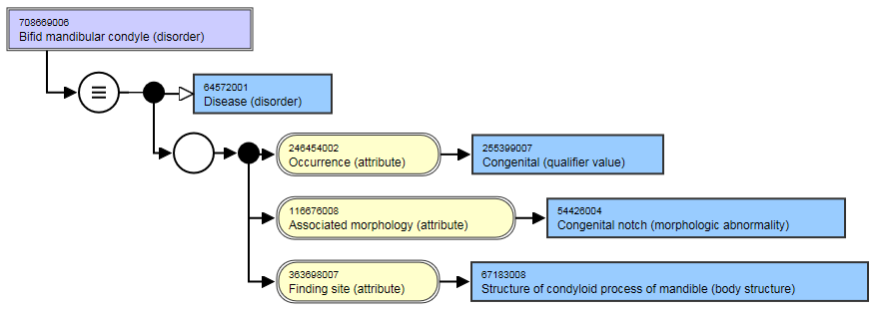
Taxonomy authors write a definition in a formal language …
http://browser.ihtsdotools.org/

Slide 20
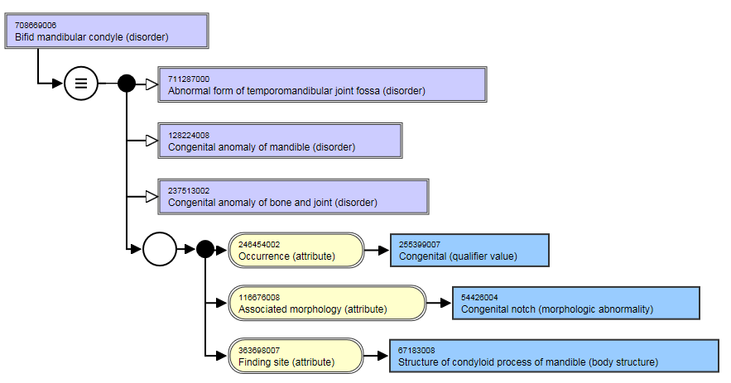
… and the system classifies automatically for them
http://browser.ihtsdotools.org/

Slide 21
However!
Formal computation alone will not save you from committing mistakes!

Slide 22
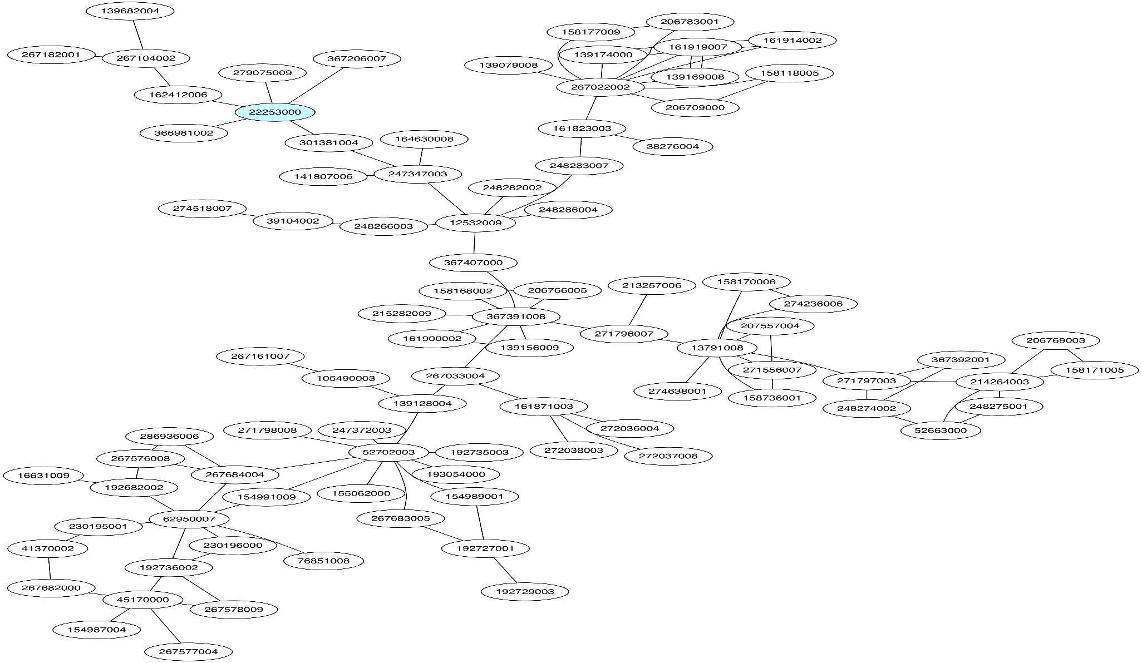
Tracing nuance changes over time
Start
Pain (Finding)
General symptom
(Finding)
Malaise (Finding)
Malaise/Lethargy (Finding)
Lethargy (Finding)
Asthenia (Finding)
Chronic Fatigue Syndrome (disorder)
Encephalomyelitis (disorder)
Ceusters W, Bona J. Representing SNOMED CT Concept Evolutions using Process Profiles. International Workshop on Ontology Modularity, Contextuality, and Evolution (WOMoCoE 2016), Annecy, France, July 6, 2016

Slide 23
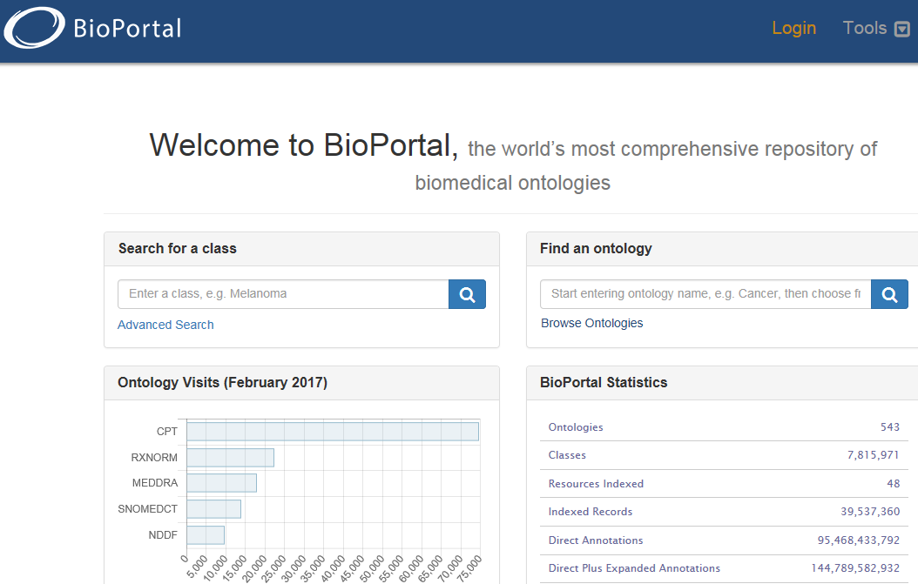
‘Computational biomedical ontologies’
https://bioportal.bioontology.org/

Slide 24
IASP Pain assessment terminology
Allodynia: pain due to a stimulus that does not normally provoke pain. Note: The stimulus leads to an unexpectedly painful response.
Analgesia: absence of pain in response to stimulation which would normally be painful.
Dysesthesia: an unpleasant abnormal sensation, whether spontaneous or evoked. Note: Special cases of dysesthesia include hyperalgesia and allodynia.
Hyperalgesia: increased pain from a stimulus that normally provokes pain.
Hyperesthesia: increased sensitivity to stimulation, excluding the special senses. Note: Hyperesthesia includes both allodynia and hyperalgesia, but the more specific terms should be used wherever they are applicable.
Hyperpathia: a painful syndrome characterized by an abnormally painful reaction to a stimulus.
Hypoalgesia: diminished pain in response to a normally painful stimulus.
Hypoesthesia: decreased sensitivity to stimulation, excluding the special senses.
Paresthesia: an abnormal sensation, whether spontaneous or evoked. Note: it has been agreed to recommend that paresthesia be used to describe an abnormal sensation that is not unpleasant while dysesthesia be used preferentially for an abnormal sensation that is considered to be unpleasant. There is a sense in which, since paresthesia refers to abnormal sensations in general, it might include dysesthesia,

Slide 25
Use of IASP terminology in BioPortal ontologies
104 ‘directly matching’ classes from 27 different sources (out of 370);
In the ICPC2, RH-MeSH and SNOMED CT some of the search terms matched directly to more than one class – thus reflecting homonymy;
104 direct classes exhibit 25 distinct preferred terms;
206 distinct ancestor classes with together 169 distinct preferred terms.
Ceusters W. Pain Assessment Terminology in the NCBO BioPortal: Evaluation and Recommendations. International Conference on Biomedical Ontologies, ICBO 2014, Houston, Texas, Oct 6-9, 2014; CEUR Workshop Proceedings 2014;1237:1-6.

Slide 26
Quality of BioPortal Resources Retrieved
→ poor quality of taxonomy ←
15 resources exhibit for at least some of the search terms a hierarchy which on the basis of the face validity of the preferred terms is composed of disjoint classes:
  analgesia is a kind of
    nervous system (COSTART),
    communication disorder (DOID - Human Disease Ontology), or
    pharmacogenomics (PHARE);
  paresthesia is a kind of peripheral nervous system (OMIM),
  hyperalgesia is a kind of adrenal adenoma (WHO-ART),
                neuroscience (CRISP)
Ceusters W. Pain Assessment Terminology in the NCBO BioPortal: Evaluation and Recommendations. International Conference on Biomedical Ontologies, ICBO 2014, Houston, Texas, Oct 6-9, 2014; CEUR Workshop Proceedings 2014;1237:1-6.

Slide 27
However!
Formal computation alone will not save you from committing mistakes!
You also need a good model

Slide 28
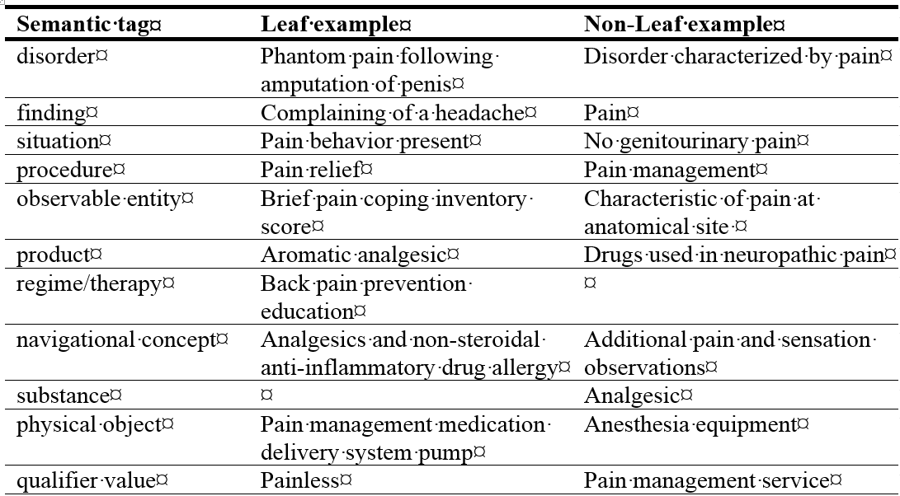
Part of SNOMED CT’s model

Slide 29
SNOMED CT type changes wrt pain-related terms
FROM | TO
context-dependent category | disorder
 | finding
 | situation
disorder | disorder
 | finding
 | navigational concept
finding | disorder
 | finding
procedure | regime/therapy
regime/therapy | procedure
substance | product
Ceusters W, Bona J. Pain in SNOMED CT: is there an anesthetic? In Zaibert, Leo (ed.) The Theory and Practice of Ontology. Palgrave MacMillan, 2016:157-185.

Slide 30
‘Pain’ vs. ‘pain condition’
‘Chronic pain is a frequent condition, …’
‘The most common chronic orofacial pains are temporomandibular disorders, which have been included in this subchapter of chronic pain.’
‘Pain may persist despite successful management of the condition that initially caused it, or because the underlying medical condition cannot be treated successfully. As such it may warrant specific diagnostic evaluation, therapy and pain rehabilitation.’
R.-D. Treede et al. A classification of chronic pain for ICD-11. Pain 156 (2015) 1003–1007
Antonia Barke, Winfried Rief, Rolf-Detlef Treede
A Classification of Chronic Pain Syndromes for ICD-11 https://videnomsmerter.files.wordpress.com/2016/10/poster_chronic_pain_classification_icd-11.pdf

Slide 31
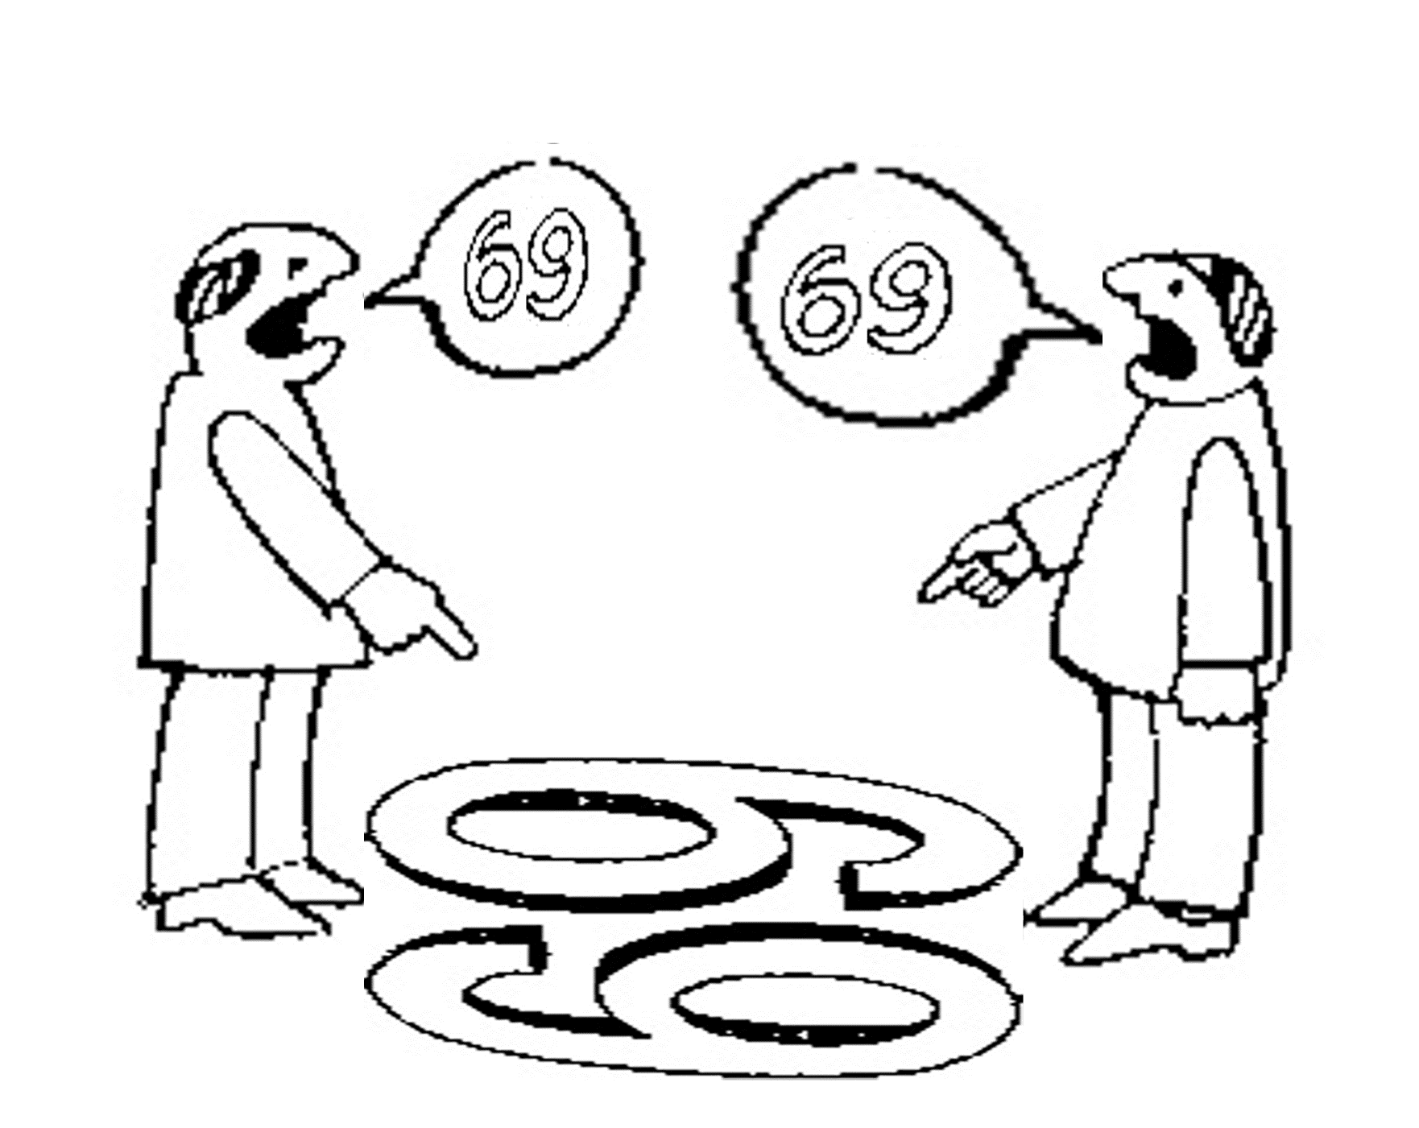
Are we arguing about something like these chaps?
six
nine
http://plato.stanford.edu/entries/scientific-objectivity

Slide 32

For instance?
nine
six
Pain
Pain
disorder
In part from http://www.endodovgan.com/Endoinfo_Toothache.htm

Slide 33
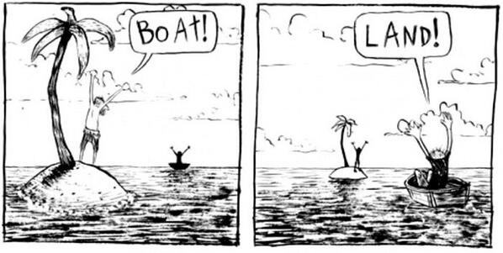
Differing views making both parties happy
… yet, the future for both parties looks bad.
http://plato.stanford.edu/entries/scientific-objectivity

Slide 34
Four notions of ‘ontology’ as a study
(O1) the study of what there is,
(O2) the study of the most general features of what there is, and how the things there are relate to each other in the metaphysically most general ways,
(O3) the study of ontological commitment, i.e. what we or others are committed to → creation of ‘ontologies’;
(O4) the study of meta-ontology, i.e. saying what task it is that the discipline of ontology should aim to accomplish, if any, how the questions it aims to answer should be understood, and with what methodology they can be answered.
http://plato.stanford.edu/entries/logic-ontology/#DifConOnt

Slide 35
Four notions of ‘ontology’ as a study
(O1) the study of what there is,
(O2) the study of the most general features of what there is, and how the things there are relate to each other in the metaphysically most general ways,
(O3) the study of ontological commitment, i.e. what we or others are committed to → creation of ‘ontologies’;
Some people commit to weird things …

Slide 36
Four notions of ‘ontology’ as a study
(O1) the study of what there is,
(O2) the study of the most general features of what there is, and how the things there are relate to each other in the metaphysically most general ways,
(O3) the study of ontological commitment, i.e. what we or others are committed to → creation of ‘ontologies’;
Some people commit to weird things …
therefor, and because of our endeavor, we need to be scientific realists.

Slide 37
Scientific Realism
Positive epistemic status towards certain aspects or components of scientific theories:
  strong position: they do have epistemic status;
  weak position: they are intended to have such status.
Aspects or components:
  (approximate) truth of (certain aspects of) scientific theories;
  successful reference of scientific terms to portions of reality;
  belief in the ontology of scientific theories.
Chakravartty, Anjan, "Scientific Realism", The Stanford Encyclopedia of Philosophy (Winter 2016 Edition), Edward N. Zalta (ed.), URL = <https://plato.stanford.edu/archives/win2016/entries/scientific-realism/>.

Slide 38
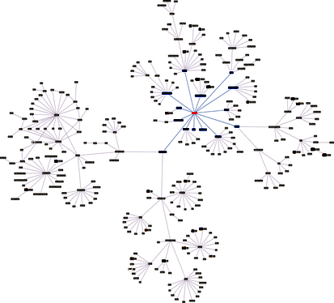
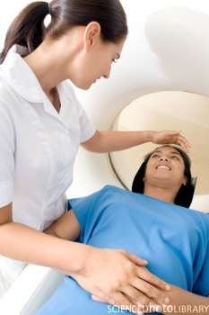
There is a non-trivial relation between representations and what they are about
Referents
Perspectives
Classifications

Slide 39
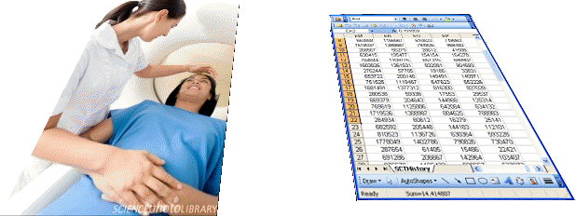
What makes it non-trivial?
  are (meta-) physically the way they are,
  relate to each other in an objective way,
  follow laws of nature.
  what is physically and technically observable,
  fit between what is measured and what we think is measured,
  fit between established knowledge and laws of nature.
  follow, ideally, the syntactic-semantic conventions of some representation language,
  are restricted by the expressivity of that language,
  to be interpreted correctly, reference collections need external documentation.
Referents
Perspectives
restricted by:
References

Slide 40


Ontology
Referents
Perspectives
References
Lexicography
Science
Metaphysics
Terminology

Slide 41
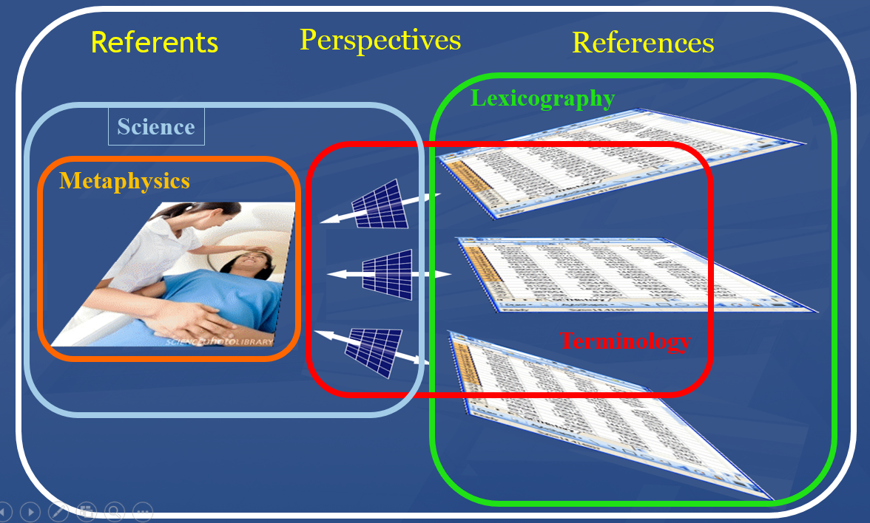
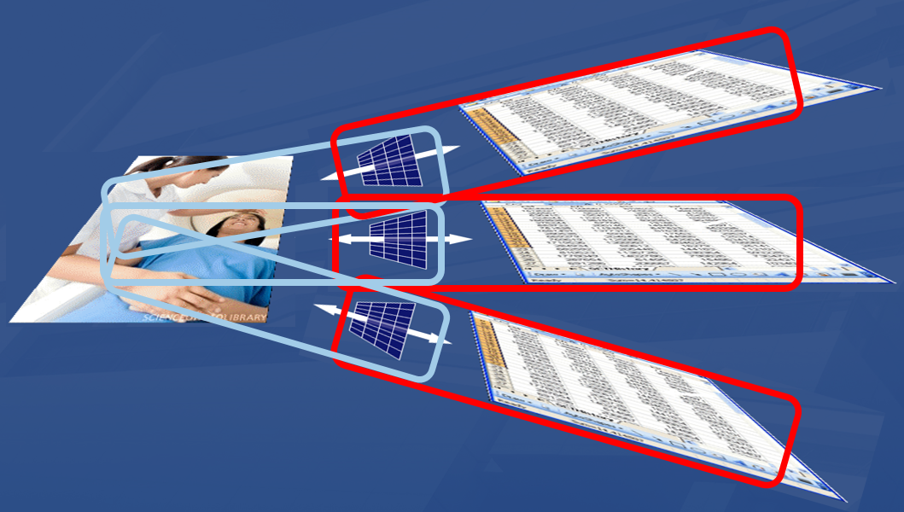
Ontology versus traditional classification
Ontology: holistic view on eveything
Traditional classification:
science + terminology with disconnects

Slide 42
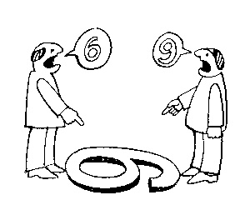
Scientific objectivity: the view from nowhere
Two kinds of qualities:
ones that vary with the perspective one has or takes, and
ones that remain constant through changes of perspective: → the objective properties.
http://plato.stanford.edu/entries/scientific-objectivity

Slide 43
The model of the Ontology for General Medical Science
disease course
produces
bears
realized_in
part-of
etiological process
disorder
disease
pathological process
produces
diagnosis
interpretive process
signs & symptoms
abnormal bodily features
produces
participates_in
recognized_as
Notes:
font was too small, color inside green boxes was hardly readable

Slide 44
Key OGMS definitions
DISORDER | A causally relatively isolated combination of physical components that is (a) clinically abnormal and (b) maximal, in the sense that it is not a part of some larger such combination.
DISEASE | A DISPOSITION (i) to undergo PATHOLOGICAL PROCESSes that (ii) exists in an ORGANISM because of one or more DISORDERs in that ORGANISM.
DISEASE COURSE | The totality of all PROCESSes through which a given DISEASE instance is realized.
DIAGNOSIS | A conclusion of an interpretive PROCESS that has as input a CLINICAL PICTURE of a given patient and as output an assertion (diagnostic statement) to the effect that the patient has a DISEASE of such and such a type.
Scheuermann R, Ceusters W, Smith B. Toward an Ontological Treatment of Disease and Diagnosis. 2009 AMIA Summit on Translational Bioinformatics, San Francisco, California, March 15-17, 2009;: 116-120. Omnipress ISBN:0-9647743-7-2

Slide 45
The model of the Ontology for General Medical Science
disease course
produces
bears
realized_in
part-of
etiological process
disorder
disease
pathological process
produces
diagnosis
interpretive process
signs & symptoms
abnormal bodily features
produces
participates_in
recognized_as
Notes:
font was too small, color inside green boxes was hardly readable

