Slide 1
15th International Conference on Formal Ontology in Information Systems (FOIS 2025)
Online: 4-5 Sept 2025 ; In-person: 8-12 Sept 2025, Catania, Italy
Towards Representing Change in the Basic Formal Ontology (BFO)
Sept 4th, 9am EST
Werner CEUSTERS ^{1,2,3} and Alan RUTTENBERG ³
¹ Department of Biomedical Informatics, University at Buffalo, USA
² Department of Psychiatry, University at Buffalo, USA
³ National Center for Ontological Research

Slide 2
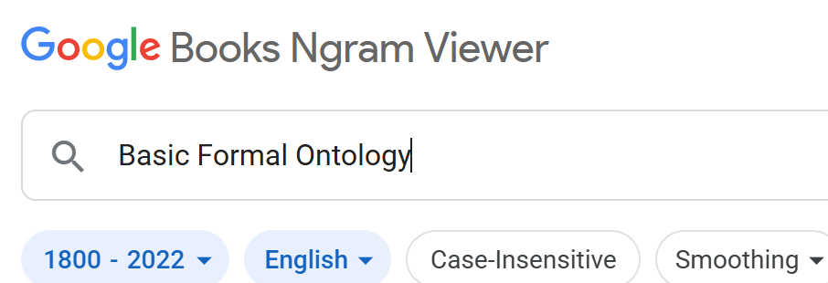
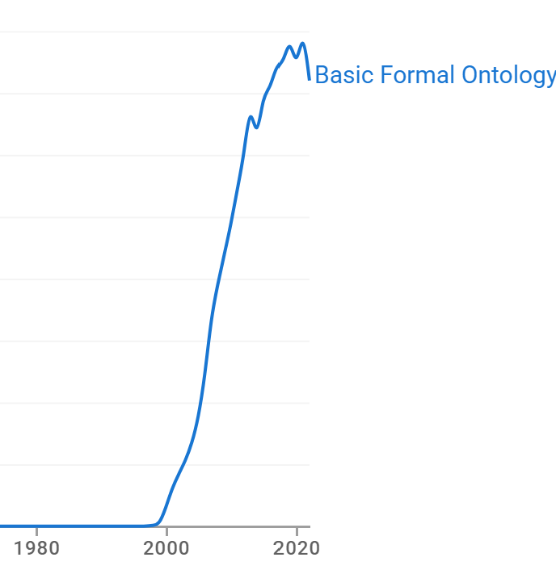
‘Change’ in the history of the BFO (1)
Some quotes from 2004:
  ‘The former [SNAP] deals with successions of instantaneous snapshots of the world, the latter [SPAN] with changes and processes as such’ [p137]
  ‘BFO endorses a view according to which the world contains occurrents, more familiarly referred to as processes, events, activities, changes’ [p140].
  ‘We also considered changes as entity in their own right, and argued that they require an ontological treatment in their own right as processual entities.’ [p160].
The authors proposed a hierarchy of processual entities encompassing processes, fiat parts (of processes), (process) aggregates, settings and events, but not changes [p142].
P. Grenon, B. Smith. SNAP and SPAN: Towards Dynamic Spatial Ontology. Spatial Cognition & Computation. 2004 2004/03/01;4(1):69-104.
Notes:
The history of the BFO started roughly at the end of the 1990’s. Its underlying theory and the foundations upon which the theory is built, is described in a collection of papers, by a variety of authors that became in one way or another parts of Barry Smith’s team when he was awarded the Wolfgang Paul Award from Germany's Humboldt Foundation in 2021. The early papers describe the BFO as consisting of two separate ontologies: s SNAP-ontology which house the continuants, and a SOAN ontology which houses the occurrents. A term frequently encountered is ‘change’ though it is in many different ways related to other occurrents. This is witnessed by the various citations shown on these slides.

Slide 3
‘Change’ in the history of the BFO (2)
2007:
  occurrents are ‘entities which occur, which happen to continuants, more familiarly referred to as processes, events, activities, changes, happenings’ [p36],
  ‘changes are processes’ p34],
2012:
  ‘processes are changes’ [p478].
Consistent throughout the literature:
  ‘processes don’t change […] because if two processes should differ with regard to even the smallest part, then these two processes are non-identical’ [p122].
P. Grenon, B. Smith. Persistence and Ontological Pluralism. In: C Kanzian, editor. Persistence. Boston: De Gruyter; 2007. p. 33-48.
B. Smith. Classifying Processes: An Essay in Applied Ontology. Ratio (Oxf). 2012 Dec 1;25(4):463-88
R. Arp, B. Smith, A. Spear. Building Ontologies with Basic Formal Ontology. Cambridge, MA: MIT Press; 2015.

Slide 4
Examples of change types proposed in BFO’s history (2004)
Spatial and locational change
Substantial change:
  ‘occurs when substances are created or destroyed, as when a substance is divided up so as to produce a plurality of substances or when a plurality of substances is fused or merged’ [p157].
Qualitative change:
  ‘change in determinables’ (e.g. color changes),
  ‘qualitative creation’ (e.g. acquisition of a role),
  ‘qualitative destruction’ (e.g. loss of function).
P. Grenon, B. Smith. SNAP and SPAN: Towards Dynamic Spatial Ontology. Spatial Cognition & Computation. 2004 2004/03/01;4(1):69-104.

Slide 5
Structure of the top level of ‘the’ BFO2020
‘SNAP’
Entity
‘SPAN’
Continuant
Entity: ‘anything that exists, or has existed, or will exist, endures or continues to exist through time while maintaining its identity’ (elucidation)
Occurrent
IC
SDC
GDC
Process
Process
Boundary
Temporal
Region
Spatiotemporal
Region
Not always in agreement: BFO theory; BFO-OWL; BFO-FOL ;
‘u isa v’:
(forall (x t)
(if (instance-of x u t)
(instance-of x v t))))
FOL domain of discourse contains universals and particulars
Immaterial
Entity
Material
Entity
History
0D TR
1D TR
Spatial
Region
…
Temporal
Instant
Temporal
Interval
Continuant:
‘an entity that persists, endures or continues to exist through time while maintaining its identity’ (elucidation)
Occurrent:
‘an entity that unfolds itself in time or it is the start or end of such an entity or it is a temporal or spatiotemporal region, or something else.’ (elucidation)
Occurrent:
‘an entity that unfolds itself in time or it is the start or end of such an entity or it is a temporal or spatiotemporal region’ (elucidation)
Notes:
But if we look at the current status of the BFO, ‘change’ is not mentioned at all.

Slide 6
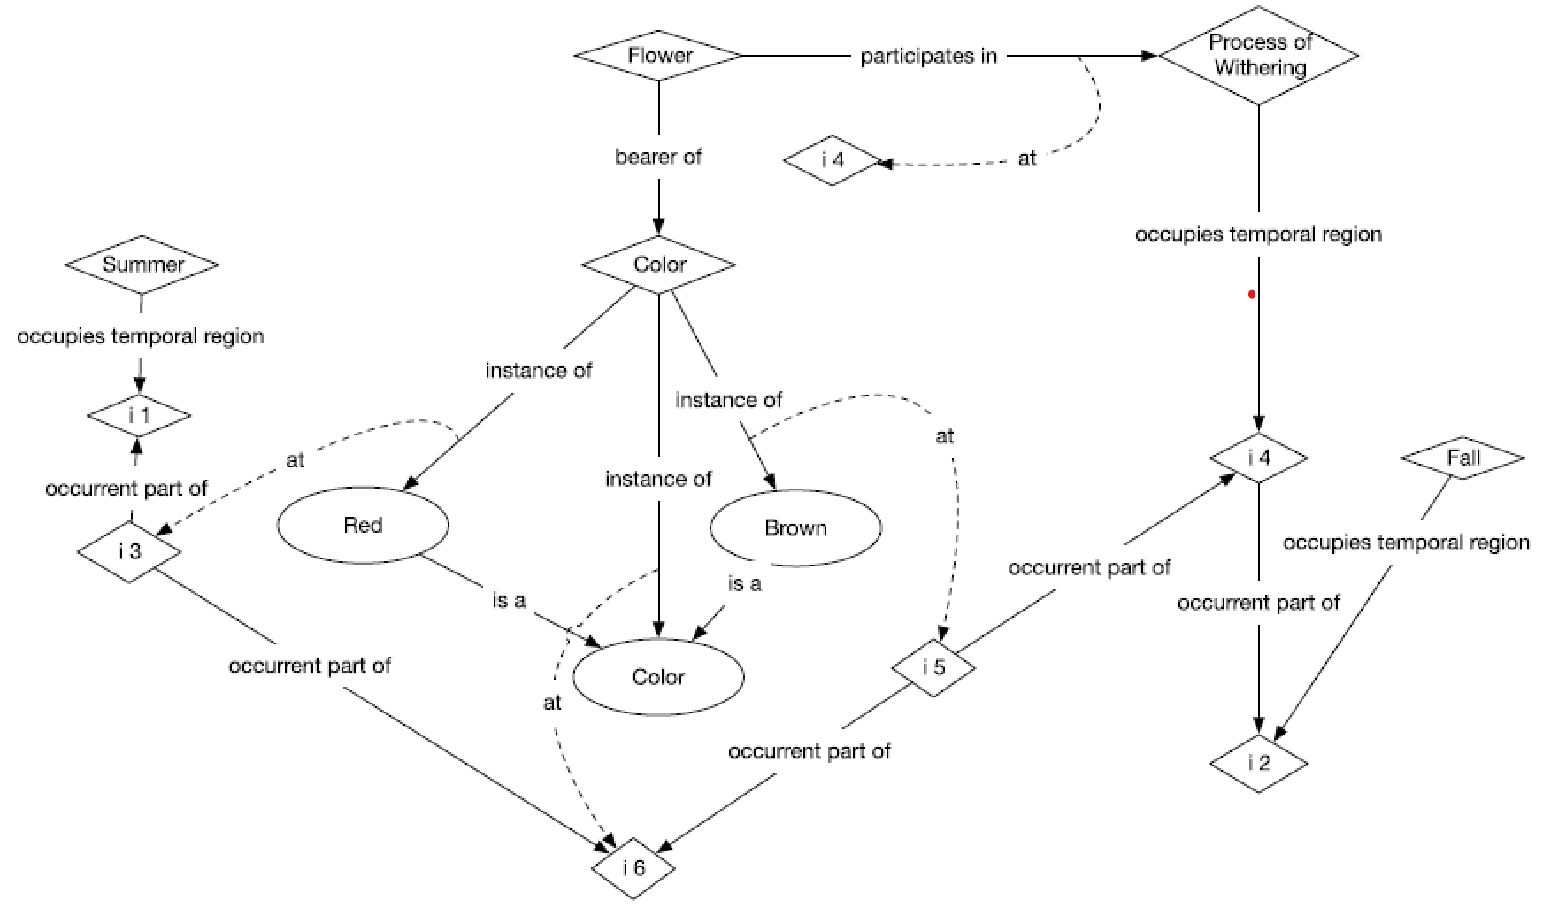
CASE 3: A flower is red in the summer. As time passes, the color changes. In autumn the flower is brown.
Fig. 6 from: J. N. Otte, J. Beverley, A. Ruttenberg. BFO: Basic Formal Ontology. Applied ontology. 2022;17(1)
(adapted)
at
Legend
universal
particular
precedes
Notes:
Although change is not explicitly referenced in the BFO, it is of course possible to use the BFO to describe portions of realities in which changes happen. Several examples thereof are provided in the paper by Otte and friends, published in a special issue of the Applied Ontology Journal, (Foundational ontologies in action: Understanding foundational ontology through examples). We use case 3 here as example.

Slide 7
CASE 3: A flower is red in the summer. As time passes, the color changes. In autumn the flower is brown.
(forall (a b) (iff (inheres-in a b) (bearer-of b a)))) [dzz-1]
(forall (a b) [tht-1]
(iff (inheres-in a b)
(and (specifically-depends-on a b)
(exists (t) (and (instance-of a specifically-dependent-continuant t)
(instance-of b independent-continuant t)
(not (instance-of b spatial-region t))))))))
Fig. 6 from: J. N. Otte, J. Beverley, A. Ruttenberg. BFO: Basic Formal Ontology. Applied ontology. 2022;17(1)
(adapted)
at
Legend
universal
particular
precedes
Notes:
Although change is not explicitly referenced in the BFO, it is of course possible to use the BFO to describe portions of realities in which changes happen. Several examples thereof are provided in the paper by Otte and friends, published in a special issue of the Applied Ontology Journal, (Foundational ontologies in action: Understanding foundational ontology through examples). We use case 3 here as example.

Slide 8
occurrent
spatiotemporal
region
temporal
region
change
process
process
boundary
compositional change
instantiation
change
change
sequence
existence
change
spatial change
mono-sequential
change
type
replacement
individuation
simple
change
change
profile
termination
generalization
specialization

Slide 9
change as 5th type of occurrent
Motivation
Process: ‘an occurrent that has some temporal proper part and for some time t, p has some material entity as participant at t’
(forall (p q) [csk-1]
(if (occurrent-part-of p q)
(if (exists (t) (instance-of p process t))
(exists (t) (instance-of q process t))))))
An odd allowed model:
m instantiates material-entity prior to t₀, from t₀ through t₅, and a bit afterwards;
s instantiates SDC but at each tr_{x} which is temporal-part-of tr, a distinct more determinate subtype of SDC;
p instantiates process and occupies-temporal-region tr₁ through tr₄;
m participates-in p at tr₂ only while s from tr₁ to tr₄.
Oddity: although p exists-at tr₁, tr₂, tr₃, and tr₄, there exists no proper-temporal-part of p that occupies-temporal-region tr₁, tr₃, or tr₄!
material-entity
specifically-dependent-continuant
process
(forall (p q) [ccz-1]
(if (has-occurrent-part p q)
(if (exists (t) (instance-of p process t))
(exists (t) (or (instance-of q process t)
(instance-of q process-boundary t)))))))
temporal-
parts-of
(forall (a b) [bal-1]
(if (temporal-part-of a b)
(occurrent-part-of a b))))

Slide 10
Elucidation of Change
occurrent that:
happens-to at least one continuant c that is not a spatial region and
happens-in a process p
such that in the course of p
  some particular comes in or goes out of existence or
  exhibits a difference in some relation to another entity, including differences in instantiation.

Slide 11
Elucidation of Change | Subsumer and domain/range axioms
occurrent that:
happens-to at least one continuant c that is not a spatial region and
happens-in a process p
such that in the course of p
  some particular comes in or goes out of existence or
  exhibits a difference in some relation to another entity, including differences in instantiation.
(forall (ch t) [cha-01]
(if (instance-of ch change t)
(instance-of ch occurrent t))))
(forall (ch c t) [cha-02]
(if (happens-to ch c t)
(and (instance-of c continuant t)
(instance-of t temporal-region t)
(instance-of ch change t)
(not (instance-of c spatial-region t))))))
(forall (ch p) [cha-03]
(if (happens-in ch p)
(exists (t) (and (instance-of p process t) (instance-of ch change t))))))

Slide 12
How happens-in and happens-to work together
occurrent that:
happens-to at least one continuant c that is not a spatial region and
happens-in a process p
such that in the course of p
  some particular comes in or goes out of existence or
  exhibits a difference in some relation to another entity, including differences in instantiation.
(forall (ch c t) [cha-05]
(if (happens-to ch c t)
(exists (p) (and (happens-in ch p)
(participates-in c p t))))))
(forall (ch p) [cha-06]
(if (happens-in ch p)
(exists (c t1) (and (happens-to ch c t1) (participates-in c p t1))))))
(forall (p ch c t) [cha-07]
(if (and (happens-to ch c t)
(happens-in ch p))
(participates-in c p t))))

Slide 13
Why happens-x: limiting FOL axioms and elucidations
happens-to
rather than
participates-in
happens-in
rather than
occurrent-part-of
(forall (a b t) [ild-1]
(if (participates-in a b t)
(and
(or
(and (instance-of a independent-continuant t)
(not (instance-of a spatial-region t)))
(instance-of a specifically-dependent-continuant t)
(instance-of a generically-dependent-continuant t))
(instance-of b process t)
(instance-of t temporal-region t)))))
(forall (p q) [czz-1]
(if (has-occurrent-part p q)
(if (exists (t) (instance-of p process t))
(exists (t)
(or (instance-of q process t) (instance-of q process-boundary t)))))))
‘p has participant c at t means: p is a process, c is a continuant and c participates in p some way at t’ (with the further note that spatial regions do not participate in processes).

Slide 14
happens-throughout
Changes:
happen-in processes and
happen-to continuants
whereby these continuants participate-in processes
  these changes happen-in or
  occupy a temporal region that temporally overlaps the unique temporal regions these changes happen-throughout.
(forall (ch t) [htr-01]
(if (happens-throughout ch t)
(and (instance-of t temporal-region t)
(instance-of ch change t)))))
(forall (ch t) [htr-04]
(if (happens-throughout ch t)
(forall (t1) (if (happens-throughout ch t1)
(= t1 t))))))
(forall (ch t tr) [htr-05*]
(if (and (instance-of ch change t)
(happens-throughout ch tr))
(temporal-part-of t tr))))

Slide 15
Proposed change hierarchy

Slide 16
Existence changes
change that brings a continuant (but not a spatial region),
process or process-boundary in or out of existence
Individuation:
  E.g.: the coming into existence of a sunburn that happens-in a process of sunbathing and happens-to some skin) ;
Termination:
  E.g.: the going out of existence of a skin laceration that happens-in a process of healing and happens-to some skin);
Existence changes only happen-to continuants.
  Processes have beginnings and endings too, but this is not expressed by relating the change to the process by means of happens-to.

Slide 17
Individuation (1)
individuates-at has domain process or continuant but not spatial region and range temporal region [ind-02]
(forall (x t)
(if (individuates-at x t)
(and (not (instance-of x spatial-region t))
(iff (instance-of x continuant t) (not (instance-of x process t)))
(instance-of t temporal-region t)))))
A particular individuates at the first instant of the temporal region throughout which it exists [ind-03]
(forall (x t t2)
(if (individuates-at x t)
(if (exists-throughout x t2) (has-first-instant t2 t)))))
A particular individuates at the last instant of the temporal region throughout which the individuation happens [ind-04]
(forall (s t)
(if (and (instance-of s individuation t) (happens-throughout s t))
(exists (p t1) (iff (individuates-at p t1)
(has-last-instant t t1))))))

Slide 18
Individuation (2)
A particular x individuates at the last instant of the temporal region throughout which some individuation s happens whereby s happens to x if x is a continuant or s happens to a continuant c which participates in x. * [ind-05]
(forall (x t)
(if (individuates-at x t)
(exists (s t2)
(and (instance-of s individuation t2)
(happens-throughout s t2)
(has-last-instant t2 t)
(iff (happens-to s x t) (instance-of x continuant t))
(if (instance-of x process t)
(exists (c)
(and (instance-of c continuant t)
(participates-in c x t)
(happens-to s c t)))))))))

Slide 19
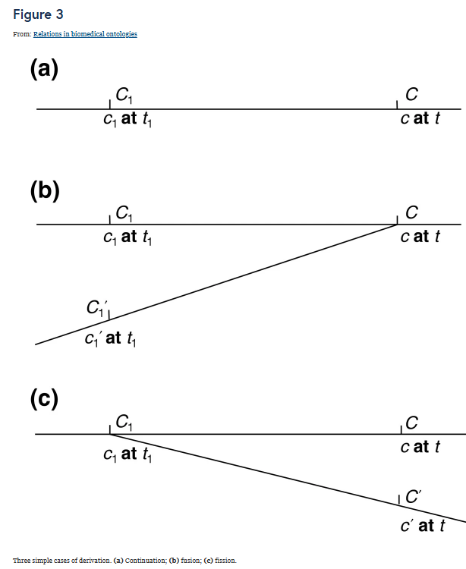
Individuation of a continuant
t2: temporal region
tx: temporal region
happens-
throughout
s: individuation
last-instant-of
happens-
to at
t
individuates-at
happens-in
x: continuant
participates-in at
Barry Smith, Werner Ceusters, Bert Klagges, Jacob Köhler, Anand Kumar, Jane Lomax, Chris Mungall, Fabian Neuhaus, Alan L Rector & Cornelius Rosse
Relations in biomedical ontologies
Genome Biology volume 6, Article number: R46 (2005)
p: process

Slide 20
Individuation of a process
t2: temporal region
tx: temporal region
happens-
throughout
s: individuation
last-instant-of
t
happens-
to at
individuates-at
x: process
happens-in
participates-in at
c: continuant
participates-in at
x2: process

Slide 21
Instantiation changes
instantiation change | change in some continuant’s instantiation of some universal
specialization | instantiation change expanding the number of universals a continuant instantiates | A spine becomes bent and starts to instantiate disorder
generalization | instantiation change diminishing the number of universals a continuant instantiates | A bent spine becomes healed
type replacement | instantiation change to a continuant c keeping the number of universals c instantiates constant | The color of a flower petal changes from red to brown

Slide 22
Type replacement
A continuant c replaces a type u1 for u2 whenever all the universals (except u1) c instantiates before the replacement are also instantiated by c (in addition to u2) after the replacement. [trp-05]
(forall (c u1 u2 t)
(iff (replaces-type c u1 u2 t)
(exists (t1 t2)
(and (has-first-instant t t1)
(instance-of c u1 t1)
(not (instance-of c u2 t1))
(has-last-instant t t2)
(instance-of c u2 t2)
(not (instance-of c u1 t2))
(forall (un)
(if (and (instance-of c un t1)
(not (= un u1)))
(instance-of c un t2))))))))

Slide 23
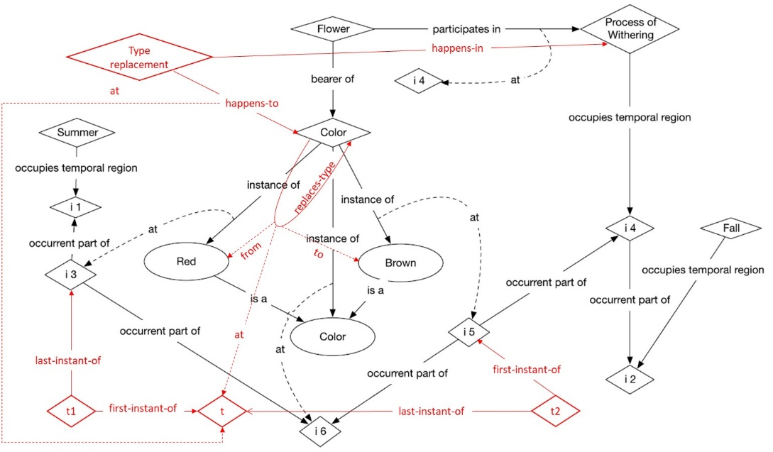

Slide 24
Temporal-layer-of (‘co-occurrence while in occurrent parthood’)
x temporal-layer-of y iff x occurrent-part-of y, both exists throughout the same time, but neither are temporal regions.
(forall (x y) [tlo-01]
(iff (temporal-layer-of x y)
(exists (t)
(and
(occurrent-part-of x y)
(not (instance-of x temporal-region y))
(exists-throughout x t)
(exists-throughout y t))))))
(forall (x y z) [tlo-02]
(if (and (temporal-layer-of x y)
(temporal-layer-of y z))
(temporal-layer-of x z))))
(forall (x y) [tlo-03]
(if (and (temporal-layer-of x y)
(temporal-layer-of y x))
(= x y))))

Slide 25
Mono-sequential change
t₁
t₂
A mono-sequential change cch is a change whose occurrent parts that are changes are temporal layers of cch. [cch-02]
(forall (cch t)
(if (and (instance-of cch mono-sequential-change t)
(happens-throughout cch t))
(forall (ch)
(iff (temporal-layer-of ch cch)
(and (instance-of ch change t)
(happens-throughout ch t)))))))
happens-throughout
t: temporal region
h: spatial change of head
n: spatial change of nose
c: spatial change of ear
l: spatial change of earlobe
temporal-layer-of
Notes:
Co-occurs

Slide 26
Special mono-sequential change: simple change
a simple-change happens to precisely one continuant [sch-02]
(forall (ch c t)
(if (and (instance-of ch simple-change t)
(exists-throughout ch t)
(happens-to ch c t))
(forall (c1)
(if (happens-to ch c1 t)
(= c1 c))))))
A simple change does not have other changes as occurrent parts [sch-03]
(forall (x y t)
(if (and (instance-of x simple-change t)
(occurrent-part-of y x))
(if (instance-of y change t)
(= x y)))))
Notes:
Is like first quarter of process

Slide 27
Change sequence
A change whose proper-temporal parts that are mono-sequential changes are temporally ordered.
(forall (chs cch) [chs-02]
(if (is-sequence-part-of cch chs)
(exists (ts tc)
(and
(instance-of chs change-sequence ts)
(instance-of cch mono-sequential-change tc)
(proper-temporal-part-of cch chs)
(proper-temporal-part-of tc ts))))))
(forall (chs t) [chs-03]
(if (and (happens-throughout chs t)
(instance-of chs change-sequence t))
(forall (ch1 ch2)
(if (and (is-sequence-part-of ch1 chs)
(is-sequence-part-of ch2 chs)
(not (= ch1 ch2)))
(or (precedes ch1 ch2)
(precedes ch2 ch1)))))))
Can there be overlapping mono-sequential changes?
Notes:
Overlapping changes?

Slide 28
Change profile
A change sequence whose sequence parts are mono-sequential changes all of which are simple changes that happen to the same continuant.
(forall (chp) [chp-03]
(if (exists (t) (instance-of chp change-profile t))
(forall (ptp)
(if (is-sequence-part-of ptp chp)
(forall (z)
(if (temporal-layer-of z ptp)
(exists (pt)
(and (instance-of z simple-change pt)
(exists (c)
(and (happens-to z c pt)
(change-profile-of chp c)
)))))))))))
(forall (x y) [chp-04]
(if (change-profile-of x y)
(forall (ch)
(if (is-sequence-part-of ch x)
(forall (z)
(if (temporal-layer-of z ch)
(exists (t)
(and (instance-of z simple-change t) (happens-to z y t))))))))))

Slide 29
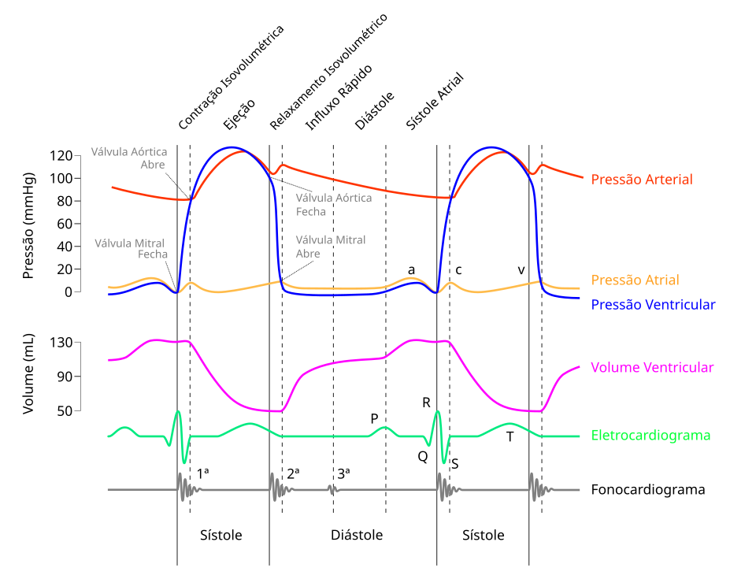
Change profile
‘Process profile: something which two processes share in common’.
B. Smith. Classifying Processes: An Essay in Applied Ontology. Ratio (Oxf). 2012 Dec 1;25(4):463-88.
Image:
Matheus Trabuco Gonzalez
https://commons.wikimedia.org/wiki/File:Wiggers_Diagram_2-pt.svg
Creative Commons Attribution 4.0 International

Slide 30
Concluding remarks
Neutral about:
  time being dense or discrete (as in BFO2020);
  whether changes happen throughout extended temporal regions or time-instants (except for change sequences and type replacements);
  what happens ‘within’ a change, even whether there is a transition.
Future work:
  tighter connection with BFO ?
    requires changes in BFO2020-FOL, which requires agreement of BFO custodians.
    offers a solution for issues with BFO2020:history (submitted to ICBO-2025).
  comparison with Zemach’s 4 ontologies? Galton & Mizoguchi’s ‘waterfall’?
  replacing weaker axioms with stronger ones;
  consistency proof.
Notes:
ISO document mention BFO developer maintenance group

