Slide 1
Representing
SNOMED CT Concept Evolutions using Process Profiles
International Workshop on Ontology Modularity, Contextuality, and Evolution (WOMoCoE 2016)
Annecy, France, July 6, 2016 part of
9th International Conference on Formal Ontology in Information Systems (FOIS 2016)
Annecy, France, July 6th-9th, 2016.
Werner CEUSTERS, MD
Jonathan P. BONA, PhD
Department of Biomedical Informatics,
Jacobs School of Medicine, University at Buffalo
Buffalo, NY - USA

Slide 2
Talk overview
Providing context to the paper, rather than just covering the paper
  Realist view on ontology
    Basics
    Application to change
    Embodiment in BFO
  Earlier work on changes in SNOMED CT
  Information content entities
  Process profiles
    application for non-numerical qualities

Slide 3
Central research questions
How can ontologies be designed in such a way that:
they are faithful presentations of reality, and that
changes introduced in updates reflect faithfully corresponding changes in reality?
What are the requirements for formalisms able to concretize ontologies satisfying (1a) and (1b) to allow users thereof acquiring a faithful representation of the changes in reality by merely looking at the changes in the ontology?

Slide 4
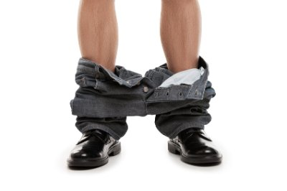
You think?

Slide 5
Reviewers’ comments
‘Although it is not mentioned explicitly, it gives the impression that the authors assume that there is only one reality and that this reality can be faithfully modelled’ (reviewer 3, WOMOCoE);
‘The somewhat naive realism that seems to underly the work, namely, that there is an objective reality out there to be observed and recognized’
  (reviewer 3, FOIS main).

Slide 6

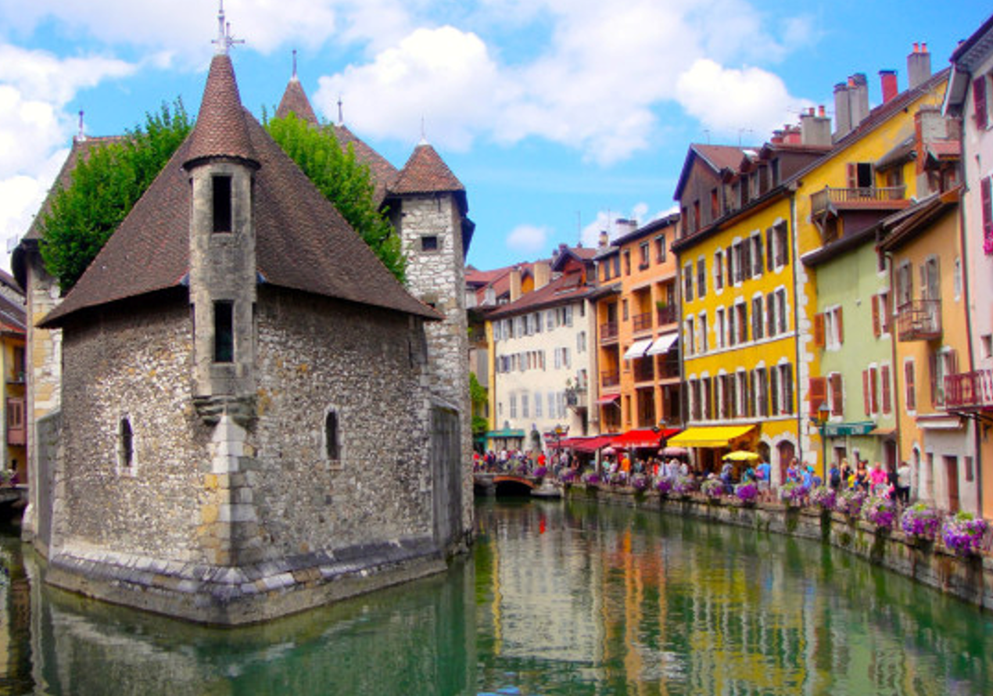
You think?
Is there really somebody in the room here who claims that it is not the case that:
I am standing here talking,
there is a brownish rectangle projected on the screen,
the rectangle pictures what people would take for an open window,
the ‘window’ is projected over an image of the Palais de l’Ile?

Slide 7
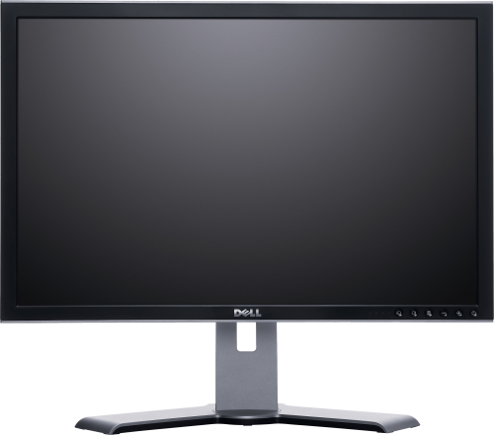
Realist ontology claims:
There is one objective reality and an ontology should be a faithful representation of the part of that reality that it covers
Smith B, Ceusters W. Ontological Realism as a Methodology for Coordinated Evolution of Scientific Ontologies. Applied Ontology, 2010;5(3-4):139-188.

Slide 8


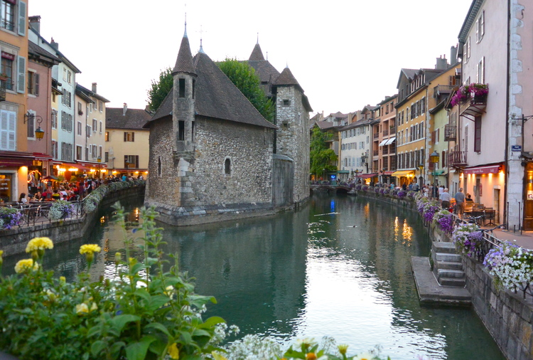
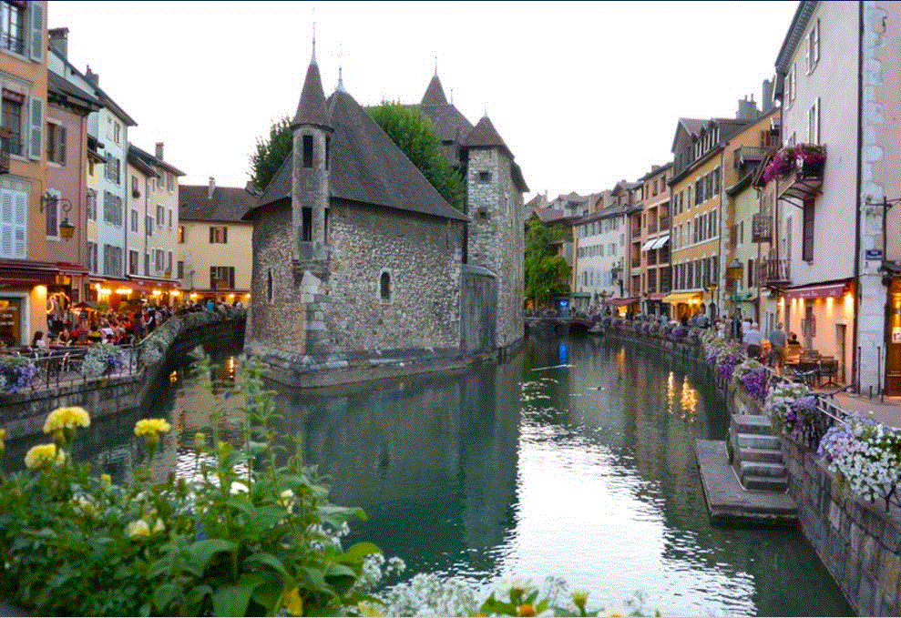
Realist ontology
There is one objective reality and an ontology should be a faithful representation of the part of that reality that it covers
?
Smith B, Ceusters W. Ontological Realism as a Methodology for Coordinated Evolution of Scientific Ontologies. Applied Ontology, 2010;5(3-4):139-188.

Slide 9
You think?

Slide 10
Reviewers’ comments
‘it is impossible to distinguish whether ontology modifications result from observed changes in reality or changes in understanding of reality. ’
  (reviewer 4, FOIS main).
‘Our understanding of a phenomenon can also change in the course of time. For instance in Physics, the notions of gravity and matter have quickly evolved in the past decades.’ (reviewer 3, WOMOCoE);

Slide 11
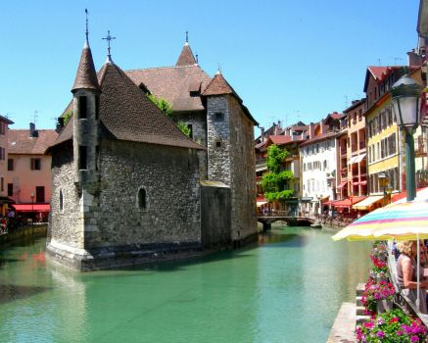
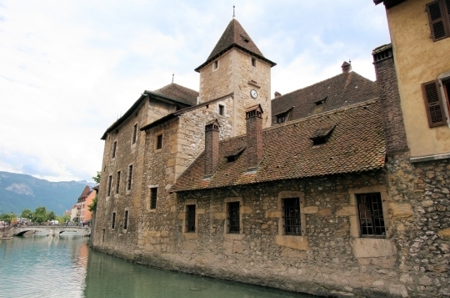
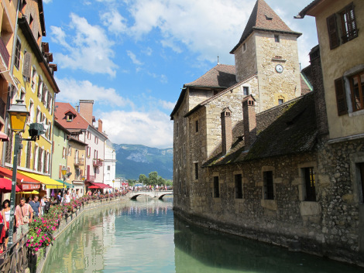
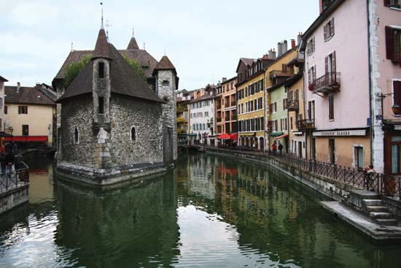
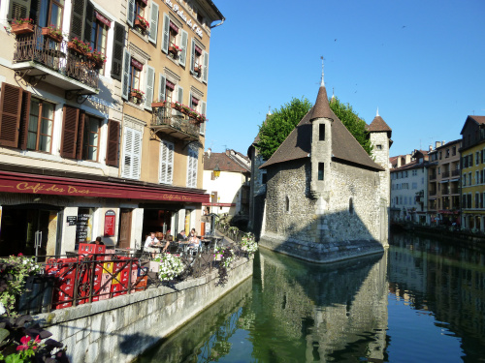
One reality ←→ distinct veridical perspectives

Slide 12
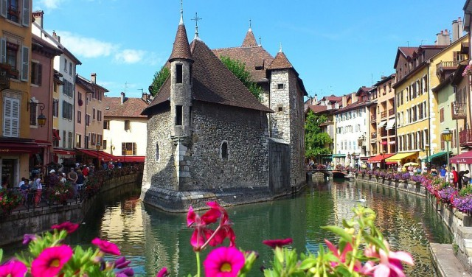
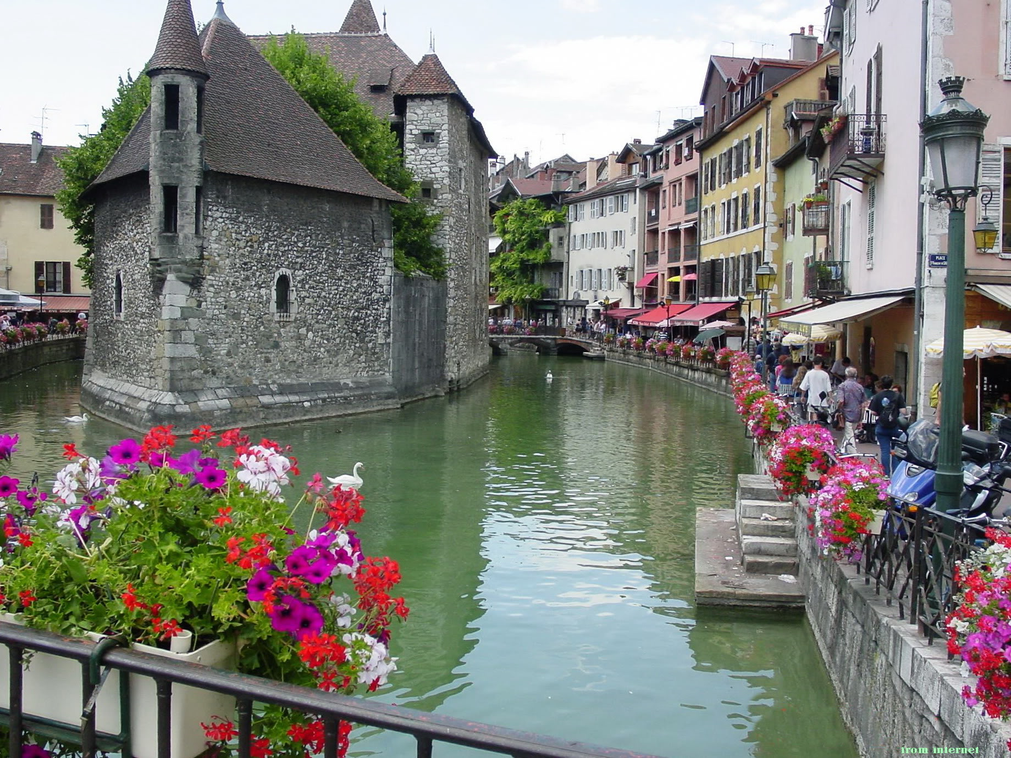
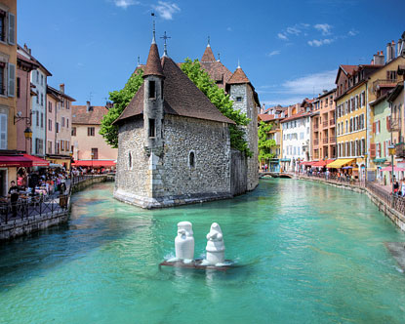
Reality changes → requires time indexing

Slide 13
Reality changes
Requires also accurate representation of what exactly it is that changes
Same (identical) flowers that change color
or
different flowers altogether?

Slide 14


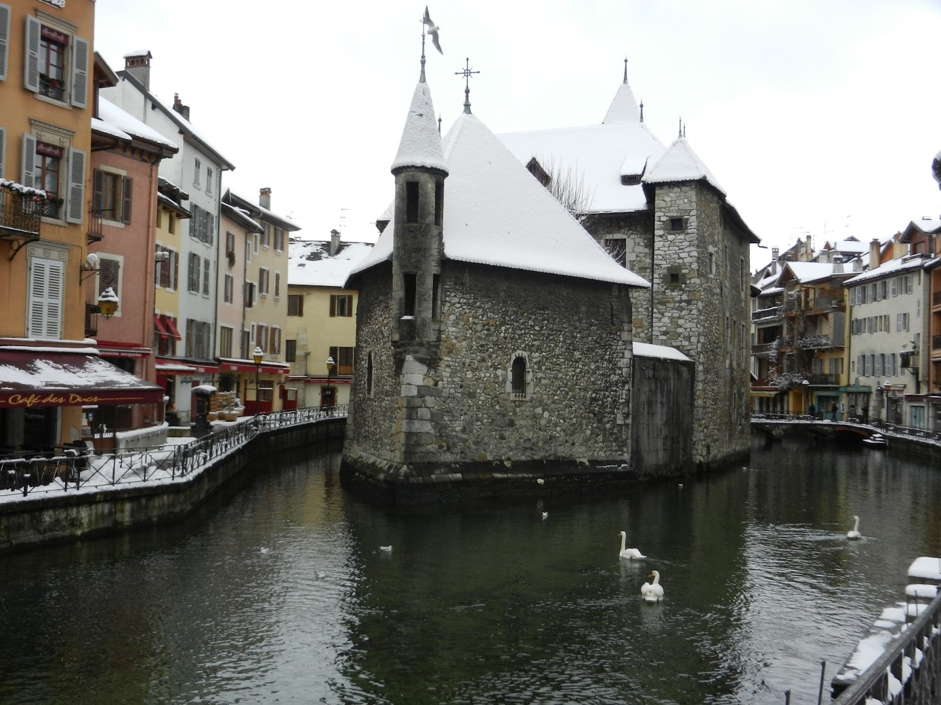
Veridicality in tokens
This portion of snow covers this surface at t₁
This portion of snow covers this surface at t₂

Slide 15
Veridicality in tokens and types
This portion of snow covers this surface at t₁
The disposition of snow to cover surfaces
This portion of snow covers this surface at t₂

Slide 16
Continuants versus Processes
c instance_of C at t - a primitive relation between a continuant instance and a class which it instantiates at a specific time
C is_a C₁ = [definition] for all c, t, if c instance_of C at t then c instance_of C₁ at t.
p instance_of P - a primitive relation between a process instance and a class which it instantiates holding independently of time
P is_a P₁ = [definition] for all p, if p instance_of P then p instance_of P₁.
Smith B, Ceusters W, Klagges B, Koehler J, Kumar A, Lomax J, Mungall C, Neuhaus F, Rector A, Rosse C. Relations in biomedical ontologies, Genome Biology 2005, 6:R46.

Slide 17
Sorts of changes in ontologies
Ontology versions exhibit differences of the following sorts:
  Add a subtree
  Delete a subtree
  Move a subtree to a different location
  Move a set of sibling classes to a different location
  Create a new abstraction and move a set of siblings down in a class hierarchy, creating a new superclass.
  Delete a class, moving its subclasses to become subclasses of its superclass.
  Split a class
  Merge classes
These distinctions don’t tell us the motivations behind the changes
Noy, N.F., Kunnatur, S., Klein, M., and Musen, M.A. Tracking changes during ontology evolution. In Proceeding of the 3rd International Semantic Web Conference (ISWC2004), Hiroshima, Japan, November 2004.

Slide 18
What should be registered in ontologies to interpret changes?
→ Match/mismatch representation vs reality
Ceusters W, Smith B. A Realism-Based Approach to the Evolution of Biomedical Ontologies. Proceedings of AMIA 2006, Washington DC, 2006;:121-125.

Slide 19

Quality improvements in versions
Representational unit | Reality | Ontology V1 |  | Ontology V2 |  | Ontology V3
 | Config | Config | Error | Config | Error | Config | Error
Animal | P+1 | P+1 | 0 | P+1 | 0 | P+1 | 0
Fish | P+1 | P+1 | 0 | P+1 | 0 | P+1 | 0
Whale | P+1 | P+1 | 0 | P+1 | 0 | P+1 | 0
Mammal | P+1 | P+1 | 0 | P+1 | 0 | P+1 | 0
Fish are animals | P+1 | P+1 | 0 | P+1 | 0 | P+1 | 0
Mammals are animals | P+1 | P+1 | 0 | P+1 | 0 | P+1 | 0
Whales are fish | A+1 | P-1 | 3 | A+1 | 0 | A+1 | 0
Whales are animals | P+1 | P+1 | 0 | P+1 | 0 | P+1 | 0
Whales are mammals | P+1 | A-2 | 1 | A-2 | 1 | P+1 | 0
Score | 8*5/ ((8*5) + (0*4)) = 1.00 | ((7*5) + (1*2))/ ((8*5) + (1*4)) = 0.84 |  | 7*5/ ((7*5) + (1*4)) = 0.90 |  | 8*5/ ((8*5) + (0*4)) = 1.00
Ceusters W. Applying Evolutionary Terminology Auditing to the Gene Ontology. Journal of Biomedical Informatics 2009;42:518–529

Slide 20
Changes in SNOMED CT (RF2) concepts and relationships
conceptID | Effective Time | Active | ModuleID | Definitional Status
301381004 | 20020131 | 1 | 900000000000207008 | 900000000000074008
301381004 | 20080131 | 0 | 900000000000207008 | 900000000000074008
FSN = ‘Discomforting present pain (finding)’
RelID | Effective Time | Active | Attribute | Target
126300024 | 20020131 | 1 | Is a | Pain (finding)
126300024 | 20040131 | 0 | Is a | Pain (finding)
126301023 | 20020131 | 1 | Is a | Finding of present pain intensity (finding)
126301023 | 20080131 | 0 | Is a | Finding of present pain intensity (finding)
657858027 | 20020131 | 1 | Finding site | Structure of nervous system (body structure)
657858027 | 20060131 | 0 | Finding site | Structure of nervous system (body structure)
2260209021 | 20030731 | 1 | Interprets | Nervous system function (observable entity)
2260209021 | 20050131 | 0 | Interprets | Nervous system function (observable entity)
2458913020 | 20040131 | 1 | Is a | Discomfort (finding)
2458913020 | 20080131 | 0 | Is a | Discomfort (finding)
2858465020 | 20060131 | 1 | Finding site | Anatomical structure (body structure)
2858465020 | 20080131 | 0 | Finding site | Anatomical structure (body structure)

Slide 21
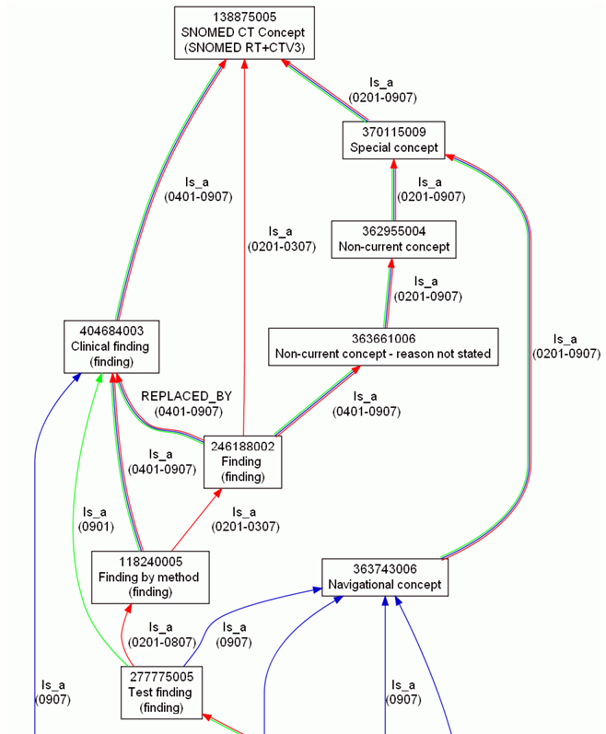
Concept evolution in SNOMED CT
Ceusters W. Applying Evolutionary Terminology Auditing to SNOMED CT. In American Medical Informatics Association 2010 Annual Symposium (AMIA 2010) Proceedings, Washington DC, November 13-17, 2010:96-100.

Slide 22
How SNOMED CT components change
HARS name | Use
POSSIBLY EQUIVALENT TO | From an ambiguous concept to one or more active concepts that represents one of the possible meanings of the inactive concept.
MOVED TO | From a component to a namespace to which the component has been moved
REPLACED BY | From an erroneous or obsolete inactive component to a single active replacement component.
SAME AS | From a duplicate component to the active component that this component duplicates.
WAS A | From an inactive classification concept such as "not otherwise specified" to the active concept that was formerly its most proximal supertype.
ALTERNATIVE | From an inactive classification concept derived from ICD-9 Chapter XVI 'Symptoms signs and ill-defined conditions' with the most similar active concept.
REFERS TO | From an inactive description which is inappropriate to the concept it is directly linked to but instead should refer to the concept referenced.

Slide 23
Changes in descriptions
descriptionID | Effective Time | Active | Description Type | Term
410015012 | 20020131 | 1 | Synonym | Asthenia [D]
410015012 | 20020731 | 0 | Synonym | Asthenia [D]
666971011 | 20020131 | 1 | FSN | Asthenia [D] (finding)
666971011 | 20030131 | 0 | FSN | Asthenia [D] (finding)
1237162017 | 20020731 | 1 | Synonym | Asthenia [D]
1472277017 | 20030131 | 1 | FSN | [D]Asthenia (context-dependent category)
1472277017 | 20060731 | 0 | FSN | [D]Asthenia (context-dependent category)
1489933012 | 20030131 | 1 | Synonym | [D]Asthenia
2610401019 | 20060731 | 1 | FSN | [D]Asthenia (situation)

Slide 24
Mapping ‘reasons for change’ to ETA
CT | Existing concept made … | N | Error Type
0 | active: in current use | 2,010 | A-1
1 | inactive: ‘retired’ without a specified reason | 1,993 | P-1
2 | inactive: withdrawn because duplication | 9,711 | P-9
3 | inactive because no longer recognized as a valid clinical concept (outdated) | 1,348 | P-1
4 | inactive because inherently ambiguous. | 5,829 | P-4
5 | inactive because found to contain a mistake | 1,204 | P-1
6 | active with limited clinical value (classification concept or an administrative definition) | 4,461 | A-1
10 | inactive because moved elsewhere | 14,406 | P-6
11 | pending move |  | P-6
 | TOTAL | 40,962
Ceusters W. Applying Evolutionary Terminology Auditing to SNOMED CT. In American Medical Informatics Association 2010 Annual Symposium (AMIA 2010) Proceedings, Washington DC, November 13-17, 2010:96-100.

Slide 25
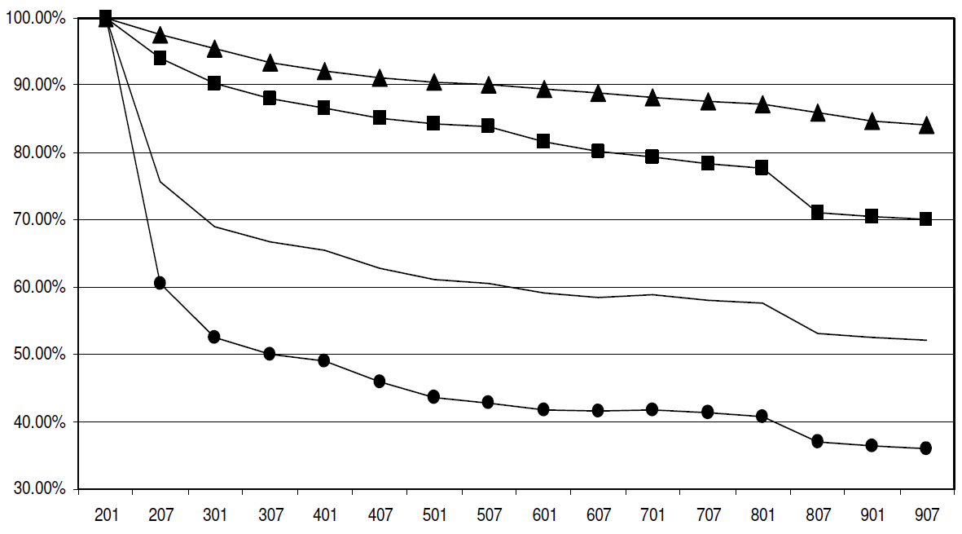
Ungraceful degradation of assertions in SNOMED CT
concepts
terms
all
relationships
Ceusters W. Applying Evolutionary Terminology Auditing to SNOMED CT. In American Medical Informatics Association 2010 Annual Symposium (AMIA 2010) Proceedings, Washington DC, November 13-17, 2010:96-100.

Slide 26
Concepts and confusions in SNOMED CT
‘concept’:
  ‘a clinical idea to which a unique concept identifier has been assigned’; ‘the meaning of a concept can be determined from relationships to other concepts and from associated descriptions that include human readable terms’
the term is also stated to be a homonym for:
  ‘concept identifier’ as well as for
  ‘the real-world referent(s) of the concept identifier, that is, the class of entities in reality that the concept identifier represents’

Slide 27
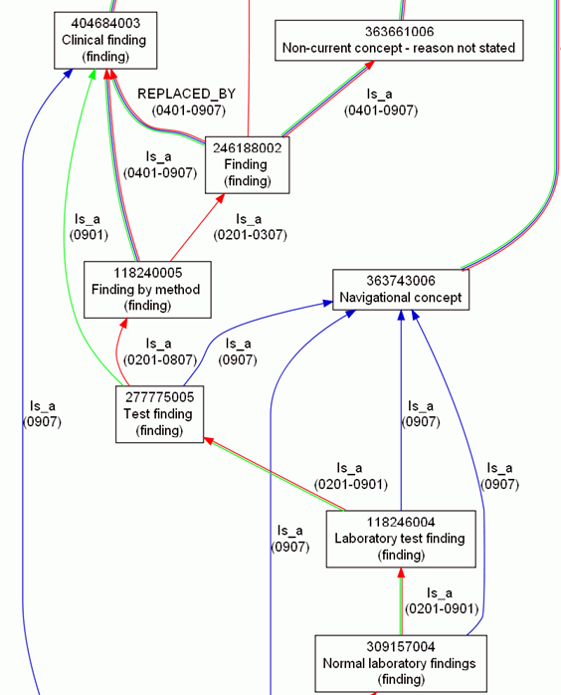
Consequence: more confusion
What is
inside
versus
outside SNOMED CT?

Slide 28
Inside versus outside an ontology
What is
inside
versus
outside SNOMED CT?

Slide 29
Inside versus outside an ontology
What is
inside
versus
outside SNOMED CT?

Slide 30
Inside versus outside an ontology
What is
inside
versus
outside SNOMED CT?
Clear shift in meaning, incompatible with SNOMED CT’s change policy

Slide 31
Inside versus outside an ontology
What is
inside
versus
outside SNOMED CT?
‘halfway’ concept:
denotes external entities but viewed through internal organization

Slide 32
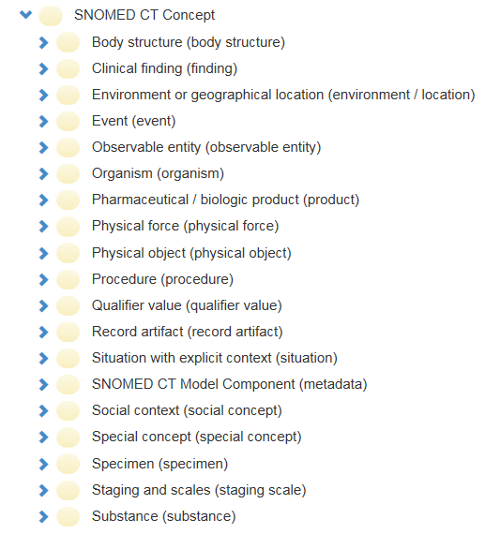
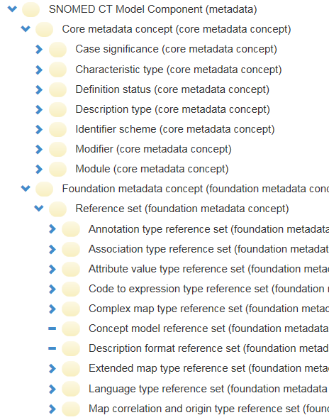
SNOMED CT inside versus outside

Slide 33
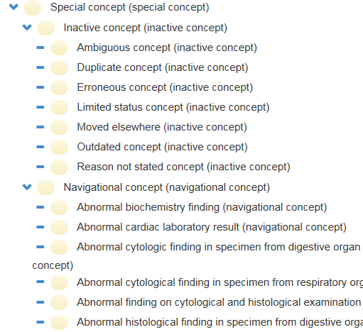
SNOMED CT inside versus outside

Slide 34
Core definitions for information and representation
information content entity (ice) =def. an entity which is (1) generically dependent on (2) some material entity and which (3) stands in a relation of aboutness to some portion of reality.
information quality entity (iqe) =def. a quality that is the concretization of some information content entity.
artifact =def. a material entity created or modified or selected by some agent to realize a certain function or role.
information artifact =def. an artifact whose function is to bear an information quality entity.
representation =def. a quality which is_about or is intended to be about a portion of reality.
mental quality =def. a quality which specifically_depends_on an anatomical structure in the cognitive system of an organism.
cognitive representation =def. a representation which is a mental quality.
representational unit (ru) = def. a smallest constituent sub-representation, including icons, names, simple word forms, or the sorts of alphanumeric identifiers we might find in patient records.
Smith B, Ceusters W. Aboutness: Towards Foundations for the Information Artifact Ontology. International Conference on Biomedical Ontologies, ICBO 2015, Lisbon, Portugal, July 27-30, 2015;47-51.

Slide 35
Information and representation
isAbout
continuant
Portion of Reality
GDC
SDC
material entity
ICE
quality
function
artifact
GenDepOn
IQE
function to bear
an IQE
isConcretizationOf
Information artifact
representation
inhererOf
isA
isAbout or isIntendedToBeAbout
representational unit
Smith B, Ceusters W. Aboutness: Towards Foundations for the Information Artifact Ontology. International Conference on Biomedical Ontologies, ICBO 2015, Lisbon, Portugal, July 27-30, 2015;47-51.

Slide 36
SNOMED CT parts as ICEs
Portion of Reality
~isA
isAbout
Something around discomforting pain
ICE
isA
isA
isAbout
SNOMED CT
concept identifier
SNOMED CT
FSN
instanceOf at t₁
instanceOf at t₂
SNOMED CT:
301381004
SNOMED CT:
‘Discomforting present pain (finding)’

Slide 37
SNOMED CT parts as …
Portion of Reality
~isA
isAbout
Something around discomforting pain
ICE
isA
isA
isAbout
?
SNOMED CT
concept identifier
SNOMED CT
FSN
instanceOf at t₁
instanceOf at t₂
SNOMED CT:
301381004
SNOMED CT:
‘Discomforting present pain (finding)’
conceptID | Effective Time | Active | ModuleID | Definitional Status
301381004 | 20020131 | 1 | 900000000000207008 | 900000000000074008
301381004 | 20080131 | 0 | 900000000000207008 | 900000000000074008

Slide 38
SNOMED CT parts as IQEs
Quality
Portion of Reality
~isA
isA
isAbout
Something around discomforting pain
IQE
ICE
instanceOf at t1
isA
isA
isAbout
instanceOf at t1
Q301381004 (2)
SNOMED CT
concept identifier
SNOMED CT
FSN
instanceOf at t₁
instanceOf at t₂
Q301381004 (1)
SNOMED CT:
301381004
SNOMED CT:
‘Discomforting present pain (finding)’
inheresIn at t1
concretizationOf at t1
inheresIn at t1
GenDepOn at t1
conceptID | Effective Time | Active | ModuleID | Definitional Status
301381004 | 20020131 | 1 | 900000000000207008 | 900000000000074008
301381004 | 20080131 | 0 | 900000000000207008 | 900000000000074008

Slide 39
Strings out of context
Portion of Reality
~isA
isAbout
Something around discomforting pain
ICE
isA
isA
isAbout
?
SNOMED CT
concept identifier
SNOMED CT
FSN
instanceOf at t₁
instanceOf at t₂
SNOMED CT:
301381004
SNOMED CT:
‘Discomforting present pain (finding)’
301381004
301381004

Slide 40
Strings out of context
Quality
GDC
isA
instanceOf at t1
IQE
isA
instanceOf at t1
Numeric
pattern
Q301381004 (2)
Q301381004 (1)
instanceOf at t₁
inheresIn at t1
inheresIn at t1
Numeric pattern:
301381004
concretizationOf at t1
301381004
301381004
GenDepOn at t1

Slide 41
What remains valid in light of, f.i., ‘Active’?
?
Quality
Portion of Reality
~isA
isA
isAbout
Something around discomforting pain
IQE
ICE
instanceOf at t1
isA
isA
isAbout
instanceOf at t1
Q301381004 (2)
SNOMED CT
concept identifier
SNOMED CT
FSN
instanceOf at t₁
instanceOf at t₂
Q301381004 (1)
SNOMED CT:
301381004
SNOMED CT:
‘Discomforting present pain (finding)’
inheresIn at t1
concretizationOf at t1
inheresIn at t1
GenDepOn at t1
conceptID | Effective Time | Active | ModuleID | Definitional Status
301381004 | 20020131 | 1 | 900000000000207008 | 900000000000074008
301381004 | 20080131 | 0 | 900000000000207008 | 900000000000074008

Slide 42
How to formalize changes over time ?
Quality
Portion of Reality
~isA
isA
isAbout
Something around discomforting pain
IQE
ICE
instanceOf at t1
isA
isA
isAbout
instanceOf at t1
Q301381004 (2)
SNOMED CT
concept identifier
SNOMED CT
FSN
?
instanceOf at t₁
instanceOf at t₂
Q301381004 (1)
SNOMED CT:
301381004
SNOMED CT:
‘Discomforting present pain (finding)’
inheresIn at t1
concretizationOf at t1
inheresIn at t1
GenDepOn at t1
conceptID | Effective Time | Active | ModuleID | Definitional Status
301381004 | 20020131 | 1 | 900000000000207008 | 900000000000074008
301381004 | 20080131 | 0 | 900000000000207008 | 900000000000074008

Slide 43
Similarity with process profiles
(1) Attributions in BFO
spatial region r has volume w | r instance_of universal region with volume w
height quality q has value 2 meters at t | q projects onto a one-dimensional spatial region r at t and r instance of universal 2 meter long one-dimensional spatial region
temporal region t has duration d | t instance_of universal temporal region with duration d
temperature quality q has value 63° Celsius | q instance_of universal 63° Celsius temperature quality
process p has duration d | process p spans temporal region t and t instance_of universal temporal region with duration d
motion p of object o has trajectory with shape s | the sequence of locations occupied by object o at successive instants of time forms a spatiotemporal region t and t instance_of universal spatiotemporal region with shape s

Slide 44
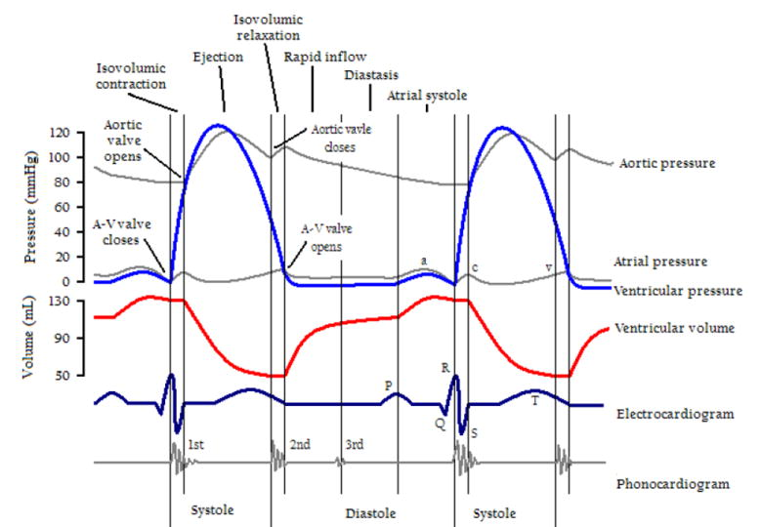
Similarity with process profiles
(2) change of quality instantiations
Smith B. Classifying processes: an essay in applied ontology. Ratio 25 (4):463-488 (2012)

Slide 45
Process Profile Representations (PPR)
S | FSN | Attr. | Value | Value label | Process Profile Representation (PPR)
C1 | GS NOS | Dstatus | DSP-05 |  | DDDDDDDDDDDDDDDDDDDDDDDDDDDDD
C1 | GS NOS | Reason | CIP-15 |  | DDDDDDDDDDDDDDDDLLLLLLLLLLLLL
C1 | GS NOS | FSN | T-367 | GS NOS (finding) | _____________AAAAAAAAAAAAAAAA
C1 | GS NOS | Same-as | C4 | GS NOS (finding) | _AAAAAAAAAAAAAAAAAAAAAAAAAAAA
C1 | GS NOS | Was-a | C5 | GS (finding) | ________________AAAAAAAAAAAAA
C2 | GS NOS | Dstatus | DSP-05 |  | DDDDDDDDDDDDDDDDDDDDDDDDDDDDD
C2 | GS NOS | Reason | CIP-15 |  | DDDDDDDDDDDDDDDDLLLLLLLLLLLLL
C2 | GS NOS | FSN | T-367 | GS NOS (finding) | _____________AAAAAAAAAAAAAAAA
C2 | GS NOS | Same-as | C4 | GS NOS (finding) | _AAAAAAAAAAAAAAAAAAAAAAAAAAAA
C2 | GS NOS | Was-a | C5 | GS (finding) | ________________AAAAAAAAAAAAA
C3 | GS NOS | Dstatus | DSP-05 |  | DDDDDDDDDDDDDDDDDDDDDDDDDDDDD
C3 | GS NOS | Reason | CIP-15 |  | DDDDDDDDDDDDDDDDLLLLLLLLLLLLL
C3 | GS NOS | FSN | T-367 | GS NOS (finding) | _____________AAAAAAAAAAAAAAAA
C3 | GS NOS | Same-as | C4 | GS NOS (finding) | _AAAAAAAAAAAAAAAAAAAAAAAAAAAA
C3 | GS NOS | Was-a | C5 | GS (finding) | ________________AAAAAAAAAAAAA
historyOf

Slide 46
Future work
Ontological theory:
  Full characterization in terms of ICE
  Combination of quality-like features
    are we too parsimonious?
Implementation of historic browser

Slide 47
Acknowledgements
This work was supported in part by:
  Clinical and Translational Science Award, NIH 1 UL1 TR001412-01 from the National Institutes of Health,
  R21LM009824 from the National Library of Medicine (NLM), and
  1R01DE021917-01A1 from the National Institute of Dental and Craniofacial Research (NIDCR).
The content of this paper is solely the responsibility of the authors and does not necessarily represent the official views of the NIDCR, the NLM or the National Institutes of Health.

