Slide 1

Defeating Standard Terminology
Approaches through Novel Formalisms for Ontology Research and Development
Wednesday, March 5, 2014, 9:30 am – 10:30 am
134B Farber Hall
Werner CEUSTERS, MD
Professor
UB Department of Psychiatry
Ontology Research Group, NYS CoE in Bioinformatics & Life Sciences
UB Institute for Healthcare Informatics

Slide 2
Presentation context
Thesis: mainstream ontology and EHR design approaches fail in achieving their objectives:
  various sorts of mistakes in ontologies,
  inability to use ontologies adequately in EHRs,
  failure to integrate data repositories even if these ontologies are appropriately designed.
Root causes:
  inadequacy of their conceptual semantic foundations,
  lack of knowledge about ontology as a philosophical discipline.
Proposed solution:
  a new grand vision of the areas in which research in biomedical knowledge representation needs to move.

Slide 3

Is this thesis a bold claim in light of …?
HIMMS 2014
http://www.orlandosentinel.com/health/os-pictures-himss-healthcare-information-technology-conference-20140224,0,1443512.photogallery

Slide 4


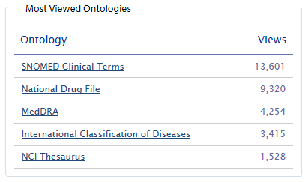
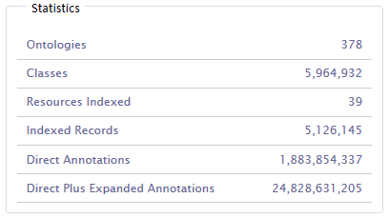
Is this thesis a bold claim in light of …?
NCBO BioPortal (March 4, 2014)
https://bioportal.bioontology.org/

Slide 5

Fair to compare?
Another bold claim (?): this is art
http://painting.about.com/od/famouspainters/ig/famous-paintings/Ad-Reinhardt-.htm

Slide 6
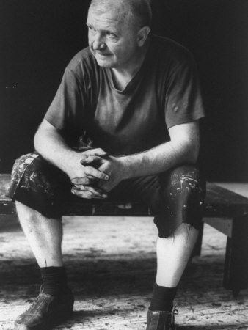
Is this art? Depends on who the creator is.
http://ludwig-mies-vanderrohe.blogspot.com/2011/07/ad-reinhardt-abstract-expressionist.html
Adolph ‘Ad’ Frederick Reinhardt
✳ Buffalo, NY 12/24/1913
† Manhattan, NY 8/30/1967
http://painting.about.com/od/famouspainters/ig/famous-paintings/Ad-Reinhardt-.htm

Slide 7
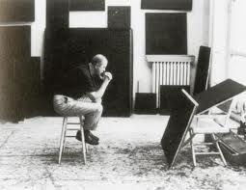
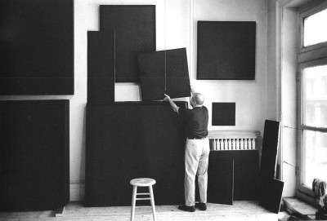
There is something wrong, irresponsible and mindless about color; something impossible to control. Control and rationality are part of my morality.
-- Ad Reinhardt in 1960
http://thesingleroad.blogspot.com/2011_02_01_archive.html
http://minimalissimo.com/2012/10/black-paintings/

Slide 8

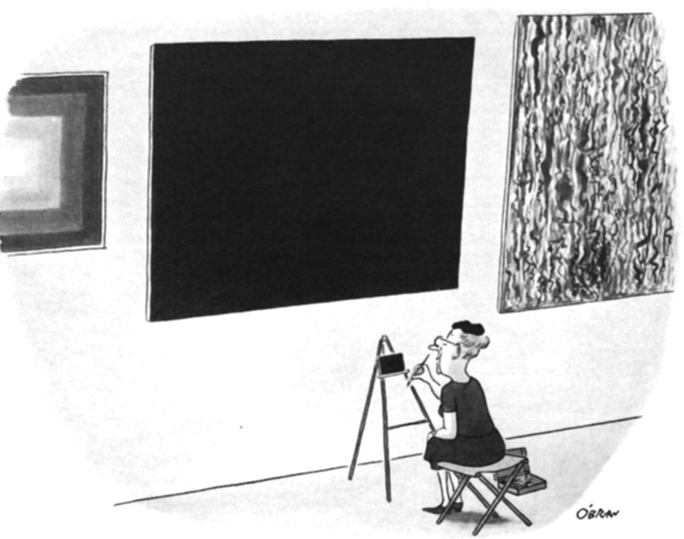
Are these right ways to understand this?
http://www.nytimes.com/slideshow/2008/08/01/arts/0801-BLACK_index.html?_r=0
William O’Brian, August 19, 1967
http://www.newyorker.com/online/blogs/culture/2013/12/slide-show-ad-reinhardts-cartoons-make-an-appearance-at-at-david-zwirner.html#slide_ss_0=1

Slide 9


There is something wrong, irresponsible and mindless about color; something impossible to control. Control and rationality are part of my morality.
-- Ad Reinhardt in 1960
http://www.wikipaintings.org/en/ad-reinhardt/untitled-1937
http://www.cavetocanvas.com/post/20595013175/ad-reinhardt-red-and-blue-composition-1941-from
http://minimalissimo.com/2012/10/black-paintings/
One can, perhaps, understand this by studying his history.

Slide 10
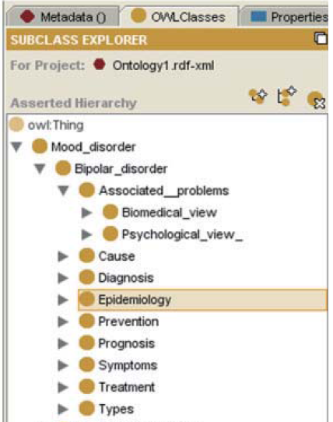
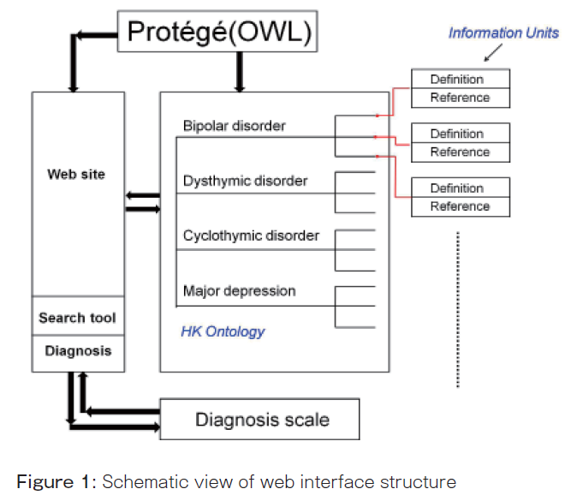
There is something wrong, irresponsible and mindless about mainstream ontology and biomedical informatics; something impossible to control. Control and rationality are part of my morality.
-- Werner Ceusters in 2014

Slide 11
Two abundantly present fundamental mistakes (1)
Psychological views are as much special kinds of associated problems as associated problems are special kinds of bipolar disorder;
= using ontology tools while ignoring the underlying semantics.


Slide 12
Two abundantly present fundamental mistakes (2)
You can’t exchange mental illnesses through websites or have Protégé interact with illnesses;
= confusing information with what information is about!

Slide 13
A trajectory of mixes and mingles …
Informatics
Knowledge Representation
Linguistics
Computational Linguistics
Ontology
Philosophy
Medical Natural
Language Understanding
Realism-Based
Ontology
Electronic
Health Records
Translational
Research
Referent
Tracking
Medicine
Pharmacogenomics
Performing
Arts
Defense &
Intelligence
Biology
Pharmacology

Slide 14

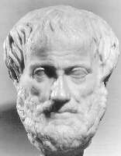


Education and Training
MD, Board certified (in Belgium)
  neuro-psychiatry (last of its kind)
  healthcare informatics
PostDoctoral Degree (~MSc)
  knowledge engineering (Dept. of philosophy)
    theoretical parts focused on epistemology, philosophy of language, modal and non-monotonic logics, fuzzy logics,
    practical parts: design of problem-specific representation languages
Awards from the Belgian and Dutch Medical Informatics Organizations on computer-based patient (and provider) assessment instrument
1984
1990
2002
1993

Slide 15



Missionary work through EU funded projects
MEDIREC → PROREC:
  Getting EHR systems accepted nationally
  Promoting quality criteria for data capture and data exchange
EUROREC:
  European alignment of EHR systems
  Certification of EHR systems
ARGOS: Transatlantic Observatory for Meeting Global Health Policy Challenges through ICT-Enabled Solutions
1994
2000
2010

Slide 16
A trajectory of mixes and mingles … (2)
Informatics
Knowledge Representation
Linguistics
Computational Linguistics
Medical Natural
Language Understanding
Electronic
Health Records
Medicine

Slide 17


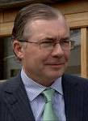

Early research in EU funded projects
ANTHEM: automatic coding of diagnostic expressions in ICD-10
Multi-Tale: syntactic – semantic tagging
of terms and phrases in surgery reports
DOME: Document Management in
Healthcare Informatics Systems.
GALEN-IN-USE: development of a large scale medical terminologic knowledge base.
ToMeLo: building a Strategic Alliance between Developers of Medical Terminology and Health Care Record Systems

Slide 18

Language & Computing nv / Inc.
Created in 1998 with traditional 3F investors, raised $10,000,000 capital in 2000;
Mission: develop NLU applications to turn medical free text into structured representations;
I functioned as CTO and VP R&D until 2004
  my team: 12 MDs, 4 computational linguists, 5 software engineers;
Several awards:
  1998: startup company of the year Flanders Technology International,
  2003: Frost and Sullivan Healthcare Information Technology and Life Sciences Product-of-the-Year Award;
US Patent filed in 2001, accepted in 2009;
Bought by Nuance Inc (“Dragon”) in 2010.

Slide 19
My 1993 interest in Natural Language Understanding: prove the 1990 HIT dogma wrong
Fact: computers can only deal with a structured representation of reality:
  structured data:
    relational databases, spread sheets
  structured information:
    XML simulates context
  structured knowledge:
    rule-based knowledge systems
Conclusion: a need for structured data entry
→ Use speech recognition to turn speech into text, and NLU to turn text into structured representations.
?

Slide 20
Main problem to solve: language is ambiguous
‘I know that you believe that you understood what you think I said, but I am not sure you realize that what you heard is not what I meant.’
  Robert McCloskey, State Department spokesman (attributed).
    http://www.quotationspage.com/quotes/Robert_McCloskey/

Slide 21
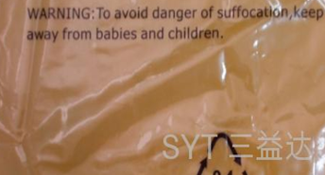
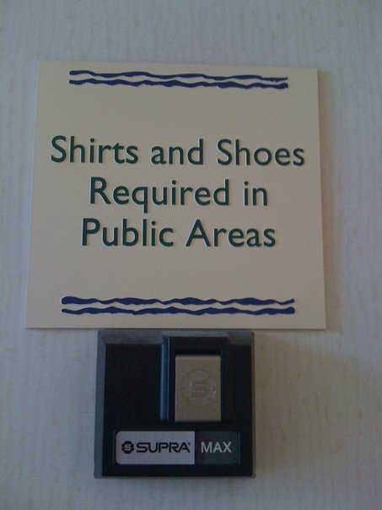

Language is ambiguous
Often we can figure it out …
warning on plastic bag
in Miami hotel lobby
in Miami bar

Slide 22
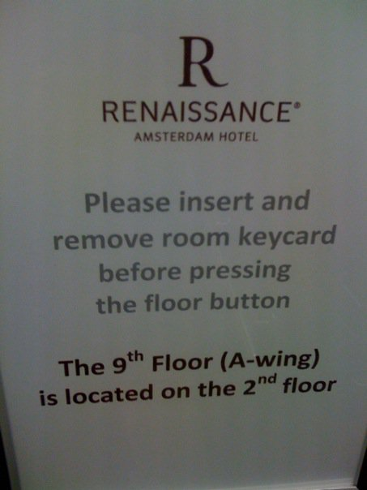
Language is ambiguous
Sometimes, we can not …
in Amsterdam hotel elevator

Slide 23
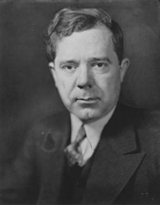
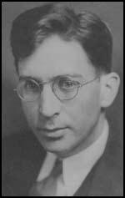
Problems hide in simple words
For sure, Carl Weiss did kill Huey Long.
But, when did Carl Weiss kill Huey Long?
Huey Pierce Long, Jr.
(Aug 30, 1893 - Sept 10, 1935)
Carl Austin Weiss, MD
(Dec 6, 1906 – Sept 8, 1935)

Slide 24
Ambiguous references in free text
‘The surgeon examined Maria. She found a small tumor on the left side of her liver. She had it removed three weeks later.’
Ambiguities:
  who denotes the first ‘she’: the surgeon or Maria ?
  on whose liver was the tumor found ?
  who denotes the second ‘she’: the surgeon or Maria ?
  what was removed: the tumor or the liver ?

Slide 25
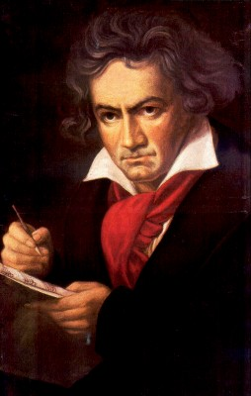
Main resources of those days: terminologies embracing the semantic/semiotic triangle
Ludwig van Beethoven
that great German composer that became deaf
…
concept
term
referent
‘Beethoven’

Slide 26
Semantic triangle useful in explaining …
synonymy
homonymy

Slide 27
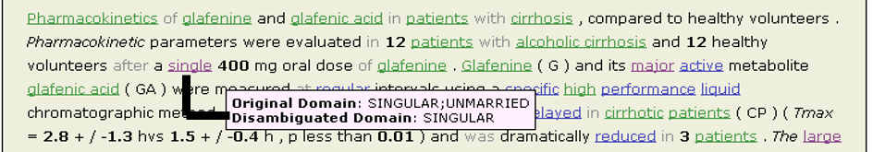
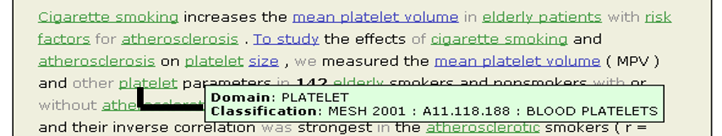
‘Concept’ disambiguation
‘Concept’ recognition
Jackson B, Ceusters W. A novel approach to semantic indexing combining ontology-based semantic weights and in-document concept co-occurrences. In Baud R, Ruch P. (eds) EFMI Workshop on Natural Language Processing in Biomedical Applications, Cyprus, 2002;:75-80.

Slide 28
Major problems with the theory
What qualifies as concepts ?
How to organize concepts appropriately ?

Slide 29
Problem: one can create terms and ‘meaningful’ concepts to trick people
the symphony Beethoven wrote after the tenth
…
concept
term
referent
‘Beethoven's Symphony No. 11’

Slide 30
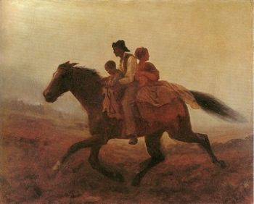
Or worse …
Prehistoric ‘psychiatry’: drapetomania
disease which causes slaves to suffer from an unexplainable propensity to run away
…
concept
term
referent
painting by Eastman Johnson. A Ride for Liberty: The Fugitive Slaves. 1860.
‘drapetomania’

Slide 31
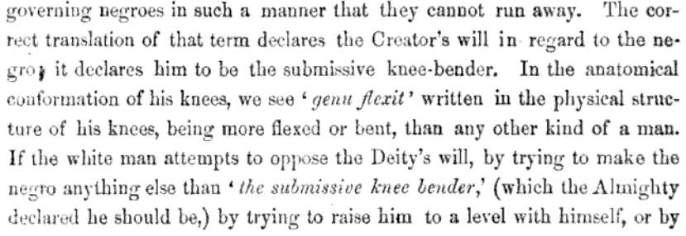
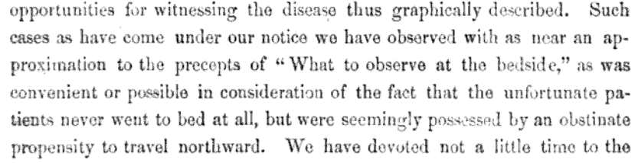
From: Buffalo Medical Journal, vol 10, p439, 1855
Some etiologic and diagnostic reflections

Slide 32
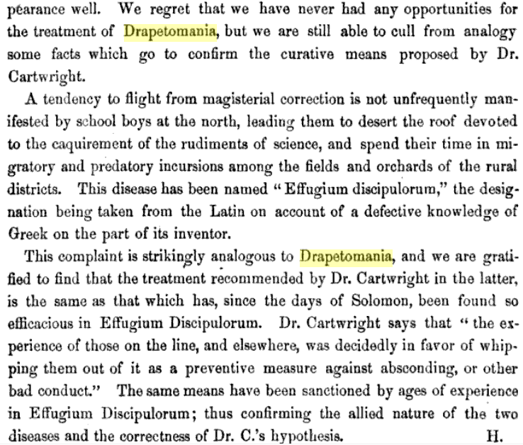
How to treat the North’s ‘Effugium Discipulorum’

Slide 33
SNOMED about diseases and concepts (2010)
‘Disorders are concepts in which there is an explicit or implicit pathological process causing a state of disease which tends to exist for a significant length of time under ordinary circumstances.’
And also: “Concepts are unique units of thought”.
Thus: Disorders are unique units of thoughts in which there is a pathological process …???
And thus: to eradicate all diseases in the world at once we simply should stop thinking ?

Slide 34
MeSH: Geographic Locations [Z01] (2013)
Africa [Z01.058] +
Americas [Z01.107] +
Antarctic Regions [Z01.158]
Arctic Regions [Z01.208]
Asia [Z01.252] +
Atlantic Islands [Z01.295] +
Australia [Z01.338] +
Cities [Z01.433] +
Europe [Z01.542] +
Historical Geographic Locations [Z01.586] +
Indian Ocean Islands [Z01.600] +
Oceania [Z01.678] +
Oceans and Seas [Z01.756] +
Pacific Islands [Z01.782] +
Ancient Lands [Z01.586.035] +
Austria-Hungary [Z01.586.117]
Commonwealth of Independent States [Z01.586.200] +
Czechoslovakia [Z01.586.250] +
European Union [Z01.586.300]
Germany [Z01.586.315] +
Korea [Z01.586.407]
Middle East [Z01.586.500] +
New Guinea [Z01.586.650]
Ottoman Empire [Z01.586.687]
Prussia [Z01.586.725]
Russia (Pre-1917) [Z01.586.800]
USSR [Z01.586.950] +
Yugoslavia [Z01.586.980] +

Slide 35
MeSH: some paths from top to Wolfram Syndrome
All MeSH Categories
Diseases Category
Nervous System Diseases
Female Urogenital Diseases
and Pregnancy Complications
Eye Diseases
Male Urogenital
Diseases
Cranial Nerve
Diseases
Female Urogenital Diseases
Optic Nerve
Diseases
Neurodegenerative
Diseases
Optic Nerve
Diseases
Eye Diseases,
Hereditary
Heredodegenerative
Disorders,
Nervous System
Urologic Diseases
Optic Atrophy
Kidney Diseases
Optic Atrophies,
Hereditary
Diabetes Insipidus
Wolfram Syndrome

Slide 36
What would it mean if used in the context of a patient ?
All MeSH Categories
???
Diseases Category
Nervous System Diseases
Female Urogenital Diseases
and Pregnancy Complications
Eye Diseases
Male Urogenital
Diseases
Cranial Nerve
Diseases
Female Urogenital Diseases
…
Neurodegenerative
Diseases
Optic Nerve
Diseases
Optic Nerve
Diseases
Eye Diseases,
Hereditary
has
Heredodegenerative
Disorders,
Nervous System
Urologic Diseases
Optic Atrophy
Kidney Diseases
Optic Atrophies,
Hereditary
Diabetes Insipidus
has
Wolfram Syndrome

Slide 37
Major problems with the theory
What qualifies as concepts ?
How to organize concepts appropriately ?
→ Too close to language, too much cultural biases, no solid foundations.
Smith B., Ceusters W, Temmerman R. Wüsteria. In: Engelbrecht R. et al. (eds.) Medical Informatics Europe, IOS Press, Amsterdam, 2005;:647-652

Slide 38
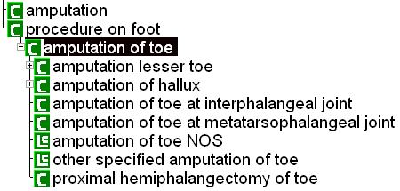

Another false belief
Computer science will solve this by using description logic classifiers.
SNOMED-RT (2000)
SNOMED-CT (2003)
Ceusters W, Smith B, Kumar A, Dhaen C. Mistakes in medical ontologies: where do they come from and how can they be detected? in Pisanelli DM (ed) Ontologies in Medicine. Proceedings of the Workshop on Medical Ontologies, Rome October 2003, IOS Press, Studies in Health Technology and Informatics, 2004;102: 145-63.

Slide 39
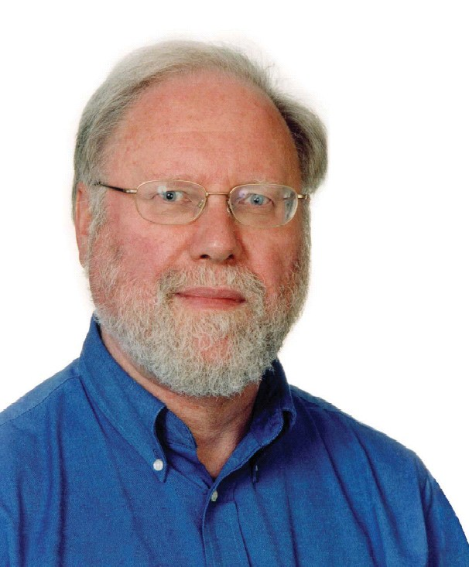
GALEN project: Generalized Architecture for Languages, Encyclopedias and Nomenclatures
→ try to represent independent of language
The Galen view
ResourseManagementProcess
InstallingProcess
LiquidInstallingProcess
Filling
Injecting
Alan Rector, University of Manchester
‘Making the impossible very difficult’

Slide 40
My contribution: try to represent independent of any specific language, but build extra resources to exploit the relationships between language and what it is about
The Galen view The linguistic semantic view
(domain ontology) (linguistic ontology)
ResourseManagementProcess
InstallingProcess To install <theme> [ in <goal> ]
LiquidInstallingProcess
Filling To fill <goal> [with <theme> ]
Injecting To inject <theme> [ in <goal> ]
To inject <goal>

Slide 41
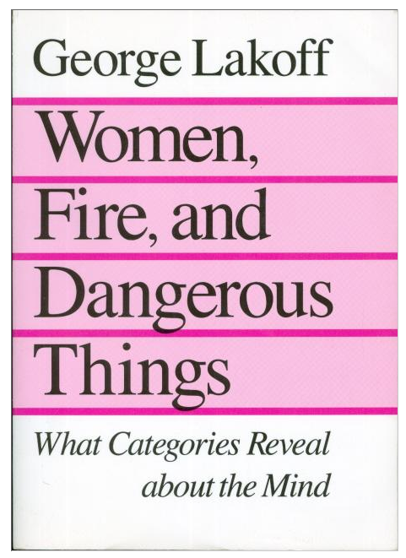
My motivation

Slide 42
My contribution,
try to represent independent of any specific language, but build extra resources to exploit the relationships between language and what it is about,
was necessary, but had an unavoidable drawback:
‘Making the impossible
very difficult’
Make it work
‘Making the impossible
extremely difficult’
Do it right

Slide 43
Take-home message
Concept-based terminology (and standardisation thereof) is there as a mechanism to improve understanding of messages by humans.
It is NOT the right device
  to explain why reality is what it is, how it is organised, etc., (although it is needed to allow communication),
  to reason about reality,
  to make machines understand what is real,
  to integrate across different views, languages, conceptualisations, ...

Slide 44
My 1998 requirements for NLU
Knowledge about terms and how they are used in valid constructions within natural language;
Knowledge about that what terms denote and how the things denoted interrelate;
An algorithm that is able to calculate a language user’s representation of that what is described by means of the utterances that are the subject of the analysis.
However: the notion of ‘domain’ and ‘that what is denoted’ was not sufficiently addressed.

Slide 45
A trajectory of mixes and mingles …(3)
Informatics
Knowledge Representation
Linguistics
Computational Linguistics
Ontology
Philosophy
Medical Natural
Language Understanding
Realism-Based
Ontology
Electronic
Health Records
Medicine

Slide 46
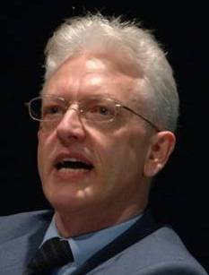


The two faces of ‘ontology’
In philosophy:
  Ontology (no plural) is the study of what entities exist and how they relate to each other;
In mainstream computer science and biomedical informatics:
  An ontology (plural: ontologies) is a shared and agreed upon conceptualization of a domain;
  usually: a terminology in disguise which therefor suffers from:
    ambiguities and idiosyncrasies in natural language,
    the concept theory which underlies terminology as a scientific discipline,
    Ignorance on the side of (biomedical) subject matter experts about these issues when they build ontologies.
2001
2004

Slide 47
My 2004 requirements for NLU
Knowledge about terms and how they are used in valid constructions within natural language;
Knowledge about the world, i.e. how the referents denoted by the terms interrelate in reality and in given types of context;
An algorithm that :
  is able to calculate a language user’s representation of that part of the world described in the utterances that are the subject of the analysis.
  can track the ways in which people express what does NOT represent anything in reality (eg for medico-legal reasons)
Only a realist ontology (and not an ontology that deals with “alternative realities”) permits correct disambiguation between 3a and 3b.

Slide 48
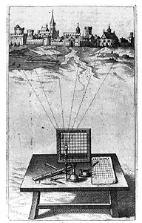
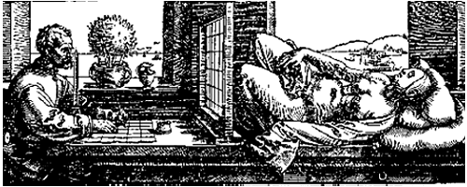
Foundation 1:
Ontology as if it were Alberti’s grid
reality
Ontological
theory
representation

Slide 49
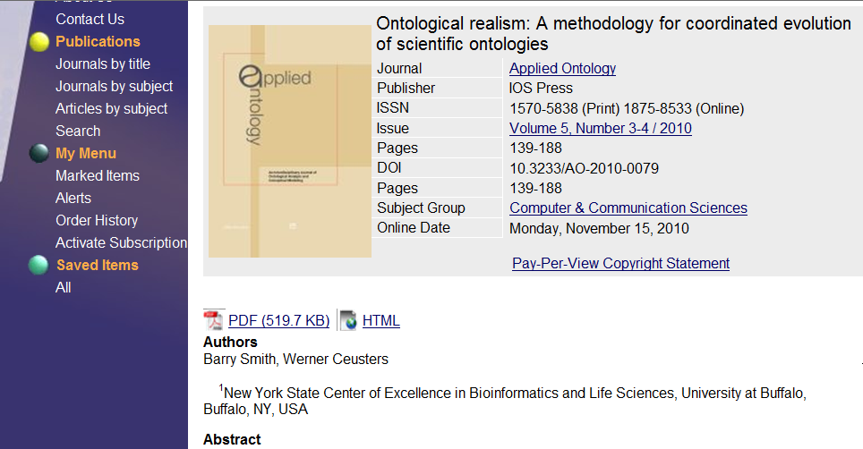


Slide 50
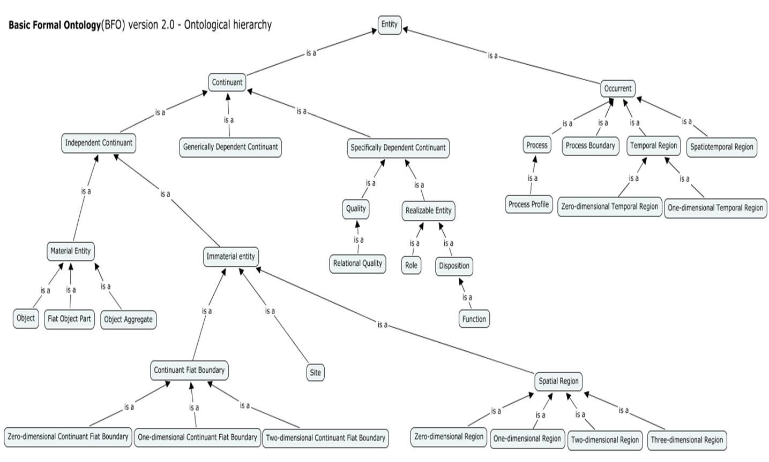
Basic Formal Ontology (BFO)

Slide 51
OBO Foundry ontologies in BFO-dress
RELATION TO TIME GRANULARITY | CONTINUANT |  |  |  | OCCURRENT
 | INDEPENDENT |  | DEPENDENT
ORGAN AND ORGANISM | Organism (NCBI Taxonomy) | Anatomical Entity (FMA, CARO) | Organ Function (FMP, CPRO) | Phenotypic Quality (PaTO) | Biological Process (GO)
CELL AND CELLULAR COMPONENT | Cell (CL) | Cellular Component (FMA, GO) | Cellular Function (GO)
MOLECULE | Molecule (ChEBI, SO, RnaO, PrO) |  | Molecular Function (GO) |  | Molecular Process (GO)
Notes:
51

Slide 52
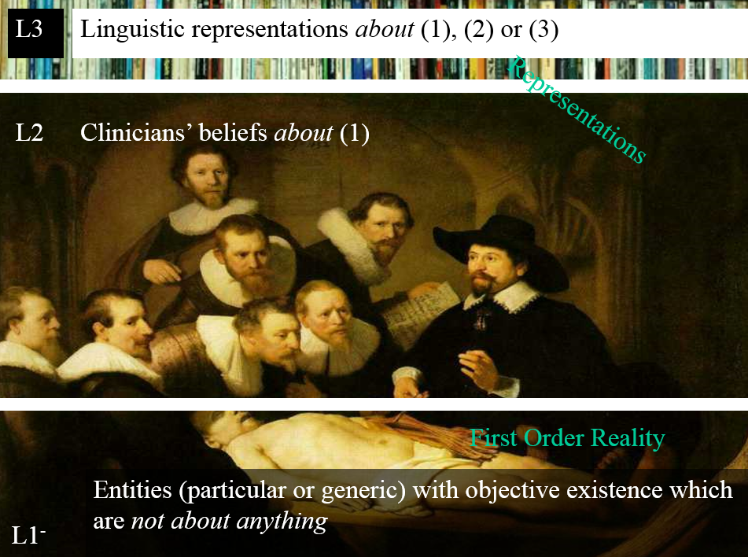
Foundation 2:
Constantly tracking three levels of reality

Slide 53
Terminological versus Ontological approach
The terminologist defines:
  ‘a clinical drug is a pharmaceutical product given to (or taken by) a patient with a therapeutic or diagnostic intent’. (RxNorm)
The (good, real) ontologist thinks:
  Does ‘given’ includes ‘prescribed’?
  Is manufactured with the intent to … not sufficient?
    Are newly marketed products – available in the pharmacy, but not yet prescribed – not clinical drugs?
    Are products stolen from a pharmacy not clinical drugs?
    What about such products taken by persons that are not patients?
      e.g. children mistaking tablets for candies.

Slide 54
OGMS: Ontology of General Medical Science
a disease is a disposition rooted in a physical disorder in the organism and realized in pathological processes.
produces
bears
realized_in
etiological process
disorder
disposition
pathological process
produces
diagnosis
interpretive process
signs & symptoms
abnormal bodily features
produces
participates_in
recognized_as
Scheuermann R, Ceusters W, Smith B. Toward an Ontological Treatment of Disease and Diagnosis. 2009 AMIA Summit on Translational Bioinformatics, San Francisco, California, March 15-17, 2009;: 116-120. Omnipress ISBN:0-9647743-7-2
Notes:
font was too small, color inside green boxes was hardly readable

Slide 55
Cirrhosis - environmental exposure

Slide 56
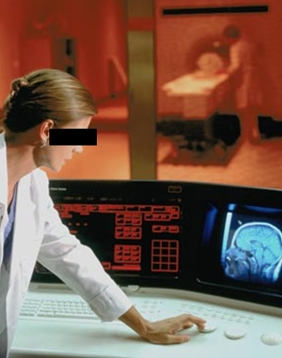
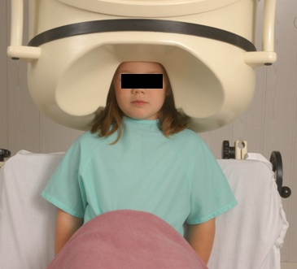
No conflation of diagnosis, disease, and disorder as in all EHRs to date !
The diagnosis is here
The disorder is there
The disease is there

Slide 57
It offers three ways of relating
drapetomania
slave
running away
mental disorder
propensity
How beliefs are / can
be related
How terms are related
How referents (in
reality) are related

Slide 58
A trajectory of mixes and mingles … (4)
Informatics
Knowledge Representation
Linguistics
Computational Linguistics
Ontology
Philosophy
Medical Natural
Language Understanding
Realism-Based
Ontology
Electronic
Health Records
Referent
Tracking
Medicine

Slide 59
Terminologies for ‘unambiguous representation’ ???
PtID
Date
ObsCode
Narrative
5572
04/07/1990
26442006
closed fracture of shaft of femur
5572
04/07/1990
81134009
Fracture, closed, spiral
5572
12/07/1990
26442006
closed fracture of shaft of femur
5572
12/07/1990
9001224
Accident in public building (supermarket)
5572
04/07/1990
79001
Essential hypertension
0939
24/12/1991
255174002
benign polyp of biliary tract
2309
21/03/1992
26442006
closed fracture of shaft of femur
2309
21/03/1992
9001224
Accident in public building (supermarket)
47804
03/04/1993
58298795
Other lesion on other specified region
5572
17/05/1993
79001
Essential hypertension
298
22/08/1993
2909872
Closed fracture of radial head
298
22/08/1993
9001224
Accident in public building (supermarket)
5572
01/04/1997
26442006
closed fracture of shaft of femur
5572
01/04/1997
79001
Essential hypertension
0939
20/12/1998
255087006
malignant polyp of biliary tract

Slide 60
The problem in a nutshell
Generic terms used to denote specific entities do not have enough referential capacity
  Usually enough to convey that some specific entity is denoted,
  Not enough to be clear about which one in particular.
For many ‘important’ entities, unique identifiers are used:
  UPS parcels
  Patients in hospitals
  VINs on cars
  …

Slide 61
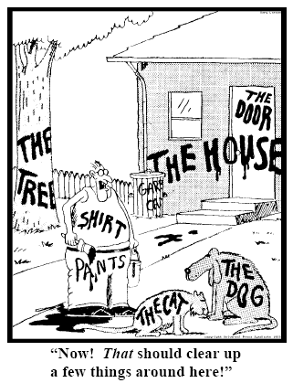
Fundamental goals of Referent Tracking
explicit reference to the concrete individual entities relevant to the accurate description of some portion of reality, ...
Ceusters W, Smith B. Strategies for Referent Tracking in Electronic Health Records. J Biomed Inform. 2006 Jun;39(3):362-78.

Slide 62
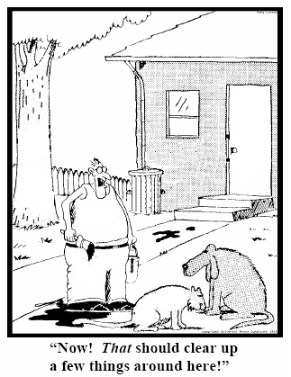
Method: numbers instead of words
  Introduce an Instance Unique Identifier (IUI) for each relevant particular (individual) entity
78
235
5678
321
322
666
427
Ceusters W, Smith B. Strategies for Referent Tracking in Electronic Health Records. J Biomed Inform. 2006 Jun;39(3):362-78.

Slide 63
Codes for ‘types’ AND identifiers for instances
PtID
Date
ObsCode
Narrative
5572
04/07/1990
26442006
IUI-001
closed fracture of shaft of femur
5572
04/07/1990
81134009
IUI-001
Fracture, closed, spiral
5572
12/07/1990
26442006
IUI-001
closed fracture of shaft of femur
5572
12/07/1990
9001224
IUI-007
Accident in public building (supermarket)
5572
04/07/1990
79001
IUI-005
Essential hypertension
0939
24/12/1991
255174002
IUI-004
benign polyp of biliary tract
2309
21/03/1992
26442006
IUI-002
closed fracture of shaft of femur
2309
21/03/1992
9001224
IUI-007
Accident in public building (supermarket)
47804
03/04/1993
58298795
IUI-006
Other lesion on other specified region
5572
17/05/1993
79001
IUI-005
Essential hypertension
298
22/08/1993
2909872
IUI-003
Closed fracture of radial head
298
22/08/1993
9001224
IUI-007
Accident in public building (supermarket)
5572
01/04/1997
26442006
IUI-012
closed fracture of shaft of femur
5572
01/04/1997
79001
7 distinct disorders
IUI-005
Essential hypertension
0939
20/12/1998
255087006
IUI-004
malignant polyp of biliary tract

Slide 64

RT mentioned in ‘Principles for Success’
Radical change:
    Principle 6: Architect Information and Workflow Systems to Accommodate Disruptive Change
        Organizations should architect health care IT for flexibility to support disruptive change rather than to optimize today’s ideas about health care.
    Principle 7: Archive Data for Subsequent Re-interpretation
        Vendors of health care IT should provide the capability of recording any data collected in their measured, uninterpreted, original form, archiving them as long as possible to enable subsequent retrospective views and analyses of those data.
Willam W. Stead and Herbert S. Lin, editors; Committee on Engaging the Computer Science Research Community in Health Care Informatics; National Research Council. Computational Technology for Effective Health Care: Immediate Steps and Strategic Directions (2009)

Slide 65
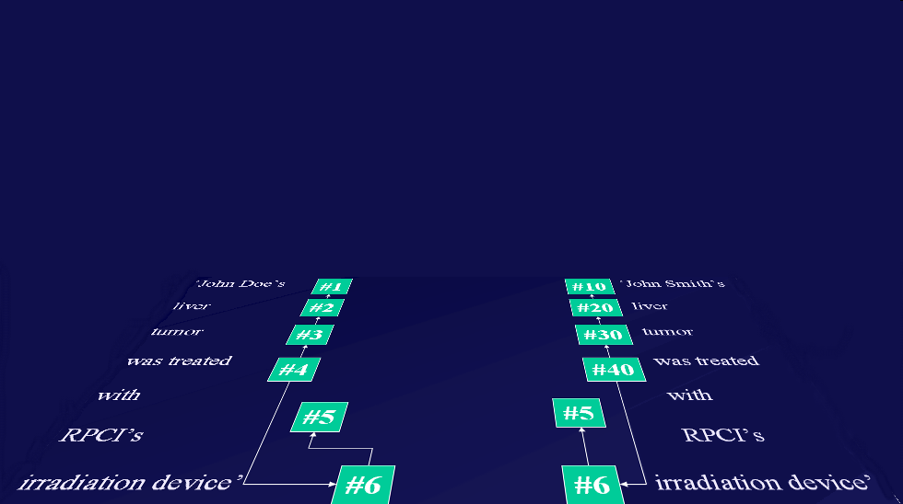
Relevance: the way RT-compatible systems ought to interact with representations of generic portions of reality
instance-of at t
caused
by
#105

Slide 66
The shift envisioned
From:
  ‘this man is a 40 year old patient with a stomach tumor’
To (something like):
  ‘this-1 on which depend this-2 and this-3 has this-4’, where
    this-1 instanceOf human being at t
    this-2 instanceOf age-of-40-years at t
    this-2 qualityOf this-1 at t
    this-3 instanceOf patient-role at t
    this-3 roleOf this-1 at t
    this-4 instanceOf tumor at t
    this-4 partOf this-5 at t
    this-5 instanceOf stomach at t
    this-5 partOf this-1 at t
    …
time stamp in
case of continuants

Slide 67

Ceusters W, Manzoor S. How to track absolutely everything? In: Obrst L, Janssen T, Ceusters W (eds.) Ontologies and Semantic Technologies for the Intelligence Community. Frontiers in Artificial Intelligence and Applications. IOS Press Amsterdam, 2010;:13-36.

Slide 68

A trajectory of mixes and mingles (5) …
Informatics
Knowledge Representation
Linguistics
Computational Linguistics
Ontology
Philosophy
Medical Natural
Language Understanding
Realism-Based
Ontology
Electronic
Health Records
Translational
Research
Referent
Tracking
Medicine
Pharmacogenomics
Performing
Arts
Defense &
Intelligence
Biology
Pharmacology

Slide 69
Need for a holistic approach
Ontology
Authoring Tools
Computer Science approach to ‘ontology’
create
Domain
Ontologies
Reasoners
Semantic
Applications
‘Philosophical’ approach to ontology
use

Slide 70
Some elements of a holistic approach
Improvement of current efforts in:
  (1) Ontology design
    Faithful representation should come first
    Cutting corners because of computational issues is sin;
  (2) Ontology authoring tools
    These should implement the principles of (1)
  (3) Information system (IS) design
    IS should model both information and what the information is about
Bring ontology forward in the value chain, for example:
  Avoid making datasets compatible after the facts
  Use ontology principles in study design and dataset generation

Slide 71
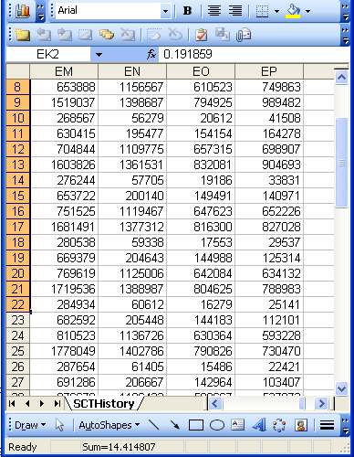

Data generation and use
data
organization
model development
observation &
measurement
further R&D
(instrument and
study optimization)
add
verify
use
Δ = outcome
Generic
beliefs
application

Slide 72
Standard approach in data analysis
Cases | Characteristics
 | ch1 | ch2 | ch3 | ch4 | ch5 | ch6 | ...
case1
case2
case3
case4
case5
case6
...
{
generalization ?
finding correlations
therefore
expectation
phenotypic
genotypic
treatment
outcome …

Slide 73
Correlation with reality comes at best after the facts
What type of relationship is there between data items and the part of reality they are obtained from?
What, if anything at all, do variable names in header rows correspond to?
Do correlations between data items mimic the relationships between the entities in reality the data items are obtained from?

Slide 74

A non-trivial relation
Referents
References

Slide 75

For instance: source and impact of changes
Are differences in data about the same entities in reality at different points in time due to:
  changes in first-order reality ?
  changes in our understanding of reality ?
  inaccurate observations ?
  differences in perspectives ?
  registration mistakes ?
Ceusters W, Smith B. A Realism-Based Approach to the Evolution of Biomedical Ontologies. AMIA 2006 Proceedings, Washington DC, 2006;:121-125. http://www.referent-tracking.com/RTU/sendfile/?file=CeustersAMIA2006FINAL.pdf

Slide 76
What makes it non-trivial?
Referents
  are (meta-) physically the way they are,
  relate to each other in an objective way,
  follow ‘laws of nature’.
Window on reality
  restricted by:
  what is physically and technically observable,
  fit between what is measured and what we think is measured,
  fit between established knowledge and ‘laws of nature’.
References
  follow, ideally, the syntactic-semantic conventions of some representation language,
  are restricted by the expressivity of that language,
  reference collections need to come, for correct interpretation, with documentation outside the representation.

Slide 78
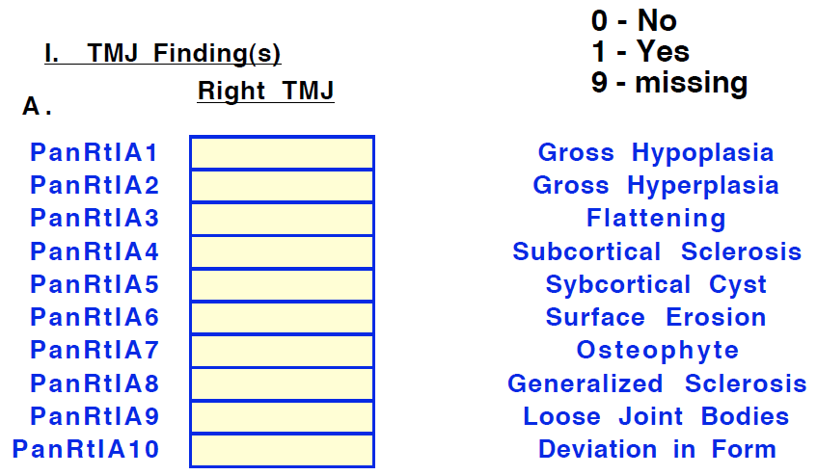
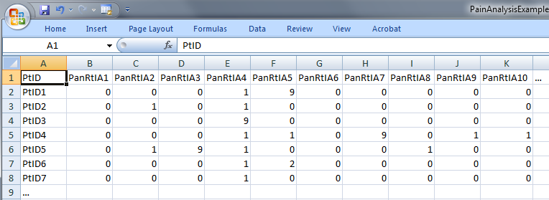
‘meaning’ of values in data collections
‘The patient with patient identifier ‘PtID4’ is stated to have had a panoramic X-ray of the mouth which is interpreted to show subcortical sclerosis of that patient’s condylar head of the right temporomandibular joint’
meaning
1

Slide 79
Preemptive study design
Goal: register data at a more fine-grained level
Method:
Start with a detailed description of the constructs to study as well as of hypothesized relationships amongst them
Translate constructs in (perhaps overlapping) sets of variables
Determine for each possible value V of each variable all possible configurations of entities (according to our best scientific understanding) for which the following can be true:
  V
  ‘it is stated that V’
Describe these possible configurations by means of sentences from a formal language that mimic the structure of reality.

Slide 80
For example
For value V for patient P stating that ‘P has had a panoramic X-ray of the mouth which is interpreted to show subcortical sclerosis of that patient’s condylar head of the right temporomandibular joint’ to be true,
  this statement must have been made,
for the statement to be true, there must have been that patient, an X-ray, etc, …
BUT! It is not necessarily true that that patient has indeed the sclerosis as diagnosed.

Slide 81
Coded variable expansion
Formulate for each variable a sentence explaining as accurately as possible what the variable stands for,
list the entities in reality that the terms in the sentence denote,
list recursively for all entities listed further entities that ontologically must exist for the entity under scrutiny to exist,
classify all entities in terms of realism-based ontologies (RBO),
specify all obtaining relationships between these entities,
outline all possible configurations of such entities for the sentence to be true,
translate this configurations in appropriate (coded) values.

Slide 82
Use of explicit references
CLASS | INSTANCE IDENTIFIER | DIRECTLY REFERENTIAL DESCRIPTIONS
person | IUI-1 | the person to whom IUI-2 is assigned
patient identifier | IUI-2 | the patient identifier of IUI-1
assertion | IUI-3 | 'the patient with patient identifier PtID4 has had a panoramic X-ray of the mouth which is interpreted to show subcortical sclerosis of that patient’s right temporomandibular joint'
technically investigating | IUI-4 | the technically investigating of IUI-6
panoramic X-ray | IUI-5 | the panoramic X-ray that resulted from IUI-4
mouth | IUI-6 | the mouth of IUI-1
interpreting | IUI-7 | the interpreting of the signs exhibited by IUI-5
seeing | IUI-8 | the seeing of IUI-5 which led to IUI-7
diagnosis | IUI-9 | the diagnosis expressed by means of IUI-3
condylar head of right TMJ | IUI-10 | the condylar head of the right TMJ of IUI-1
right TMJ | IUI-11 | the right TMJ of IUI-1

Slide 83
Classifying entities in terms of realism-based ontologies
CLASS | HIGHER CLASS
person | BFO: Object
patient identifier | IAO: Information Content Entity
assertion | IAO: Information Content Entity
technically investigating | OBI: Assay
panoramic X-ray | IAO: Image
mouth | FMA: Mouth
interpreting | MFO: Assessing
seeing | BFO: Process
diagnosis | IAO: Information Content Entity
condylar head of right TMJ | FMA: Right condylar process of mandible
right TMJ | FMA: Right temporomandibular joint
assigner role | BFO: Role
assigning | BFO: Process
study subject role | OBI: Study subject role
requires more ontological and philosophical skills than domain expertise or expertise with Protégé,
not just term matching

Slide 84
Specifying relationships between these entities
For instance:
  at least during the taking of the X-ray the study subject role inheres in the patient being investigated:
    IUI-23 inheres-in IUI-1 during t1
  the patient participates at that time in the investigation
    IUI-4 has-participant IUI-1 during t1
These relations need to follow the principles of the Relation Ontology / BFO 2.0.
Smith B, Ceusters W, Klagges B, Koehler J, Kumar A, Lomax J, Mungall C, Neuhaus F, Rector A, Rosse C. Relations in biomedical ontologies, Genome Biology 2005, 6:R46.

Slide 85
Outlining all possible configurations of such entities for the sentence to be true (a one semester course on its own)
Such outlines are collections of relational expressions of the sort just described,
Variant configurations for the example:
  perceptor and interpreter are the same or distinct human beings,
  the X-ray machine is unreliable and produced artifacts which the interpreter thought to be signs motivating his diagnosis, while the patient has indeed the disorder specified by the diagnosis (the clinician was lucky)
  …

Slide 86
Conclusion
Realism-based ontology has a lot to offer to make data collections A PRIORI comparable and unambiguously understandable.
It is hard !
How far one needs to go depends on the purposes.
  ideally: an analysis should be such that it can accommodate ALL purposes, i.e. the analysis should be independent of any purpose;
    distinction between reference ontologies and application ontologies.

Slide 87
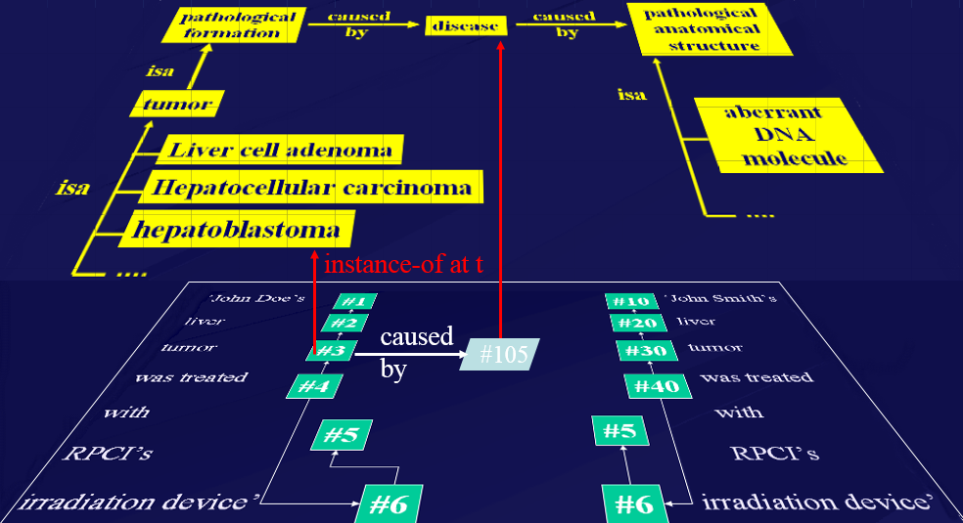
We need to do more on ontology education
Get people’s attention
Train them how to look at ontology appropriately

Slide 88

Is it worth it?
http://www.arcadja.com/auctions/en/reinhardt_ad/artist/24077/

Slide 89

For sale
Ad Reinhardt, Buffalo/New York 1913 – 1967 New York
IRIS MYSTIQUE
1957. Oil on canvas in artist's frame.
96,5 x 45 cm (without frame), 102 x 51 cm (framed) (38 x 17 ¾ in. (without frame), 40 ⅛ x 20 ⅛ in. (framed)) Inscribed on the reverse : Ad Reinhardt Portrait d‘Iris Clert 1957 Oil Collection Ahrenberg Chexbres. On the stretcher a label of the Pace Gallery, New York.
Relined..
EUR 250.000 – 350.000 / US $ 324,000 – 453,000
We would like to thank Anna Reinhardt, New York, for kindly providing additional information
Provenance: Theodor Ahrenberg, Chexbres (Acquired in 1961 from the Galerie Iris Clert, Paris) / Pace Gallery, New York (1997) / Private collection, Berlin
Exhibitions: Les 41 presentent: Iris Clert. Paris, Galerie Iris Clert, 1961 (no. cat.) / Kompass New York. Frankfurt, Kunstverein, 1968, cat. no. 50, ill. / Der Sammler Theodor Ahrenberg und das Atelier in Chexbres. 15 Jahre mit Kunst and Künstlern 1960 - 1975. Düsseldorf, Kunsthalle, 1977, Kat-no. 289, full-page ill., o.S
Literature and Illustration: Exh. cat. Norman Lewis. Black Paintings 1944-1977. New York, Studio Museum of Harlem, 1998, ill. p. 17 pl. 9 (not exhibited)
http://www.arcadja.com/auctions/en/reinhardt_ad/artist/24077/

Slide 90
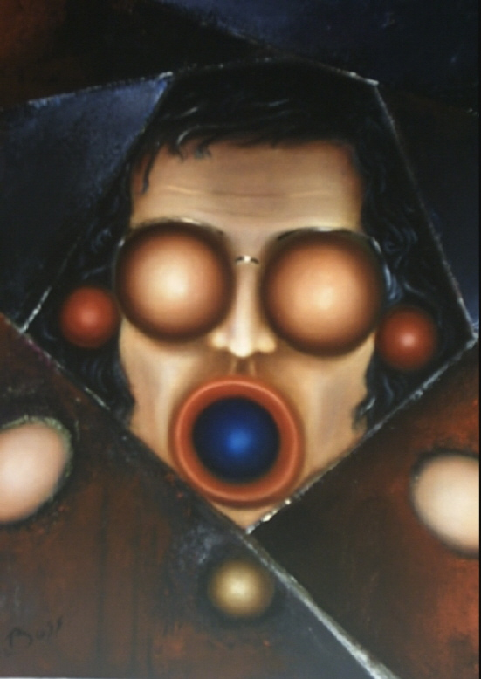
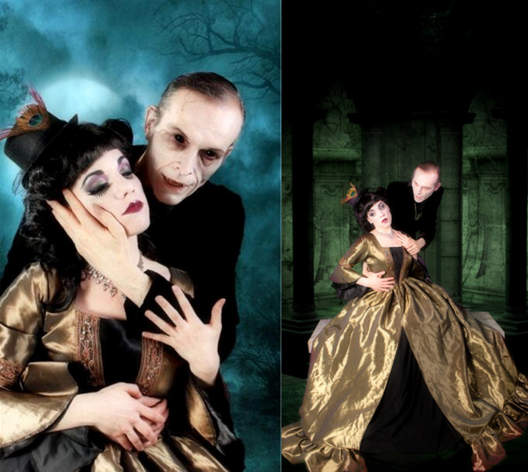
But then, art is perhaps more worth than reality
(Your servant through the lenses of two artists)
DBoss
Laura Dark

