Slide 1
Structure of research data files; how to do it right and wrong?
CTSI Core Competency Lectures in
Biomedical Informatics part 2 – lecture 1 – September 5, 2017
Werner Ceusters

Slide 2

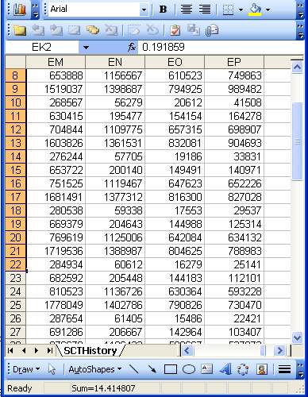
Beings, happenings and descriptions
(research) domain
(research) data
Beings & happenings
Descriptions
https://ubphoto.smugmug.com/Years/2017/17011-Medicine-Satyanarayana-Lakshminrusimha-Newborn-MFS/i-Vj8g6p2

Slide 3
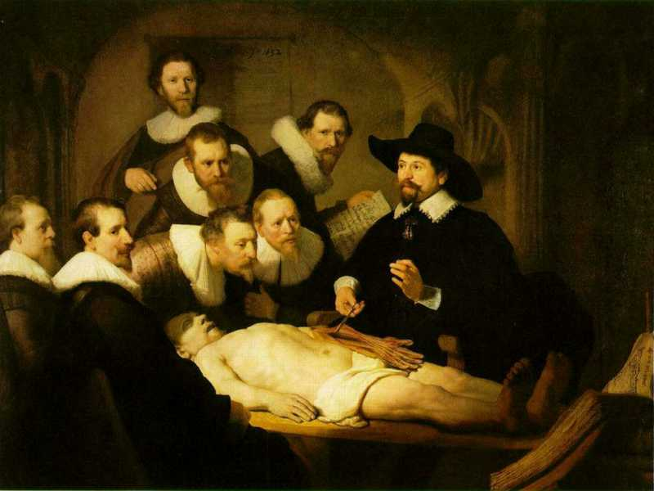
L3
Linguistic representations about (L1⁻), (L2) or (L3)
L2
Beliefs about (1)
Representations
First Order Reality
Entities (particular or generic) with objective existence which are not about anything
L1⁻

Slide 4

Characteristics and limitations
Referents
  are (meta-) physically the way they are,
  relate to each other in an objective way,
  follow ‘laws of nature’.
Window on reality
  restricted by:
  what is physically and technically observable,
  fit between what is measured and what we think is measured,
  fit between established knowledge and ‘laws of nature’.
References
  follow, ideally, the syntactic-semantic conventions of some representation language,
  are restricted by the expressivity of that language,
  reference collections need to come, for correct interpretation, with documentation outside the representation.
L1: what is real L2: beliefs L3: representations

Slide 5
Characteristics and limitations
Referents
  are (meta-) physically the way they are,
  relate to each other in an objective way,
  follow ‘laws of nature’.
Window on reality
  restricted by:
  what is physically and technically observable,
  fit between what is measured and what we think is measured,
  fit between established knowledge and ‘laws of nature’.
Data quality
References
  follow, ideally, the syntactic-semantic conventions of some representation language,
  are restricted by the expressivity of that language,
  reference collections need to come, for correct interpretation, with documentation outside the representation.
L1: what is real L2: beliefs L3: representations

Slide 6
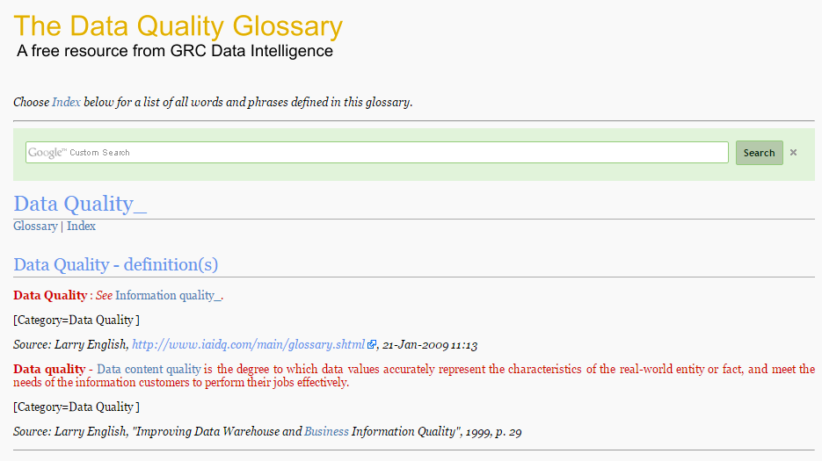
A wide range of data quality perspectives
http://www.dqglossary.com/data%20quality_.html

Slide 7
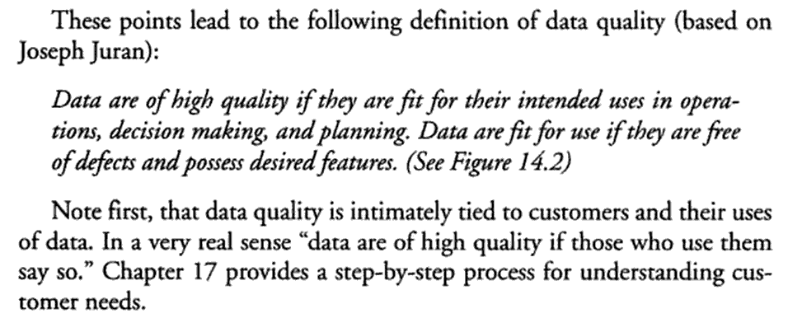
Data quality … really ?
Thomas C. Redman (Navesink Consulting Group, Little Silver, NJ) .
Data quality: the field guide.
Digital Press Newton, MA, USA ©2001, ISBN:1-55558-251-6

Slide 8
Data quality … really ?
Thomas C. Redman (Navesink Consulting Group, Little Silver, NJ) .
Data quality: the field guide.
Digital Press Newton, MA, USA ©2001, ISBN:1-55558-251-6

Slide 9
Data quality … reality!
Almost there:
  the data are deemed of high quality if they correctly represent the real-world construct to which they refer.
    Elisa Bertino, Chenyun Dai, .Murat Kantarcioglu. The Challenge of Assuring Data Trustworthiness, Database Systems for Advanced Applications, Lecture Notes in Computer Science, 2009, Volume 5463/2009, 22-33.
  An information system is to provide a representation of an application domain (also termed the real-world system) as perceived by the user.
    Anchoring Data Quality Dimensions in Ontological Foundations Y Wand and RY. Wang. November 1996/Vol. 39, No. 11 COMMUNICATIONS OF THE ACM

Slide 10
Data quality … reality!
Almost there:
  the data are deemed of high quality if they correctly represent the real-world construct to which they refer.
    Elisa Bertino, Chenyun Dai, .Murat Kantarcioglu. The Challenge of Assuring Data Trustworthiness, Database Systems for Advanced Applications, Lecture Notes in Computer Science, 2009, Volume 5463/2009, 22-33.
  An information system is to provide a representation of an application domain (also termed the real-world system) as perceived by the user.
    Anchoring Data Quality Dimensions in Ontological Foundations Y Wand and RY. Wang. November 1996/Vol. 39, No. 11 COMMUNICATIONS OF THE ACM

Slide 11

Data quality … reality!
Almost there:
  the data are deemed of high quality if they correctly represent the real-world construct to which they refer.
    Elisa Bertino, Chenyun Dai, .Murat Kantarcioglu. The Challenge of Assuring Data Trustworthiness, Database Systems for Advanced Applications, Lecture Notes in Computer Science, 2009, Volume 5463/2009, 22-33.
  An information system is to provide a representation of an application domain (also termed the real-world system) as perceived by the user.
Extremely close:
1978 - 2000 - 2012

Slide 12
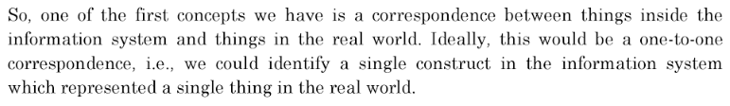
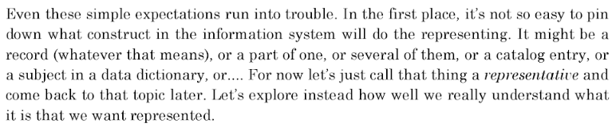
William Kent in ‘Data and Reality’
p35, 3rd edition, 2012.

Slide 13
Some Data Quality Dimensions
Dimension | # cited | Dimension | # cited | Dimension | # cited
Accuracy | 25 | Format | 4 | Comparability | 2
Reliability | 22 | Interpretability | 4 | Conciseness | 2
Timeliness | 19 | Content | 3 | Freedom from bias | 2
Relevance | 16 | Efficiency | 3 | Informativeness | 2
Completeness | 15 | Importance | 3 | Level of detail | 2
Currency | 9 | Sufficiency | 3 | Quantitativeness | 2
Consistency | 8 | Usableness | 3 | Scope | 2
Flexibility | 5 | Usefulness | 3 | Understandability | 2
Precision | 5 | Clarity | 2
Wang, R.Y., Storey, V.C., and Firth, C.P.
A framework for analysis of data quality research.
IEEE Trans. on Knowl. Data Eng. 7, 4 (1995), pp. 623–640.

Slide 14
Some Data Quality Dimensions
Dimension | # cited | Dimension | # cited | Dimension | # cited
Accuracy | 25 | Format | 4 | Comparability | 2
Reliability | 22 | Interpretability | 4 | Conciseness | 2
Timeliness | 19 | Content | 3 | Freedom from bias | 2
Relevance | 16 | Efficiency | 3 | Informativeness | 2
Completeness | 15 | Importance | 3 | Level of detail | 2
Currency | 9 | Sufficiency | 3 | Quantitativeness | 2
Consistency | 8 | Usableness | 3 | Scope | 2
Flexibility | 5 | Usefulness | 3 | Understandability | 2
Precision | 5 | Clarity | 2
Wang, R.Y., Storey, V.C., and Firth, C.P.
A framework for analysis of data quality research.
IEEE Trans. on Knowl. Data Eng. 7, 4 (1995), pp. 623–640.

Slide 15
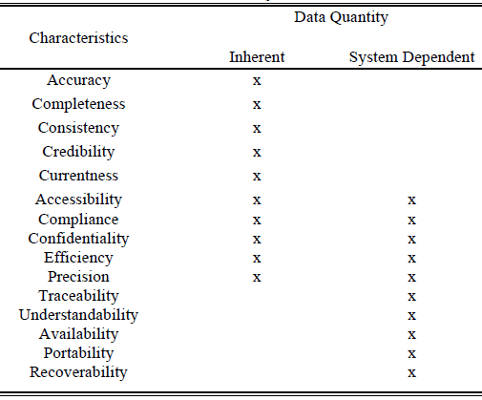
ISO 25012:2008(E) Data quality
Irfan Rafique, Philip Lew, Maissom Qanber Abbasi and Zhang Li.
Information Quality Evaluation Framework: Extending ISO 25012 Data Quality Model.
International Journal of Computer, Electrical, Automation, Control and Information Engineering Vol:6, No:5, 2012.

Slide 16
ISO 25012:2008(E) Data quality
Irfan Rafique, Philip Lew, Maissom Qanber Abbasi and Zhang Li.
Information Quality Evaluation Framework: Extending ISO 25012 Data Quality Model.
International Journal of Computer, Electrical, Automation, Control and Information Engineering Vol:6, No:5, 2012.

Slide 17
An ideal dataset from an ontological perspective
A representation of some pre-existing portion of reality which
  reflects the particulars within its domain – and the relations between them – in such a way that there obtains a systematic correlation between reality and the representation itself,
  is intelligible to a domain expert,
  is formalized in a way that allows it to support automatic information processing.
Smith B, Kusnierczyk W, Schober D, Ceusters W. Towards a Reference Terminology for Ontology Research and Development in the Biomedical Domain. Proceedings of KR-MED 2006, Biomedical Ontology in Action, November 8, 2006, Baltimore MD, USA

Slide 18
Some characteristics of an optimal research dataset
Each representational unit in the dataset would designate:
  a single particular,
Ceusters W, Smith B. A Realism-Based Approach to the Evolution of Biomedical Ontologies.
Proceedings of AMIA 2006, Washington DC, 2006;:121-125.

Slide 19
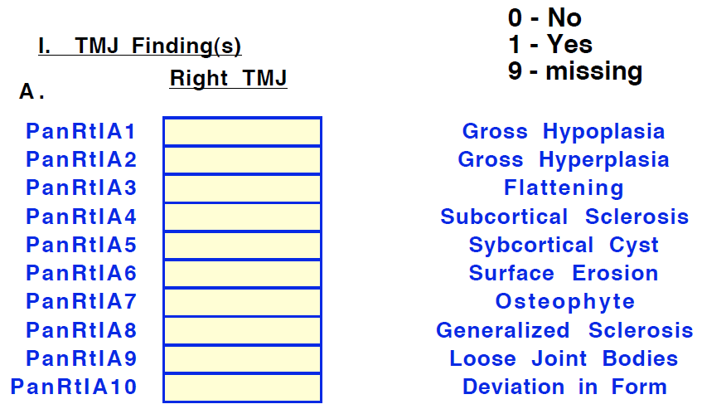
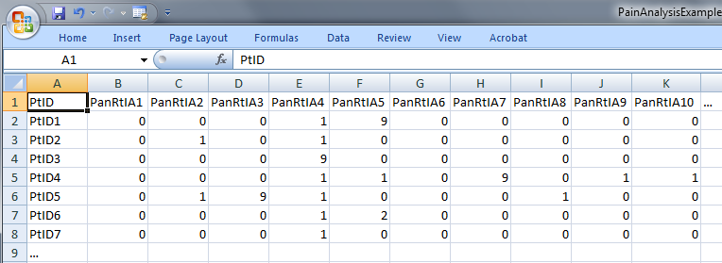
Single particulars?
‘The patient with patient identifier ‘PtID4’ is stated to have had a panoramic X-ray of the mouth which is interpreted to show subcortical sclerosis of that patient’s condylar head of the right temporomandibular joint’
meaning
1

Slide 20
Some characteristics of an optimal research dataset
Each representational unit in the dataset would designate:
  a single particular, which is
  relevant to the purposes of the research and such that
  the authors of the dataset intended to use this unit to designate this particular, and
  there would be no particulars objectively relevant to these purposes that are not referred to in the dataset.
Ceusters W, Smith B. A Realism-Based Approach to the Evolution of Biomedical Ontologies.
Proceedings of AMIA 2006, Washington DC, 2006;:121-125.

Slide 21
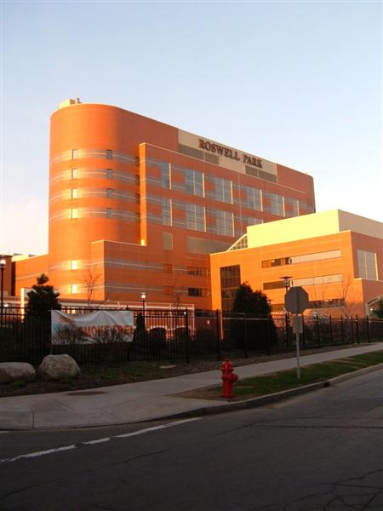

Exchangeability and comparability are key!
Everything collected wherever, whenever and about whomever which is relevant to a medical problem in whomever, whenever and wherever, should be accessible without loss of relevant detail.

Slide 22
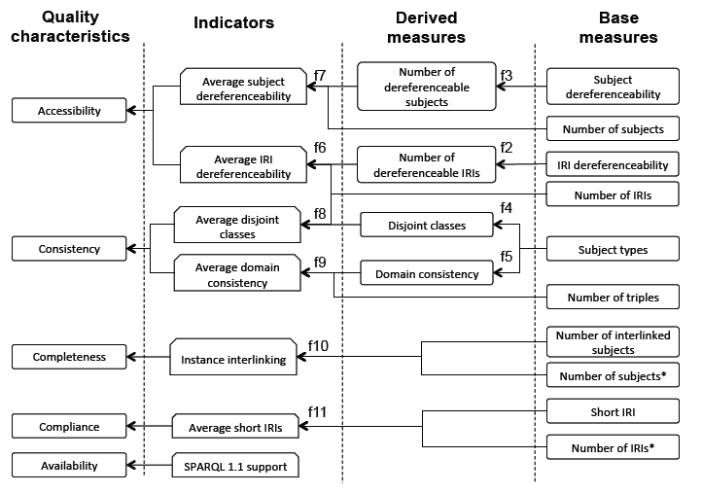
Linked data quality dimensions
Filip Radulovic , Nandana Mihindukulasooriya, Raúl García-Castro and Asunción Gómez Pérez
A comprehensive quality model for Linked Data
http://www.semantic-web-journal.net/content/comprehensive-quality-model-linked-data-0. 2016

Slide 23
Data models

Slide 24
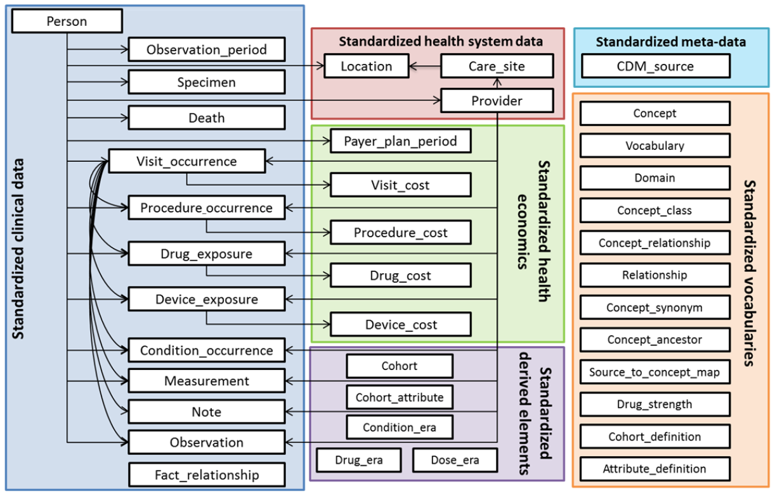
OMOP Common Data Model

Slide 25
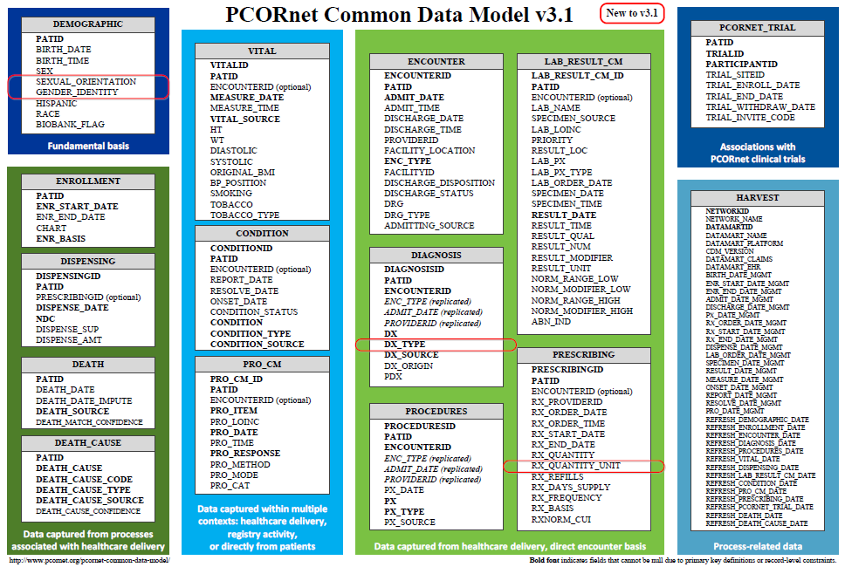
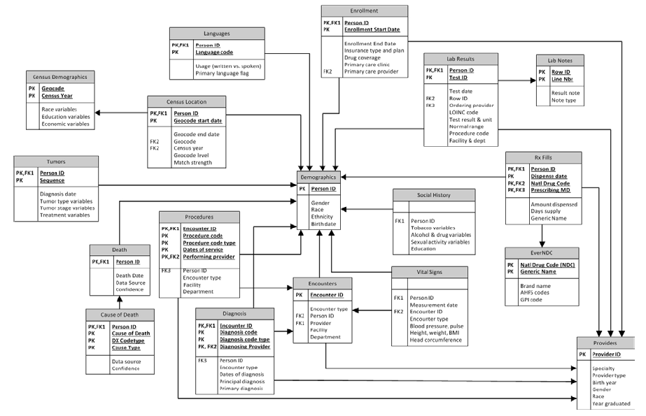
Common Data Models for Secondary Use
The Observational Medical Outcomes Partnership (OMOP)
Health Care Systems Research Network (HCSRN)
The National Patient-Centered Clinical Research Network (PCORNet)

Slide 26
Experiences with CDMs
OMOP scores best:
  Garza M, Del Fiol G, Tenenbaum J, Walden A, Zozus M. Evaluating common data models for use with a longitudinal community registry. J Biomed Inform. 2016 Oct 28.
  Ogunyemi OI, Meeker D, Kim HE, Ashish N, Farzaneh S, Boxwala A. Identifying appropriate reference data models for comparative effectiveness research (CER) studies based on data from clinical information systems. Medical care. 2013 Aug;51(8 Suppl 3):S45-52.
CDMs lead to information loss:
  Hersh WR, Weiner MG, Embi PJ, Logan JR, Payne PR, Bernstam EV, et al. Caveats for the use of operational electronic health record data in comparative effectiveness research. Medical care. 2013 Aug;51(8 Suppl 3):S30-7.
  Rijnbeek PR. Converting to a common data model: what is lost in translation? : Commentary on "fidelity assessment of a clinical practice research datalink conversion to the OMOP common data model". Drug Saf. 2014 Nov;37(11):893-6.
  Yoon D, Ahn EK, Park MY, Cho SY, Ryan P, Schuemie MJ, et al. Conversion and Data Quality Assessment of Electronic Health Record Data at a Korean Tertiary Teaching Hospital to a Common Data Model for Distributed Network Research. Healthc Inform Res. 2016 Jan;22(1):54-8.
Streamlining of CDM evaluation methods is needed:
  Garza M, Del Fiol G, Tenenbaum J, Walden A, Zozus M. Evaluating common data models for use with a longitudinal community registry. J Biomed Inform. 2016 Oct 28.
  Huser V, Cimino JJ. Desiderata for healthcare integrated data repositories based on architectural comparison of three public repositories. AMIA Annual Symposium proceedings / AMIA Symposium AMIA Symposium. 2013;2013:648-56.
None use realism-based ontology for information modeling.

Slide 27
Results of a PhD student project on OMOP
Three sorts of count errors, resp. due to:
  cardinality and attribute restrictions,
  inconsistent normalization,
  confusing data with what it is about.
Ceusters W, Blaisure J.
A Realism-Based View on Counts in OMOP’s Common Data Model.
14th International Conference on Wearable, micro & Nano Technologies (pHealth 2017), Eindhoven, The Netherlands, May 14-16, 2017. Studies in Health Technology and Informatics 2017;237:55-62.

Slide 28
PERSON table
Allows for each unique patient only
  one location,
  one gender,
  one primary care provider, and
  one care site.
Although:
  ‘patients over time can have distinct locations, genders’;
  ‘it is the responsibility of the data holder to select the one value to use in the CDM’.
What criteria to use?
What with the multiple observation periods?

Slide 29
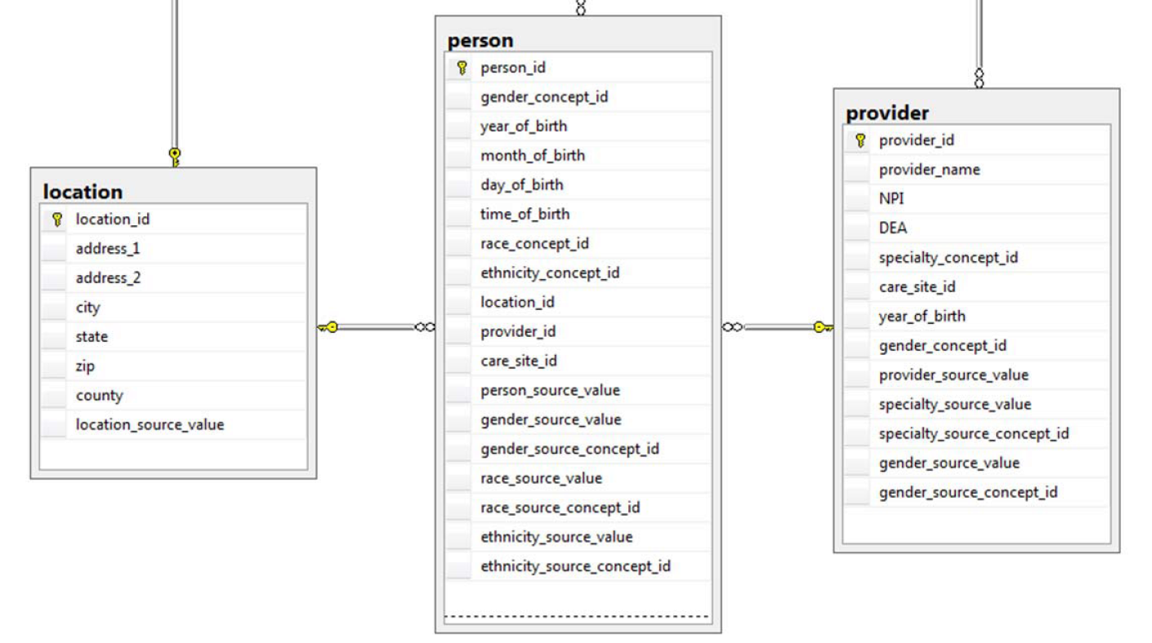
Person versus Provider

Slide 30
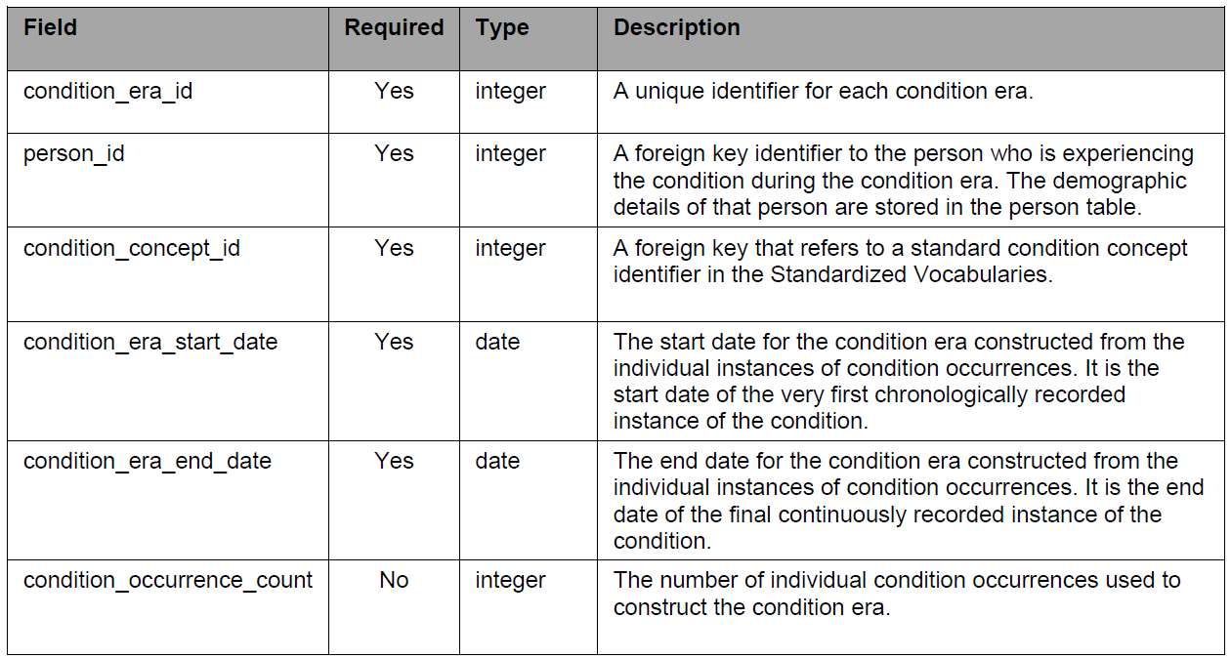
Condition-occurrences versus eras

Slide 31
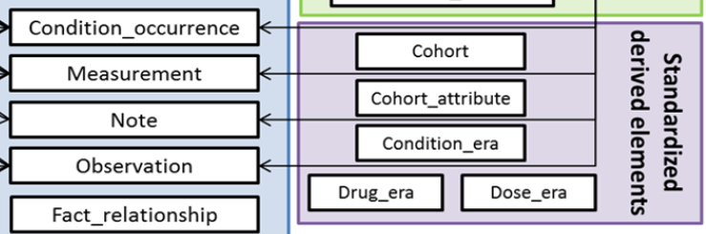
Conventions
Condition Era records will be derived from the CONDITION_OCCURRENCE table using a standardized algorithm.
Each Condition Era corresponds to one or many CONDITION_OCCURRENCE records that form a continuous interval and contain the same drug condition-occurrence.

Slide 32
Conventions
The condition_concept_id field contains Concepts that are identical to those of the CONDITION_OCCURRENCE table records that make up the Condition Era.
The Condition Era Start Date is the start date of the first Condition Occurrence.
The Condition Era End Date is the end date of the last Condition Occurrence.

Slide 33
An erroneous example
‘a Condition Era representing ICD-9 code 410.01
  (Acute Myocardial Infarction (AMI) of anterolateral wall, initial episode)
  would be aggregated to a Condition Era representing ICD-9 code 410.41
  (AMI inferior wall, initial episode)
  occurring within 30 days
  as both of these ICD-9 codes annotate to the same Condition Concept, Acute Myocardial Infarction, within the MedDRA hierarchy’.
Reisinger SJ, Ryan PB, O'Hara DJ, Powell GE, Painter JL, Pattishall EN, et al. Development and evaluation of a common data model enabling active drug safety surveillance using disparate healthcare databases.
J Am Med Inform Assoc. 2010 Nov-Dec;17(6):652-62, p656

Slide 34
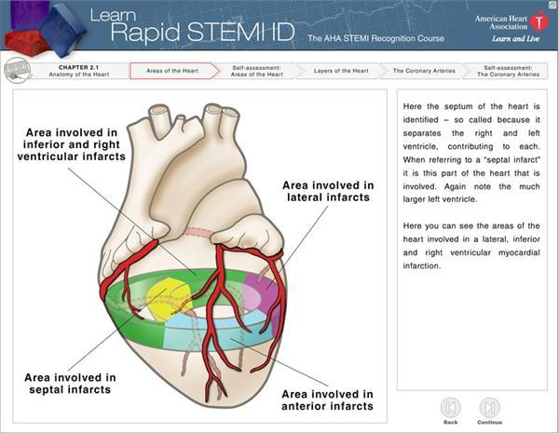
http://myheart.net/articles/stemi/

Slide 35
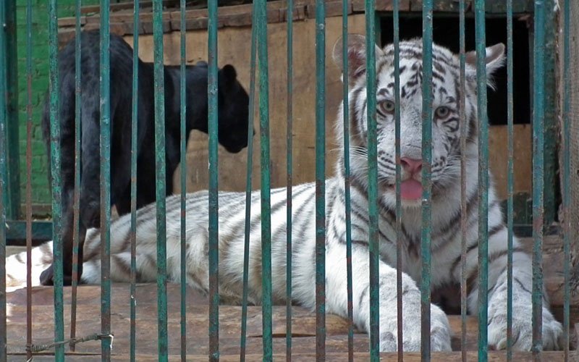
feline
isa
isa
panther
tiger
Instance-of
Instance-of
Only one feline in this cage?

Slide 36
Definitions

Slide 37
Three purposes for definitions
to specify the conditions that must be satisfied in some community for a term to be an acceptable designator for an entity;
  → A terminological issue
to describe the ways in which entities of one type differ from entities of another type
  → Primarily about types
to provide assistance in determining what type a specific entity belongs to.
  → Primarily to determine instantiation by particulars

Slide 38
Use Aristotelian definitions.
A
  B isa A which X
    C isa B which Y
    D isa C which Z
Make sure that X holds for C and that both X and Y hold for D.
Use this also in label formation to prevent, f.i.,
  ‘13.3 Nervus Intermedius (Facial Nerve) Neuralgia’ ‘13.3.2. Secondary Nervus Intermedius Neuropathy attributed to Herpes Zoster’

Slide 39
Maintain a strict subsumption hierarchy
13.1. Trigeminal Neuralgia
  13.1.2 Painful Trigeminal Neuropathy
ICHD definitions:
  ‘neuralgia’ = pain in the distribution of nerve(s)
  ‘pain’ = a sensorial and emotional experience ...
  ‘neuropathy’ = a disturbance of function or pathological change in a nerve.
Several mismatches:
  (1) and (2): neuralgia is a sensorial and emotional experience in the distribution of nerve(s) ?
  (1) and (3): with much of goodwill, one could accept neuropathy to subsume neuralgia, but chapter 13 claims the opposite for the trigeminal case.
subsumes?

Slide 40
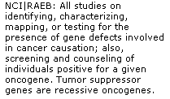

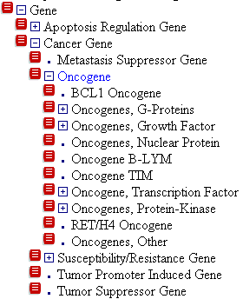
Let definitions reflect what is in the taxonomy

Slide 41
Do not use names with a precise meaning in general language to designate entities which are of a more specific or totally different type in the context of a specific application
Animal (BRIDG logical model p526)
Type: Class InvestigatedParty
Status: Proposed. Version 1.0. Phase 1.0.
Package: InvestigatedSubject Keywords:
Detail: Created on 03/10/2006. Last modified on 03/10/2006.
GUID: {996CB91C-04EC-4b1d-9AFF-57B878D532D7}
A non-person living entity which is chosen to be the subject of an investigation, or which is the subject of an implicated act.

Slide 42
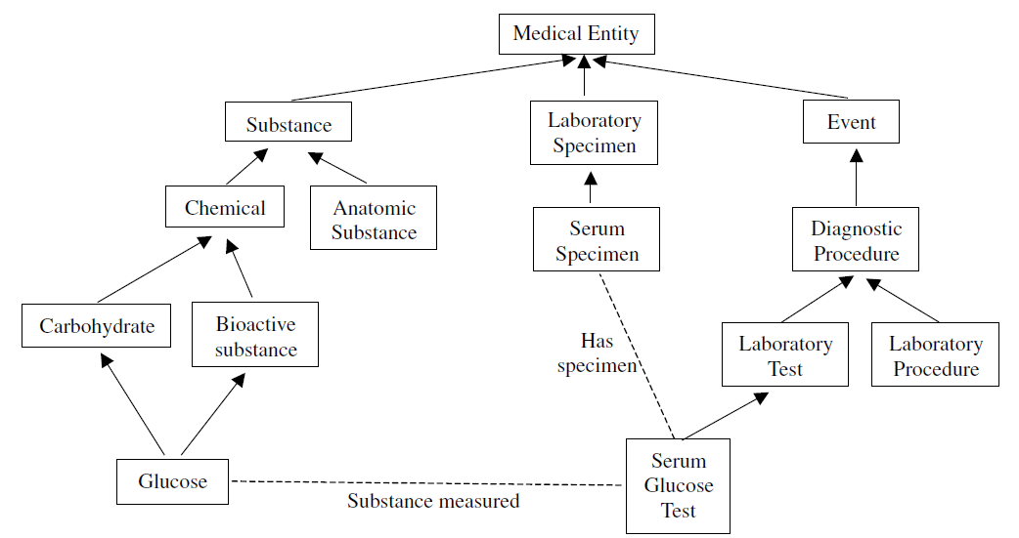
Similar problem here

Slide 43
Similar problem here
?
?

Slide 44
Clinical criteria do not replace Aristotelian definitions
‘13.1.1.1 Classical trigeminal neuralgia, purely paroxysmal’, has the criterion ‘at least three attacks of facial pain fulfilling criteria B-E’.
This does not mean: a patient with 2 such attacks does not exhibit this type of neuralgia;
It rather means: do not diagnose the patient (yet) as exhibiting this type of neuralgia.
If ‘chronic pain’ is defined as ‘pain lasting longer than three months’, at what point in time starts a patient to have that type of pain?

Slide 45
‘Chronic pain’ in ICD-11
‘Chronic pain was defined as persistent or recurrent pain lasting longer than 3 months.
This definition according to pain duration has the advantage that it is clear and operationalized.’
It is not clear, rather clearly wrong!
Confusion of ‘chronic pain’ with ‘diagnosis of chronic pain’.
Does a pain p diagnosed as ‘chronic primary pain’ becomes ‘chronic cancer pain’ after the cancer is discovered or are the latter 2 distinct diagnoses about p?
R.-D. Treede et al. A classification of chronic pain for ICD-11. Pain 156 (2015) 1003–1007

Slide 46
Foundational Model of Anatomy
Old definition of Anatomical Structure
Anatomical structure
is a material physical anatomical entity
which has inherent 3D shape;
is generated by coordinated expression of the organism’s own structural genes;
consists of parts that
are anatomical structures
spatially related to one another in patterns
determined by coordinated gene expression.

Slide 47
Avoid circularity in definitions
Ingredient (BRIDG logical model p507)
Status: Proposed. Version 1.0. Phase 1.0.
Package: Adverse Event Keywords:
Detail: Created on 03/01/2006. Last modified on 03/01/2006.
GUID: {7D53B2A1-CEC4-49ae-8BD6-611E2CF4D862}
A substance that acts as an ingredient within a product. Note, that ingredients may also have ingredients.

Slide 48
Make it clear whether assertions are about particulars or types
‘Persistent idiopathic facial pain (PIFP)’
  = ‘persistent facial pain with varying presentations …’
persistent
facial pain
presentation
type1
presentation
type2
presentation
type3
types
t₂
t₃
t₁
t₁
t₁
t₂
t₂
t₃
t₁
t₃
parti-
culars
t₁
t₂
t₂
t₁
t₃
t₂
t₃
t₃
my pain
her pain
his pain

Slide 49
Make it clear whether assertions are about particulars or types
‘Persistent idiopathic facial pain (PIFP)’
  = ‘persistent facial pain with varying presentations …’
  if the description is about types, then the three particular pains fall under PIFP.
  if the description is about (arbitrary) particulars, then only her pain falls under PIFP.

Slide 50
Separate knowledge from what it is about.
‘13.1.2.4 Painful trigeminal neuropathy attributed to MS plaque’
‘attributed to’ relates to somebody’s opinion about what is the case, not to what is the case.
  the mistake: a feature on the side of the clinician – his (not) knowing - is taken to be a feature on the side of the patient.
Similar mistakes:
  ‘Probable migraine’
  ‘facial pain of unknown origin’ (not in ICHD).

Slide 51
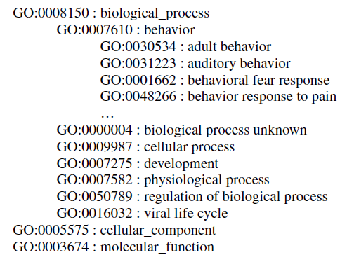
A similar problem here

Slide 52
A similar problem here

Slide 53
Same problem here
Type: Class PerformedActivity
Status: Proposed. Version 1.0. Phase 1.0.
Package: CTOM Elements Keywords:
Detail: Created on 01/05/2005. Last modified on 12/14/2006.
GUID: {2289C0E8-855D-42e3-86FA-2ECBE59D8982}
The description of applying, dispensing or giving agents or medications to subjects.

Slide 54
Same problem here
Type: Class PerformedActivity
Status: Proposed. Version 1.0. Phase 1.0.
Package: CTOM Elements Keywords:
Detail: Created on 01/05/2005. Last modified on 12/14/2006.
GUID: {2289C0E8-855D-42e3-86FA-2ECBE59D8982}
The description of applying, dispensing or giving agents or medications to subjects.

Slide 55
Class descriptions should be consistent with class labels
‘13.1.2.4 Painful Trigeminal neuropathy attributed to MS plaque’:
  described as ‘Trigeminal neuropathy induced by MS plaque’.
    attributed ←→ induced
    reference to pain missing in the description

Slide 56
Don’t confuse the act of observing with what the observation is directed at
Old BRIDG definition of adverse event:
An observation of a change in the state of a subject that is assessed as being untoward by one or more interested parties within the context of protocol-driven research or public health.

Slide 57
Referent Tracking Model
Model dictated by the most basic distinctions in Basic Formal Ontology:
Particulars versus types
Continuants versus occurrents

Slide 58
Basic Formal Ontology: what is out there …
(… we want/need to deal with)?
portions of reality
relations
configurations
?
participation
me participating in my life
universals
entities
?
particulars
continuants
occurrents
me
my life
organism

Slide 59
A faithful representation of reality through BFO
dependent continuant
material
object
spacetime
region
spatial
region
temporal
region
history
t
t
instanceOf
t
participantOf at t
occupies
some temporal region
some quality
my life
my 4D STR
projectsOn
me
… at t
projectsOn at t
some spatial
region
located-in at t
BFO = Basic Formal Ontology

Slide 60
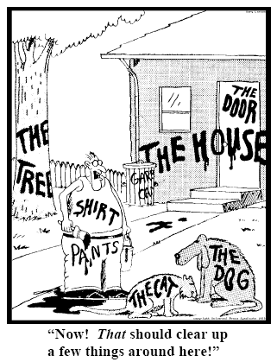
Representing specific entities
explicit reference to the individual entities relevant to the accurate description of some portion of reality, ...
Ceusters W, Smith B. Strategies for Referent Tracking in Electronic Health Records. J Biomed Inform. 2006 Jun;39(3):362-78.

Slide 61
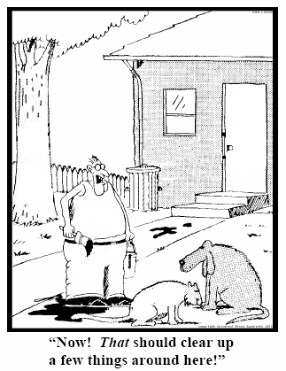
Method: IUI assignment
  Introduce an Instance Unique Identifier (IUI) for each relevant particular (individual) entity
78
235
5678
321
322
666
427
Ceusters W, Smith B. Strategies for Referent Tracking in Electronic Health Records. J Biomed Inform. 2006 Jun;39(3):362-78.

Slide 62
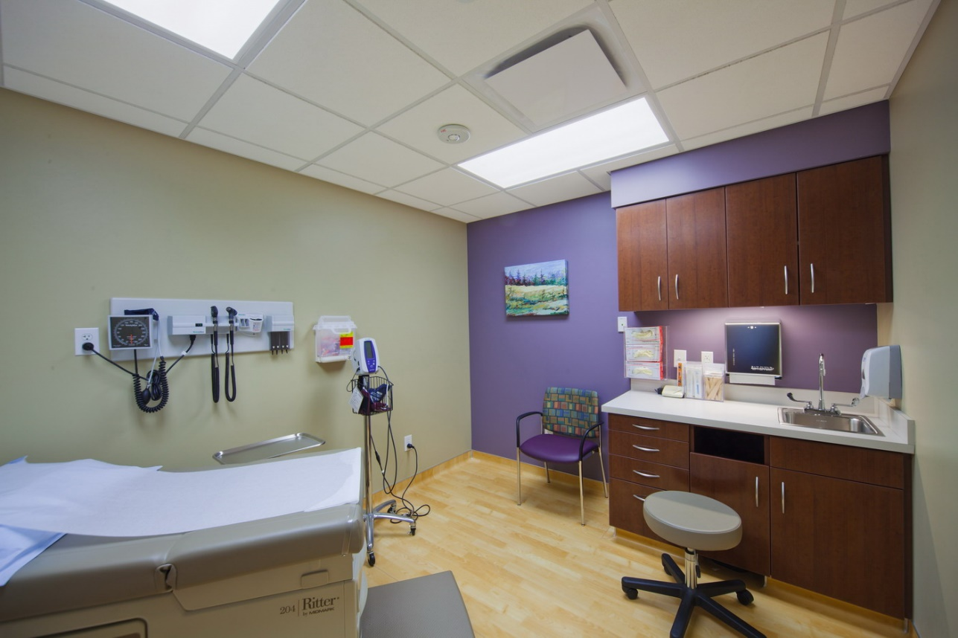
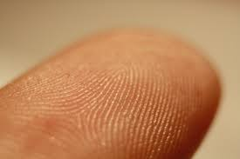



IUI assignment in a temperature assay (1)
#3
#11
#4
#9
#2
#1
#6

Slide 63
IUI assignment in a temperature assay (2)
#7
#9
#6
#1

Slide 64
Criteria for IUI assignment (1)
The particular’s existence must be determined:
  Easy for persons in front of you, tools, ...
  Easy for ‘planned acts’: they do not exist before the plan is executed !
    Only the plan exists and possibly the statements made about the future execution of the plan
  More difficult: a subject’s intensions, emotions
    But the statements observers make about them do exist !
  However:
    no need to know what the particular exactly is, i.e. which universal it instantiates
    No need to be able to point to it precisely
      A member of a specific organization
      But: this is not a matter of choice, not ‘any’ out of ...

Slide 65
Criteria for IUI assignment (2)
The particular’s existence may not already have been determined ‘as the existence of something else’:
    Morning star and evening star / Himalaya
    ➔ 2 observers not knowing they observed the same thing
May not have already been assigned a IUI.
It must be relevant to do so:
    Personal decision, (scientific) community guideline, ...
    Possibilities offered by the annotation system
    If a IUI has been assigned by somebody, everybody else making statements about the particular should use it

Slide 66
The shift envisioned
From:
  ‘this man is a 40 year old patient with a stomach tumor’
To (something like):
  ‘this-1 on which depend this-2 and this-3 has this-4’, where
    this-1 instanceOf human being …
    this-2 instanceOf age-of-40-years …
    this-2 qualityOf this-1 …
    this-3 instanceOf patient-role …
    this-3 roleOf this-1 …
    this-4 instanceOf tumor …
    this-4 partOf this-5 …
    this-5 instanceOf stomach …
    this-5 partOf this-1 …
    …

Slide 67
The shift envisioned
From:
  ‘this man is a 40 year old patient with a stomach tumor’
To (something like):
  ‘this-1 on which depend this-2 and this-3 has this-4’, where
    this-1 instanceOf human being …
    this-2 instanceOf age-of-40-years …
    this-2 qualityOf this-1 …
    this-3 instanceOf patient-role …
    this-3 roleOf this-1 …
    this-4 instanceOf tumor …
    this-4 partOf this-5 …
    this-5 instanceOf stomach …
    this-5 partOf this-1 …
    …
denotators for particulars

Slide 68
The shift envisioned
From:
  ‘this man is a 40 year old patient with a stomach tumor’
To (something like):
  ‘this-1 on which depend this-2 and this-3 has this-4’, where
    this-1 instanceOf human being …
    this-2 instanceOf age-of-40-years …
    this-2 qualityOf this-1 …
    this-3 instanceOf patient-role …
    this-3 roleOf this-1 …
    this-4 instanceOf tumor …
    this-4 partOf this-5 …
    this-5 instanceOf stomach …
    this-5 partOf this-1 …
    …
denotators for appropriate relations

Slide 69

Relations

Slide 70
The shift envisioned
From:
  ‘this man is a 40 year old patient with a stomach tumor’
To (something like):
  ‘this-1 on which depend this-2 and this-3 has this-4’, where
    this-1 instanceOf human being …
    this-2 instanceOf age-of-40-years …
    this-2 qualityOf this-1 …
    this-3 instanceOf patient-role …
    this-3 roleOf this-1 …
    this-4 instanceOf tumor …
    this-4 partOf this-5 …
    this-5 instanceOf stomach …
    this-5 partOf this-1 …
    …
denotators for universals or particulars

Slide 71
The shift envisioned
From:
  ‘this man is a 40 year old patient with a stomach tumor’
To (something like):
  ‘this-1 on which depend this-2 and this-3 has this-4’, where
    this-1 instanceOf human being …
    this-2 instanceOf age-of-40-years …
    this-2 qualityOf this-1 …
    this-3 instanceOf patient-role …
    this-3 roleOf this-1 …
    this-4 instanceOf tumor …
    this-4 partOf this-5 …
    this-5 instanceOf stomach …
    this-5 partOf this-1 …
    …
time stamp in
case of referenced continuants

Slide 72
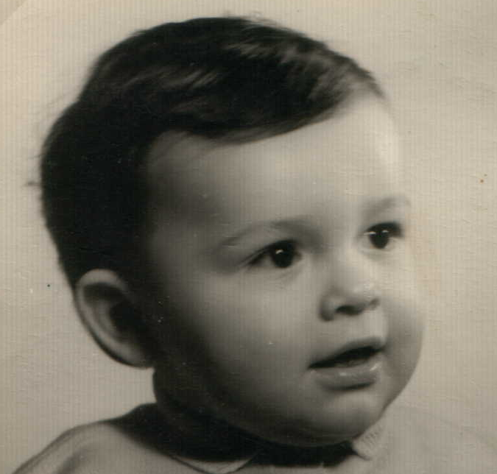



Identity & instantiation
child
adult
person
t
Living
creature
animal
caterpillar
butterfly

Slide 73
Type assignment in a temperature assay (1)
site
Subject
of care
Bodily component
sensordevice
instanceOf at t_{x}
device
caregiver
#3
#11
#4
#9
#2
#1
#6

Slide 74
Type assignment in a temperature assay (2)
assay
instanceOf
#7
#9
#6
#1

Slide 75
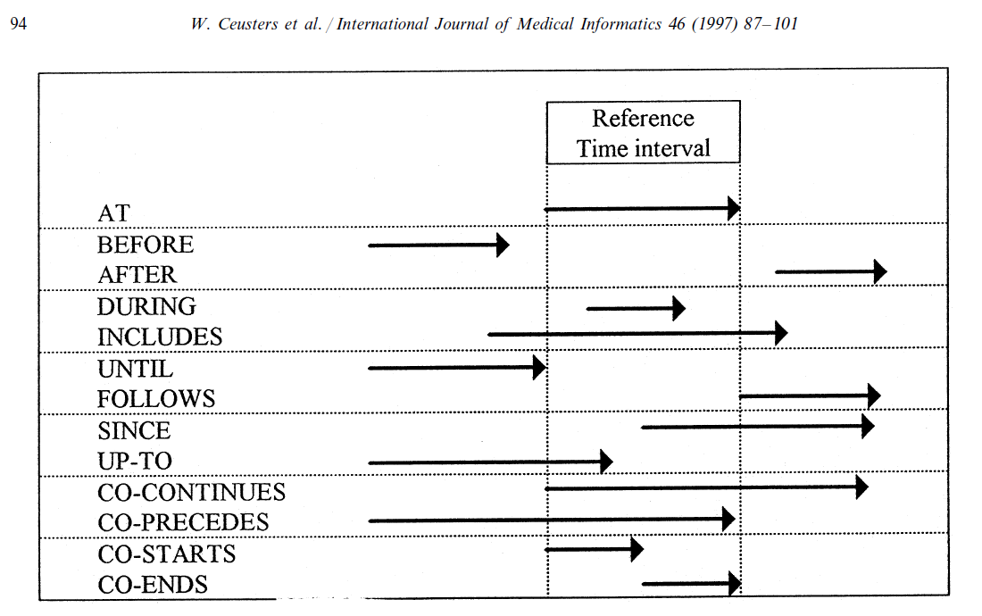
Representation of relation with time intervals

Slide 76
Representing particular adverse event cases
Is the generic representation of the portion of reality adequate enough for the description of particular cases?
Example: a patient
  born at time t₀
  undergoing anti-inflammatory treatment and physiotherapy since t₂
  for an arthrosis present since t₁
  develops a stomach ulcer at t₃.
Notes:
76

Slide 77
Adverse event domain definitions
 | Denotation | Class Type |  |  | Particular Type |  | Description (role in adverse event scenario)
Level 1 (PORTION OF REALITY AS IT IS PRIOR TO PERCEPTION)
C1 | subject of care |  | DC | independent continuant |  | person to whom harm might have been done through an act under scrutiny
C2 | act under scrutiny |  | DC | act of care |  | act of care that might have caused harm to the subject of care
C7 | structure change |  | U | process |  | change in an anatomical structure of a person
C8 | structure integrity |  | U | dependent continuant |  | aspect of an anatomical structure deviation which would bring it about that the anatomical structure would either (1) itself become dysfunctional or (2) cause dysfunction in another anatomical structure
C12 | subject investigation |  | DC | process |  | looking for a structure change in the subject of care
Level 2 (REPRESENTATIONSIN OUR MINDS)
C15 | observation |  | DC | dependent continuant |  | cognitive representation of a structure change resulting from an act of perception within a subject investigation
C16 | harm diagnosis |  | DC | dependent continuant |  | cognitive representation, resulting from a harm assessment, and involving an assertion to the effect that a structure change is or is not a harm
Level 3 (REPRESENTATIONAL ARTIFACT)
C18 | care reference |  | DC | information entity |  | concretized (through text, diagram, …) piece of knowledge drawn from state of the art principles that can be used to support the appropriateness of (or correctness with which) processes are performed involving a subject of care

Slide 78
Anti-inflammatory treatment with ulcer development
IUI | Description of particular | Properties
#1 | the patient who is treated | #1 member_of C1 since t₂
#2 | #1’s treatment | #2 instance_of C3 #2 has_participant #1 since t₂ #2 has_agent #3 since t₂
#3 | the physician responsible for #2 | #3 member_of C4 since t₂
#4 | #1’s arthrosis | #4 member_of C5 since t₁
#5 | #1’s anti-inflammatory treatment | #5 part_of #2 #5 member_of C2 since t₃
#6 | #1’s physiotherapy | #6 part_of #2
#7 | #1’s stomach | #7 member_of C6 since t₂
#8 | #7’s structure integrity | #8 instance_of C8 since t₀ #8 inheres_in #7 since t₀
#9 | #1’s stomach ulcer | #9 part_of #7 since t₃
#10 | coming into existence of #9 | #10 has_participant #9 at t₃
#11 | change brought about by #9 | #11 has_agent #9 since t₃ #11 has_participant #8 since t₃ #11 instance_of C10 (harm) at t₃
#12 | noticing the presence of #9 | #12 has_participant #9 at t_{3+x} #12 has_agent #3 at t_{3+x}
#13 | cognitive representation in #3 about #9 | #13 is_about #9 since t_{3+x}
Notes:
78

Slide 79
Time line and dependencies (1)
t₀
t₁
t₂
t₃
#1
the patient (#1) who is treated
#7
#1’s stomach
#8
#7’s structure integrity
C8
structure integrity
At t₀, the patient is born, and since that time, his stomach is part of him and a structure integrity (C8) inheres in it:
  #1 instance-of person since t₀
  #7 part-of #1 since t₀
  #8 instance_of C8 since t₀
  #8 inheres_in #7 since t₀
Notes:
79

Slide 80
Time line and dependencies (2)
t₀
t₁
t₂
t₃
#1
the patient who is treated
#7
#1’s stomach
#8
#7’s structure integrity
C8
structure integrity
#4
#1’s arthrosis
C5
underlying disease
At t₁, the patient acquires arthrosis:
  #4 member_of C5 since t₁
  #4 inheres_in #1 since t₁
Notes:
80

Slide 81
Time line and dependencies (3)
t₀
t₁
t₂
t₃
#1
the patient who is treated
C1
subject of care
#7
#1’s stomach
C6
involved structure
#8
#7’s structure integrity
C8
structure integrity
#4
#1’s arthrosis
C5
underlying disease
#2
#1’s treatment
C3
act of care
#6
#1’s physiotherapy
#5
#1’s anti-inflammatory treatment
At t₂, the patient consults #3 who starts treatment. It is then that the patient becomes a member of the class subject of care (C1) and his stomach a member of the class involved structure (C6)
#3
the physician responsible for #2
C4
care giver
Notes:
81

Slide 82
Time line and dependencies …
t₀
t₁
t₂
t₃
#1
the patient who is treated
C1
subject of care
#7
#1’s stomach
C6
involved structure
#8
#7’s structure integrity
C8
structure integrity
#4
#1’s arthrosis
C5
underlying disease
#2
#1’s treatment
C3
act of care
#6
#1’s physiotherapy
#5
#1’s anti-inflammatory treatment
C2
act under scrutiny
#9
#1’s stomach ulcer
#11
change brought about by #9
C10
harm
#12
noticing #9
#13
cognitive representation in #3 about #9
#3
the physician responsible for #2
C4
care giver
Notes:
82

Slide 83
Referent Tracking:
An application in dataset disambiguation

Slide 84
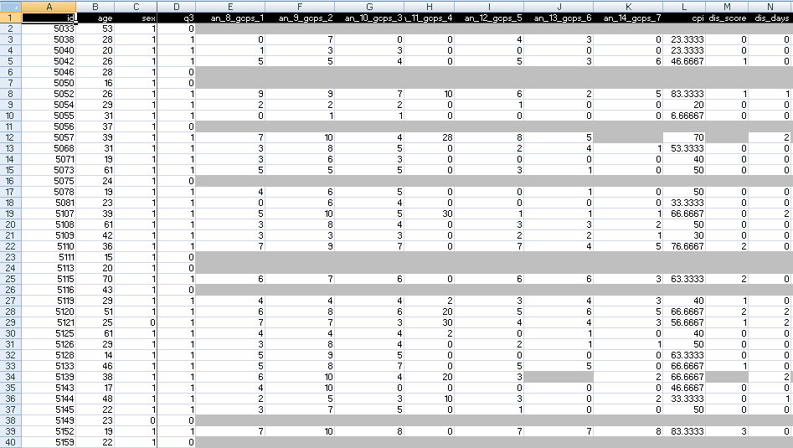
A colleague shares his research data set

Slide 85
Step 1: ‘meaning’ of values in data collections
‘The patient with patient identifier ‘PtID4’ is stated to have had a panoramic X-ray of the mouth which is interpreted to show subcortical sclerosis of that patient’s condylar head of the right temporomandibular joint’
meaning
1

Slide 86
Step 2 (1): list the entities denoted
1(The patient) with 2(patient identifier ‘PtID4’) 3(is stated) 4(to have had) a 5(panoramic X-ray) of 6(the mouth) which 7(is interpreted) to 8(show) 9(subcortical sclerosis of 10(that patient’s condylar head of the 11(right temporomandibular joint)))’
CLASS | INSTANCE IDENTIFIER
person | IUI-1
patient identifier | IUI-2
assertion | IUI-3
technically investigating | IUI-4
panoramic X-ray | IUI-5
mouth | IUI-6
interpreting | IUI-7
seeing | IUI-8
diagnosis | IUI-9
condylar head of right TMJ | IUI-10
right TMJ | IUI-11
notes: colors have no meaning here, just provide easy reference,
this first list can be different, any such differences being resolved in step 3

Slide 87
Step 2 (2): provide directly referential descriptions
CLASS | INSTANCE IDENTIFIER | DIRECTLY REFERENTIAL DESCRIPTIONS
person | IUI-1 | the person to whom IUI-2 is assigned
patient identifier | IUI-2 | the patient identifier of IUI-1
assertion | IUI-3 | 'the patient with patient identifier PtID4 has had a panoramic X-ray of the mouth which is interpreted to show subcortical sclerosis of that patient’s right temporomandibular joint'
technically investigating | IUI-4 | the technically investigating of IUI-6
panoramic X-ray | IUI-5 | the panoramic X-ray that resulted from IUI-4
mouth | IUI-6 | the mouth of IUI-1
interpreting | IUI-7 | the interpreting of the signs exhibited by IUI-5
seeing | IUI-8 | the seeing of IUI-5 which led to IUI-7
diagnosis | IUI-9 | the diagnosis expressed by means of IUI-3
condylar head of right TMJ | IUI-10 | the condylar head of the right TMJ of IUI-1
right TMJ | IUI-11 | the right TMJ of IUI-1

Slide 88
Step 3: identify further entities that ontologically must exist for each entity under scrutiny to exist.
assigner role | IUI-12 | the assigner role played by the entity while it performed IUI-21
assigning | IUI-21 | the assigning of IUI-2 to IUI-1 by the entity with role IUI-12
asserting | IUI-20 | the asserting of IUI-3 by the entity with asserter role IUI-13
asserter role | IUI-13 | the asserter role played by the entity while it performed IUI-20
investigator role | IUI-14 | the investigator role played by the entity while it performed IUI-4
panoramic X-ray machine | IUI-15 | the panoramic X-ray machine used for performing IUI-4
image bearer | IUI-16 | the image bearer in which IUI-5 is concretized and that participated in IUI-8
interpreter role | IUI-17 | the interpreter role played by the entity while it performed IUI-7
perceptor role | IUI-18 | the perceptor role played by the entity while it performed IUI-8
diagnostic criteria | IUI-19 | the diagnostic criteria used by the entity that performed IUI-7 to come to IUI-9
study subject role | IUI-22 | the study subject role which inheres in IUI-1

Slide 89
Step 3: some remarks
interpreter role, perceptor role, …
  reference to roles rather than the entity in which the roles inhere because it may be the same entity and one should not assign several IUIs to the same entity
each description follows similar principles as Aristotelian definitions but is about particulars rather than universals

Slide 90
Step 4: classify all entities in terms of realism-based ontologies
CLASS | HIGHER CLASS
person | BFO: Object
patient identifier | IAO: Information Content Entity
assertion | IAO: Information Content Entity
technically investigating | OBI: Assay
panoramic X-ray | IAO: Image
mouth | FMA: Mouth
interpreting | MFO: Assessing
seeing | BFO: Process
diagnosis | IAO: Information Content Entity
condylar head of right TMJ | FMA: Right condylar process of mandible
right TMJ | FMA: Right temporomandibular joint
assigner role | BFO: Role
assigning | BFO: Process
study subject role | OBI: Study subject role
requires more ontological and philosophical skills than domain expertise or expertise with Protégé,
not just term matching

Slide 91
Step 5: specify relationships between these entities
For instance:
  at least during the taking of the X-ray the study subject role inheres in the patient being investigated:
    IUI-23 inheres-in IUI-1 during t1
  the patient participates at that time in the investigation
    IUI-4 has-participant IUI-1 during t1
These relations need to follow the principles of the Relation Ontology.
Smith B, Ceusters W, Klagges B, Koehler J, Kumar A, Lomax J, Mungall C, Neuhaus F, Rector A, Rosse C. Relations in biomedical ontologies, Genome Biology 2005, 6:R46.

Slide 92
Step 6: outline all possible configurations of such entities for the sentence to be true (a one semester course on its own)
Such outlines are collections of relational expressions of the sort just described,
Variant configurations for the example:
  perceptor and interpreter are the same or distinct human beings,
  the X-ray machine is unreliable and produced artifacts which the interpreter thought to be signs motivating his diagnosis, while the patient has indeed the disorder specified by the diagnosis (the clinician was lucky)
  …

