Slide 1
Bioinformatics and
Data Science Skills Course
CLIMB UBIDS – Summer 2019
Class 7 – July 17, 2019
Theoretical Aspects of
Biomedical Ontology
Werner CEUSTERS, MD

Slide 2


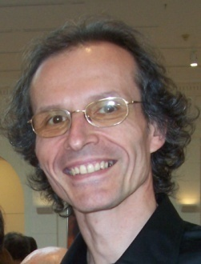



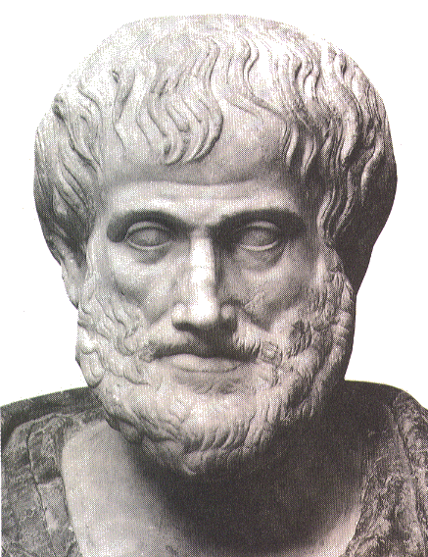






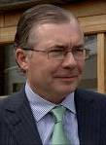

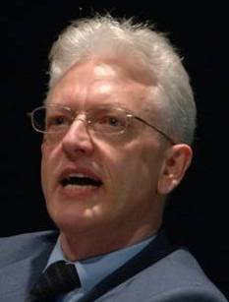


Short professional history
2014
2012
1977
1959 -
2006
1989
2004
1992
2002
1995
1998
1993

Slide 3
Context of this lecture
Thesis: mainstream ontology design approaches fail in achieving their objectives:
  various sorts of mistakes in ontologies,
  inability to use ontologies adequately in information systems,
  failure to integrate data repositories even if these ontologies are appropriately designed.
Root causes:
  inadequacy of their conceptual semantic foundations,
  lack of knowledge about ontology as a philosophical discipline.
Proposed solution:
  Better use of ontology (the philosophical discipline) to design ontologies (specific sorts of representational artifacts) and integrate them in information systems.

Slide 4
What you should NEVER FORGET !!!
(major take home message)
Crucial distinctions made in Ontological Realism
ontology ←→ ontologies
reality ←→ representation
particulars ←→ types
continuants ←→ occurrents

Slide 5
Keeping this in mind, you will be able to:
do justice to the differences between general truths and individual facts:
    e.g. tumors are disorders versus this person has now a tumor.
do justice to the differences between representations and what they are about:
    ‘tumors are disorders’ versus tumors being disorders,
    ‘this person has now a tumor’ versus this person having now a tumor.
create ontologies that contain only representations of general truths,
create information systems that contain representations of individual facts (perhaps in combination with general truths),
see that representations are not always faithful to reality,
use Ontological Realism as a tool to create faithful representations.

Slide 6
Components of this lecture
Highlighting the activities in biomedical informatics that require good insight in ontology;
Contributions of philosophy to science and research relevant for biomedical informaticists;
What is ‘ontology’ and what are ‘ontologies’;
Principles of high quality ontology design and examples of violations thereof in heavily used systems;
Ontological Realism as an example of a discipline based on these principles.

Slide 7
Biomedical Informatics
Definition:

Slide 8
Biomedical Informatics
Definition:
Biomedical informatics (BMI) is
the interdisciplinary field
that studies and pursues the effective uses of biomedical data, information, and knowledge
for scientific inquiry, problem solving, and decision making,
driven by efforts to improve human health.
CA Kulikowski, EH Shortliffe, LM Currie, PL Elkin, LE Hunter, TR Johnson, IJ Kalet, LA Lenert, MA Musen, JG Ozbolt, JW Smith, PZ Tarczy-Hornoch, JWilliamson; AMIA Board white paper: definition of biomedical informatics and specification of core competencies for graduate education in the discipline, Journal of the American Medical Informatics Association, Volume 19, Issue 6, 1 November 2012, Pages 931–938, https://doi.org/10.1136/amiajnl-2012-001053

Slide 9
Biomedical Informatics
Definition:
Biomedical informatics (BMI) is
the interdisciplinary field
that studies and pursues the effective uses of biomedical data, information, and knowledge
for scientific inquiry, problem solving, and decision making,
driven by efforts to improve human health.
CA Kulikowski, EH Shortliffe, LM Currie, PL Elkin, LE Hunter, TR Johnson, IJ Kalet, LA Lenert, MA Musen, JG Ozbolt, JW Smith, PZ Tarczy-Hornoch, JWilliamson; AMIA Board white paper: definition of biomedical informatics and specification of core competencies for graduate education in the discipline, Journal of the American Medical Informatics Association, Volume 19, Issue 6, 1 November 2012, Pages 931–938, https://doi.org/10.1136/amiajnl-2012-001053

Slide 10
Interdisciplinary Nature of Biomedical Informatics: the mainstream view
Computer Science (hardware)
Computer Science (software)
Cognitive Science
& Decision Making
Bioengineering
Biomedical
Informatics
Management
Sciences
Epidemiology
And Statistics
Basic Biomedical
Sciences
Clinical
Sciences

Slide 11
Biomedical Informatics
Definition:
Biomedical informatics (BMI) is
the interdisciplinary field
that studies and pursues the effective uses of biomedical data, information, and knowledge
for scientific inquiry, problem solving, and decision making,
driven by efforts to improve human health.
CA Kulikowski, EH Shortliffe, LM Currie, PL Elkin, LE Hunter, TR Johnson, IJ Kalet, LA Lenert, MA Musen, JG Ozbolt, JW Smith, PZ Tarczy-Hornoch, JWilliamson; AMIA Board white paper: definition of biomedical informatics and specification of core competencies for graduate education in the discipline, Journal of the American Medical Informatics Association, Volume 19, Issue 6, 1 November 2012, Pages 931–938, https://doi.org/10.1136/amiajnl-2012-001053

Slide 12

What it tried to solve first

Slide 13
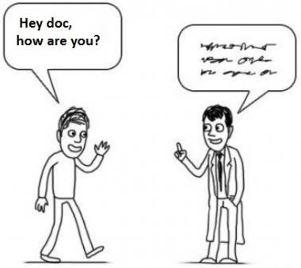

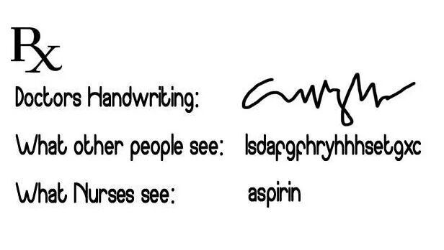
What it solved next
http://topyaps.com/doctors-handwriting

Slide 14
Biomedical Informatics
Definition:
Biomedical informatics (BMI) is
the interdisciplinary field
that studies and pursues the effective uses of biomedical data, information, and knowledge
for scientific inquiry, problem solving, and decision making,
driven by efforts to improve human health.
CA Kulikowski, EH Shortliffe, LM Currie, PL Elkin, LE Hunter, TR Johnson, IJ Kalet, LA Lenert, MA Musen, JG Ozbolt, JW Smith, PZ Tarczy-Hornoch, JWilliamson; AMIA Board white paper: definition of biomedical informatics and specification of core competencies for graduate education in the discipline, Journal of the American Medical Informatics Association, Volume 19, Issue 6, 1 November 2012, Pages 931–938, https://doi.org/10.1136/amiajnl-2012-001053

Slide 15
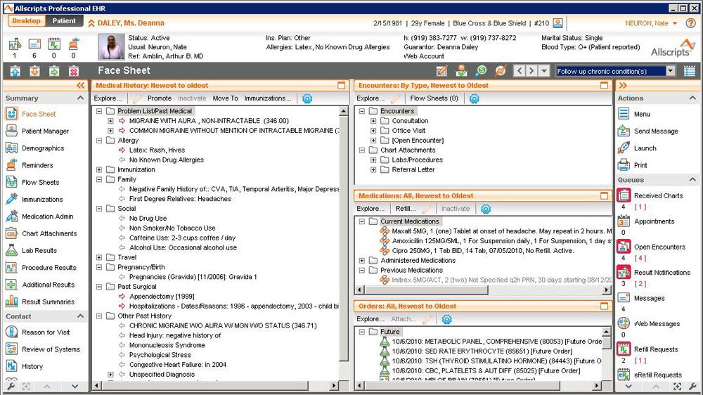

Slide 16
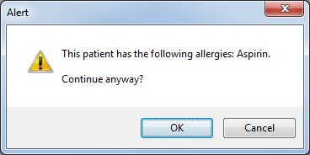

Slide 17
Is
Biomedical Informatics
the Holy Grail
for better healthcare?

Slide 18
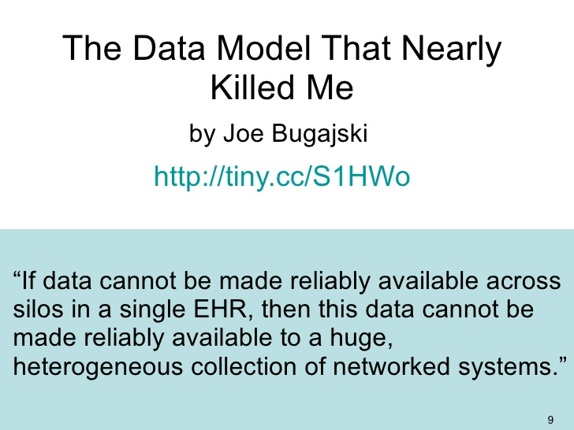

Slide 19
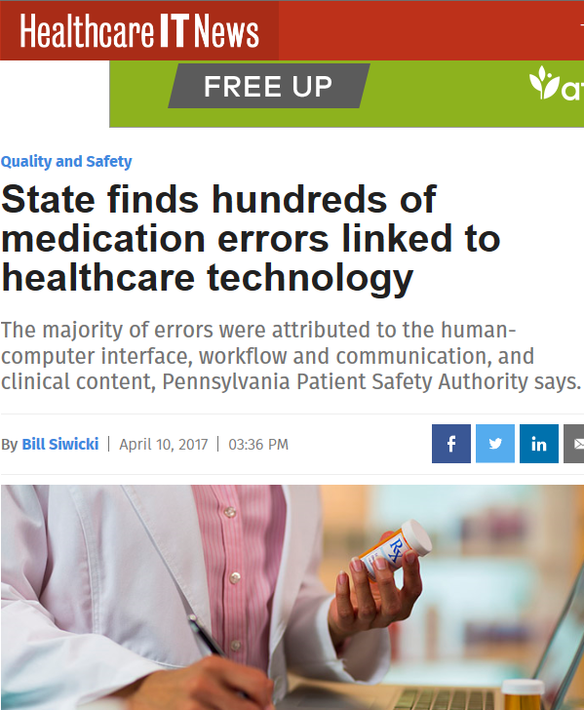
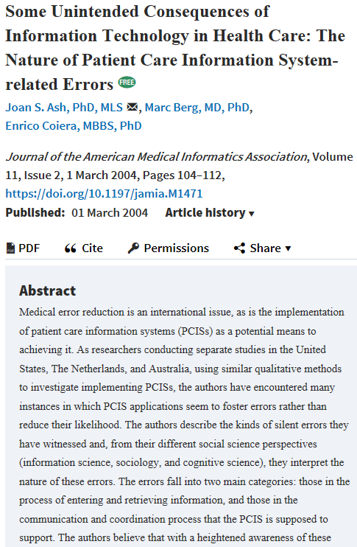
Biomedical Informatics to the rescue ?

Slide 20
In all these aspects of biomedical informatics, ontology can play a crucial role!

Slide 21
Biomedical Informatics
Definition:
Biomedical informatics (BMI) is
the interdisciplinary field
that studies and pursues the effective uses of biomedical data, information, and knowledge
for scientific inquiry, problem solving, and decision making,
driven by efforts to improve human health.
CA Kulikowski, EH Shortliffe, LM Currie, PL Elkin, LE Hunter, TR Johnson, IJ Kalet, LA Lenert, MA Musen, JG Ozbolt, JW Smith, PZ Tarczy-Hornoch, JWilliamson; AMIA Board white paper: definition of biomedical informatics and specification of core competencies for graduate education in the discipline, Journal of the American Medical Informatics Association, Volume 19, Issue 6, 1 November 2012, Pages 931–938, https://doi.org/10.1136/amiajnl-2012-001053

Slide 22
Three relevant disciplines
Data science:
‘an interdisciplinary field about scientific methods, processes, and systems to extract knowledge or insights from data in various forms, either structured or unstructured, similar to data mining’.
https://en.wikipedia.org/wiki/Data_science
Statistics:
‘a branch of mathematics dealing with the collection, analysis, interpretation, presentation, and organization of data’.
https://en.wikipedia.org/wiki/Statistics
Several branches of philosophy:
Philosophy of science
Ontology

Slide 23
Philosophy of Science
Basic principles of science

Slide 24

Basic principle of science
https://www.youtube.com/watch?v=OL6-x0modwY

Slide 25
Philosophy of Science (PhyS)
a rigorous academic study that deals specifically with what science is, how it works, and the logic through which we build scientific knowledge.
    http://undsci.berkeley.edu/article/philosophy
a general philosophy of science seeks to describe and understand how science works within a wide range of sciences.
    Malcolm Forster. An Introduction to Philosophy of Science, 2004.
philosophy of science should help us look at claims made within science, and claims made about science, and should help us make informed judgments about how and what we are to think about each case.
    http://www.thegreatcourses.com/professors/jeffrey-l-kasser/

Slide 26

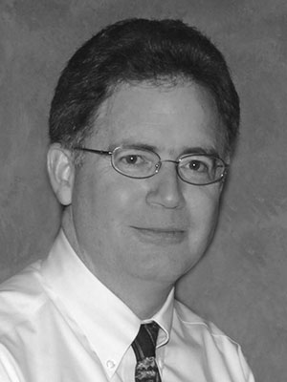
Philosophy of science: use(ful/less)?
‘Philosophy of science is about as useful to scientists as ornithology is to birds’.
    Attributed to Richard Feynman in Donald E. Simanek and John C. Holden, Science Askew: A Light-Hearted Look at the Scientific World (Philadelphia: Institute of Physics Publishing, 2002) , 215.
Feynman photo © Richard Hartt/Caltech archives
‘Science can't be free of philosophy any more than baseball can be free of physics’.
    Jeffrey L. Kasser, Ph.D. http://www.thegreatcourses.com/courses/philosophy-of-science.html#BVRRWidgetID

Slide 27
Questions addressed in PhyS (1)
• What exactly is science?
www.hu.mtu.edu/~tlockha/h3700qst.doc

Slide 28
Definitions of ‘science’ (1)
3a : knowledge or a system of knowledge covering general truths or the operation of general laws especially as obtained and tested through scientific method
3b : such knowledge or such a system of knowledge concerned with the physical world and its phenomena: natural science
http://www.merriam-webster.com/dictionary/science

Slide 29
Definitions of ‘science’ (2)
Science is a systematic search for knowledge whose validity does not depend on the particular individual but is open for anyone to check or rediscover.
Hansson, Sven Ove, "Science and Pseudo-Science", The Stanford Encyclopedia of Philosophy (Spring 2015 Edition), Edward N. Zalta (ed.). https://plato.stanford.edu/archives/spr2015/entries/pseudo-science/.
Science is the pursuit and application of knowledge and understanding of the natural and social world following a systematic methodology based on evidence.
http://sciencecouncil.org/about-us/our-definition-of-science/

Slide 30
What is the fundamental distinction between these two definitions ?
Science is….
knowledge or a system of knowledge covering general truths or the operation of general laws especially as obtained and tested through scientific method
a systematic search for knowledge whose validity does not depend on the particular individual but is open for anyone to check or rediscover.

Slide 31
Questions addressed in PhyS (2)
• What exactly is science? How to differentiate from pseudo-science?
www.hu.mtu.edu/~tlockha/h3700qst.doc

Slide 32
Some key principles in how to do science
Objective observation: measurement and data (possibly although not necessarily using mathematics as a tool),
Evidence,
Experiment and/or observation as benchmarks for testing hypotheses,
Induction: reasoning to establish general rules or conclusions drawn from facts or examples,
Repetition,
Critical analysis,
Verification and testing: critical exposure to scrutiny, peer review and assessment.
http://sciencecouncil.org/about-us/our-definition-of-science/

Slide 33
Questions addressed in PhyS (3)
• What exactly is science? How to differentiate from pseudo-science?
• Is there a single basic method of science? If there are several, what makes them all "scientific"?
•
www.hu.mtu.edu/~tlockha/h3700qst.doc

Slide 34
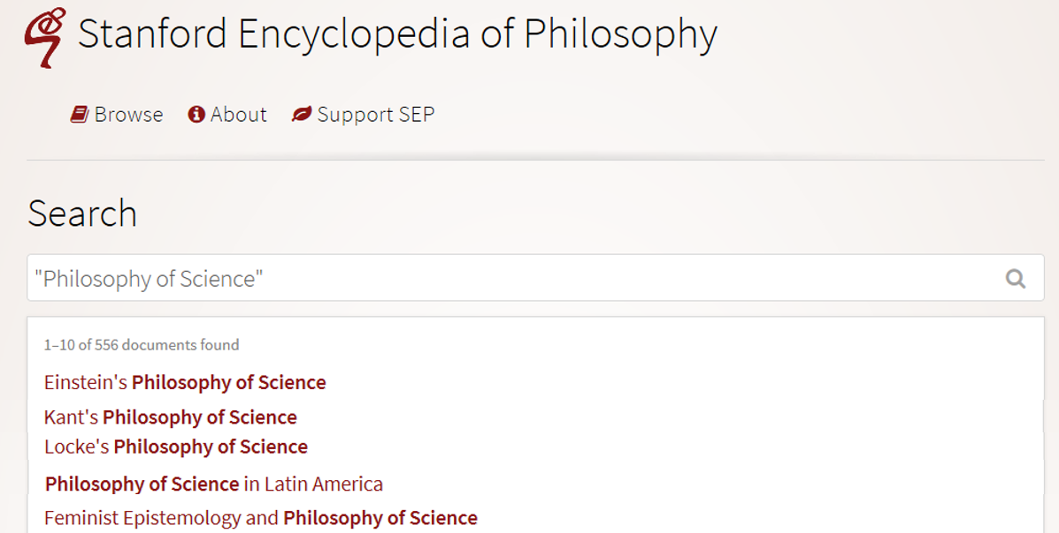
Many philosophies of science
https://plato.stanford.edu/search/search?query=%22Philosophy+of+Science%22

Slide 35
Questions addressed in PhyS (4)
• What exactly is science? How to differentiate from pseudo-science?
• Is there a single basic method of science? If there are several, what makes them all "scientific"?
• Is science the best way to know about the world?
• Is science compatible with religion, or do they conflict? If they conflict, which one should we believe?
www.hu.mtu.edu/~tlockha/h3700qst.doc

Slide 36
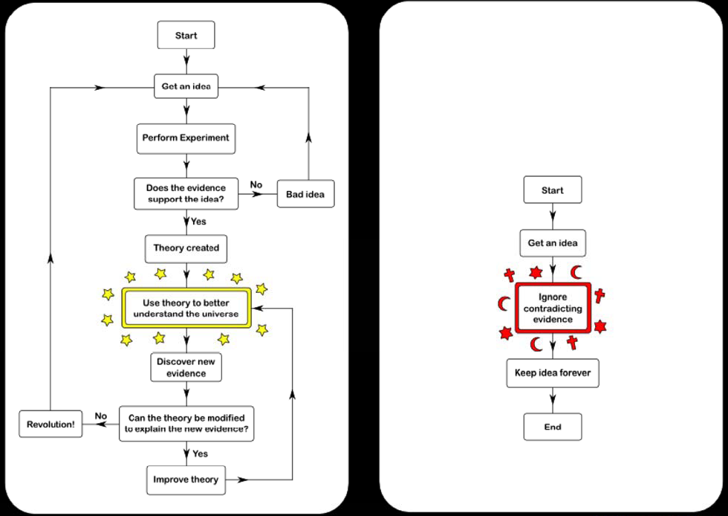
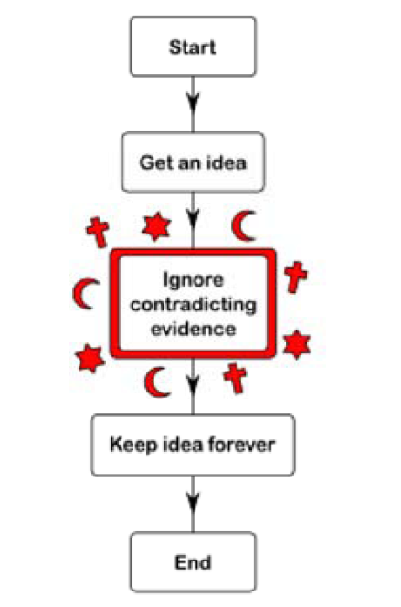
Science
Argument
Faith
Opinion
https://rationalwiki.org/wiki/Scientific_method

Slide 37
Questions addressed in PhyS (6)
• What exactly is science? How to differentiate from pseudo-science?
• Is there a single basic method of science? If there are several, what makes them all "scientific"?
• Is science the best way to know about the world?
• Is science compatible with religion, or do they conflict? If they conflict, which one should we believe?
• What is a scientific theory? How should scientists decide which among competing theories to accept?
• Why do scientists sometimes disagree with each other, even when they have the same data? Could fully rational scientists have such disagreements?
www.hu.mtu.edu/~tlockha/h3700qst.doc

Slide 38
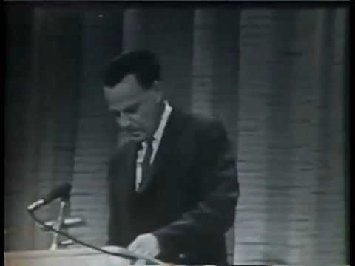
Feynman’s answer

Slide 39
Did you notice ?
Feynman said:
‘ … a lot of ideas, say euh, I believe there are there is a space-time … ’
‘ … six or seven different representations for the same physics … ’

Slide 40
Components of utmost importance
Feynman said:
‘ … a lot of ideas, say euh, I believe there are there is a space-time … ’
‘ … six or seven different representations for the same physics … ’

Slide 41
‘Ontology’
Helps scientists to determine and describe what sorts of entities their research is intended to be directed at.

Slide 42
Goals of Biomedical Ontology in
Healthcare Information Technology (HIT)
supporting the creation and use of adequate biomedical terminology.
supporting the creation of adequate coding and classification systems.
solving the semantic interoperability problem for heterogeneous biomedical information systems.
improving biomedical decision support applications.

Slide 43
In all these aspects of biomedical informatics, ontology can play a crucial role.
Only realism-based ontology will do so adequately!

Slide 44
Additional Goals of Realism-based Biomedical Ontology in HIT
supporting the identification of what sorts of biomedical entities exist, how they relate to each other and how they are best represented.
supporting the creation and use of adequate biomedical terminology.
supporting the creation of adequate coding and classification systems.
solving the semantic interoperability problem for heterogeneous biomedical information systems.
improving biomedical decision support applications.
assisting in the education of healthcare workers.
…

Slide 45
Biomedical Informatics
Realism-based Ontology | Inter-disciplinary | Data, Information, Knowledge | Science, Problem Solving, Decision Making | Improving Health
Entity identification
Terminologies
Classification Systems
Semantic Interoperability
Decision Support
Education

Slide 46
Biomedical Informatics
Realism-based Ontology | Inter-disciplinary | Data, Information, Knowledge | Science, Problem Solving, Decision Making | Improving Health
Entity identification
Terminologies
Classification Systems
Semantic Interoperability
Decision Support
Education
Success rests on 4 essential distinctions!
‘ontology’ ←→ ‘an ontology’
reality ←→ representation
particulars ←→ universals
continuants ←→ occurrents

Slide 47
Biomedical Informatics
Realism-based Ontology | Inter-disciplinary | Data, Information, Knowledge | Science, Problem Solving, Decision Making | Improving Health
Entity identification
Terminologies
Classification Systems
Semantic Interoperability
Decision Support
Education
Success rests on 4 essential distinctions!
‘ontology’ ←→ ‘an ontology’
reality ←→ representation
particulars ←→ universals
continuants ←→ occurrents

Slide 48
‘Ontology’
In philosophy:
  Ontology (no plural) is the study of what entities exist and how they relate to each other;

Slide 49

Borat’s study of what there is in an American grocery store

Slide 50
‘Ontology’
In philosophy:
  Ontology (no plural) is the study of what entities exist and how they relate to each other;
  by some philosophers taken to be synonymous with ‘metaphysics’ while others draw distinctions in many distinct ways (the distinctions being irrelevant for this talk), but almost agreeing on the following classification:
    metaphysics → studies ‘how is the world?’
      general metaphysics → studies general principles and ‘laws’ about the world
        ontology → studies what type of entities exist in the world
      special metaphysics → focuses on specific principles and entities
  distinct from ‘epistemology’ which is the study of how we can come to know about what exists.
  distinct from ‘terminology’ which is the study of what terms mean and how to name things.

Slide 51
The Terminology / Ontology divide
Terminology:
  solves certain issues related to language use, i.e. with respect to how we talk about entities in reality (if any);
    Relations between terms / ‘concepts’
  does not provide an adequate means to represent independent of use what we talk about, i.e. how reality is structured;
    Women, Fire and Dangerous Things (Lakoff).
Ontology (of the right sort):
  Language and perception neutral view on reality.
    Relations between entities in first-order reality
This is the ‘terminology / ontology divide’

Slide 52
Take a good look
In philosophy:
  Ontology (no plural) is the study of what entities exist and how they relate to each other;
  by some philosophers taken to be synonymous with ‘metaphysics’ while others draw distinctions in many distinct ways (the distinctions being irrelevant for this talk), but almost agreeing on the following classification:
    metaphysics → studies ‘how is the world?’
      general metaphysics → studies general principles and ‘laws’ about the world
        ontology → studies what type of entities exist in the world
      special metaphysics → focuses on specific principles and entities
  distinct from ‘epistemology’ which is the study of how we can come to know about what exists.
  distinct from ‘terminology’ which is the study of what terms mean and how to name things.

Slide 53
Distinct questions. What type are they of?
Terminological:
  what does ‘pain’ mean ?
Metaphysical:
  what have all pains in common in virtue of which they are pains?
Ontological:
  what type of entity is pain?
Onto-terminological:
  what, if anything at all, does ‘pain’ denote?
Epistemological:
  how can we find out whether something is pain?

Slide 54
Unfortunately, ‘ontology’ denotes ambiguously
In philosophy:
  Ontology (no plural) is the study of what entities exist and how they relate to each other;
In computer science and many biomedical informatics applications:
  An ontology (plural: ontologies) is a shared and agreed upon conceptualization of a domain;

Slide 55
Computer science approach to ontology
Ontology
Authoring Tools
create
Domain
Ontologies
Reasoners
Semantic
Applications
use

Slide 56
Computer science approach to ontology
Ontology
Authoring Tools
the logic in reasoners:
guarantees consistent reasoning,
does not guarantee the faithfulness of the representation.
create
Domain
Ontologies
Reasoners
Semantic
Applications
use

Slide 57

Philosophical approach to ontology
Ontological Realism: uses ontology as philosophical discipline to build ontologies as faithful representations of reality.

Slide 58
Realism
Generic Realism (on some subject matter):
a, b, and c and so on exist,
and the fact that they exist and have properties such as F-ness, G-ness, and H-ness is (apart from mundane empirical dependencies of the sort sometimes encountered in everyday life) independent of anyone's beliefs, linguistic practices, conceptual schemes, and so on.
http://plato.stanford.edu/entries/realism/

Slide 59
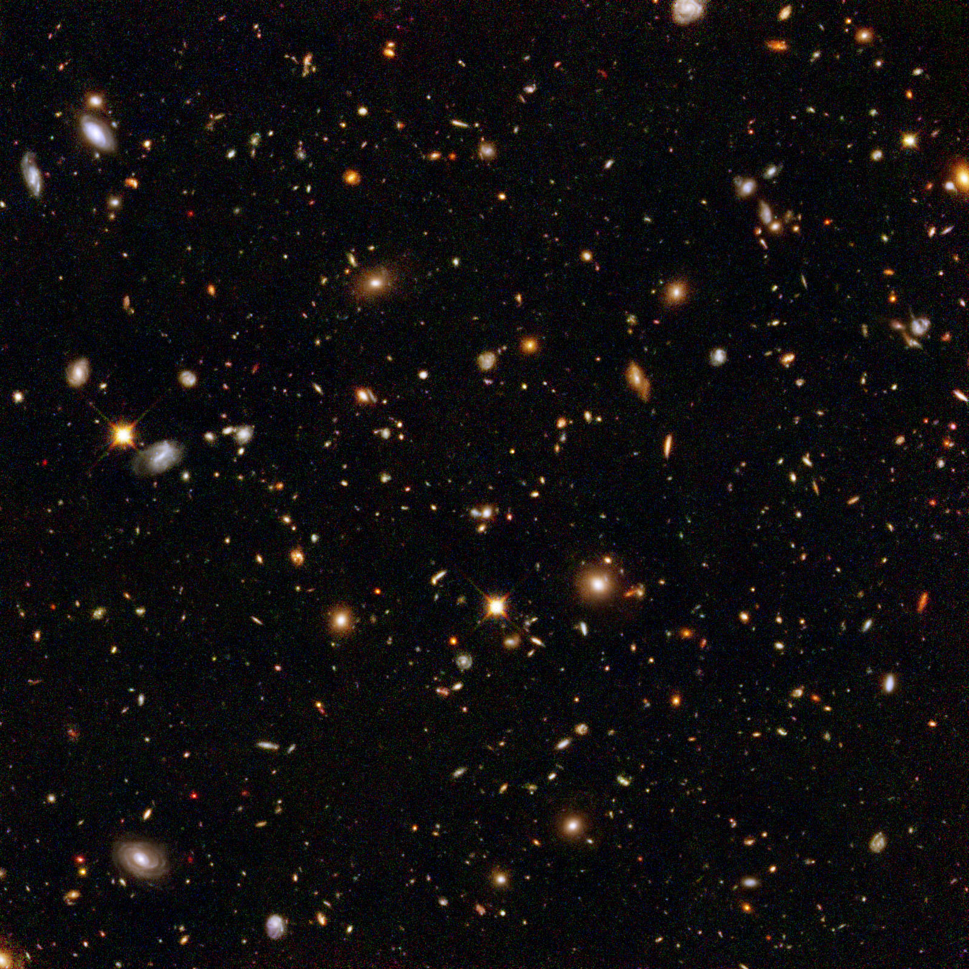
The basis of Ontological Realism (O.R.)
There is an external reality which is ‘objectively’ the way it is;
That reality is accessible to us;
We build in our brains cognitive representations of reality;
We communicate with others about what is there, and what we believe there is there.
Smith B, Kusnierczyk W, Schober D, Ceusters W. Towards a Reference Terminology for Ontology Research and Development in the Biomedical Domain. Proceedings of KR-MED 2006, Biomedical Ontology in Action, November 8, 2006, Baltimore MD, USA

Slide 60
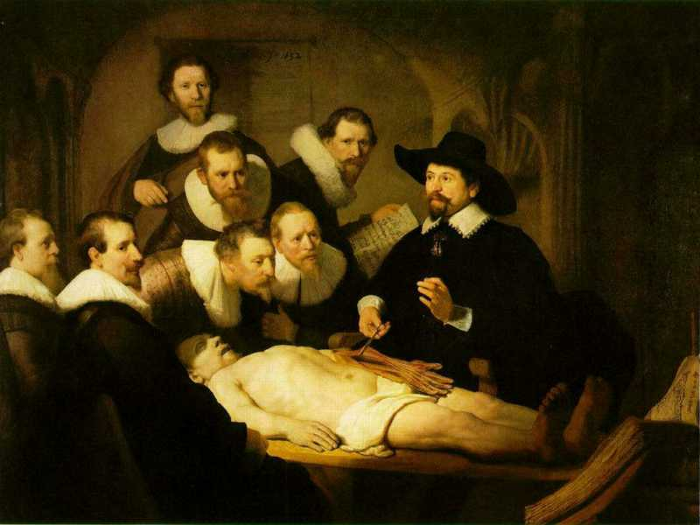

Slide 61
L3
Linguistic representations about (L1⁻), (L2) or (L3)
L2
Beliefs about (1)
Representations
First Order Reality
Entities (particular or generic) with objective existence which are not about anything
L1⁻

Slide 62
Scientific Objectivity (1)
Objectivity as Faithfulness to Facts
Objectivity as Absence of Normative Commitments and the Value-Free Ideal
Objectivity as Freedom from Personal Biases
  Measurement and Quantification
  Inductive and Statistical Inference

Slide 63
Scientific Objectivity (2)
Science is objective in that, or to the extent that:
its products—theories, laws, experimental results and observations—constitute accurate representations of the external world. The products of science are not tainted by human desires, goals, capabilities or experience.
  product objectivity
the processes and methods that characterize it neither depend on contingent social and ethical values, nor on the individual bias of a scientist
  → process objectivity.
http://plato.stanford.edu/entries/scientific-objectivity

Slide 64
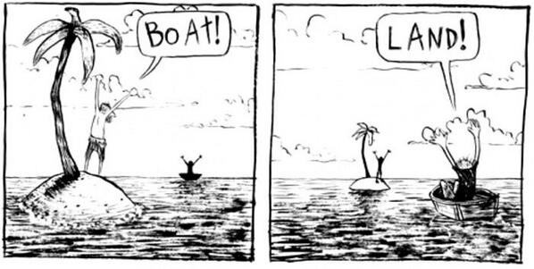
The view from nowhere
There are two kinds of qualities: ones that vary with the perspective one has or takes, and ones that remain constant through changes of perspective. The latter are the objective properties.
http://plato.stanford.edu/entries/scientific-objectivity

Slide 65
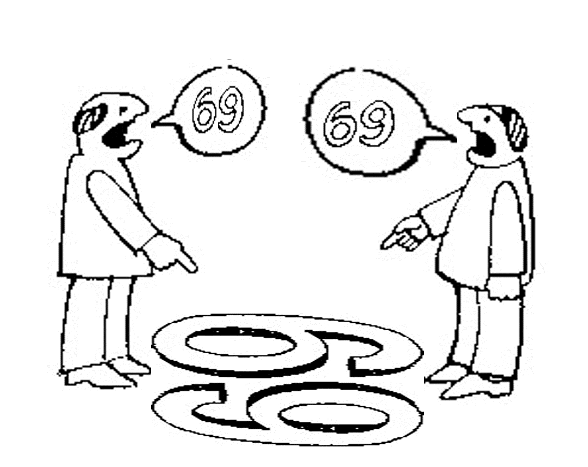
No scientific objectivity here
six
nine

Slide 66
No scientific objectivity here
nine
six

Slide 67
Is there scientific objectivity here?
sixty
nine
sixty
nine

Slide 68
Biomedical Informatics
Realism-based Ontology | Inter-disciplinary | Data, Information, Knowledge | Science, Problem Solving, Decision Making | Improving Health
Entity identification
Terminologies
Classification Systems
Semantic Interoperability
Decision Support
Education
Success rests on 4 essential distinctions!
‘ontology’ ←→ ‘an ontology’
reality ←→ representation
particulars ←→ universals
continuants ←→ occurrents

Slide 69
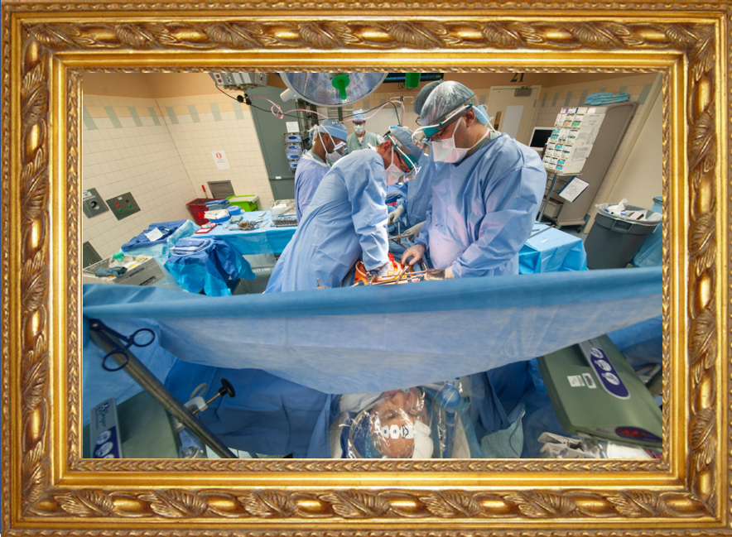

Reality ←→ Representation

Slide 70
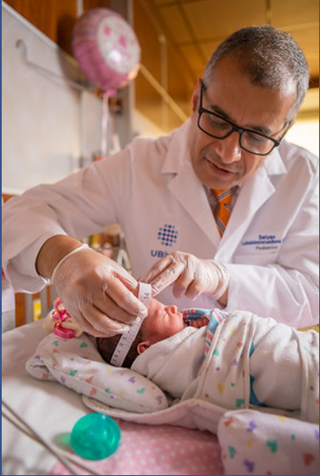
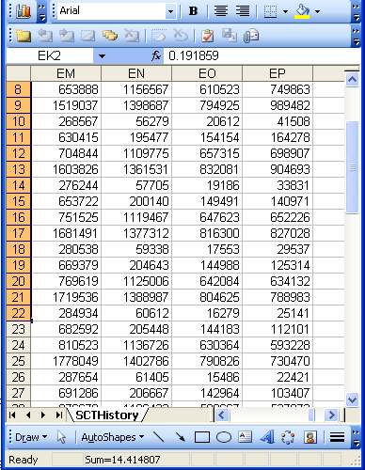
Reality ←→ Representation
(research) domain
(research) data
Beings & happenings
Descriptions

Slide 71
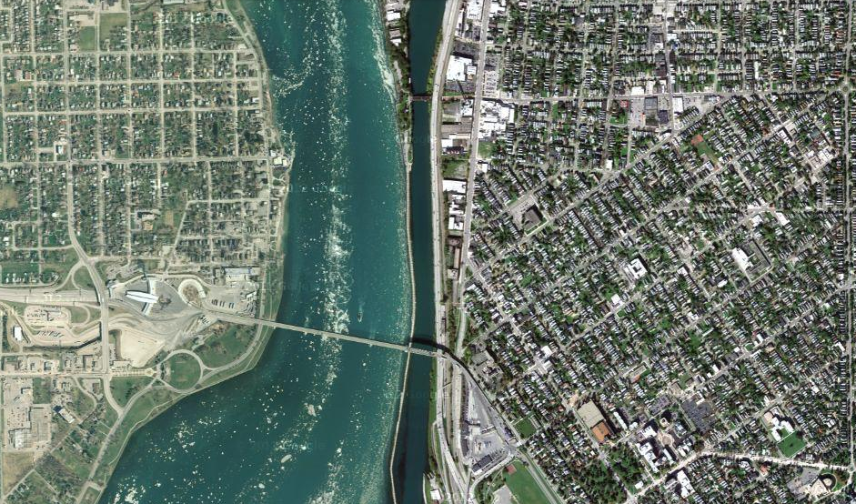
Satellite view

Slide 72
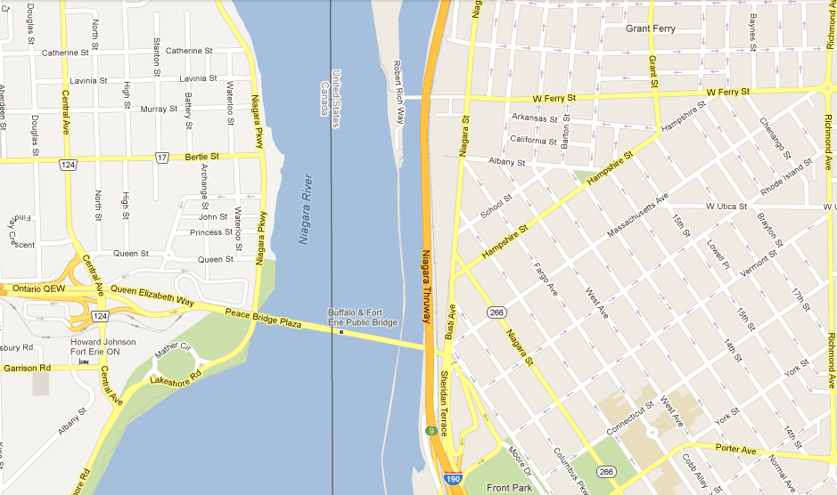
Map

Slide 73
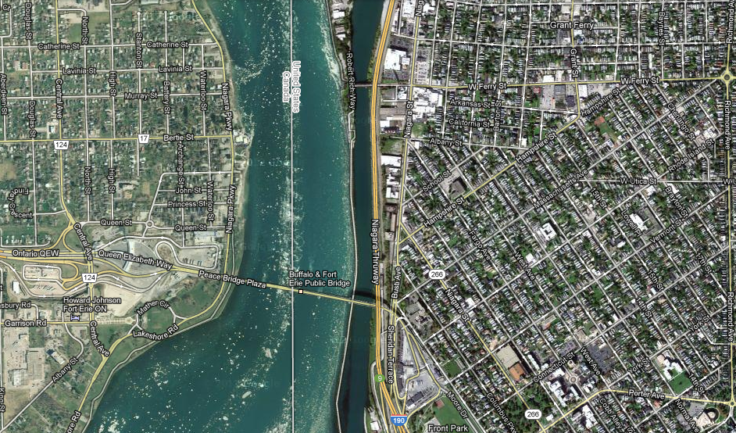
Map overlay

Slide 74
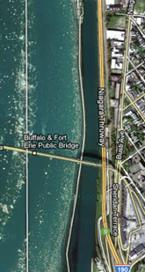
Map ←→ Reality
A message to map makers: “Highways are not painted red, rivers don’t have county lines running down the middle, and you can’t see contour lines on a mountain”
W. Kent. Data and Reality. North-Holland, Amsterdam, the Netherlands, 1978.

Slide 75
Main data ←→ reality views
Nominalism:
  there are no generic entities in reality: there is no personhood, there are only individual persons.
Conceptualism:
  generalizations are in our ‘minds’. Personhood is a concept construed in our ‘mind’ that allows us to reason about persons without any particular person in mind.
Realism:
  generic entities do exist and are called ‘universals’. Each particular person is an instance of the universal we call ‘person’.

Slide 76
Main data ←→ reality views
Nominalism:
  there are no generic entities in reality: there is no personhood, there are only individual persons.
Conceptualism: ← mainstream approach
  generalizations are in our ‘minds’. Personhood is a concept construed in our ‘mind’ that allows us to reason about persons without any particular person in mind.
Realism: ← our approach
  generic entities do exist and are called ‘universals’. Each particular person is an instance of the universal we call ‘person’.

Slide 77
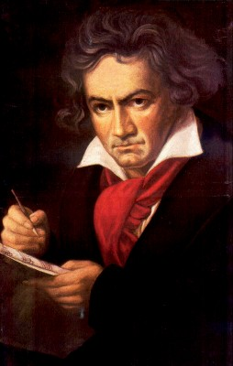
The semantic/semiotic triangle:
(the sandbox of the conceptualist)
Ludwig van Beethoven
that great German composer that became deaf
…
concept
term
referent
‘Beethoven’

Slide 78
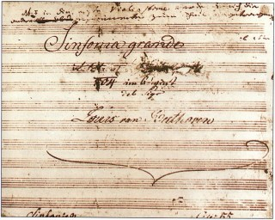
The semantic triangle works sometimes fine
Beethoven’s symphony dedicated to Bonaparte
the symphony played after the Munich Olympics massacre
…
concept
term
referent
‘Eroica’
‘Beethoven's Symphony No. 3’
‘Beethoven's Opus 55’

Slide 79
Sometimes the semantic triangle fails
the symphony Beethoven wrote after the tenth
…
concept
term
referent
‘Beethoven's Symphony No. 11’

Slide 80
Sometimes the semantic triangle fails
the symphony Beethoven wrote after the tenth
…
some hold this term has meaning
concept
term
referent
‘Beethoven's Symphony No. 11’

Slide 81
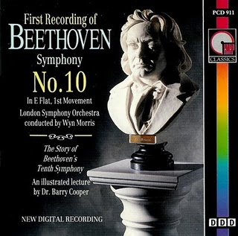
Sometimes the semantic triangle fails
the one assembled by Barry Cooper from fragmentary sketches
Beethoven’s hypothetical symphony
…
concept
term
referent
‘Beethoven's Symphony No. 10’

Slide 82
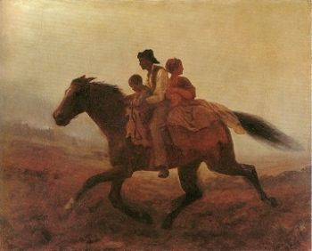
Prehistoric ‘psychiatry’: drapetomania
disease which causes slaves to suffer from an unexplainable propensity to run away
…
concept
term
referent
painting by Eastman Johnson. A Ride for Liberty: The Fugitive Slaves. 1860.
‘drapetomania’

Slide 83
SNOMED about diseases and concepts (until 2010)
‘Disorders are concepts in which there is an explicit or implicit pathological process causing a state of disease which tends to exist for a significant length of time under ordinary circumstances.’
And also: “Concepts are unique units of thought”.
Thus: Disorders are unique units of thoughts in which there is a pathological process …???
And thus: to eradicate all diseases in the world at once we simply should stop thinking ?

Slide 84
Remember: ‘Biomedical Informatics’
Definition:
Biomedical informatics (BMI) is
the interdisciplinary field
that studies and pursues the effective uses of biomedical data, information, and knowledge
for scientific inquiry, problem solving, and decision making,
driven by efforts to improve human health.
CA Kulikowski, EH Shortliffe, LM Currie, PL Elkin, LE Hunter, TR Johnson, IJ Kalet, LA Lenert, MA Musen, JG Ozbolt, JW Smith, PZ Tarczy-Hornoch, JWilliamson; AMIA Board white paper: definition of biomedical informatics and specification of core competencies for graduate education in the discipline, Journal of the American Medical Informatics Association, Volume 19, Issue 6, 1 November 2012, Pages 931–938, https://doi.org/10.1136/amiajnl-2012-001053

Slide 85
Current mainstream informatics thinking
knowledge
information
data

Slide 86
Current mainstream informatics thinking
?
knowledge
information
data

Slide 87
Current mainstream informatics thinking
wisdom
knowledge
information
data

Slide 88
Where do data come from?
knowledge
information
data
Representation
What is there on the side of the patient
Reality

Slide 89
Where do data come from?
knowledge
information
data
Questions not often enough asked:
What parts of our data correspond with something out there in reality ?
What parts of reality are not captured by our data, but should because they are relevant ?
Reality
What is there on the side of the patient

Slide 90
Where do data come from?
knowledge
information
data
Questions not often enough asked:
What parts of our data correspond with something out there in reality ?
What parts of reality are not captured by our data, but should because they are relevant ?
Ontology
Reality
What is there on the side of the patient

Slide 91
Where do data come from?
References
knowledge
information
data
Questions not often enough asked:
What part of our data corresponds with something out there in reality ?
What part of reality is not captured by our data, but should because it is relevant ?
Ontology
- representation
Reality
What is there on the side of the patient
Referents

Slide 92
Also representations are real!
References
knowledge
information
data
Questions not often enough asked:
What part of our data corresponds with something out there in reality ?
What part of reality is not captured by our data, but should because it is relevant ?
Ontology
- representation
Reality
What is there on the side of the patient
Referents

Slide 93
Generalization: data generation and use
data
organization
model development
observation &
measurement
further R&D
(instrument and
study optimization)
add
verify
use
Δ = outcome
Generic
beliefs
application

Slide 94
Reality as benchmark for data organization and representation
data
organization
model development
observation &
measurement
further R&D
(instrument and
study optimization)
add
verify
use
Δ = outcome
Generic
beliefs
application

Slide 95

Realism-based Ontology (RBO)
Referents
  are (meta-) physically the way they are,
  relate to each other in an objective way,
  follow ‘laws of nature’.
Window on reality
  restricted by:
  what is physically and technically observable,
  fit between what is measured and what we think is measured,
  fit between established knowledge and ‘laws of nature’.
References
  follow, ideally, the syntactic-semantic conventions of some representation language,
  are restricted by the expressivity of that language,
  reference collections need to come, for correct interpretation, with documentation outside the representation.

Slide 96
Biomedical Informatics
Realism-based Ontology | Inter-disciplinary | Data, Information, Knowledge | Science, Problem Solving, Decision Making | Improving Health
Entity identification
Terminologies
Classification Systems
Semantic Interoperability
Decision Support
Education
Success rests on 4 essential distinctions!
‘ontology’ ←→ ‘an ontology’
reality ←→ representation
particulars ←→ universals
continuants ←→ occurrents

Slide 97
What is out there …
(… we want/need to deal with)?
portions of reality
relations
configurations
?
participation
me participating in my life
universals
entities
?
particulars
continuants
occurrents
me
my life
organism

Slide 98
Types versus particulars
Types
Particulars
counterparts in reality of (some of)
the general terms used in the formulation of scientific theories
concrete individual entities
(entities that exist in space and time and that exist only once)
Smith B, Ceusters W. Ontological Realism as a Methodology for Coordinated Evolution of Scientific Ontologies. Applied Ontology, 2010;5(3-4):139-188.

Slide 99
‘Types’
‘concepts’
‘kinds’
‘universals’
‘categories’
‘classes’
‘prototypes’
…
In realism-based ontology:
  Universals: human being
  Defined classes: human being in Buffalo

Slide 100
Types versus particulars
for every universal there is or has been at least one instance
some type
instanceOf …
entities on either site cannot ‘cross’ this boundary
every particular is an instance of at least one universal
some particular

Slide 101




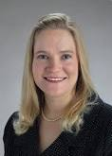
Types versus particulars
Human being
instance of at t
particulars

Slide 102
Types versus particulars
Photograph
instance of at t
particulars

Slide 103
Instances are the objects of classification …
isa
Organism
isa
Vertebrate
isa
Mammal
Human being
instance of at t
particulars

Slide 104
Instances are the objects of classification …
isa
Organism
isa
Vertebrate
isa
Mammal
Human being
instance of at t
particulars

Slide 105
Conceptualism versus Ontological Realism
First order reality
concept
universal
term
referent
representational
unit
particular
Conceptualism
Ontological Realism

Slide 106
Ontological Realism offers three ways of relating, without assigning beliefs (concepts) a central status
drapetomania
slave
running away
mental disorder
propensity
How beliefs are / can
be related
How terms are related
How referents (in
reality) are related

Slide 107
Biomedical Informatics
Realism-based Ontology | Inter-disciplinary | Data, Information, Knowledge | Science, Problem Solving, Decision Making | Improving Health
Entity identification
Terminologies
Classification Systems
Semantic Interoperability
Decision Support
Education
Success rests on 4 essential distinctions!
‘ontology’ ←→ ‘an ontology’
reality ←→ representation
particulars ←→ universals
continuants ←→ occurrents

Slide 108
Continuants ←→ Occurrents
 | Continuant | Occurrent
Entities that at any time they exist,
exist
in total
Entities that at any time they exist,
exist only
partially
Smith B, Ceusters W. Ontological Realism as a Methodology for Coordinated Evolution of Scientific Ontologies. Applied Ontology, 2010;5(3-4):139-188.

Slide 109
An ontological square
 | Continuant | Occurrent
Types | Tooth | Teeth grinding
Particulars | My left maxillary first molar | My teeth grinding

Slide 110
An ontological square
 | Continuant | Occurrent
Types | Tooth | Teeth grinding
Particulars | My left maxillary first molar | My teeth grinding
Instance
of at t
Instance
of

Slide 111
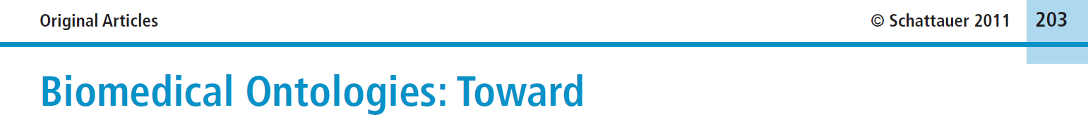


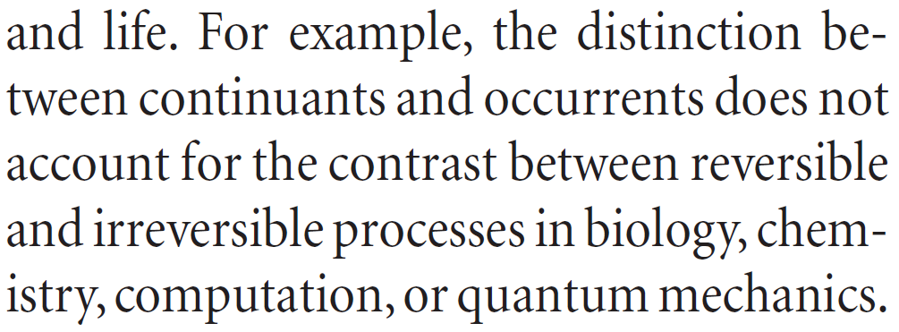
Simple, yet seemingly hard to grasp …
Methods Inf Med 2011; 50: 203-216
Page 205

Slide 112
How could the distinction account for it ?
Continuant | Occurrent
‘the distinction between
continuants and occurrents does not account for the contrast between reversible
and irreversible processes’
Irreversible Process
Reversible Process
Maojo V, Crespo J, Garcia-Remesal M, de la Iglesia D, Pérez-Rey D, Kulikowski C.
Biomedical Ontologies: Toward scientific debate.
Methods Inf Med 2011; 50 (3):203-216.

Slide 113
What is the fundamental distinction between these two definitions ?
Science is….
knowledge or a system of knowledge covering general truths or the operation of general laws especially as obtained and tested through scientific method
a systematic search for knowledge whose validity does not depend on the particular individual but is open for anyone to check or rediscover.

Slide 114
What is the fundamental distinction between these two definitions ?
Science is….
knowledge or a system of knowledge covering general truths or the operation of general laws especially as obtained and tested through scientific method
a systematic search for knowledge whose validity does not depend on the particular individual but is open for anyone to check or rediscover.
Continuant | Occurrent

Slide 115
The importance of temporal indexing
benign
tumor
malignant
tumor
stomach
instanceOf at t₂
instanceOf at t₁
instanceOf at t₂
instanceOf at t₁
partOf at t₁
this-4
this-1’s stomach
partOf at t₂

Slide 116
The importance of temporal indexing
benign
tumor
malignant
tumor
stomach
instanceOf at t₂
instanceOf at t₁
instanceOf at t₂
instanceOf at t₁
this-4
partOf at t₁
this-1’s stomach
this-5
partOf at t₂

Slide 117




Continuants preserve identity while changing
human
being
me
me
t
Instance-of
in 1960
child
Instance-of
since 1980
adult
living
creature
animal
caterpillar
butterfly

Slide 118
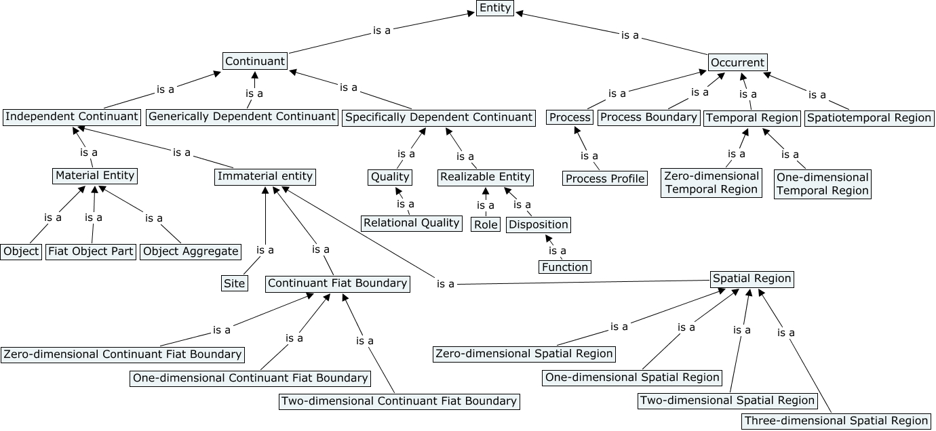
The Basic Formal Ontology (BFO)

Slide 119
What happens if you don’t pay attention to these distinctions?

Slide 120

Shopping for ‘chicken’

Slide 121



Slide 122



Slide 123
Ontology design

Slide 124
Typical use of ontology as discipline
Creation of ontologies throughout their entire life cycle
Principles
based design
maintenance
Development
An ontology’s
ideal lifecycle
Use
Implementation
Validation
Verification

Slide 125
An ideal ontology
A representation of some pre-existing domain of reality (a portion of reality) which
  reflects the generic entities within its domain – and the relations between them – in such a way that there obtains a systematic correlation between reality and the representation itself,
  is intelligible to a domain expert,
  is formalized in a way that allows it to support automatic information processing.
Smith B, Kusnierczyk W, Schober D, Ceusters W. Towards a Reference Terminology for Ontology Research and Development in the Biomedical Domain. Proceedings of KR-MED 2006, Biomedical Ontology in Action, November 8, 2006, Baltimore MD, USA

Slide 126
Focus for scientists and researchers
Principles
based design
Principles
based design
maintenance
Development
An ontology’s
ideal lifecycle
Use
Use
Implementation
Validation
Verification

Slide 127
An ideal dataset
A representation of some pre-existing portion of reality which
  reflects the particulars within its domain – and the relations between them – in such a way that there obtains a systematic correlation between reality and the representation itself,
  is intelligible to a domain expert,
  is formalized in a way that allows it to support automatic information processing.
Smith B, Kusnierczyk W, Schober D, Ceusters W. Towards a Reference Terminology for Ontology Research and Development in the Biomedical Domain. Proceedings of KR-MED 2006, Biomedical Ontology in Action, November 8, 2006, Baltimore MD, USA

Slide 128
Adequate taxonomy design and classification
Taxonomy design:
Identify examples of particulars (‘individuals’, ‘things’, ‘entities’, …) you want to classify;
Identify the various characteristics that are possessed by (all or some of) these individual entities;
Identify groups (classes) on the basis of combinations of characteristics that co-occur;
Organize the groups hierarchically (‘parent-child’) so that characteristics that apply to a ‘parent’ (‘grandparent’,…) group apply to ALL groups beneath it;
Name the groups with terms that have face value.
Classification:
Assign individual entities to the groups that correspond with the combination of characteristics they exhibit.

Slide 129
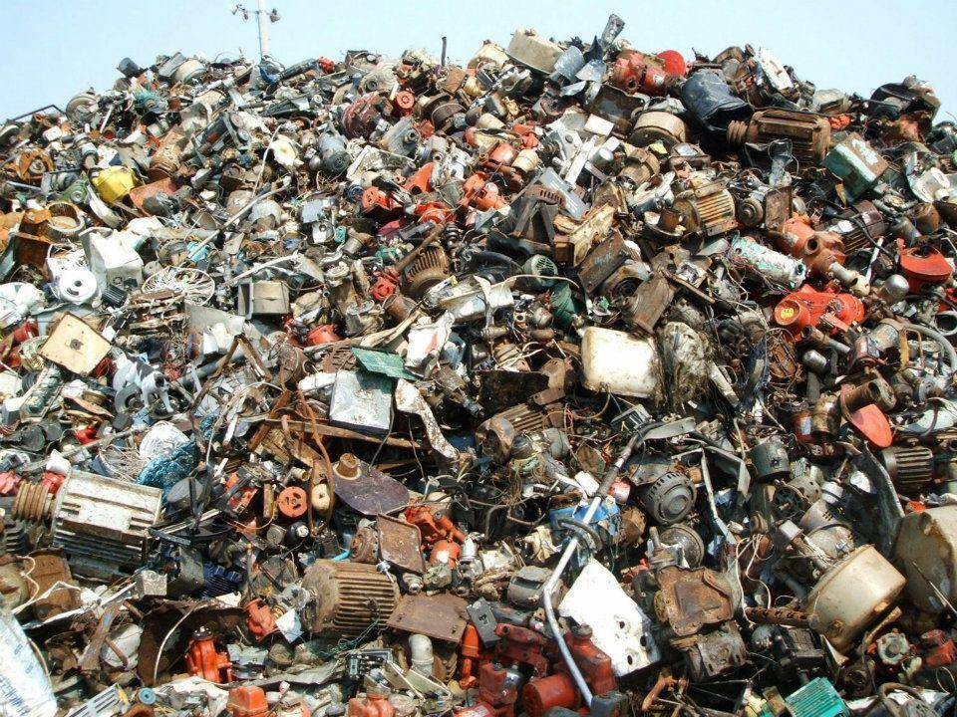
A large collection of individual entities
https://clipartfest.com/download/c2bd0a0071663cef17ac2126d73bf9350a9d15e2.html

Slide 130
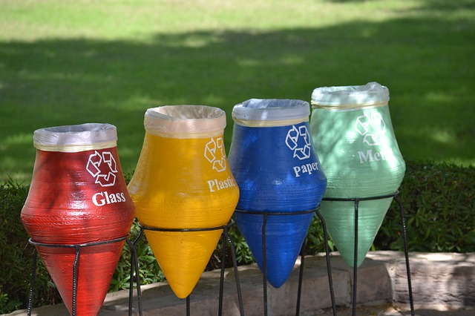
Groups based on material composition

Slide 131
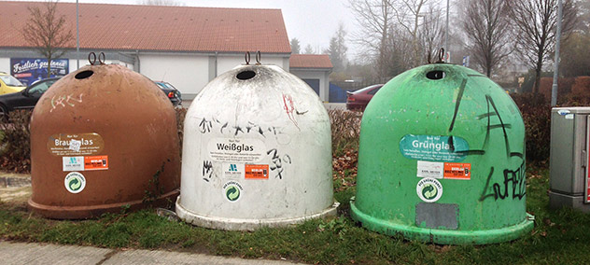
Groups for glass divided by color

Slide 132


Slide 133


Slide 134
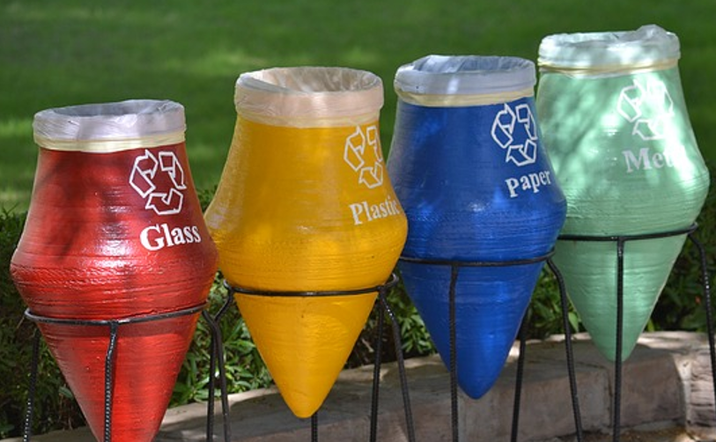


Slide 135


Slide 136
Basic rules for realism-based ontology design

Slide 137
First Rule: Univocity
Terms (including those describing relations) should have the same meanings on every occasion of use.
In other words, they should refer to the same universals (the same kinds of entities in reality) or to the same relations between universals on every occasion of use
Notes:
Problem example: ‘chromosome’ in Sequence Ontology and in Cell Component Ontology means different things
Current solution: two distinct terms involved (qualified by respective namespace)

Slide 138
Second Rule: Positivity
Complements of universals are not themselves universals.
Terms such as ‘non-mammal’ or ‘non-membrane’ do not designate genuine universals.
Notes:
There is no species called ‘non-rabbit’

Slide 139
Third Rule: Objectivity
Which universals exist is not a function of our biological knowledge.
Terms such as ‘unknown’ or ‘unclassified’ or ‘unlocalized’ do not designate biological natural kinds.
Notes:
There is no biological species: unknown rabbit. See discussion below.

Slide 140
Fourth Rule: Single Inheritance
  No universal in a classificatory hierarchy should have more than one is_a parent on the immediate higher level

Slide 141
Fifth Rule: Intelligibility of Definitions
The terms used in a definition should be simpler (more intelligible) than the term to be defined
otherwise the definition provides no assistance
  to human understanding
  for machine processing

Slide 142
Terms and relations should have clear definitions
These tell us how the ontology relates to the world of biological universals, and thereby also to the instances, the actual particulars in reality:
  actual cells, actual portions of cytoplasm, actual hearts, and so on…

Slide 143
Sixth Rule: Basis in Reality
When building or maintaining an ontology, always think carefully about how universals (types, kinds, species) relate to instances and to the associated time-indexed facts in reality

Slide 144
Exercise:
An ontology of
‘pieces of fruit’

