Slide 1

Data Dictionaries for Pain and
Chronic Conditions Ontology
Investigator’s Meeting on Chronic Overlapping Pain Conditions
September 16-17th, 2014, NIH Main Campus: Bldg. 31, Bethesda, MD
Werner CEUSTERS, MD
Professor, Department of Biomedical Informatics, University at Buffalo
Director, National Center for Ontological Research
Director of Research, UB Institute for Healthcare Informatics

Slide 2
Miami 2009 International Consensus Workshop -Convergence on an Orofacial Pain Taxonomy
Recommendations:
  study the terminology and ontology of pain as currently defined,
  find ways to make individual data collections more useful for international research,
  develop an ontology for integrating knowledge and data concerning TMD and its relationship to complex disorders, and
  expand this ontology to cover all pain-related disorders.
Ohrbach R, List T, Goulet JP, Svensson P. Recommendations from the International Consensus Workshop: convergence on an orofacial pain taxonomy. J Oral Rehabil. 2010;37:807–812

Slide 3







This resulted in OPMQoL:
Ontology for Pain, Mental Health and Quality of Life
NIDCR: 1R01DE021917-01A1
Werner Ceusters – Richard Ohrbach
University at Buffalo (PIs)
Mike T. John – Eric L. Schiffman
University of Minnesota
Vishar Aggarwal
Manchester, UK
Joanna Zakrzewska
London, UK
Thomas List
Malmö, Sweden
Rafael Benoliel
Rutgers, Newark NJ

Slide 4
Ontology
In computer science and biomedical informatics:
  An ontology (plural: ontologies) is a shared and agreed upon conceptualization of a domain represented in a formal language that allows, f.i., for the computational classification of instances in terms of a taxonomy;
Smith B, Ceusters W. Ontological Realism as a Methodology for Coordinated Evolution of Scientific Ontologies.
Applied Ontology, 2010;5(3-4):139-188.

Slide 5
An example ontology representing my most recent toothache
organism
brain
disposition
process
Is_a
instance-of at t
Is_a
Is_a
instance-of at t
human being
ability to generate pain in me
pain
neurotransmission
instance-of
at t
inheres-in
at t
is-realized-
in at t₂
instance-of
instance-of
has-participant at t₂
part-of
my caries
signaling
part-of at t
my brain
my toothache
me
participant-of at t₂
participant-of at t₂
part-of at t
my left lower
wisdom tooth
part-of at t₁
my LLWT
caries
instance-of at t
instance-of at t₁
TYPES
tooth
disorder
PARTICULARS

Slide 6
Ontology for accurate representation
Vr = Mr + Es + Er
    Vr = real value Mr = measured value
    Es = systematic error Er = random error
Ontological analysis helps here in determining:
  The plausibility for Vr to exist,
  What entities are involved in bringing about Es and Er,
  If Vr exists, how does it relate to Es and Er entities.
In addition to, if multiple (putative) Vr’s of distinct types are measured:
  How these types relate to each other in a taxonomy,
  How choices in taxonomy design have impact on Es and/or Er.

Slide 7
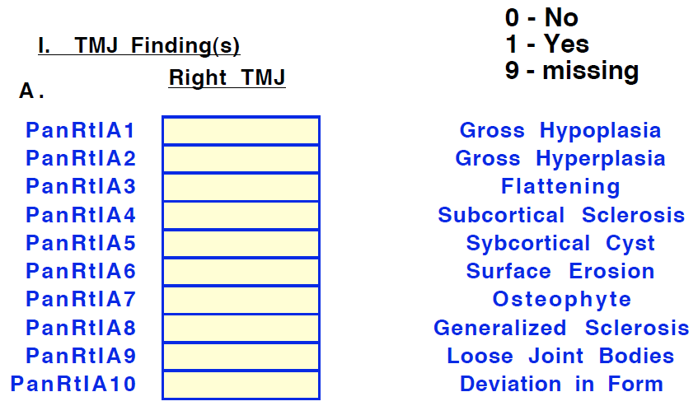
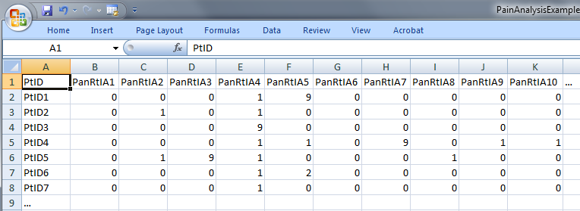
We can use it to give unambiguous ‘meaning’ to values in data collections
‘The patient with patient identifier ‘PtID4’ is stated to have had a panoramic X-ray of the mouth which is interpreted to show subcortical sclerosis of that patient’s condylar head of the right temporomandibular joint’
meaning
1

Slide 8
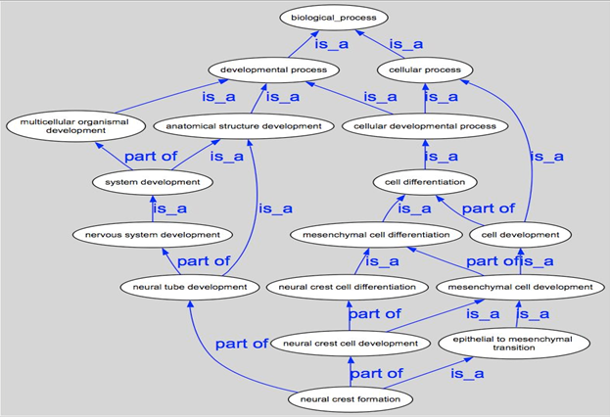
We can use it to map data collections

Slide 9
And enjoy positive effects of appropriate mappings
more precise and comparable semantics of what data items in (distinct) data collections denote
identification of ontological relations prior to statistical correlation:
  ch1 and ch4
  ch1 and ch5
  ch1 and ch2
  …

Slide 10
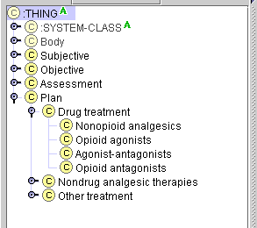
However, most ‘ontologies’ are seriously flawed
The problem:
very bad ontological design:
erroneous domain analysis
violations against representation language semantics
http://www.idi.ntnu.no/emner/tdt4210/2004/2004link/ovinger/smerteontologi_oving/

Slide 11
The solution: Realism-based Ontology
In computer science and biomedical informatics:
  An ontology (plural: ontologies) is a shared and agreed upon conceptualization of a domain represented in a formal language that allows, f.i., for the computational classification of instances in terms of a taxonomy;
In philosophy:
  Ontology (no plural) is the study of what entities exist and how they relate to each other;
Ontological realism:
  Apply the principles of ontology as philosophical discipline as part of the methodology to develop the taxonomy of ontologies in the informatics sense.
Smith B, Ceusters W. Ontological Realism as a Methodology for Coordinated Evolution of Scientific Ontologies.
Applied Ontology, 2010;5(3-4):139-188.

Slide 12
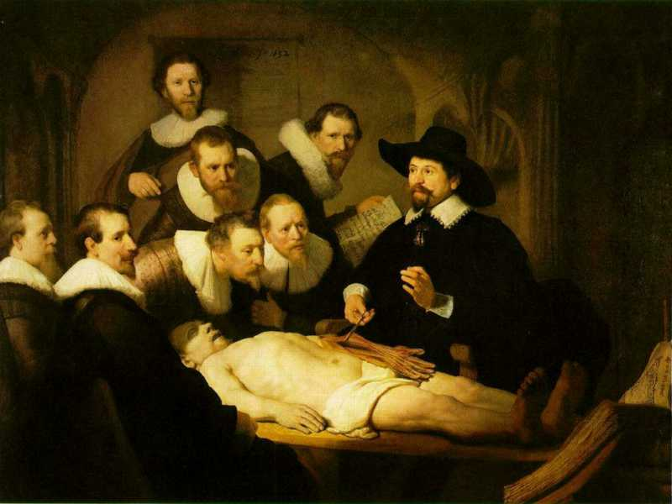
Three levels of reality in Ontological Realism
L3: accessible representations about (1), (2) or (3)
L2: beliefs, some of which are about (1), (2) or (3)
L1: entities with objective existence,
some of which (L1⁻) are not about anything

Slide 13
Ontological Realism is an improvement over the most common foundation for knowledge representation: the semantic/semiotic triangle
concept
term
referent

Slide 14
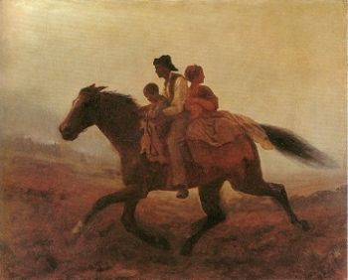
There are many problems with this approach due to its focus on concepts e.g.: Prehistoric (1884) ‘psychiatry’: drapetomania
disease which causes slaves to suffer from an unexplainable propensity to run away
…
concept
term
referent
painting by Eastman Johnson. A Ride for Liberty: The Fugitive Slaves. 1860.
‘drapetomania’

Slide 15
Ontological Realism offers three ways of relating, without assigning beliefs (concepts) a central status
drapetomania
slave
running away
mental disorder
propensity
How beliefs are / can
be related
How terms are related
How referents (in
reality) are related

Slide 16
Available ontology components
Basic Formal Ontology
→ Generic top-level ontology
Relation Ontology (part of BFO 2.0)
→ Relations between particulars
Information artifact Ontology
→ Covers L3 (with extensions also bearers of L3)
Foundational Model of Anatomy
→ Human anatomy
Ontology of General Medical Science
→ Foundations for diseases, symptoms, investigations, …
Referent Tracking
  → To relate particulars to each other and to universals

Slide 17
Example: The dimensions/axes of the
Ontology of General Medical Science (OGMS)
produces
bears
realized_in
etiological process
disorder
disease
pathological process
produces
diagnosis
interpretive process
signs & symptoms
abnormal bodily features
produces
participates_in
recognized_as
Scheuermann R, Ceusters W, Smith B. Toward an Ontological Treatment of Disease and Diagnosis. 2009 AMIA Summit on Translational Bioinformatics, San Francisco, California, March 15-17, 2009;: 116-120.
http://www.referent-tracking.com/RTU/sendfile/?file=AMIA-0075-T2009.pdf
http://code.google.com/p/ogms/
Notes:
font was too small, color inside green boxes was hardly readable

Slide 18
Main findings from OPMQoL
The pain domain could benefit dramatically from applying the principles of ontological realism as there are major issues with existing definitions, classifications, terminologies and data repositories;

Slide 19
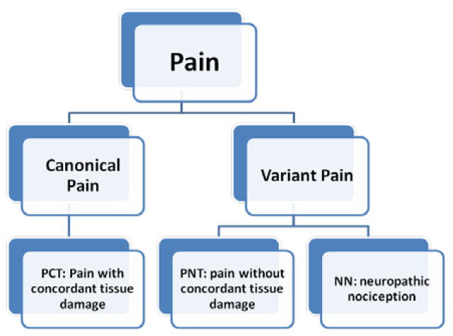
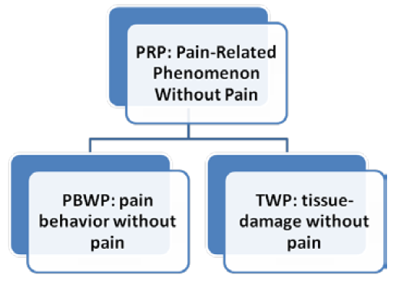
Issues with definitions e.g.: IASP definition of pain → 5 pain-related phenomena
Smith B, Ceusters W, Goldberg LJ, Ohrbach R. Towards an Ontology of Pain. In: Mitsu Okada (ed.), Proceedings of the Conference on Logic and Ontology, Tokyo: Keio University Press, February 2011:23-32.

Slide 20
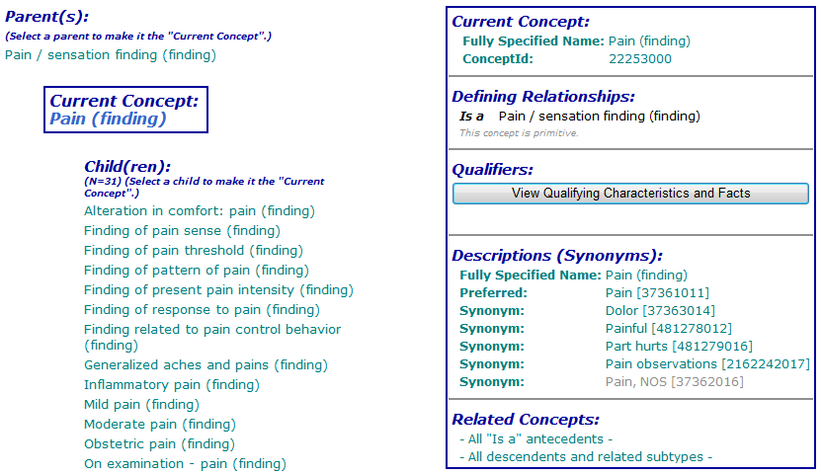
Issues with terminologies (e.g. SNOMED CT 2011©)

Slide 21
Issues in classification systems (e.g. ICHD) e.g. inconsistency between taxonomy and definitions
13.1. Trigeminal Neuralgia
  13.1.2 Painful Trigeminal Neuropathy
ICHD definitions:
  ‘neuralgia’ = pain in the distribution of nerve(s)
  ‘pain’ = a sensorial and emotional experience ...
  ‘neuropathy’ = a disturbance of function or pathological change in a nerve.
Several mismatches:
  (1) and (2): neuralgia is a sensorial and emotional experience in the distribution of nerve(s) ?
  (1) and (3): with much of goodwill, one could accept neuralgia to be a kind of neuropathy, but chapter 13 claims the opposite for the trigeminal case.
a kind of?

Slide 22
Some principles for ontology-based taxonomies
P1: Be explicit whether assertions are about particulars or types
  ‘persistent facial pain with varying presentations …’
P2: Be precise about the sort of particulars to be classified using the classification
P3: Particulars that correctly can be classified at a certain class level, and thus are instances of the corresponding type, should also be instance of all the types that correspond with higher level classes.
P4: Keep knowledge separate from what the knowledge is about.
P5: Class descriptions should be consistent with class labels.
P6: Use Aristotelian definitions.
P7: Clinical criteria do not replace Aristotelian definitions.
Are all violated in (at least) Chapter 13 of ICHD

Slide 23
Main findings from OPMQoL
The pain domain could benefit dramatically from applying the principles of ontological realism as there are major issues with existing definitions, classifications, terminologies and data repositories;
Post-hoc ontological curation of research data is extremely time-consuming and cannot resolve all issues:
  Incomplete documentation,
  Ambiguities,
  Different interpretations over sites

Slide 24
Recommendations from OPMQoL
Install a repository for data-elements,
  each such element being precisely defined,
  each such definition following the principles of ontological realism;
Have this repository operationally managed in a data center staffed by skilled ontologists tasked to
  assist clinical researchers in evaluating whether they can use existing data elements for their studies, or whether new ones need to be created,
  maintain coherence and consistency when creating new data elements,
  Link research data obtained through various studies;
Make collaboration with this center mandatory for NIH funded clinical research.

