Slide 1

Ontological investigations into medical diagnoses
Grand Round of the Department of Biomedical Informatics
August 26, 2015 – Buffalo, NY, USA
Werner CEUSTERS, MD
Department of Biomedical Informatics
and
UB Institute for Healthcare Informatics,
University at Buffalo

Slide 2
Observation / Claim
Patient data,
as currently gathered through EHRs,
communicated over RHIOs, and
collected and aggregated in data warehouses,
have minimal, if not missing at all, background information,
and
are insufficiently precise to allow the construction of a completely accurate view on what is (and has been) the case in reality.

Slide 3
Idiosyncrasies in relation to diagnoses
Diagnostic uncertainty
  Diagnosis may be recorded when there is only a suspicion of disease
  Some overlapping clinical conditions are difficult to distinguish reliably
  Patients may only partially fit diagnostic criteria
  Patients in whom diagnostic testing is done but is negative are still more likely to have disease
Diagnostic timing
  Repeated diagnosis codes over time may represent a new event or a follow-up to an earlier event
  First diagnosis in a database is not necessarily an incident case of disease
Hersh, WR, Weiner, MG, et al. (2013).
Caveats for the use of operational electronic health record data in comparative effectiveness research. Medical Care. 51(Suppl 3): S30-S37.

Slide 4
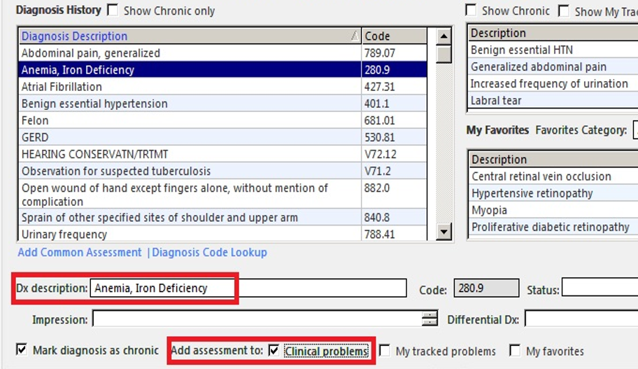

A user interface for the Problem List
http://incerio.com/planning-nextgen-version-5-8-upgrade-things-know-diagnosis-module/

Slide 5
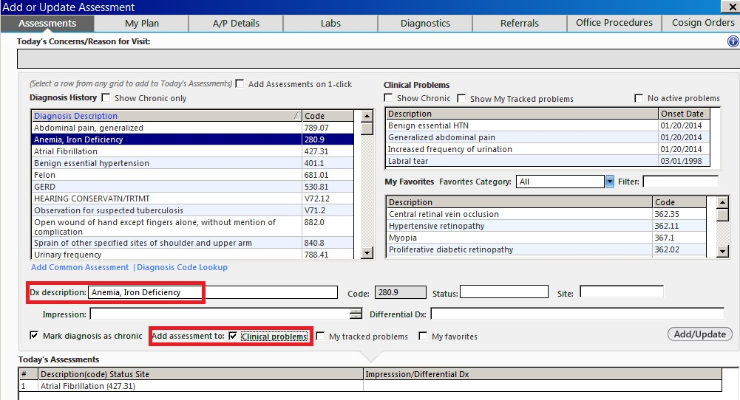
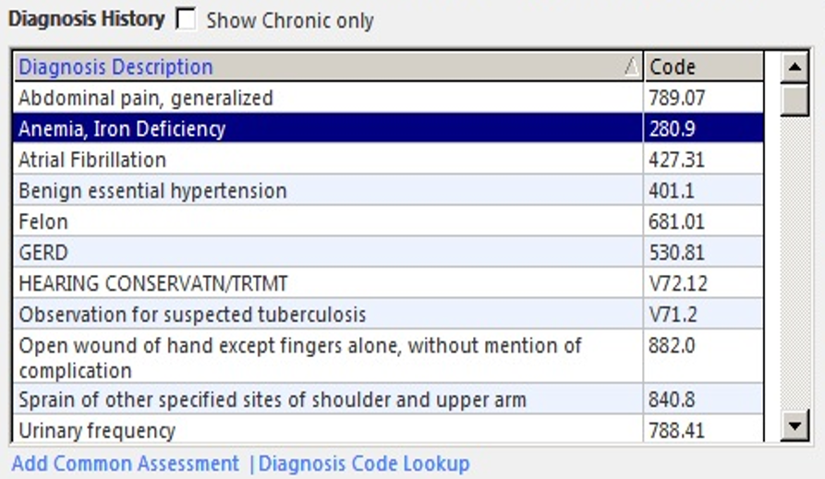
Is this patient really so sick ?
http://incerio.com/planning-nextgen-version-5-8-upgrade-things-know-diagnosis-module/

Slide 6
What are the referents ?
Are there really ‘chronic diagnoses’, or is it diseases that are chronic ?
http://incerio.com/planning-nextgen-version-5-8-upgrade-things-know-diagnosis-module/

Slide 7
What are the referents ?
Whose problems and favorites are intended here: the patient’s or the clinician’s?
http://incerio.com/planning-nextgen-version-5-8-upgrade-things-know-diagnosis-module/

Slide 8
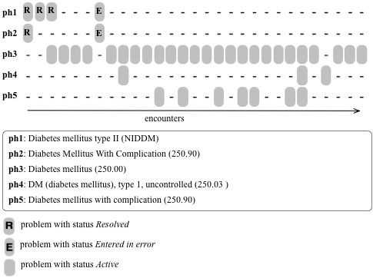
Diabetes and its diagnosis
, retrospectively annotated at month 7 while asserting E
Bona J, Ceusters W. Replacing EHR structured data with explicit representations. International Conference on Biomedical Ontologies, ICBO 2015, Early career track, Lisbon, Portugal, July 27-30, 2015.

Slide 9
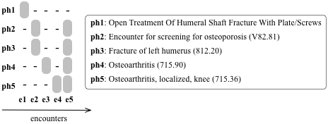
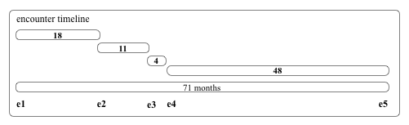
A fracture mystery

Slide 10
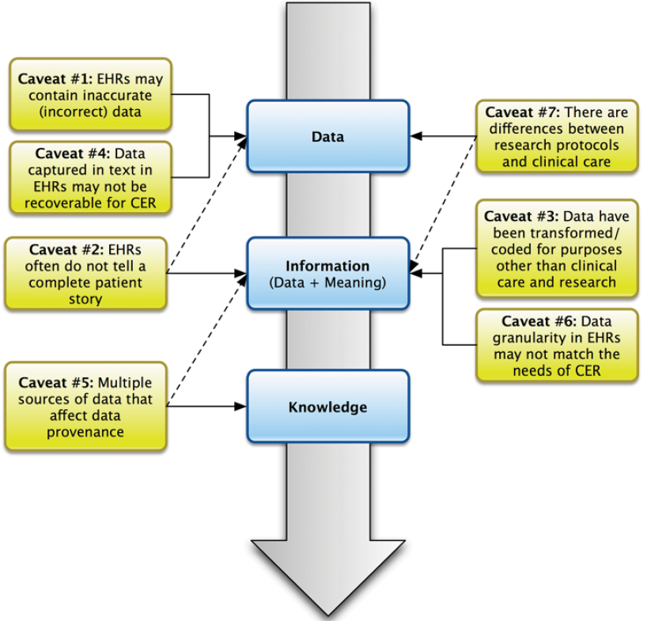
Caveats from a traditional informatics perspective
Hersh, WR, Weiner, MG, et al. (2013). Caveats for the use of operational electronic health record data in comparative effectiveness research. Medical Care. 51(Suppl 3): S30-S37.

Slide 11
Hersh et al.’s proposed solutions
Improve the quality of data through attention to standards, appropriate health information exchange, and usability of systems that will lead to improved data capture.
Development of a clinical research workforce trained to understand nuances of clinical data and its analytical techniques, and development of guidelines and practices for optimal data entry, structure and extraction should be part of a national research agenda to identify and implement optimal approaches in the use of EHR data for CER.
Hersh, WR, Weiner, MG, et al. (2013).
Caveats for the use of operational electronic health record data in comparative effectiveness research. Medical Care. 51(Suppl 3): S30-S37.

Slide 12

What the traditional informatics perspective ignores
12

Slide 13
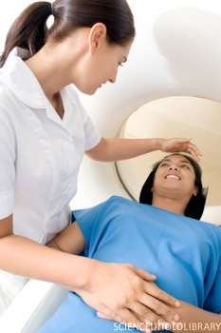
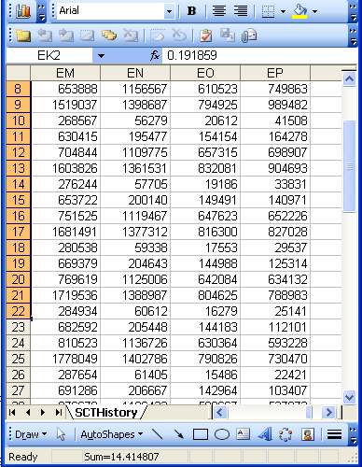
A crucial distinction:
Reality and Data
Referents
References

Slide 14
A non-trivial relation
Referents
References

Slide 15

What makes it non-trivial?
Referents
  are (meta-) physically the way they are,
  relate to each other in an objective way,
  follow laws of nature.
Window on reality
  restricted by:
  what is physically and technically observable,
  fit between what is measured and what we think is measured,
  fit between established knowledge and laws of nature.
References
  follow, ideally, the syntactic-semantic conventions of some representation language,
  are restricted by the expressivity of that language,
  to be interpreted correctly, reference collections need external documentation.

Slide 16
For instance: meaning and impact of changes
Are differences in data about the same entities in reality at different points in time due to:
  changes in first-order reality ?
  changes in our understanding of reality ?
  inaccurate observations ?
  registration mistakes ?
Ceusters W, Smith B. A Realism-Based Approach to the Evolution of Biomedical Ontologies. AMIA 2006 Proceedings, Washington DC, 2006;:121-125. http://www.referent-tracking.com/RTU/sendfile/?file=CeustersAMIA2006FINAL.pdf

Slide 17

A crucial distinction: data and what they are about
data
organization
First-
Order
Reality
is about
model development
observation &
measurement
Representation
further R&D
(instrument and
study optimization)
add
verify
use
Δ = outcome
Generic
beliefs
application

Slide 18
What is out there in reality
(… we want/need to deal with)?
portions of reality
relations
configurations
?
participation
me participating in my life
universals
particulars
continuants
occurrents
me
my life
organism
?

Slide 19
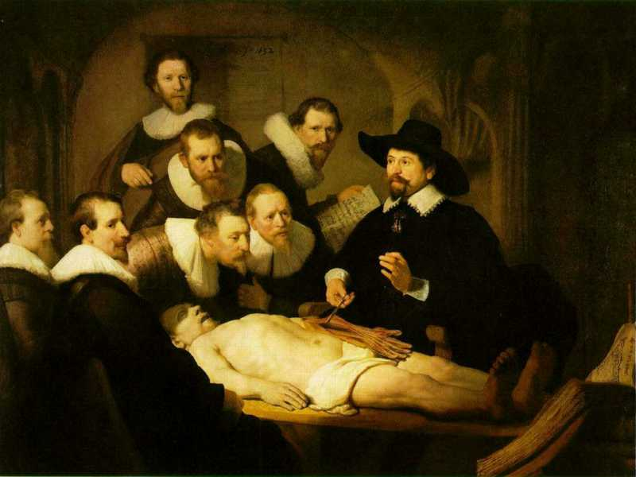
Important distinctions amongst particulars from an IT perspective
L3
Linguistic representations
L2
Beliefs
Representations
L1⁻
Particulars which are not about anything
First Order Reality

Slide 20
Generic versus specific entities
Generic
Generic (universals)
Specific
Specific (particulars)
L3. Linguistic representation
pain classification
EHR
ICHD
my EHR
L2. Beliefs (knowledge)
DIAGNOSIS
my doctor’s
work plan
my doctor’s
diagnosis
INDICATION
L1.
First-order reality
PATHOLOGICAL
STRUCTURE
my doctor
my doctor’s computer
PERSON
me
DRUG
DISEASE
my migraine
MIGRAINE
HEADACHE
my headache
MOLECULE
Basic Formal Ontology
Referent Tracking

Slide 21
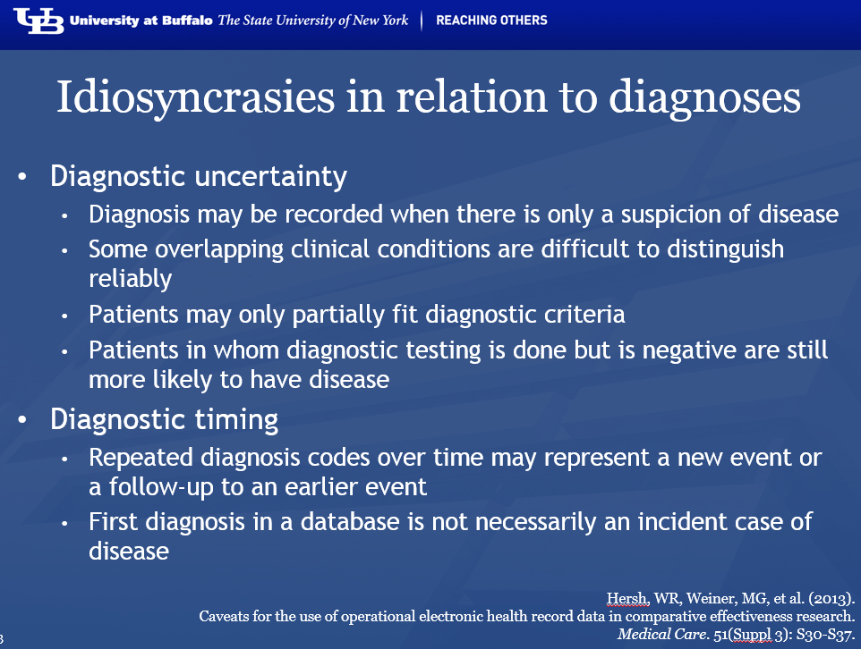
Remember
Most of them are due to failures in acknowledging the L1-L2-L3/generic-specific distinctions !!!

Slide 22
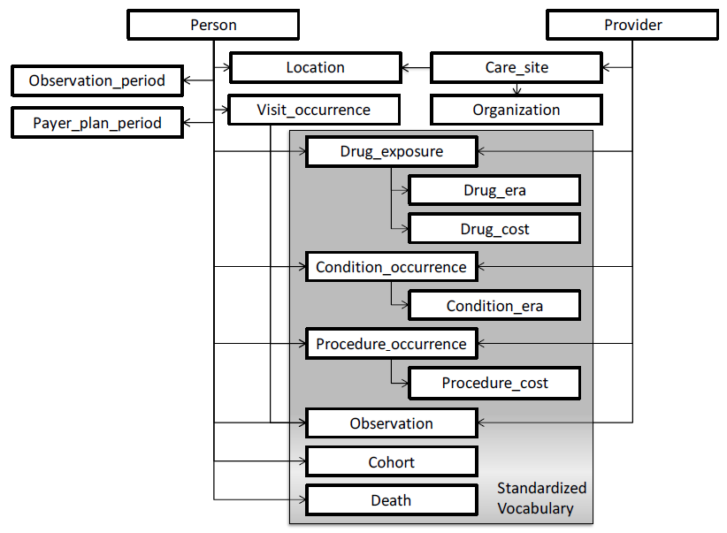
This is not just in EHRs, but also in ‘standards’ for information exchange and data aggregation, eg. OMOP
Condition Occurrence: A diagnosis or condition that has been recorded about a person at a certain time:
→ confuses two types: the diagnosis, and the condition about which a diagnosis is made.
Observational Medical Outcomes Partnership Common Data Model Specifications Version 4.0

Slide 23
This is not just in EHRs, but also in ‘standards’ for information exchange and data aggregation, eg. OMOP
Drug Exposure: Association between a Person and a Drug at a specific time
→ confuses two particulars: the drug and the exposure
Observational Medical Outcomes Partnership Common Data Model Specifications Version 4.0

Slide 24
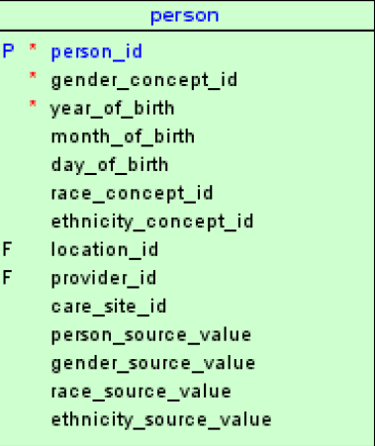
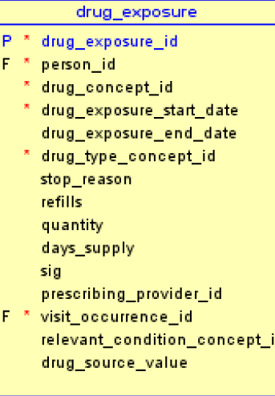
OMOP’s tables: an ontologist’s nightmare
Observational Medical Outcomes Partnership Common Data Model Specifications Version 4.0

Slide 25
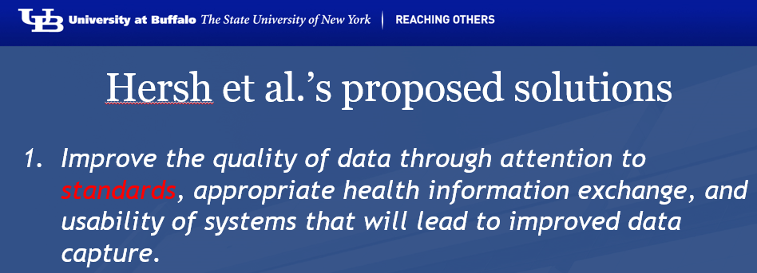
Generic versus specific entities
Generic
Generic (universals)
Specific
Specific (particulars)
L3. Linguistic representation
pain classification
EHR
ICHD
my EHR
L2. Beliefs (knowledge)
DIAGNOSIS
my doctor’s
work plan
my doctor’s
diagnosis
INDICATION
L1.
First-order reality
PATHOLOGICAL
STRUCTURE
my doctor
my doctor’s computer
PERSON
me
DRUG
DISEASE
my migraine
MIGRAINE
HEADACHE
my headache
MOLECULE
Basic Formal Ontology
Referent Tracking

Slide 26
Potentially useful ontologies
BFO compatible:
  the Ontology of General Medical Science (OGMS)
  the Foundational Model of Anatomy (FMA)
  the Ontology of Biomedical Investigations (OBI)
  the Information Artifact Ontology (IAO)
BFO inspired:
  the Ontology of Medically Related Social Entities (OMRSE)
BFO wannabe:
  the Disease Ontology (DO)

Slide 27
Key OGMS definitions
DISORDER | A causally relatively isolated combination of physical components that is (a) clinically abnormal and (b) maximal, in the sense that it is not a part of some larger such combination.
DISEASE | A DISPOSITION (i) to undergo PATHOLOGICAL PROCESSes that (ii) exists in an ORGANISM because of one or more DISORDERs in that ORGANISM.
DISEASE COURSE | The totality of all PROCESSes through which a given DISEASE instance is realized.
DIAGNOSIS | A conclusion of an interpretive PROCESS that has as input a CLINICAL PICTURE of a given patient and as output an assertion (diagnostic statement) to the effect that the patient has a DISEASE of such and such a type.
Scheuermann R, Ceusters W, Smith B. Toward an Ontological Treatment of Disease and Diagnosis. 2009 AMIA Summit on Translational Bioinformatics, San Francisco, California, March 15-17, 2009;: 116-120. Omnipress ISBN:0-9647743-7-2

Slide 28
Disorder related configurations
No disorder instance → no disease instance,
→ no pathological processes;
A disorder instance can eliminate the range of circumstances under which another disorder instance can lead to pathological processes → no disease instance;
Disorders of the same type in distinct patients, or in the same patient at distinct times, may lead to diseases of distinct types;
Diseases of the same type may lead to disease courses of distinct types;
Diseases of distinct types may lead to disease courses of the same type;
…

Slide 29
What are diagnoses in EHRs possibly about?
DISORDER | A causally relatively isolated combination of physical components that is (a) clinically abnormal and (b) maximal, in the sense that it is not a part of some larger such combination.
DISEASE | A DISPOSITION (i) to undergo PATHOLOGICAL PROCESSes that (ii) exists in an ORGANISM because of one or more DISORDERs in that ORGANISM.
DISEASE COURSE | The totality of all PROCESSes through which a given DISEASE instance is realized.
DIAGNOSIS | A conclusion of an interpretive PROCESS that has as input a CLINICAL PICTURE of a given patient and as output an assertion (diagnostic statement) to the effect that the patient has a DISEASE of such and such a type.
Scheuermann R, Ceusters W, Smith B. Toward an Ontological Treatment of Disease and Diagnosis. 2009 AMIA Summit on Translational Bioinformatics, San Francisco, California, March 15-17, 2009;: 116-120. Omnipress ISBN:0-9647743-7-2

Slide 30
What are diagnoses in EHRs possibly about?
DISORDER | A causally relatively isolated combination of physical components that is (a) clinically abnormal and (b) maximal, in the sense that it is not a part of some larger such combination.
DISEASE | A DISPOSITION (i) to undergo PATHOLOGICAL PROCESSes that (ii) exists in an ORGANISM because of one or more DISORDERs in that ORGANISM.
DISEASE COURSE | The totality of all PROCESSes through which a given DISEASE instance is realized.
DIAGNOSIS | A conclusion of an interpretive PROCESS that has as input a CLINICAL PICTURE of a given patient and as output an assertion (diagnostic statement) to the effect that the patient has a DISEASE of such and such a type.
749.01 - Cleft palate, unilateral, complete

Slide 31
What are diagnoses in EHRs possibly about?
DISORDER | A causally relatively isolated combination of physical components that is (a) clinically abnormal and (b) maximal, in the sense that it is not a part of some larger such combination.
DISEASE | A DISPOSITION (i) to undergo PATHOLOGICAL PROCESSes that (ii) exists in an ORGANISM because of one or more DISORDERs in that ORGANISM.
DISEASE COURSE | The totality of all PROCESSes through which a given DISEASE instance is realized.
DIAGNOSIS | A conclusion of an interpretive PROCESS that has as input a CLINICAL PICTURE of a given patient and as output an assertion (diagnostic statement) to the effect that the patient has a DISEASE of such and such a type.
256.0 - Hyperestrogenism

Slide 32
What are diagnoses in EHRs possibly about?
DISORDER | A causally relatively isolated combination of physical components that is (a) clinically abnormal and (b) maximal, in the sense that it is not a part of some larger such combination.
DISEASE | A DISPOSITION (i) to undergo PATHOLOGICAL PROCESSes that (ii) exists in an ORGANISM because of one or more DISORDERs in that ORGANISM.
DISEASE COURSE | The totality of all PROCESSes through which a given DISEASE instance is realized.
DIAGNOSIS | A conclusion of an interpretive PROCESS that has as input a CLINICAL PICTURE of a given patient and as output an assertion (diagnostic statement) to the effect that the patient has a DISEASE of such and such a type.
250.23 Diabetes with hyperosmolarity, type I, uncontrolled

Slide 33
What are diagnoses in EHRs possibly about?
DISORDER | A causally relatively isolated combination of physical components that is (a) clinically abnormal and (b) maximal, in the sense that it is not a part of some larger such combination.
DISEASE | A DISPOSITION (i) to undergo PATHOLOGICAL PROCESSes that (ii) exists in an ORGANISM because of one or more DISORDERs in that ORGANISM.
DISEASE COURSE | The totality of all PROCESSes through which a given DISEASE instance is realized.
DIAGNOSIS | A conclusion of an interpretive PROCESS that has as input a CLINICAL PICTURE of a given patient and as output an assertion (diagnostic statement) to the effect that the patient has a DISEASE of such and such a type.
781.2 Abnormality of gait

Slide 34
What are diagnoses in EHRs possibly about?
DISORDER | A causally relatively isolated combination of physical components that is (a) clinically abnormal and (b) maximal, in the sense that it is not a part of some larger such combination.
DISEASE | A DISPOSITION (i) to undergo PATHOLOGICAL PROCESSes that (ii) exists in an ORGANISM because of one or more DISORDERs in that ORGANISM.
DISEASE COURSE | The totality of all PROCESSes through which a given DISEASE instance is realized.
DIAGNOSIS | A conclusion of an interpretive PROCESS that has as input a CLINICAL PICTURE of a given patient and as output an assertion (diagnostic statement) to the effect that the patient has a DISEASE of such and such a type.
V65.5 - Person with feared complaint in whom no diagnosis was made

Slide 35
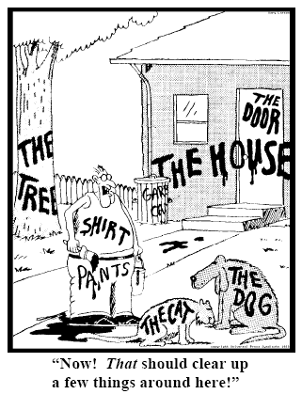
How to use ontologies appropriately in IT systems
Referent Tracking
  explicit reference to the individual entities relevant to the accurate description of some portion of reality, ...
Ceusters W, Smith B. Strategies for Referent Tracking in Electronic Health Records. J Biomed Inform. 2006 Jun;39(3):362-78.

Slide 36
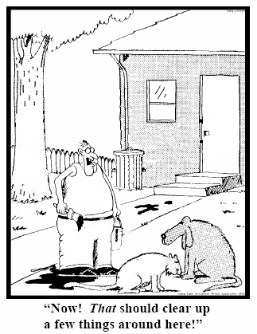
A solution proposed 10 years ago
Referent Tracking
  explicit reference to the individual entities relevant to the accurate description of some portion of reality, …
  by means of an Instance Unique Identifier (IUI) for each such particular (individual) entity.
78
235
5678
321
322
666
427
Ceusters W, Smith B. Strategies for Referent Tracking in Electronic Health Records. J Biomed Inform. 2006 Jun;39(3):362-78.

Slide 37
Referent Tracking Tuples (RTTs)
From:
  “ this patient has ICD-9 diagnosis ‘279.4 – Gout, unspecified’ ”
To (very roughly, simplified and in abstract syntax):
  ‘this-1 is about this-2 which is realized in this-3’, where
    this-1 instanceOf diagnosis …
    this-1 isAbout this-2 …
    this-2 instanceOf disease …
    this-2 realizedIn this-3 …
    this-3 instanceOf human being …
    …

Slide 38
Referent Tracking Tuples (RTTs)
From:
  “ this patient has ICD-9 diagnosis ‘279.4 – Gout, unspecified’ ”
To (very roughly, simplified and in abstract syntax):
  ‘this-1 is about this-2 which is realized in this-3’, where
    this-1 instanceOf diagnosis …
    this-1 isAbout this-2 …
    this-2 instanceOf disease …
    this-2 realizedIn this-3 …
    this-3 instanceOf human being …
    …
denotators for particulars

Slide 39
Referent Tracking Tuples (RTTs)
From:
  “ this patient has ICD-9 diagnosis ‘279.4 – Gout, unspecified’ ”
To (very roughly, simplified and in abstract syntax):
  ‘this-1 is about this-2 which is realized in this-3’, where
    this-1 instanceOf diagnosis …
    this-1 isAbout this-2 …
    this-2 instanceOf disease …
    this-2 realizedIn this-3 …
    this-3 instanceOf human being …
    …
denotators for appropriate relations

Slide 40
Referent Tracking Tuples (RTTs)
From:
  “ this patient has ICD-9 diagnosis ‘279.4 – Gout, unspecified’ ”
To (very roughly, simplified and in abstract syntax):
  ‘this-1 is about this-2 which is realized in this-3’, where
    this-1 instanceOf diagnosis …
    this-1 isAbout this-2 …
    this-2 instanceOf disease …
    this-2 realizedIn this-3 …
    this-3 instanceOf human being …
    …
denotators for universals or particulars

Slide 41
Referent Tracking Tuples (RTTs)
From:
  “ this patient has ICD-9 diagnosis ‘279.4 – Gout, unspecified’ ”
To (very roughly, simplified and in abstract syntax):
  ‘this-1 is about this-2 which is realized in this-3’, where
    this-1 instanceOf diagnosis …
    this-1 isAbout this-2 …
    this-2 instanceOf disease …
    this-2 realizedIn this-3 …
    this-3 instanceOf human being …
    …
time stamp at least one continuant is referenced

Slide 42
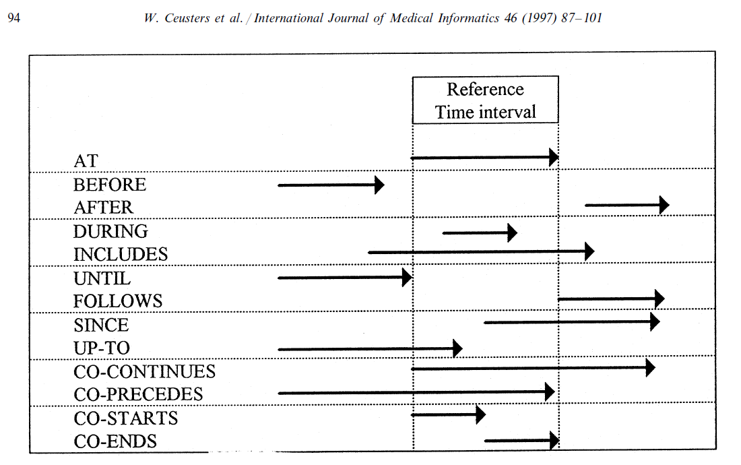
Representation of relation with time intervals

Slide 43
Meta RT tuples (D-template)
RT assertions are assigned IUIs of their own which in the D-template is symbolized by IUIt_{i}.
D_{i} = <IUId, IUIt_{i}, t, E, C, S>.
  IUId: the IUI of the entity annotating IUIt_{i} by means of the D_{i} entry,
  E: either the symbol ‘I’ (for insertion) or any of the error type symbols,
  C: a symbol for the applicable reason for change
  t: the time the tuple denoted by IUIt_{i} is inserted or ‘retired’,
  S: a list of IUIs denoting the tuples, if any, that replace the retired one.

Slide 44
Research question
To what extent is it possible for 2 ontologists to develop independently from one another a collection of RTTs that describe the same portion of reality (POR) in relation to a diagnosis in a semantically-interoperable way.
Ceusters W, Hogan W. An ontological analysis of diagnostic assertions in electronic healthcare records. International Conference on Biomedical Ontologies, ICBO 2015, Lisbon, Portugal, July 27-30, 2015.

Slide 45
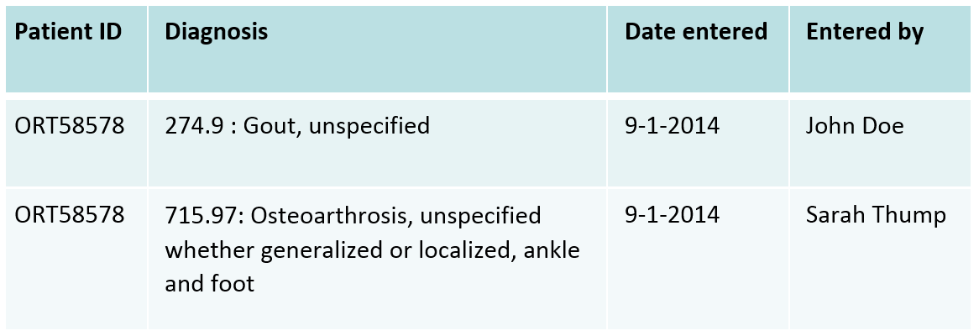
An intellectual experiment
Context:
  An EHR with a problem list shows in a spreadsheet for a specific patient two diagnostic entries entered at the same date, but by distinct providers:
    It is assumed that the patient with ID ORT58578 has only one disorder.
Task: - List the different kinds of Referent Tracking statements that would represent this situation.
  - Consider what must and can be the case for the table to make sense.
Players: Ceusters and Hogan, two experts in Referent Tracking
    (hereafter referenced as X and Y, not to be assumed in a specific order)

Slide 46
Methodology
No instructions on ontologies to use, or format of RTTs.
Results exchanged after each author finished work.
Analysis:
  identification of the particulars that both authors referred to in their assertions.
  re-assign IUIs to particulars referred to by both authors as if the collection of RTTs was merged into one single RT system, thereby still keeping track of which RTT was asserted by which author.
  analyze and discuss differences in representations, however without paying attention to the temporal indexing required for RTTs describing a POR in which a continuant is involved.

Slide 47
Quantitative Results
 | X | Y | X+Y
# particulars referenced (TR excluded) | 21 | 28 | 39
# instantiations | 23 | 28 | 49/47/41
# instantiated classes | 12 | 11 | 20
# realism-based ontologies drawn from | 5 | 4 | 7
# classes without ontological home | 3 | 4 | 7
# particular-to-particular (PtoP) relations | 26 | 35 | 55
# RTTs judged not at all appropriate | 4 | 0 | 0
of which PtoP / P-inst | 4 / 0 | 0 / 0 | 0 / 0
# RTTs judged arguably appropriate | 22 | 20 | 16
of which PtoP / P-inst | 7 / 15 | 11 / 9 | 7 / 9
# RTTs judged for sure appropriate | 83 | 89 | 83
of which PtoP / P-inst | 48 / 35 | 48 / 41 | 48 / 35

Slide 48
Appropriateness
measured in terms of what an optimal collection of RTTs for the POR under scrutiny would be;
POR under scrutiny:
  Assertional part: what is in the EHR
  Non-assertional part: what is on the side of the patient
Optimal collection:
  satisfies the following criteria:
    (1) it consists of RTTs which describe the non-assertional part of the POR only to the extent to which there is enough evidence for what those RTTs themselves assert to be true (e.g. there is sufficient evidence that the patients are human beings, there is not sufficient evidence that the diagnoses are correct), and
    (2) it consists of other RTTs which describe the assertional part in relation to the RTTs referenced under (1).

Slide 49
Very high inter-rater agreement
Obs |  | Y
 |  | 0 | 1 | 2
X | 0 | 0 | 4 | 0 | 4
 | 1 | 0 | 16 | 6 | 22
 | 2 | 0 | 0 | 83 | 83
 |  | 0 | 20 | 89 | 109
agreement |  | 0 | 16 | 83 | 99
by chance |  | 0 | 0.73 | 3.27 | 4
Cohen's kappa |  |  |  |  | 0.904762
http://www.real-statistics.com/reliability/cohens-kappa/

Slide 50
Main reasons for disagreement
Absence of uniform conventions on which ontologies and relations to use,
Problems in the ontological theories,
Issues with implementation of ontologies,
  both authors resorted to OGMS for a large part of their RTTs,
  Yet, differences in representation were observed because of the source material consulted:
    X used the OGMS OWL artifact as basis, whereas Y used the definitions and descriptions in the paper that led to the development of OGMS (Scheuermann et al., 2009).
Lack of appropriate documentation.

Slide 51
Ontologies and orphan classes referenced
Ontologies X Y
  Ontology of General Medical Science (OGMS) x x
  Ontology of Medically Related Social Entities (OMRSE) x
  the Foundational Model of Anatomy (FMA) x x
  the Disease Ontology (DO) x
  Ontology of Biomedical Investigations (OBI) x
  Basic Formal Ontology (BFO) x
  Information Artifact Ontology (IAO) x
Orphan classes
  ‘denotator’ x
  ‘EHR’ x
  ‘dataset record’ x
  ‘patient identifier’ x
  ‘ICD-9-CM code and label’ x

Slide 52
Material entity / human being
Ind | IUI | Description | Ontology Class |  | Y | X
T1 | P1 | the patient | OBI | Homo sapiens | 1 | 2
T2 | P2 | the doctor who made diagnosis #1 | OBI | Homo sapiens | 1 | 2
T3 | P3 | the doctor who made diagnosis #2 | OBI | Homo sapiens | 1 | 2
T15 | P13 | the patient's patient role | OMRSE | Patient role | 2 | 2
Ind | IUI | Description | Ontology Class |  | Y | X
T27 | P1 | the material entity whose ID is ‘1234’ in the spreadsheet | BFO | Material entity | 1 | 1
T2 | P2 | the person whose name is ‘J. Doe’ in the spreadsheet | FMA | Human being | 1 | 1
T3 | P3 | the person whose name is ‘S. Thump’ in the spreadsheet | FMA | Human being | 1 | 1
X represented P1 as a human with a patient role.
Y represented P1 as a material entity (P1 has been a material entity all the time through its existence, but not a human (e.g., it was a zygote at a time prior to being human)) without assigning a patient role.
This difference in representation is related to the temporal indexing that RT requires for continuants.
Given the two authors’ temporal indexing, both agree that each other’s views re material entity/human being (cave next slide) were correct.

Slide 53
Human being / Homo sapiens
Ind | IUI | Description | Ontology Class |  | Y | X
T1 | P1 | the patient | OBI | Homo sapiens | 1 | 2
T2 | P2 | the doctor who made diagnosis #1 | OBI | Homo sapiens | 1 | 2
T3 | P3 | the doctor who made diagnosis #2 | OBI | Homo sapiens | 1 | 2
T15 | P13 | the patient's patient role | OMRSE | Patient role | 2 | 2
Ind | IUI | Description | Ontology Class |  | Y | X
T27 | P1 | the material entity whose ID is ‘1234’ in the spreadsheet | BFO | Material entity | 1 | 1
T2 | P2 | the person whose name is ‘J. Doe’ in the spreadsheet | FMA | Human being | 1 | 1
T3 | P3 | the person whose name is ‘S. Thump’ in the spreadsheet | FMA | Human being | 1 | 1
Disagreement about how to interpret the representational units for the universal Human being from the selected ontologies:
  Is ‘human being’ synonym for the FMA’s ‘human body’ class ?
  Does OBI’s ‘Homo sapiens’ because of its linking to other ontologies in Ontobee confuse ‘Homo sapiens’ as an instance of ‘species’ with those instances of organism that belong to – but are not instances of – the species ‘Homo sapiens’?
    ‘Homo sapiens’ and similar classes in OBI all descend from a class called ‘organism’.
    The ‘Homo sapiens’ class in OBI has synonyms ‘Human being’ and ‘human’.
The problem here is the lack of face value of terms selected as class names in the respective ontologies.

Slide 54
Disorders, diseases, diagnoses and DO
Agreement on the existence of a disorder, a disease, two diagnoses and two distinct processes that generated each.
Agreement that none of these entities should be confused or conflated: nothing at the same time can be an instance of two or more of the following: disease, disorder, diagnosis, and diagnostic process.
Disagreement on the appropriateness of DO.
  Agreement that DO confuses not only disorders and disease, but also disease courses.
    E.g.: ‘physical disorder’ is a subtype of ‘disease’, in direct contradiction to OGMS.
  Goodwill argument: DO at least purports to strive for compliance with realist principles. If perfection were a requirement to use an ontology, we could make no progress. Nevertheless, the persistent, glaring flaws of DO from the perspective of OGMS give serious pause on using it accurately and precisely.

Slide 55
What part of the EHR constitutes a diagnosis?
Agreement that such part is built out of continuants that are concretizations of instances of ICE reflecting a diagnosis.
Disagreement on the extent of the part that denotes the diagnosis:
  the mere concretization of the ICD-code and label?
  the above, plus the concretization of the patient identifier?
Root cause of disagreement: distinct interpretations of the literature on
  the nitty-gritty of how to deal with ICE and concretizations thereof,
  how instances of ICE relate to other instances of ICE,
  what exactly the relata are of relationships such as aboutness and denotation.
Examples:
  Can ICE be parts of other ICE or does parthood only apply to the independent continuants in which inhere the qualities that concretize the corresponding ICE?
  Is it the qualities concretizing the ICE that are about something or the ICE itself?
      See Smith & Ceusters, ICBO 2015

Slide 56
Are diagnoses to be assumed correct? (1)
X interpreted both
    (1) the RT tuple that instantiated the disease as gout (by Doe) and
    (2) the RT tuple that instantiated it as osteoarthritis (by Thump)
  as being faithful representations of what Thump and Doe believed at the time they formulated their diagnoses.
X did not believe himself to be recognizing both diagnoses as straightforwardly accurate and therefore resorted in his representation to a mechanism offered in RT to craft RTTs about RTTs that are later found to have been based on a misunderstanding of the reality at the time they were crafted.

Slide 57
Are diagnoses to be assumed correct? (2)
Y crafted a representation that does not commit to what specific disease type(s) the patient’s disease actually is an instance of.
This was achieved by representing the diagnoses to be simultaneously about the patient on the one hand (in contrast to X who represents the diagnoses to be about the disorder/ disease itself), and about the disease universals – gout and osteoarthrosis resp. – denoted by the respective ICD-codes and labels on the other hand.
This aboutness-relation between an instance of ICE and a universal can be represented in RT but of course cannot be represented in OWL without recourse to workarounds such as those discussed by Schulz et al (2014).

Slide 58
Conclusions (1)
The two authors agreed on the existence of key entities for the diagnoses to make sense.
They agreed in general about the types instantiated by the particulars in the scenario, and how the particulars are related to each other.
They chose different representational units and relations from different ontologies due to various issues such as
  potential lack of orthogonality in the OBO Foundry and
  in some cases disagreement on what types the classes in the ontologies represent.
These distinctions exist, not because the authors entertained distinct competing conceptualizations, but because they expressed matters differently.
Disagreements primarily due to different interpretations of the literature on ICEs.

Slide 59
Conclusions (2)
Although this study is limited by the participation of only 2 subjects and the analysis of one report, it highlights the fact that the RT method and the clarity and precision it requires in representing reality is a powerful tool in identifying areas of needed improvement in existing, realism-based ontologies.

