Slide 1
Biomedical Informatics I The discipline of Biomedical Informatics Lecture in BMS515: Fundamentals of Biomedical Research. Nov 29, 2021
Werner CEUSTERS, MD
Departments of Biomedical Informatics and Psychiatry,
UB Institute for Healthcare Informatics,
Ontology Research Group, Center of Excellence in Bioinformatics and Life Sciences,
University at Buffalo, NY, USA

Slide 2
Last year’s BMS515’s BMI course evaluations
Student 1: ‘Dr. Ceusters' lectures were all over the place and I wasn't sure how biomedical informatics fits into biomedical research. To me it seemed that the lectures were more geared towards medical students, which has no relevance to me. On the other hand, the topic was interesting, just hard to follow’.
Student 2: ‘After leaving this class I still feel unsure on what the field of biomedical informatics entails’.
Student 3: ‘The material itself was challenging because biomedical informatics is a complicated but the professor made it a tiny bit less complicated to understand’.

Slide 3
Last year’s BMS515’s BMI course evaluations
Student 1: ‘Dr. Ceusters' lectures were all over the place and I wasn't sure how biomedical informatics fits into biomedical research. To me it seemed that the lectures were more geared towards medical students, which has no relevance to me. On the other hand, the topic was interesting, just hard to follow’.
Student 2: ‘After leaving this class I still feel unsure on what the field of biomedical informatics entails’.
Student 3: ‘The material itself was challenging because biomedical informatics is a complicated but the professor made it a tiny bit less complicated to understand’.

Slide 4
Last year’s BMS515’s BMI course evaluations
Student 1: ‘Dr. Ceusters' lectures were all over the place and I wasn't sure how biomedical informatics fits into biomedical research. To me it seemed that the lectures were more geared towards medical students, which has no relevance to me. On the other hand, the topic was interesting, just hard to follow’.
Student 2: ‘After leaving this class I still feel unsure on what the field of biomedical informatics entails’.
Student 3: ‘The material itself was challenging because biomedical informatics is a complicated but the professor made it a tiny bit less complicated to understand’.

Slide 5
Why be bothered with biomedical informatics?

Slide 6
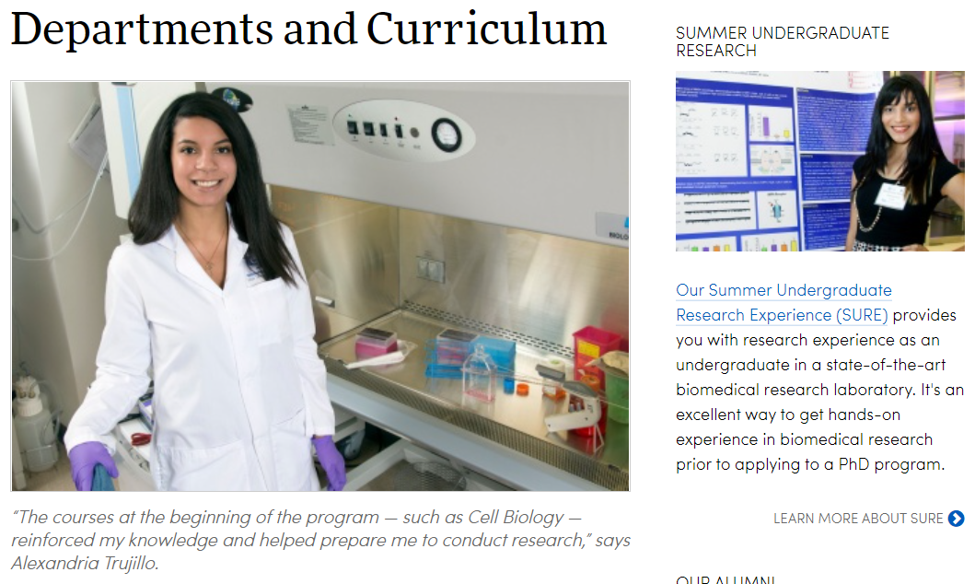
We offer a comprehensive education emphasizing research, collaboration and scientific discovery.

Slide 7
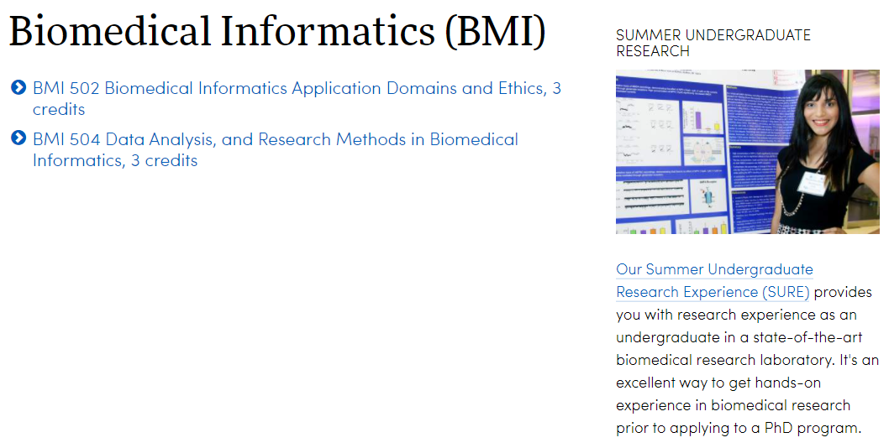
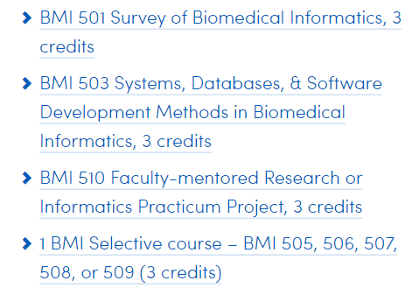
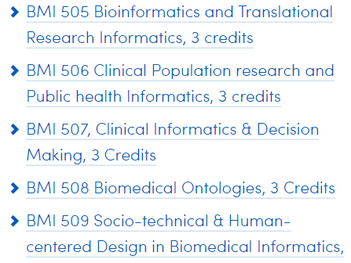
PPBS electives

Slide 9
This course provides an introduction to research design and methods and aims to enhance the students’ skills in quantitative and qualitative research. The course surveys the formulation of research questions, the development of testable hypotheses, the selection and application of appropriate research designs and methods, data collection and analysis methods. These skills can be applied in subsequent courses and research projects.

Slide 10
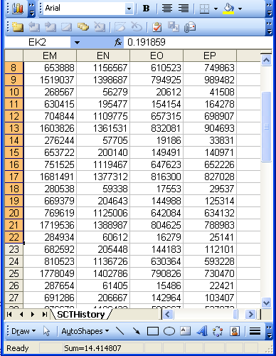
‘Discovery’ (naïve version)
beliefs
observing
phenomena
interpreting
data
information
accepting

Slide 11
By ArchonMagnus - Own work, CC BY-SA 4.0, https://commons.wikimedia.org/w/index.php?curid=42164616

Slide 12
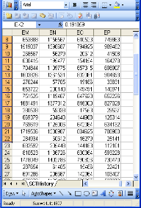
Scientific discovery
data
interpreting
phenomena
information
observing
questioning
phenomena
comparing
hypothesis
designing

Slide 13
Scientific discovery
data
interpreting
phenomena
information
observing
questioning
phenomena
comparing
hypothesis
designing

Slide 14
Scientific discovery
data
interpreting
phenomena
information
observing
concluding
phenomena
comparing
knowledge

Slide 15
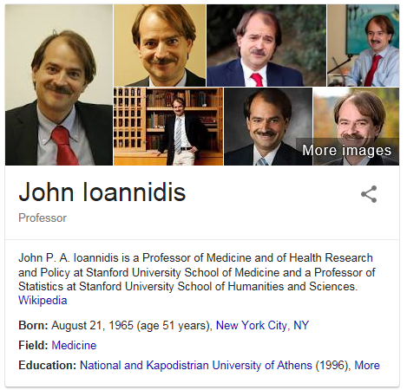
However, despite the scientific method …
John P. A. Ioannidis.
Why Most Published Research Findings Are False.
PLOS Medicine 2005;2(8):e124
http://robotics.cs.tamu.edu/RSS2015NegativeResults/pmed.0020124.pdf

Slide 17
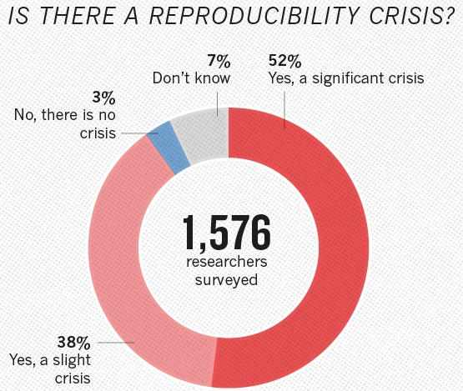
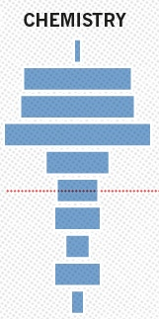
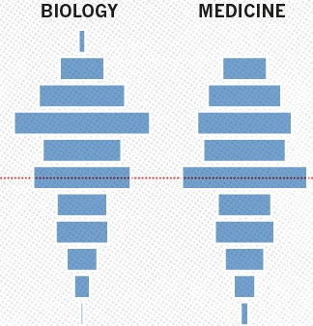

Slide 18
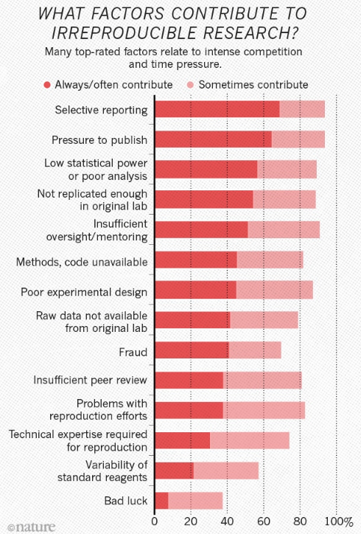
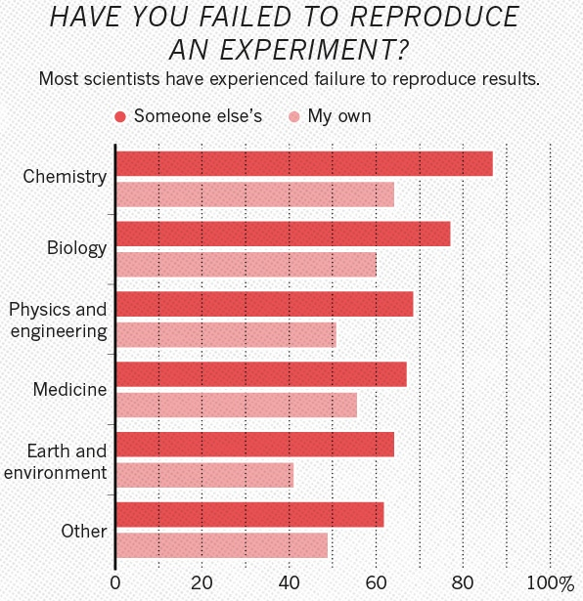

Slide 19
Shortcomings in biomedical research education
The scientific method:
Focused on obtaining knowledge through controlled experiments;
Goal of control is eliminating bias and confounding;
Control is mainly guided by statistics;
Reproducibility is expected to come from adequate reporting of all activities performed and parameters used.
What is missing in education of the scientific method:
That science can’t help you in deciding which of two distinct scientific theories that reliably predict the same outcomes is correct.
The detailed ontological nature of what the variables and their values might denote.
→ (biomedical) ontology

Slide 20
Hence … this week in context
Monday:
Biomedical informatics: research domains and applications.
Wednesday:
Principles of biomedical ontology relevant for biomedical research.
Friday:
How to structure data files in line with these principles.

Slide 21
Today’s learning outcomes (BMI I)
Being able to explain what biomedical informatics is, what is part of it, and what parts of it aim to contribute to the advance of biomedical science and research and the application thereof in healthcare.

Slide 22
Biomedical Informatics
Definition:
Biomedical informatics (BMI) is
the interdisciplinary field
that studies and pursues the effective uses of biomedical data, information, and knowledge
for scientific inquiry, problem solving, and decision making,
driven by efforts to improve human health.
CA Kulikowski, EH Shortliffe, LM Currie, PL Elkin, LE Hunter, TR Johnson, IJ Kalet, LA Lenert, MA Musen, JG Ozbolt, JW Smith, PZ Tarczy-Hornoch, JWilliamson; AMIA Board white paper: definition of biomedical informatics and specification of core competencies for graduate education in the discipline, Journal of the American Medical Informatics Association, Volume 19, Issue 6, 1 November 2012, Pages 931–938, https://doi.org/10.1136/amiajnl-2012-001053

Slide 23
Biomedical Informatics
Definition:
Biomedical informatics (BMI) is
the interdisciplinary field
that studies and pursues the effective uses of biomedical data, information, and knowledge
for scientific inquiry, problem solving, and decision making,
driven by efforts to improve human health.
CA Kulikowski, EH Shortliffe, LM Currie, PL Elkin, LE Hunter, TR Johnson, IJ Kalet, LA Lenert, MA Musen, JG Ozbolt, JW Smith, PZ Tarczy-Hornoch, JWilliamson; AMIA Board white paper: definition of biomedical informatics and specification of core competencies for graduate education in the discipline, Journal of the American Medical Informatics Association, Volume 19, Issue 6, 1 November 2012, Pages 931–938, https://doi.org/10.1136/amiajnl-2012-001053

Slide 24
Interdisciplinary Nature of Biomedical Informatics: the main stream view
Computer Science (hardware)
Computer Science (software)
Cognitive Science
& Decision Making
Bioengineering
Biomedical
Informatics
Management
Sciences
Epidemiology
And Statistics
Basic Biomedical
Sciences
Clinical
Sciences

Slide 25
Interdisciplinary Nature of Biomedical Informatics: UB Department of BMI’s view
Computer Science (hardware)
Informatics
Human factors
ergonomics
Computer Science (software)
Cognitive Science
& Decision Making
Bioengineering
Biomedical
Informatics
Management
Sciences
Epidemiology
And Statistics
Philosophy
Basic Biomedical
Sciences
Clinical
Sciences
Philosophy
Of Science
(Biomedical)
Ontology

Slide 26
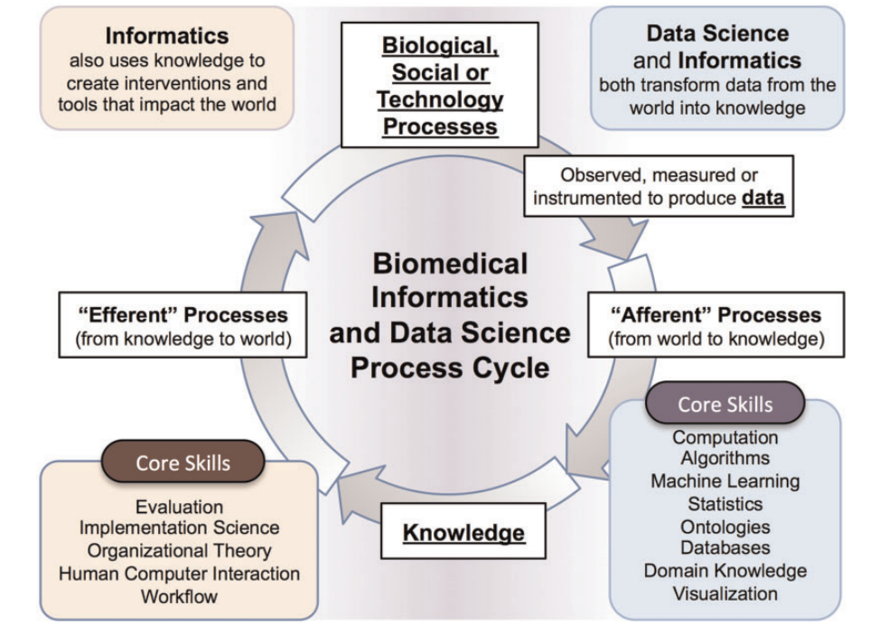
Philip R O Payne, Elmer V Bernstam, Justin B Starren, Biomedical informatics meets data science: current state and future directions for interaction, JAMIA Open, Volume 1, Issue 2, October 2018, Pages 136-141,
https://doi.org/10.1093/jamiaopen/ooy032

Slide 27
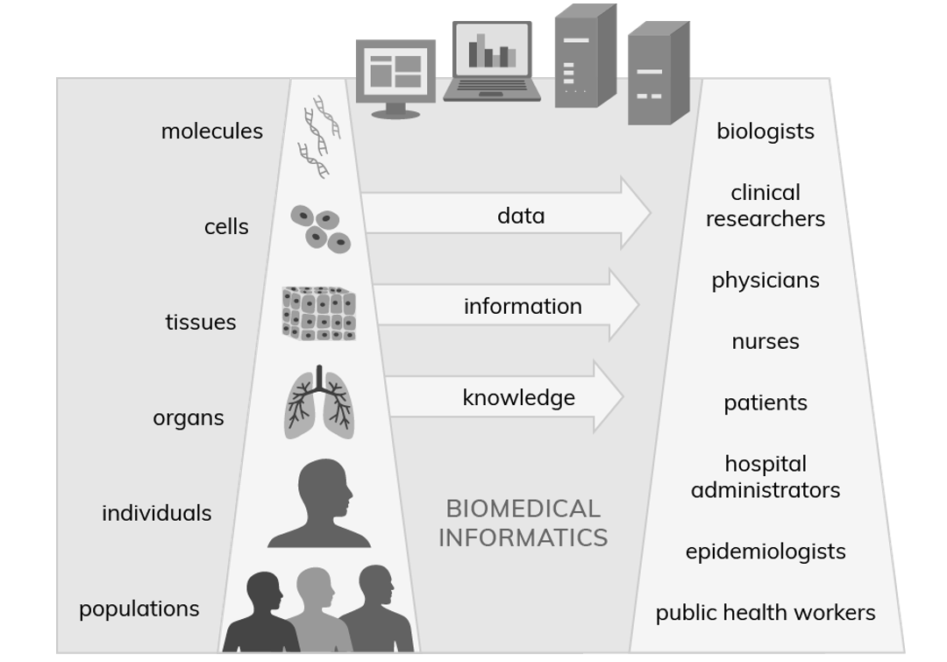
Adapted from
https://ibi.uky.edu/static_pages/biomedical_informatics

Slide 28
Biomedical Informatics in Perspective
Basic
Research
Biomedical Informatics Methods, Techniques, and Theories
Sociotechnical and Human Centered
Design
Imaging
Informatics
Clinical
Informatics
Public Health Informatics
Bioinformatics
Applied
Research
and
Practice

Slide 29
Biomedical Informatics in Perspective
Basic
Research
Biomedical Informatics Methods, Techniques, and Theories
Sociotechnical and Human Centered
Design
Imaging
Informatics
Clinical
Informatics
Public Health Informatics
Bioinformatics
Applied
Research
and
Practice
Molecular and
Cellular
Processes
Tissues and
Organs
Individuals
(Patients)
Populations
And Society
Healthcare
workforce

Slide 30
Subdiscipline: Bio-informatics
Basic
Research
Biomedical Informatics Methods, Techniques, and Theories
Sociotechnical and Human Centered
Design
Biomedical Informatics ≠
Bioinformatics
Imaging
Informatics
Clinical
Informatics
Public Health Informatics
Bioinformatics
Applied
Research
and
Practice
Molecular and
Cellular
Processes
Tissues and
Organs
Individuals
(Patients)
Populations
And Society
Healthcare
workforce

Slide 31
‘Bioinformatics’
Biology
Medicine
Agriculture
Forestry
Bioinformatics
Drug
discovery
Proteomics
Metabolomics
Genomics
A Bioinformatics Pep Talk David Wishart University of Alberta. http://slideplayer.com/slide/4545718/

Slide 32
‘Bioinformatics’ → all species
Biology
Medicine
Agriculture
Forestry
Bioinformatics
Drug
discovery
Proteomics
Metabolomics
Genomics

Slide 33
‘Bioinformatics’ → human beings
Agriculture
Biology
Medicine
Forestry
Biomedical
informatics
Drug
discovery
Proteomics
Metabolomics
Genomics

Slide 34
Combinations: Health Informatics
Basic
Research
Biomedical Informatics Methods, Techniques, and Theories
Sociotechnical and Human Centered
Design
Imaging
Informatics
Clinical
Informatics
Public Health Informatics
Bioinformatics
Applied
Research
and
Practice
Molecular and
Cellular
Processes
Tissues and
Organs
Individuals
(Patients)
Populations
And Society
Healthcare
workforce

Slide 35
Combinations: Pharmacogenomics
Basic
Research
Biomedical Informatics Methods, Techniques, and Theories
Sociotechnical and Human Centered
Design
Imaging
Informatics
Clinical
Informatics
Public Health Informatics
Bioinformatics
Applied
Research
and
Practice
Molecular and
Cellular
Processes
Tissues and
Organs
Individuals
(Patients)
Populations
And Society
Healthcare
workforce

Slide 36
Combinations: Consumer health
Basic
Research
Biomedical Informatics Methods, Techniques, and Theories
Sociotechnical and Human Centered
Design
Imaging
Informatics
Clinical
Informatics
Public Health Informatics
Bioinformatics
Applied
Research
and
Practice
Molecular and
Cellular
Processes
Tissues and
Organs
Individuals
(Patients)
Populations
And Society
Healthcare
workforce

Slide 37
Combinations: Biomolecular imaging
Basic
Research
Biomedical Informatics Methods, Techniques, and Theories
Sociotechnical and Human Centered
Design
Imaging
Informatics
Clinical
Informatics
Public Health Informatics
Bioinformatics
Applied
Research
and
Practice
Molecular and
Cellular
Processes
Tissues and
Organs
Individuals
(Patients)
Populations
And Society
Healthcare
workforce

Slide 38
Combinations: Translational Informatics
Basic
Research
Biomedical Informatics Methods, Techniques, and Theories
Sociotechnical and Human Centered
Design
Imaging
Informatics
Clinical
Informatics
Public Health Informatics
Bioinformatics
Applied
Research
and
Practice
Molecular and
Cellular
Processes
Tissues and
Organs
Individuals
(Patients)
Populations
And Society
Healthcare
workforce

Slide 39
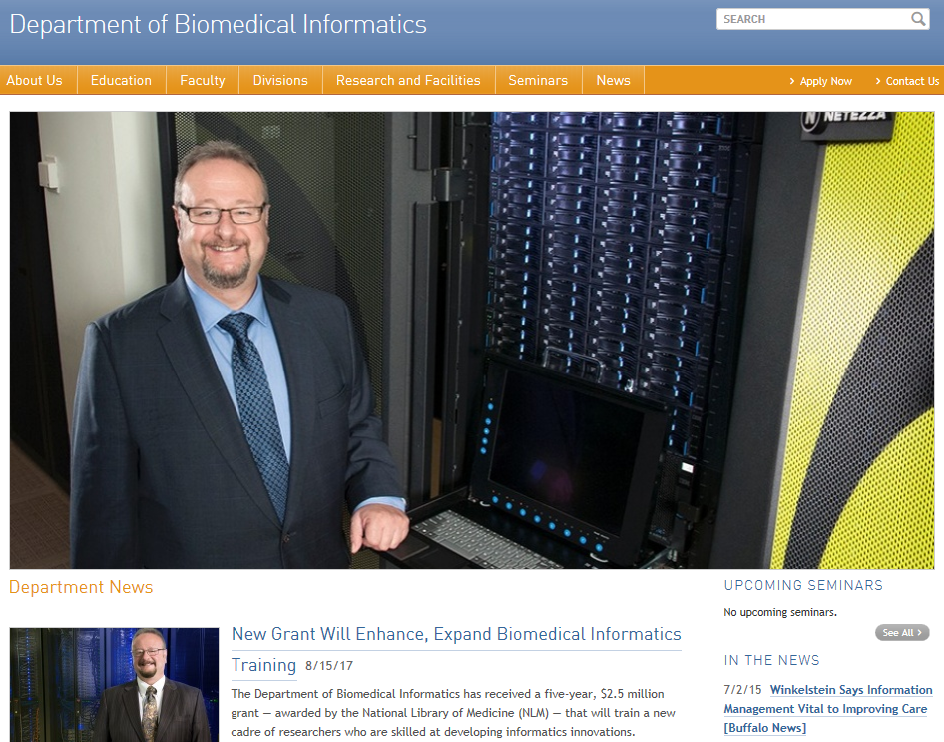

Slide 40
UB BMI Divisions
Basic
Research
Biomedical Informatics Methods, Techniques, and Theories
Sociotechnical and Human Centered
Design
Imaging
Informatics
Clinical
Informatics
Public Health Informatics
Bioinformatics
Applied
Research
and
Practice
Molecular and
Cellular
Processes
Tissues and
Organs
Individuals
(Patients)
Populations
And Society
Healthcare
workforce
Biomedical Ontology

Slide 41
UB BMI Divisions
Basic
Research
Biomedical Informatics Methods, Techniques, and Theories
Sociotechnical and Human Centered
Design
Clinical
Informatics
Public Health Informatics
Bioinformatics
Applied
Research
and
Practice
Molecular and
Cellular
Processes
Individuals
(Patients)
Populations
And Society
Healthcare
workforce
Biomedical Ontology

Slide 42
Biomedical Informatics
Definition:
Biomedical informatics (BMI) is
the interdisciplinary field
that studies and pursues the effective uses of biomedical data, information, and knowledge
for scientific inquiry, problem solving, and decision making,
driven by efforts to improve human health.
CA Kulikowski, EH Shortliffe, LM Currie, PL Elkin, LE Hunter, TR Johnson, IJ Kalet, LA Lenert, MA Musen, JG Ozbolt, JW Smith, PZ Tarczy-Hornoch, JWilliamson; AMIA Board white paper: definition of biomedical informatics and specification of core competencies for graduate education in the discipline, Journal of the American Medical Informatics Association, Volume 19, Issue 6, 1 November 2012, Pages 931–938, https://doi.org/10.1136/amiajnl-2012-001053

Slide 43
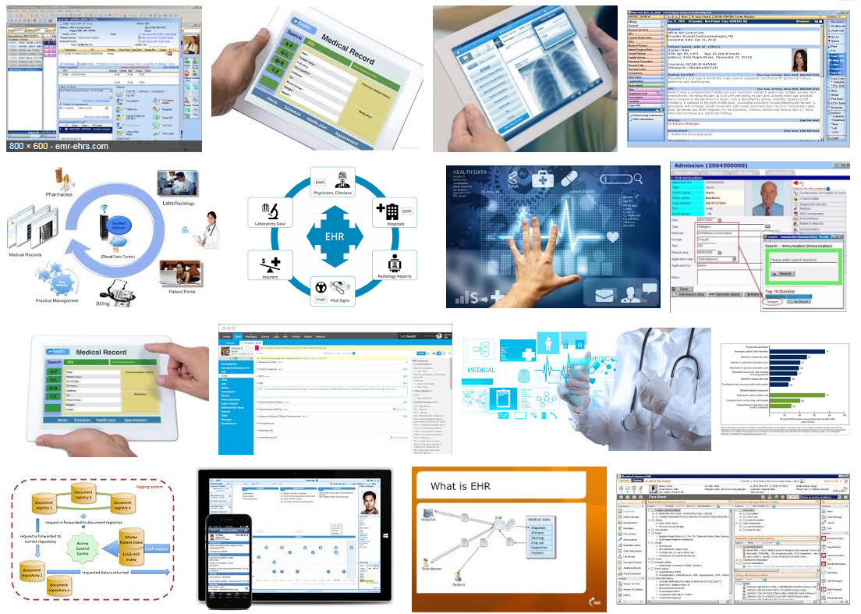
Electronic health records

Slide 44
What it tried to solve first

Slide 46
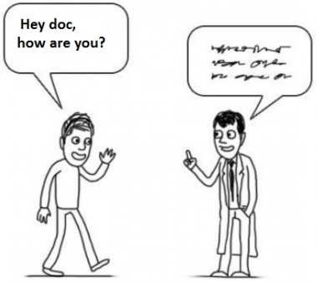
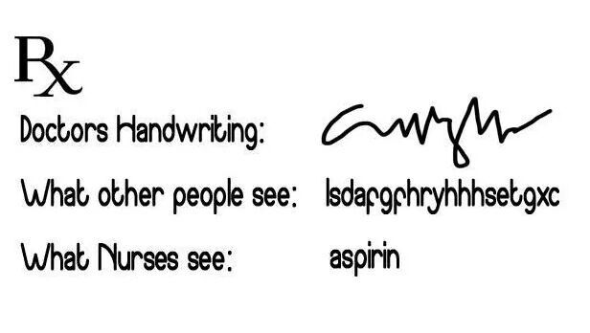
What it solved next
http://topyaps.com/doctors-handwriting

Slide 47
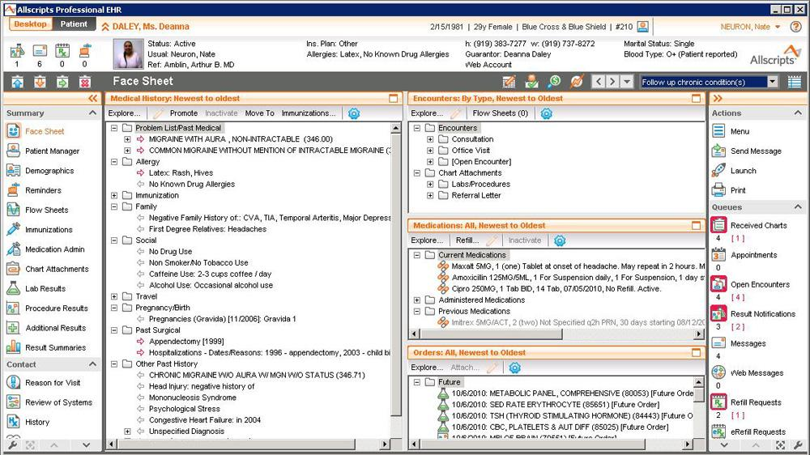

Slide 48
Attention to functionality (US)
← Billing
← Practice management
← Lab results
← ePrescribing
← Regulations
← Clinical

Slide 49
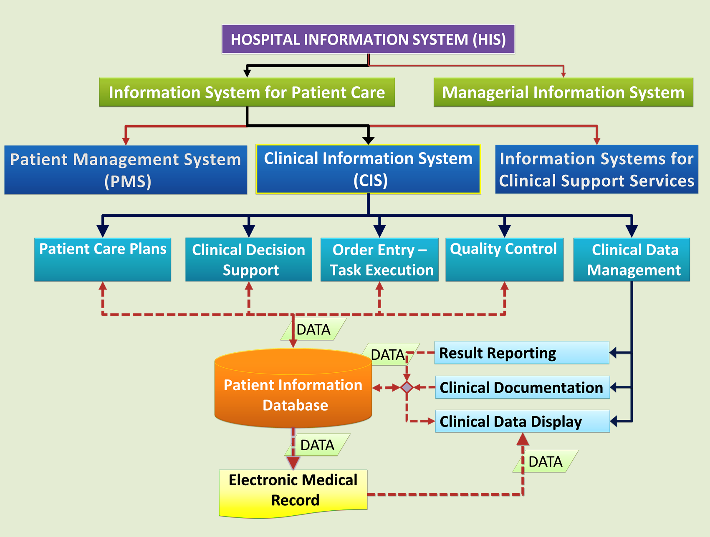
Abdollah Salleh.
Clinical Information System.
Date Last Revised: March 4, 2018.
https://drdollah.com/clinical-information-system/

Slide 50
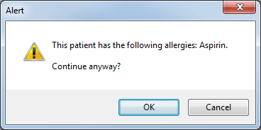

Slide 51
https://www.genomeweb.com/molecular-diagnostics/
acmg-developing-decision-support-tools-non-geneticist-docs-secondary-findings

Slide 53
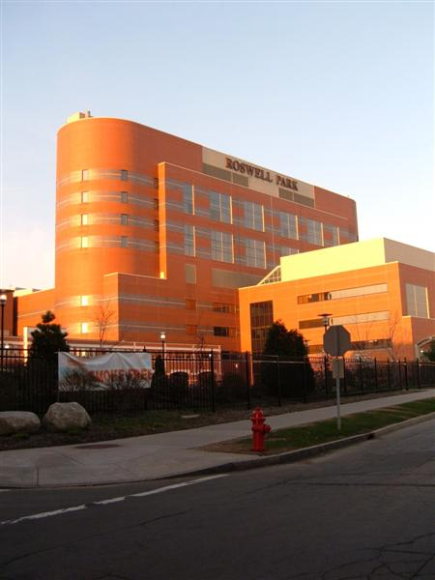
Semantic interoperability
Everything collected wherever, whenever and about whomever which is relevant to a medical problem in whomever, whenever and wherever, should be accessible without loss of relevant detail.

Slide 55
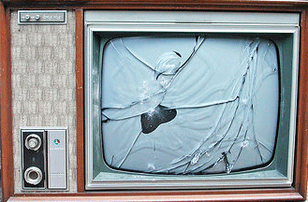
A possible end-goal for biomedical informatics
http://www.youtube.com/watch?v=-vT1Jm0jKmM

Slide 56
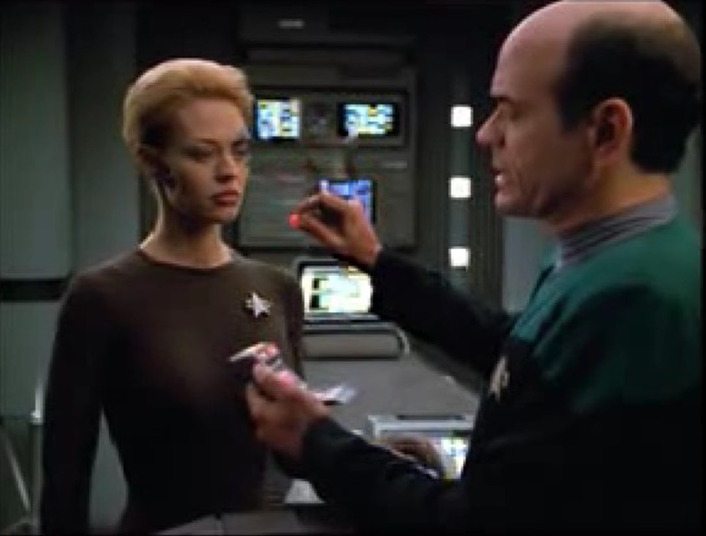
Why should we be surprised ?
A human being with function enhancing electronic implants
A ‘doctor’ who is in fact some sort of computer program capable of making medical diagnoses
A tiny scanner capable of detecting bodily anomalies
Flawless communication between a human and a computer

Slide 57
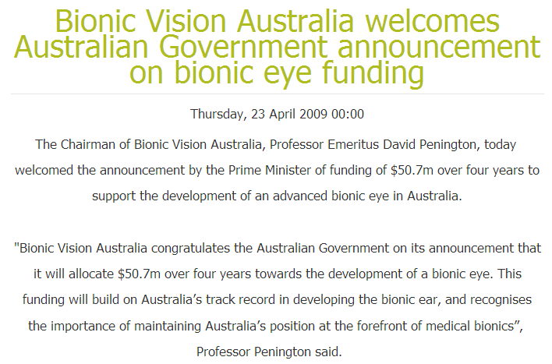
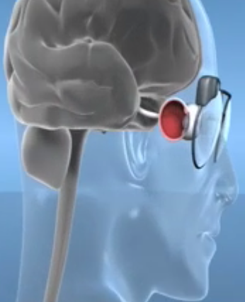
Or not ? … towards a bionic eye
http://bionicvision.org.au/

Slide 58
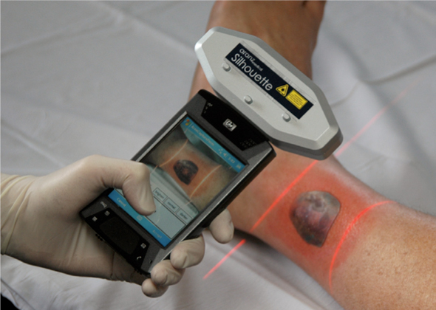
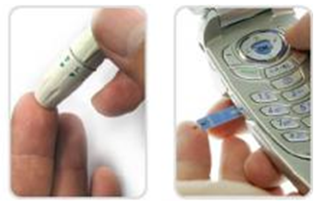
Or not ? … mobile diagnostics
SilhouetteMobile™
scans and stores information about a wound's width and depth, which helps nurses track healing over time as new tissue fills in the injury
GlucoPack™
reads and transmits glucose readings

Slide 59
Internet of Things

Slide 60
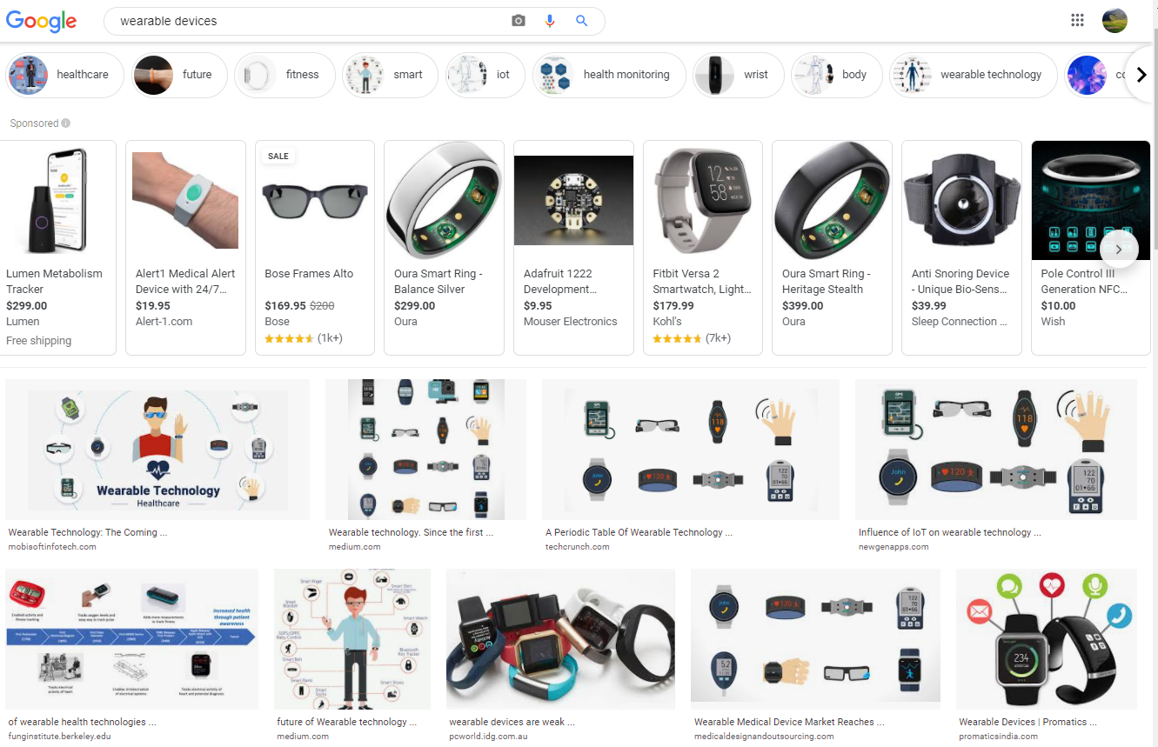
‘Wearable devices’ on Google (Nov 2020)

Slide 61
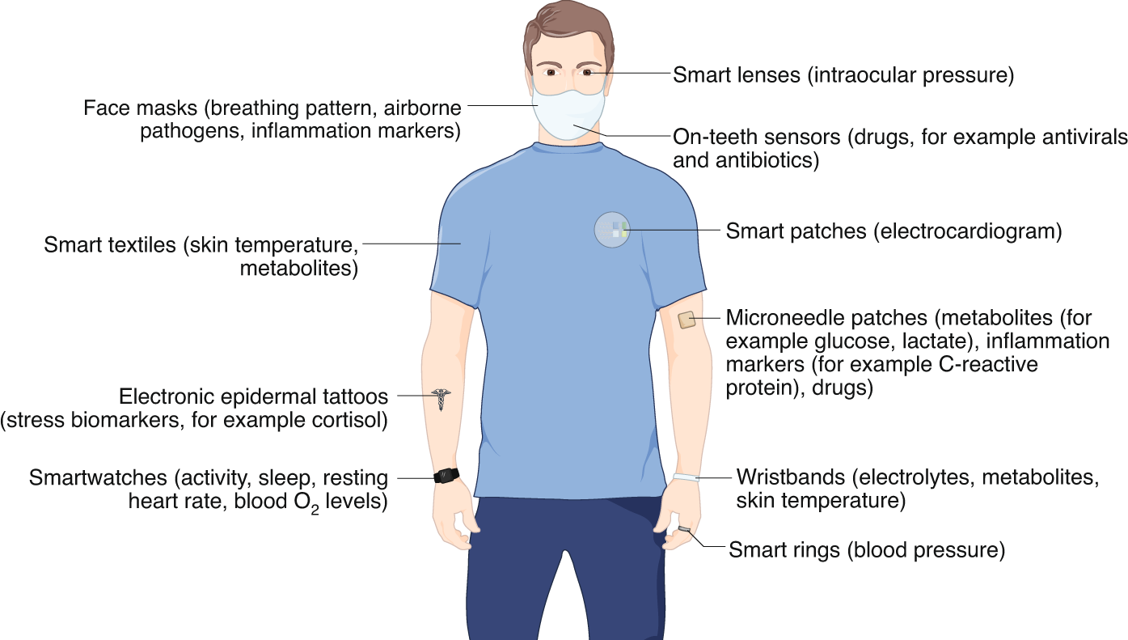
The future of wearable electronic devices
Ates, H.C., Yetisen, A.K., Güder, F. et al. Wearable devices for the detection of COVID-19. Nat Electron 4, 13–14 (2021). https://doi.org/10.1038/s41928-020-00533-1

Slide 62
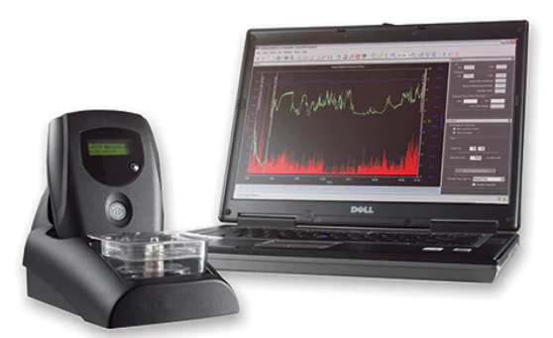
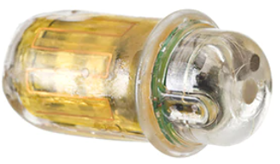
SmartPill™ motility capsule
Assists in localizing transit abnor-malities to a specific GI region by collecting data from the entire GI tract. As the SmartPill™ motility capsule travels through the patient's GI tract, it measures pressure, pH and temperature to provide you with valuable diagnostic infor-mation, including gastric emptying and total GI transit times in your patients.
MotiliGI™ software provides data analysis tools, offering physicians a variety of test reporting and exporting options to aid in the identification of motility disorders. The software calculates gastric emptying time, small bowel transit time, colonic transit time, combined small/ large bowel transit time, and whole gut transit time in graphical and statistical formats, and presents this data in a summary report.
www.medtronic.com

Slide 63
https://www.fda.gov/news-events/press-announcements/fda-approves-pill-sensor-digitally-tracks-if-patients-have-ingested-their-medication

Slide 64
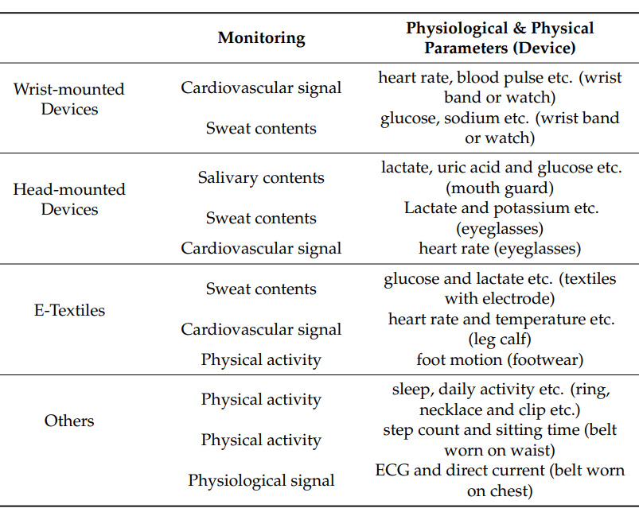
Guk K, Han G, Lim J, et al. Evolution of Wearable Devices with Real-Time Disease Monitoring for Personalized Healthcare. Nanomaterials (Basel). 2019;9(6):813. Published 2019 May 29. doi:10.3390/nano9060813

Slide 65
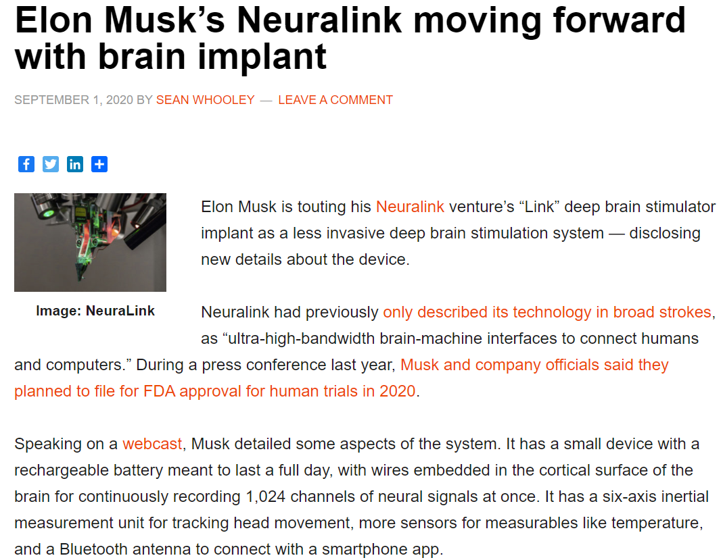
https://www.massdevice.com/elon-musks-neuralink-moving-forward-with-brain-implant/

Slide 66
Or not ? … Transhumanism
"Philosophies of life that seek the continuation and acceleration of the evolution of intelligent life beyond its currently human form and human limitations by means of science and technology, guided by life-promoting principles and values."
Max More

Slide 67
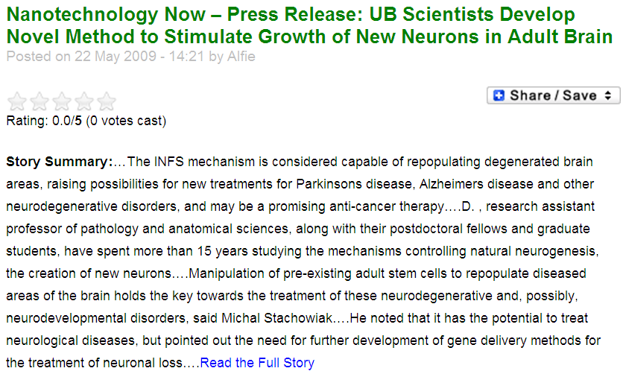
Beyond natural evolution …

Slide 68
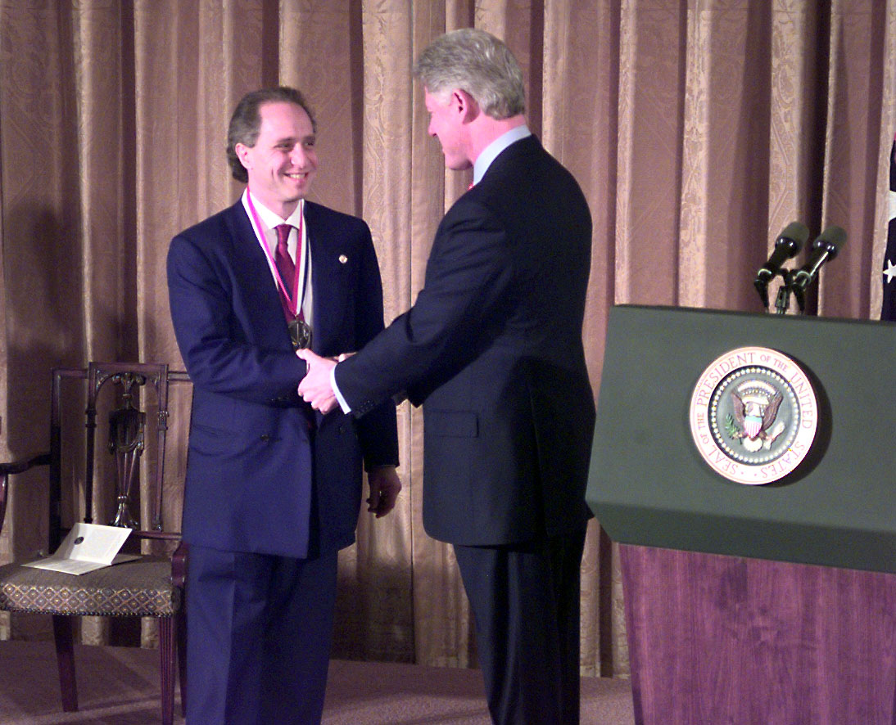
to … mind uploading ?
Ray Kurzweil receives National Medal of Technology (1999).

Slide 69
Biomedical Informatics
Definition:
Biomedical informatics (BMI) is
the interdisciplinary field
that studies and pursues the effective uses of biomedical data, information, and knowledge
for scientific inquiry, problem solving, and decision making,
driven by efforts to improve human health.
Wednesday
CA Kulikowski, EH Shortliffe, LM Currie, PL Elkin, LE Hunter, TR Johnson, IJ Kalet, LA Lenert, MA Musen, JG Ozbolt, JW Smith, PZ Tarczy-Hornoch, JWilliamson; AMIA Board white paper: definition of biomedical informatics and specification of core competencies for graduate education in the discipline, Journal of the American Medical Informatics Association, Volume 19, Issue 6, 1 November 2012, Pages 931–938, https://doi.org/10.1136/amiajnl-2012-001053

