Slide 1
Biomedical Informatics III
How to structure data files
Lecture in BMS515: Fundamentals of Biomedical Research.
Dec 4, 2020
Room 1225A, JSMBS, University at Buffalo
Werner CEUSTERS, MD
Departments of Biomedical Informatics and Psychiatry,
UB Institute for Healthcare Informatics,
Ontology Research Group, Center of Excellence in Bioinformatics and Life Sciences,
University at Buffalo, NY, USA

Slide 2
Today’s learning outcomes (BMI-III)
Being able to describe the most general ontological distinctions amongst entities and understanding why they matter in science and research (continued from BMI-II).
Being able to structure data files using ontological principles and annotate them by means of ontologies.
Understand how to construct data files for maximal faithfulness and reusability for different purposes.

Slide 3
Some Data Quality Dimensions
Dimension | # cited | Dimension | # cited | Dimension | # cited
Accuracy | 25 | Format | 4 | Comparability | 2
Reliability | 22 | Interpretability | 4 | Conciseness | 2
Timeliness | 19 | Content | 3 | Freedom from bias | 2
Relevance | 16 | Efficiency | 3 | Informativeness | 2
Completeness | 15 | Importance | 3 | Level of detail | 2
Currency | 9 | Sufficiency | 3 | Quantitativeness | 2
Consistency | 8 | Usableness | 3 | Scope | 2
Flexibility | 5 | Usefulness | 3 | Understandability | 2
Precision | 5 | Clarity | 2
Wang, R.Y., Storey, V.C., and Firth, C.P.
A framework for analysis of data quality research.
IEEE Trans. on Knowl. Data Eng. 7, 4 (1995), pp. 623–640.

Slide 4


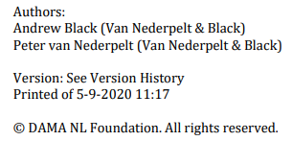
http://www.dama-nl.org/wp-content/uploads/2020/09/DDQ-Dimensions-of-Data-Quality-Research-Paper-version-1.2-d.d.-3-Sept-2020.pdf

Slide 5

https://www.dama.org/cpages/home

Slide 6
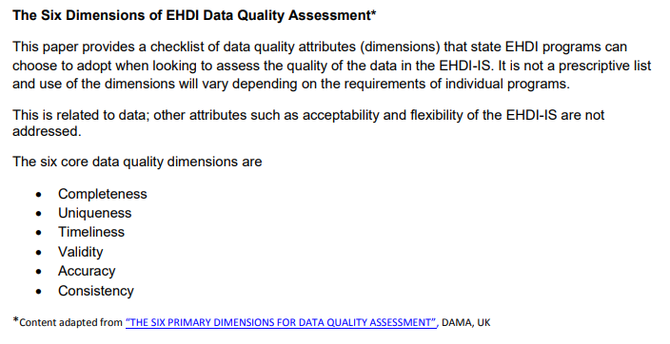
CDC and data quality
https://www.cdc.gov/ncbddd/hearingloss/documents/dataqualityworksheet.pdf

Slide 7
The problem of tables
Registering blood pressures:
  Person-ID | RR-dia | RR-sys
  Person-ID | RR-dia | RR-sys | Pos
  Person-ID | RR-dia | RR-sys | Pos | T-ID
  …
Then come some more requirements:
  RR needs to be taken both sitting and standing.
  Let’s do it before and after a 10 minute physical stress test.
  Oh, we need to register also the maximum amount of physical stress applied.
  And by the way, it is possible that the technician that will take the pre-test RR is on coffee break so somebody else might take the post-test RR.

Slide 8
The beginnings of a solution:
Entity-Attribute-Value triples
Person-ID | RR-dia | RR-sys |
#1 90 150
#2 77 125
…
(#1 , RR-dia , 90)
(#1 , RR-sys, 150)
(#2 , RR-dia , 77)
(#2 , RR-sys, 125)
…

Slide 9
When adding position
Person-ID | RR-dia | RR-sys | Position
#1 90 150 sitting
#2 77 125 standing
…
(#1 , RR-dia-sitting , 90)
(#1 , RR-sys-sitting, 150)
(#2 , RR-dia-standing, 77)
(#2 , RR-sys-standing, 125)
…

Slide 10
Both standing and sitting
Person-ID | RR-dia | RR-sys | Position
#1 90 150 sitting
#1 85 145 standing
…
(#1 , RR-dia-sitting , 90)
(#1 , RR-sys-sitting, 150)
(#1 , RR-dia-standing, 85)
(#1 , RR-sys-standing, 145)
…

Slide 11
Adding more constraints
(#1 , RR-dia-sitting-pre-test , 75)
(#1 , RR-dia-standing-pre-test , 65)
(#1 , RR-sys-sitting-post-test , 145)
(#1 , RR-sys-standing-post-test , 155)
…
Add time, add those who registered, …?
→ attribute overloading.

Slide 12
Everything - overloading
(<patient XYZ, 1/5/98 9:30 AM>, <Temperature in degrees Fahrenheit>, "102" )
(<patient XYZ, 1/5/98 9:30 AM>, <Presence of Cough>, "True" )
(<patient XYZ, 1/5/98 9:30 AM>, <Type of Cough>, "With phlegm, yellowish, streaks of blood" )
(<patient XYZ, 1/5/98 9:30 AM>, <Heart Rate in beats per minute>, "98" )
...
https://en.wikipedia.org/wiki/Entity%E2%80%93attribute%E2%80%93value_model
(though not recognized as a problem)

Slide 13
What goes where?
(<patient XYZ, 1/5/98 9:30 AM>,
    <Presence of Cough>,
      "True" >)
(<patient XYZ, 1/5/98 9:30 AM>,
    <Cough>,
      “Present" >
(<patient XYZ, 1/5/98 9:30 AM>,
    <Symptom>,
      “Cough" >

Slide 14
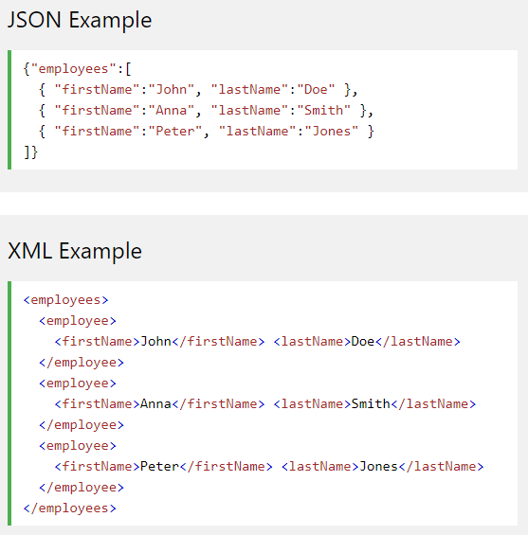
Exchange syntaxes don’t solve this
Employee table
firstName | lastName
John | Doe
Anna | Smith
Peter | Jones
https://www.w3schools.com/js/js_json_xml.asp

Slide 15
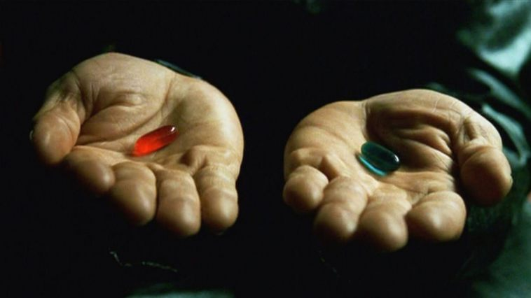
‘Ontology’
Helps scientists to determine and describe what sorts of entities their research is intended to be directed at.

Slide 16
‘Referent Tracking’
Helps scientists to determine and describe what the data they collect(ed) are about and how their referents are related.

Slide 17
An ideal dataset
A representation of some pre-existing portion of reality which
  reflects the particulars within its domain – and the relations between them – in such a way that there obtains a systematic correlation between reality and the representation itself,
  is intelligible to a domain expert,
  is formalized in a way that allows it to support automatic information processing.
Smith B, Kusnierczyk W, Schober D, Ceusters W. Towards a Reference Terminology for Ontology Research and Development in the Biomedical Domain. Proceedings of KR-MED 2006, Biomedical Ontology in Action, November 8, 2006, Baltimore MD, USA

Slide 18
Particulars in the blood pressure example
For a given patient on a particular day, there is/are:
One ‘fat’ process (#1) which is made up in part by the measurements and the stress test,
Relevant process parts of #1 (in temporal order):
  #2: the patient takes a seat
  #3: a technician performs the first RR-measurement
  #4: the patient stands up
  #5: a technician performs the second RR-measurement
  #6: the patient undergoes the stress test
  #7: the patient takes a seat
  #8: a technician performs the third RR-measurement
  …
Instance unique identifiers (IUI)
Notes:
Note: the following analysis is ‘quick and dirty’ but good enough for this very introductory lesson.

Slide 19
Representation of #1’s composition
(#1, instance of, PROCESS)
(#1, has part, #2)
  (#2, instance of, TAKING A SEAT)
  (#2, has agent, #3, at, t1)
  (#3, instance of, PATIENT, at t1)
(#1, has part, #4)
  (#4, instance of, MEASURING BLOOD PRESSURE)
  (#4, preceded by, #2)
…
(#1, has part, #9)
  (#9, instance of, MEASURING BLOOD PRESSURE)
…
Identifiers
Relations
TYPES

Slide 20
Describing the first RR measurement
(#4, instance of, MEASURING BLOOD PRESSURE)
(#4, has observee, #20, at, t2)
  (#20, instance of, BLOOD PRESSURE, at, t2)
  (#20, inheres in, #3, at, t2)
(#4, has agent, #21, at, t2)
(#21, instance of, NURSE, at, t2)
(#4, has output, #22, at, t2)
  (#22, instance of, BLOOD PRESSURE VALUE, at, t2)
  (#22, concretized as, “125/95 mmHg”, at, t2)
  (#22, is about, #20, at t2)
…

Slide 21
Results of further RR measurements
We had:
  (#22, concretized as, “125/95 mmHg”, at, t2)
  (#22, is about, #20, at, t2)
Then:
  (#48, concretized as, “145/105 mmHg”, at, t3)
  (#48, is about, #20, at, t3)
  (#69, concretized as, “115/85 mmHg”, at, t4)
  (#69, is about, #20, at, t4)
  …

Slide 22
Graph representations
instance of
isa
PERSON
PROCESS
TAKING A SEAT
PATIENT
t1
has part
has agent at t1
QUALITY
1
2
3
has part
preceded by
inheres in at t2
MEASURING BLOOD PRESSURE
t2
BLOOD
PRESSURE
4
20
has observee at t2
has agent at t2
has output at t2
is about at t2
NURSE
21
t2
BLOOD
PRESSURE
VALUE
t2
22
GDC
‘125/85 mmHg’
concretized as at t2

Slide 23
Application
‘Linked data’: https://ontola.io/what-is-linked-data/

Slide 24
Minimal ontological principles for high quality research data
Identify the particulars you want to collect data about;
Identify the types these particulars are instances of;
Organize the types in a taxonomy using high quality ontologies;
Represent the relationships that hold between the particulars;
Verify repeatedly you are not confusing reality with descriptions/hypotheses/…;
Do 1-5 for cited literature/measurement instruments you will rely on;
Do not only consult a biomedical statistician before designing a study, but also a biomedical ontologist.

Slide 25
Guided Exercise

Slide 26

https://www.huffpost.com/entry/white-blood-cell-goes-aft_n_463887

Slide 27
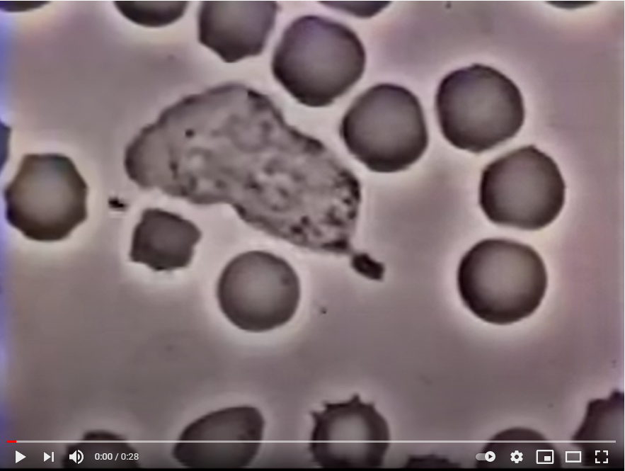
#4
#7
#1
#6
#2
#3
#5
Notes:
#1 instanceOf NEUTROPHIL at t1
#2 instanceOf BACTERIUM at t1
#3 instanceOf RED BLOOD CELL at t1
#4 instanceOf RED BLOOD CELL at t1
#5 instanceOf SPIKED RED BLOOD CELL at t1
#6 instanceOf QUASI-RECTANGULAR SHAPE at t1
#6 inheresIn #1 at t1
#7 instanceOf IMAGE at t1
#7 isAbout #1 at t1

Slide 28
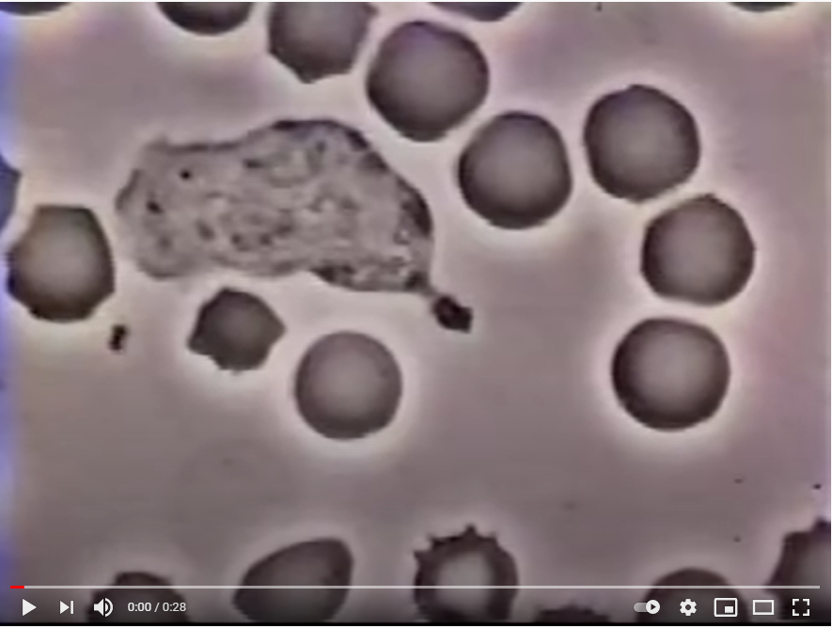

Slide 29
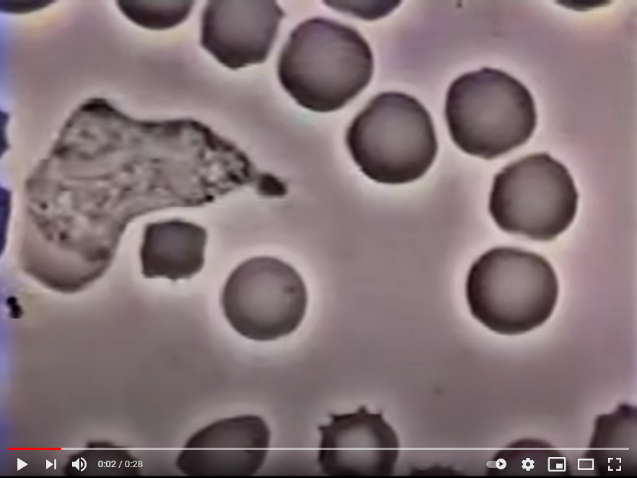
Notes:
#1 instanceOf NEUTROPHIL at t3
#6 inheresIn #1 at t3
#6 instanceOf QUASI-TRIANGULAR SHAPE at t3
#10 instanceOf SHAPE CHANGE
#6 agentOf #10, between t1 and t3

Slide 30
Assignment
Annotate entities in the following 4 phases in phagocytosis and some processes from which they result.
See: http://www.informatics.jax.org/vocab/gene_ontology/GO:0006909

Slide 31
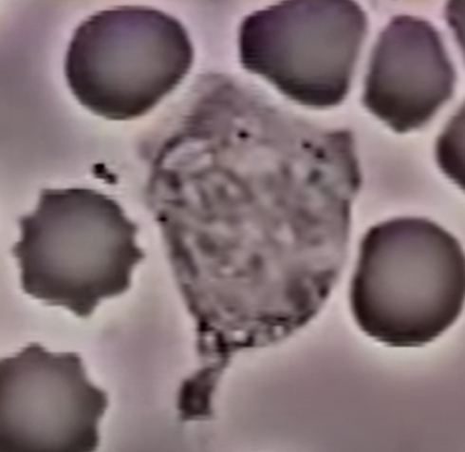
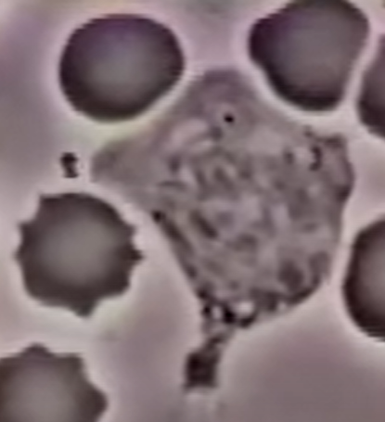
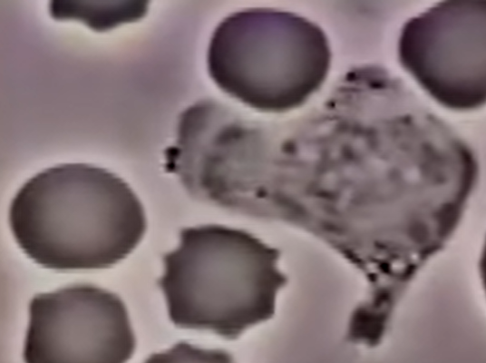
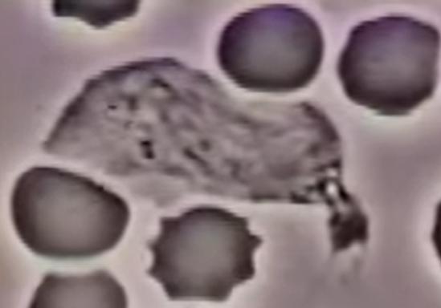
t1
t2
t3
t4

Slide 32
Tasks
Represent the entities involved in these four process part types: FOREIGN BODY RECOGNITION, FOREIGN BODY CHASE, FB ENCLOSING, PHAGOCYTOSIS.
Write the triples
Build the graph

Slide 33
Student corrections
instance of
isa
QUASI-
CIRCULAR
SHAPE
t1
t3
QUASI-TRIANGULAR
SHAPE
Inheres in
between t1 and t4
1
6
SHAPE
QUASI-RECTANGULAR
SHAPE
t2
t4
QUASI- TRAPEZOID
SHAPE
Agent of
between t1 and t4
50
SHAPE CHANGE PROCESS

