Slide 1
Biomedical Informatics III
How to structure data files
Lecture in BMS515: Fundamentals of Biomedical Research.
Nov 25, 2019
Room 1225A, JSMBS, University at Buffalo
Werner CEUSTERS, MD
Departments of Biomedical Informatics and Psychiatry,
UB Institute for Healthcare Informatics,
Ontology Research Group, Center of Excellence in Bioinformatics and Life Sciences,
University at Buffalo, NY, USA

Slide 2
Today’s learning outcomes (BMI-III)
Being able to describe the most general ontological distinctions amongst entities and understanding why they matter in science and research (continued from BMI-II).
Being able to structure data files using ontological principles and annotate them by means of ontologies.
Understand how to construct data files for maximal faithfulness and reusability for different purposes.

Slide 3
Basic Ontological Distinctions
(continued from BMI-II)

Slide 4
Basic Formal Ontology: what is out there …
(… we want/need to deal with)?
portions of reality
relations
configurations
?
participation
me participating in my life
universals
entities
?
particulars
continuants
occurrents
me
my life
organism

Slide 5
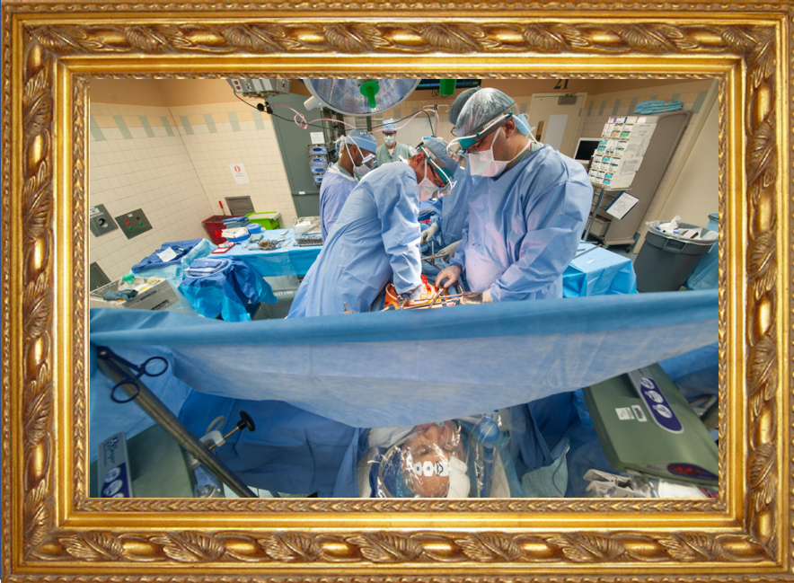
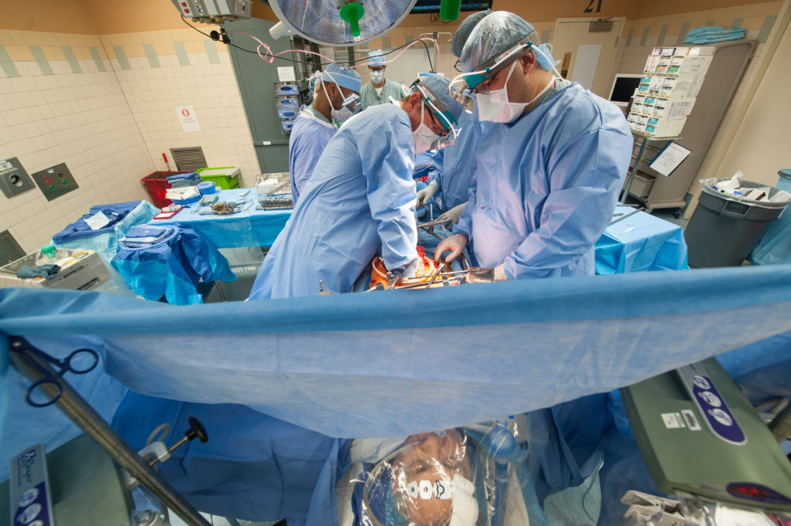
(1) Reality ←→ Representation

Slide 6


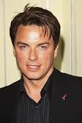
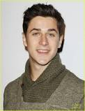
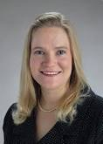
(2) Types ←→ particulars
Human being
instance of at t
particulars

Slide 7
Instances are the objects of classification …
isa
Organism
isa
Vertebrate
isa
Mammal
Human being
instance of at t
particulars

Slide 8
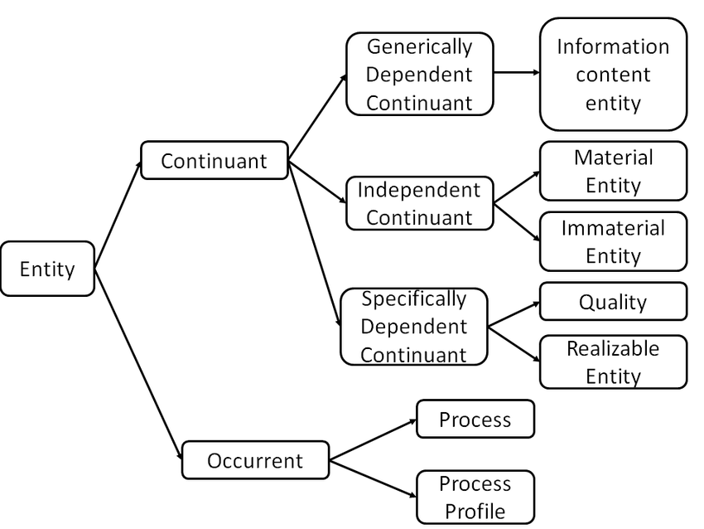
Most generic entities in Basic Formal Ontology

Slide 9
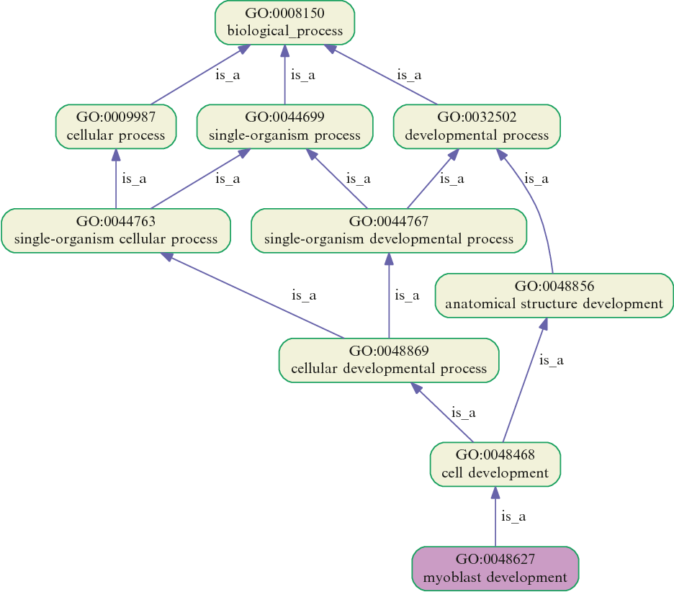
Gene Ontology Fragment

Slide 10
(3) Continuants ←→ Occurrents
 | Continuant | Occurrent
Entities that at any time they exist,
exist
in total
Entities that at any time they exist,
exist only
partially
Smith B, Ceusters W. Ontological Realism as a Methodology for Coordinated Evolution of Scientific Ontologies. Applied Ontology, 2010;5(3-4):139-188.

Slide 11
An ontological square
 | Continuant | Occurrent
Types | Tooth | Teeth grinding
Particulars | My left maxillary first molar | My teeth grinding

Slide 12
An ontological square
 | Continuant | Occurrent
Types | Tooth | Teeth grinding
Particulars | My left maxillary first molar | My teeth grinding
Instance
of at t
Instance
of

Slide 13
Continuants versus Occurrents: differences for temporal indexing
Continuant
has_participant
Occurrent
e.g. pathological
process
is_a
is_a
Independent
Continuant
e.g. organism
Dependent
Continuant
e.g. patient
role
inheres_in
instance_of
universals
instance_of at t
.... ..... .......
particulars

Slide 14
The importance of temporal indexing
benign
tumor
malignant
tumor
stomach
instanceOf at t₂
instanceOf at t₁
instanceOf at t₂
instanceOf at t₁
partOf at t₁
this-4
this-1’s stomach
partOf at t₂

Slide 15
The importance of temporal indexing
benign
tumor
malignant
tumor
stomach
instanceOf at t₂
instanceOf at t₁
instanceOf at t₂
instanceOf at t₁
this-4
partOf at t₁
this-1’s stomach
this-5
partOf at t₂

Slide 16
Do you see the ambiguity ?
‘Persistent idiopathic facial pain (PIFP)’
  = ‘persistent facial pain with varying presentations …’
persistent
facial pain
presentation
type1
presentation
type2
presentation
type3
types
t₂
t₃
t₁
t₁
t₁
t₂
t₂
t₃
t₁
t₃
parti-
culars
t₁
t₂
t₂
t₁
t₃
t₂
t₃
t₃
my pain
her pain
his pain

Slide 17
Make it clear whether assertions are about particulars or types
‘Persistent idiopathic facial pain (PIFP)’
  = ‘persistent facial pain with varying presentations …’
  if the description is about types, then the three particular pains fall under PIFP.
  if the description is about (arbitrary) particulars, then only her pain falls under PIFP.

Slide 18
(4) Some relations in BFO
Instance-level relations
  Your heart (instance-level) continuant_part_of your body at t
  Your heart beating (instance-level) has_participant your heart at t
Instance-type relations
  John’s heart instantiates human heart at t.
  John’s heart beating instantiates human heart beating.
Type-level relations
  human heart continuant_part­_of human body
  human heart beating process has_occurrent_part beat profile

Slide 19
color
anatomical structure
is_a
is_a
red
eye
instantiates
instantiates
the particular case of redness (of a particular fly eye)
an instance of an eye (in a particular fly)
Depends_on at t

Slide 20
depends_on
Continuant
Occurrent
process, event
Independent
Continuant
thing
Dependent
Continuant
quality
temperature depends
on bearer
.... ..... .......

Slide 21
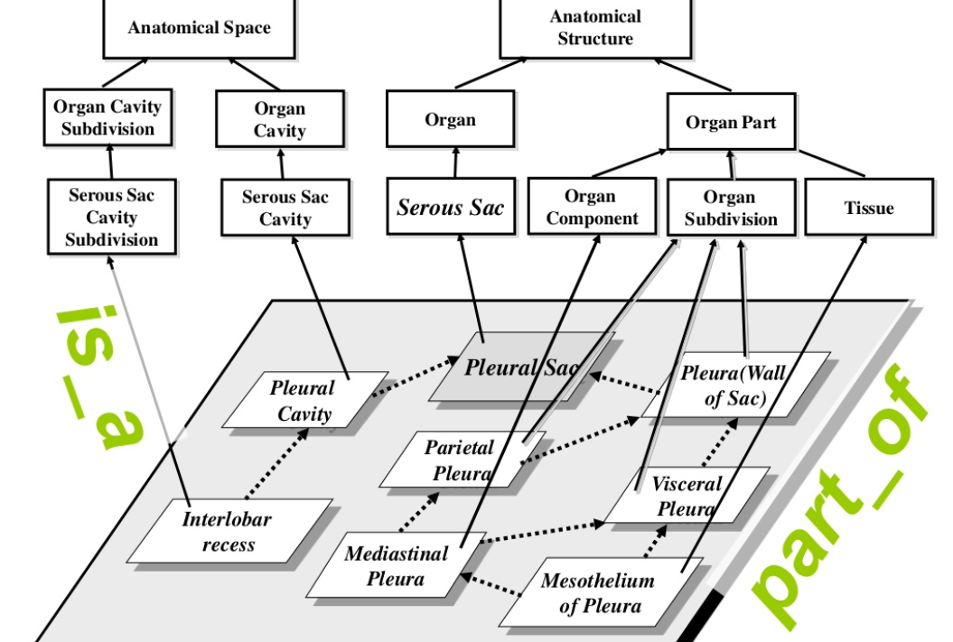
Foundational Model of Anatomy

Slide 22
derives_from
C
c at t
C₁
c₁ at t₁
time
C'
c' at t
instances
ovum
zygote derives_from
sperm

Slide 23
Relational PoRs ←→ relational expressions
⁴
¹
²
³
‘Mary is patient of John’
isAbout at t
¹
Mary
John
patientOf at t
inheresIn at t
²
instanceOf
at t
Mary’s patient role
patient
role
instanceOf at t
Patient
³

Slide 24
Relational PoRs ←→ relational expressions
‘Mary is friend of John’
isAbout at t
Mary
John
friendOf at t
inheresIn at t
inheresIn at t
M&J’s friendship
instanceOf at t
friendship

Slide 25
Structuring data files

Slide 26
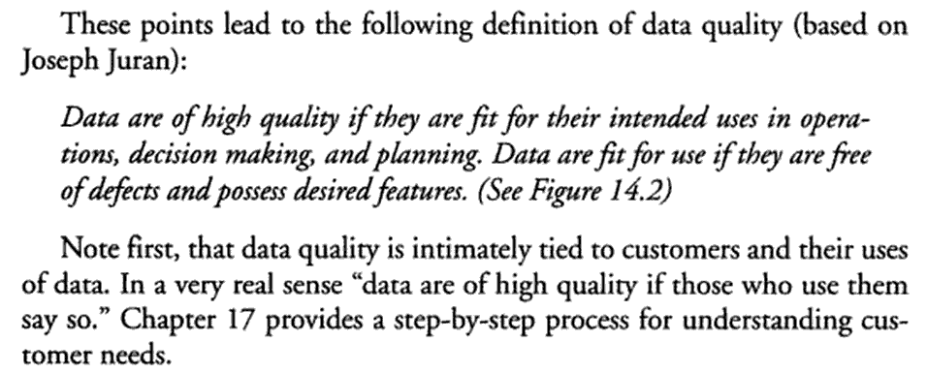
Data quality … really ?
Thomas C. Redman (Navesink Consulting Group, Little Silver, NJ) .
Data quality: the field guide.
Digital Press Newton, MA, USA ©2001, ISBN:1-55558-251-6

Slide 27
Data quality … really ?
Thomas C. Redman (Navesink Consulting Group, Little Silver, NJ) .
Data quality: the field guide.
Digital Press Newton, MA, USA ©2001, ISBN:1-55558-251-6

Slide 28
Data quality … reality!
Almost there:
  the data are deemed of high quality if they correctly represent the real-world construct to which they refer.
    Elisa Bertino, Chenyun Dai, .Murat Kantarcioglu. The Challenge of Assuring Data Trustworthiness, Database Systems for Advanced Applications, Lecture Notes in Computer Science, 2009, Volume 5463/2009, 22-33.
  An information system is to provide a representation of an application domain (also termed the real-world system) as perceived by the user.
    Anchoring Data Quality Dimensions in Ontological Foundations Y Wand and RY. Wang. November 1996/Vol. 39, No. 11 COMMUNICATIONS OF THE ACM

Slide 29
Data quality … reality!
Almost there:
  the data are deemed of high quality if they correctly represent the real-world construct to which they refer.
    Elisa Bertino, Chenyun Dai, .Murat Kantarcioglu. The Challenge of Assuring Data Trustworthiness, Database Systems for Advanced Applications, Lecture Notes in Computer Science, 2009, Volume 5463/2009, 22-33.
  An information system is to provide a representation of an application domain (also termed the real-world system) as perceived by the user.
    Anchoring Data Quality Dimensions in Ontological Foundations Y Wand and RY. Wang. November 1996/Vol. 39, No. 11 COMMUNICATIONS OF THE ACM

Slide 30

Data quality … reality!
Almost there:
  the data are deemed of high quality if they correctly represent the real-world construct to which they refer.
    Elisa Bertino, Chenyun Dai, .Murat Kantarcioglu. The Challenge of Assuring Data Trustworthiness, Database Systems for Advanced Applications, Lecture Notes in Computer Science, 2009, Volume 5463/2009, 22-33.
  An information system is to provide a representation of an application domain (also termed the real-world system) as perceived by the user.
Extremely close:
1978 - 2000 - 2012

Slide 31
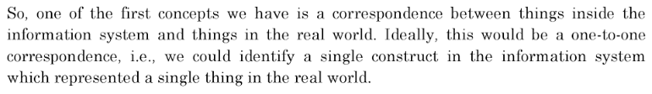
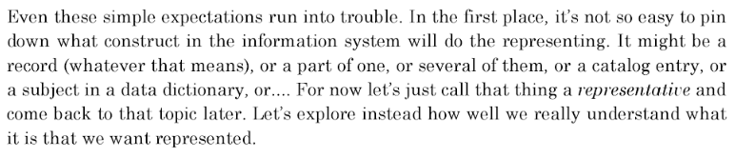
William Kent in ‘Data and Reality’
p35, 3rd edition, 2012.

Slide 32
Some Data Quality Dimensions
Dimension | # cited | Dimension | # cited | Dimension | # cited
Accuracy | 25 | Format | 4 | Comparability | 2
Reliability | 22 | Interpretability | 4 | Conciseness | 2
Timeliness | 19 | Content | 3 | Freedom from bias | 2
Relevance | 16 | Efficiency | 3 | Informativeness | 2
Completeness | 15 | Importance | 3 | Level of detail | 2
Currency | 9 | Sufficiency | 3 | Quantitativeness | 2
Consistency | 8 | Usableness | 3 | Scope | 2
Flexibility | 5 | Usefulness | 3 | Understandability | 2
Precision | 5 | Clarity | 2
Wang, R.Y., Storey, V.C., and Firth, C.P.
A framework for analysis of data quality research.
IEEE Trans. on Knowl. Data Eng. 7, 4 (1995), pp. 623–640.

Slide 33
Minimal ontological principles for high quality research data
Identify the particulars you want to collect data about;
Identify the types these particulars are instances of;
Organize the types in a taxonomy using high quality ontologies;
Represent the relationships that hold between the particulars;
Verify repeatedly you are not confusing reality with descriptions/hypotheses/…;
Do 1-5 for cited literature/measurement instruments you will rely on;
Do not only consult a biomedical statistician before designing a study, but also a biomedical ontologist.

Slide 34
Exercise and subsequent assignment

Slide 35
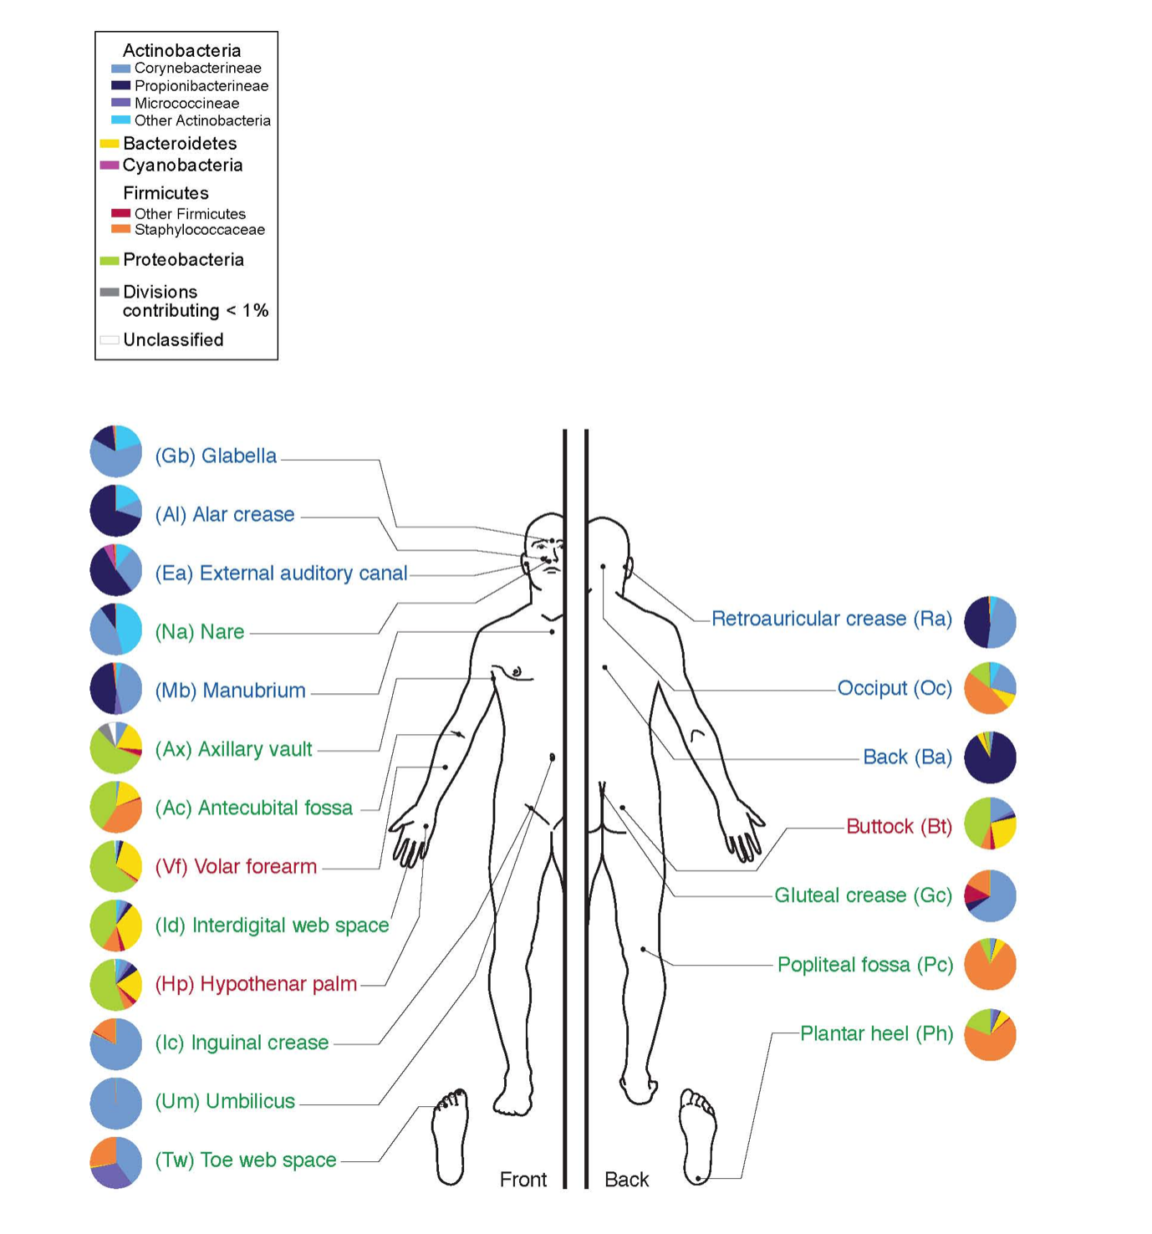
Darryl Leja, NHGRI - http://www.genome.gov/dmd/img.cfm?node=Photos/Graphics&id=85320

Slide 36
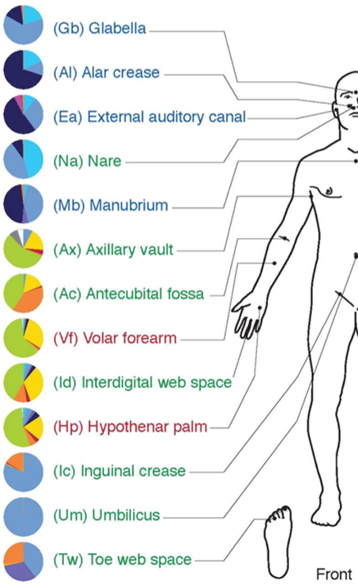

Possible origin of this drawing
https://generated.photos/

Slide 37
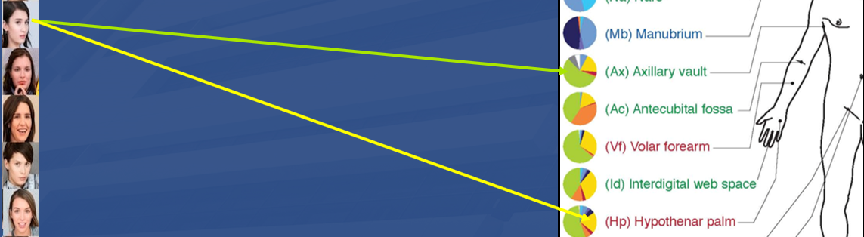
1. Identify the particulars you want to collect data about
#1: Lisa Doe
#2: #1’s left axillary vault
#3: #1’s left hypothenar palm
#4: material collected from #2
#5: material collected from #3
#6: organism strain grown from #4
…

Slide 38
2. Identify the types these particulars are instances of
#1: Lisa Doe → human being
#2: #1’s left axillary vault
#3: #1’s left hypothenar palm
#4: material collected from #2
#5: material collected from #3
#6: organism strain grown from #5 → Gabonibacter
…

Slide 39
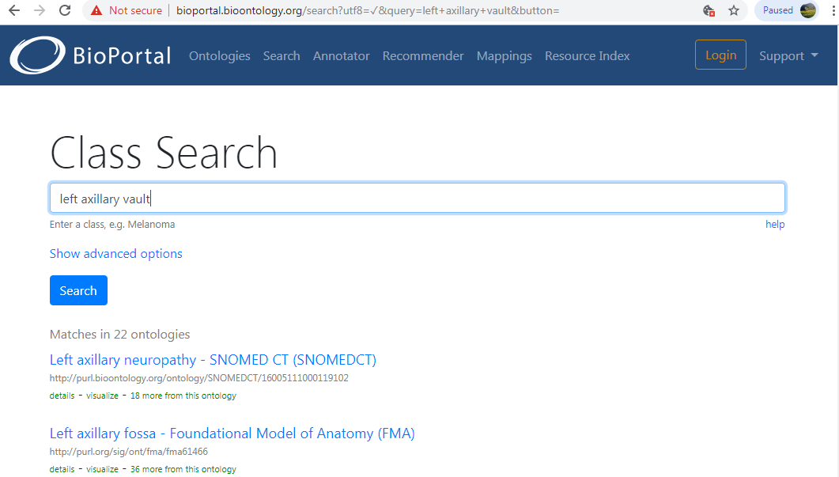
3. Organize the types in a taxonomy using high quality ontologies

Slide 40


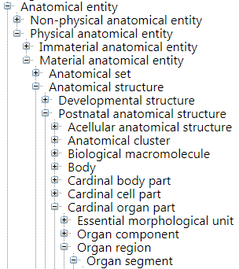
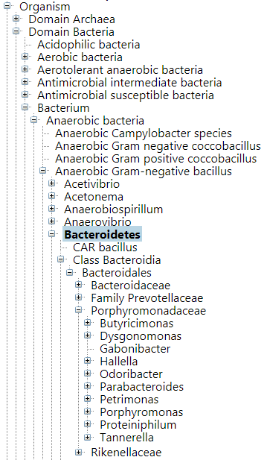
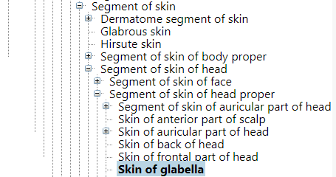
https://bioportal.bioontology.org/ontologies/FMA/

Slide 41
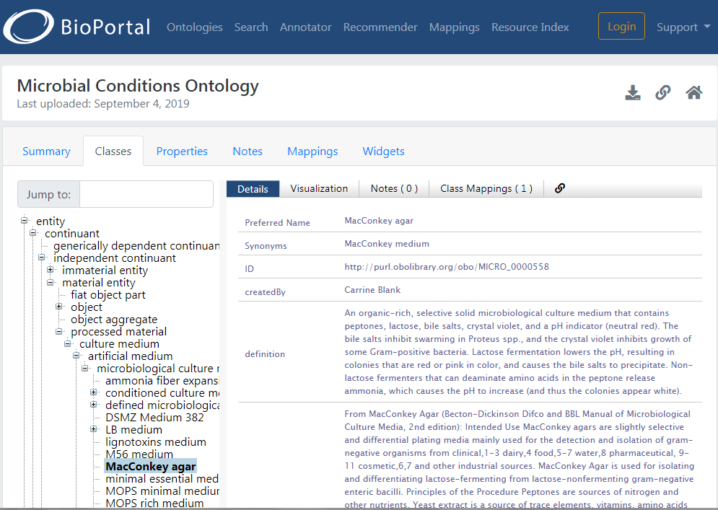

Slide 42
4. Represent the relationships that hold between the particulars
#1 instanceOf FMA:human body at t_{x}
#1 hasName ‘Lisa Doe’ at t_{y}
#2 instanceOf FMA:left axillary fossa at t_{y}
#3 part of #1 at t_{y}
…

Slide 43
Near-perfect datafile
#1 instanceOf FMA:human body at t_{x}
#1 hasName ‘Lisa Doe’ at t_{y}
#2 instanceOf FMA:left axillary fossa at t_{y}
#3 part of #1 at t_{y}
…
5-column Excel file
Generate any summary derivative

Slide 44
Assignment
Read the paper for BMS516: https://www.sciencedirect.com/science/article/pii/S1574954118301961
Complete the analysis for the configuration depicted in slide 36;
Use the BioPortal (FMA, SNOMED CT, any other relevant ‘ontology’) to find some most specific types for the particulars involved;
Create an Excel in the format shown;
Most importantly: list with utmost detail to issue you encountered in trying to do this assignment.
Due: Wednesday Dec 4, 9am. Send the Excel file and a Word file with your issues to wceusters@gmail.com.
(no links from UBBox, Dropbox, Google docs, …, but the actual files!!!)

Slide 45
BMS516
Dec 4: Discussion of the paper
Dec 6: Discussion of the assignment in light of
  the BMS515 classes BMI-I, II and III
  The paper.

Slide 46
Related BMI courses
BMI504: Research methods and statistics for BMI
BMI508: Introduction to Biomedical Ontology
BMI708: Advanced Biomedical Ontology
BMI714: Referent Tracking

